Slide 1
Structure, Tectonics and Metamorphism
of the Blackbird Co-Cu Deposit and its
Metasedimentary Host Rocks
Art Bookstrom, Steve Box, Pam Cossette, Tom Frost, Virginia Gillerman, George King, and Alex Zirakparvar

Slide 2
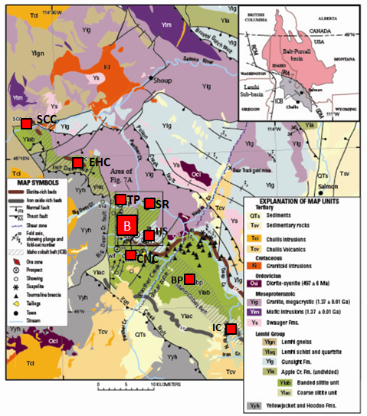
Mesoproterozoic rift, Cretaceous arc
The Blackbird Co-Cu deposit
Is in the Lemhi sub-basin of the Mesoproterozoic Belt-Purcell basin (inset),
Is at the center of the Idaho cobalt belt (ICB),
Is hosted in banded siltite and argillite of the Lemhi Gp,
Contains JK garnets (north of the red line)
Is near plutons of Y, C-O, K, and T age.
Is in a thrust plate, bounded by post-ore thrust faults of Cretaceous age
(geologic map modified from Evans and Green, ‘03)

Slide 3
Blackbird is a CoCuAu (+Bi + REE) deposit
in metasedimentary rocks (Slack et al., 2010)
It contains:
Major cobaltite, chalcopyrite and biotite,
Common quartz and tourmaline,
Minor to locally abundant pyrrhotite, pyrite, and siderite,
sparse arsenopyrite, safflorite, glaucodot, marcasite, gold, bismuth, bismuthinite, xenotime, and monazite
Local garnet and chloritoid.
Production + estimated resources of ~13 Mt of ore with overall average grades = 0.58 % Co, 1.16% Cu, and ~0.4 ppm Au.
Most ore zones are open down-dip.
Co price generally is at least 5x Cu price, so Blackbird is a Co deposit with byproduct Cu.

Slide 4
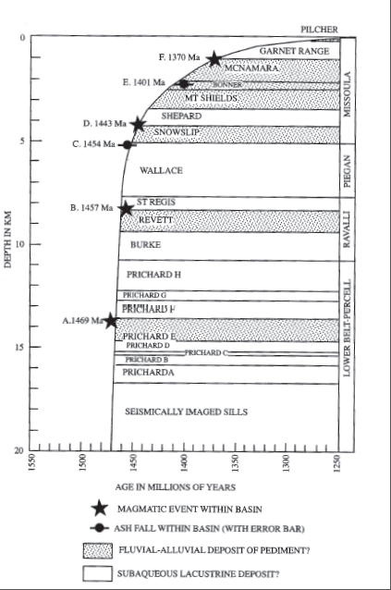
0 km
Lemhi Rift sed-accum curve
~1450-1390 Ma
The Lemhi Rift:
Tectonic Setting for Protolith Depositon
sag
Banded siltite
0 km
sag
rift
12 km
Lemhi rift underwent rapid subsidence as subsidence slowed in the Belt basin.
Strata in the lower part of the Lemhi section resemble Belt rift-stage strata but are younger.
Belt-basin
sed-accum curve
~1470-1250 Ma
(Sears, 2007)
Depth (km)
rift
Age (Ma)
20 km Belt

Slide 5
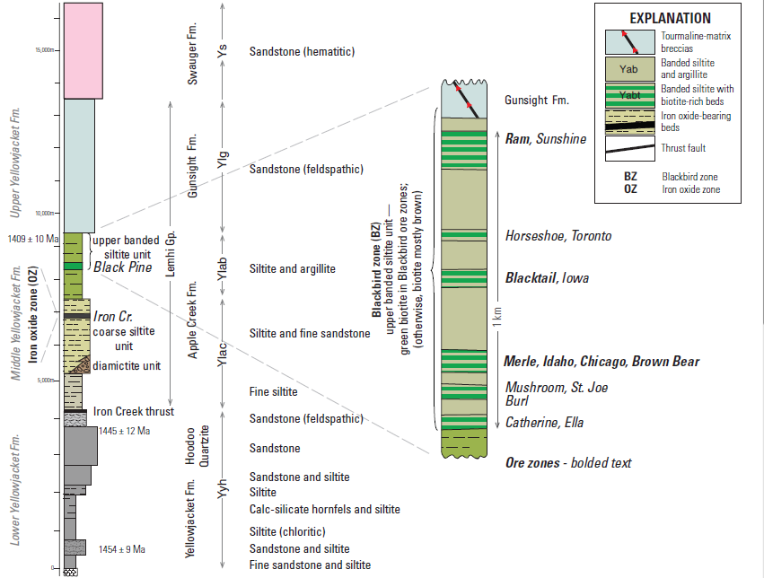
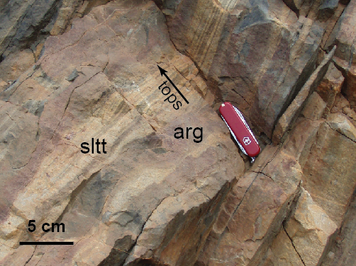
Interlayered siltite and argillite of the banded siltite unit of the Lemhi Group host the Blackbird ore zones. Most cobaltite ore is in biotitite (after argillite), but some is in chloritic quartzite (after siltite), and some is in tourmalinite.
Indicators of stratigraphic tops and bottoms (such as scour troughs, graded bedding, and crinkle cracks) are commonly preserved — except in hinge zones of tight folds.

Slide 6
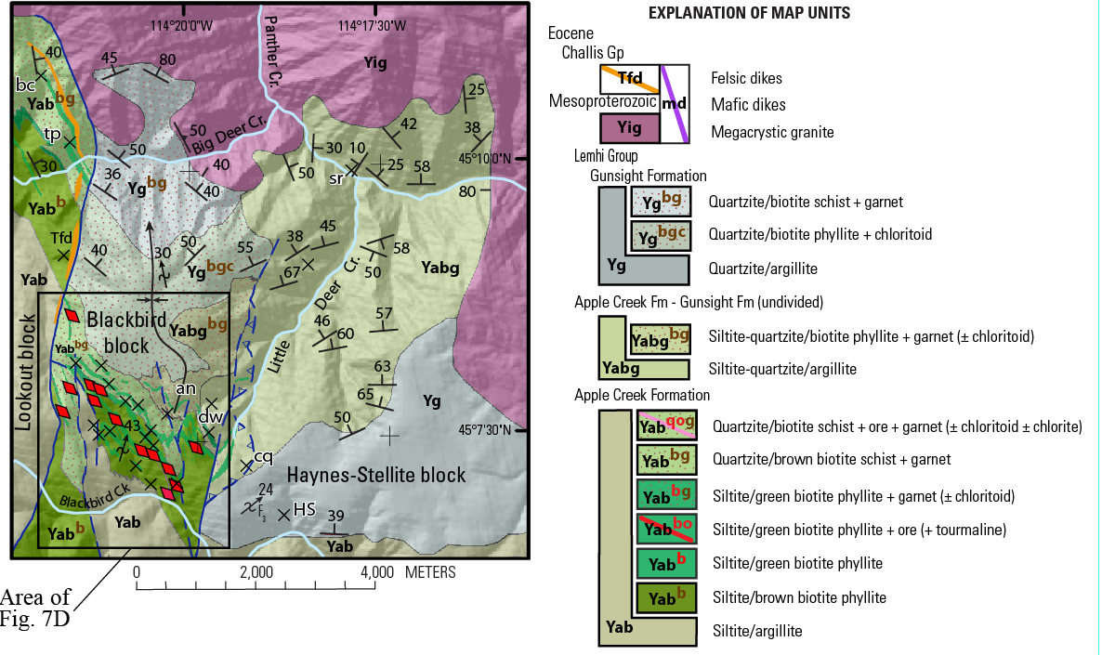
Geologic map showing the Blackbird structural block in relation to its bounding thrust faults and the granite pluton of Big Deer Cr (dated 1.37 Ga).

Slide 7
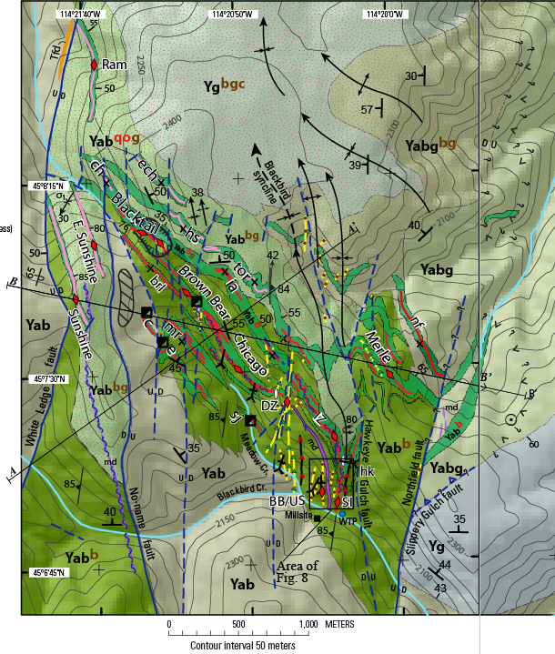
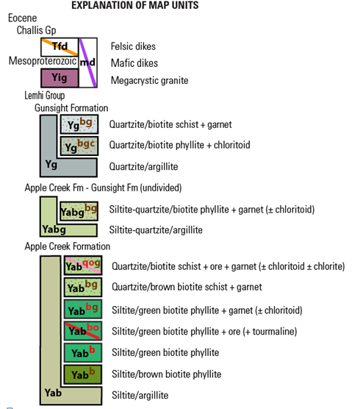
Blackbird Mine Area
geologic map, showing biotitite intervals, ore zones, dikes, the garnet zone, folds & faults, AA’ & BB’ lines of section.

Slide 8
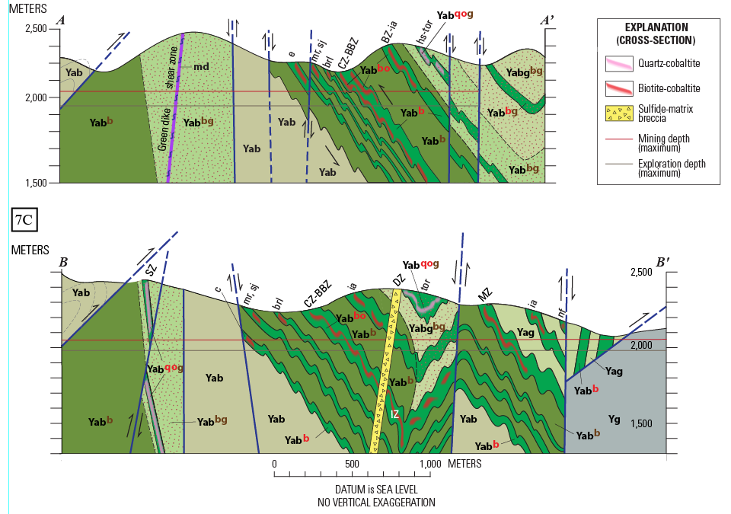

Slide 9
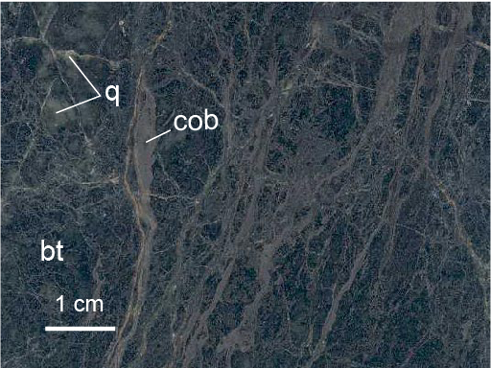
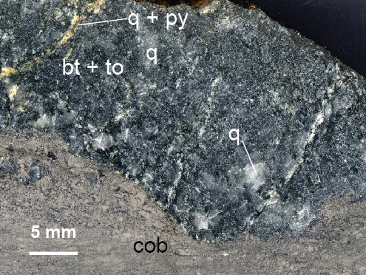
Ore Types: Anastamosing cobaltite veinlets in a biotitic matrix with quartz clasts — relatively un-metamorphosed ore from the Merle zone
The biotite is greenish black biotite, rich in ferrous Fe and Cl
Cobaltite replacement front in breccia with quartz clasts in a biotitic matrix (Chicago zone)
Quartz & biotite are interpreted as hydrothermal

Slide 10
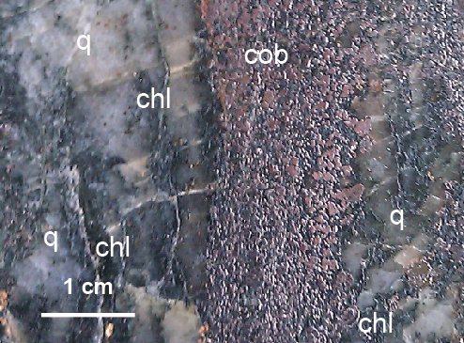
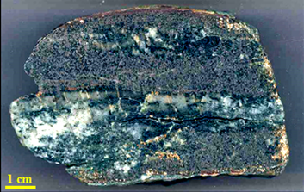
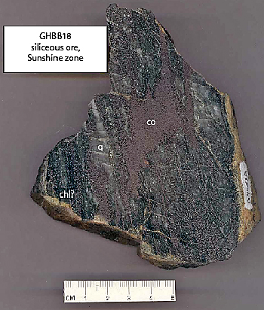
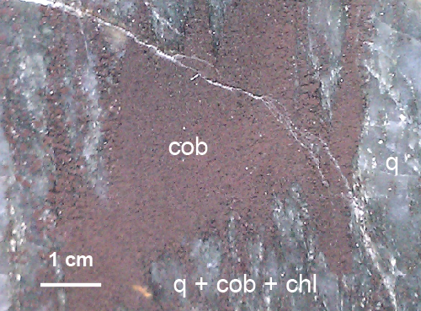
Disseminated to semi-massive cobaltite in “chloritic qtzt” (Sunshine ore zone)
The host rock is interpreted as silicified siltite & chloritized cobaltite-biotitite ore. It is from the highly sheared hinge zone of the Sunshine syncline.

Slide 11
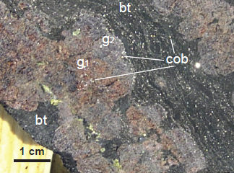
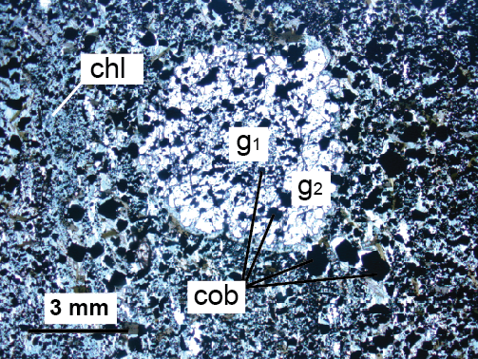
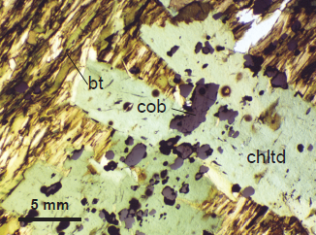
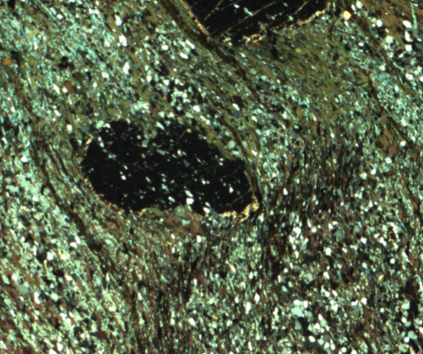
Garnet and chloritoid porphyroblasts overgrow cobaltite and truncate schistosity but some garnets are affected by crenulation of schistosity.

Slide 12
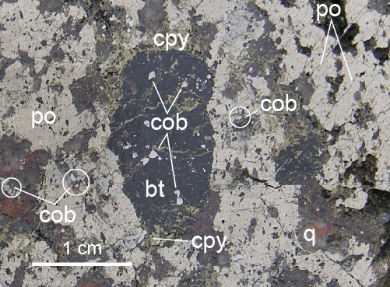
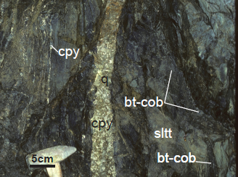
Relative Ages of Ore Types
Late Dandy breccia contains clasts of vein quartz and cobaltite-biotite ore in a massive-sulfide matrix of pyrrhotite and later chalcopyrite, pyrite, marcasite, and siderite
A quartz-chalcopyrite vein cuts a black bed that appears to contain cobaltite-biotite ore. A black fracture below the synclinal hinge may also contain cobaltite-biotite ore.

Slide 13
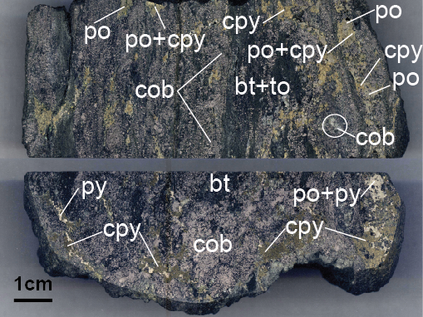
Top (or bottom) view
Composite ore — folded cobaltite-biotite ore with cobaltite rods and streaks parallel to fold axes.
By contrast, shapes of pyrite and chalcopyrite overgrowths are irregular.
End-on view
This is interpreted as folded cobaltite-biotite ore with a post-fold overprint of pyrite and chalcopyrite..

Slide 14
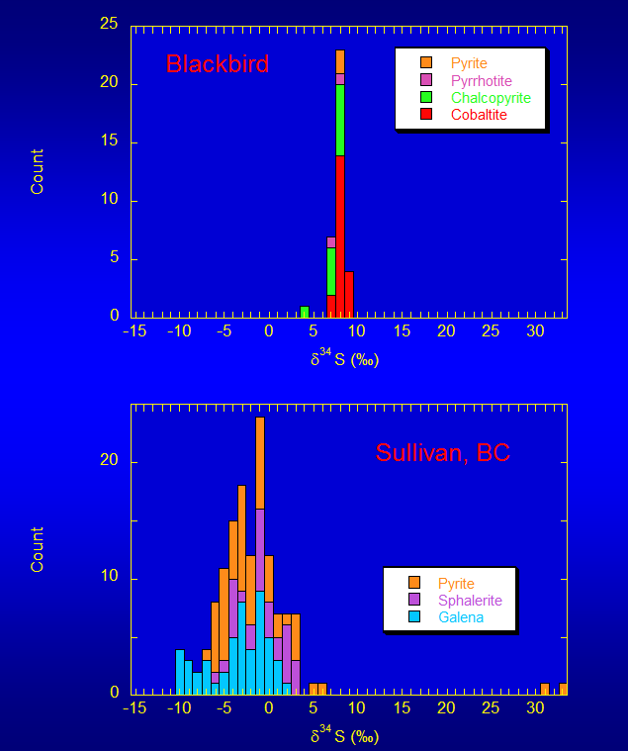
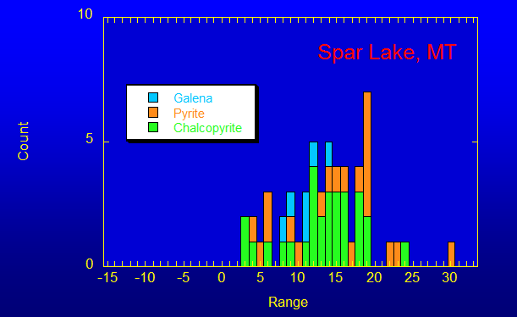
Sulfur isotopic ratios
In Blackbird ore minerals
are very tightly grouped
compared to those of
syngenetic and diagenetic deposits (Johnson et al., ‘12)
This indicates a deep metamorphic source (below basal decollement?) +/- subordinate igneous input

Slide 15
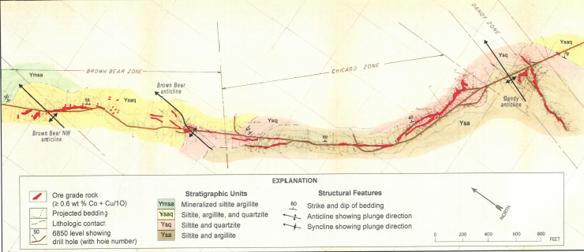
Geologic Map of the Blackbird 6850 Level
(by Calera mine geologists ~1960)
Although semi-stratabound, the Chicago and Brown Bear ore zones cut across stratigraphic layering a low angles. Locally, ore also extends into axial planar cleavage. The late Dandy-breccia zone also follows an axial-planar fractures. .

Slide 16
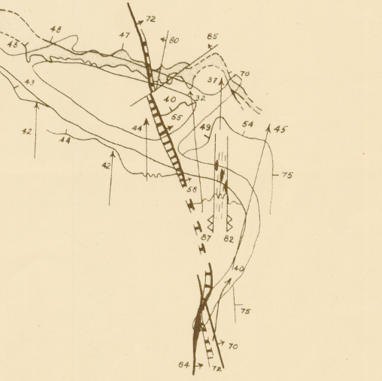
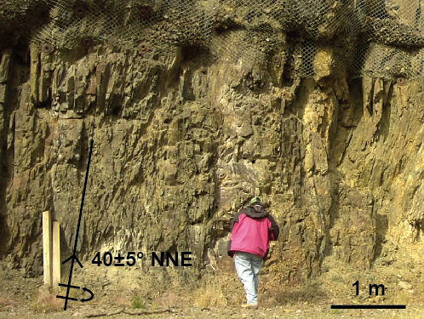
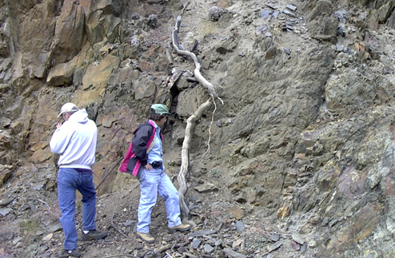
48
47
70
55
1
44
3
75
2
82
4
Blackbird Mine
7100 Level
Calera SE drift
Vhay (1948)
5
84
20 ft
20 ft
A biotite-lamprophyre dike cuts folds and folded cobaltite-biotite ore, but is cut by a late vein (probably a quartz-chalcopyrite vein).

Slide 17
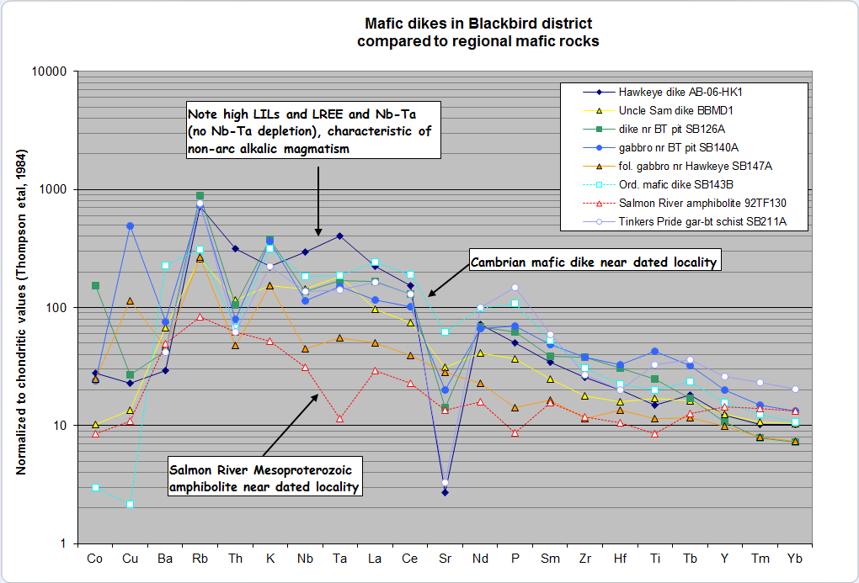
Nb
Ta
La
Blackbird mafic dikes have high LILs & REE, and Nb-Ta >=La (within-plate, not subduction-related)

Slide 18
Isotopic Age Constraints
Mesoproterozoic
1409 ± 10 Ma: Siltite, upper banded siltite unit (youngest detrital zircons) — U-Pb zircon, Aleinikoff et al., 2012
1377 ± 4 Ma: Monogranite of Big Deer Cr. — U-Pb zircon, Aleinikoff et al., 2012
1370 ± 4 Ma: Xenotime (inclusions in cobaltite) — U-Pb xenotime,Aleinikoff et al., 2012
Late Jurassic – Early Cretaceous
151 ± 1 to 122 ± 1 Ma: Biotite (from post-cobaltite mafic dikes) — Ar-Ar, Gillerman et al., 2004
151 ± 35 to 94 ± 8 Ma: Garnet (some with cobaltite inclusions) — Lu-Hf, Zirakparvar et al., 2007
144 to 83 Ma: Monazite (some enclosing cobaltite) – U-Pb monazite, Aleinikoff et al, 2012
100 Ma: Pb in late polymetallic ore (Panneerselvam et al.,’12)
83 Ma: Sericite (selvage around a late quartz veinlet), Ar-Ar, sericite, Lund et al., 2011

Slide 19
Conclusions:
Cobaltite-biotite ore is younger than xenotime, dated 1.37 Ga but older than a mafic dike that contains metamorphic biotite, dated 151 Ma.
Mafic dikes have alkalic, within-plate geochemical character.
Within-plate magmatism occurred at 1.37 Ga, ~ 750 Ma, and ~ 500 Ma — not in Late Jurassic to Cretaceous-Eocene time.
Early cobaltite-biotite ore probably was deposited and deformed between 1.37 Ga and 500 Ma.
Cretaceous garnets truncate host-rock schistosity, contain cobaltite inclusions, and are present in some mafic dikes that cut folded ore.
Late polymetallic breccias and veins, which cut cobaltite lodes and mafic dikes probably are Cretaceous.

