Slide 1
Paradox of drilled devil’s toenails: taphonomic mixing obscures Cretaceous drilling predation in Utah oysters
Ashley Ferguson
Leif Tapanila
Idaho State University

Slide 2
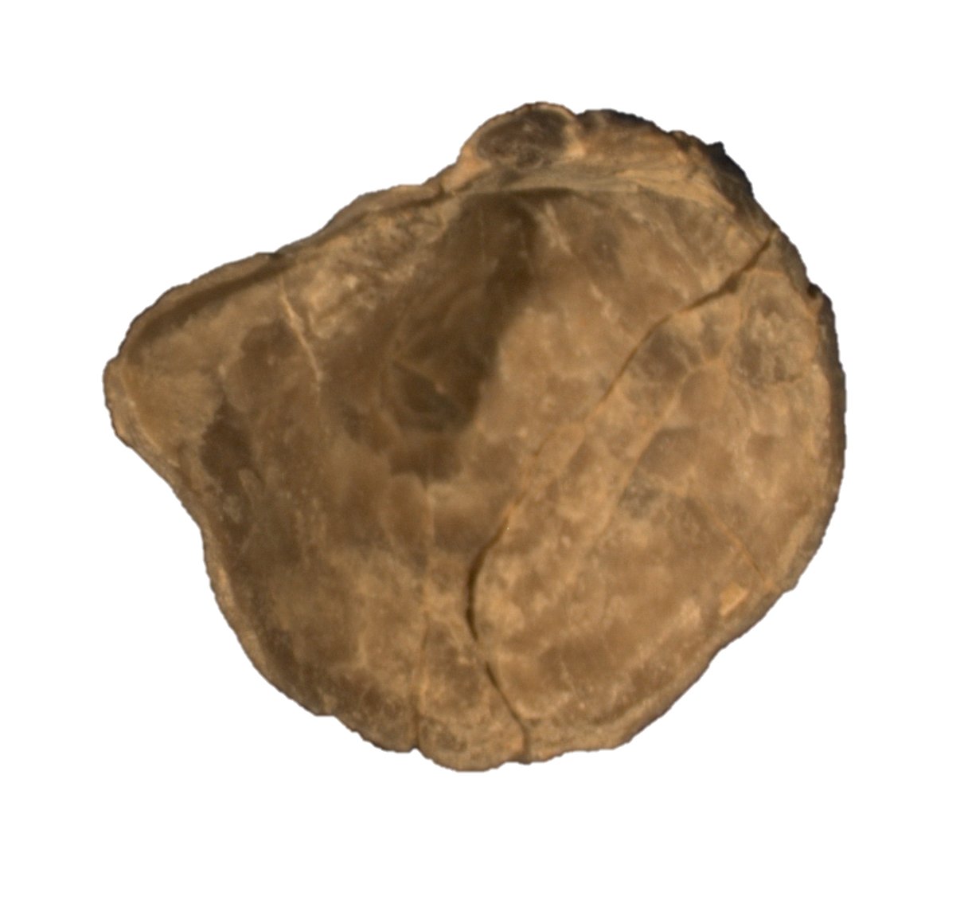
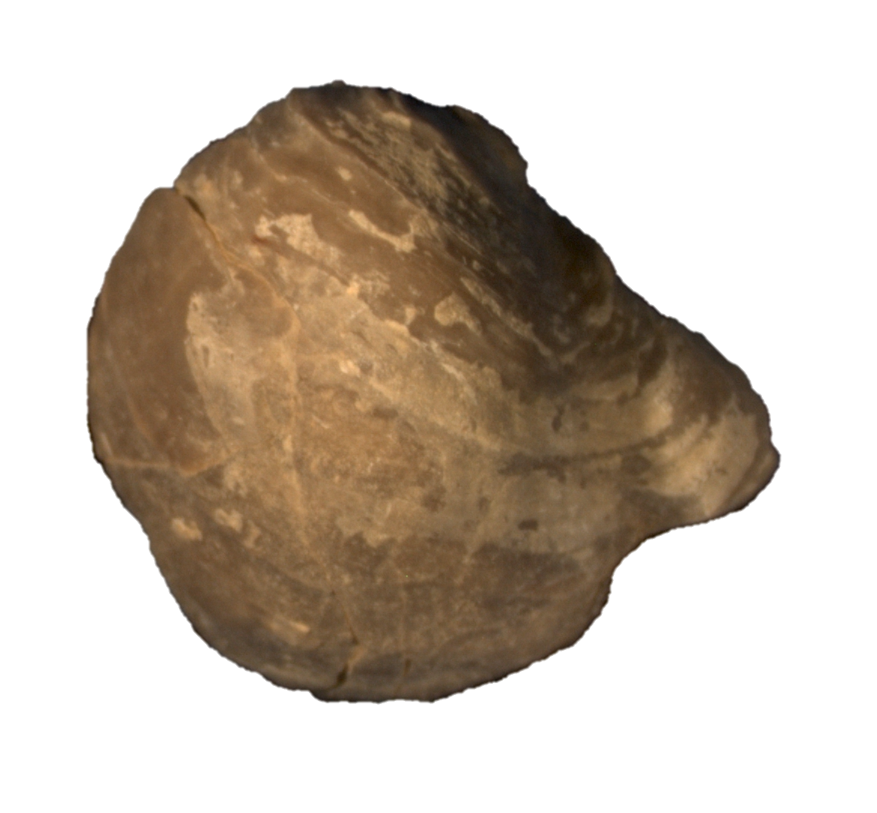
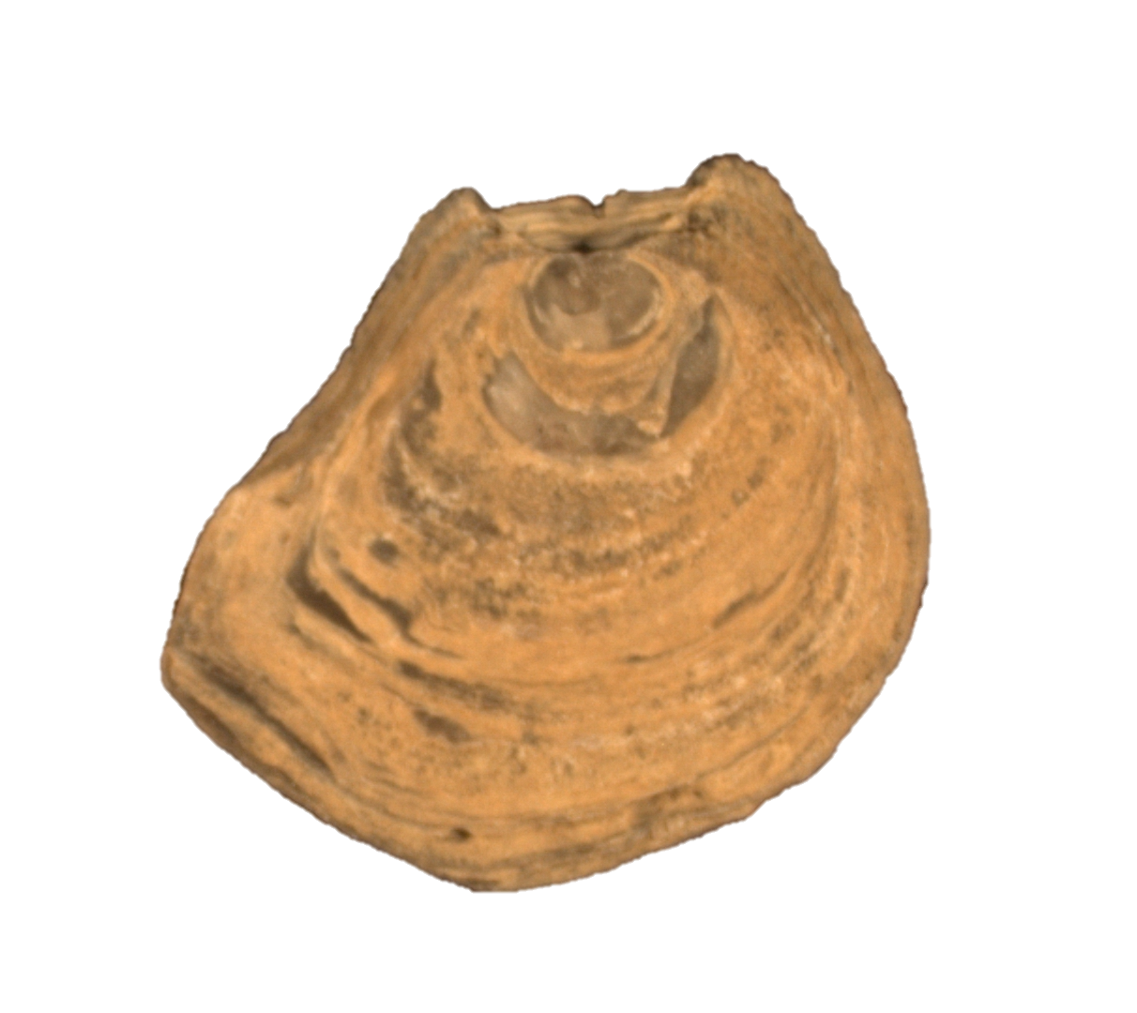
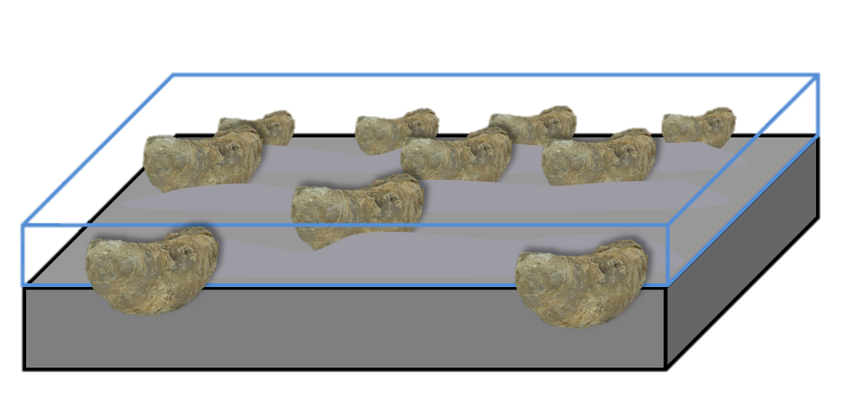
Pycnodonte Newberryi oysters
Left Valve
“Devil’s toenails”
  Large convex left valve
    Thick toward the umbo
  Flat right valve
    “Toilet seat”
    Spirals from anterior end outward
  Animal sits recumbent in sediment with larger left valve down.
Ventral
Dorsal
5 mm
Right Valve
Pycnodonte life position on sea floor.

Slide 3
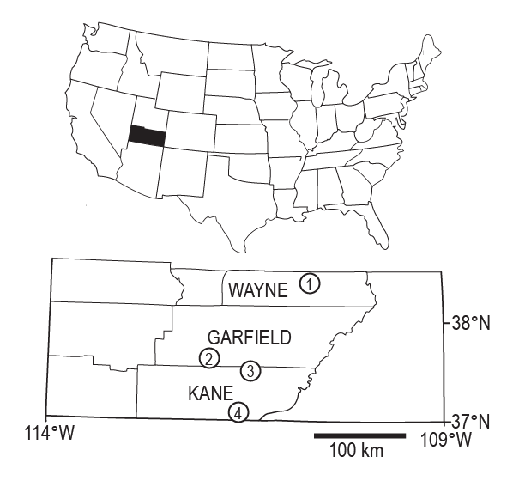
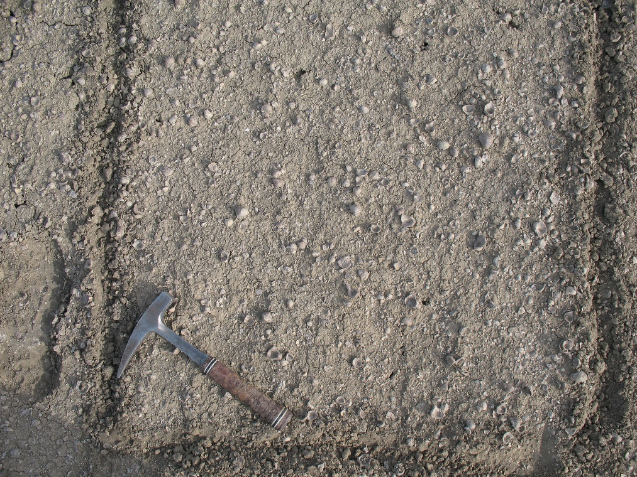
The Great Pycnodonte Cemetery
Notes:
1. Hanksville Material
2. HWY 12
3. Left Hand Collet
4. Bigwater
Clay dominated material, shallow shoreline of the WIS

Slide 4
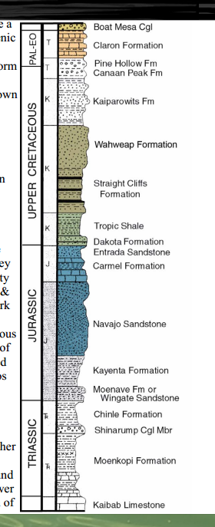
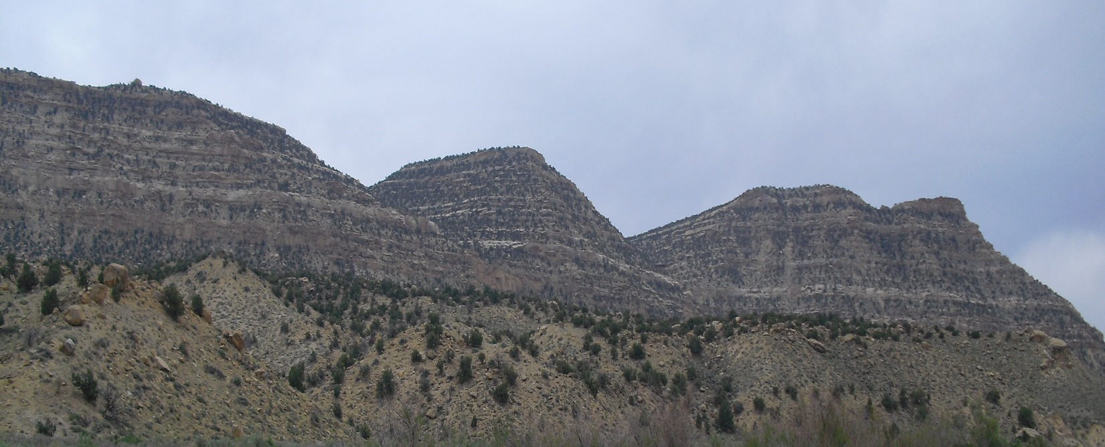
Stratigraphy
Straight Cliffs
Formation
Tropic Shale
Dakota Formation
Greenhorn Cyclothem of the Western Interior Seaway
Tropic Shale/Mancos.
Precedes Cenomanian-Turonian extinction event.
6 localities, triplicate, 1sq m bulk sample
N=4,822 specimens
Notes:
Tropic Shale unit in Southern Utah bordering the Escalante Grand Staircase National Monument. Stratigraphic section from http://www.astrobio.nau.edu/~koerner/ast184l/park_guides/brycecyn.pdf and picture from my computer. Cenomanian-Turonian extinction event, anoxic extinction.

Slide 5
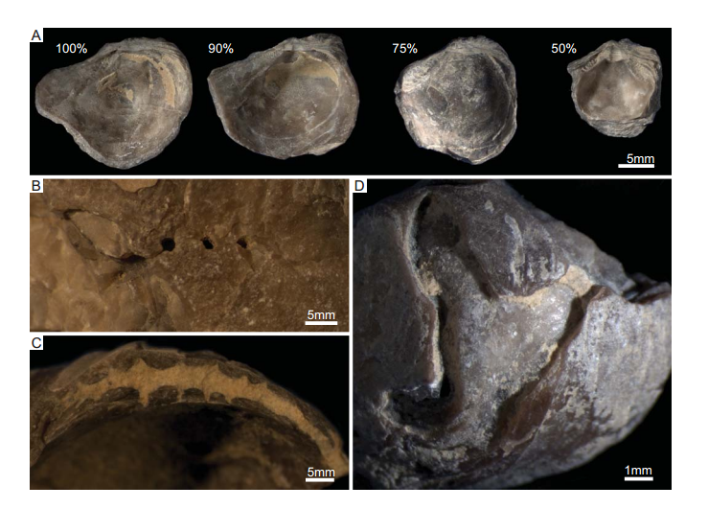
Taphonomy
Left valves dominate N = 89%
  Individual localities range from 80-100%
  BW U1 is an exception with up to 70% right valves.
Most specimens are in the ~50% fragmentation class.
Post-mortem Entobia and Caulostrepsis drillings affect ~14% of the assemblage.
Oichnus borings affect 1-4.2% of Pycnodonte shells on average.
  Only two drilled right valves found.

Slide 6
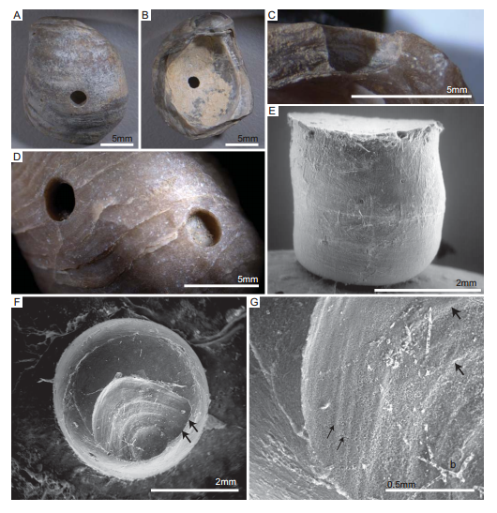
Oichnus morphology
Straight parallel margins.
Circular and penetrate perpendicular to shell surface.
Range in diameter from 0.62–4.5 mm.
Slight taper from outside to inside of shell.
Marginal boss.
Animal carves terrace-like structures.

Slide 7
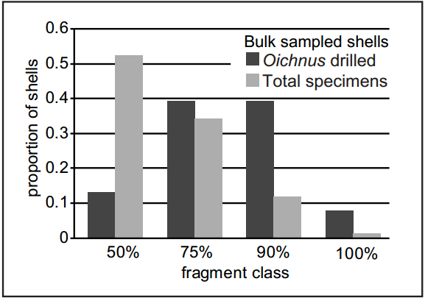
Fragmentation Relative to Oichnus

Slide 8
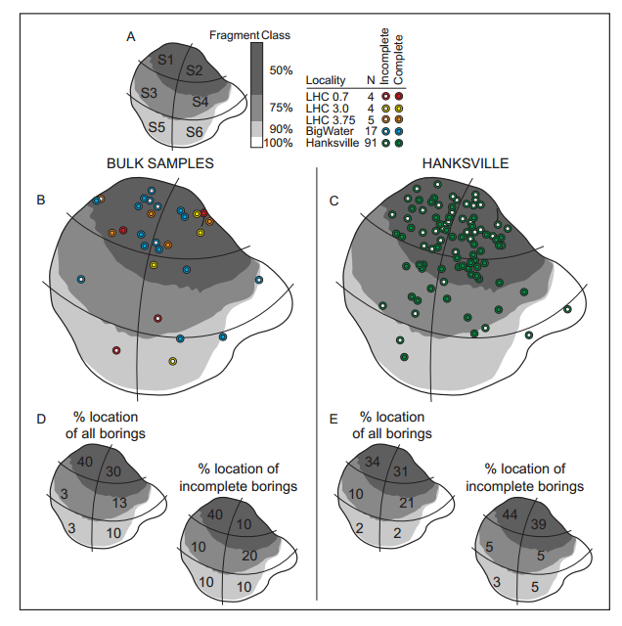
Drill Hole Measurements
Sector maps
  Drilling is concentrated at umbo of LV (60%).
    Thickest part of shell.
    Corresponds to 50% fragmentation class.
    Bulk samples match the pattern shown by the selectively chosen Hanksville collection.
Notes:
Used to model the expected frequency in the bulk samples from Lefthand Collet, HWY 12 and Bigwater.

Slide 9
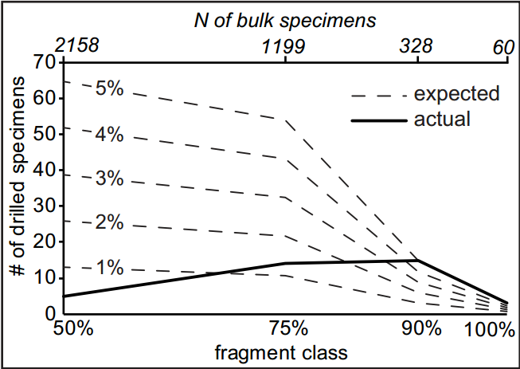
The Paradox between Drilling Frequency and Fragmentation
60% of drilled specimens should appear in the 50% fragmentation class.
  Observed decline in boring frequency for smaller fragments is counterintuitive.
  Majority of drillholes in complete specimens are found in the umbonal part of the shell, which is not subject to fragmentation.

Slide 10
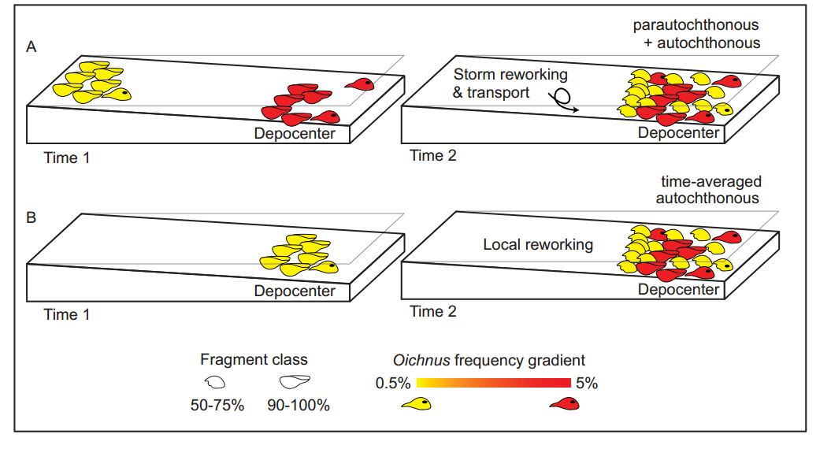
The model

Slide 11
What does the Taphonomy Say?
Fragmentation Drilling
Not because of taphonomic loss but…
MIXED SHELL POPULATIONS!
Spatial mixing of low to high predated shells.

Slide 12
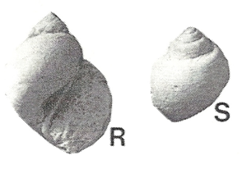
Who is the Culprit?
The only known body fossil record of predatory snails in WIS are naticids, such as Euspira (Kirkland, 2005).
  Do not co-occur with Pycnodonte (taphonomically) but are contemporaneous in Tropic/Mancos Shale
2 cm

Slide 13
And what else?
Complete shells offer more accurate % of predation.
  Diluted by fragmentation.
Cenomanian is early in the history of naticid drilling behavior
  5% is low predation pressure compared to Late Cretaceous (10-15%)

Slide 14
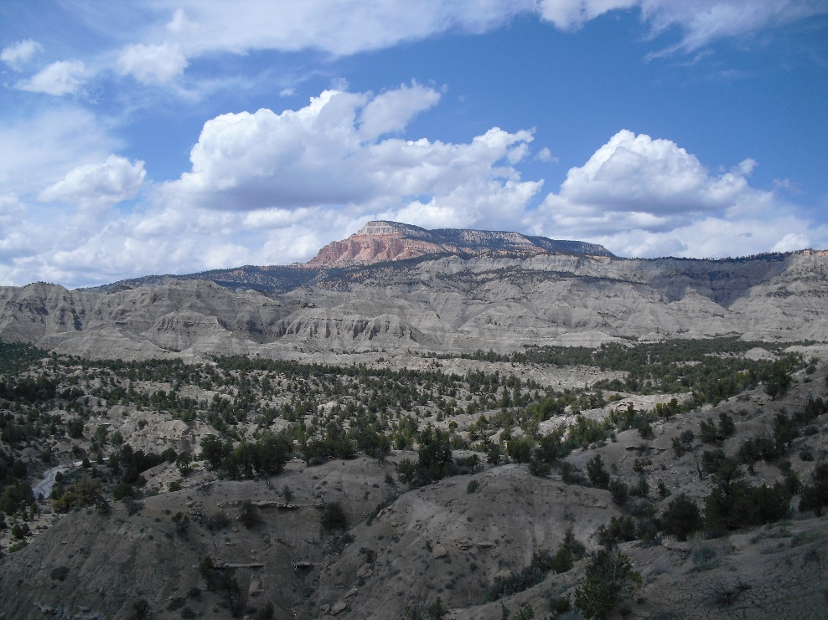
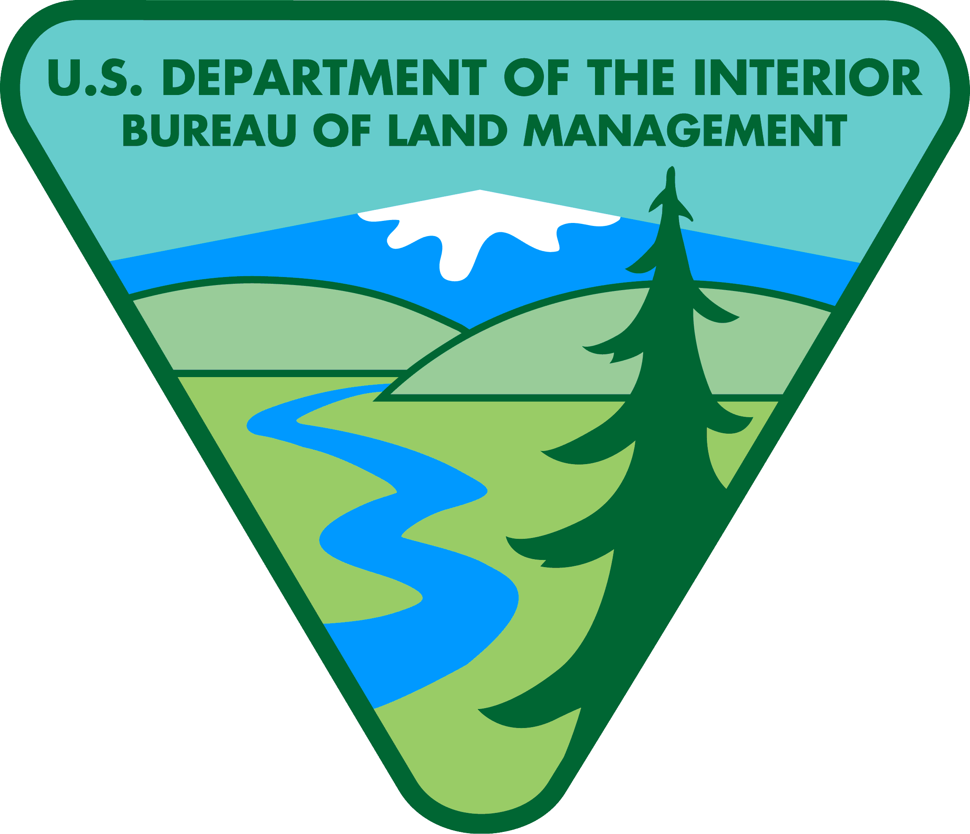
Acknowledgments
Grand Staircase Escalante-National Monument (GSENM)
Alan Titus BLM
Dr. Eric Roberts, James Cook University

