Slide 1

Geologic Map of the Blackbird Co-Cu Mine Area,
East-Central Idaho — Metasedimentary Strata,
Ore Types, Folds, Dikes, and Metamorphic Overprint
Art Bookstrom, Steve Box, Pam Cossette,
Tom Frost, and Shane Kostka

Slide 2
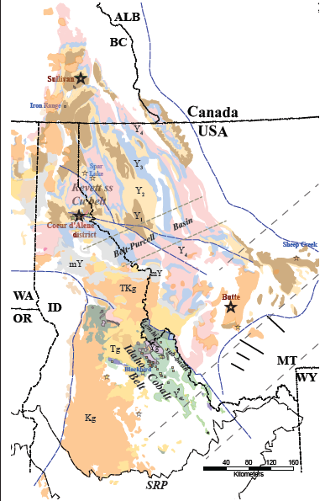
Regional Geologic Map showing the Mesoproterozoic Belt-Purcell basin and the Lemhi sub-basin
in relation to the Idaho Cobalt Belt, the Blackbird Co-Cu deposit, and other significant mineral deposits.
Metasedimentary units include rocks correlative with the Lower Belt (Y1), Ravalli Gp (Y2), Piegen Gp (Y3), Missoula Gp (Y4), rocks of the Lemhi sub-basin (Y4L), and amphibolite-facies meta-belt rocks (mY).
Also shown are igneous intrusions of Mesoproterozoic (Y), Neoproterozic to Ordovician (OZ), Cretaceous (K), Tertiary-Cretaceous (TK), and Tertiary (mostly Eocene) age (T).
OZi
Yg
(SRP = Snake River Plain)

Slide 3
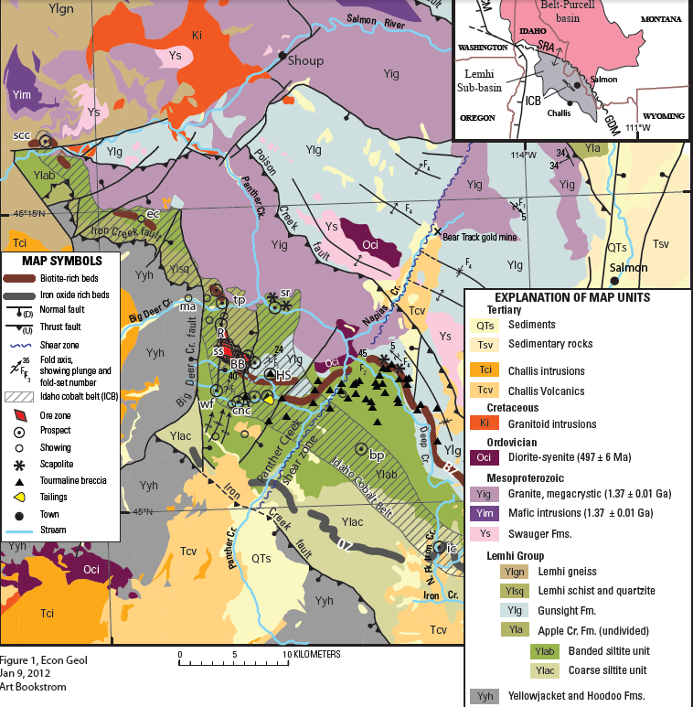
Index map showing the Idaho cobalt belt (ICB) in relation to the Belt-Purcell basin and the
Lemhi sub-basin
Geologic Map,
Salmon River Mtns
west of Salmon, Idaho,
showing Co-Cu deposits
and prospects of the
Idaho cobalt belt in
relation to host rocks of
the Lemhi Gp and
igneous intrusions of
Mesoproterozoic to
Tertiary age. Also shown
are fold axes and faults,
Tertiary volcanics, and
Quaternary-Tertiary
sediments.
(Modified from Evans and Green, 2003)

Slide 4
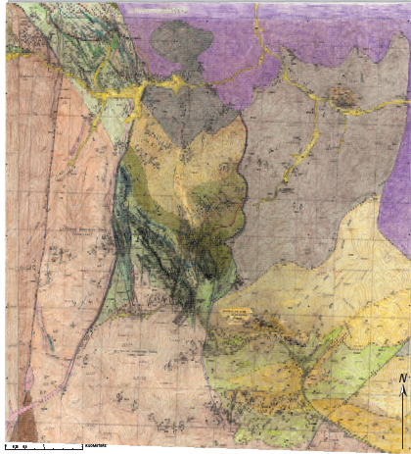
Geologic Map of the Blackbird Co-Cu
Mine Area and its Geologic Surroundings
This image shows a geologic map that was compiled at a scale of 1:12,000 from sources listed on the next slide. This map is intended for informal publication by the Idaho Geological Survey (probably as a print or .pdf with an explanatory pamphlet).
Blackbird
structural block
Lookout
structural
block
Haynes-Stellite
structural block
Enlarged images of selected parts of this map follow, along with accompanying explanations of map-unit symbols and colors.
0
1
2 km

Slide 5
Principal Sources of Information
Bennett, E.H., 1977, Reconnaissance geology and geochemistry of the Blackbird Mountain-Panther Creek region, Lemhi County, Idaho: Idaho Bureau of Mines and Geology pamphlet, 167 p.
Calera Mining Co., 1978, Surface geology, Blackbird, Lemhi County, Idaho, in Hughes, G.H., Jr. and Chevillon, C.V., Summary Geologic Report of the Blackbird Project, Lemhi County, Idaho: Noranda Exploration, Inc., unpublished report, 25 p., plate A., scale 1:2,400.
Daggett, M.D., and Smit, J.H., 1981, An investigation of surface geology from the Blackbird mine north to Big Deer Creek, Blackbird mining district, Lemhi County, Idaho: Noranda Exploration, Inc., unpublished report, 20 p., 1 pl. with overlay, scale 1:12,000
Evans, K.V. and Connor, J.J., 1993, Geologic map of the Blackbird Mountain 15-minute quadrangle, Lemhi County, Idaho: U.S. Geological Survey Field Studies Map MF-2234, scale 1:62,500.
Evans, K.V. and Green, G.N., 2003, Geologic map of the Salmon National Forest and vicinity, east-central Idaho: U.S. Geological Survey Geologic Investigations Series Map I2765, 2 sheets, scale 1:100,000, pamphlet, 19p.
Formation Capital Corp., 2001, Idaho cobalt project comilation map, Cobalt Ranger District, Lemhi County, Idaho, USA: Salmon Idaho, Formation Capital Corp., unpublished map, scale 1:4,800.
Johnson, Rick, Close, Terry, and McHugh, Ed, 1998, Mineral resource appraisal of the Salmon National Forest, Idaho: U.S. Geological Survey Open-File Report 98-478, 277 p., 7 plates, scale 1:125,000.
Shenon, P.J., Full, R.P., Snyder, D.M., and Bauer, H.L., Jr., 1956, Surface geology of the Big Deer Creek area, Blackbird mining district, Lemhi County Idaho: Idaho Metallurgical Industries, Inc., unpublished geologic map, scale 1:12,000.
Vhay, J.S., 1948, Cobalt-copper deposits in the Blackbird district, Lemhi County, Idaho: U.S. Geological Survey Strategic Minerals Investigations Preliminary Report 3-219 (also released as U.S. Geological Survey Open-File Report 48-1), 26 p., pl. 1 scale 1:15,000, pl. 2 scale 1:2,850, pl. 3A and 3B scale 1:600.
(+ field data collected by the authors)

Slide 6
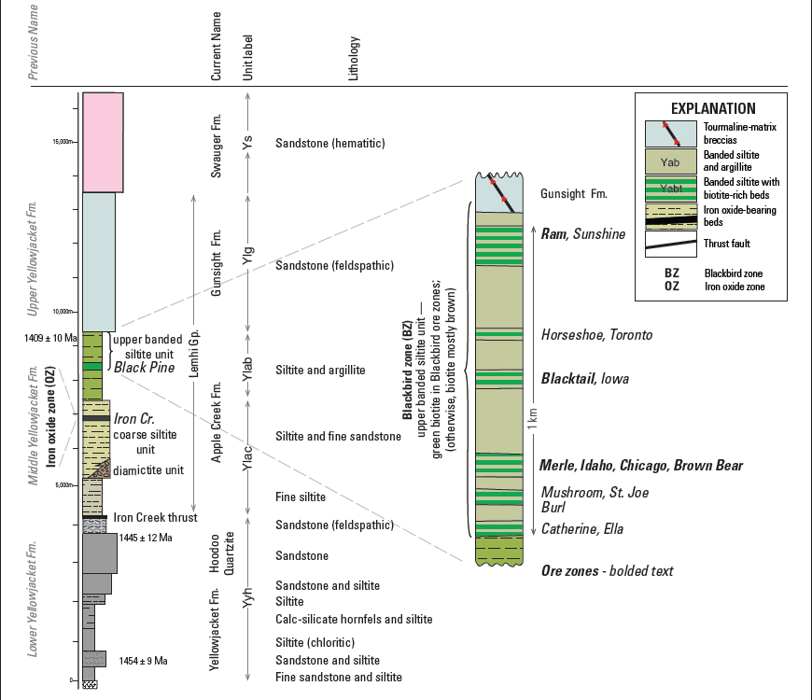
Columnar sections, showing stratigraphic units of the Lemhi sub-basin (left, modified from Link et al., 2007), and the Blackbird zone (right, modified from Nash and Hahn, 1989).

Slide 7
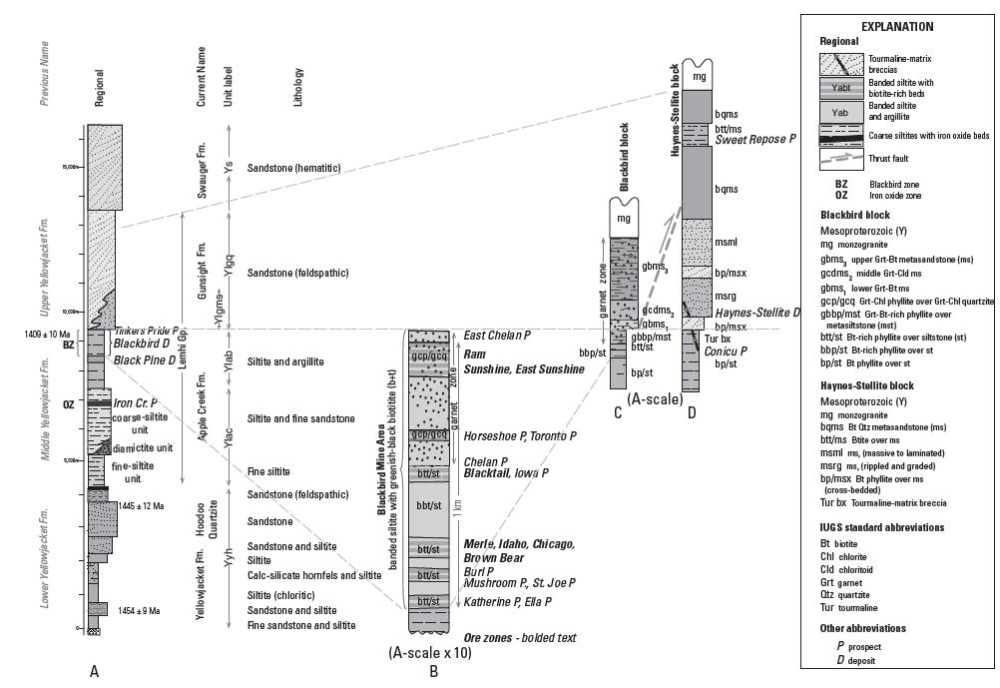
Columnar sections, modified on the basis of field observations made during preparation of the geologic map shown in slide #4.

Slide 8
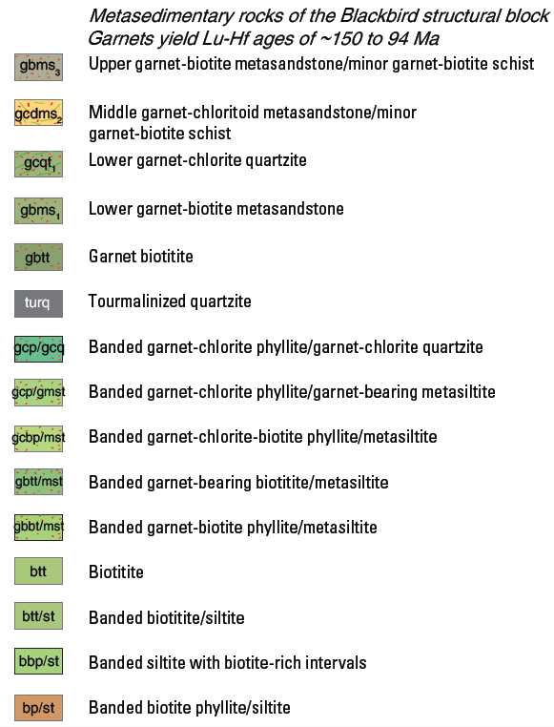
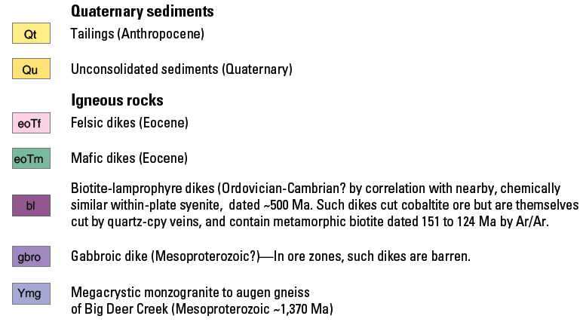
Map Units of the Blackbird Structural Block

Slide 9
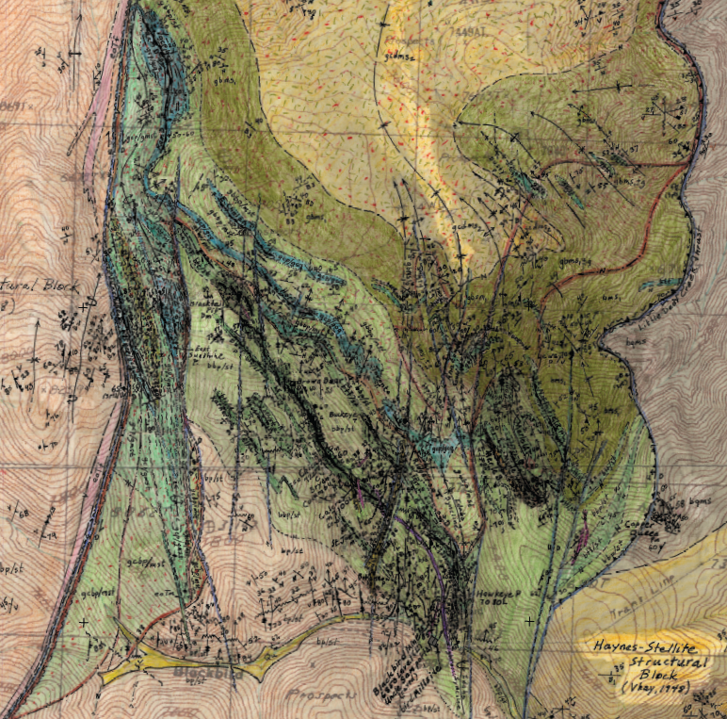
The Blackbird block
Is characterized by north-plunging chevron folds in locally biotitized, mineralized, garnetized and chloritized banded siltite (overlain by metasandstone).
Is bounded on the west by the White- Ledge shear zone (WLsz), and on the east by the Little Deer thrust (LDt), which locally places garnet-bearing over garnet-free rocks
Blackbird structural block
LDt
WLsz
1 km
Semi-stratabound cobaltite ore zones occupy sheared and biotitized rocks along limbs and hinges of N-plunging folds.

Slide 10
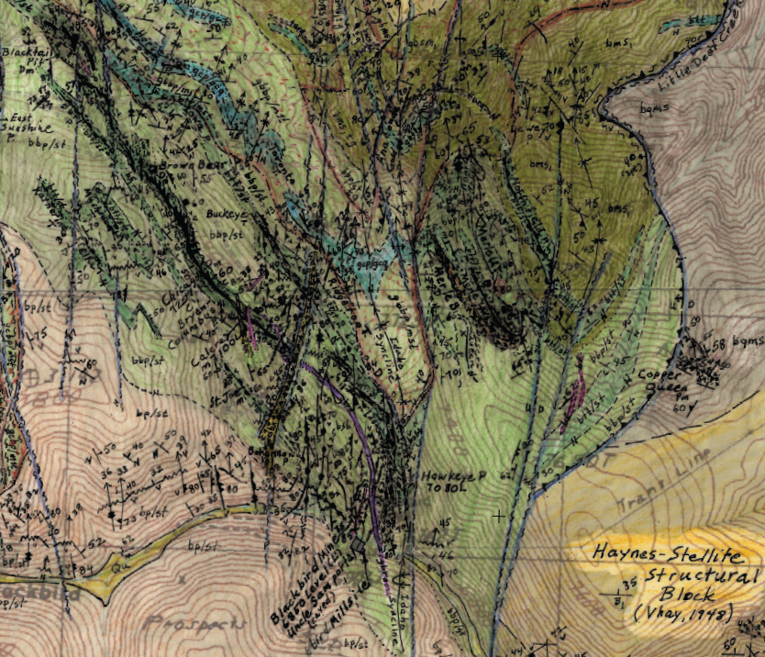
Blackbird - central mine area — close-up image, showing the Merle (M), Idaho (ID), Chicago (CH), Brown Bear (BB), and Blacktail (BT) ore zones.
Also shown are mafic dikes that cut previously folded cobaltite-biotite ore.
Except where faulted, the garnet zone grades down and SE into garnet-free rocks
BT
BB
CH
M
ID
1 km
Mafic dikes cut folded, foliated cobaltite-biotite ore. Dandy breccia
(yellow) and chalcopyrite veins cut cobaltite-biotite ore and mafic dikes.

Slide 11
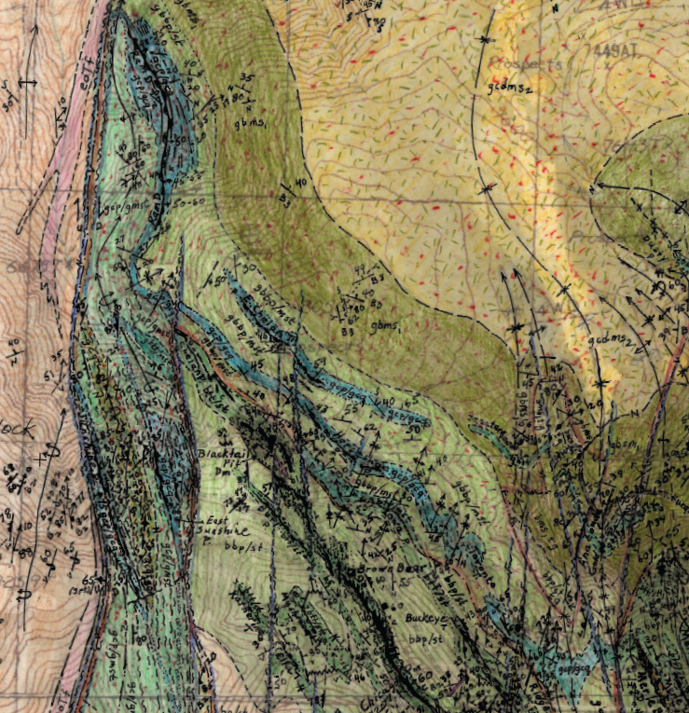
Blackbird NW —
close-up image, showing NW ore zones:
Brown Bear (Bb), Blacktail (Bt),
Sunshine (SS), E. Sunshine (ES),
and Ram (RM).
Also shown are axes
of the north-plunging,
Idaho syncline (Is), Calera anticline (Ca) & Sunshine syncline (Ss).
Ore zones coincide with banded siltite, altered to biotitite (grn), or quartz-chlorite rock (blugrn) ± post-cobaltite garnet.
RM
IDs
Ca
Ss
Bt
ES
SS
Bb
IDs

Slide 12
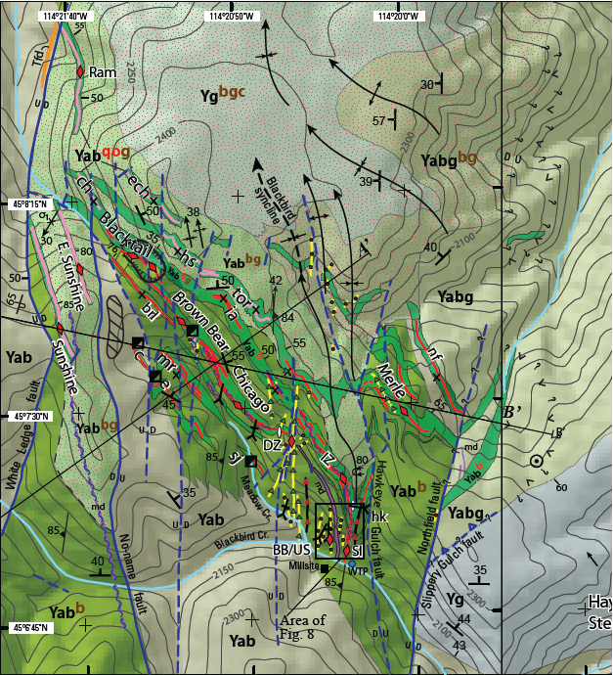
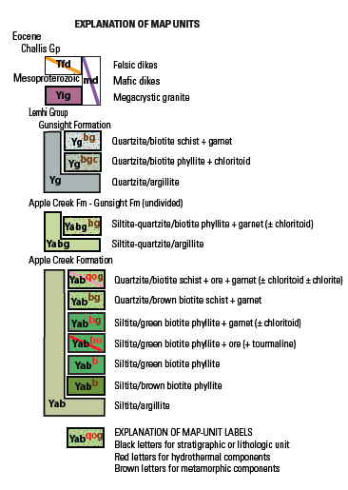
Diagrammatic geologic map of the Blackbird mine area, showing ore zones, host strata, folds, faults, and lines of section AA’ and BB’.

Slide 13
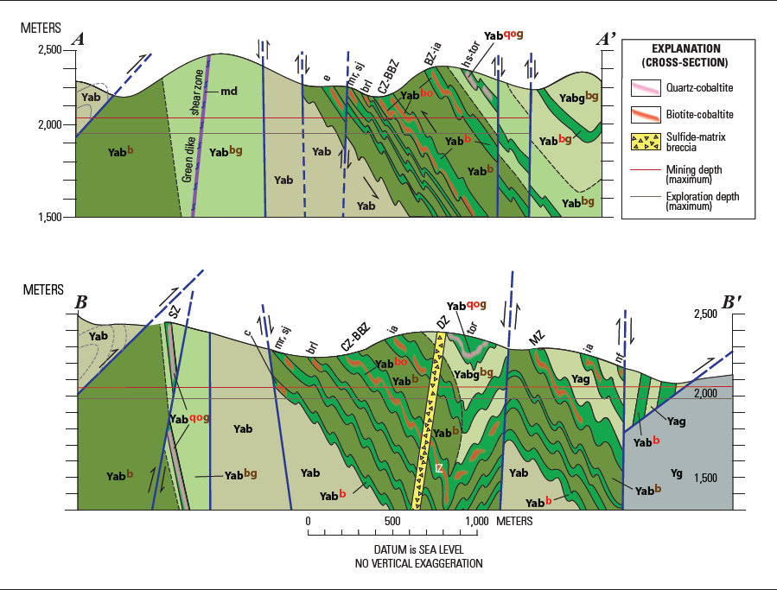
Interpretive geologic cross-sections AA’ and BB’,
across the Blackbird mine area

Slide 14
Summary of Isotopic Age Constraints
Mesoproterozoic
1409 ± 10 Ma: Siltite, upper banded siltite unit (youngest detrital zircons) — U-Pb zircon, Aleinikoff et al., 2012
1377 ± 4 Ma: Monogranite of Big Deer Cr. — U-Pb zircon, Aleinikoff et al., 2012
1370 ± 4 Ma: Xenotime (inclusions in cobaltite) — U-Pb xenotime,Aleinikoff et al., 2012
Mesoproterozoic to Ordovician
< 1377 ± 4 Ma to > 497 ± 6 Ma: (mafic dikes, in or near the Blackbird area, with within-plate chemical character) — Similar dikes cut monzogranite of Big Deer Creek, dated 1377 ± 4 Ma (U-Pb zircon age by Aleinikoff et al., 2012). Blackbird mafic dikes also are chemically similar to the nearby Deep Creek pluton, dated 497 ± 6 Ma (U-Pb zircon age by Lund et al., 2010). Such dikes cut folded and foliated cobaltite-biotite ore at Blackbird. Some mafic dikes contain post-dike garnets, and some are cut by relatively undeformed polymetallic breccias and veins.
Late Jurassic to Early Cretaceous
151 ± 1 to 122 ± 1 Ma: Biotite (from post-cobaltite mafic dikes) — Ar-Ar, Gillerman et al., 2004
151 ± 35 to 94 ± 8 Ma: Garnet (some with cobaltite inclusions) — Lu-Hf, Zirakparvar et al., 2007
144 to 83 Ma: Monazite (some enclosing cobaltite) – U-Pb monazite, Aleinikoff et al, 2012
100 Ma: Pb in late polymetallic sulfide minerals (Panneerselvam et al.,’12)
83 Ma: Sericite (selvage around a late quartz veinlet), Ar-Ar, sericite, Lund et al., 2011

Slide 15
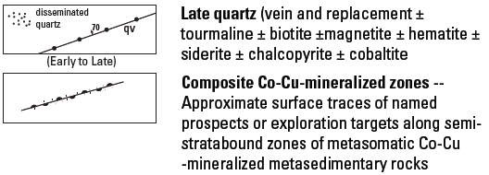
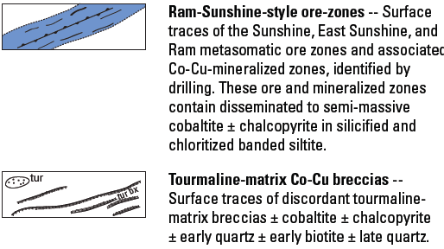
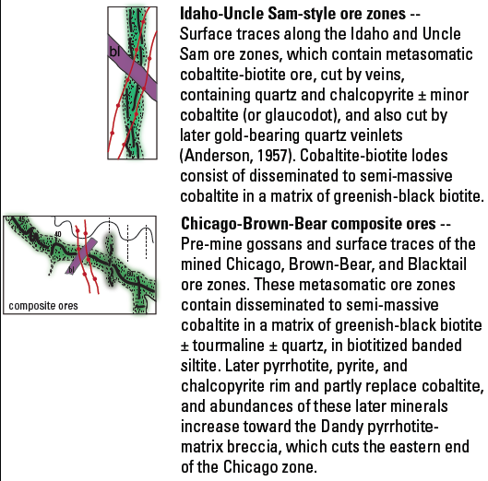
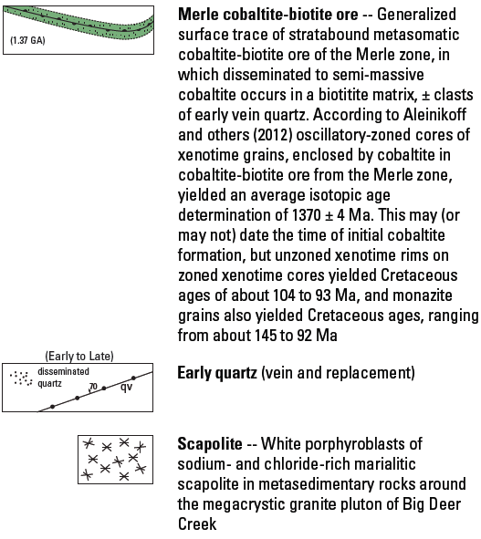
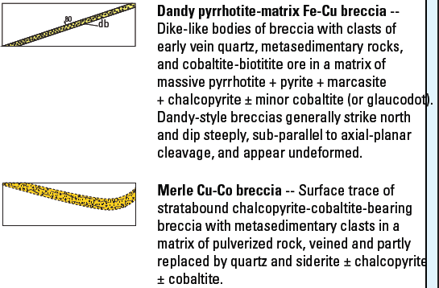
Syn- to post-F₂ folds,
pre-mafic dikes, & pre-garnet
Blackbird Paragenesis
2b. NW Blackbird
Composite (2 + 3)
Pre- to syn-F₂ folds, pre-mafic dikes
2. cob-bt (Y?)
+ 3. po-py-cpy (K?)
2a. Central Blackbird
2 + 3,
Central
Blackbird
3. Post-cobaltite-biotite,
Post-D2 folding,
Post-mafic dikes,
Syn- to post-KJ garnet
(151-94 Ma),
Syn-K monazite
(144-83 Ma)
3b. Central
Blackbird
(BB)
(± xenotime, 1.37 Ga)
1.
Near Ymg
Syn-Ymg (1.37 Ga)
3a. SE BB

Slide 16
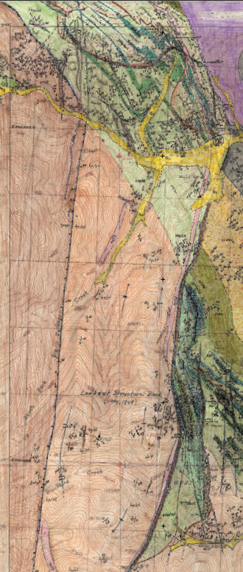
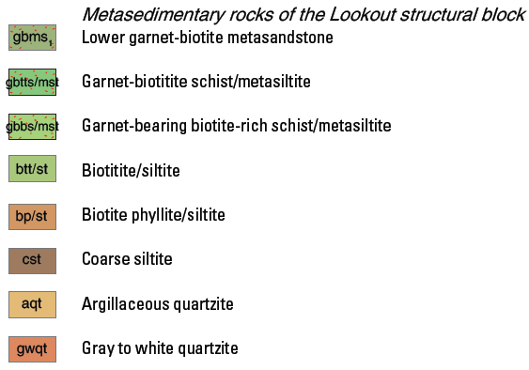
Ymg
ICt
Map Units of the Lookout Block
WLsz
BDc
Lookout
Structural
Block
BDf
WLsz
South of Big Deer Creek (BDc), the Lookout block is bounded by
the White Ledge shear zone (WLsz) and the Big Deer Creek fault
(BDf).
North of Big Deer Creek, the Lookout block is bounded by
the White Ledge shear zone (WLsz) and the Iron Creek thrust
(ICt).
The White Ledge shear zone is a west-dipping , west-over-east reverse-right-lateral fault with about 3.5 km of apparent right-lateral offset.
The Big Deer Creek fault dips steeply and displaces the Iron Creek thrust with 15 km of apparent right-lateral offset.
1 km

Slide 17
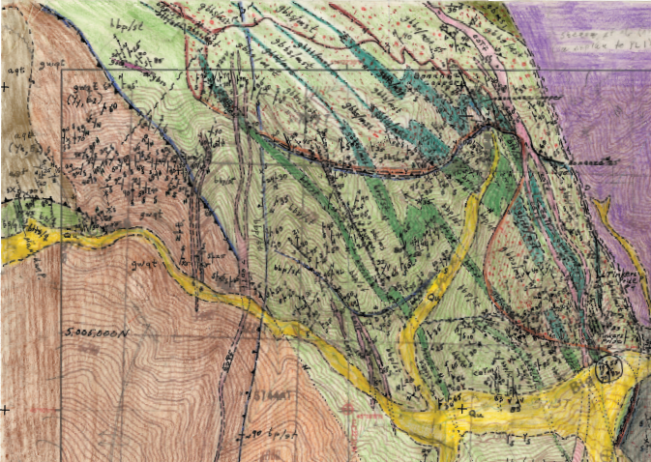
Geologic setting of Co-Cu prospects west of the White Ledge shear zone
Prospects are —
Tinkers Pride (TP)
Bonanza Cu (BC)
Mary Ann (MA)
Labeled faults are —
White Ledge shear zone (WLsz),
Big Deer Cr fault (BDf),
Iron Cr thrust (ICt),
MaryAnn thrust (MAt).
ICt
BC
WLsz
MAt
?
MA
ICt
?
TP
BDf
WLsz
1 km
Co-Cu prospects W of the White Ledge shear zone and N of
Big Deer Creek represent the up-thrown, lower-NW margin
of the Blackbird cluster of Co-Cu ore zones and prospects.

Slide 18
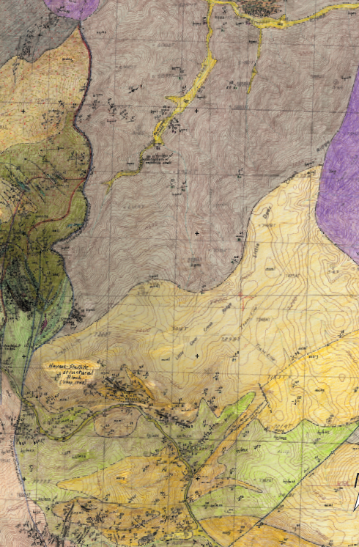
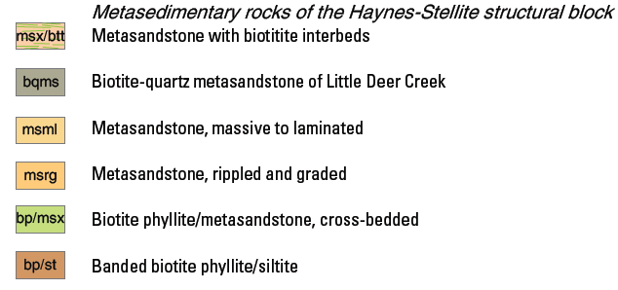
Map Units of Haynes-Stellite Block
The Little Deer thrust (LDt) dips about
45ºW, placing the W margin of the
Blackbird block over the E margin of the
Haynes-Stellite block. The Northfield-
Slippery Gulch fault (NSf) is a down-to-east
normal fault that cuts the Little Deer thrust.
LDt
Haynes-Stellite structural block
Banded siltite grades NE (up-section)
to metasandstone (Gunsight Fm of Evans &
Green, 2003). This grades N and up-section
to biotitic metasandstone.
NSf
Biotitic metasandstone may represent a muddy sand facies of Gunsight Fm.
NSf

Slide 19
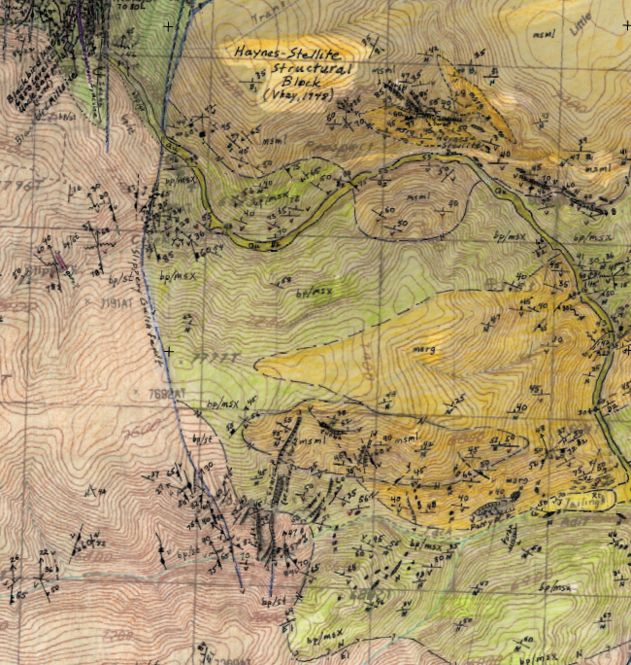
Geologic setting of
Co-Cu mines and prospects
In the Haynes-Stellite block,
SE of the Blackbird mine
HS
Haynes-Stellite mine (HS —
tourmaline-matrix breccia with
disseminated cobaltite)
CoNiCu prospect (CnC —
tourmaline-matrix breccia with
disseminated cobaltite and
chalcopyrite)
Patty B prospect (PtB —
tourmaline replacement
with disseminated cobaltite.
CnC
PtB
Tailings from the Blackbird mill
are impounded near the Patty B.
Co-Cu bearing tourmaline breccias and replacements in the
Haynes-Stellite block are on the down-thrown, upper-SE margin
of the Blackbird cluster of Co-Cu ore zones and prospects.

