Slide 1
USE OF MORPHOMETRIC ANALYSIS ON CUBONAVICULAR AND ASTRAGALI TO DIFFERENTIATE BISON SPECIES
Ashley Ferguson
Department of Geosciences, Idaho State University
Mary E. Thompson, Ph.D.
Idaho Museum of Natural History/ISU

Slide 2
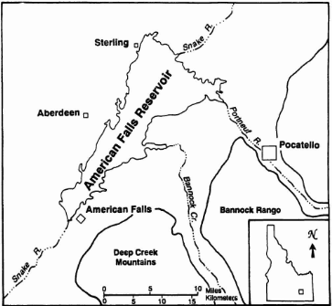
Introduction
Bison species currently identified by skull morphology only.
Skulls do not preserve well.
Several species of bison are found in one area.
Can astragali and/or cubonaviculars be used to differentiate bison species?
Pinsof, 1991 Journal of Vertebrate Paleontology

Slide 3
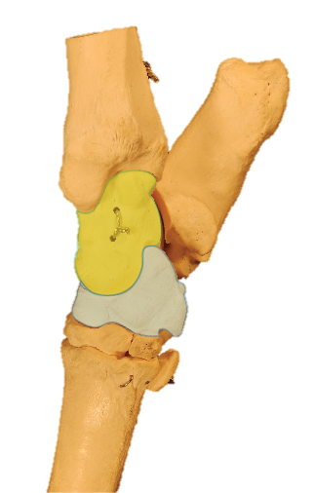
Material
American Falls, Idaho – Pleistocene
Wasden, Owl Cave, Idaho – 8000 BP
Modern Osteological material:
Antilocapra
Bison
Ovis
Odocoileus
Astragali
Wasden: 90
Pleistocene Bison: 12
Bison latifrons: 29
Odocoileus: 8
Antilocapra: 12
Bison: 6
Ovis: 12
Cubonaviculars
Wasden: 83
Pleistocene Bison: 21
Bison latifrons: 27
Odocoileus: 4
Antilocapra: 9
Bison: 5
Ovis: 10
5 cm

Slide 4
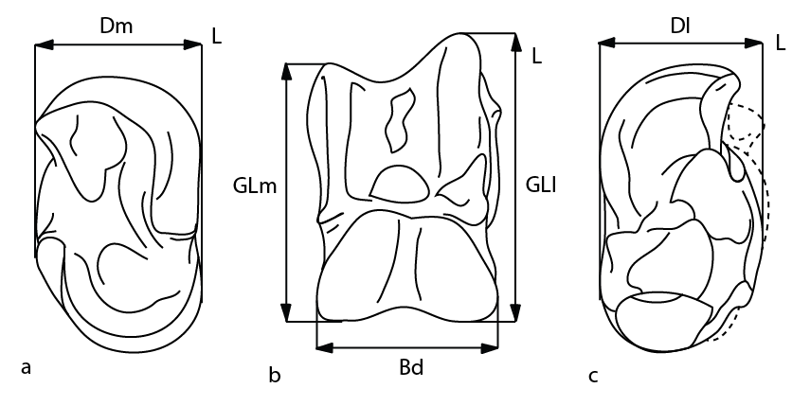
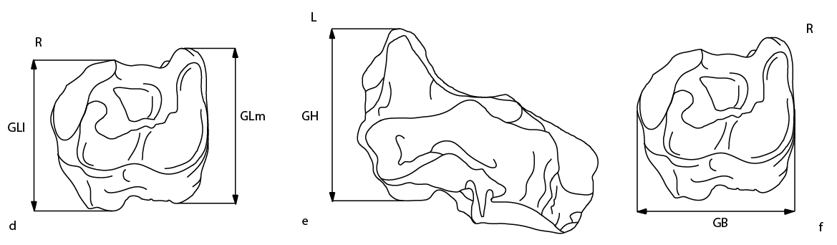
Standard Biometric Analysis
GLl = Greatest Length Lateral
GLm = Greatest Length Medial
Dl = Greatest Depth Lateral
Dm = Greatest Depth Medial
GB = Greatest Breadth (distal end)

Slide 5
Results: Astragali (Standard Measurements)

Slide 6
Results: Cubonavicular (Standard Measurements)
62001/23046
72010/26415
62001/26412

Slide 7
Results: Standard Measurements
Very conservative across all measurements.
Five outliers, may be identified incorrectly.
Possibility of overlap by juveniles or sexual dimorphism?
Does the Morphometric data match?

Slide 8
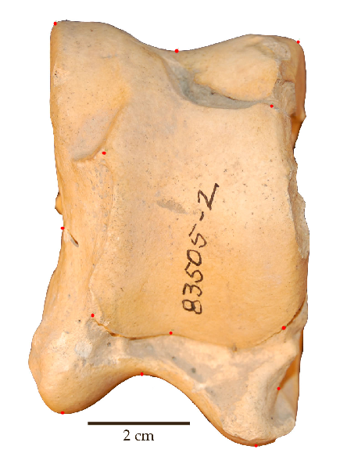
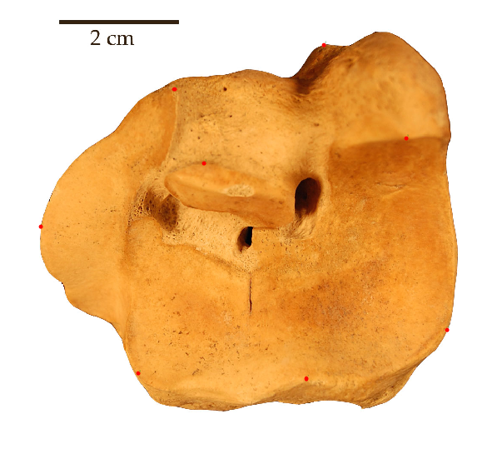
Landmark Analysis
Type 2 Landmarks
Inflection points on convex or concave curves.
Picked homologous structures that are visible on all specimens.
Procrustes Fit
Removes information not about shape.
Covariance Matrix
Generalizes variance to multiple dimensions.
Principle Component Analysis (PCA)
Projects as much variation as possible and plots them into a few dimensions.
83827-13
Notes:
Shape is not altered by translation, scaling, or rotation.

Slide 9
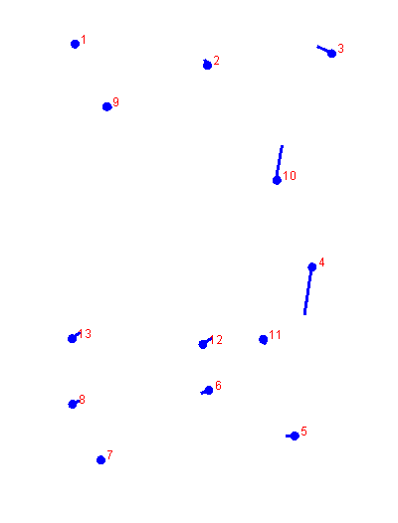
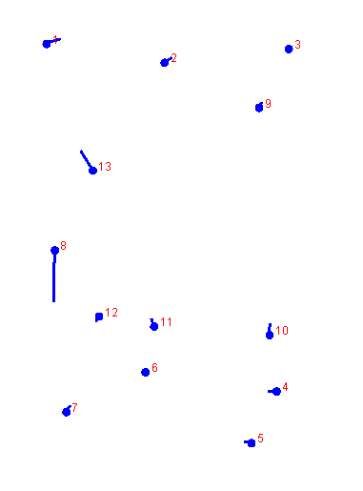
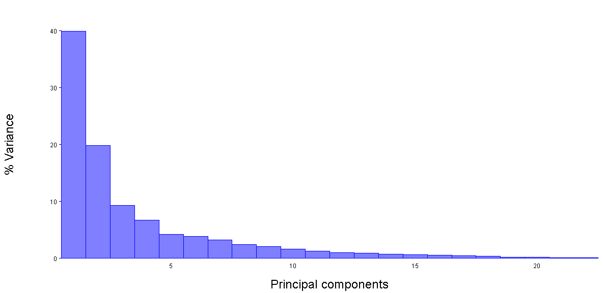
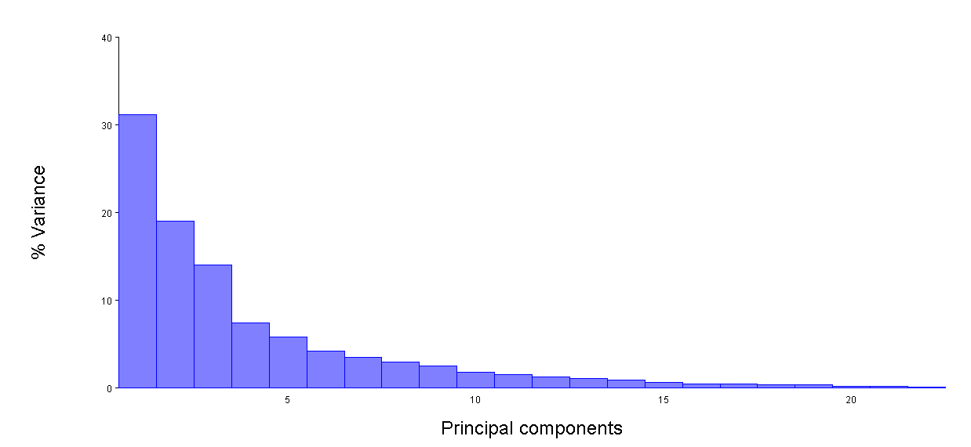
Results: Astragali (Morphometric Analysis)
Right Astragali
Left Astragali

Slide 10
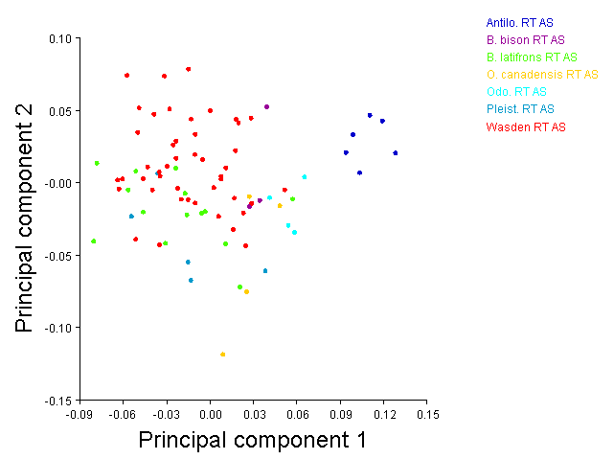
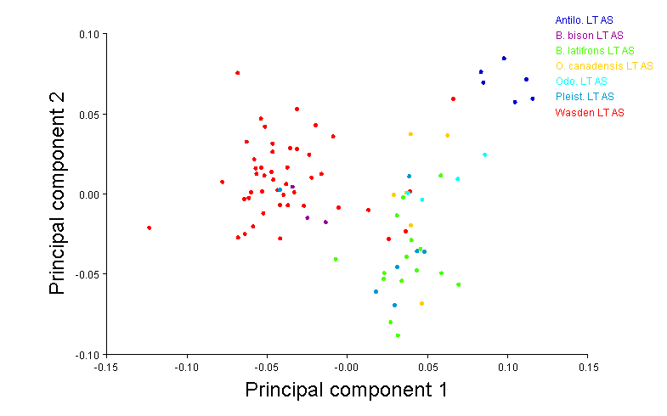
Results: Astragali (Morphometric Analysis)
Left Astragali
Right Astragali
303/14139
48001/1481
65003/8571

Slide 11
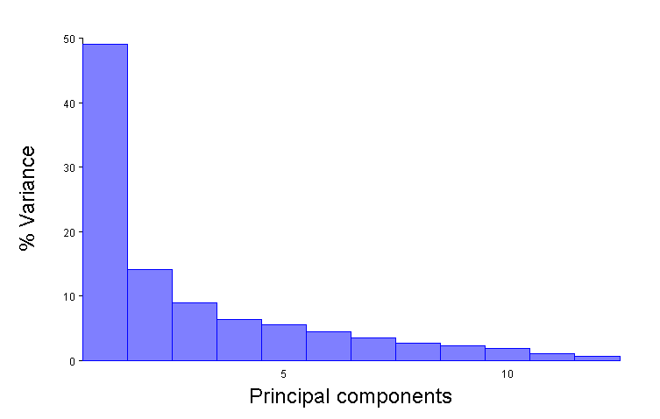
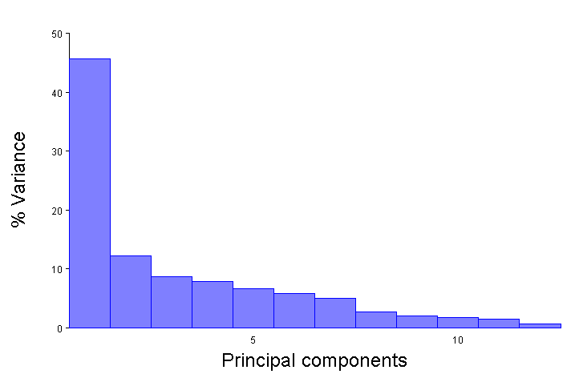
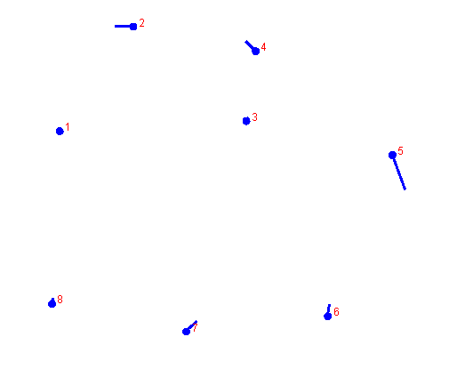
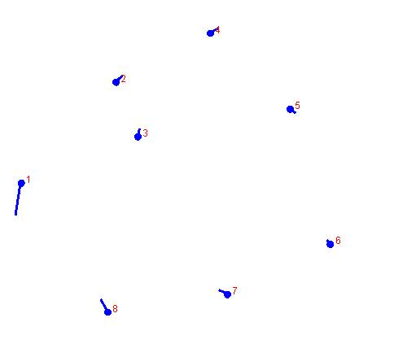
Results: Cubonavicular (Morphometric Analysis)
Left Cubonavicular
Right Cubonavicular

Slide 12
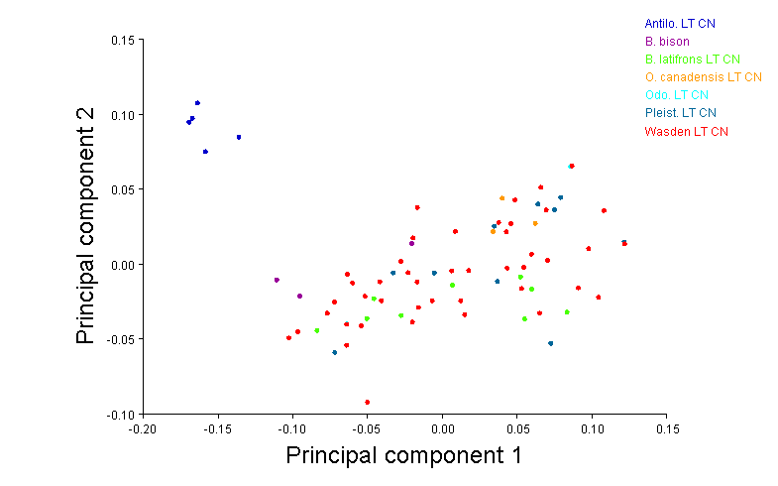
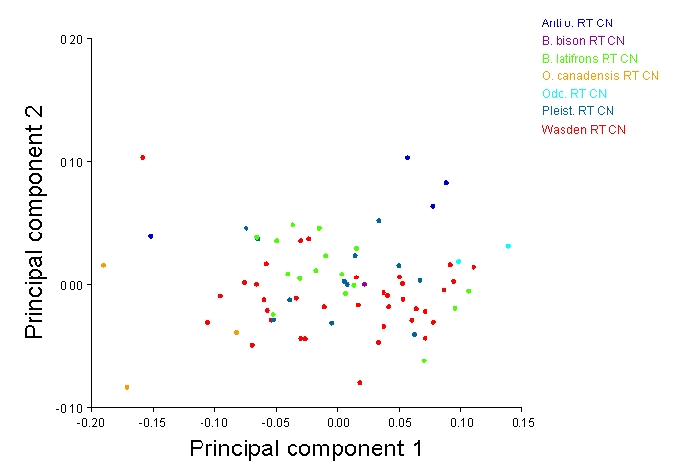
Results: Cubonavicular (Morphometric Analysis)
Right Cubonavicular
Left Cubonavicular
72010/26412
72010/26415
62001/23046

Slide 13
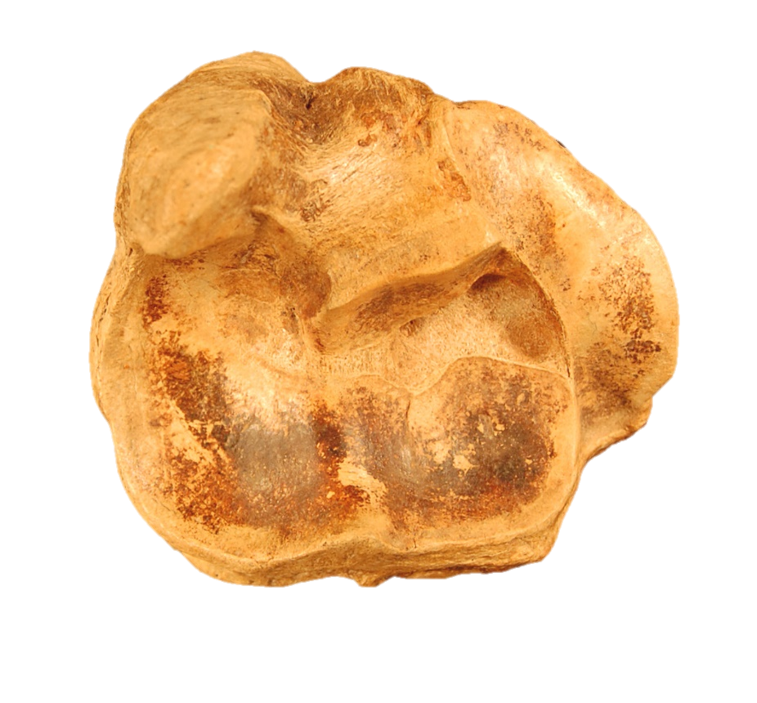
Conclusions
Family level
Distinguishable with astragali, more clearly on the left side than the right.
Genus level
Some separation of Ovis, Bison, and Odocoileus on the left side with overlap.
Species level
Some separation of B. latifrons and the Wasden material.
Cubonaviculars are ineffective for identification at the family, genus, or species level.

Slide 14
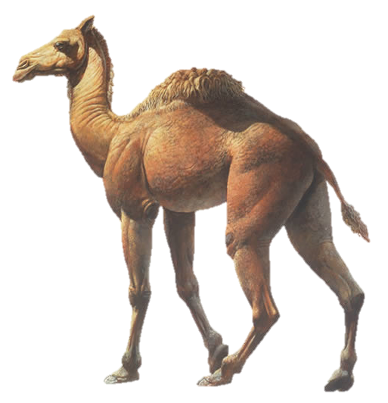
Future Research
Include Camelops material into the astragali measurments and morphometrics.
Integrate known B. antiquus, B. priscus, B. alaskensis and B. latifrons into morphometric analysis to narrow down groupings.

Slide 15
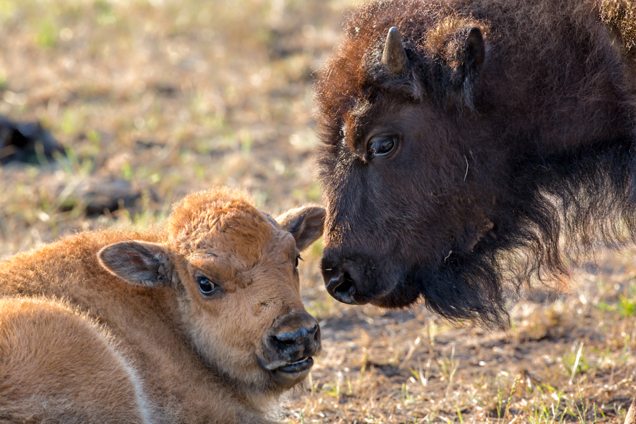
Things to Consider…
What could be occurring in Wasden?
Could other post-cranial material be more successful?
What effects does right-hoofed vs. left-hoofed have on morphometric data?
How do juveniles or sexual dimorphism play a role?

Slide 16
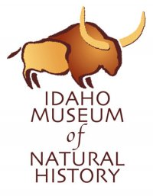
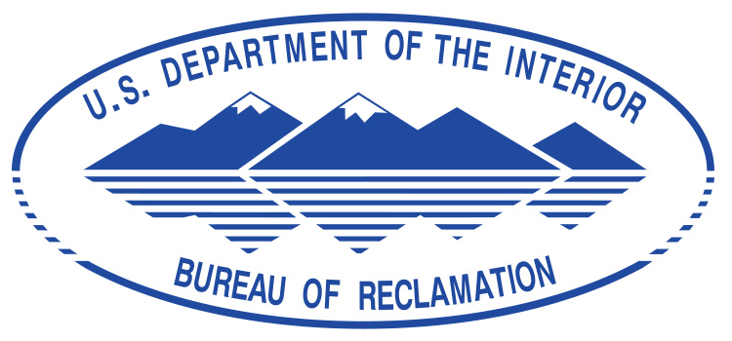
Acknowledgements
Idaho Museum of Natural History Amber Tews – Wasden Material
Earth Sciences Divison – Paleo and Comparative Osteo.
Department of the Interior, Bureau of Reclamation

