Slide 1

Characterizing the earliest stages of partial melting: A study of the pyrometamorphic aureole of Miocene Mt. Perkins pluton, NW Arizona
Mathew Beshears
Rodney Metcalf
Department of Geosciences
University of Nevada – Las Vegas
Notes:
I would like to begin this talk by informing you this is still very much a work in progress.

Slide 2
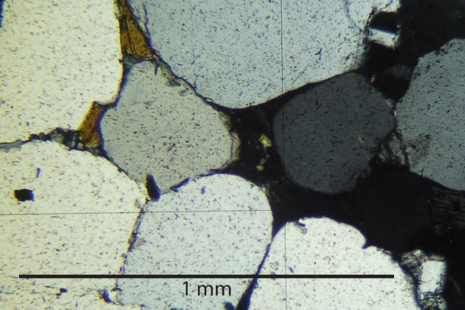
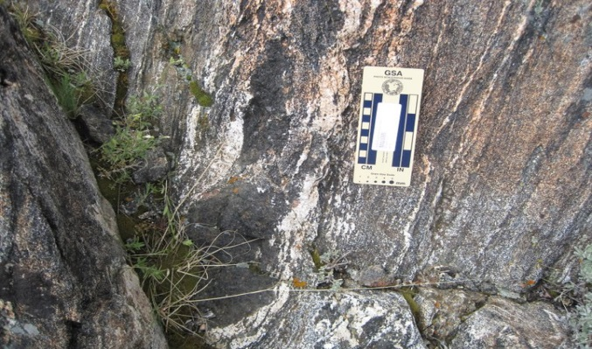
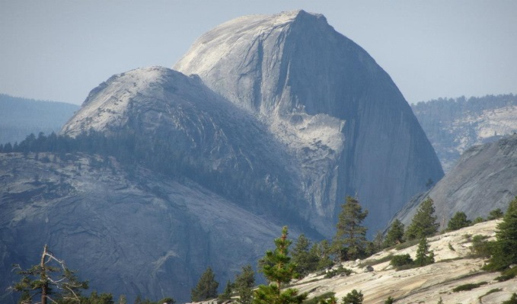
Introduction
Partial Melting
  Rock rheology
  Crustal generation & evolution
  Progressive process
    Early stages often not preserved
Sawyer, 2001
Micro-scale
Meso-scale
Mega-scale
Sample 111-5
Photo courtesy: Stacy Yager
Photo courtesy: Lauren Thomas
Notes:
Partial melting is an important process for many processes. For example, at small degree partial melt, about 4-5%, rock strength is reduced significantly. Partial melting is an important process in crustal generation and evolution. Sawyer, 2001 outlines a cross-section of the crust showing the evolution of continental crust. Partial melting forms migmatites in the lower crust and ascending magma may coalesce into intrusion complexes and/or plutons. Partial melting is a progressive process that begins at the micro scale at grain boundaries….

Slide 3
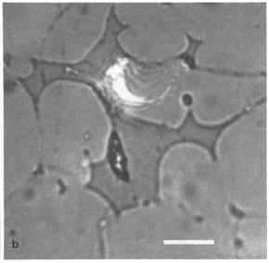
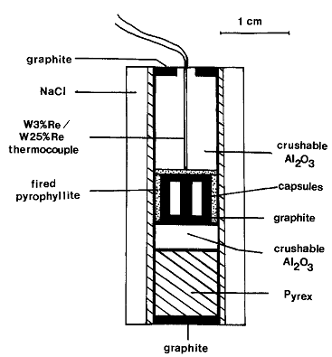
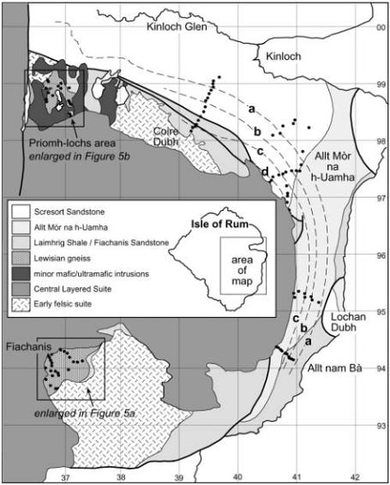
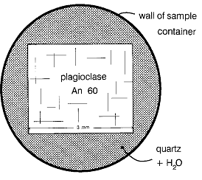
Investigating initial partial melt
Experimental approach
Field approach
  Pyrometamorphic aureoles of mafic intrusions, xenoliths
Jurewicz and Watson, 1984
Jurewicz and Watson, 1984
Johannes, 1989
Holness & Isherwood, 2003
Notes:
Previous workers have simulated P-T conditions to investigate partial melting at early stages. Starting materials can be synthetic or natural. However these experiments are restricted to human timescales. The field approach looks at xenoliths and pyrometamorphic aureoles of mafic intrusions to investigate partial melting. These partially melted regions are natural laboratories for experiments ran at geologically short timescales… from decades to hundreds of thousands of years.

Slide 4
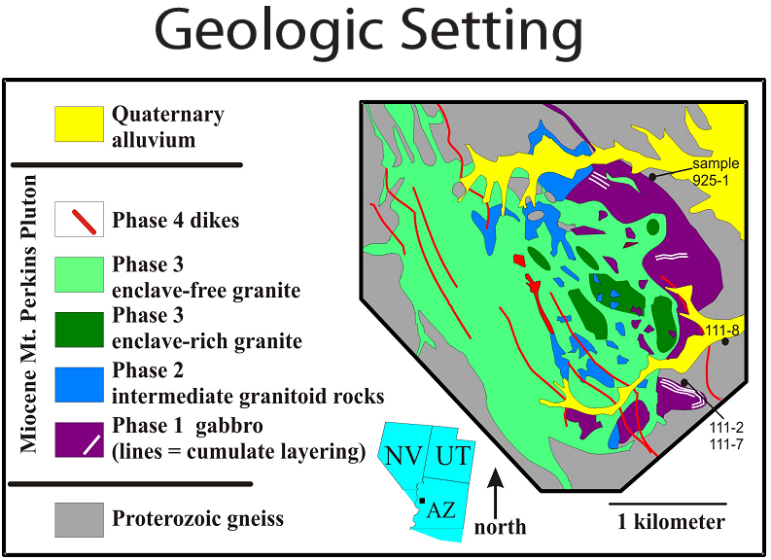
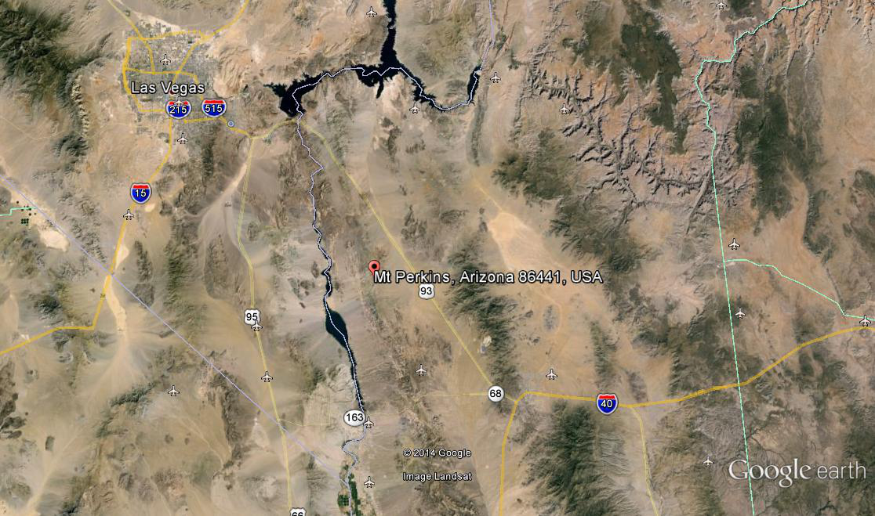
Mt. Perkins pluton
  Compositionally diverse, composite, tilted pluton
    Paleodepth 5-7 km (Metcalf et al., 1995)
  Pyrometamorphic contact aureole
    Amphibole-bearing tonalitic gneiss
    Natural laboratory

Slide 5
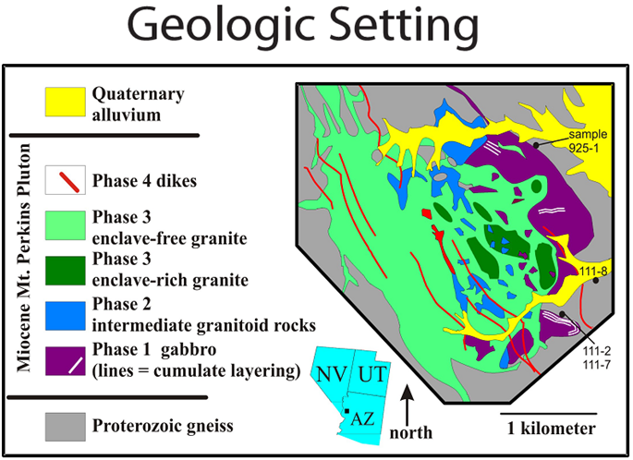
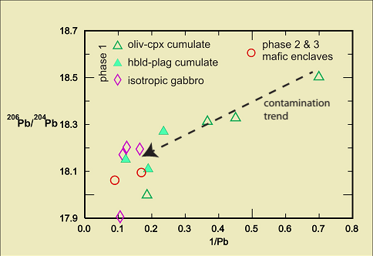
Goals
Document partial melt microtextures
Map psuedomelts on a thin section scale
  Melt
    volume %
    composition
    reaction(s)
    distribution
Map scale melt variations
P-T-x conditions
Document local partial melting
  In situ crustal contamination
    Metcalf et al., 1995
Notes:
Another goal for this project is to document local partial melting to answer the question “can magma bodies experience in situ crustal contamination?” Olivine-clinopyroxene cumulates of the Mt. Perkins pluton show a crustal contamination trend. This project will document partial melt conditions for further tests on in situ crustal contamination. This talk will focus on difficulties identifying and mapping partial melt microtextures.

Slide 6
PLM Mapping pseudomelt textures
Notes:
As with a field study where mapping is one of the first objectives, being able to map pseudomelt pockets is the first objective. To map in the field you have to recognize and define units. In this case, it is critical to identify what is pseudomelt and residual crystals. Think of these as map units. This one of the early efforts to map pseudomelts, but this talk will show some difficulties when mapping psuedomelt quartz and plag.

Slide 7
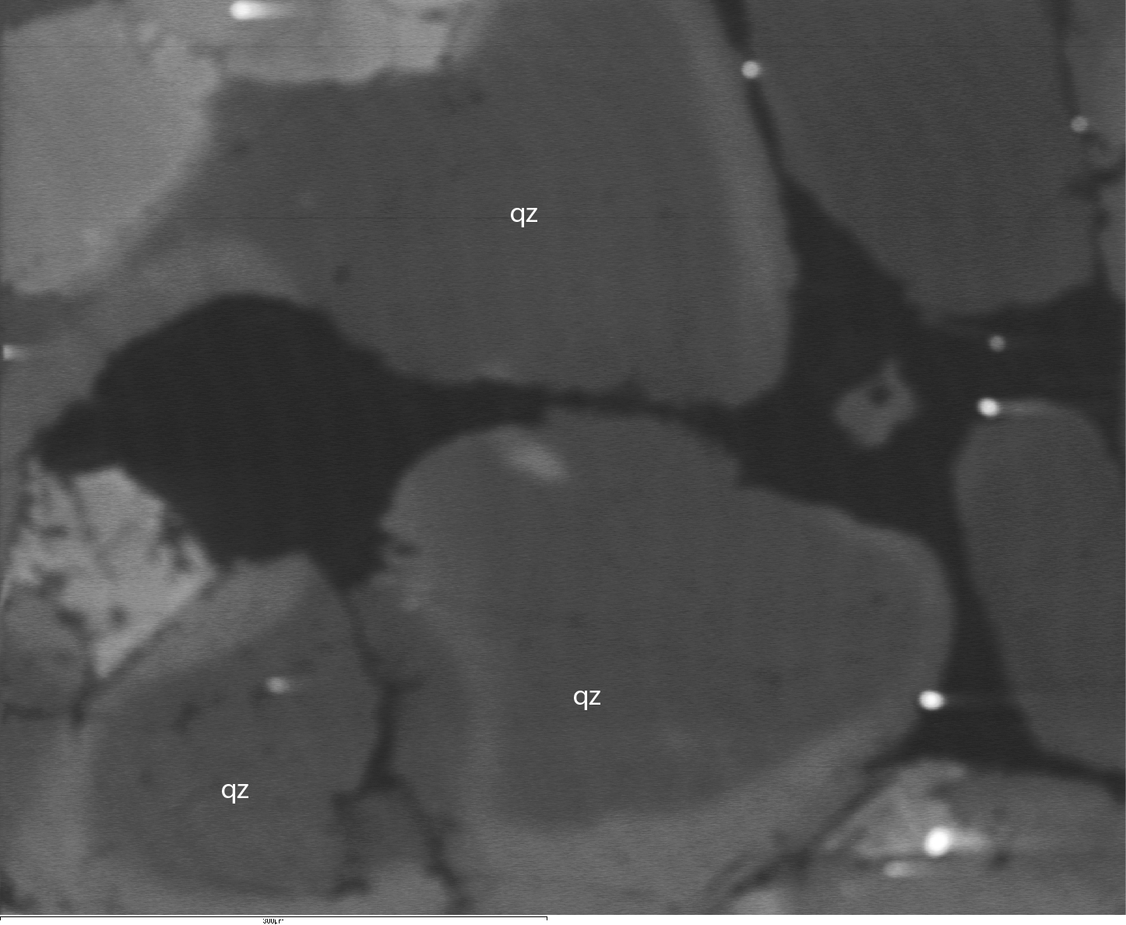
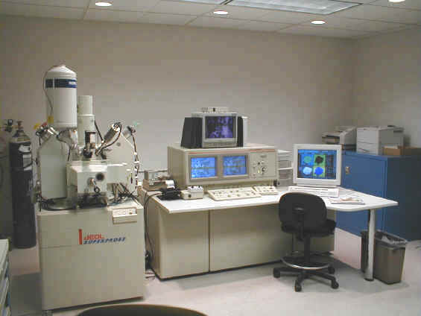
Methods
Recognizing pseudomelt microstructures
  Optical microscopy
  EPMA techniques
  SEM-BSE
  SEM-CL
Map pseudomelt pockets with imaging software
111-4a
900 um
111-2
Electron Probe Microanalyzer, UNLV
Notes:
ImageJ

Slide 8
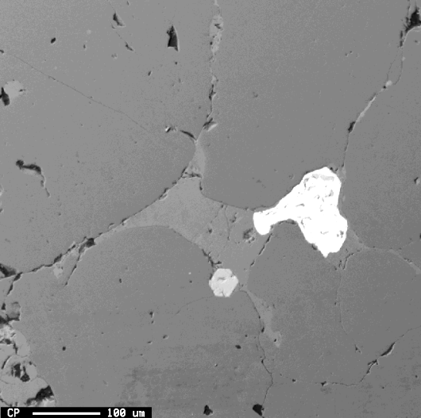
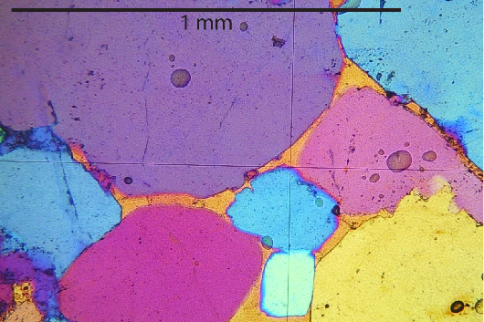
Recognizing pseudomelt textures
Melt Film
String of Beads
Pseudomelt Pocket
111-4a
Melt films
  Usually monomineralic
  Cuspate grain boundaries
  Low melt-solid-solid dihedral angles
111-2
Jurewicz and Watson, 1984

Slide 9
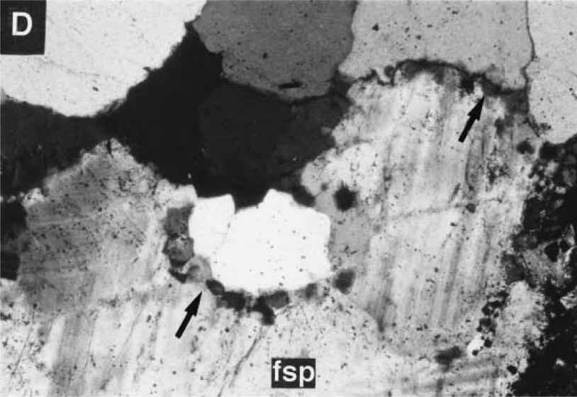
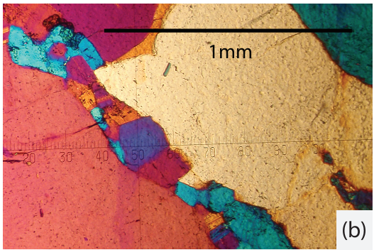
Recognizing pseudomelt textures
Melt Film
String of Beads
Pseudomelt Pocket
“String of Beads”
  Multiple phases crystallized between grains
  “blocky grain boundaries”
925-1
  (Holness & Isherwood, 2003)
111-2

Slide 10
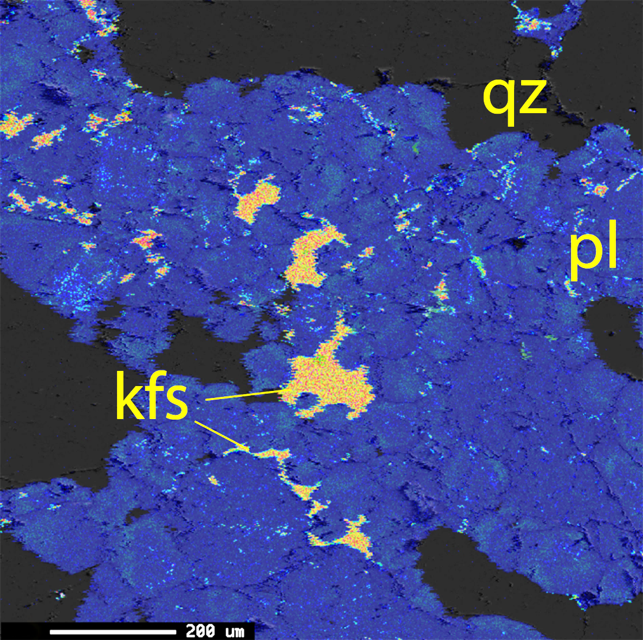
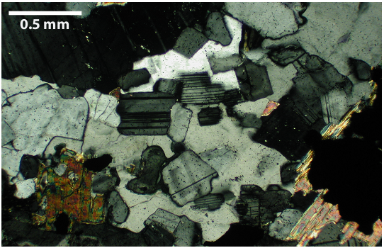
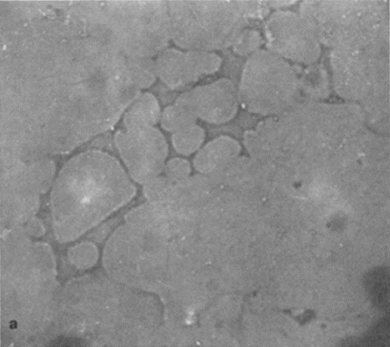
Recognizing pseudomelt textures
Melt Film
String of Beads
Pseudomelt Pocket
Pseudomelt Pockets
  Multiphase
  Plagioclase crystals with rounded cores
  Plagioclase may be zoned
  Cuspate grain boundaries
111-2
111-2
Jurewicz and Watson, 1984

Slide 11
Pseudomelt texture mineralogy
Melt films
Residual Mineralogy
K-feldspar
Plagioclase
Amphibole
Biotite (minor)
Magnetite
Quartz
Plagioclase
Amphibole
Magnetite
Biotite (minor)
Where is quartz in melt?
Pseudomelt Pocket
& String of Beads
K-feldspar
Plagioclase
Notes:
Kspar, plag and amphibole; ADD AMPH MELT FILM IMAGE EARLIER; Where is the pseudomelt quartz that should be expected? Need CL imaging to recognize.

Slide 12
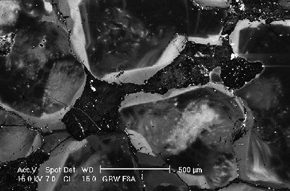
Recognizing pseudomelt pockets
Cathodoluminescent imaging (SEM-CL)
  Rounded quartz shows bright rims
    Growth rim (Holness & Watt, 2001)
    (Holness & Watt, 2001)
Notes:
Holness image

Slide 13
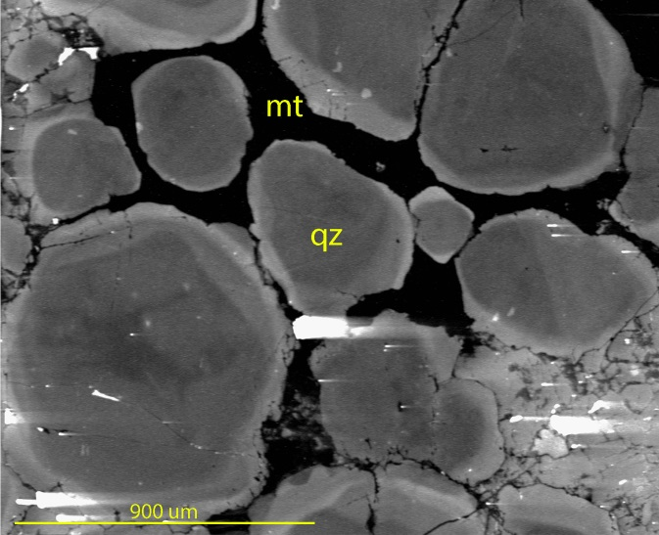
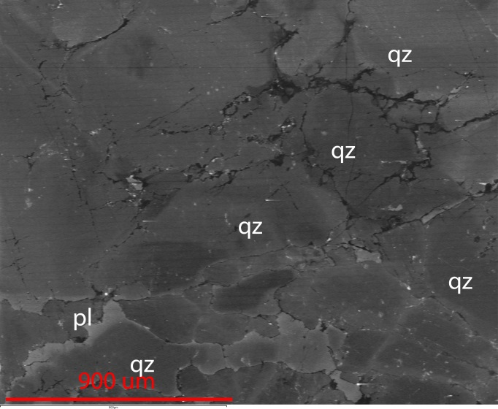
CL imaging
unmelted
melted
melted
111-8
136-2B
111-2
qz
qz
900 um
111-8
111-4a
111-2
pl
qz
pl
qz
amph
111-8
900 um
qz

Slide 14
Pseudomelt texture mineralogy
Melt films
Residual Minerals
Quartz (overgrowth)
K-feldspar
Plagioclase
Amphibole
  Magnetite
  Biotite (minor)
Quartz
Plagioclase
Amphibole
Magnetite
Biotite (minor)
Pseudomelt Pocket
& String of Beads
Quartz (overgrowth)
K-feldspar
Plagioclase
Notes:
Need CL imaging to ID quartz pseudomelt, without under map psmp

Slide 15
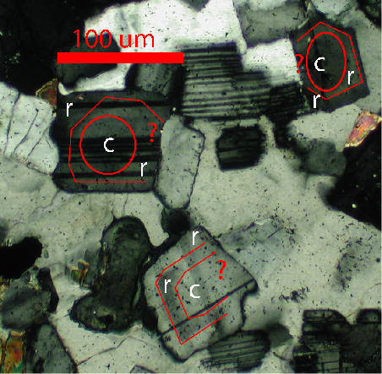
Pseudomelt texture mineralogy
Melt films
Residual Minerals
Quartz (overgrowth)
K-feldspar
Plagioclase
Amphibole
  Magnetite
  Biotite (minor)
Quartz
Plagioclase
Amphibole
Magnetite
Biotite (minor)
Pseudomelt Pocket
& String of Beads
Quartz (overgrowth)
K-feldspar
Plagioclase
Notes:
Need CL imaging to ID quartz pseudomelt, without under map psmp

Slide 16
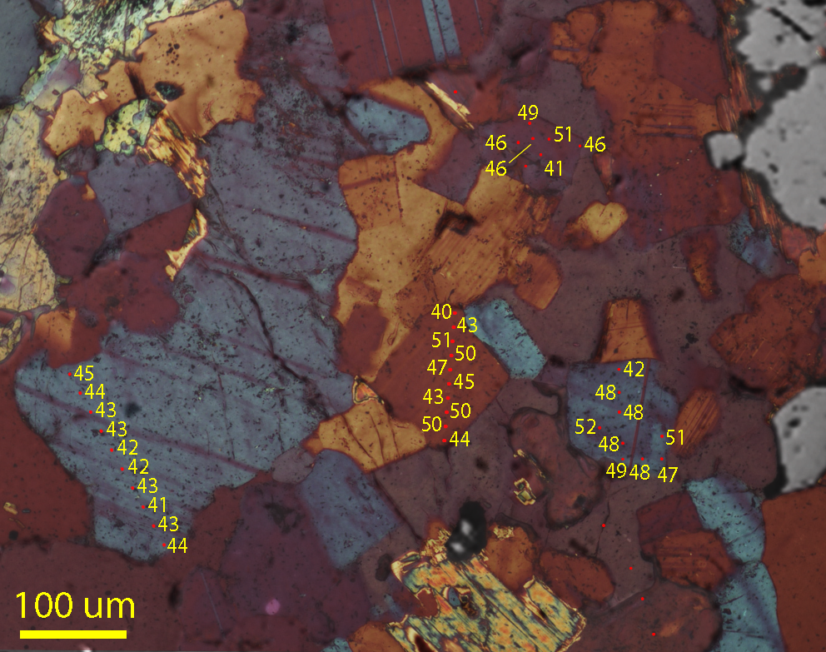
111-2 pseudomelt pocket
An
Residual
Pseudomelt
Or
Ab
Or

Slide 17
111-4a melt film
An
500 um
Residual
Melt film
Or
Ab
Or

Slide 18
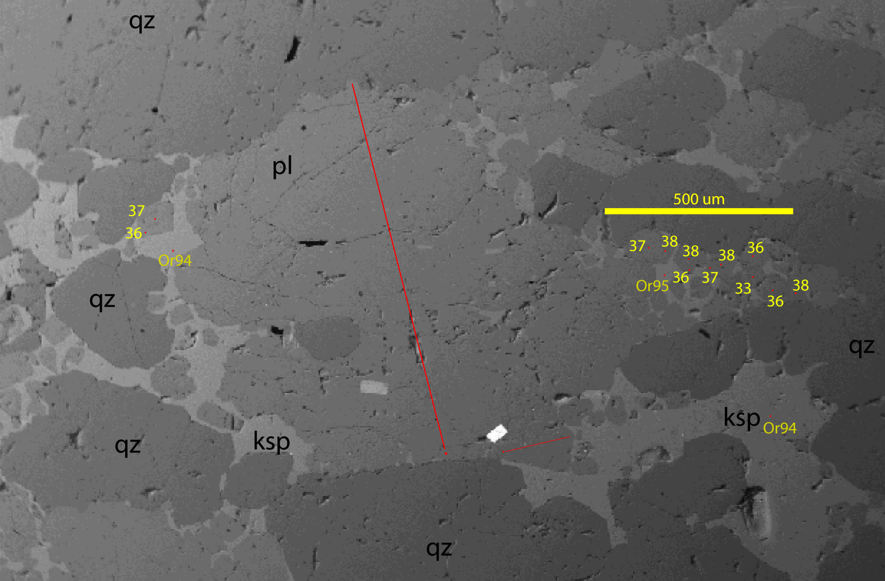
925-1 Pseudomelt Pocket 3
1
An
1
2
2
Residual
Pseudomelt
Or
Ab
Or

Slide 19
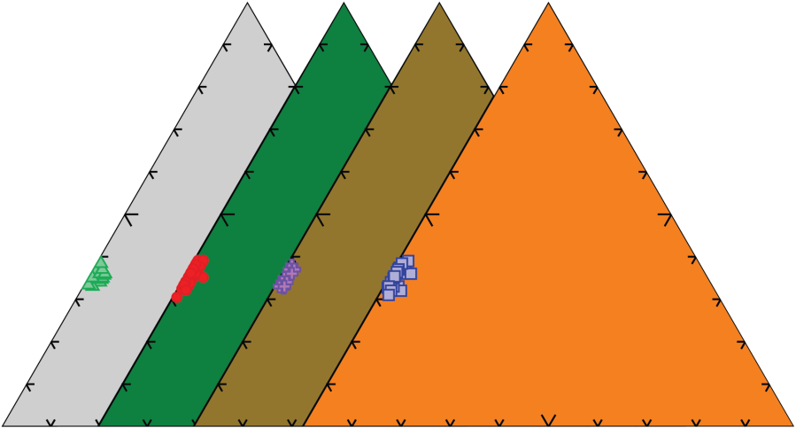
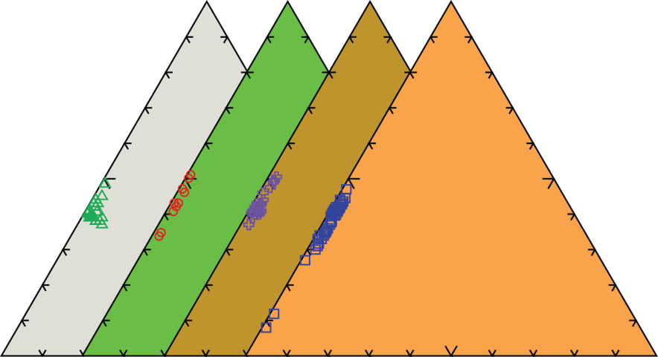
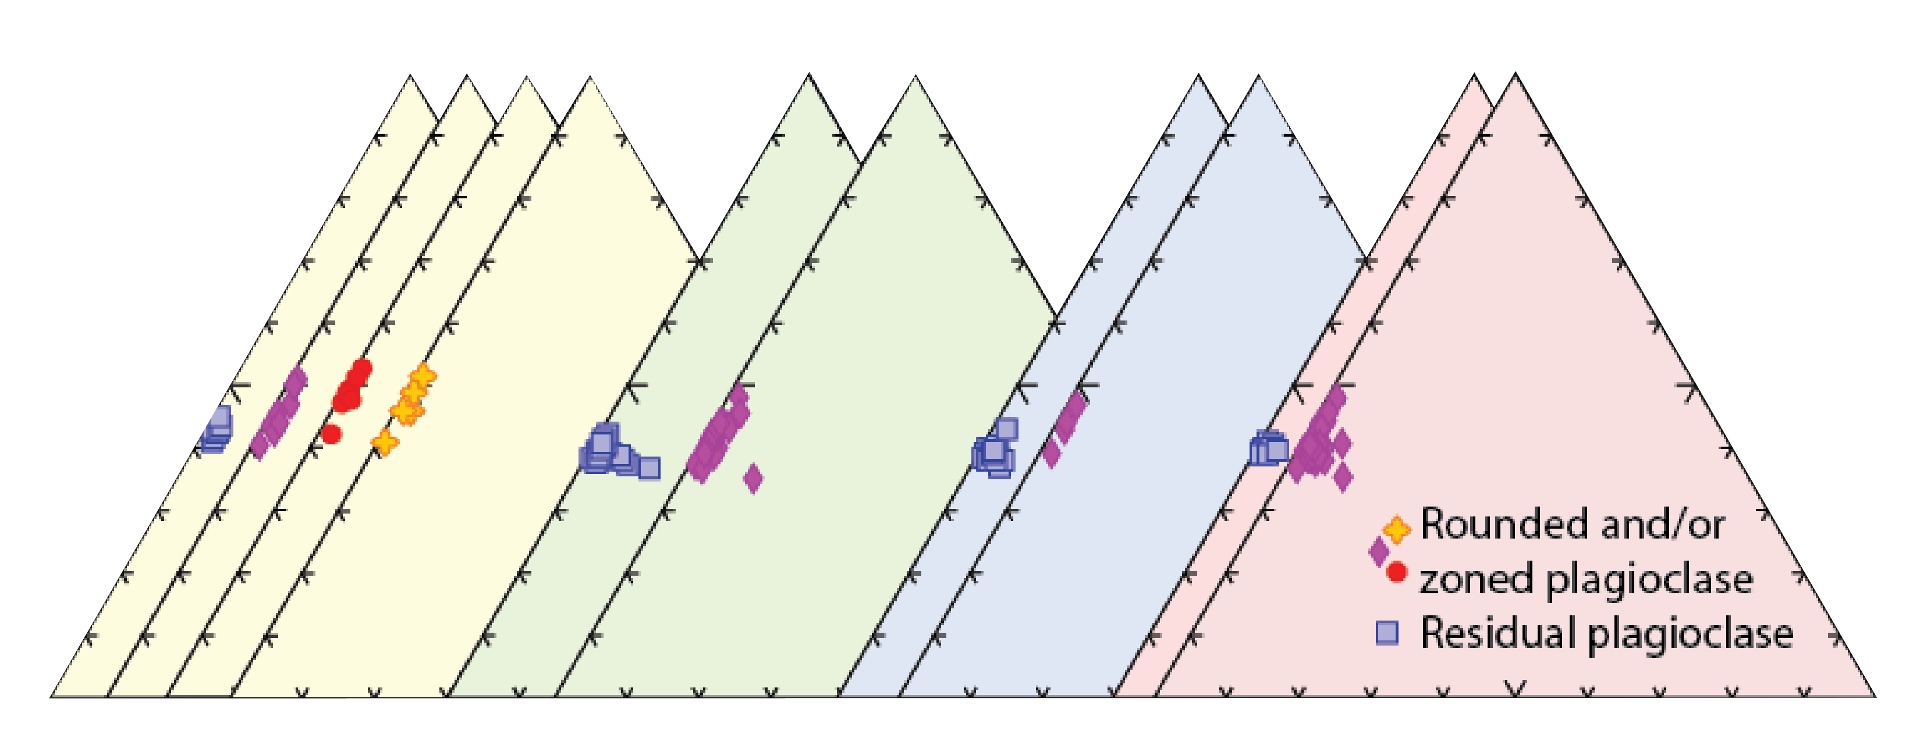
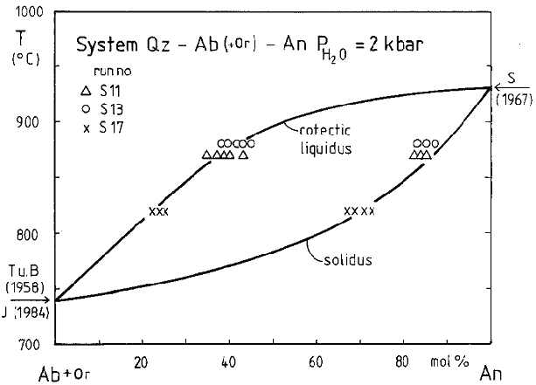
Plagioclase Chemistry
925-1
An
111-4a
An
String of Beads
Pseudomelt
String of Beads
111-8
Melt films
111-8
Overgrowth
Residual
Residual
Melt films
Ab
Or
Ab
Or
111-2
An
Ab
Or
Johannes, 1989
Notes:
This slide shows the relationship between 111-8 residual and melted slides. Here, I will explain the plagioclase problem as it relates to these rocks.

Slide 20
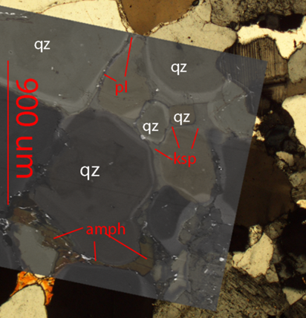
PLM Mapping pseudomelt

Slide 21
Mapping pseudomelt
5%
11%
17%
12%
14%
15%

Slide 22
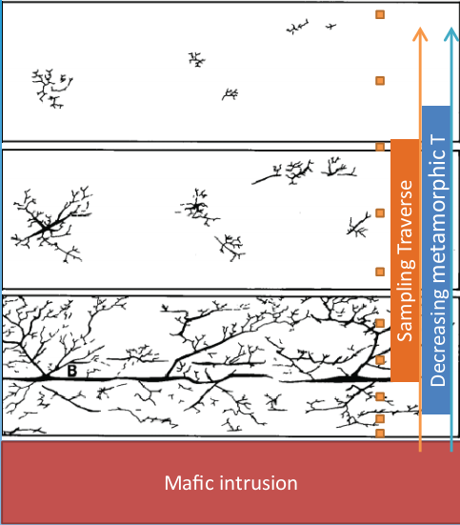
Continuing work
Thin-section scale mapping
  Quartz rims
  Zoned plagioclase
Traverses
  “Unmelted” protolith
  Melt chemistry
  Melt volume %
Melt reactions
  Ksp + plag + qtz ± amph ± mt + H₂0 = melt
P-T Conditions
Modified from Sawyer, 2001

Slide 23
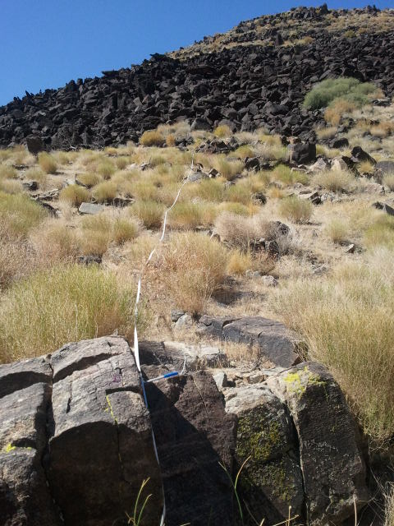
Acknowledgements:
Geologic Society of America
Rod Metcalf
Minghua Ren
UNLV Department of Geoscience
Questions?
Mat Beshears (beshears@unlv.nevada.edu)
Modified from Sawyer, 2001

Slide 24
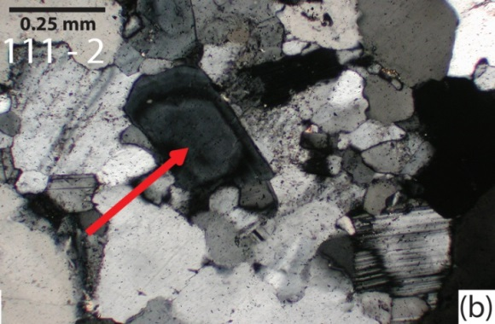
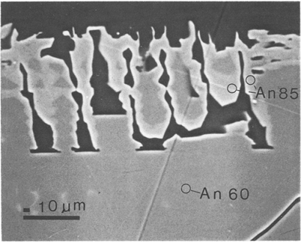
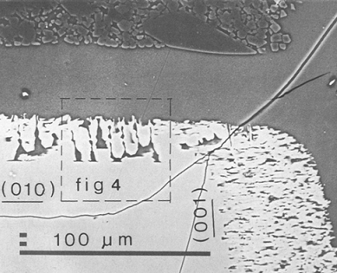
Plagioclase “problem”
Melting
  Residual plagioclase vs. Melt composition
  An-content of plagioclase often does not agree with thermodynamic models.
Metcalf and Kopeitz, 2011
Johannes, 1989
Johannes, 1989

Slide 25
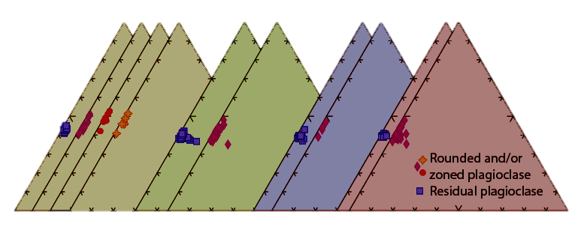
An enrichment?
Melt migration
  Add Ca or subtract Na
Temperature rose above liquidus
  Melt films record fractional crystallization
  Incomplete melting
  Limiting reactant
    K-feldspar and/or water
Johannes, 1989
An
111-2
Ab
Or

Slide 26
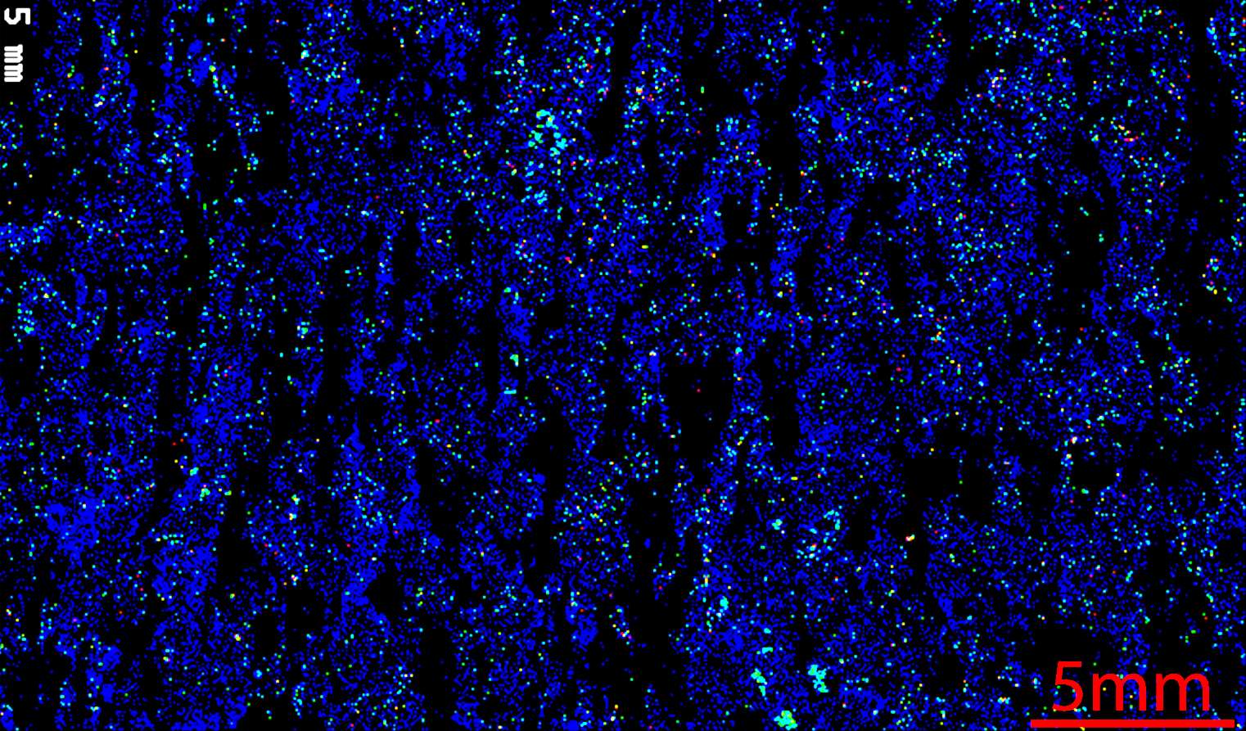
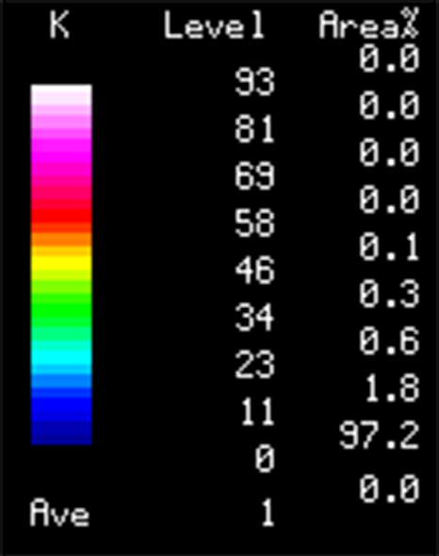
K-feldspar source?
Biotite breakdown
Heterogeneous protolith
Sample 111-8

