Slide 1
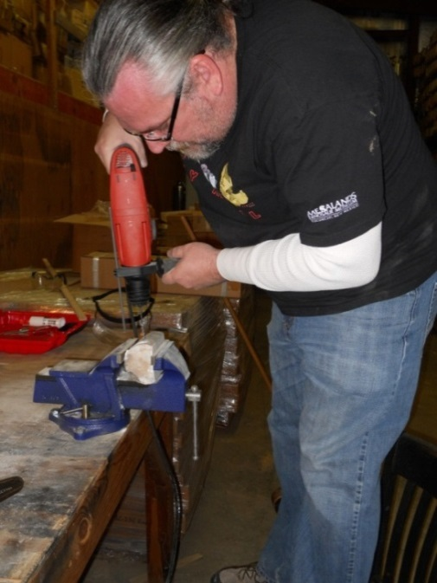
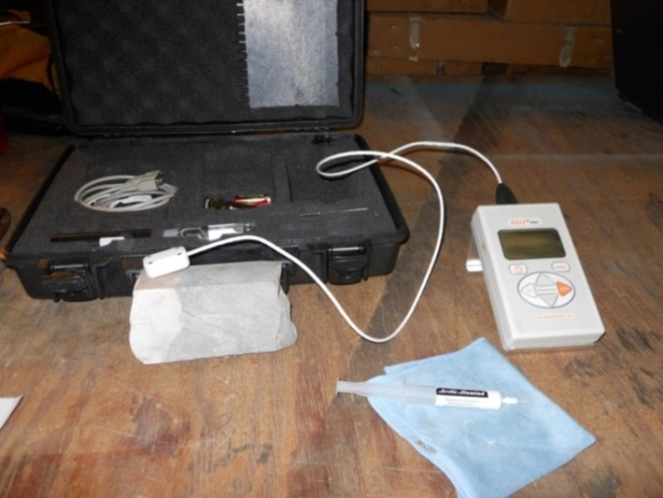
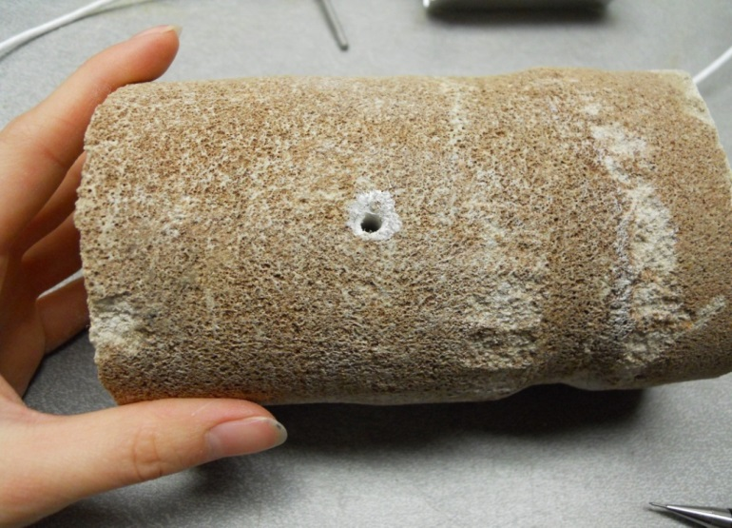

thermal conductivity, thermal gradient, and heat flow estimations for the smackover formation, southwest arkansas
AGS Miscellaneous Publication 23
Lea Nondorf and Corbin Cannon
Arkansas Geological Survey
Notes:
Summary and Discussion of AGS Misc. Pub 23, published last summer.

Slide 2
Geothermal Project
State Geothermal Data Project
AGS contributed geothermal-relevant data from Smackover Formation.
  Borehole Temps, driller logs, documents, and thermal conductance measurements.
  http://services.usgin.org/track/report/AR
Notes:
As you heard form the previous talk, this presentation/publication is part of the AGS deliverables in participation with a federally funded state geothermal data project, started by Lee Allison, state geologist at Arizona Survey.
AGS signed in September of 2010. We started working on the project in March of 2011. Funding officially ended this last December.
For the entirety of the project we contributed data mostly from the Smackover Formation in the form of
BHT,
drillers’ logs,
geothermal-related documents,
geologic maps,
aeromagnetic maps,
geothermal gradient maps, and
thermal conductance measurements.
Anyone can look up data at the above website.

Slide 3
Smackover Formation
Notes:
Smackover Formation, located in southern Arkansas, is early Late Jurassic (Oxfordian), 161-156 million years old. Divided into two informal units, the upper and lower Smackover, aka the Reynolds oolite and Brown dense.
The upper section consists mostly of a white to brown, porous oolitic to pisolitic grainstone with inclusions of calcite, pyrite, anhydrite, gypsum, and lignite (Vestal, 1950). The upper Smackover Formation was the major hydrocarbon producer in southern Arkansas, especially during the late 30’s to late 40’s, primarily from the Reynolds oolite (where present).
Currently, bromine brines are associated with the upper Smackover in south Arkansas. A Mining Engineering journal (Ober, 2012) reports all U.S. bromine was recovered from the bromine-rich brines of the Smackover Formation in Arkansas and is the state’s leading mineral commodity.
(Uses: Flame retardant, gasoline additive, pesticide, medicinal/veterinary).
The informal lower Smackover is the source rock. The lower section is described as an organic-rich, very dense (hence the name Brown dense), dark-brown, very fine-grained, calcareous mudstone (Weeks, 1938). Because of the development of new drilling technologies, several oil and gas companies are currently exploring the economic potential of the lower Smackover, or Brown dense, as a commercial and unconventional reservoir.

Slide 4
Notes:
From Information Circular 14, J. Vestal (1950). Digitized Isopach and Structural Contour maps.
Isopach shows Smackover thickening towards the southwest, with greatest thickness at 1200’. Structural contours on the top of the Smackover Formation show the unit ranges from a depth of 1,000 ft (305 m) near its northernmost boundary to approximately 11,000 ft (3,353 m) in extreme southwestern Arkansas.

Slide 5
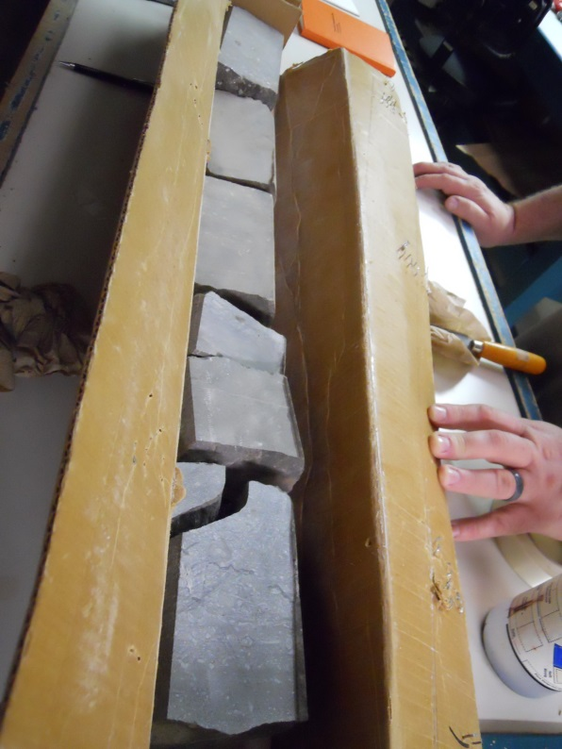
Why the Smackover?
1. Information is readily available at the survey
  Geophysical logs, drillers’ logs, documents, core

Slide 6
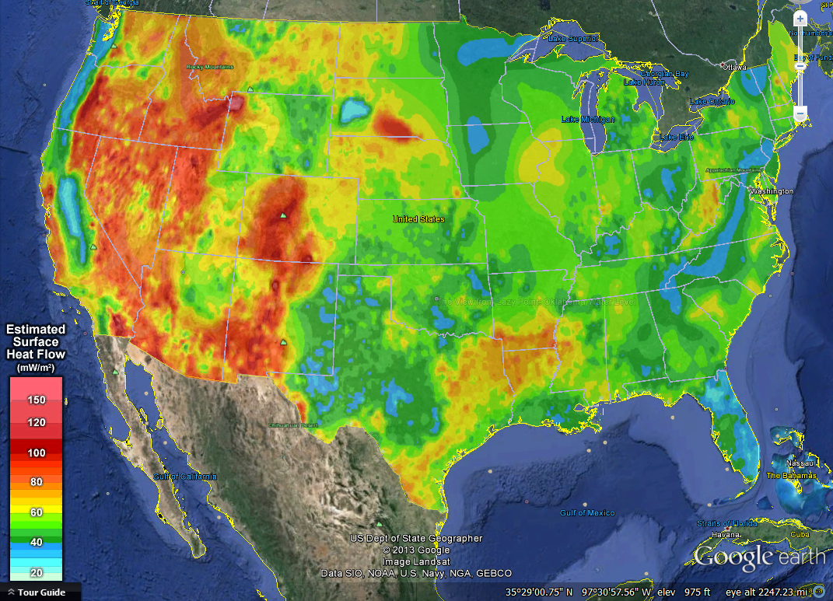
2. Warmest BHT’s recorded in the state
From Blackwell and Richards (2011), www.google.org/egs
Notes:
A study conducted by Southern Methodist University shows South AR and Northern LA as having anomalously high subsurface temperatures for the eastern U.S.

Slide 7
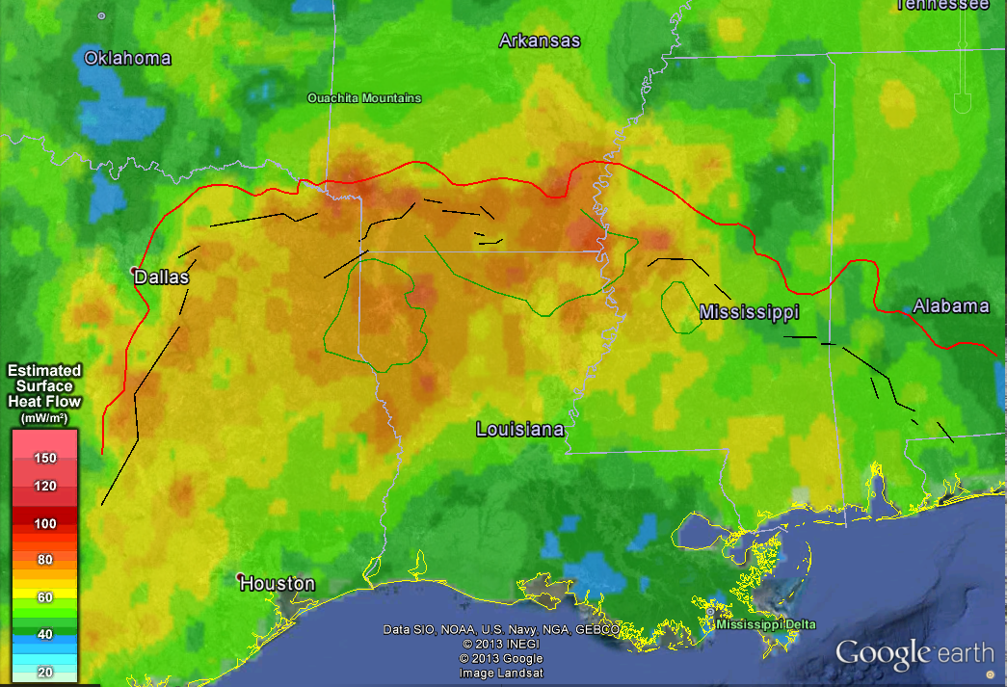
Approximate updip limit of Upper Jurassic rocks
South Arkansas Fault System
Rodessa Fault
Monroe Uplift
Pickens-Gilbertown Fault System
Sabine Uplift
Jackson Dome
Mexia-Talco Fault System
Heat Flow Map (Blackwell and Richards, 2011 ; Updip limit, fault, and uplift/dome information, modified from Dickinson, 1968
Notes:
Here is the heat flow map showing the updip limit of the upper jurassic rocks. Looks as if highest heat flow values for southern AR are delineated by this updip limit.
It appears that the northern extent of the estimated high heat flow values are closely following the trend updip limit of the Upper Jurassic rocks.

Slide 8
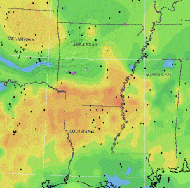
Geothermal Map of America, well locations (taken from Blackwell and Richards, 2004)
Notes:
Geothermal map of the well locations whose BHT’s were used to determine heat flow in Arkansas.
Only 2 or 3 BHT’s were used to calculate heat flow values for southern Arkansas; likely extrapolated from TX, MS, and LA BHT values.

Slide 9
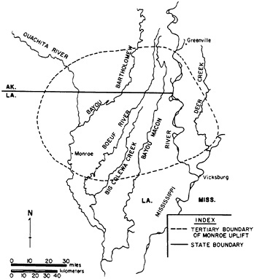
Possible Explanation of High Subsurface Temperatures in South AR
Origin of warm temperatures and brines in Smackover are not clearly understood
Smith & Dees (1982)-high heat flow may be attributed to abnormal concentrations of radiogenic heat sources within the Alkali igneous rocks of the Monroe Uplift
Burnett and Schumm (1983)
Notes:
Really, have no idea.
Thermal data were also collected on phonolite samples (permit number 21198) from the Monroe Uplift (potential origin of heat source) (late cretaceous) in Ashley County
Radiogenic-produced by radioactivity from U, Th, K. If abnormally high concentrations of radiogenic heat sources, then more conductive rocks will contribute to spread of the heat source to the extent of those highly conductive rocks.

Slide 10
Previous Geothermal Studies on the Smackover
Bromine-rich brines of Smackover at boiling upon reaching surface (depths of 6500 ft) (Roy et al., 1980).
AP&L (Entergy Operations, Inc.) and DOE initiated geothermal feasibility study near El Dorado in 1979
Tested 100 kW direct contact boiling/condensing binary system (Ellis, 1980)
Operated from Sept-Dec, 1979
Shut down due to control system issues
Notes:
A 1980 report on Heat Flow Measurements in the State of Arkansas (Roy et al.) states that associated bromine-rich brines of the Smackover, extracted from depths of over 2,000 m (6,500 ft), are at temperatures near boiling at the surface.
Arkansas Power and Light, Co. (AP&L) (now part of Entergy Operations, Inc), in collaboration with the DOE, initiated a geothermal feasibility study near El Dorado, AR in 1979.
AP&L tested a 100kW direct contact boiling/condensing binary system using extracted brines from the Smackover to vaporize isopentane (C₅H₁₂), or the working fluid for this particular binary system, having a boiling point near 28°C (82°F) (Ellis, 1980).
(summarization) A binary power plant is useful for reservoirs with fluids at temperatures below approximately 150°C (300°F). The extracted geothermal fluid heats a secondary fluid, with a boiling point below that of water. These liquids are kept separate using a heat exchanger that transfers heat from the geothermal fluid to the working fluid which expands into a gaseous vapor that drives the turbines. All extracted geothermal water is reinjected back into the reservoir through a closed-loop system.
According to AP&L’s plant manager, the plant operated intermittently from September through December 1979, during which several problems occurred as a result of control system issues, which allowed only short working intervals for the plant.

Slide 11
Thermal Conductivity (λ)
Measures the ability of heat to flow through material
  Watts per meter·Kelvin (W/m·K)
  Mineralogy, porosity, and physical components affect thermal conductivity
83 Smackover Core from 18 wells sampled
  Included samples of overlying lower Buckner Formation-red to gray shale.
  Sampled at AGS Core Library
Notes:
We wanted to focus on the Smackover b/c the unit appears to have thermal properties that are most promising for a geothermal feasibility study with new technology. These thermal properties, specifically thermal conductivity, is an important factor in calculating heat flow, a major parameter in considering geothermal feasibility of a particular unit.
Higher thermal conductivity values for a particular lithology indicate a higher allowance for heat flow.
Since the Smackover core was readily available, the AGS could easily provide unique Thermal K measurements for the project, which was something that only 1 other state was providing.
The void spaces in high porosity rocks (>80%) are filled with low conducting air (0.024 W/m·K at 25°C) or water (0.58 W/m·K at 0°C).
Core samples selected for analyses were chosen based on
even distribution of well locations across southern Arkansas. Turns out, most core is available from SW AR.
competency for drilling and thermal testing.
Thermal measurements took place over a three month period beginning in mid-February 2012.

Slide 12
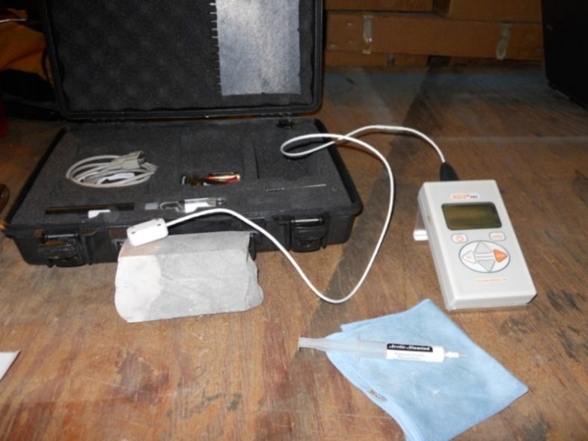
KD2 Pro Thermal Analyzer with Beta Probe and Thermal Compound (Polysynthetic, ceramic compound), Decagon Devices, Inc.
Hilti Rotary Hammer in vice, using 5/32 in. bit
Notes:
A Hilti Rotary Hammer was used to drill holes in the core using a 5/32 in. bit.
Holes were drilled to the depth equal to the length of the thermal probe.
After drilling was complete, compressed air removed debris from within the hole. The core was then set aside to cool to an average room temperature of 21°C (70°F) for at least ten minutes.
After cooling, Arctic Alumina thermal grease (approximately 0.2 to 0.4 mL) was applied to the drilled hole.
Thermal grease improves thermal contact between the thermal probe and the core; contact resistance will occur if no thermal grease is applied and will cause a decrease in normal thermal conductivity values registered by the probe.
For better accuracy, measurements were set to run for ten minutes on High Power Mode (HPM). During the measuring process, the thermal probe increased in temperature for a length of time followed by a decrease, allowing the sensor in the probe to measure thermal properties of the sample.
Results were uploaded to excel providing Thermal conductivity (W/m·K), thermal resistivity (°C·cm/W), error values, initial temperature of the core sample (°C), sample ID (arbitrary), and read time (ten minutes per sample) data for each sample.
A TR-1 thermal needle probe, with dimensions of approximately 4 in. in length by 0.10 in. in diameter was originally provided with the analyzer.
Several issues were noted when using the TR-1 probe on the core samples. INHIBITED US FROM OBTAINING A VARIETY OF DATA.
First, bits used for drilling were much wider than the diameter of the TR-1 probe, creating a significant gap between the core and probe.
To account for this gap and allow for suitable thermal contact between the core and probe, a large amount of thermal grease (0.6 to 1 mL) was applied to the drilled hole.
For some measurements, the amount of thermal grease added may have generated thermal results more reflective of the thermal grease (8 W/m·K, arcticsilver.com) and possibly contributed to higher error readings (≥0.02 or 2%).
Second, the probe requires 1 cm (0.40 in.) of rock surround the probe to allow the induced heat to be properly distributed throughout the sample.
In most cases, samples of thermal interest did not meet this requirement and could not be measured.
Finally, the diameters of most available core were approximately 3.5 in.; therefore, no measurements parallel to bedding were recorded due to the probe length, thus eliminating the potential to determine lateral, or anisotropic, thermal characteristics, important in reservoir characterization for feasibility studies.
Beta Probe was sent soon after starting, with dimensions of 2.5 in. long by 5/32 in. wide in early 2012.
Drilling the appropriate beta probe dimensions within the core was simpler, which greatly increased the thermal contact between the core and probe, providing more reliable thermal measurements.
Also, its shorter length allowed for measurements both perpendicular (isotropic) and parallel (anisotropic) to bedding.
Overall, the beta probe provided more consistent results among lithologies and generated lower error values compared to the TR-1 probe. Therefore, only the beta probe was used for further thermal measurements.

Slide 13
Permit Numbers of All Core Sampled for Thermal Conductivity
Notes:
This map shows an additional 10 wells that were sampled both above and below the Smackover across Southern AR. Labeled according to permit number
Data from additional 10 wells is provided in the publication in the Appendices.

Slide 14
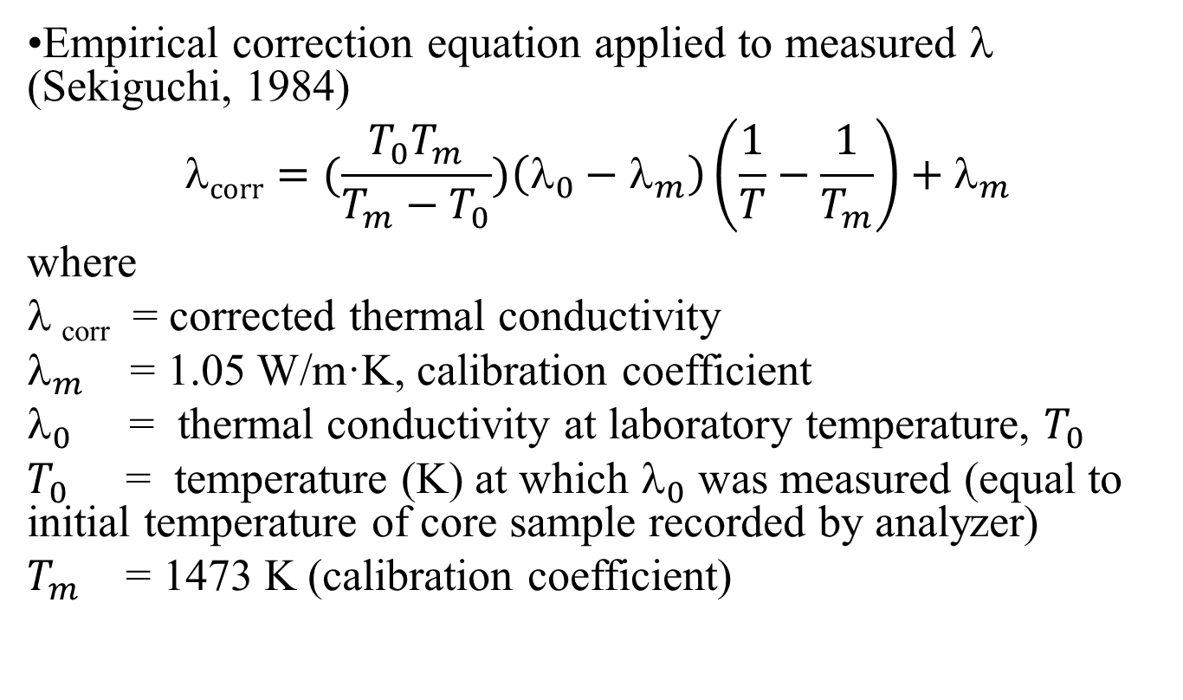
Correction for in-situ Thermal Conductivity
•Empirical correction equation applied to measured λ (Sekiguchi, 1984)
$$corr=(\frac{{T_{0}T}_{m}}{T_{m}−T_{0}})\left(λ_{0}−λ_{m}\right)\left(\frac{1}{T}−\frac{1}{T_{m}}\right)+λ_{m}$$
where
$$_{corr} = corrected thermal conductivity
$_{m}$ = 1.05 W/m·K, calibration coefficient
$_{0}$ = thermal conductivity at laboratory temperature, $T_{0}$
$T_{0}$ = temperature (K) at which $_{0}$ was measured (equal to initial temperature of core sample recorded by analyzer)
$T_{m}$ = 1473 K (calibration coefficient)
Notes:
Beardsmore and Cull (2001) state that thermal conductivity measured in a laboratory should be corrected for in situ temperature conditions.
Sekiguchi (1984) provided an empirical correction equation that applies to any rock with a temperature range between 0-300°C (273-573 Kelvin (K)) (Equation 1).
This equation was used to correct all AGS measured thermal conductance values (λ_{corr}) for in situ conditions.
For each measurement, the corrected values were then averaged using the harmonic mean method to determine the average corrected thermal conductance (λ_{avg}) per well for the Smackover Formation (Table 1).
The average corrected thermal conductance per well was then used to calculate average heat flow per well, described in the Heat Flow section.

Slide 15
Correction for in-situ λ
ID # | Permit # | Depth (ft) | W/m·K |  |  | Err | MeasDir | Lithologic Description
 |  |  | λ_{o} | λ_{corr} | λ_{avg}
5 | 21661 | 10810 | 4.04 | 2.97 | 1.79 | 0.02 | para | Fine-grained grainstone
2 | 21661 | 10811 | 1.41 | 1.28 |  | 0.07 | perp | Fine-grained grainstone
3 | 21661 | 10812 | 2.38 | 1.44 |  | 0.21 | perp | Fine-grained grainstone
10 | 21661 | 10820 | 3.06 | 2.36 |  | 0.02 | para | Anhydrite
11 | 21661 | 10836 | 3.68 | 2.77 |  | 0.01 | para | Oolitic, pisolitic crystalline limestone
12 | 21661 | 10835 | 3.06 | 2.38 |  | 0.01 | perp | Oolitic, pisolitic crystalline limestone
13 | 26150 | 8545 | 3.76 | 3.01 | 2.47 | 0.01 | para | Fine-grained, shaley dolopackstone
14 | 26150 | 8547 | 2.61 | 2.19 |  | 0.01 | perp | Fine-grained, shaley dolopackstone
15 | 26150 | 8549 | 2.40 | 2.03 |  | 0.01 | para | Crystalline limestone
16 | 26150 | 8551 | 3.85 | 3.10 |  | 0.02 | perp | Oolitic, pisolitic crystalline limestone
17 | 26150 | 8551.5 | 2.55 | 2.15 |  | 0.01 | para | Oolitic, pisolitic crystalline limestone
18 | 26150 | 8559 | 2.59 | 2.18 |  | 0.03 | para | Oolitic, pisolitic crystalline limestone
19 | 26150 | 8566 | 3.94 | 3.18 |  | 0.05 | para | Oolitic, pisolitic crystalline limestone
24 | 25774 | 9400 | 2.33 | 1.93 | 2.31 | 0.01 | perp | Red shale
23 | 25774 | 9402 | 3.42 | 2.69 |  | 0.01 | para | Crystalline dolostone
25 | 25774 | 9403 | 5.48 | 4.05 |  | 0.26 | perp | Fine-grained grainstone
26 | 25774 | 9406 | 3.60 | 2.78 |  | 0.01 | para | Fine-grained grainstone
27 | 25774 | 9410 | 1.27 | 1.20 |  | 0.09 | perp | Oolitic, pisolitic crystalline limestone
28 | 25774 | 9411 | 2.53 | 2.06 |  | 0.00 | perp | Oolitic, pisolitic crystalline limestone
29 | 25774 | 9416 | 5.10 | 3.80 |  | 0.12 | para | Oolitic, pisolitic grainstone
30 | 25774 | 9425 | 3.18 | 2.51 |  | 0.03 | perp | Oolitic, pisolitic grainstone
31 | 25774 | 9430 | 2.91 | 2.33 |  | 0.01 | perp | Oolitic, pisolitic grainstone
32 | 27575 | 5299 | 2.24 | 2.01 | 1.7 | 0.01 | para | Oolitic, pisolitic grainstone
33 | 27575 | 5302 | 2.61 | 2.32 |  | 0.01 | para | Fine-grained, grainstone
38 | 27575 | 5305 | 1.46 | 1.39 |  | 0.01 | para | Fine-grained, grainstone; oomoldic f
35 | 27575 | 5310 | 1.94 | 1.77 |  | 0.01 | para | Fine-grained oolitic, grainstone;oomoldic porosity
36 | 27575 | 5321 | 1.18 | 1.16 |  | 0.01 | para | Fine-grained oolitic, grainstone;oomoldic porosity
37 | 27575 | 5322 | 2.10 | 1.90 |  | 0.02 | perp | Fine-grained, dolograinstone; oomoldic porosity
39 | 27575 | 5339 | 2.54 | 2.26 |  | 0.01 | para | Fine-grained grainstone
40 | 27575 | 5349 | 1.85 | 1.70 |  | 0.01 | para | Crystalline limestone
Notes:
Part of table showing the results of λ corrected with harmonic average correction.
Harmonic mean vs arithmetic mean- harmonic mean is best when comparing rates
Showing first four wells completed

Slide 16
Average Corrected Thermal Conductance Values for Smackover Wells
Notes:
Includes entire Smackover suite.
Lithologies included grainstones, packestones, dolograinstones, oolitic to pisolities varities, with inclusions of anhydrite and organics.
1.90 (perm # 28603)- only brown dense; 1.58 (perm # 29667)-brown dense and reynolds oolite.

Slide 17
Comparing λ Values
Lithology | Beardsmore (1996) * | Majorowicz & Jessop (1981) * | Beach et al. (1987) * | Reiter & Jessop (1985) * | Reiter & Tovar (1982) ⁺ | AGS Average n = 83 #
Shale | 2.9 | 1.5 ± 0.5 | 1.4 ± 0.4 | 2.1 ± 0.4 | 2.1 ± 0.4 | 2.7
Limestone | 3.1 | 2.9 ± 0.9 | 2.4 ± 0.9 | 2.8 ± 0.4 | 2.8 ± 0.3 | 1.9
Mudstone | 2.9 | -- | -- | -- | 2.0 ± 0.4 | 2.0
Dolostone | -- | 5.0 ± 0.6 | 3.1 ± 1.4 | 4.7 ± 0.8 | 4.7 ± 1.1 | 2.3
Anhydrite | -- | -- | -- | -- | 5.4 ± 0.4 | 2.4
* Indicates published compilations of thermal conductivities reported from Beardsmore and Cull (2001).
+ Indicates published thermal conductivity reported from Reiter and Tovar (1982) averaged from Clark (1966) and Reiter (1969).
# Indicates AGS average based on harmonic mean.
Notes:
Average thermal conductance values for each measured lithology were calculated using harmonic mean.
$\frac{n}{\frac{1}{x1}+\frac{1}{x2}+\frac{1}{x3}}$
All grainstone and crystalline limestone were categorized as limestone;
wackestone, mudstone, dolowackestone, and dolomudstone were classified as mudstone;
and all dolograinstone and dolopackestone were classified as dolostone.
Average AGS thermal conductance values for shale, limestone, mudstone, and dolostone lie within the range of at least one published value; however, the single sampled anhydrite value is less than the published value. This discrepancy may be reduced if more anhydrite samples are measured and averaged and more comparison data is available to validate these results.

Slide 18
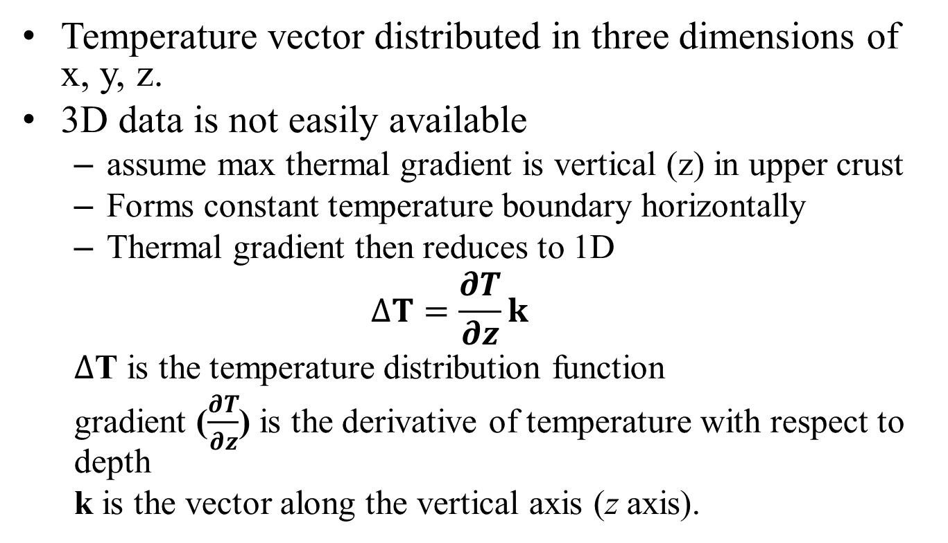
Thermal Gradient
Temperature vector distributed in three dimensions of x, y, z.
3D data is not easily available
  assume max thermal gradient is vertical (z) in upper crust
  Forms constant temperature boundary horizontally
  Thermal gradient then reduces to 1D
  $$∆T=\frac{∂T}{∂z}k$$
  $∆$T is the temperature distribution function
  gradient ($\frac{∂T}{∂z}$) is the derivative of temperature with respect to depth
  k is the vector along the vertical axis (z axis).
Notes:
Some information on the basics of thermal gradient
BHT’s were used to calculated thermal gradient values-only 2 temperature logs were available.
BHT’s needed to be corrected for in-situ conditions
Calculated this by using the Harrison Correction Equation-derived from a correction curve representing deviation of BHT’s from true formation temperatures from wells in OK.

Slide 19
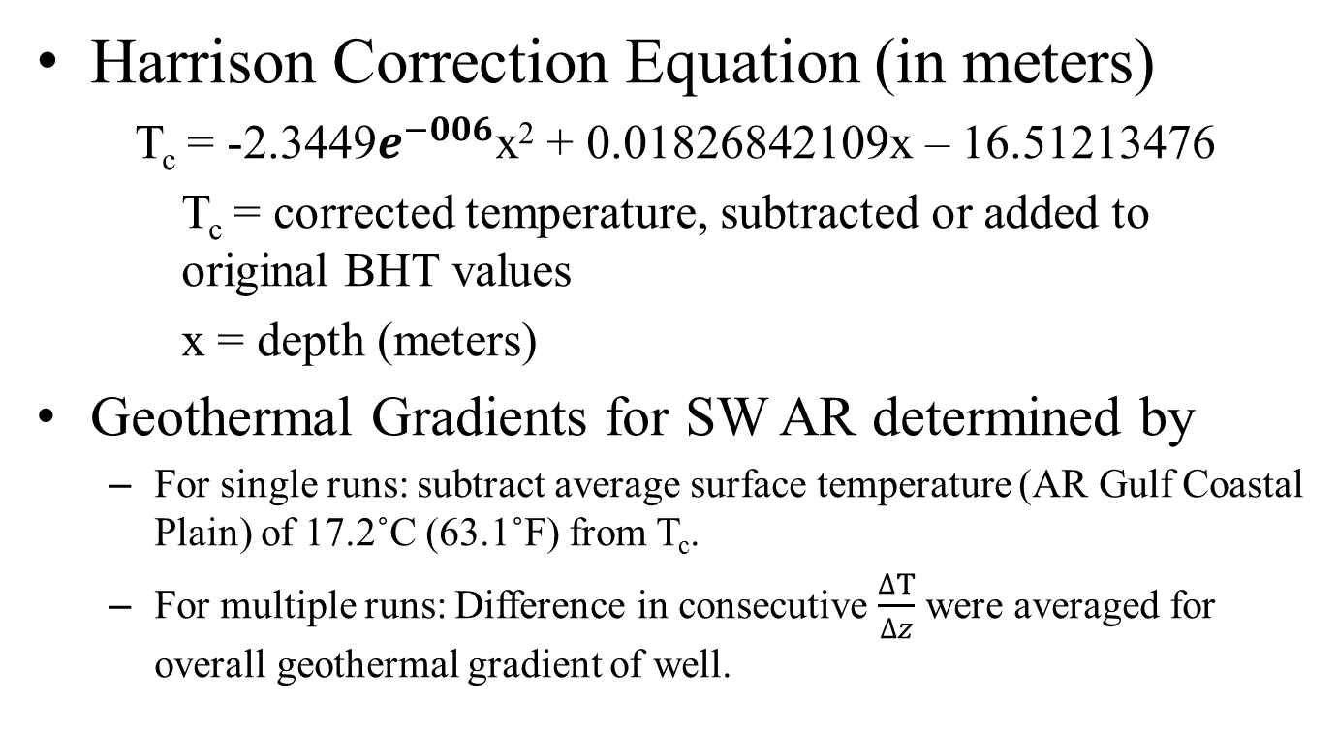
Corrected Borehole Temperatures for Thermal Gradient Calculations
Harrison Correction Equation (in meters)
T_{c} = -2.3449$e^{−006}$x² + 0.01826842109x – 16.51213476
T_{c} = corrected temperature, subtracted or added to original BHT values
x = depth (meters)
Geothermal Gradients for SW AR determined by
  For single runs: subtract average surface temperature (AR Gulf Coastal Plain) of 17.2˚C (63.1˚F) from T_{c}.
  For multiple runs: Difference in consecutive $\frac{∆T}{∆z}$ were averaged for overall geothermal gradient of well.
Notes:
Once again, we need to correct the BHT values for in-situ temperature values.
Calculated this by using the Harrison Correction Equation-derived from a correction curve representing deviation of BHT’s from true formation temperatures per change in depth from wells in OK.
For multiple runs, average gradients were calculated for each run where then all runs were averaged. All geothermal gradients were multiplied by 100 for $\frac{∆T}{∆z}$ per 100 feet.

Slide 20
Corrected Temperatures and Geothermal Gradients
Permit # | Total Depth (m) | MaxTemp (°C) from well log | Harrison Correction (T_{c}) | Corrected Temp °C | Geothermal Gradient °C/100m | Geothermal Gradient, K/m (converted for heat flow) | Heat Flow mW/m² (refer to heat flow section below)
21661 | 3343 | 107 | 18.35 | 125.35 | 3.24 | 0.0324 | 58.09
26150 | 2632 | 80 | 15.33 | 95.33 | 2.97 | 0.0298 | 73.35
25774 | 2972 | 100 | 17.07 | 117.07 | 3.36 | 0.0337 | 77.62
27575 | 1699 | 64.4 | 7.75 | 72.20 | 3.24 | 0.0325 | 56.09
28603 | 2889 | 90 | 16.69 | 106.69 | 3.10 | 0.0310 | 58.99
18345 | 1981 | 68.89 | 10.47 | 79.36 | 3.14 | 0.0315 | 53.32
28258 | 1983 | 73.89 | 10.49 | 84.38 | 3.39 | 0.0340 | 61.66
24087 | 1755 | 60 | 8.33 | 68.33 | 2.91 | 0.0292 | 40.03
24227 | 977 | 79.44 | -0.90 | 78.54 | 6.28 | 0.0630 | 136.8
26677 | 1758 | 66.67 | 8.35 | 75.02 | 3.29 | 0.0330 | 51.12
28301 | 1934 | 71.11 | 10.04 | 81.16 | 3.31 | 0.0332 | 72.36
30929 | 3414 | 105 | 18.52 | 123.52 | 3.11 | 0.0312 | 71.17
21807 | 3303 | 110 | 18.25 | 128.25 | 3.36 | 0.0337 | 83.33
28591 | 2591 | 85 | 15.08 | 100.08 | 3.20 | 0.0321 | 82.43
29667 | 2609 | 87.78 | 15.19 | 102.96 | 3.29 | 0.0330 | 52.17
29766 | 2731 | 87.78 | 15.89 | 103.67 | 3.17 | 0.0317 | 59.04
26489 | 2438 | 77.78 | 14.09 | 91.87 | 3.06 | 0.0307 | 58.12
26424 | 1372 | 60.56 | 4.13 | 64.69 | 3.46 | 0.0348 | 85.80
Harmonic mean |  |  |  |  | 3.29 | 0.0330 | 63.80
Notes:
Table showing all 18 Smackover wells.
~ < 1000 m, correction values are negative
> 4000 m, correction values are constant 19.

Slide 21
Corrected Geothermal Gradient Results for Each Smackover Well
Notes:
Geothermal gradient results for each well

Slide 22
Geothermal Gradient Raster for Smackover Formation
Notes:
Geothermal gradient raster showing general area of highest geothermal gradient created from the point data using the natural neighbor method in Spatial Analyst ArcGIS 10.1.
Natural neighbor interpolates values from each point to create a surface or raster map.
IDW provided very similar results, but NN provided more of a pleasing map that is visually more understandable for the public.

Slide 23
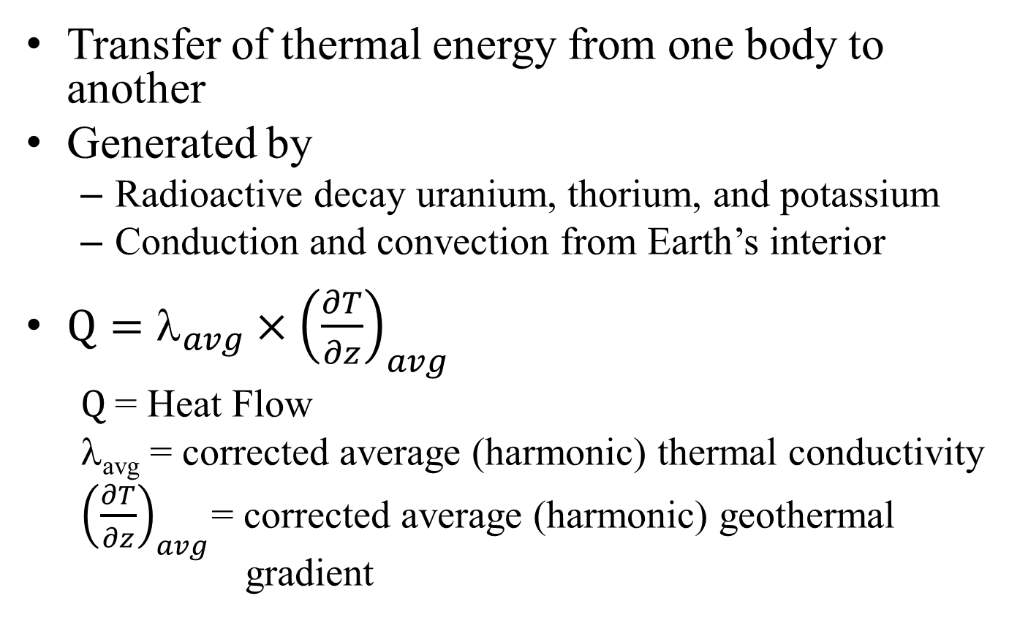
Heat Flow
Transfer of thermal energy from one body to another
Generated by
  Radioactive decay uranium, thorium, and potassium
  Conduction and convection from Earth’s interior
$Q=λ_{avg}×{\left(\frac{∂T}{∂z}\right)}_{avg}$
  $Q$= Heat Flow
  λ_{avg} = corrected average (harmonic) thermal conductivity
  ${\left(\frac{∂T}{∂z}\right)}_{avg}$= corrected average (harmonic) geothermal gradient

Slide 24
Heat Flow
Permit # | Total Depth (m) | Thermal Conductivity λ_{avg} (W/m·K) | Geothermal Gradient, K/m (converted for heat flow) | Heat Flow mW/m² (refer to heat flow section below)
21661 | 3343 | 1.79 | 0.0324 | 58.09
26150 | 2632 | 2.47 | 0.0298 | 73.35
25774 | 2972 | 2.31 | 0.0337 | 77.62
27575 | 1699 | 1.70 | 0.0325 | 56.09
28603 | 2889 | 1.90 | 0.0310 | 58.99
18345 | 1981 | 1.69 | 0.0315 | 53.32
28258 | 1983 | 1.81 | 0.0340 | 61.66
24087 | 1755 | 1.37 | 0.0292 | 40.03
24227 | 977 | 2.17 | 0.0630 | 136.8
26677 | 1758 | 1.55 | 0.0330 | 51.12
28301 | 1934 | 2.18 | 0.0332 | 72.36
30929 | 3414 | 2.28 | 0.0312 | 71.17
21807 | 3303 | 2.47 | 0.0337 | 83.33
28591 | 2591 | 2.57 | 0.0321 | 82.43
29667 | 2609 | 1.58 | 0.0330 | 52.17
29766 | 2731 | 1.86 | 0.0317 | 59.04
26489 | 2438 | 1.86 | 0.0307 | 58.12
26424 | 1372 | 2.47 | 0.0348 | 85.80
Harmonic mean |  |  | 0.0330 | 63.80
Notes:
Heat flow is in mW/m2
$Q=λ_{avg}×{\left(\frac{∂T}{∂z}\right)}_{avg}$x 1000
The harmonic average heat flow for the 18 Smackover wells is 63.8 mW/m².
For rate comparison, an MIT panel (Tester et al., 2006) reports geothermal heat flows through the Earth’s crust at an average rate of 59 mW/m².
A previous heat flow investigation in Arkansas (Smith and Fishkin, 1988) indicated a heat flow value of 68 mW/m² located near the town of Jerome in Drew County, southeast Arkansas.

Slide 25
Heat Flow Values per Well
Notes:
Estimated heat flow values per well.
This figure shows a well in northwestern Columbia County having the highest estimated heat flow value near 137 mW/m² (permit number 24227). Heat flow values for most of southwest Arkansas range from 47 to 81 mW/m² (Figure 13) and are lowest in southeast Hempstead County (40 mW/m²).
A geothermal study conducted by SMU’s Geothermal Laboratory (2011) shows heat flow values for southwest Arkansas to range from 60 to 100 mW/m² (google.org/egs, 2011).
Figure 16 shows SMU’s calculated heat flow data in raster format. The map shows the highest heat flow for southwest Arkansas to be in southeast Hempstead and southwest Nevada Counties (~100mW/m²), just slightly translated to the northwest of the highest heat flow value projected by the AGS, illustrated in Figure 14. Unfortunately, core samples were not available to verify if the heat flow hot spot extends into southeast Hempstead and southwest Nevada Counties as indicated by SMU. However, note that AGS data shows the lowest heat flow value in southwest Arkansas in southeast Hempstead County.

Slide 26
Heat Flow Raster of Smackover Formation
Notes:
A raster heat flow map was generated from the heat flow values of Figure 13 using the nearest neighbor method in Spatial Analyst, ArcGIS 10.1.
This figure shows the area of highest heat flow is in northwestern Columbia County, likely influenced by the significant geothermal gradient value of 0.0630K/m (6.30°C/100m) for permit number 24227. This heat flow value is nearly twice the harmonic geothermal gradient for southwest Arkansas. The last column of Appendix 3 lists the estimated heat flow data for the 10 non-Smackover wells.

Slide 27
Heat Flow Contours of Smackover Formation
Notes:
Heat flow contours generated from the raster image.

Slide 28
Verification of Data
2 Smackover core samples sent to UND for thermal conductance testing
  Permit # 21661 at 3,304 m (10,839 ft)-oolitic limestone- 2.91 W/m·K with ± 3.5% accuracy
  Permit # 25774 at 2,878 m (9,441 ft)-fine-grained limestone- 2.47 W/m·K with ± 3.5% accuracy
    Both samples measured at depths greater than samples measured at AGS
    Compared with λ_{avg} for both wells
Notes:
As part of our deliverables, AZGS required that we send off some of our samples to another laboratory to verify the quality of our thermal conductance values. 2 smackover samples were sent to the University of North Dakota (UND), Harold Hamm School of Geology and Geological Engineering Laboratory for thermal conductance testing.
However, the laboratory results provide the only exclusive verification of the thermal conductivity data measured at the AGS, thus it is important to discuss this information briefly.

Slide 29
Verification of Data (with TR-1 Probe)
ID # | Permit # | Depth (ft) | W/m·K |  |  | Err | MeasDir | Lithologic Description
 |  |  | λ_{o} | λ_{corr} | λ_{avg}
5 | 21661 | 10810 | 4.04 | 2.97 | 1.79 | 0.02 | para | Fine-grained grainstone
2 | 21661 | 10811 | 1.41 | 1.28 |  | 0.07 | perp | Fine-grained grainstone
3 | 21661 | 10812 | 2.38 | 1.44 |  | 0.21 | perp | Fine-grained grainstone
10 | 21661 | 10820 | 3.06 | 2.36 |  | 0.02 | para | Anhydrite
12 | 21661 | 10835 | 3.06 | 2.38 |  | 0.01 | perp | Oolitic, pisolitic crystalline limestone
11 | 21661 | 10836 | 3.68 | 2.77 |  | 0.01 | para | Oolitic, pisolitic crystalline limestone
-- | 21661 | 10839 | 2.91 |  |  | -- | -- | Oolitic limestone
24 | 25774 | 9400 | 2.33 | 1.93 | 2.31 | 0.01 | perp | Red shale
23 | 25774 | 9402 | 3.42 | 2.69 |  | 0.01 | para | Crystalline dolostone
25 | 25774 | 9403 | 5.48 | 4.05 |  | 0.26 | perp | Fine-grained grainstone
26 | 25774 | 9406 | 3.60 | 2.78 |  | 0.01 | para | Fine-grained grainstone
27 | 25774 | 9410 | 1.27 | 1.20 |  | 0.09 | perp | Oolitic, pisolitic crystalline limestone
28 | 25774 | 9411 | 2.53 | 2.06 |  | 0.00 | perp | Oolitic, pisolitic crystalline limestone
29 | 25774 | 9416 | 5.10 | 3.80 |  | 0.12 | para | Oolitic, pisolitic grainstone
30 | 25774 | 9425 | 3.18 | 2.51 |  | 0.03 | perp | Oolitic, pisolitic grainstone
31 | 25774 | 9430 | 2.91 | 2.33 |  | 0.01 | perp | Oolitic, pisolitic grainstone
-- | 25774 | 9441 | 2.47 |  |  | -- | -- | Fine-grained limestone
Notes:
As you can see, my calculated values are less than the measurements from UND.
However, as you notice there are two values in both wells that are bold. These values are from the TR-1 probe. I chose to keep these TR-1 results and include them in the average thermal conductance for the well because their error values were relatively low and also provides the only available data for a specific lithology at a specific depth. However, the results are outliers compared to the beta probe results.

Slide 30
Verification of Data (without TR-1 Probe)
ID # | Permit # | Depth (ft) | W/m·K |  |  | Err | MeasDir | Lithologic Description
 |  |  | λ_{o} | λ_{corr} | λ_{avg}
5 | 21661 | 10810 | 4.04 | 2.97 | 2.59 | 0.02 | para | Fine-grained grainstone
2 | 21661 | 10811 | 1.41 | 1.28 |  | 0.07 | perp | Fine-grained grainstone
3 | 21661 | 10812 | 2.38 | 1.44 |  | 0.21 | perp | Fine-grained grainstone
10 | 21661 | 10820 | 3.06 | 2.36 |  | 0.02 | para | Anhydrite
11 | 21661 | 10836 | 3.68 | 2.77 |  | 0.01 | para | Oolitic, pisolitic limestone
12 | 21661 | 10835 | 3.06 | 2.38 |  | 0.01 | perp | Oolitic, pisolitic limestone
-- | 21661 | 10839 | -- | -- | 2.91 | -- | -- | Oolitic limestone
24 | 25774 | 9400 | 2.33 | 1.93 | 2.48 | 0.01 | perp | Red shale
23 | 25774 | 9402 | 3.42 | 2.69 |  | 0.01 | para | Crystalline dolostone
25 | 25774 | 9403 | 5.48 | 4.05 |  | 0.26 | perp | Fine-grained grainstone
26 | 25774 | 9406 | 3.60 | 2.78 |  | 0.01 | para | Fine-grained grainstone
27 | 25774 | 9410 | 1.27 | 1.20 |  | 0.09 | perp | Oolitic, pisolitic crystalline limestone
28 | 25774 | 9411 | 2.53 | 2.06 |  | 0.00 | perp | Oolitic, pisolitic crystalline limestone
29 | 25774 | 9416 | 5.10 | 3.80 |  | 0.12 | para | Oolitic, pisolitic grainstone
30 | 25774 | 9425 | 3.18 | 2.51 |  | 0.03 | perp | Oolitic, pisolitic grainstone
31 | 25774 | 9430 | 2.91 | 2.33 |  | 0.01 | perp | Oolitic, pisolitic grainstone
-- | 25774 | 9441 | -- | -- | 2.47 | -- | -- | Oolitic limestone
Notes:
After removing the TR-1 results from these two wells, leaving only the beta probe results, the average thermal conductance for permit number 21661 was 2.59 W/m·K, and for permit number 25774 was 2.48 W/m·K, values much closer to the UND results.
Only the first three wells contained results that include TR-1 probe results while the other 15 wells contain only the beta probe results. This leads me to believe that the Beta probe results are fairly accurate estimations of in situ thermal conductivity of the Smackover Formation.

Slide 31
Revised Heat Flow Raster
Notes:
A raster heat flow map was generated from the heat flow values of Figure 13 using the nearest neighbor method in Spatial Analyst, ArcGIS 10.1.
This figure shows the area of highest heat flow is in northwestern Columbia County, likely influenced by the significant geothermal gradient value of 0.0630K/m (6.30°C/100m) for permit number 24227. This heat flow value is nearly twice the harmonic geothermal gradient for southwest Arkansas. The last column of Appendix 3 lists the estimated heat flow data for the 10 non-Smackover wells.

Slide 32
Conclusion
Calculated area of highest heat flow-northwestern Columbia and northeastern Lafayette Counties
  Highest area of heat flow strongly influenced by Permit # 24227-heat flow value = 137 mW/m².
Compare this data to heat flow
data from SMU
www.google.org/egs
  Shows higher heat flow area in SE Hempstead, SW Nevada counties-translated to NW of AGS’s projected highest heat flow.
Notes:
V For the Smackover Formation, northwestern Columbia and northeastern Lafayette Counties show an area of high geothermal potential.
This area exhibits relatively high thermal conductivity, thermal gradient, and heat flow.
This hot spot basically provides estimates for future potential industrial geothermal power plants that are conducting feasibility studies in southern Arkansas.
This is an estimation but a starting point for future industrial geothermal power plants wanting to explore potential geothermal energy in Arkansas.
Permit number 24227 has the highest geothermal gradient (6.3°C/100m) along with a moderate thermal conductivity (2.2 W/mK), producing an overall high heat flow value at around 137 mW/m².
Surrounding wells also show high geothermal gradient and thermal conductivity values, generating an overall high heat flow hot spot for this area.
The binary power plant utilizes formation fluid temperatures near or below boiling to heat a secondary fluid which operates a turbine to generate electricity. In south Arkansas, a binary power plant operated intermittently in mid-1979, but was quickly shut down due to operating issues.

Slide 33
Conclusion
Notes:
Also notice some sort of structure in this same general area of estimated high heat flow.

Slide 34
Acknowledgments
This publication was written to provide geothermal results generated by the Arkansas Geological Survey for the State Geothermal Data Project, sponsored by the U.S. Department of Energy under prime award number DE-EE0002850, awarded to the State of Arkansas under sub award number AR-EE002850.
I would like to thank Corbin Cannon for helping to collect, drill, and measure core samples, Jason Tipton for providing well log and core information and for assisting me in generating the raster maps, and the AGS staff for helping with the editing of this manuscript.

Slide 35
References
Blackwell, D.D., and M. Richards, 2004. Geothermal Map of North America. Assoc. Petroleum Geologist (AAPG), 1 sheet, scale 1:6,500,000. <http://smu.edu/geothermal/2004NAMap/Geothermal_MapNA_7x10in.gif>
Dickinson, K.A., 1968. Upper Jurassic Stratigraphy of Some Adjacent Parts of Texas, Louisiana, and Arkansas. USGS, Geological Survey Professional Paper 594-E. 25 p. <http://pubs.usgs.gov/pp/0594e/report.pdf>
Ellis, P.F. II, 1980. Geothermal Materials Survey Arkansas Power and Light Development and Demonstration Project. 100 kW Power System Using Direct Contact Heat Exchangers, El Dorado, Arkansas. U.S. Department of Energy. 27 p. <http://www.osti.gov/bridge/servlets/purl/5034780-oSQu7F/native/5034780.pdf>
Harrison, W.E., K.V. Luza, M.L Prater, and P.K Cheung, 1983. Geothermal Resource Assessment in Oklahoma. Special Publications 83-1. Oklahoma Geological Survey. <http://www.ogs.ou.edu/pubsscanned/SPs/SP83_1.pdf>
Roy, R.F., B. Taylor, A.J. Pyron, and J.C. Maxwell, 1980. Heat Flow Measurements in the State of Arkansas. Final report to the University of California, Los Alamos Scientific Laboratory. <http://library.lanl.gov/cgi-bin/getfile?00311086.pdf>
Southern Methodist University Geothermal Laboratories, 2011. Google Earth download. Accessed July, 2012. <http://www.google.org/egs/>
Smith D.L. and W.T. Dees. 1982. Heat Flow in the Gulf Coastal Plain. J Geophys Res. Abstract, V.87, No. B9.
Vestal, J.H., 1950. Petroleum Geology of the Smackover Formation of Southern Arkansas. Information Circular 14, Arkansas Geological Commission. 37 p.

Slide 36
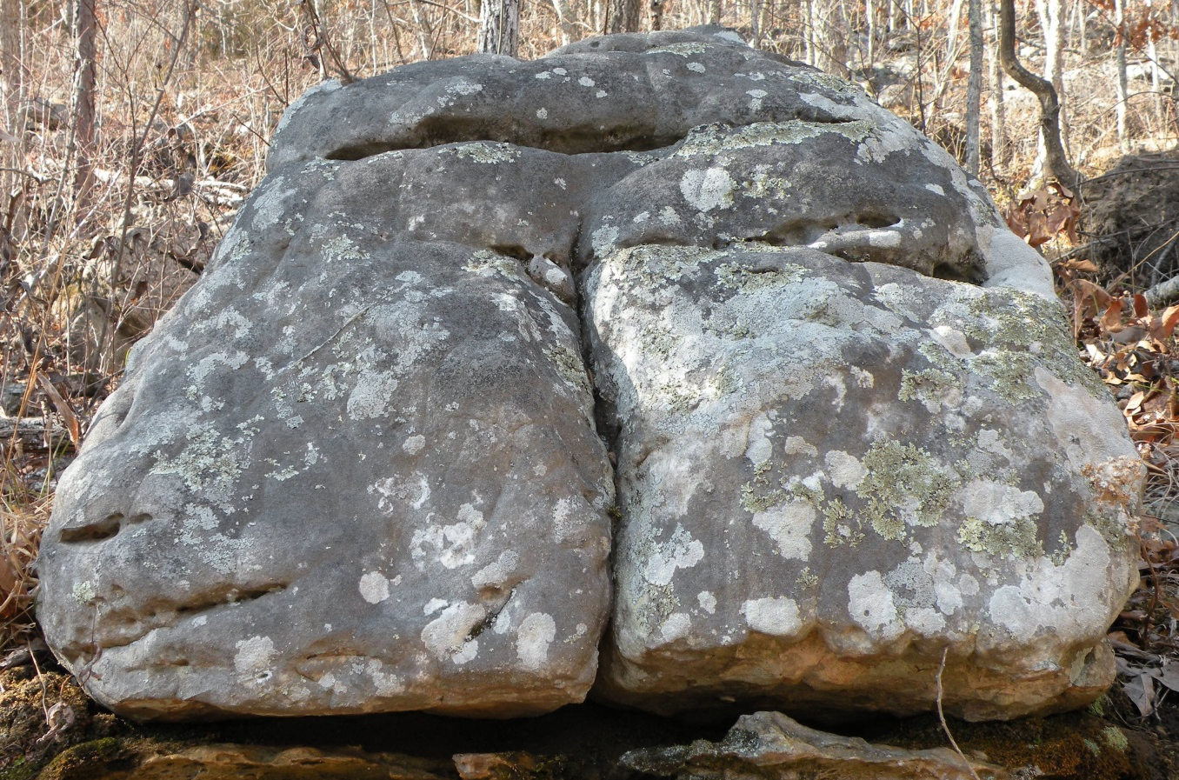
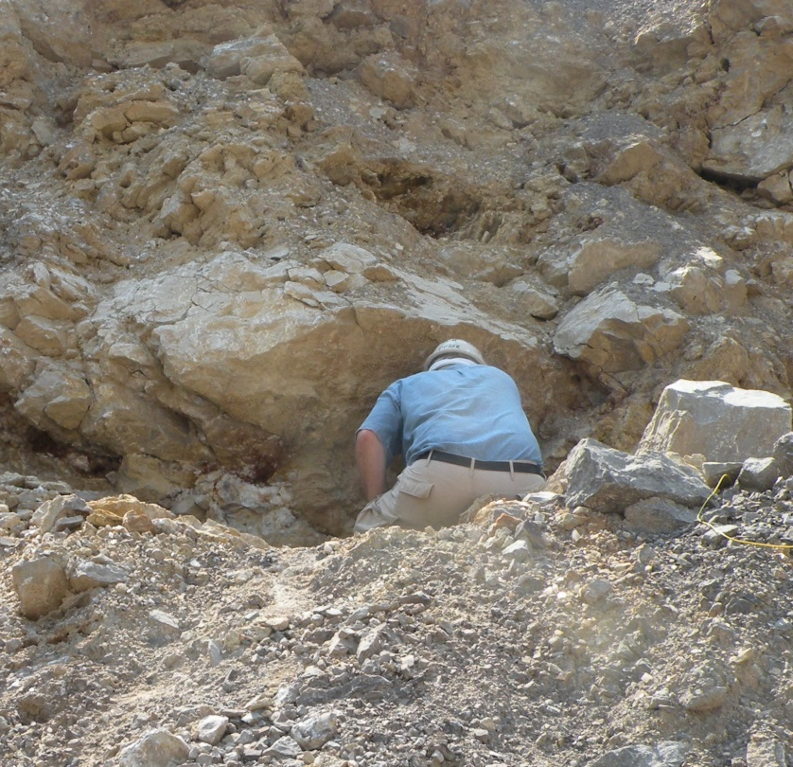
The End

