Slide 1
Stratigraphic Variations within Morrowan and Lower Atoka Strata on the Arkoma Shelf, in Early Pennsylvanian Time, Northwest Arkansas
Elizabeth Studebaker University of Arkansas
Doy L. Zachry University of Arkansas

Slide 2
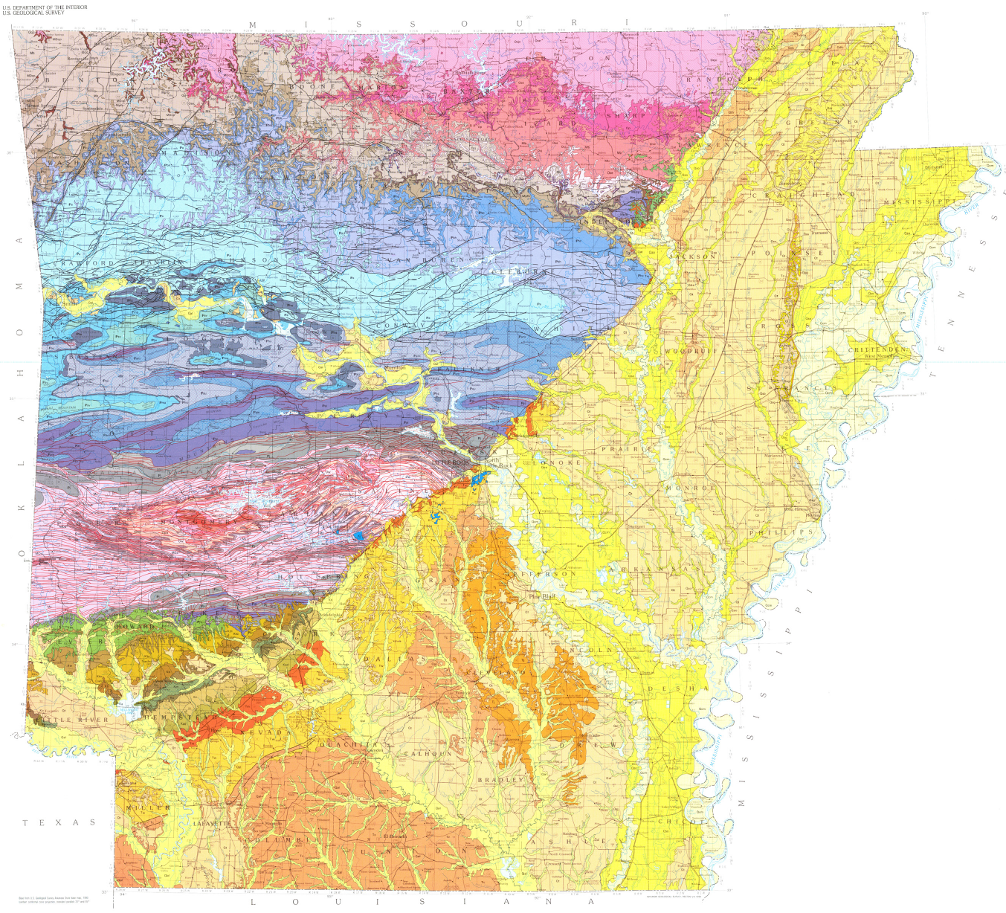
Arkoma Shelf and Basin
Haley and others, 1993, Geologic Map of Arkansas

Slide 3
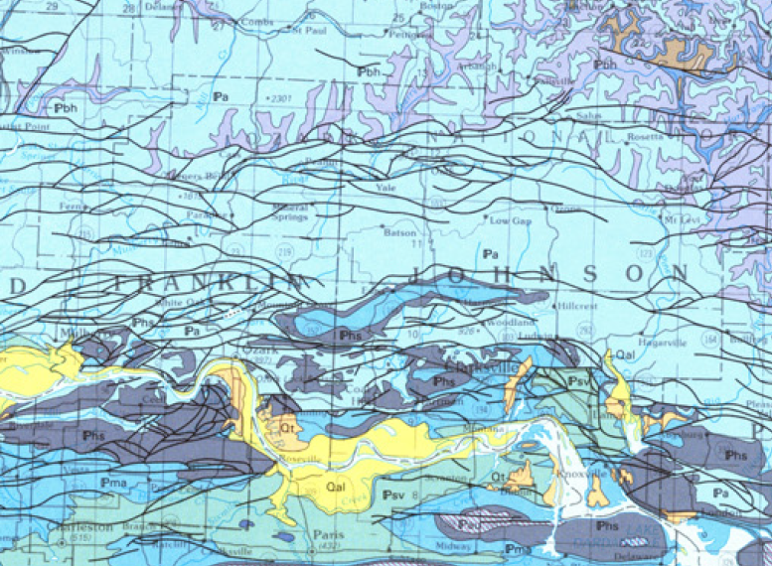
Arkoma Shelf and Basin

Slide 4
Morrowan and Lower Atokan Stratigraphy

Slide 5
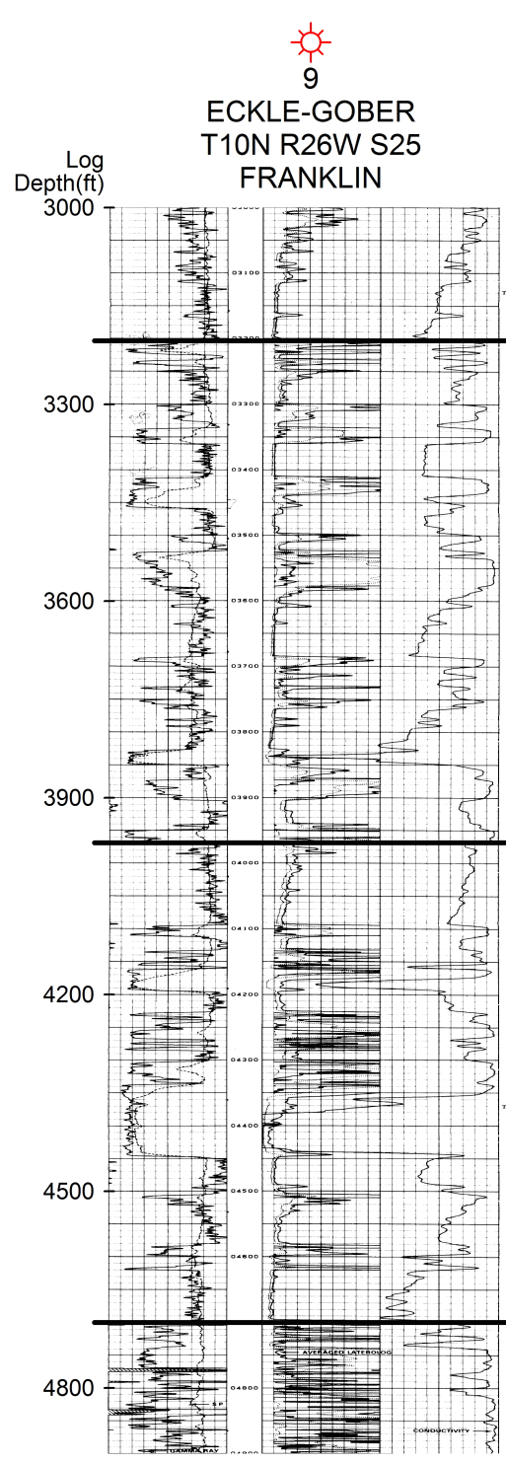
Lower Atoka
Pennsylvanian Section
Morrowan
Pitkin
(Mississippian)

Slide 6
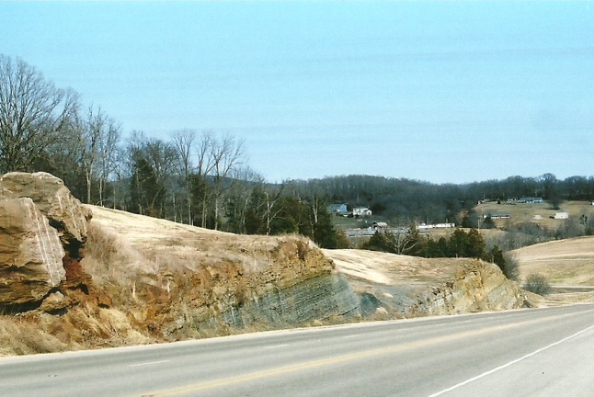
Hale, Cane Hill Member
Lower Atoka
Morrowan
Pitkin
(Mississippian)

Slide 7
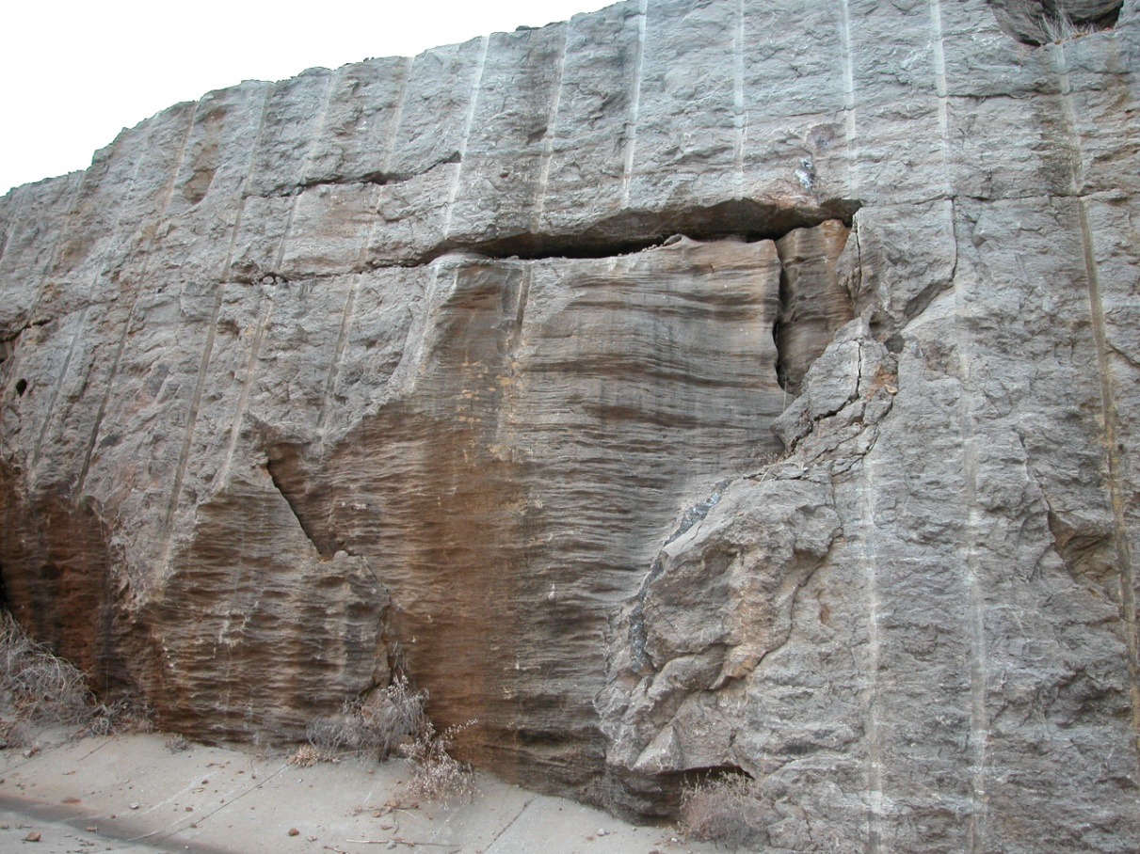
Prairie Grove Member
Lower Atoka
Morrowan
Pitkin
(Mississippian)

Slide 8
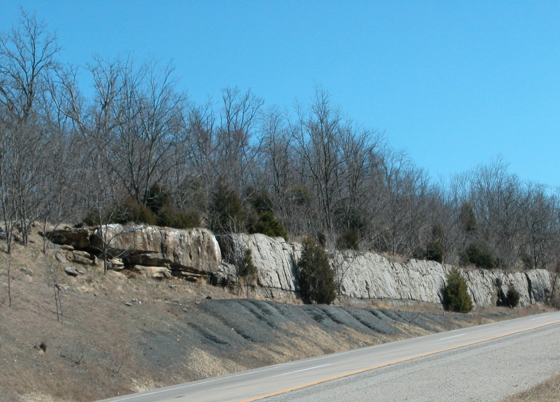
Kessler and Dye Shale Members
Lower Atoka
Morrowan
Pitkin
(Mississippian)

Slide 9
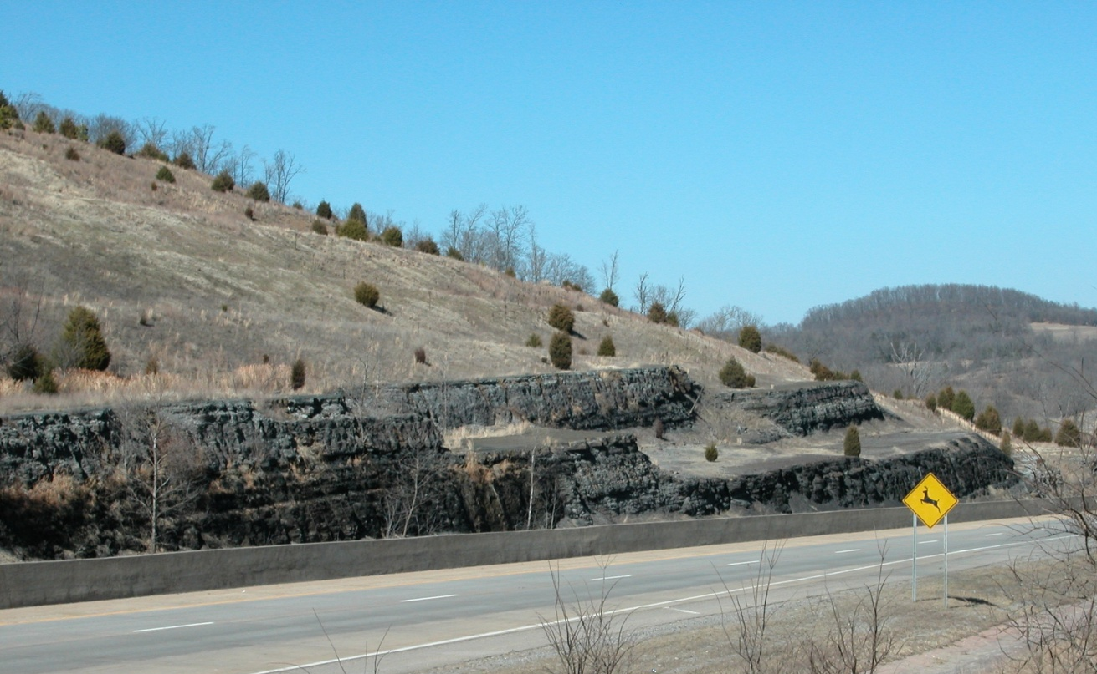
Lower Atoka Sandstone Units
Lower Atoka
Morrowan
Pitkin
(Mississippian)

Slide 10
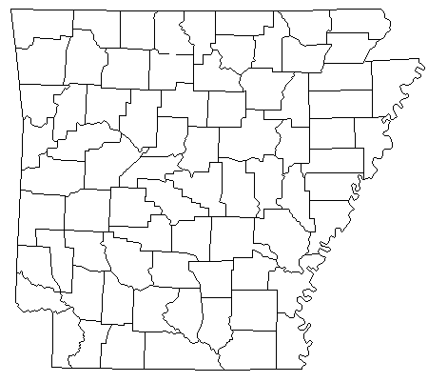
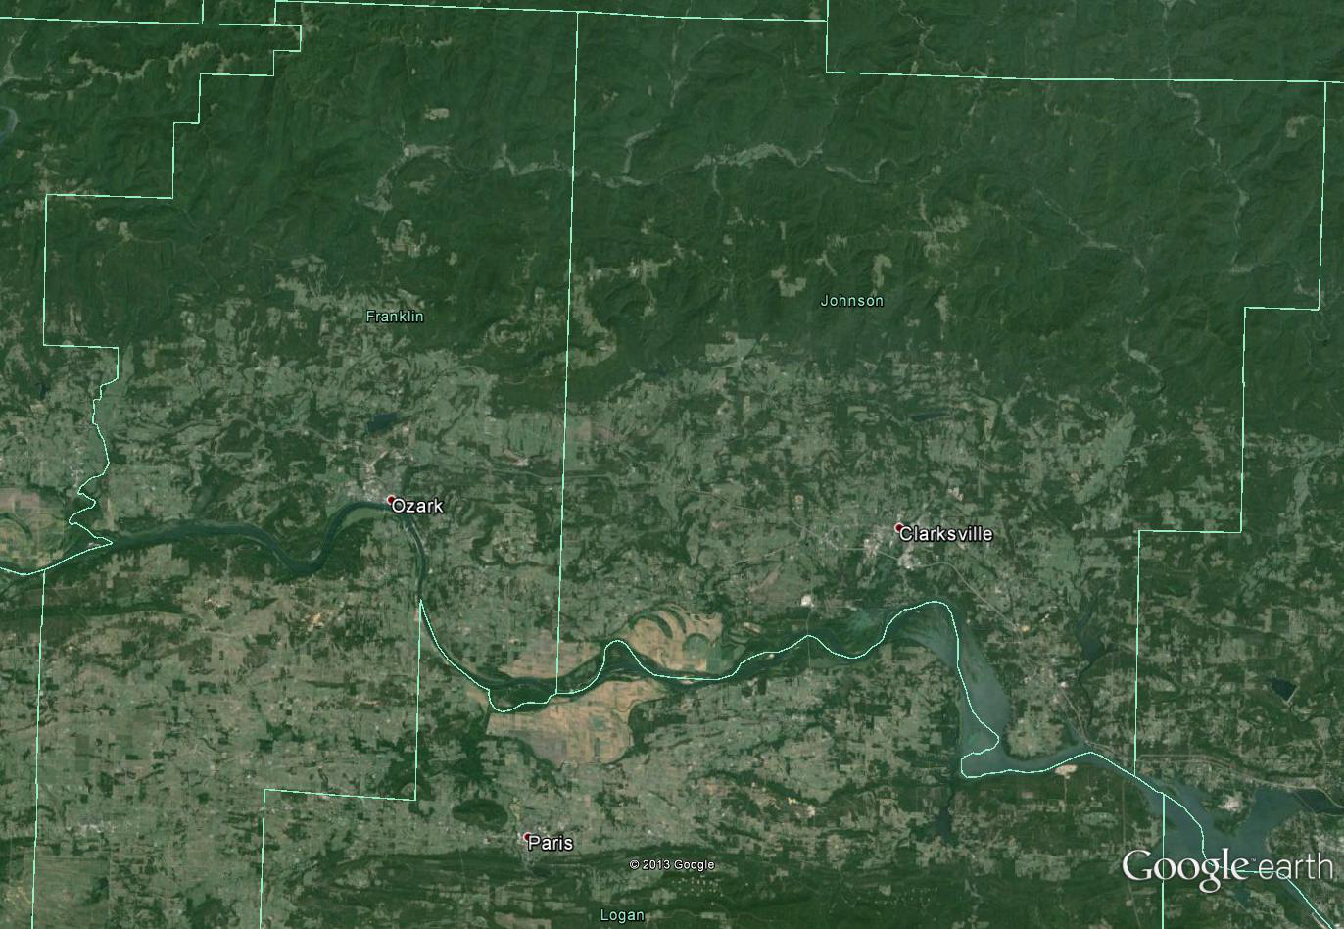
Google earth image of study area which includes Franklin and Johnson Counties in northwest Arkansas.

Slide 11
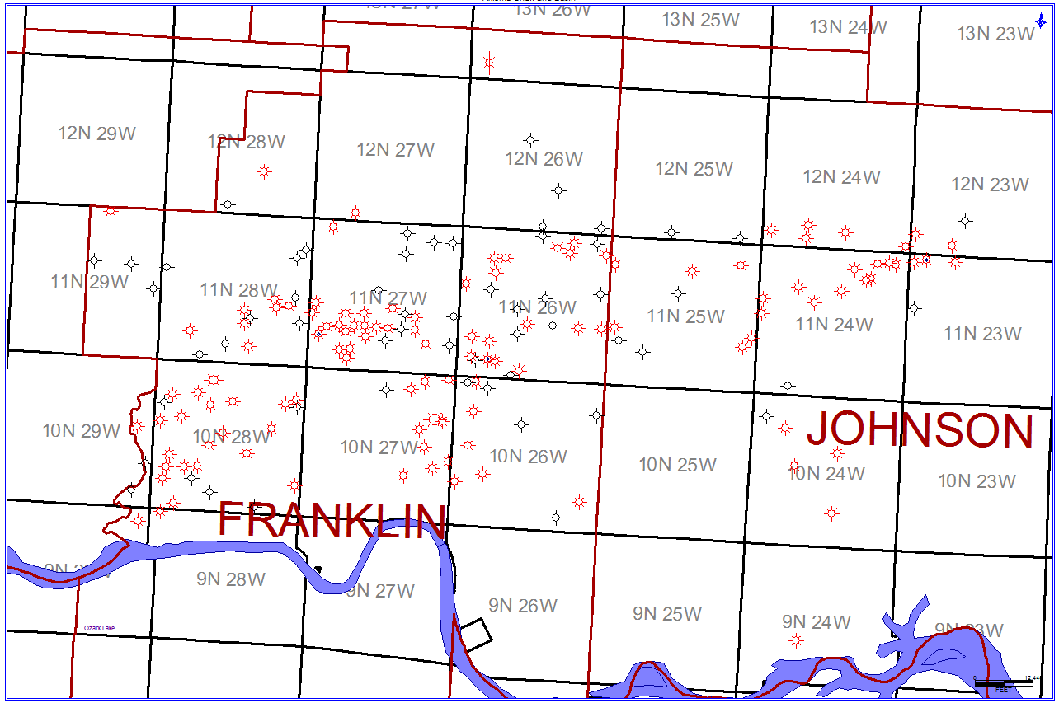
Petra generated map of study area including well locations that were utilized for the construction of cross sections, isopach maps, and structural contour maps. Approximately 342 were selected for use.

Slide 12
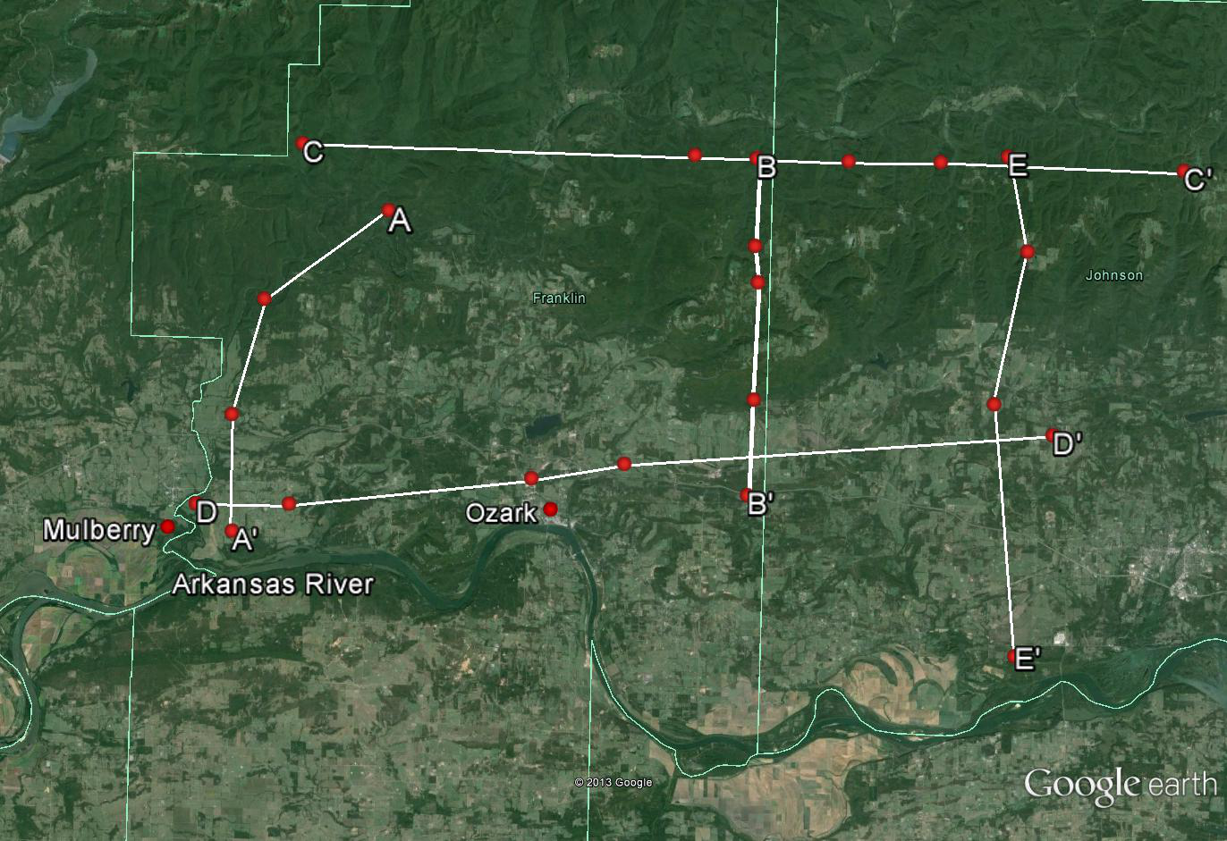
Google Earth image of study area depicting cross section lines A, B, C, D, E in Franklin and Johnson Counties.

Slide 13
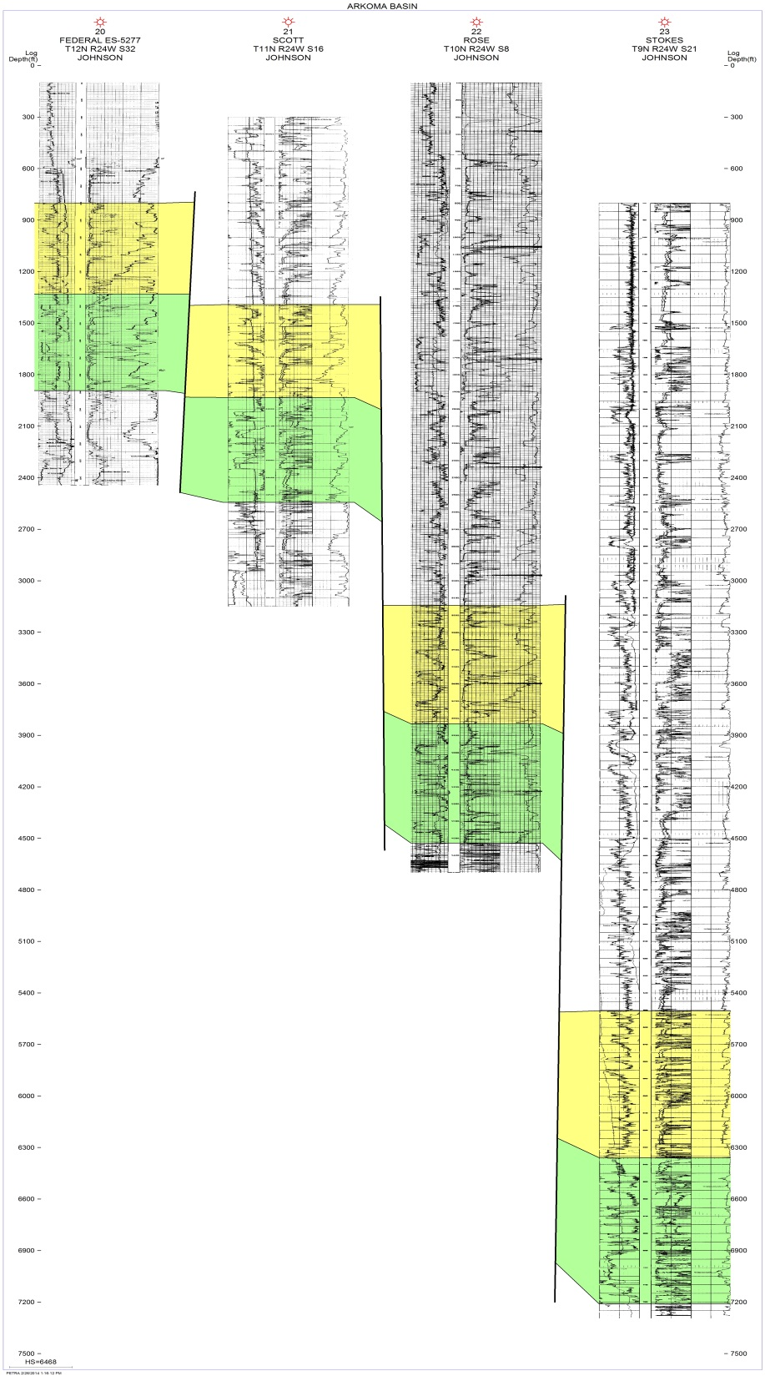
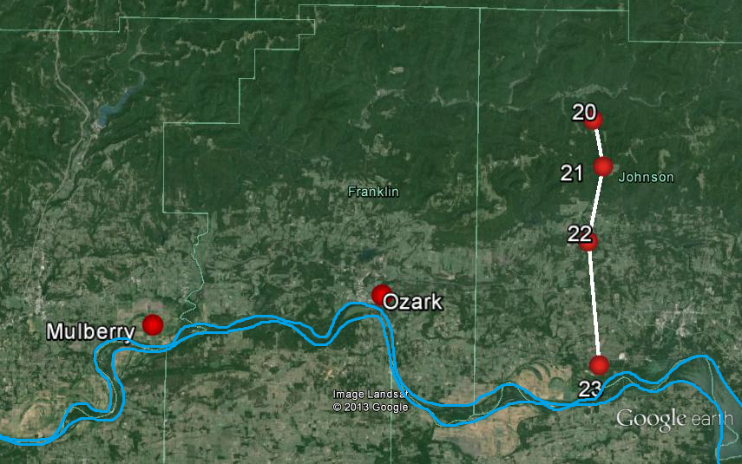


North-South cross section E – E’ located in Johnson County in Township 9N-12N, Range 24W
Lower Atoka
Morrowan

Slide 14
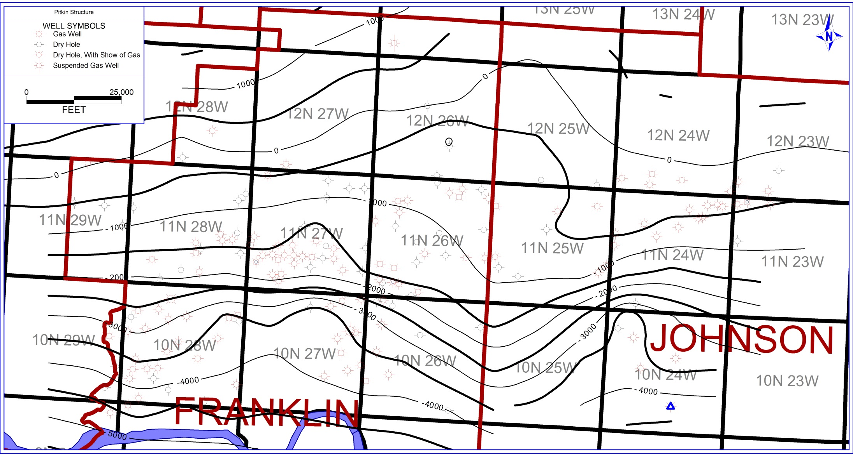
Structural contour map, generated in Petra, of the top of the Pitkin (Mississippian).

Slide 15
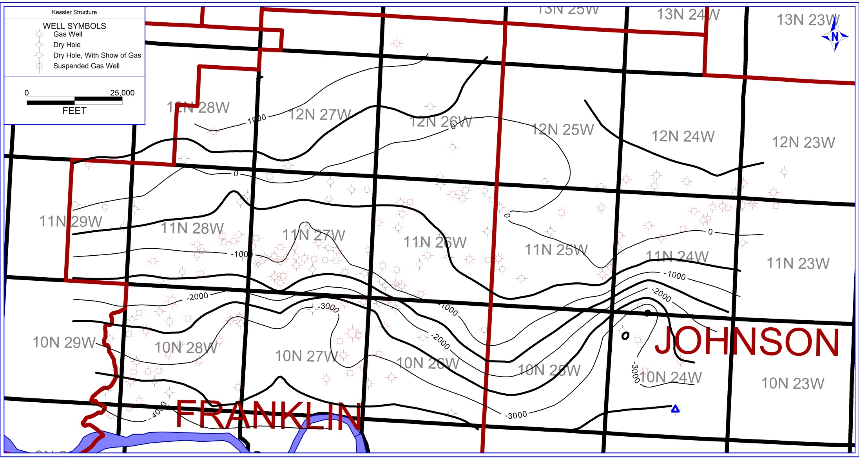
Structural contour map of the top of the Morrowan.

Slide 16
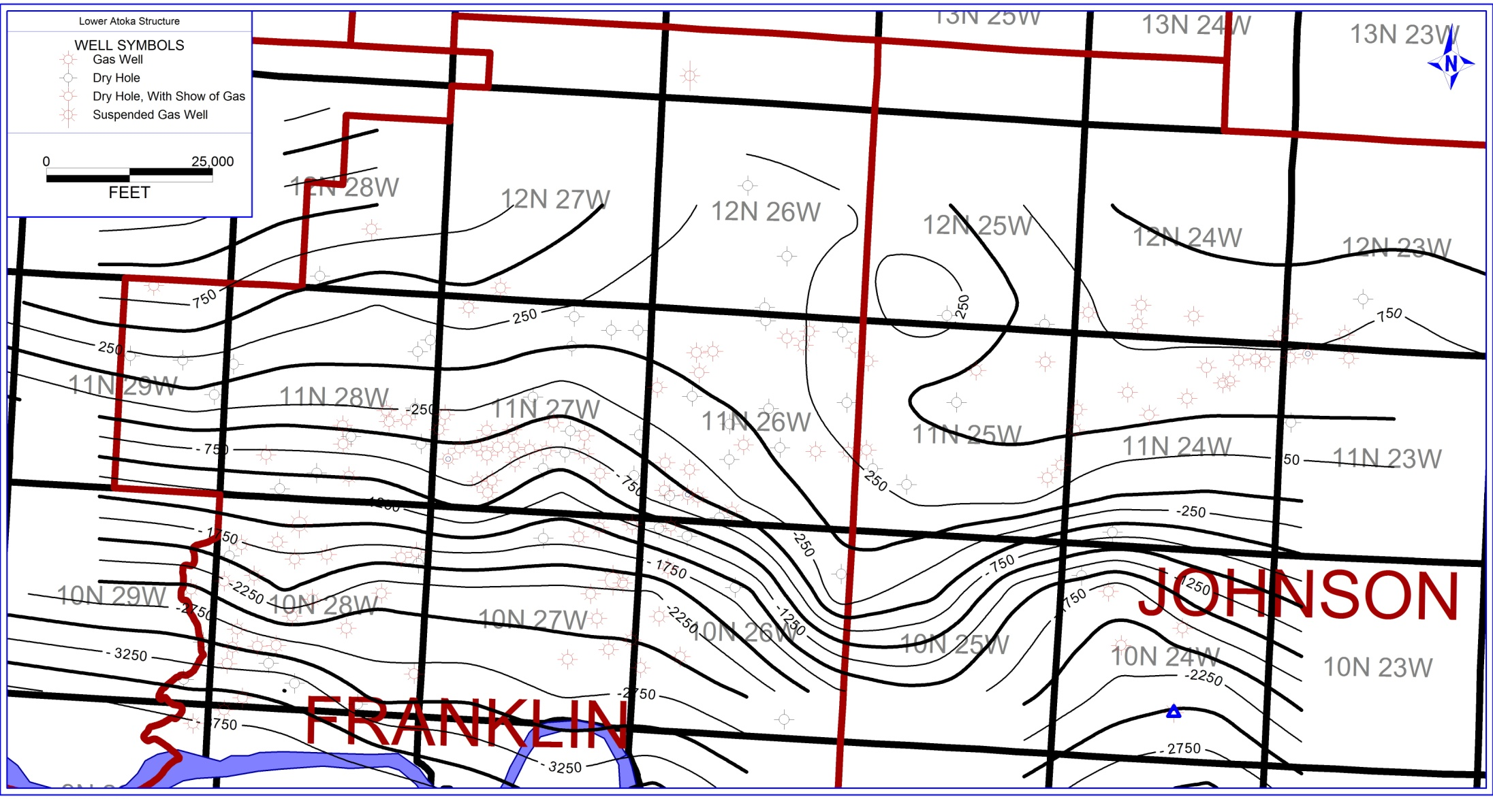
Structural contour map of the top of the Lower Atoka.

Slide 17
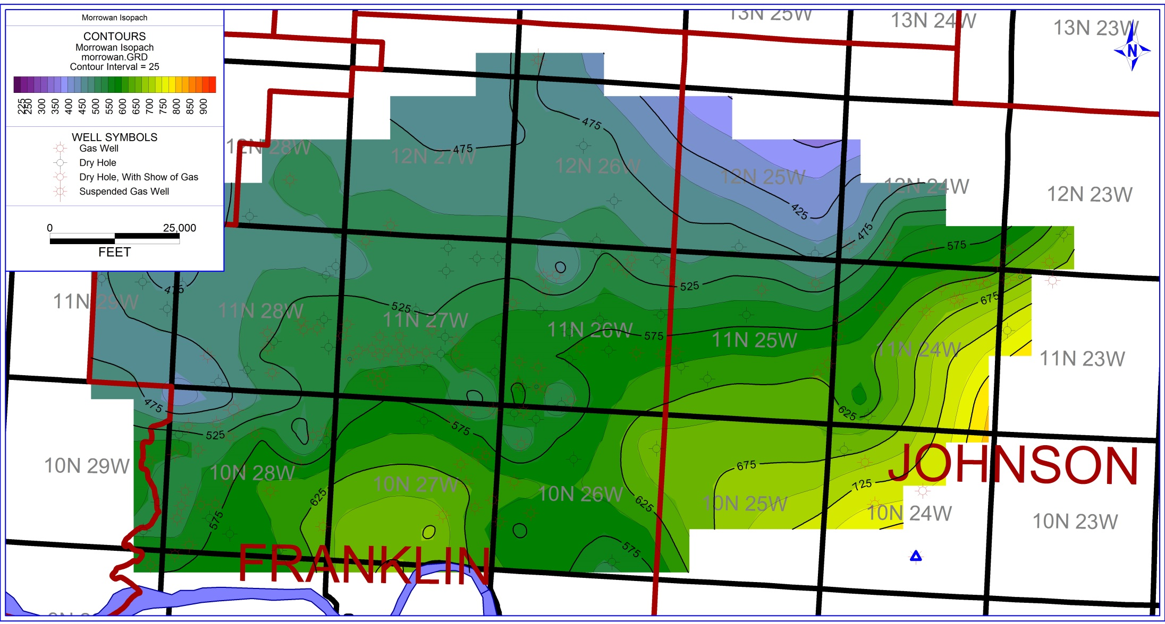
Isopach map of the Morrowan illustrating thickening to the southeast.

Slide 18
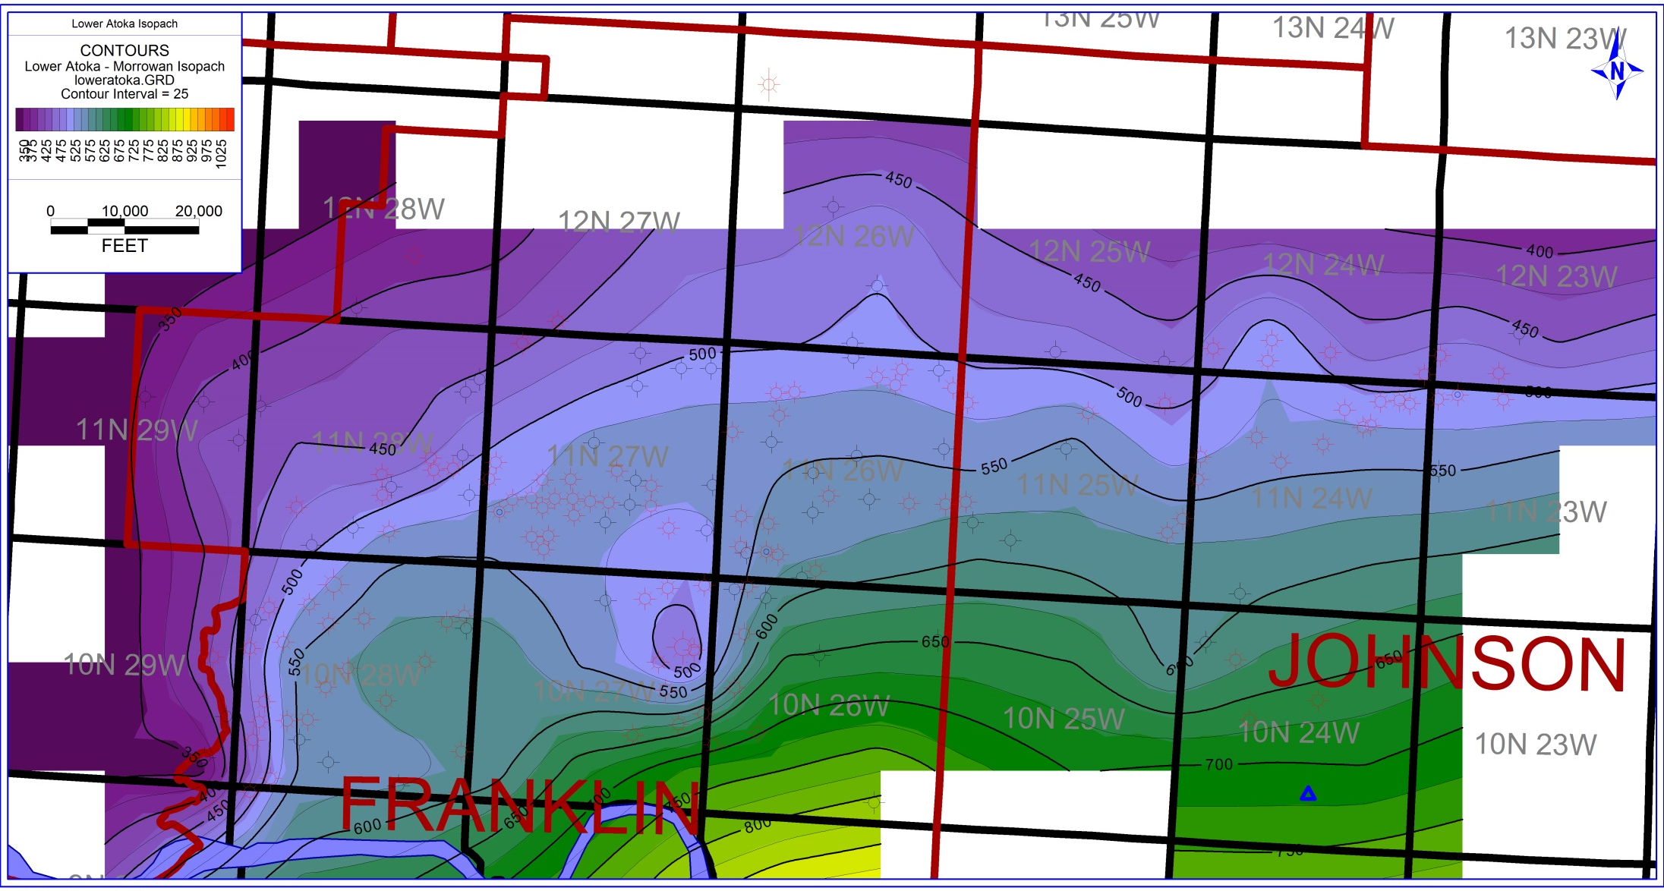
Isopach map of the lower Atoka displaying thickening to the south.

Slide 19
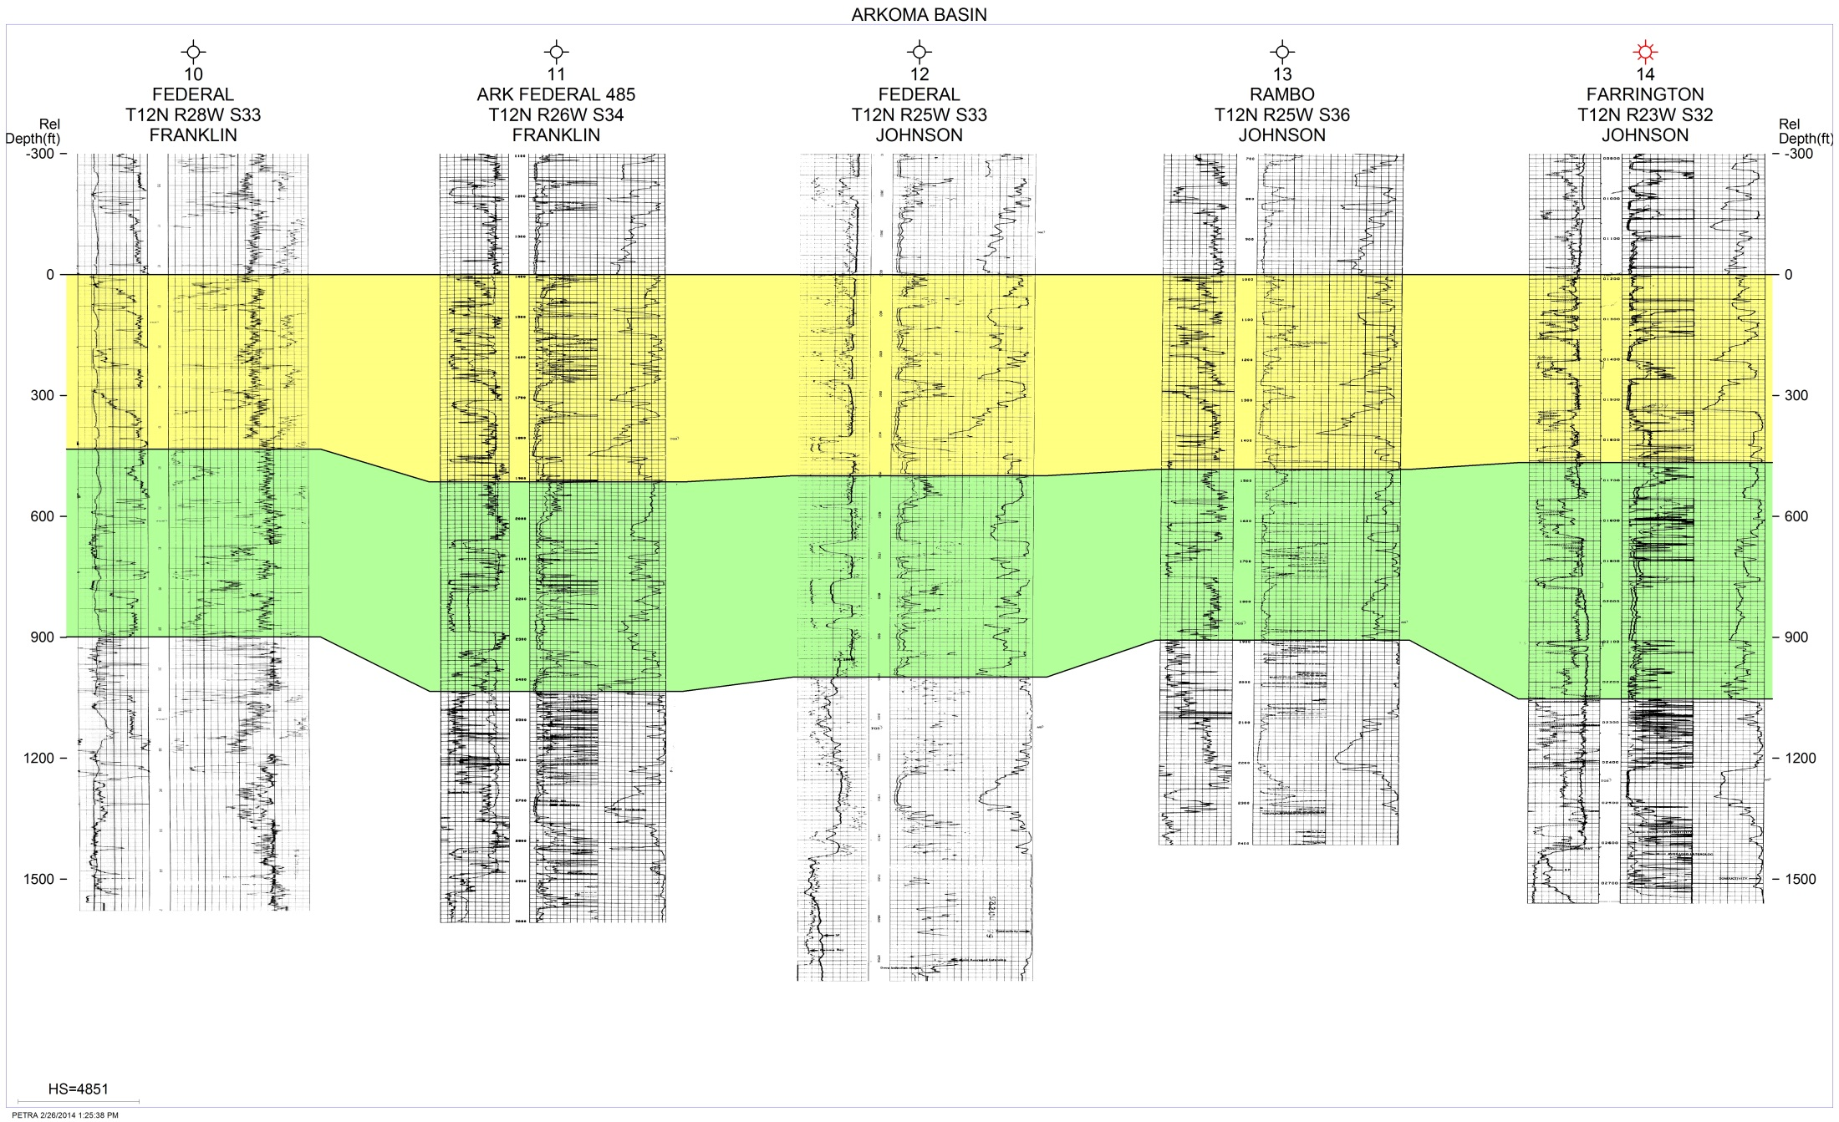
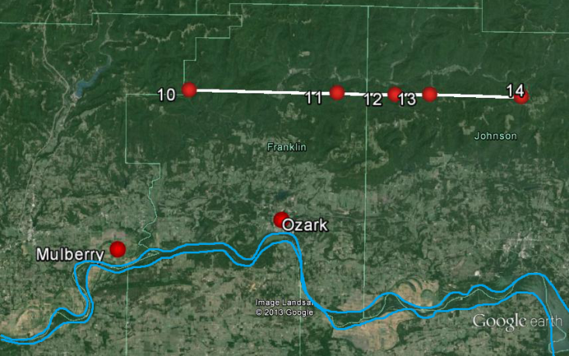
Lower Atoka
Morrowan
West to East stratigraphic cross section C – C’ hung on the Sells. Located in Franklin and Johnson Counties in Township 12N, Range 28W-23W.

Slide 20
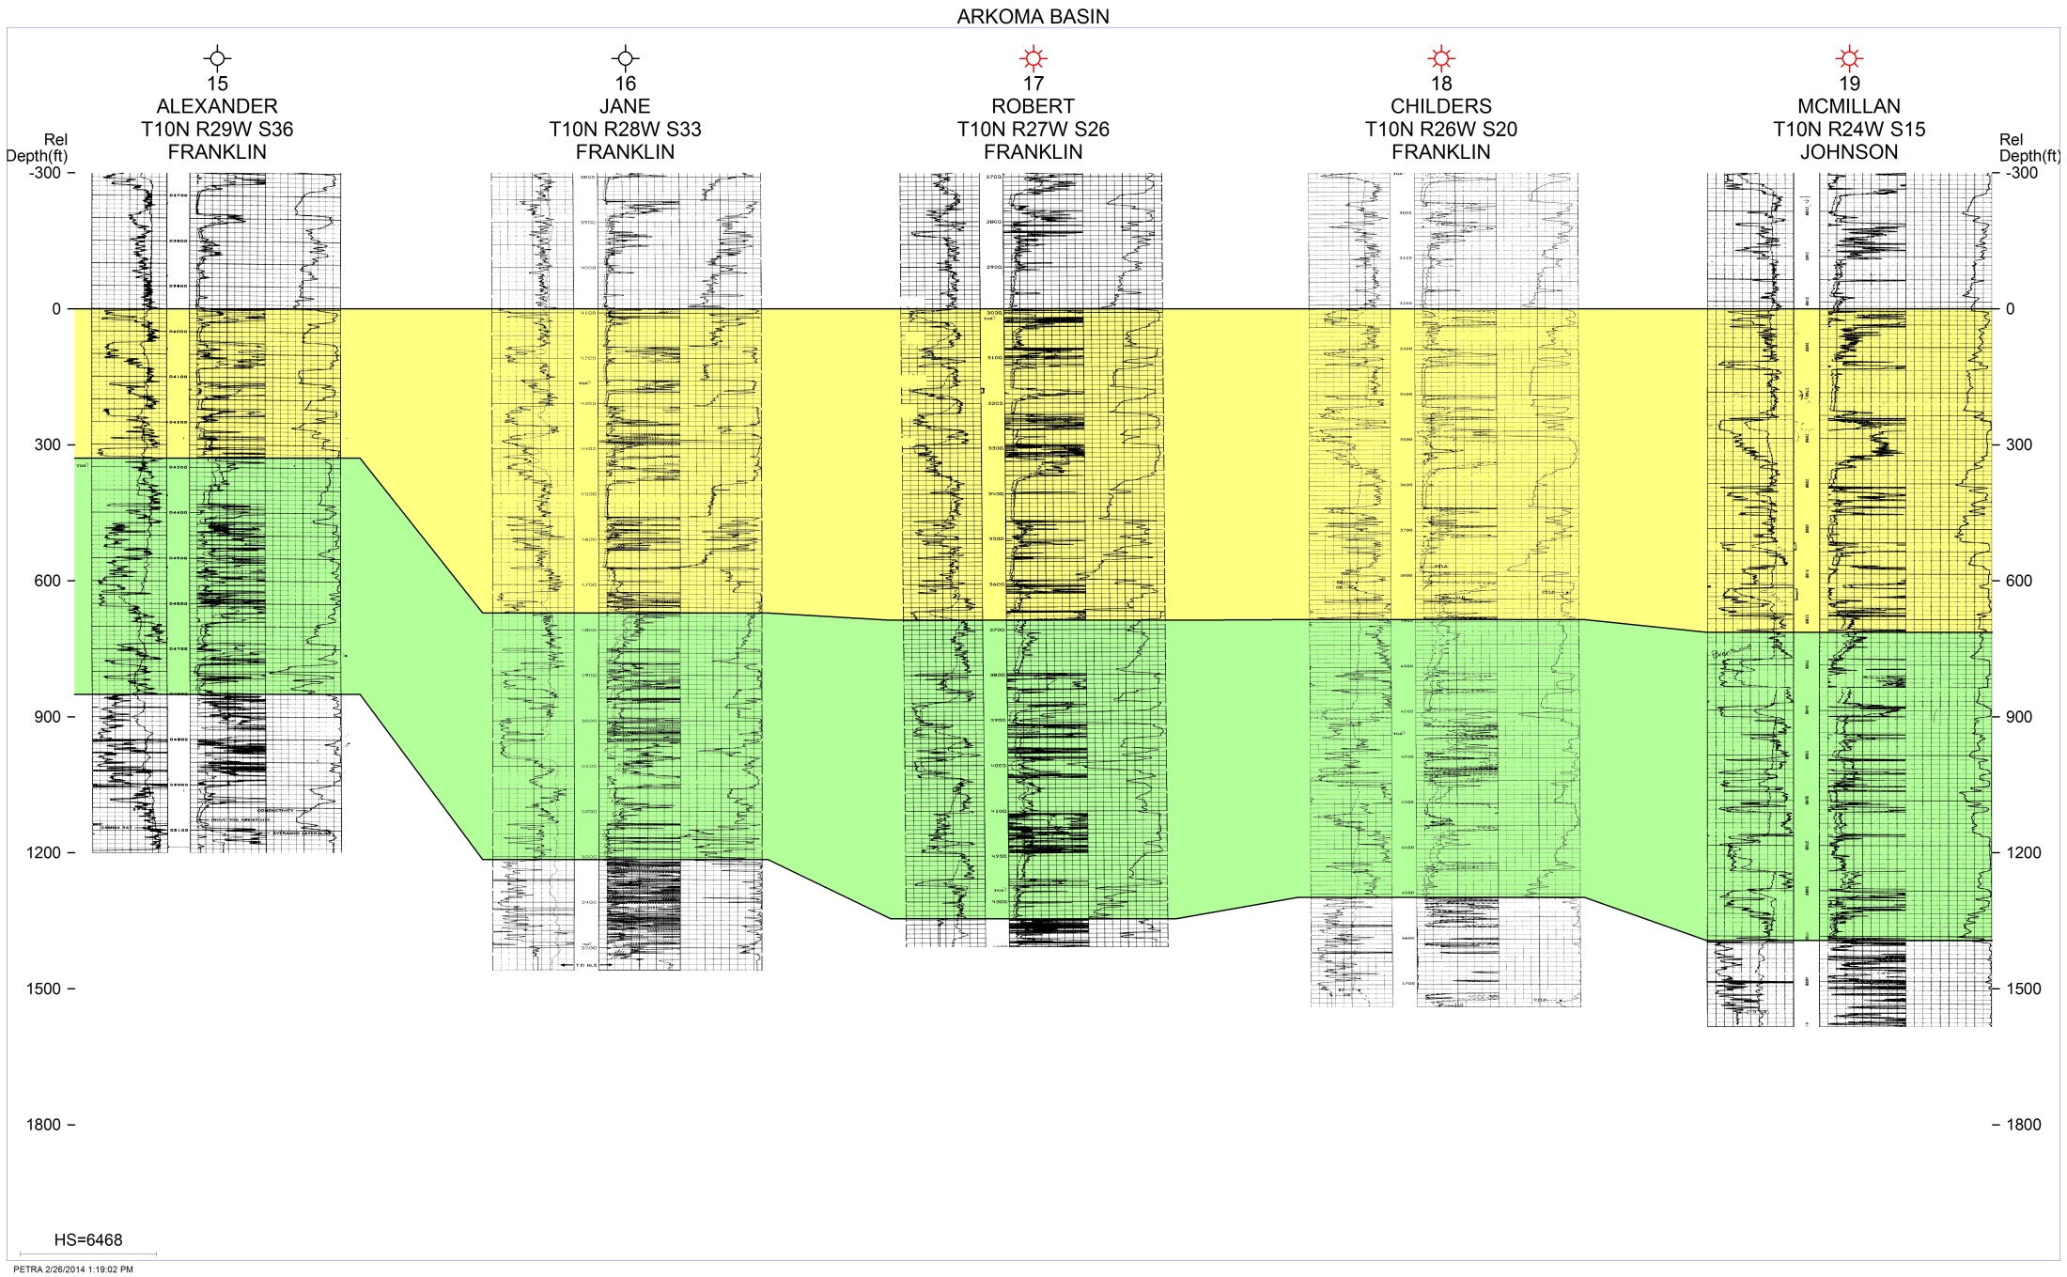
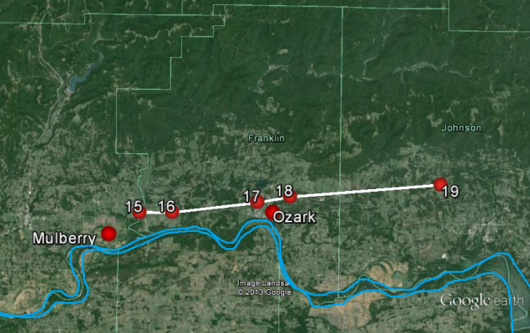
Lower Atoka
Morrowan
West to East stratigraphic cross section D – D’ hung on the Sells. Located in southern Franklin and Johnson Counties in Township 10N, Range 29W-24W.

Slide 21
North-South cross section E – E’ located in Johnson County in Township 9N-12N, Range 24W
Lower Atoka
Morrowan

Slide 22
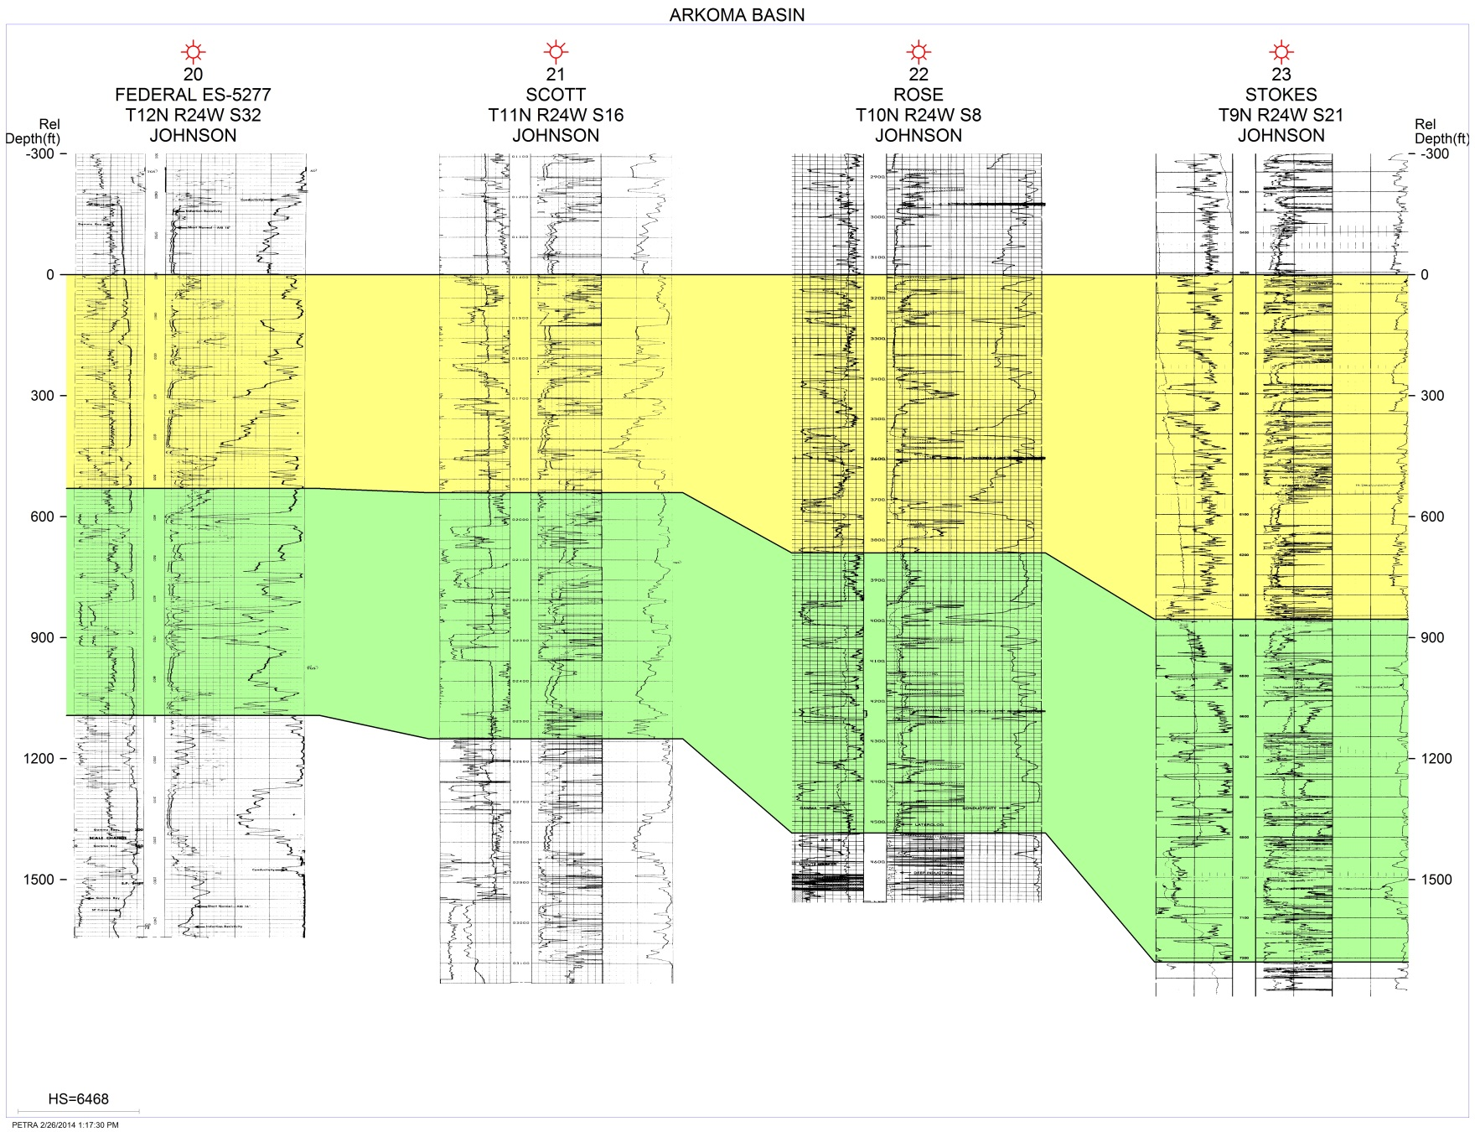
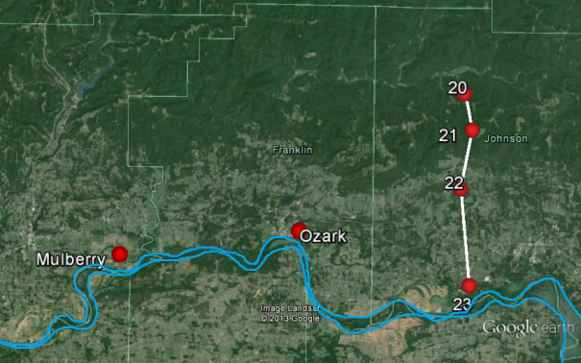
Lower Atoka
Morrowan
North to South stratigraphic cross section E – E’ hung on the Sells in Johnson County in Township 9N-12N, Range 24W.

Slide 23
Conclusions:
Deposition occurred on stable shelf
Influx of terrigenous sediments from the east
Initial subsidence in northern part of basin provided accommodation space

