Slide 1
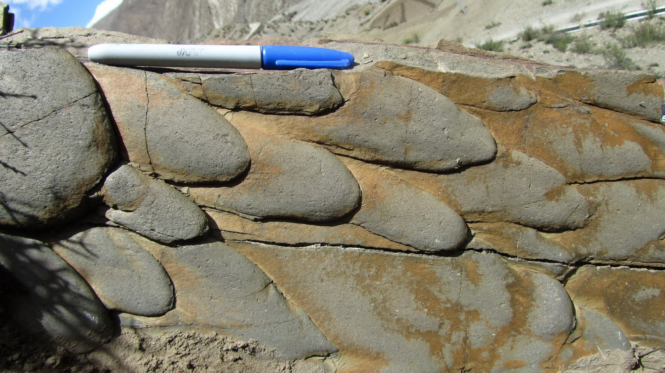
Multiple sources of the Upper Triassic flysch in eastern Himalaya orogen, Tibet, China: Implications to paleogeography and paleotectonic evolution
Xianghui Li¹, Frank Mattern², Chaokai Zhang¹, Qinggao Zeng³, Guozheng Mao³
1School of Earth Sciences and Engineering, Nanjing University, Nanjing, 210046, China. Email: leeschhui@126.com
2College of Science/Earth Science Department, Sultan Qaboos University, PO Box 36, Sultanate of Oman. Email: fmattern@zedat.fu-berlin.de
3The 1st Geology Survey, Tibet Bureau of Land and Resources, Lhasa, 850000, China. Email: zqinggao@sina.com

Slide 2
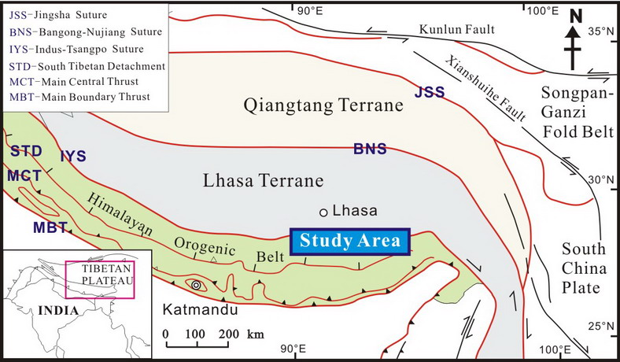
INTRODUCTION
Simplified from Searle et al. (2006)

Slide 3
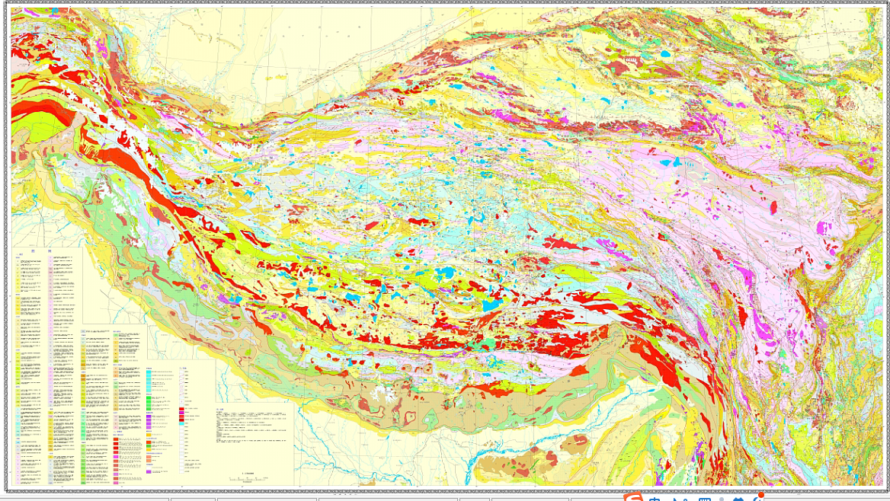
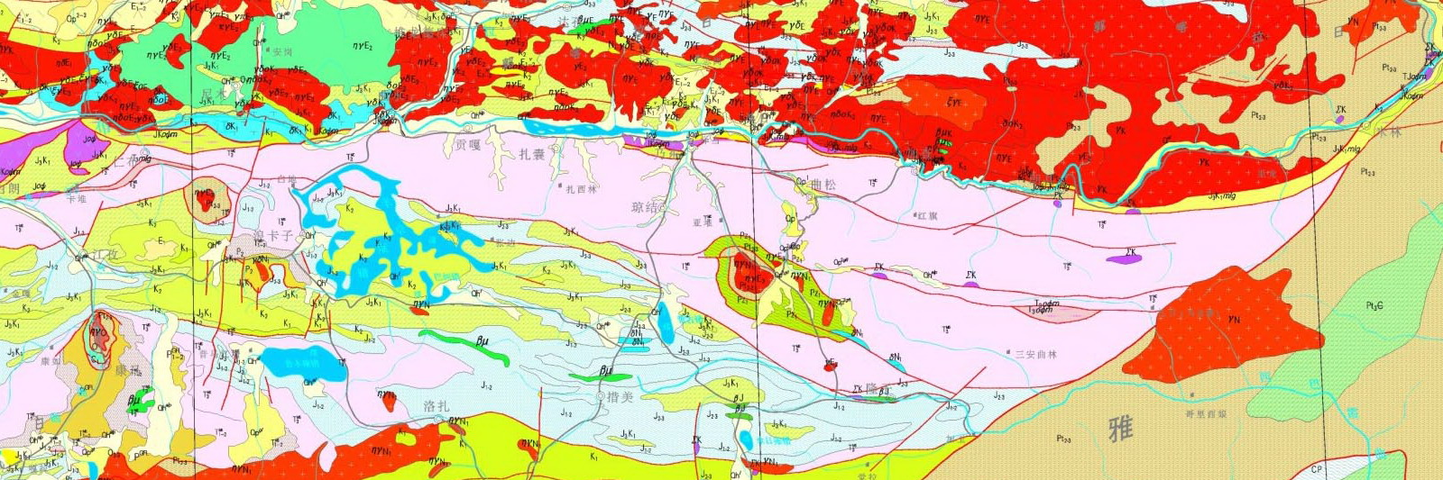
Geological map of Tibet-Himalaya and adjacent areas（Pan et al., 2004; Wang et al., 2013）
As a accretionary prism within eastern YZSZ

Slide 4
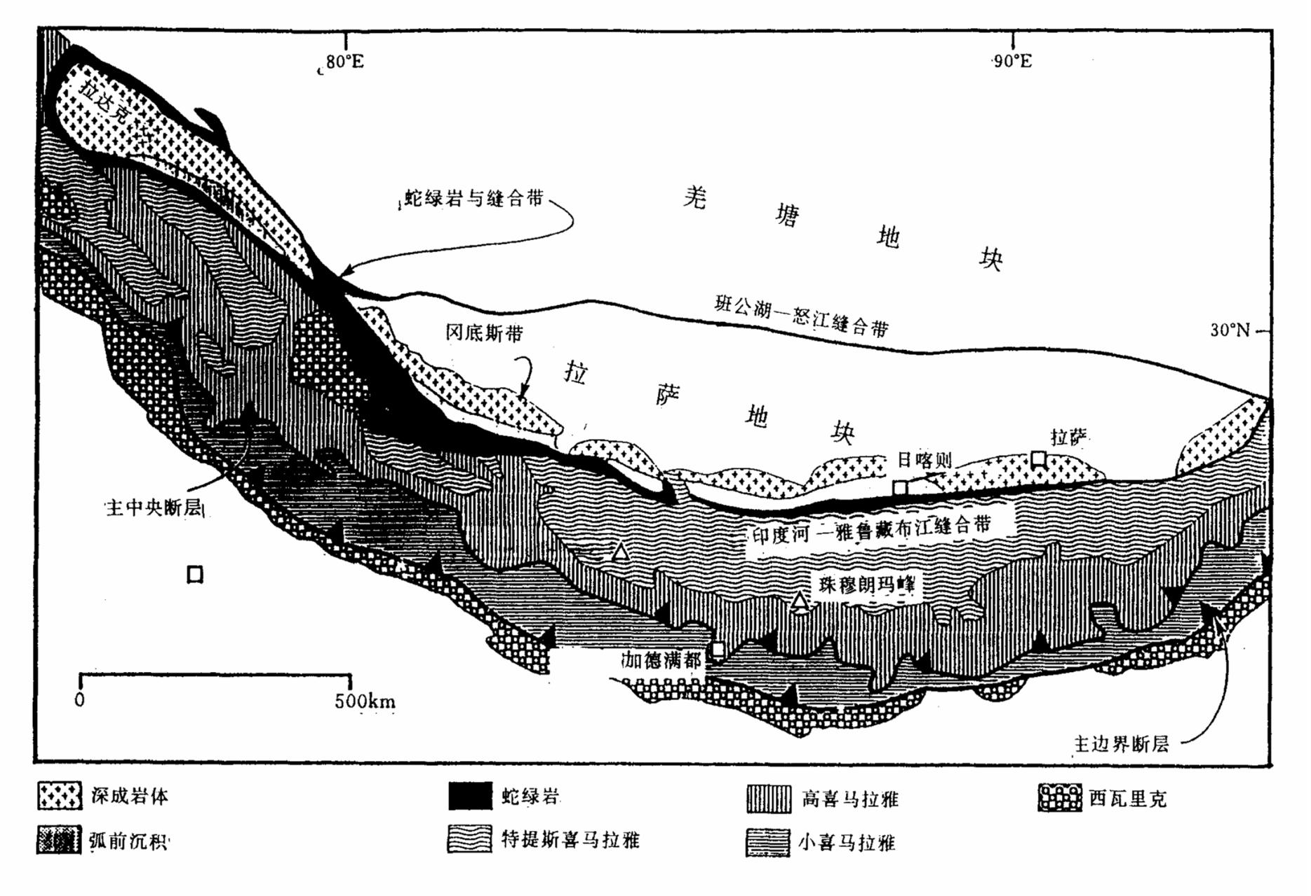
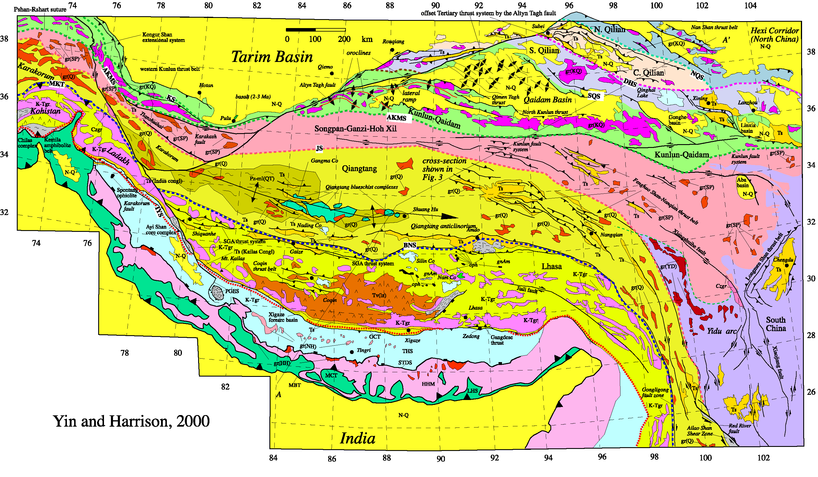
As a eastern part of Tethys Himalaya within the Himalaya Orogen, internationally.
e.g. Gansser, Sengor, Yin and Harrison, Searle et al., Wang, et al.

Slide 5
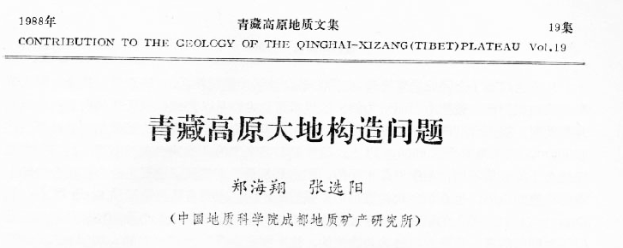
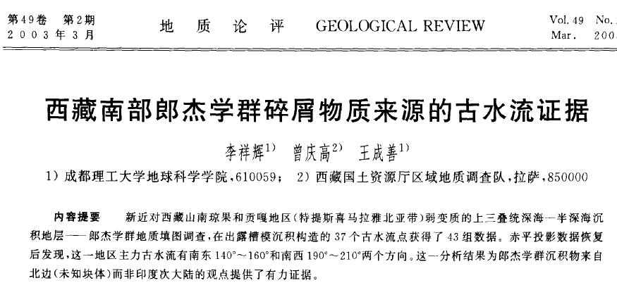
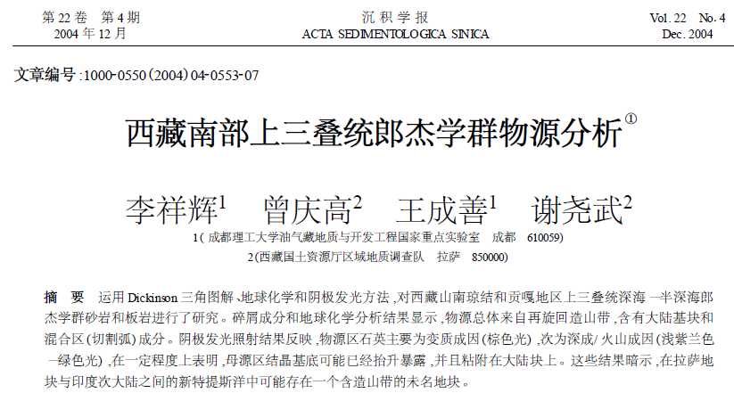
1988----question was suspected by Zheng and Zhang
2003 ---- paleocurrent evidence provided by Li XH et al.
2004----clastics derived from north (Lhasa) or independent terrane provided by Li XH et al.
After 2004, relevant papers published

Slide 6
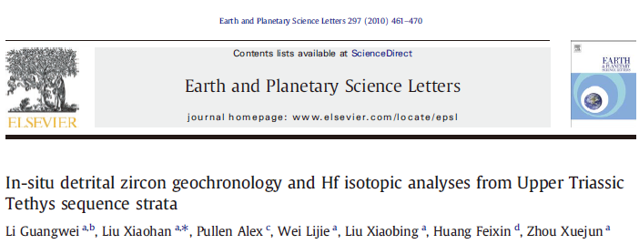
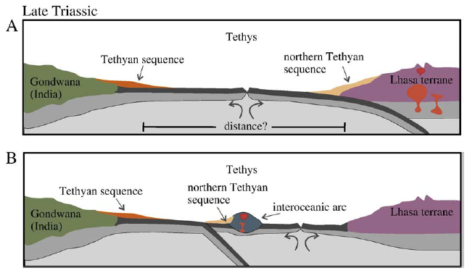
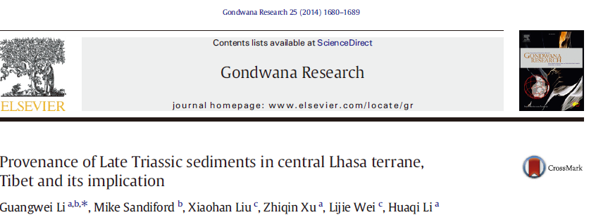
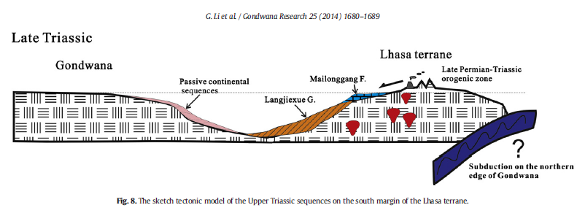
2010, 2013, 2014----
Nonaffinity to Tethys Himalaya from detrital zircon and Hf isotope
Rift model within southern margin of Lhasa Terrane
by Li GW et al and Webb et al.
Li GW et al., 2010, 2014
Webb et al., 2013

Slide 7
MAIN QUESTIONS
Previous works limited in two localities: Rinbung and Qonggyai
Few evidences demonstrated the derivation of the Lhasa terrane: only age population of detrital zircon and not matchable exactly
Rift basin model conflicted the tectonic setting form the Dickinson triplot of sandstone clastic composition
Provenance optional

Slide 8
OUR NEW WORKS
Geochronology of detrital zircon of the Triassic sandstones in both entire Shannan Terrane and adjacent terranes
Hf isotope of detrital zircon from sandstones
Geochemistry of Cr-spinels
Geochronology of zircons from diabase

Slide 9
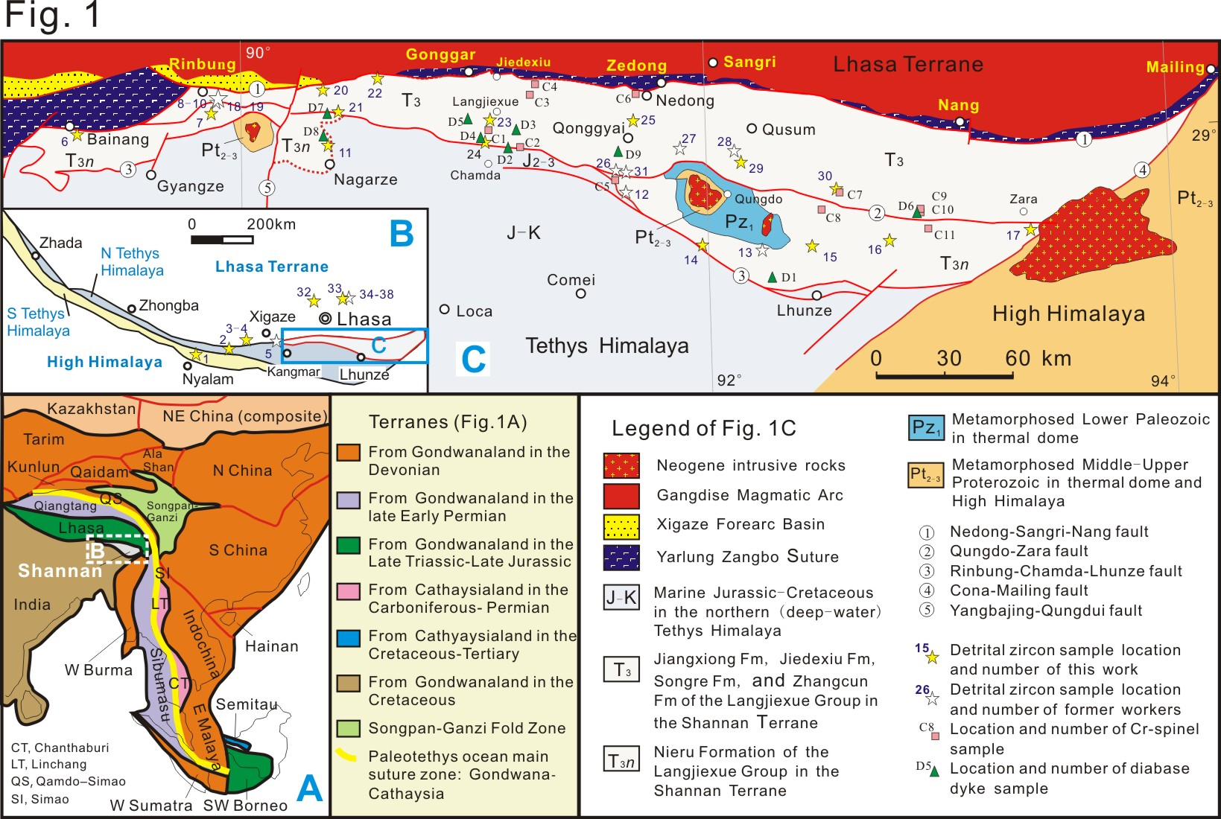
OUR NEW WORKS

Slide 10
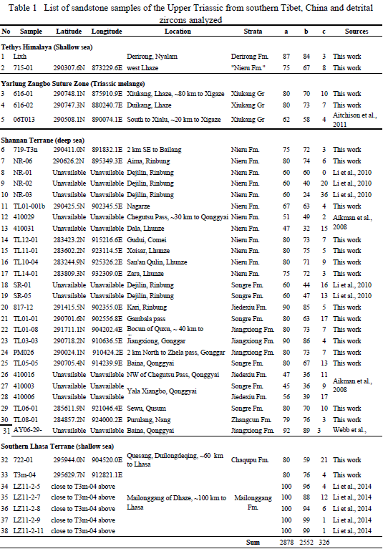
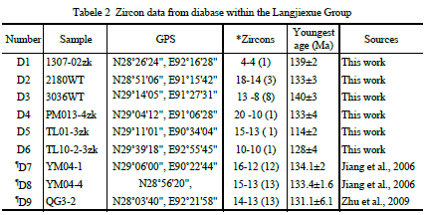
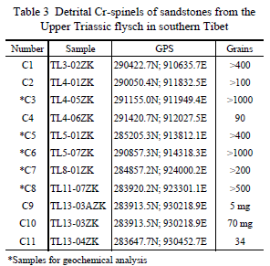
Sandstone samples 20 of 38,
Detrital zircons (concordant): 1522 of 2552
Zircons from diabase: 70
Hf isotopes (400-200 Ma): 175 of 186
Cr-chromes sample geochem: 141

Slide 11
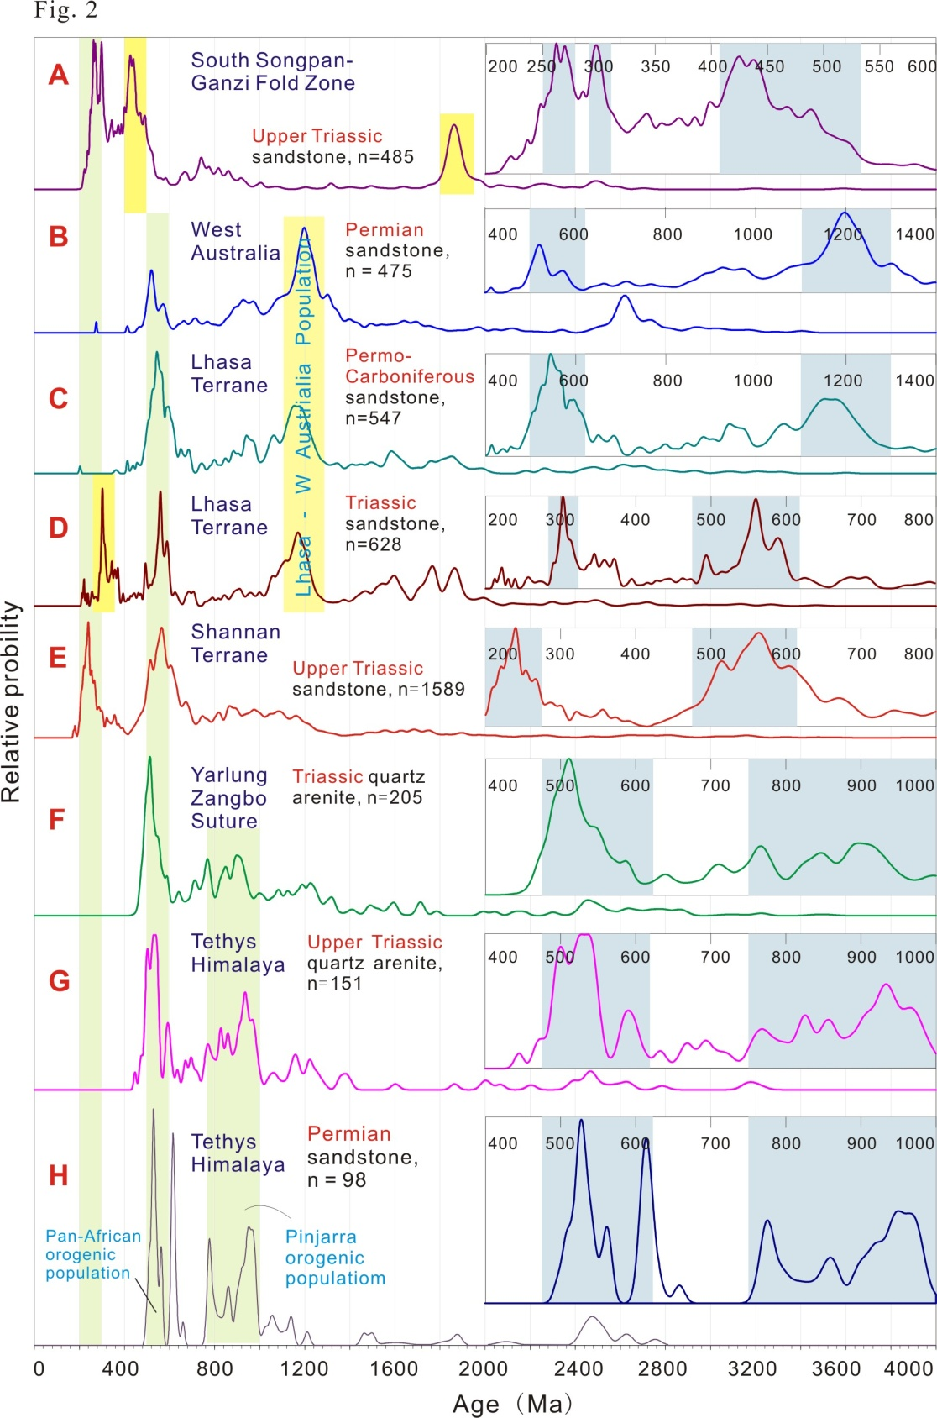
RESULTS
Geochronology of detrital zircon
Discrepancy between Lhasa and Shannan terranes:
Comp. D and E

Slide 12
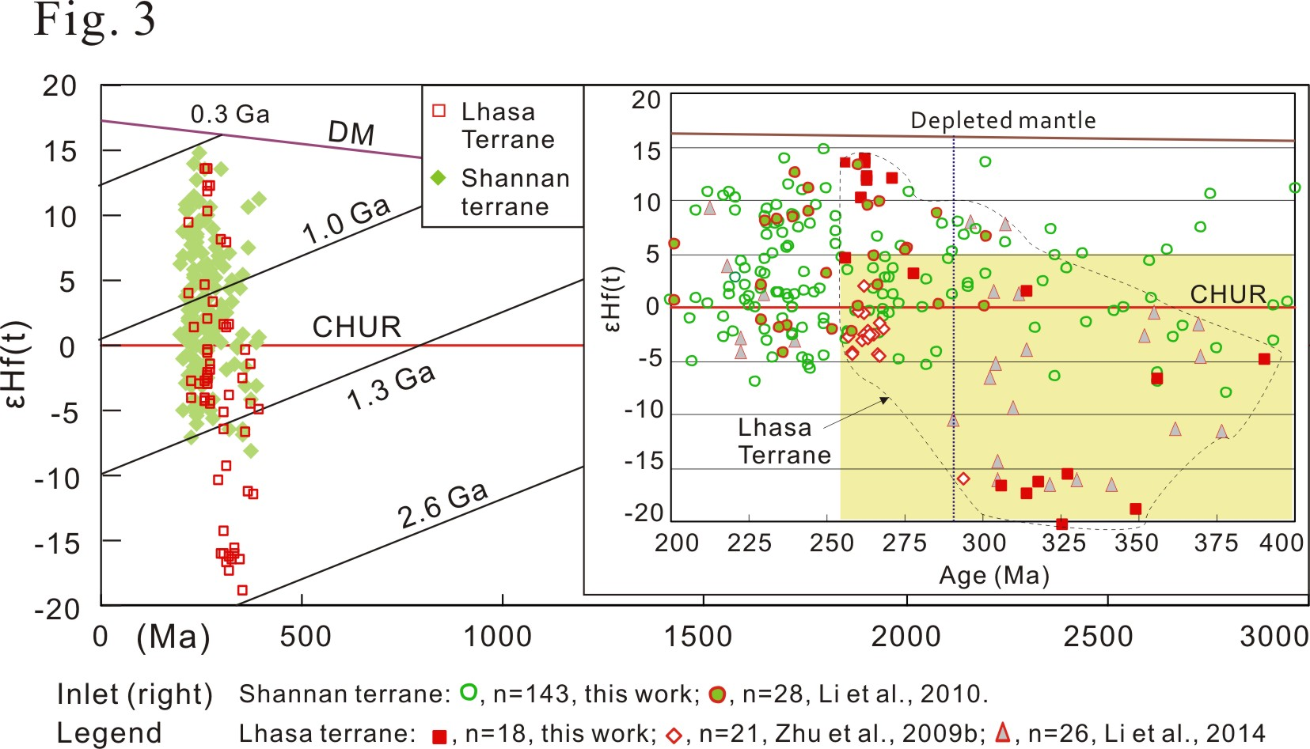
Hf isotope of detrital zircon (400-200 Ma)
400-290 Ma: -10~-20 ƐHt (t) in Lhasa Terrane, not found in Shannan Terrane

Slide 13
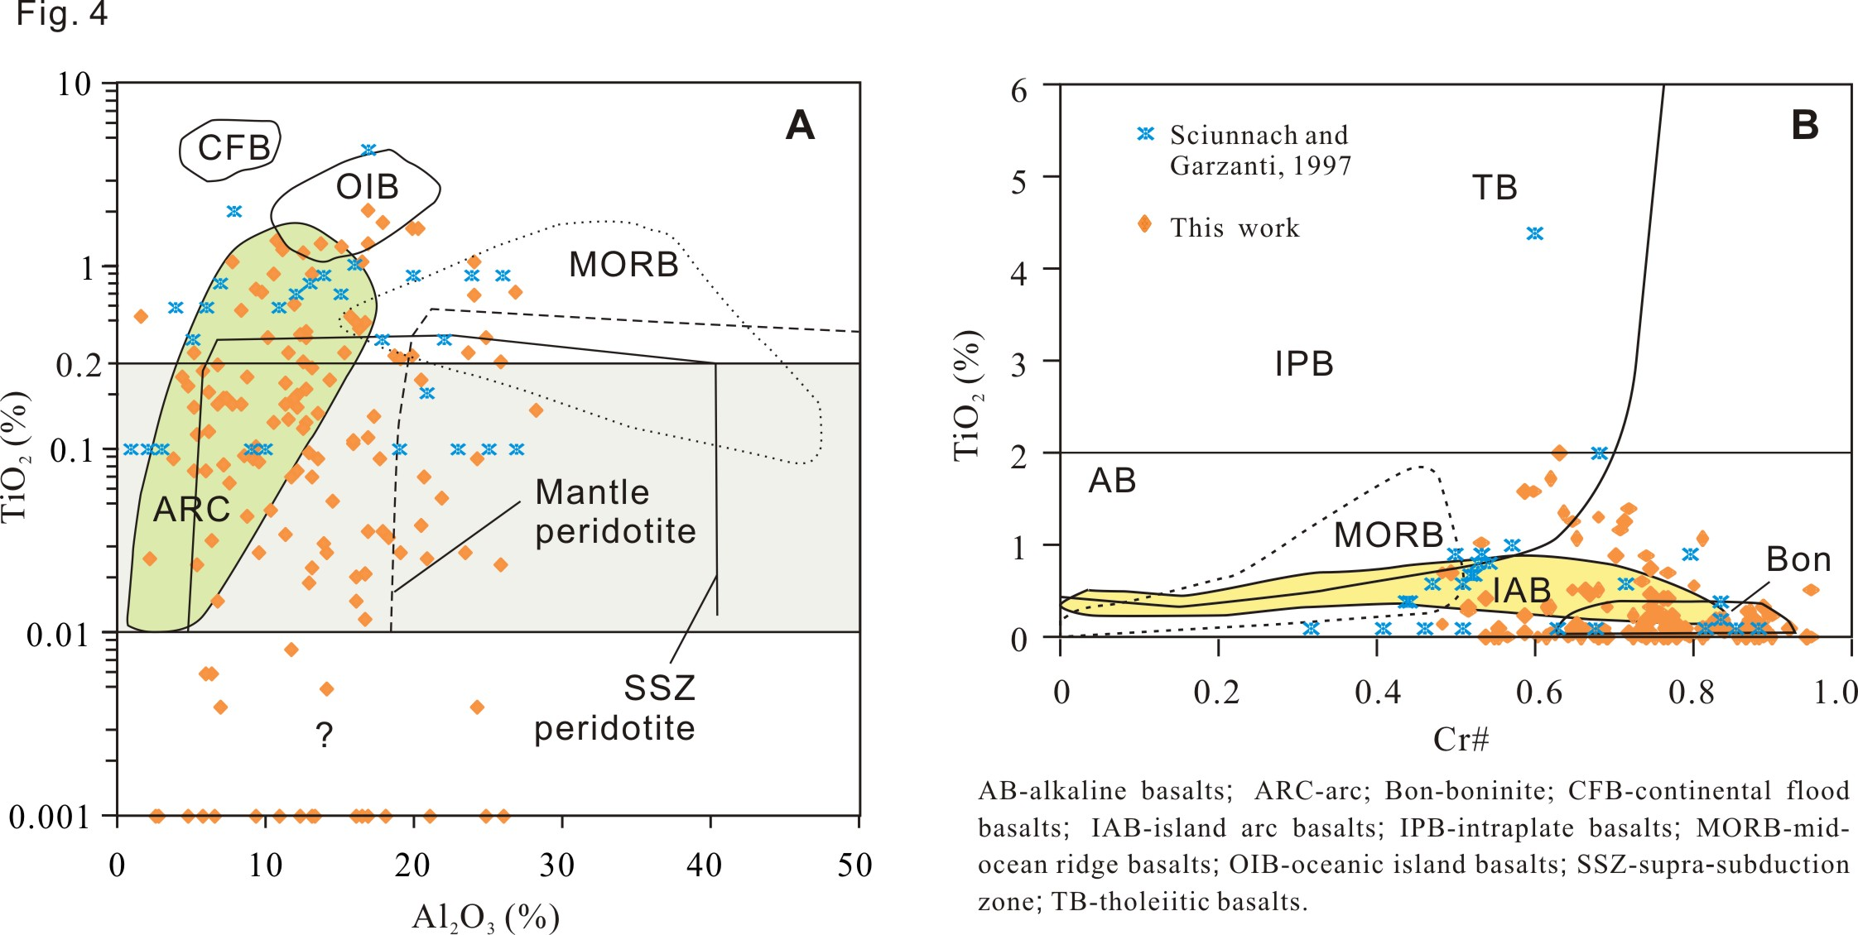
Geochemistry of Cr-spinels:
basalts, peridotites, and boninites
No spinels in 6 samples from Lhasa Terrane (Li et al., 2014, GR)
Multiple sources, not only from Lhasa Terrane

Slide 14
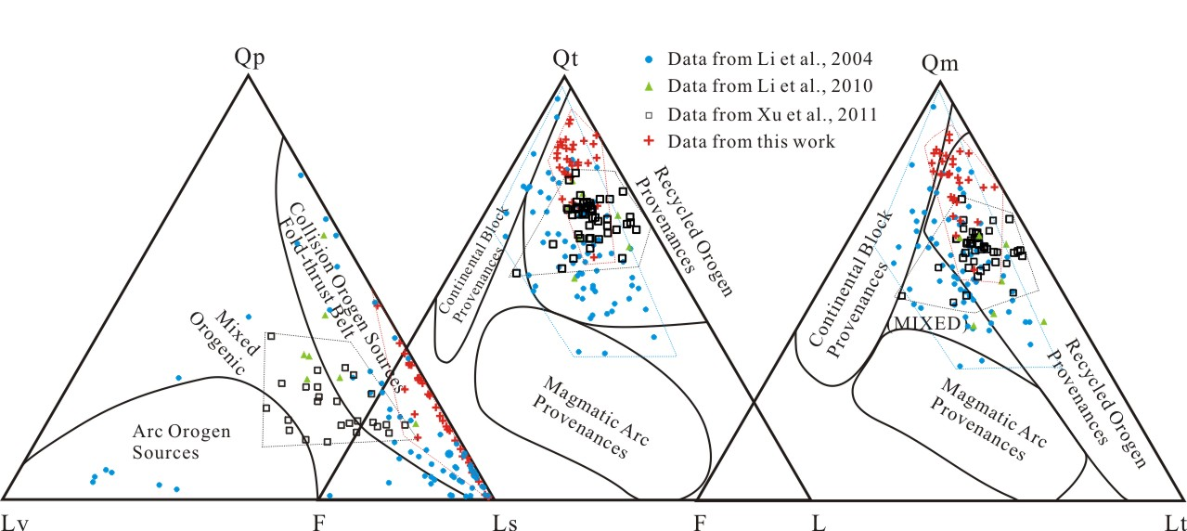
Dickinson triplot:
Zhang et al., submitted to GSA Bull.
Multiple sources: recylced orogen, arc orogen, mixed

Slide 15
Two points
Different from Lhasa terrane
Multiple sources
WHERE THE SHANNAN TERRANE CAME FROM?

Slide 16
Four possible answers for original location:
Lhasa Terrane (Li XH et al., 2004; Li GW et al., 2010, 2014; Webb et al., 2013)
A remnant basin in eastern Bangong-Nujiang Zone between Qiangtang and Lhasa (Schneider et al., 2003)
Outlet of Paleotethys suture
Remnant between India and W Australia

Slide 17
Lhasa Terrane
1) Difference of age population and Hf isotope of detrital zircon between two terranes;
2) 132 Ma diabase of Cona LIP
At least, Lhasa Terrane is not the only source.

Slide 18
2 A remnant basin in eastern Bangong-Nujiang Zone between Qiangtang and Lhasa (Schneider et al., 2003)
Is it a tectonic relict or a remnant ocean/sea basin at the terminal outlet of an orogen?
The eastern remnant Bangong-Nujiang basin was geographically far away from the eastern terminal of the Paleotethys suture/orogen. How did the Shannan Terrane move to its present position?
Such an origin of the Shannan Terrane would call for a strike-slip megafault in E-W direction

Slide 19
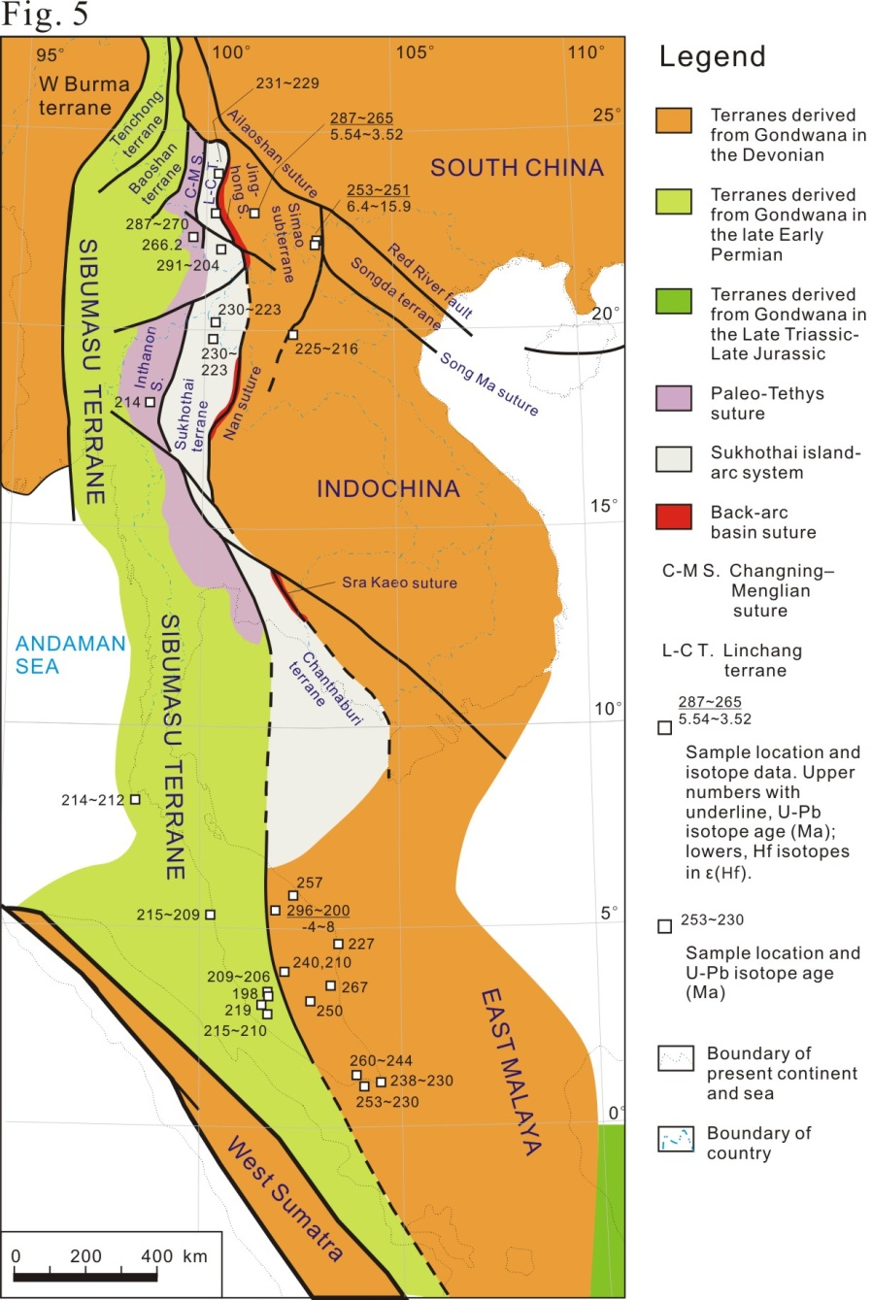
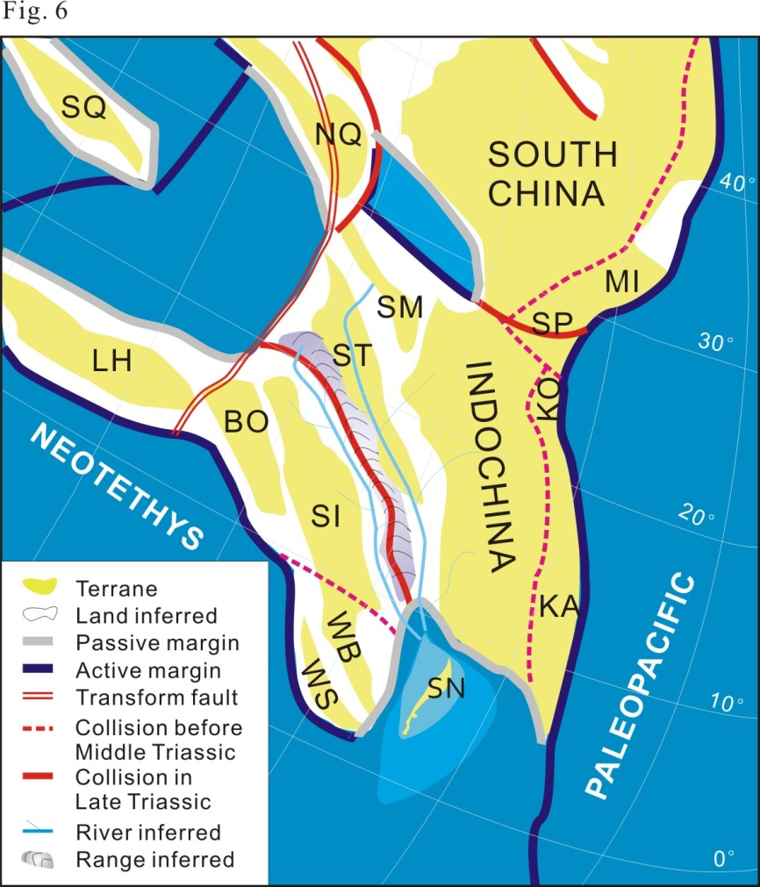
3 Outlet of Paleotethys suture

Slide 20
The disappeared remnant basin in eastern terminal outlet of the Paleotethys suture/orogen between West Sumatra and E Malaya (Indochina) is a candidate. If so,
------It is extremely challengeable and difficult for its moving to present (Shannan Terrane) location. It has to have westward proceeded by a sinistral strike-slip megafault with an extent of at least 3000 km movement while the Neotethys ocean was convergent to South Asia.
----If the Shannan Basin was related to the Paleotethys Suture, it should be located in the northern hemisphere during the latest Triassic. This to great degree conflicts the fact that the Shannan Terrane was confined in southern hemisphere, near which the Comei-Bunbury LIP (Zhu et al., 2009b) developed in the eastern Gondwanaland by abundant coeval diabase dykes.

Slide 21
4. Remnant between India and W Australia √
Paleotethys
Pan-Africa

Slide 22
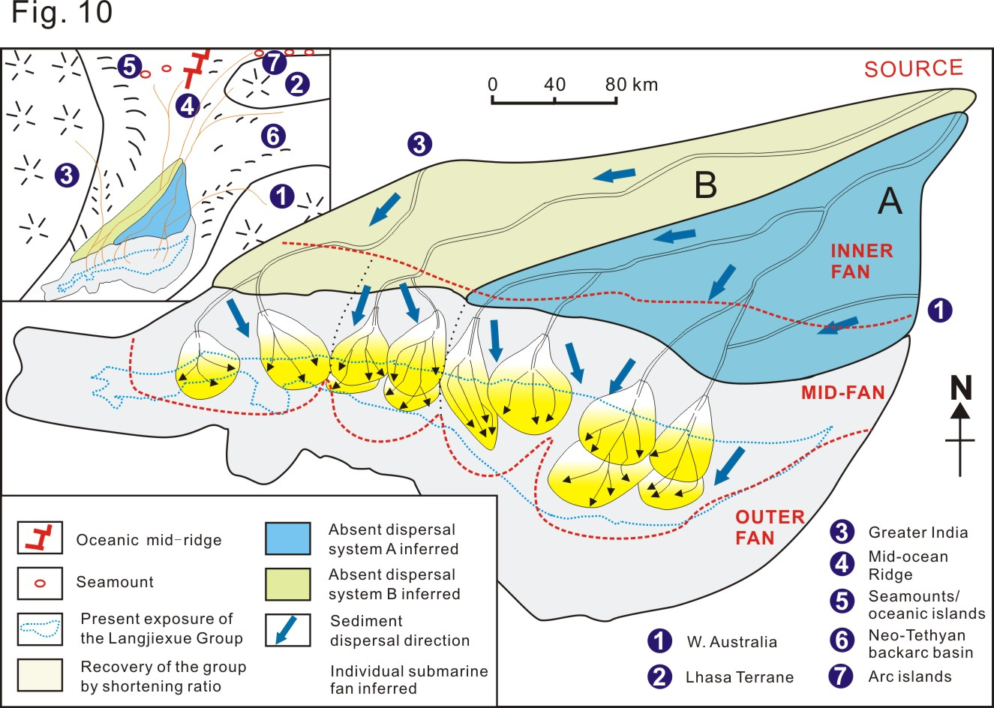
Zhang et al., submitted to GSA Bull.

Slide 23
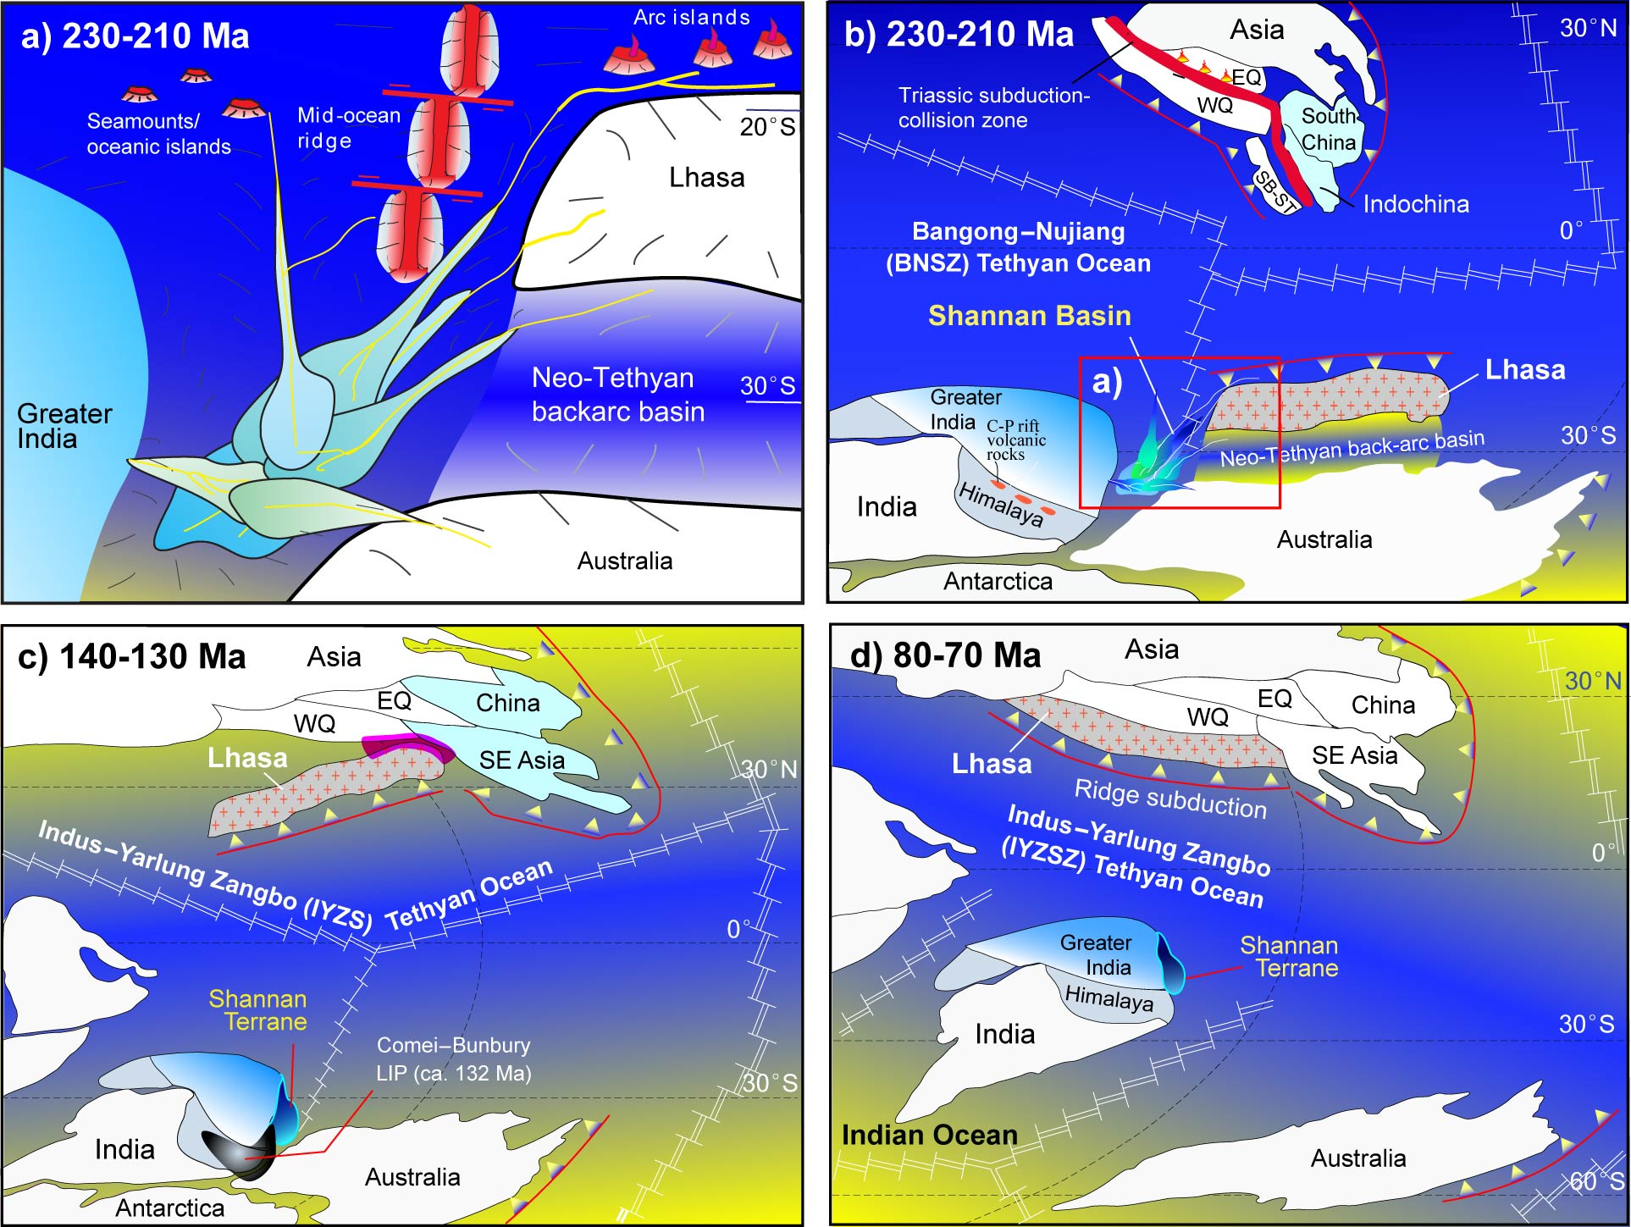

Slide 24
This model excludes the accretionary prism of YZSZ!
Thank you for attention!

Slide 25
Zhang Chaokai, Li Xianghui 1, Mattern F., Zeng Qinggao, Mao Guozheng。 Sedimentological research of the Upper Triassic flysch in eastern Himalayan Orogen (Tibet, China): Insight for the remnant basin model. GSA Bull. Submitted
Li Xianghuii, Mattern F. , Zhang Chaokai, Zeng Qinggao, Mao Guozheng. Multiple sources of the Upper Triassic flysch in eastern Himalaya orogen, Tibet, China: Implications to paleogeography and paleotectonic evolution. Tectonophysics, Revised.
Zhang Chaokai, Li Xianghui, Mattern F., Mao Guozheng, Zeng Qinggao, and Xu Wenli. Deposystem architectures and lithofacies of a submarine fan-dominated deep sea succession in an orogen: A case study from the Upper Triassic Langjiexue Group of southern Tibet). Journal of Asian Earth Science, 2015, 111, 222–243 . doi.org/10.1016/j.jseaes.2015.07.013
张朝凯，李祥辉. 喜马拉雅造山带东部上三叠统复理石北部特征及其构造边界意义. 地质通报，2015
张朝凯，李祥辉，王尹，孙勇。西藏山南地区上三叠统复理石郎杰学群岩性分布样式及其意义。沉积学报，2014，32 (1)：9-16。
李祥辉，王尹，徐文礼，孙勇，孔庆友，曾庆高，谢饶武，毛国政，尼玛次仁，周勇，刘玲，2011. 试论西藏南部上三叠统复理石郎杰学群与涅如组。地质学报，85(10): 1551-1562。
徐文礼，李祥辉，王尹，曾庆高，孙勇，尼玛次仁，2011。西藏仁布地区上三叠统复理石物源分析。高校地质学报，17（2）：220-230
曾庆高，李祥辉，夏斌，徐文礼，尼玛次仁，普琼，李君。西藏仁布地区上三叠统重矿物组合与物源分析。地质通报，2009，28（1）：38-44
李祥辉，曾庆高，王成善，谢尧武。西藏南部上三叠统郎杰学群物源分析。沉积学报，2004，22（4）：553-559。
李祥辉，曾庆高，王成善。西藏南部郎杰学群来源的古水流证据。地质论评，2003，49（2）：132-137。
李祥辉，曾庆高，王成善。西藏山南地区琼结南部上三叠统郎杰学群岩石、岩相特征与浊积扇模式。现代地质，2003，17(1)：52-58。

Slide 26
