Slide 1

GEOMECHANICAL EFFECTS OF OILFIELD CHEMICALS ON SAND FAILURE IN RESERVOIR ROCKS
Elizabeth O. Wuyep*
Gbenga F. Oluyemi*
Kyari Yates*
Alfred Akisanya**
*Robert Gordon University, Aberdeen
**University of Aberdeen, Aberdeen
GSA 2015 Annual meeting and Exposition
1 – 4 November, Baltimore, Maryland, USA

Slide 2
Outline
Introduction
Approaches
Results
Conclusion

Slide 3
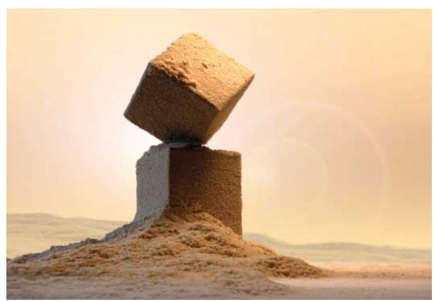
Introduction
Sand failure!!!!!
How does this failure happen?
The role of oilfield chemicals.
Current industry’s approach.

Slide 4
Limitations of the previous works
The Seto et al., 1997:
- Was restricted to static tests;
- Chemicals utilized have different chemistry entirely from the commonly used oilfield chemicals.
The Oluyemi, 2014:
- the study was restricted to the use of scale inhibitor amongst the wider range of chemicals
- no mechanical test was involved;
- did not use XRD to quantify the mineral composition of the rock before and after chemical treatment.

Slide 5
So what next…..???
Mechanisms of the effects of oilfield chemicals on the geomechanical strength of reservoir rocks.
Mechanical testing, analytical techniques and a wider range of laboratory chemical applications.
Baseline for further study to quantify the effects of these chemicals on sand failure and production.

Slide 6
Experimental flow chart
Saturation tests
Mechanical test
Particle size analysis
Analytical tests
SEM
SEM/EDX
XRD

Slide 7
Saturated fluids
Brine filtered using sintered glass filter papers to eliminate extraneous fines.
A stock of 1% betaine, glutaraldehyde and 5% phosphonate scale inhibitor (ATMP) were prepared by diluting 2.50g and 12.50g of the chemicals respectively in 250ml of brine.
Element | Na | K | Ca | Mg | Ba | Sr | Fe | Cl | SO₄ | HCO₃
Concentration (ppm) | 24870 | 887 | 785 | 136 | 561 | 108 | 3 | 39800 | 35 | 2014

Slide 8
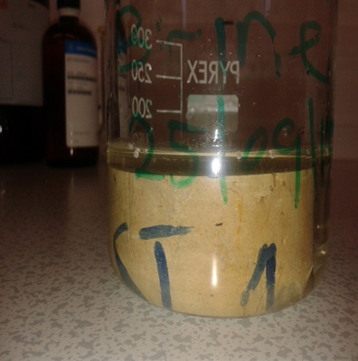
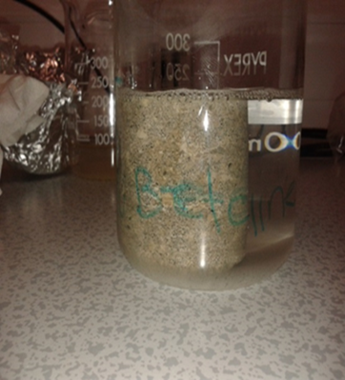
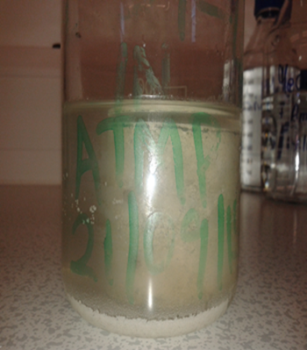
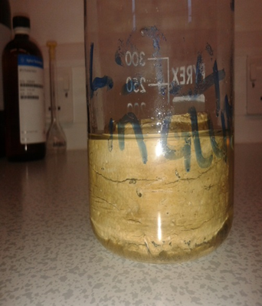
Static Saturation Test
Cores inside Brine and chemicals
Brine
Betaine
ATMP
Glutaraldehyde

Slide 9
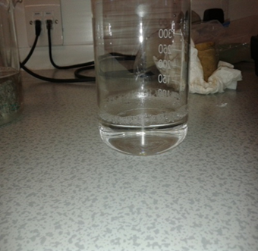
Static Saturation Test
Cores inside Brine and chemicals
Brine
Betaine
ATMP
Glutaraldehyde
Effluents from Brine and chemicals
Brine effluent

Slide 10
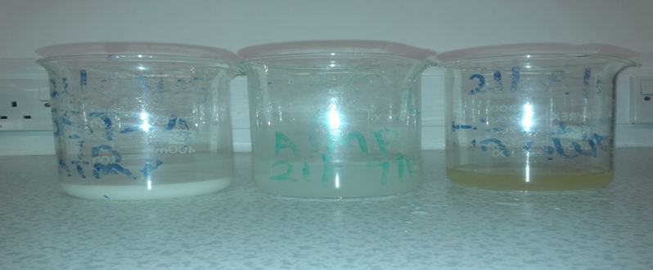
Static Saturation Test
Cores inside Brine and chemicals
Brine
Betaine
ATMP
Glutaraldehyde
Effluents from Brine and chemicals
Brine effluent
ATMP effluent
Betaine effluent
Glut. effluent

Slide 11
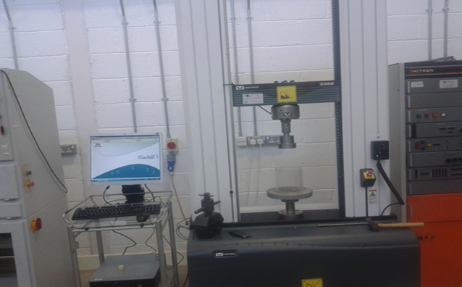
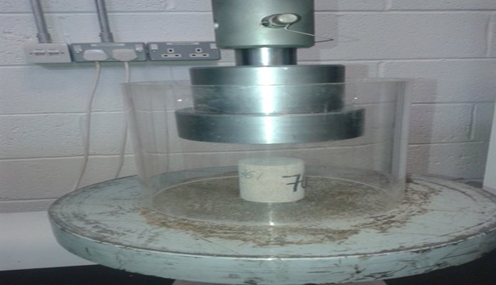
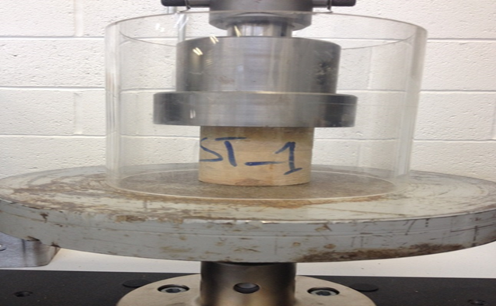
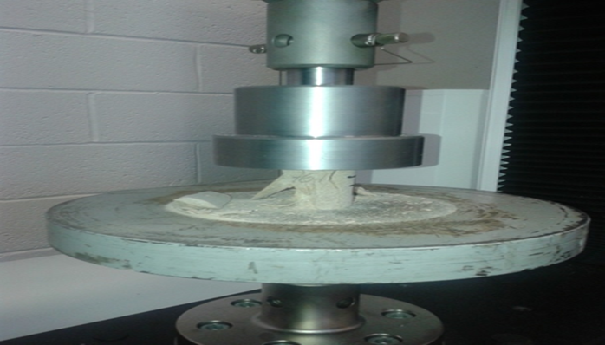
Mechanical Test (UCT)

Slide 12
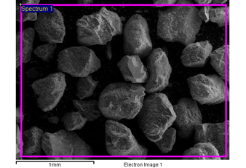
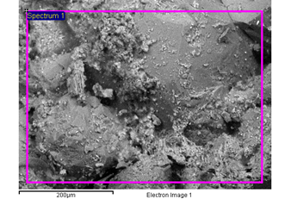
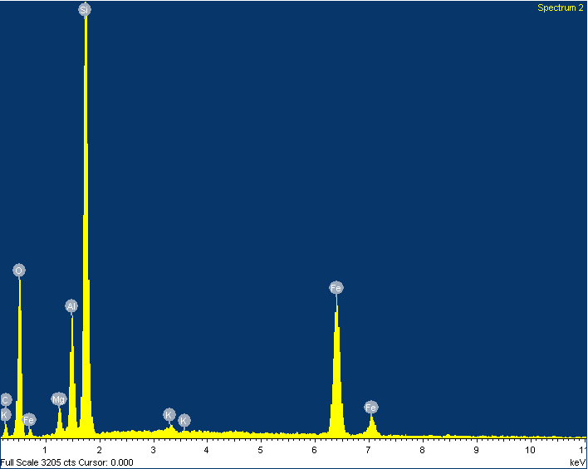
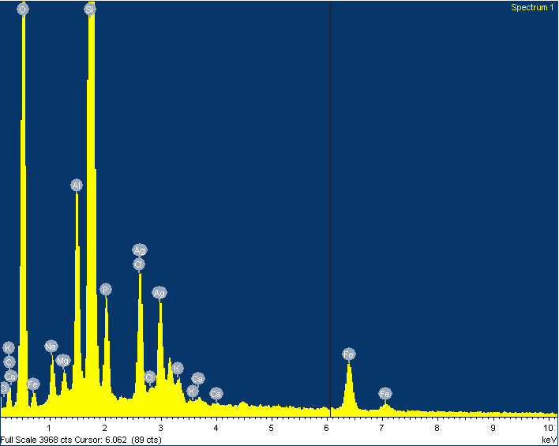
Results
SEM/EDX results for sandstone before and after treatment
Well-sorted, sub-rounded quartz mineral confirmed by EDX scan (c) .
Fine-grained mineral assemblages resulting from altered mineral constituent.
Evidence of altered minerals spread on the surface of the larger unaltered quartz grains.
SEM Image – SST before treatment
SEM Image – SST after treatment
(a)
(b)
EDX Scan- SST before treatment
EDX Scan – SST after treatment
(c)
(d)

Slide 13
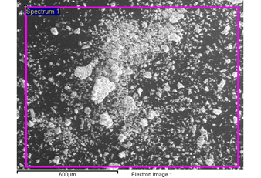
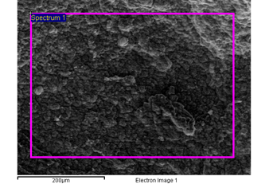
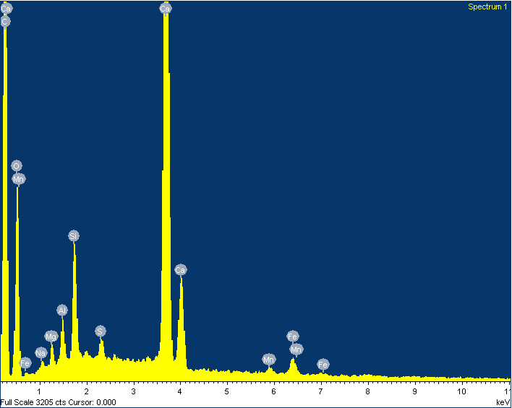
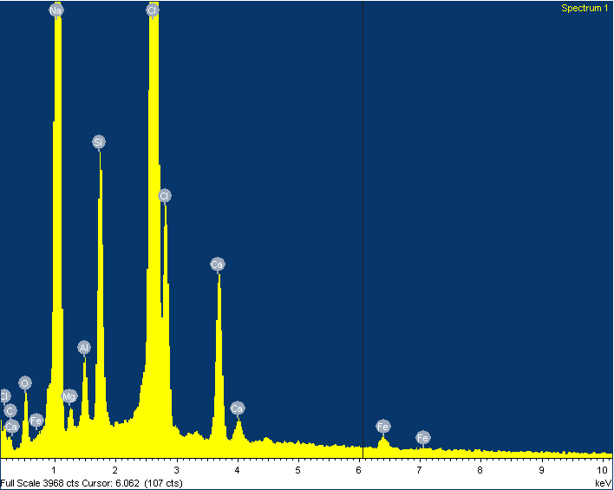
SEM/EDX results for limestone
SEM image (a) shows poorly sorted, rhombohedral calcite as confirmed by EDX.
Evidence of grain loosening in image (b) as a result of alteration caused by chemical – formation interaction.
No alteration feature is observed with image (a).
SEM Image – LST after treatment
SEM Image – LST before treatment
(a)
(b)
EDX scan - LST before treatment
EDX scan – LST after treatment
(c)
(d)

Slide 14
Elemental composition of the sandstone using EDX
Elements | Untreated Sandstone atomic wt% | Normalized ratio (element/Si) % | SST treated with Corrosion inhibitor atomic wt% | Normalized ratio (element/Si) % | SST treated with Scale inhibitor atomic wt% | Normalized ratio (element/Si) % | SST in Brine | Normalized ratio (element/Si) %
Na | ND | ND | 0.48 | 2.3 | 1.29 | 6.4 | ND | ND
Mg | 0.61 | 2.5 | 0.23 | 1.4 | 0.49 | 2.4 | nd | ND
Al | 6.25 | 0.3 | 2.92 | 17.6 | 2.81 | 14 | 1.57 | 5.2
Ag | ND | ND | ND | ND | 1.33 | 6.6 | ND | ND
P | 0.25 | 1 | ND | ND | 2.03 | 10.1 | ND | ND
Cl | 1.55 | 6.4 | 0.33 | 2 | 2.07 | 10 | 0.21 | 0.7
K | 0.88 | 3.6 | 1.05 | 6.3 | 0.24 | 1.2 | 0.24 | 0.8
Ca | 0.13 | 0.5 | 4.53 | 27 | 0.10 | 0.5 | ND | ND
Fe | 0.86 | 3.5 | 0.42 | 2.5 | 1.46 | 7.2 | 0.10 | 03
Ti | ND | ND | 0.26 | 1.6 | ND | ND | ND | ND
Si | 24.27 | 100 | 16.56 | 100 | 20.18 | 100 | 30.03 | 100
ND =Not detected

Slide 15
Elemental composition of the limestone using EDX
Elements | Untreated limestone atomic wt% | Normalized ratio (element/Ca) % | LST treated with Biocide atomic wt% | Normalized ratio (element/Ca) % | LST treated with Corrosion inhibitor atomic wt% | Normalized ratio (element/Cl) % | LST treated with Scale inhibitor atomic wt% | Normalized ratio (element/Ca) %
Na | ND | ND | ND | ND | 33.46 | 93.4 | ND | ND
Mg | 0.26 | 1.5 | 0.32 | 1.3 | 0.58 | 1.6 | 0.37 | 1.3
Al | 0.13 | 0.75 | 0.45 | 1.9 | 1.02 | 2.8 | 2.02 | 6.9
Si | 0.48 | 2.8 | 0.35 | 1.4 | 3.98 | 11.1 | 0.34 | 1.2
S | 0.10 | 0.58 | ND | ND | ND | ND | ND | ND
Cl | ND | ND | 0.15 | 0.6 | 35.84 | 100 | ND | ND
Fe | 0.20 | 1.2 | 0.17 | 0.7 | 0.36 | 1 | 0.24 | 0.8
Ca | 17.29 | 100 | 24.16 | 100 | 3.09 | 8.6 | 29.36 | 100
ND = Not detected

Slide 16
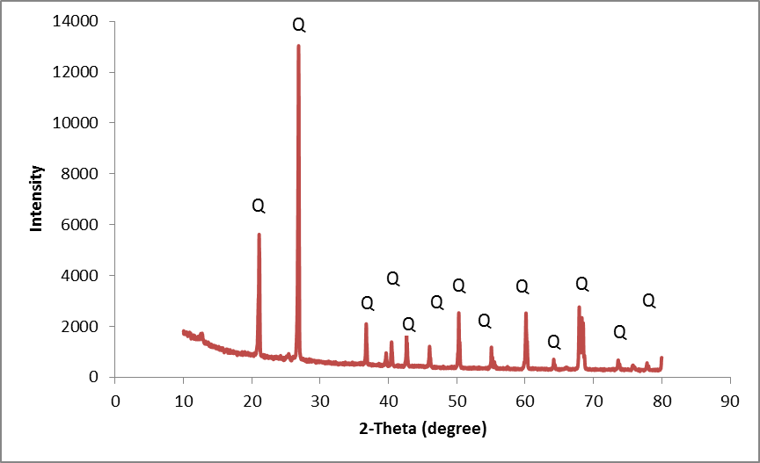
XRD Analysis before chemical treatment
SST_XRD
Quartz (SiO2): 85%
Calcite = 85%
Quartz = 9%

Slide 17
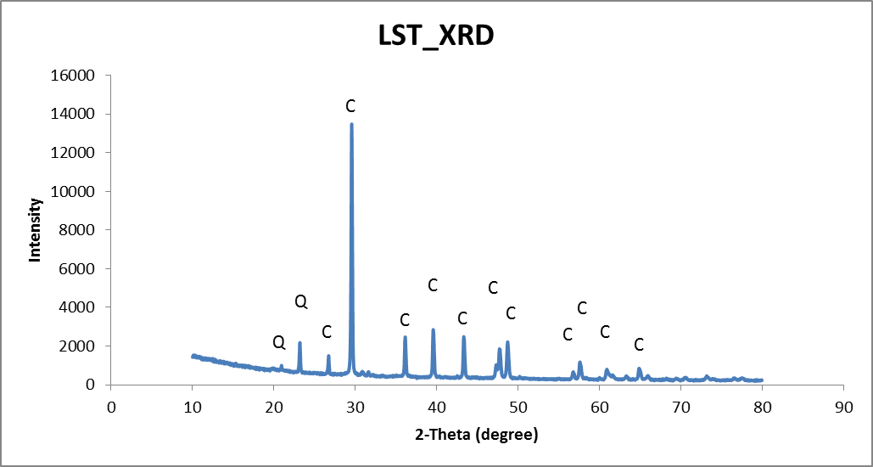
XRD Analysis before chemical treatment
SST_XRD
Quartz (SiO2): 85%
Calcite = 85%
Quartz = 9%

Slide 18
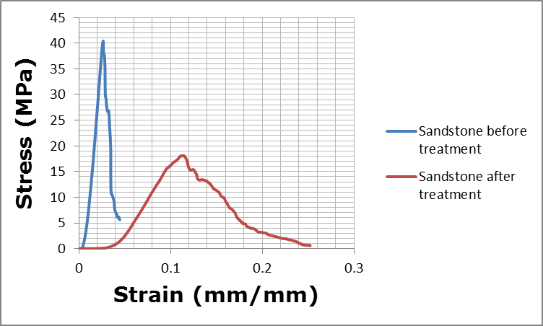
Mechanical Test – Failure effects chemically treated sandstone
Samples | Test rate (mm/min) | Max. Load (N) | Strain (mm/mm) | Stress (MPa) | Young’s modulus (MPa)
Sandstone before treatment | 0.5 | 45,307 | 0.04 | 40.44 | 2,221
Sandstone after treatment | 0.5 | 54,618 | 0.07 | 18.09 | 282

Slide 19
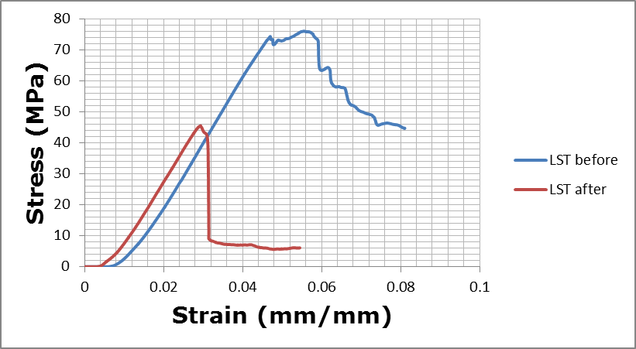
Mechanical Test- Failure effects of chemically treated Limestone

Slide 20
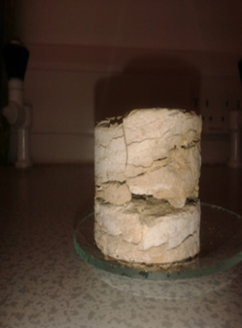
Mechanical Test- Failure effects of chemically treated Limestone

Slide 21
Mechanical Test- Failure effects of chemically treated Limestone
Samples | Test rate (mm/min) | Max. Load (N) | Strain (mm/mm) | Stress (MPa) | Young’s modulus (MPa)
Limestone before treatment | 0.5 | 85,176 | 0.04 | 74.27 | 2,134
Limene after treatment | 0.5 | 78,922 | 0.02 | 45.46 | 2,083

Slide 22
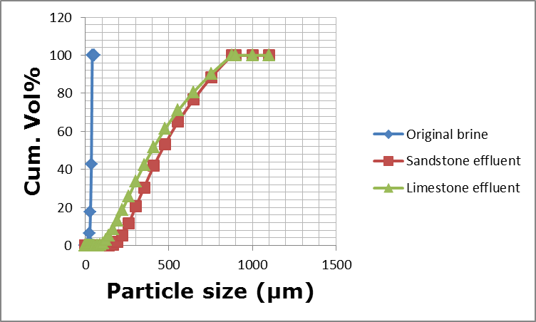
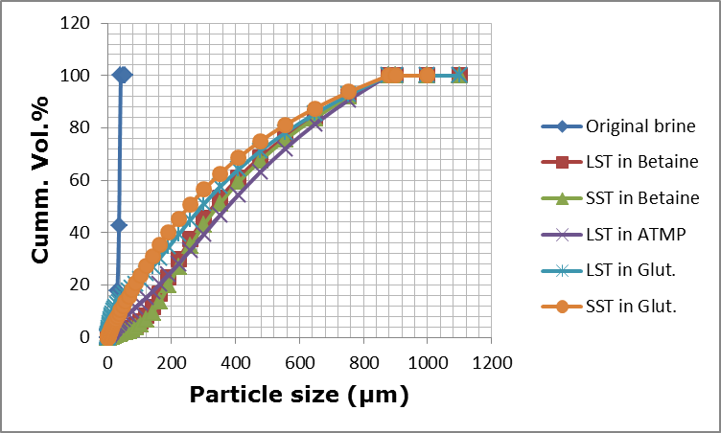
Particle size distributions test
Substantial Particles introduced into the chemicals
Chemical interaction with core materials
Weakening of the cores grain fabrics
Disintegration of the existed grain–to–grain binding
Release and migration of sand grain.

Slide 23
Conclusion
Results clearly suggest that oilfield chemicals application:
Altered the grain fabrics of the reservoir rock.
Weakened the UCS.
Caused fine-grained mineral ass.
Future works.

Slide 24
References
Oluyemi, G.F., 2014. Conceptual Physicochemical Models for Scale Inhibitor-Formation Rock Interaction. Petroleum Science and Technology, 32:3, pp 253 -260.
Seto, M., Engebretson, R.R., VonWandruszka, R., Nag, D.K., Vutukuri, V.S., and Katsuyama, K, (1997). Effect of chemical additives on the strength of sandstone. Int. J. Rock Mech. Min. Sci. Geomech. 34:691.

Slide 25
Thank you
Questions??

