Slide 1



Climate and Vegetation Change in
South Africa and Namibia
in relation to the
Benguela Upwelling System
Lydie Dupont
Enno Schefuß, Florian Rommerskirchen,
Sebastian Hoetzel, Gerlinde Jung, Gesine Mollenhauer
Notes:
Good morning.
I would like to take you to the southwestern part of Africa,
to a period between 10 and 3 Ma,
when Benguela Upwelling was increasing but had not yet reached its modern strength.
I acknowledge my colleagues Enno, Florian, and Gesine, who did the geochemistry,
Sebastian who did pollen and charcoal, and Gerlinde who did the numerical modelling.
I’ll show results of several sites of the Ocean Drilling Program.
Our projects have been financially supported by the DFG.

Slide 2
Benguela Upwelling System (BUS)
geography, importance, development
West South Africa & Namibia
precipitation and vegetation
Notes:
This talk is in two parts.
I’ll start by way of introduction with the importance of Eastern Boundary Currents in general and the Benguela system in particular,
before I continue with the Late Miocene development of this ocean system
and the related developments on the continent.

Slide 3
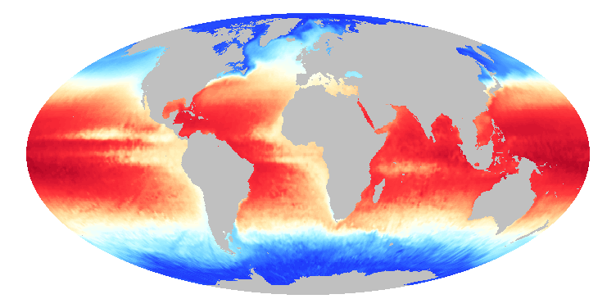
Eastern Boundary Currents
-5
0
10
SST [°C]
20
30
Notes:
Eastern Boundary Currents bring cold surface water from high latitudes to low latitudes and redistribute heat in the ocean.
Moreover, in combination with wind stress, upwelling of cold nutrient-rich sub-surface waters occur in these regions.
I will talk about one of the bigger upwelling systems,
the Benguela Upwelling System or BUS.

Slide 4
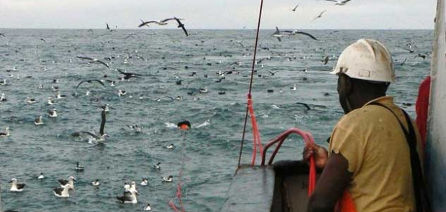
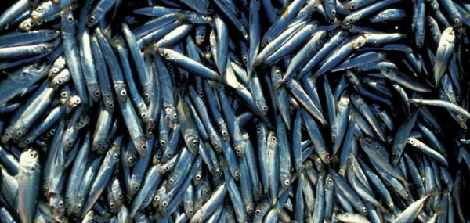
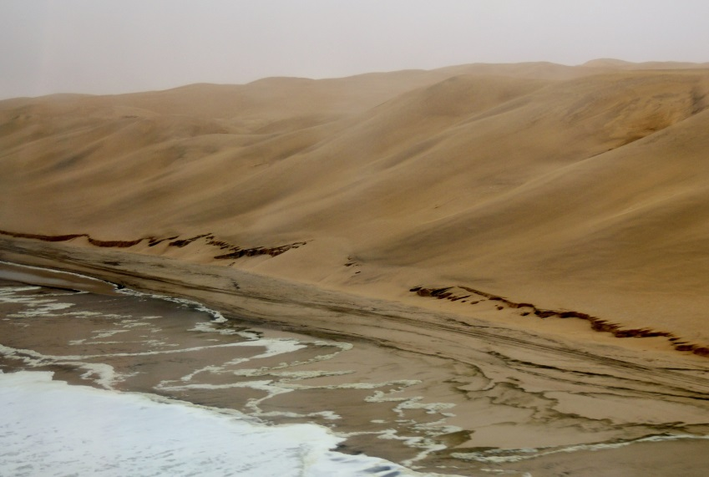
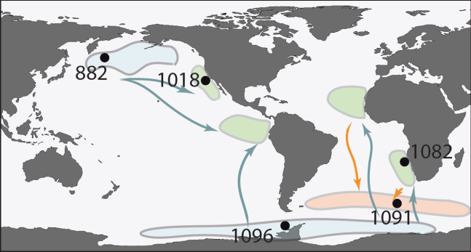
Importance of the Benguela Upwelling System (BUS)
high marine productivity
  CO₂ draw down
  Pleistocene glaciations
coastal aridity
J Paterson
Etourneau et al. 2010, 2012
Robur.q
Notes:
The cold nutrient-rich waters of the Benguela Upwelling System, BUS, are very productive, which is of course important for fisheries.
But it is also important in the uptake and storage of CO2 by the ocean.
High productivity areas capture a lot of carbon,
which is partly stored in organic-rich sediments under the upwelling system.
Therefore, important upwelling areas such as the BUS play a role in global climate
and the development of Pleistocene glaciations.
On the other hand, the cold surface waters cause intense aridity along the coast,
as illustrated by this photo of the Namibian coast.

Slide 5
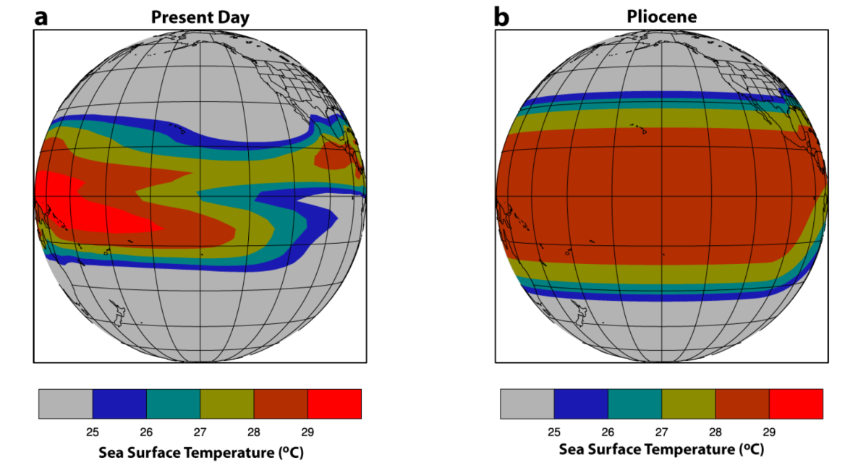
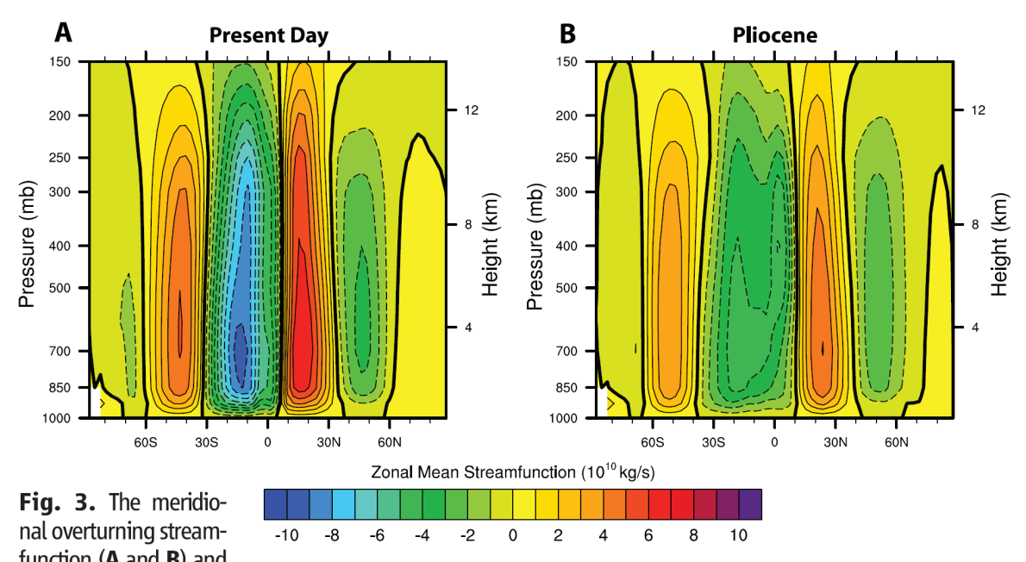
Eastern Boundary Currents driven by meridional SST gradient
Right: Pliocene weaker meridional sea surface temperature gradient results in
weaker and broader atmospheric circulation
weaker Hadley cells
weaker trade winds
weaker Eastern Boundary Currents
weaker upwelling
Brierley et al. 2009
Notes:
It is thought that the Eastern Boundary Currents are driven by
the global sea surface temperature gradient between poles and equator.
The SST gradient influences the atmospheric circulation patterns,
in particular the strength and position of the Hadley Cell.
Modelling compares a Pliocene situation with a weaker SST gradient
and weaker atmospheric circulation cells (right)
to the modern situation with strong Hadley circulation (left).
A strong Hadley circulation results in strong trade winds
and strong trade winds drive the boundary currents and the upwelling.

Slide 6
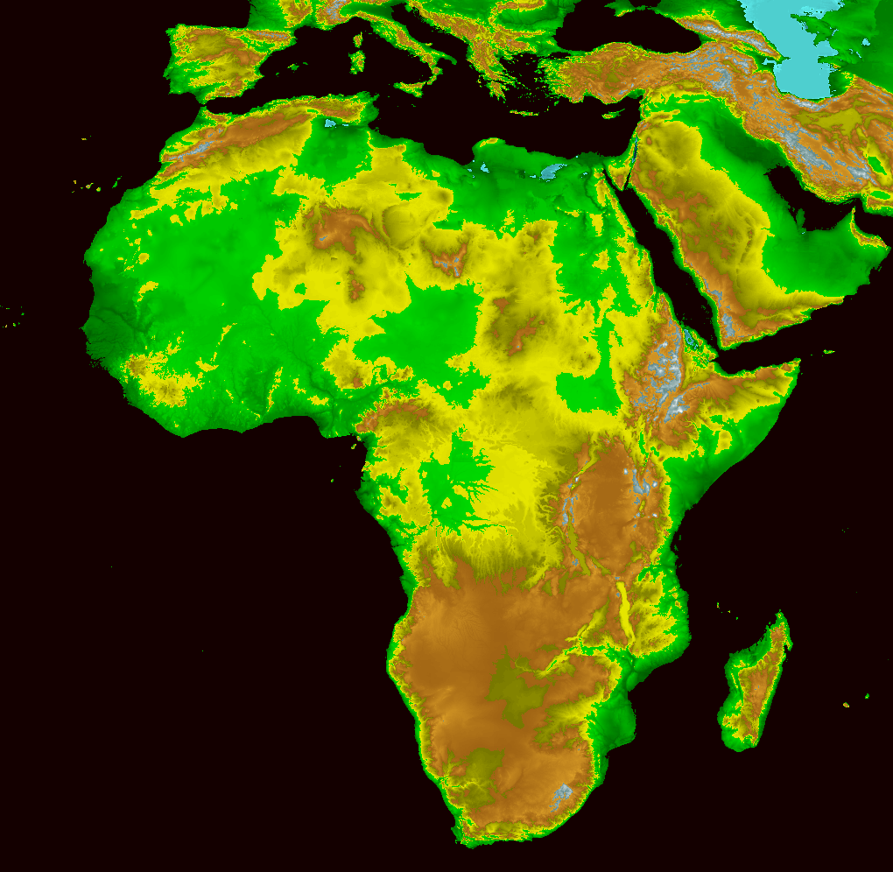
BUS also driven by uplift of southern Africa
Benguela Jet
(trade winds pp)
L
L
H
Notes:
But in Southern Africa another mechanism is also important:
the formation of the mountains in Southern and Eastern Africa,
which occurred for a large part as recently as the Pliocene.

Slide 7
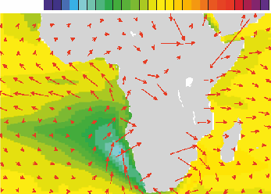
BUS also driven by uplift of southern Africa
2 m/s
-2
-1
0
Δ SST [°C]
Benguela Jet
(trade winds pp)
L
L
H
Benguela Jet
(trade winds pp)
Jung et al., 2014
Notes:
Modelling showed that the uplift of Southern and Eastern Africa,
strengthened the trade winds along the southwest African coast
and the Benguela Jet could develop.
This also strengthened the upwelling of the BUS.

Slide 8
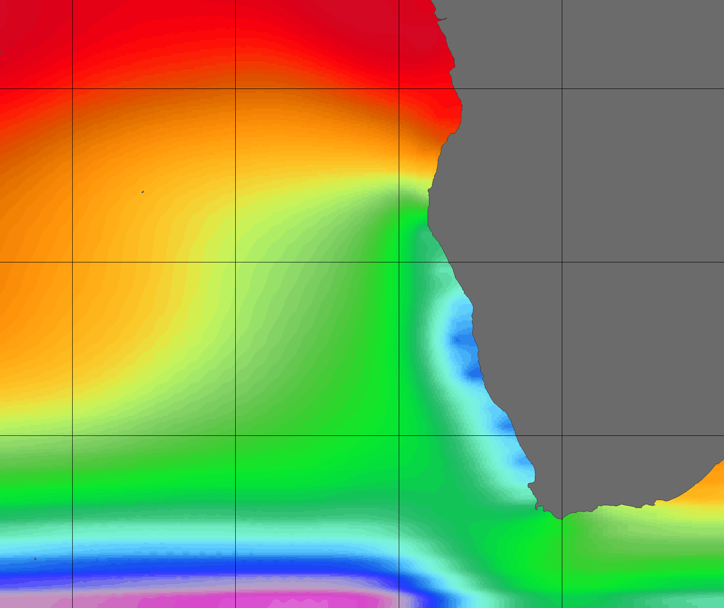
ODP sites record BUS development since 10 Ma
SST
[°C]
10°S
25
20°S
1081
1084
20
BUS
1085
30°S
15
40°S
10°W
0°
10°E
20°E
30°E
Notes:
The Benguela Upwelling System is very clear in the map of modern SSTs
as the blue colored anomaly along the coast.
Thus the development of the BUS since the Miocene can be followed with
the paleotemperature record, estimated at three different sites along the African coast:
ODP Site 1081 at the northern end of the BUS, ca 20°S, in red;
ODP Site 1085 at the southern end of the BUS, ca 30°S, in blue;
and ODP Site 1084 (green) in the middle,
where in modern times upwelling is strongest and SSTs are lowest.
I will keep this color coding throughout the talk.
Site Latitude Longitude
ODP 1081 -19,62 +11,32
ODP 1082 -21,10 +11,82
ODP 1084 -25,51 +13,03
ODP 1085 -29,37 +13,98

Slide 9
SST development of the BUS since 10 Ma
Miocene
Pliocene
,
Pleistocene
26
[°C]
24
26
22
24
20
22
18
20
16
18
14
Sea Surface Temperatures
16
12
Northern BUS, ~20°S
14
10
Middle BUS, ~25°S
12
Southern BUS, ~30°S
10
8
[°C]
8
10
9
8
7
6
5
4
3
2
1
0
age [Ma]
Marlow et al. 2000, Rommerskirchen et al. 2011, Hoetzel et al. 2013, Rosell-Melé et al. 2014
Notes:
This a compilation of sea surface temperatures from several locations.
Time is on the X-Axis running from 10 Ma ago (left) to modern (right).
SST decline was moderate from 10 to 4 Ma in the northern BUS (ODP Site 1081 in red).
After 4 Ma temperature decline accelerated in the northern and middle BUS.
in the southern BUS (blue curve) SSTs were lower during the Miocene and Pliocene.
The youngest – late Pleistocene – blue samples, however, show that
the SST decline in the southern BUS is less strong than further north,
indicating that during the Pleistocene the upwelling became much stronger
in the middle and northern BUS but not so much in the southern BUS.
A shift of upwelling intensity from south to north in the BUS took place.

Slide 10
Benguela Upwelling System (BUS)
geography, importance, development
West South Africa & Namibia
precipitation and vegetation
Notes:
So far about the ocean.
I now switch to the development of precipitation and vegetation on the continent

Slide 11
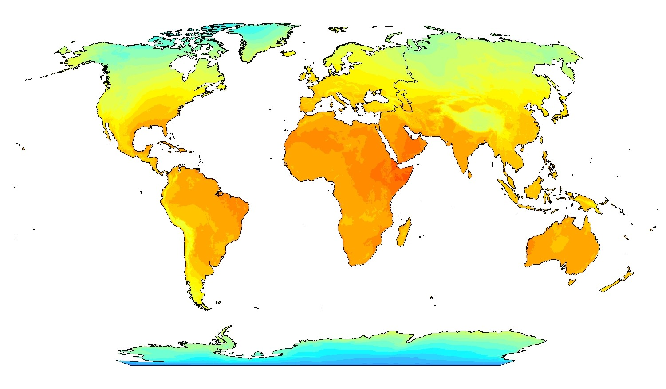
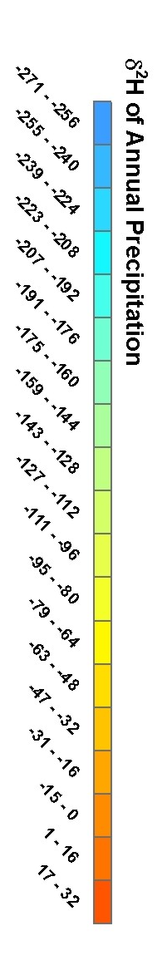
Deuterium in precipitation
Temperature effect
Continent effect
Amount effect
Altitude effect
Bowen & Revenaugh, 2003
Notes:
We estimated continental paleoprecipitation using Deuterium from higher plant wax,
which depends on evapotranspiration and on the isotopic composition of the rain.
Here is a global map of the Deuterium in precipitation
expressed relative to mean ocean water.
Rain has its ultimate source as vapor from the ocean but is altered in mainly four ways.
The Temperature effect is
the strong depletion in Deuterium of rain at low temperatures (blue at high latitudes).
The Altitude effect is
the depletion in Deuterium of rain in the mountains (for instance yellow along the Andes).
The Continent effect is
the depletion in Deuterium of rain that has traveled far into the continent;
see the gradient in North America. This effect also takes place in southern Africa.
Thus, almost everywhere the Deuterium value of rain is negative relative to ocean water.
Only the Amount effect enriches rain in Deuterium when aridity increases.
The last two effects are important for our study.

Slide 12
Development of continental precipitation
Miocene
Pliocene
,
Pleistocene
26
24
22
20
18
-170
Deuterium of plant wax
16
Amount
Continent
14
-160
12
-150
10
δD
[‰]
8
[°C]
10
9
8
7
6
5
4
3
2
1
0
age [Ma]
Marlow et al. 2000, Rommerskirchen et al. 2011, Dupont et al. 2013, Hoetzel et al. 2013, Rosell-Melé et al. 2014
Notes:
Back to the Benguela System and west southern Africa.
We estimated continental paleoprecipitation by Deuterium from higher plant wax measured on sediments of ODP Site 1085, under the southern BUS.
Upward, to more negative values, you see the Continent effect.
We surmise that before 7 Ma most rain came from the Atlantic Ocean,
but then the source shifted and after 4.5 Ma most rain came from the Indian Ocean.
On the other hand,
if aridity increases, Deuterium values become less negative by the Amount effect,
whereby the effect of increased evapotranspiration enhances the effect of aridity.
The brown arrow indicates increasing aridity.
Until the beginning of the Pleistocene, I recognize three periods.
Between 8 and 7 Ma the region became drier.
Between 7 and 4.5 Ma the region still became drier
as the source of the rain shifted from the Atlantic to the Indian Ocean.
However, rain became more depleted in Deuterium
because of its longer path over the continent.
After 4.5 Ma the aridity trend continued,
while the rain originated in the Indian Ocean.

Slide 13
Vegetation development
northern BUS
southern BUS
2
tropical element
Petalidium
0
-170
-160
[% pollen]
Deuterium
-150
8
δD
[‰]
fynbos element
Stoebe/Elytropappus
4
0
10
9
8
7
6
5
4
3
2
1
0
age [Ma]
Dupont et al. 2011, 2013, Hoetzel et al. 2013, 2015
Notes:
Changes in the vegetation are indicated by
changes in the pollen abundance of specific plants.
During the period between 7 and 4.5 Ma,
when the source of rain shifted to the Indian Ocean,
pollen from Petalidium indicates that the tropical vegetation declined
in Namibia and the Western Cape (upper curves),
while an extra-tropical fynbos related vegetation developed in west South Africa,
which is here illustrated by the pollen percentages of renosterbos (lower curve).

Slide 14
10
9
8
7
6
5
4
3
2
1
0
4
tropical element
Petalidium
[% pollen]
2
0
80
grass
60
northern BUS
[% pollen]
southern BUS
40
20
Dupont et al. 2011, 2013, Hoetzel et al. 2013, 2015
0
15
8
fynbos element
Stoebe/Elytropappus
[% pollen]
4
0
10
9
8
7
6
5
4
3
2
1
0
age [Ma]
Petalidium
Petalidium
grass
grass
mountain/fynbos:
mountain/fynbos:
Stoebe/Elytropappus
Stoebe/Elytropappus
Notes:
Somewhat earlier, since 8.5 Ma, open grass-rich vegetation,
as indicated by the high percentages of grass pollen,
became more and more important in both Namibia and South Africa.

Slide 15
Savanna development
southern BUS
-25
[‰]
-27
C₄
plants
δ
13
C
wax
-29
50
-31
40
[% pollen]
30
grass
20
10
10
9
8
7
6
5
4
3
0.5
age [Ma]
Dupont et al. 2013
Notes:
When we compare pollen percentages with the stable carbon isotope signature of plant wax,
here from the core under the southern BUS,
we see not only an increase in grasses but also an increase in C4 plants,
which we interpret as the increase in C4 grasses.
We might see here the earliest C4 savanna in west southern Africa.

Slide 16
10
9
8
7
6
5
4
3
0.5
northern BUS
-22
C₃₃
-24
C₄ plants
-26
[‰]
C₃₁
δ
13
C
-28
wax
80
-30
grass
60
[% pollen]
10
40
[% pollen]
desert
0
10
9
8
7
6
5
4
3
0.5
age [Ma]
Hoetzel et al. 2013, 2015
Notes:
We see this development in Namibia, too, as shown by records from the northern BUS.
Development of grasslands since 8.5 Ma and
somewhat later the development of C4 savanna, since 7.5 Ma.
However, after 4.5 Ma grasses became less abundant
while the amount of C4 plants in the vegetation further rose,
which we attribute to an increase in desert vegetation
when aridity further increased.

Slide 17
10
9
8
7
6
5
4
3
0.5
northern BUS
-22
C₃₃
-24
C₄ plants
-26
[‰]
C₃₁
δ
13
C
-28
wax
80
-30
grass
60
[% pollen]
1.2
40
0.8
charcoal
[particles/pollen]
0.4
0
10
9
8
7
6
5
4
3
0.5
age [Ma]
Hoetzel et al. 2013
Notes:
We also could show that the development of C4 savanna in Namibia
was accompanied by increased amounts of charcoal (lower curve).
Grasses and especially C4 grasses would have promoted the spread of fire,
which in turn would have promoted C4 grasses.
Fire activity got less after 5.5 Ma,
when the spread of C4 savanna halted and desert vegetation increased.
Then the amount of fuel decreased and so did the fire activity.

Slide 18
Summary
8.5 - 7 Ma: increased aridity, retreat tropical vegetation elements, expansion C₃ grasses
7 - 4.5 Ma: shift of the precipitation source to the Indian Ocean, further increase in aridity, expansion C₄ grasses/savannas, increased fire activity
4.5 - 3 Ma: further increase in aridity, development of winter rain vegetation, retreat savannas, increase desert vegetation
After 2.7 Ma: strong decline in SST, development of the intense upwelling in the middle BUS
Thank you for your attention
Notes:
In summary,
three large changes in west southern Africa can be recognized
during the late Miocene and Pliocene stages of the BUS.
Retreat of the tropical vegetation and expansion of C3 grasses
between 8.5 and 7 Ma.
Expansion of C4 savannas and increased fires,
when the source pf precipitation shifted from the Atlantic to the Indian Ocean.
Retreat of savanna, the development of extra-tropical vegetation (fynbos),
expansion of the desert since 4.5 Ma.
It is remarkable
that these developments took already place in the earliest stages of the BUS
and that only thereafter, during the Pleistocene, SSTs strongly declined.
Thank you for your attention.

Slide 19
References
Bowen GJ, Revenaugh J, 2003. Interpolating the isotopic composition of modern meteoric precipitation. Water Resources research, 39, 1299. doi:10.1029/2003WR002086.
Brierley CM, Fedorov AV, Liu Z, Herbert TH, Lawrence KT, Lariviere JP, 2009. Greatly Expanded Tropical Warm Pool and Weakened Hadley Circulation in the Early Pliocene. Science, 323: 1714-1718.
Dupont LM, Linder HP, Rommerskirchen F, Schefuß E, 2011. Climate-driven rampant speciation of the Cape flora. Journal of Biogeography, 38: 1059–1068.
Dupont LM, Rommerskirchen F, Mollenhauer G, Schefuß E, 2013. Miocene to Pliocene changes in South African hydrology and vegetation in relation to the expansion of C4 plants. Earth and Planetary Science Letters, 375: 408-417.
Etourneau J, Schneider RR, Blanz T, Martinez P, 2010. Intensification of the Walker and Hadley atmospheric circulations during the Pliocene–Pleistocene climate transition. Earth and Planetary Science Letters, 297: 103-110.
Etourneau J, Ehlert C, Frank M, Martinez P, Schneider RR, 2012. Contribution of changes in opal productivity and nutrient distribution in the coastal upwelling systems to Late Pliocene/Early Pleistocene climate cooling. Climate of the Past, 8: 1435-1445.
Hoetzel S, Dupont LM, Schefuß E, Rommerskirchen F, Wefer G, 2013. The role of fire in Miocene to Pliocene C4 grassland and ecosystem evolution. Nature Geoscience, 6: 1027-1030.
Hoetzel S, Dupont LM, Wefer G, 2015. Miocene–Pliocene vegetation change in south-western Africa (ODP Site 1081, offshore Namibia). Palaeogeography, Palaeoclimatology, Palaeoecology, 423: 102-108.
Jung G, Prange M, Schulz M, 2014. Uplift of Africa as a potential cause for Neogene intensification of the Benguela upwelling system. Nature Geoscience, 7: 741-747.
Marlow JR, Lange CB, Wefer G, Rosell-Melé A, 2000. Upwelling intensification as part of the Pliocene-Pleistocene climate transition. Science, 290: 2288-2291.
Rommerskirchen F, Condon T, Mollenhauer G, Dupont LM, Schefuß E, 2011. Miocene to Pliocene development of surface and sub-surface temperatures in the Benguela Current System. Paleoceanography, 26, PA3216. doi:10.1029/2010PA002074.
Rosell-Melé A, Martinéz-Garcia A, McClamont EL, 2014. Persistent warmth across the Benguela upwelling system during the Pliocene epoch. Earth and Planetary Science Letters, 386: 10-20.
Notes:
References mentioned in the presentation.

