Slide 1
ONYX FROM AIN SMARA (NORTH- EASTERN ALGERIA): A NATURAL STONE TO BE CONSIDERED AS A GLOBAL HERITAGE STONE
By
Diab Hamida Engineer in sedimentary geology National Office of Geological and Mining Research (ORGM) Tebessa-Algeria diabhamida@rocketmail.com

Slide 2
GENERALITY

Slide 3
DEFINITION
The name of "Onyx" seems to have come from the Greek word Onux, which means finger nail or claw. This term is occasionally used to described any engraved stone with a solid color base, or it may describe any banded gemstone with parallel banding. Onyx can be classified according to the chemical formula into two basic types; cryptocrystalline quartz « chalcedony », or calcareous « Marble Onyx » , We find it banded with a variety of colors, white, milk-white, yellowish, reddish, brownish…

Slide 4
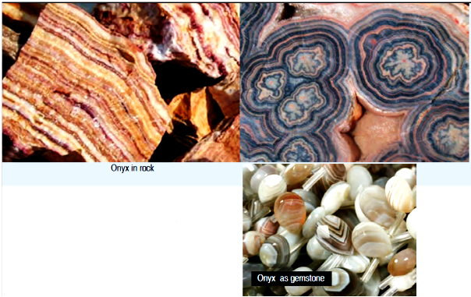
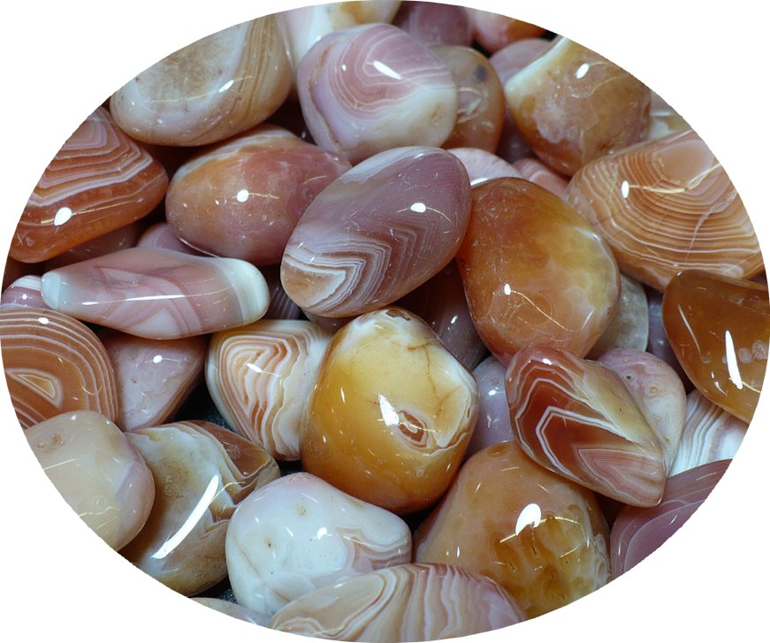

Slide 5
TYPES OF ONYX
siliceous (Onyx stone, 99 % SiO₂)
Onyx stone is the familiar one consisting of cryptocrystalline quartz (chalcedony), it has a hardness of 7 and hexagonal habit. it’s specified as a parallel banded chalcedony. Onyx stone is commonly used in the ornaments like necklaces, rings, ear-rings, brooches, and many other jewellery pieces.
Onyx stone is widely used as an astrological gemstone and believed that this gemstone eliminates negative thinking in the wearer and also protects from negative influences and forces. This stone is good for those who are under stress and especially for those who have trouble sleeping.

Slide 6
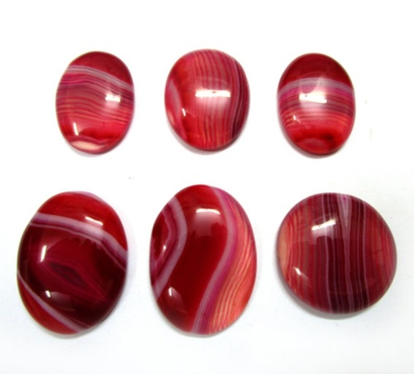
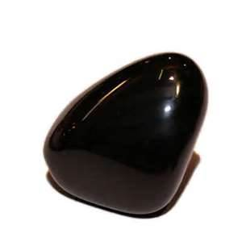
Siliceous Onyx (chalcedony)

Slide 7
Calcareous Onyx (Marble Onyx, 99 % CaCo₃)
characterized by banded, translucent and capable of being polished to a high gloss. This type originates in the drip stone deposits of limestone caverns where it forms stalactites, stalagmites, and other formations that can fill an entire cavern or void space. It is deposited by gentle, dripping water movement followed by evaporation between drops that deposits calcium carbonate from the water onto the formation, incrementally enlarging formations by thousandths of an inch or less per drop. Calcareous Onyx is also a chemical sedimentary stone, and may envelop terrestrial fossil remains. The Onyx found in Ain Smara it’s a Calcareous Onyx

Slide 8
Marble onyx can be classified according to the color into three types;
Multi colored onyx: ranged from pale green with little veining or variation in color to something reminiscent of a wild abstract painting.
Honey colored onyx: ranged from swirly to striped to mottled and the color ranges from palewhitish/yellow to a brownish/yellow.
White onyx: ranged from partially white with yellow, reddish or rusty colored veining to the very rare almost pure white.
Marble onyx is chiefly used in making various decorative items, monuments and internal decoration of houses.

Slide 9
Brown and White Onyx,
White Onyx
Calcareous Onyx
(Marble Onyx)
Multi colored Onyx
Green Onyx

Slide 10
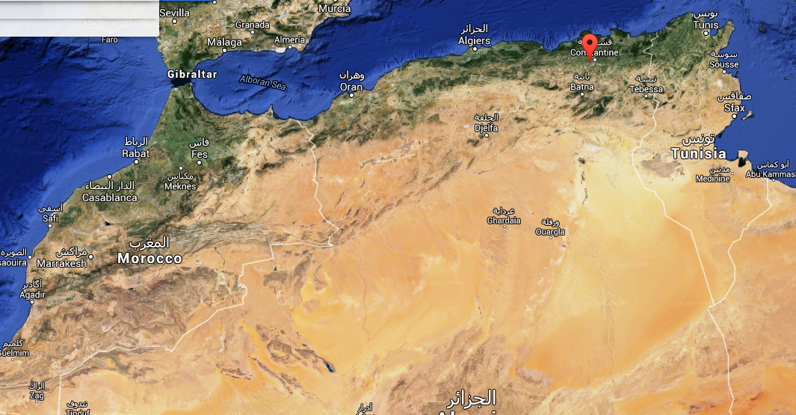
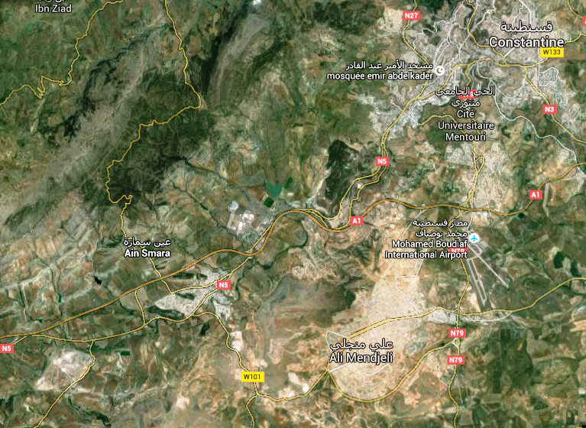
ONYX AIN SMARA:
GEOGRAPHICAL LOCATION
Ain Smara deposit located about 18 km Southwestern of Constantine City, Northeastern of Algeria, over than ​​1200 m².

Slide 11
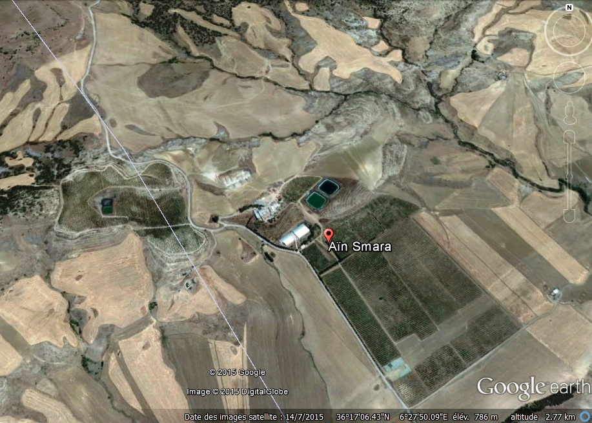
DEPOSIT AIN SMARA

Slide 12
GEOLOGY OF AIN SMARA:
Ain Smara area was separated to two geological units:
Anticline of jebel Sidi salem, jebel sekoum- Rmmam, and jebel Felten
(jebel = Mountain)
2. Syncline chettaabas.
Ain Smara area is constituted by deposits belonging to lower cretaceous and middle cretaceous, upper cretaceous, tertiary and quaternary.

Slide 13
a-Lower Cretaceous: represented only by the Aptian, composed of limestone with orbitolines.
b-Middle Cretaceous (Albian): Limestones with fragments of Ammonites.
c-Cenomanian: it is characterized by fine limestone, alternating with marl and calcareous marl at the base, interruptions of dolomitic limestone with calcareous crystallized rudist, and calcareous with orbitolines at the upper part.
d-Upper Cretaceous:
1-Emschérian: outcrops only in the chettaabas syncline where it is constituted by laminate hard limestone and schistose marl.
2-Campanian: schistose marl with calcareous marl intercalation.
3-Maastrichtian: limestone, with marl intercalations.

Slide 14
e. Tertiary:
1-Lower Eocene - lower Lutetian: hard laminate limestone alternating with layers of marl.
2-Upper Lutetian: brown limestone with blue marl
3-Priabonian-Oligocene: green marl sometimes reddish-blue.
4-Neogene - upper Miocene: developed in two facies :
- Sandstone facies, conglomerate, limestone
- Marl and limestone facies, gray marl with limestone
5-Pliocene-villafranchien: reddish marls and grey dolomitic limestones
f. Quaternary: alluvial stone, gravel , feebly cemented conglomerates.

Slide 15
GEOLOGY AND GENESIS OF DEPOSIT AIN SMARA
There are several types of « marble Onyx » in Algeria but the best known and most used is the one that comes from Ain Smara.
Ain Smara affect by deep faults trending NS, 70-95° inclinations, after which the synclinal subsidence was take place. Outside this tectonic line in the calcareous anticline, a system of intense transverse faults with NS and NNW-SSE direction which creates tectonic compartment Sidi Rmamm.
The magmatic activity of the late Pliocene, which powerfully manifested on the southern river of the Mediterranean Sea have been here a deeper surface activity manifesting itself only by hydrothermal mineralization as a result of the circulation of aqueous solutions in these epithermal deep faults.

Slide 16
This hypothesis is confirmed by the length of the main fractures of the mass of calcareous veins with Pb and Zn mineralization. The minerals of these veins (galène- PbS, sphalerite ZnS, smithsonite CO₃ Zn, Pb, cerusite CO₃, calamine Zn (OH) 2 Si₂ O₇, Aragonite and Calcite Ca CO₃), and their capacity limestone, show a contact hydrothermal métasomtisation of the epithermal phase.
The magmatic phase are continued in the Quaternary and the epithermal acidic waters, low temperature and low concentration of metallic minerals which completely lack the minerals, are continued to come out to the surface through cracks from various parts of the zone. They are reacted with limestone depositing the last metallic minerals and dissolving CaCO₃. By decreased pressure, the phenomenon that favored the deposition of Ca Co3 on the walls of the fault as aragonite and calcite.

Slide 17
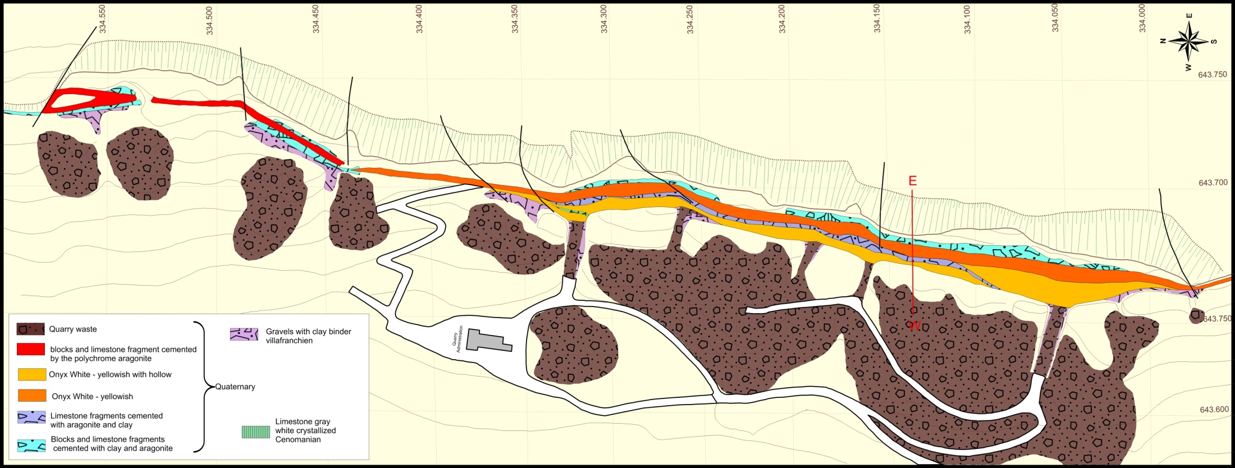
The deposit Onyx Ain Smara was formed under the same conditions. Aqueous solutions of low temperature hydrothermal circulated through the open fault that separates the limestone massif of jebel Sekoum west to the déprissions of Sidi Rmmam, filing the form of aragonite CaCO₃. Deposits are made successively in the walls of faults until the middle. This filling phenomenon gave birth to a tabular form vein.
Onyx massif
Onyx with hollow
Geological sketch of deposit Ain Smara

Slide 18
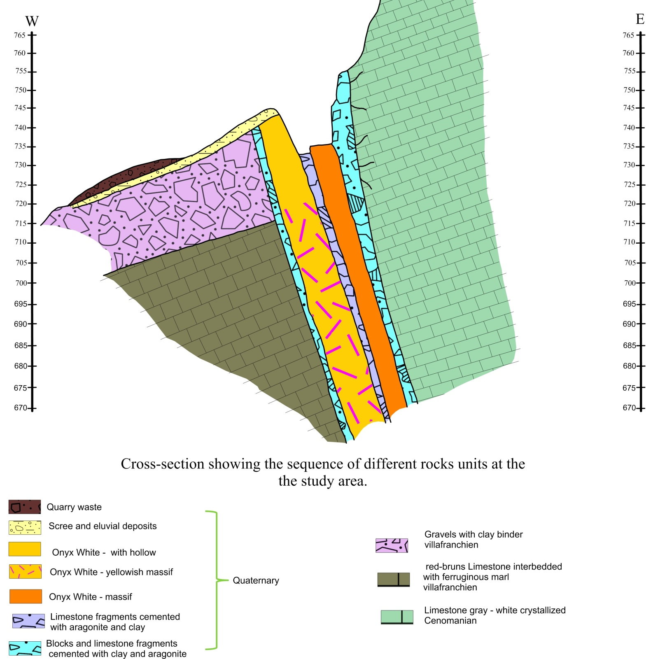
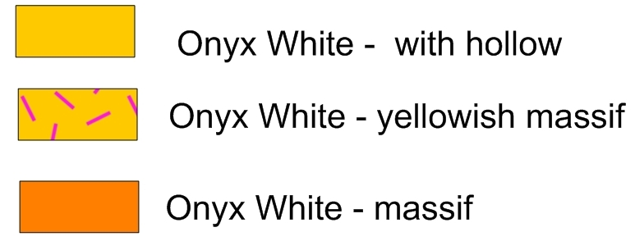

Slide 19
CHEMICAL COMPOSITION, TEXTURE, STRUCTURE AND COLOR OF ONYX AIN SMARA
Marble Onyx Ain smara is composed of microcrystalline to coarse calcite and, more by aragonite. The microcrystals occur as a fibrous or a lamellar texture. The rock is organized in translucent banded horizons with different colors depending on variable amounts of impurities like iron oxides. It is frequently yellow-brown due to the presence of iron oxides, but there are also whitish, light to dark yellow, honey colored, amber, red. Band contacts range from sharp to vague and massive structure is less common. The Moh’s hardness of onyx marble Ain Smara is 3 with aragonite varieties slightly harder than calcite varieties.

Slide 20
VARIETIES OF ONYX AIN SMARA AND CHARACTERISTICS
Based on conditions of deposits, density of hollows and textures, we can be separateed two types of onyx in Ain Smara
1- Onyx massif
Often seen as an expensive material and used especially in architecture and sculpture. This type has many application uses as in houses, ancient palaces, including staircases, fireplaces and statues and utensils. It has the following features;
- High compacted
- White, yellowish-white and yellowish-cream in color
- Chemical composition :(CaCO₃ 99.4%, MgO 0.77%, Fe₂O₃ 0.03% &Al₂O₃ 0.19%).
- Mineralogical compostion; (Aragonite 99.9%, iron oxide less than 0.1%)
- Structure: predominant microcrystalline
- Texture: parallel, undulating

Slide 21
2. Onyx with hollow:
The variety of onyx with hollow can be used for the production of mosaic tiles and percentage reduced to making plywood with low quality. It has the features as;
-High compacted
- White, yellowish-white, yellowish-cream, and yellowish brown in color
- Chemical composition; (CaCO₃ 99.34%, MgO 0.85%, CaO 54.92%, Fe₂O₃ 0.02%, Al₂O₃ 0.12% & SiO₂ 0.053).
- Structure: microcrystalline
- Texture: parallel corrugated and interspersed with hollow geodes dimentions (0, 5mm until 10-15 cm in diameter ) .

Slide 22
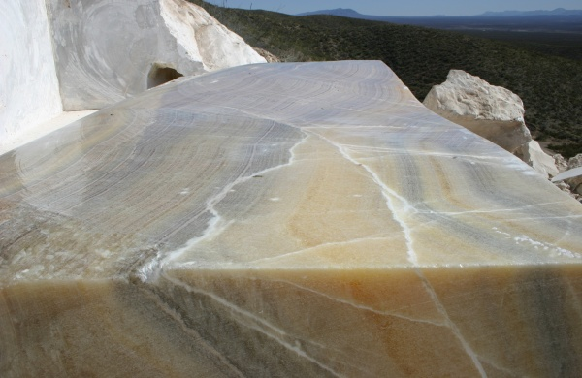
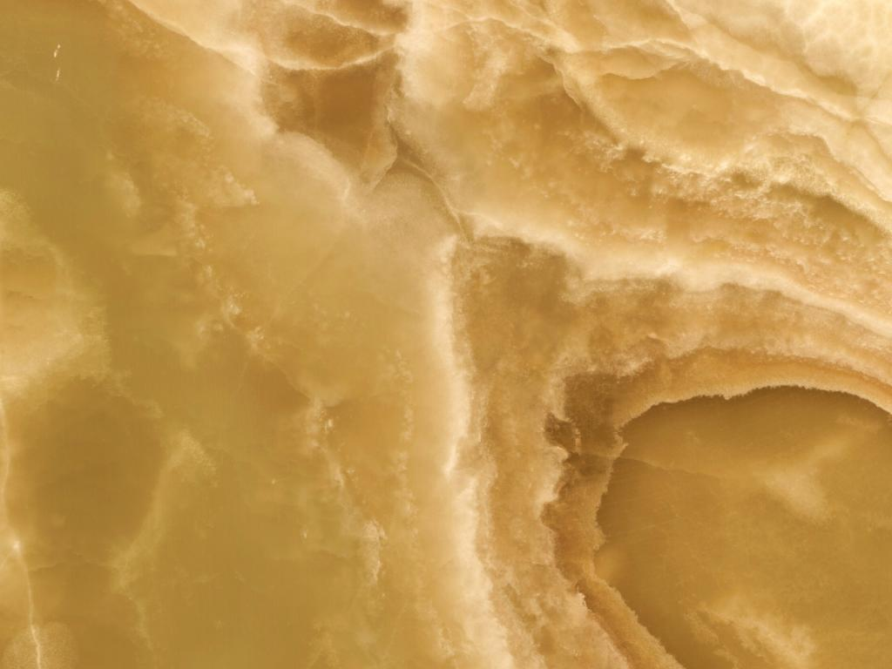
Onyx massif
Onyx with hollow

Slide 23
EXPLOITATION OF ONYX AIN SMARA
The operating activity in Ain Smara is divided into three (3) parts:
1st part is the period of the Roman Empire (until 680 JC), which evidenced by the remains that are discovered in the area (slices with depths of up to 25m, of Roman art objects carved in onyx ... .etc).
2nd part is the period of French colonial rule (1930 -1962), which after the period of the Roman Empire, the information showing that there are no activity in Ain Smara, except the extraction that used for some restoration work that has affected several important sites throughout the world, including the White House in 1914 and Rockefeller Center, also found several archaeological sites in Tunisia, particularly El Kef, Kairouan, Carthage, and in Italy, until the French colonial rule, when the operating activity is began again from 1882 until 1962.
3rd part is the period after the national independence of Algeria (1962 - present): The extraction of Onyx is continued.

Slide 24
THE TECHNIQUES USED FOR EXPLOITATION OF ONYX AIN SMARA
Ain Smara it a vein deposit (simple filling vein with great detention in direction and depth) . The first method which describe in Ain smara is the use of drilling -blasting work and the second is use of diamond wire and cutting machines. The extraction of onyx blocks from the hard rock mass is done in this way:
1. Drilling (Fig. 1).
2.Blasting
3. Block excavation by the use of Diamond wire saw Fig 2 (a and b).
4. Block excavation by the use of cutting machines

Slide 25
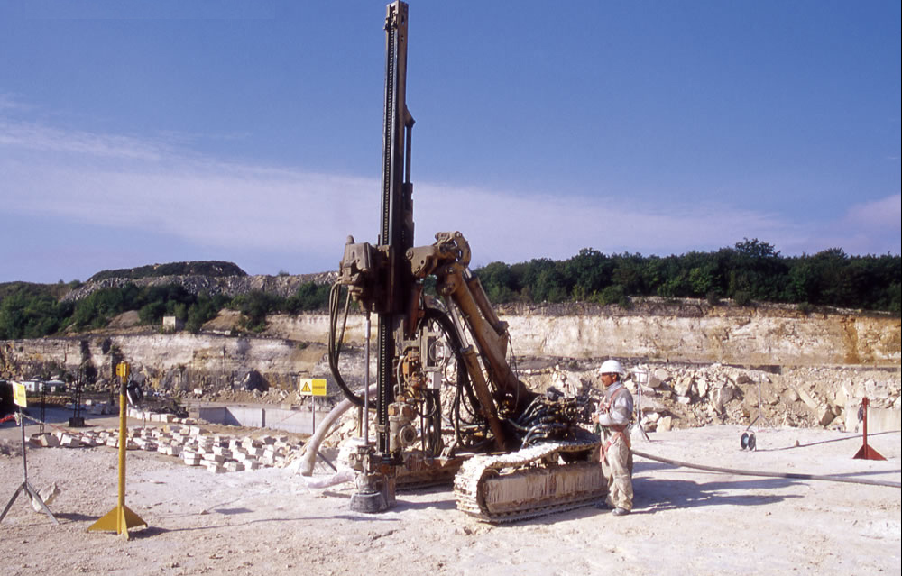
Fig 1 : Pattern of vertical and
horizontal drill holes and way of initiation

Slide 26
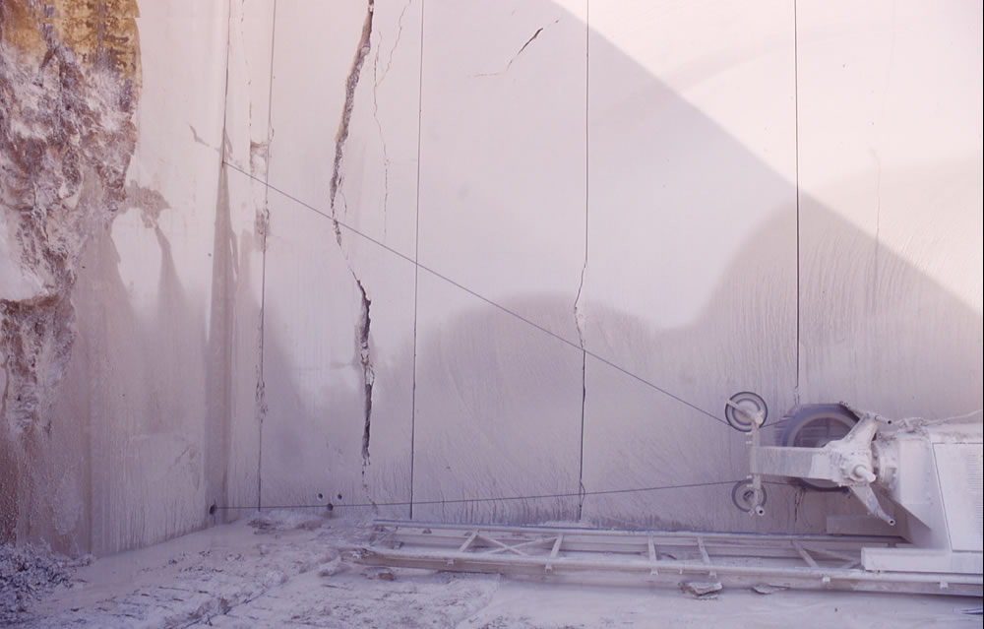
Figure 2. Preparing of drill holes for cutting, (a) Cutting of horizontal , and vertical , cuts with diamond wire (b)

Slide 27
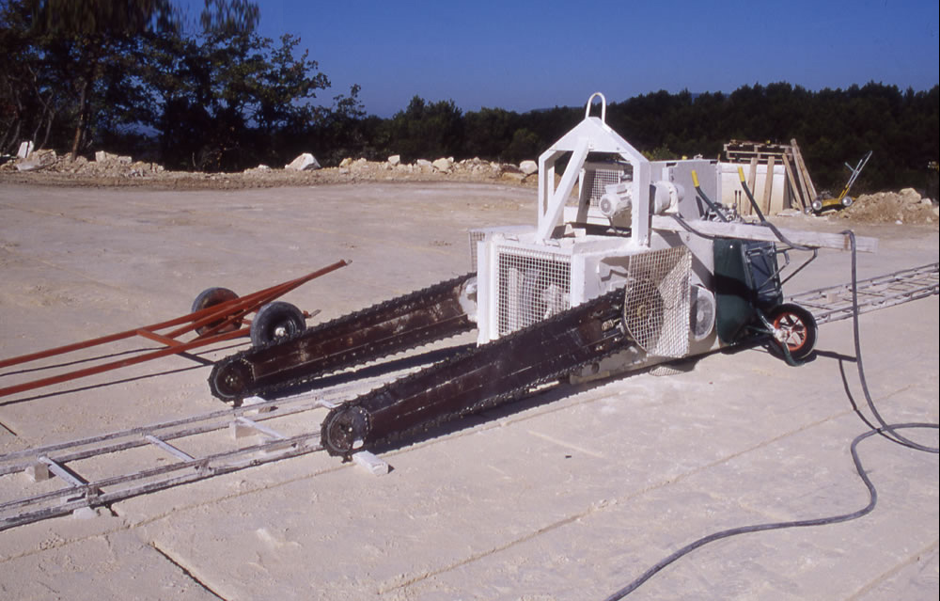
Figure 3. Cutting an vertical
cut with cutting machine

Slide 28
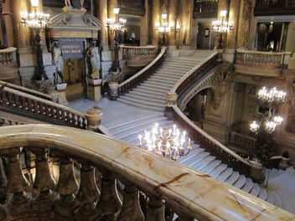
SOME PICTURES OF ONYX AIN SMARA
USED AROUND OF THE WORLD
The Onyx staircase ramp from the Opera « Garnier » , Paris.1878

Slide 29
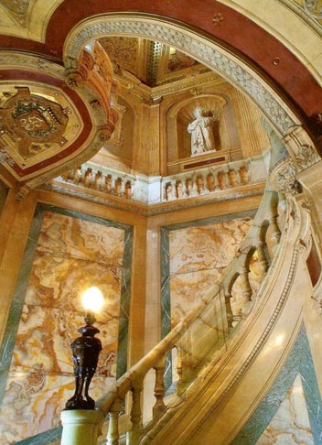
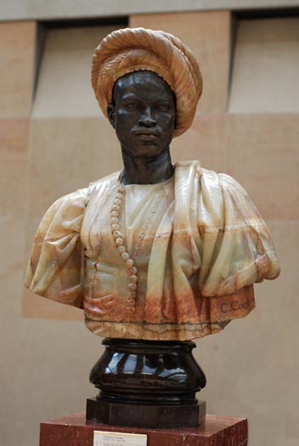
The onyx staircase of the
Hotel “La Paiva” , Paris.
The Negro of the Sudan,
sculpture Charles Cordier. 1899

Slide 30

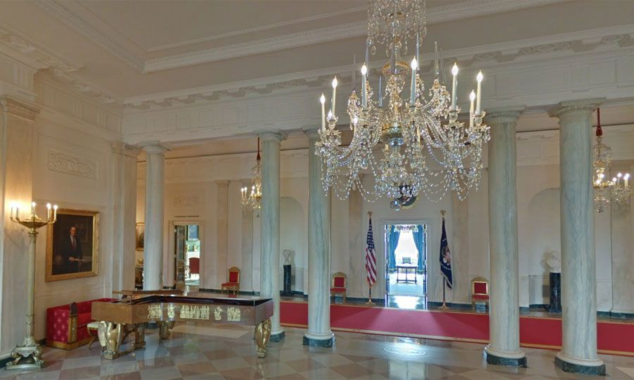
Restauration of The white house 1814
Ernest Barrias , La Nature se dévoilant
devant la Science 1899

Slide 31

St. Augustine's Basilica ,Annaba ,
Algeria 1842
albert-ernest carrier-belleuse
sculpture , 1824 - 1887

Slide 32
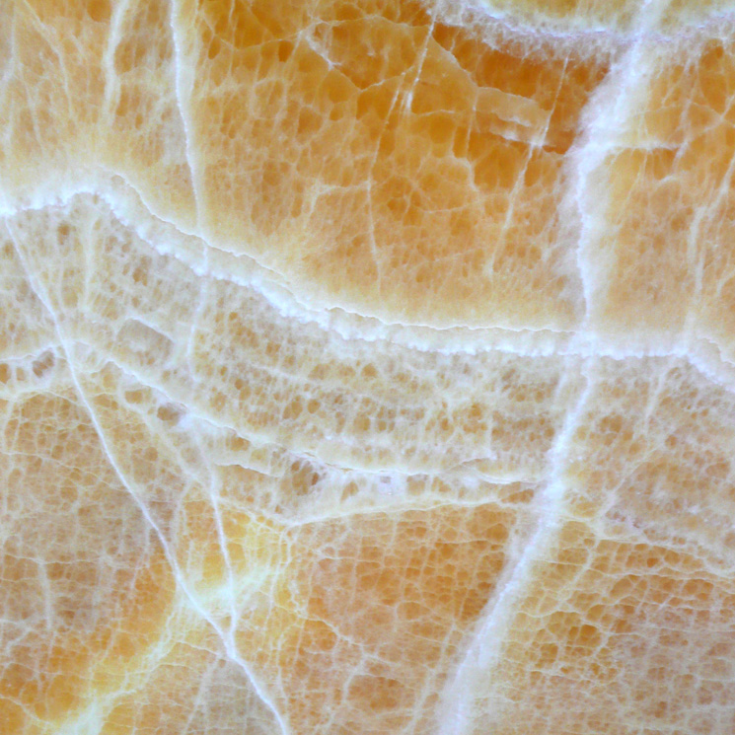
THANK YOU FOR YOUR
ATTENTION

