Slide 1
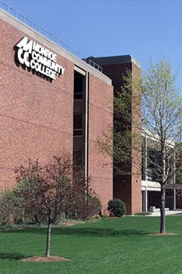
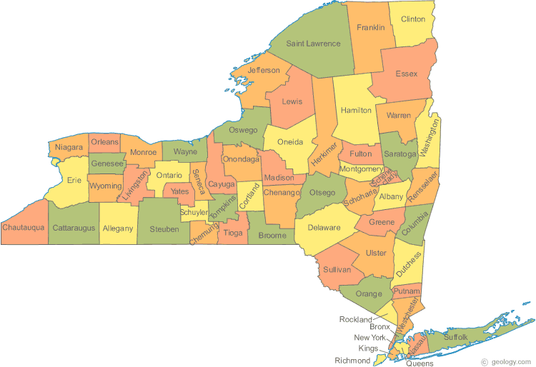

THE STUDENT BECOMES THE TEACHER: Utilizing Teaching Assistants in a 2YC Classroom to Improve Understanding and Increase Retention Prior to Transfer
Amanda Colosimo
Jessica Barone
Monroe Community College
Department of Chemistry and Geosciences

Slide 2
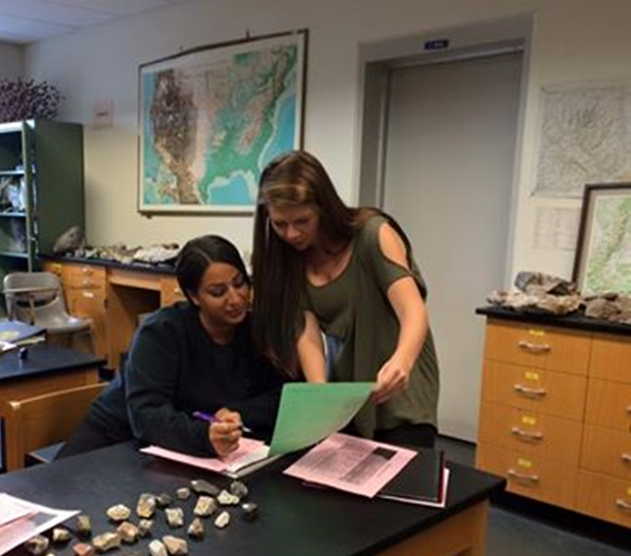
Project Overview
Teaching Assistantship in Physical Geology lab:
1-semester; 2-credit independent study
Surprise pre-test and post-test
Attend weekly pre-laboratory prep meetings
Attend weekly 3-hour lab meeting
Complete post-lab summary
Hold a weekly tutoring hour

Slide 3
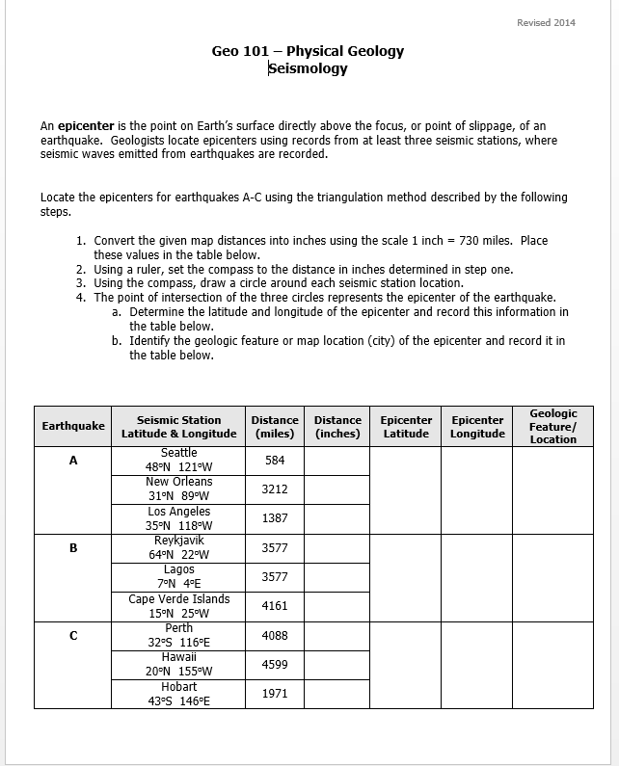
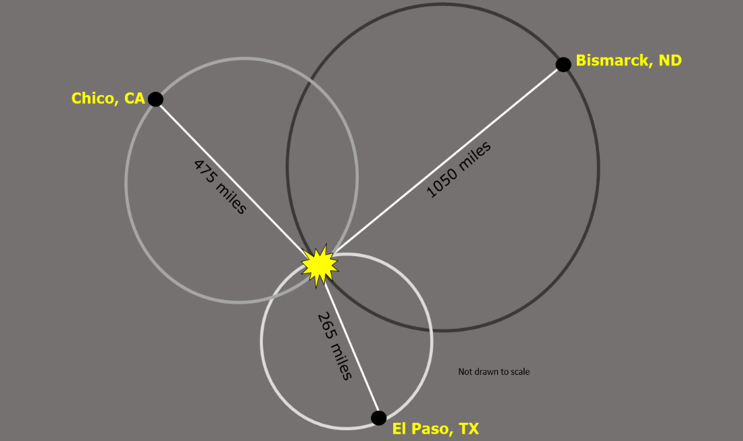
Project Overview
Prepare and teach a Seismology lesson

Slide 4
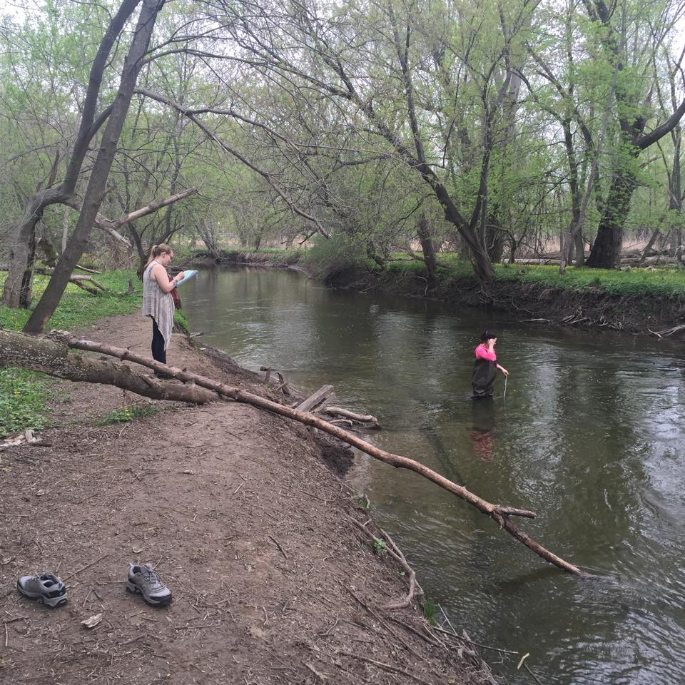
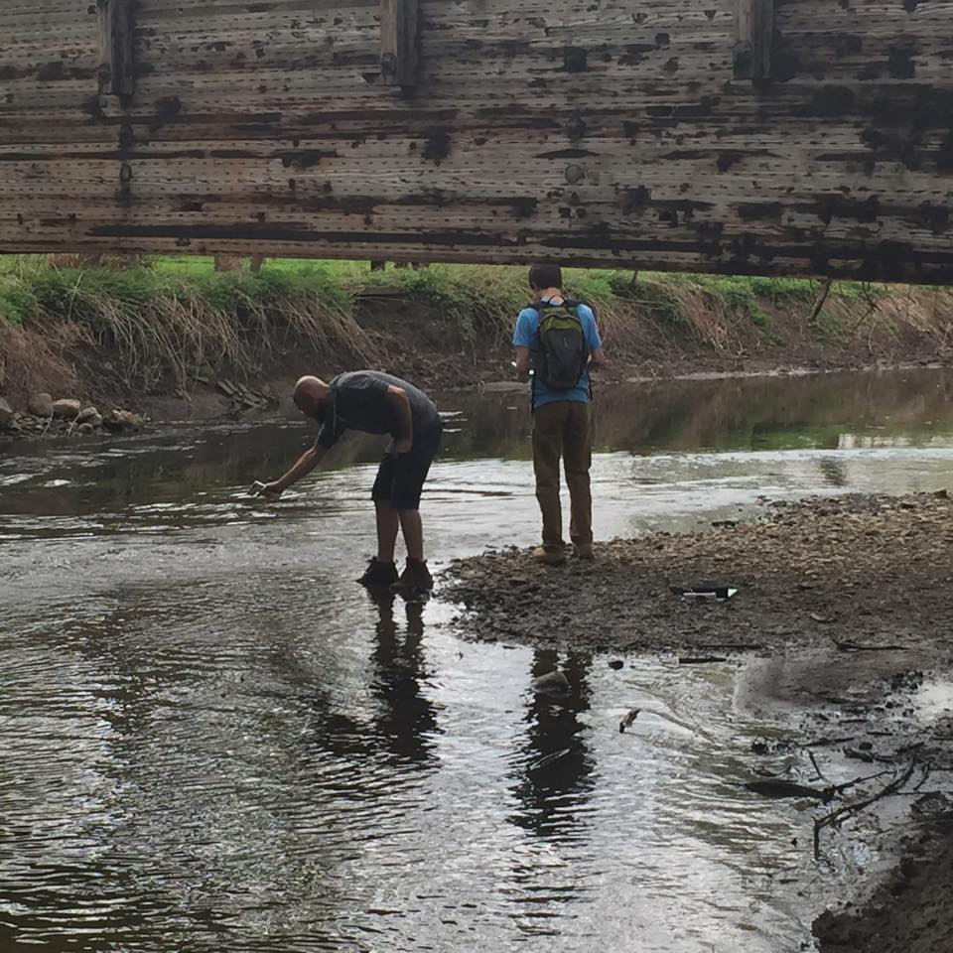
Project Overview
Co-lead two field trips
Write a final reflection paper
Option to present a poster at GSA

Slide 5
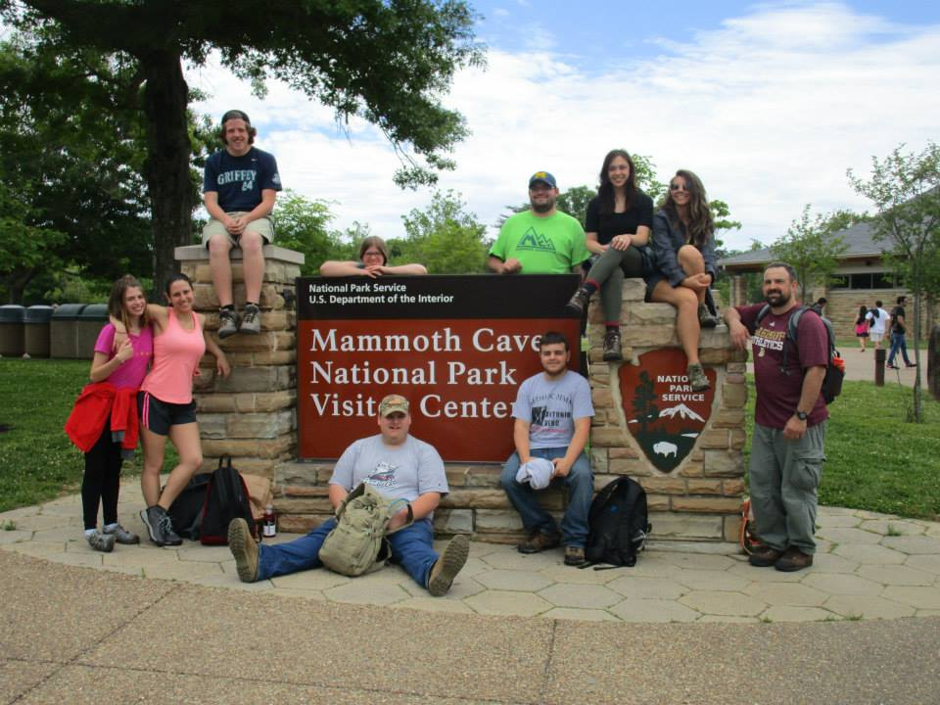
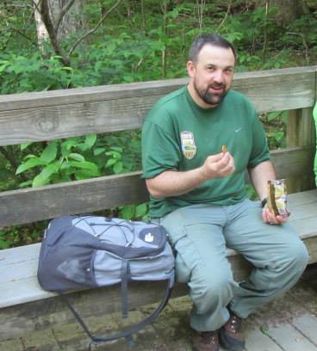
The Students
Jeremy
Returning adult student after job-related disability
Physical Geology, Mineralogy

Slide 6
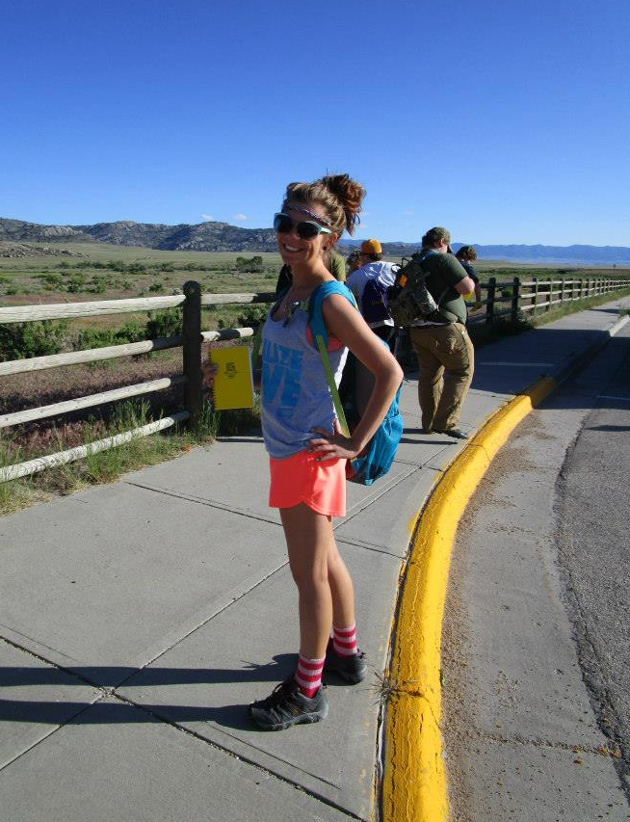
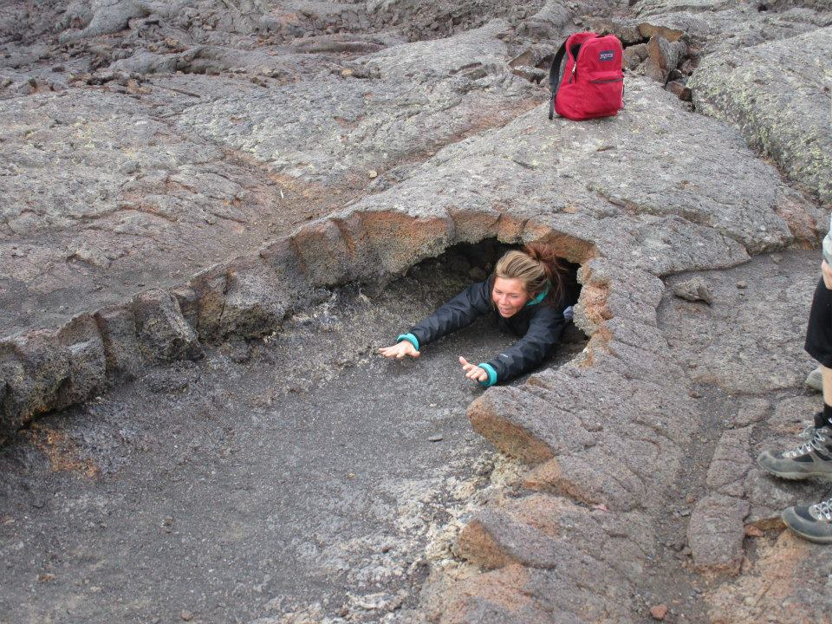
The Students
Kristie:
First-generation, returning student
Physical Geology, Historical Geology,
Field Studies, Mineralogy

Slide 7
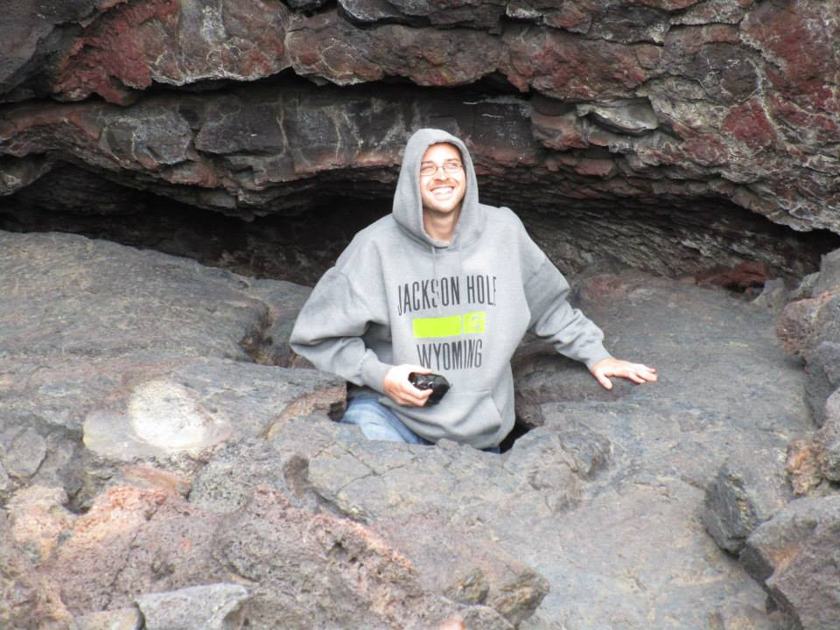
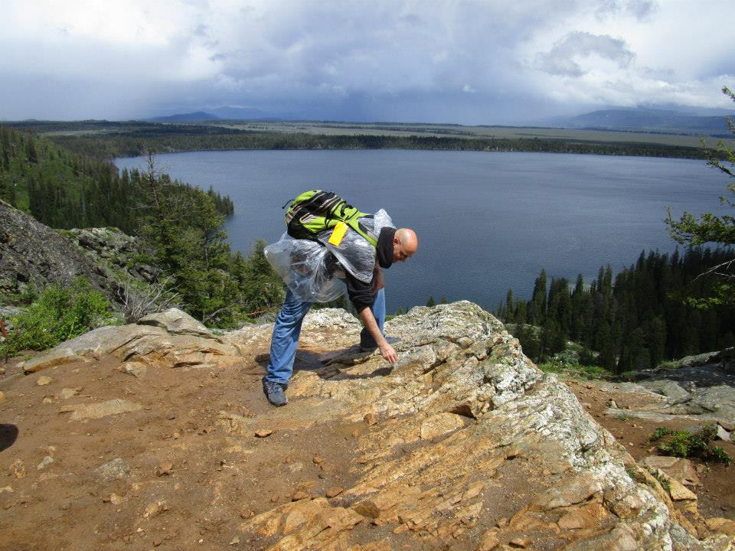
The Students
Randy
Returning adult after managing health and substance abuse issues
Physical Geology, Historical Geology, Field Studies, Mineralogy

Slide 8
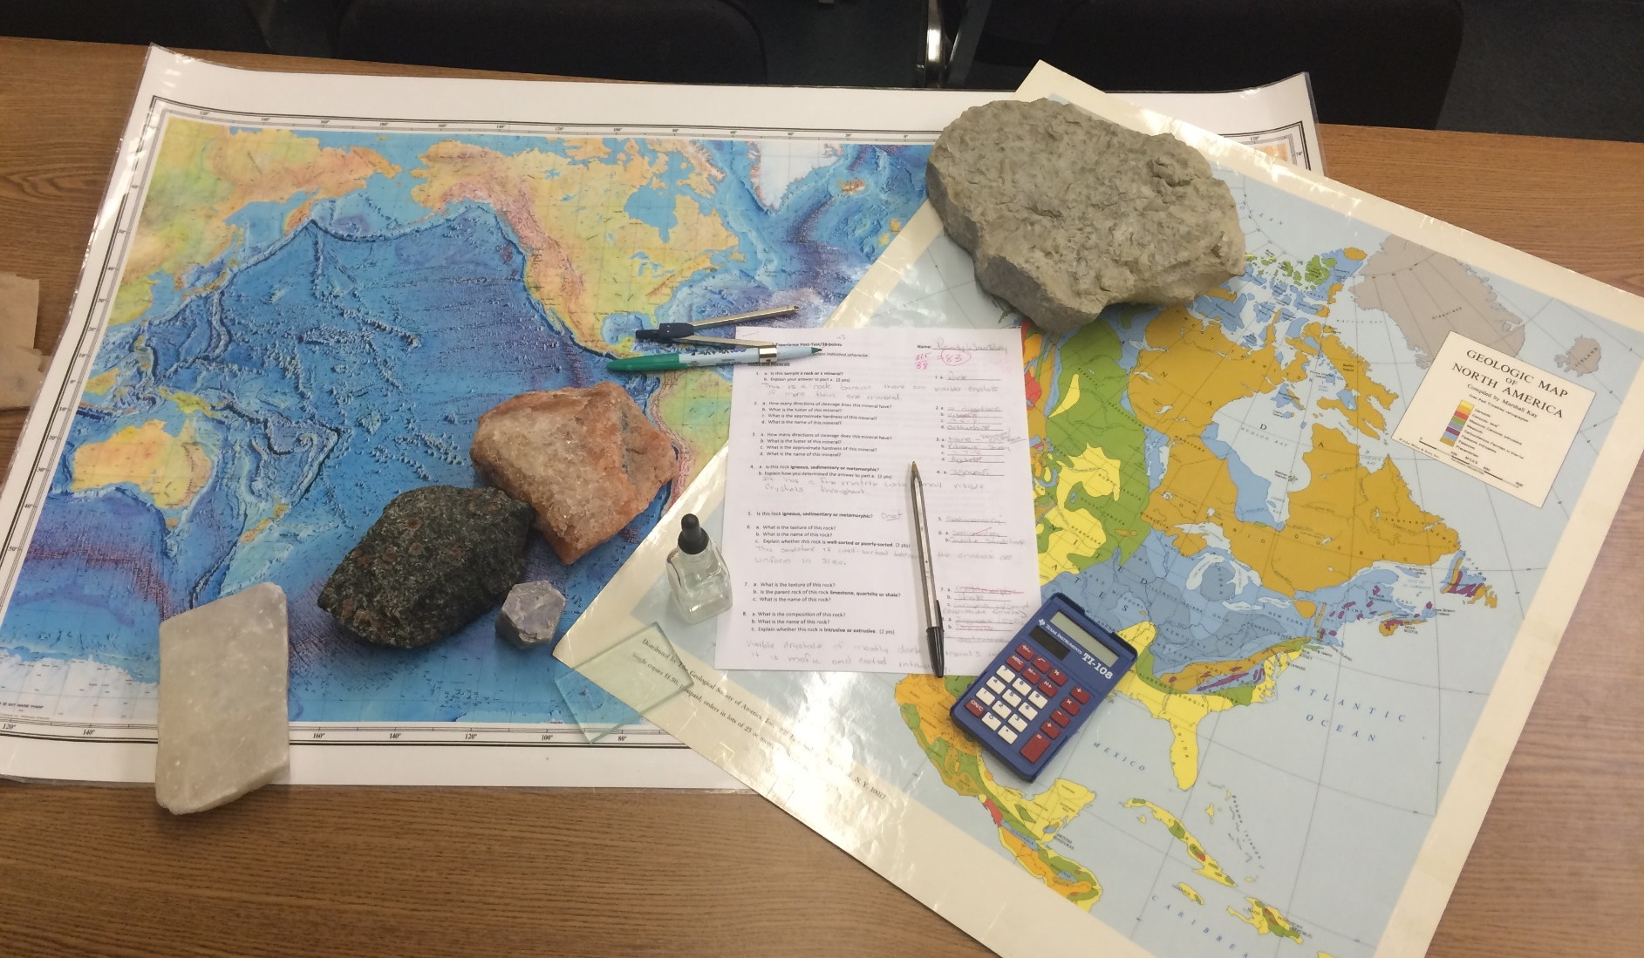
Quantitative Results
Pre- and post-semester lab practicals

Slide 9
Quantitative Results
Rock and Mineral Identification
75
59
Percent
Topographic and Geologic Map Interpretation
77
Percent
69

Slide 10
Quantitative Results
Field Trip Course Content
Greatest improvement:
Most recent material? Greater learning in field setting?
100
Percent
62

Slide 11
Quantitative Results
Physical Geology Student Surveys
91% v. good or outstanding
85% v. good or outstanding
85% v. good or outstanding

Slide 12
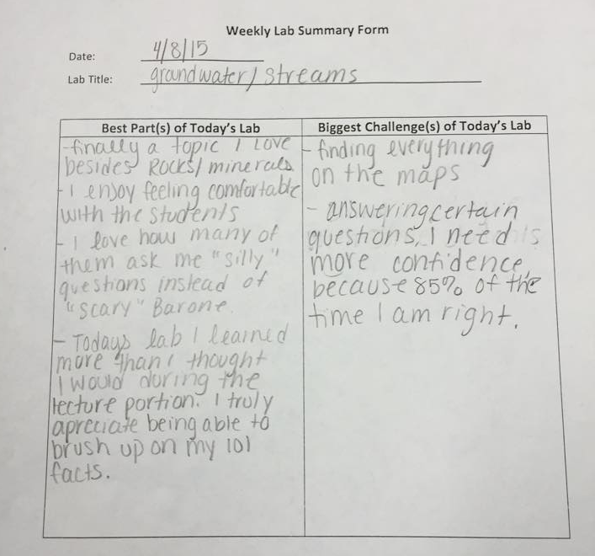
Qualitative Results
Self-evaluated through weekly lab summaries and final reflection paper

Slide 13
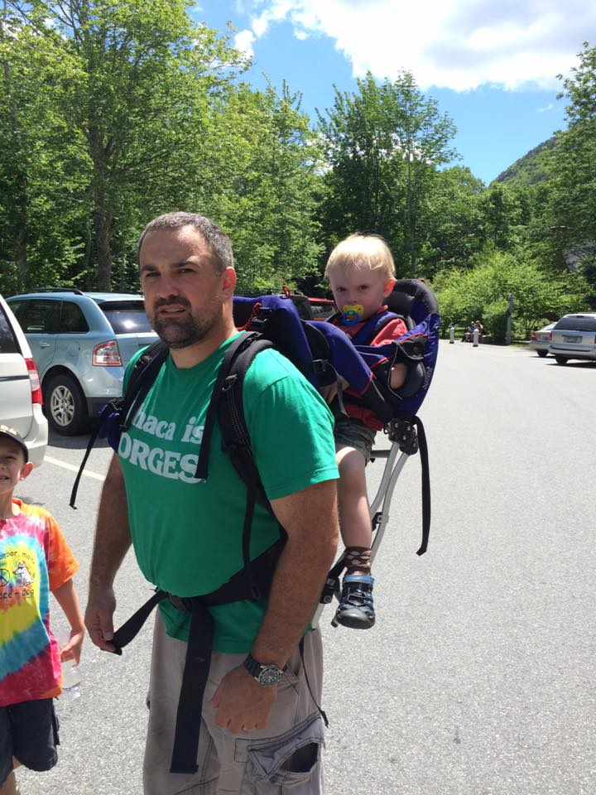
Qualitative Results
Shifts in metacognition
“ I found that I liked being asked, and sometimes challenged, by [student] questions. This caused me, at times, to have to determine if I knew the material as well as I should.”

Slide 14
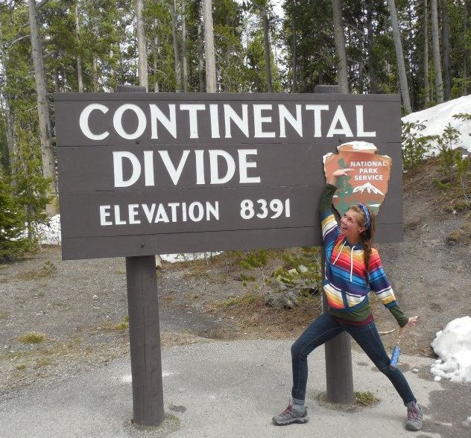
Qualitative Results
Changes in self-perception
“My biggest obstacle was overcoming my perception of myself. I didn’t believe I was smart enough to help students.”

Slide 15
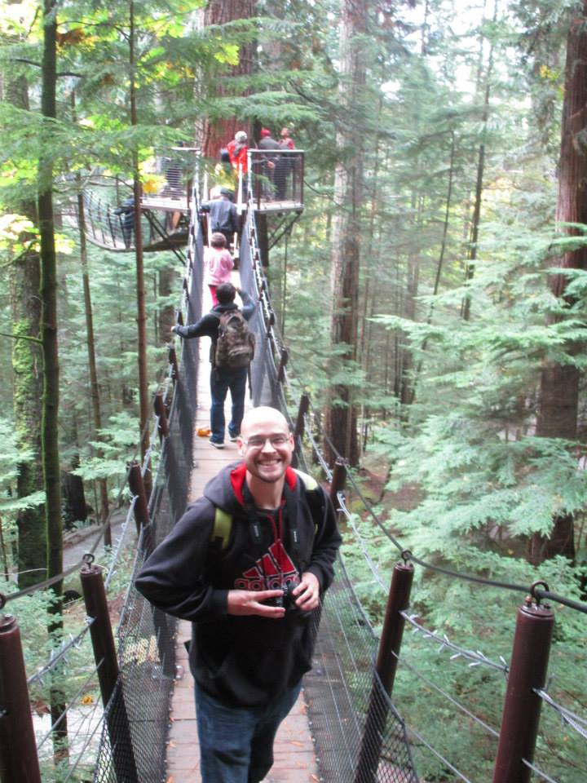
Qualitative Results
Increasing confidence
“Seeing myself make a
difference was a definite
confidence booster.”

Slide 16
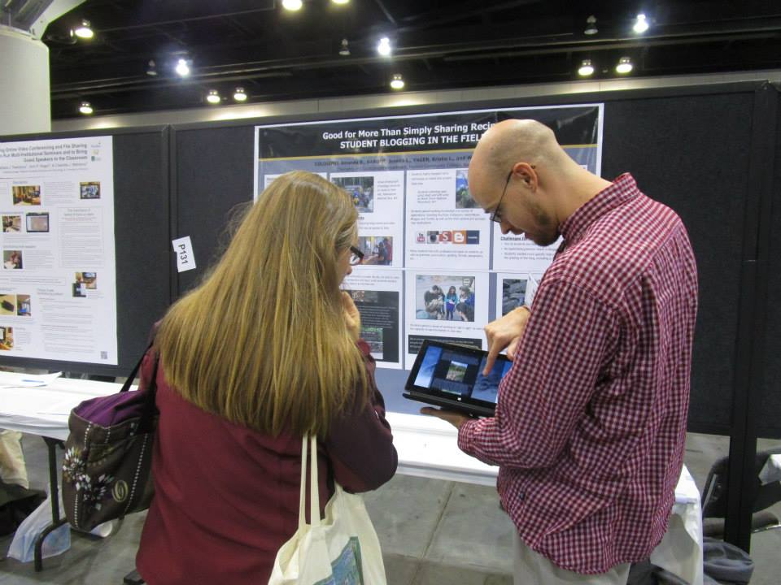
Qualitative Results
Understanding of teaching as a profession
“Some students just don’t seem to care about their own success.”
“[Teaching is] a lot harder than it looks. [I] give you teachers credit!”

Slide 17
Qualitative Results
“Were there benefits to having a TA?”
Hearing things explained more than one way helps me understand concepts better.
Extra hours to see someone for help if the professor is not available; less intimidating than professor.
Two individuals with advanced understanding of the material made the labs easy to complete and two people answer questions faster than only one person.
I think it’s a great idea to have a TA and wish I did for other science classes.

Slide 18
Take Away
Two transferred to GEO programs; one transfers in the fall 2016
“Refresher” before transfer; More prepared when arriving at 4YC
Increases potential for obtaining TA position
Improved communication and public speaking skills
Potentially increases retention of introductory Physical Geology students
Keeps students engaged w/faculty

Slide 19
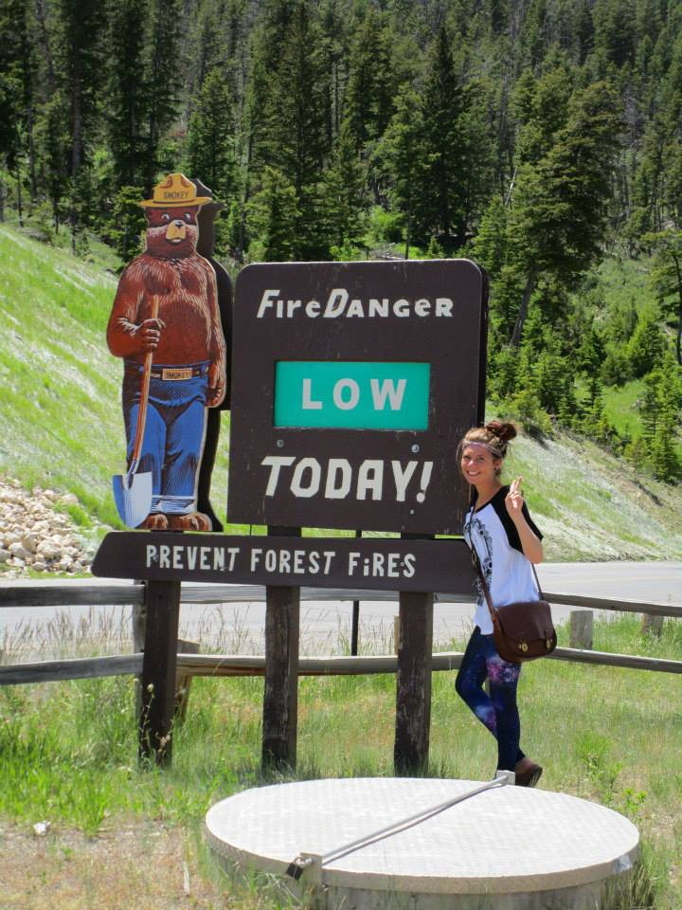
Questions?

