Slide 1
ON DEDUCING THE UNOBSERVABLE:
NICOLAUS STENO'S
SEMINAL ILLUSTRATIONS IN EARTH SCIENCE AND BIOLOGY TELL ABOUT A METHOD TO DESCRIBE CONCEALED MECHANISMS AND SOLID TRANSFORMATIONS
KARDEL, Troels, retired physician Holte, 2840 Denmark, kardel@dadlnet.dk

Slide 2
After having studied Steno for 30 years I have come to a better understanding of his way of scientific reasoning from Steno’s illustrations to be presented.
I acknowledge the inspiration from professor Gary Rosenberg.

Slide 3
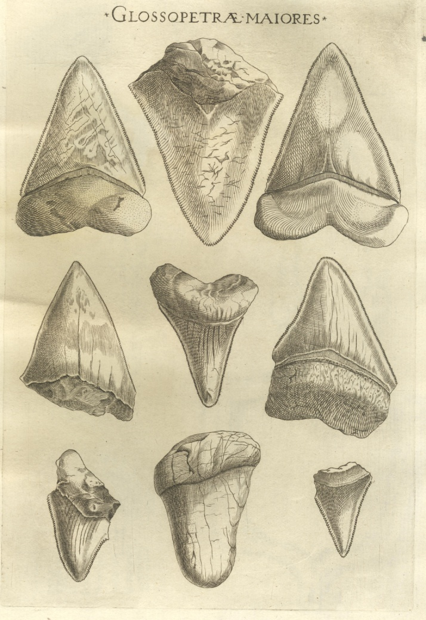
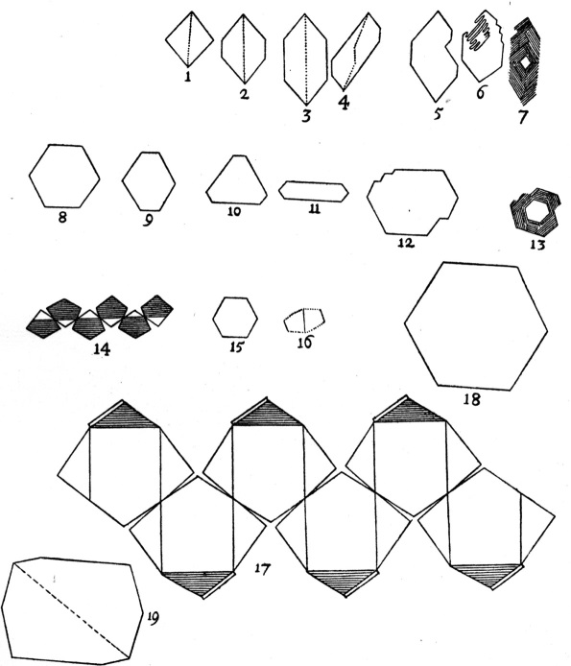
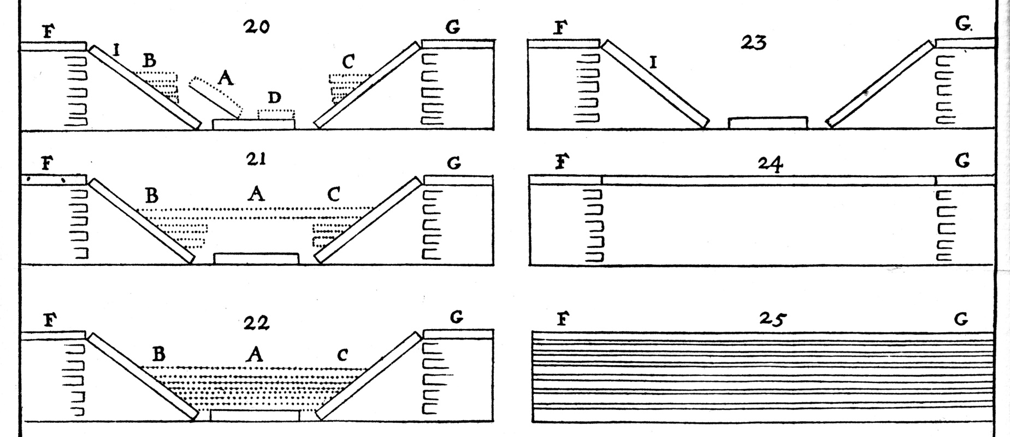
Steno described processes in stratigraphy, paleontology and crystallography as shown in his illustrations published 1667 and 1669.
Each single step in these processes are observed and documented. But how were they connected as processes? By postulates, conjecturae.
Is there any resemblance in the method he used in anatomy and geology?

Slide 4
Steno studied objects and current explanations of origin and consequences. Were they trustworthy? Disagreements triggered him to propose new explanations of the process, ”conjecturae”. They were validated when corroborated by other observations and enabling observable predictions.
When preparing this paper I became aware that he used the same way of reasoning, the hypothetico-deductive method, to describe biological mechanisms concealed from direct observation like the geological processes. He did that from his earliest to his latest investigation.

Slide 5
TABLE. EXEMPLARS OF CASES STUDIED BY STENO
 | Objects studied by Steno | Old concepts challenged | Hypothetical event or mechanism deduced | p.*
1 | Teeth of shark / glossopetrae | A formative ability of rocks | Biological origin of fossils | 574-575
2 | Stratified rocks | Landscapes are created as they are seen | Stratified rocks are earlier horizontal deposits at the bottom of a sea flooding the area and later elevated and transformed. A relative chronology is indicated by these layers | 658
3 | Crystals of different size | Crystals grow vegetatively from the inside | They grow from the surface by accretion with constant inter-facial angles | 658
* Find Steno’s illustrations in Kardel and Maquet, eds., Nicolaus Steno, Springer 2013

Slide 6
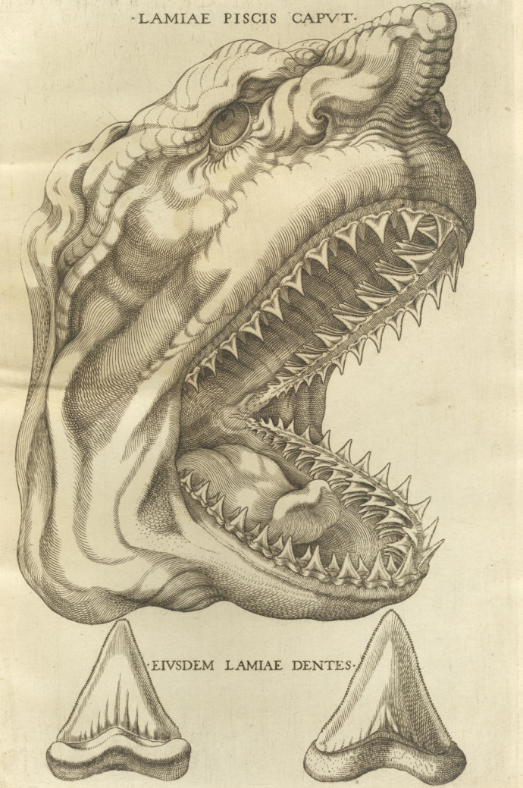
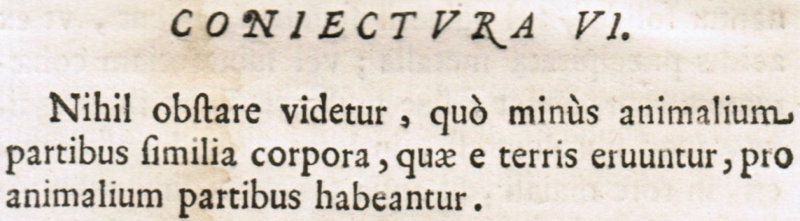
(Mercati)
”There seems to be no objection to the opinion that bodies dug from the ground which resemble parts of animals should be considered to have been parts of animals” N.S., Biogr.Sci.Papers, 592
Notes:
Glossopetrae Conjectura VI

Slide 7

“A crystal grows while new crystalline material is added to the exterior planes of the already formed crystal. There is no room for the opinion that crystals grow vegetatively, and that they draw nourishment from the side on which they are attached when particles are added internally to the crystal”N.S., Biogr.Sci.Papers, 640
”Both the number and length of the sides are changed in various ways without the angles being changed” N.S., Biogr.Sci.Papers, 659

Slide 8
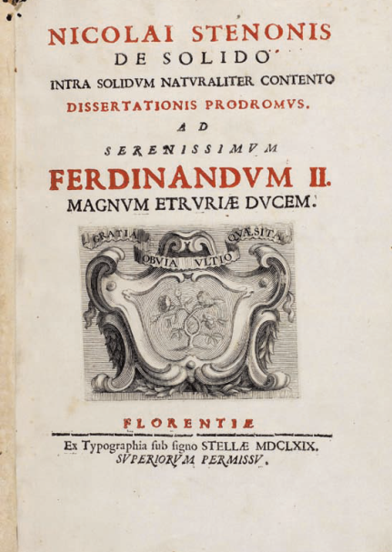
25: “Vertical section of Tuscany when the rocky strata were still complete”
24: “Vast cavities eaten out by force of fires and water. Upper strata being unbroken”
23: “Mountains and valleys are produced by the disruption of upper strata”
22: “New strata produced by the sea” (like in 25)
21: “Lower strata of the new strata destroyed”
20: “Hills and valleys produced by the disruption of the upper sandy strata”
N.S., Biogr.Sci.Papers 659-660:
Notes:
De solido

Slide 9
 | Object studied | Concept challenged | Event and mechanism Steno deduced | p.*
4 | Secretory ducts of glands | Glands are sponges removing excess surrounding liquid | Saliva, tears and milk are filtered from arterial blood in glands | 372 412
5 | The heart dissected | Passions of the soul that heat the heart | The heart is actually a muscle | 464
6 | Pennate muscle structure | Muscle expansion by animal spirits causes contraction | Fiber shortening and muscle structure enable contraction without change of volume | 553
7 | Vessels conducting blood in circulation | No earlier concept | Exchange of fluid between blood and tissue takes place in the capillaries | 704
8 | Reproductive organs | Ovaries of viviparous are “female testicles”! | Ovaries of viviparous are analogous to ovaries of oviparous. Mammal ovum discovered 1827 | 620
9 | A calf with hydrocephalus | Fetal malformations caused by maternal imaginations! | Block of flow of CSF from the inner cavities to the surface of the brain. Monro’s foraminae described 1783 | 664
TABLE. EXEMPLARS OF CASES STUDIED BY STENO

Slide 10
Ergo; Steno described processes in geology that no one can observe since they took place in the past; and likewise he described mechanisms in biology that were concealed from observation in his time. Thanks to a sound self criticism most of his descriptions are still valid theories if not just common knowledge.

Slide 11
QUOD ERAT
FINIS
DEMONSTRANDUM

