Slide 1
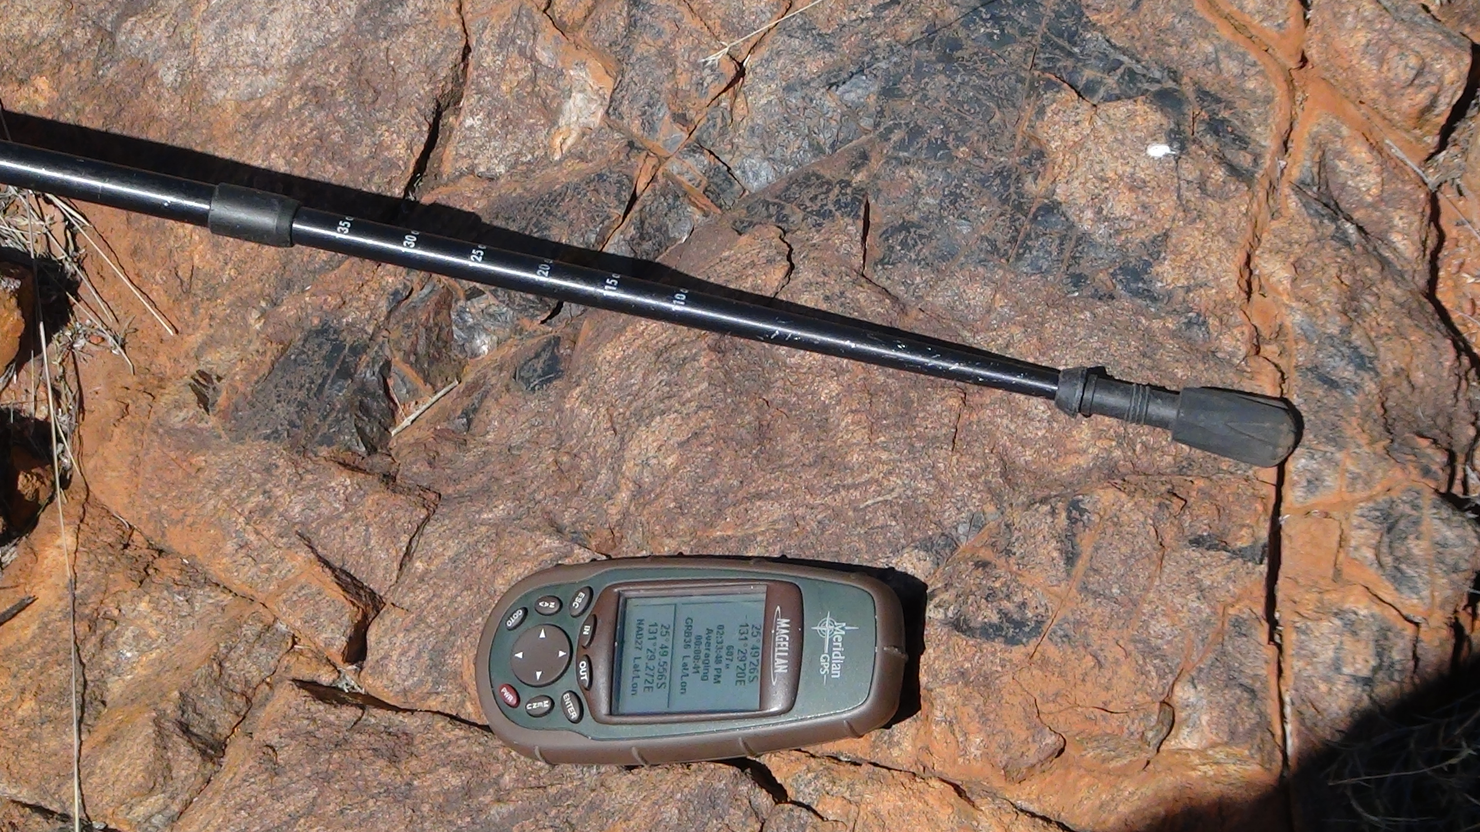
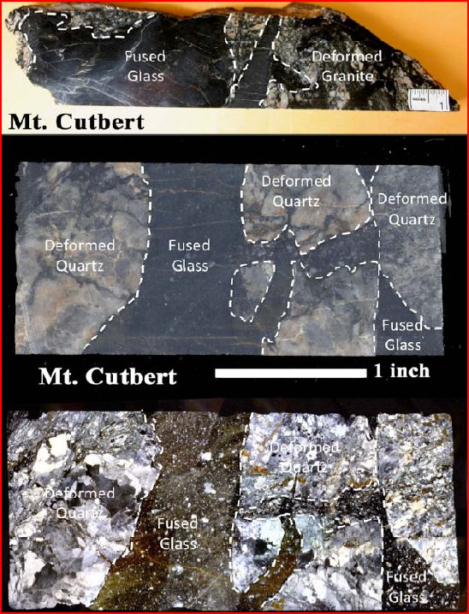
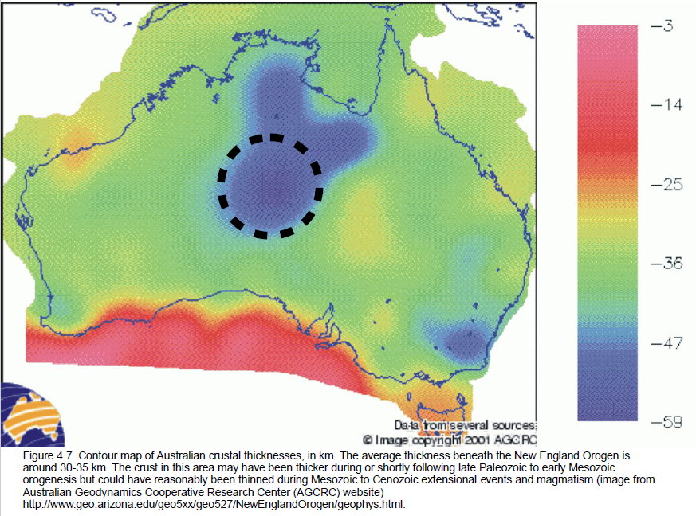
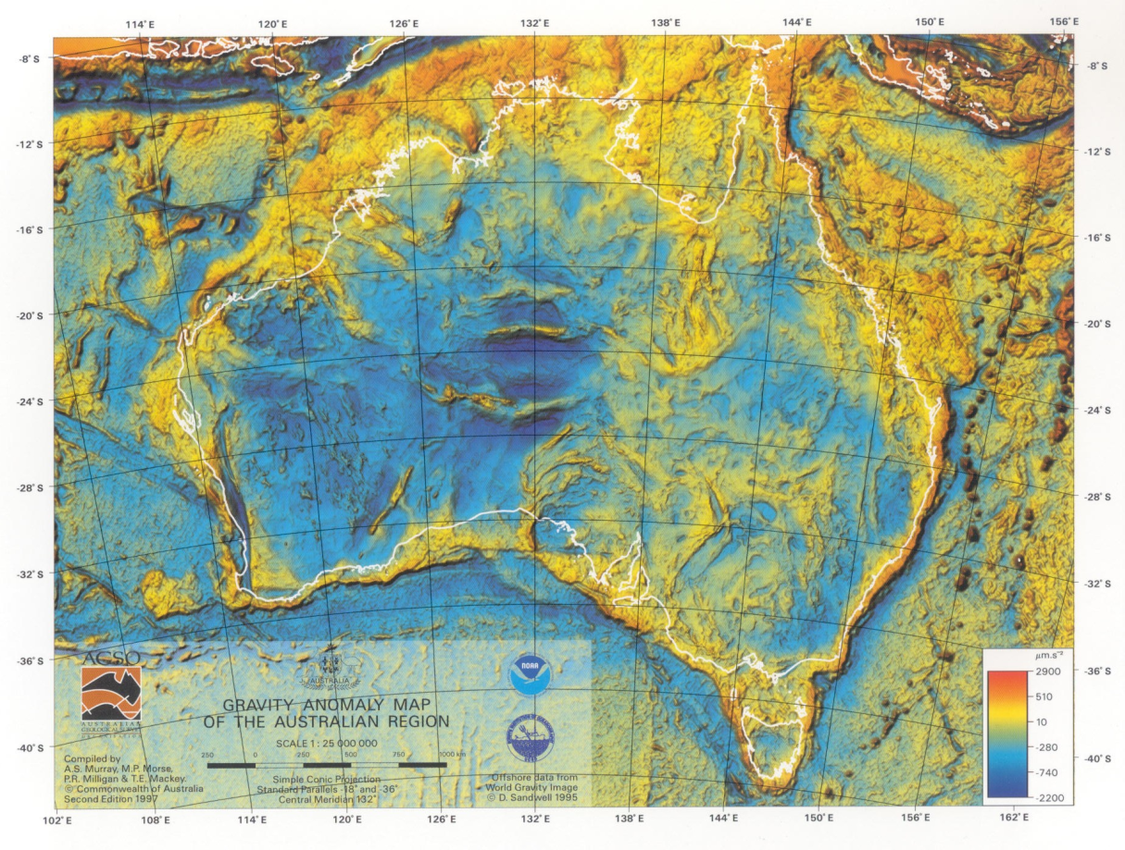
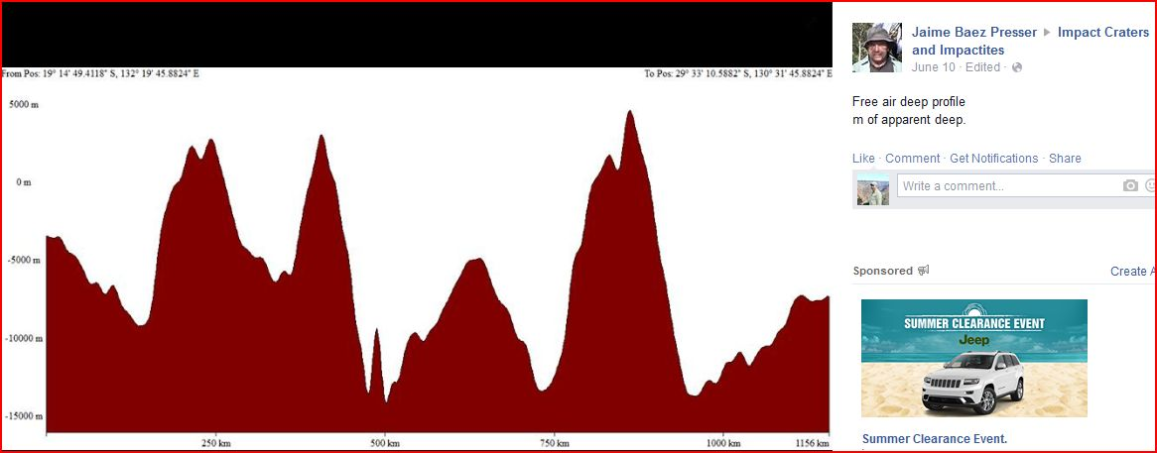
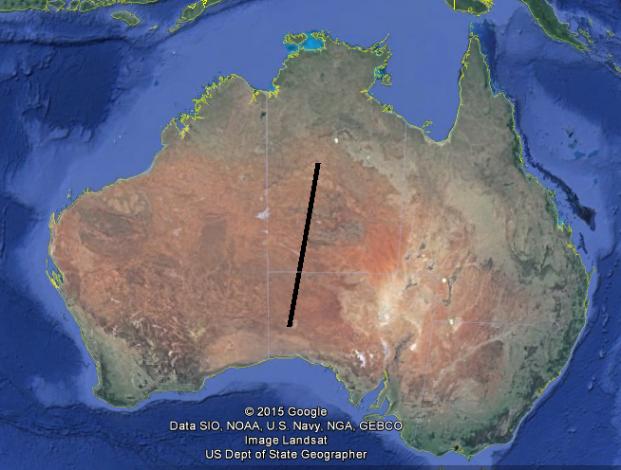
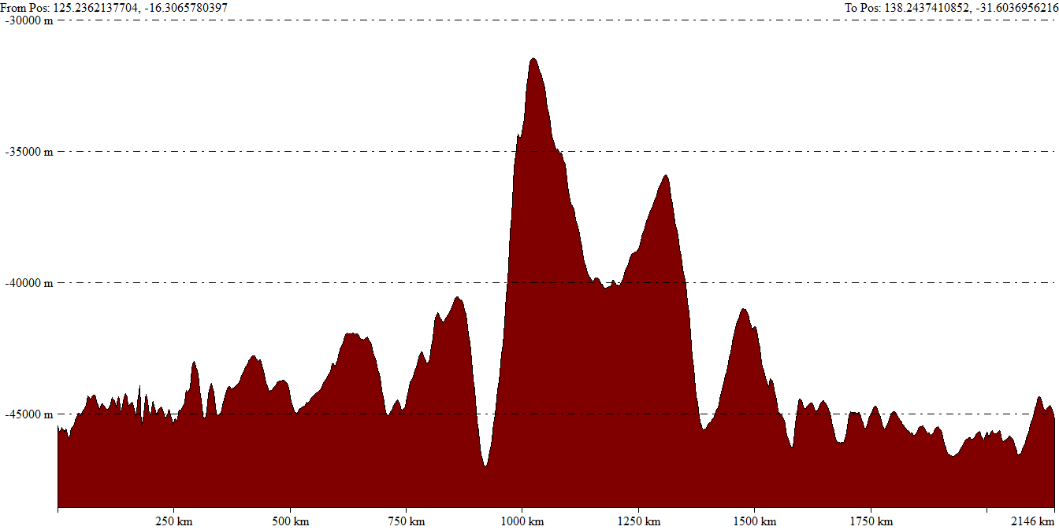
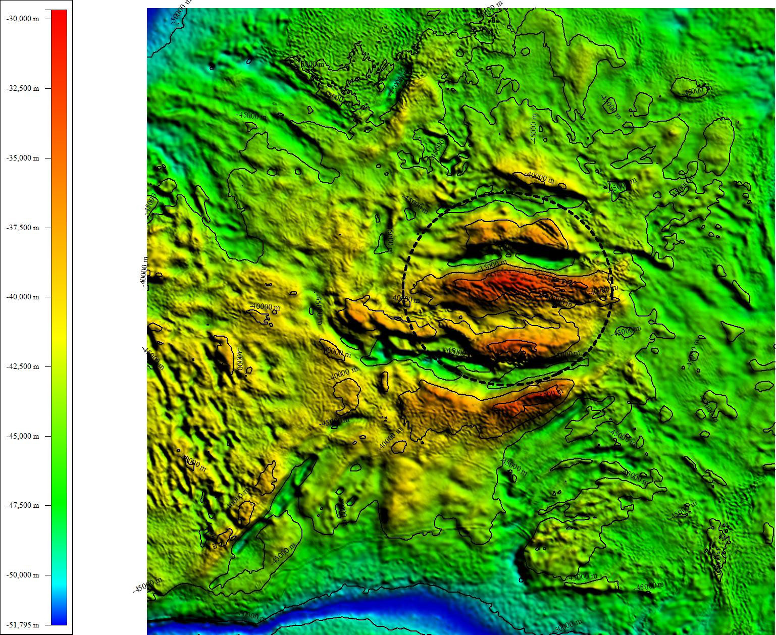
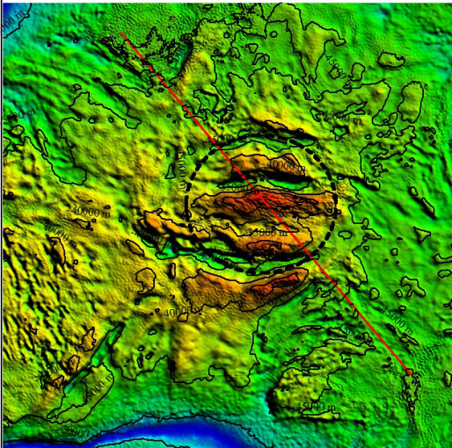
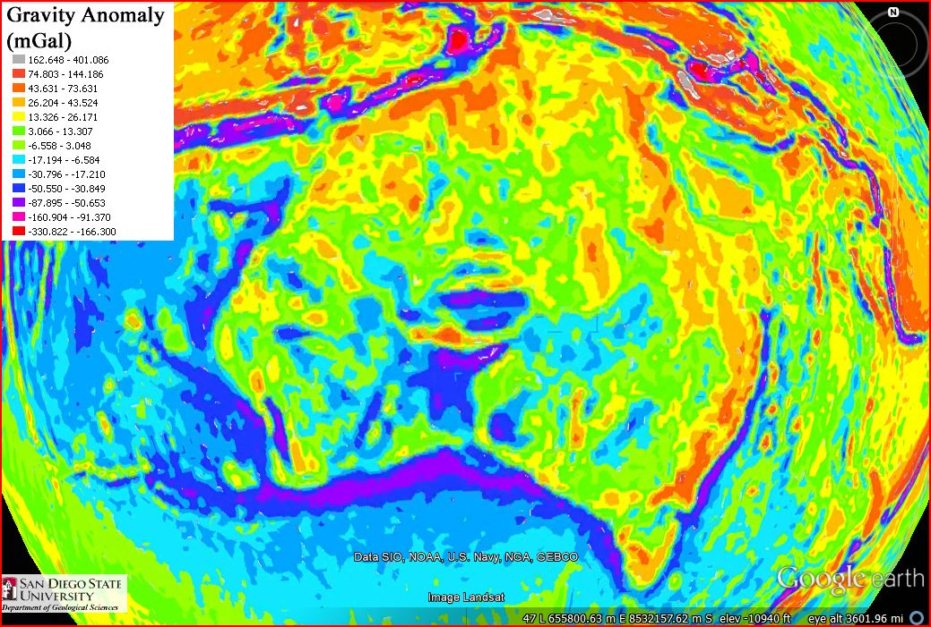
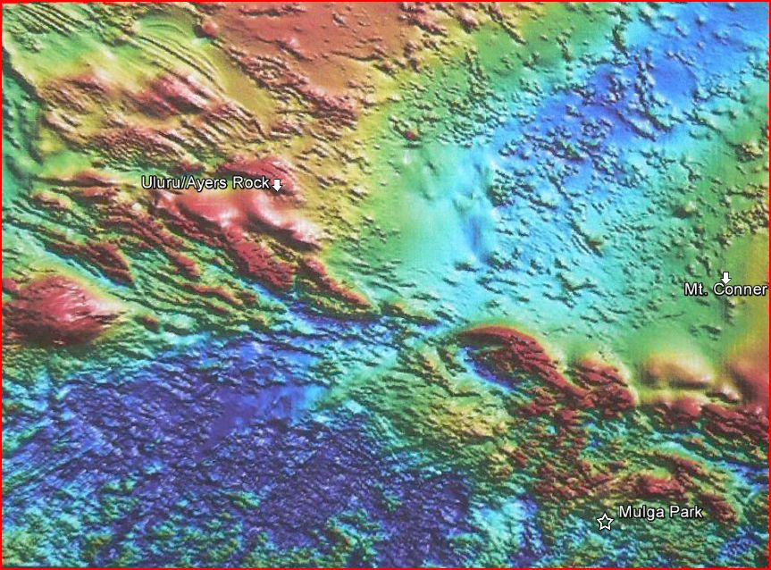
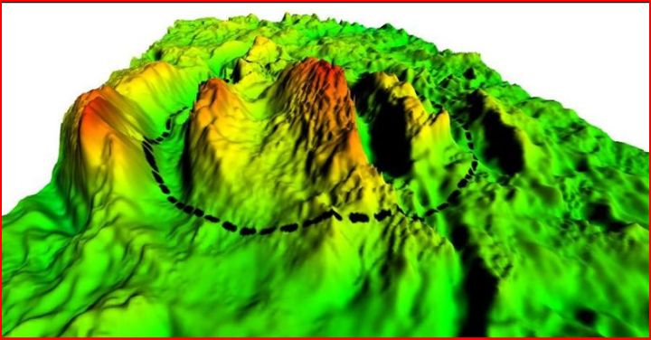
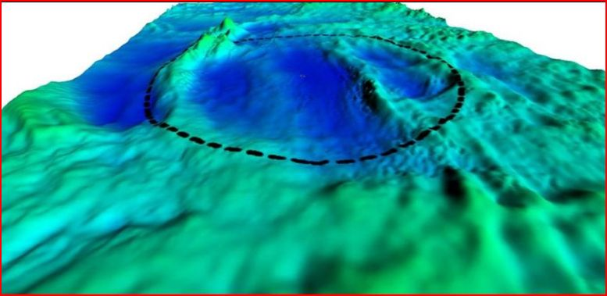
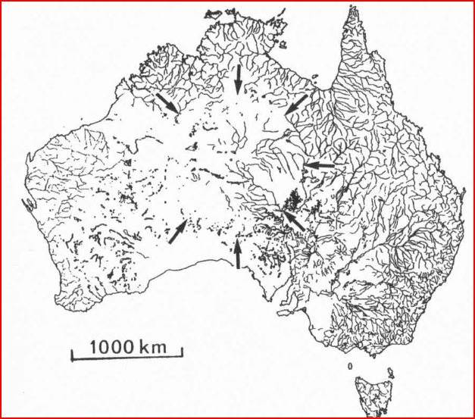
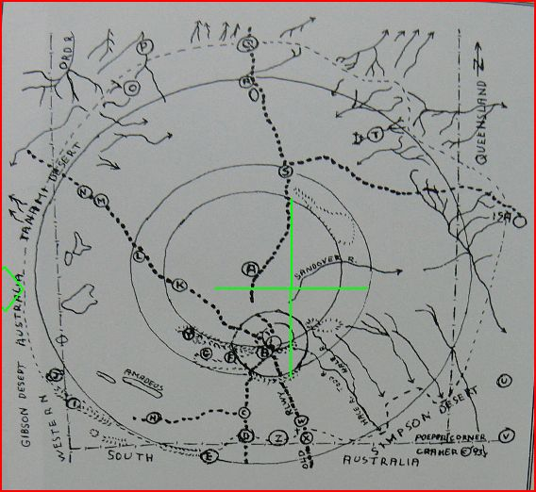
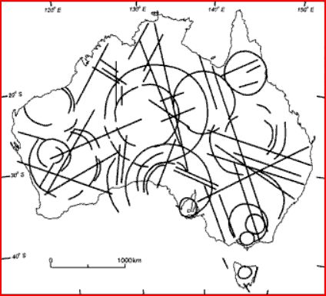
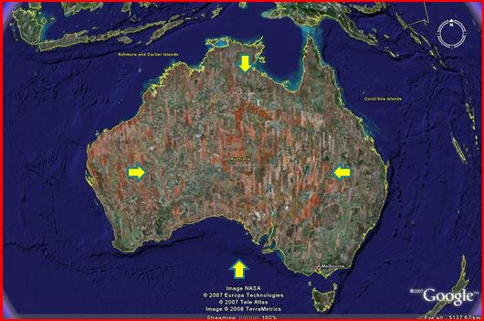
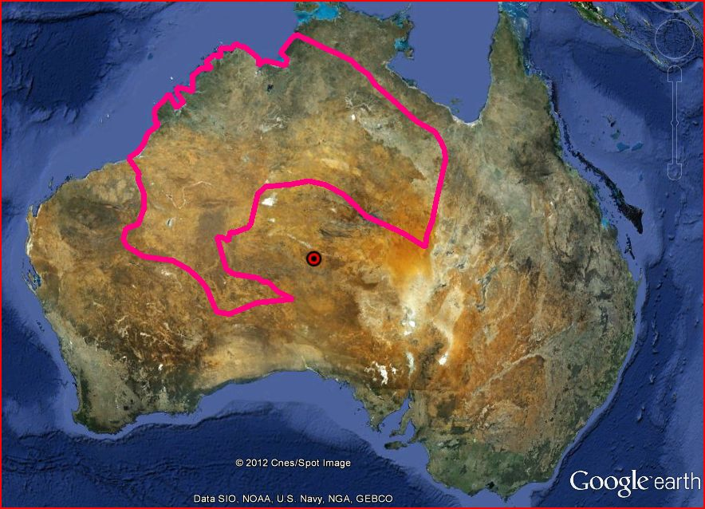
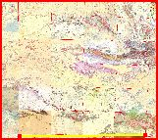
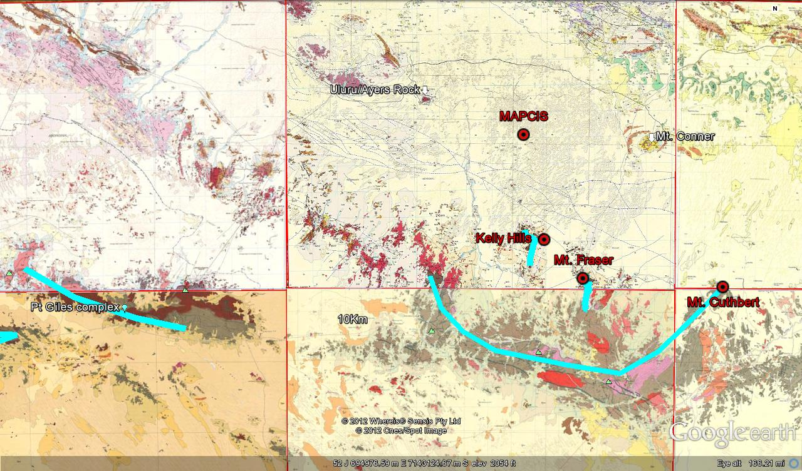
MAPCIS, NEW IMAGING REVEALS DEEP STRUCTURE
Mt. Cuthbert - 25°59'11"S 132°11‘5"E from large deposit of Pt Breccia zone that is ~5km wide and the eastern end of 300km long zone of deposits.
Mt. Cuthbert
Connelly Daniel P., MAPCIS Research, 4815 Covered Bridge Rd, Millville, NJ 08332 danielconnelly@comcast.net
PRESSER, Jaime L.B., Asunción, 2169, Paraguay
.
Mt. Cuthbert
Abstract
Early maps were vague and misleading.
The latest maps give a third dimension of depth and thickness along with greater detail
Discussion
Massive Australian Precambrian-Cambrian Impact Structure (MAPCIS) ~542Ma, a proposed impact continues to reveal itself. Advances in computer power and imaging are showing new detail in the deep gravity structure of the impact. We are now able to visualize the a more complete crater rim ~650km diameter, while eliminating most post impact adjunct structure likely produced by post-impact crustal shortening, notably from the Alice Springs Orogeny ~ 450Ma-300Ma. We are able to correlate the deep gravity structure with the exposed surface ring geology. We are able to show a detailed crustal thickness MOHO up-warp of 14km to 15.5km that corresponds with within the ring surface, deep gravity and associated central MASCON. This new information will be integrated with the eight years of MAPCIS research to support upgrading MAPCIS from a proposed impact, to a probable or highly probable impact.
Free Air Gravity Slice
The following maps and slices show that the crust in central Australia is not uniformly t hick as previous thought. Neither is it simply thinned under discreet domains or geologic provinces like the Musgrave Province as some suggest. The thinning transcends these provinces as would be expected from a large impact. Post impact tectonics have affected the impact weakened crust in a approximately 100km North-South crust shortening in the impact itself. The cause of this transpressive intraplate shortening has been a much debated enigma that continues to spawn competing hypothesizes with inherently fatal flaws.
Being able to see the crustal cross section thickness profile and to see the impact structure in 3D of MAPCIS is a great advance. This lays to rest several nagging questions which I have worked on with since 2007. The >600km diameter surface ring had been well defined through use of 1;250,000 geology maps and dating for the uplift of the exposed outcrops. Subsurface geology of MAPCIS has been a more complex problem especially since early gravity mapping suggested a more homogenous thick crust in central Australia or thinning just under the Musgrave Province. Both these assumptions prove not to be true with the newer mapping provided by Jaime Baez presser.
There has been extensive post impact remodeling of the crater. First by immediate mantle and crustal rebound and infill by tsunami type deposits as the impact hit a large sea known as the Centralian Superbasin. Secondary remodeling occur as the weakened crust within the impact structure was subjected to North-South shortening of about 100km creating East-West ridges and mountain ranges across the crater basin. The crustal profile cross-section and the gravity anomalies are largely unaffected by these post impact mountain ranges and ridges.
North
Sea-level
South
JBP 2015
Crustal Thickness Profile
Gravity anomaly mode 2.
The thinning of the crust, though uplifted MOHO, missing mountain ranges and deep basins matches the predicted impact crater and no other possible geologic process or event.
Crustal Thickness Map 2001 showed a much thicker crust under central Australia but without sufficient detail to indicate an impact, misdirecting geoscientists away from this possibility. Newer maps show a variably thinned crust in central Australia.
This Gravity Anomaly Map 1997 although showing a significant central anomaly emphasized an E-W trend from post impact N-S crustal shortening during the Petermann (~550-535Ma) and Alice Springs( ~400-300Ma) orogenies
NE
SE
Contrast to crustal thickness background up to ~15.5 km
Introduction
Maps begin to show better detail in 2 dimensions
OPINION
It is time that the general geology community attends to MAPCIS making it a priority to support or to challenge. There are numerous enigmas surrounding the transition from the Precambrian to Cambrian not the least which is the rapid development of life. There are many dedicated scientists working to unravel these mysteries yet without this key piece of Earth history, I believe that much their work is an exercise in futility. I welcome challenges to MAPCIS, as almost every challenge has lead to new insights and paths to explore. Eight years and counting, there have been no successful challenges to show that this structure is anything but an impact.
This is the 8th year since the rediscovery of the ring structure initially known as CAR, Central Australian Ring and is now associated with MAPCIS, Massive Australian Precambrian/Cambrian Impact Structure. There have been nine oral or poster presentations on divers lines of MAPCIS evidence at national and international conferences, including the 34th IGC in Brisbane, Australia 2012, and 4th IPC in Mendoza, Argentina 2014. There are also three associated published papers with Chinese astrophysicists. MAPCIS is well on its way, along the journey from discovery of initial evidence to confirmation as an impact which usually takes 10 to 30 years. Besides collecting evidence and presenting it, the most important thing is to raise awareness of MAPCIS so that others may add their expertise in support or as a challenge to the evidence.
To learn about the earlier work, go to the Geological Society of America website and search past meeting abstracts for “MAPCIS”, or “Musgrave pseudotachylite” to get downloadable presentations.
JBP 2015
JBP 2015
The Moho is up warped by ~1.5-2 km near the center of the Chicxulub crater
Authors: Christeson, GL, Collins, GS, Morgan, JV, Gulick, SPS, Barton, PJ, Warner, MR,
Title: Mantle deformation beneath the Chicxulub impact crater
Journal: Earth and Planetary Science Letters, 2009, Vol: 284, Pages: 249 - 257
DOI: doi:10.1016/j.epsl.2009.04.033
Gravity anomaly mode one (3D), attenuates the East-West mountain ranges while leaving <600km diameter MAPCIS crater rim visible .
References
South
North
South
North
Camacho A., Vernon R.H., Fiztgerald J.D. 1995- Large volumes of Anhydrous pseudotachylite in the Woodroffe Thrust, eastern Musgrave Ranges, Australia, Journal of Structural Geology
Cramer Bert 1993- Sourgrapes & Justice (or 3 comets & a camel)
O’Driscoll E.S.T. &Campbell I.B. 1997-Mineral deposits related to Australian continental ring and rift structures with some terrestrial and planetary analogies, Global Tectonics and Metallogeny Vol 6. No 2.
Reimold Wolf Uwe, Gibson Roger L. 2002- “Pseudotachylites” in large impact structures
Glikson A.Y. & Mernaugh T.P. 1990 Significance of pseudotachylite vein systems, Giles basic/ultrabasic complex, Tomkinson ranges, western Musgrave Block, central Australia, Journal of Australian Geology & Geophysics 11, 509-519
Wenk H.R. &Weiss L.E. 1982- Al-rich calcic pyroxene in pseudotachylite an indication of high pressure and high temperature ? Tectonophysics, 84, 329-341
Edgoose CJ, Scrimgeour IR, and Close DF, 2004, Geology of Musgrave Block, Northern Territory, Northern Territory Geological Survey, Report 15
A Camacho, I McDougall ,2000- Intracratonic, strike-slip partitioned transpression and the formation and exhumation of eclogite facies rocks: An example from the Musgrave Block, central Australia- Tectonics
H.M. Howard, et al., 2014- The burning heart—The Proterozoic geology and geological evolution of
the west Musgrave Region, central Australia, Gondwana Research
D. Connelly 2012-PSEUDOTACHYLITE BRECCIA OF THE MUSGRAVE PROVINCE, AUSTRALIA
2012 GSA Annual Meeting in Charlotte Paper No. 104-3
MAPS
Ayers Rock, Total Magnetic Intensity Map 2002 Sheet SG52-8 Northern Territory Geological Survey
“The International Gravimetric Bureau”. In: IAG Geodesist’s Handbook, 2012- Journal of Geodesy, V 86, N 10, Oct.2012
GRACE Gravity Anomaly Map clearly shows the central anomaly as a circular feature
Ayers Rock Map 2002 Magnetic Intensity Anomaly Suggests a deep trench ( greater than 10km deep and up to 70km wide) in the basement under the plain between Uluru/Ayers Rock and Mt. Conner as the central impact zone of an oblique impact.
(Note, this is where the massive Pseudotachylite breccias deposits were found)
Gravity anomaly mode 2 (3D) strongly supports a MASCON
JBP 2015
JBP 2015
Drainage Map Outlines Ring
CAR- Central Australian Ring
Post Impact Far-field Ring from satellite images
Kalkarindji LIP surrounds higher ground
Inner ring which fits inside the donut to the left
Objective
Progression to 3D
2015
To show that new imaging directly supports evidence of a massive impact.
To show that the central mountains are not East-West trending but part of a circular structure
To show that previously established surface ring structure continues deep within the crust.
To show that the crust has been thinned and uplifted under the impact as would be expected.
1969 Div. Nat. Map noted by O'Driscoll & Campbell 1997
1993 B. Cramer considers impact origin of CAR
1997 E.S.T. O’Driscoll & I. B. Campbell consider origin of CAR. Meets “square root of 2 rule” for impact rings.
2006 G. Harvey & 2007 D. Connelly independently discover the outer ring and consider an impact origin.
2010 Based on Jon Claoué-Long & Dean Hoatson Kalkarindji LIP ~540Ma – 500Ma
Red dot is the impact center
D. Connelly 2011 Mosaic map made from 30+ Geoscience Australia 1:250,000 geology maps clearly shows the exposed outcrops of a >600km crater rim.
All current Musgrave intraplate tectonic models have fatal flaws
1983 first intraplate model for Petermann Orogeny
Conflicting models created for the short duration, violent, intraplate Petermann Orogeny ~550Ma- 535Ma without ruling out an impact.
Acknowledgements
Anangu Pitjanjatjara Yankkunyjatjara Land Rights Act 1981 severely limits access to the Musgrave Province.
Connection between impact craters and pseudotachylite develops.
Large volume pseudotachylite breccia become associated with impact origin, not yet for Musgraves.
Thank you to Dr. Jaime Baez Presser, who by challenging the theory, greatly advanced the research.
Thank you to Dr. Malgorzata Piszcz-Connelly for funding the research.
H.R. Wenk & L.E. Weiss study origin of Musgrave pseudotachylite 1982
Glikson, A. Y., Mernagh, T. P., study Pseudotachylite in western Musgraves 1990
Camacho A., Vernon R.H., Fiztgerald J.D. contemplate impact origin of Musgrave pseudotachylite 1995
2008 D. Connelly goes to Australia & discovers that the pseudotachylite is near the proposed impact center
2011 D. Connelly collects Musgrave pseudotachylite breccia for research and dating. Searches for PDFs as well.

