Slide 1
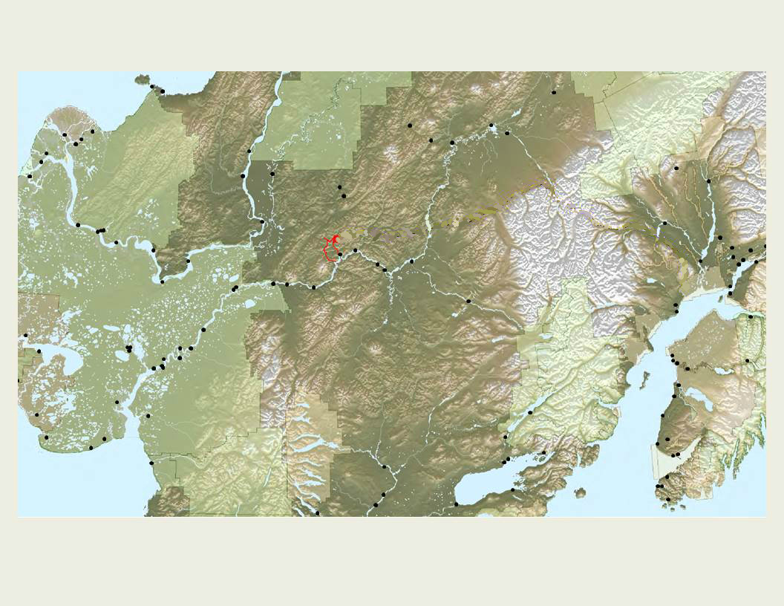
Tribal Voices
a tale of 3 mines
GSA National Conference
November 2015
Kendra Zamzow, PhD, CSP2
Ann Maest, PhD, Buka Environmental

Slide 2
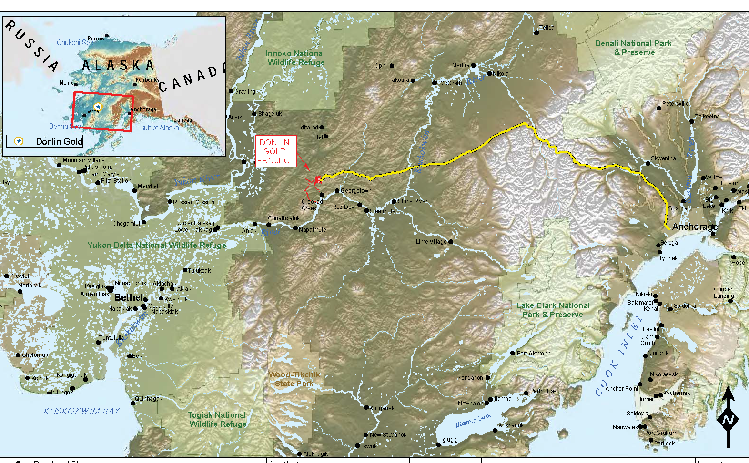
Influencing mine permitting
Before, During, or Outside of the EIS* process
Donlin Gold
Wishbone Hill Coal
Proposed Donlin pipeline
Pebble Copper-Gold
*Environmental Impact Statement

Slide 3
Will the action significantly impact the environment?
The EIS process
Chapter 1: Introduction
Identify important and unimportant issues
Chapter 2: Possible actions
What the company wants to do
Alternatives
Describe alternatives that were dropped
Chapter 3: Environmental Analysis
Land, air, water, wildlife, and people and the potential impacts to each.
Chapter 4: Cumulative Effects
Chapter 5: Mitigation
Yes
Agency must prepare an EIS
Step 1: Public scoping on issues and alternatives
Public comment
Step 2: Draft EIS
Public comment
Step 3: Final EIS
Agency responds to comments
Step 4: Record of Decision – agency explains decision and mitigation measures

Slide 4
PEBBLE – before the EIS
Education
Trust responsibility
Legal challenges
Voices
Will the action significantly impact the environment?
Yes
Agency must prepare an EIS
Pebble Project
Notes:
Before the mine proponents submitted permits
Tribes at Pebble
Requested educational presentations from independent consultants, mining company, state of Alaska
Individuals and villages made decisions on whether to oppose the project
Strategic alliances – most joined an anti mine coalition
Unique to tribes: used EPAs trust responsibility to engage EPA before the EIS process
Requested EPA to deny wetland dredge and fill permits, therefore preventing the mine
EPA assessed risks to the watershed and stated they would limit – but not block – dredge and fill permits
Extremely unusual for a high profile project
Tribal members also sued the State of Alaska for not providing public notice for exploration and water permits (and won)

Slide 5
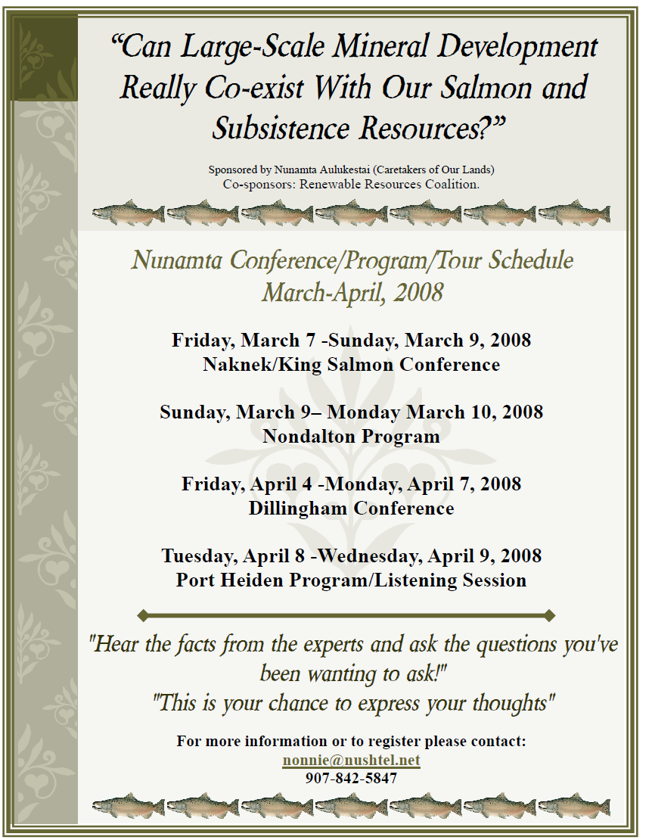
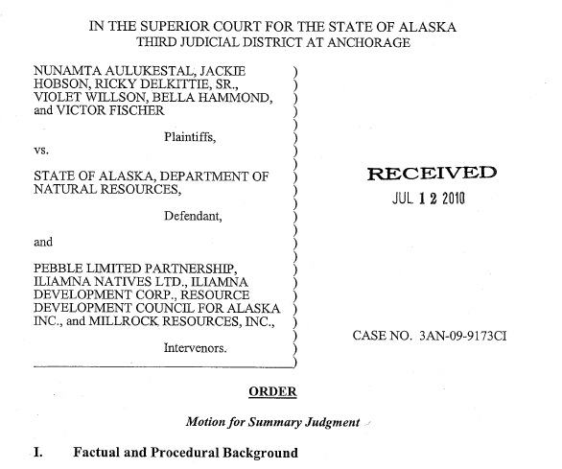
PEBBLE
Notes:
Examples of educational meeting flyer
Example of lawsuit against state of Alaska
Current status – mine project has no financial backers, mining company is suing EPA, project is on hold

Slide 6
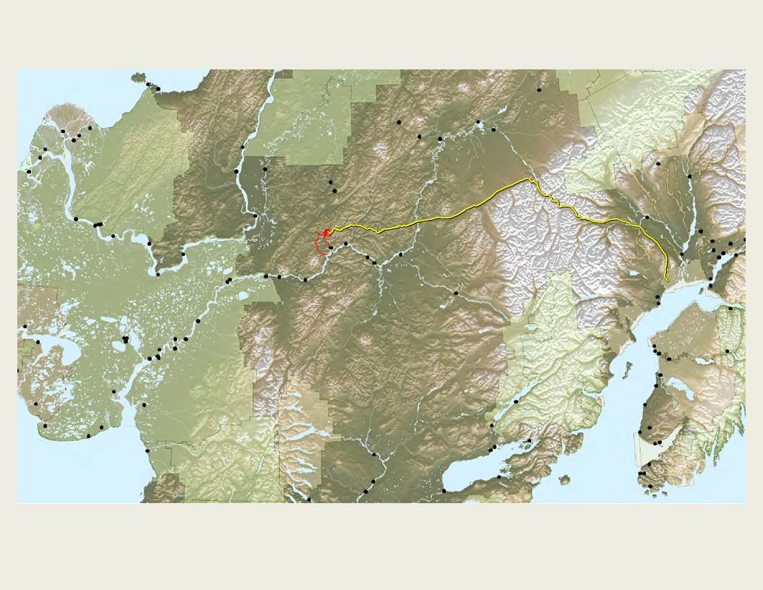
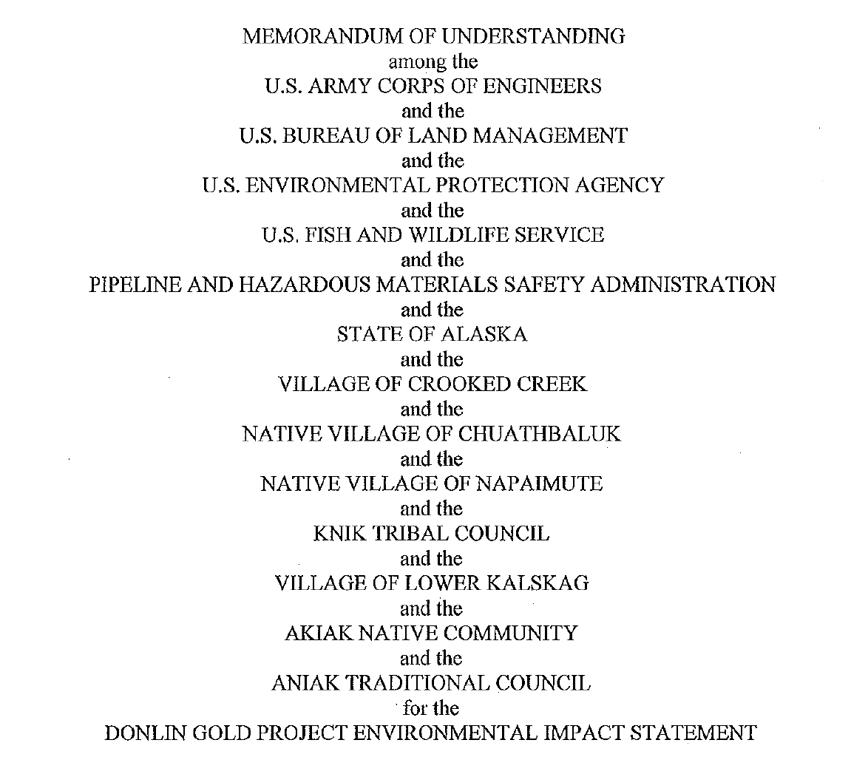
Will the action significantly impact the environment?
Donlin - during EIS
Tribes take on “agency” status
“Cooperating agency”
Yes
Agency must prepare an EIS
Donlin
Gold Project
Step 1: Public scoping
Tribes at the table
Chapter 1: Introduction
Identify important and unimportant issues
Chapter 2: Possible Actions
Discusses Alternatives
Chapter 3: Environmental Analysis
Potential impacts
Step 2: Draft EIS
Tribes at the table
Step 3: Final EIS
Agency responds to comments
Step 4: Record of Decision
Notes:
Mine plan submitted
Kicked off NEPA/EIS
ACOE as lead agency, sent a letter to 66 tribes
6 engaged
Chuathbaluk engaged CSP2
Tribes have a unique understanding of the environment in an area where few people have been.
Suggest studies that need to be done to fill data gaps (for example, how barging could affect juvenile salmon)
Highlight areas of concern or interest for consultants to focus on

Slide 7
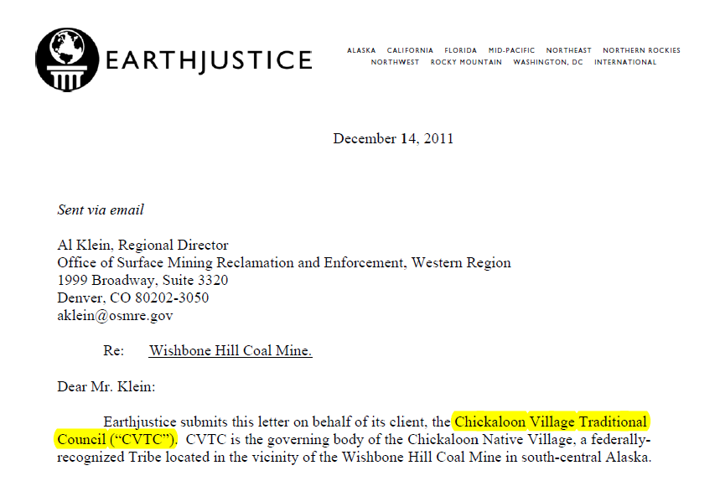
Tribes outside the EIS process
Is there a federal agency nexus? (CWA, CAA)
Yes
No
Wishbone Hill Coal
Agency must prepare an EIS
No EIS
State permit notices
Public comment
Final state permits issued
Legal challenges
Notes:
Unique to tribes, they can request government to government consultation with federal agencies
They can also engage the UN
They cannot engage with the State of Alaska in a unique position; the state does not recognize tribes as nations, the state considers them to have the same status as general public or land owners
In the letter shown, they requested the federal Office of Surface Mining to deny a mining permit because state requirements for permit renewals had not been fulfilled. Here, they acted as any member of the public.
The request was denied. However, coal prices have dropped so the mine was not put in.

Slide 8
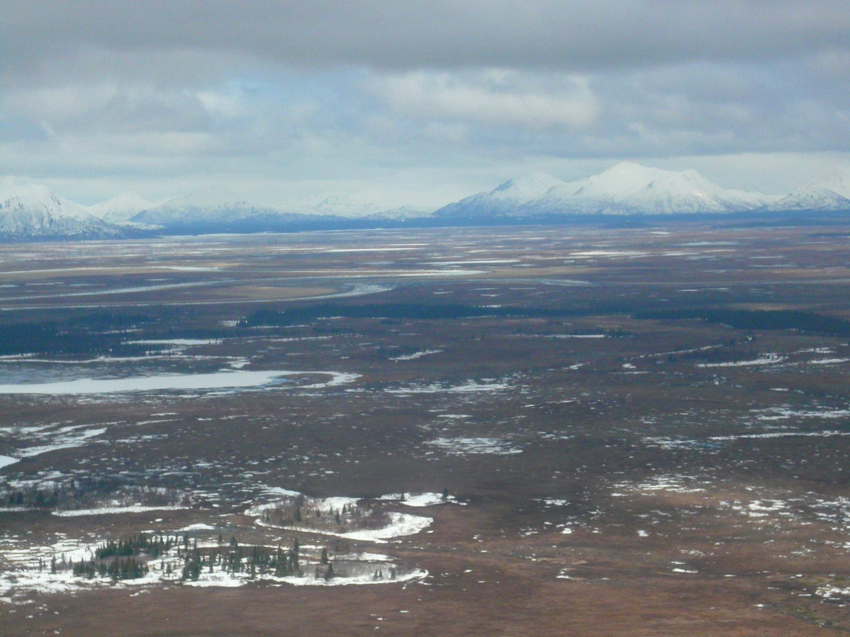
Before the EIS
Pebble
Trust responsibility and legal challenges to STOP mine
Requires time and money from tribes
Requires investments of time, money, and political capital on the part of agencies – extremely rare

Slide 9
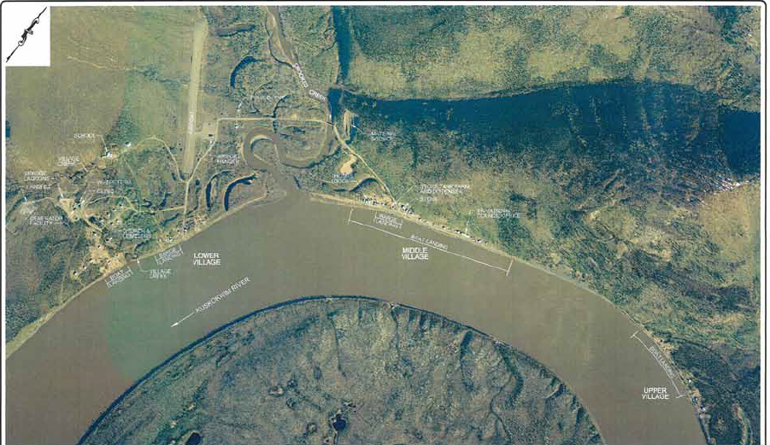
During the EIS
Donlin
Tribal governments as cooperating agencies
Address critical resources and critical problems with proposed mining company plans
Requires investments of time, money, and alliance with technical experts on the part of tribes
Tribes CAN oppose the mine after the EIS process

Slide 10
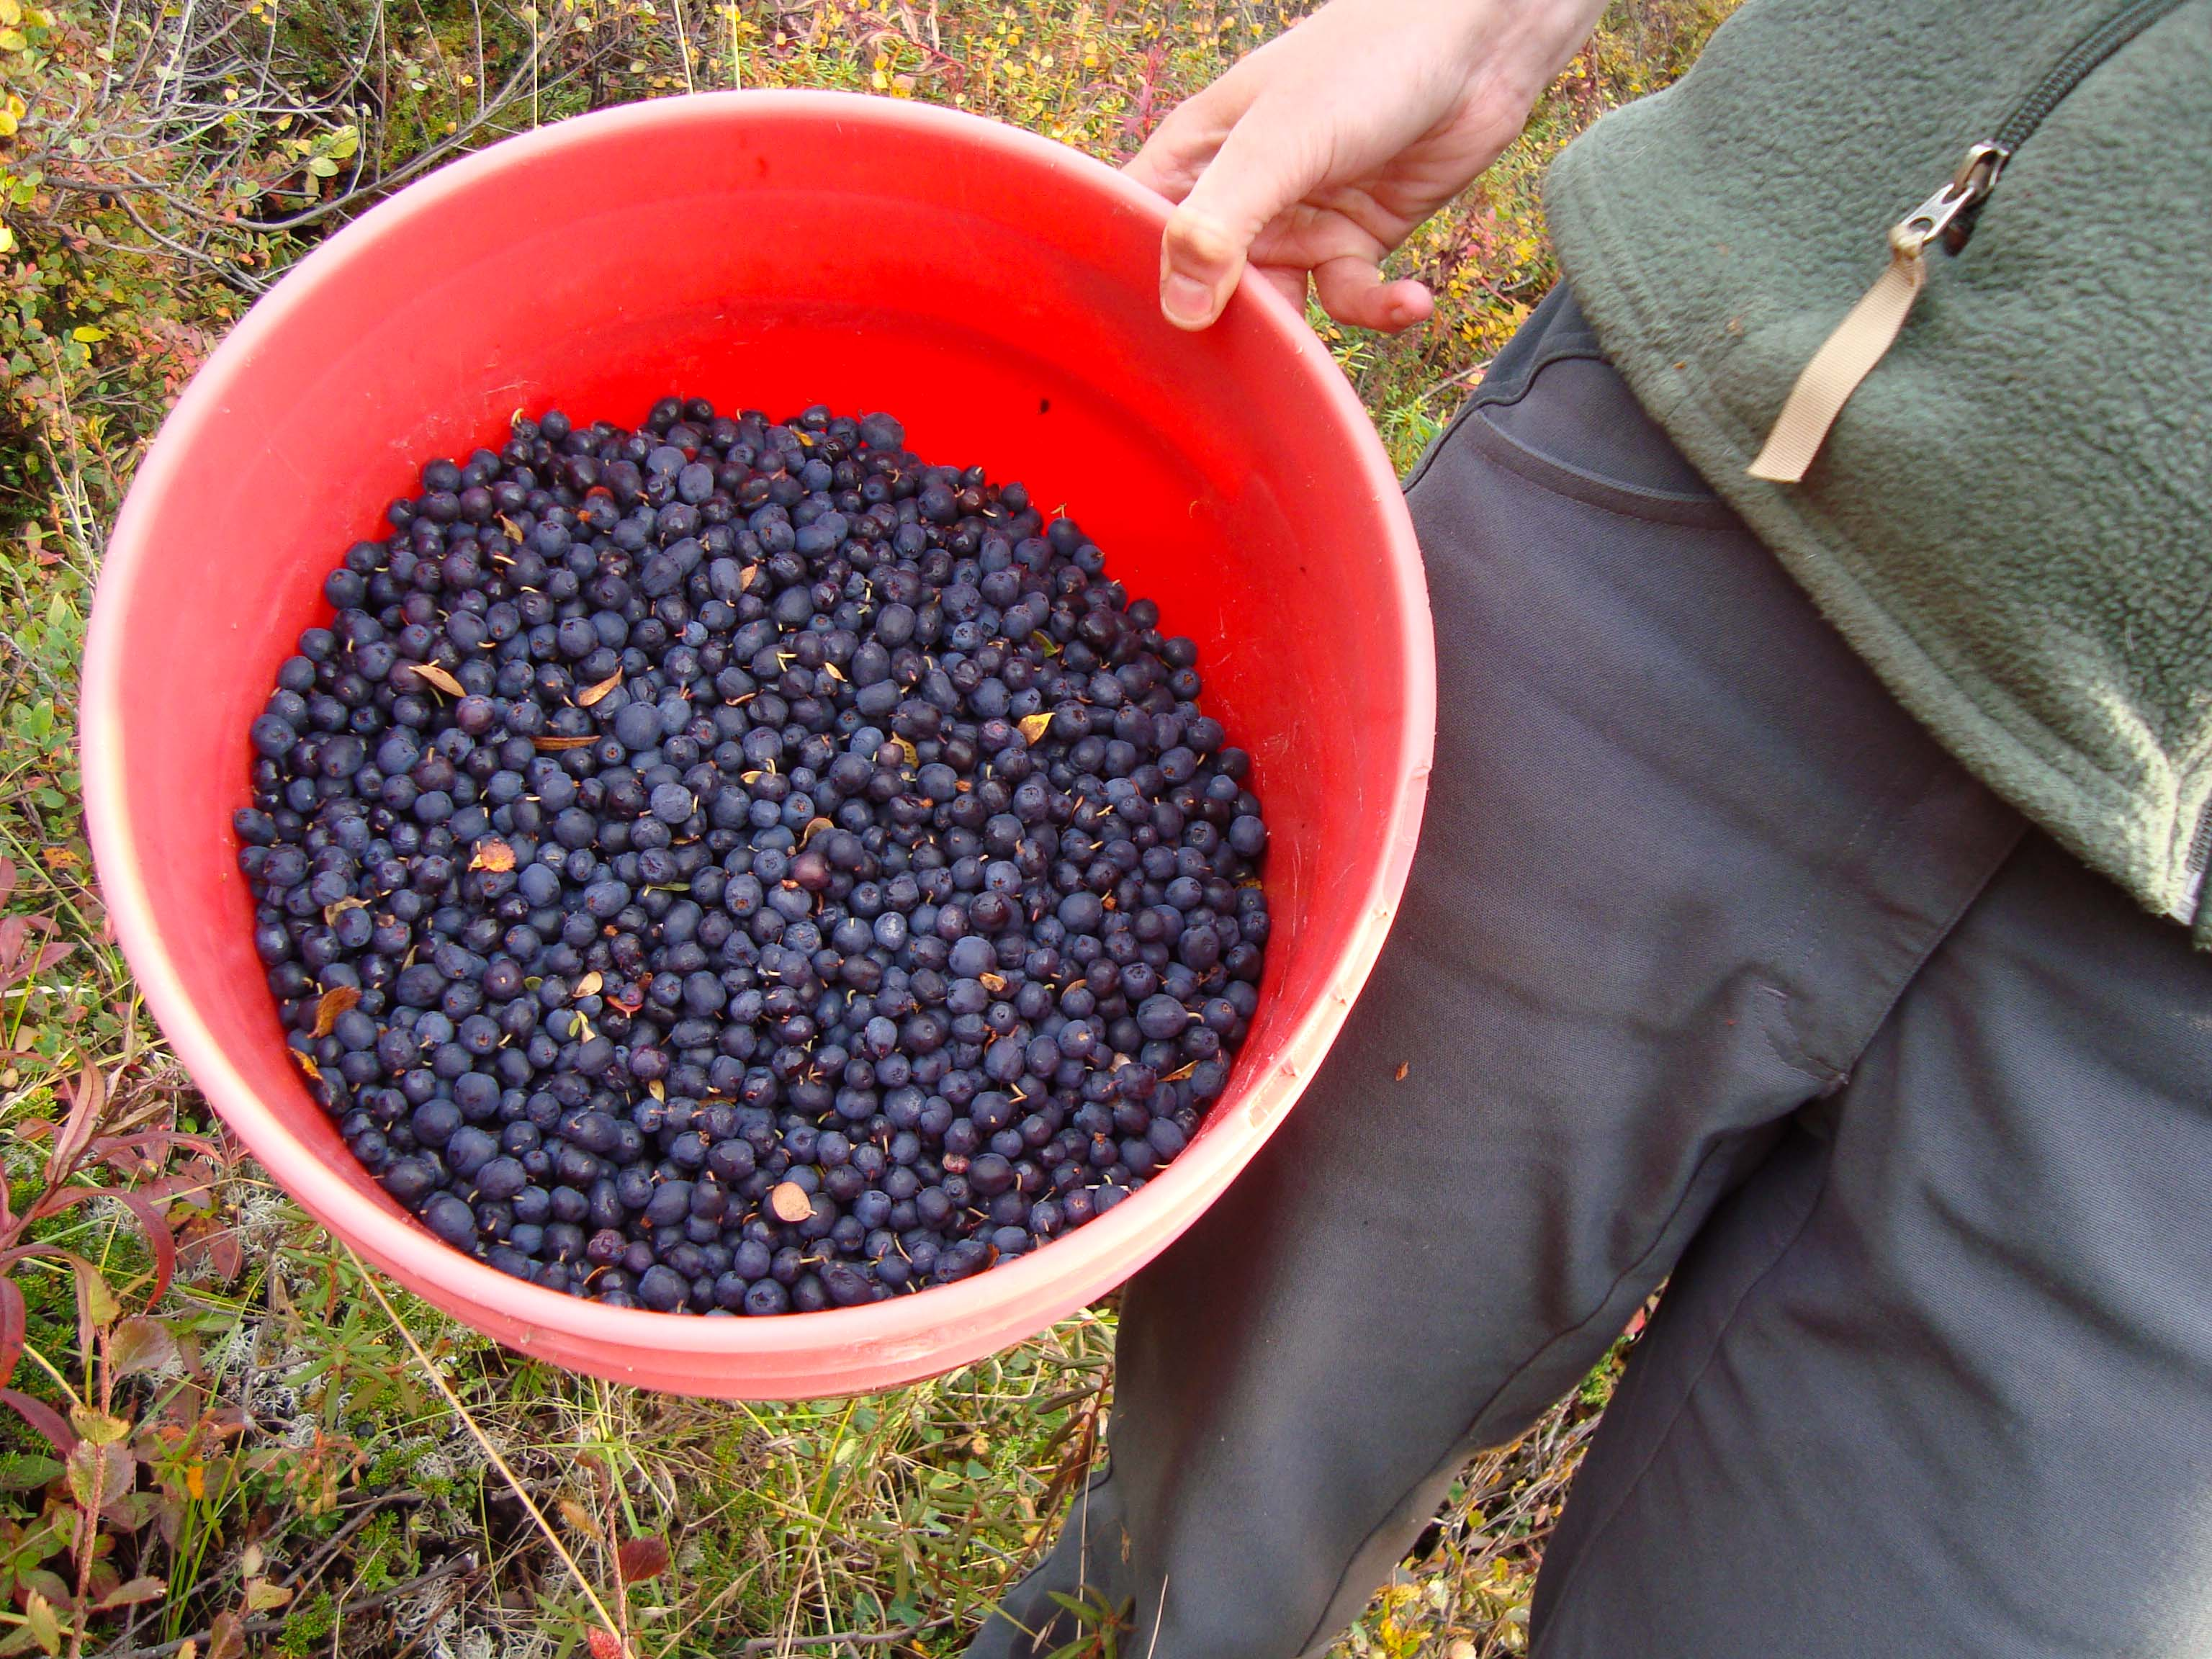
Outside the EIS
Wishbone hill coal mine, and commonly
Tribe is outside the EIS process
Legal challenges
Time, money, and alliances
The most likely outcome is the mine project is approved, or it is delayed until the company walks away

Slide 11
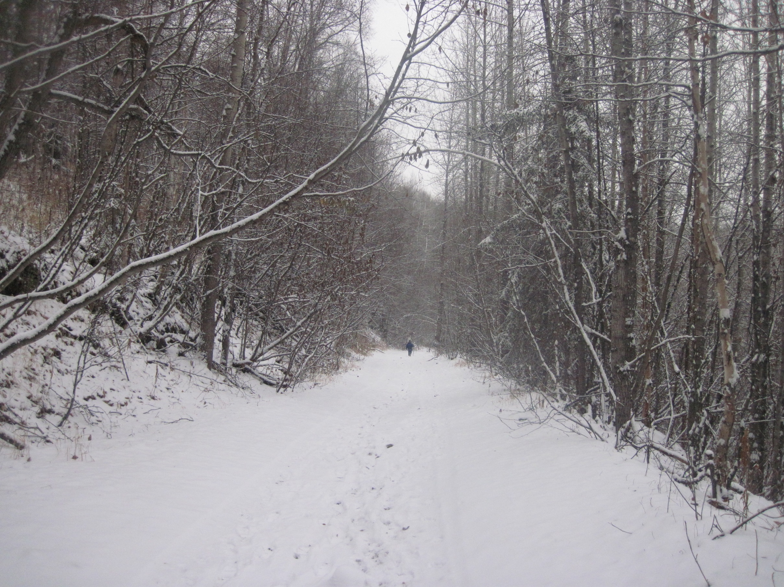
Summary
Tribes have unique status
Trust responsibility
After a mine is proposed, but before the EIS process has started, they can make requests of the federal government because the US government is "trusted" with protecting tribal nation resources
Tribes as regulatory agencies
After a mine is proposed, if there is a federal nexus, tribes can participate in developing the EIS, with the same status as state and federal agencies
Tribes as public
Where there is no federal nexus, there will be no EIS and tribes have no unique status, but can participate as members of the public.

Slide 12
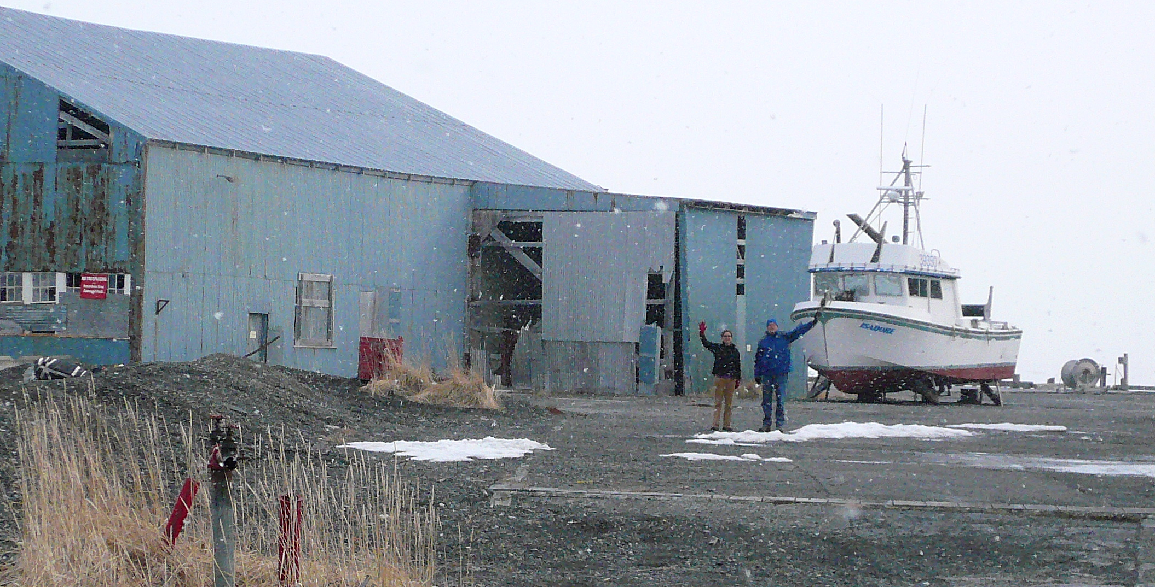
Tsin’aen
CSP²
Center for Science in Public Participation
“Technical Support for Grassroots Public Interest Groups”
kzamzow@csp2.org

