Slide 1
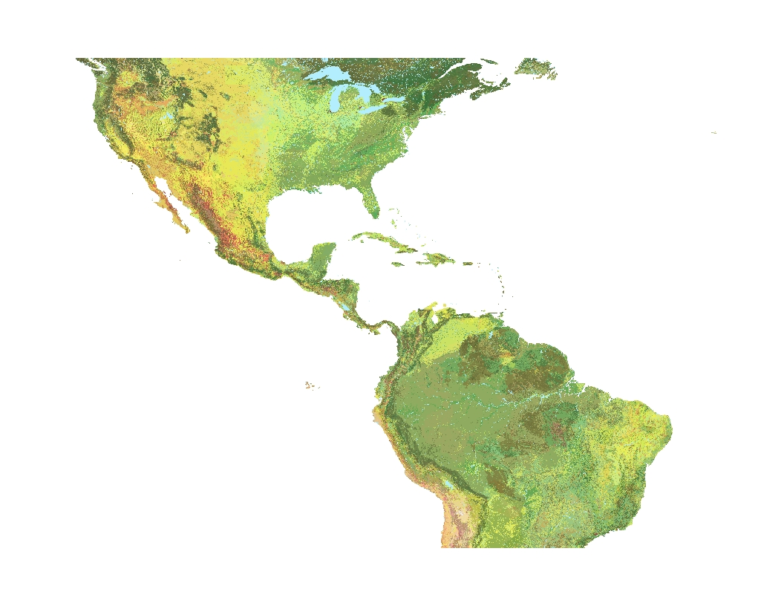

BISON, BBIF and Fossil Insects: Reconstructing Pleistocene Climate Change with Digitized Data
Sara H. Lubkin
Dept. of Geospatial Studies, Northern Virginia Community College
Earth and Environmental Science, University of Mary Washington

Slide 2
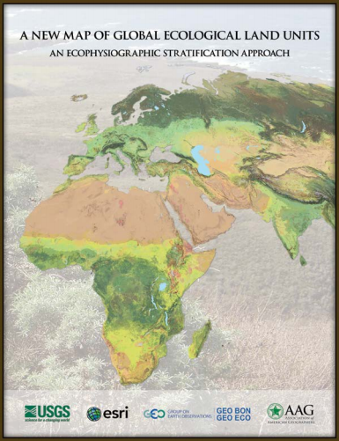
World Ecological Land Units Map
USGS, Esri
Climate
Lithology
Vegetation
Landforms
47,650 unique combinations
3,923 ecological land units
250 meter resolution
Source: http://geobon.org/Downloads/reports/2014/AAG_Global_Ecosyst_bklt72.pdf

Slide 3
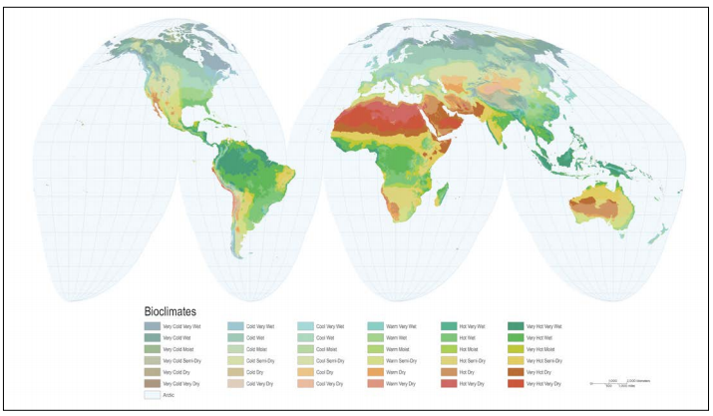
Source: http://geobon.org/Downloads/reports/2014/AAG_Global_Ecosyst_bklt72.pdf

Slide 4
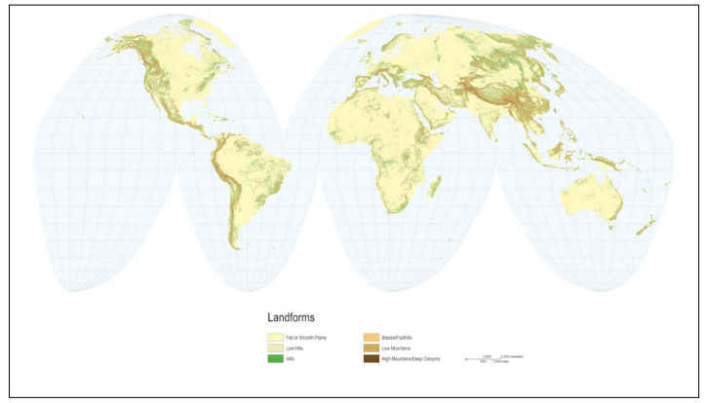
Source: http://geobon.org/Downloads/reports/2014/AAG_Global_Ecosyst_bklt72.pdf

Slide 5
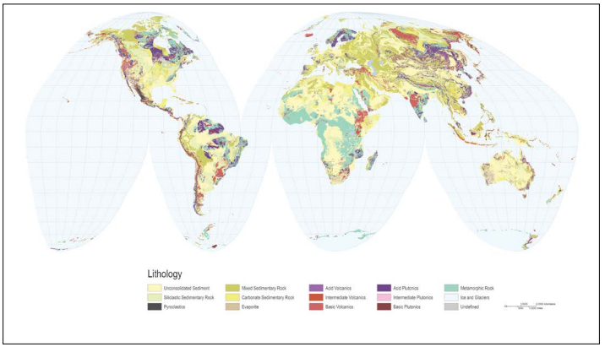
Source: http://geobon.org/Downloads/reports/2014/AAG_Global_Ecosyst_bklt72.pdf

Slide 6
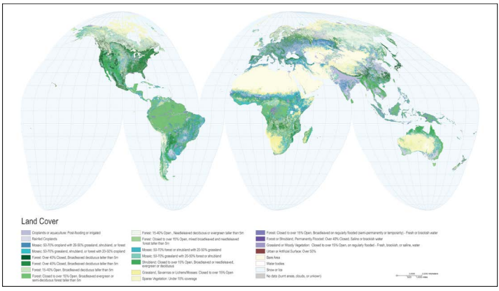
Source: http://geobon.org/Downloads/reports/2014/AAG_Global_Ecosyst_bklt72.pdf

Slide 7
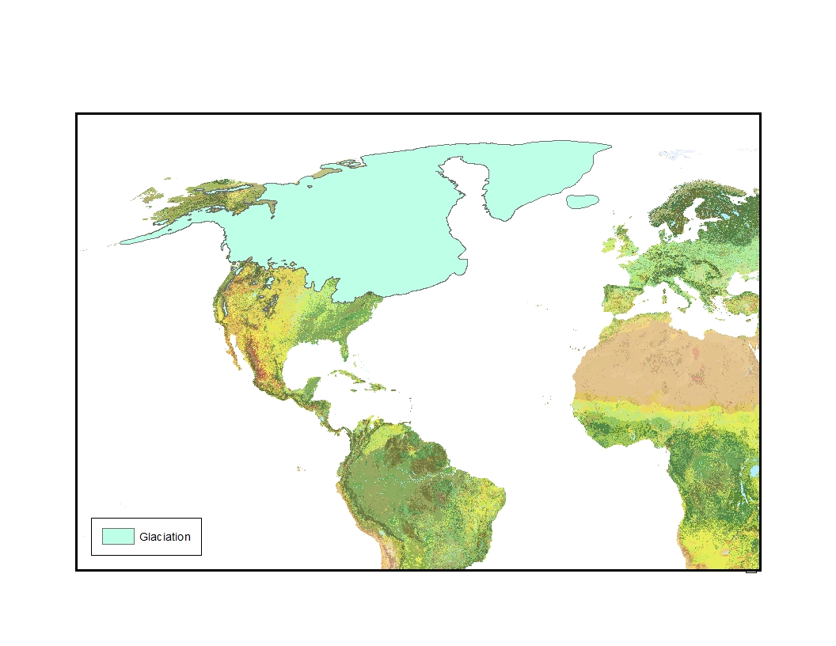
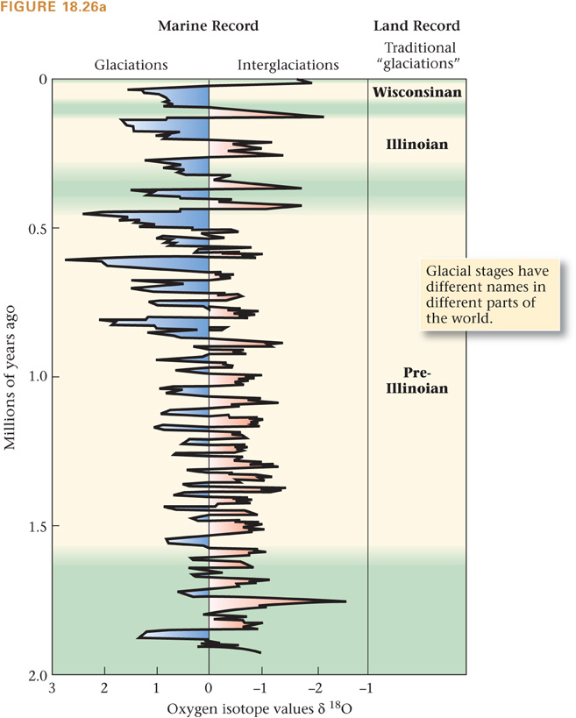
Pleistocene Epoch
Glacial Extent 18,000 BP
2.8 Ma – 12 Ka
Glaciers extended over much of the world’s temperate regions.
Glacial periods separated by interglacial periods.
Source: http://academic.macewan.ca/furzem/files/2011/10/Dyke-2004.pdf

Slide 8
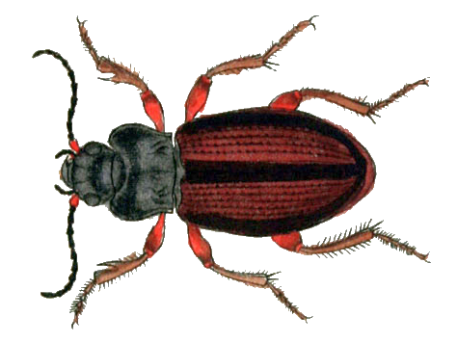
Insects as Climate Proxy
Many of the insect species alive today originated millions or tens of millions of years ago.
Many insect species have specific temperature, humidity and food requirements.
Insect species tend to migrate rather than adapt.
Source: https://en.wikipedia.org/wiki/Amara_alpina

Slide 9
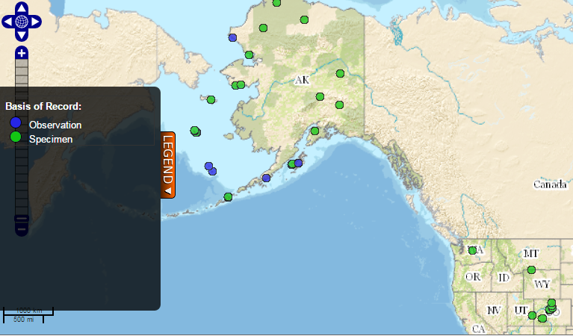
Insects as Climate Proxy
Amara alpina, Paykull 1790
High altitudes and high latitudes
Norway, Sweden, Finland, Siberia, Mongolia, Alaska
Fossil specimens from Verona, Northern Italy (Foddai & Minelli, 1994) and New York (Nelson ET AL.)
Sources:
http://bison.usgs.ornl.gov/, https://commons.wikimedia.org/wiki/File:Amara_alpina.png

Slide 10
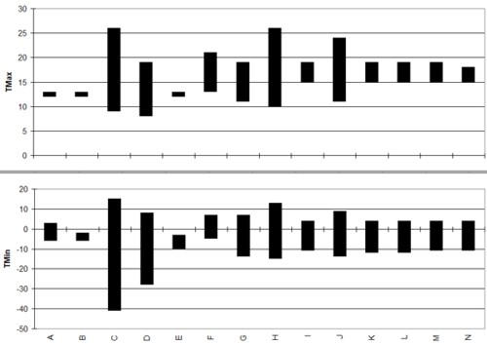
Mutual Climate Range (MCR) method
Source: http://www.bugscep.com/

Slide 11
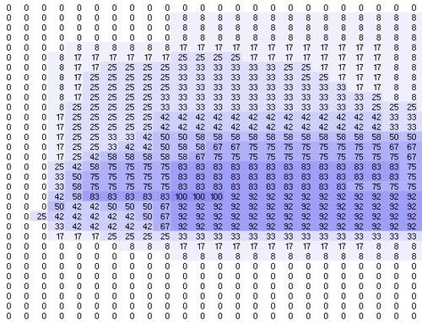
Mutual Climate Range (MCR) method
Source: http://www.bugscep.com/

Slide 12
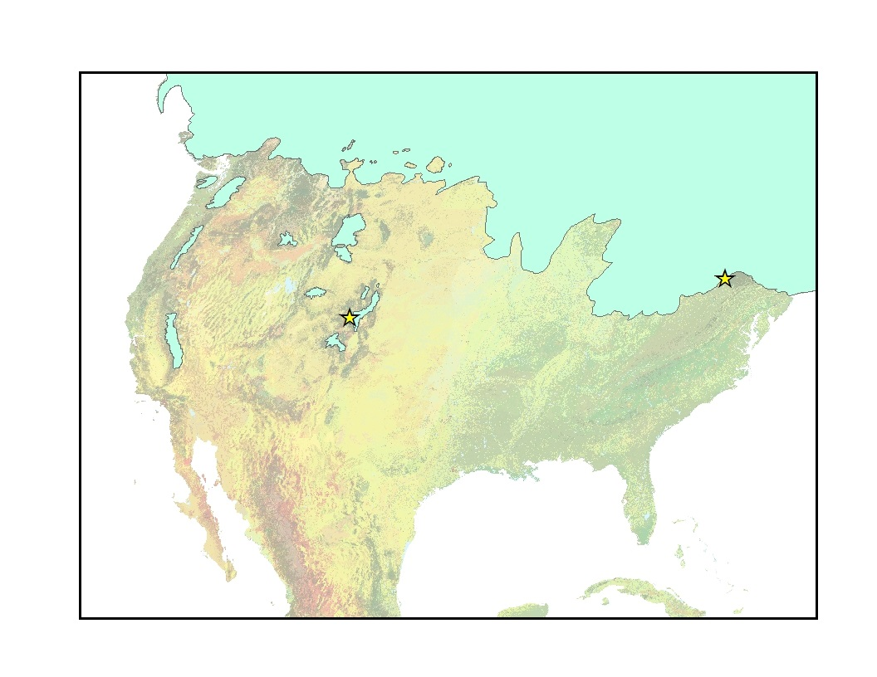
Study Sites
Titusville Peat, Titusville, PA
43.5 – 39 Ka
Peat bog
Ziegler Reservoir, Snowmass Village, CO
126-77 Ka
Mountain, elevation 2705 m
Titusville
Snowmass

Slide 13
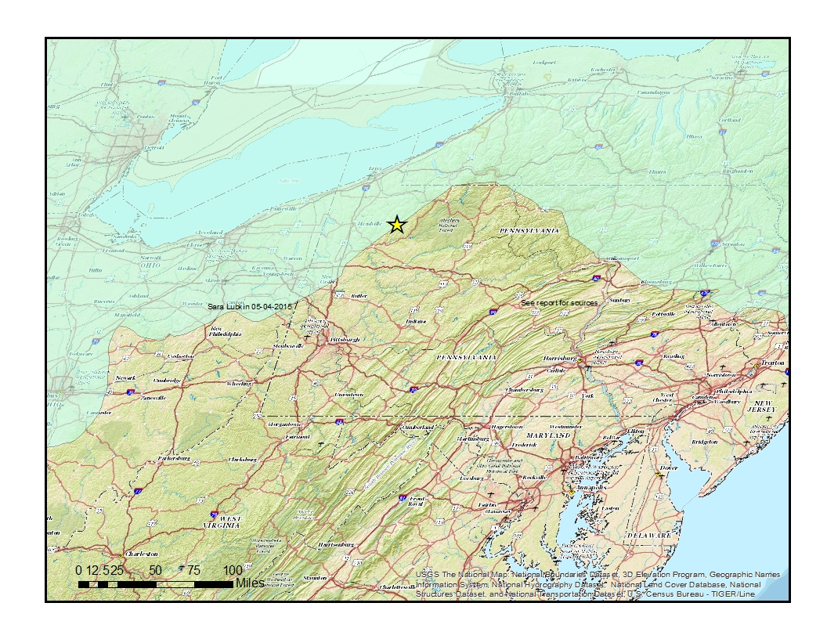
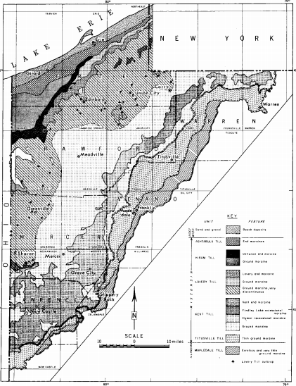
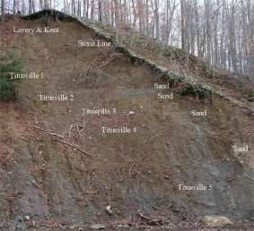
Titusville Peat, Titusville, Pennsylvania
Ancient peat bog surrounding Titusville Till
Located about 6km from late Wisconsinan ice margin
Carbon dating age: 43.5-39 Ka
Elias, 1999
Photo: Gary Fleeger, PaGS;
Map inset: http://fcopg.org/wp-content/uploads/2014/06/41st1976.pdf

Slide 14
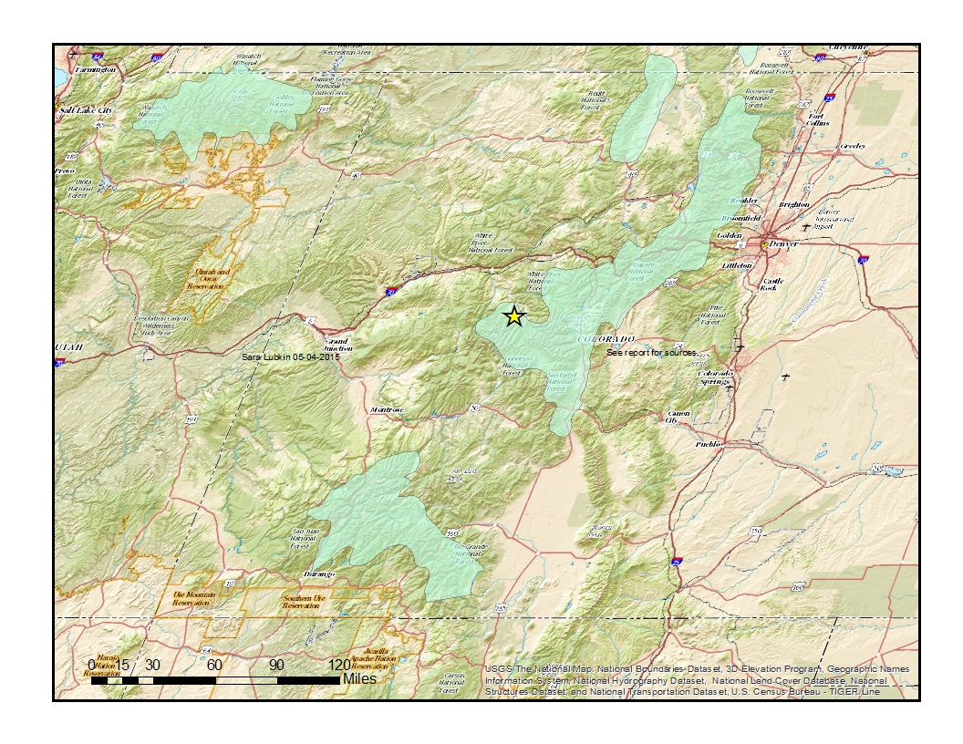
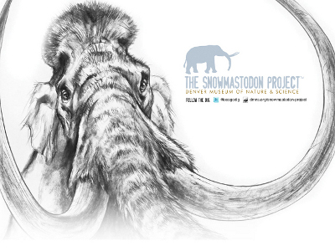
Ziegler Reservoir, Snowmass, Colorado
Paleontological excavation uncovered mammoths, mastodons, ground sloths, bison and camels
Elevation 2,720 m: Only high elevation insect site soanning MIS 5
Preserves deposits from before LGM
Carbon dating age for insect layers: 126-77Ka
Elias, 2014
Snowmastodon Poster by Denver Museum of Nature & Science

Slide 15

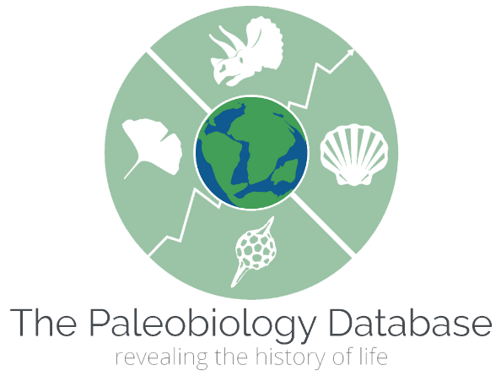

Databases used
The Paleobiology Database https://paleobiodb.org
Biodiversity Information Serving Our Nation (BISON) http://bison.usgs.ornl.gov
Global Biodiversity Information Facility http://www.gbif.org/
Potential Resource: IDigBio https://www.idigbio.org

Slide 16
Assumptions
Insects were correctly identified
Museum collections represent entire species range
Locations correctly identified
Precursor to BeetleData feature class

Slide 17
Import .csv to ArcGIS as data table
Use longitude, latitude to create x,y coordinates
Export data into ArcGIS shape file (Robinson Coordinate System)

Slide 18
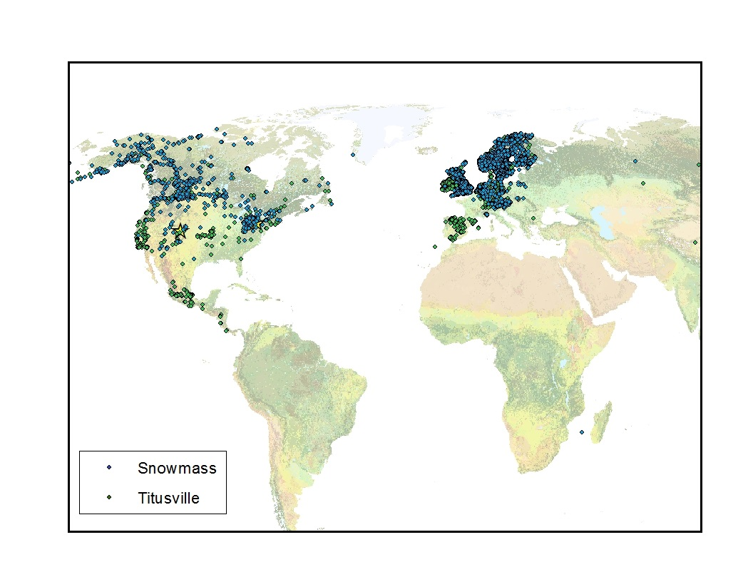
Distribution of Extant Species Based on Museum Specimens
Sources: BISON, http://bison.usgs.ornl.gov and GBIF, http://www.gbif.org/

Slide 19
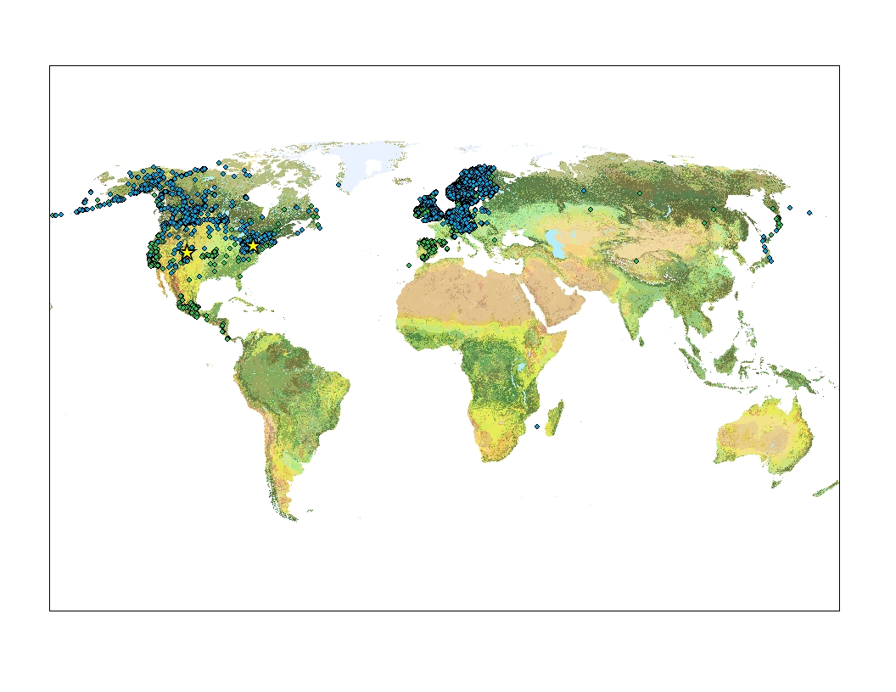
Global Ecological Land Units
Source: http://rmgsc.cr.usgs.gov/outgoing/ecosystems/Global/

Slide 20
Create a 2,000 meter around the species feature class
Use buffer to create a mask
Extract ELU data by mask
Convert to polygon feature class
Use spatial joins to add information about bioclimate and landcover to BeetleData feature class

Slide 21
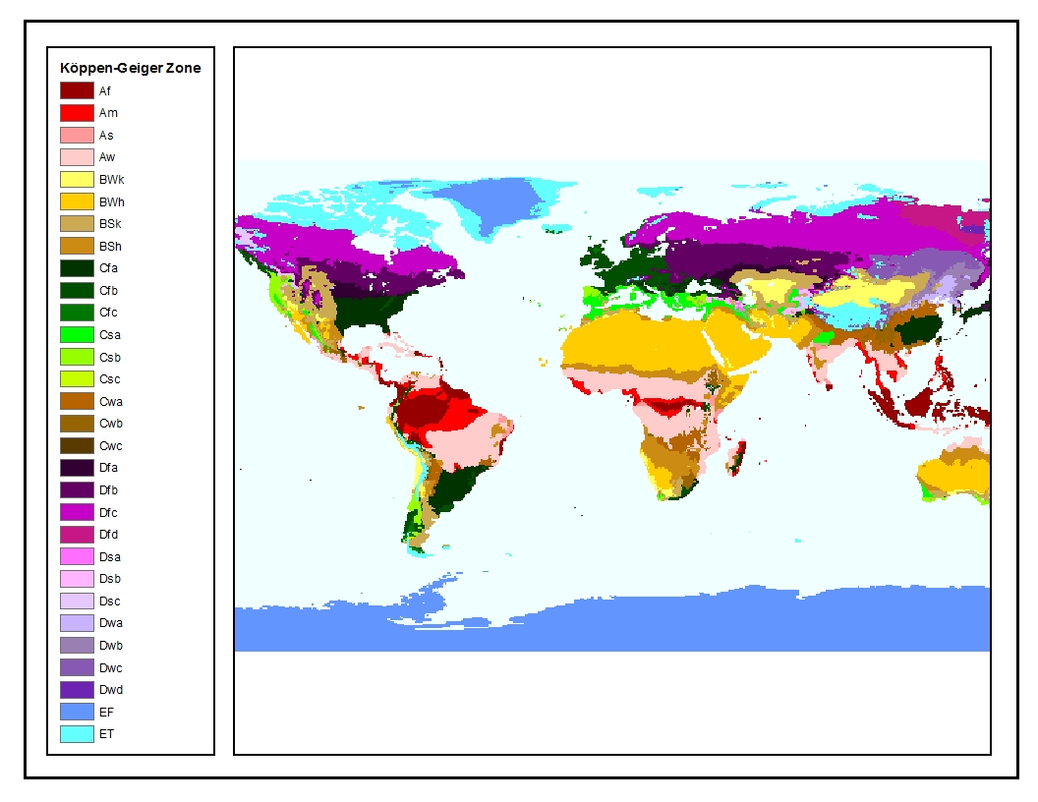
Köppen-Geiger Zones of the World
Source: http://koeppen-geiger.vu-wien.ac.at/

Slide 22
Project raster in Robinson projected coordinate system
Convert to polygon feature class
Use spatial join to add climate zone information to BeetleData feature class

Slide 23
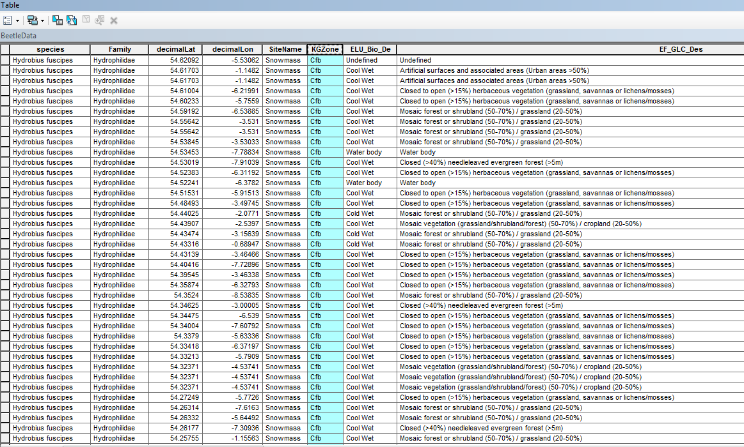

Slide 24
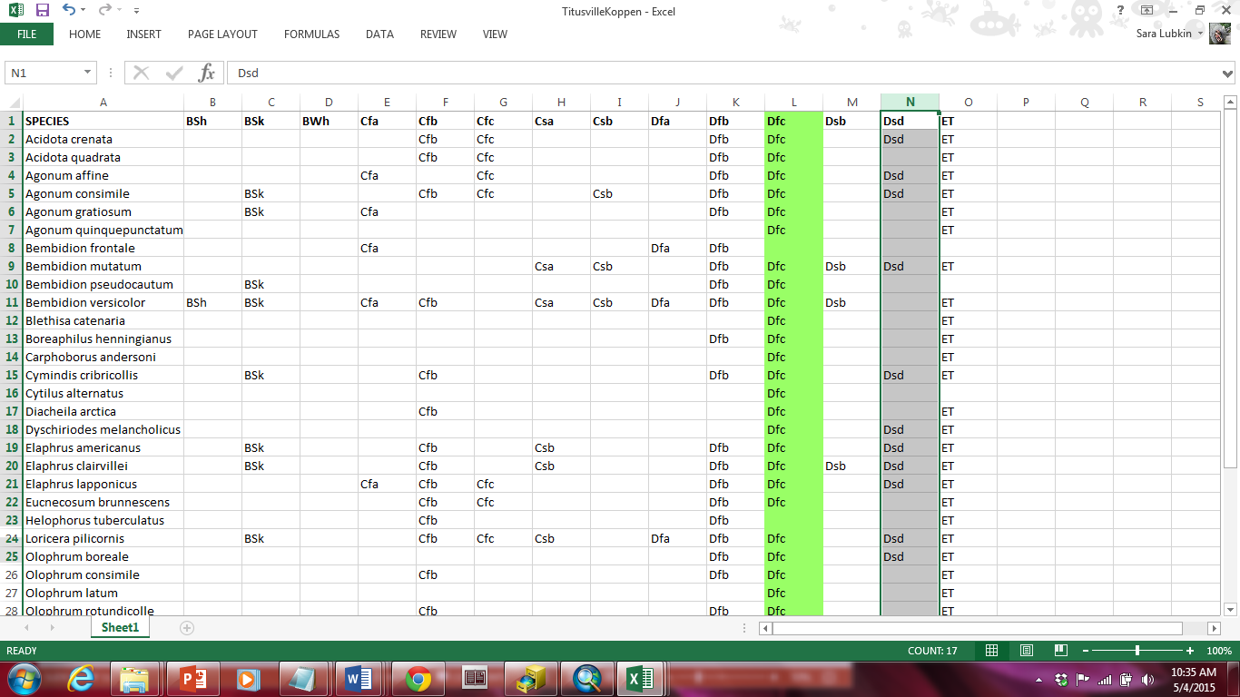

Slide 25
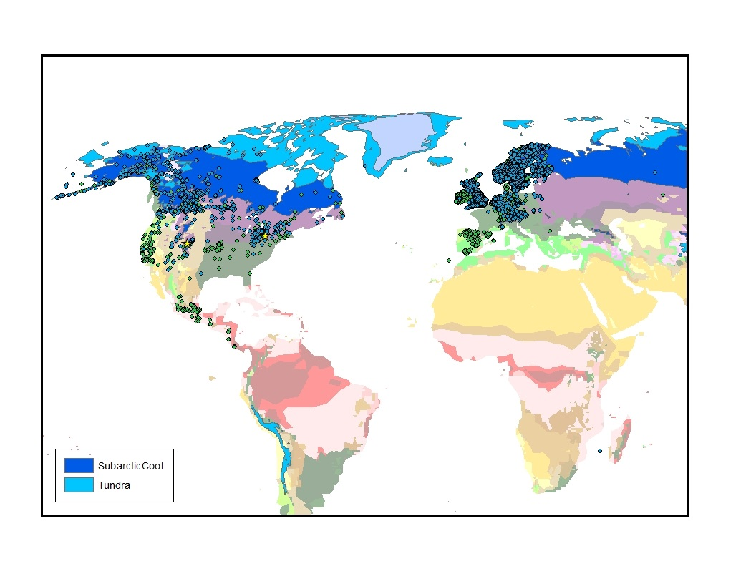
Modern Distribution of Subarctic Cool (Dfc) Climate Zone

Slide 26
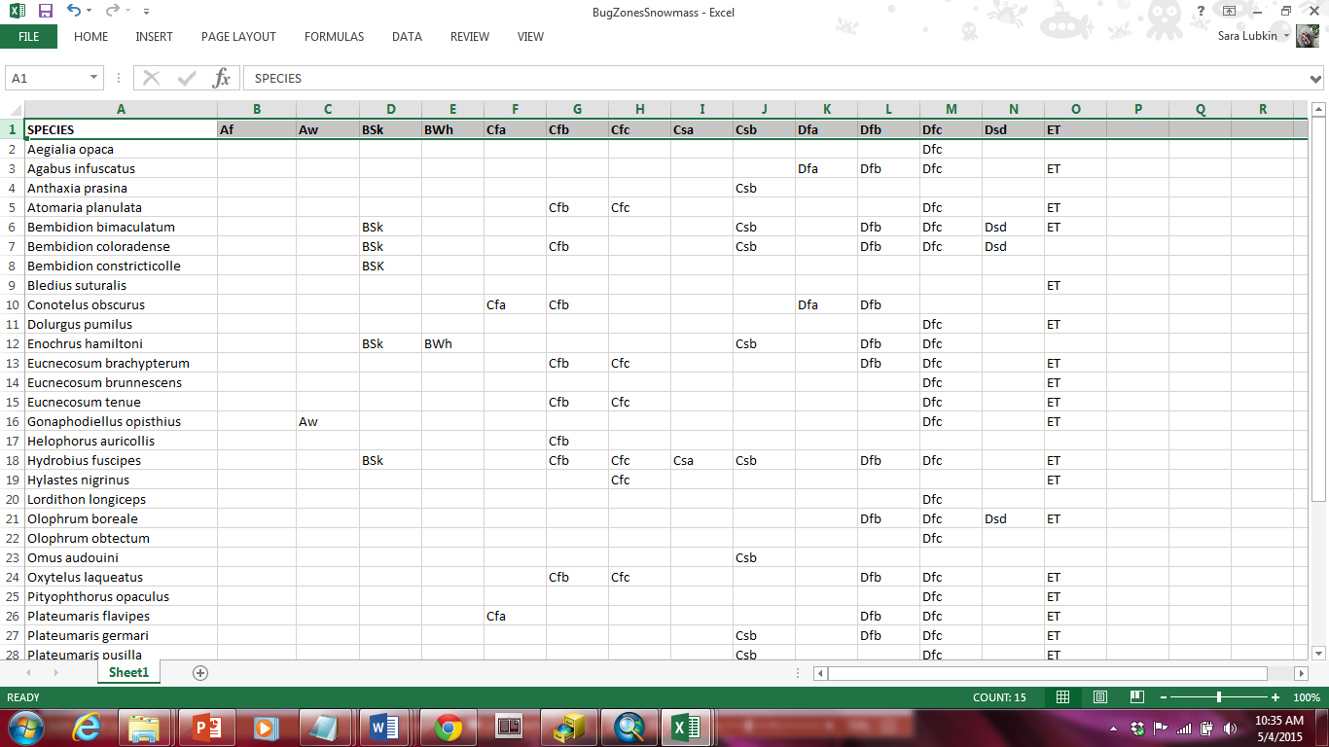

Slide 27
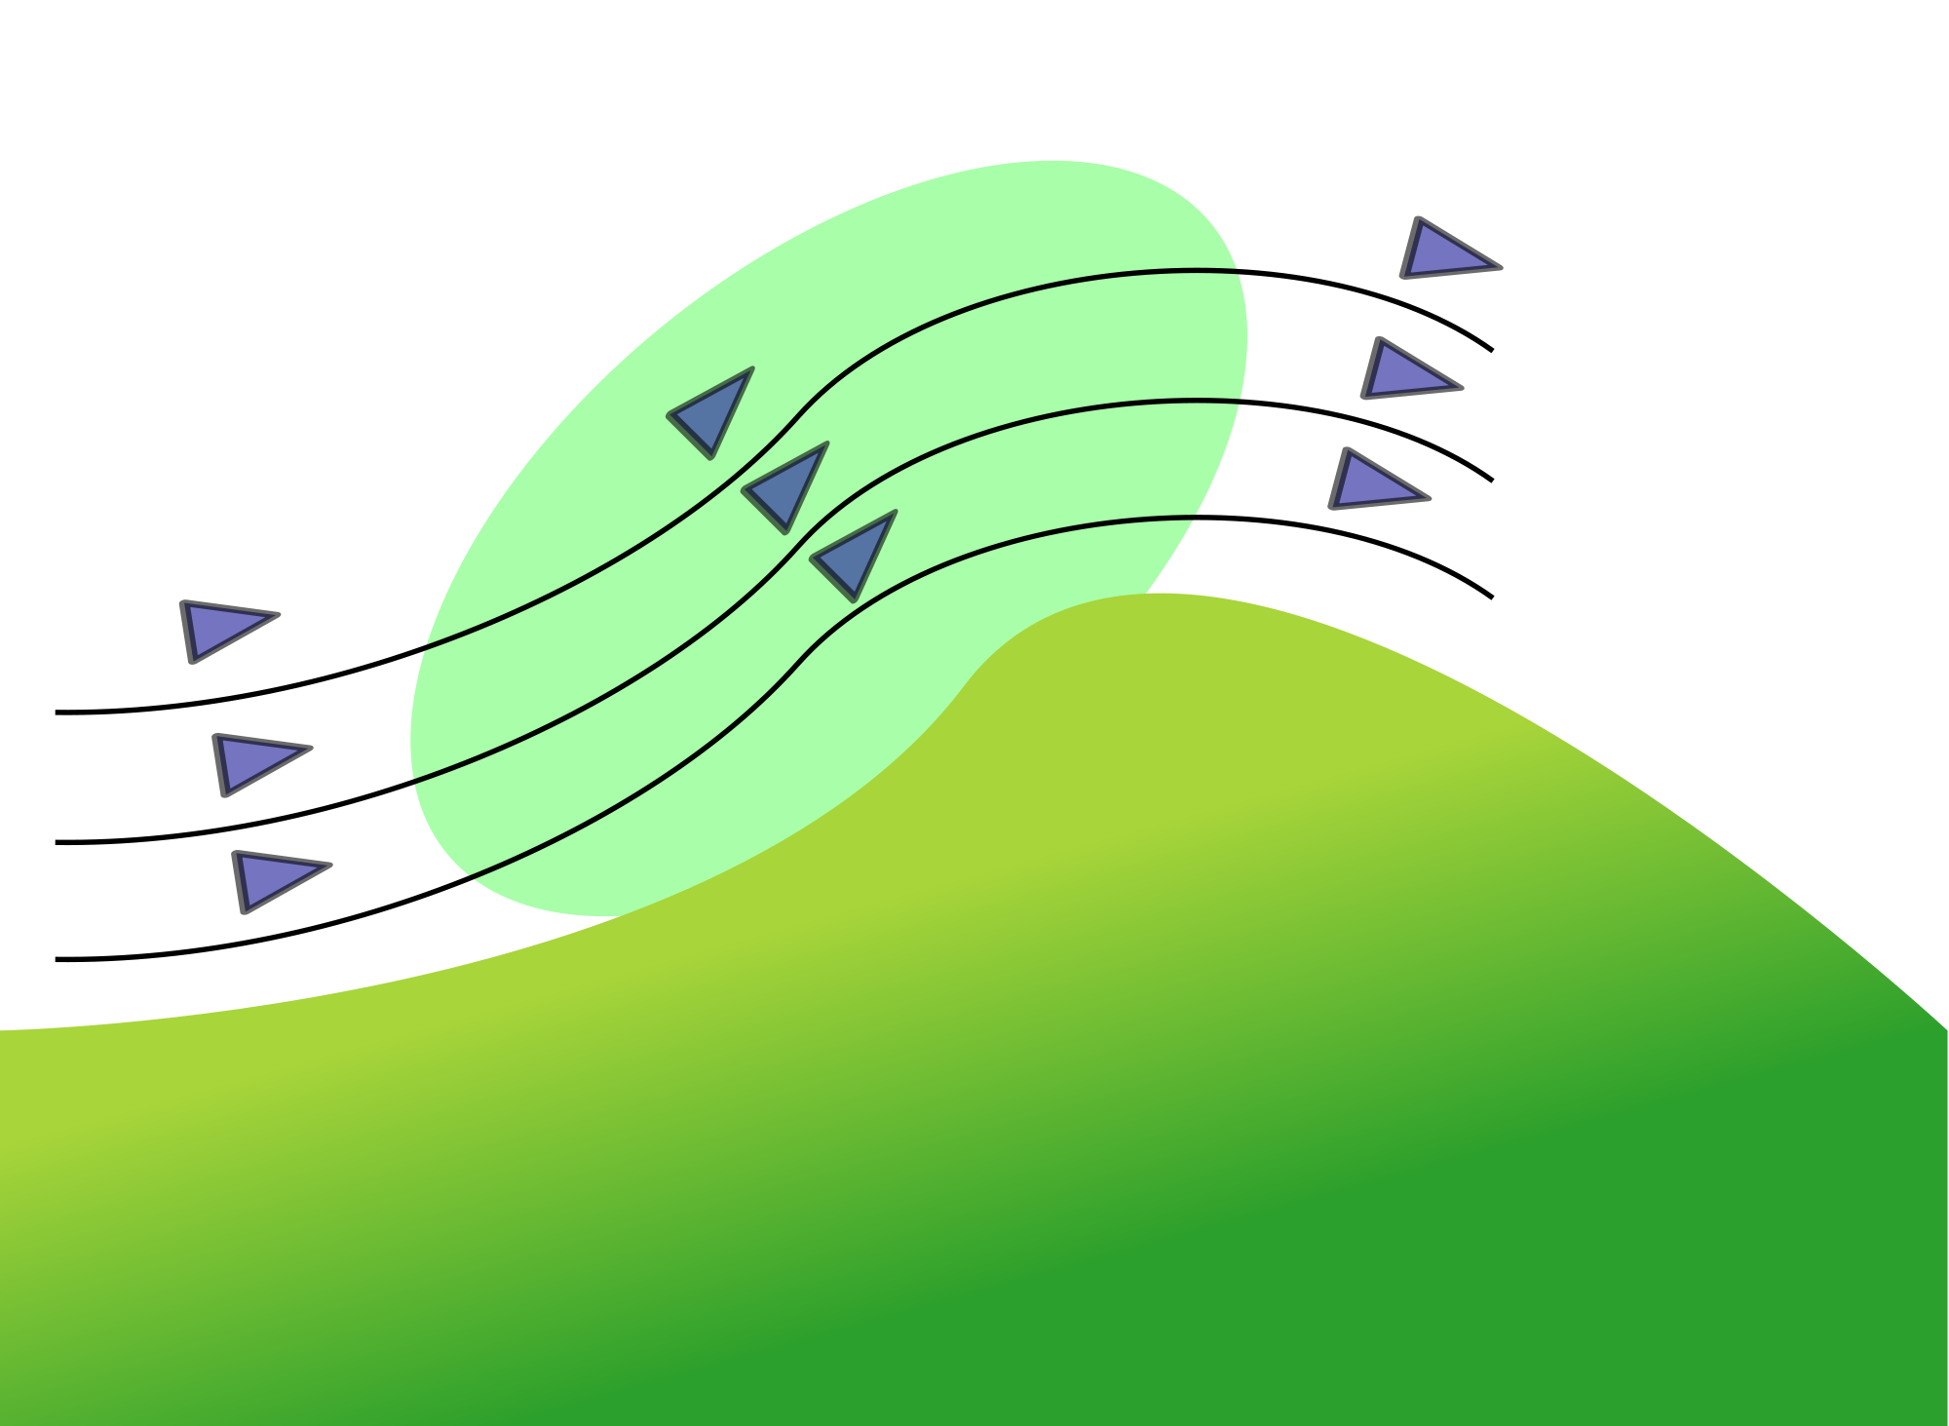
Orographic Lifting
Source: https://en.wikipedia.org/wiki/Ridge_lift

Slide 28
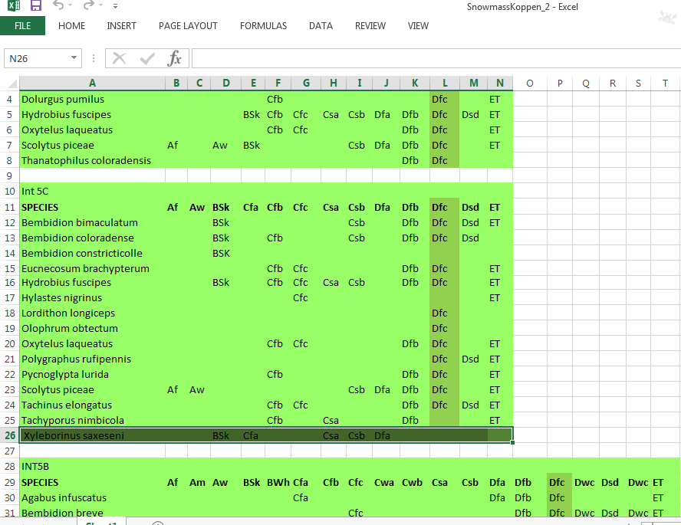

Slide 29
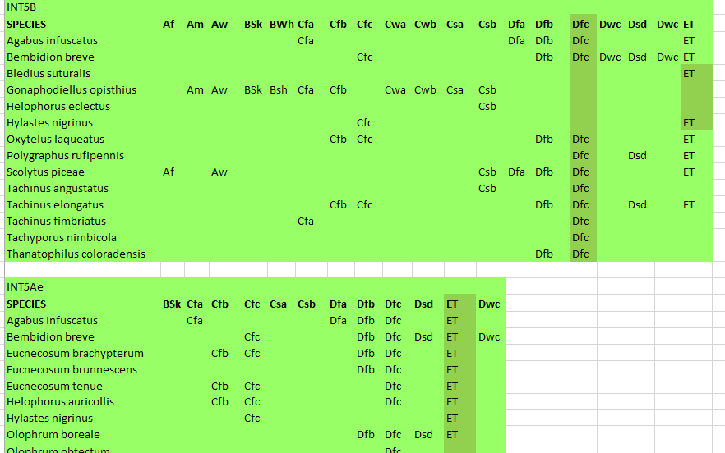

Slide 30
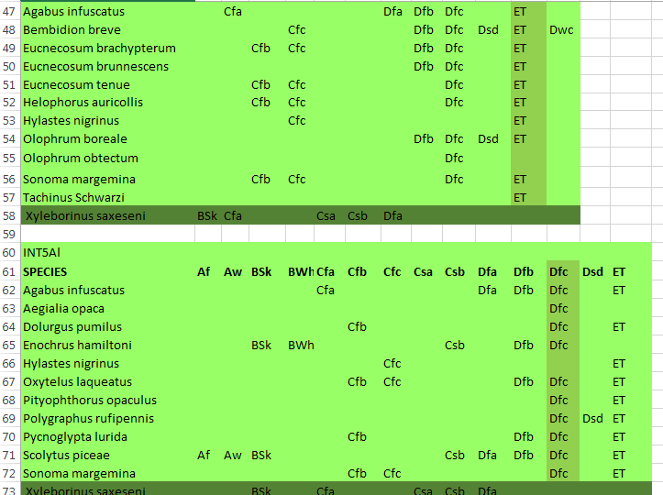

Slide 31
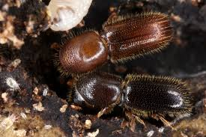
Xyleborinus saxeseni
Fruit-tree pinhole borer
Ambrosia beetle
Agricultural pest native to Europe and the Middle East
Introduced to the United States
Source: BugGuide.net

Slide 32
Conclusions – Titusville PA
Köppen-Geiger: The climate in Titusville was subarctic with severe winters and cool summers with no dry season (zone DFC)
Bioclimate: Cold, wet climate (300-2,500 growing degree days; aridity index of 1.0 – 70)
Vegetation: Needle leaf/evergreen forest
Similar to: the Yukon, Siberia, Northwest Territories, and the High Rocky Mountains of Colorado

Slide 33
Conclusions – Snowmass, CO
Köppen-Geiger:
Interval 5e, 126-120 Kya, zone Dfc
Interval 5d, 103-101 Kya, zone Dfc to zone ET
Interval 5b, 93-87 Kya, zone Dfc to zone ET
Interval 5a (early), 87-84 Kya, zone ET
Interval 5a (late), 84-77 Kya, zone Dfc
Bioclimate: Cold, wet climate (300-2,500 growing degree days; aridity index of 1.0 – 70)
Vegetation: Needle leaf/evergreen forest
Results are consistent with previous insect studies and marine isotope data

Slide 34
Modern Distribution of Subarctic Cool (Dfc) and Tundra (ET) Climate Zones

Slide 35
Next Steps
Create tools using ArcMap’s Model Builder and Python
Expand to 26 North American, late Pleistocene fossil sites
Add mean summer and winter temperature, precipitation and other variables
Develop a method to address species density within species range when data is available

Slide 36
Acknowledgements
A big thank you to:
Dr. Michael Krimmer, Geospatial Studies, Northern Virginia Community College
Dr. Robert Nelson, Department of Geology, Colby College

Slide 37
References
Atkinson, T. C., Briffa, K. R., Coope, G. R., Joachim, M. J., and Perry, D. W., 1986, Climatic calibration of coleopteran data in Berglund, B.E., ed., Handbook of Holocene Palaeoecology and Palaeohydrology: Wiley, Chichester, p. 851–859.
BISON, Biodiversity Information Serving Our Nation, http://bison.usgs.ornl.gov (accessed 17 April 2015).
Elias, S.A., 1999, Mid-Wisconsin seasonal temperatures reconstructed from fossil beetle assemblages in eastern North America: comparison with other proxy records from the Northern Hemisphere, Journal of Quaternary Science, v. 14, p. 255-262.
Elias, S.A., 2014, Environmental interpretation of fossil insect assemblages from MIS 5 at Ziegler Reservoir, Snowmass Village, Colorado, Quaternary Research, v. 82, p. 592-603.
Foddai, D., and Minelli, A., Fossil arthropods from a full-glacial site in northeastern Italy, Quaternary Research, v. 41, p. 336-342.
Rubel, F., and Kottek, M., Observed and projected climate shifts 1901-2100 depicted by world maps of the Köppen-Geiger climate classification, Meteorologische Zeitschrift, v. 1, p. 135-141.
GBIF.org, GBIF Occurrence Downloads, http://www.gbif.org/ (accessed 17th April 2015).
PBDB, Paleobiology Database Occurrence Data, http://paleobiodb.org/navigator (accessed 17th April 2015).
Sayre, R. J., Dangermond, Frye, C., Vaughan, R., et. al., 2014, A New Map of Global Ecological Land Units — An Ecophysiographic Stratification Approach, http://rmgsc.cr.usgs.gov/outgoing/ecosystems/Global/ (accessed 17th April 2015).
Walker, K., 2008, Fruit-tree pinhole borer (Xyleborinus saxeseni), Pest and Diseases Image Library. http://www.padil.gov.au (accessed 17th April 2015).

