Slide 1
Eruption cycles and explosive hazards at Kīlauea Volcano, Hawaiʻi
Don Swanson
USGS Hawaiian Volcano Observatory

Slide 2
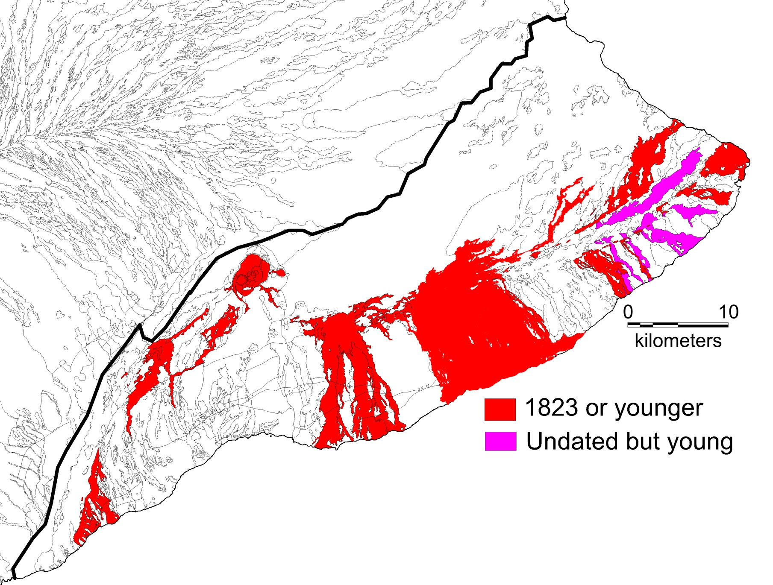
Mauna Loa
Kīlauea
About 21%―304 km²―of Kīlauea’s subaerial surface has been covered by lava flows since 1823
(23.5%, ~ 335 km², since ~1800)

Slide 3
A notable change in thinking about Kīlauea
During the past 25 years, we’ve come to realize that Kīlauea is an explosive volcano, in terms of frequency of eruption (though not volume)
Its explosions include not only the familiar Hawaiian-style lava fountains but also powerful phreato-magmatic and phreatic activity
It is this activity, driven partly or entirely by external water, that is the subject of this talk
Explosive eruptions are not curiosities but instead fundamental parts of Kīlauea’s eruptive behavior

Slide 4
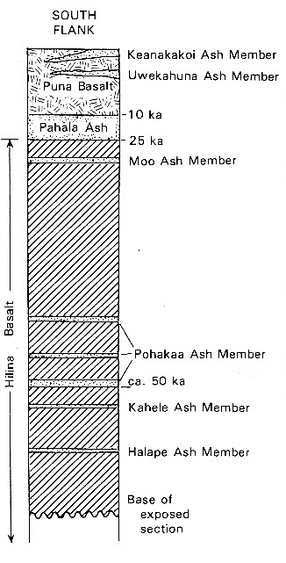
Exposed only
distally, 15–20 km
from summit vent
From Mike Easton, 1987, Stratigraphy of Kilauea Volcano: USGS Prof Paper 1350

Slide 5
Major characteristics of Kīlauea explosive eruptions in the past 2500 years
Subplinian plume heights ( ̴10 km) were often reached, and pyroclastic surges were common
Ejecta volumes for single eruptions are small
Maximum ejecta volume for single eruption ̴ 0.02 km³ (low VEI 3)
Almost every eruption ejected both lithic and juvenile components
Striking contrast to the 100% juvenile content of lava fountains

Slide 6
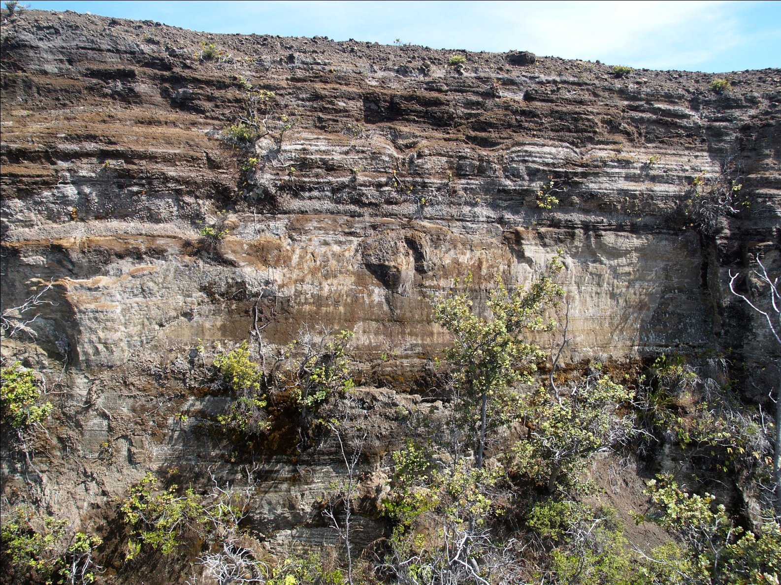
A major finding is that the explosive activity, at least for the past 2500 years, occurred in periods lasting centuries, defined by calendar-calibrated ¹⁴C ages
Ca. 200 BCE to 1000 CE: Uwēkahuna, including the Kulanaokuaiki Tephra Member
Ca. 1500 to 1800 CE: Keanakākoʻi Tephra
1790
~1650
~11 m
~1500
Keanakāko‘i Tephra in south caldera

Slide 7
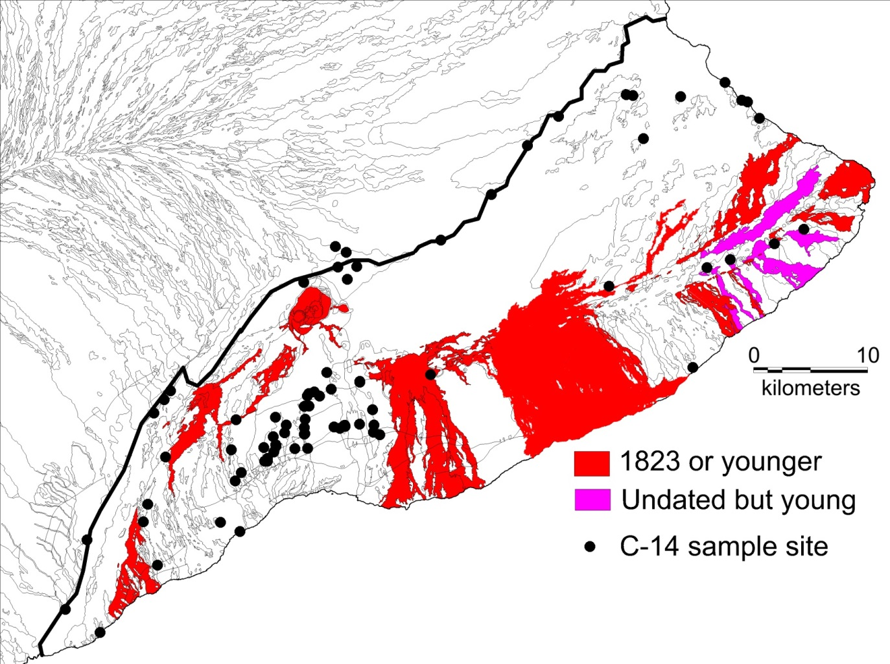
Are the explosive periods superimposed on periods of lava flow effusion?
Or, do explosive periods alternate with effusive periods in binary fashion?
Sites of dated lava flows on Kīlauea

Slide 8
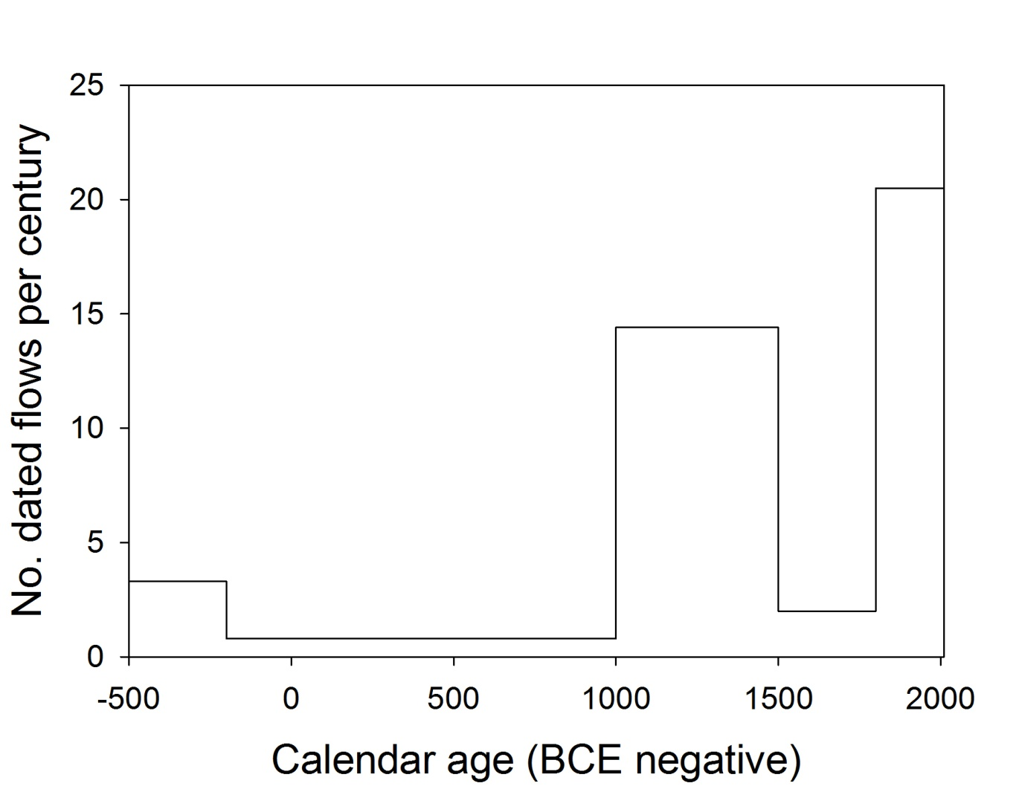
Keanakākoʻi Tephra
14.4
20
UwēkahunaTephra
3.3
0.8
2
Number of calendar-calibrated ¹⁴C ages of lava flows per century
Edifice-building lava flows dominant 40% of past 2500 y
Episodic explosive activity dominant 60% of past 2500 y

Slide 9
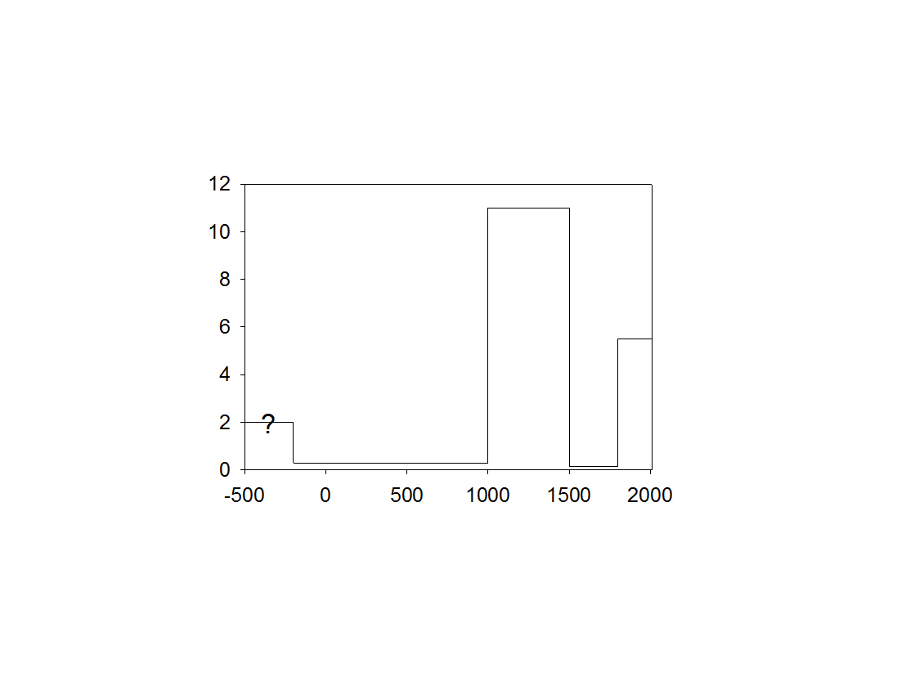
Volume (km³)
Keanakākoʻi Tephra
?
Uwēkahuna
Tephra
Calendar years (BCE negative)
Approx. magma supply rate to the GROUND SURFACE
200 BCE-1000 CE, 2.5×10⁻⁴ km³/yr
1000-1500 CE, 2.2×10⁻² km³/yr
1500-1800 CE, 5×10⁻⁴ km³/yr
1800-2015 CE, 2.6×10⁻² km³/yr

Slide 10
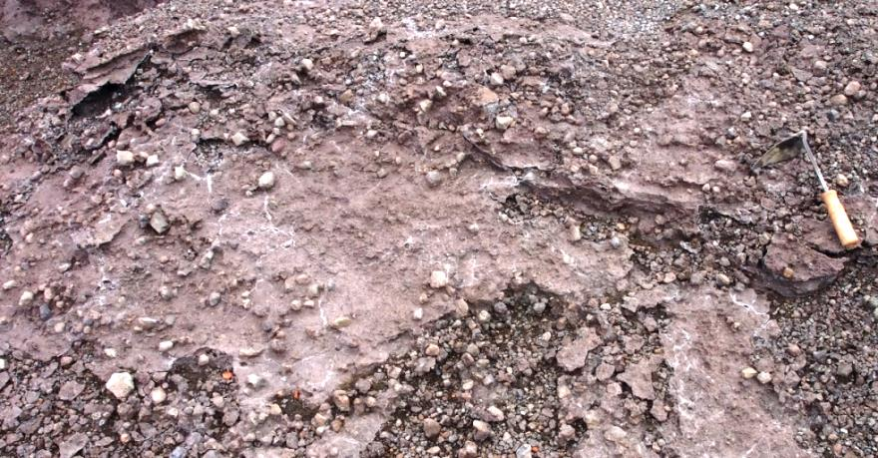
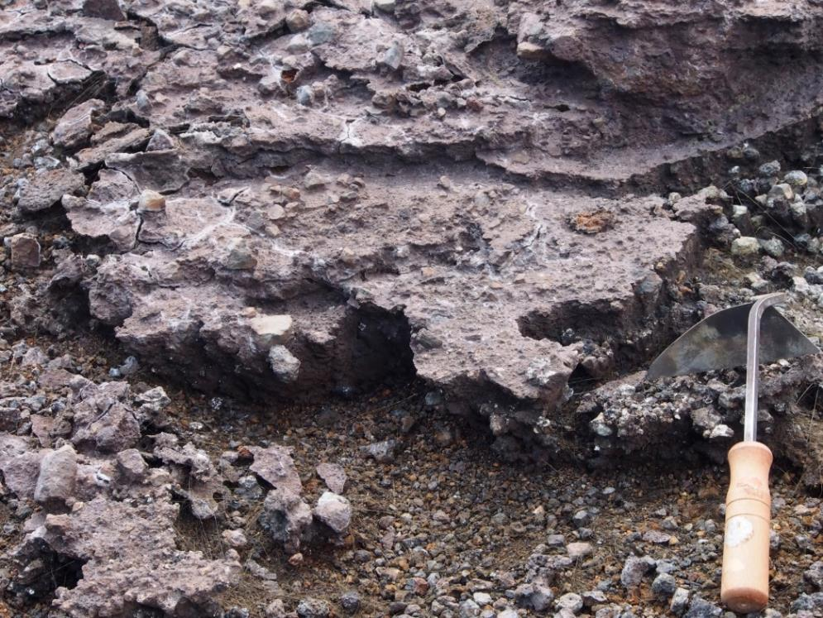
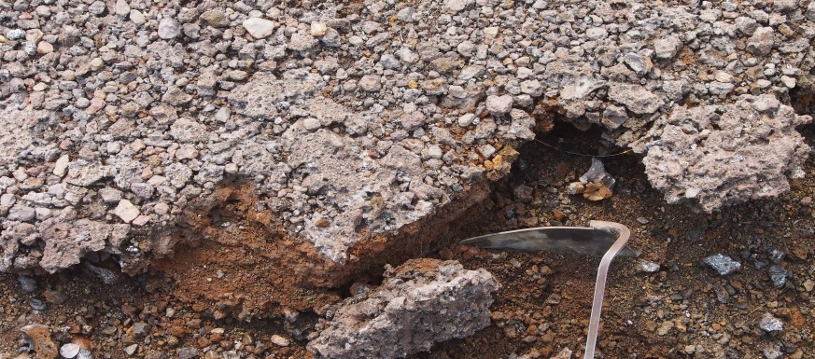
Supporting evidence for decreased magma supply rate during explosive periods
Today, silicic crusts are forming downwind from the summit area on all exposed surfaces
Amorphous silica and, locally, jarosite

Slide 11
The silicic crusts form from interaction of sulfuric-acid-rich aerosol “fog” with tephra and lava flows
Schiffman, Zierenberg et al., 2006, Geology
The acid forms from SO₂ emitted at the summit, currently ca. 800 tonnes/day
Crusts are forming today, recognizable in a month’s time on scraped surfaces
SILICIC CRUSTS ARE ABSENT IN THE KEANAKĀKO‘I
This suggests that SO₂ output was much lower than at present
Consistent with reduced magma supply, since SO₂ flux is proportional to the mass of magma nearing the ground surface

Slide 12
Deep caldera
The phreatomagmatic and phreatic explosive eruptions are thought to be generated at or below the water table (Mastin model)
Water table today is ca. 615 m below caldera rim
This implies the existence of a deep caldera during the long periods of tephra production
Possibly repeated small collapses, but the caldera never overflowed, according to the ¹⁴C ages
Initial caldera volume, ca. 4-6 km³
Caldera would have filled in several decades at today’s average rate of ca. 0.12 km³/yr
This is more evidence of reduced magma supply rate

Slide 13
Chemical extremes
The shallow magma reservoir complex must be destroyed or severely modified during caldera collapse
Before it is restored, relatively unusual melt compositions may be ejected
Primitive magma can erupt without shallow storage
Glass compositions up to nearly 13% MgO in Kulanaokuaiki (Tim Rose) and ≥11% in Keanakāko‘i (Ado Mucek)
Such high MgO glass is otherwise rare at Kīlauea’s summit and may appear when the summit reservoir is absent (or bypassed, as during the 1959 Kīlauea Iki eruption)
Strong fractionation may occur in magma bodies isolated from throughput (typically, TiO₂ 2.5% and K₂O 0.4-0.5%)
TiO₂ >3% and K₂O >0.7% in Kulanaokuaiki
TiO₂ up to 4.7% and K₂O to 0.9% in Keanakāko‘i

Slide 14
What causes lowered magma supply rate to Kīlauea’s surface during explosive periods?
Is the melting rate constant but magma isn’t reaching Kīlauea, perhaps hijacked into sills in the oceanic crust?
Or, is the melting rate in the mantle reduced?
There is suggestive evidence that the melting rate may actually be lower during explosive periods
In the Keanakāko‘i, the K₂O/MgO ratio of glass is mostly higher during explosive periods than during effusive periods
This suggests a lower degree of partial melting during explosive periods, consistent with reduced magma supply
Assuming no K enrichment by mantle metasomatism

Slide 15
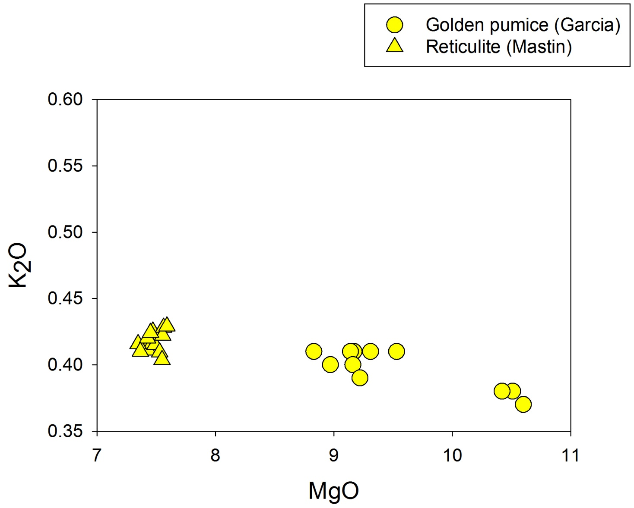
Just before,
or at start of,
Keanakāko‘i
Just after, or at end of,
Keanakāko‘i
Keanakāko‘i vitric tephra (pumice and ash)

Slide 16
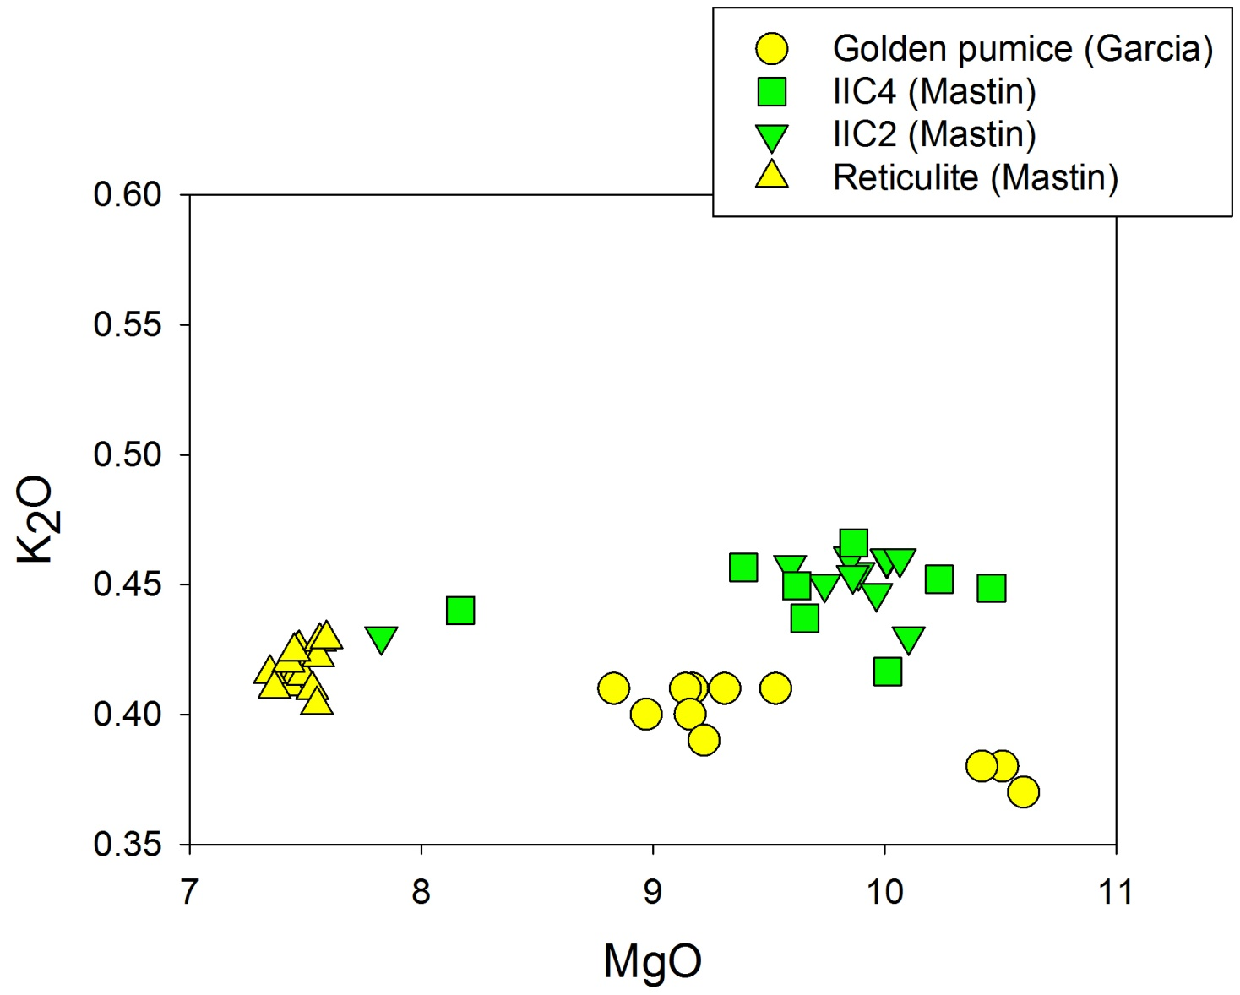
Keanakāko‘i vitric tephra (pumice and ash)

Slide 17
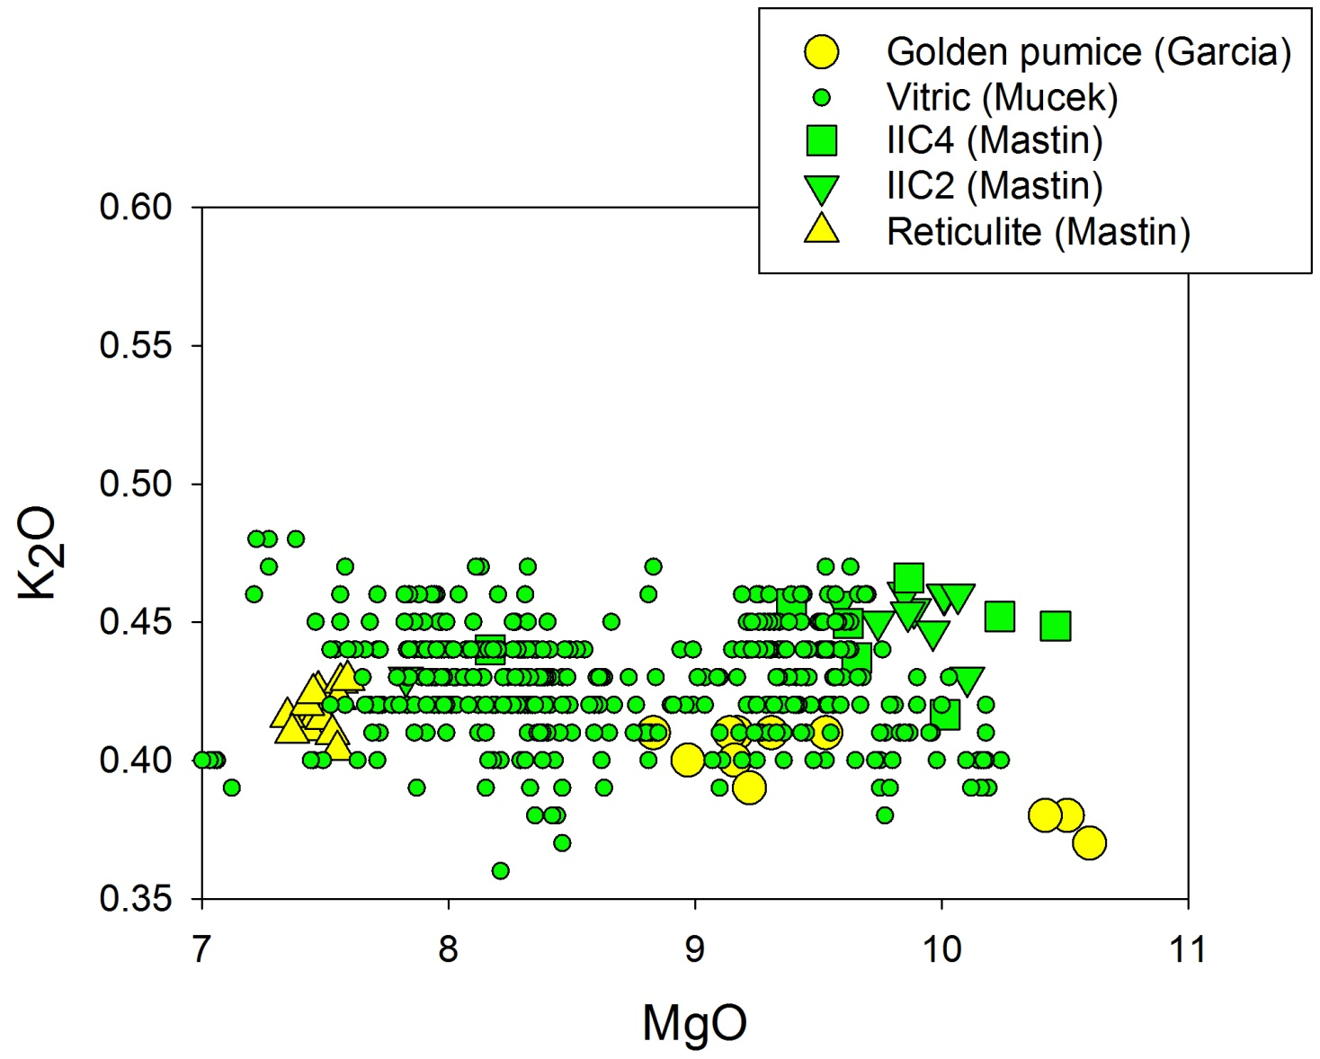
Keanakāko‘i vitric tephra (pumice and ash)
Note: Vitric (Mucek) overlaps ages of IIC2 Mastin) and IIC4 (Mastin)

Slide 18
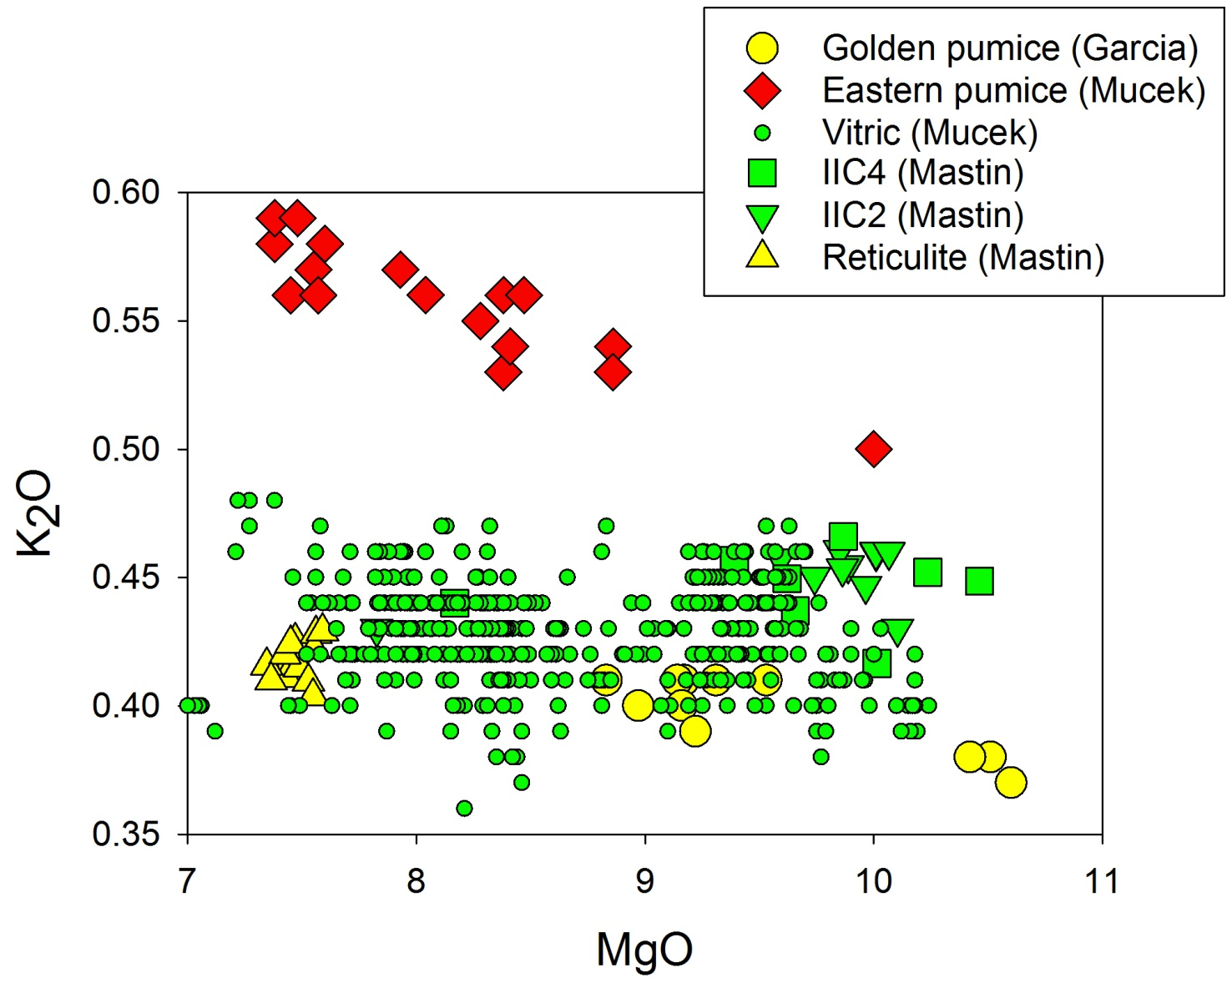
Keanakāko‘i vitric tephra (pumice and ash)
Note: Vitric (Mucek) overlaps ages of IIC2 Mastin) and IIC4 (Mastin)

Slide 19
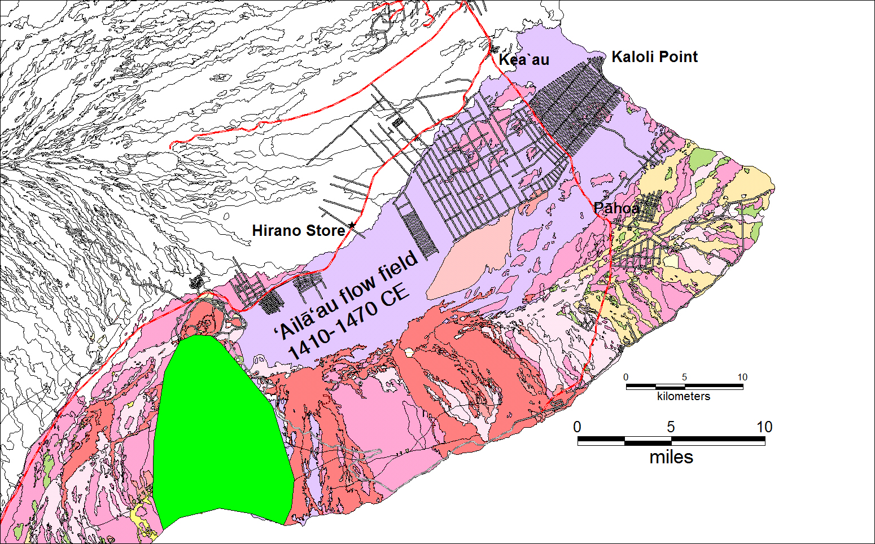
Kīpuka Nēnē
flow field
(ca. 200 BCE)

Slide 20
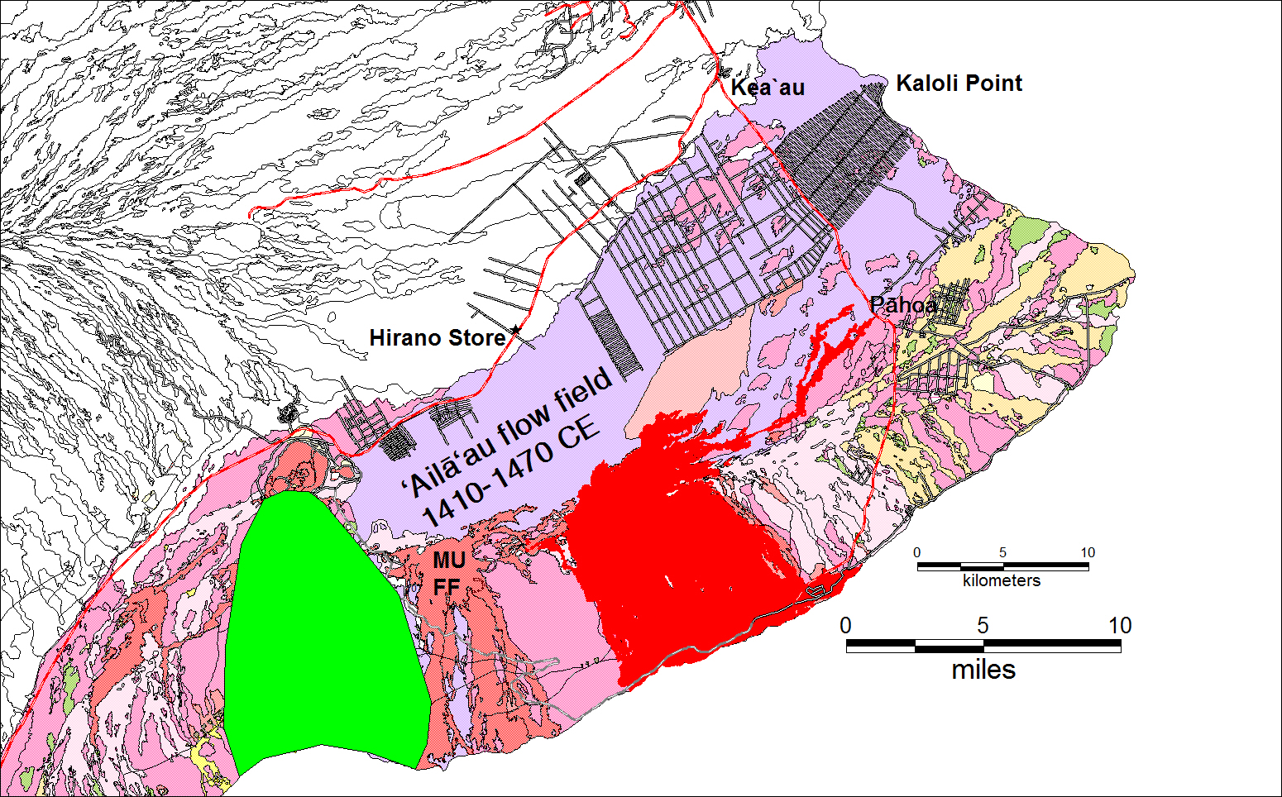
Pu‘u ‘Ō‘ō
flow field
Kīpuka Nēnē
flow field
(ca. 200 BCE)

Slide 21
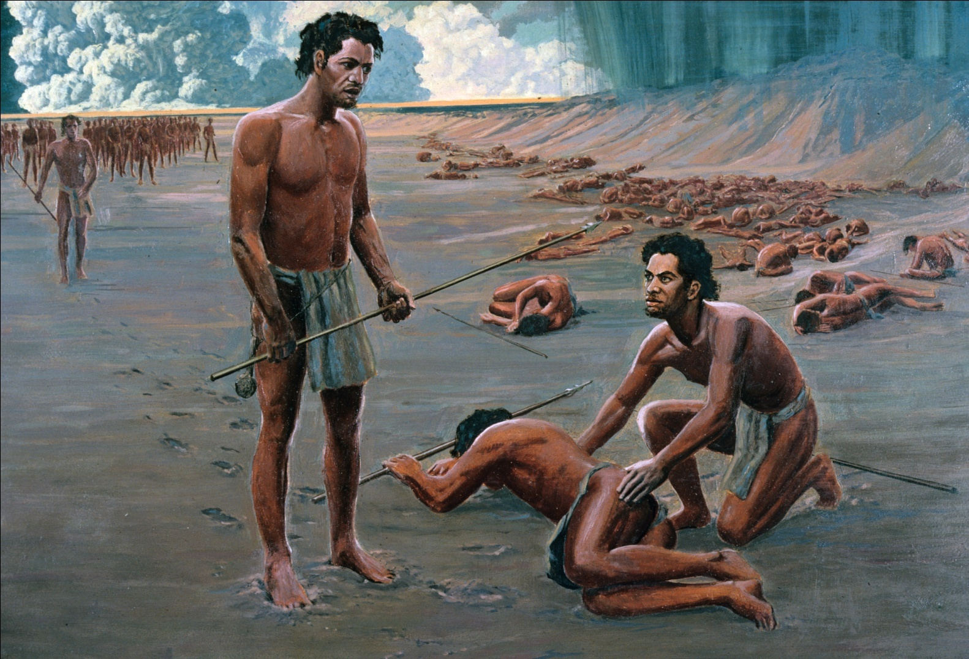
Hazard implications
Once Kīlauea enters a period of episodic explosive activity, we can expect several centuries (not just a few days) of behavior very different from that of today
The summit region, including adjacent communities, would be subject to repeated explosive activity, including tephra falls and pyroclastic surges
Nov. 1790; several hundred killed by surge
Painting by Paul Clark Rockwood for NPS

Slide 22
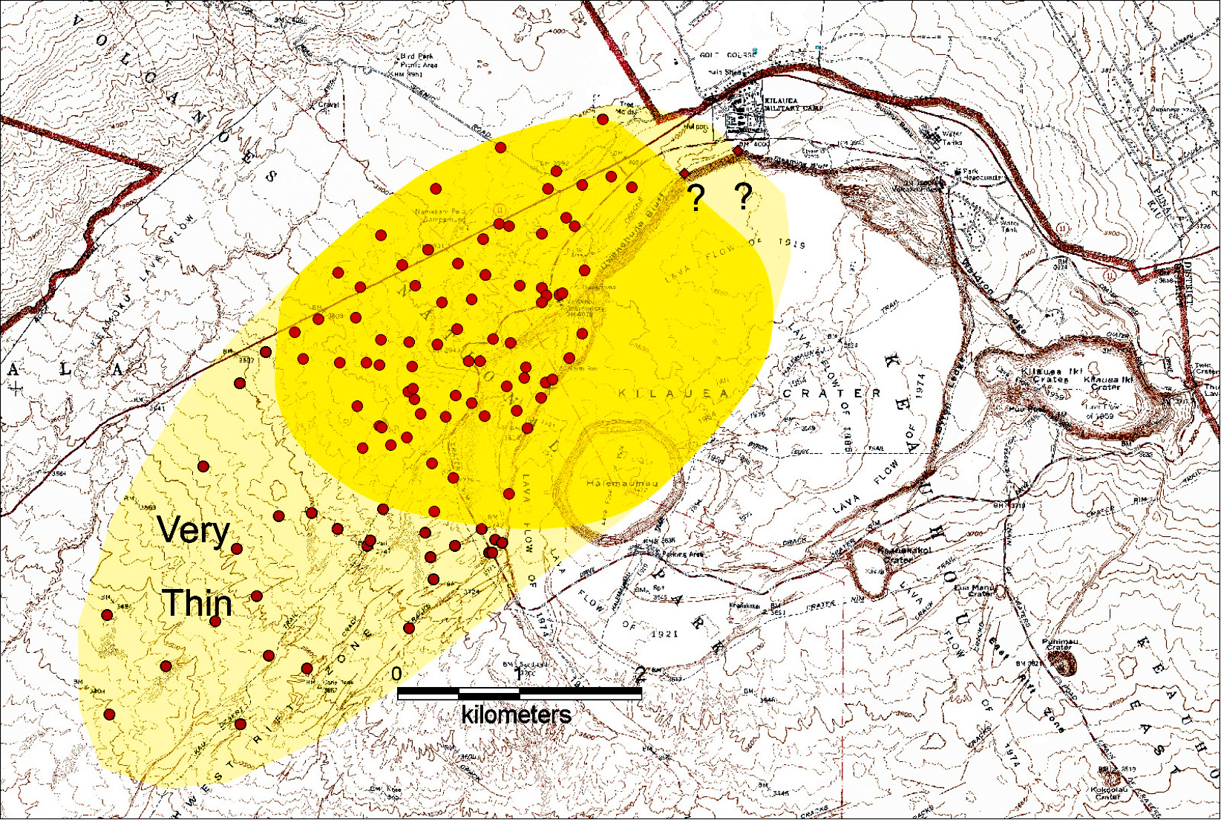
3
Possible area
of fatalities
2
1
Area covered by lethal pyroclastic surge in November 1790. Numbers show possible locations of the three parties that suffered fatalities

Slide 23
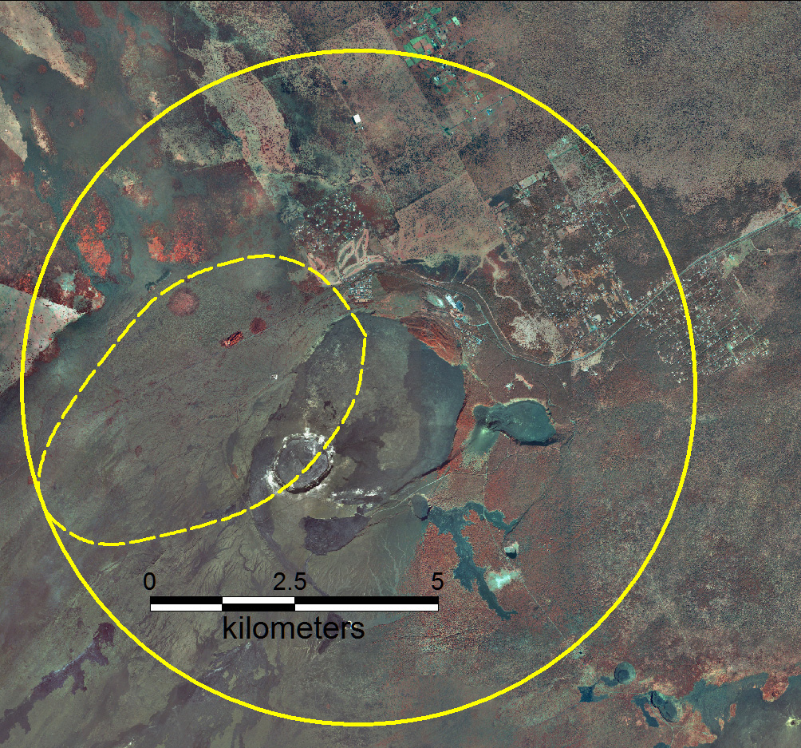
Pyroclastic surges into local communities
GC
VV
Area of one surge in 1790
VC
ML
Area at risk from future surge like one of the 1790 surges, depending on eruption direction. GC, Golf Course subdivision, VV, Volcano Village; ML, Mauna Loa Estates; VC, Visitor Center of Hawaiʻi Volcanoes National Park

Slide 24
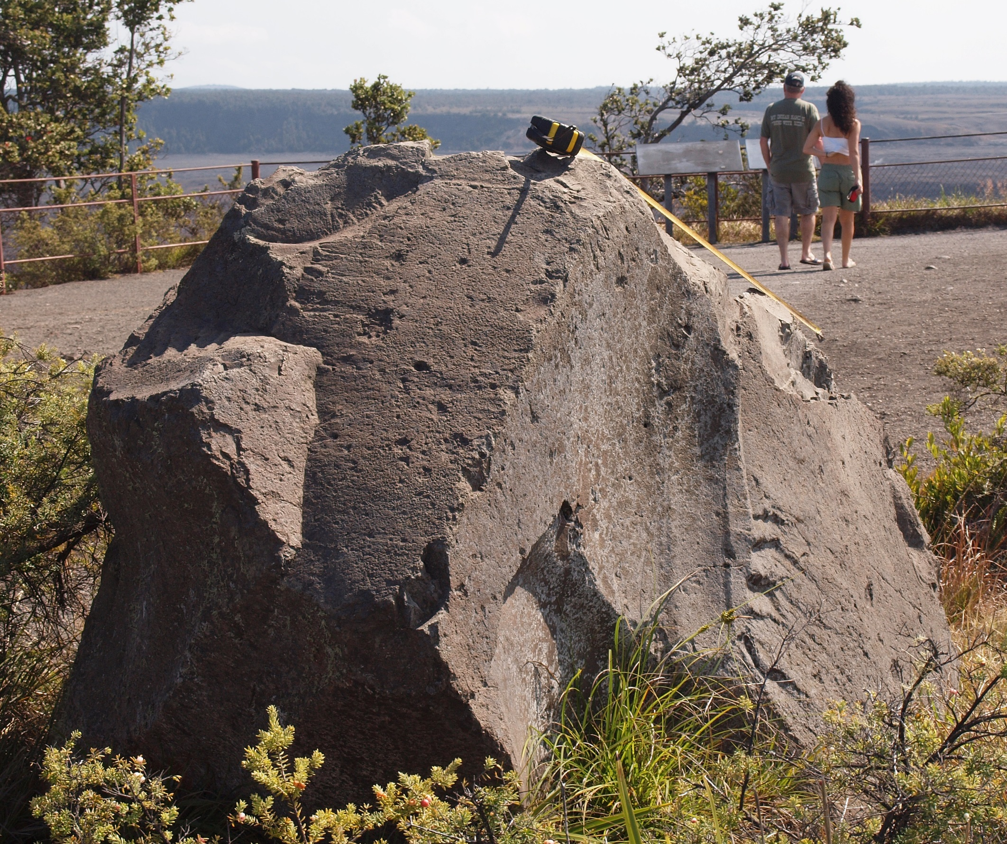

Slide 25
Downwind
Depending on wind directions, ash could fall repeatedly in Ka‘ū, Puna, and South Hilo
Eruption columns could send ash to jet-stream heights (>5 km), creating problems for aircraft
Economic consequences could be severe throughout the state, particularly related to tourism
With south wind, very fine ash could fall in Waikiki!

Slide 26
On the bright side…
Lava flows will be infrequent, to the relief of people who live near or in the east rift zone in the Puna District
Vog (volcanic smog) throughout the state will be minimal, owing to reduced magma supply and SO₂ output

Slide 27
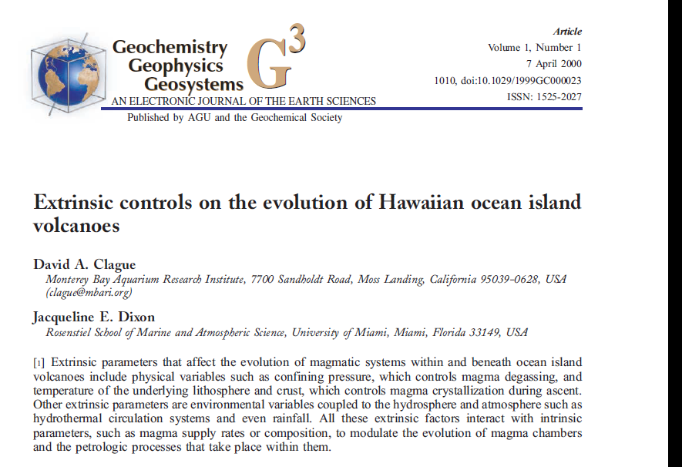

Slide 29
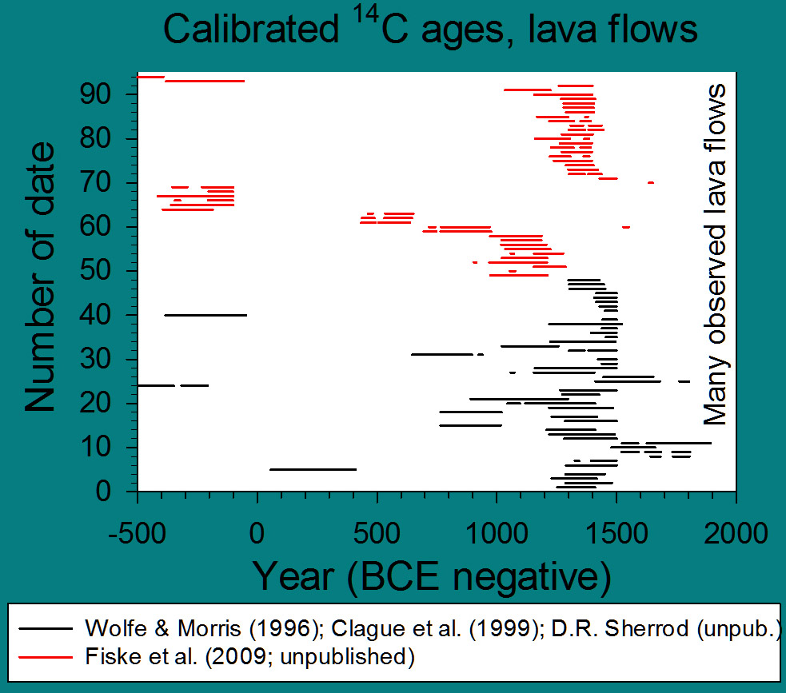
Uwēkahuna, incl.
Kulanaokuaiki Tephra
Kean.
Teph.
Stratigraphically older than ash
Stratigraphically younger than ash
Edifice-building lava flows dominant 40% of past 2500 y
Episodic explosive activity dominant 60% of past 2500 y
Calendar-calibrated ¹⁴C age ranges of lava flows for the past 2500 years; (red, unpublished ages)

Slide 30
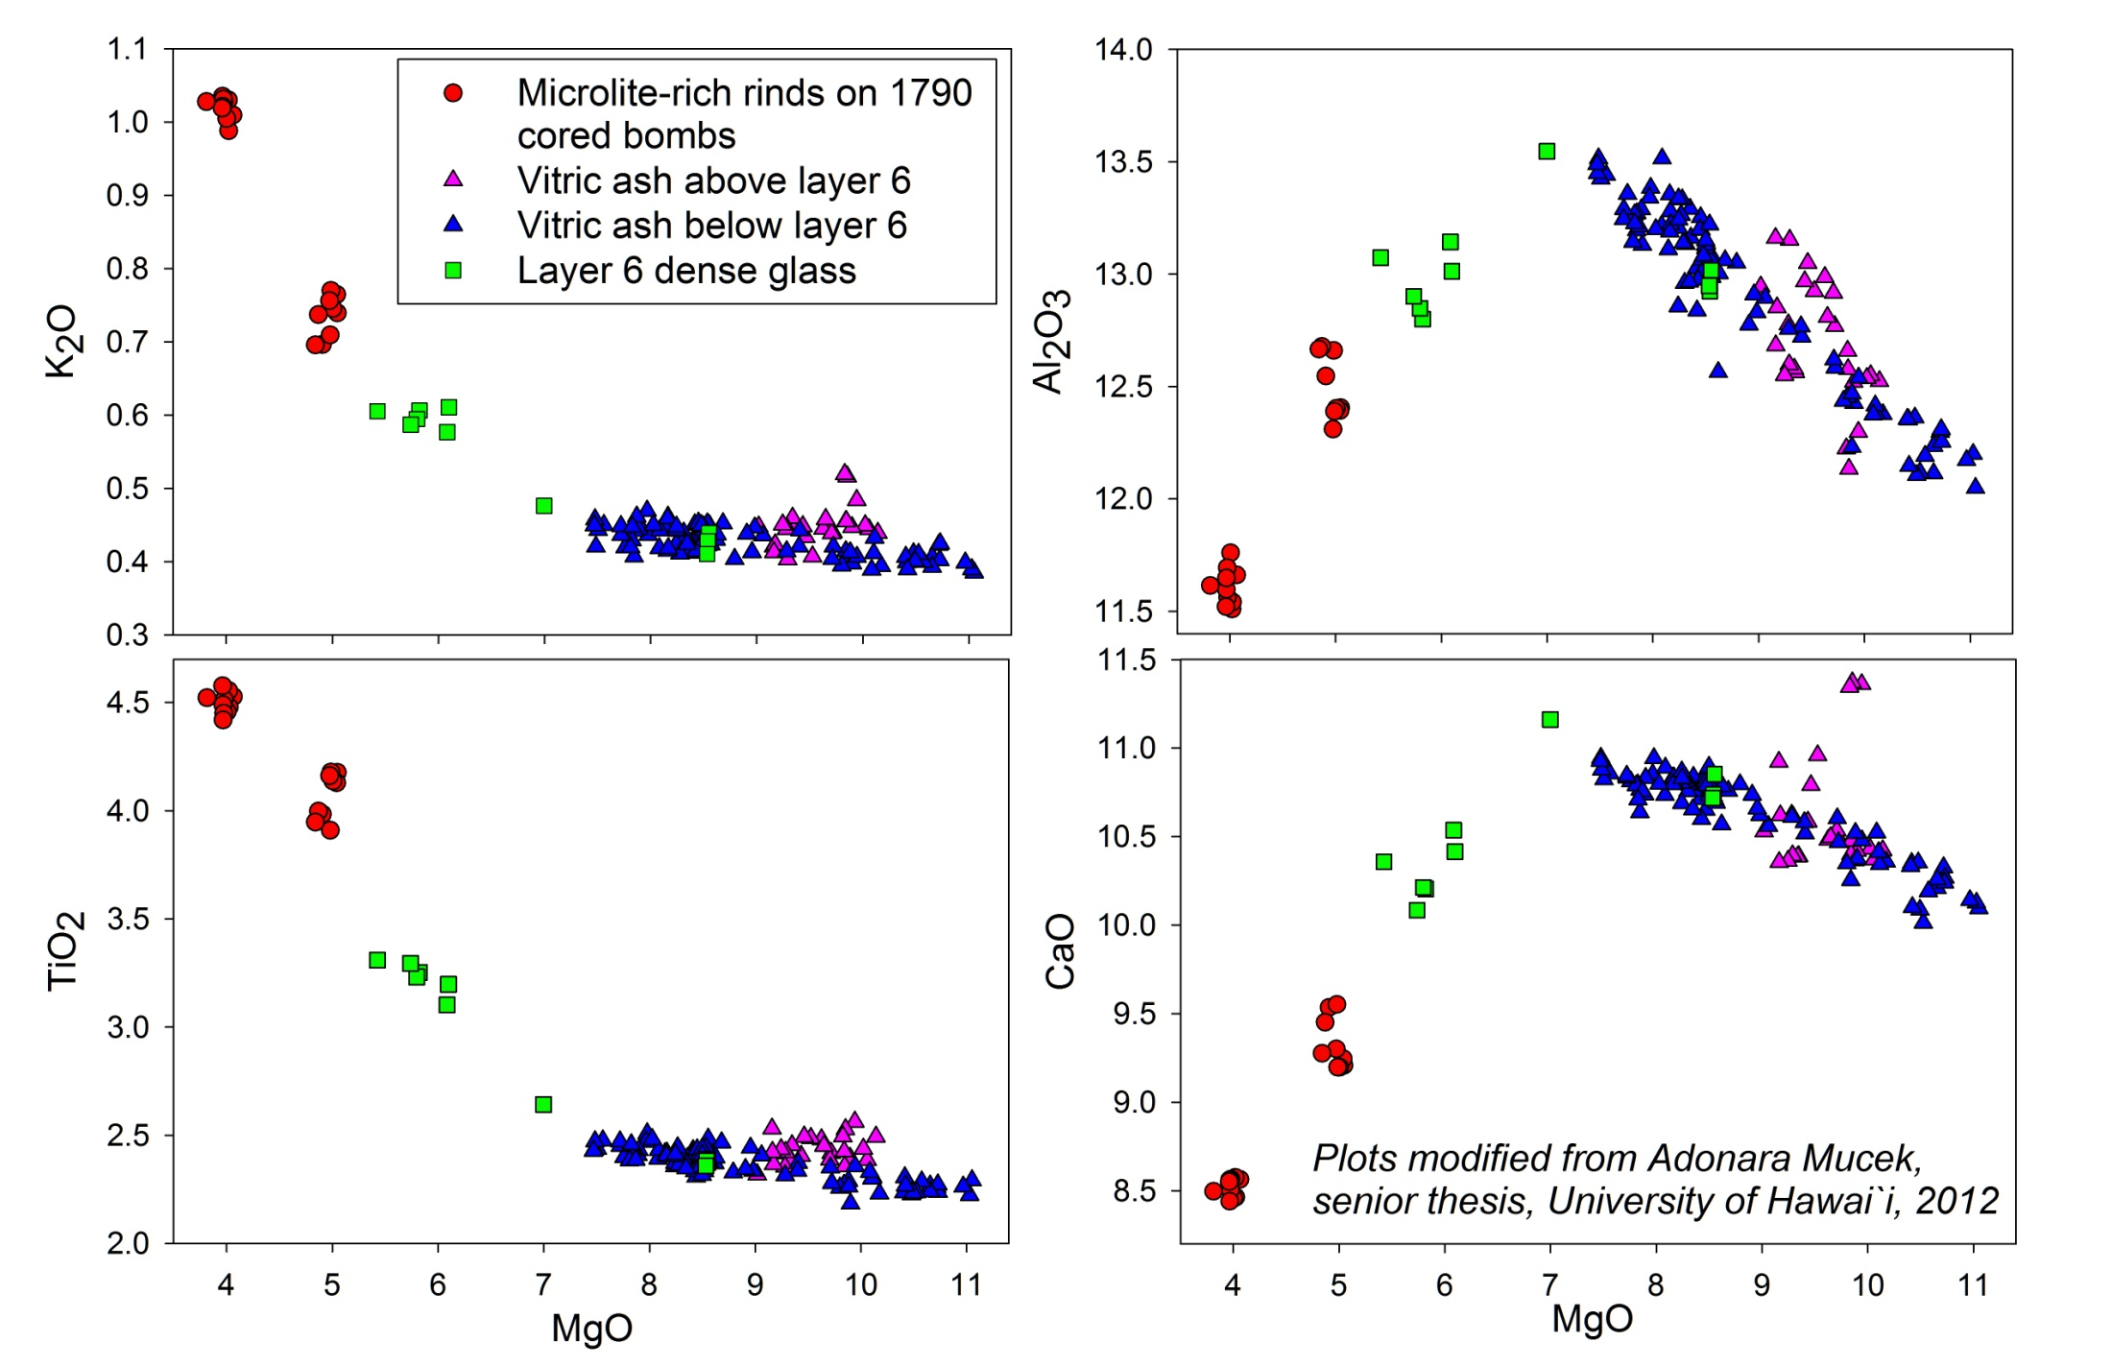

Slide 31
During the past 25 years…
Jocelyn McPhie (1990) developed a stratigraphy for the youngest explosive deposits, the Keanakākoʻi Tephra
Dave Clague and coworkers (1995, 2015) examined compositions of the oldest known explosive deposits (the Pāhala and older units)
Dan Dzurisin, Jack Lockwood, and others (1995) described the Uwēkahuna Tephra ca. 2000 years old
Dick Fiske, Tim Rose, and I (2009) recognized deposits of previously unrecognized explosive eruptions 1000-1500 years ago, the Kulanaokuaiki Tephra Member of the Uwēkahuna
Bruce Houghton, his students, and I (2012, 2015) expanded some of McPhie’s stratigraphic work on the Keanakākoʻi Tephra, showing it was produced over a ca. 300-year period, ≈1500-1800 CE

Slide 32
For perspective:
The ̴0.13 km³ volume of the Keanakākoʻi Tephra erupted over 300 years is equivalent to the volume of lava erupted in 1 year at today’s effusion rate!

Slide 33
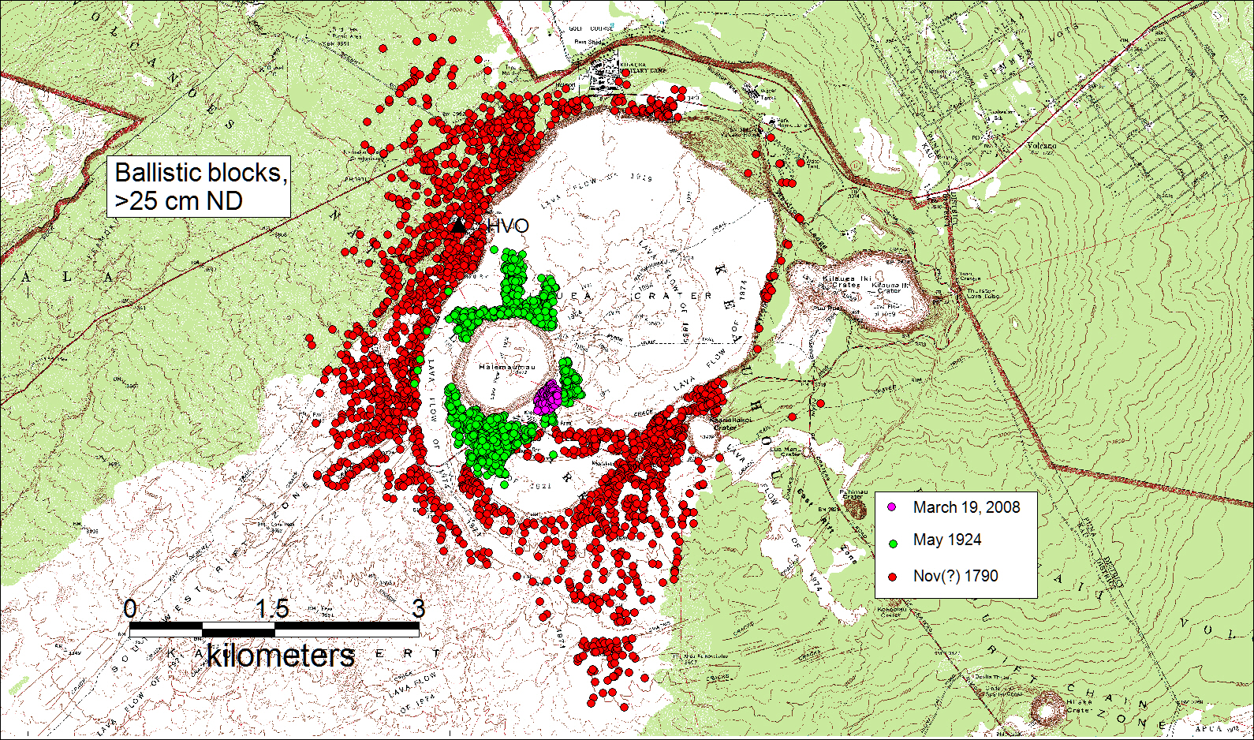
Distributions of ballistic blocks from tiny eruption in 2008, small eruption in 1924, and large eruptions in 1790s

