Slide 1
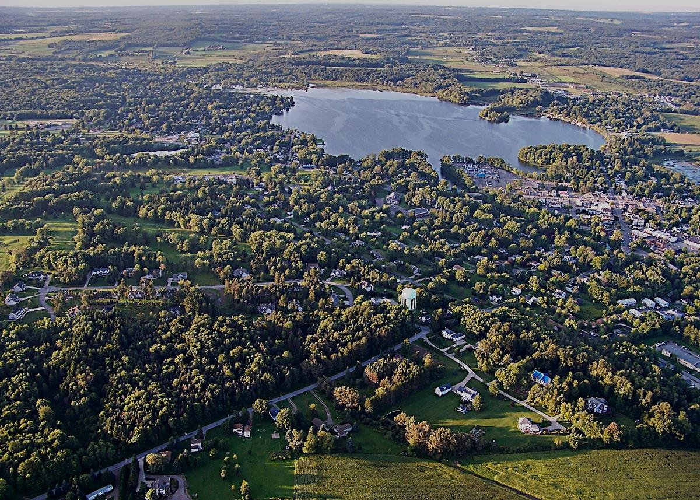


Edinboro Environmental Assault Mission
A Model for a Place-based, Field-driven Exercise to Connect Introductory Students with Their Local Environmental Surroundings
Joe Reese
Department of Geosciences
Edinboro University of Pennsylvania

Slide 2
For an introductory geology course with an environmental component…
I’ve created a place-based exercise where students document and assess the environmental underbelly of their local community.
The exercise…
constitutes a small-scale research project with field, data, synthesis, and reporting components.
“It’s time to get out and comb the grimy, decaying streets of Edinboro, PA. The purpose of this exercise is to expose and document the seamy environmental underbelly of our fair, sleepy community, town and university included. We must assess the environmental conditions of the ‘Boro! The Edinboro Environmental Assault Mission Task Force has been deployed.”

Slide 3
Versatility in design…
I use this exercise in several introductory courses:
PA Rocks – First-Year Experience (freshmen-only)
Intro to Earth Environments (honors)
Dynamic Earth (Gen Ed)

Slide 4
Prelude to the exercise…
As an introduction to the project, students inquire about aspects of their local surroundings that are somehow connected to the greater Earth system.

Slide 5
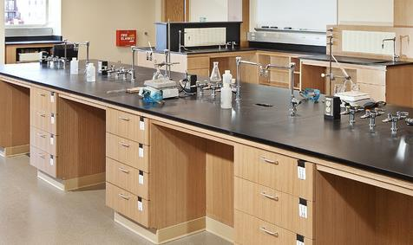
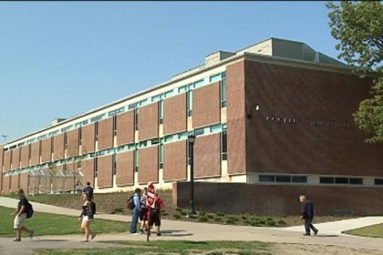
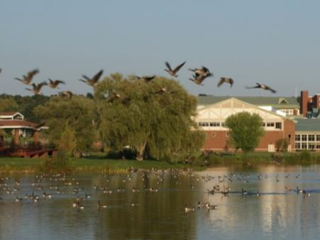
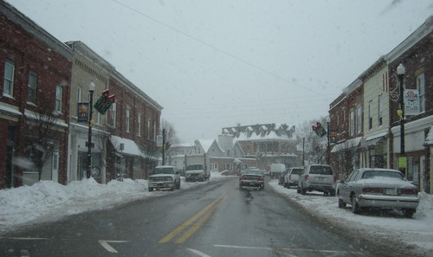
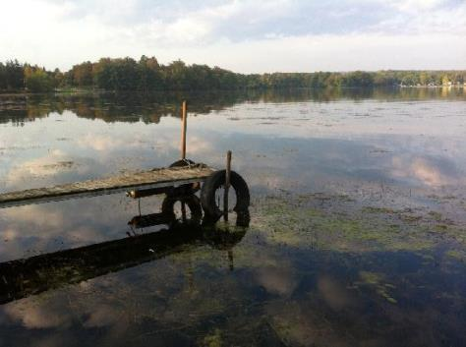
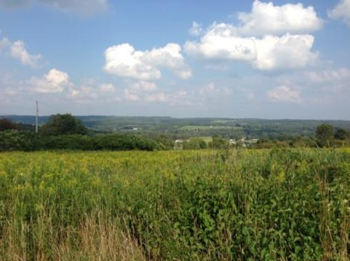
We “scale up”…
… from the classroom, to our building, to campus-wide environs, to the townsite, to the surrounding countryside …
…asking basic questions about each.

Slide 6
Students, working as teams of two, pick an environmental topic pertinent to town, university, or outlying area.
Suggested possible targets include:
Campus grounds
Neighborhoods
Commercial, agricultural or industrial activities
Waste or water treatment practices
Water or energy resources
Aspects of the local Earth system that especially impact place-specific human activities
“Pick an area or topic, within or on the outskirts of Edinboro. The university area, neighborhoods, commercial and industrial districts, waste treatment practices, the water treatment facilities, the ‘Boro’s glacial past, EUP’s solar energy facility, water resources, energy resources, Edinboro Lake, industrial practices, outlying agricultural operations, Conneauttee Creek, etc., are all likely targets!”

Slide 7
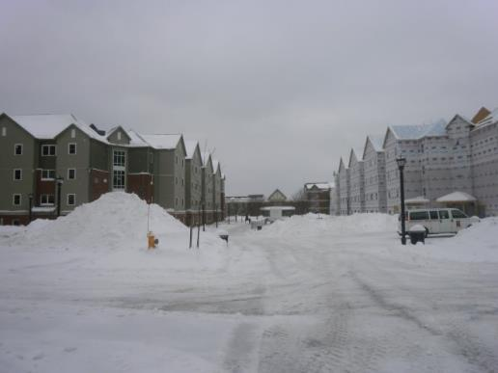
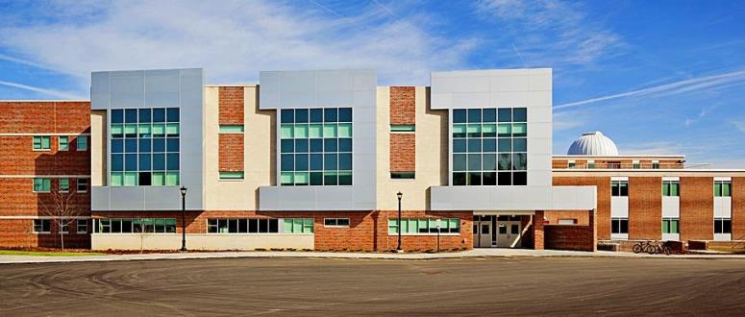

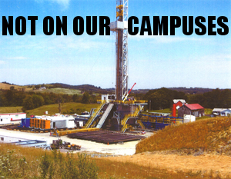
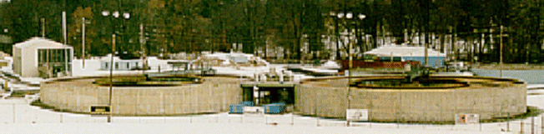
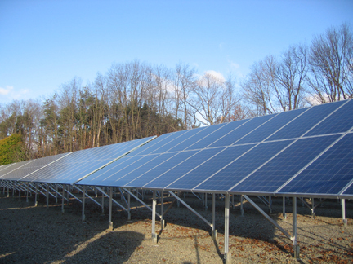
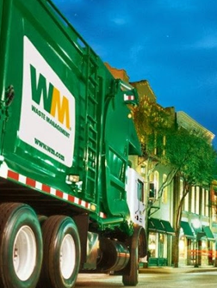
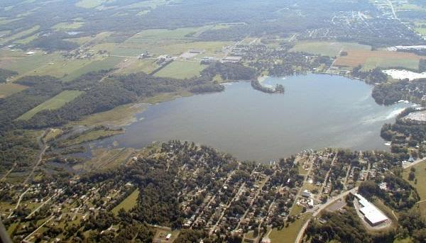

Slide 8
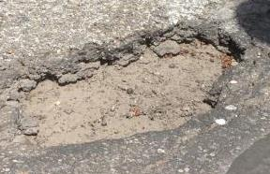
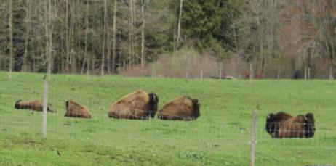
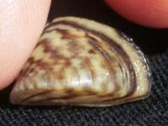
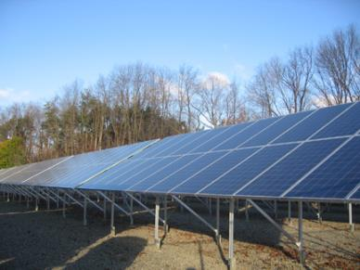
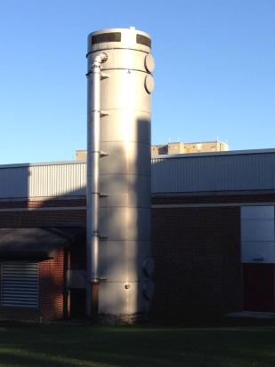
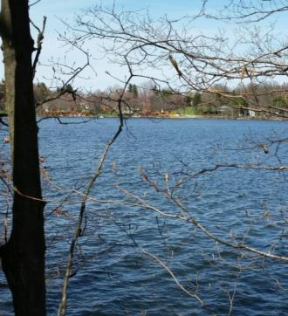
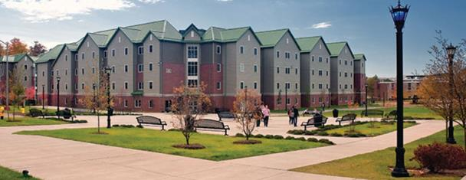
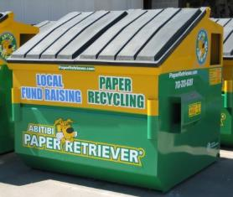
Topics have included…
Conditions necessary for formation of potholes
Environmental concerns related to snow removal practices
Municipal water supply contamination and remediation
University solar energy facility project
Environmental issues and practices at local bison farm
Geothermal heating and cooling of university buildings
Run-off related pollution in Edinboro Lake
Zebra mussels in Edinboro Lake
Recycling practices of local bars

Slide 9
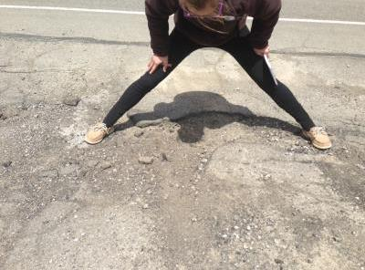
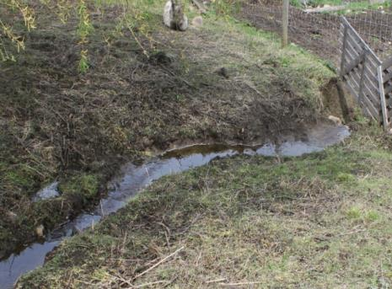
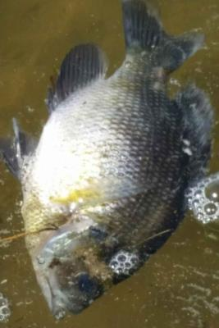
Teams go into the field to hone their observational skills.
They describe variables, issues, and concerns related to their topic.
They write field notes, take photos, focus on the myriad natural processes at work, and comment on how humans interact or are impacted.
“Go into the field. Open your eyes and hone your observational skills. Be armed and psychologically prepared for what you are about to observe …”
“Systematically locate, document, and describe all of the environmental variables, problems, issues, and/or concerns observed in your area / topic. Get down and dirty - note every interesting and/or nasty thing you observe.”

Slide 10

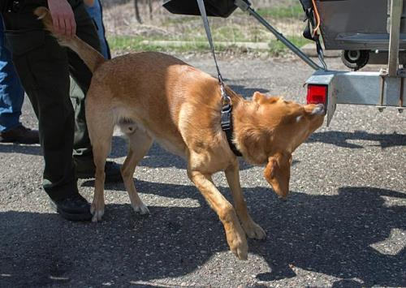
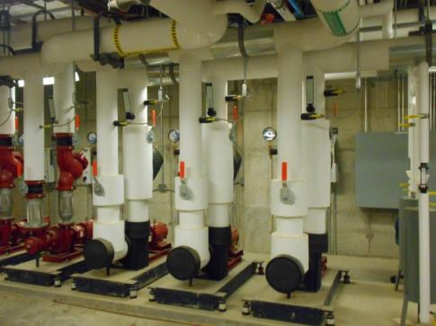
If they encounter measures being taken to address problems, they’re to document these as well.
Teams may contrast results from their setting to other locales or provide a greater context to their findings.
“Go into the field. Open your eyes and hone your observational skills. Be armed and psychologically prepared for what you are about to observe …”
“Systematically locate, document, and describe all of the environmental variables, problems, issues, and/or concerns observed in your area / topic. Get down and dirty - note every interesting and/or nasty thing you observe.”

Slide 11
With many people in the community being knowledgeable and willing to talk with students...
An additional course of action is for teams to interview a local expert who is well versed in their topic.
…Borough or Township Manager,
leader at a local environmental firm,
Director of the water treatment facility,
Edinboro Lake Watershed Association president, and/or experts on particular local environmental topics…
“A possible alternative course of action is to interview an important person / group / agency in the university and/or borough community who is especially familiar with your area / topic. Whether it be borough or township manager, someone at a local environmental firm, the director of the water treatment facility, the Edinboro Lake Watershed Association president, and/or experts on particular local environmental topics, several people / organizations in our community are quite knowledgeable on these topics and issues.”

Slide 12
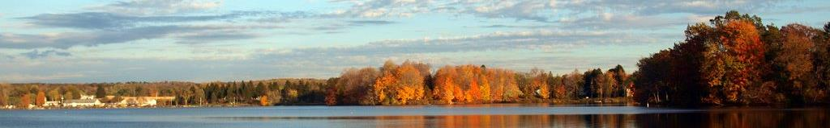
After fieldwork is conducted…
Teams write a short (~2-3-page) report on their topic, complete with appendices of photos, figures, tables, and information sources.
Students describe their topic and propose plans of action to alleviate or remedy the concerns related to their topic to benefit the community.
“Prepare a short report highlighting your list of urban environmental issues and/or vagaries; as appendices, photos, information sources, figures, tables, etc., should be included. Propose solutions for the major environmental problems in your area or related to your topic. What can be done to alleviate these concerns? How would you propose to implement a plan of action to remedy the community’s environmental woes? Highlight benefits.”

Slide 13
With their report serving as an outline…
Teams then design and give a short presentation on their findings.
“Design and give a short (~5-10-minute) presentation that documents your findings. You will give this presentation during class. You and your teammate will basically report your results back to the rest of us in class. You are encouraged to prepare a PowerPoint presentation to show your findings and give your possible solutions. This is good place to show your pictures, figures, tables, etc.!”

Slide 14
After all teams have reported, we…
Consider the community’s environmental layout and its most pressing environmental issues.
Address the controls and issues affecting the local environment as revealed by the teams.
Discuss what the community is doing, what actions and plans are in place to benefit the community, and what can be done to raise community awareness and promote action.
“We will then consider and discuss Edinboro’s environmental layout, practices and/or functions and its most hideous and threatening environmental issues, hazards and/or oversights (purposeful or accidental …). In essence, you will address the major controls and gravest issues affecting the Edinboro environment revealed by task force participants. This time also serves as an opportunity to see what the community is doing right. What sort of actions, plans, policies are in place that benefit the community?”

Slide 15
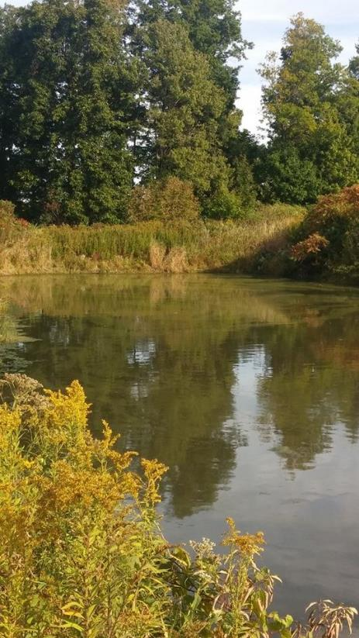
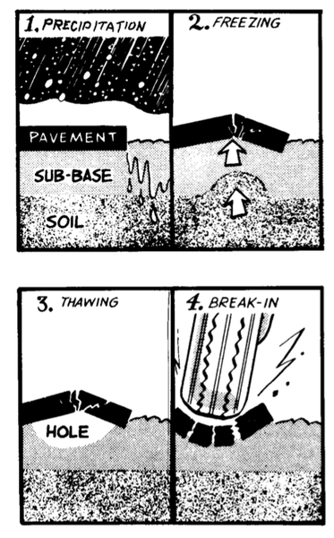
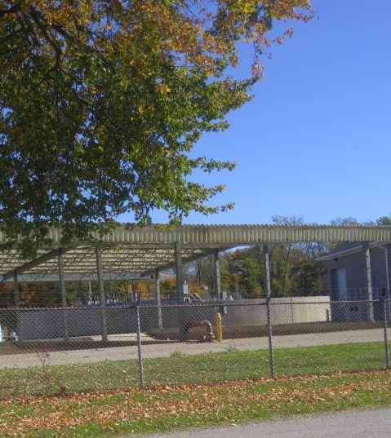
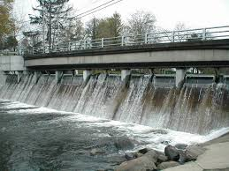
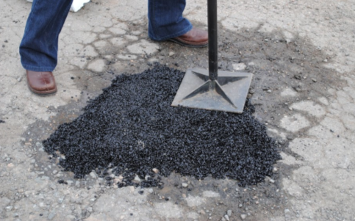

Water issues

Slide 16
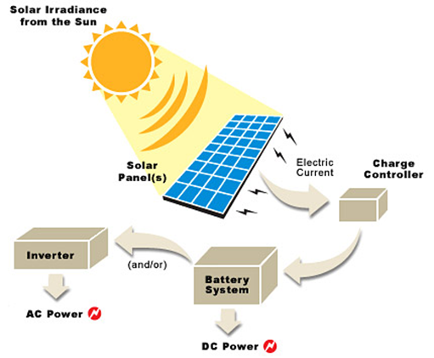
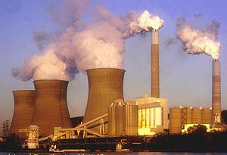
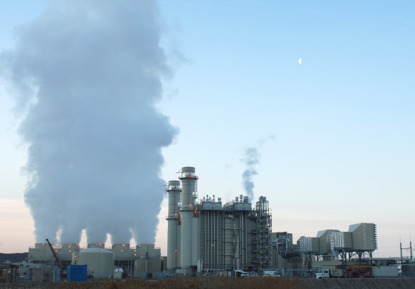
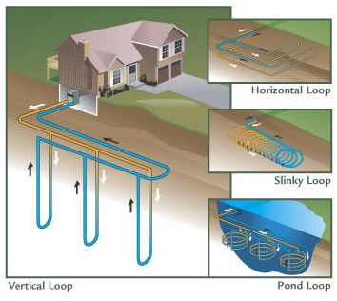
Energy
issues
Edinboro electricity energy usage

Slide 17
Sustainability…
Multidisciplinary…
Eutrophication…
Conservation…
Complexity…
Change…
Risk…
Mitigation…
Comparison
Uncertainty…
Water Quality…
Complexity
Remediation…
Systems…

Slide 18
Conclusion: Ultimately, with this project design, students…
In a variety of introductory geoscience courses, conduct a higher impact practice assignment
Do a place-based exercise where they document and assess the environment of their community
Make connections and explore interactions and impacts between Earth systems, environment, and humans
“Consider the question: What can we do about raising community awareness of the environmental controls, problems, issues, and concerns? Learn and enjoy. Become an environmental watchdog!”

Slide 19
Conclusion: Ultimately, with this project design, students…
Conduct a small-scale research project with field, data, synthesis, and reporting components
Build many non-content skills (writing, presentation, teamwork)
Investigate their local surroundings and become a more aware and active citizen
“Consider the question: What can we do about raising community awareness of the environmental controls, problems, issues, and concerns? Learn and enjoy. Become an environmental watchdog!”

Slide 20
The End… Thank You!
Questions? Comments?

