Slide 1


Determining basin structure of the Hueco and southern Mesilla Bolsons, west Texas, southern New Mexico and northern Chihuahua: Geophysical Challenges in an urban setting
D. Doser*, V. Avila*, O.Dena+, P. Budhathoki*, A. Thapalia*, C. Montana*, M. Moncada*+
*University of Texas at El Paso
+Universidad Autónoma de Ciudad Juárez

Slide 2
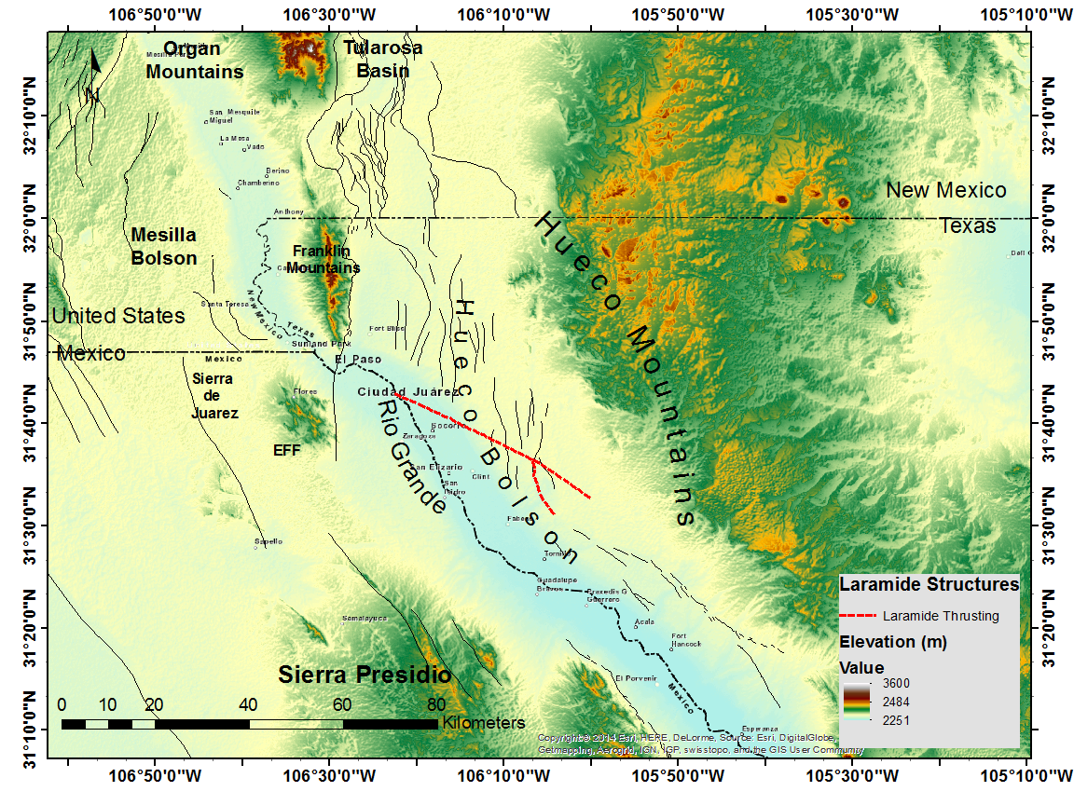
Setting

Slide 3
Focus
Water resources
Tectonics
Earthquake hazards
Tools
Water well logs
Gravity
Resistivity
MASW
Seismic reflection (limited)

Slide 4
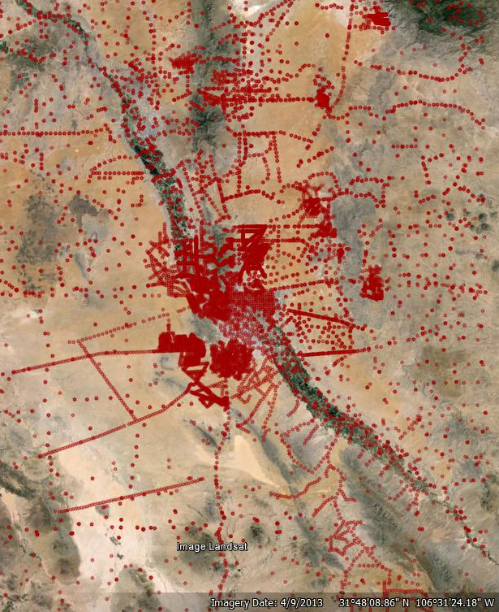
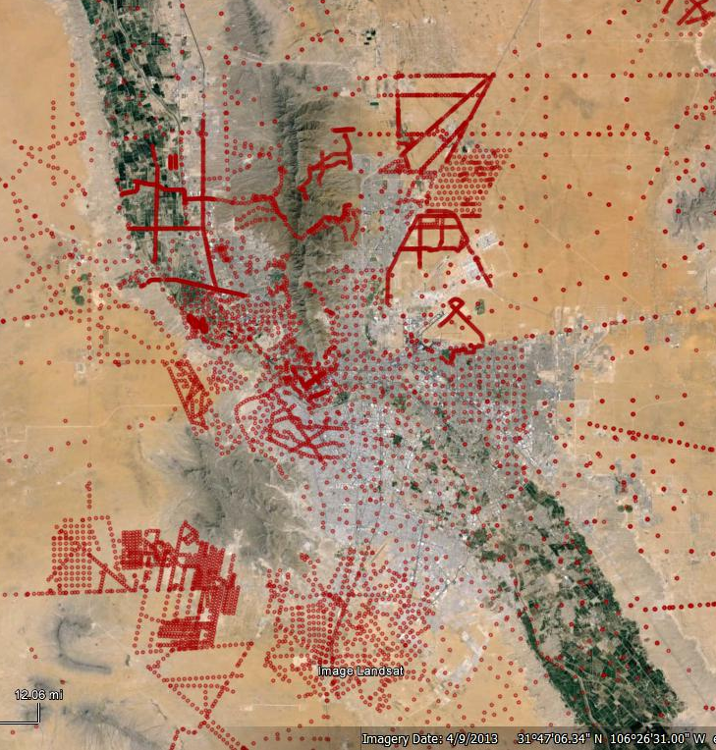
Gravity database

Slide 5
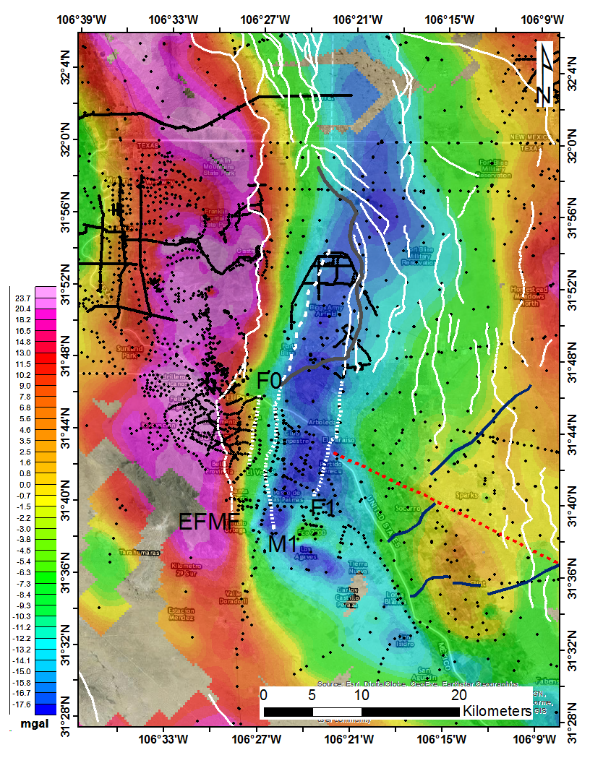
Residual Bouguer anomaly

Slide 6
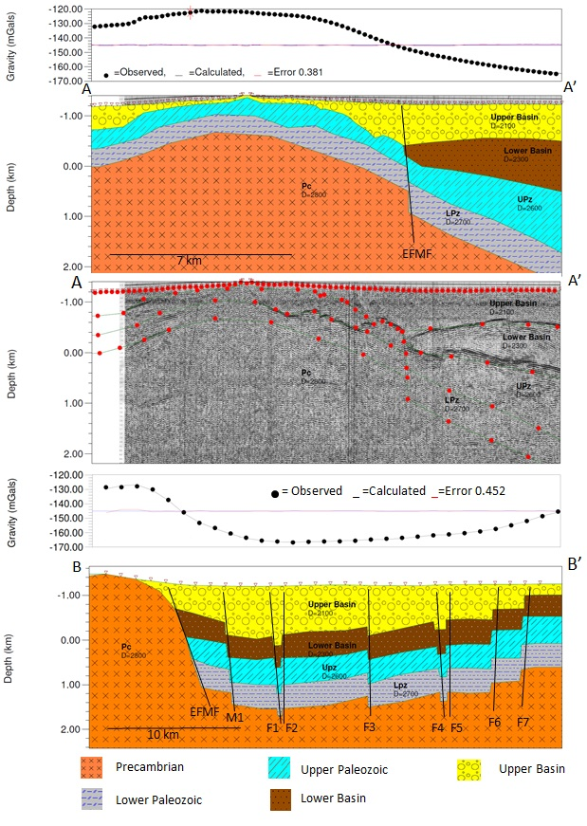
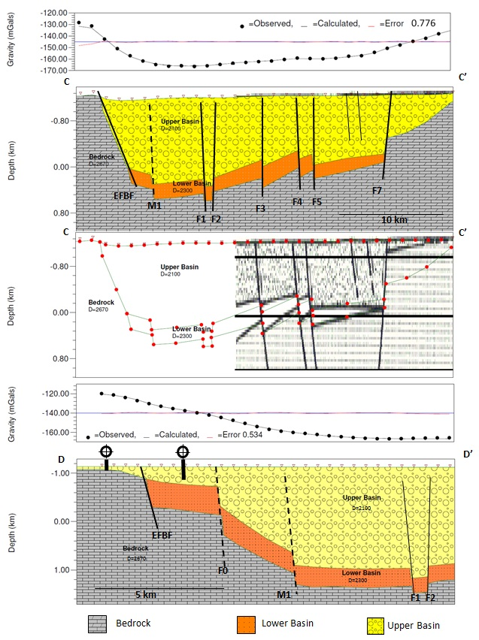
2-D Modeling

Slide 7
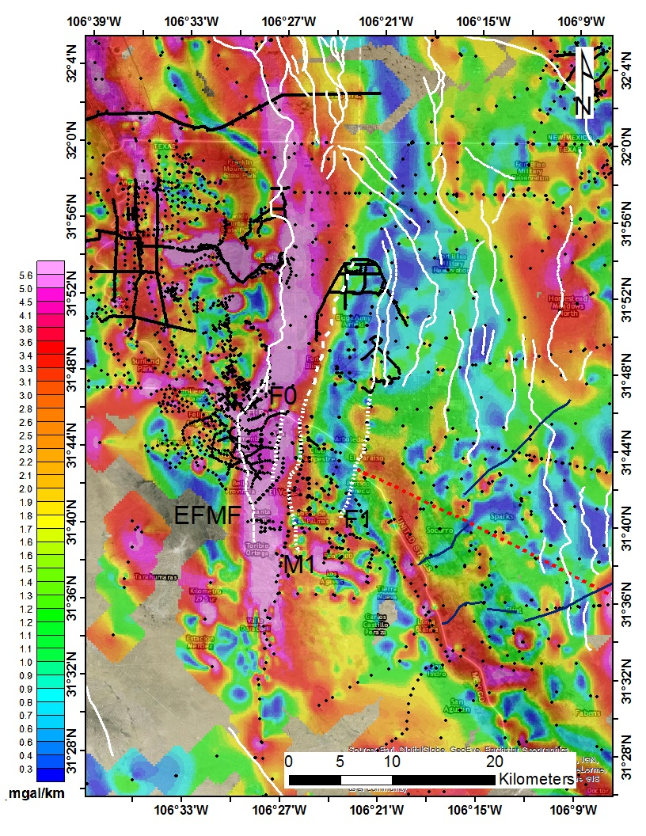
Horizontal Gradient Magnitude

Slide 8
Gravity, well logs, geochemistry
Cl/SO4 ratios
Red 1:2
Blue 1.5:1
Green 4:1
Pink 12:1

Slide 9
MASW results

Slide 10
Conclusions
East Franklin Mts. Fault extends at least 30 km into Cd. Juárez
Several intrabasin faults extend across border
Intrabasin faults control groundwater flow and salinity
Class D and E soils located above regions where sediment > 1800 m thick
Southern bolson structure related to Laramide features

Slide 11
In progress:
Using 2-D models to build 3-D structure
MASW studies in El Paso
Investigation of extent of andesite in Mesilla Valley
Relation of Mesilla Valley faults to changes in salinity along the Rio Grande
Studies of eastern Hueco Bolson faults and relation to Laramide structures
Strong ground motion studies using structural and soil information

