Slide 1




Vegetation and morphology changes in the mouth of the Amazon and Doce river during the late Quaternary
Session n.º 17: Palynology
2015 GSA Annual Meeting
Baltimore, Maryland, USA
Marlon C. França
Marine Geology
marlon.franca@ifpa.edu.br

Slide 2

Main Questions
Have a change on the sea level?
Have a climatic change?
How the vegetation reply those changes?
Why use the mangroves?

Slide 3
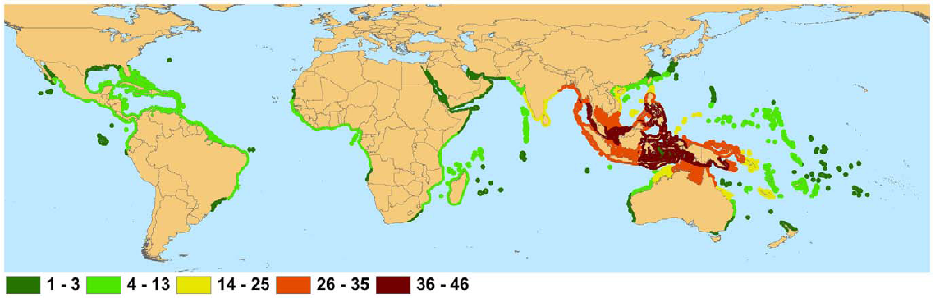
Mangroves
Background
Are various kinds of trees and shrubs that grow in saline coastal sediment habitats in the tropics and subtropics
Rhizophora, Avicennia and Laguncularia

Slide 4
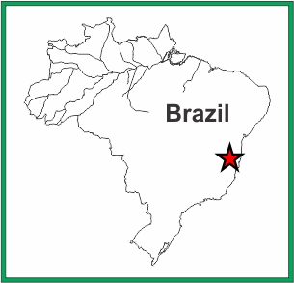
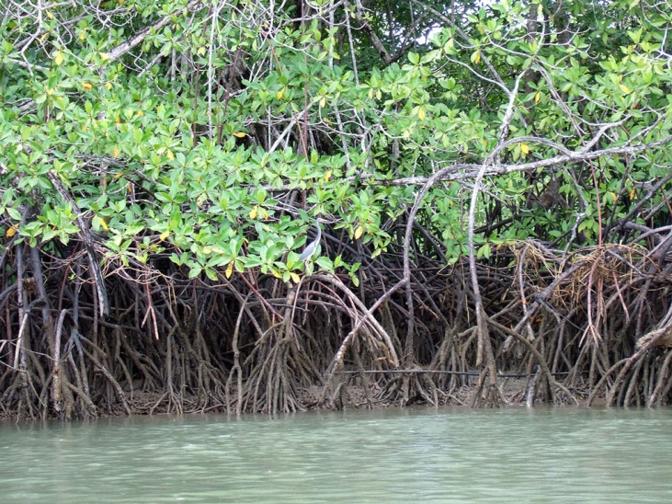
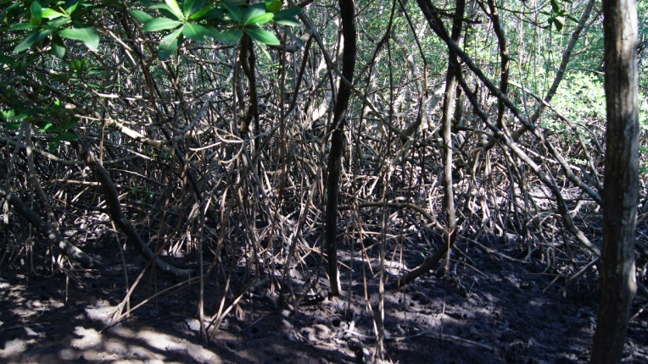
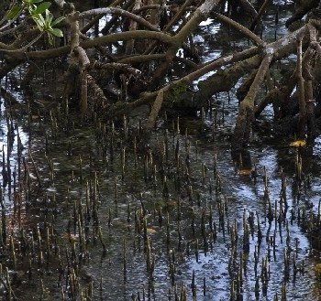
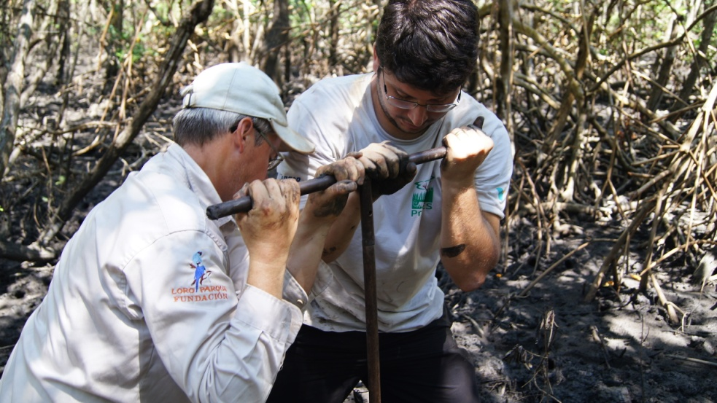
Mangroves
Background
Laguncularia
Rhizophora
Avicennia

Slide 5
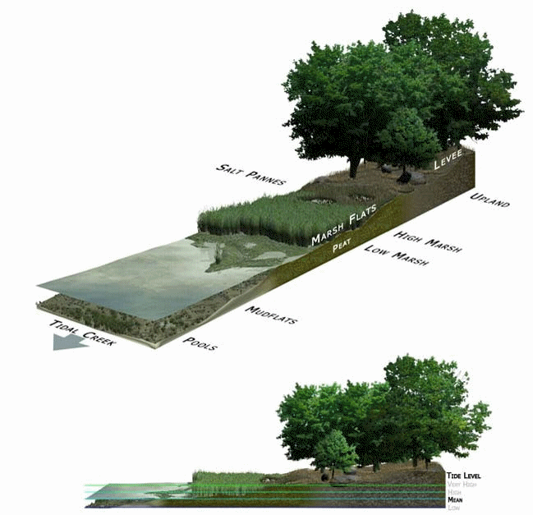
Mangroves
Background
Need:
  Adequate light
  Shallow water
  Low wave action
  Mild water temperature
  No frosts
  Suitable levels of salinity

Slide 6
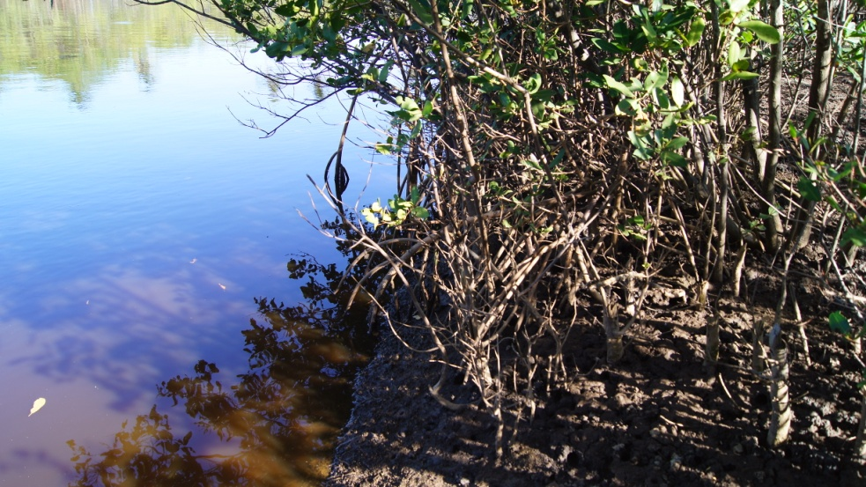
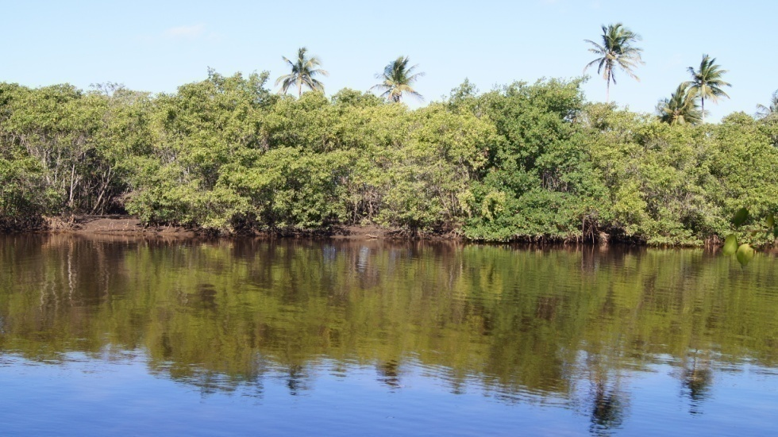
Mangroves
Background
Mangroves are highly susceptible to climatic changes and sea-level oscillations
They have been almost continuously exposed to disturbance as a result of fluctuations in sea-level
The relative rise in sea-level may result in mangroves migrating inland and/or disappear
(Alongi, 2008; Blasco et al., 1996; Cahoon and Lynch, 1997; Sanders et al., 2012)

Slide 7
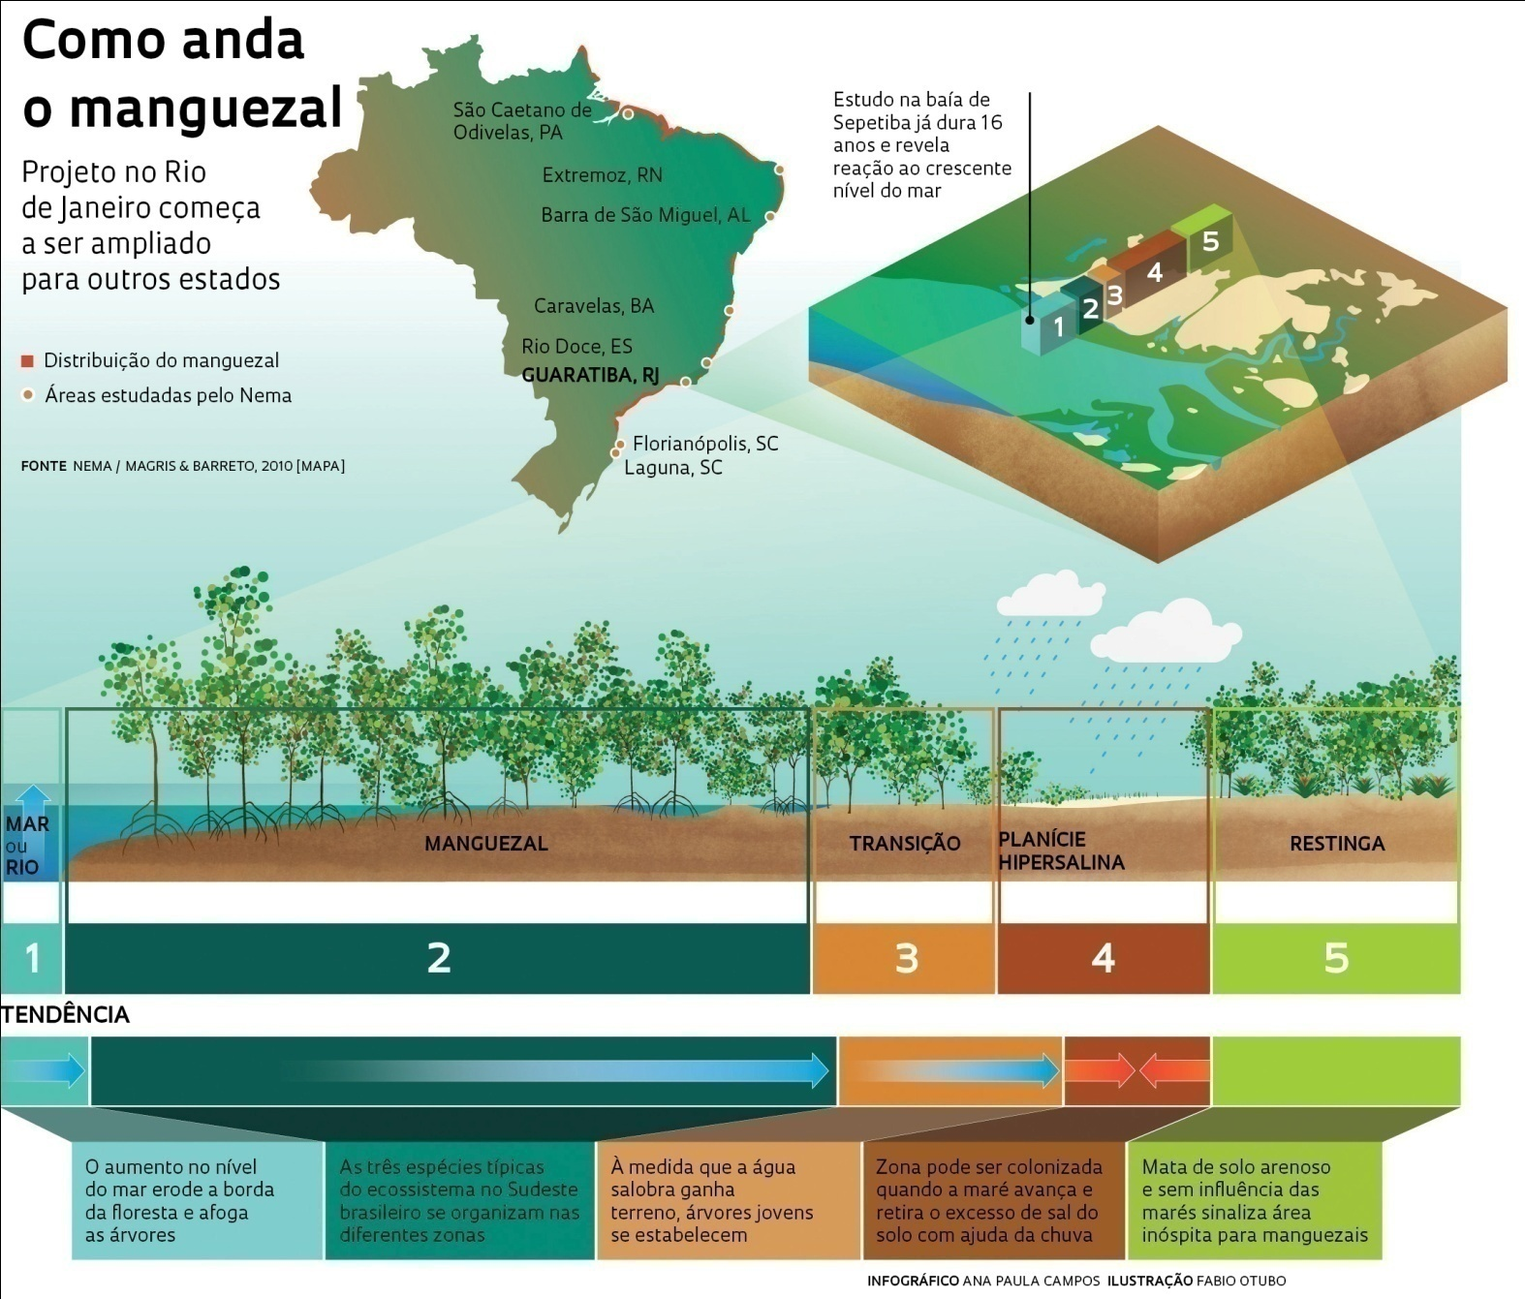


Sampling site
Sea and/or river
Mangrove
Transition
High salinity
Restinga

Slide 8
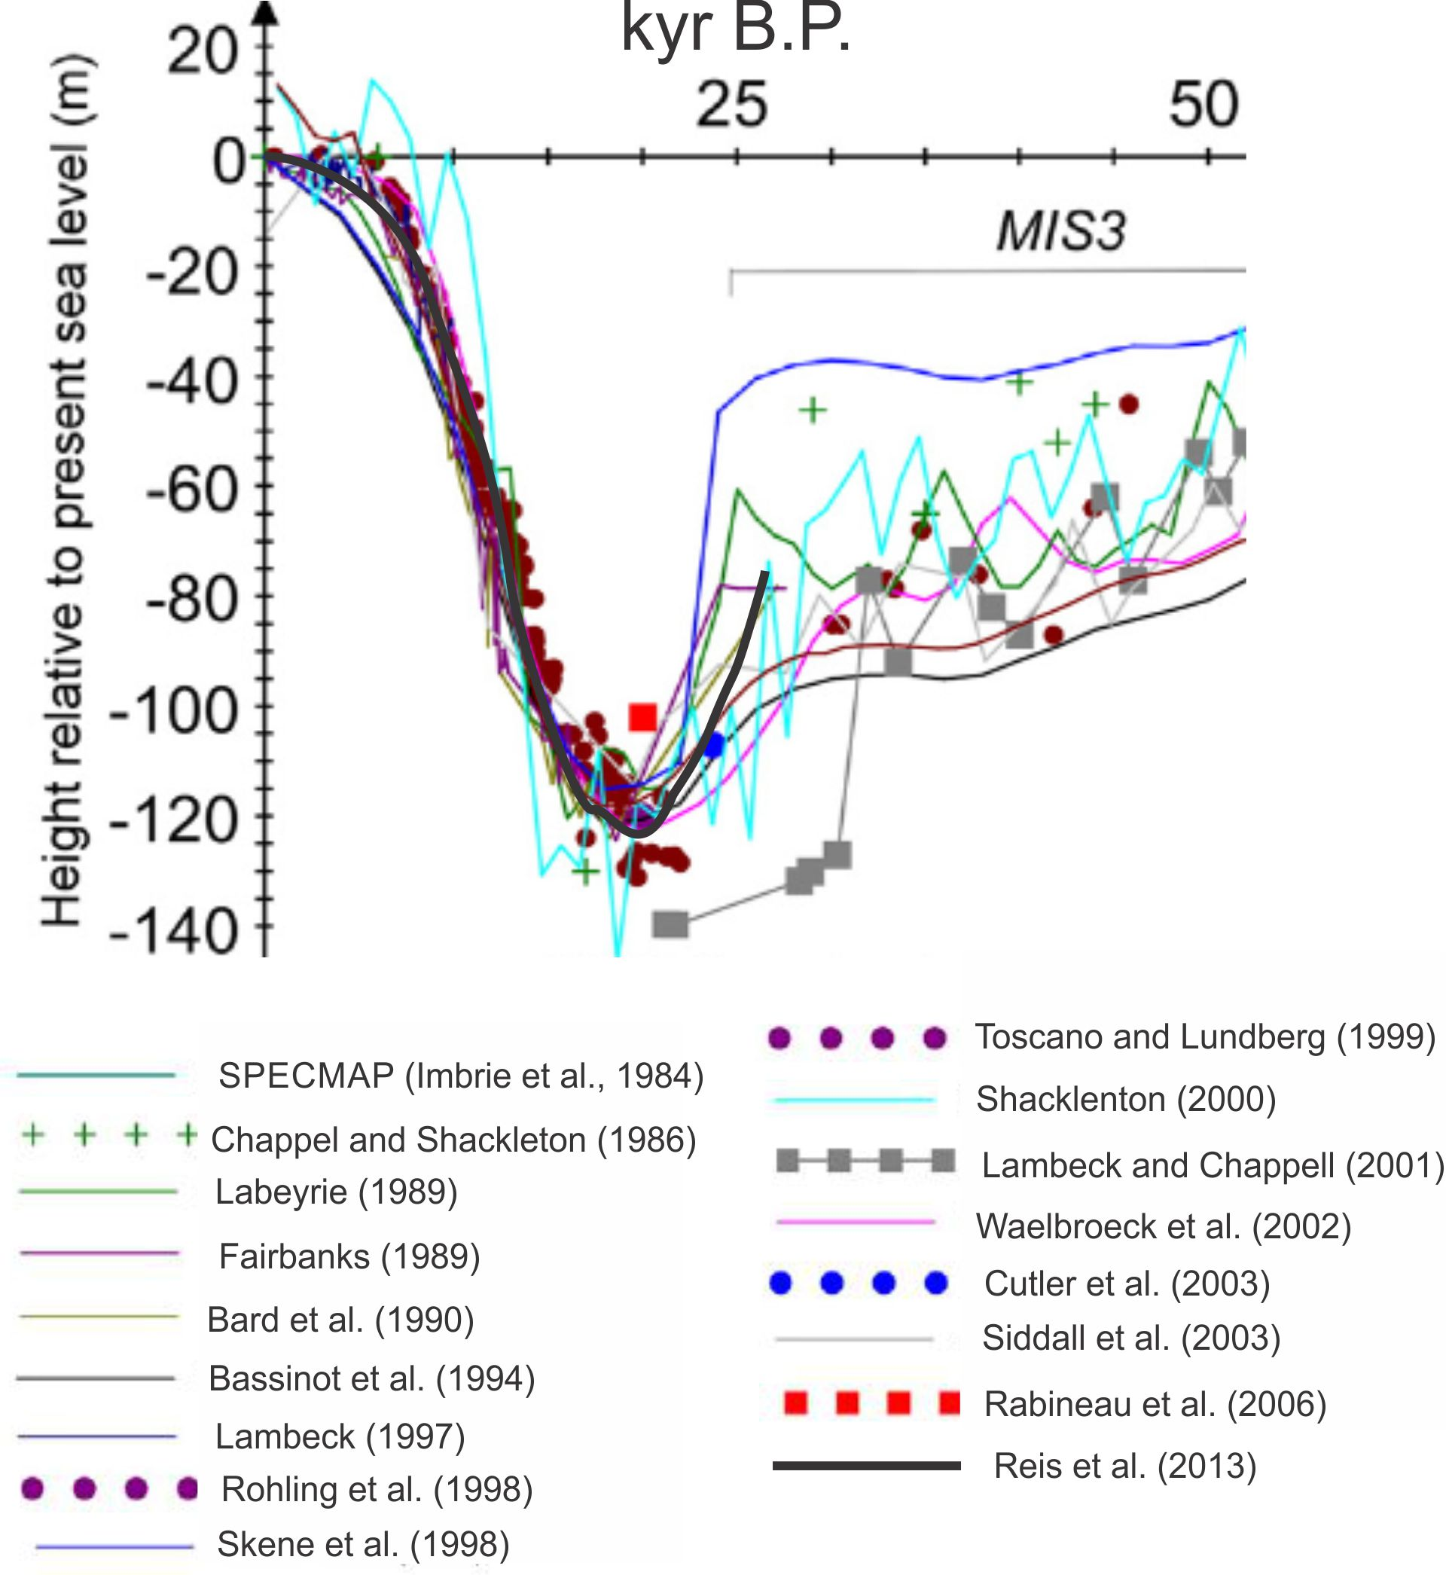
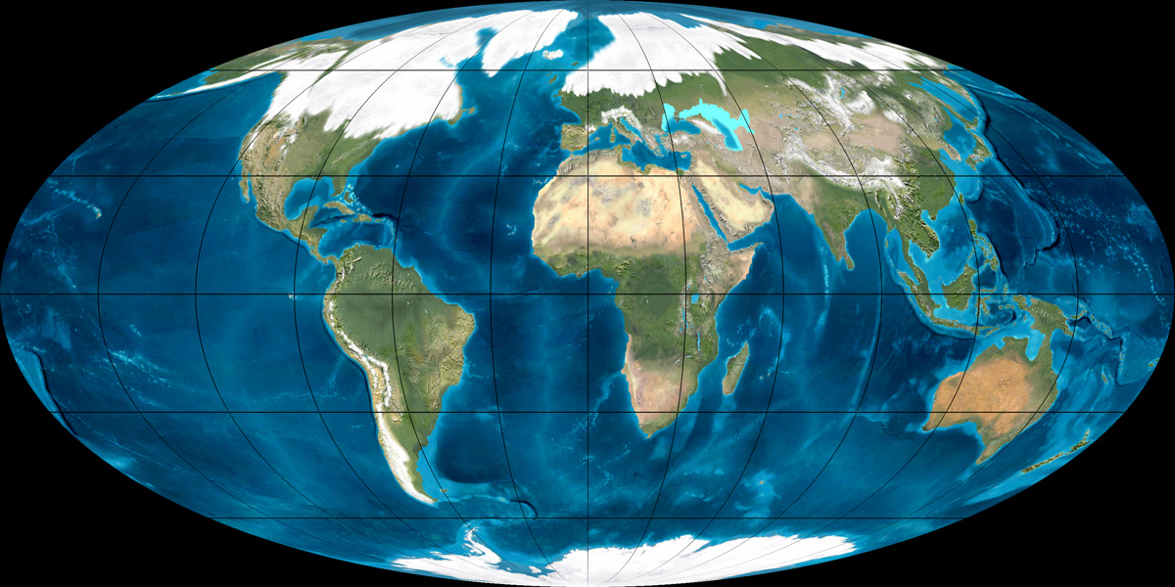
Late Pleistocene

Slide 9
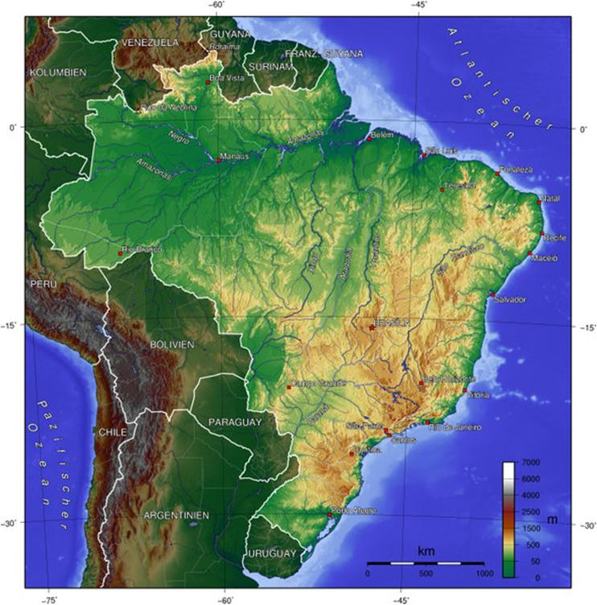
Amazon region
HOLOCENE
Early
Medium
Late
Pessenda et al., 2004ab; Freitas et al., 2001
Wet
Pessenda et al., 1998; 2001
Rossetti et al., 2005
Servant & Fontes, 1978; Wirmann et al., 1988
Ybert, 1992; Desjardins et al., 1996
Dry
Absy et al., 1991
Bush et al., 2007
Pessenda et al., 1998; Pessenda et al., 2001

Slide 10
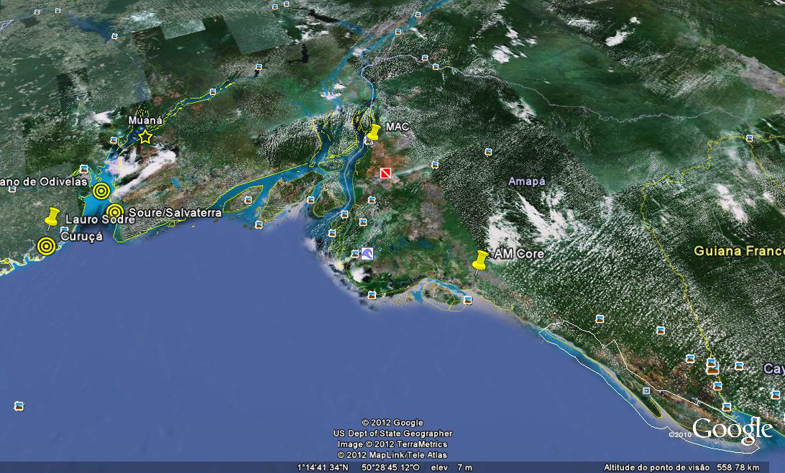
Tocantins
Amazon
Pará
Marajó Island
Varzea
Amapá
Mangrove
Mangrove
Atlantic

Slide 11
Central - Brazil
HOLOCENO
Early
Medium
Late
Águas emendadas (DF): Ledru et al. (2009)
Úmido
Cromínia (GO): Salgado-Labouriau, 1997
Pessenda et al. 2004
Salitre (MG): Ledru et al. (1998)
Águas emendadas (DF): Ledru et al. (2009)
Seco
Cromínia (GO): Salgado-Labouriau, 1997
Piracicaba (SP) e Londrina (PR): Pessenda et al. 2004
Salitre (MG): Ledru et al. (1998)

Slide 12
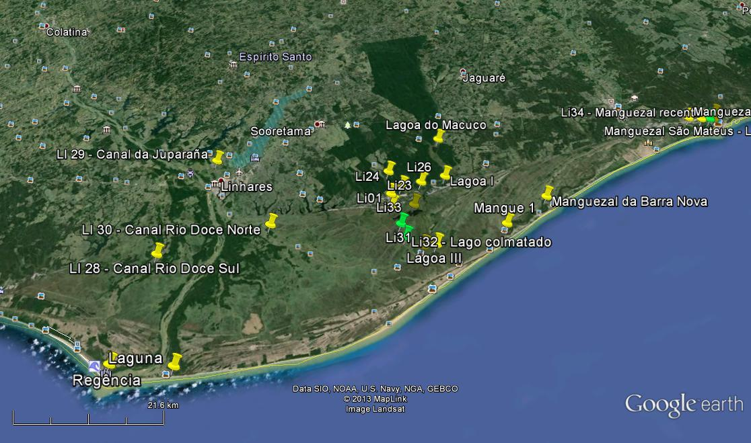
Coastal plain of the Rio Doce
State of Espírito Santo - Brazil
São Mateus River
Doce River
Sediment core
Current Mangrove Area
Atlantic Ocean
França et al., 2013

Slide 13
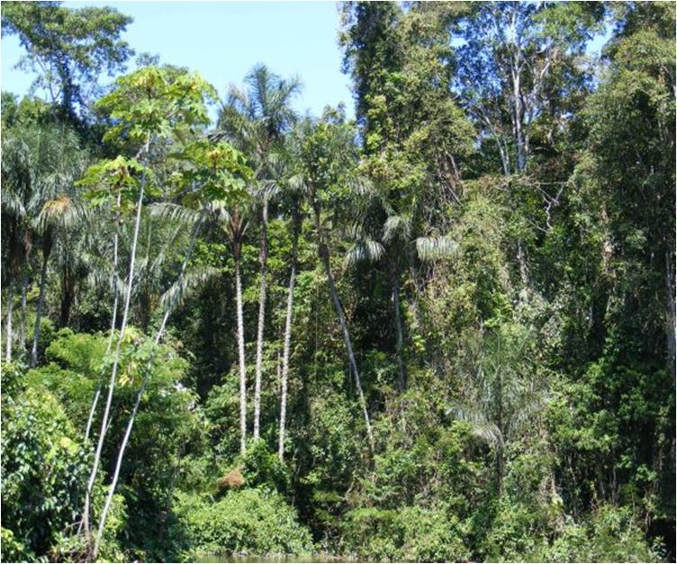
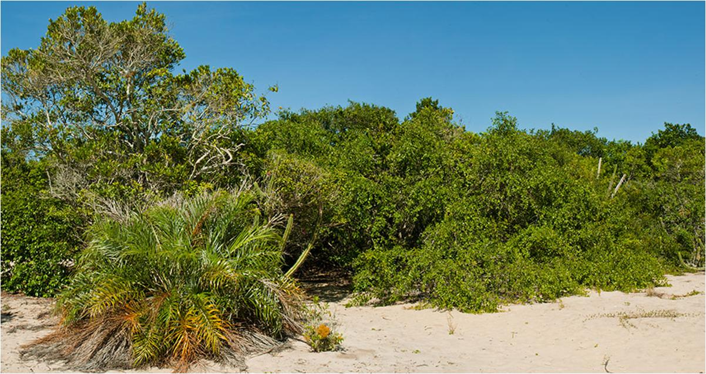
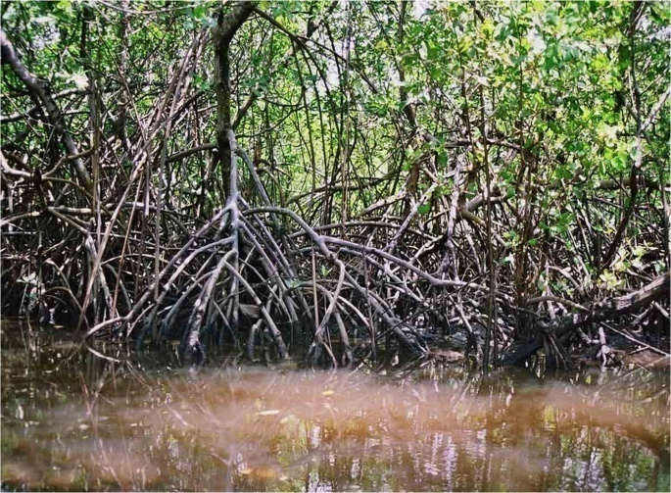
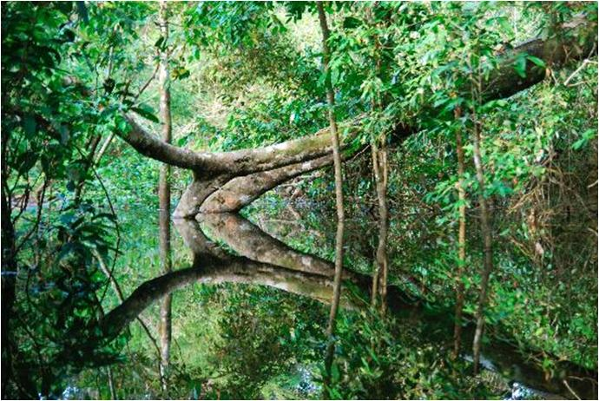
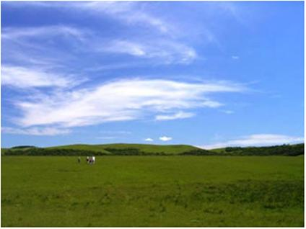
Coastal vegetation
Forest
Restinga
Mangrove
Herbaceous flat
Varzea

Slide 14
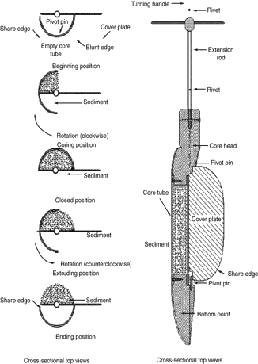
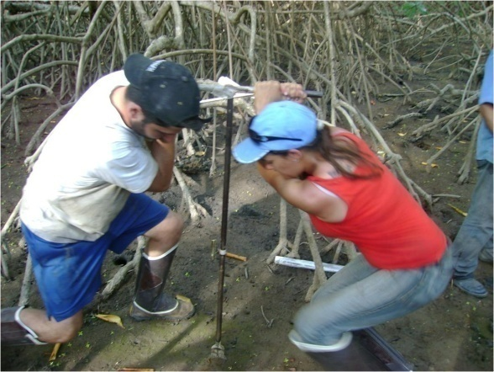
Materials and Methods
Grain size (35)
X-Ray (6 m)
Palynology (116)
Sampling and Laboratory
Facies (4)
Isotopes (232)
Radiocarbon – ¹⁴C (5)

Slide 15
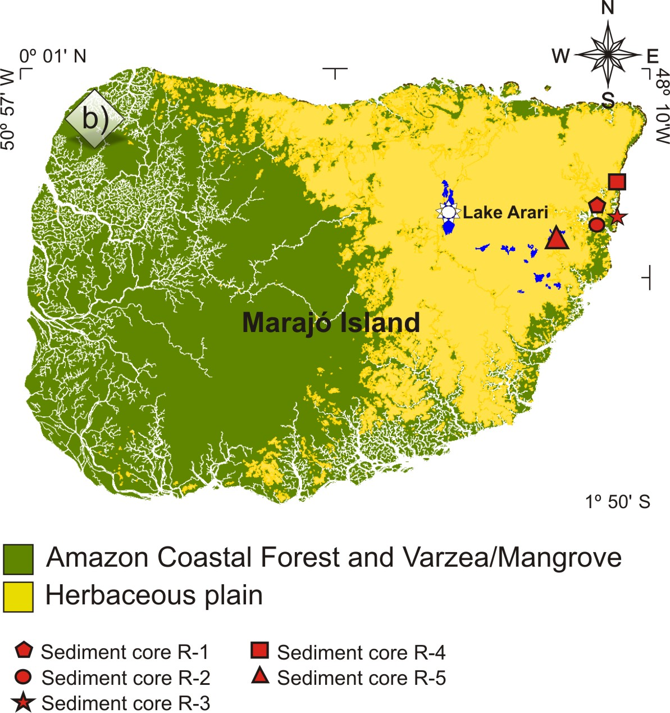
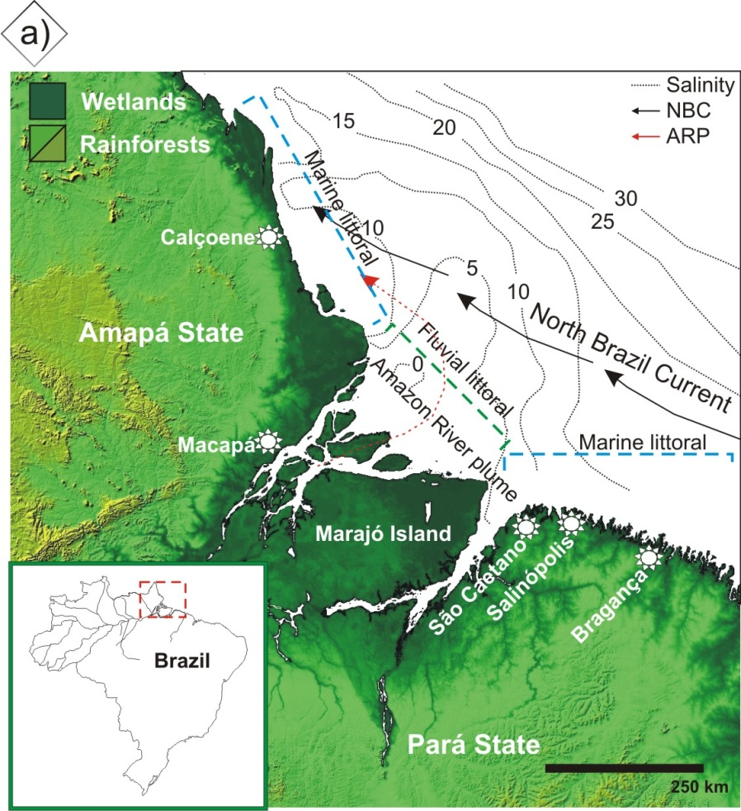
Marajó Island (Amazon Region)

Slide 16
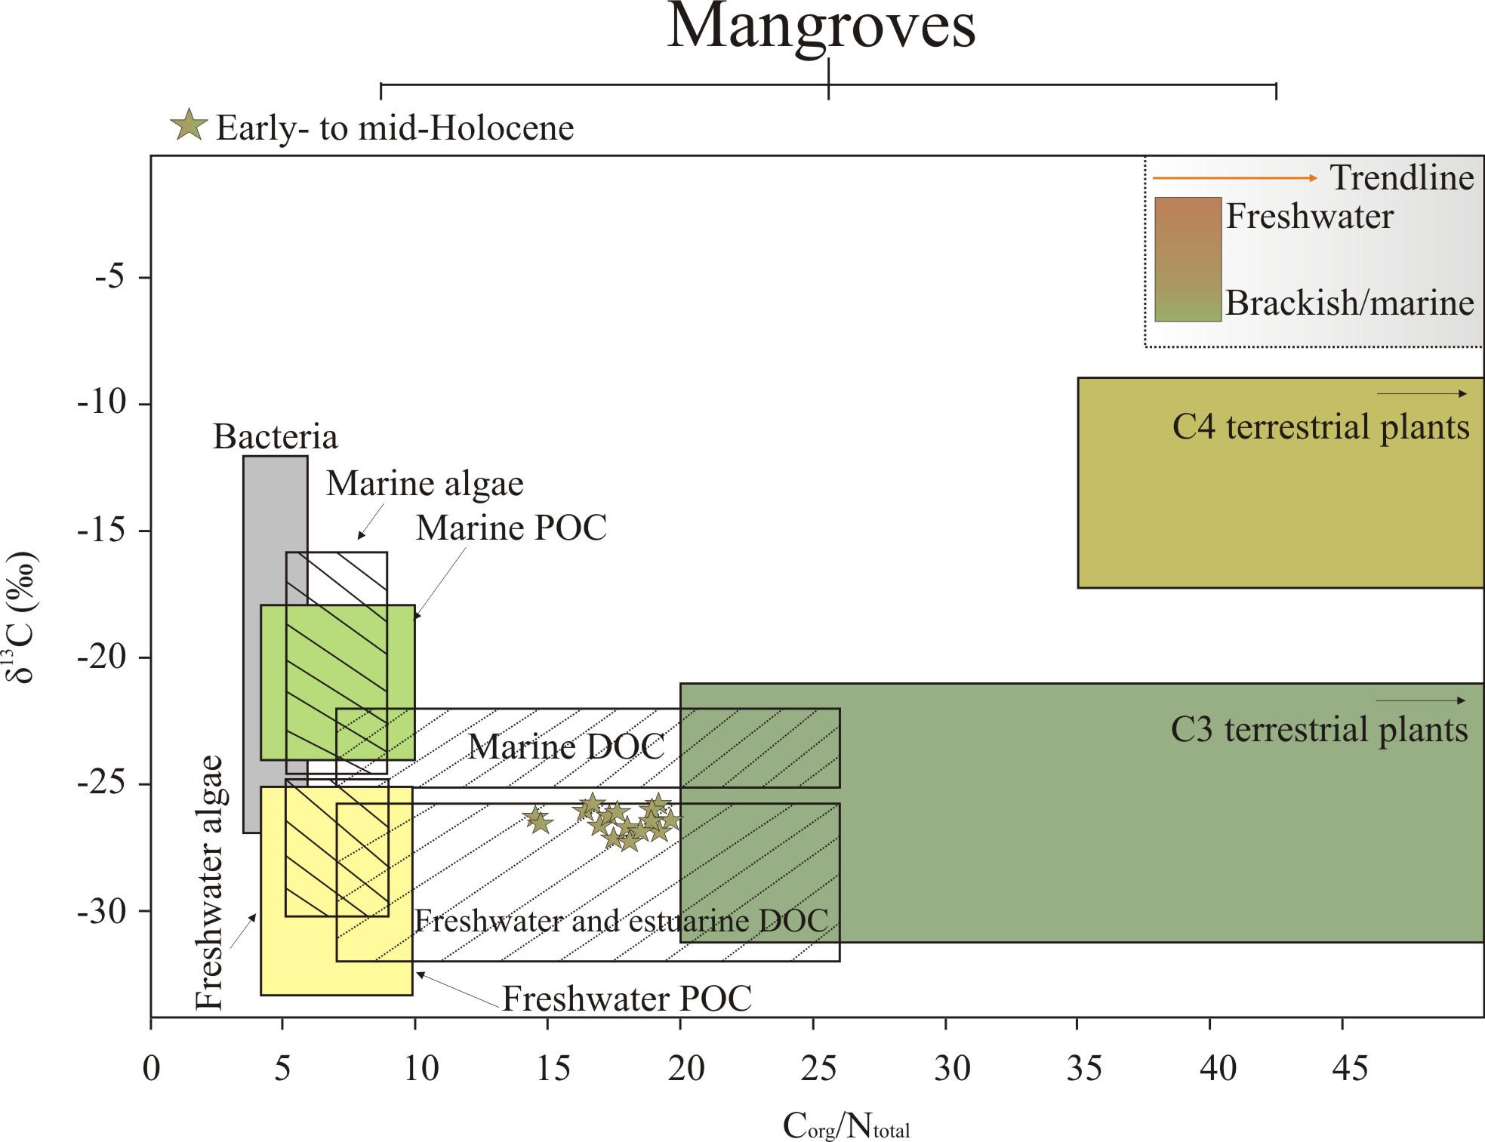

Slide 17
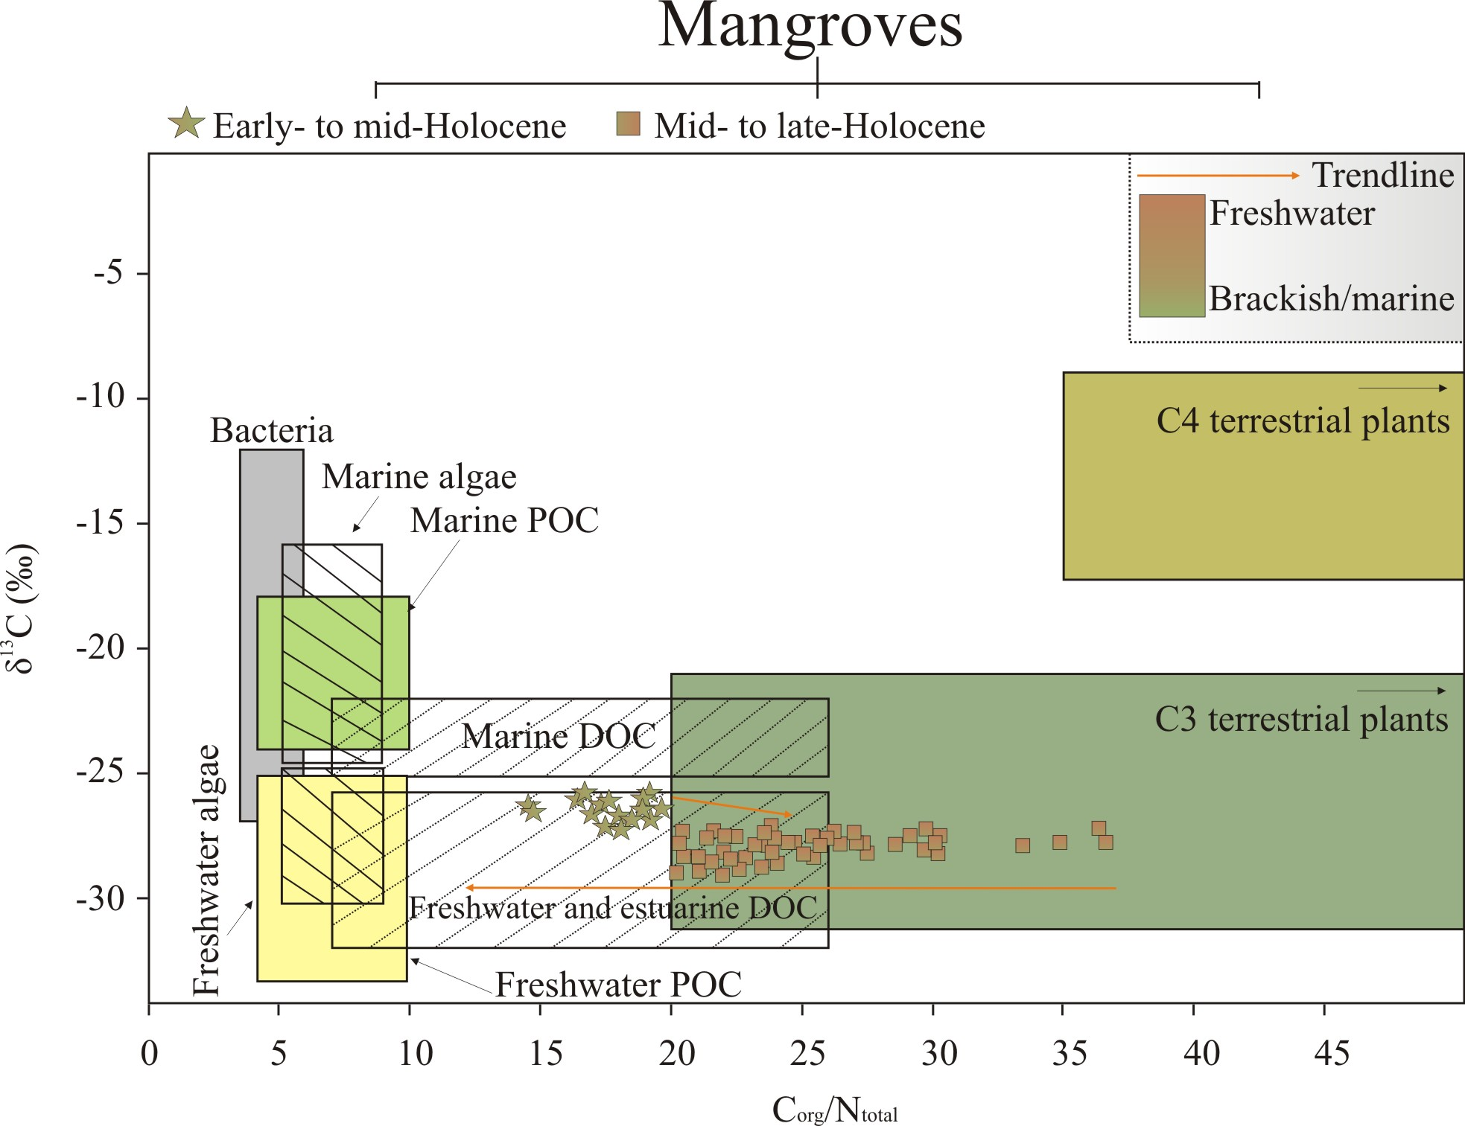

Slide 18
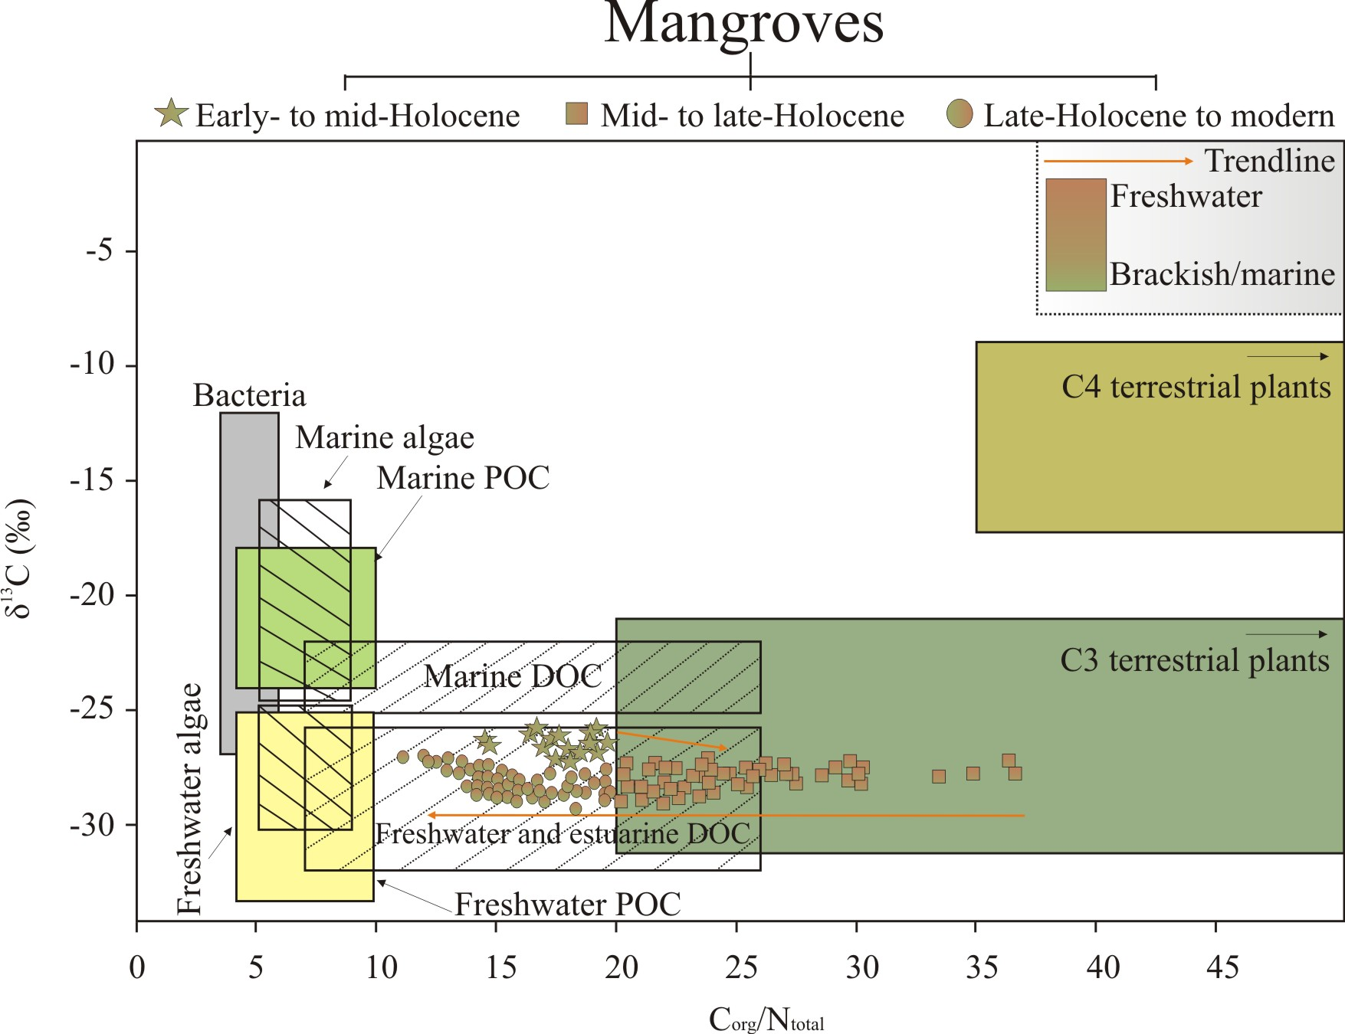

Slide 19
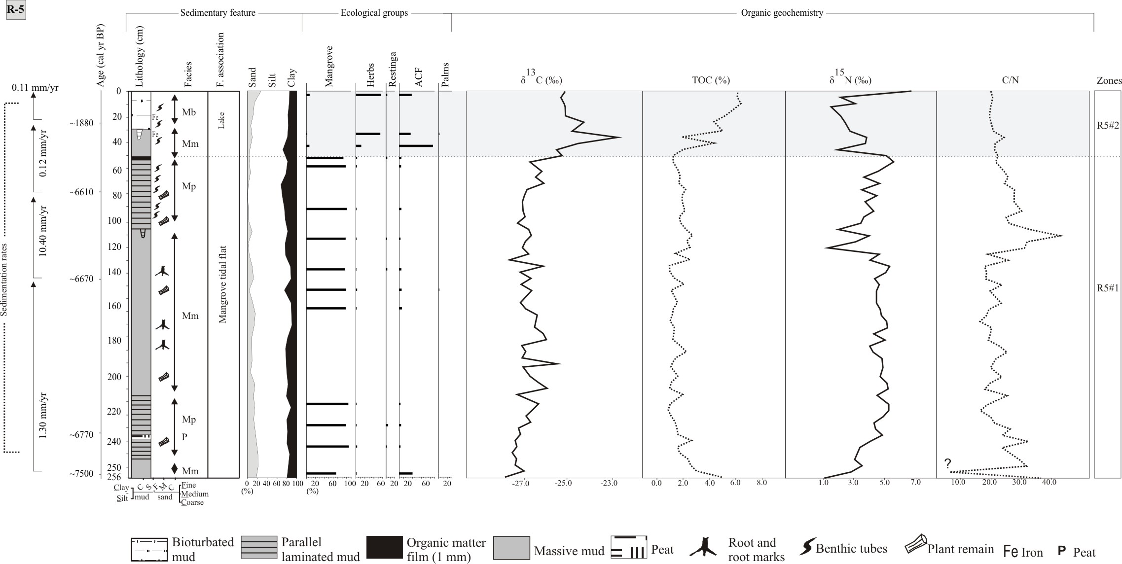
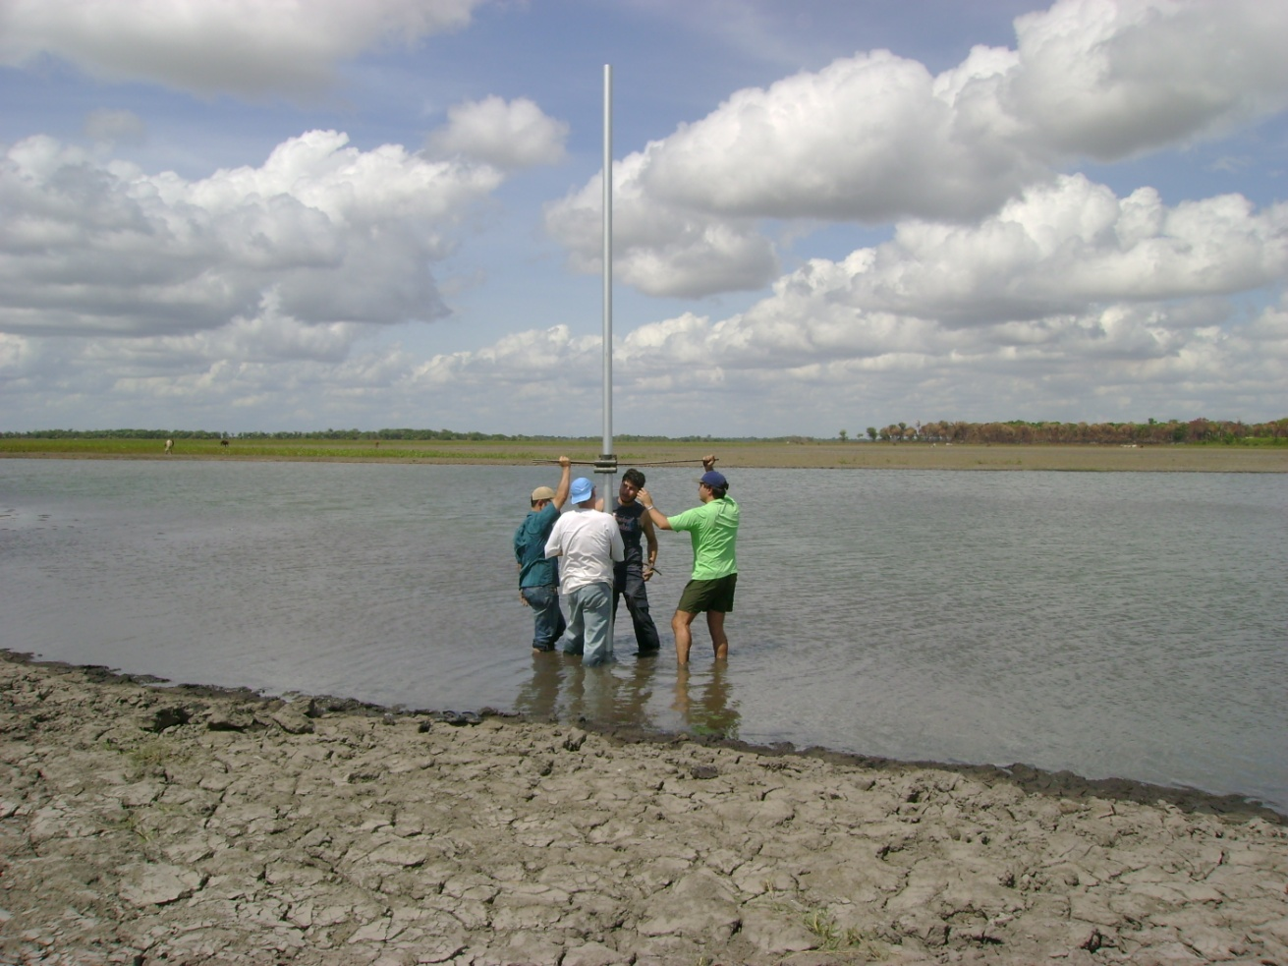
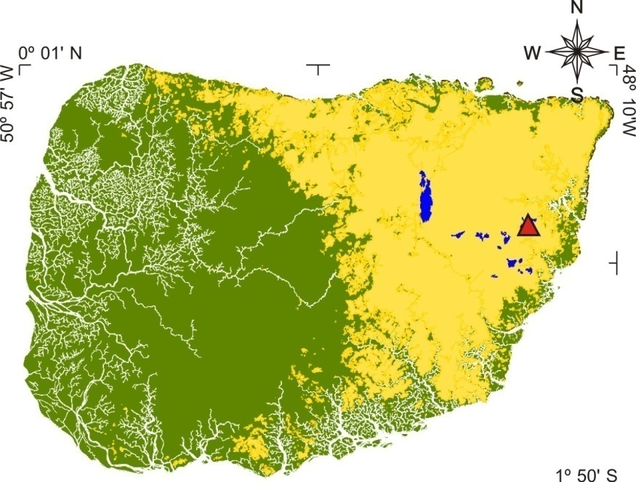
Core R-5
Pará

Slide 20
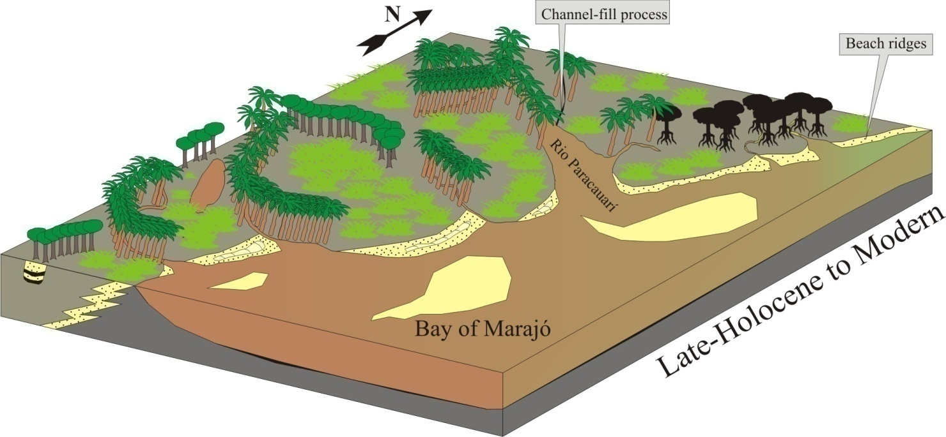
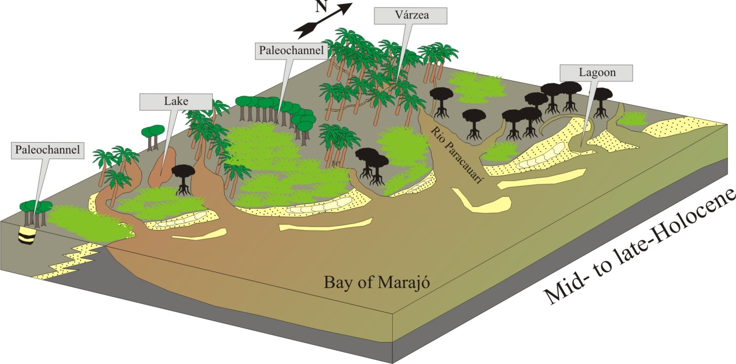
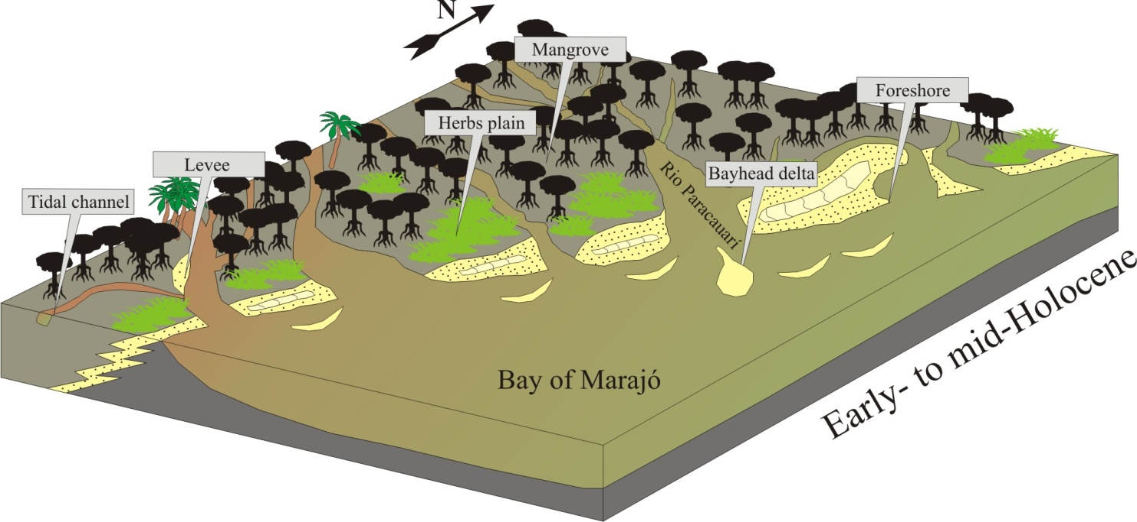
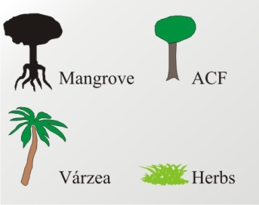
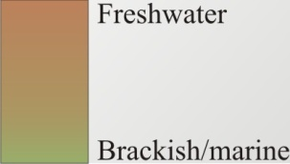

Slide 21
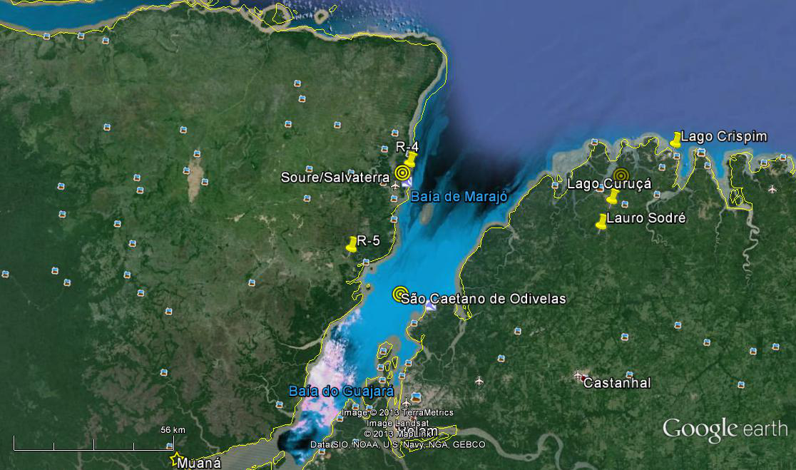
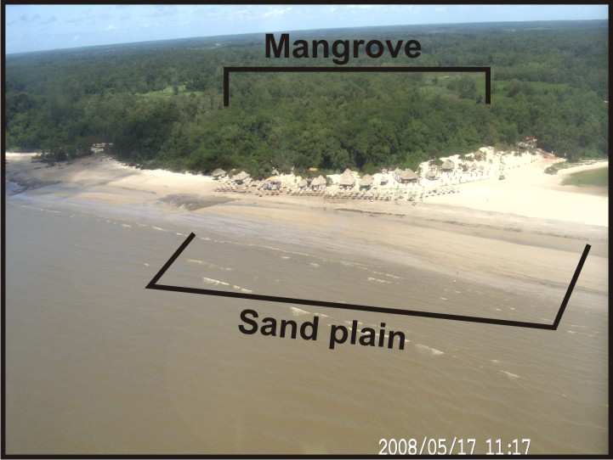
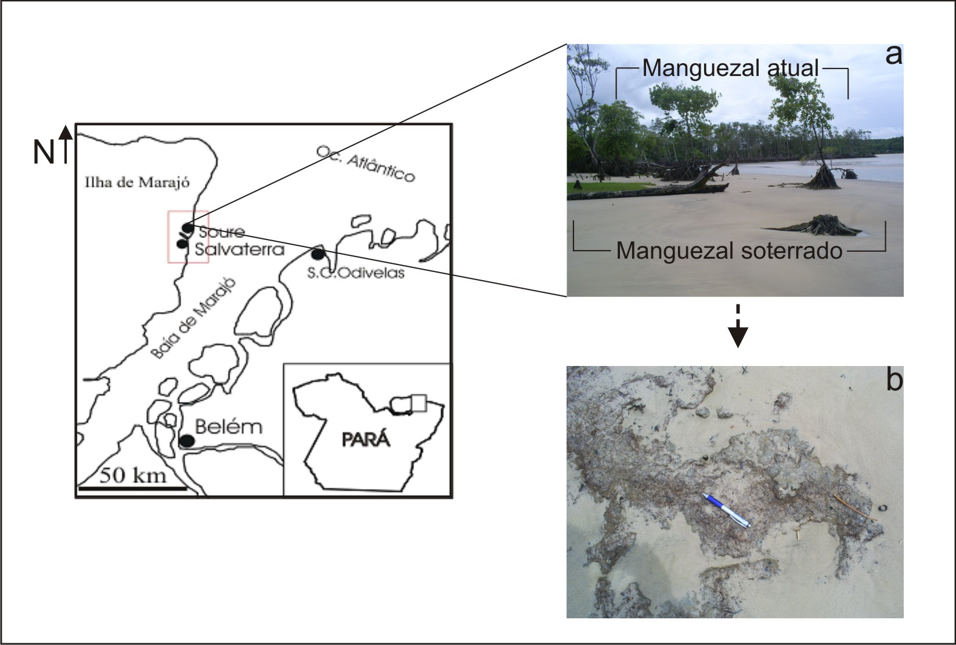
Mangrove - today
Sandy sediments

Slide 22
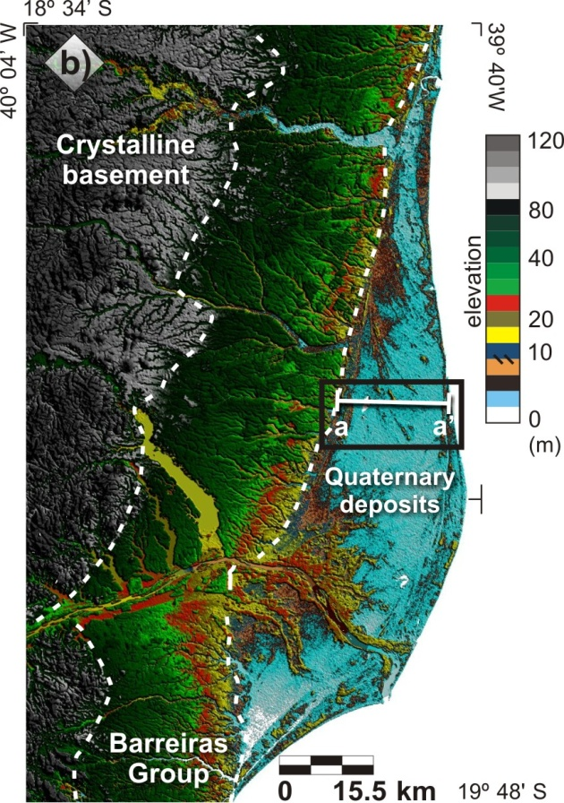
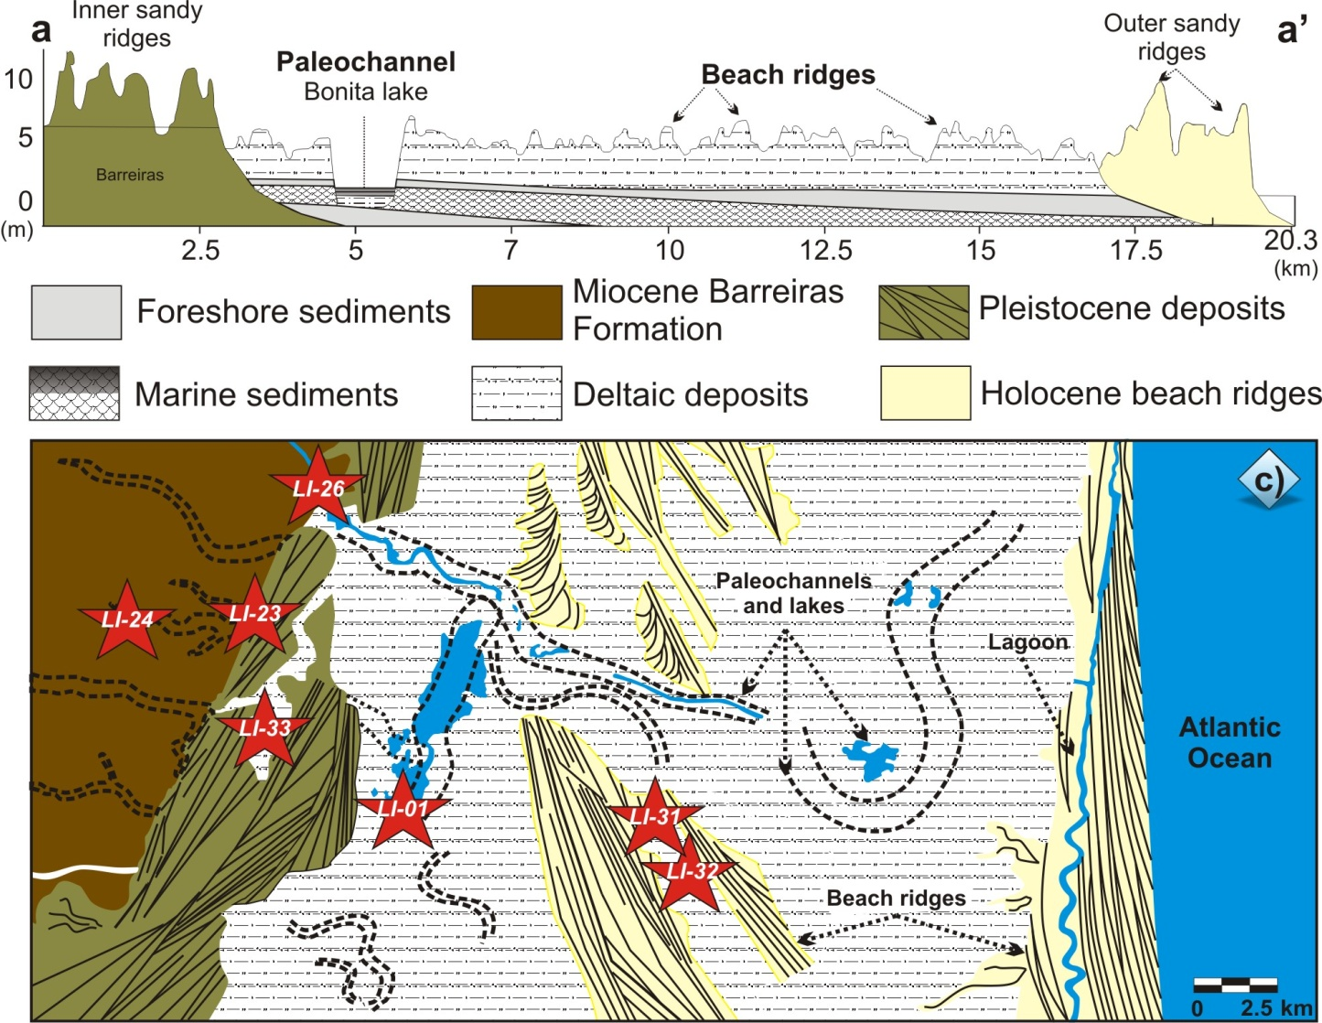
Doce River (SE – Brazil)
LI34

Slide 23
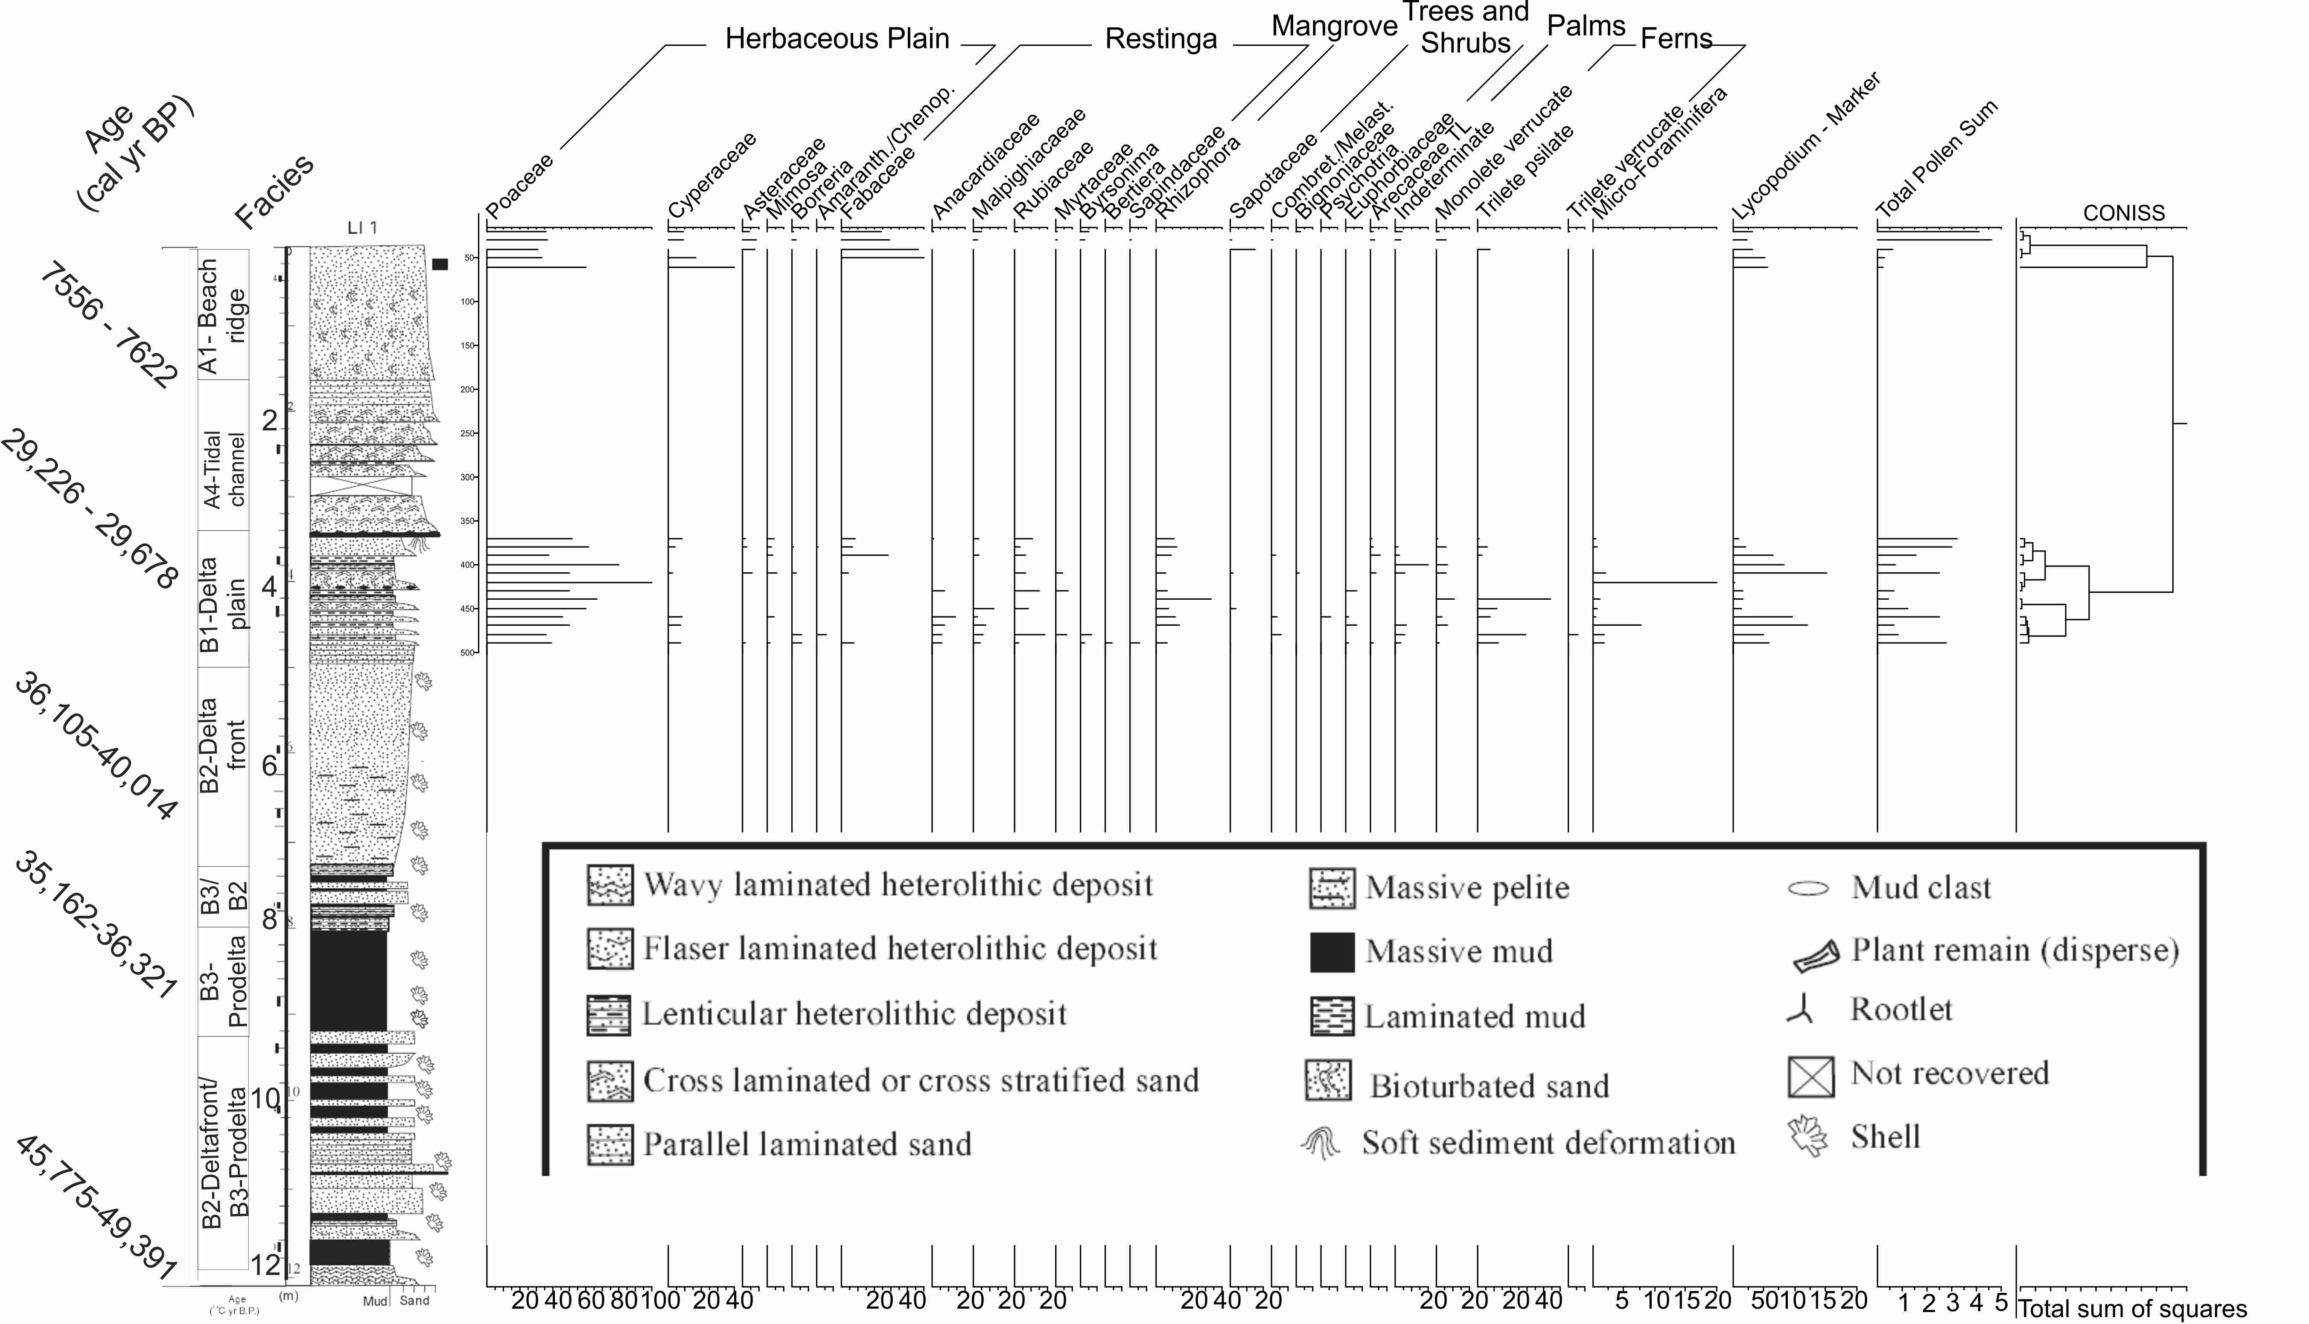
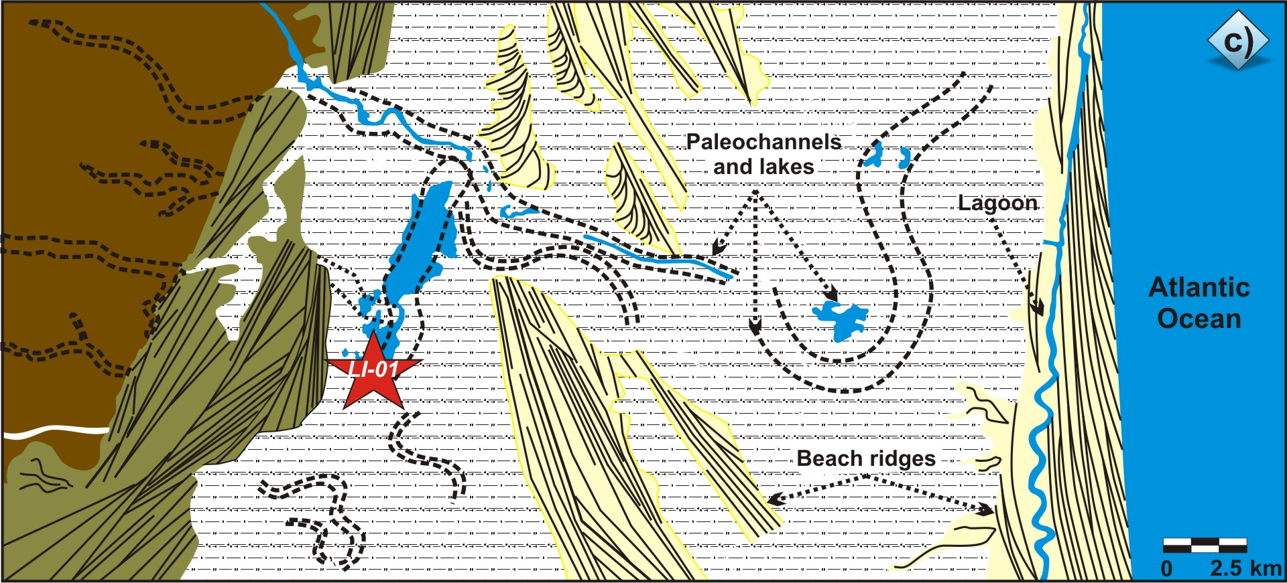
Dados paleoambientais (LI-01)
Espírito Santo

Slide 24
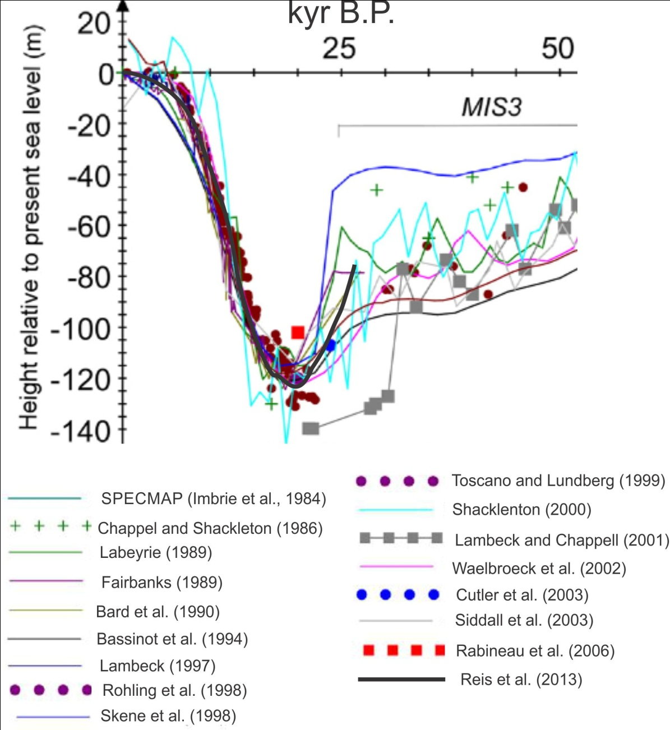
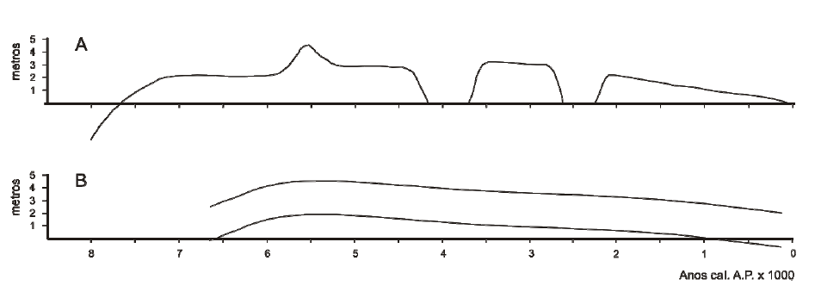
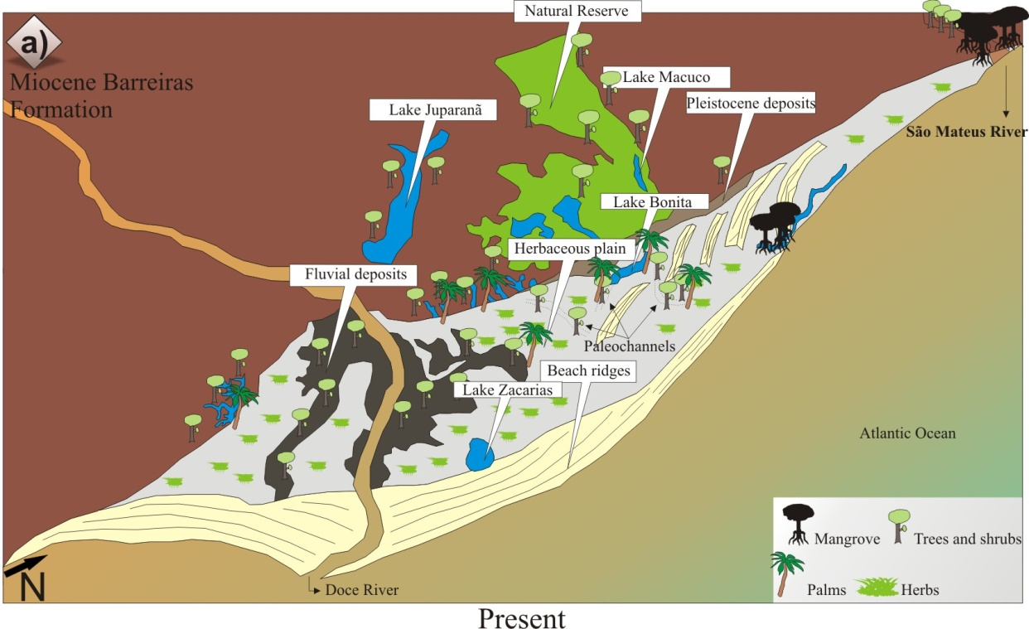
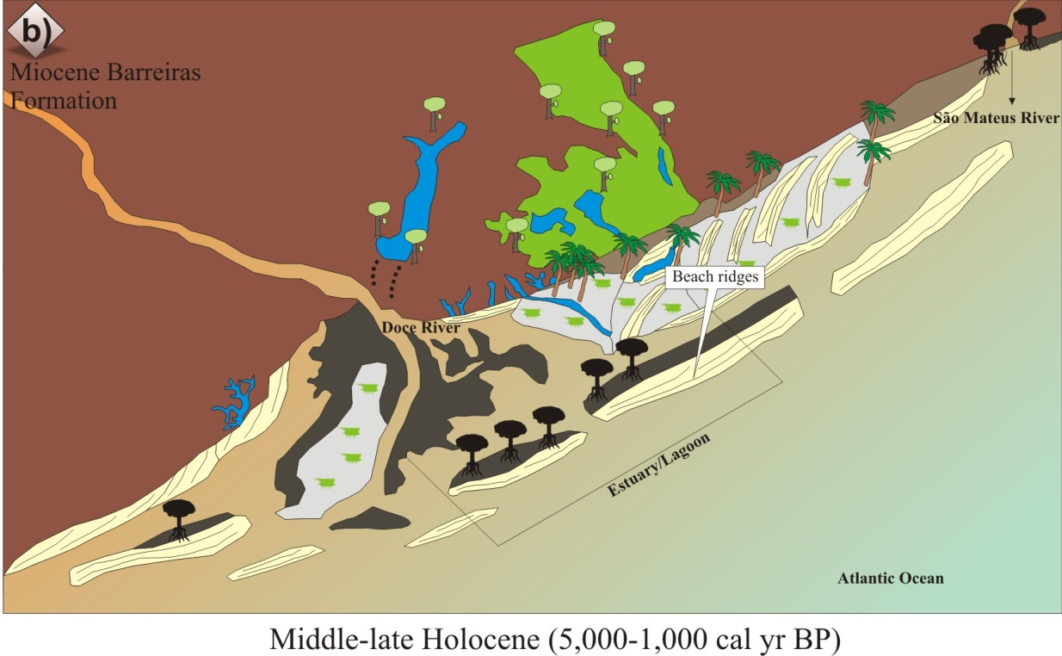
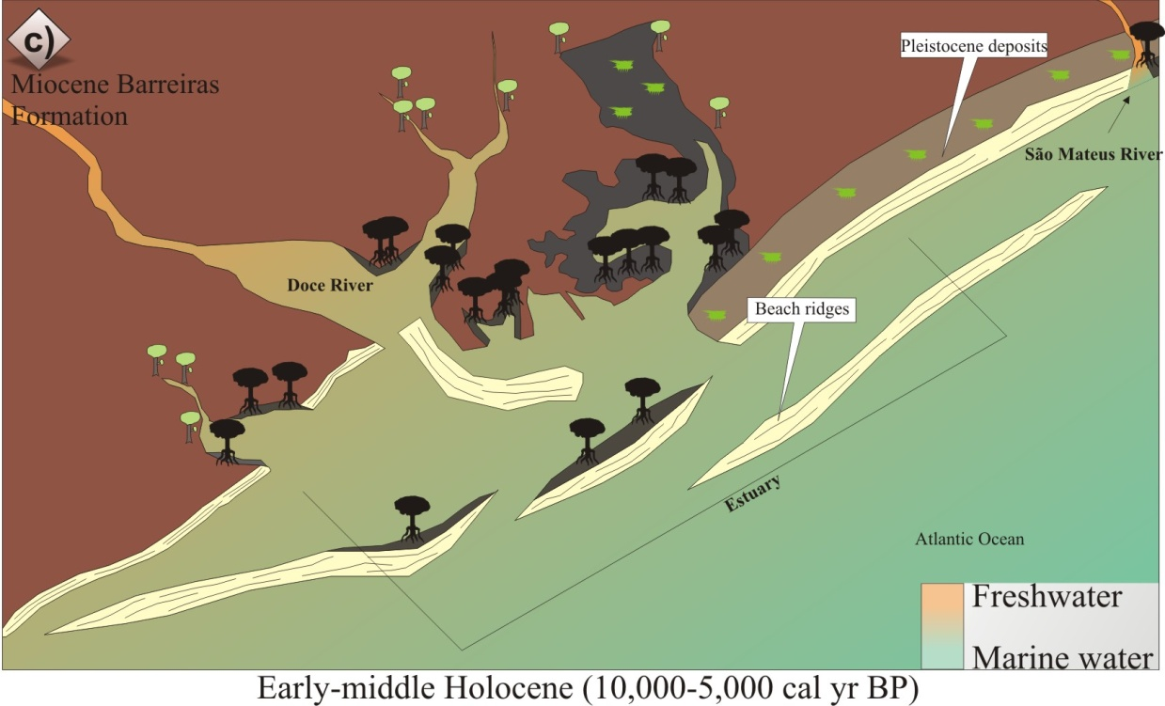
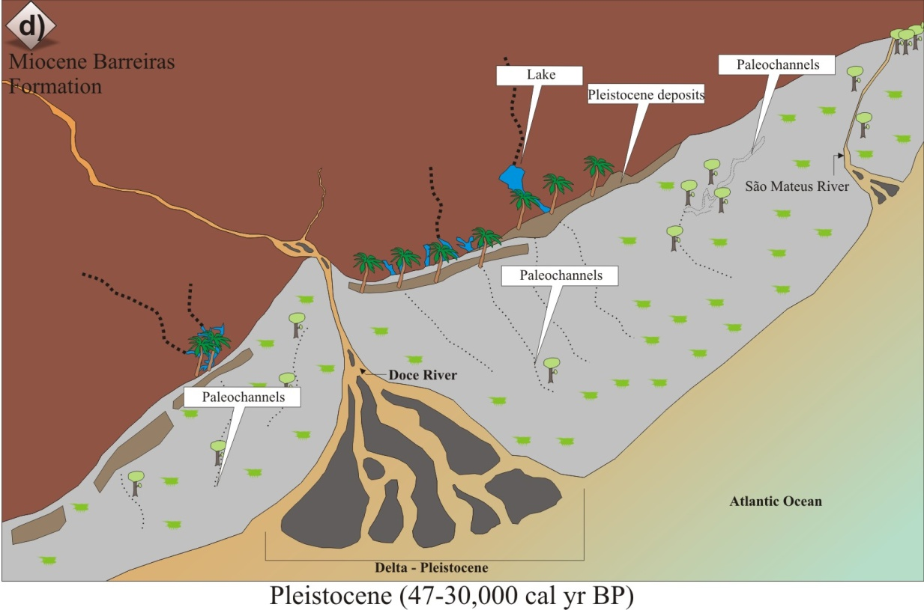
Doce River
Martin et al. 2003
Angulo et al. 2006

Slide 25
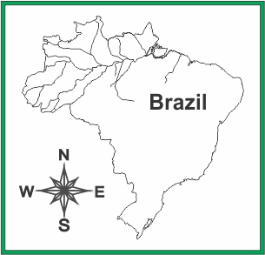
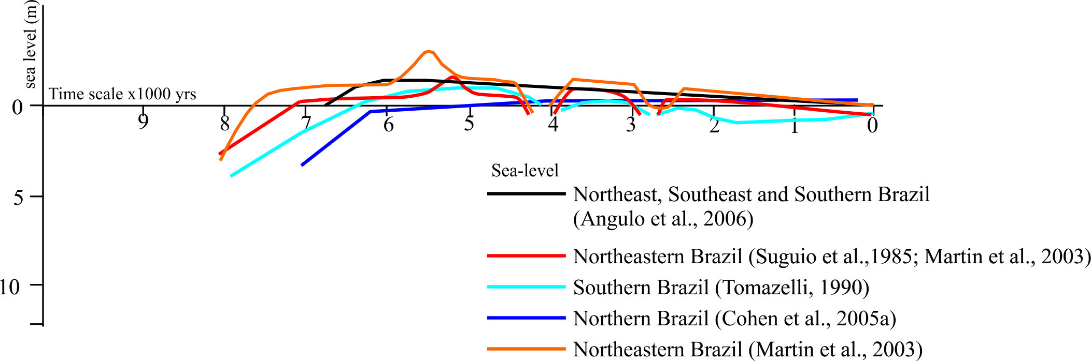
Holocene – Sea Level

Slide 26


Holocene - Results

Slide 27

Holocene - Results

Slide 28

Holocene - Results

Slide 29

Holocene - Results

Slide 30


Holocene - Results

Slide 31

Holocene - Results

Slide 32


Holocene - Results

Slide 33



Summary
Have a change on the sea level?
  Yes!
Have a climatic change?
  Yes!
How the vegetation reply those changes?
  We can see different phases!
Why use the mangroves?
  Mangroves are highly susceptible to climatic changes and sea-level oscillations
  They have been almost continuously exposed to disturbance as a result of fluctuations in sea-level

Slide 34
Summary
Considering the Marajó Island during the early and middle Holocene (~7500 and ~3200 cal yr BP) mangrove area increased over tidal mud flats with accumulation of estuarine/marine organic matter. Dry conditions in the Amazon region during this time led to a rise is tidal water salinity and contributed to mangrove expansion.

Slide 35
Summary
On the coastal plain of the Doce River between ~47,500 and ~29,400 cal yr BP, a deltaic system was developed in response mainly to sea-level fall.
The post-glacial sealevel rise caused a marine incursion with invasion of embayed coast and broad valleys, and it favored the evolution of a lagoonal/estuary system with wide tidal mud flats occupied by mangroves between at least ~7400 and ~5100 cal yr BP.

Slide 36







Acknowledgments

Slide 37
Thank you very much!
Marlon C. França
marlon.franca@ifpa.edu.br
+55 91 991.361.522

