Slide 1
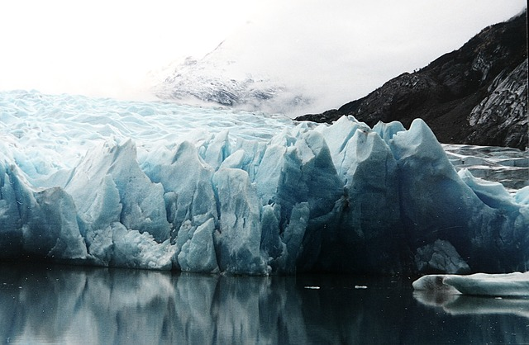
Educating to Live More Sustainably
In Our Changing Climate
Dr. James Brey
Director, Education Program | American Meteorological Society
Notes:
To reproduce the picture effects on this slide, do the following:
On the Home tab, in the Slides group, click Layout and then click Blank.
On the Insert tab, in the Images group, click Picture. In the Insert Picture dialog box, select a picture, and then click Insert.
Under Picture Tools, on the Format tab, in the Size group, click the Size and Position dialog box launcher. In the Format Picture dialog box, resize or crop the image so that the height is set to 3.17” and the width is set to 10”. To crop the picture, click Crop in the left pane, and in the right pane, under Crop position, enter values into the Height, Width, Left, and Top boxes. To resize the picture, click Size in the left pane, and in the right pane, under Size and rotate, enter values into the Height and Width boxes.
Select the picture. On the Home tab, in the Drawing group, click Arrange, point to Align, and then do the following:
Click Align to Slide.
Click Align Top.
Under Picture Tools, on the Format tab, in the Picture Styles group, click Picture Effects, point to Reflections, and then under Reflection Variations click Half Reflection, touching (first row, second option from the left).
On the Insert tab, in the Text group, click Text Box, and then on the slide, drag to draw the text box.
Enter text in the text box, select the text, and then on the Home tab, in the Font group, select Impact from the Font list and then enter 42 in the Font Size box.
On the Home tab, in the Paragraph group, click Align Text Right to align the text right in the text box.
Select the text box. Under Drawing Tools, on the Format tab, in the WordArt Styles group, click Text Effects, point to Reflection, and then under Reflection Variations click Half Reflection, touching (first row, second option from the left).
Under Drawing Tools, on the Format tab, in the WordArt Styles group, click the Format Text Effects dialog box launcher. In the Format Text Effects dialog box, click Text Fill in the left pane, select Solid fill in the Text Fill pane, and then do the following:
Click the button next to Color, and then under Theme Colors, click White, Background 1 (first row, first option from the left).
In the Transparency box, enter 12%.
On the slide, drag the text box onto the picture to position as needed.
To reproduce the background on this slide, do the following:
Right-click the slide background area, and then click Format Background. In the Format Background dialog box, click Fill in the left pane, select Gradient fill in the Fill pane, and then do the following:
In the Type list, select Radial.
Click the button next to Direction, and then click From Center (third option from the left).
Under Gradient stops, click Add or Remove until two stops appear on the slider.
Also under Gradient stops, customize the gradient stops that you added as follows:
Select Stop 1 from the list, and then do the following:
In the Stop position box, enter 10%.
Click the button next to Color, and then under Theme Colors click White, Background 1, Darker 5% (second row, first option from the left).
Select Stop 2 from the list, and then do the following:
In the Stop position box, enter 99%.
Click the button next to Color, and then under Theme Colors click White, Background 1, Darker 35% (fifth row, first option from the left).

Slide 2
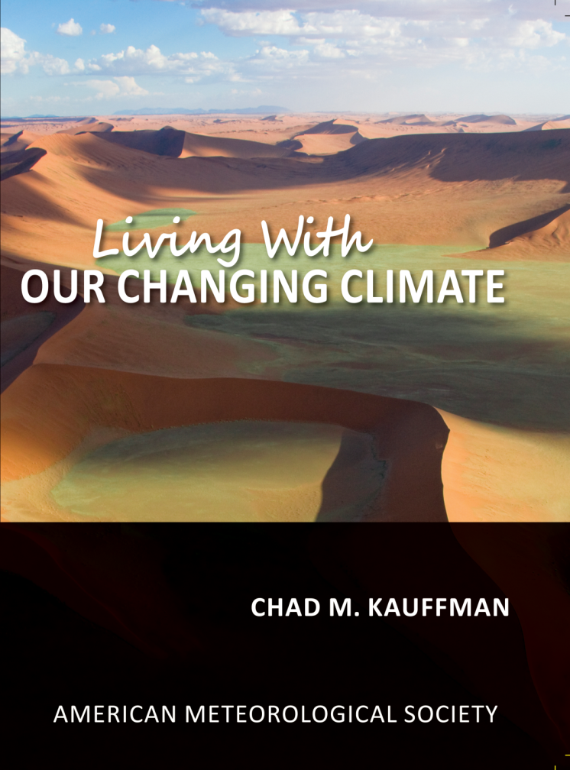
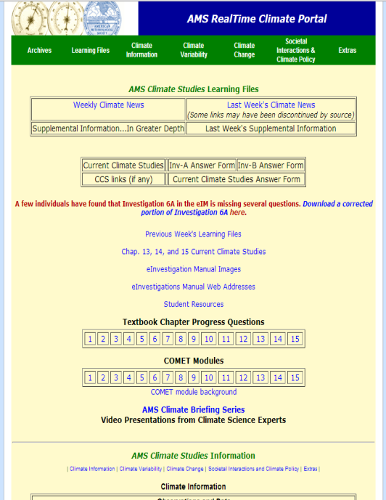
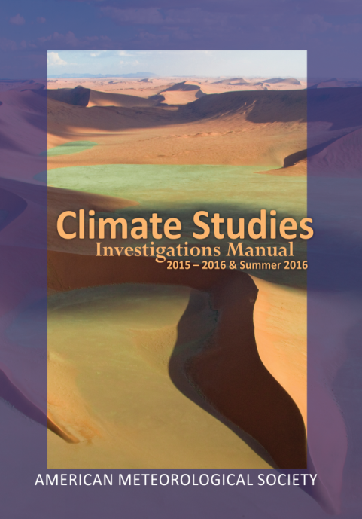
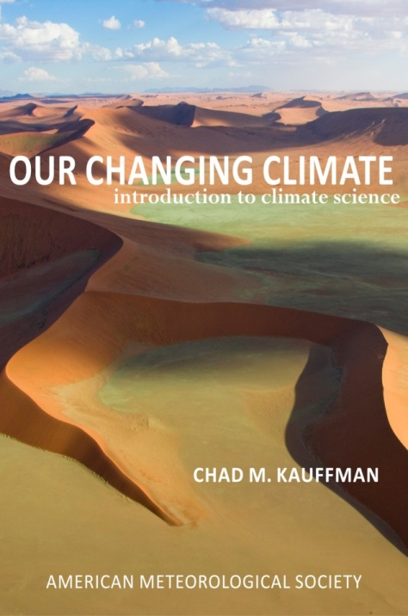
The AMS Education Program produces materials for climate system education 2 ways:
5 chapter Living With Our Changing Climate textbook
A full Earth’s Climate System Course suite of materials

Slide 3
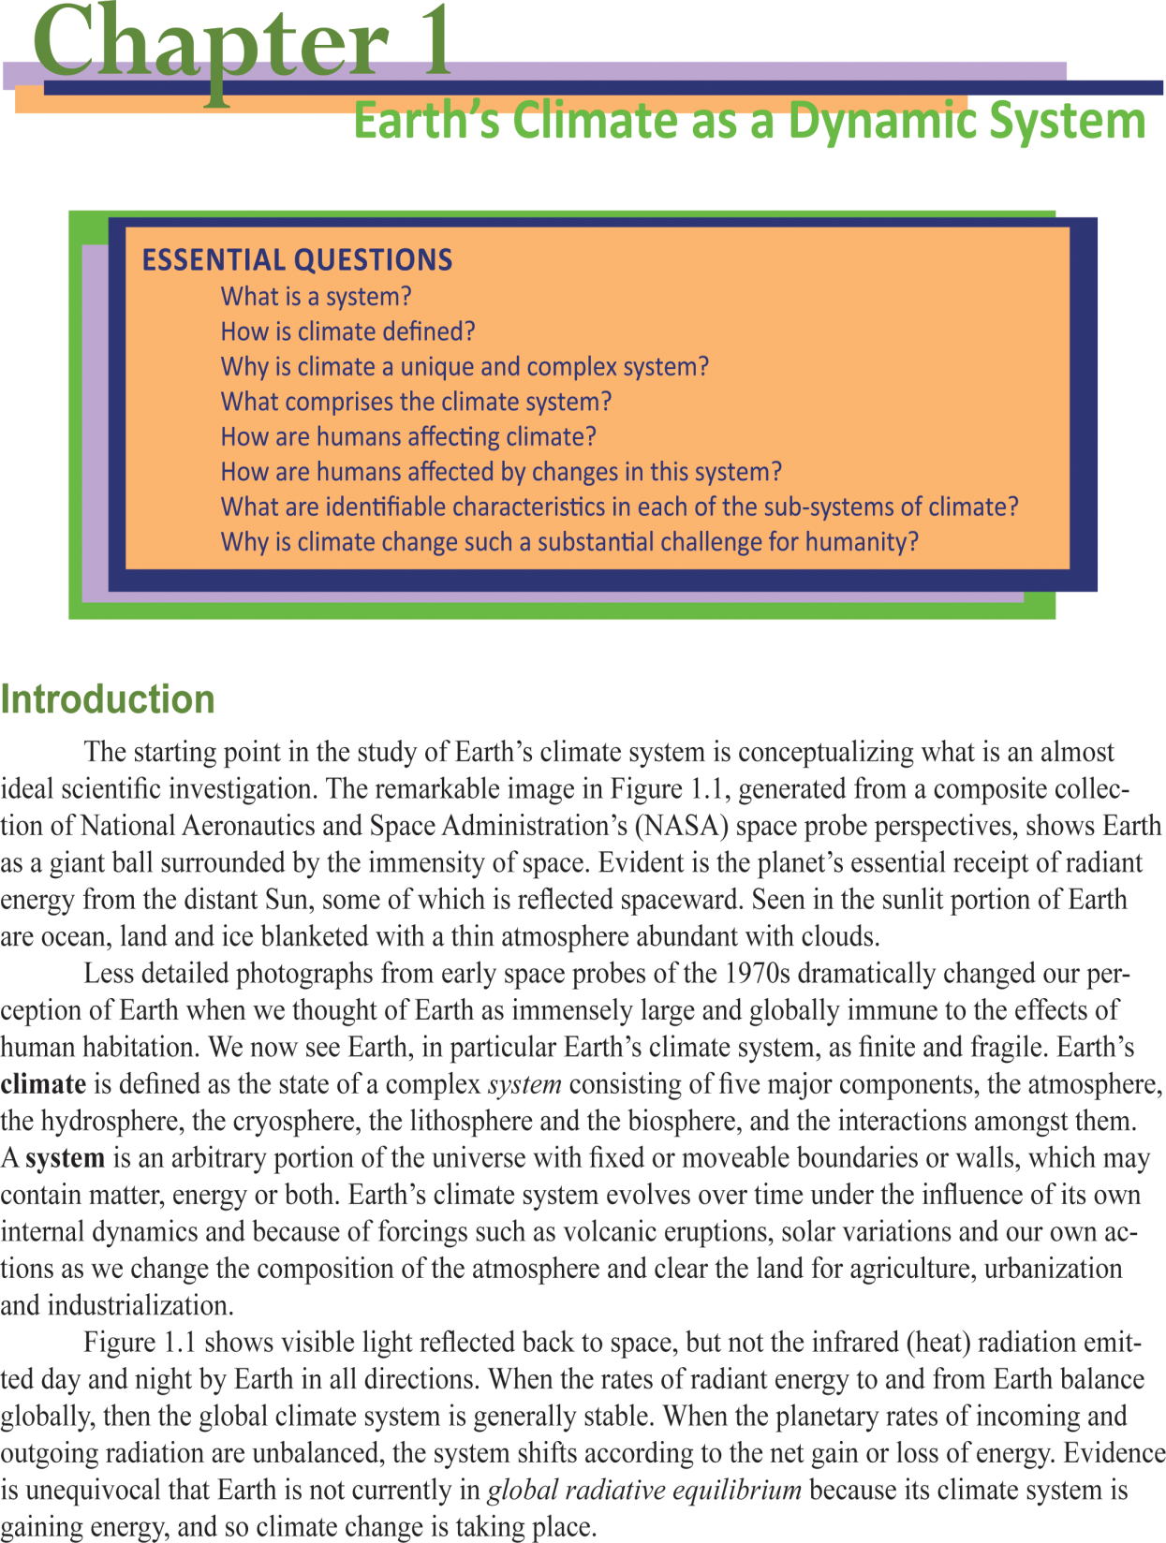

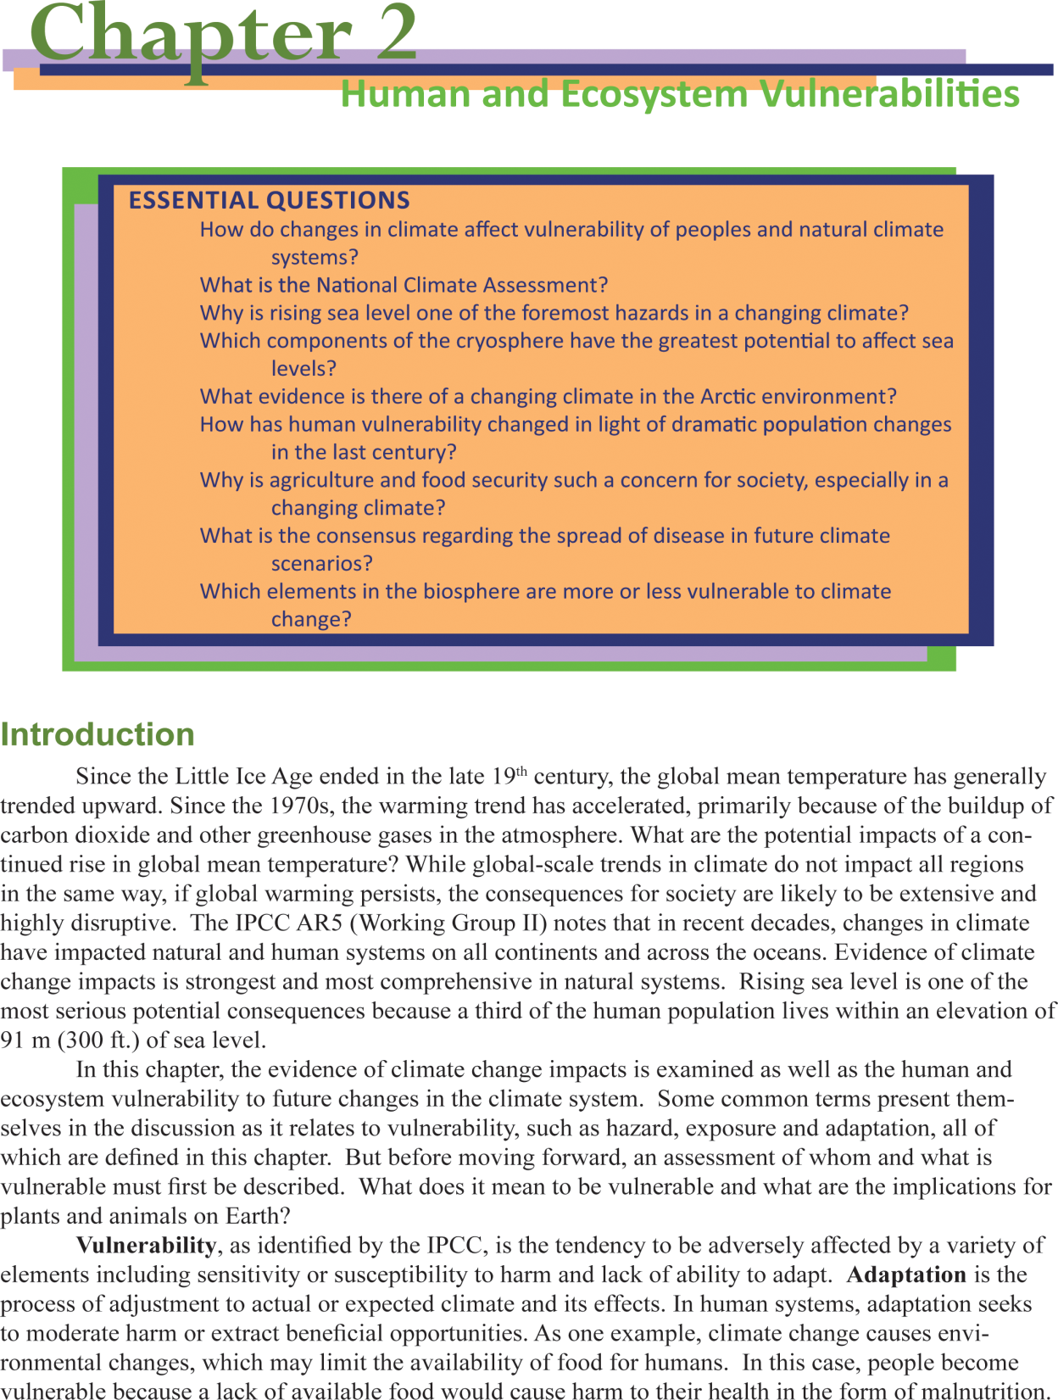
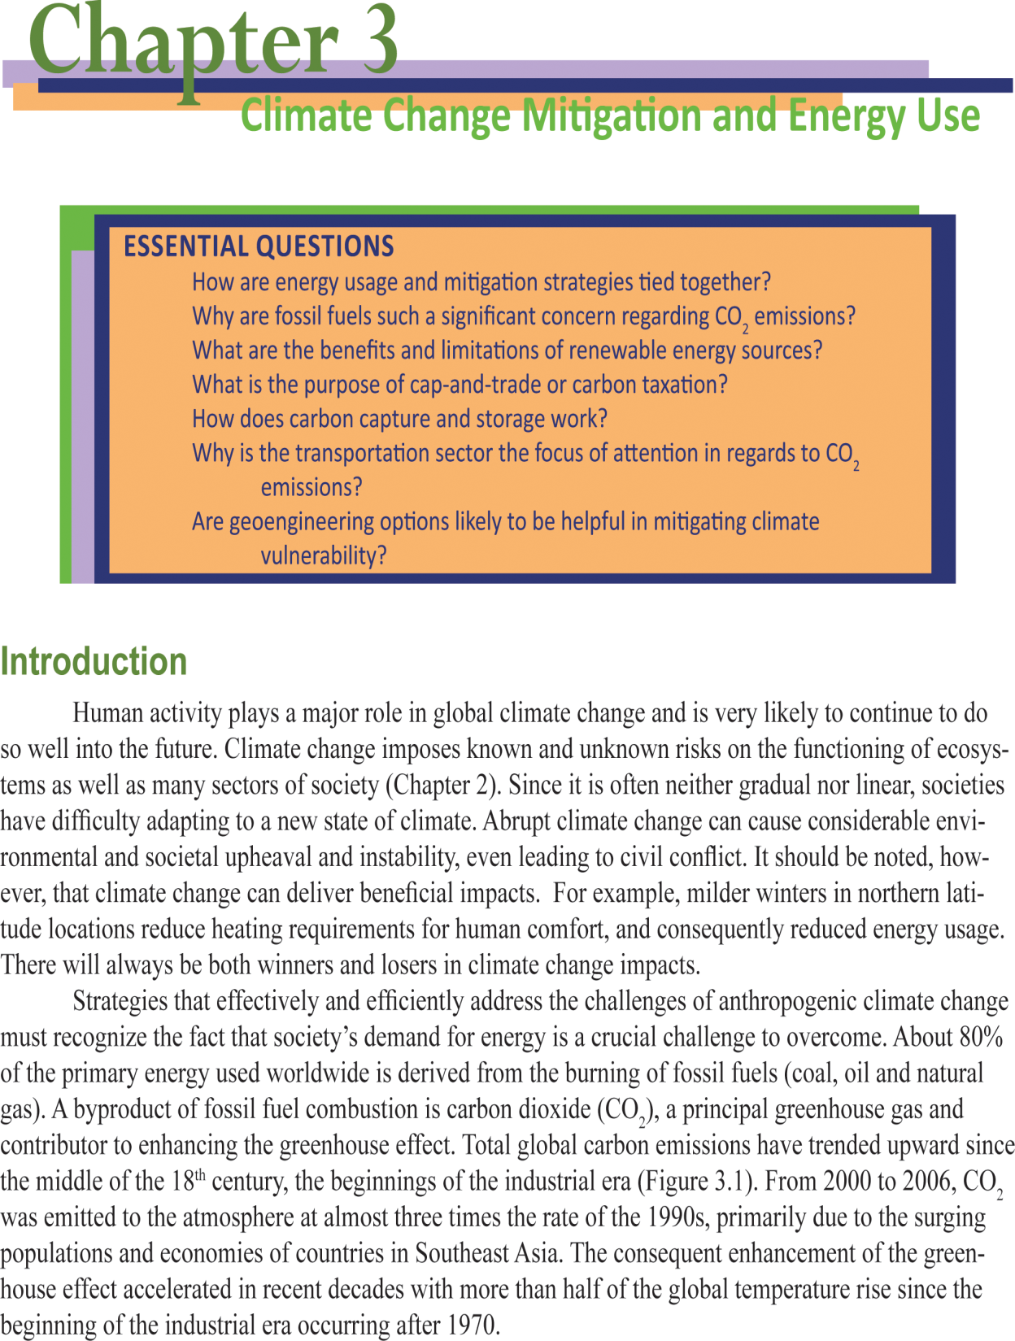
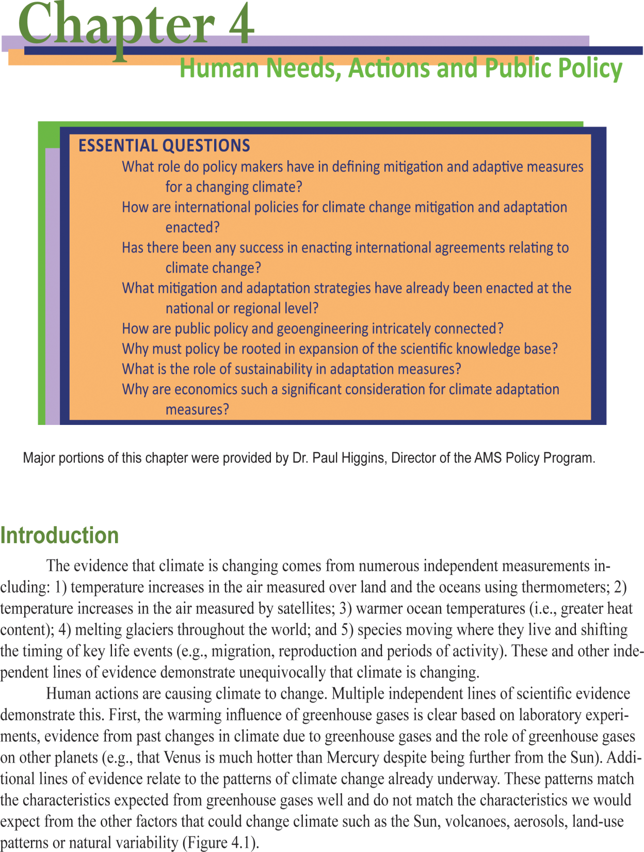
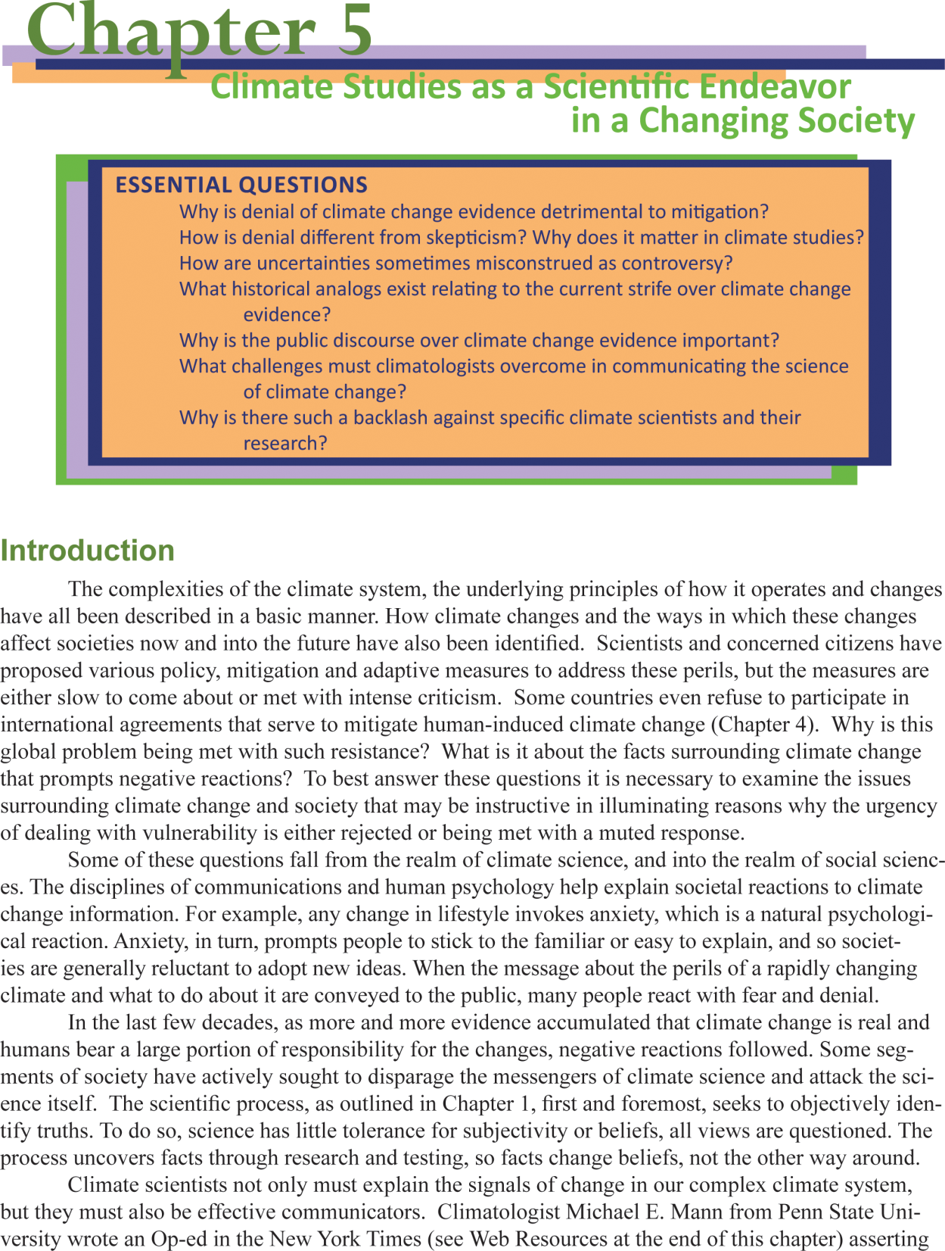
Brand new 5 chapter eBook
Emphasizes the role of sustainability, environmental geology, and other environmental sciences
Perfect for injecting climate change related topics into geoscience and other related courses
Similar features as the full 14 chapter Our Changing Climate eBook

Slide 4
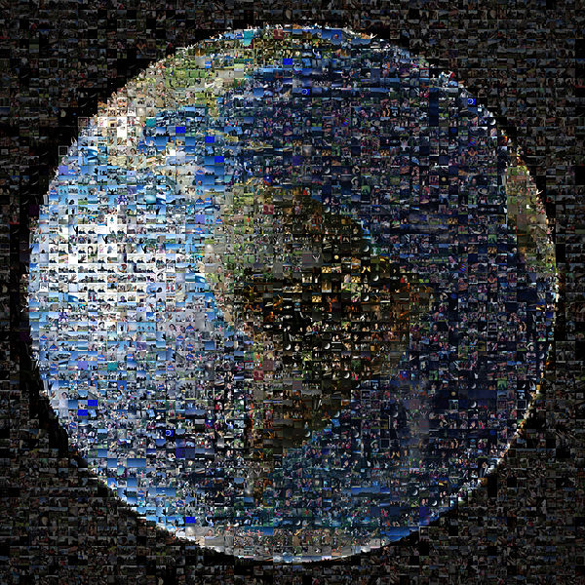


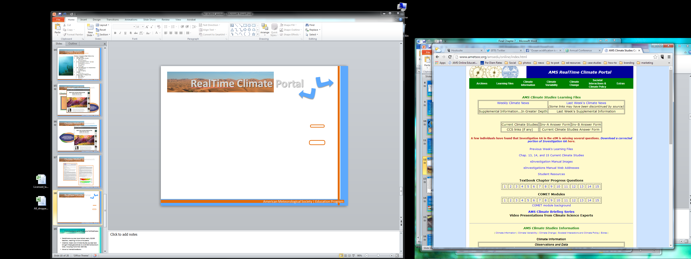
A New Dynamic course about Earth’s climate system designed for online, on-the-go learning .

Slide 5

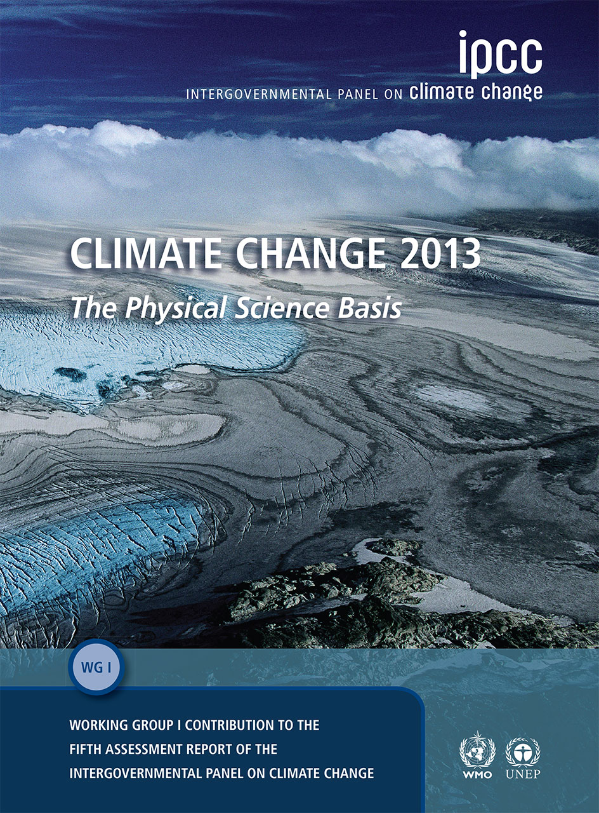
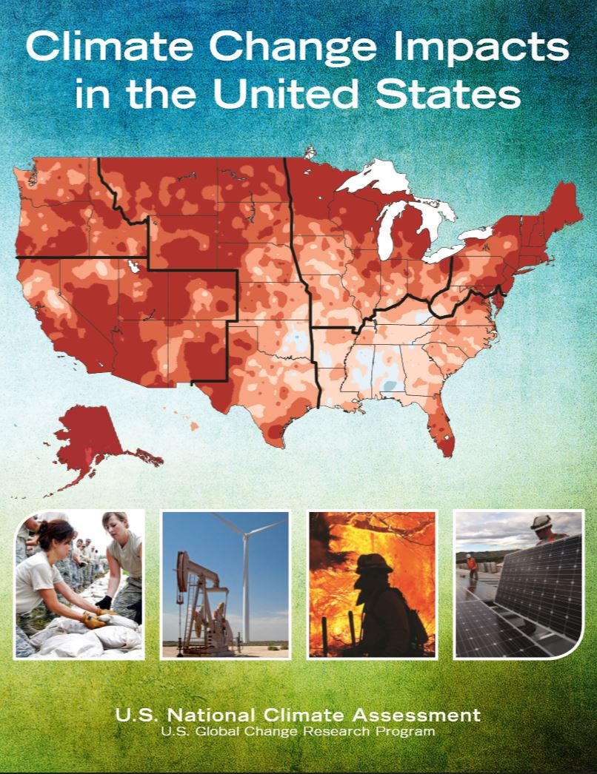
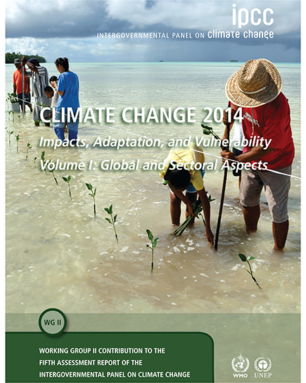
Course materials:
  Use real-world information
  Contain latest from NCA 3 & IPCC AR5

Slide 6

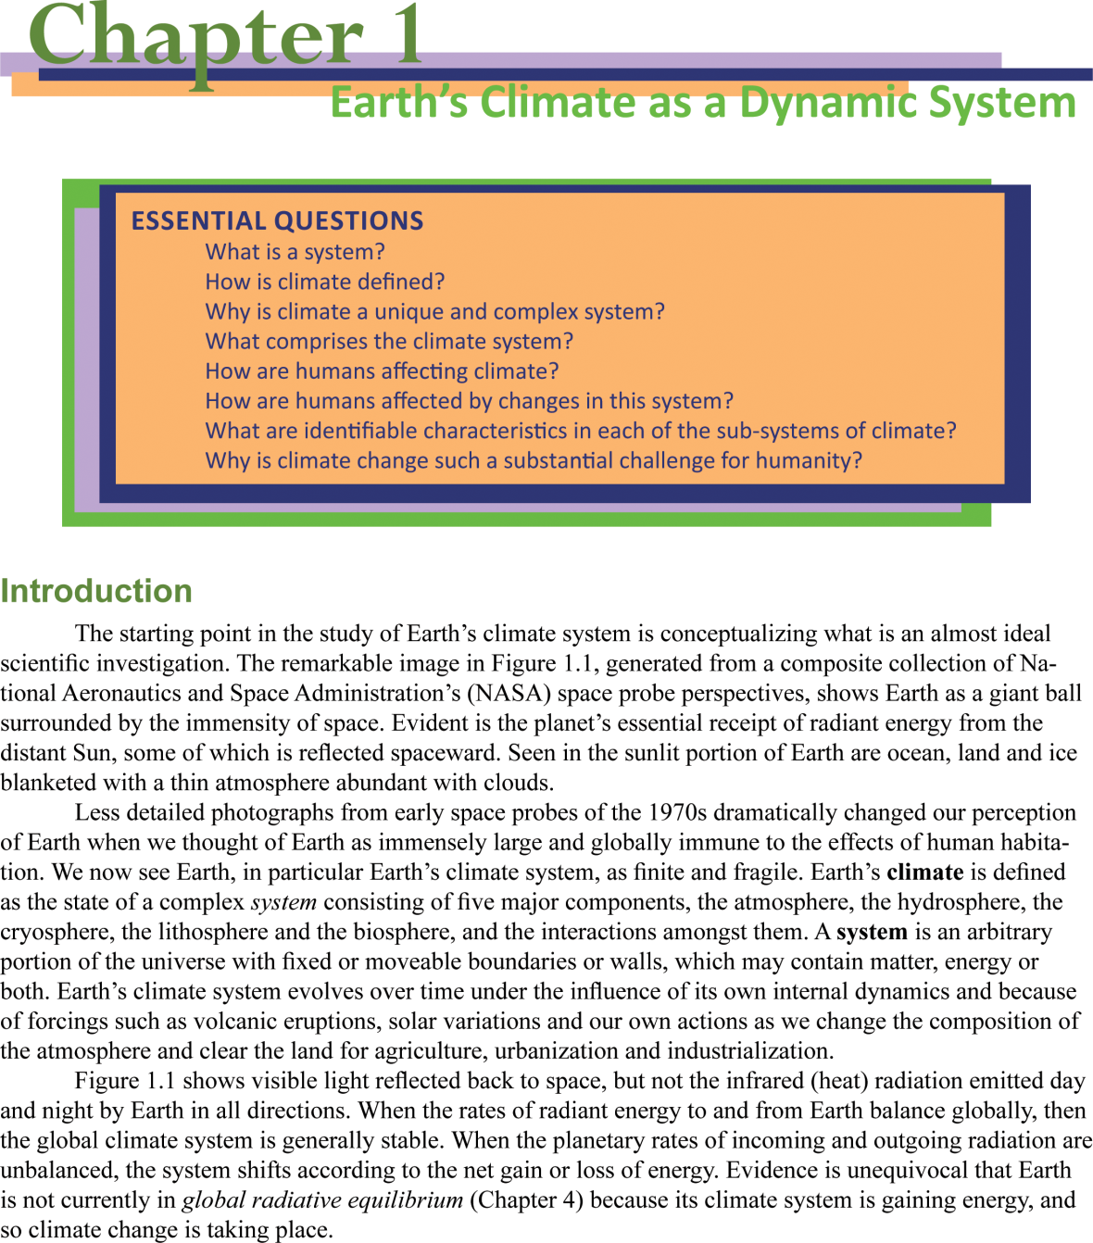
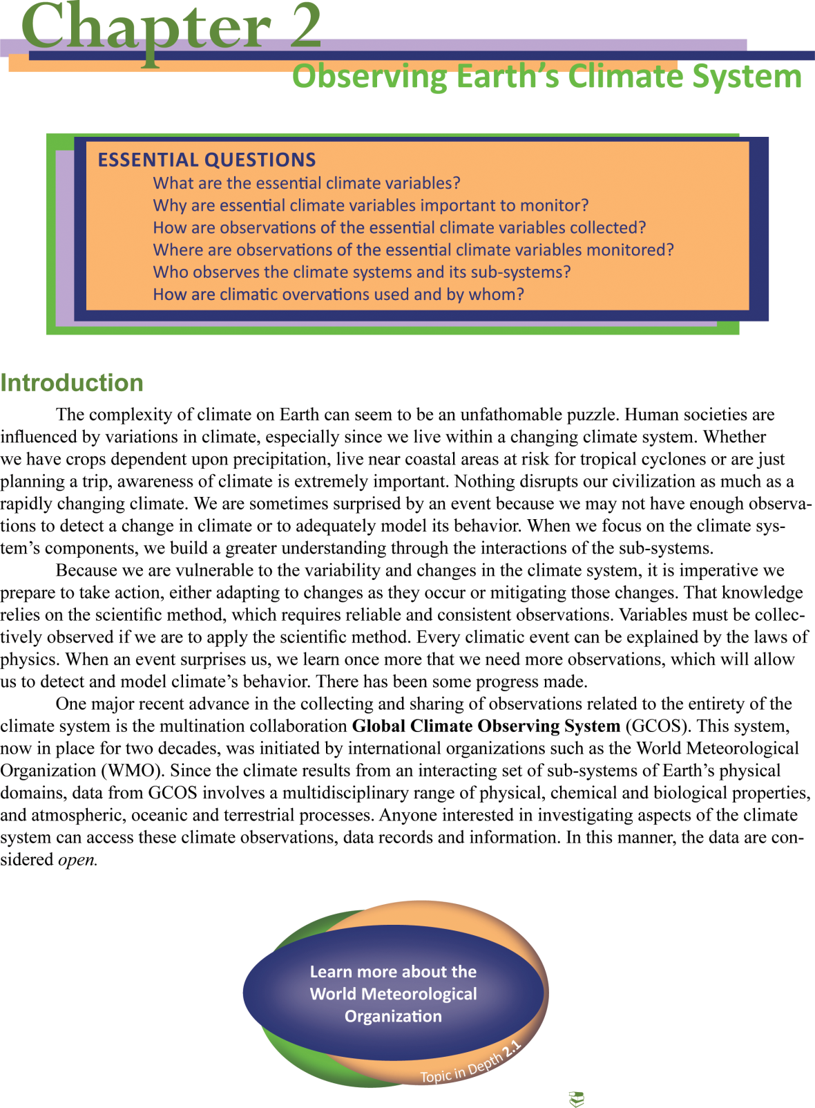
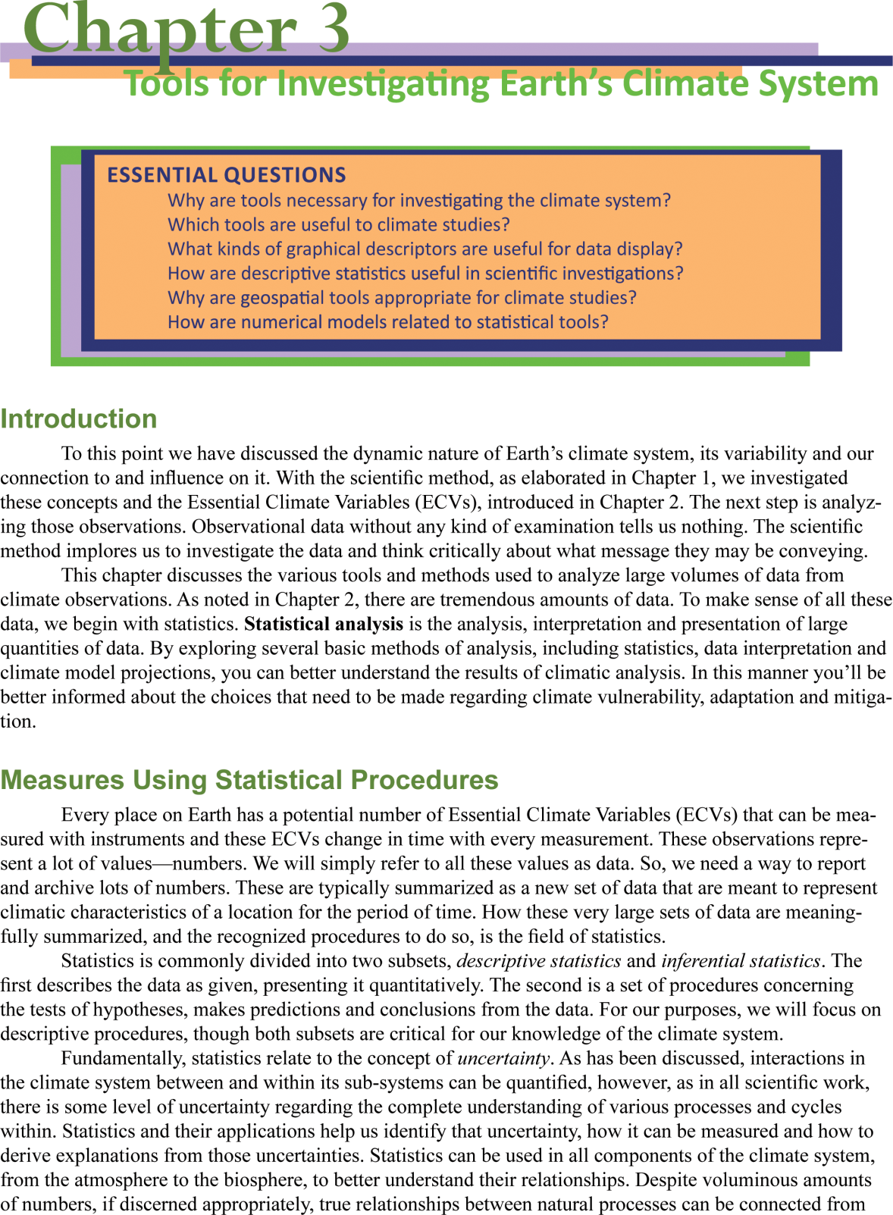
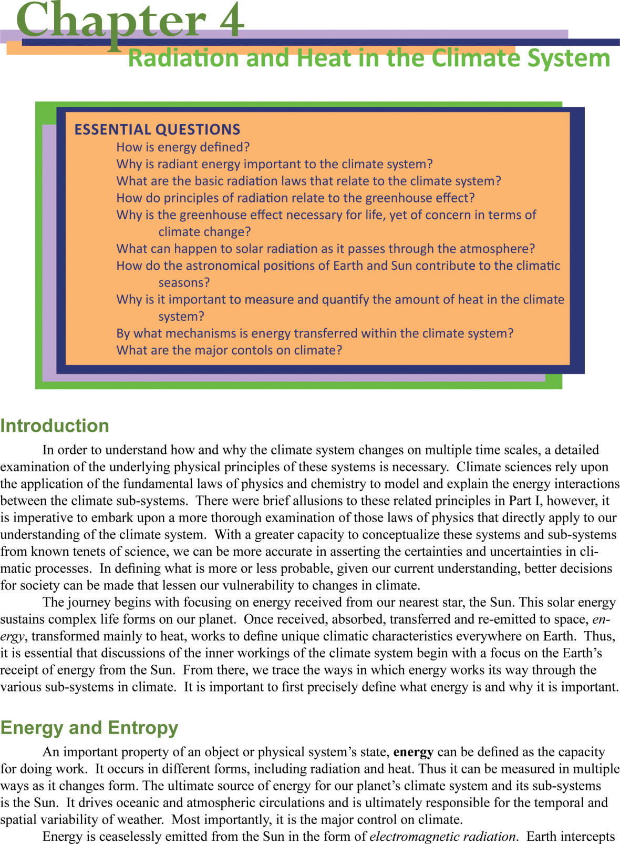
The eText resource… interactive, dynamic, more than just a book! Created for today’s mobile student.
Four Parts:
  Defining Climate
  Principles of Climatic Processes
  Variability of Climate
  Our Relationship to Climate Variability

Slide 7
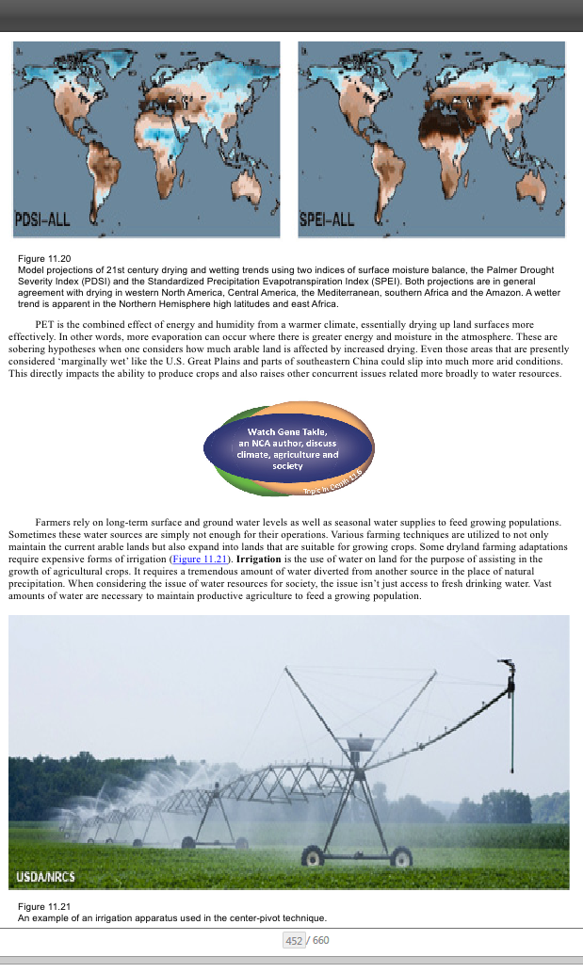
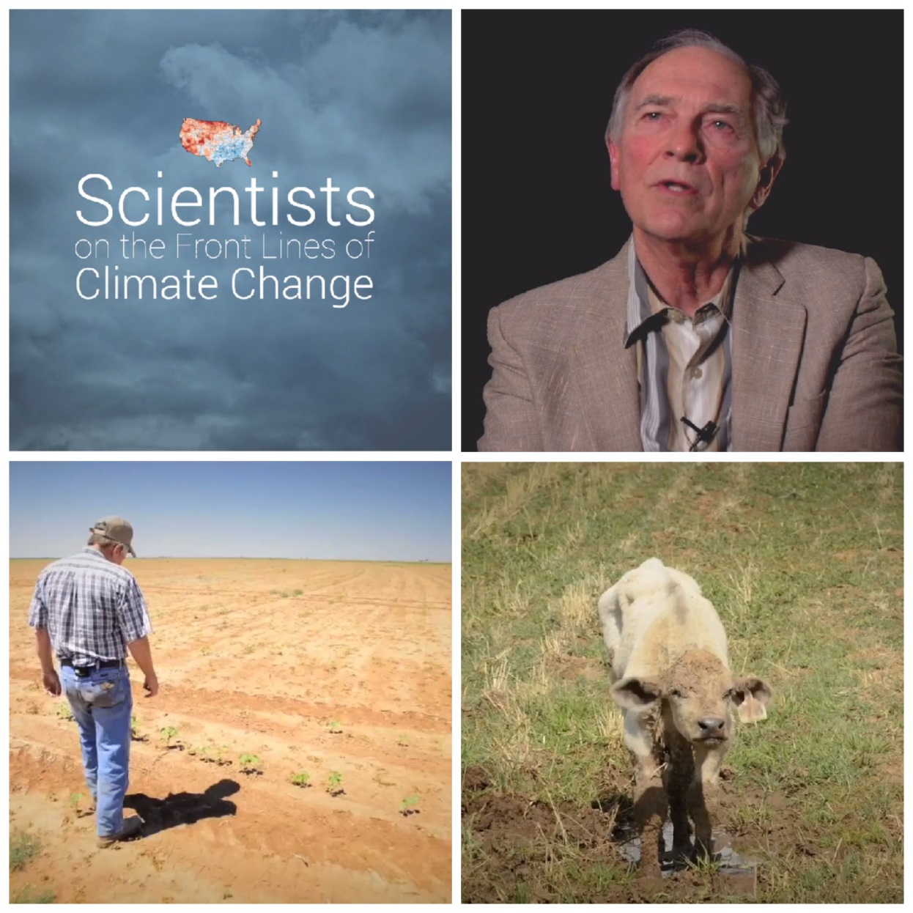

Topics in Depth:
Engage with more advanced topics

Slide 8
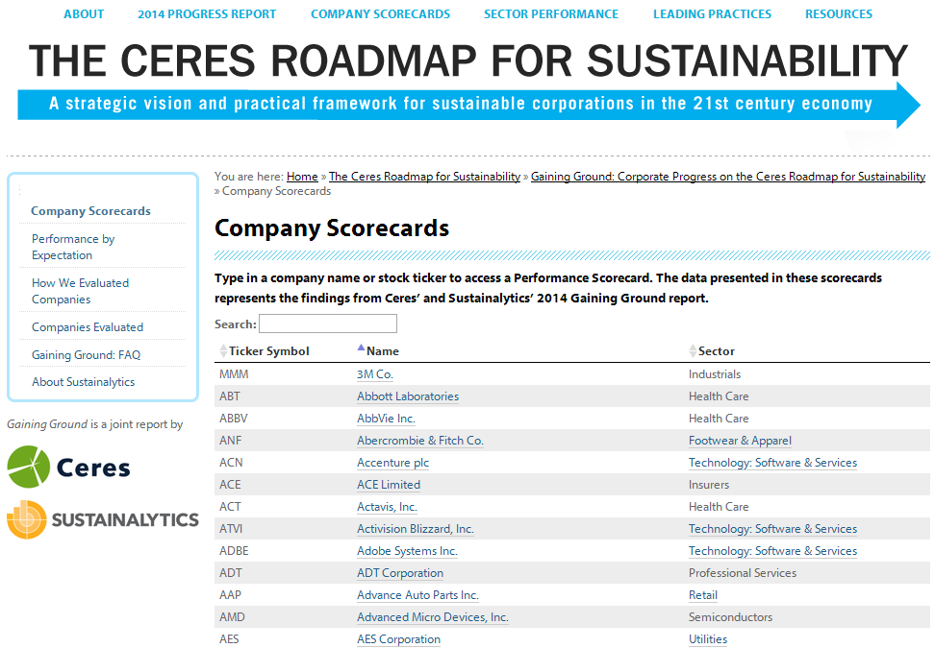
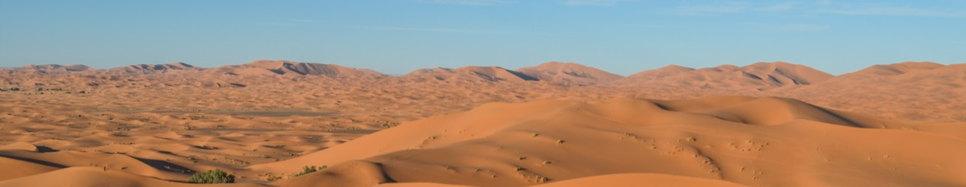
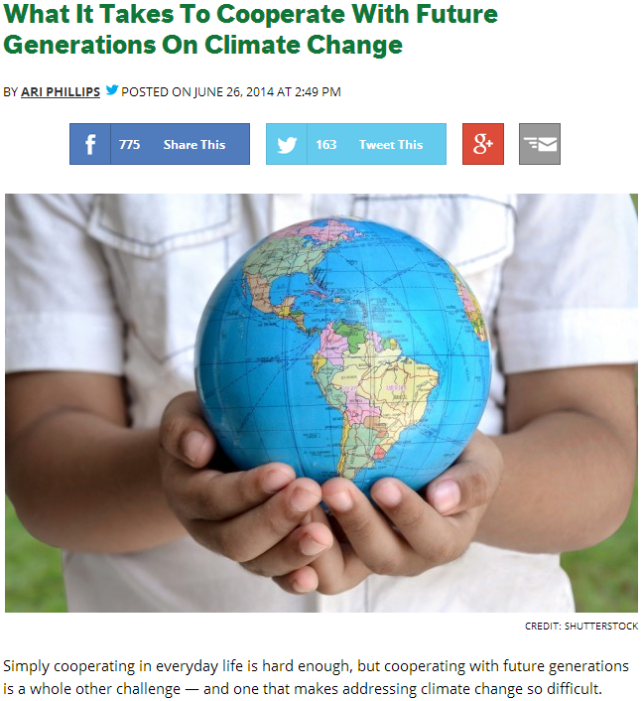
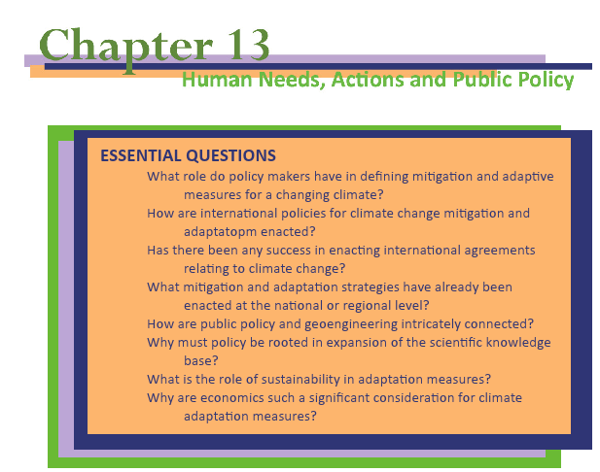
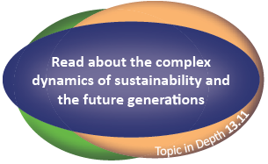
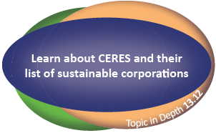
Our Changing Climate
introduction to climate science
American Meteorological Society | Education Program

Slide 9
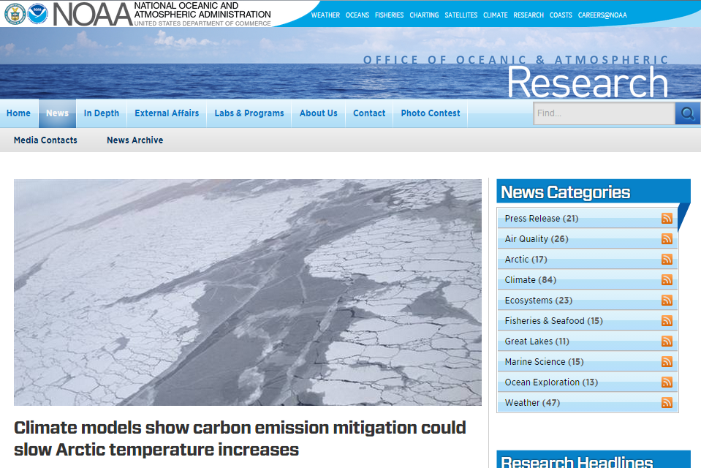
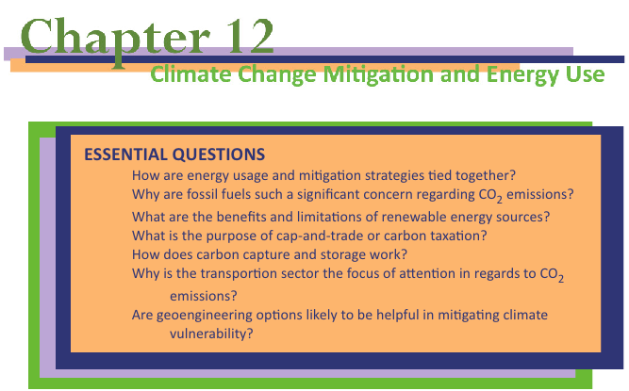
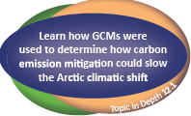
Our Changing Climate
introduction to climate science
American Meteorological Society | Education Program

Slide 10
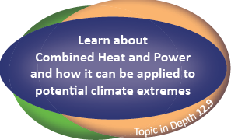
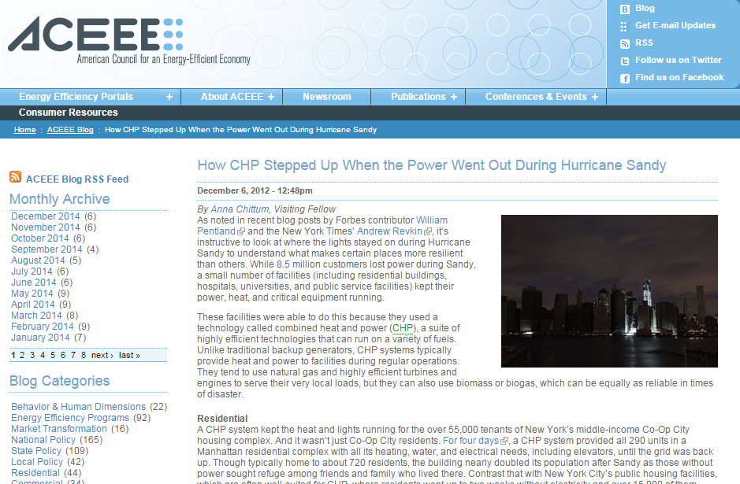
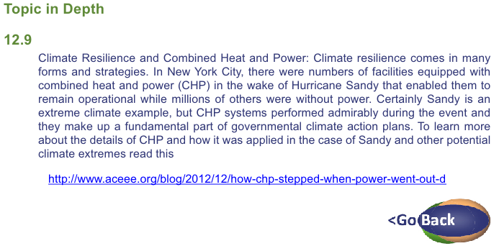
Our Changing Climate
introduction to climate science
American Meteorological Society | Education Program

Slide 11
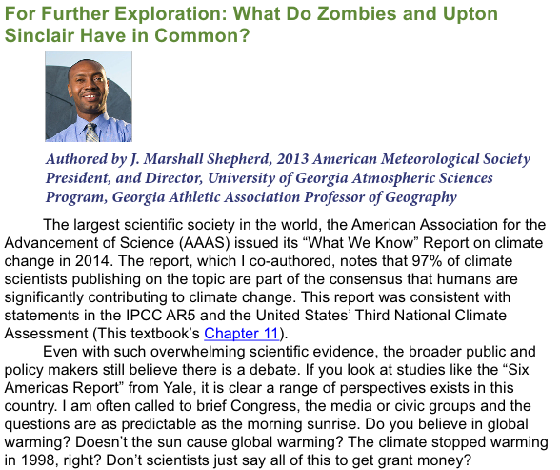
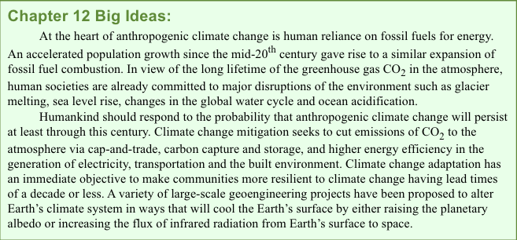
Our Changing Climate
introduction to climate science
Each chapter ends with:
Big Ideas
For Further
Exploration
Essays written by distinguished experts
American Meteorological Society | Education Program

Slide 12
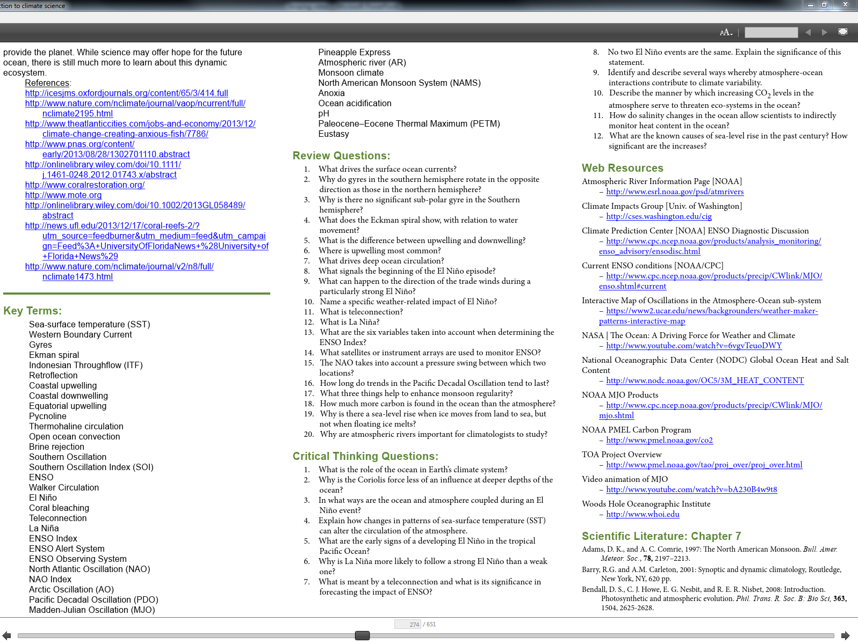
End of chapter resources

Slide 13
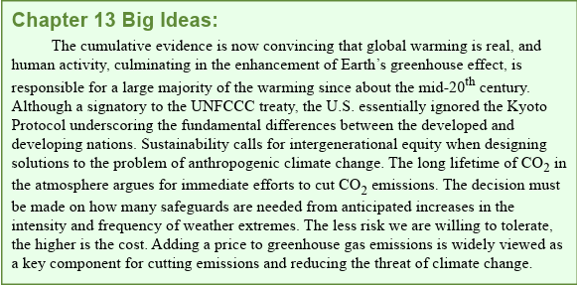

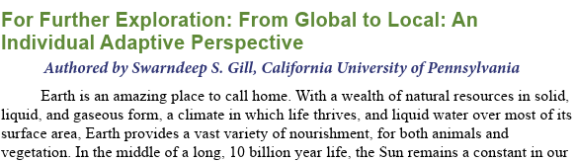
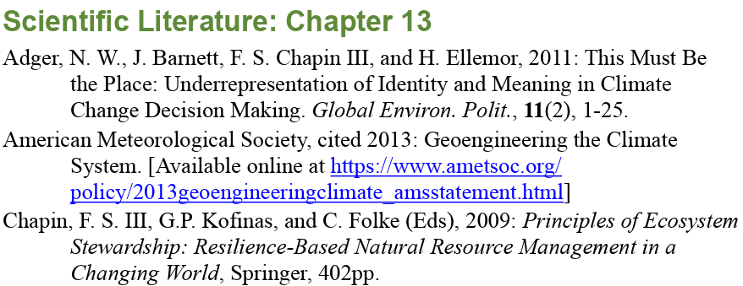
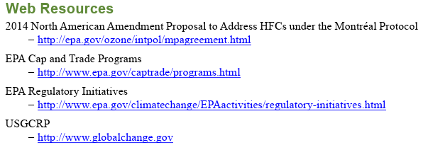
Our Changing Climate
introduction to climate science
Each chapter ends with:
Big Ideas
For Further Exploration
Key Terms
Review Questions
Critical Thinking Questions
Web Resources
Scientific Literature
American Meteorological Society | Education Program

Slide 14

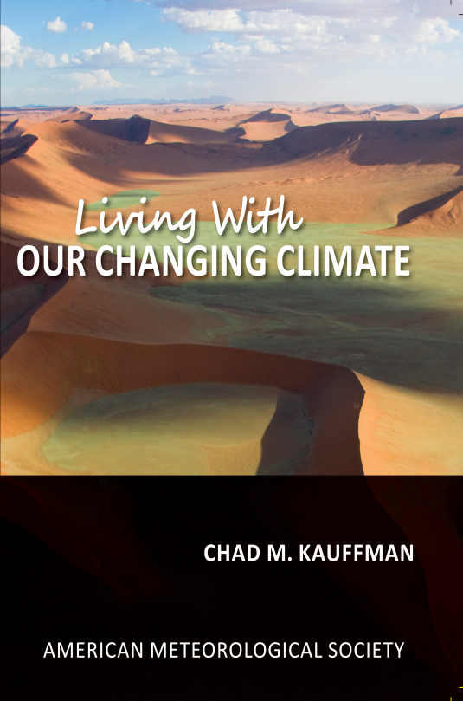
There are SO MANY benefits of our ebooks
Digital note taking
Bookmark pages
Adjustable background color
Ability to highlight
Hyperlinked footnotes
Read aloud function
Essential Questions
Adjustable text size
End of chapter resources
Hyperlinked table of contents
Searchable content
Big Ideas
For Further Exploration

Slide 15

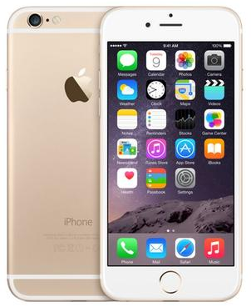


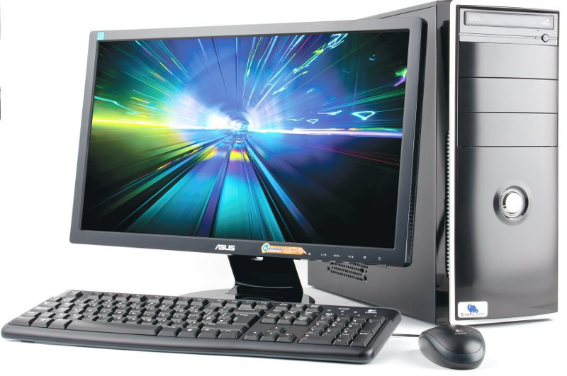

Compatible with a variety of devices

Slide 16
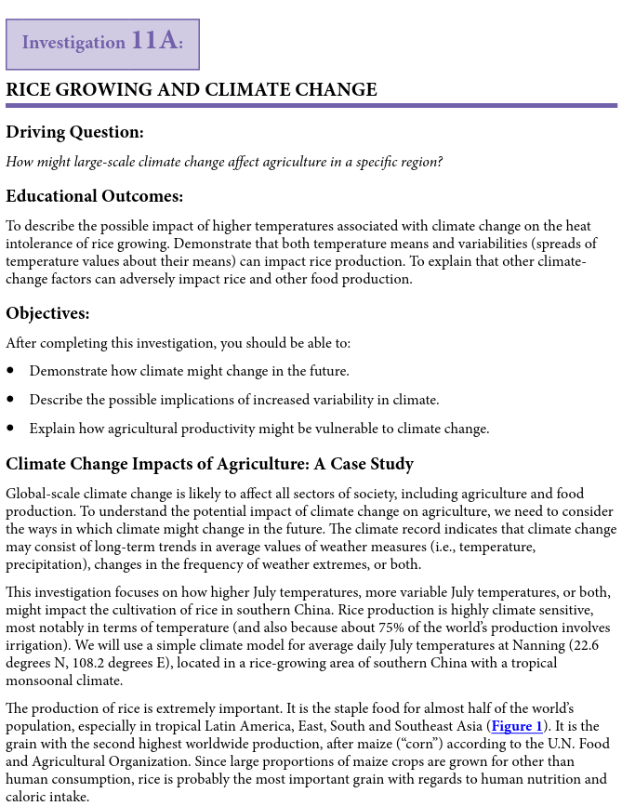
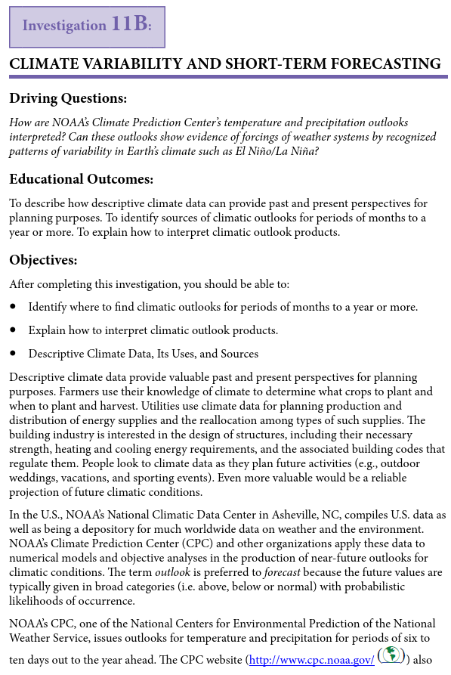
Two labs per chapter:
Reinforce chapter concepts

Slide 17
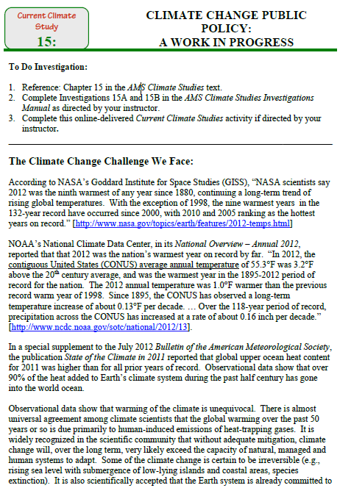
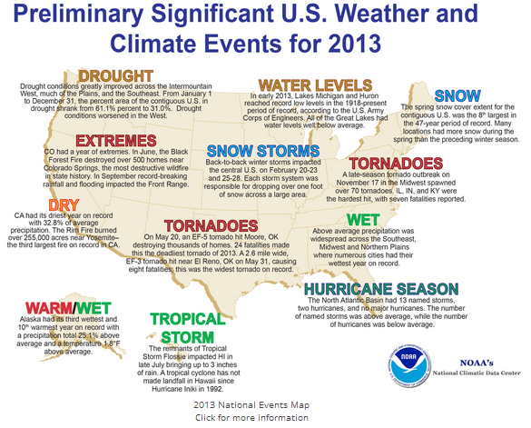
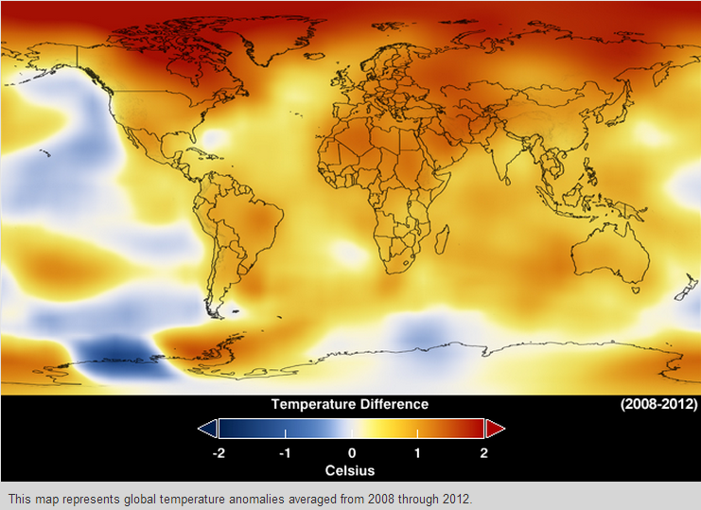
Climate Studies Coursework
American Meteorological Society | Education Program

Slide 18
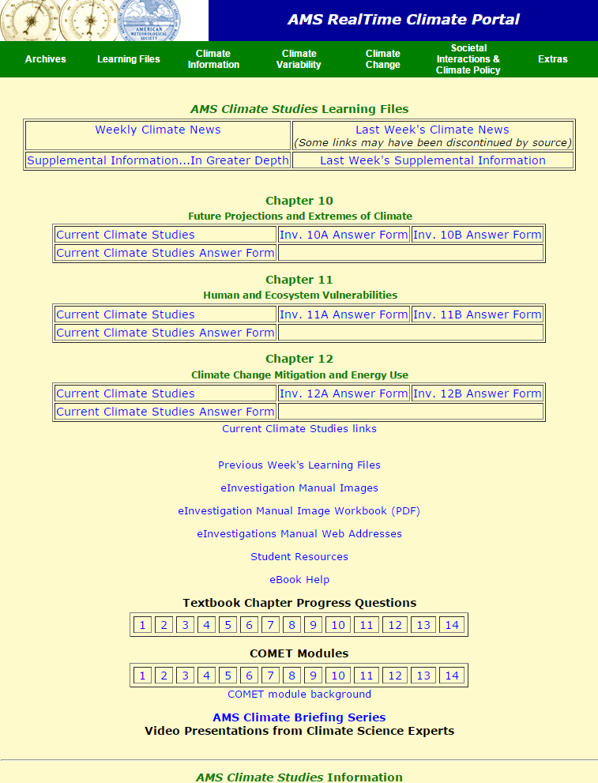
RealTime Climate Portal:
  Weekly Climate News
  Current Climate Studies
  Climate Data
  Climate Variability & Change
  Societal Interactions & Climate Policy

Slide 19
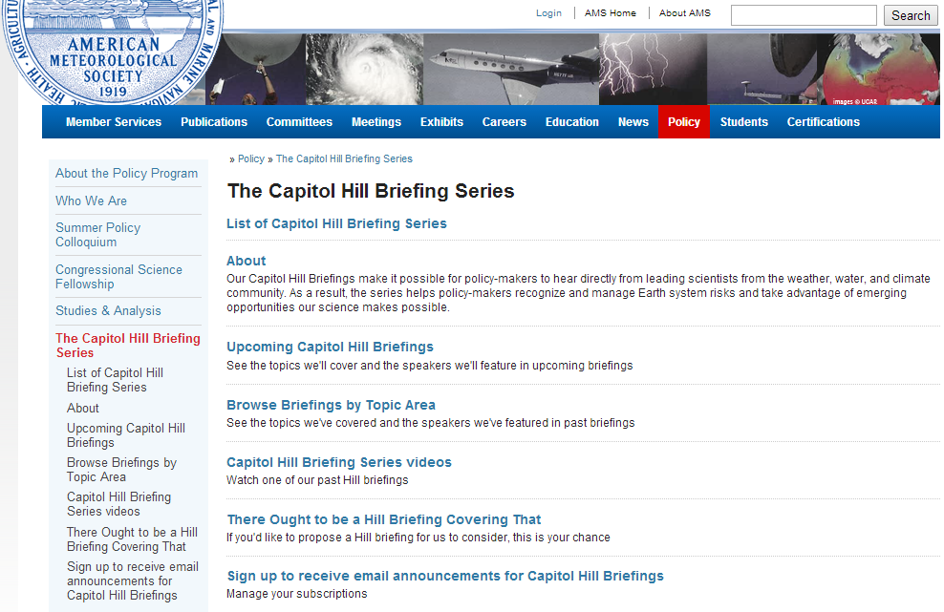
RealTime Climate Portal
American Meteorological Society | Education Program

Slide 20

Faculty Portal:
  IM/CCS answers
  Textbook review/critical thinking answers
  Chapter progress answers
  PowerPoint presentations

Slide 21






In Summary…
Dynamic, interactive, current, exciting … AMS Climate Studies is designed for online offering.
It has been introduced at 158 institutions, 113 of which have been MSIs.
Opportunities…
The second MSI-REACH workshop will take place in August 2016 (application deadline in mid-March).
  Focuses on IODP paleoclimate data
The second School of Ice workshop will take place in May 2016 (application deadline in mid-February).
  Focuses on ice core paleoclimate data
Any opinions, findings, and conclusions or recommendations expressed in this material are those of the author(s) and do not necessarily reflect the views of the National Science Foundation.

Slide 22

?
@AMSeducation
brey@ametsoc.org
www2.ametsoc.org/EducationProgram
Stop by booth #748. We will show you this incredible AMS climate change course!
Dr. James Brey
Director, Education Program | American Meteorological Society

