Slide 1
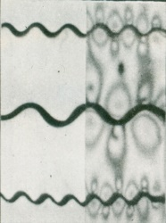
Recognition and Mechanical Significance of Buckle-Fold vs. Classic Detachment-Fold Styles
Richard H. Groshong, Jr.
Consultant and University of Alabama, Emeritus

Slide 2
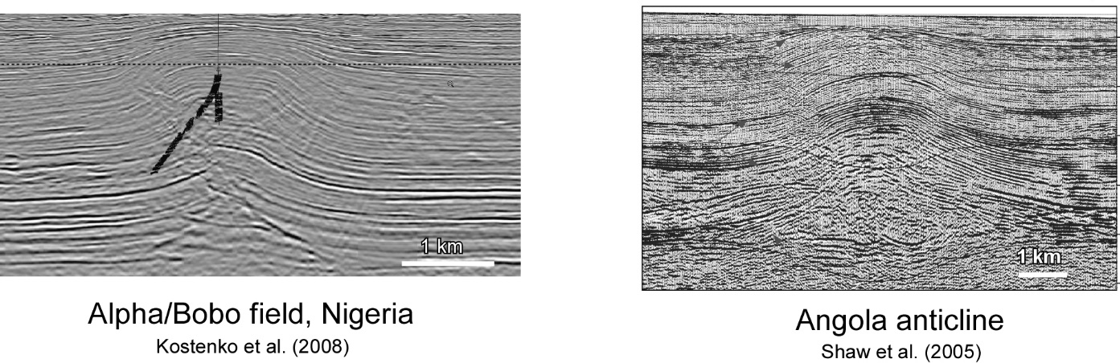
Buckle fold or classic Detachment fold?
first-order, map-scale anticlines

Slide 3
Outline
Geometric differences between the 2 major fold styles
Area-depth-strain relationships for the 2 styles
Application to Alpha/Bobo field and Angola anticline
Conclusions
Questions for future work

Slide 4
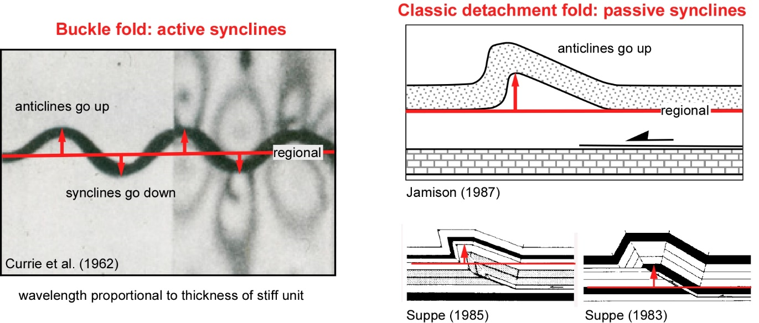
Buckle Fold vs. Classic Detachment Fold
(in common usage: buckle fold = detachment fold)

Slide 5
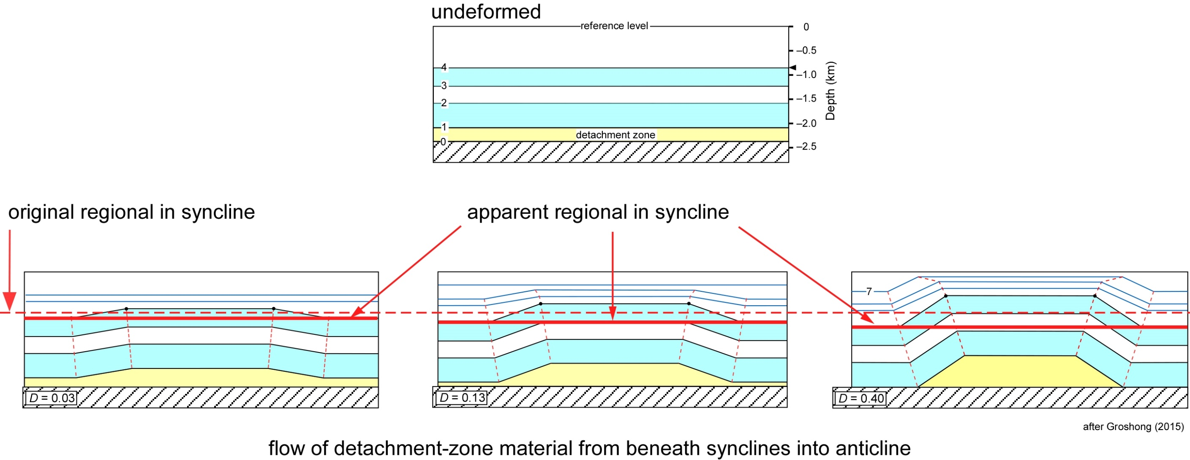
Apparent regionals in buckle fold

Slide 6
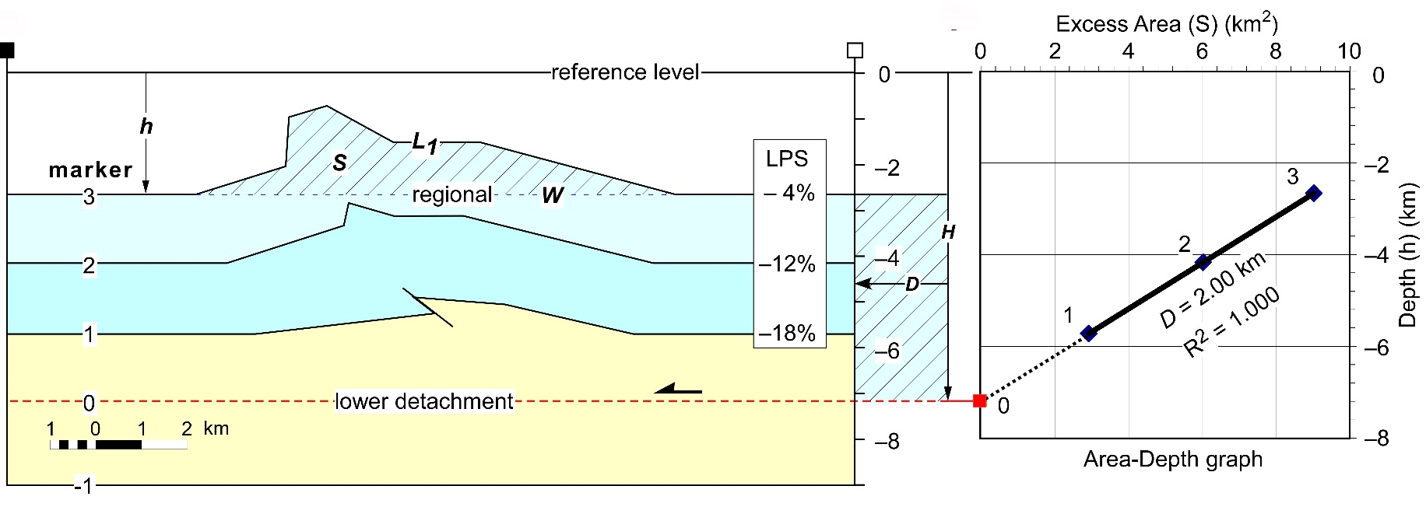
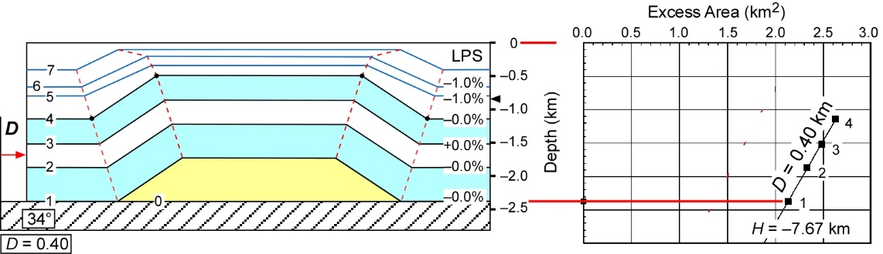
Area-Depth-Strain Relationships
D = 2.0
Classical detachment fold
Pregrowth units
fixed regionals
D = 2.0
LPS = (L₁ – L₀) / L₀
where L₀ = W + D
Buckle-style fold
Pregrowth units
apparent regionals
after Groshong (2015)

Slide 7
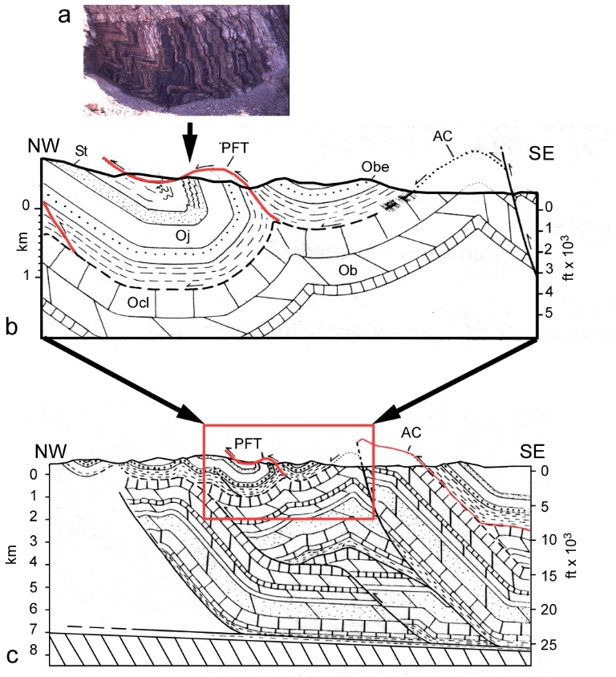
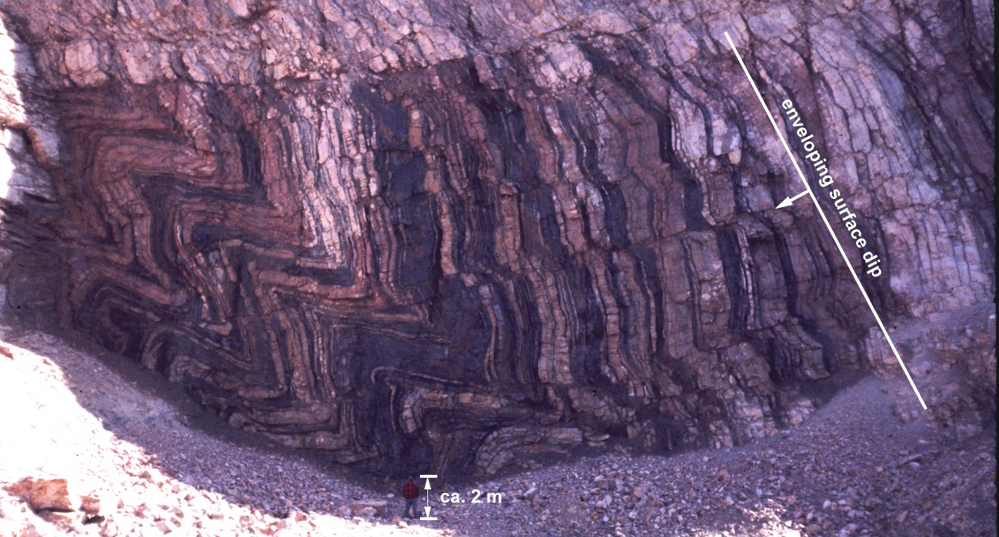
Subresolution Layer-Parallel Strain
shortening and thickening may look like this
Tuscarora ss., Laurel Run, Appalachian fold-thrust belt
central Pennsylvania
sections by Nickelsen and Engelder (1989)

Slide 8
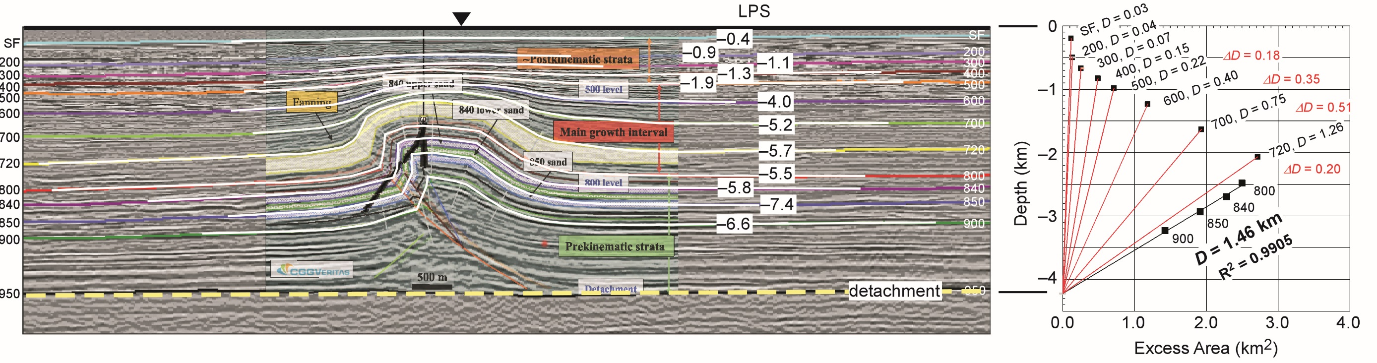
Alpha/Bobo Field, Nigeria
growth trend
shale
after Groshong (2015)
Interpretation after drilling, modified from Kostenko, et al. (2008)
top of overpressured shale (Cobbold et al., 2009)
Classical Detachment Fold

Slide 9
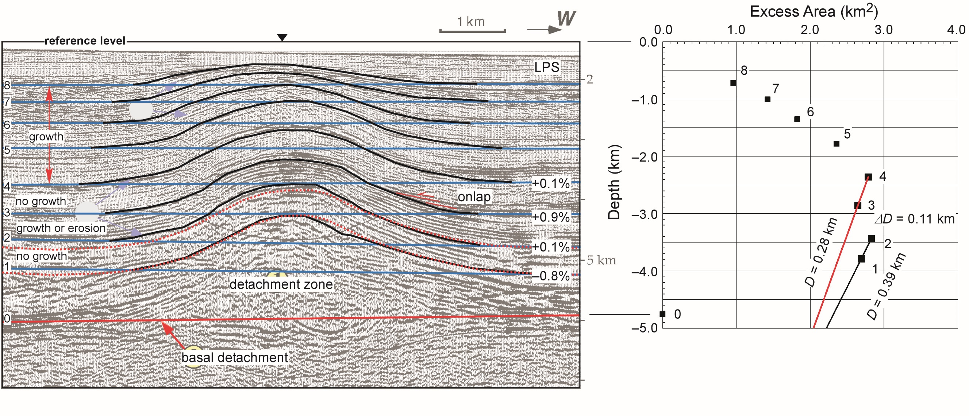
Angola Fold
growth trend
salt
modified from Shaw at al. (2005)
after Groshong (2015)
original interpretation
revised interpretation
Buckle-Style Fold

Slide 10
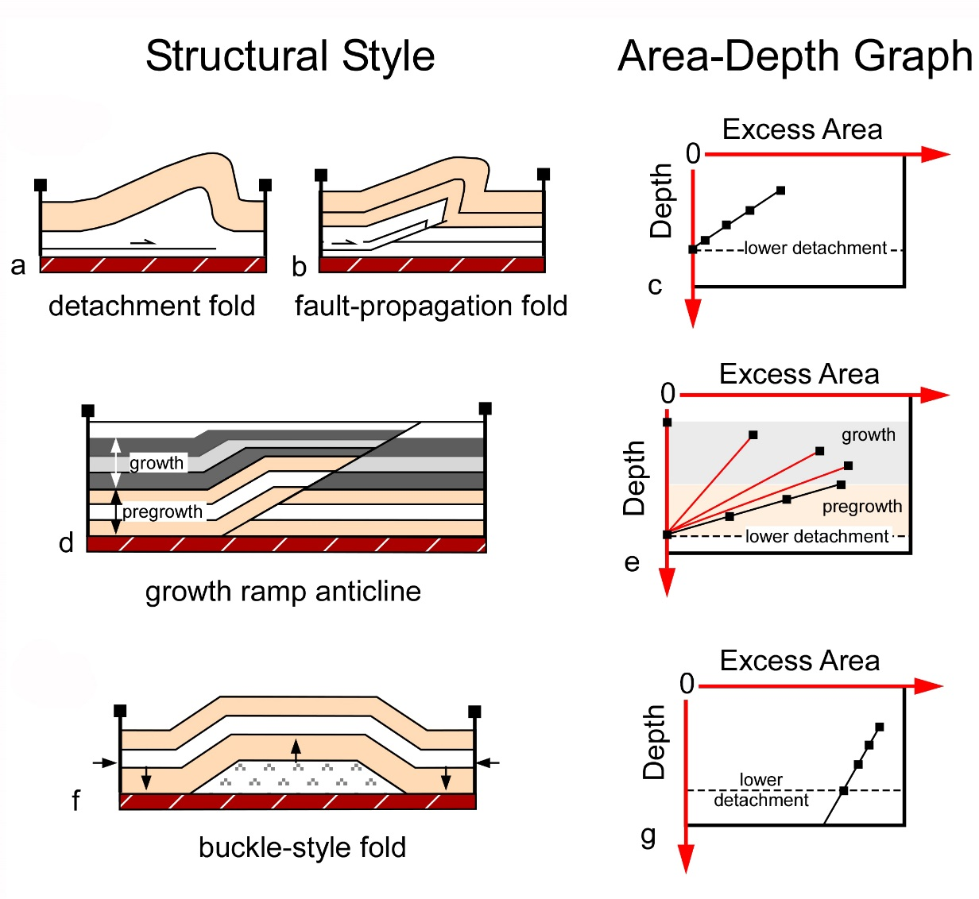
Conclusions
Detachment-Zone behavior
Layer-Parallel Strain
Thickening in anticline
Large shortening, increasing downward
Flow from syncline into anticline
Small shortening, possibly outer-arc extension
after Groshong (2015)
Smaller LPS = less subresolution deformation = less reservoir damage

Slide 11
Questions for Future Work
Does a salt detachment zone always flow from the syncline?
Does a shale detachment zone never flow from the syncline?
Do buckle-style folds always always have low strain?

