Slide 1
Who Is Using Our Datasets and
Data Products?
Carol A. Deering, Innovate!, contractor to the U.S. Geological Survey, Earth Resources Observation and Science (EROS) Center, Sioux Falls, South Dakota, USA.
Work performed under USGS contract G15PC00012.
Notes:
Did you ever have one of those days where an information request turns into something like a trek through gale force winds? Something like this, for example.

Slide 2
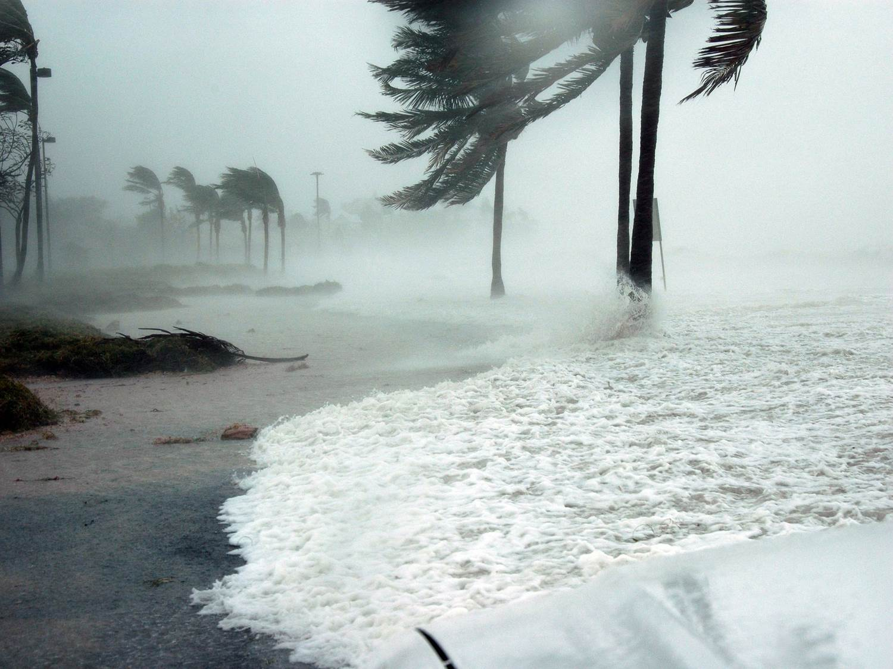

Notes:
This is how I used to feel about literature searches for information about data usage – overwhelmed, pushed back at every step . . . . I just wanted to run and take cover!!!

Slide 3
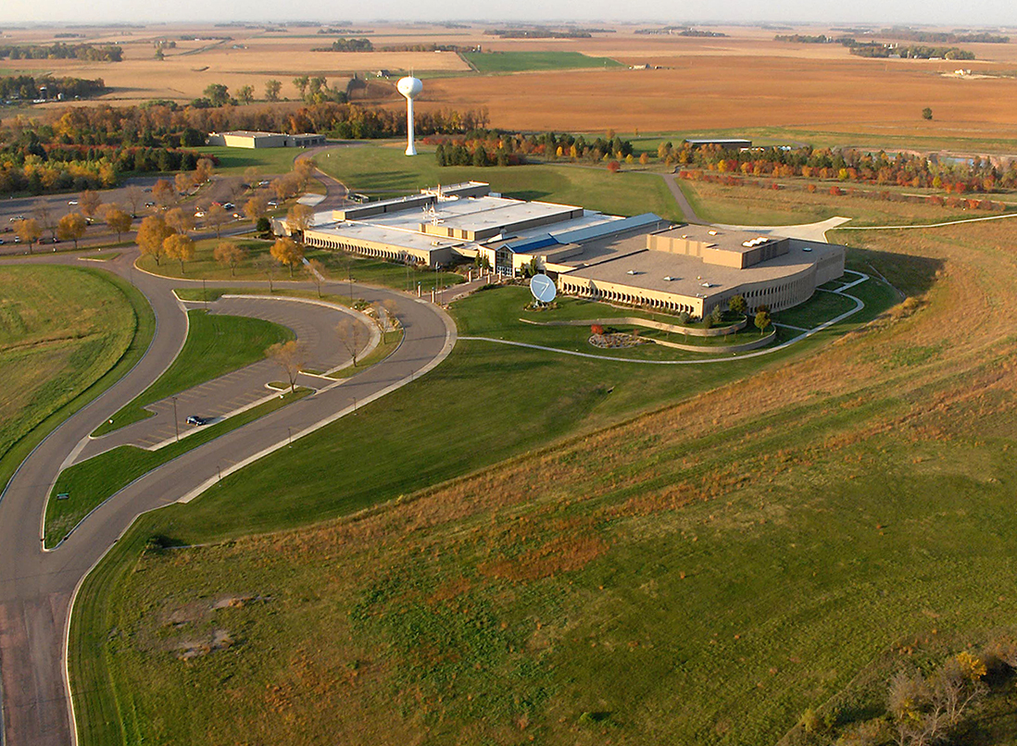
USGS EROS Center
Sioux Falls, South Dakota
land science for understanding a changing Earth
Notes:
At the USGS EROS Center in Sioux Falls, SD, where I’m librarian, providing data to the world about land use and land change is a pillar of our mission.
And the producers of those data products want to know about the data usage:
who is using it, how, where, and why?
Data teams need this information to compile metrics . . . Yes . . . but they also need to reach beyond the numbers and understand how the data is being used and not used. They need to discover the strengths of the data as well as where it can be improved. Their goal is an understanding about data usage that will enable them to enhance visibility of their data, increase its usage, address needs for new capabilities, secure funding, and more.
I’m happy to say . . . Responding to requests for information about data usage is no longer daunting! Over the last few years, my experience has taught me some lessons in slaying the beast, and this afternoon I want to share with you some of what I’ve learned.
Despite the lack of data citation consistency, it is possible to reel in metrics, analyses, and stories about data usage across the spectrum of user communities.

Slide 4
Who is Using Our Datasets and
Data Products?
1) Literature Indexes
Notes:
The first resources I’ll turn to when I start a search for data usage are the literature indexes.
Why? Index a vast amount of peer-reviewed STI literature. They’re curated and reliable. You can discover how researchers are using the data to extend our knowledge about the world. How they are applying the data in their studies. How they are coming up with fresh, new, novel uses of the data.

Slide 5


Literature Indexes
reference sections
title, abstract, keywords
funding text
citations to data paper(s)
Notes:
I typically begin with Scopus and WOS, the two major indexes we have access to
Using the dataset name or identifier or the URL for the data location or maybe just the sensor that collects it, or maybe all of the above, I’ll search
reference sections
title, abstract, keywords
Funding text in WOS
And, if there’s a data paper, I’ll look for citations to it
In Scopus and WOS I can pretty quickly gather metrics about the number of publications using the data

Slide 6
Literature Indexes
MTBS
Notes:
I can also use the analysis tools that each index provides to gather metrics about citations to the data across disciplines, its usefulness to the global community, the affiliations of authors citing the data, and more.
This bar graph is from WOS. It shows the 21 disciplines across which data from the Monitoring Trends in Burn Severity project was cited, per the WOS index categories.

Slide 7


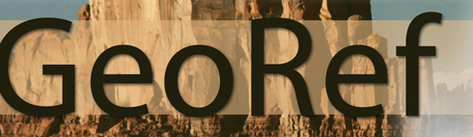




Literature Indexes
full text
&
images
Notes:
I might also search some of the indexes that provide full-text text and/or image searching. Data used is often mentioned in the full-text even when it’s not acknowledged anywhere else in the publication, or in any of the other searchable fields of the index.

Slide 8
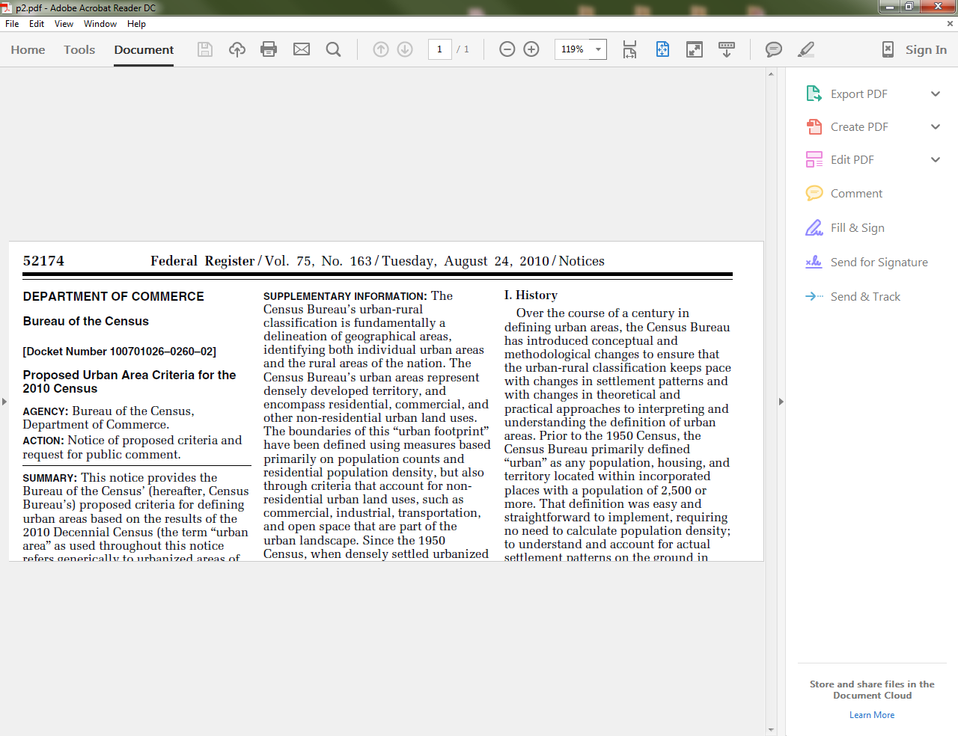
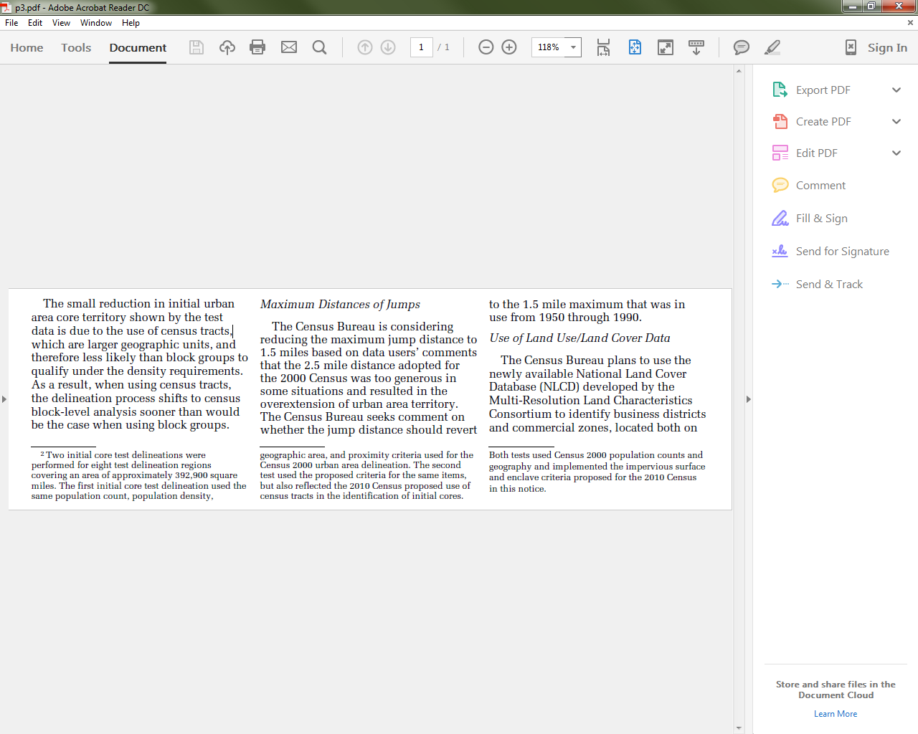
Literature Indexes
Census Bureau
NLCD
identify urban-related territory
via impervious surface land cover
Notes:
In a full-text search of ProQuest Research Library, I found this 2010 Federal Register notice that the Census Bureau would use NLCD data to identify urban-related territory.

Slide 9
Who is Using Our Datasets and
Data Products?
2) Publisher Sites
Notes:
Next, I’ll turn to the publisher Websites, another great source for digging into the peer-reviewed STI literature
Why? Data usage may be cited/acknowledged within the full-text and not the indexed fields. Most publisher sites include advanced searching of the full-text of their publications. You can search for references to the data papers using either the full-text or reference field searching. In addition, some indexed sources at the publisher sites may not be in Scopus or WOS.

Slide 10












Publisher Sites
full text
Notes:
These publishers, relevant to the work at our Center, provide for full-text searching on their Advanced Search screens.
As I mentioned, full-text searching can be a real asset because data used in a study is often mentioned within a paper, but not formally in the reference section.

Slide 11
Publisher Sites
NLCD or
“national land cover database” in title, abstract, or keyword
MRLC.gov in full-text
3
108
Notes:
This graphic shows a specific example of that.
I ran a full-text search at Wiley for mrlc.gov, which is part of the URL that would typically be found in a reference to NLCD (National Land Cover Database) products.
My search yielded 108 results in the Wiley full-text search.
Only 3 of those 108 results included NLCD or National Land Cover Database in the title, abstract or keyword fields.
Or put another way, searching the full-text yielded 105 results that would not have been returned with a search in just the TAK fields.

Slide 12
Who is Using Our Datasets and
Data Products?
3) Federal Agencies
Notes:
In addition to understanding how researchers are interacting with the data, our data teams want to know how their data is being used and applied by environmental planners and managers, by law and policy makers, by academia. They need to know if they’re getting the data to the people who need it, and how those people are using it.
Thus, after searching the literature indexes and publisher sites, I’ll begin casting my net in other sources.
The first: Federal Agencies
Why? Our projects want to identify how our land data is being used and applied by other federal agencies, beyond the USGS. Usage by other agencies is evidence of federal work and progress that could not have been realized without the products our center provides.
And of course this evidence of cooperation – this synergy – between federal agencies translates into cost savings and fiscal efficiency – always good!

Slide 13
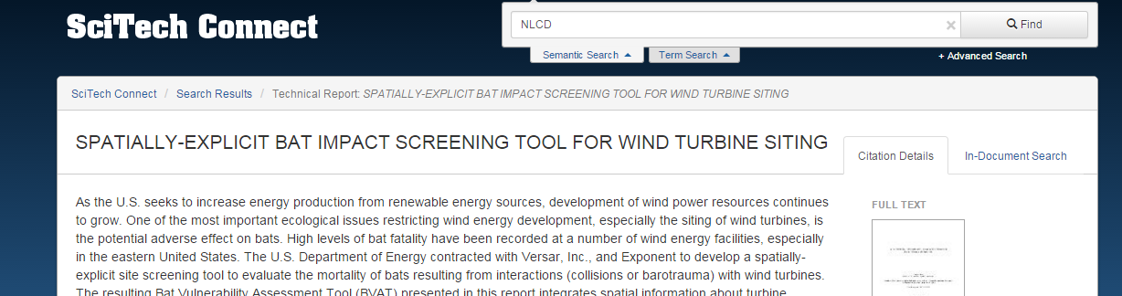
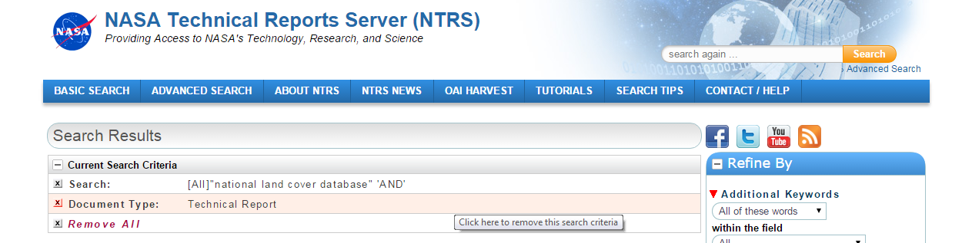
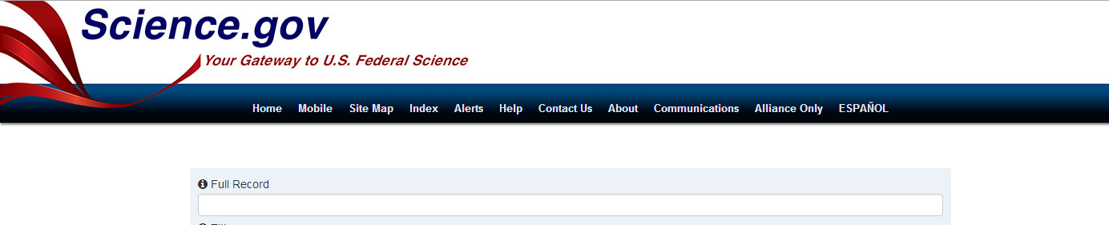
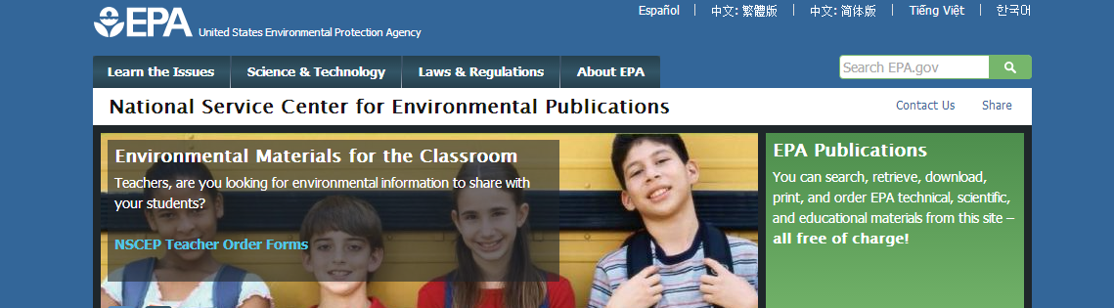
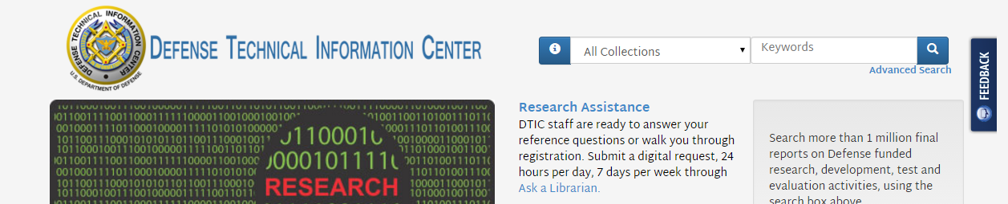
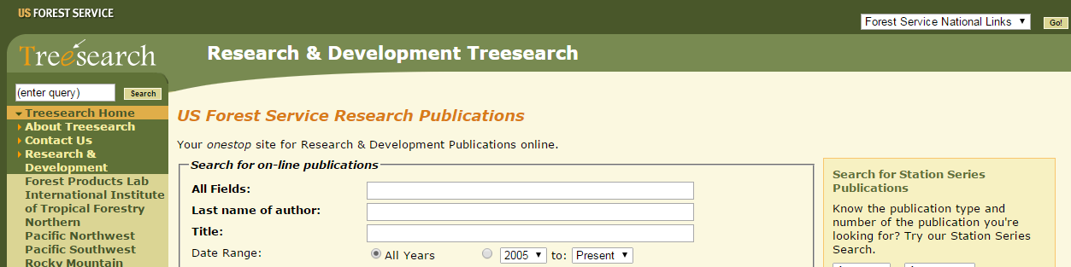
Federal Agencies
Notes:
Some of the federal search sites I’ve used:
SciTech
NASA Technical Reports
Science.gov
EPA
Defense Technical Information Center
TreeSearch by the Forest Service

Slide 14
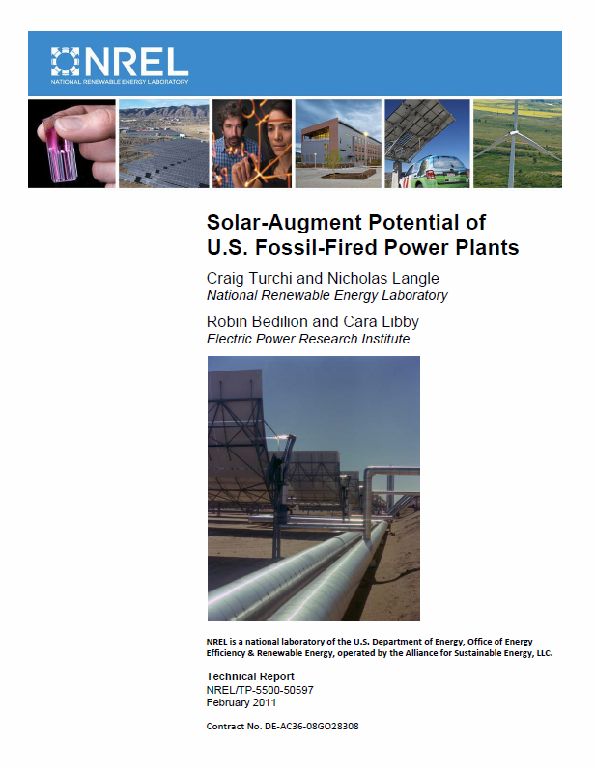
Federal Agencies
Department
of
Energy
NLCD
assess solar-augment potential of fossil-fired power plants
NLCD
Notes:
Some of the things I found:
Dept of Energy
NLCD data
Report about augmenting fossil-fire power plants with solar power

Slide 15
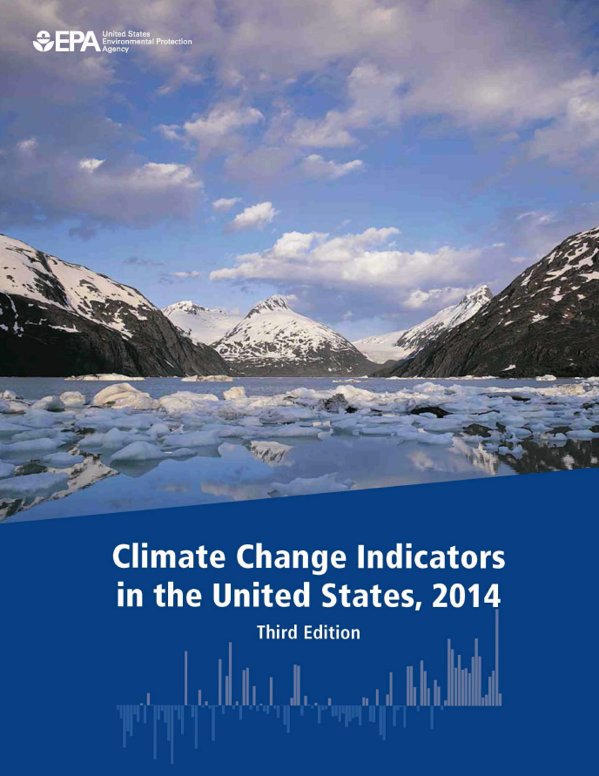
Federal Agencies
Environmental Protection Agency
MTBS
damage caused by wildfires; land area burned by wildfires
MTBS
Notes:
EPA
MTBS data use
Report about climate change indicators

Slide 16
Who is Using Our Datasets and
Data Products?
4) States, Counties, Cities
Notes:
I’ll also look at state and local government sites.
Why? Identifying usage of our products in applications at the state and local levels is evidence that we are getting environmental data into the hands of local professionals. It’s evidence that our data is helping to meet their needs for environmental assessment, planning, and management.
And again, it underscores a strong return on investment as a result of productive, effective use of government monies.

Slide 17
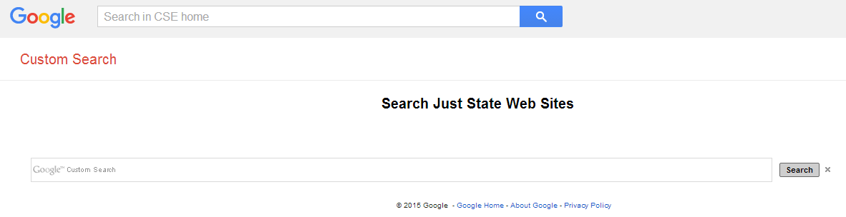
States, Counties, Cities
Notes:
This is one of the tools I use to search for information at state and local Websites.
This Google custom search was put together by a librarian. It searches official state sites for all 50 states, and will also, in a results list, identify sites at the county and city level.

Slide 18
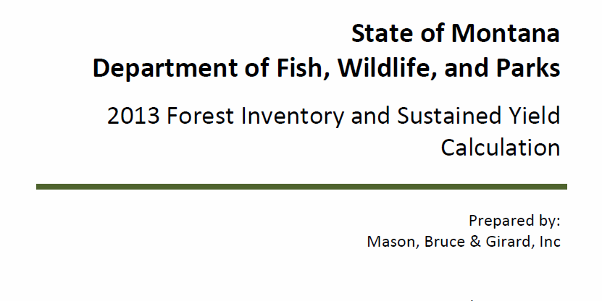
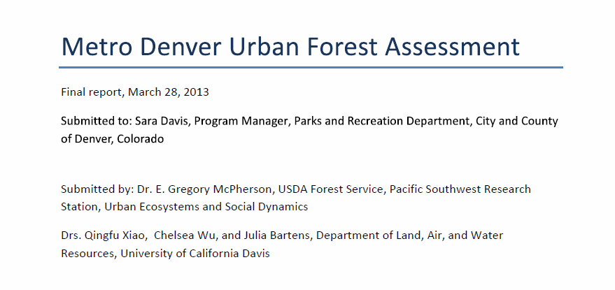
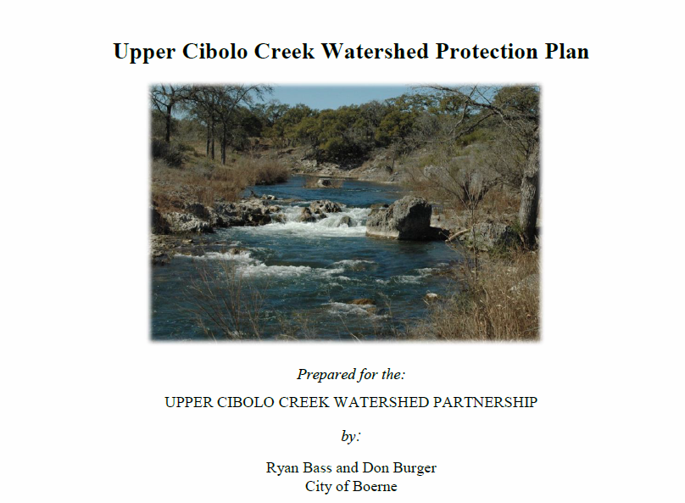
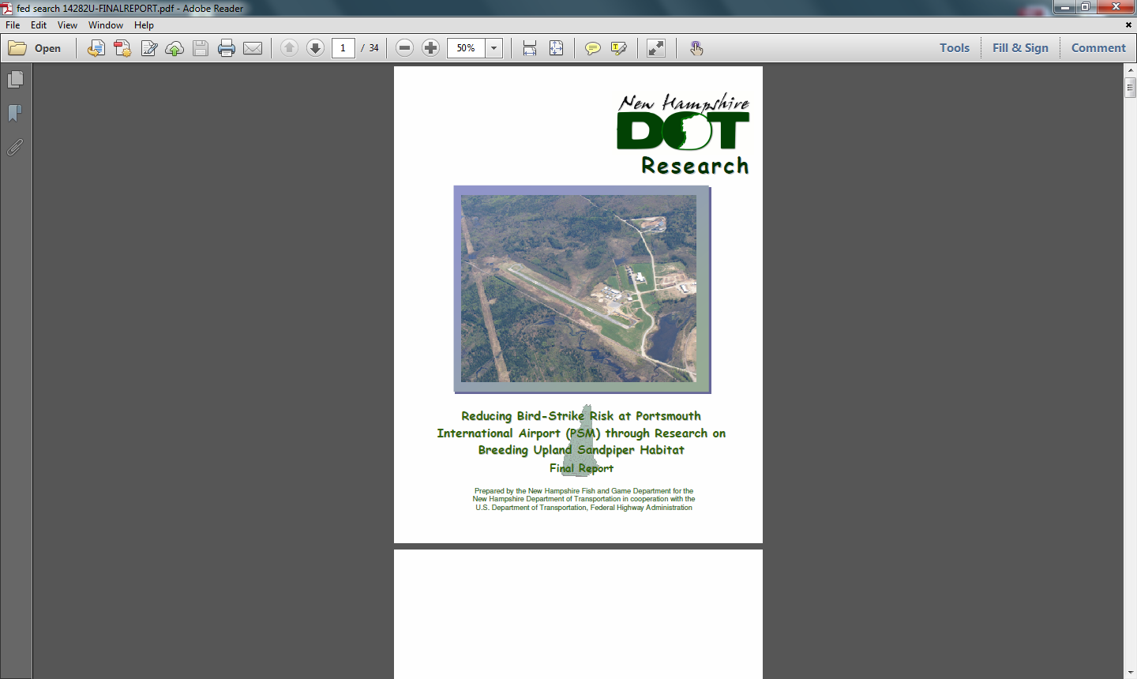
States, Counties, Cities
MTBS
MODIS
NLCD
NLCD
Notes:
Some of the state and local reports I’ve found indicating usage of data from our Center:
Montana, Dept of Fish, Wildlife, and Parks
MTBS data in a Forest Inventory
Denver
MODIS data in an urban forest assessment
Cibolo, Texas
NLCD data in a watershed protection plan
New Hampshire
NLCD in a report about reducing bird-strike risk at the Portsmouth Intl Airport

Slide 19
Who is Using Our Datasets and
Data Products?
5) NGOs, IGOs, Think Tanks
Notes:
Other resources I take a look at are those from NGO’s, IGO’s and think thanks
Why? NGO’s, IGO’s, and think tanks seek to influence public opinion. They put forth evidence to craft and support law and policy aimed at assessing and managing Earth’s resources.
Finding usage of our data in publications from these sources spotlights how our products are being applied to protect not just our nation’s but the world’s natural resources and ultimately the people who rely on them.

Slide 20
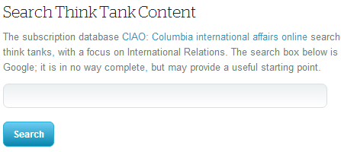
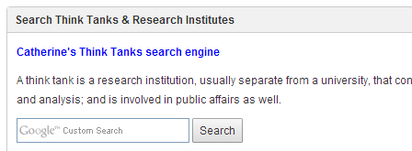
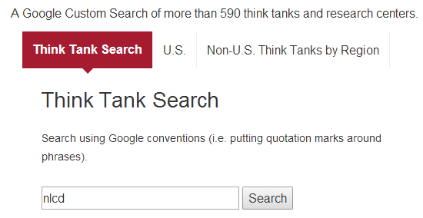
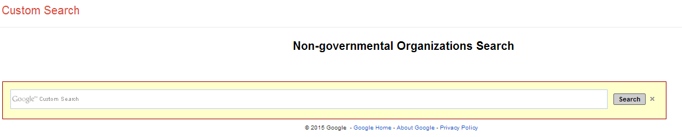
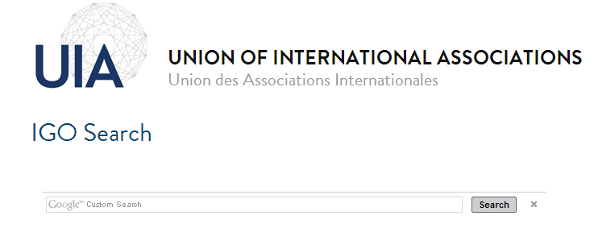
NGOs, IGOs, Think Tanks
Notes:
Again, Google Custom Searches come in handy…….these are five custom searches created by other information professionals that I have run across and have filed away.

Slide 21
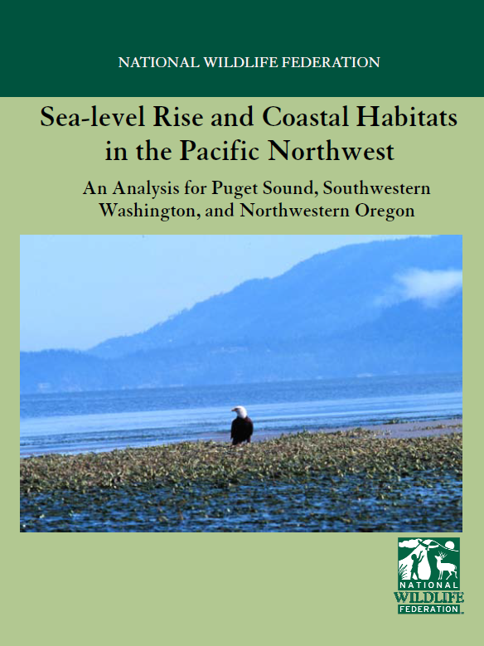
NGOs, IGOs, Think Tanks
National Wildlife Foundation
NLCD
determine which portions of the study area are likely subject to diking
NLCD
Notes:
And some of what I’ve found with them:
National Wildlife Foundation
NLCD data in an analysis of sea-level rise and coastal habitats in the Pacific Northwest

Slide 22
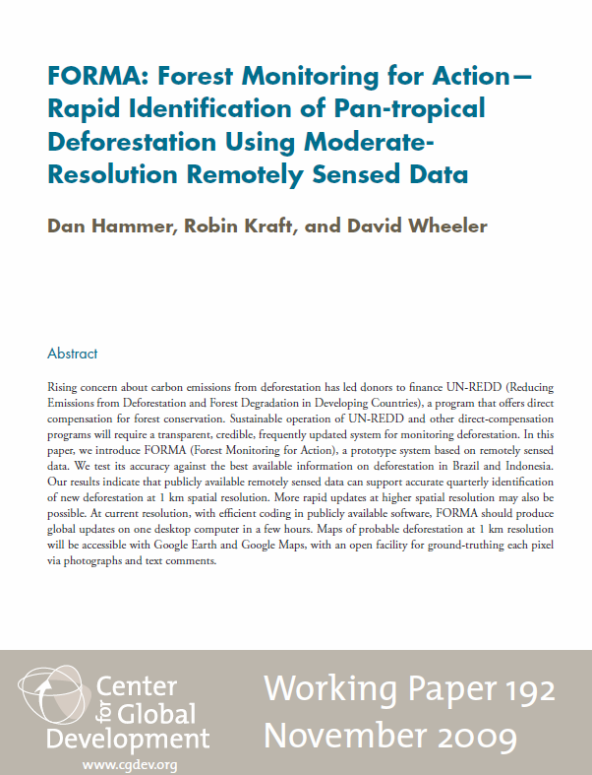
NGOs, IGOs, Think Tanks
Center for Global Development
MODIS
construction of a prototype system; Forest Monitoring for Action (FORMA)
MODIS
Notes:
Center for Global Development
MODIS data in the development of FORMA, a prototype system for forest monitoring

Slide 23
Who is Using Our Datasets and
Data Products?
6) Graduate Research
Notes:
Graduate research, too, can be another fruitful source
Why? Graduate research is often a source of new ideas -- new methodologies, new insights, new study areas. And remember, it’s literature that might not see the light of day elsewhere!
In addition, finding evidence of our data usage in this realm can also throw additional light on the interdisciplinary and international reach of our data.

Slide 24
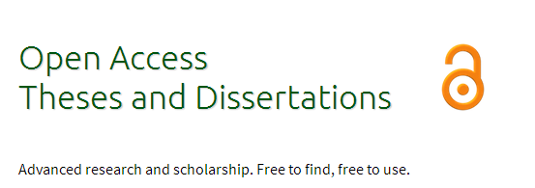



Graduate Research
Notes:
A few of the sites I’ve collected and use to dig around in the graduate studies across both U.S. and international universities

Slide 25
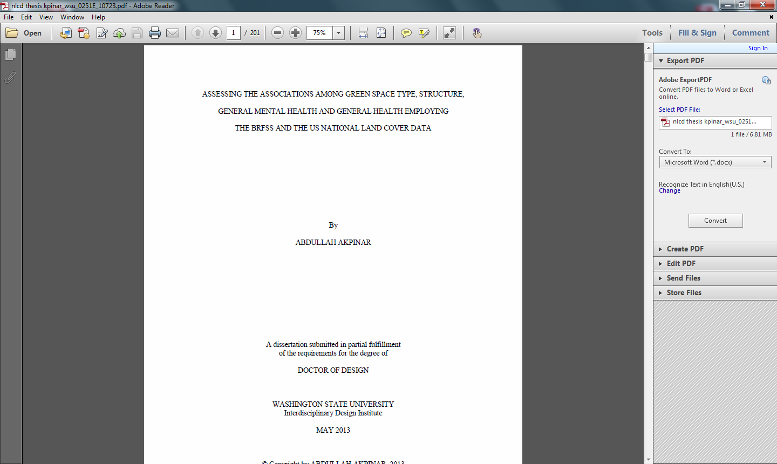
Graduate Research
Interdisciplinary Design
NLCD
relationship between green space and mental and general health
Washington State University
NLCD
Notes:
And again, some of what I’ve found:
NLCD data used in a dissertation in Interdisciplinary Design at Washington State University
Studying the relationship between green space and human health

Slide 26
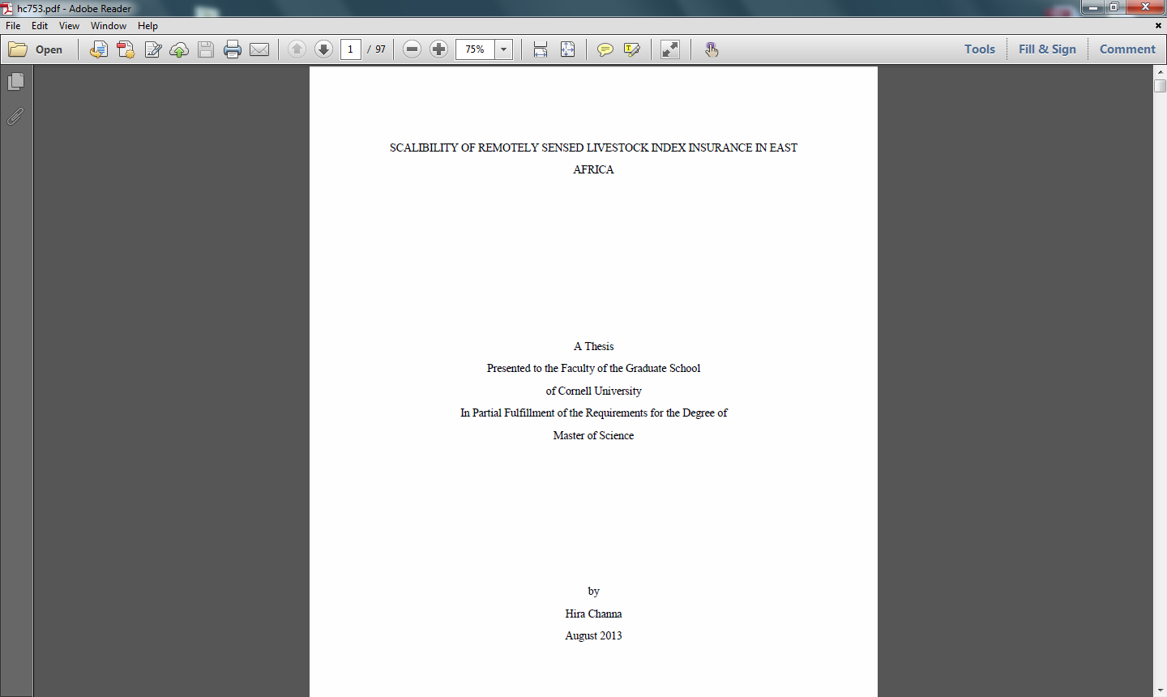
Graduate Research
Applied Economics
MODIS
index based livestock insurance product in Kenya
Cornell University
MODIS
Notes:
MODIS data used in a dissertation in Applied Economics at Cornell, proposing an index-based livestock insurance product in Kenya

Slide 27
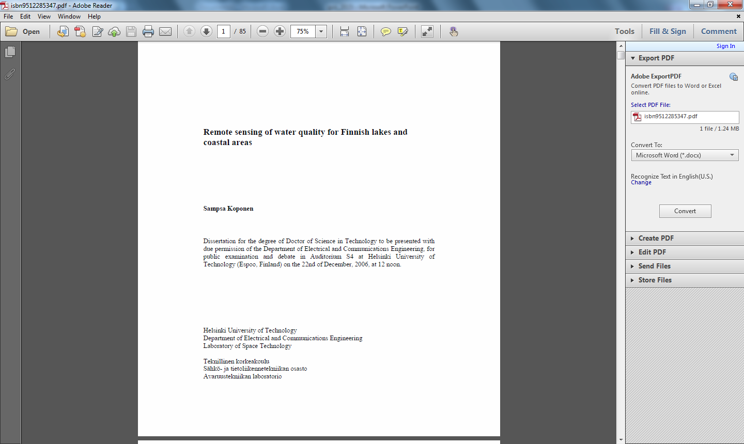
Graduate Research
Electrical and Communications Engineering
MODIS
water quality in Finnish lakes
Helsinki University of Technology
MODIS
Notes:
MODIS data used in a dissertation in Electrical and Communications Engineering at Helsinki University of Technology, studying the water quality in Finnish lakes

Slide 28
Who is Using Our Datasets and
Data Products?
7) News Sites
Notes:
And I keep an eye on news sites, because you never know what you might run across!

Slide 29
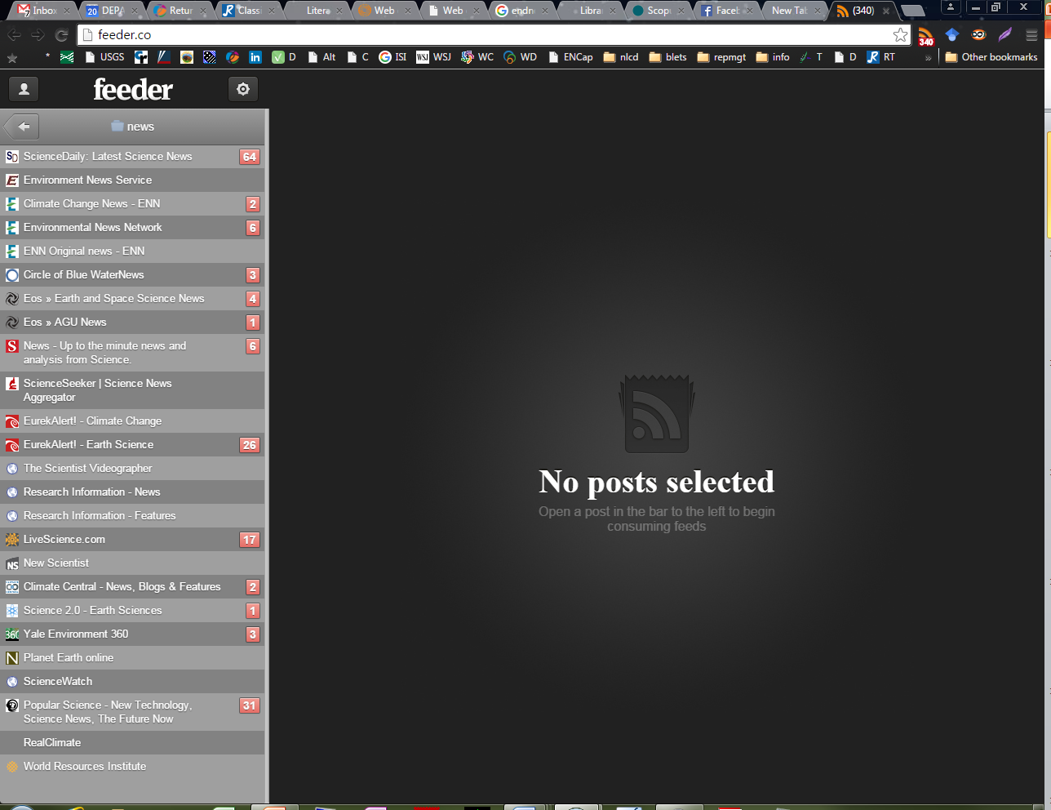
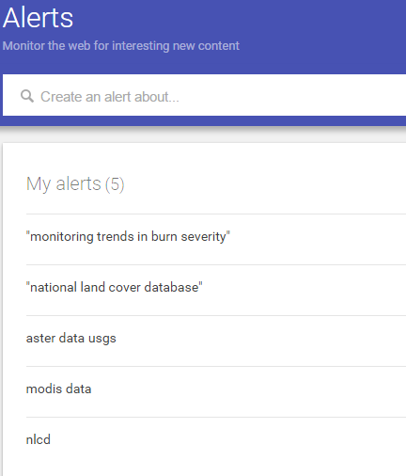

News Sites
Notes:
I’ve set up Google Alerts, and I make liberal use of RSS feeds .......
These are snapshots of tiny pieces of my Google Alerts page and my feed reader

Slide 30
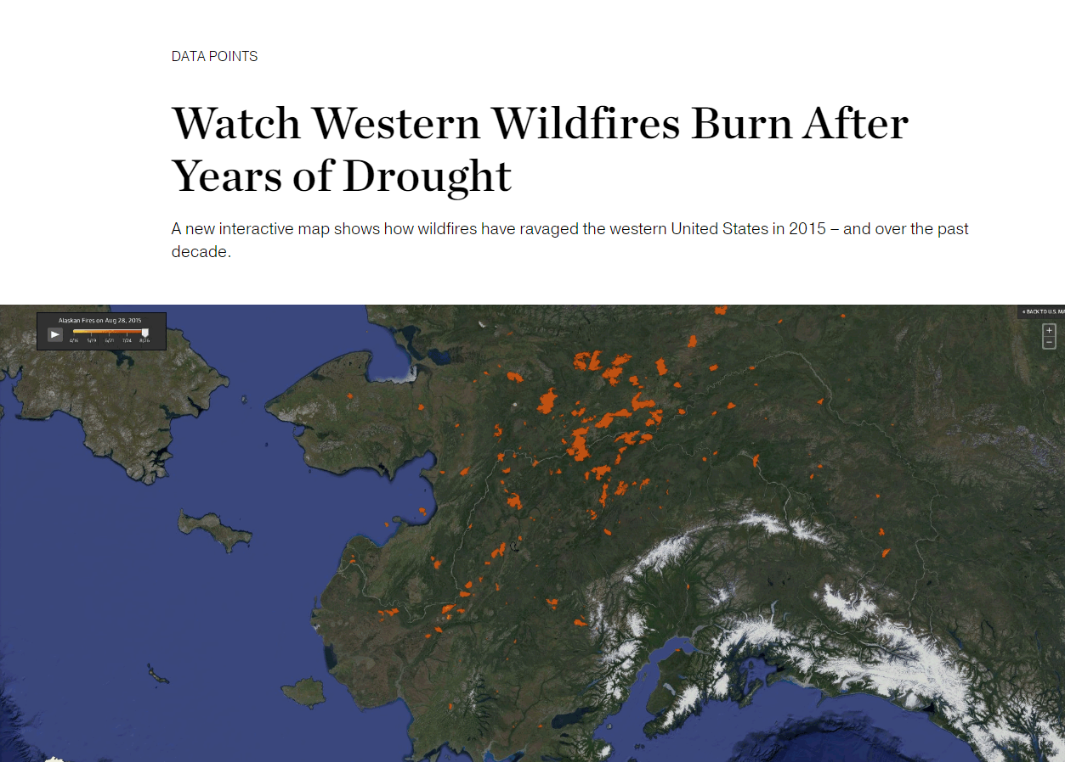
News Sites
MTBS
Notes:
Through my news searching, I found MTBS data used in an interactive map of western wildfires hosted at the Nat Geo news site.
The MTBS team was quite excited to get this.

Slide 31
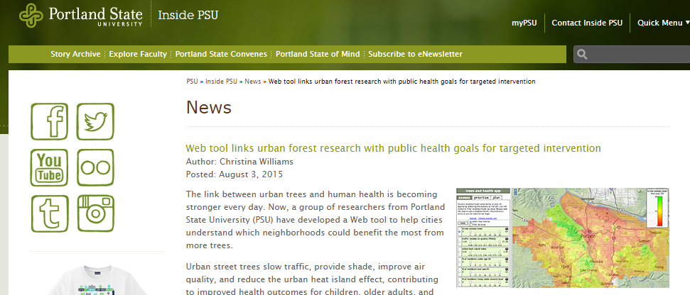
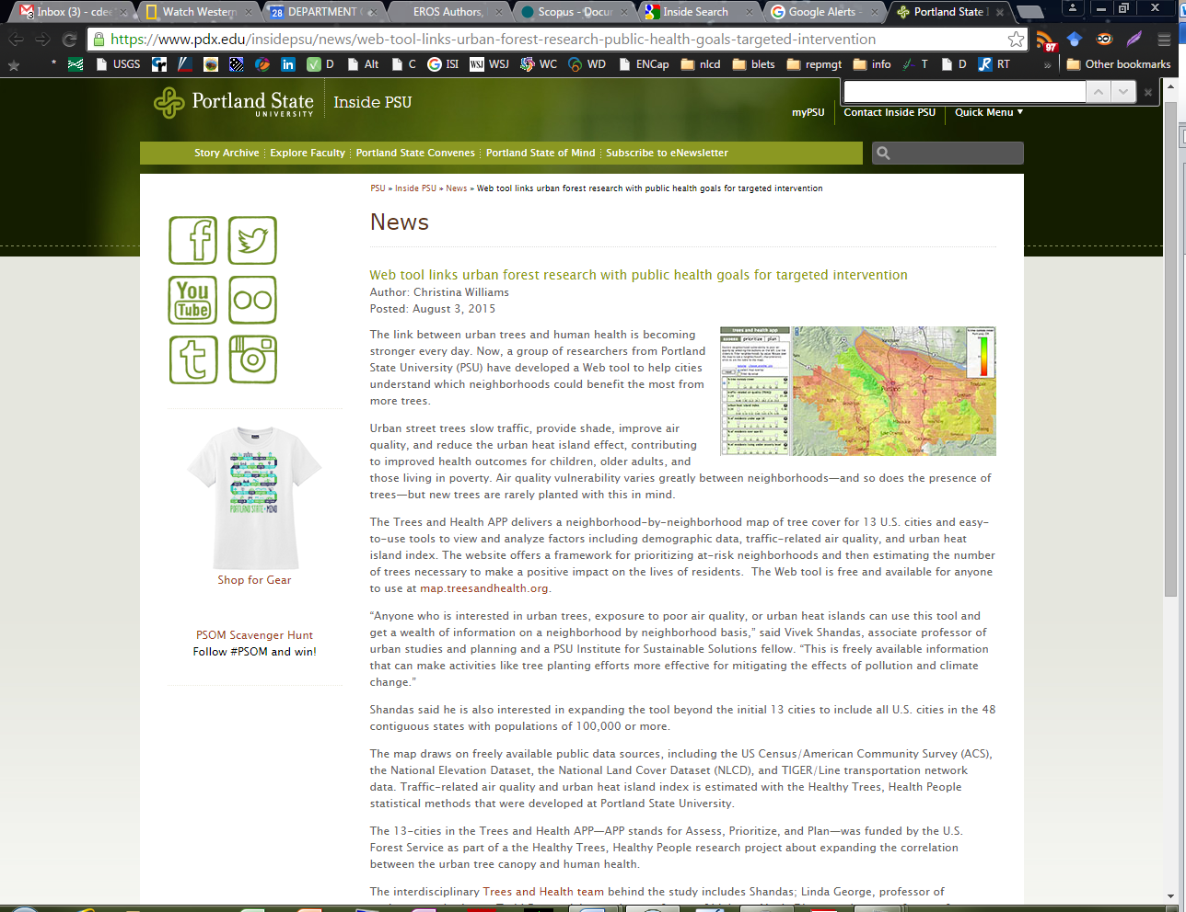
News Sites
NLCD
Notes:
And more recently, I found this in one of my news alerts.
A Web tool that helps cities understand which neighborhoods could benefit the most from more trees.
The tool draws on data from the NLCD.

Slide 32
Who is Using Our Datasets and
Data Products?
8) Google
Notes:
And finally, and of course, Google…..
So much you can do with Google Scholar or Advanced Searching on regular Google.

Slide 33
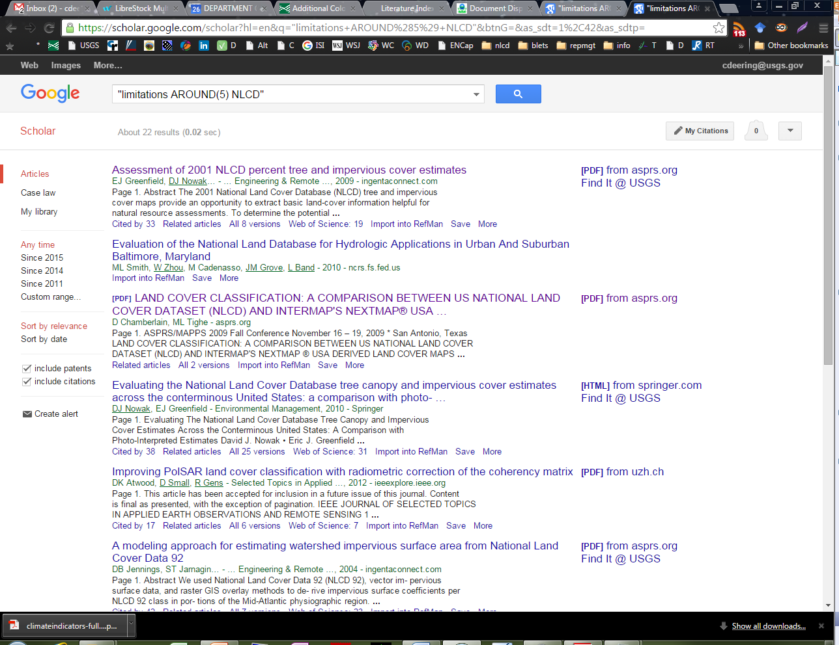
Google
Notes:
I’ve collected lots of power searching tools and tips.
One example I’ll give you: Proximity searching.
I’ve used this to look for publications that mention or discuss where our data can be improved. Searching for this kind of information can be very hit and miss, time consuming. A Google proximity search isn’t perfect, but it’s a step forward.
To look for publications that might be discussing limitations of the NLCD data, I ran a proximity search in Google Scholar to look for the word “limitations” before and within five words of the acronym NLCD.
Of course, it’s really a trial and error proposition, but nonetheless, I can pull up results about needed data improvements much faster this way than with any other tool or strategy.

Slide 34
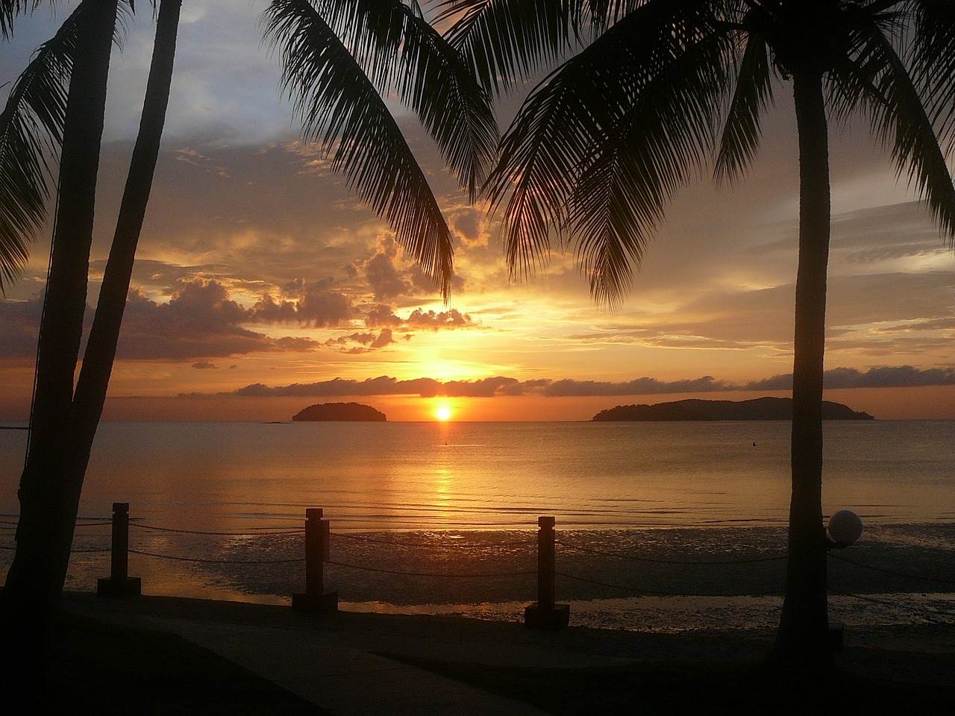
Notes:
As I said at the outset, for me, search requests for data usage used to be daunting. Thankfully, experience has been, as always, a tried and true teacher. It’s helped me build a toolbox – which is always growing – of resources and strategies that make those searches for data usage a whole lot easier, and more productive. And I’ve found that despite the rough seas you can encounter due to a lack of consistent data citation, it is possible to pull together a rich variety of metrics about data usage, as well as application and use stories that add substance to the numbers. I can now say, that at the end of day, life is pretty good!

