Slide 1
Exploring Social Media as a Research Tool for Measuring Engagement in a Paleontological Community of Practice
Lisa Lundgren*, School of Teaching and Learning (STL), UF
Kent Crippen, STL, UF
Bruce MacFadden, Florida Museum of Natural History (FLMNH), UF
Betty Dunckel, FLMNH, UF
Shari Ellis, FLMNH, UF
Eleanor Gardner, FLMNH, UF

Slide 2
Theoretical Framework
Characteristic | Definition (Wenger, 2002) | FOSSIL CoP
Domain of Knowledge | The area of interest | Understanding the natural world through the collection, preparation, curation and study of fossils and the science of paleontology.
Community of People | People who care about the domain; "the social fabric of learning"(p. 28) | Fossil group members Fossil enthusiasts Professional paleontologists Professional science educators
Shared Practice | "a set of frameworks, ideas, tools, information, styles, language, stories and documents that community members share"(p. 28) "a set of socially defined ways of doing things in a domain: a set of common approaches and shared standards that create a basis for action, communication, problem solving, performance and accountability."(p. 38) | Inquiry Social Learning Field Trips Collection Preparation Identification Digitization Outreach
Notes:
The FOSSIL Project is a community of practice. A community of practice is defined by Wenger by three characteristics: the domain of knowledge, the community of people, and shared practice. The domain of knowledge of the FOSSIL Project is what we call social paleontology: understanding the natural world through the collection, preparation, curation and study of fossils and the science of paleontology. The community of people in the FOSSIL CoP are fossil group members, professional paleontologists, as well as fossil enthusaists (people who enjoy fossils but are not a part of a group), and professional science educators. The practices which the community share include inquiry (learning through questioning), social learning (learning through each other), field trips upon which fossils are collected, fossil prep and id, as well as digitization and outreach.

Slide 3
Research Question
Which social media components are most engaging, for whom, and under what conditions?

Slide 4
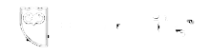


Social Media Tools
Notes:
In order to create quality posts, we used a number of tools:
Consistent language & branding from a marketing plan created through working with Atmosphere Apps:
“amateurs,”“social paleontology”Join us!”
Individual call outs to paleo orgs
Consistent posting time
Nearly always at noon every day of the week, only post 1x/day unless a huge story breaks.
If posting more than once a day, never posted consecutively
Usage of Hootsuite helped manage posting
Usage of TweepsMap ensured we knew (at least on Twitter) where the audience was

Slide 5
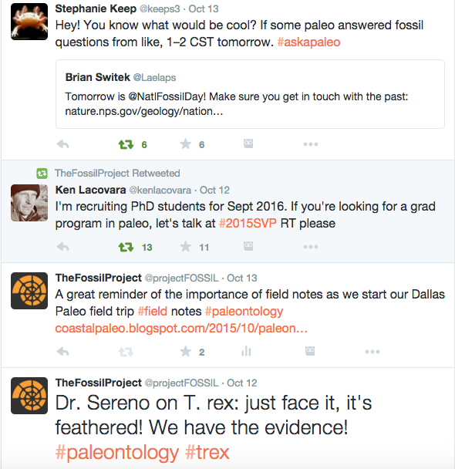
FOSSIL Project Twitter
Tweets | Following | Followers
640 | 148 | 580
How does FOSSIL use Twitter?
Retweeting important paleo news
Informing followers of upcoming FOSSIL events
Sharing photos & interesting information learned at conferences, field trips, & meetings

Slide 6
How FOSSIL defines “Engagement” for Twitter
Levels of Engagement
1. No Interaction | User scrolls past post
2. Favoriting a message | Indication of interest in content
3. Retweeting a message | Wanting a post to show up in own Twitter feed
4. Retweeting a message & adding own commentary | Post appears in own feed with person’s thoughts
Notes:
No Interaction Post appears in a user’s newsfeed. User scrolls past post. Unable to identify if user interacts with post (e.g. reading the post or scrolling past it).
Favoriting a message User clicks favorite ( ) indicating that they are interested in the content. This does not indicate that the user read the post fully or clicked a link embedded in the post.
Retwteeting the message: User clicks retweet indicating that they want the post to show up in their Twitter feed, showing the post to their followers.
Retweeing nad adding User clicks retweet indicating they want the post to show up for their followers, but the user also indicates their thoughts on the content through a comment of their own

Slide 7
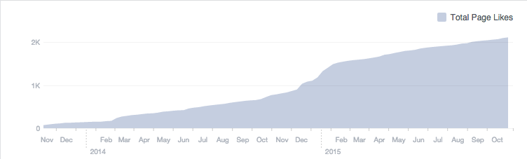
FOSSIL Project Facebook
2,113 likes as of October 2015
How does FOSSIL use Facebook?
Creating novel content which informs likers of upcoming FOSSIL events
Sharing photos & interesting information learned at conferences, field trips, & meetings
Posting paleontological news stories featuring amateur or professional paleontologists
Posting resources for k-12 teachers, such as links to websites with lesson plans

Slide 8
How FOSSIL defines “Engagement” for Facebook
Levels of Engagement
1. No Interaction | User scrolls past post
2. Liking a post | User clicks “like”
3. Sharing a post | User includes post on own or another’s timeline
4. Commenting on a post | User adds own thoughts to a post
Notes:
By examining the ways in which our community engages with the social media platforms of Twitter and Facebook, we can offer unique insights into best practices for using social media to support science based communities of practice.
Post appears (or not) in a user’s newsfeed. User scrolls past post. Unable to identify if user interacts with post (e.g. reading the post or scrolling past it).
User clicks “like” indicating that they are interested in the content. This does not indicate that the user read the post fully or clicked a link embedded in the post.
User clicks “share” to include the post on their own or another’s timeline. This does not necessarily indicate agreement with or dissent from the post.
User leaves a comment on the post. Comments can range from agreement with the post, dissention, additional information, telling friends about the post (e.g. @Jane Doe, look at this).

Slide 9
Findings: Levels of Engagement on Facebook

Slide 10
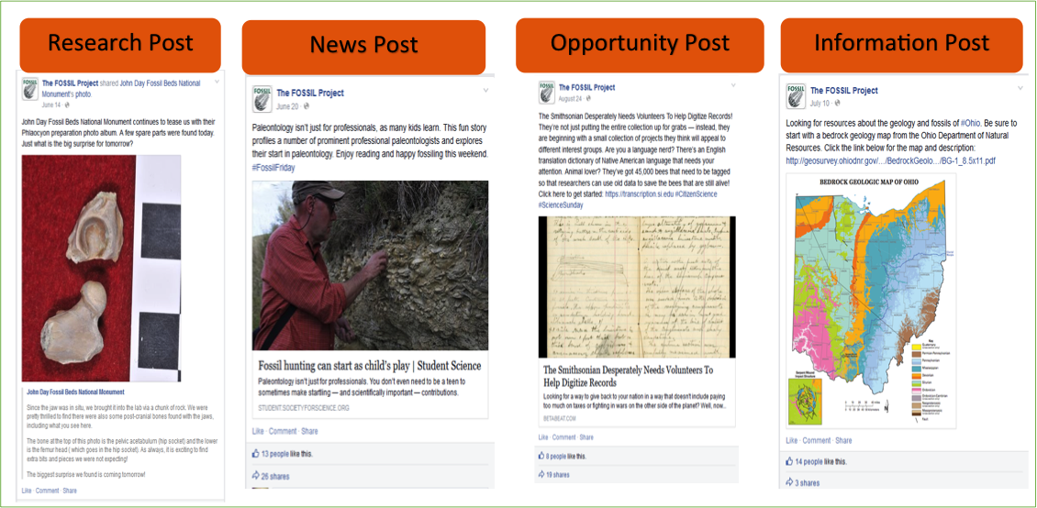
Findings: Different Post Types on Facebook
Notes:
We coded posts on Facebook into four different categories, seen here. In the course of the year (may 2014-may2015), we coded 77 posts for their story type. The stories that were chosen to be coded were based on Facebook’s data showing the number of likes, shares, and comments on each post
After analysis, we found that News posts contained the most engagement (likes, comments, shares) while opportunity posts contained the least engagement

Slide 11
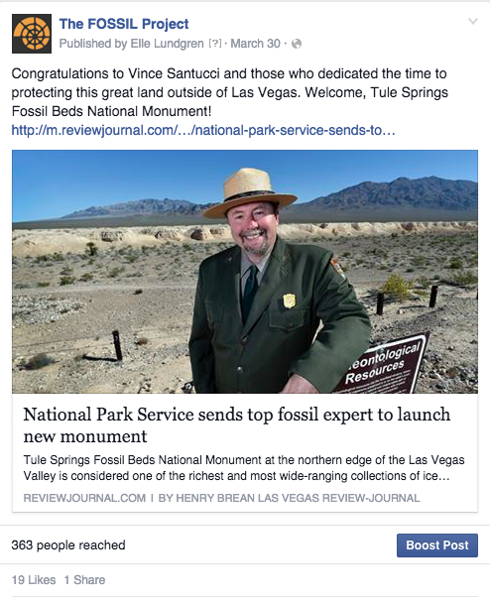
Most Engaged with: News Post
Contains information about current happenings in paleontology; links to a “news” website or other social media page

Slide 12
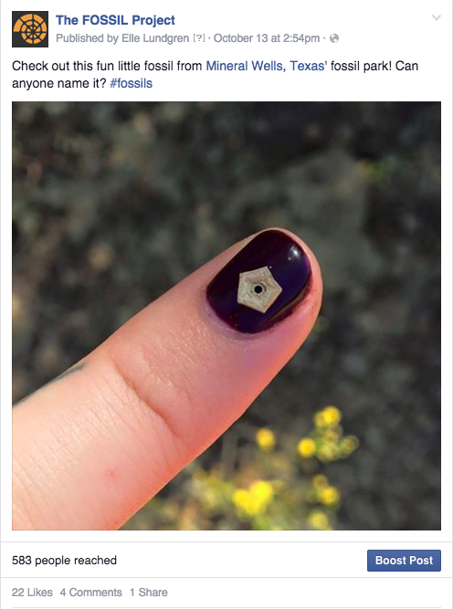
Findings: Summary
Post types
Most engagement: News
Least engagement: Opportunity
Most engagement is low
in the form of likes
SOLUTION: Create posts more relevant to our user base
Community feedback via focus group
Fossil ID posts & posts about upcoming events

Slide 13
Further Research
Do social media personas (e.g. lurkers, “average” users, or advanced users) influence the ways in which the FOSSIL CoP engage in social paleontology?
Creating interview protocols & focus groups from random sampling of social media users to understand their social media desires

Slide 14



Join us in social paleontology!
facebook.com/thefossilproject
twitter.com/projectfossil
community.myfossil.org
THANKS!
QUESTIONS?

