Slide 1
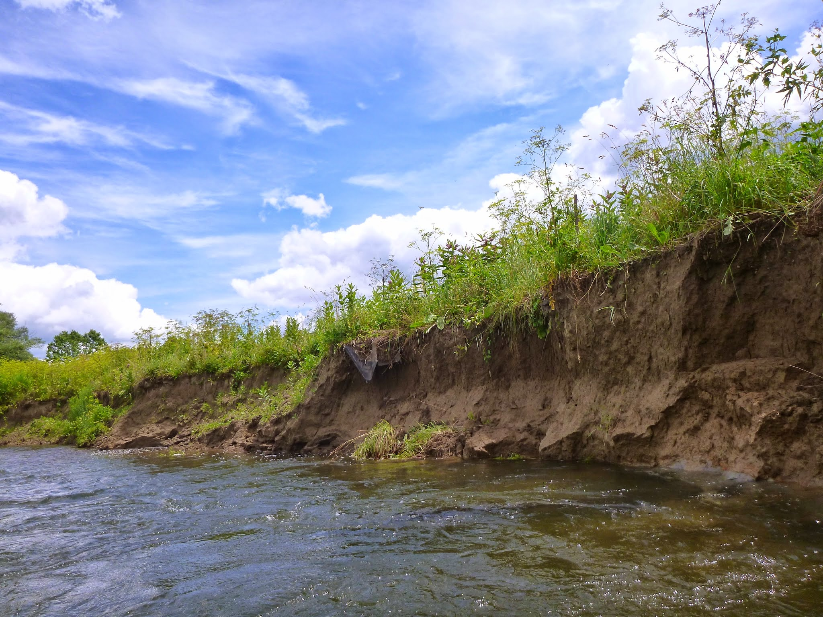


Views of the river: flood records, lidar, UAV,
and canoe based monitoring of meander migration in upstate New York
Les Hasbargen, Earth & Atmospheric Sciences, SUNY Oneonta
Peter T. Booth, Geography, SUNY Oneonta
Derek Walling, Earth & Atmospheric Sciences, SUNY Oneonta
David Busby, Geography, SUNY Oneonta
GSA Abstracts with Programs Vol. 47, No. 7.
Session number 72 titled “T188. Inside or Out? Investigations into Driving Forces in Fluvial Systems,” 1:50-2:05 PM, Sunday, 1 November 2015, in the Baltimore Convention Center, Room 340.

Slide 2
Acknowledgements
Robert and Blevyn Wheeler
The Research Foundation of SUNY for faculty research grant to Hasbargen
Biological Field Station, SUNY Oneonta for summer internships, research fellowship, logistical support (including a UAV)

Slide 3
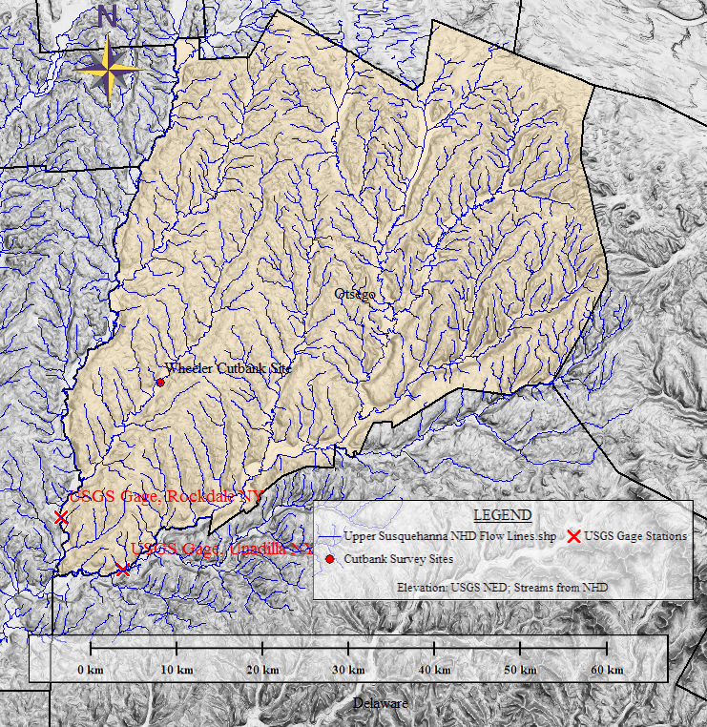
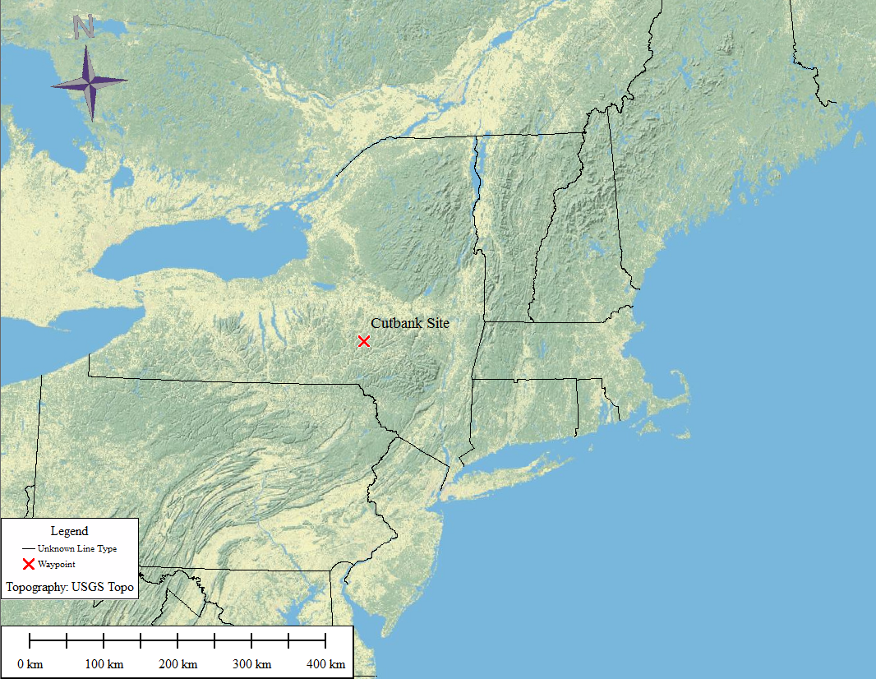
Field Site:
Susquehanna River
headwaters, NY

Slide 4
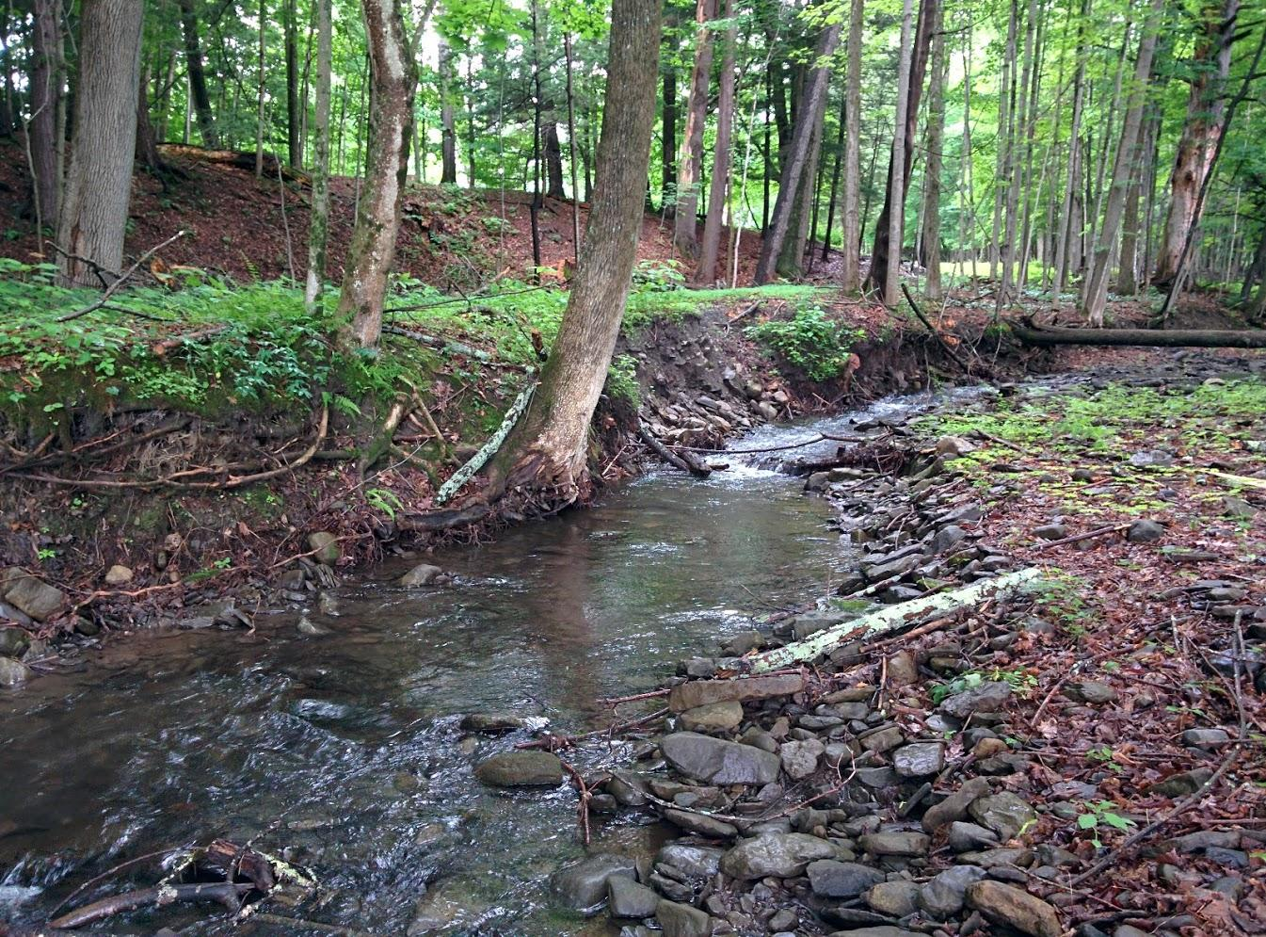
Motivation for the study...
Relative importance of cutbank erosion processes: who’s the gorilla?!
River discharge and migration rates: are they related?
Is there a balance of erosion and deposition in local meandering streams?
How effective is treeplanting to mitigate bank erosion?
Do we now have an affordable tool to measure processes? Proof of concept for SfM survey methods...

Slide 5
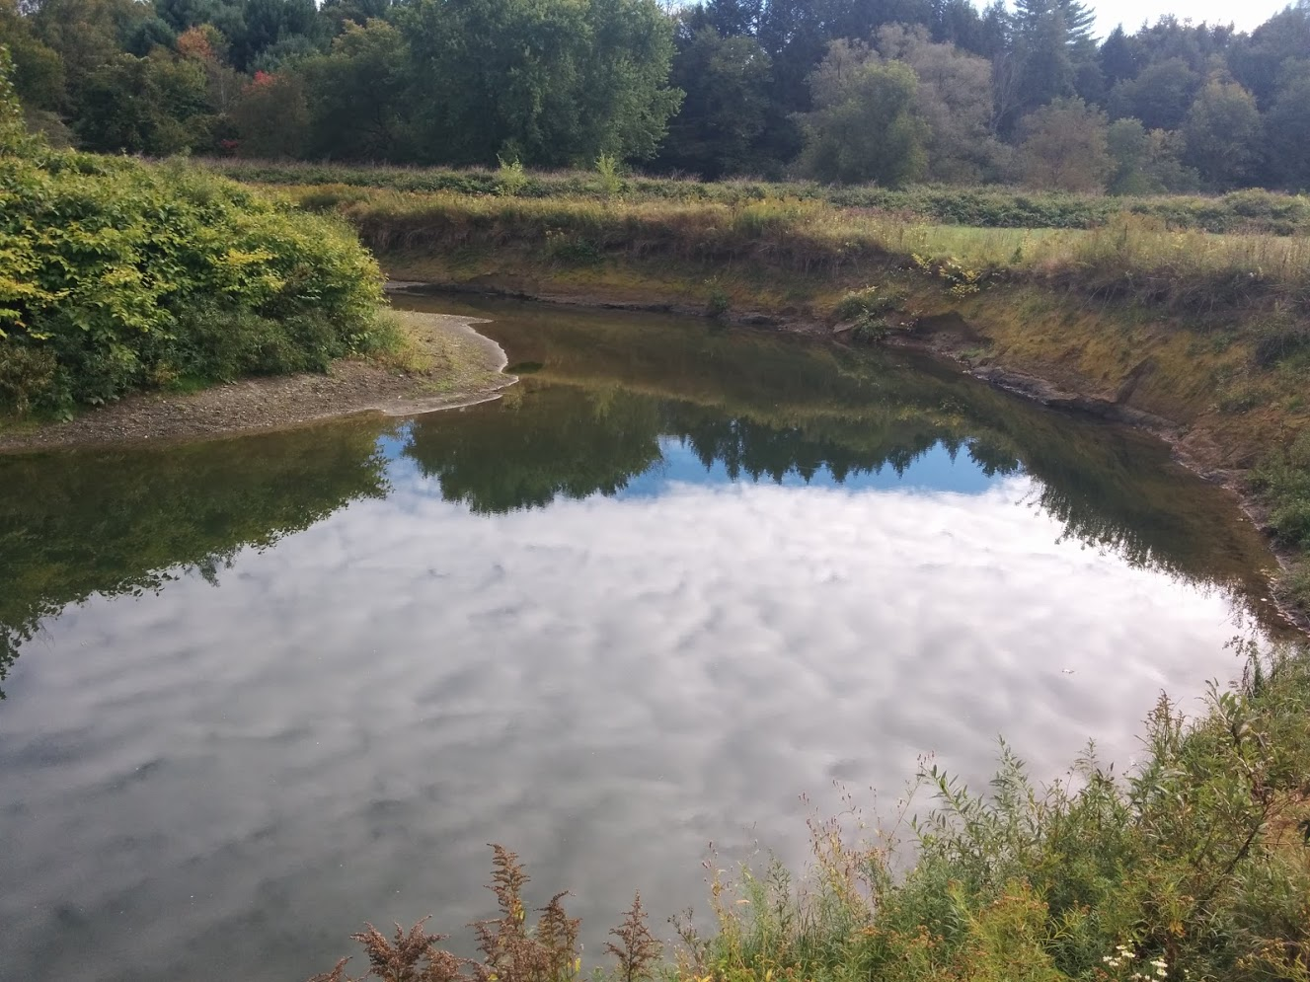
Which processes are most responsible for migration?
Frost needles?
Bed shear stress?
  Are low flows effective? Do they undercut and drive bank collapse?
  Is most of the work done by high flows? Once it’s over the bank, does size matter?
Bank collapse?
  Is the falling flood stage, with pore fluid pressure changes, the most effective?
  Is there time dependence to collapse, with rapid falling stages more prone to drive collapse?

Slide 6
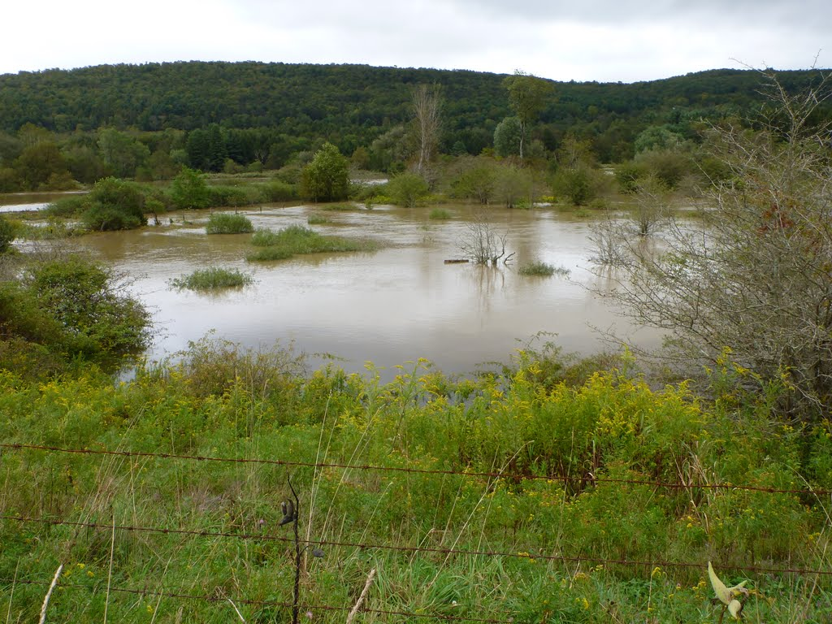
Overbank flows

Slide 7
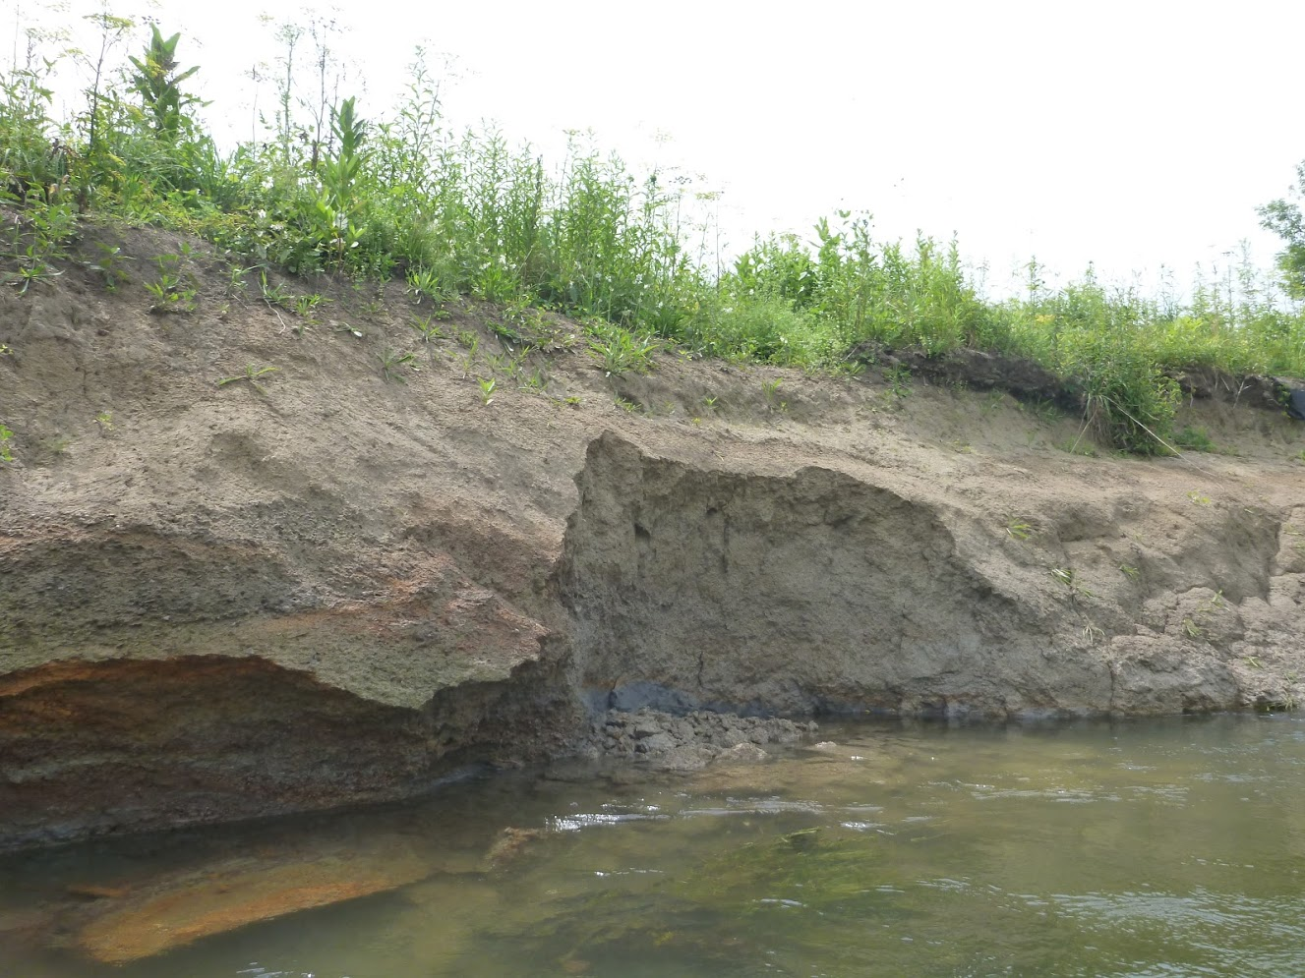
Which processes are most responsible for migration?
Bank collapse?
  Is the falling flood stage, with pore fluid pressure changes, the most effective?
  Is there time dependence to collapse, with rapid falling stages more prone to drive collapse?
  Do low flows undercut and drive migration?

Slide 8
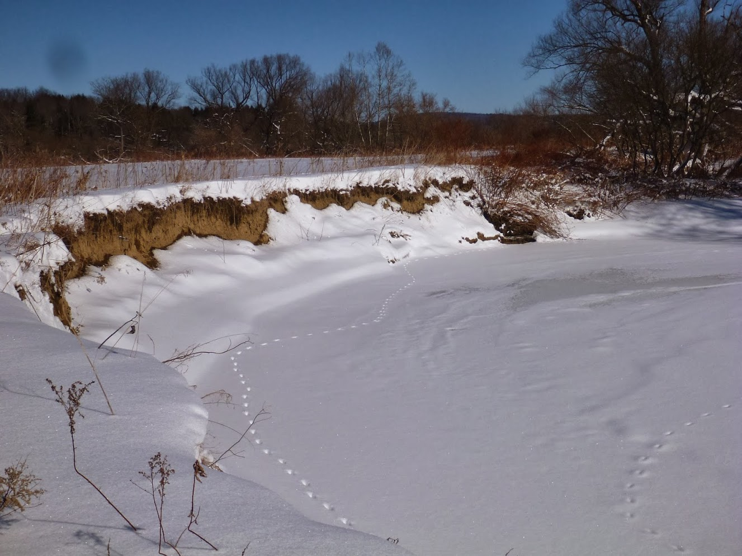
Frost needles?Daily freeze-thaw of cutbanks

Slide 9
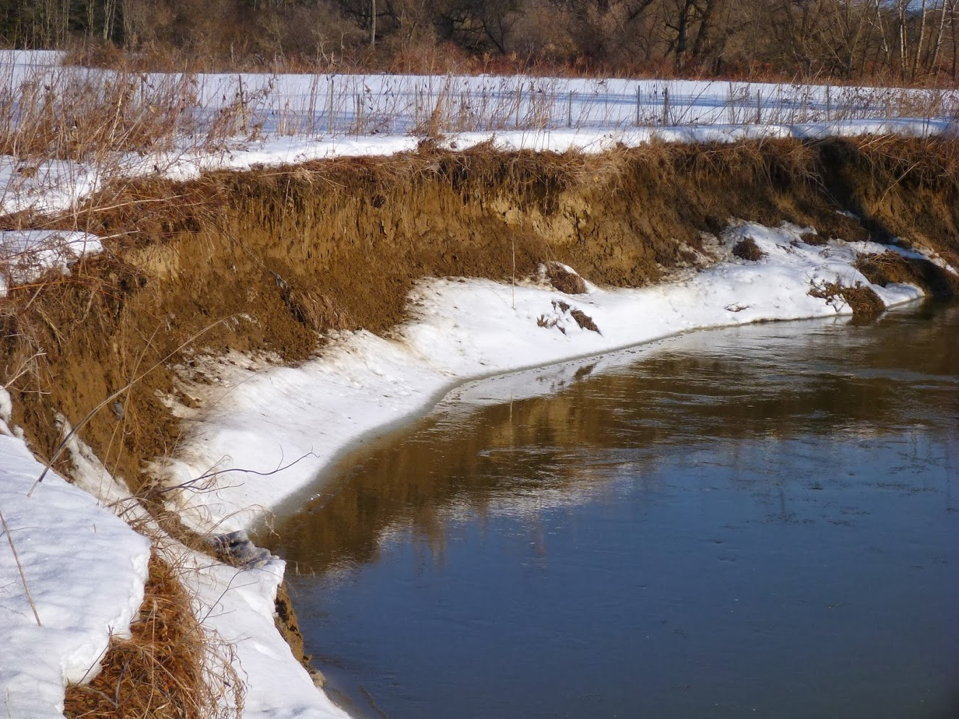
Frost needles?Daily freeze-thaw of cutbanks

Slide 10
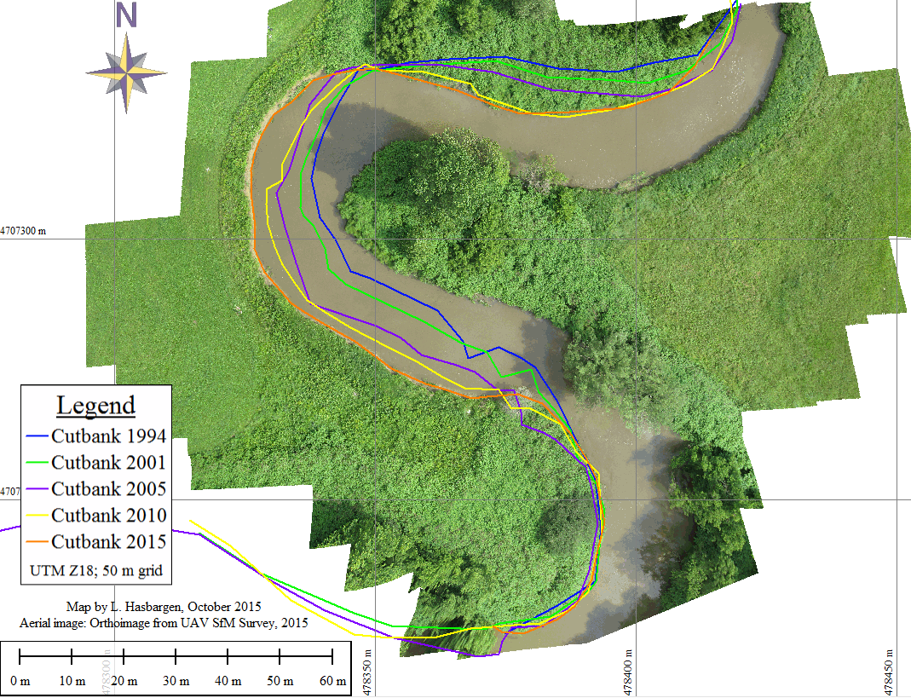
Meander migration: rates
Time series of orthoimagery from New York State GIS Clearinghouse, +UAV in 2015

Slide 11
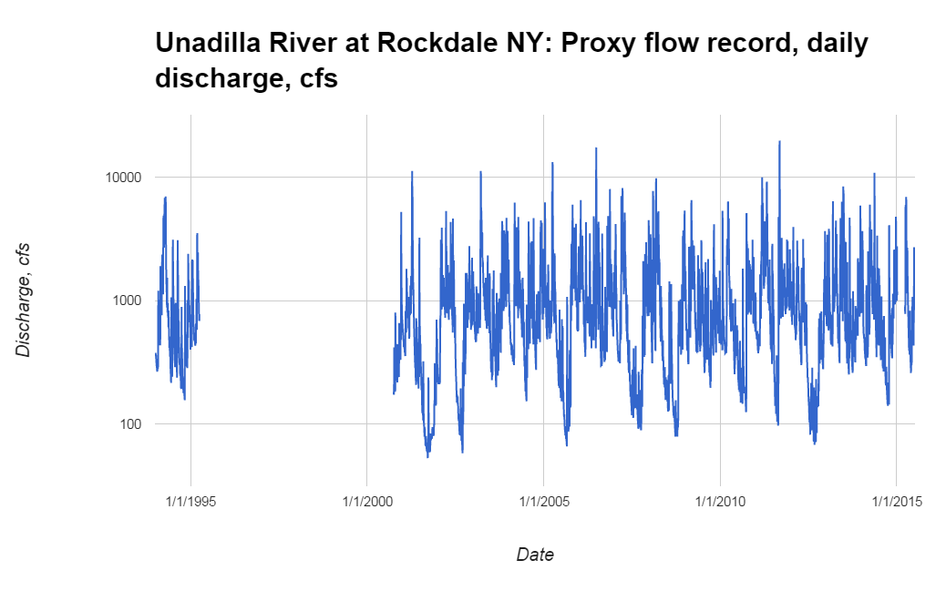
Flood of Record, Hurricane Lee
Gage not recording...

Slide 12
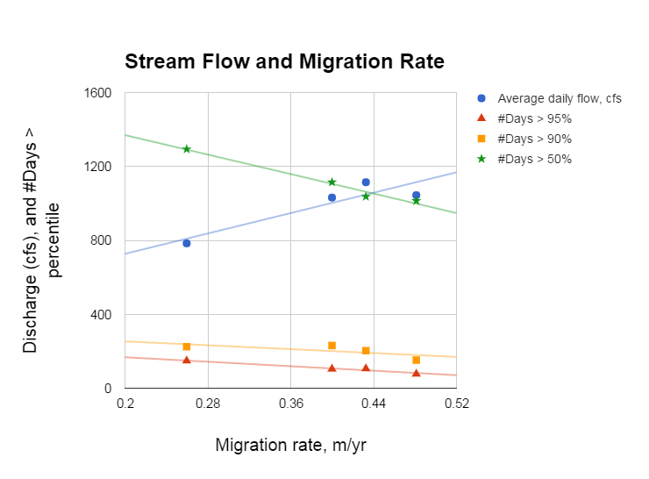
Migration Rates
So what’s going on here??!!
More high flow days appear to stymie migration.
Do they suppress undercutting and bank collapse?
We could use more close range observations of processes...

Slide 13
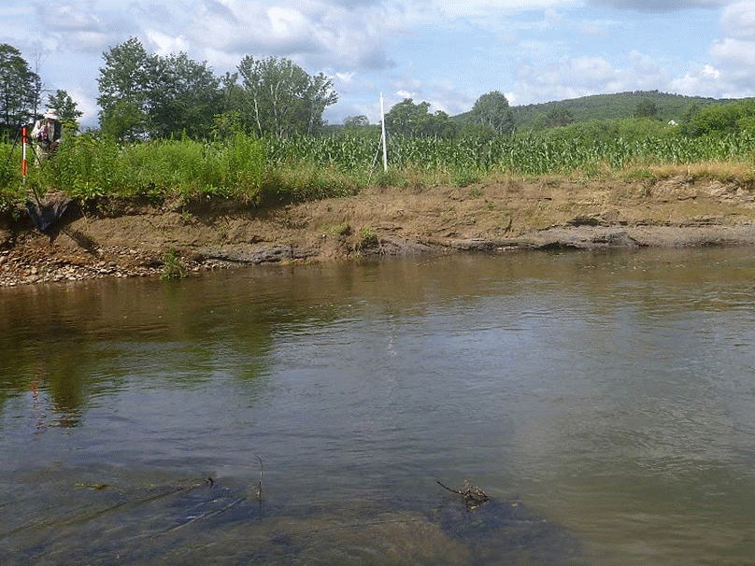
SfM: Take overlapping photos
The software (PhotoScan, by Agisoft):
  Aligns photos
  Finds common points in photos
  Calculates 3D coordinates of each point
  Colors the point
  Rectifies the coordinates, if ground control points are known

Slide 14
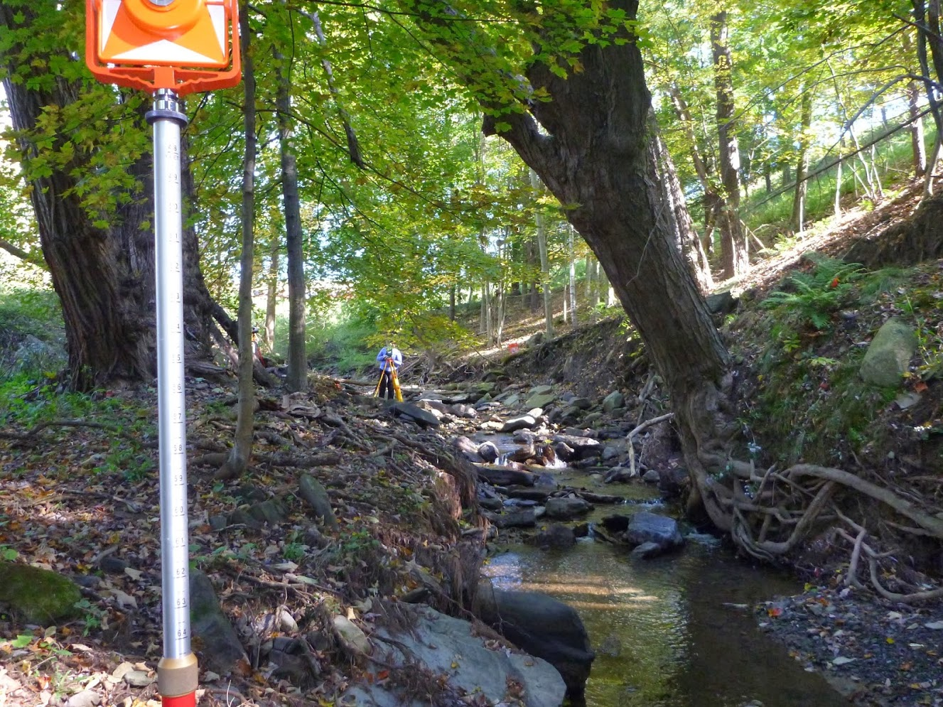
Surveying systematics...
Choices must be made about...
Airborne vs ground-based traverses
Distance between camera stations
Viewing direction of camera
Unreferenced models or...
Georeferenced Ground Control Points
And then there’s the need for mensuration software...

Slide 15
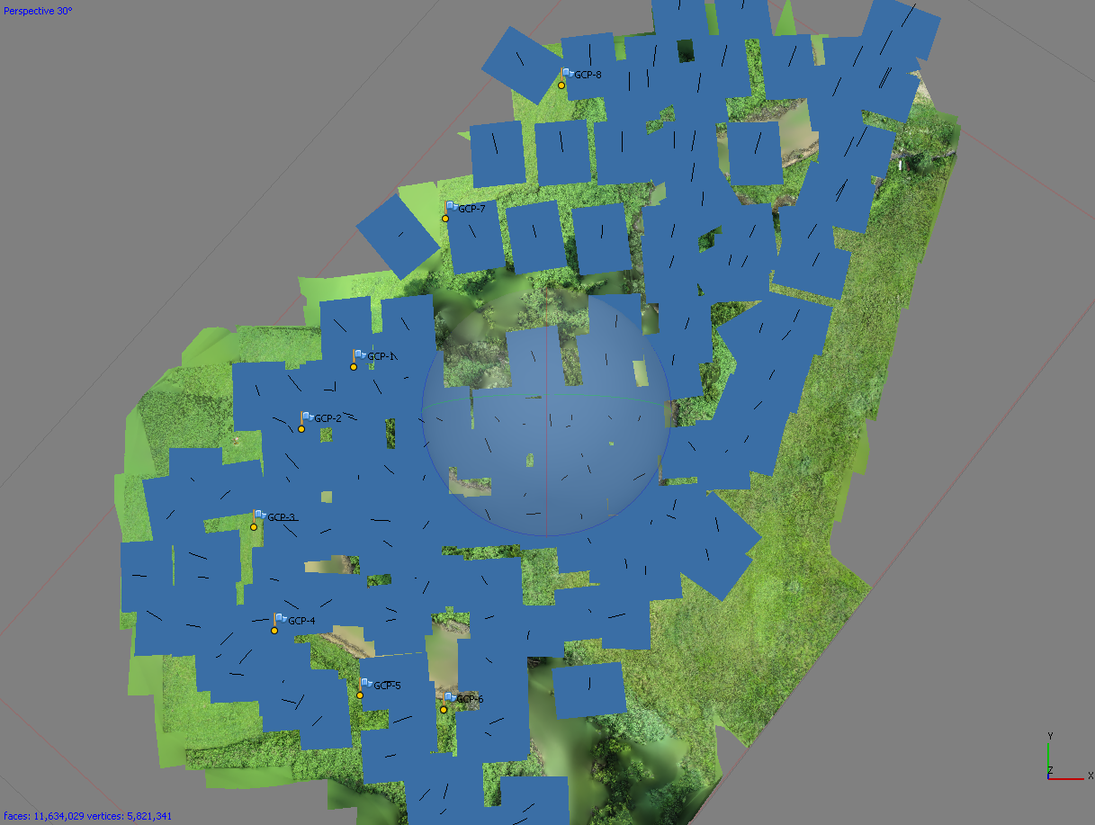
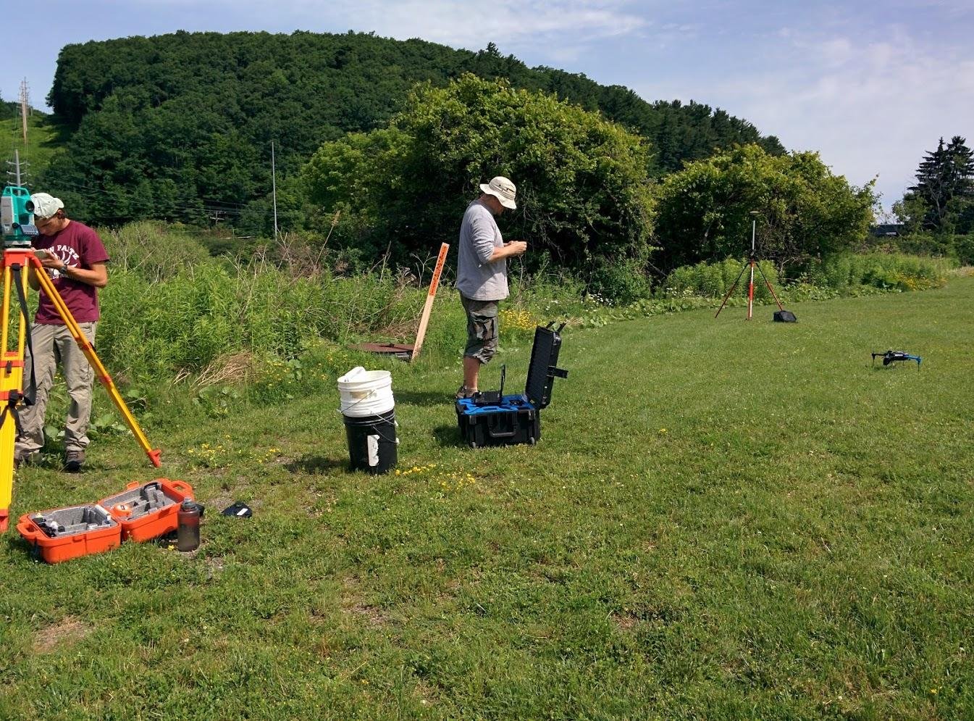
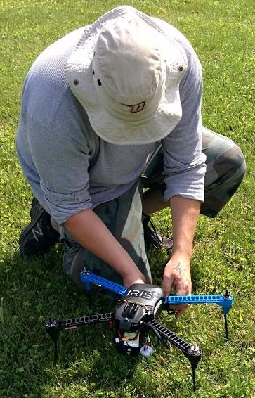
UAV Survey with SfM
Camera: Canon A2400 Powershot
UAV: Iris 3D Robotics
Software: Canon Developer’s Kit and

Slide 16
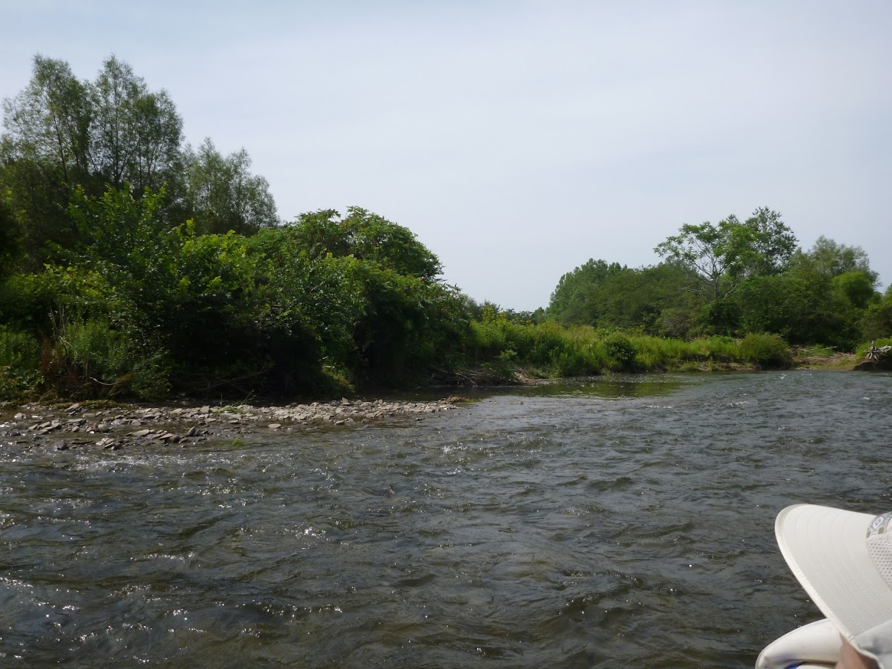
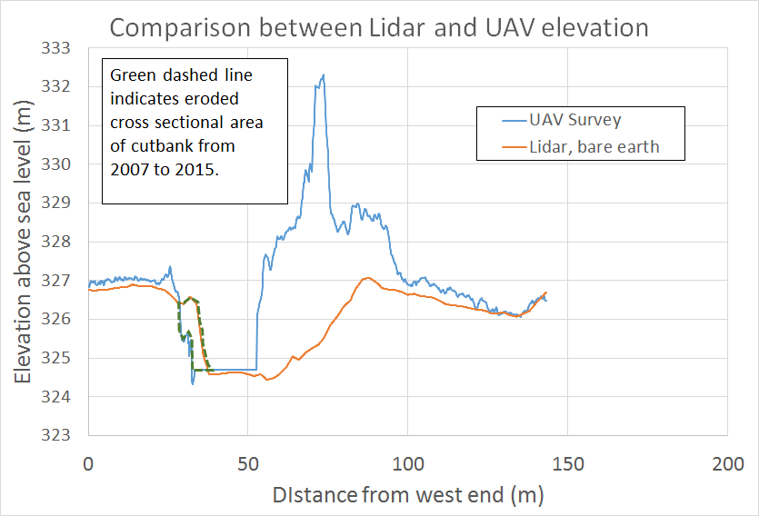
Comparing Lidar and UAV

Slide 17
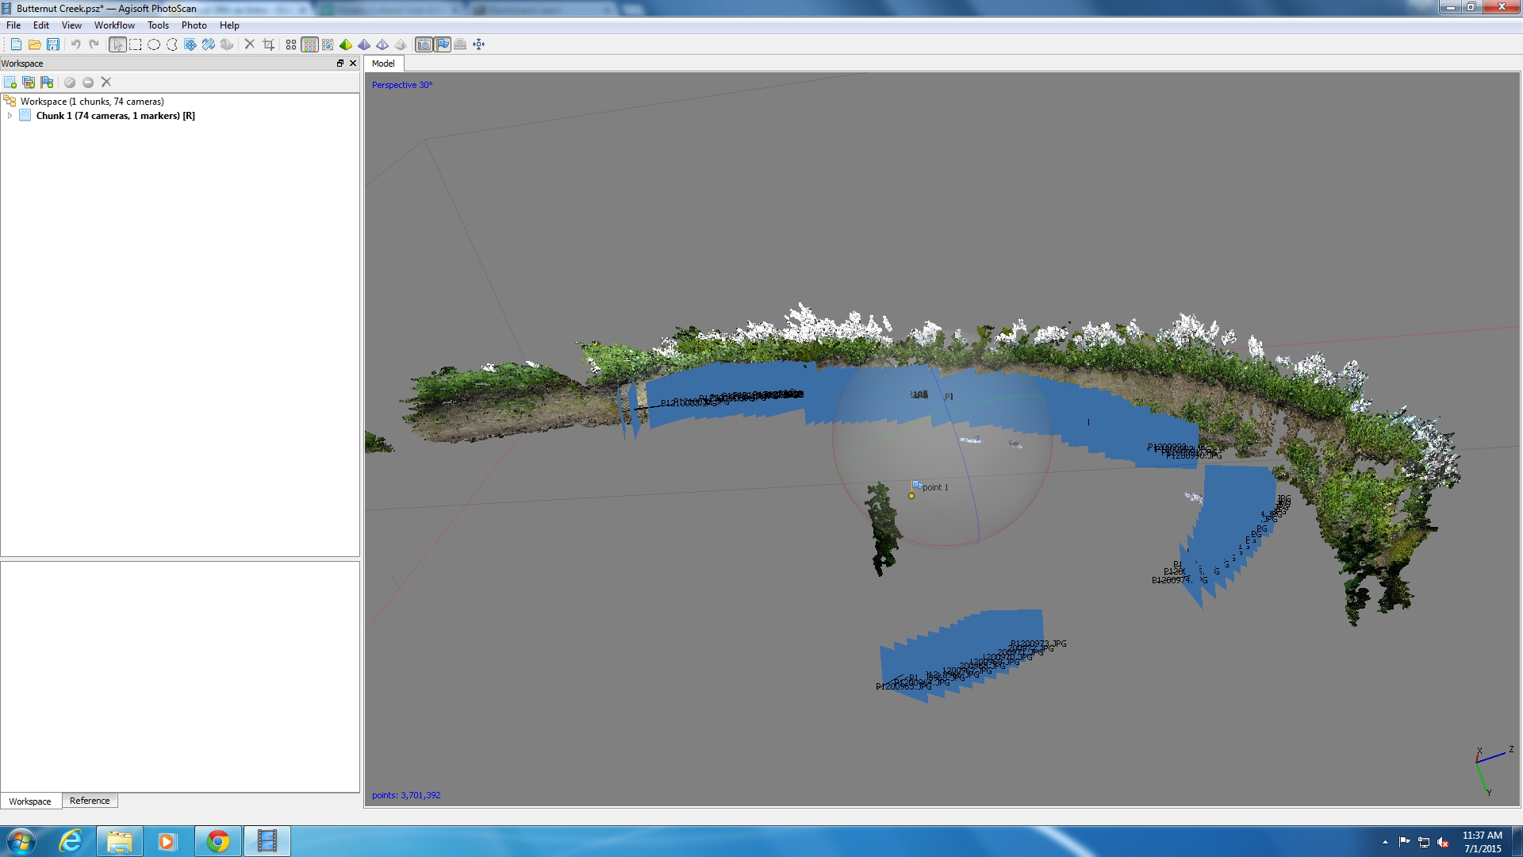
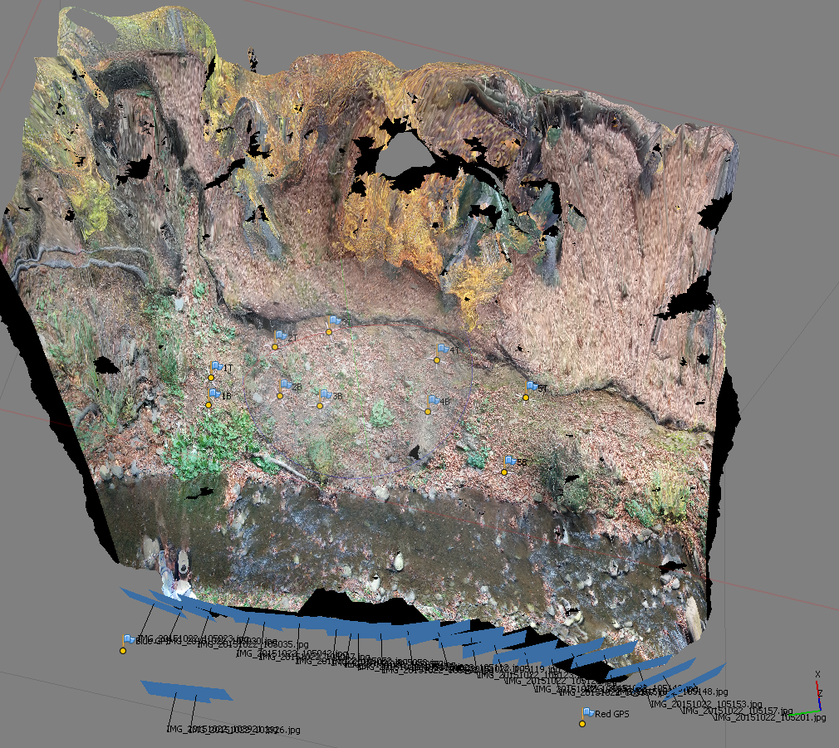
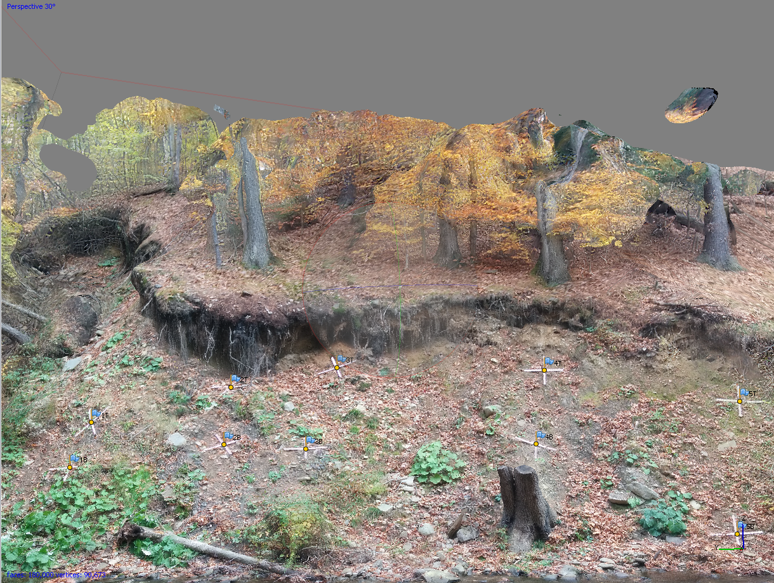
Single path surveys with SfM

Slide 18
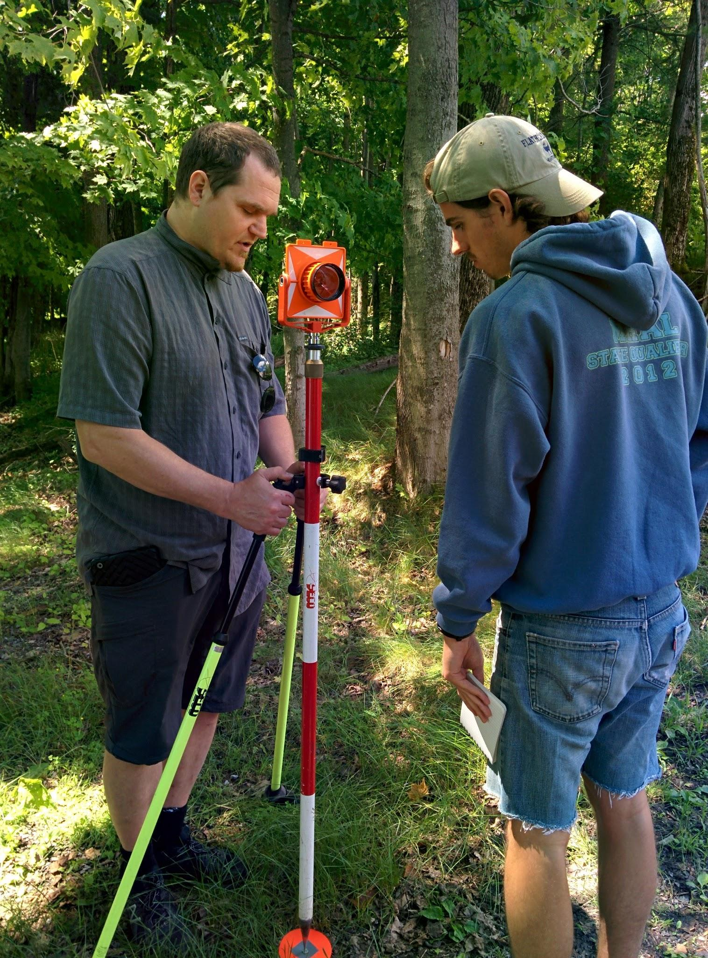
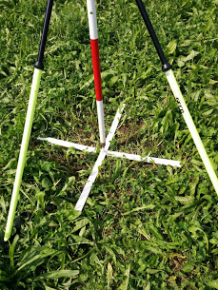
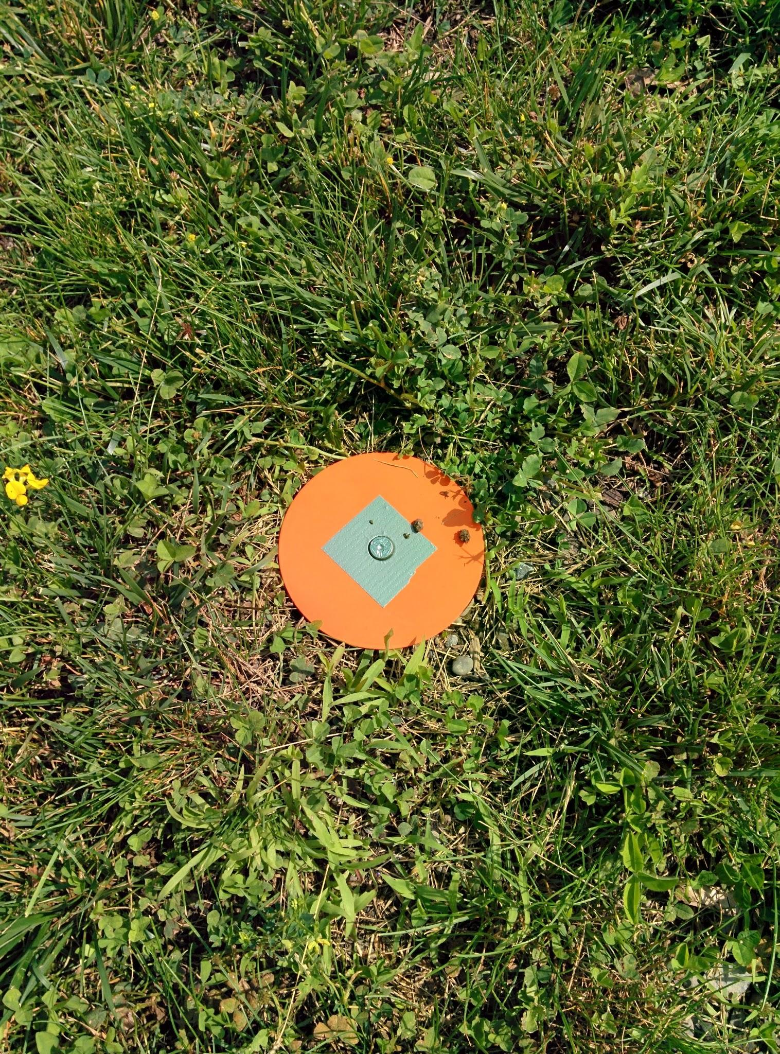
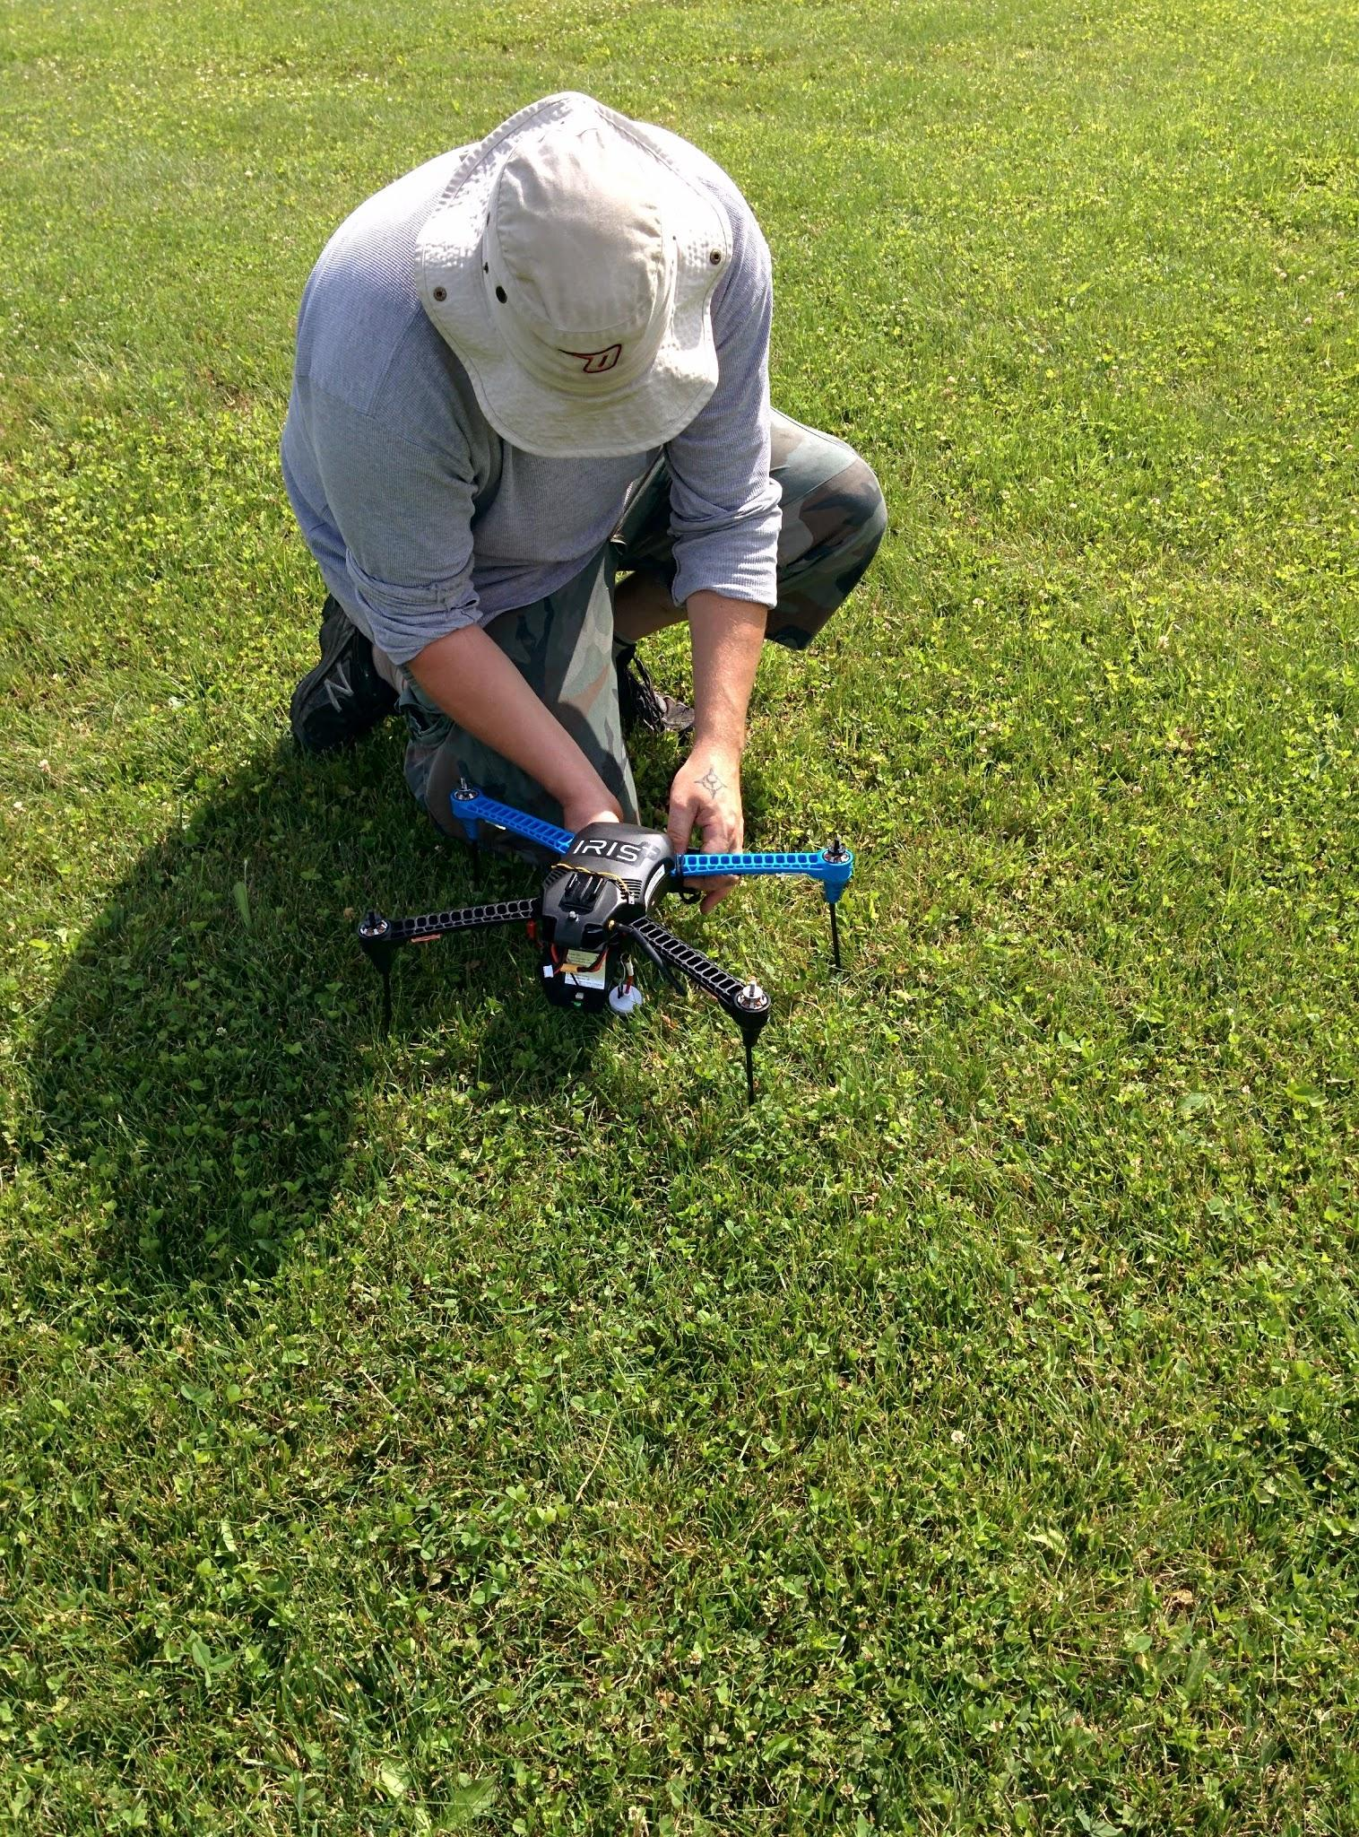
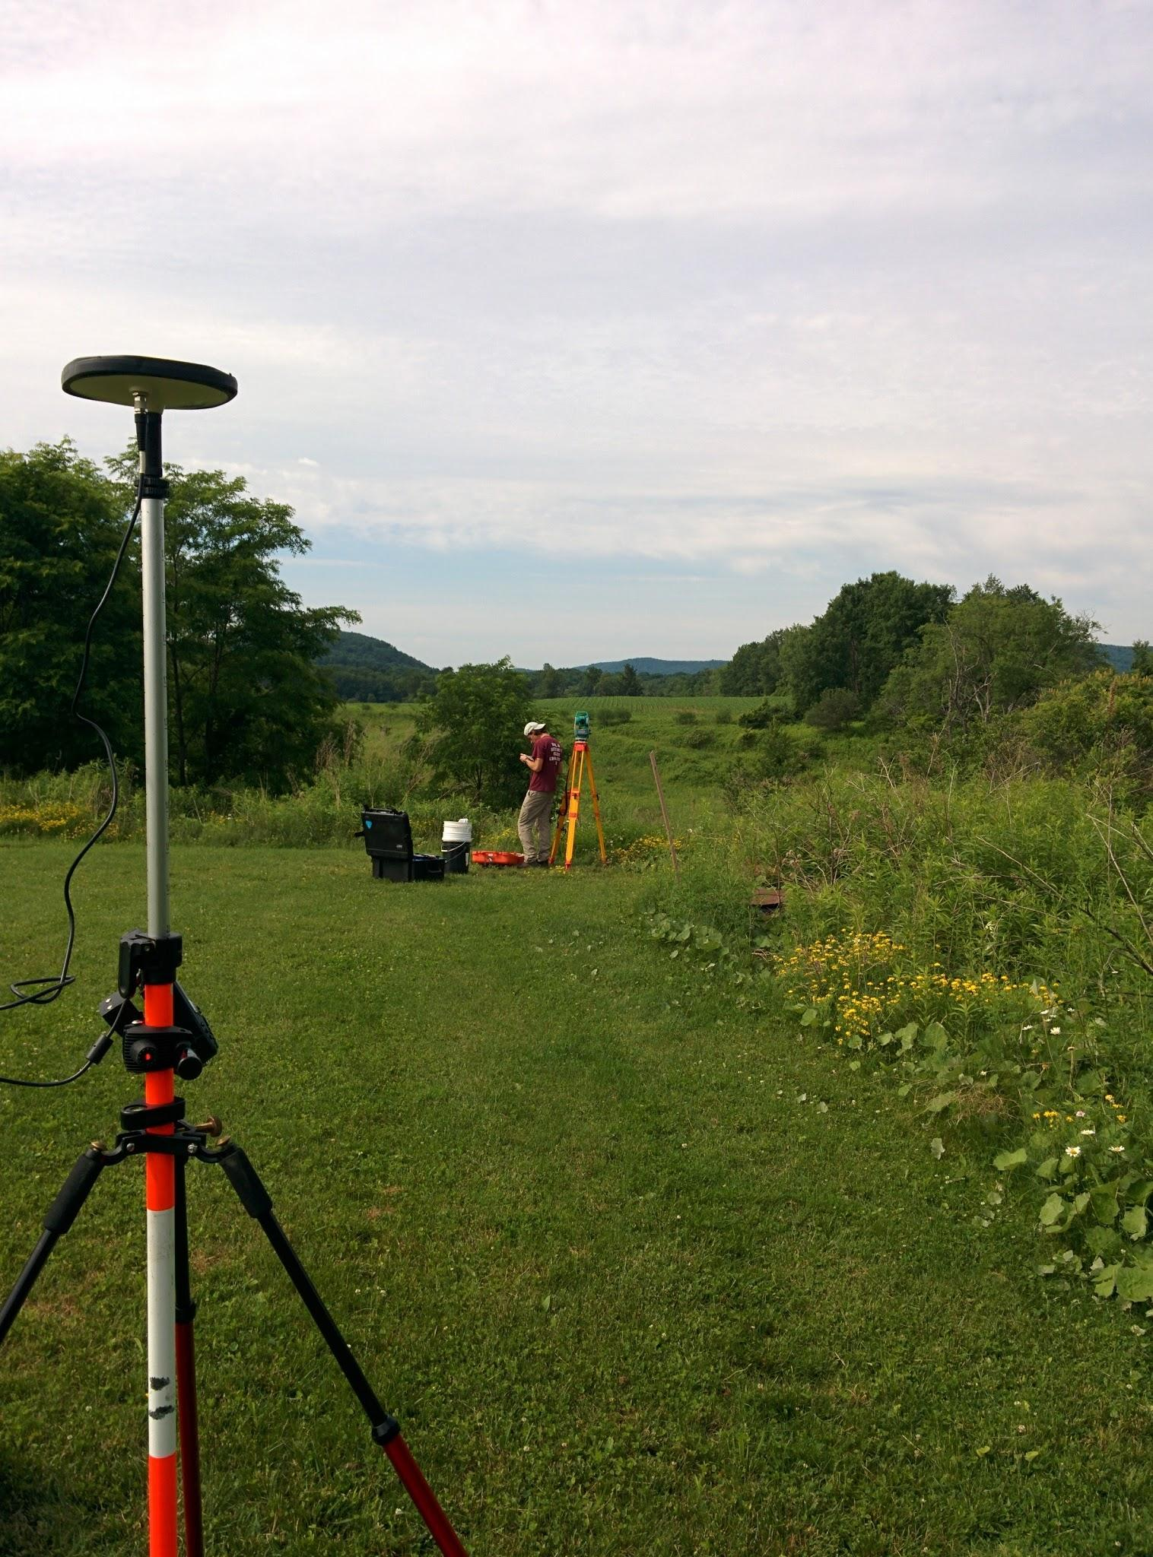
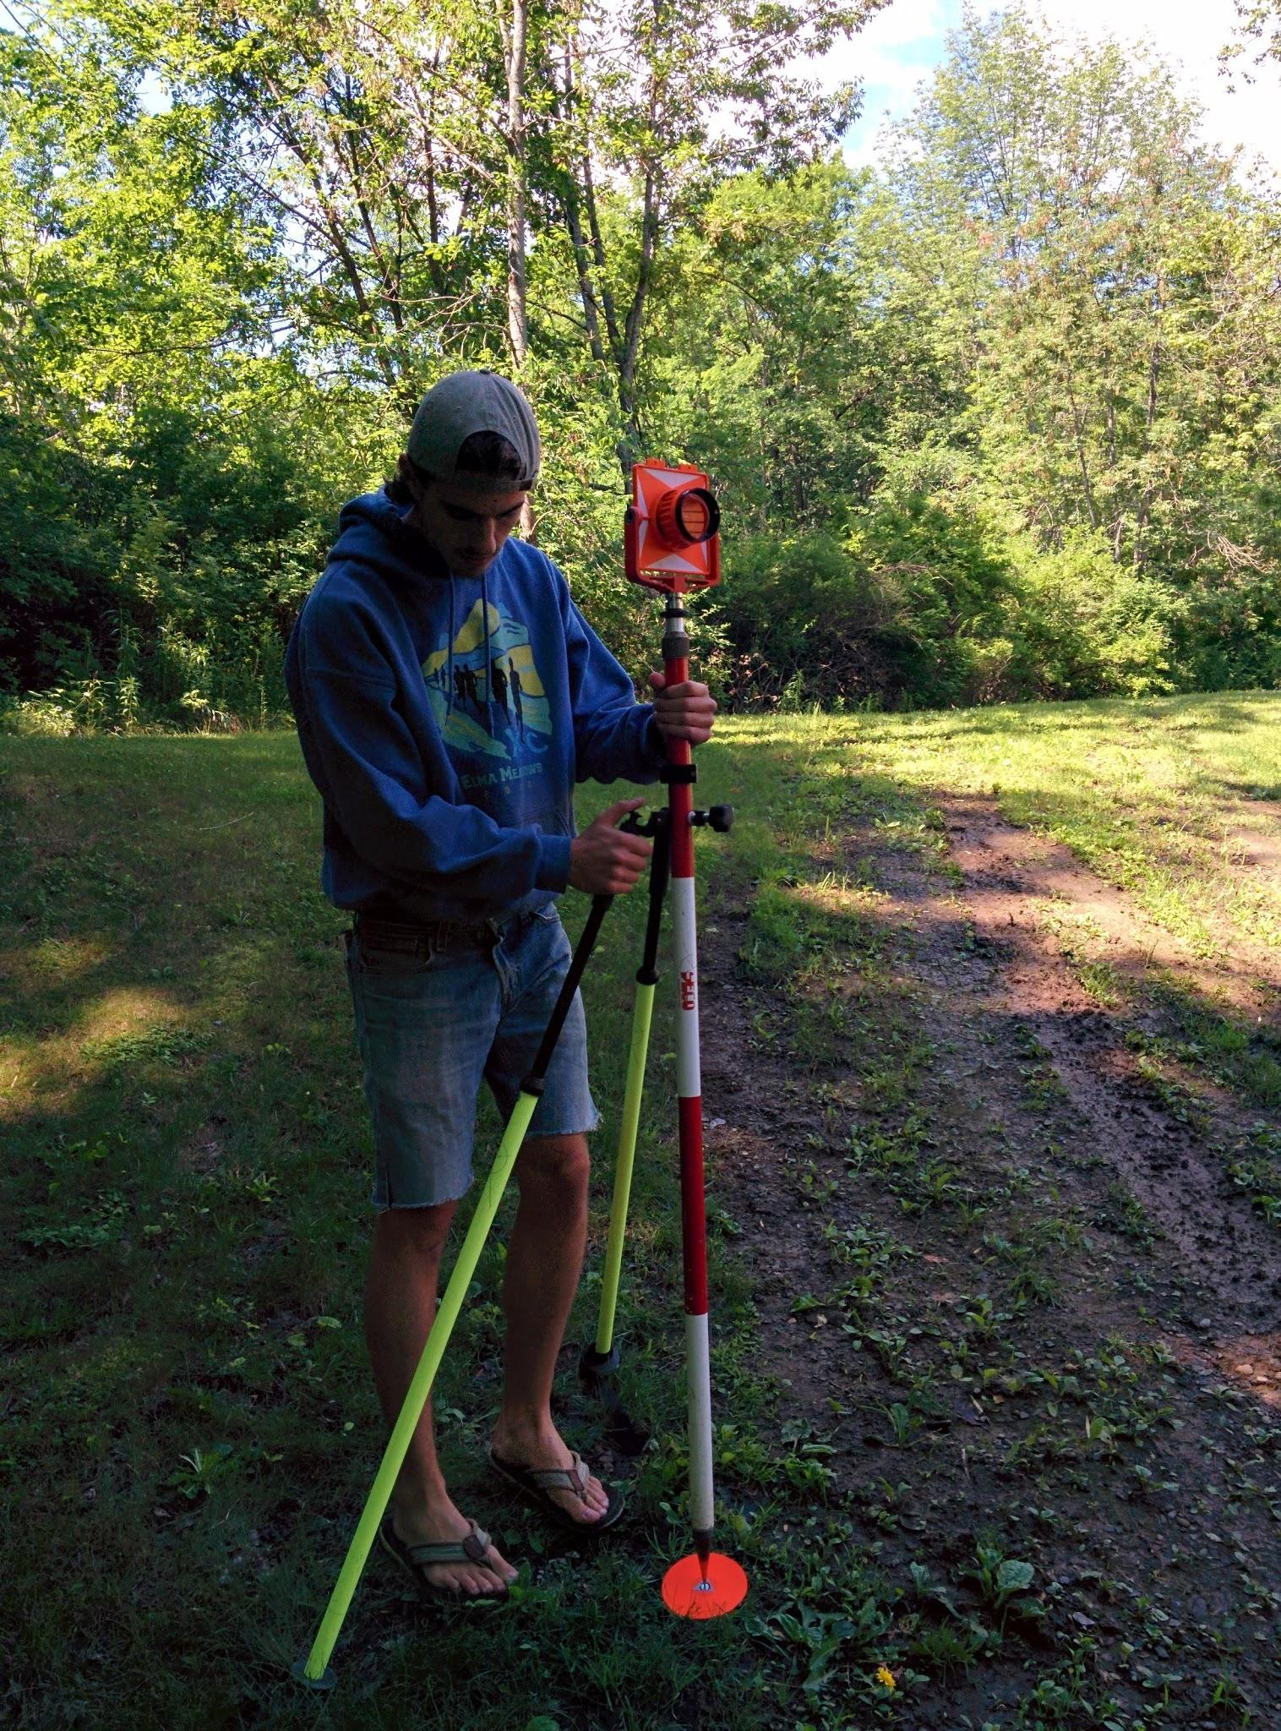
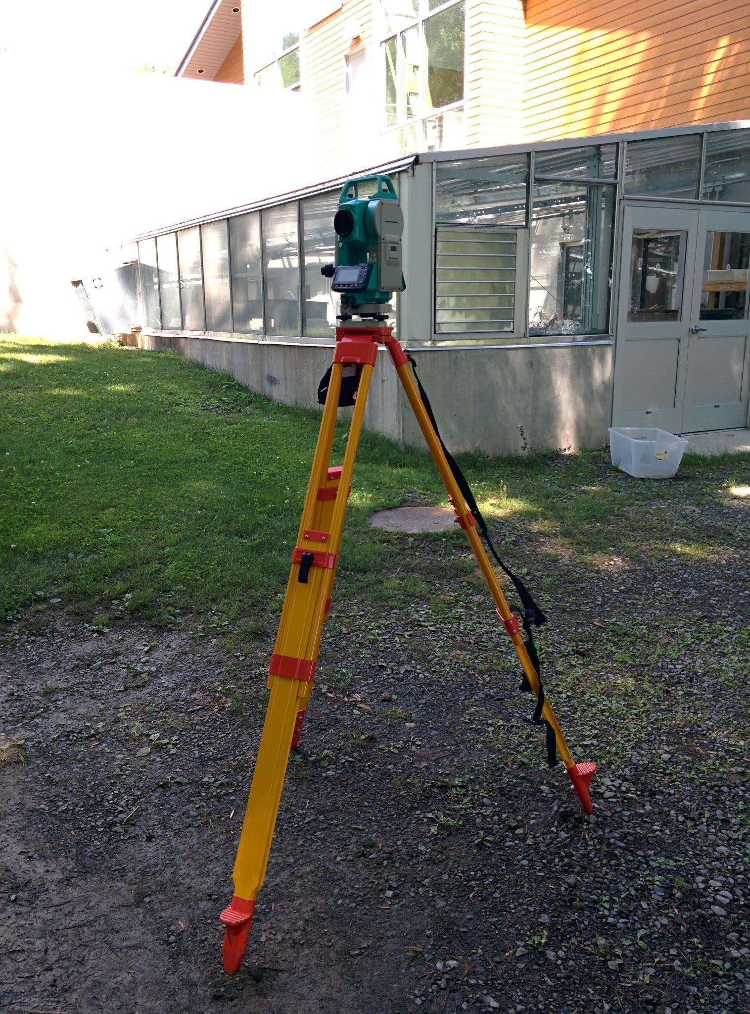
Ground Control Points
Scale, orient, and georeference the model
We used two static Magellan ProMark 3 GPS receivers and a total station survey tool (Sokkia 530R) to tie GCPs into a global reference frame
The heavy lifting is done by PhotoScan

Slide 19
Georeferenced Object Models...

Slide 20
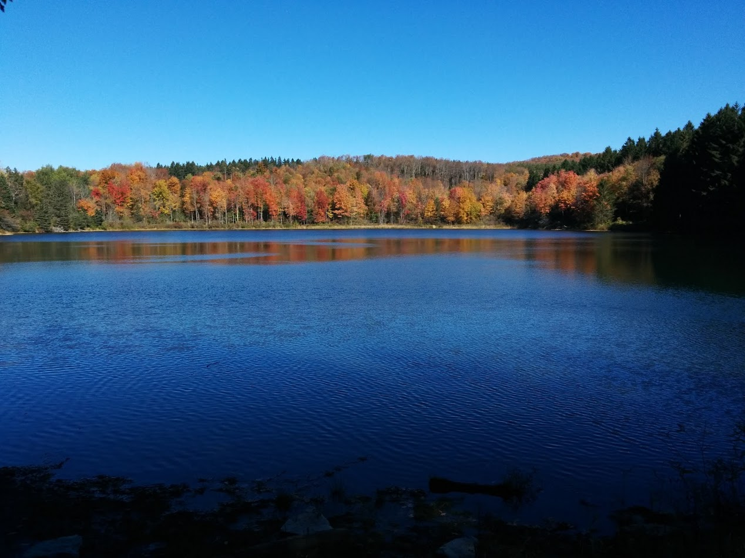
Conclusions
Migration rate decreases with more high flow events
The view from the river is the next step: we need to monitor undercutting and bank shear processes (maybe not so much with frost needles--but it could still be very illuminating)
We have the tools to monitor them!
I’ll take your questions...

Slide 21
Talking Points
Controls on Migration Rates in Butternut Creek
Les’ Thoughts, October 29-30, 2015
Talking points for the presentation on Sunday
Setting: Post glacial low gradient stream, Holocene flood plain development with mud banks and meanders
Key Question: Will an increase in flood frequency increase migration rate?
Warning: Preliminary study!!
Mechanisms of bank erosion: freeze thaw cycles; bank shear; undercutting; bank collapse; pulsing flows; bioturbation.
Approach: measure migration rate (by area lost over time divided by perimeter/2)
  bank erosion goes to 0 at the ends of the arc
  some deposition occurring within the system
First Hypothesis: Migration rate increases with larger flow events
  The test: Compare large flow events to migration rate: but which size? I choose the number of days with flows above some size (percentiles of 50, 90, and 95) for the time between photos, and hypothesize that bank migration should increase with the number of days of such flows; alternatively, the average flow during the erosion rate time period might also drive migration rate. Note, the discharge record is a proxy based on Unadilla River, into which the Butternut flows...
Results: Migration rate is inversely proportional to the number of flow days;
  Choosing a smaller percentile (including more flow days) appears to strengthen the relationship, so clearly the hypothesis fails. Not only do more floods not increase the rate, but they actually decrease the rate
  Perhaps there is a clue to a process here--is undercutting more common at lower (but still erosive) flows?
Why would migration rate decrease with more high flow days? Do more high flows stymie an effective process? Guessing here, but here’s a thought. If bank collapse is the dominant process in driving migration, then undercutting would appear to be important, as might rise-fall cycles. Higher flows might stymie undercutting by eroding the cutbank uniformly through bank shear stress. The bank still erodes, but is lacking the undercutting mechanism at higher flows. The rise-fall hypothesis as a driver of bank collapse and thus faster migration may not hold water...

Slide 22
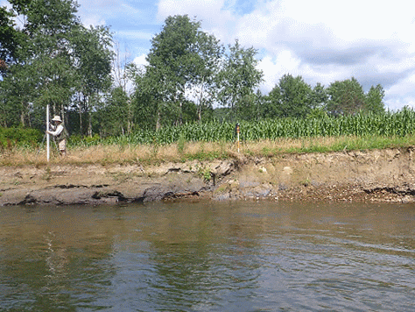
Questions?

Slide 23
Abstract
Several natural processes erode stream cutbanks including bank collapse, fluid shear stress, burrowing and bioturbation, and freeze-thaw events. Which of these dominate? How do river channels respond to large floods? Do large floods cause more bank erosion and channel migration than small floods? If fluid shear and bank collapse dominate, are they likely to increase with larger and/or more frequent floods? These are very important questions that are not easily answered without detailed measurements of stream banks. The answers have implications for bank erosion mitigation efforts and climate change. The approach taken here is to begin the work of establishing a baseline condition for streams against which changes can be measured. A long term goal is to conduct frequent surveys at a scale which reveals processes, examine changes over time, and tie these to stream gage records. While there is nothing new about this idea, the development of structure-from-motion software has opened up avenues for realizing these goals.
The field site is Butternut Creek, a tributary to the Susquehanna River in upstate New York, which has a well-developed Holocene floodplain nestled into glacial deposits. The cutbanks are ~ 2 m high, extend for ~100 m, and exhibit signs of recent erosion. Oxbows etched in the floodplain suggest long term activity. We captured overlapping photographs of the stream banks on the ground, from a canoe, and from an unmanned aerial vehicle (UAV). PhotoScan, a structure-from-motion software by Agisoft, was used to construct three dimensional topographic models of the cutbank. We found that well-located ground control points greatly enhance the value of photographic surveys, yielding orthophoto mosaics and 3D object models that compare favorably with aerial based Lidar surveys. Thus far, lateral migration rates in the decimeter per year range are common. Less clear at this time is the relationship between stream discharge records and cutbank migration rates.

Slide 24
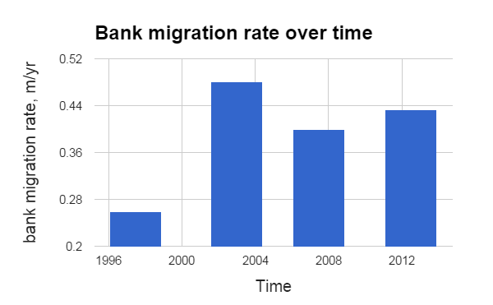
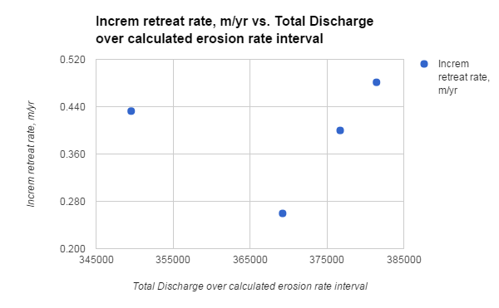
Links to stuff
Agisoft PhotoScan: http://www.agisoft.com/
RTK set up for UAVs: http://store.swiftnav.com/s.nl/it.A/id.4216/.f
Iris 3DR UAV: https://3drobotics.com/kb/iris/
Software (open source): http://copter.ardupilot.com/

