Slide 1

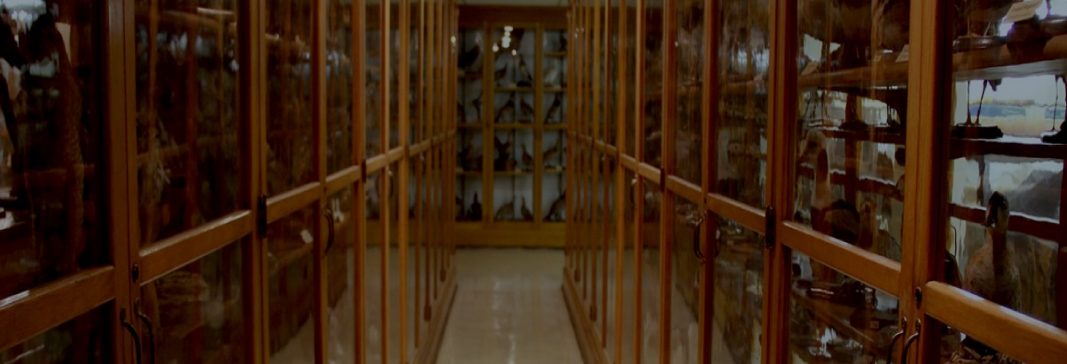
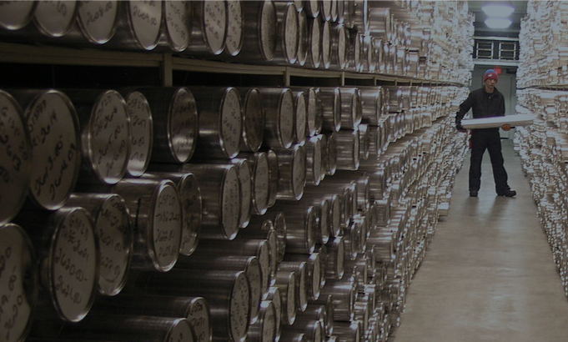




A Global Registry for Scientific Collections:
Striking a Balance between Disciplinary Detail & Interdisciplinary Discoverability
Eileen S. Graham¹ & David E. Schindel²
GOALS OF GRSciColl, USFSC & GRBio
Improve access to information about collections and specimen types, the institutions that house them, and the staff members who care for them.
Facilitate electronic linkages to this information through web services which rely on unique identifiers.
WHAT ARE THE GLOBAL REGISTRIES?
GRSciColl: The Global Registry of Scientific Collections (GRSciColl) is an online information resource developed to gather and disseminate basic information about scientific collections.
USFSC: A subset of GRSciColl, the registry for U.S. Federal Scientific Collections (USFSC), provides unparalleled access to collections developed and supported by U.S. federal departments.
GRBio: A precursor to GRSciColl, the Global Registry of Biodiverstiy Repositories (GRBio), houses information on biological collections.
COMMUNITY CURATED RESOURCE
All three registries are community curated and are therefore dependent on curators, collection managers, and researchers to update records. Entering and updating records requires only a small investment of time by key staff members and provides the community with high quality and up-to-date information.
Scientific Collections International (SciColl) moderates the data in the registries through a moderation queue and approval process. New additions and changes are usually approved within several working days.
CONTROLLED VOCABULARY
GRSciColl uses controlled vocabulary to balance the need to properly define collection contents yet remain searchable and discoverable across disciplines.
Institutions – an entity tasked with supporting collections – are categorized by governance, to identify the type of major funding source, and discipline, which allows for as many classifiers as is necessary.
Collections – an assemblage of specimens grouped by a common factor – are categorized by content type, the types of specimens found within, and preservation methods, the main preservation and/or storage methods.
HOW DOES IT WORK?
The overlapping domains of the three registries ensure that collections and institutions are discoverable in multiple ways.
INTERDISCINPLINARY DISCOVERABILITY
GRSciColl enables the discovery of collections across disciplines by employing controlled vocabularies. When a common vocabulary is applied across disciplines, the discovery of collections for new and unique research will benefit from a search that returns all collections of similar contents – irrespective of the original collection purpose (e.g., soil samples collected for geological versus agricultural research).
GRSciColl
USFSC
NASA – Johnson Space Center
Antarctic Meteorite Collection
Apollo Moon Rock and Soil Collection
Space Exposed Hardware Collection
Example Vocabulary
?
Institutional Governance
Public (Federal/State/Local)
Private (Non-profit/For-profit)
Undefined
Institutional Discipline
Archaeology
Ocean & Marine Sciences
Geological & Earth Sciences
Space Sciences
GRSciColl
Microbes in biorepositories
Fossils and microfossils
Human medical samples
Living material in genebanks, culture collections
Rocks, sediment and ice cores
GRSciColl
USFSC
Museum of Geology – South Dakota School of Mines and Technology
Invertebrate Paleontology
Vertebrate Paleontology
Paleobotany
Herbarium
Rocks, Minerals, Ores
US Environmental Protection Agency
Integrated Atmospheric Deposition Network
Freshwater Genetic Biodiversity Collection
Great Lakes Plankton & Benthos Monitoring Program
Human artefacts
Plants and animals in zoos, botanical gardens, aquariums
Plants and animals in museums, herbaria
Extraterrestrial samples
Example Vocabulary
Collection Content Type
Archaeological
Paleontological
Plant Fossils
Invertebrate Fossils
Trace Fossils
Earth and Planetary
Ice
Soils
Metals or Ore
GRBio
GRBio
registry: grscicoll.org
web: scicoll.org
twitter: @sci_coll
Author Affiliations
¹Scientific Collections International, grahame@si.edu
²Smithsonian Institution National Museum of Natural History
Paper Number: 290-3

