Slide 1



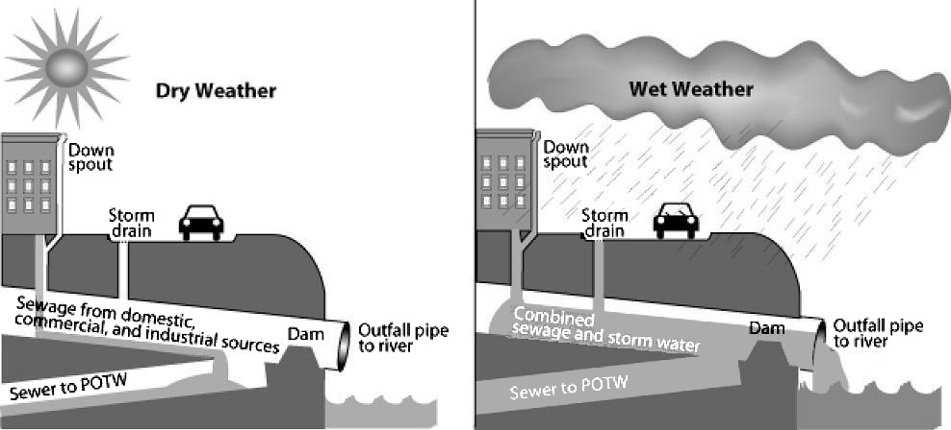
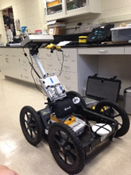
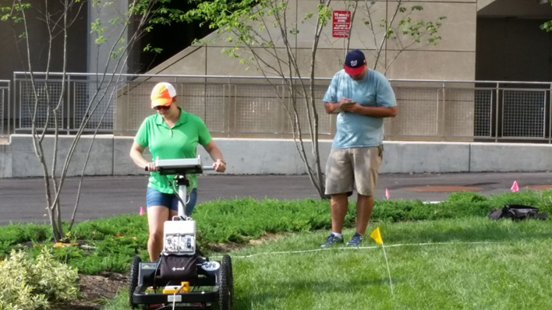
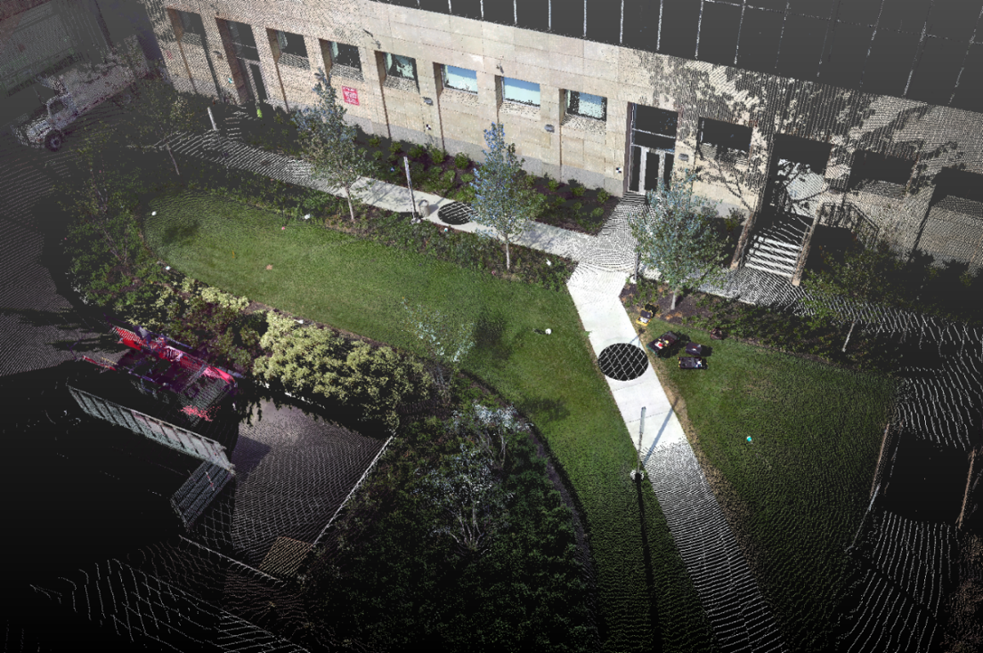
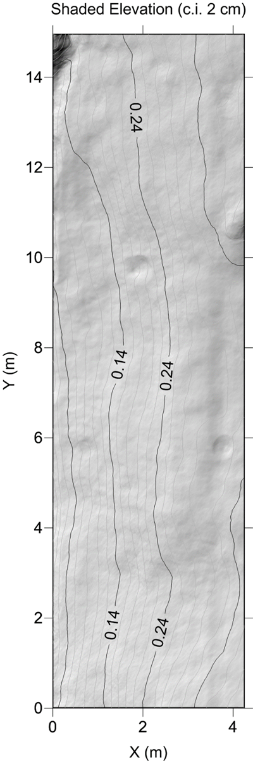
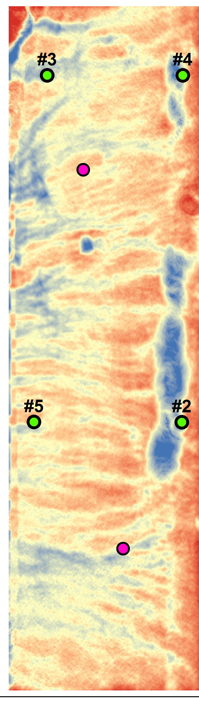
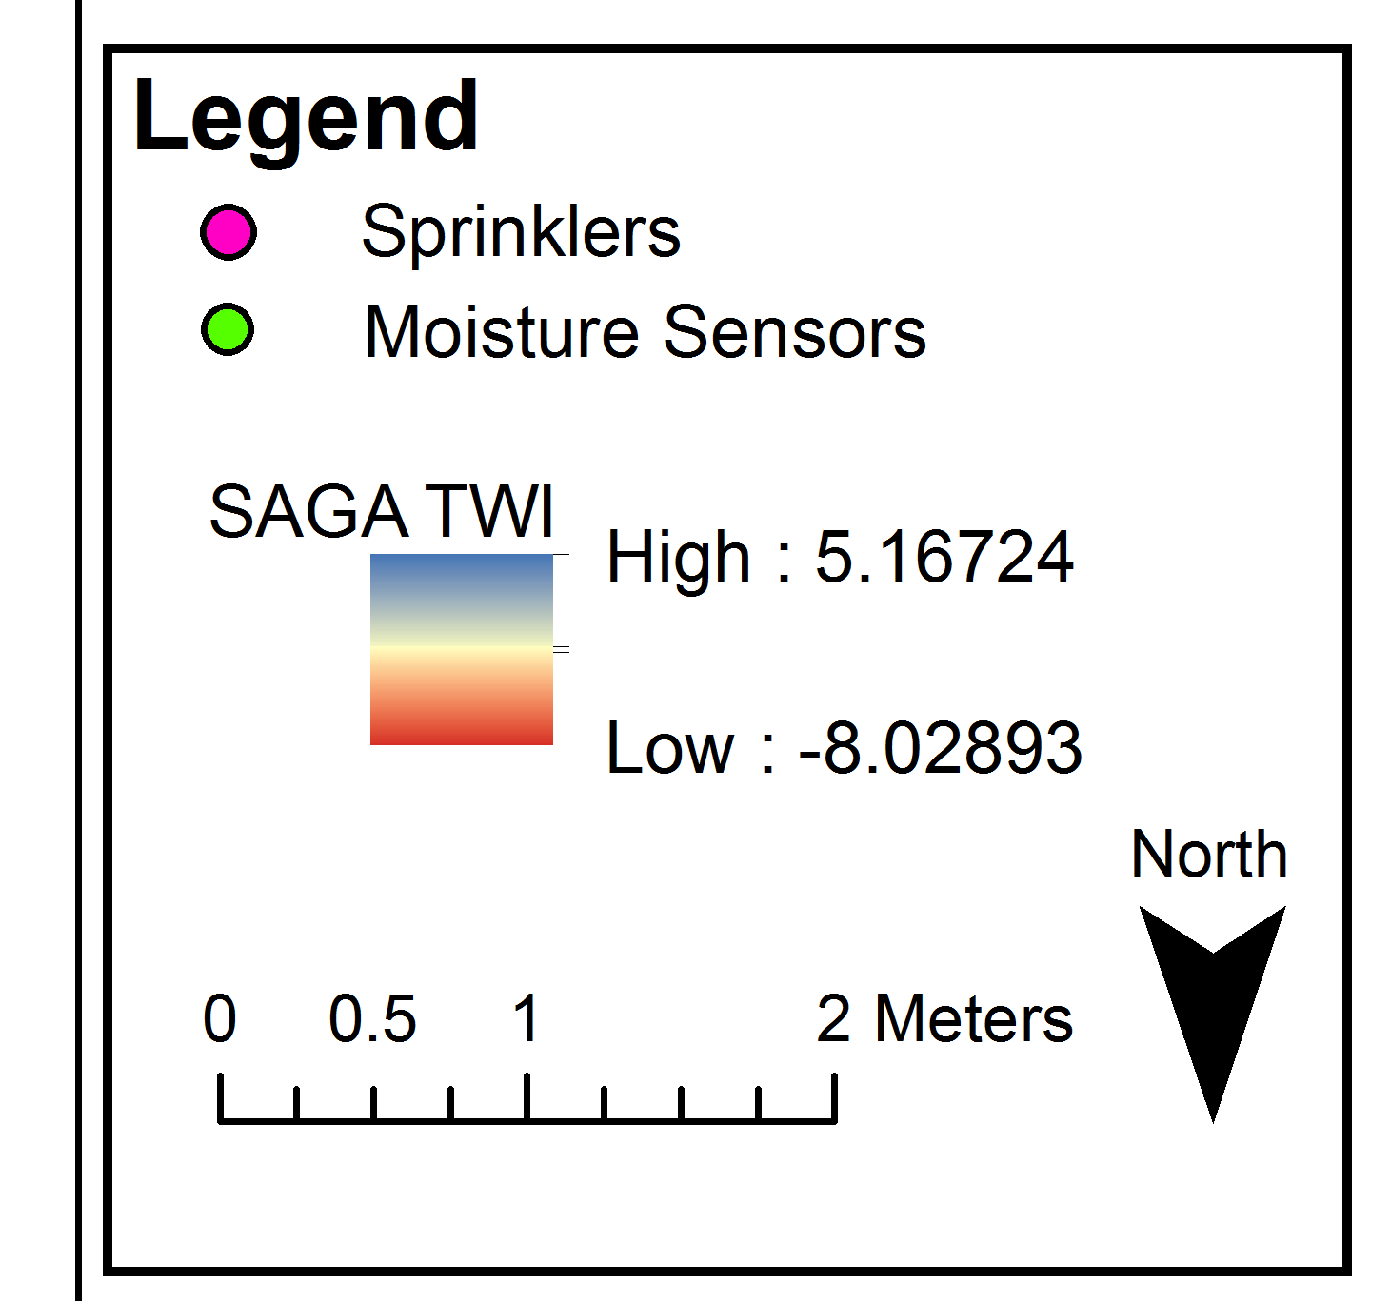
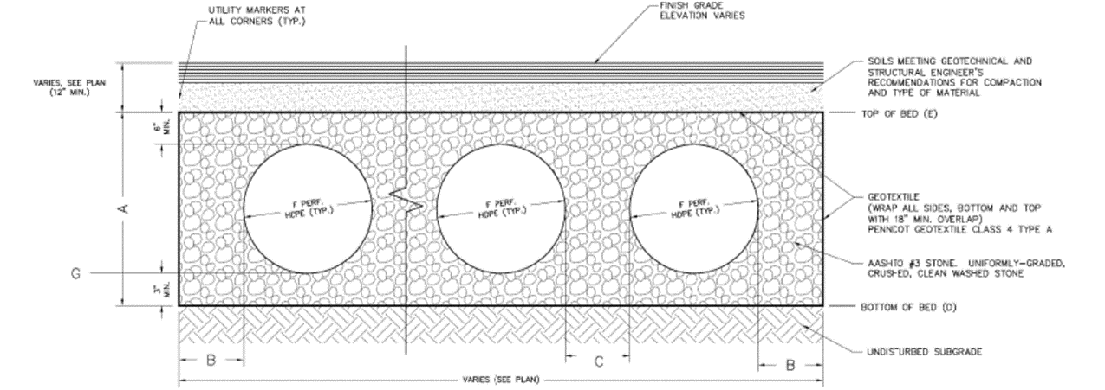
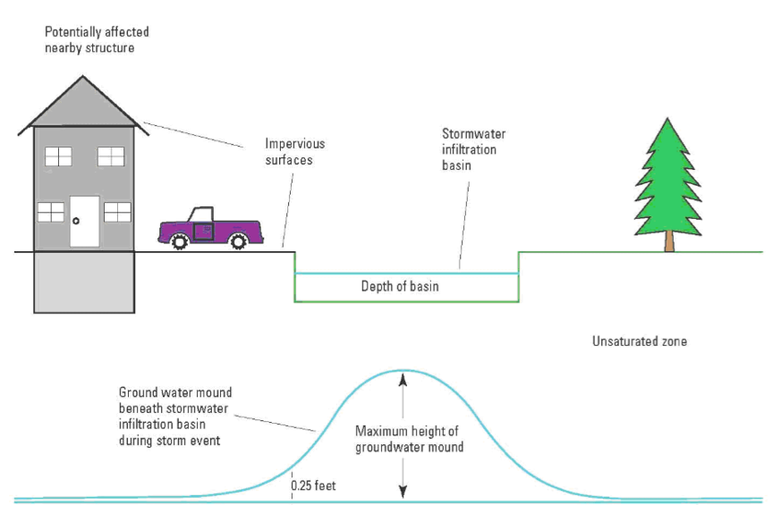
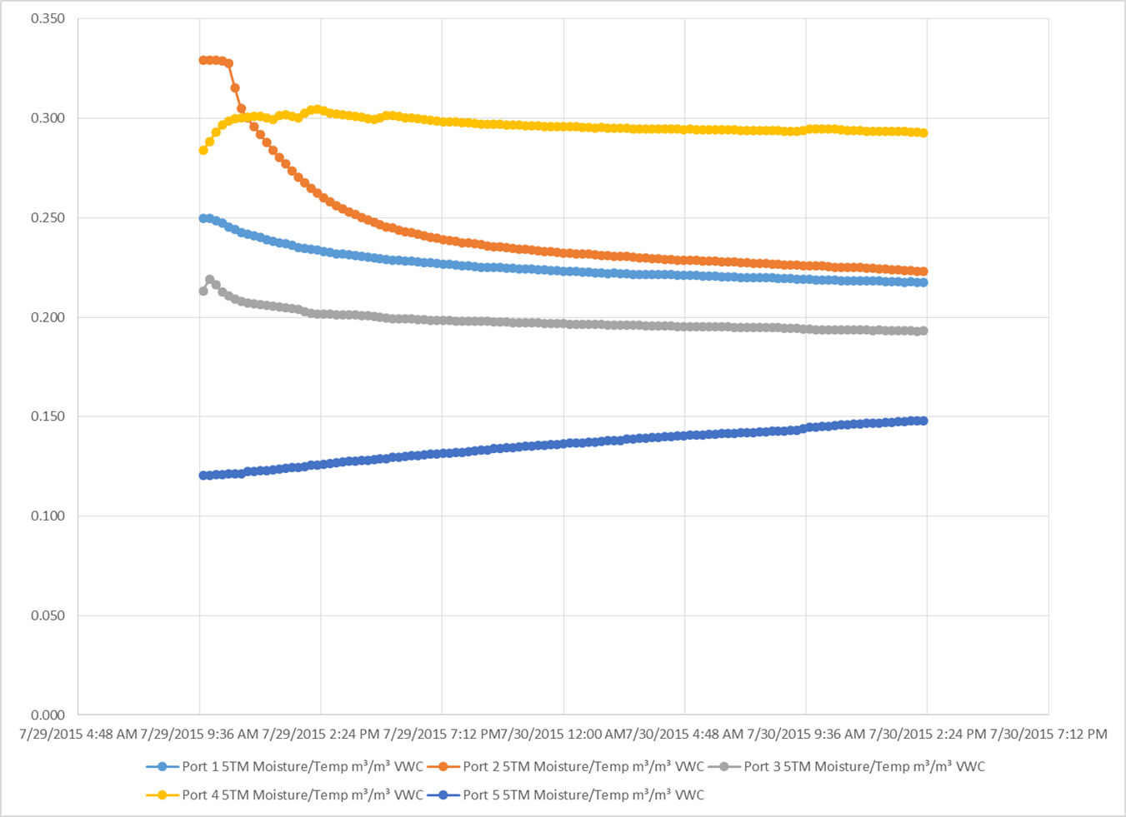
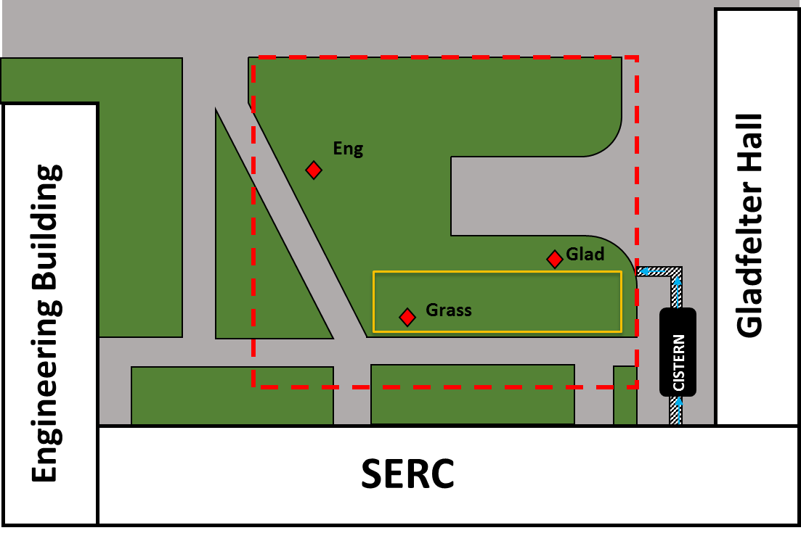
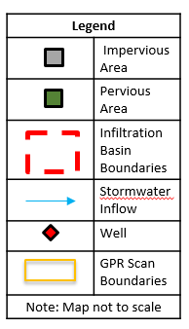
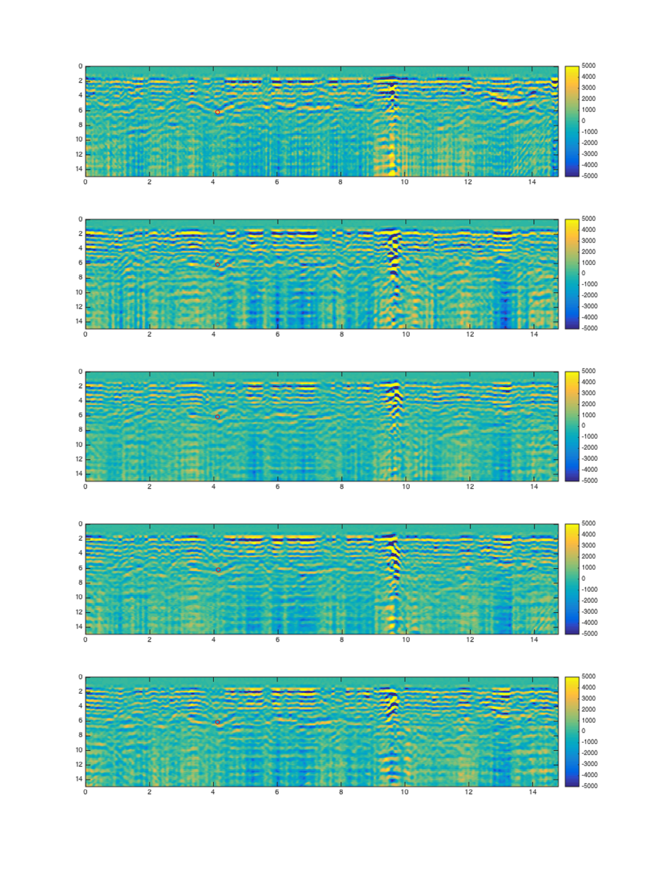
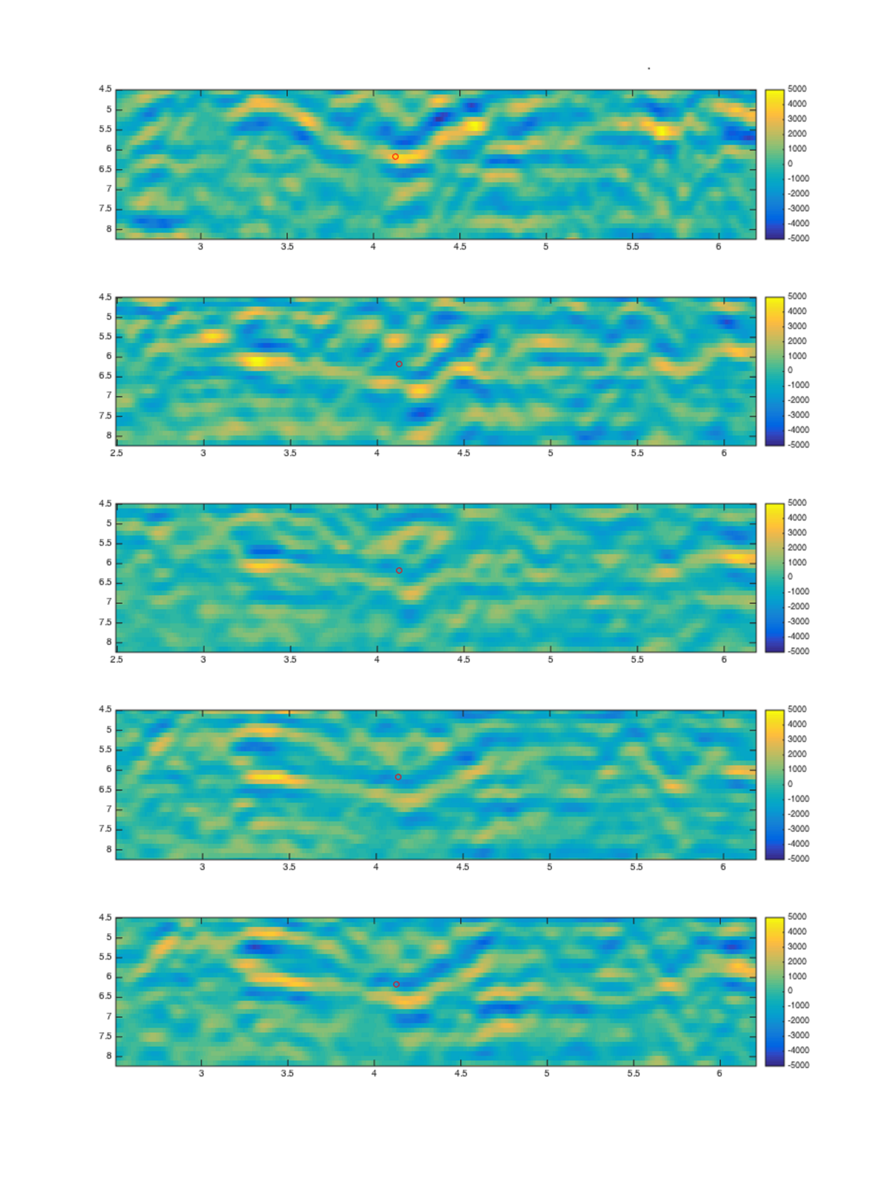
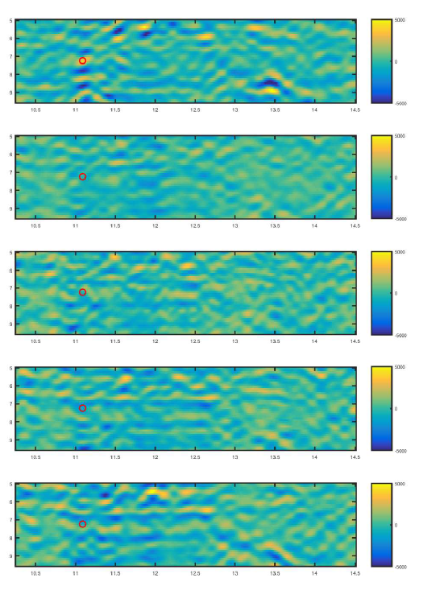
Use and limitations of ground penetrating radar to map infiltration in an urban stormwater basin
Kelly Devlin*, Paul Zarella, Ashley Newman, Jonathan Nyquist, and Laura Toran
Department of Earth and Environmental Science, Temple University, Philadelphia, PA 19122, kellydevlin@temple.edu*
Introduction
Experiment
Conclusion
Figure 1: In Philadelphia, Green Infrastructure (GI) is being used to increase infiltration and reduce CSO discharge. However, the effectiveness needs to be evaluated and side effects such as groundwater mounding can occur (Fig 3).
The GPR scans did not contain structures that resembled the water table, failing to provide more groundwater data. This was due to high clay content in the top layer of urban soil and the resulting attenuation.
Infiltration and changes in soil moisture were seen with the GPR, further showing this technique is useful in mapping soil moisture.
The soil moisture sensors showed uneven recovery rates. The slowest response was seen where LiDAR data showed low TWI.
Groundwater response to storms was low before cistern tie in to the roof and rose close to the basin after cistern tie in. Variation in direct infiltration did not explain difference in groundwater levels. Mounding close to the basin bottom occurred.
Infiltration basin installed outside new science building on campus (Fig 4)
Lined, with 15 drainage pipes, surrounded by gravel and topped with fill (Fig 2)
Basin is also attached to roof drainage (Fig 4)
Geophysical surveys, wells, and soil moisture probes were used to monitor effectiveness
Does the water table rise to the bottom of the trench?
Does the water infiltrate evenly? Can geophysics and terrain wetness index help predict infiltration?
Does the water infiltrate directly or mostly from the roof?
Figure 7c: LiDAR scan from Trimble TX-5 to provide detailed basin topography. Used to create TWI map (Fig 9)
Figure 7a (left) showing Mala Pro-Ex System with 800 Mhz antenna and Figure 7b (above) showing data collection using GPR system.
Figures 8a and 8b: A digital elevation map (DEM) and derived Total Wetness Index (TWI) map. GPR scans shown in Figures 10 and 12 are marked with red lines. The grid has low topographic relief with a slight downhill slope in the x direction. TWI offers some insight to the infiltration patterns seen with the GPR and soil moisture response (Fig 9b).
Figure 3: Schematic illustration of groundwater mounding beneath an infiltration basin.
A 15 m by 5 m grid was laid out over the basin for 3D GPR surveys (Fig 4)
Ground-penetrating radar (GPR) has been shown to be effective in measuring soil moisture content (Lunt et al., 2005; Jadoon et al., 2012)
Two sprinklers watered the grid for two hours (Fig 8b).
GPR surveys were collected before the induced rain event, immediately after, and three during the recovery period.
Five Decagon capacitance sensors collected soil moisture data (Fig 9)
Terrain-based LiDAR system performed a 3D scan of the basin (Fig 7c) to collect topographic data (Fig 8a) and calculate the terrain wetness index (TWI) (Fig 8b)
Figure 2: Schematic showing drainage pipes in basin surrounded by gravel topped with file
Figure 9: The volumetric water content (VWC) of the five sensors plotted over the recovery period. Uneven infiltration rates could be seen, with Sensor 5 suggesting it was not yet in a recovery period by the end of the surveys. This sensor is located where TWI is lowest (Fig 8b).
Wells and Monitoring
Figure 4: Sketch map of the study area, showing the extent of the vegetated infiltration basin and well locations. This basin is designed to cover a 9000 sq. ft. area and has a 5:1 impervious area to infiltration area ratio.
GPR Results
References
References
Lunt, I S. Hubbard, Y. Rubin, Soil moisture content estimation using ground-penetrating radar reflection data, Journal of Hydrology 307, 254-269 (2005).
Jadoon K Z et. al., Estimation of soil hydraulic parameters in the field by integrated hydrogeophysical inversion of time-lapse ground-penetrating radar data, Vadose Zone Journal 11 (2012).
Project Tracking Number: 2011-TEMP-1739-01, PWD stromwater descriptions (2011).
McClymont and Rak Geotechnical Engineers LLC, Project No.4266, Geotechnical Investigation Report (2011).
Machusick, Matthew, Andrea Welker, and Robert Traver. "Groundwater mounding at a storm-water infiltration BMP." Journal of Irrigation and Drainage Engineering 137.3 (2011): 154-160.
Maimone, Mark, et al. "Potential impacts of extensive stormwater infiltration in Philadelphia." Environ. Eng. Appl. Res. Pract 14 (2011): 1-12.
Signal is lost around 8 ns, or about 40 cm
Three wells 8 m deep monitor the water table beneath the basin.
Infiltration was low before cistern tie in (Fig 5a) and is uneven across the basin (Fig 5b)
Water table rises to within 0.6 m of the basin (recommended distance) (Fig 5b)
Two-way Traveltime (ns)
Pre-Construction
10.0 m
Direct Infiltration
Replaced Fill
Figure 6a: Cross-Section view of the infiltration basin. Prior to cistern tie in only direct infiltration at the surface is contributing to stormwater inflow, which has a small magnitude.
Two-way Traveltime (ns)
Two-way Traveltime (ns)
7.95
Gravel & Storage Pipes
6.95
6.34
Undisturbed Fill
4.28
Average Engineering Water Depth Before Cistern Tie in
Figure 5b: Hydrograph prior to basin completion and cistern tie in.
Datum
Post-Construction
10.0 m
Direct Infiltration
Replaced Fill
Figure 6b: Cross-Section view of the infiltration basin after cistern tie in shows An increase in stormflow response. Groundwater mounding above the suggested threshold (dashed line) points to increase water from the cistern.
Acknowledgements
Infiltration from Cistern
7.95
Gravel & Storage Pipes
6.95
Funding was provided by the EPA STAR Grant, the Science Scholars Program, and the Undergraduate Research Program. Additional thanks to the Temple University Facilities Management for help completing this project.
6.34
Distance (m)
Distance (m)
Distance (m)
4.28
Maximum Engineering Water Depth After Cistern Tie in
Figure 10: GPR radargrams at the 4.25 m mark of the grid, closest to SERC. Radargrams are in order from top to bottom: baseline (dry), immediately after sprinklers were turned off (wet), and three sequential recovery periods. The urban soil causes a high attenuation rate in all surveys, leading to little penetration below 8 ns. Structure of interest shown within red rectangles with a red dot.
Figure 11: Radargrams from Figure 10 are zoomed in within red rectangles to show structures. A structure can be seen between 3.5 m and 4.5 m, denoted by red dot. As the soil becomes wet and dries, the structure loses and regains definition. The banding can also be seen with a delay of approximately 0.75 ns with the wetter surveys. The delay is caused by increased water content which reduces the radar wave velocity.
Figure 12: Radargrams from an alternative scan within the grid created, located at the 1.5 m mark. The scans have been formatted on a scale comparable to Figure 11. Unlike the previous scans, a distinct structure cannot be seen. A tangible difference between subsequent scans after wetting is difficult to observe. This can be attributed to different subsurface structures as well as uneven infiltration.
Figure 5b: Hydrograph after basin completion and cistern tie in shows greater response.
Datum

