Slide 1

At the Forefront of Energy Innovation,
^{Discovery & Collaboration}

Slide 2
Reservoir Fluid Characterization: Key to effective CCUS reservoir characterization
Scott Quillinan¹, J. Fred McLaughlin¹ and Travis McLing²
1 Carbon Management Institute-School of Energy Resources, University of Wyoming
2 Center for Advanced Energy Studies, Idaho National Laboratories
Funded under U.S. DOE NETL DE-FE0002142 and DE-FE0009202

Slide 3
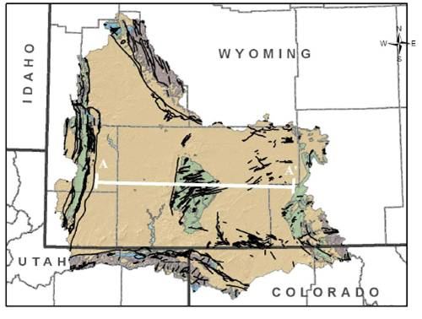
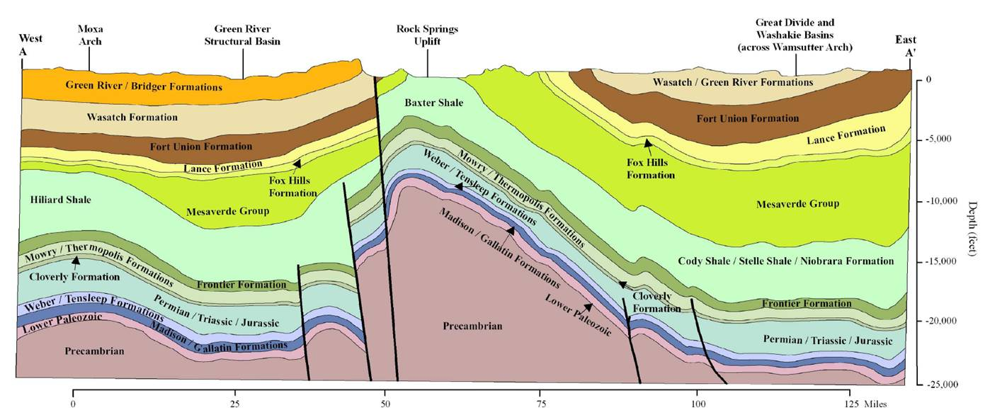
Wyoming Carbon Underground Storage Site
(WY-CUSP), Rock Springs Uplift, Southwest Wyoming
Funded by:
DE-FE-0002142 for Site Characterization,
DE-FE-0009202 for Seal Characterization,
DE-FE-0021659 for Validating pressure management techniques and moving to demonstration
Study Area

Slide 4
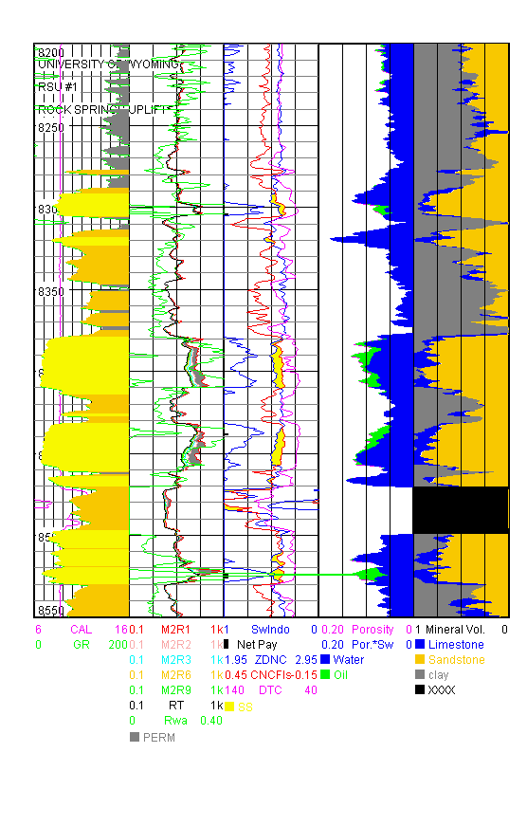
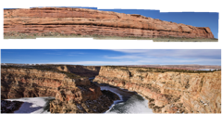
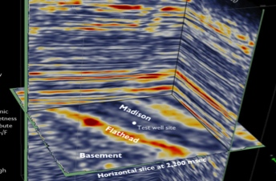
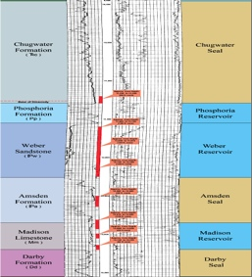
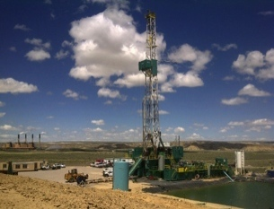
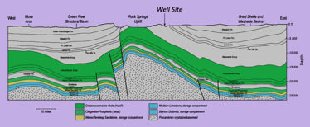
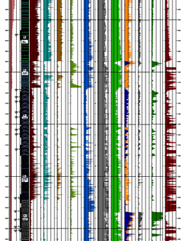
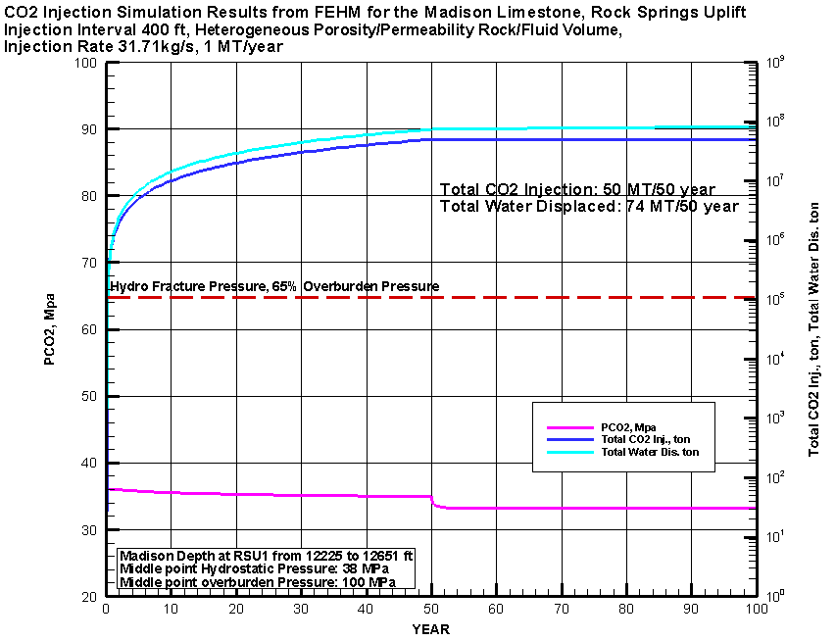
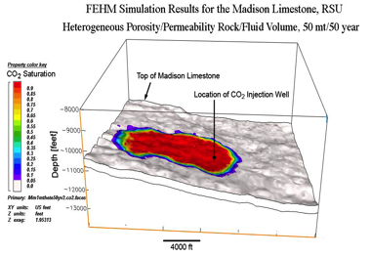
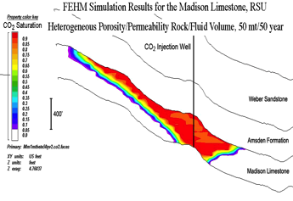
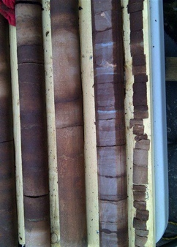
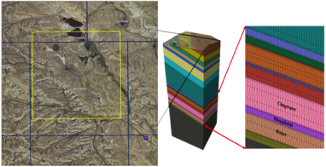
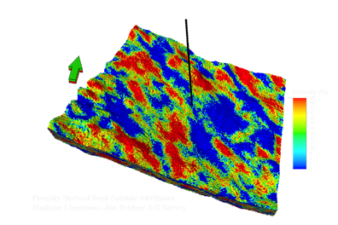
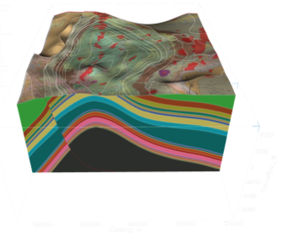
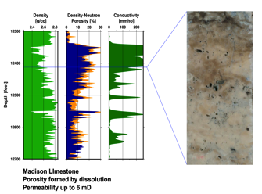
WY-CUSP (Wyoming Carbon Underground Storage Project )
Regional Log Analysis
3-D Seismic Survey
Coring Plan
Strat Test Well
Field Work
Numerical Simulation/Performance Assessment
Log Suite
920 feet Core
Property Modeling
Structural Modeling
Petrographic Study
Porosity
Fluid sampling
Mesh Generation

Slide 5
Fluid Characterization
Regulatory obligations
Evaluate brine evolution
Geochemical changes during well completion
Predict in-situ geochemical reactions with respect to CO₂
Reservoir confinement by utilizing stacked reservoirs

Slide 6
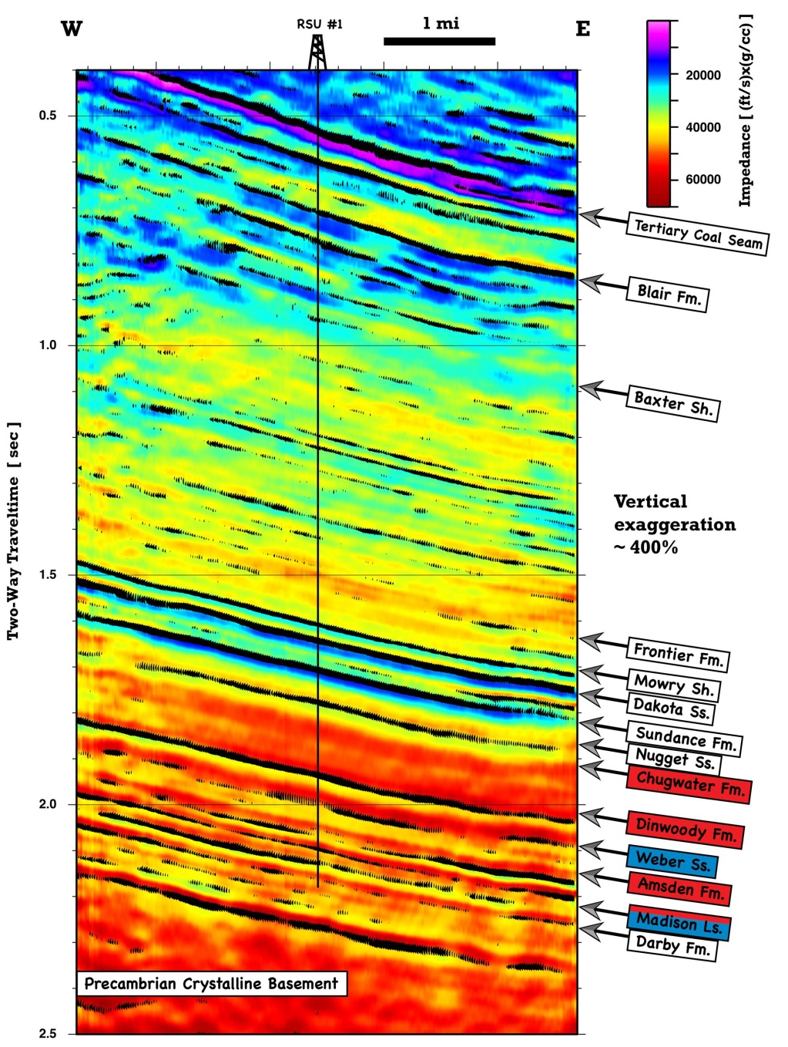
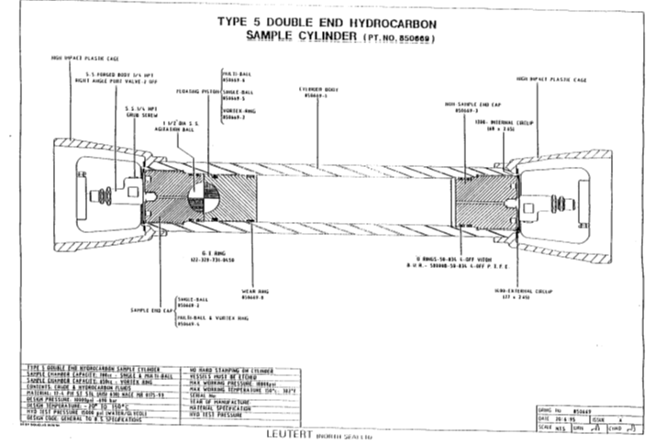
Methodologies
Samples were collected at the surface (2011) and in-situ at temperature and pressure using a pressurized sample cylinder (2012)
Samples were measured for minor and major elements, radionuclides, organic acids, VOC’s, organic characteristics, dissolved gasses, isotopic compositions
Type 5 Double End Hydrocarbon Sample Cylinder pt. no. 850669

Slide 7
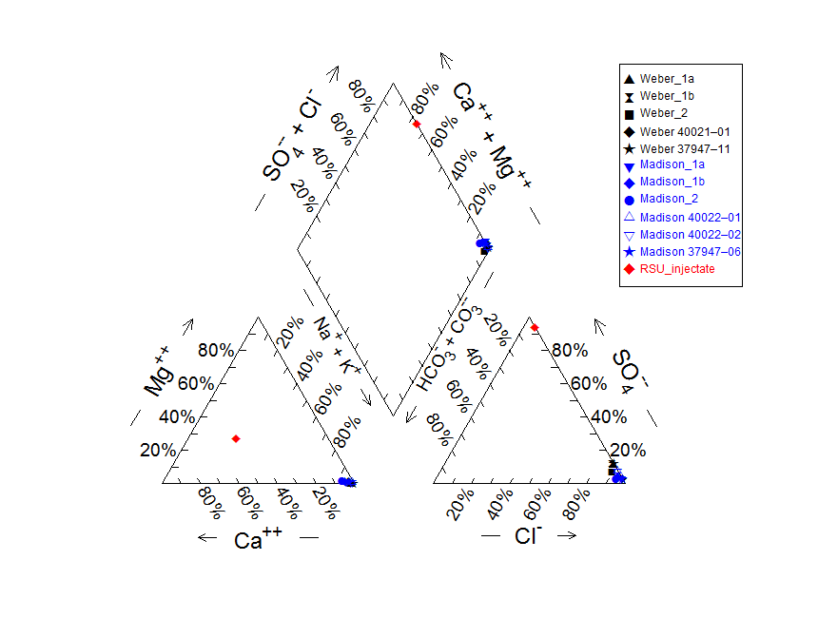
Madison and Weber brine compositions
Brines are sodium-chloride-type
TDS:
89,000–109,000 mg/L (Weber Sandstone)
75,000 –95,000 mg/L (Madison Limestone)
250 mg/L (Injectate)
Temperatures:
92°C
95°C
Pressure:
4,800 psi (Weber)
5,900 psi (Madison)
The brines exceed USEPA MCL’s for TDS, chloride, fluoride, sulfate, aluminum, barium, iron, lead, manganese, and gross beta.
Due to the high TDS the Wyoming Department of Environmental Quality has classified these as Class VI groundwater

Slide 8
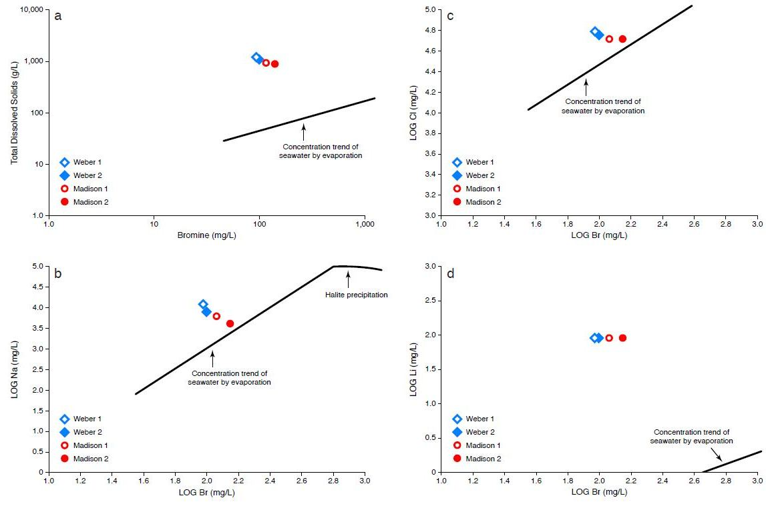
Determining the origin and the effects of water rock interactions.
Log Cl mg/L
TDS mg/L
Log Na mg/L
Log Li mg/L
Methods from Rittenhouse, 1967

Slide 9
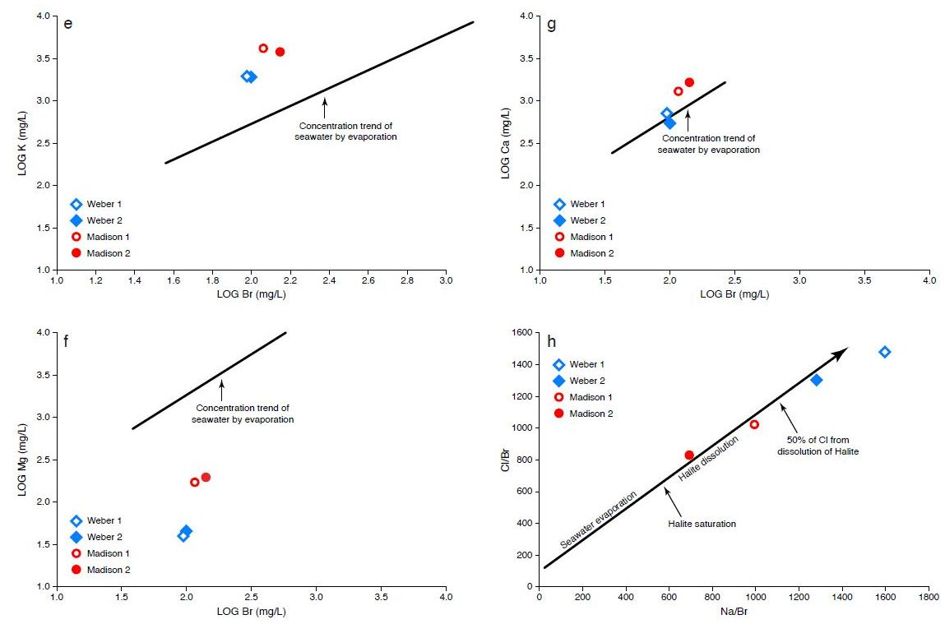
Brine evolution cont…
Log K vs. Log Br
Log Ca vs. Log Br
Log Mg vs. Log Br
Cl/Br vs. Na/Cl
Methods from Rittenhouse, 1967 and Engle &Rowan 2013

Slide 10
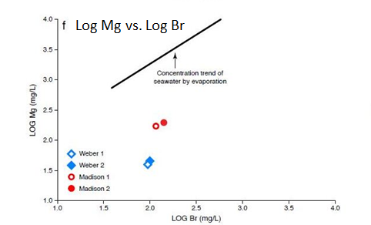
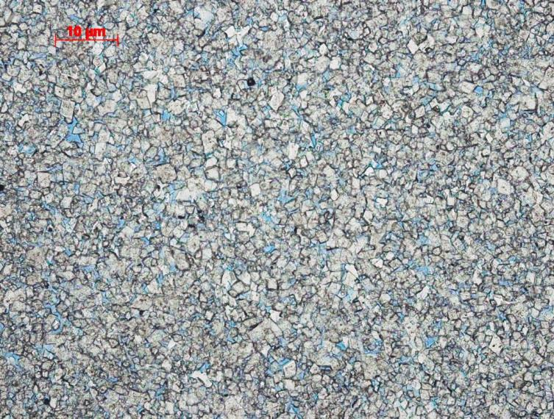
C and O isotopic composition of the Madison
δ¹⁸O and δ¹³C of Madison Dolomite indicate low temperature deposition
Brines indicate Mg depletion with respect to seawater
Thus indicating the that brine and rock have been in equilibrium for a long time
Dolostone facies, Madison Limestone

Slide 11
Geochemical changes from well-bore testing
H₂S concentrations increased between sample trips
Surface water was used as drilling fluid to drill the test well and for injectivity testing.
It is likely sulfate reducing bacteria were introduced to the reservoir causing the formation of H₂S and souring the reservoir.

Slide 12
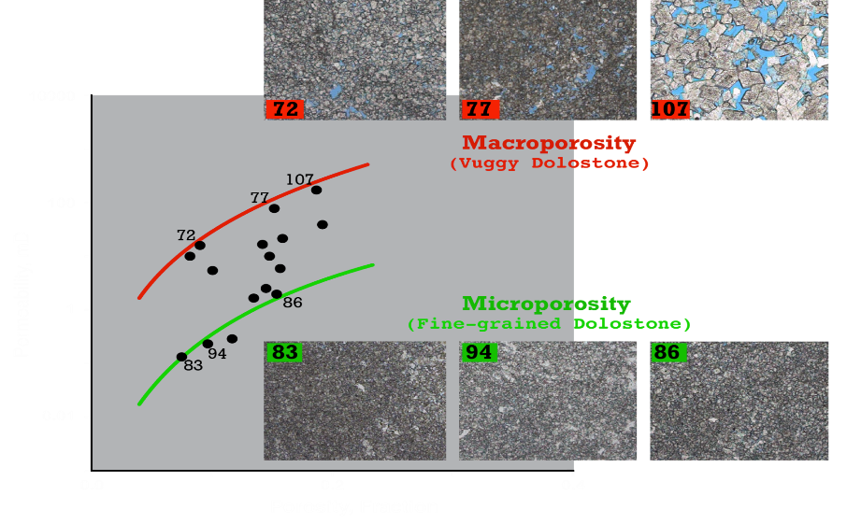
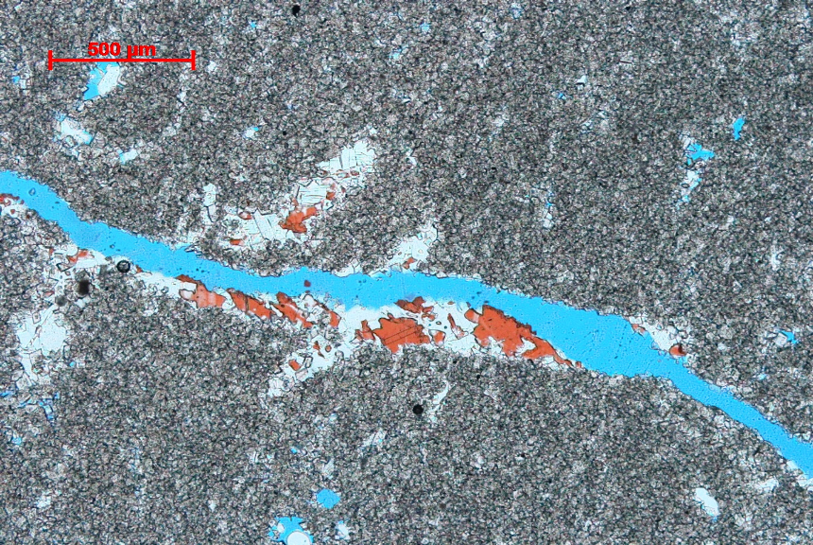
CO₂ injection models Madison Limestone
Fracture porosity in Madison Limestone

Slide 13
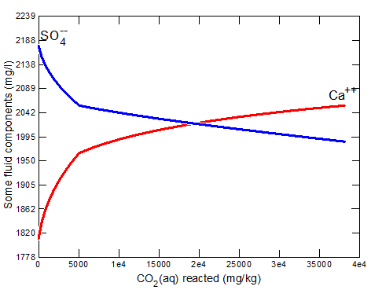
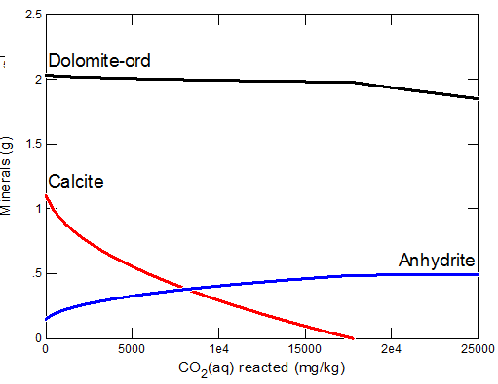
Dissolution of calcite increases the Ca²⁺ concentration of the fluid
Excess calcium drives anhydrite precipitation
Through dissolution/precipitation of these reactive minerals we estimate a net porosity increase of 0.5-3%

Slide 14
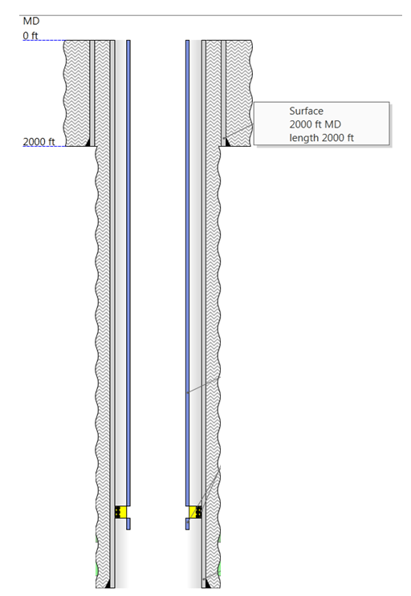
Evaluating stacked reservoir confinement
Chugwater Fm.
Dinwoody
Fm.
Chugwater Fm.
Dinwoody
Fm.
Weber Ss.
Weber Ss.
Amsden Fm.
Amsden Fm.
Madison Ls.
Madison Ls.

Slide 15
Stacked Reservoir Confinement
The Weber Sandstone has ⁸⁷Sr/⁸⁶Sr values ranging from 0.7505 to .7424 and is more radiogenic than the Madison Limestone. The ⁸⁷Sr/⁸⁶Sr of the Madison range from 0.7236 to 0.7267.
The δ¹³C_{CH4} of the Weber Sandstone measured in two samples are -22.0‰ and -21.0‰. The δ¹³C_{CH4} of the Madison Limestone are -46.0‰ and -41.0‰.
δ¹³C _{CH4} in the Weber are enriched with respect to the both the Madison and reported values for thermogenic methane indicating a distinct fluid history.
The two formations are isotopically unique and distinguishable from each other.

Slide 16
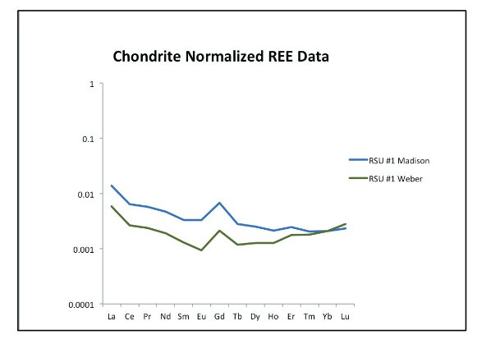
Rare earth elements as tracers
Both brines show LREE enrichment and like seawater both brines have a slightly negative Ce anomaly.
Both samples have positive Gd anomalies.
HREE depletion in the Madison Brine and enrichment in the Weber.
Higher REE concentration of REE in the Madison Formation.
This indicates that the formations are hydraulically isolated from each other
From McLing et al., 2014

Slide 17
Conclusions
The evolution of the brines in both formations have been heavily influenced by evaporite dissolution creating some of the most saline formation fluids collected in Wyoming. Magnesium depletion in the brines records dolomitization and indicates that the brine and rocks have long history.
Reservoirs and associated fluids are highly sensitive to redox reactions or non-native fluids, fluids injected during CCS (water or CO2) must be closely monitored to avoid degrading the reservoir and formation fluids.
Geochemical models indicate carbonate mineral dissolution and some anhydrite precipitation. The net porosity gain from precipitation and dissolution process is expected to be 0.5-3%, indicating that CO₂ injection will have a positive effect of reservoir porosity.
The isotopic compositions of fluids, dissolved gases and rare earth elements were found to be unique to each formation. Indicating that the target formation fluids are isolated from each other.

