Slide 1
National Technical Reports Library (NTRL)
Not Just Another Database
Angela R. Davis
Engineering Liaison Librarian
Penn State University Libraries
ard21@psu.edu
Notes:
I’m going to discuss the National Technical Reports Library database and provide information on why it is useful for locating geoscience information, how it compares to other resources, and why it is not just another database
The emergence of a new database is uncommon these days, so it is worth exploring when they do appear

Slide 2
What is National Technical Reports Library (NTRL)? http://ntrl.ntis.gov
National Technical Reports Library (NTRL) Not Just Another Database
Public access database of National Technical Information Service (NTIS) documents.
Created to solve inconsistencies in the availability of many NTIS documents.
Currently contains 26% of NTIS collection.
Notes:
NTRL is an enhanced version of searching NTIS documents on the ntis.gov website
It provides search features similar to traditional library databases
NTRL was created to refocus NTIS on their mission to be the central clearinghouse for technical government information and to meet the new federal open access policy
In addition, NTIS recognized the inconsistencies in access to many of their documents
These documents could be available for free at the sponsoring agencies website, like the USGS, or through a web search engine
But these same documents could also be available for a fee through the NTIS store or a commercial vendor
NTRL currently contains 800,000 PDF full-text, which is about 26% of the 3 million documents NTIS collects
More documents are being added electronically as they are digitized, with the goal to have all documents available electronically to meet government open access policies

Slide 3
What is National Technical Information Service (NTIS)? www.ntis.gov
National Technical Reports Library (NTRL) Not Just Another Database
Central resource for U.S. government funded scientific, technical, and engineering related information.
Permanent clearinghouse as detailed in 15 U.S.C. 1151-1157.
Covers US government agencies including: USGS, Bureau of Mines, NOAA, DOE, EPA etc.
Contains citations to 3 million publications.
20% from geosciences or related disciplines
Notes:
Before I go into the features of NTRL, I want to give you some history on NTIS – the national technical information services
It is the central repository for unclassified, publically available US government funded scientific, technical, and engineering information
It was established by US Code and is part of the Department of Commerce
It covers most US government agencies including the us geological survey, bureau of mines, NOAA, the department of energy, etc.
It currently contains over 3 million publications with the majority of them being technical reports from 1890-present, but the bulk of the reports are from 1960-onwards
In 2011, 20% of all materials from NTIS were in geosciences or related disciplines
NTIS information can be accessed a variety of ways

Slide 4







Available via Abstracting & Indexing Services
National Technical Reports Library (NTRL) Not Just Another Database
www.NTIS.gov
Cambridge Scientific Abstracts
Chemical Abstracts
EBSCO Publishing
Engineering Village
Ovid Technologies
ProQuest
STN International
Notes:
From a variety of sources
Naturally the information can be found using the government website ntis.gov
But there are also a number of commercial abstracting and indexing services of NTIS available through third party vendors that provide access for a fee
All of these database platforms present challenges for use

Slide 5
Limitations of NTIS Database Platforms
National Technical Reports Library (NTRL) Not Just Another Database
Covers materials from 1964-present
Requires precision search strings
Punctuation important
Results sorted by date
Many lack full-text
No integration with library discovery services
Notes:
Most commercial abstracting and indexing databases only provide access to NTIS documents from 1964 to present with select records back to 1890
While this does not include the entirety of NTIS information, it does provide sufficient access to the items most likely to be needed by researchers
Additionally, most databases of NTIS documents require precision search strings
This is especially evident when searching by NTIS report number as most databases require exact punctuation to be used
But this can also be seen in title or sponsoring agency searches, some database require the agency name to be abbreviated
This can lead to user frustration because there is no standard way the agency names can be abbreviated
Another limitation is that many databases returned search results based on date and not relevancy
This can lead to some confusion for users as to why a result was returned at the top of the list when most other search engines and databases return results based on relevancy
The biggest problem is that many commercial databases do not provide full-text nor do they facilitate library discovery services to link to the full text
All of these things lead to frustrated users
The National Technical Reports Library was created to overcome most of these limitations

Slide 6
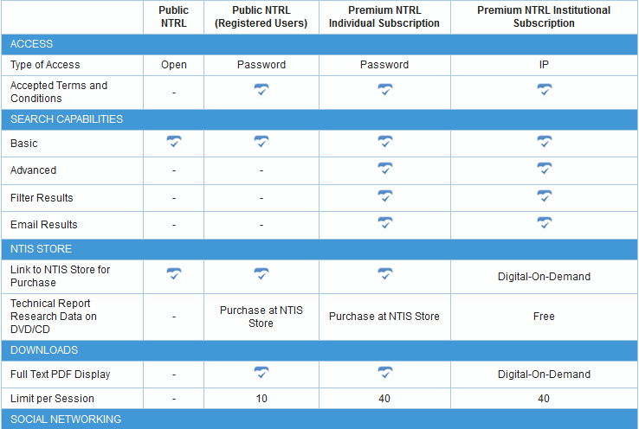
National Technical Reports Library (NTRL) Access Types
National Technical Reports Library (NTRL) Not Just Another Database
Notes:
There are several different ways to access NTIS information through NTRL
Public – free, open on website, basic search, only returns citations– same search you may be use to using through ntis.gov
Registered – free account but requires a password - same search options as public, but provides the full-text of the documents with a 10 downloads per session limit
Premium individual – paid subscription that allows for advanced searches, full-text but has a 40 download per session limit for $200 annually
Premium institutional – paid subscription based on IP addresses.
The subscriptions ranges from $1000 for less than 50 IPs to $15000 for 800,000 IPs.
Premium institutional provides the same search features as individual subscriptions but also includes digital-on-demand, which I will discuss in detail a little later

Slide 7
NTRL Search Features
National Technical Reports Library (NTRL) Not Just Another Database
Quick and Advanced searches
Accession and report number punctuation is extraneous
Example: EPA/600/J-94/280 = EPA600J94280
Automatic stemming and AND-ing of terms
Notes:
Each level of access has different search features
Public and registered users only have access to quick search but this gets the job done for most researchers
Quick search searches the Accession Number, Title, Date, Report Number, Keywords, Abstract, Report Year and Full Text fields
Advanced search, which is only available to paying subscribers, allows for use of facets and the ability to search each field individually
The most attractive thing about searching NTRL is that punctuation of accession and report numbers is extraneous (contract numbers need punctuation)
AdditionallyAutomatic stemming of terms and ANDing makes the search operate similar to Google which should make using and finding NTIS information easier for users

Slide 8
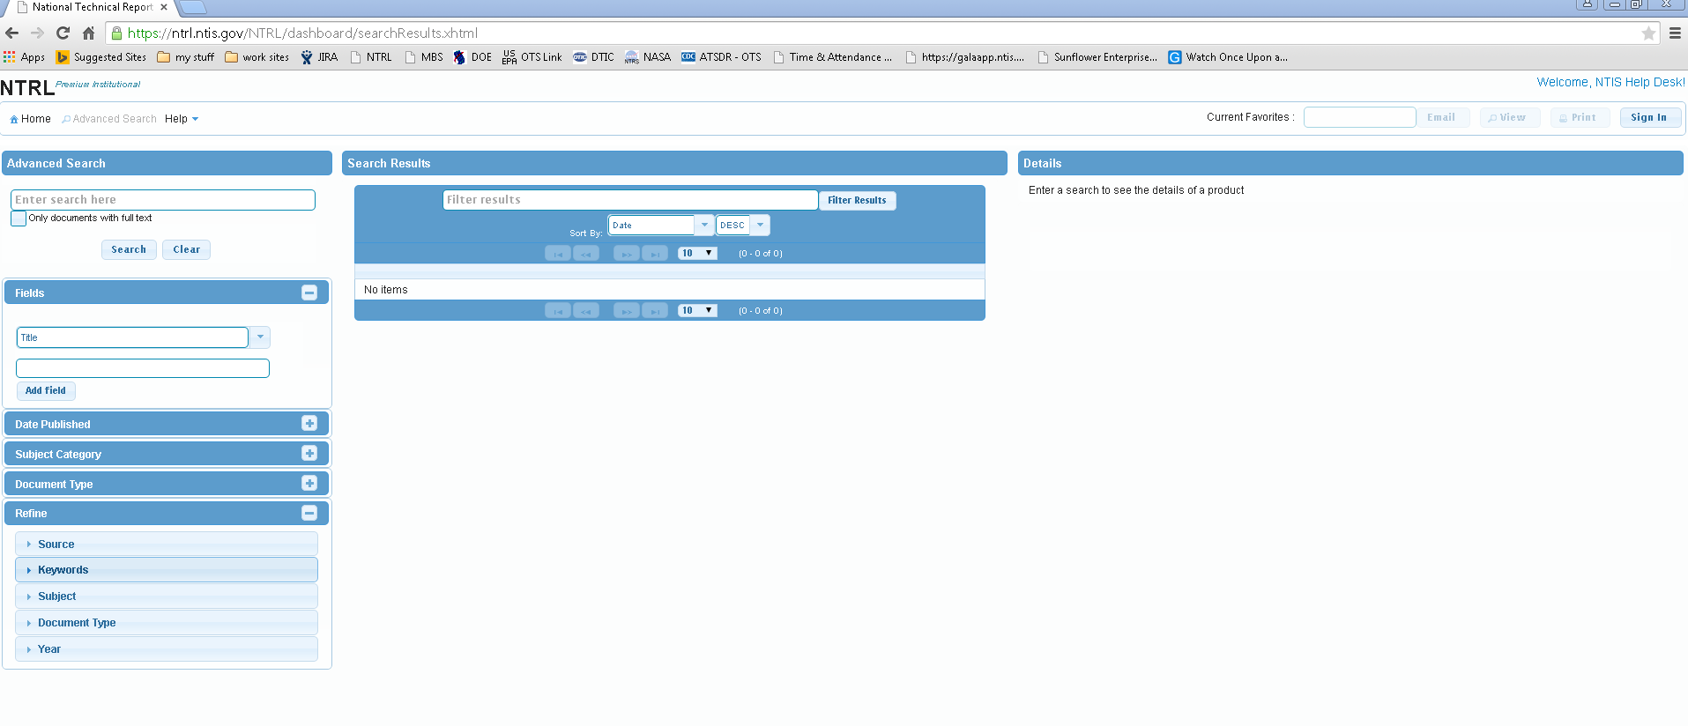
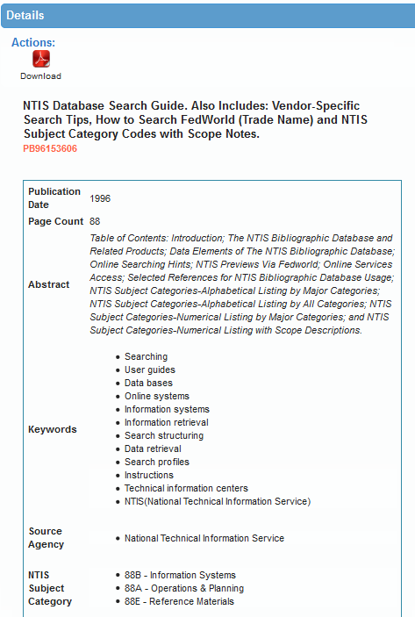
National Technical Reports Library (NTRL) Not Just Another Database
Notes:
This is what the advanced search screen looks like
You can see that it is a 3 panel display and that it will allow you to refine and build a search using the facets on the left-hand side
These facets include things such as NTIS subject category, document type (conference proceeding, tech report, patent, etc.) and source agency
One thing to note the search results are returned by relevancy, unlike most databases of NTIS documents
There is the option to sort by date if desired
The middle panel is where the results list will be displayed
And the right-hand panel is where the selected document’s metadata will be displayed in detail

Slide 9

NTRL Search Features (Cont.)
National Technical Reports Library (NTRL) Not Just Another Database
Download where available
Digital-on-Demand for institutional subscribers
Notes:
The detailed metadata looks like this
This metadata is available to all searchers, free, registered, or subscription
This means that it can be viewed for those using ntis.gov without having an account
There are some features to point out
Downloads are available to items that have been digitized, but only to registered or subscribed users
If the document is not available there will be a note for the individual to purchase a paper copy of the document at the average cost of $50
For institutional subscribers there is an option for a mediated digital-on-demand service
This service allows institutions to request that documents currently not available electronically to be digitized
There is a limit of 5 documents per week
But the newly digitized documents will then made available for all NTRL users
The digitization service can take up to 10 days – but anyone who has ordered these documents as print can attest that this is a faster method than waiting for the print to arrive on site and be cataloged before it can be available to users

Slide 10
How Should You Access?
National Technical Reports Library (NTRL) Not Just Another Database
Public
Registered
Premium
Free
Quick search
Citations Only
Free
Quick search
Full-text
Download limit (10)
Subscription
Quick & Advanced searches
Full-text
Download limit (40)
Citation management software integration
Institutional digital-on-demand
Notes:
So what is the best option for you to access NTIS information using NTRL?
This will depend on your needs
Public is very similar to the ntis.gov website search that has always been available, which means registration is unnecessary
It only offers quick searches and is good if you only need to look up citations to NTIS documents since the full-text is unavailable through this option of NTRL
Registered access can be used in conjunction with commercial A&I services to NTIS to easily locate the electronic full-text
Premium access for both individuals and institutions requires a paid subscription
It also integrates with citation managers like EndNote or RefWorks
Premium institutional subscribers have access to the digital-on-demand service
For institutions that regularly purchase paper NTIS documents for user requests or use interlibrary loan, digital-on-demand is a method to provide electronic access to these materials and could help to build or supplement a technical reports collection

Slide 11
Summary
National Technical Reports Library (NTRL) Not Just Another Database
Advanced search restricted to premium subscribers
Full-text availability for registered & subscribed users
20% from geosciences & related disciplines
Digital-on-Demand for institutional subscribers
Documents direct from central source
Notes:
So in summary
Yes there are some limitations to NTRL, like all databases
Advanced search features are only available to premium subscribers, both individual and institutional
And full-text is only available to registered or premium subscribers
But NTRL includes the full-text of 800,000 documents with 20% of all NTIS information being from the geosciences or related disciplines and includes the USGS, Bureau of Mines, DOE, etc. reports
And the digital-on-demand is a new service that allows institutions and libraries to request a document to be digitized and made available to all users of NTRL
But what I feel is the most important is that NTRL provides access to NTIS documents directly from the organization charged with collecting the information and not through a third part vendor
So NTRL is not just another database
Based on this evidence you can decide what is the best access method for you and your users, be it NTRL, ntis.gov, or a commercial providers

Slide 12
National Technical Reports Library (NTRL) Not Just Another Database
Questions?
http://ntrl.ntis.gov
References: http://tinyurl.com/NTRLgsa15
Angela R. Davis
Engineering Liaison Librarian
Penn State University Libraries
ard21@psu.edu
Notes:
Thank you and are there any questions?
Note from Linda – GeoRef does have some overlap with NTIS (and always will) but NTRL allows for broader searches
Article – Elaine Clement “Investigation of overlap in geological information between GeoRef and NTIS” 1992 GSIS proceedings

