Slide 1






The Climate Literacy and Energy Awareness Network (CLEAN) Project
Tamara Shapiro Ledley, Anne Gold, Frank Niepold, Marian Grogan, Cheryl Manning, Susan Sullivan, Sean Fox & Cathy Manduca
Notes:
Tamara
Backup - Susan

Slide 2
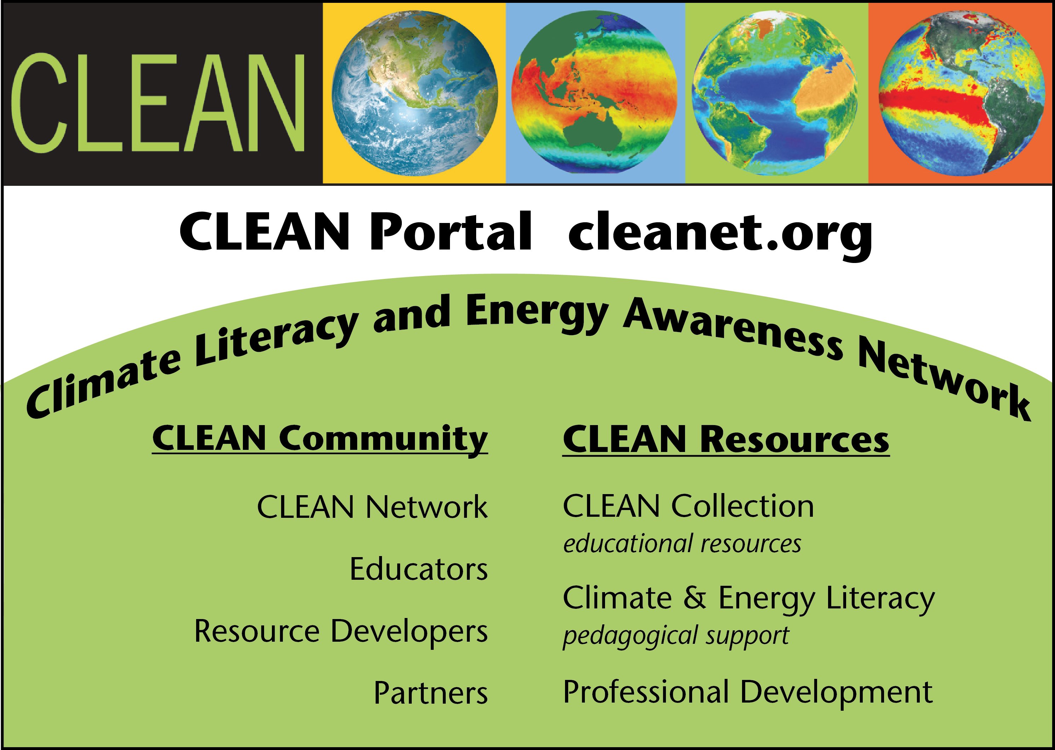

Slide 3

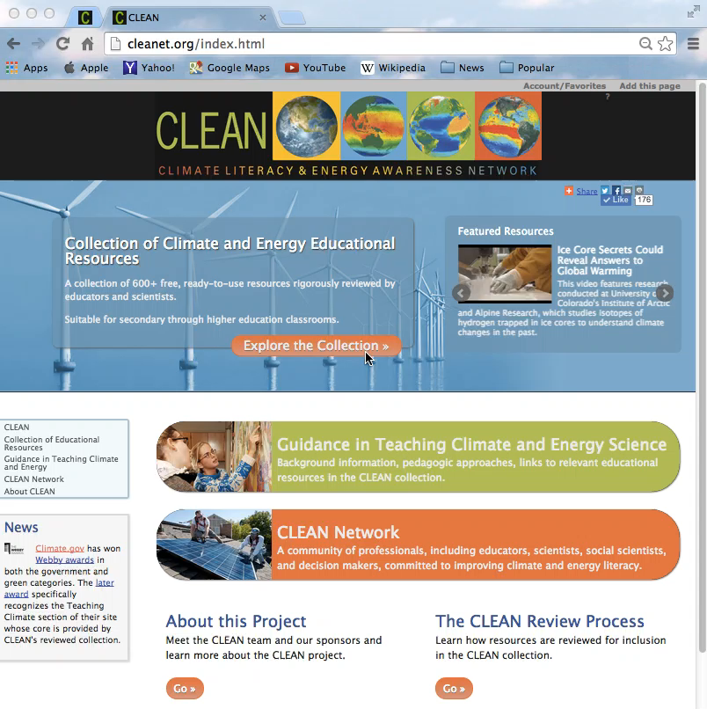
The CLEAN Portal http://cleanet.org
Notes:
Redo the video. Make smoother selections and point out the breath of topics under Climate systems to choose from

Slide 4

The CLEAN Collection

Slide 5


Framework for CLEAN Collection
Collection aligned with
  Essential Principles of Climate Science
  Energy Literacy Principles
Resources reviewed by scientists and practicing educators
  Scientific Accuracy
  Pedagogical Effectiveness
  Technical Quality/Ease of Use
Syndicated to Teaching Climate section of NOAA’s Climate.gov Portal
Notes:
Climate Literacy Essential Principles build the framework for what is in scope of the collection.
In order to include the Energy Awareness part the CLEAN team defined a preliminary set of Energy Awareness Principles

Slide 6
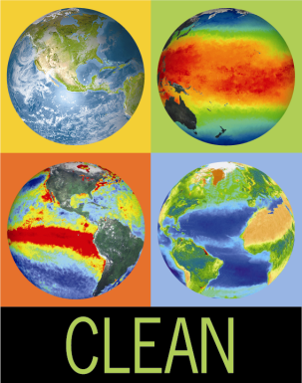
CLEAN Collection
660+ student centered resources
Resource Types
  Activities (253)
  Visualizations (164)
  Videos (242)
Grade Levels:
  middle school (492)
  high school (596)
  college – lower level (375)
  college – higher level (130)
Teaching tips, comments from reviewers, alignments
Free
Notes:
Focus in this presentation on the collection, just brief mention of the other project goals
6

Slide 7
Finding Connections between
NGSS and CLEAN
CLEAN Collection Launched 2010
NGSS Published 2013
To find the connections – Disaggregated the components of the NGSS* so they could be applied to the individual items in the collection
  *NGSS Components: Performance Expectations, Disciplinary Core Ideas, Science and Engineering Practices, Crosscutting Concepts

Slide 8
How Does a CLEAN Resource Address the NGSS Components
Performance Expectations
  Typically not fully addressed by individual activities
  Modules and units of study that incorporate multiple DCIs, SEPs, and CCCs
  Students are actively engaged in 8-15 days of focused learning around a specific content.

Slide 9
How Does a CLEAN Resource Address the NGSS Components
Disciplinary Core Ideas
  Determine the primary content that the lesson teaches
  Assess the objective and purpose

Slide 10
How Does a CLEAN Resource Address the NGSS Components
Cross Cutting Concepts – Examine the text, diagrams, and context provided; evaluate the questions and the connections that students are expected to make to
  Find and evaluate Patterns
  Determine and assess Cause and Effect relationships
  Work with Scale, Proportions, and Quantities
  Identifying the components of Systems and Modeling Systems
  Tracking the flow of Energy and Matter through Cycles
  Identifying the relationship between Structure and Function
  Assessing Stability and Change

Slide 11
How Does a CLEAN Resource Address the NGSS Components
Science and Engineering Practices -- Determine the tasks in which the students will be engaged
  Asking Questions
  Developing and Using Models
  Planning and Carrying out Investigations
  Analyzing and Interpreting Data
  Using Mathematical and Computational Thinking
  Constructing Explanation and Designing Solutions
  Engaging in Argument from Evidence
  Obtaining, Evaluating, and Communicating Information

Slide 12
Bundling of CLEAN Resources Starting with Performance Expectations
HS-ESS3-4 Evaluate or refine a technological solution that reduces impacts of human activities on natural systems
What human impacts?
What natural systems?
Ecological Footprint Activity
Carbon Footprint Activity
Ecological Systems
Energy Systems
Possible Technological Solutions
Activity: Coral Bleaching Data Analysis
Wedges Game
Keeping Watch on Coral Reefs
Big Energy Audit
Off Base – Acidity of Oceans
Activity: How Much Energy is on my Plate?
Efforts underway to provide examples of bundles of CLEAN Resources in the form of Teaching and Learning Paths that will help teachers integrate the 3-dimensions of the NGSS in their teaching

Slide 13
The CLEAN Network

Slide 14
CLEAN Portal http://cleanet.org

Slide 15
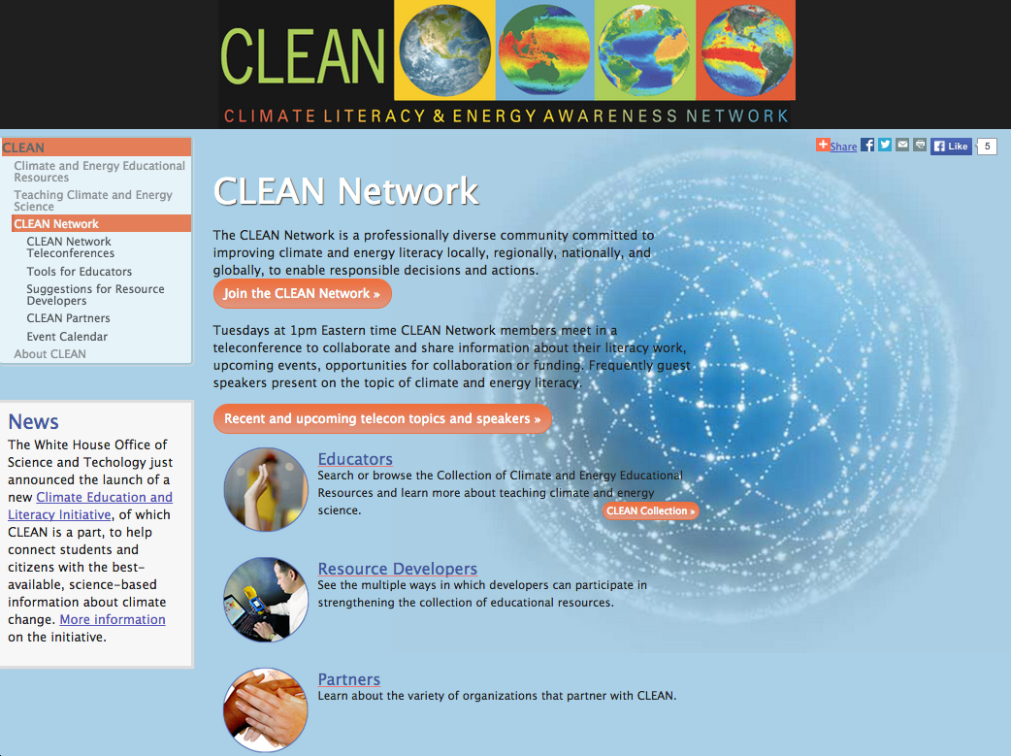

Slide 16


CLEAN
Network
Formed in January 2008
  Pressing need to to prepare society and future workforce to address the environmental issues and challenges of the future.
Active Listserv - >520 members
  Discussions and Announcements
    Average 86 messages/month
Weekly teleconferences
  Presentations & Discussions Posted
  Average 11 participants/call; ~20% presentations > 20 participants
CLEAN Facebook Page >1,200 Likes
Professionally Diverse
2008
2010
2012
Notes:
Tamara
Backup Frank

Slide 17
Professional Diversity and Use of
CLEAN Network by Members
Deep understanding of climate change requires the input from a wide range of active stakeholders with interdisciplinary and transdisciplinary expertise.

Slide 18
Professions Represented in the CLEAN Network
Profession | % Respondents
Informal educator | 47%
Professional development provider | 42%
Curriculum developer | 42%
Scientist – physical, life, earth | 34%
Formal educator (Higher education) | 33%
Program managers | 20%
Social scientist | 19%
Formal educator (K-12 teacher) | 9%
Artist | 8%
1 of 2
2015 Survey
N=104

Slide 19
Professions Represented in the CLEAN Network
Profession | % Respondents
Social media specialist/Blogger | 8%
Media specialist/Journalist | 7%
Decision makers | 4%
Policy analyst | 4%
Student | 4%
Software or hardware developers / IT support staff | 3%
Public health expert | 2%
Economist | 2%
Lobbyist | 2%
2 of 2
2 of 2
2015 Survey; N=104

Slide 20
Use of CLEAN Network by Members
2015 Survey; N=104

Slide 21
Activities of CLEAN Network
Teleconferences and Listserv

Slide 22
Number of participants in CLEAN Network weekly teleconferences, August 2010 (when recording and documenting the teleconferences began) through October 27, 2015
100 presentations in 269 sessions
Average # participants ~11
Maximum # participants – 47
22 presentations with >20 participants (10/15)

Slide 23
Monthly totals of emails sent through the CLEAN Network listserv, September 2009 (when tracking of email traffic began) through October 2015.
Average messages per month – 86; Maximum – 248 messages November 2013

Slide 24
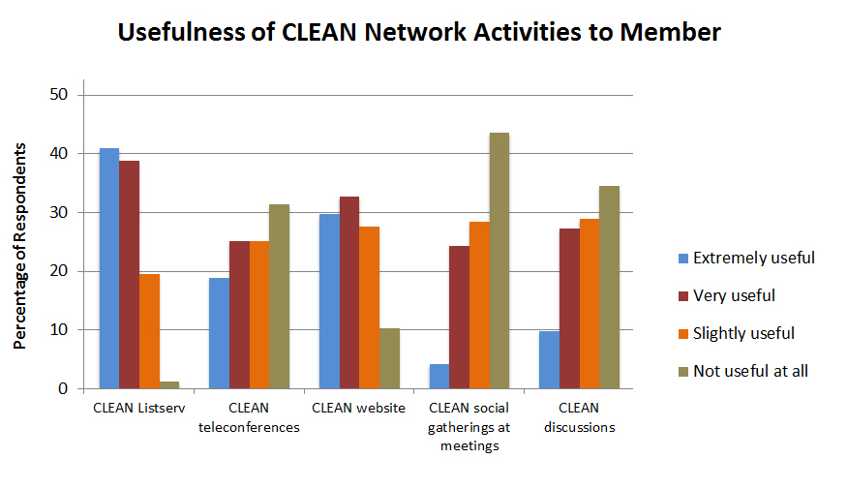
2015 Survey
N=104

Slide 25
Activities of CLEAN Network
Teleconferences and Listserv
Organizing climate literacy sessions at professional meetings - NAAEE, GSA, AGU
Participate in NCAnet & NCA Education Affinity Group
  Contributed to development of NCA Learning Pathways
Response to White House OSTP Call for Climate Education and Literacy Activities.
Moving to leveraging and coordinating efforts to achieve larger collective impact on climate literacy
Live from COP21 in Paris – Dec 1 and Dec 8, 2015

Slide 26

Contact: Tamara Shapiro Ledley Tamara_Ledley@terc.edu 617-873-9658

Slide 27
Climate and Energy Literacy Stakeholder Survey
Open until Nov 5, 2015
http://tinyurl.com/CLEANStakeholderSurvey

