Slide 1

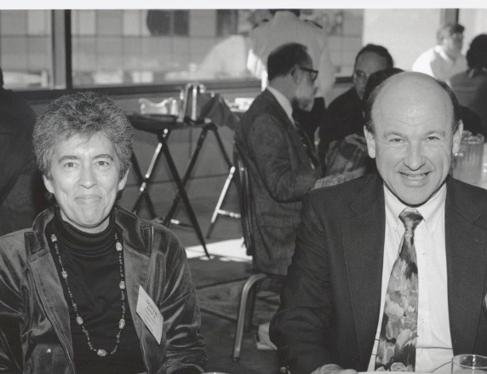
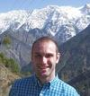
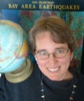
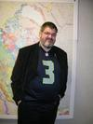
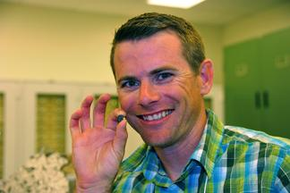
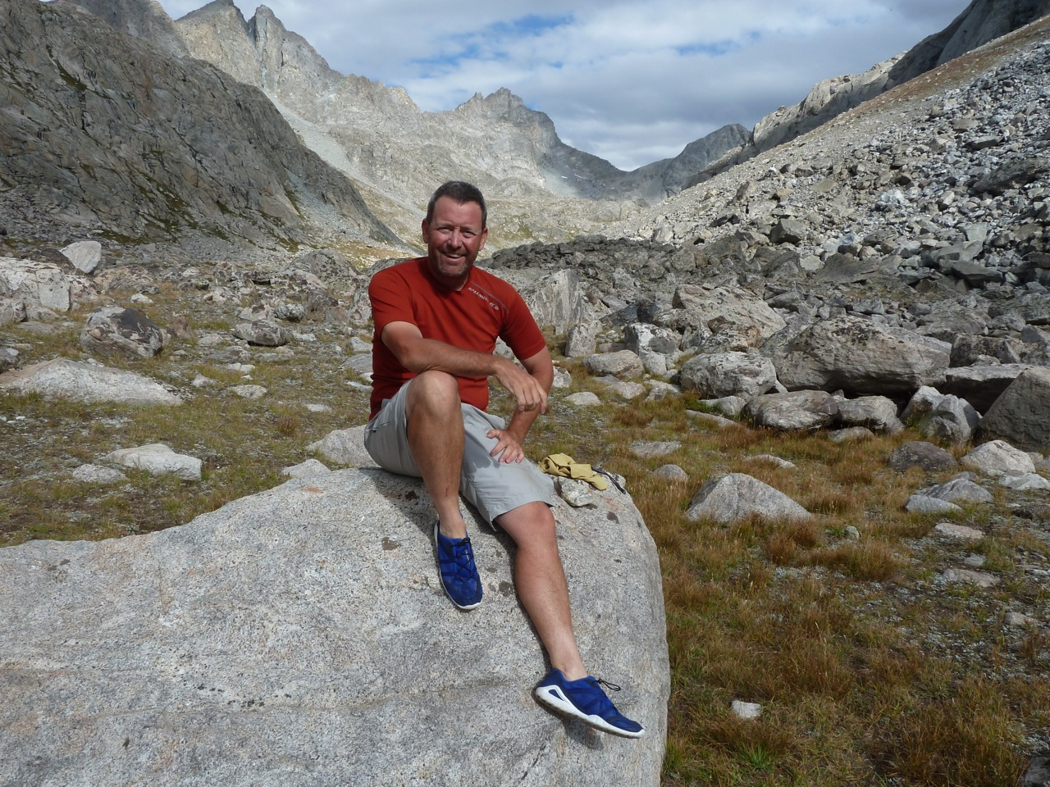
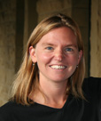
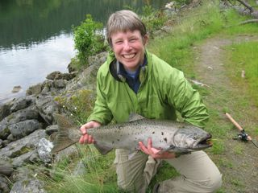
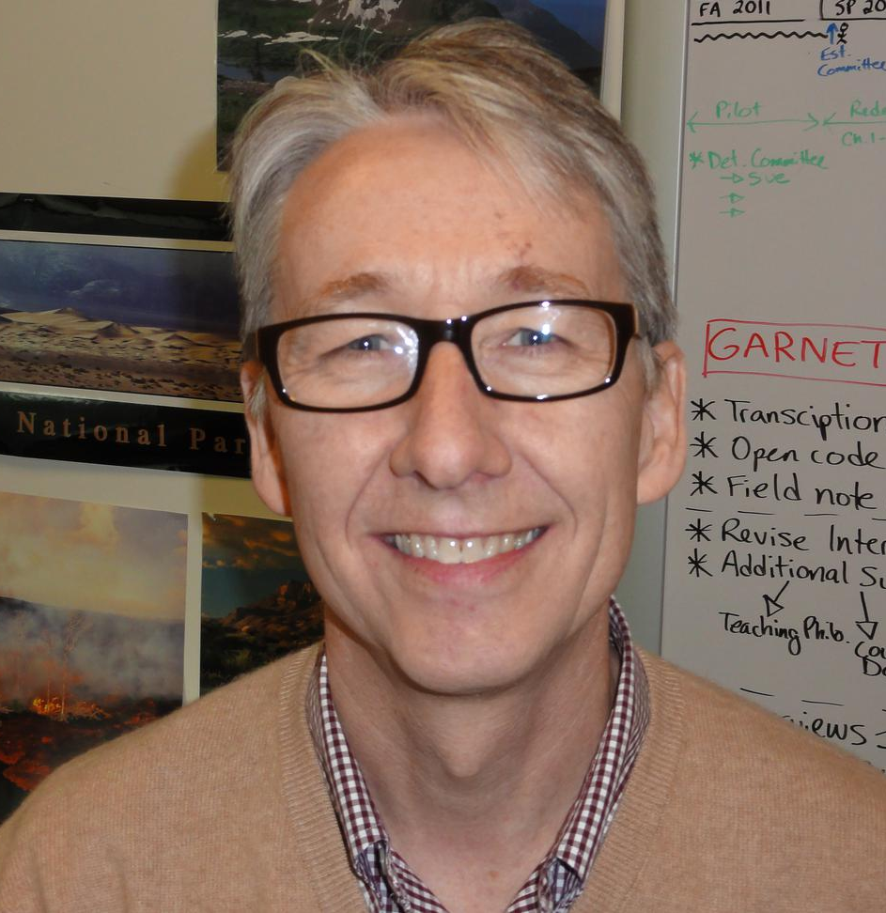
NAGT.ORG
National Association Of Geoscience Teachers: Supporting Faculty Development
Erica W. Zweifel and Randall M. Richardson, National Association of Geoscience Teachers, c/o Carleton College W-SERC, One North College Street, Northfield, MN 55057, ezweifel@carleton.edu and rmr@email.arizona.edu
Notes:
Supporting faculty development is an important part of the National Association of Geoscience Teachers (NAGT) member-driven organization. NAGT offers a variety of opportunities for faculty development including two publications, workshop programming, three topical focused divisions, and website offerings hosted through the Science Education Resource Center (SERC). These faculty development opportunities offer a wide range of ways to assist faculty with transforming the classroom.
The National Association of Geoscience Teachers works to raise the quality of and emphasis on teaching the geosciences at all levels. We count among our members K-12 teachers and college and university faculty as well as educators working with the general public through outlets such as museums and science centers. NAGT's purpose is to foster improvement in the teaching of the Earth sciences at all levels of formal and informal instruction, to emphasize the cultural significance of the Earth sciences, and to disseminate knowledge in this field to the general public.
Plus 10 geographic sections and 3 topical divisions.
In past three years, our membership has increased each year and we had added two new divisions to better serve our members.

Slide 2
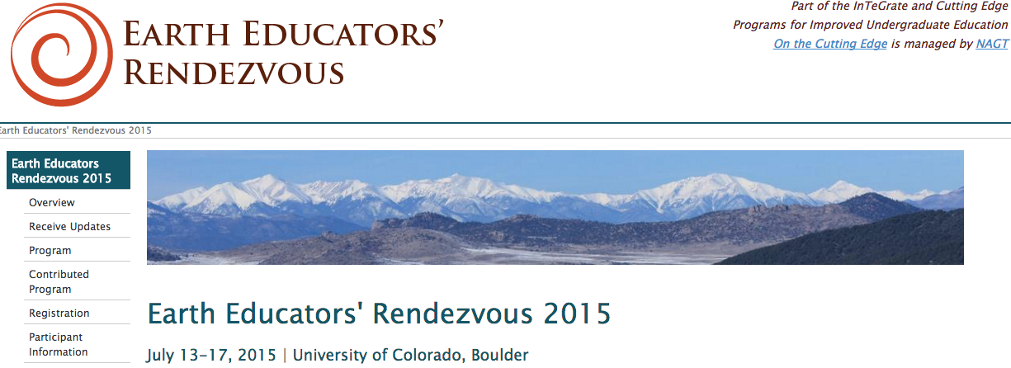
Slide II
NAGT partnered with On The Cutting Edge and InTeGrate to bring you the inaugural Earth Educators’ Rendezvous in Boulder, Colorado in July. More than 300 educators from across the country and a variety of institution types came together to capitalize on the experience of colleagues in a wide range of fields and to network with others engaged in improving undergraduate Earth education.
Notes:
We tried something new this year on the faculty development front, we help our first annual EER.
The meeting engaged participants in activities that support faculty in improving their courses, departments, or programs with the aim of increasing their overall impact of Earth education. The meeting also endeavored to build a collective capacity to use and conduct education research.

Slide 3
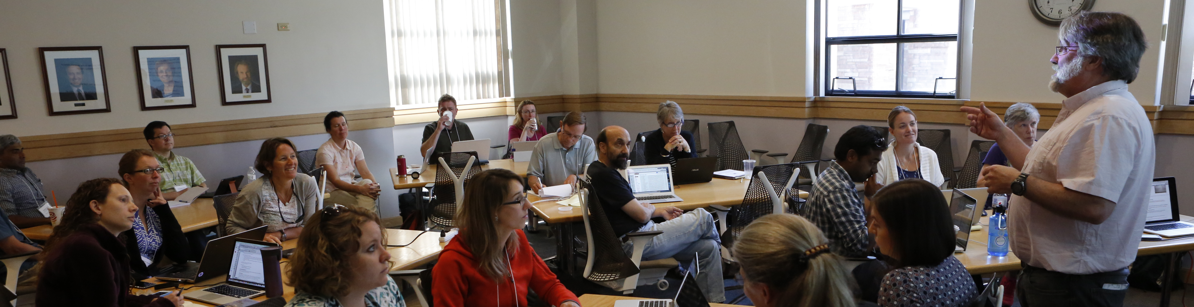
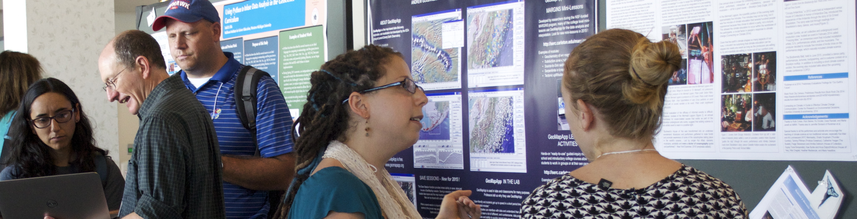
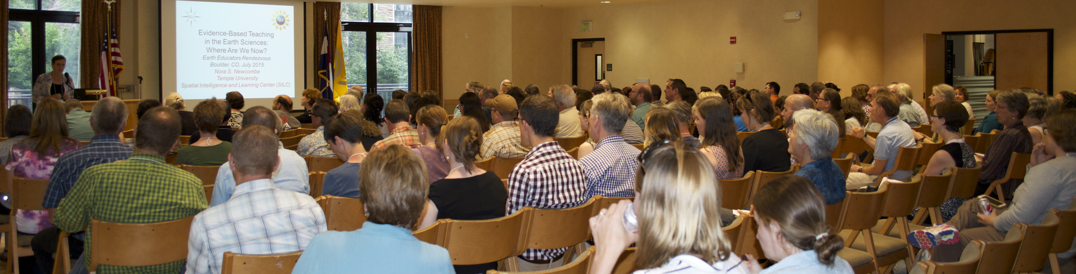
EER 2015
Slide II
Notes:
Daily schedule, start with workshops (participants register for these), lunch and poster session, more workshops or working groups, end with plenary. Also weekly schedule for 2,3 or 5 day options.

Slide 4
Traveling Workshop Program - Departments
Focus on the specific context of your department.
Engage the entire department, rather than one or two individuals, in deep, structured discussion and action planning.
Use a Strengths/Weaknesses/Opportunities/Threats (SWOT) approach to focus development of action plans for achieving your objectives
Provide an external framework and support for a department that is committed to making changes.
Two-person team approach provides two outside perspectives.
Notes:
Can’t come to one of our workshops? We will come to you.
This track of the Traveling Workshops Program brings the knowledge gained from the 'Building Strong Geoscience Departments’ project, along with 'InTeGrate’, and other NAGT-sponsored efforts onto your campus to support conversation and planning by your department as a whole. These workshops offer a menu of interactive sessions fully supported with online resources. All sessions feature presentations, discussions, and action planning.
Program application deadlines are October 15th and March 15th

Slide 5
Traveling Workshop Program - Courses
Institutions can bring in an expert to run a workshop in one or more of four important areas of teaching and learning:
designing effective and engaging courses
metacognition, motivation, and the affective domain
active learning
assessing learning and programs
Notes:
This track of the Traveling Workshop Program brings half or full day workshops, run by national leaders in undergraduate geoscience education, to institutions and events around the country. As a part of the process of hosting a workshop], NAGT members at colleges, universities and other organizations can apply to have one of our facilitators bring a workshop on an important teaching topic to their campus.

Slide 6
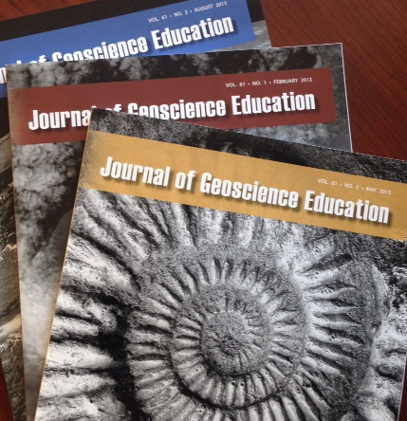
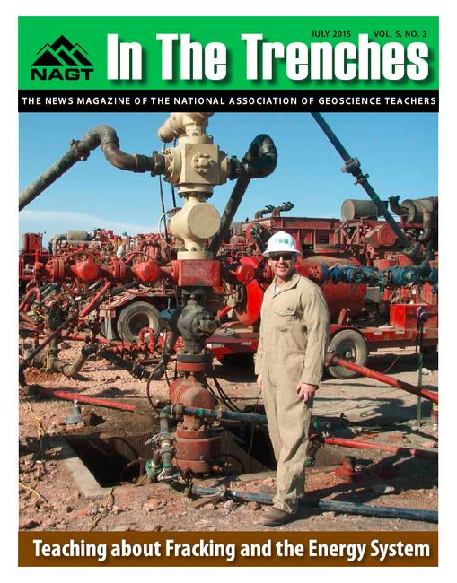
NAGT Publications – A Place to Share Your Pedagogy Research
Notes:
You’ve gone to a workshop, tried out and evaluated your new model; where do you publish your results?
JGE
Peer reviewed
Themed issues
Digitization of past content
How to be a JGE author webinar
ITT
Educator activities

Slide 7
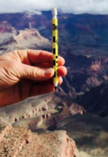
Creating Communities
Geo 2-Year College Division
Newsletter and the creation of a community
Geoscience Education Research Division
Research, Publishing, and workshops
Teacher Education Division
Professional development, NGSS
Notes:
Shifting gears from events to ongoing daily support Creating Communities
NAGT is home to three topical divisions
The Geo2YC Division is a home for NAGT members who have a shared professional interest in geoscience education at two-year colleges. Two-year college faculty are an integral part of NAGT. They serve as officers in the sections and on the Executive Committee. Many other members are interested in helping two-year college faculty teach geosciences to a growing number of students in the United States and Canada because two-year colleges are a significant feeder track for geoscience majors to four-year colleges and universities.
The Geoscience Education Research Division (GER) is committed to the promotion of high quality, scholarly research in geoscience education that improves teaching and learning in K-12, higher education, and informal learning environments. Our largest and fastest growing division.
This NAGT division seeks to improve geoscience teaching by improving teacher content and pedagogical knowledge and by encouraging research on best teaching practices.

Slide 8
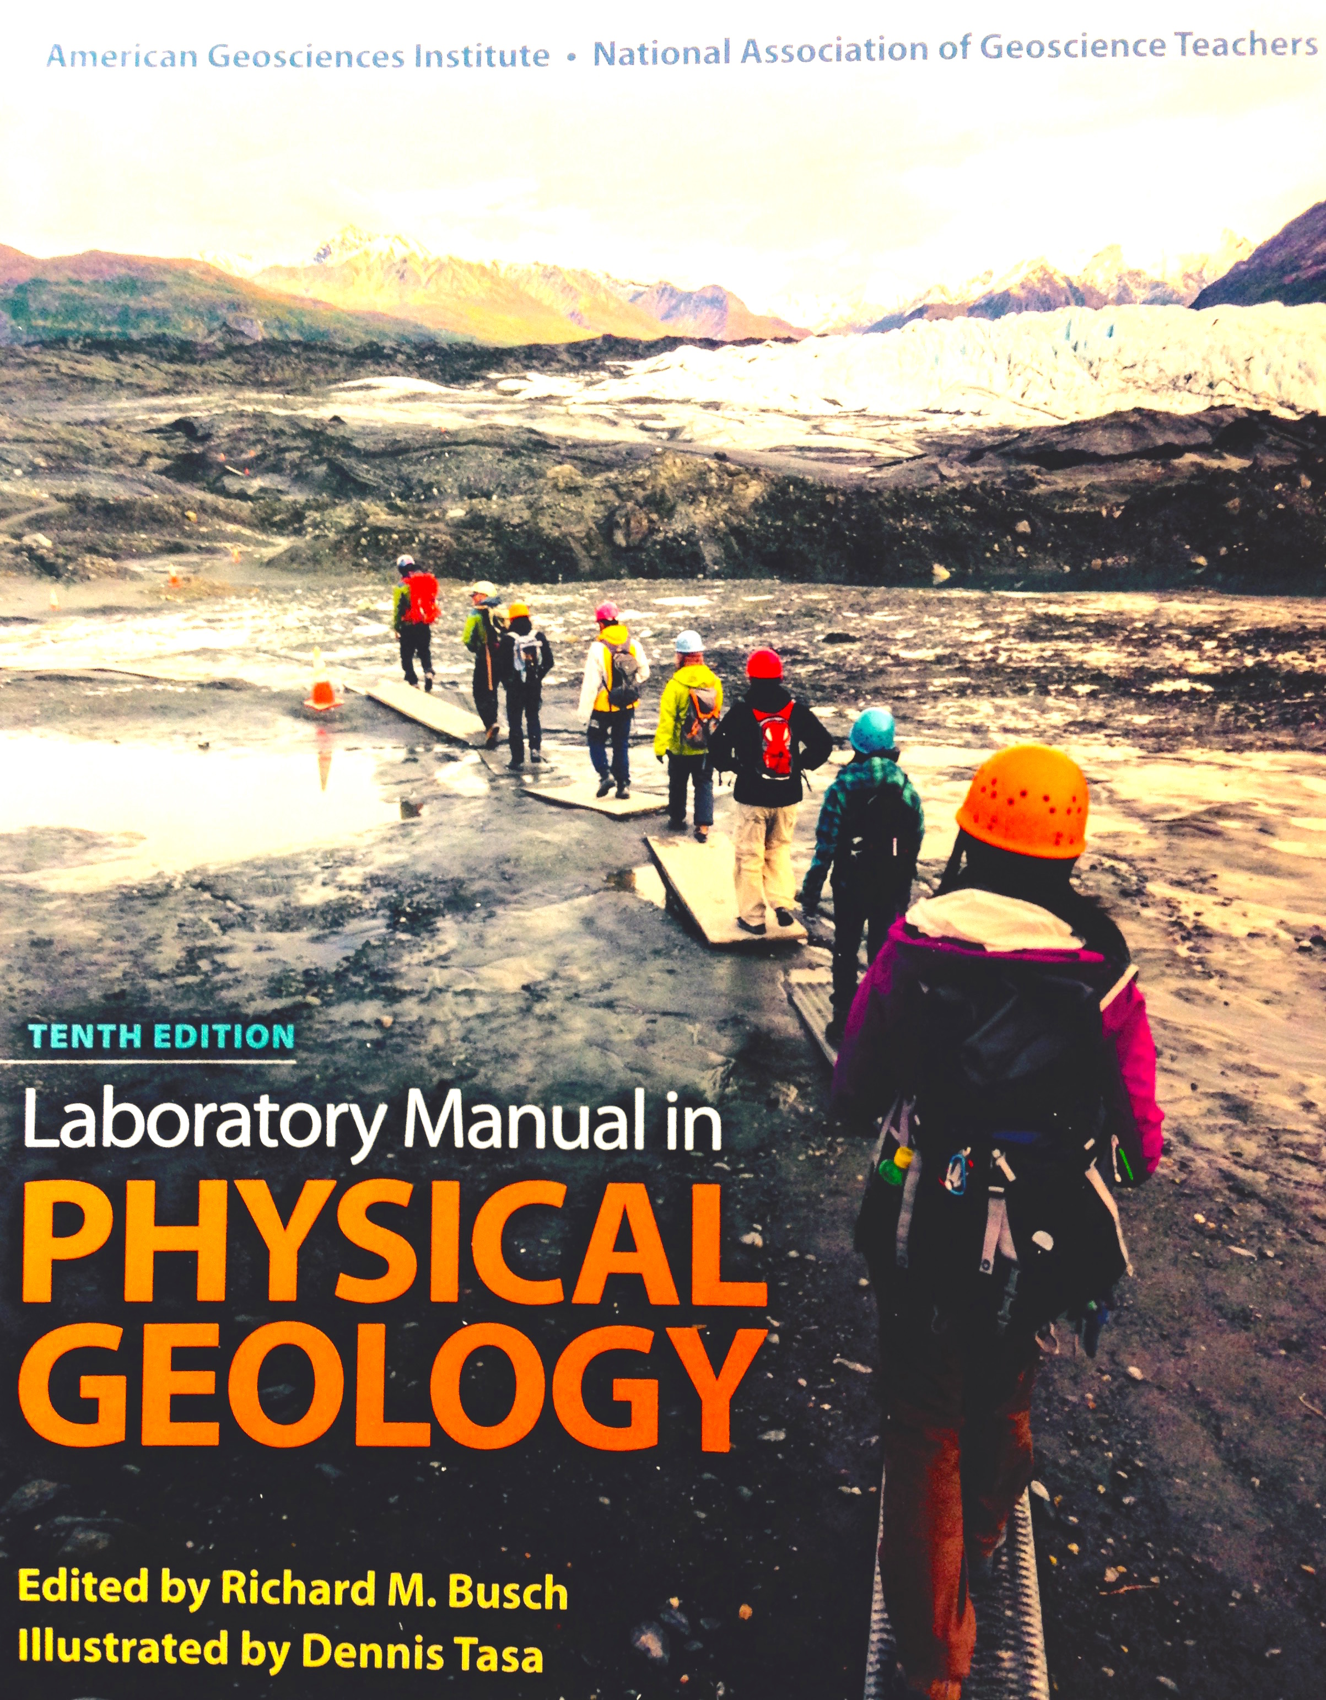
Collaborate With Us
AGI/NAGT Lab Manual
On the Cutting Edge Reviewed Collection and Website
NGSS Summit
InTeGrate
Project EDDIE
Become an NAGT Sponsored
project or collaborator
Notes:
NAGT and AGI are proud to announce Baylor University ProfessorDr. Vincent Cronin as the new Editor of the Physical Geology Lab Manual, starting with the the 11th Edition. Join us for a “Meet the Editor” event Tuesday 4:30 to 5:30 p.m
Collaborations vary from our structured agreement with AGI on the Physical Geology Lab manual to

Slide 9
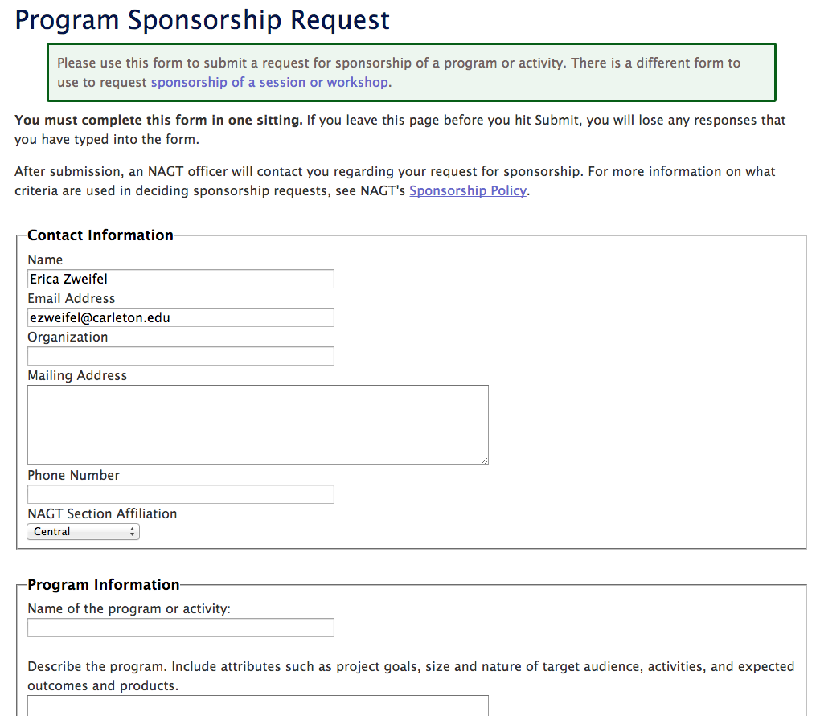
Notes:
Go to NAGT Professional Development, click on the NAGT sponsored programs link, here you will find an alphabetical list of our sponsored programs and a blue button that you can click to fill out a request to become a sponsored program.

Slide 10
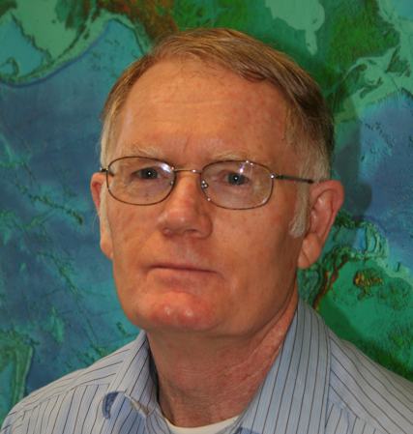
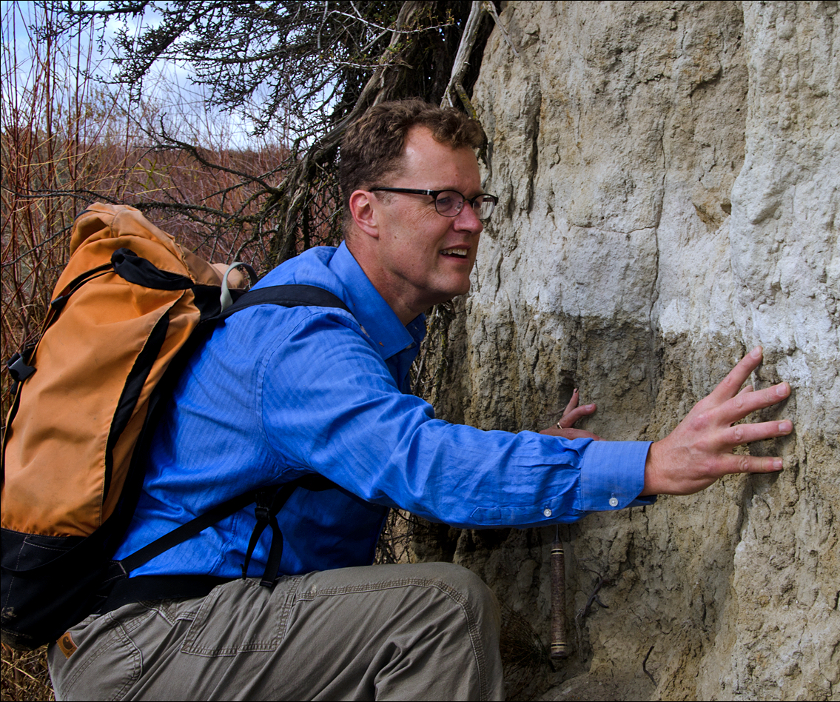
Geoscience Education Rock Stars
Dr. Robert Butler (University of Portland, OR) has been awarded the 2015 Neil Miner Award in honor of his exceptional contributions to the stimulation of interest in the Earth sciences.
Nick Zentner has been awarded the 2015 James Shea Award in honor of his exceptional contributions in the form of writing and/or editing of Earth science information that is of interest to the general public and/or teachers of Earth science.
Andrew Buddington has been awarded the 2015 Robert Christman Distinguished Service Award in honor of his commitment and service to NAGT. Andy is an Earth science instructor at Spokane Community College and a member of NAGT since 1998
Notes:
A few Examples of faculty who are doing it well! NAGT is proud to Honor those who have transformed the classroom and beyond.
Bob has developed videos, online programs, teachable moments, and field trips that have brought geoscience to the attention of millions. Bob's career exemplifies how a scholar can break out of the lab or classroom and have an immense impact on building understanding in Earth science worldwide.
Nick has a gift for communicating in an accessible and engaging way that allows people to see the landscape they've known all their lives through the eyes of a geologist. Nick shares his talents beyond his classroom walls through his 2-Minute Geology and longer Ice Age Floods YouTube videos, he has created a final product that is visually stunning, informative, and entertaining.
Andy's commitment and energy for geoscience advocacy not only assisted in rejuvenating the Pacific Northwest Section, but also led to the development of the PNW section's successful annual conference. In addition, Andy has served as the Pacific Northwest Section President and Vice President, and has served on the NAGT Executive Committee as a Councilor-at-Large and as a section Liaison.

Slide 11
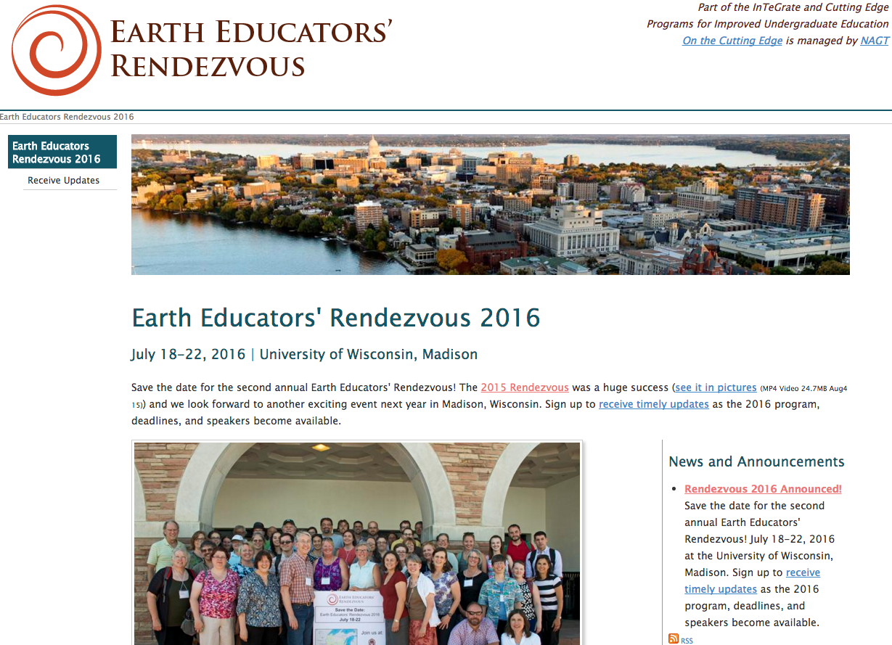
Notes:
We encourage you to join us for the 2016 EER in Madison, you can sign up now to receive notices related to this event and actual registration will begin in January 2016!
Meet up with like minded colleagues who also want to transform the classroom and beyond.

Slide 12
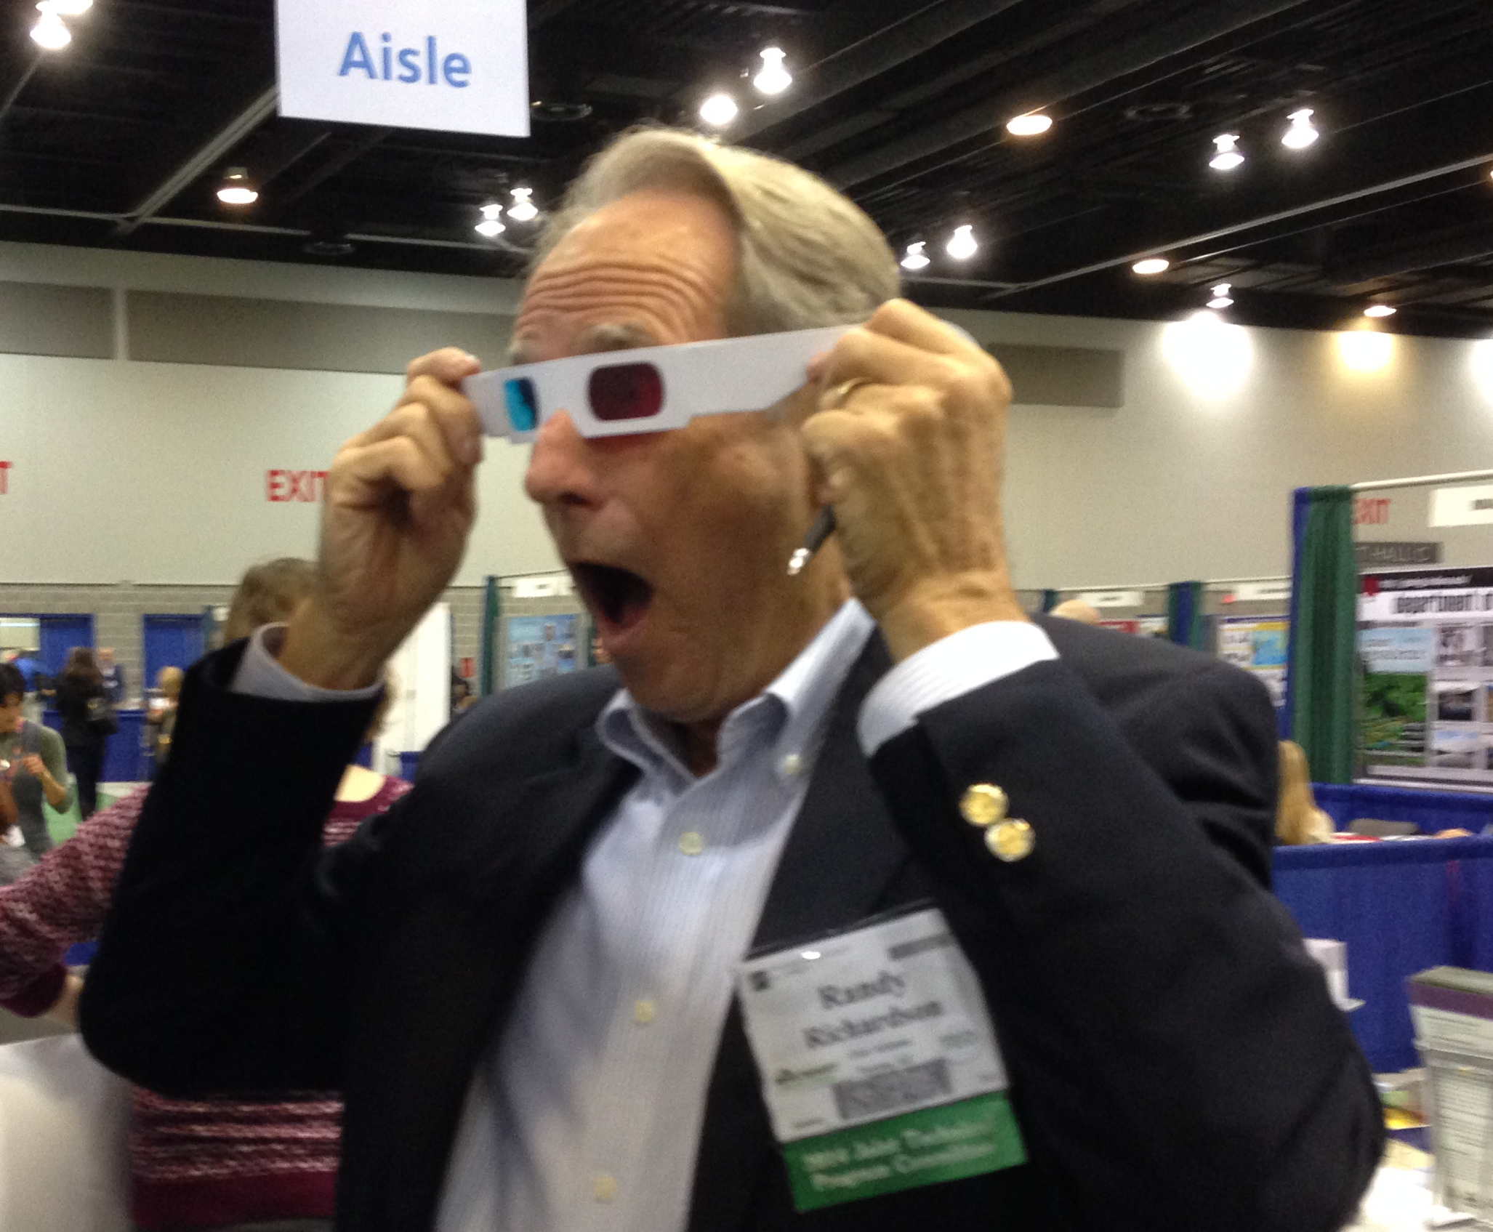
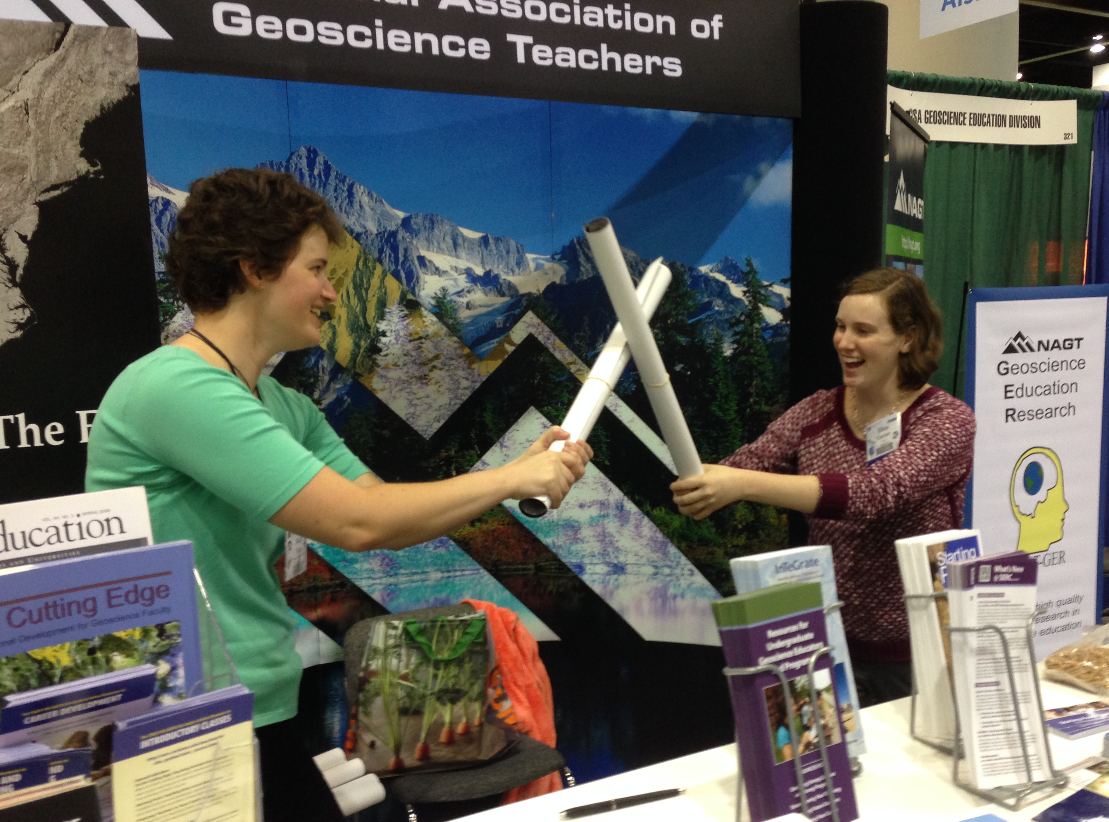
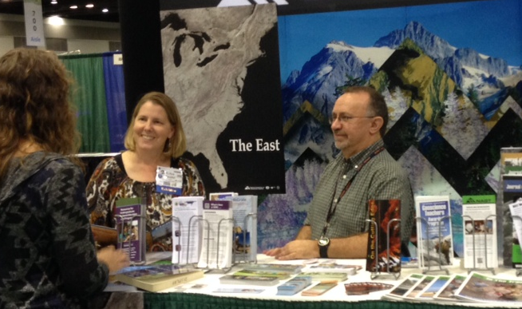
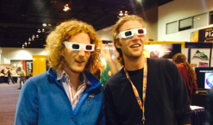
NAGT Booth #931
NAGT.ORG
Notes:
NAGT is here to support you as you transform your classroom, course or department. Please stop our booth #931 for more information. Expand or contract the booth offerings based on time. Meet the editor event, InTeGrate events, etc.
Thank you to all of our members
Executive Committee and Council
Division and Section leaders
Program Leaders
Earth Educators’ Rendezvous
Workshops
Award and Intern Programs

