Slide 1

InTeGrate Modules & Authentic Community-based Research as Program Opportunities
Sarah Fortner, John Ritter, Amber Burgett,
David Finster, Ruth Hoff, Richard Phillips
Notes:
Include overview of the InTeGrate project and our materials development team from 3 different institutions.
Our team followed the InTeGrate module development process; in this talk we will highlight key components of the process that were significant to our experience and that informed the final version of the module.

Slide 2
Abstract
INTEGRATE MODULES AND AUTHENTIC COMMUNITY-BASED RESEARCH AS SUSTAINABILITY PROGRAM OPPORTUNITIES
FORTNER, Sarah K.1, RITTER, John B.2, BURGETT, Amber A.3, FINSTER, David C.4, HOFF, Ruth J.5 and PHILLIPS, Richard S.3, (1)Geology, Wittenberg University, Springfield, OH 45501; Geology, Wittenberg University, Springfield, OH 45501, (2)Geology, Wittenberg University, P.O. Box 720, Springfield, OH 45501, (3)Biology, Wittenberg University, Springfield, OH 45501, (4)Chemistry, Wittenberg University, Springfield, OH 45501, (5)World Languages, Wittenberg University, Springfield, OH 45501, sfortner@wittenberg.edu
Sustainable stewardship of earth resources is paramount to maintaining, and even enhancing, our global quality of life. Recent curricular efforts at Wittenberg University, a liberal arts college in Springfield, Ohio, have united in this endeavor through an InTeGrate Sustainability Implementation Program and collaborative development in the Environmental Science Program. To date we have 1) developed three InTeGrate modules on topics including agricultural sustainability, freshwater justice, and ecosystem services 2) piloted action-oriented sustainability curriculum into our Freshmen Experience course, 3) implemented InTeGrate modules in five courses across 5 disciplines with a doubling of sustainability courses planned by the end of 2016, 4) introduced sustainability curriculum into our First Year Seminar and 5) built substantive community based projects with multiple stakeholders across our Environmental Science Program. We plan to expand the impact of these activities through the attention to key guiding elements from the InTeGrate Materials Development and Refinement Rubric and the Sustainability Improves Student Learning (SISL) initiative. These elements are central to cultivating student engagement and integrated research expertise and include: authentic data, systems thinking, interdisciplinarity, and proactive community-based problem solving. Here we present our curricular evolution, barriers overcome, and preliminary measures of success (numbers impacted, community recognition, student learning), and plans to formally expand our sustainability curriculum through the creation of a General Education Theme, new program, or track within the Environmental Science Major. Key to our success is a STEAM approach.

Slide 3
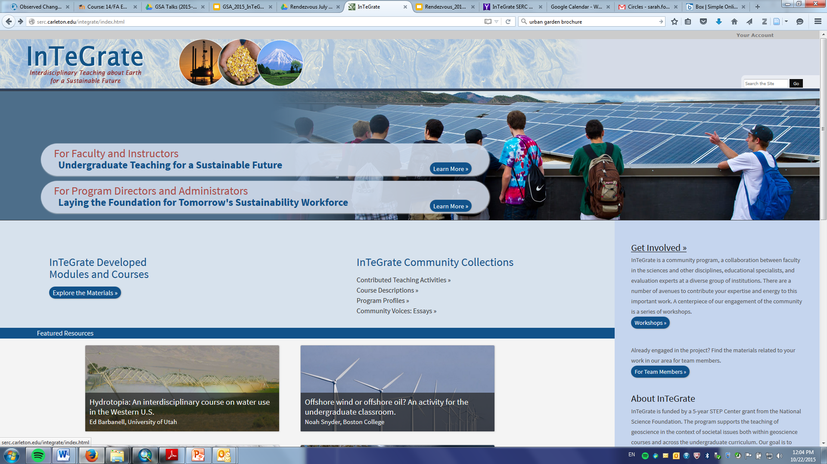
InTeGrate
On the SERC website!

Slide 4
Context: Common Curricular Threads
InTeGrate & Wittenberg Environmental Science
collaboration between faculty & experts
supports shared vision & innovation
learning goals aligned with assessments
builds habits central to earth & environmental scientists, interdisciplinary, authentic data, systems thinking, scaffolding
Notes:
The Wittenberg Environmental Science Program has evolved parallel to our engagement with InTeGrate. These are shared curricular threads between efforts.

Slide 5

Collaboration
Context: InTeGrate Project
Advisory Board
Materials
Leadership
Faculty
Collaborative development
Guidance from experts
Materials alignment with rubric
Faculty
Faculty
Materials
Reviewers
Notes:
Collaborative structure for InTeGrate Materials Development.

Slide 6
Collaboration
Context: Wittenberg Environmental Science
Stakeholder
Stakeholder
Faculty
Faculty
Collaborative development
Guidance from experts
Materials alignment with rubric
Faculty
Faculty
Stakeholder
Stakeholder

Slide 7
Rubrics
InTeGrate Rubric
(select elements)
Grand challenges
Interdisciplinary
Habits of Mind/ Process of Science
Authentic Data Inquiry
Systems thinking
Clear, measureable learning goals
Student engagement & metacognition
Inquiry & Analysis
VALUE Rubric
Topic Selection
Existing knowledge
Design/Methods
Analysis
Conclusions
Limitations/Implications
Alignment with InTeGrate Rubric
Address Grand Challenges & Stakeholder interest
Address Habits of Mind, Process of Science, & Authentic Data
Recommends solutions or provides summary of implications for the stakeholder, integrated systems assessment
Notes:
Central elements of the InTeGrate Rubric are also embedded in our Inquiry & Analysis VALUE rubric used to evaluate central projects in the Environmental Science Program. Both strategies produce learning gains, for example students make improvements in their design/methods & analysis skills between introductory environmental science & the subsequent methods course/

Slide 8
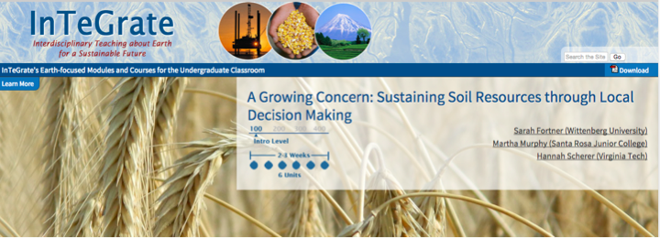
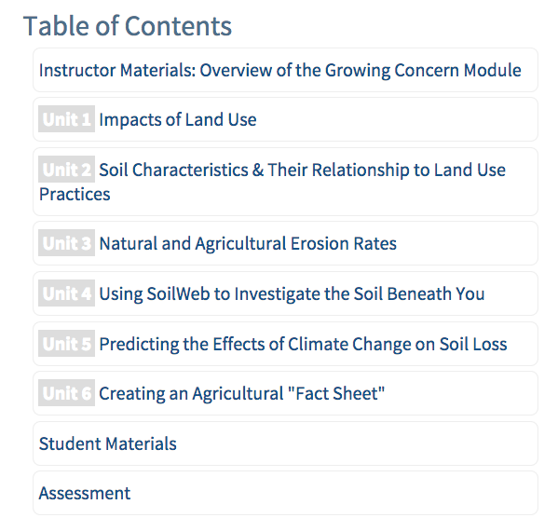
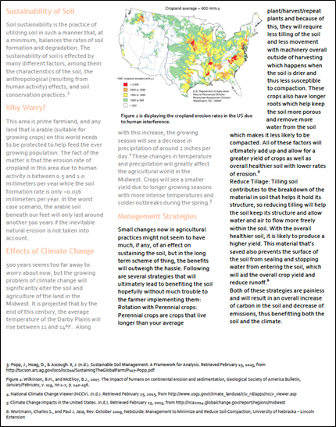
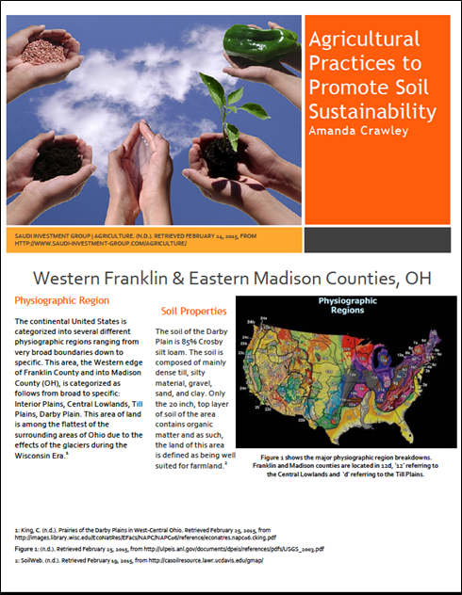
Wittenberg faculty on three module teams:
Notes:
Addresses the grand challenge of land use & soil sustainability. Students evaluate physiographic & human controls on soil quality. They consider how long soil will last under current erosion rates & in light of expected changes from climate change. The module culminates with the creation of a fact sheet for land management decisions to combat climate/erosion challenges ahead.

Slide 9
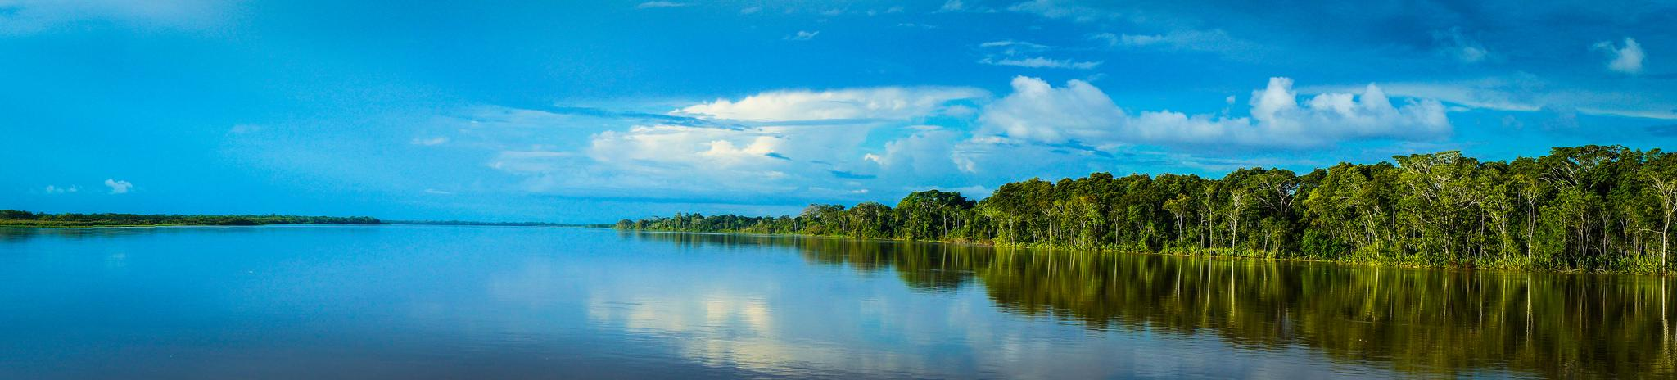
Wittenberg faculty on three module teams:
Environmental Justice & Freshwater Resources: Adaptation for Spanish course
Slide from Ruth
Identification of interdisciplinary learning goals for intermediate Spanish course
Translation of materials into Spanish and minor alteration of 3 units from the original English-language module
Introduction to Environmental Justice
The Water Cycle and Freshwater Resources
Groundwater Availability and Resources (Southwest U.S.)
Creation of 3 new units that introduce scientific and Env. Justice principles in a Latin American context with Spanish-language materials from authentic sources
Streams and Water Diversion (the Marañón River in Perú)
The Water Wars of Cochabamba, Bolivia
Hazardous Waste, Petroleum, and the Amazon
Notes:
Image from: Christian Cruzado, Creative Commons (Attribution 2.0) https://flic.kr/p/wruTxZ
Slide by Ruth Hoff

Slide 10
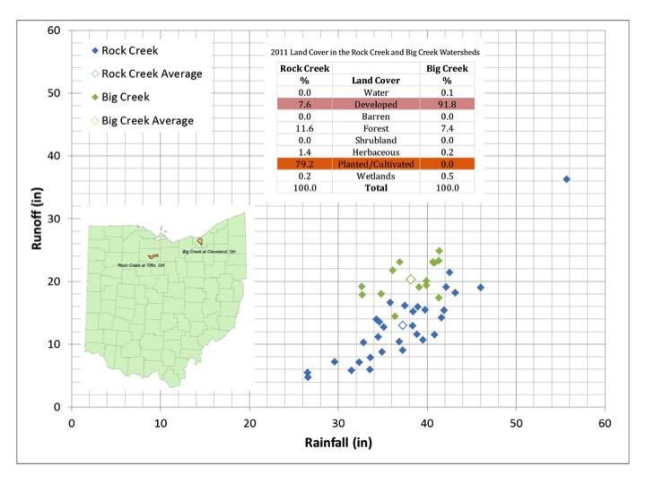
Wittenberg faculty on three module teams:
Evaluating & improving ecosystem services
Notes:
The most recently funded Wittenberg co-authored module evaluates current ecosystem services & how they might be improved based on knowledge of system responses. In this example from Ohio the impact of development on runoff response is clear.
Image from: John Ritter

Slide 11
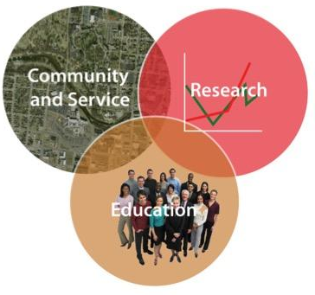
Dynamic Learning for Faculty, Partners, & Students
Partners of the Wittenberg Environmental Science Program
Government Agencies:
City Services (Stormwater, Housing)
National Trails Parks & Recreation
Clark County Soil & Water District
Springfield Conservancy District
Miami Conservancy District
Clark County Engineer
Clark County Park District
U.S. Army Corps of Engineers
Non-governmental:
Tecumseh Land Trust
Friends of Buck Creek
B-W Greenway
Rivers Unlimited
OSU Extension
Chamber of Commerce Subcommittee on Parks & Open Space
Citizens Climate Lobby
Westcott Solar House
Springfield Promise Neighborhood
Cedar Bog Nature Preserve
Notes:
Wittenberg Environmental Science works to educate at the nexus of community service & research. We partner across our courses & have evolved in the strength & reach of our collaboration through ongoing work as trust is built.

Slide 12
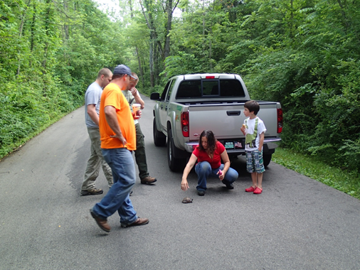
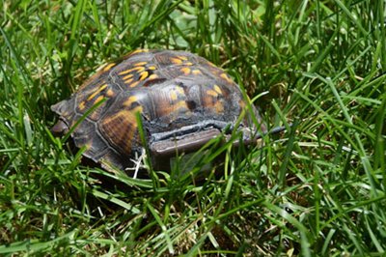
Biodiversity in urban environments
Answering questions fundamental to conservation of biodiversity
Communicating with varied stakeholders
Gaining practical habits needed to implement wildlife ecology studies
Developing a conceptual understanding of the system (drivers and responses)
Notes:
Collaborative efforts between Clark County Parks, US Army Corp of Engineers. Using radiotelemetry, student researchers and their faculty mentor examine habitat use and detectability of box turtles, a “species of concern” in Ohio, in islands of urban habitat. Students collect research while answering community driven questions regarding species presence or absence and engaging the questions about how we know what we know about populations. Species may actually be rare or just difficult to detect or both. Using real world questions and their generated datasets, students begin to explore detectability models and the important role they play in answering questions about the conservation of biodiversity. Students gain practical experience communicating with multiple stakeholders while breaking down a fundamental component of biodiversity: population numbers and change. Additional collaborative projects examine similar questions in spotted turtles, Cooper’s Hawks, and coyotes.

Slide 13
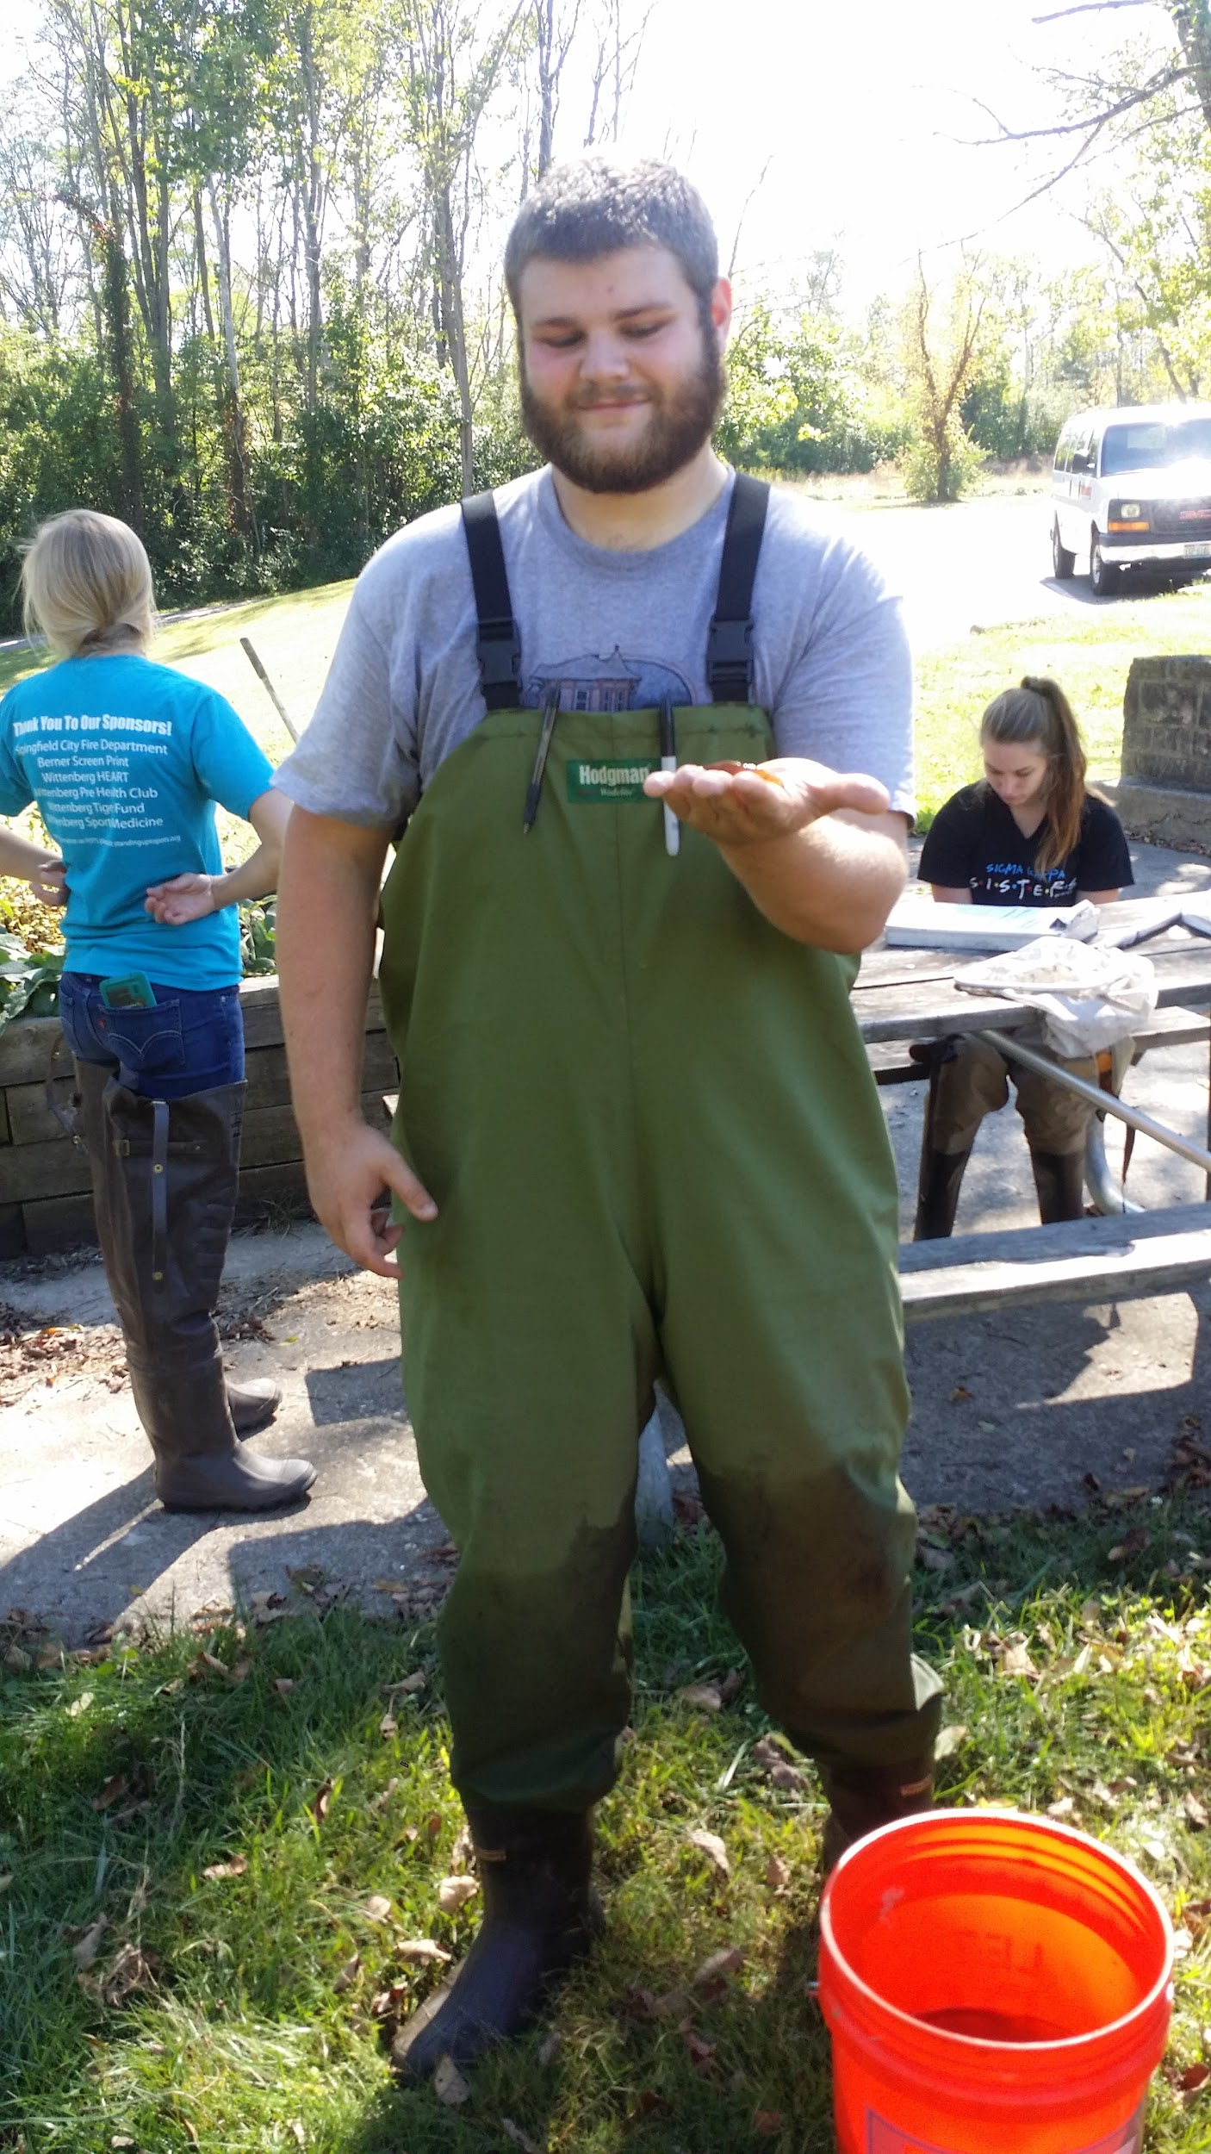
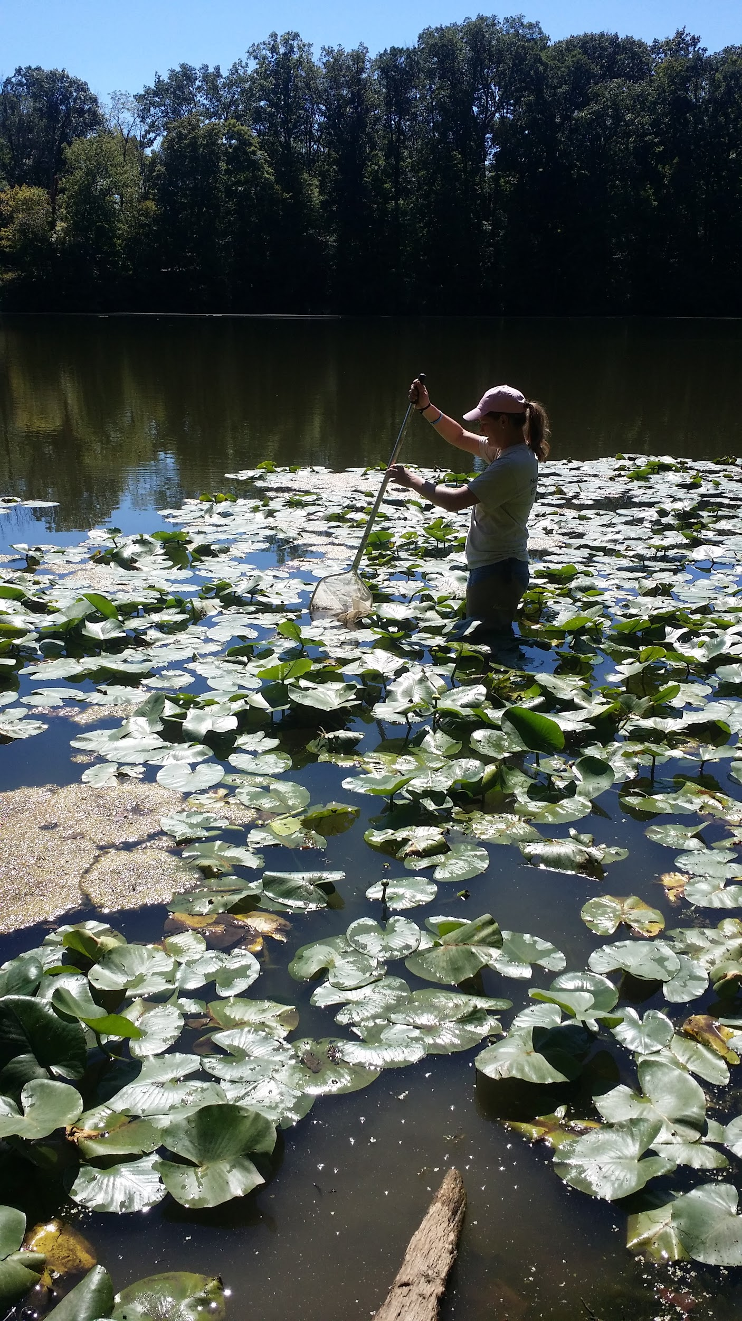
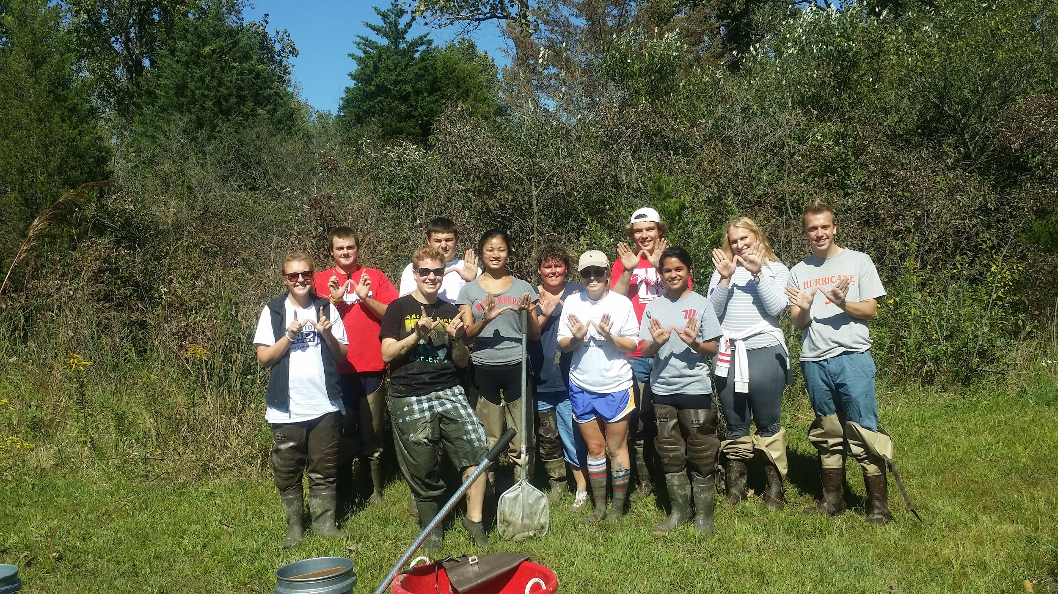
Biodiversity of wetlands
Addressing impacts of land use, invasive species, and restoration efforts on aquatic biodiversity
Developing species lists for stakeholders
Creating materials for signs, programs, websites
Notes:
Within freshwater ecology and some in our intro Esci course last time, we are collecting data from wetlands within the BW greenway, clark county park district, and cedar bog to ask research driven questions about how land use, invasion of honeysuckle, and restoration efforts impact aquatic biodiversity. We then are able to give this back to the stakeholder as a comprehensive species list (and we also provide water chemistry data). Freshwater ecology is also taught as a service learning course and the students provide some service back to the community, examples include re designing the “Boo in the Bog” materials for Cedar Bog, and working with the CCPD after school program to collaborate and develop artwork and poems for the signs they are producing for the Wenwrick Wetland.

Slide 14
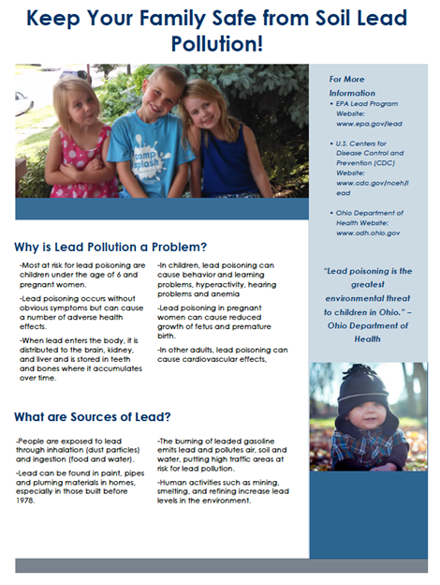
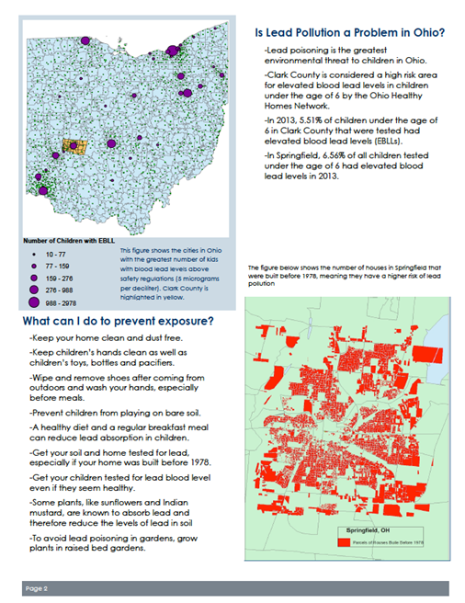
Environmental Pollution
Identifying the lead legacy issue in Ohio & in Springfield (county/track)
Analyzing the distribution of soil lead in vacant lots considered for remediation
Creating outreach materials for community audiences to improve lead health behaviors
Notes:
Students evaluate lead risks using GIS & then move on to collect & analyze soil lead data for community garden groups. Partners visit class including the Springfield Promise Neighborhood & the Combined Health District. Both of these groups have a vested interest in improving childhood health & safety.

Slide 15
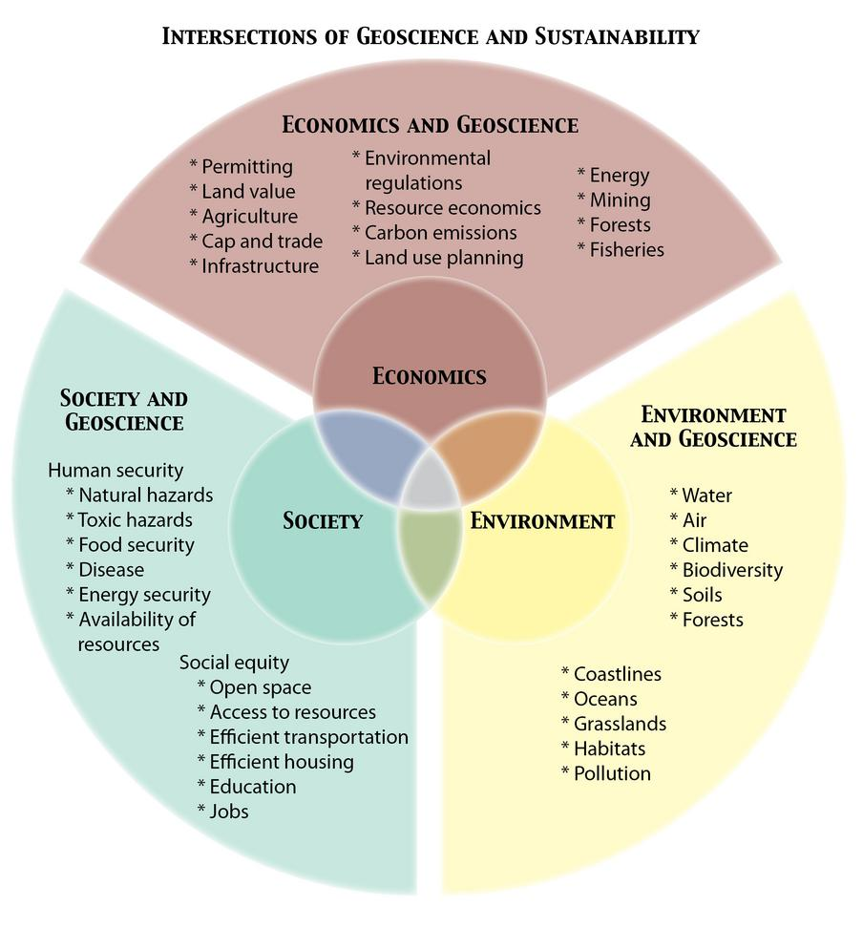
InTeGrate Implementation Programs:
Building Models for Infusing Key Ideas from InTeGrate into the Curriculum
16 Efforts, Single & Cross-Institutional
Goals Fit Participant Interests: Liberal Arts, General Education, TA training, Diverse Students, Online/Hybrid Models

Slide 16
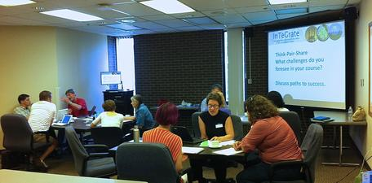
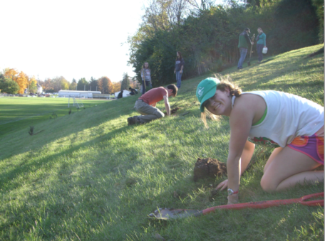
Wittenberg’s Implementation Program:
2014-2016
STEAM Effort to Build Capacity for a Theme or Program Across Disciplines (Underway)
First Year Seminar Programming (Underway)
Expanding Interdisciplinary Connection to Partners (Planned):
Faculty at near schools
Stakeholders interested in sustainability

Slide 17
Wittenberg’s Implementation Program:
2014-2016
Phase 1: Establishing Sustainability Curriculum
Chemistry, Nursing, Business, Geology, Biology, World Languages
First Year Experience Sustainability Day
Phase 2: Broadening Participation in Sustainability and Student-centered Curriculum
Expansion to include more disciplines/faculty at Wittenberg
Communication, Political Science, Physics, Math
Expansion to include faculty at nearby schools
Support for sustainability programing
First Year Experience Revised Curriculum
Phase 3: Creating Deep Learning through Expanding Collaboration with Partners

Slide 18
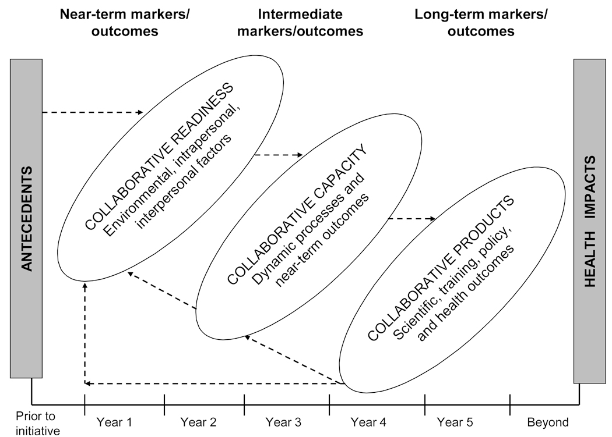
Framework for Collaborative Development
MEANINGFUL IMPACTS
COLLABORATIVE OUTCOMES
Curricular materials, program creation & other developed materials
(e.g. grants, fact sheets, publications)
Adapted from Hall et al., 2008

Slide 19

InTeGrate Feedback (Kastens et al., 2014)
Background: Barriers to success
My unfamiliarity with much of the pedagogical language and processes led to lengthy periods of torpor when I wasn’t making any progress...
The inexorable progression of linear time was the biggest challenge.
I hate participating in group projects, and this experience did nothing to change my mindset...While I understand the benefits of developing materials as a team project, sometimes it takes a lot more time and energy, and hassle to coordinate the team members than it takes for just developing the materials.
It was quite difficult to work with colleagues from an institution so far away and unlike my own.
It was really hard to collaborate with people in other time zones…
Notes:
Full quote: My unfamiliarity with much of the pedagogical language and processes led to lengthy periods of torpor when I wasn’t making any progress in materials development. Not only didn’t I know where to go, I didn’t even know what questions to ask.”
Should put full citation on here to be consistent with other slides. Or make a references slide and don’t include full citations on any.

Slide 20
Implementation Program
Background: Barriers to success
Five in seventeen faculty did not successfully implement
Three still included sustainability in their courses
I won't be teaching this coming year and won't be able to participate in the InTeGrate program....
There are too many factors conspiring against a successful outcome at this time.
From my perspective, the science portion of the course needs to answer a few basic questions. How has temperature varied over the course of Earth’s history...? I was hoping that the InTeGrate module on climate change would answer these questions. From there, I can get into the politics. But, it really doesn’t.
...if I can get the InTeGrate work to fit with the course...
It turns out I won't be teaching a class this spring that is suitable.

Slide 21
Barriers to success
Barriers noted in the InTeGrate Mid-Project Review (Kastens et al., 2014) & our Implementation Program are also barriers to collaborative readiness
Barriers to Collaborative Readiness (Hall et al., 2008) | Struggles Faced Developing Module (Kastens et al., 2014) | Struggles Faced Implementing Modules | Struggles Faced Partnering
A priori Conditions | Ability to set & meet goals negatively impacted by teams with lower BARSTL* score (*reformed teaching) | Fit, Course/Disciplinary Expectations | Fit, Interest, Ambiguity
Environmental Factors | Time Zones, Coordination | Timing of workshop, Timing of course offerings | Coordination, Availability
Intrapersonal Factors | Discomfort with group work | Discomfort with level of adaptation/ collaboration needed | Expectations

Slide 22
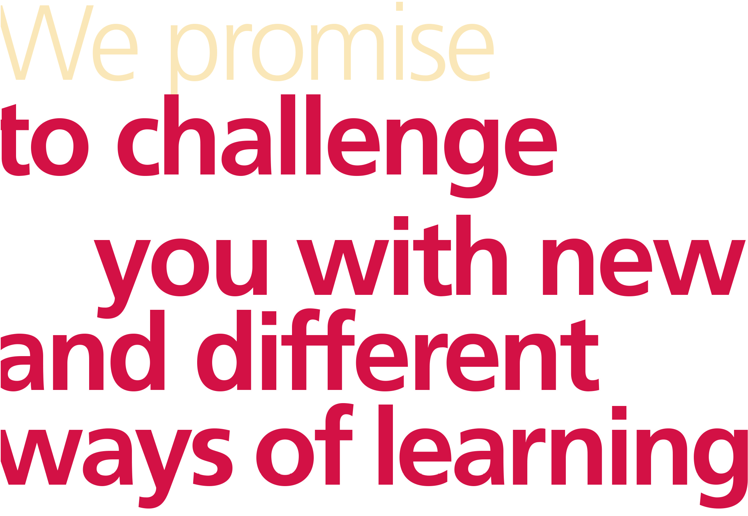
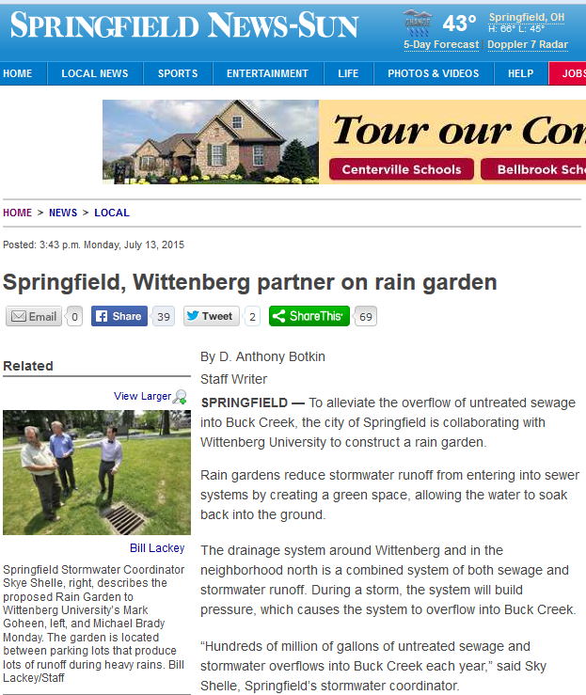
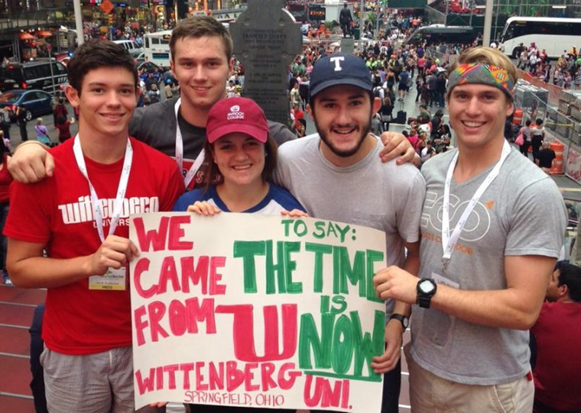
Dynamic factors supporting capacity
1) Wittenberg Commitment Promises Engaged Learning = Support from Institutional Leadership
2) Community Initiatives: EarthCare, Local Food
3) Student co-curricular Clubs & academic interests in environmental issues & sustainability grow
4) Visibility, Open Sharing, News, Public Events
5) Faculty commitment in the face of barriers (mixed & collaborative support methods/assistance to new implementers )
6) Consultation &
resources provided by
InTeGrate
7) Leveraging networks
to recruit new participants
Notes:
In spite of barriers to implementation, there were multiple factors supporting success in our effort.

Slide 23
Recommendations for Dynamic Support
1) Plan to support adaptation that fits individual courses
2) Reinforce Central Program Goals & Rubrics
3) See setbacks as opportunities to revise & recruit more aligned participants
4) At early stages, consider recruiting high capacity participants: pre-screen for teaching beliefs or willingness to meet the elements of the rubric that are new to them
5) Recognize that failure in one sphere does not mean failure in all (e.g. failure to implement a module, vs. failure to craft interdisciplinary sustainability curriculum needed for program)
6) Leverage resources/opportunities that have similar goals
(e.g. how does this tie into co-curricular, community, & resource focused efforts)

Slide 24
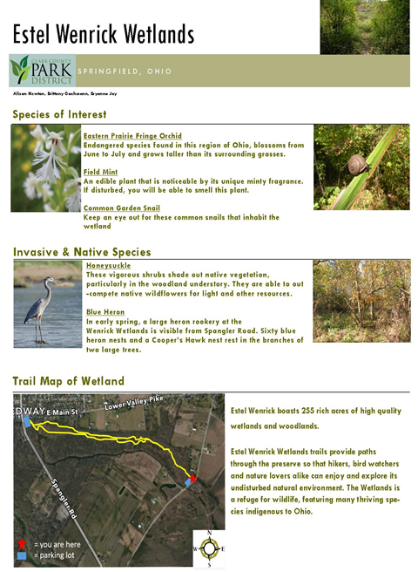
Collaborative Products
1) Workshops supporting implementation of engaged practices
2) Educational materials & consultation for community partners
3) Shared community events on Climate Change Events, Local Food Panels, Global Education Series, Science Museum, & Bioblitz Days
4) Student Resources such as shared labs, instrumentation, sampling equipment, internships, jobs
5) Professional activity joint abstracts, grants, research articles

Slide 25

Evidence of Success:
Increase in the number of faculty teaching sustainability
Increase in the number of programs involved in sustainability teaching (Business, Mathematics, Nursing, Political Science, French)
Increase in shared programing & curricular exchanges between faculty at Wittenberg, between Wittenberg & faculty at partner schools, & between Wittenberg & community stakeholders
All Freshmen are introduced to personal role in sustainability
Increase in the number of Environmental Science Majors
Student learning gains & positive attitudinal shifts shown through InTeGrate
Students learning gains in inquiry & analysis skills as they scaffold & through examining project artifacts such as figures, layout, & citations
Visibility for sustainability has grown in institutional & local media: 17 local articles featuring sustainability topics since 2014, 3 national
Multiple awards for effective teaching & community engagement for faculty leading this effort

Slide 26
Enduring collaboration
Cycle of Innovation
Capacity
Timeline clear
Just-In-Time communication
Mixed tools & support
Leveraged opportunities
Products
Align with established goals
Set the stage for next collaboration
Educative to multiple audiences
Improving Alignment of the Summative Assignment with Learning Goals & Guiding Principles
Synthesizing Concerns from Focus Group Feedback & Instructor Reflection
Identifying Revisions that Addresses Concerns & Scaffold Unit Content to Support Mastery of the Summative Assignment
Readiness
Goals inspire participants
Interest in collaboration
Resources ($)
Time, willingness,
a priori beliefs, fit

Slide 27
Opportunities:
Planning Underway
Sustainability Degree
Sustainability Certificate
Cross-curricular programing continues around grand challenge issues central to our community
Continued Growth in Environmental Science
Supporting networks between faculty-faculty & faculty-partners = program growth & interprogram growth; student learning networks grow parallel to this
Notes:
#s of students, #s of faculty, #s of courses (STARS)

Slide 28
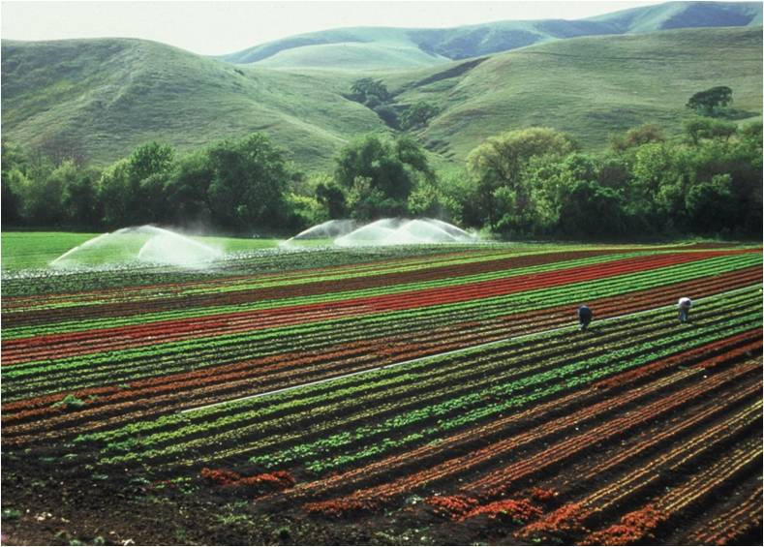
Thank You!
Ed Hasecke
John McDaris
Martha Murphy
Cailin Orr
Judith Ramaley
Hannah Scherer
Katie Warber
All those at InTeGrate!
USDA-NRCS, public use

