Slide 1
Geological Society of America (GSA) Annual Meeting Baltimore, Maryland, USA, November 1 - 4, 2015
“On the Importance of International Standardization of Methodologies and Techniques for Laboratory and Field Calibration of Soil Water Measurement Sensors Based on Capacitance, Impedance, and TDT”
Dr. Ioan C. Paltineanu
PALTIN International Inc.
Laurel, Maryland, USA

Slide 2
i) to search (data mining) both published papers and unpublished reports (in the last two decades) for methods and techniques used in: “manufacturer's bench testing” and/or “independent laboratory or field calibration studies” of EM soil water measurement sensors and probes; ii) to critically analyze the available data, interpret, and to find similarities and differences in characterizing the sensors direct output or the scaled response (frequency, voltage, etc) performed in: air and distilled water (at room temperature ~22 deg C.); reference (standard) dielectric liquids; controlled repacked soils of known intrinsic characteristics (texture, clay mineralogy, organic content, etc..).
OBJECTIVES:

Slide 3
iii) to recommend a minimal set of experimental protocols for mandatory: - “description of a specific sensor's characteristics”; - “test requirements” to be performed in: - air and in distilled water at room temperature(~ 22 deg. Celsius); - reference (standard) dielectric liquids; - controlled repacked soils of known intrinsic characteristics (texture, clay mineralogy, organic content, etc..); - “statistical analysis and interpretation procedures”; in order to be taken into consideration for future international standardization proposals.
OBJECTIVES (continued)

Slide 4
Theory on dielectric properties of soils and practical applications for soil water measurement using capacitance, impedance and TDT:
The correlation between the apparent dielectric constant of the soil-air-water mixture (Ka), and the volumetric soil water content (Ɵv), at different electromagnetic field frequencies, as well as a brief description of Time Domain Reflectometry (TDR) and Capacitance methods to measure this relationship, based on worldwide published reports, was described by Paltineanu and Starr (1997).
Overall the apparent dielectric constant (Ka) is a function of many factors including:
- electromagnetic frequency (F);
- temperature (T);
- salinity (S);
- volumetric water content (Ɵv);
- ratio of the bound water (Ɵbw) to the free water (Ɵfw), which is related to the soil surface area per unit volume;
- bulk soil density (ρb); shape of soil particles; shape of the water inclusions.
In the case of “fixed frequency capacitance based sensors”, operating in the lower part of the radiofrequency band (20 – 150 MHz), the dielectric constant of soils can be measured by capacitance.

Slide 5
According to Dean et al., (1987): “the relation between the measuring capacitance (C) and the dielectric constant (ɛ) is:
C = g ɛ [2]
where g is a geometrical constant that is difficult to calculate for other than simple electrode geometries”. Also, these authors, based on previous information from Hasted, J. B. (1973), reported that “there is no simple relation between the dielectric constant and the volumetric water content, “So, the overall relation must be determined empirically by calibration against a standard technique”, Dean et al., (1987).
F = f (Ɵv) [3]
Data on the generalized relationship between the Ɵv (m3/m3) and the dimensionless Scaled Output of a specific sensor [ex.: frequency (SF); or voltage (SV)], for different EM sensors based on capacitance and impedance calibrated under laboratory conditions were presented by Paltineanu, I. C. and I. Paltineanu (2007):
Ɵv = aSO^{b} [4]
SO = (Oair – Osoil)(Oair - Owater)⁻¹ [5]
where: O is the specific sensor’s output (ex. frequency - F, or voltage - V) measured in air, in distilled water, and in soil at room temperature (~22˚C). Coefficients (a) and (b) in formula [4] are obtained experimentally by laboratory calibration under controlled conditions.

Slide 7
Model name and type: | Independent laboratory calibration | References
EnviroSCAN, Fringe Capacitance (100 - 150 MHz) | air, water, | Paltineanu, I. C., et al., 1993*
semi permanent probe for soil water content, | air, water, repacked soils, EC | Mead, R. M., et al., 1995
multiple pairs of cylindrical brass electrodes | air, water, repacked soil, temp. | Paltineanu, I. C., and J. L. Starr, 1997
of equal heights (25 mm); O.D. (50.4 mm); | air, water, repacked soil, EC, temp. | Baumhardt, R.L., et al., 2000
with separation space (12.6 mm). | air, water, repacked soil | Williams, B., et al., 2003
 | std. liquids | Kelleners et al., 2004a
Manufacturer: | air, water, repacked soil, EC, temp. | Scobie, M., 2006
Sentek Sensor Technologies Pty. | air, water, repacked soil, temp. | Evett, S. R., et al., 2006
Stepney, SA, Australia | air, water, std. liquids | Schwank, M., et al., 2006
(United States Patent - US5418466) | air, water, repacked soil, EC | Gabriel, L. J., et al., 2010.
Watson et al, 1995 | air, water, repacked soil | Mounzer, O., et al., 2010
 | air, water, repacked soil | Rowland, R., et al., 2011
 | air, water, std. liquids, EC, soil | Avanzi, F., et al., 2013

Slide 8
Model name and type | Independent laboratory calibration | References
Hydra Probe, Impedance (50 MHz): | (in air, water, std. liquids, soils) | * unpublished data
portable and semi permanent probe for | air, water, repacked soil | Paltineanu, I. C., 2000*
soil water/EC/temperature, permittivity, | soils, freeze-thaw | Hanek, L. G., et al., 2001
four parallel stainless steel electrodes, | air, water, repacked soil, std. liquids | Seyfried, M. S., and M. D. Murdock, 2002
(1 in the center + 3 peripheral parallel shield rods) | air, water | Loiskandl, W., et al., 2003
of (4 mm diameter X 58 mm length/each). | air, water, repacked soil, std. liquids | Seyfried, M. S., and M. D. Murdock, 2004
 | soils | Bosch, D. D., 2004
Manufacturer | soils | Leao, T. P., and E. Perfect., 2007
Vitel, Inc. | soils | Leao, T. P., at al., 2010
Chantilly, VA, USA | air, std. liquids, undisturbed soil cores | Logsdon, S. D., et al., 2010
(United States Patent - US5479104 A) | soils(organic) | Mortl, A., et al., 2011
Campbell, J. E., 1995 | air, water, repacked soil | Vaz, C. M. P., et al., 2013
Stevens Water Monitoring Systems, Inc.
Beaverton, OR, USA

Slide 9
Bench top testing in air, and in distilled water, at room temperature (~ 22⁰ C):

Slide 13
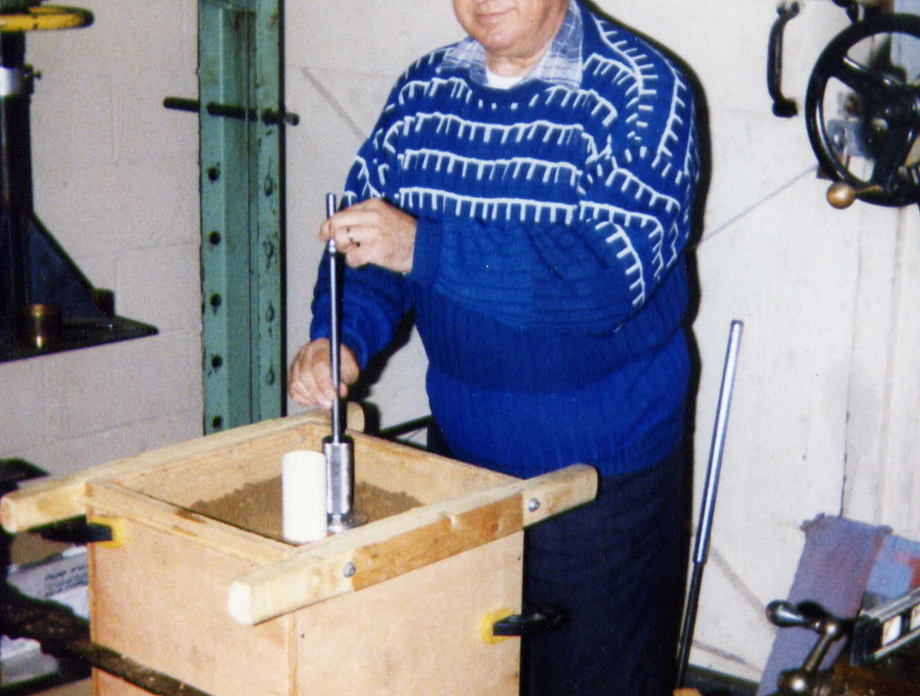
Picture 1. Experimental setup, using a 50 T hydraulic press, and details of volumetric soil water content and bulk density sampling (5 brass rings around the sensor) for laboratory calibration of fringe capacitance probe EnviroSCAN (Sentek Technologies), as reported by Paltineanu and Starr, (1997).

Slide 15
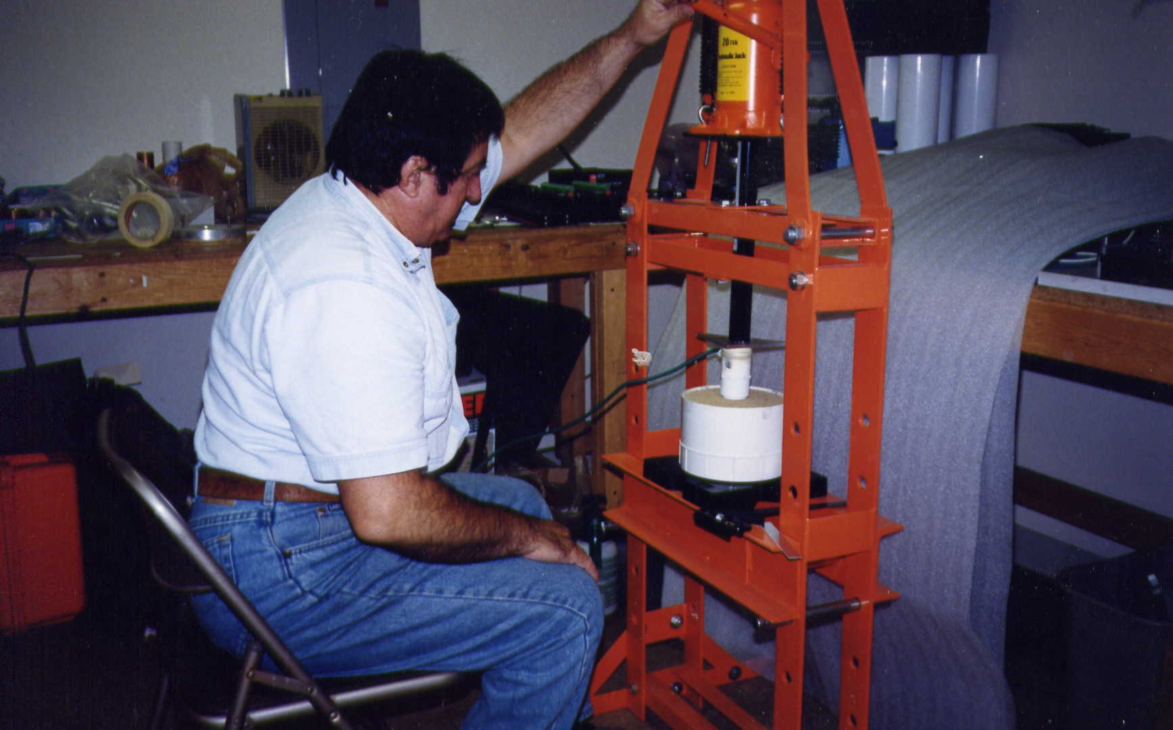

Slide 16
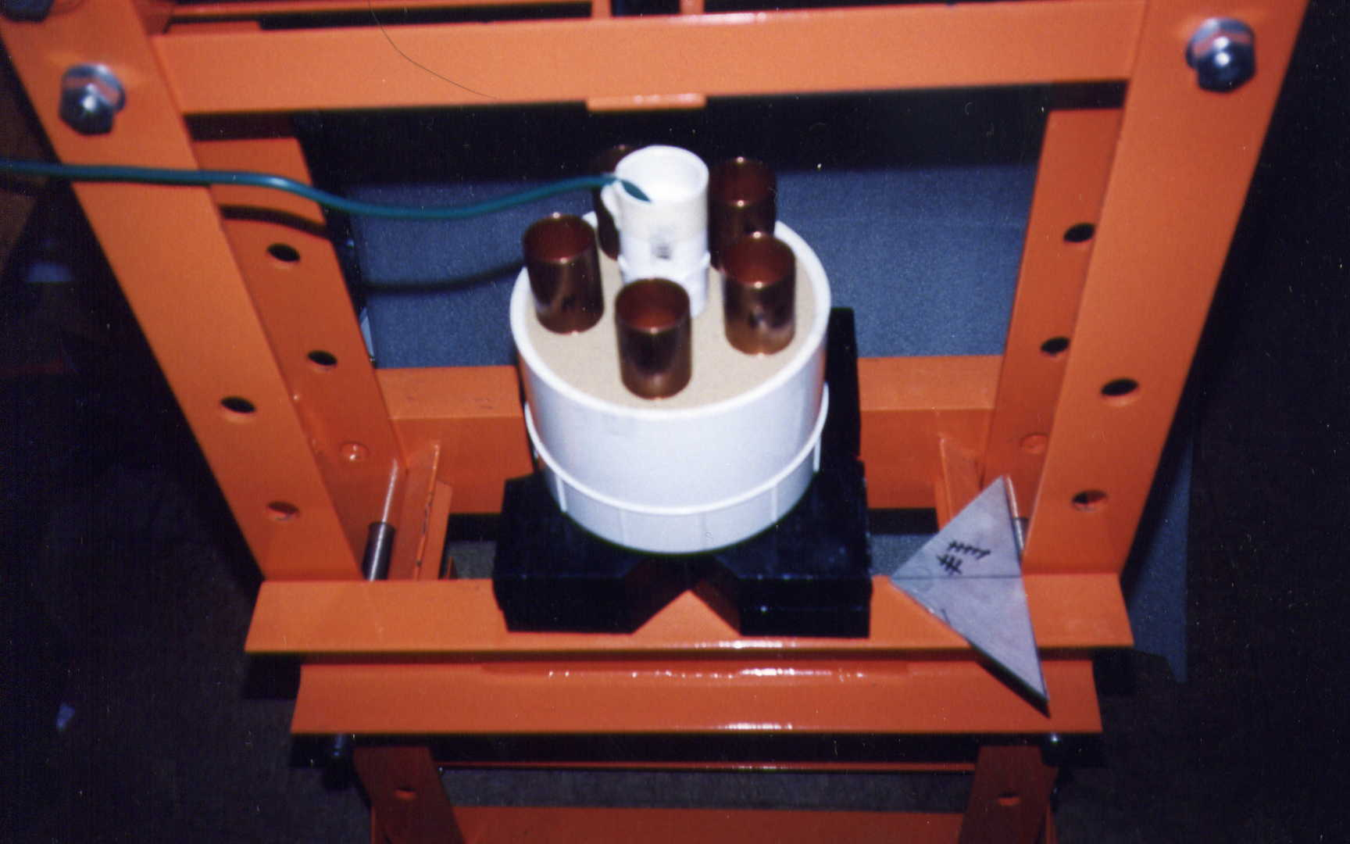

Slide 18
Table 2A Soil volumetric water content (Ɵv) vs. scaled frequency (SF) response function of fringe capacitance probe EnviroSCAN
calibrated in laboratory on specific soils from North America, Australia and Europe
Soils (location) | coeff. C | coeff. A | coeff. B | Domain of SF | Codomain of Ɵv | RMSE | R² | n
 |  |  |  | min. to max. | min. to max.
Mattapex Silt Loam | 0 | 0.49 | 2.167 | 0.39 → 0.89 | 0.07 → 0.38 | 0.009 | 1 | 15
(Beltsville, MD, USA)
Reference: Paltineanu, and Starr, 1997
Sand, Sandy Loam and Clay | 0 | 0.522 | 2.046 | 0.30 → 0.95 | 0.05 → 0.45 | 0.031 | 0.9 | 38
(Fresno, CA, USA)
Reference: Mead, R. M., et al., 1995
Sandy Loam, Loamy Sand | 0 | 0.5 | 2.231 | 0.35 → 0.90 | 0.04 → 0.42 | 0.016 | 1 | 24
(Adelaide, SA, Australia)
Reference: Dighton, J. C., and P. J. Dillon., 1993 (unpublished data)

Slide 19
Table 2A (continued)
Soils (location) | coeff. C | coeff. A | coeff. B | Domain of SF | Codomain of Ɵv | RMSE | ^{R²} | n
 |  |  |  | min. to max. | min. to max.
Olton Soil, 2:1 clay mineralogy, | 0 | 0.752 | 3.841 | 0.25 → 0.85 | 0.02 → 0.41 | 0.028 | 1 | 89
dominant montmorillonite,
pooled untransformed data
(Lubbock, TX, USA)
Reference: Baumhardt, R. L., et al., 2000
Pullman Soil, 2:1 clay dominant, | 0.024 | 0.605 | 3.812 | 0.35 → 0.95 |  | 0.022 | 1 | 178
illite and montmorillonite (smectite)
Soil A (silty clay loam) + B (clay).
(Bushland, TX, USA)
Reference: Evett, S. R., et al., 2006
Pullman Soil, 2:1 clay dominant, | 0.041 | 0.781 | 4.981 | 0.35 → 0.95 |  | 0.018 | 1 | 90
illite and montmorillonite (smectite)
Soil C, clay loam (containing 50% CaCO3)
(Bushland, TX, USA)
Reference: Evett, S. R., et al., 2006
Typic Xerochrept, Silty Clay Loam Soil | 0 | 0.482 | 3.097 | 0.27 → 0.95 | 0.015 → 0.455 | 0.027 | 1 | 672
illite and montmorillonite
(Aranjuez, Madrid, Spain)
Reference: Gabriel, J. L., et al., 2010 & Quemada, M., et al., 2010

Slide 20
Fig.2A. Laboratory calibration of EnviroSCAN fringe capacitance probe studies performed on different soils from North America, Australia and Europe (adaptation from: Paltineanu and Star 1997; Baumhardt et al., 2000; Evett et al., 2006; Gabriel et al., 2010; and Quemada et al., 2010)

Slide 21
Fig. 2B. Comparison of laboratory and field calibration of EnviroSCAN performed on soils from North America and Europe (adaptation from: Paltineanu and Starr, 1997; Guber et al, 2010; Gabriel et al., 2010, and Quemada et al., 2010)

Slide 22
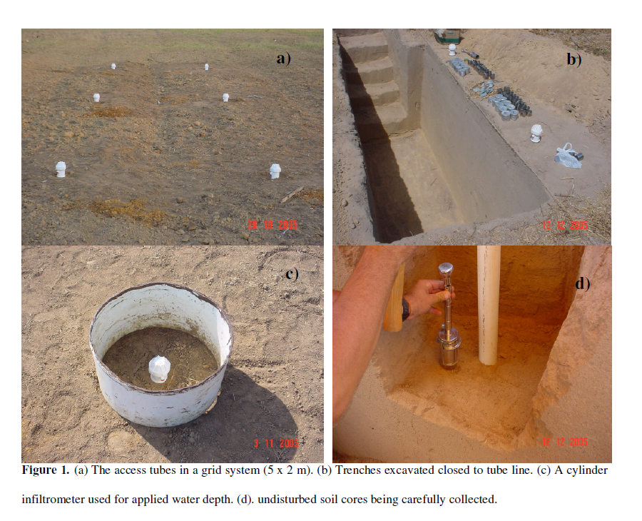

Slide 23
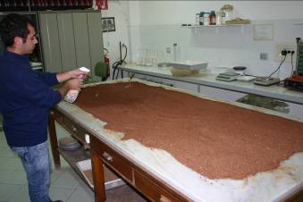
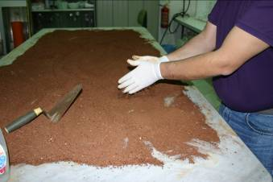
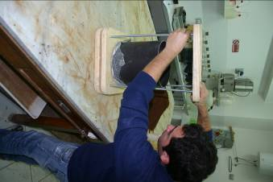
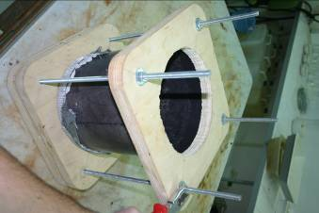
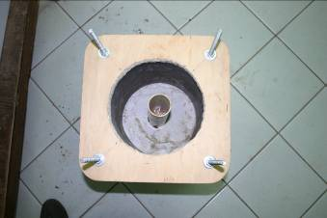
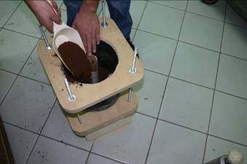
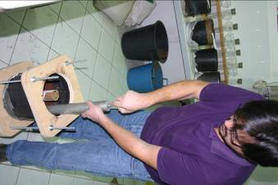
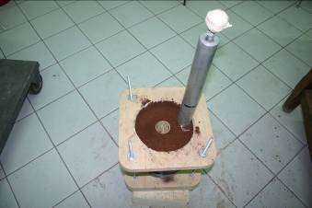
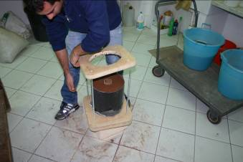
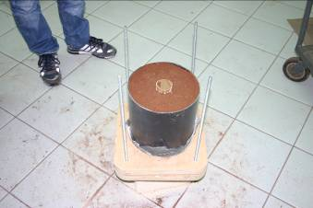
Laboratory Calibration of Diviner2000 (Sentek Pty, Australia) on soils from Sicily, Italy, as reported by Rallo, G., et al., 2012, 2014

Slide 24
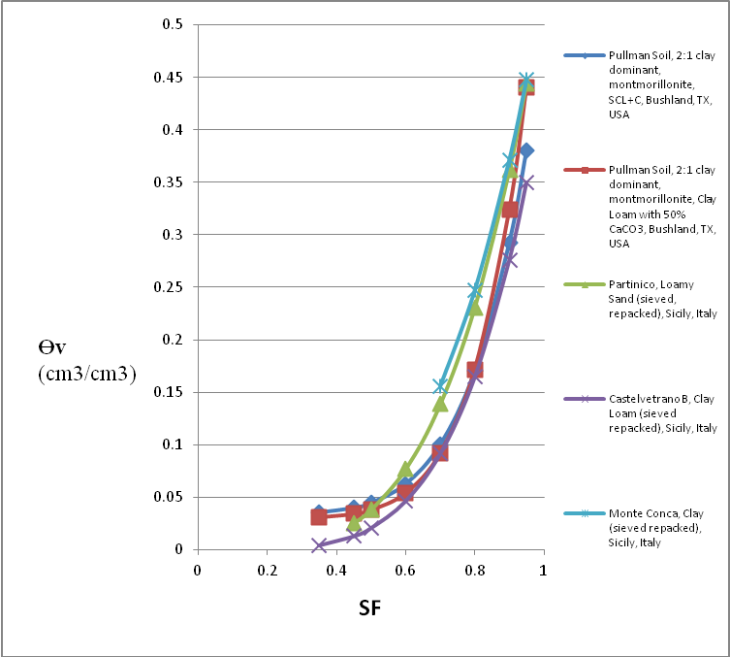
Fig. 3A. Laboratory calibration of Diviner2000 fringe capacitance sensor studies performed on different soils from North America and Europe (adaptation from: Evett et al., 2006; Rallo et al., 2012 and 2014)

Slide 25
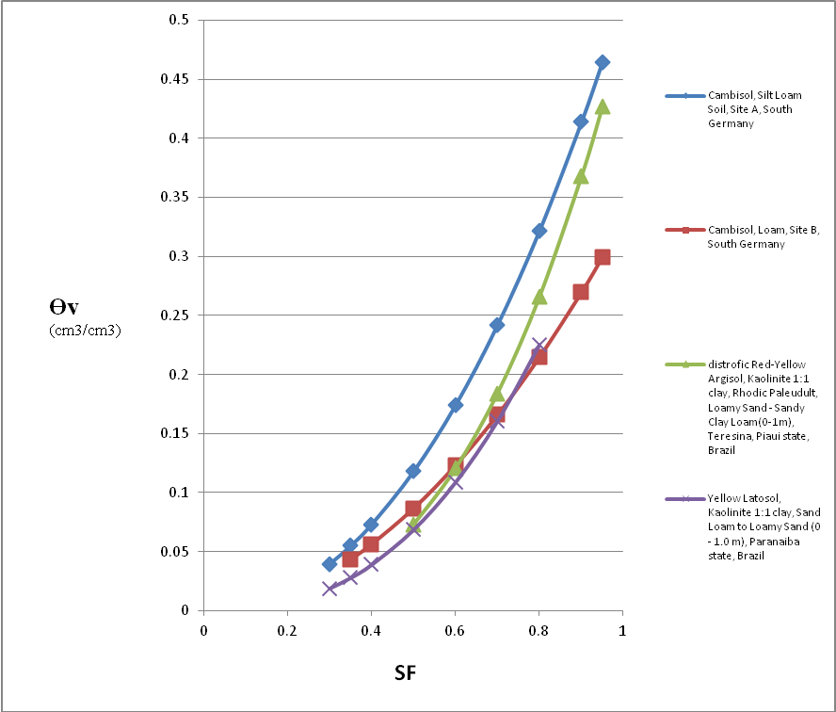
Fig. 3B. Field calibration of Diviner2000 fringe capacitance sensor studies performed on different soils from South America and Europe (adaptation from: Geesing et al., 2004; Silva et al., 2007; Andrade et al., 2010)

Slide 26
CONCLUSIONS and RECOMMENDATIONS:
After two decades of accumulated experience on using diverse methodologies, materials and techniques for both laboratory and field calibration methods, of commercial EM sensors based on capacitance, impedance and TDT, it is important to elaborate international agreed protocols and standards in order to guide the potential users in their research and practical application projects.
A minimal of experimental protocols describing sensors and test requirements as well as statistical analysis and interpretation should include: frequency(s) of operation; response of sensors in air and distilled water at room temperature ( ~22 deg. C); detailed description of soil intrinsic characteristics (texture, clay mineralogy, EC, organic material, gravel content, etc..); method and techniques for uniform soil repacking and compaction (coefficient of uniformity for dry and wet bulk density around the sensor); axial and radial sensitivity of sensors in distilled water, in air – water and in air – soil interfaces, as well as in soil at different depths; rotational orientation response of cylindrical sensors inside access tubes; sensors response in controlled levels of temperature in air, in distilled water, and in soil; sensors response at different soil EC and temperature conditions; soil volumetric water content Ɵv (m3/m3) versus SO scaled output(frequency, voltage, etc..); description of specific liquid of known dielectric constant, etc..
It is important that both the sensor output (voltage, SF, etc.) relationship with the apparent dielectric constant, along with the intrinsic apparent dielectric constant to the volumetric soil water content curve should be published.
Special experimentation criteria and reporting of results must be elaborated to better describe how soil salinity can distort the measurement of apparent soil volumetric water content.

