Slide 1

Potential over-development and aquifer co-mingling in the Hensell “Middle Trinity” aquifer; A study with bi-partisan management support
Jim Tucker
Baylor University – Southern Trinity Groundwater Conservation District – Clearwater Underground Water Conservation District

Slide 2
Presentation Overview Part 1
Population Growth, Groundwater Production, and Management
Extent of aquifer and identification of study area
Growth locations and high production areas
Purpose and cooperation between groundwater conservation districts in Groundwater Management Area 8
Introduction to the Middle Trinity Aquifer
Regional stratigraphy
Depositional environment

Slide 3
Presentation Overview Part 2
Desired Future Conditions and Declining Water Levels
Defining Desired Future Conditions
Co-mingling Between the Upper and Middle Trinity Aquifers
Water migration into the freshwater Middle Trinity Aquifer from the high TDS Upper Trinity Aquifer
Migration pathways, natural or artificial
Chemical analysis of Middle Trinity water in the study area
Preliminary Conclusions

Slide 4
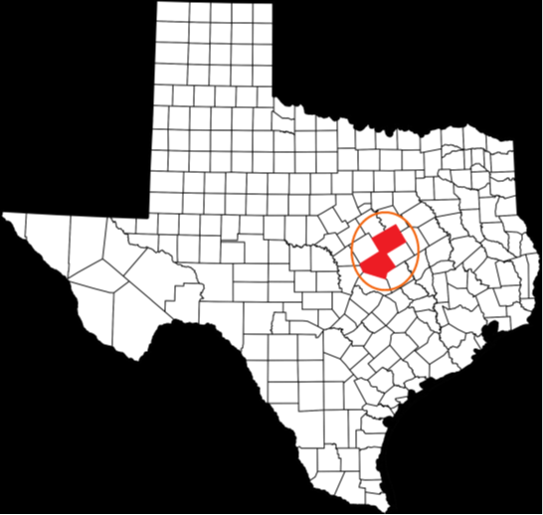

Study Area – McLennan and Bell County, TX

Slide 5
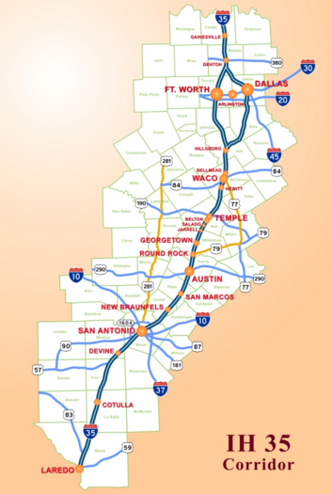
Population Growth and Production Needs
Texas populations are expected to increase by 60% by 2030
In central Texas this population growth is concentrated along the I-35 corridor, which runs through the study area
The Middle Trinity Aquifer is primarily produced to meet domestic, municipal, and agricultural demands
http://tti.tamu.edu/

Slide 6
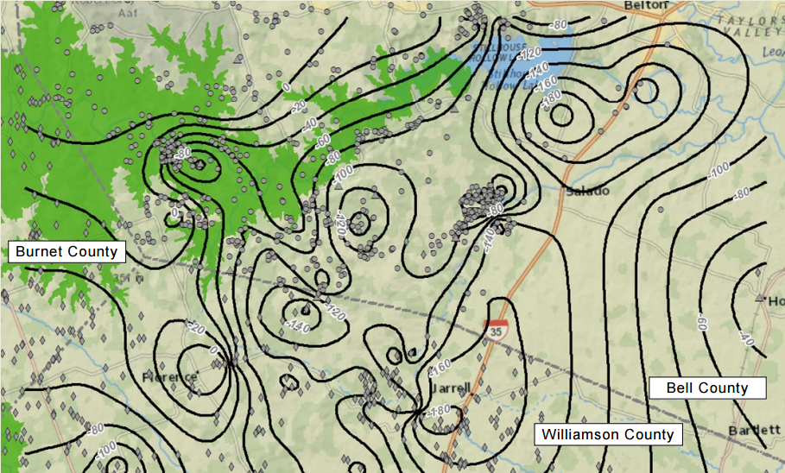
Population Growth and Water Level Declines
Population growth along I-35 is increasing production
Water levels declines along the I-35 corridor are compounded by clusters of high capacity wells
Water level changes 2011-2014 – CUWCD.org

Slide 7
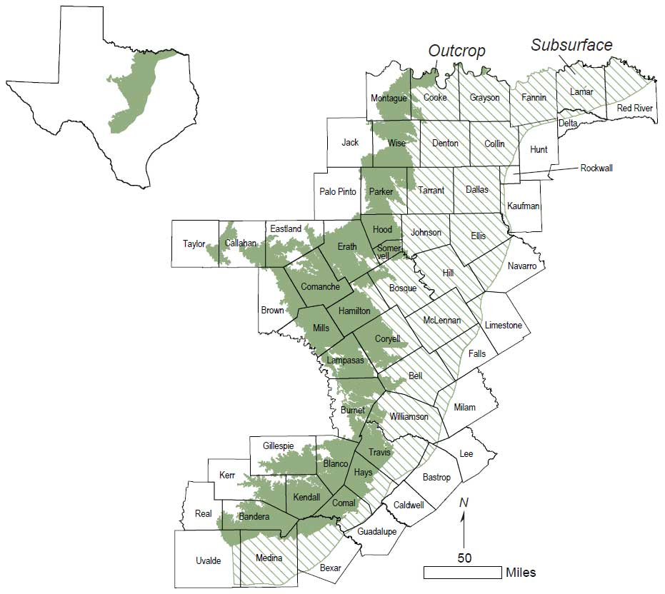
Introduction to the Middle Trinity Aquifer
The Trinity aquifer, stretches from Southern Oklahoma to Central Texas
It is a major aquifer system with three aquifers:
Upper Trinity
Middle Trinity
Lower Trinity
The Middle Trinity or Hensell Formation is a freshwater sandstone aquifer
CUWCD.org

Slide 8
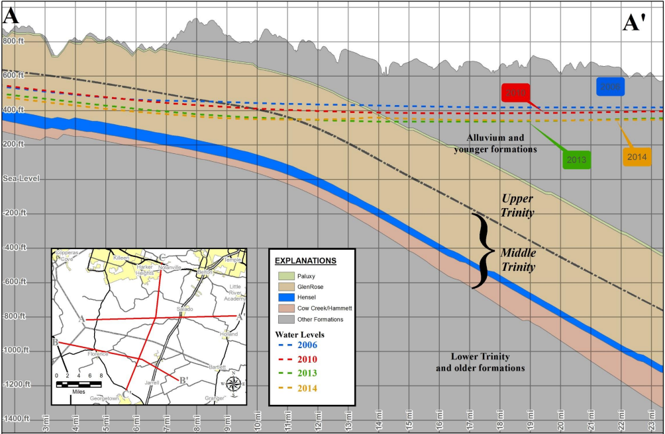
Middle Trinity Aquifer
Keister, 2014

Slide 9
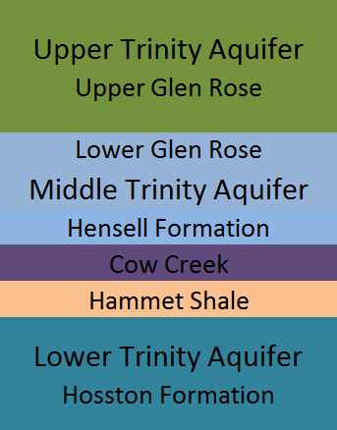
Depositional Environment
The Middle Trinity aquifer or Hensell Formation is a sandstone that was deposited during the Cretaceous period
It is a result of a series of transgressive and regressive near shore shifts part of the Western Interior Seaway

Slide 10
Groundwater Conservation Districts (GCDs)
Groundwater Conservation Districts were formed to serve as a management entity to protect and regulate the groundwater
Bell County – Clearwater Underground Water Conservation District
McLennan County – Southern Trinity Underground Water Conservation District
Funding for hydrogeologic research

Slide 11
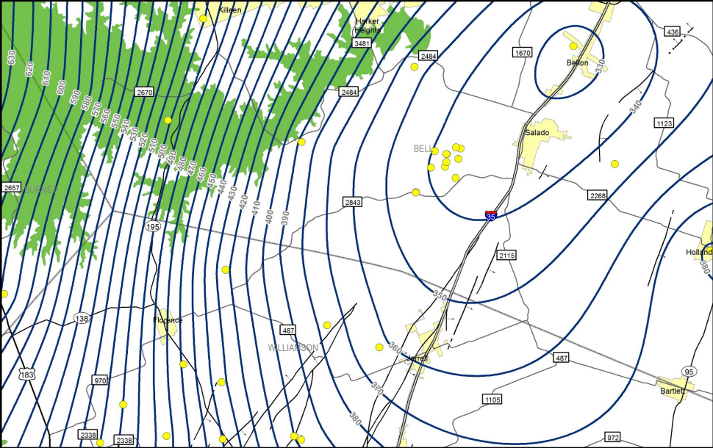
Declining Water Levels
Groundwater Conservation Districts manage their district, but the entire area has a hydrologic connection
LBG Guyton

Slide 12
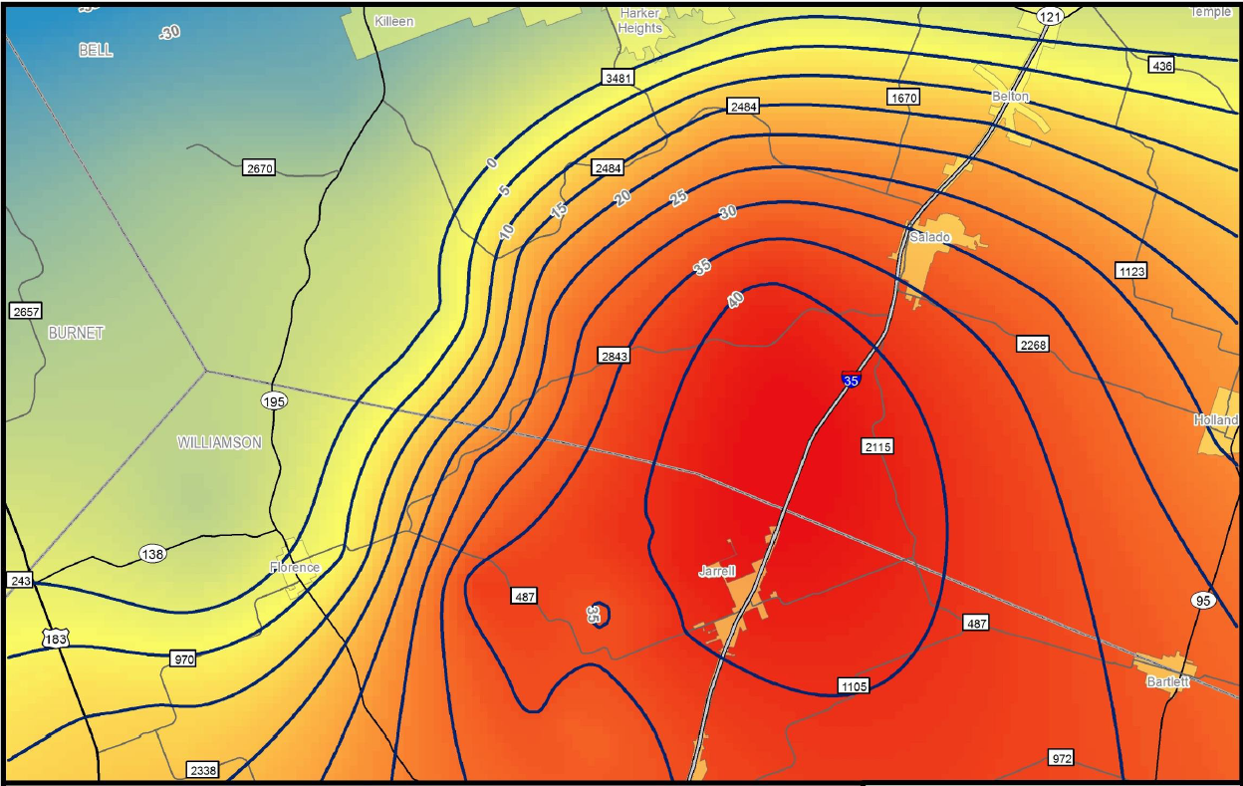
Declining Water Levels
Change in water levels 2006-2010
Keister, 2014

Slide 13
Desired Future Conditions (DFCs)
The Groundwater Conservation Districts set desired future conditions or DFCs for a 50 year period
These DFCs are based on historic water levels changes, current production rates, and Managed Available Groundwater (MAG)
Middle Trinity DFCs
Bell County: 286 ft/50 years or 5.72 ft/yr
McLennan County: 489 ft/50 years or 9.78 ft/yr

Slide 14
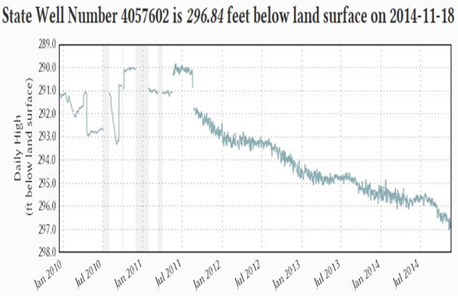
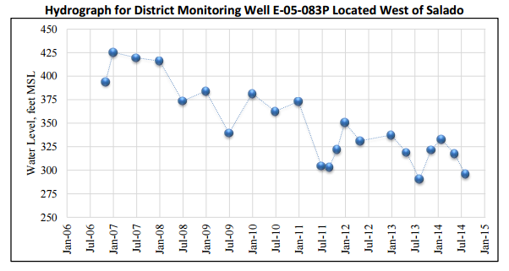
DFCs and Declining Water Levels
The Middle Trinity is experiencing observed water level declines ranging from 2-10 feet annually.
-12.44 feet/yr
-1.67 feet/yr
DFC = 5.72 ft/yr
DFC=9.78 ft/yr
STGCD.org
CUWCD.org

Slide 15
Co-Mingling and Water Quality Degradation
The Upper Trinity aquifer or the Upper Glen Rose Formation is a highly fractured limestone bearing brackish water
The Upper Glen Rose is a formation with seams of gypsum that dissolve into solution causing high levels of total dissolved solids in the water
Decreasing head levels in the Middle Trinity may be allowing brackish water from the Upper Trinity to migrate downward, degrading water quality

Slide 16
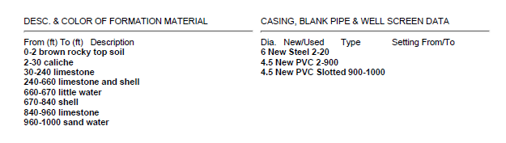

Possible Migration Pathways for Co-mingling
The pathway of migration may be natural, artificial, or both
The fractured nature of the Glen Rose limestone may provide a natural conduit for migration
Alternately, poorly completed wells may allow migration along the outer well casing, or through the well column in wells screened in both the Middle Trinity and Upper Trinity aquifers

Slide 17
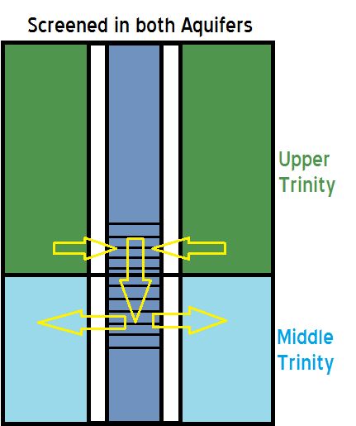
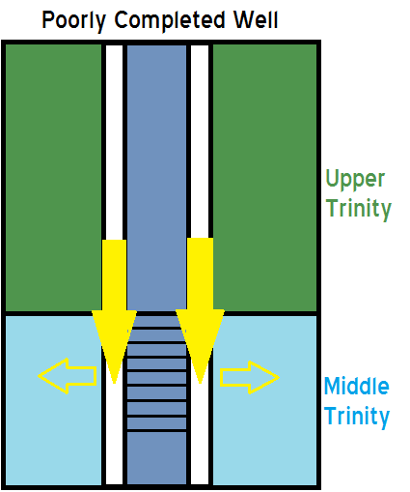
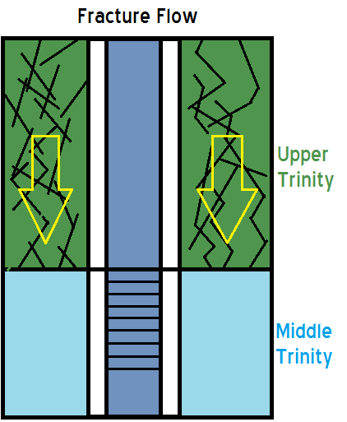
Migration Pathways

Slide 18
Water Chemistry and Co-mingling
Within the study area, 26 wells were randomly selected to be sampled
The analysis focused on TDS and the ionic concentrations of Na, K, Ca, Mg, Cl, HCO₃, and SO₄
In the ion analysis, SO₄ was used as a indicator for potential co-mingling, as gypsum (CaSO4) dissociates into Ca + SO₄

Slide 19
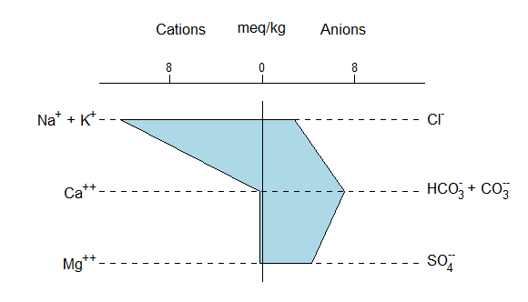
Water Chemistry Analysis
Stiff diagrams were generated to show spatial variation of the wells sampled within the study area

Slide 20
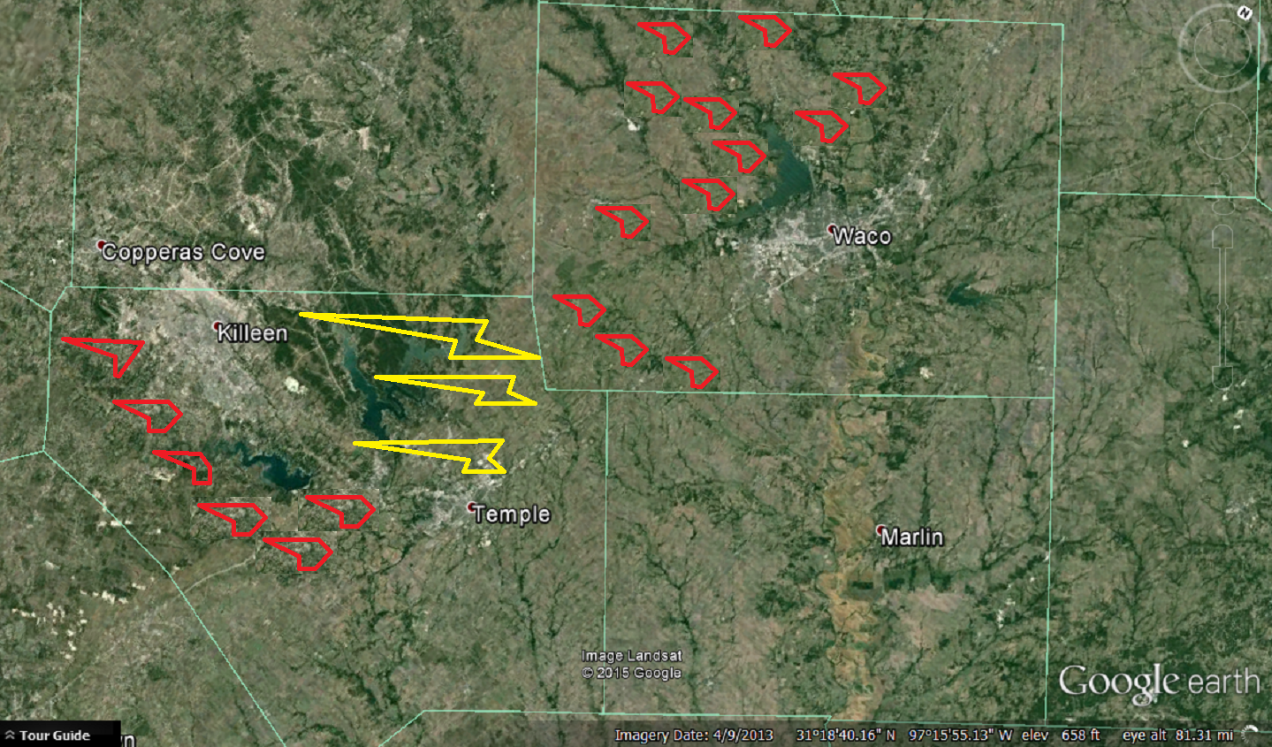
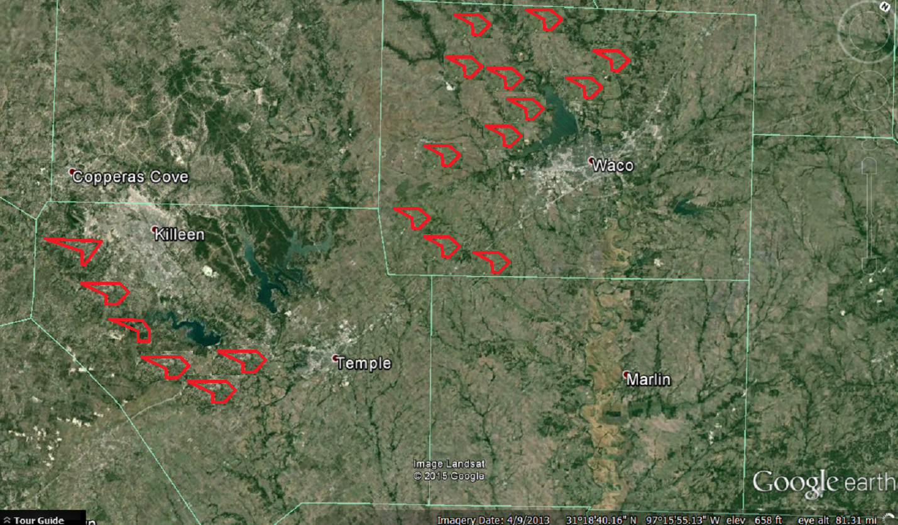

Water Chemistry Analysis

Slide 21
Preliminary Conclusions
Increased drawdown is occurring across GCD boundaries in the Middle Trinity in southern Bell County:
Recommendations for cooperation in future management strategies will be submitted to the GCD boards
The water quality of the Middle Trinity in Northern Bell County appears to be adversely effected by possible co-mingling:
Natural migration: water movement through fractured limestone in the Upper Trinity
Artificial migration: poorly completed wells allow migration along the well column

Slide 22
Cooperation with GCDs
Single County GCDs have historically managed their county without cooperation or sharing ideas with neighboring GCDs
Since the aquifers flow across county lines it is important to have GCDs working with each other to set similar DFCs
Through this research, lines of communication have been enhanced between the GCDs of Bell and McLennan County, with the hope that future management strategies will be implemented across district lines

Slide 23


Special thanks to:
The Southern Trinity Groundwater Conservation District
The Clearwater Underground Water Conservation District
My Advising Committee: Dr. Yelderman, Dr. James, and Dr. Tubbs
Scooter Radcliffe
Dirk Aaron

