Slide 1
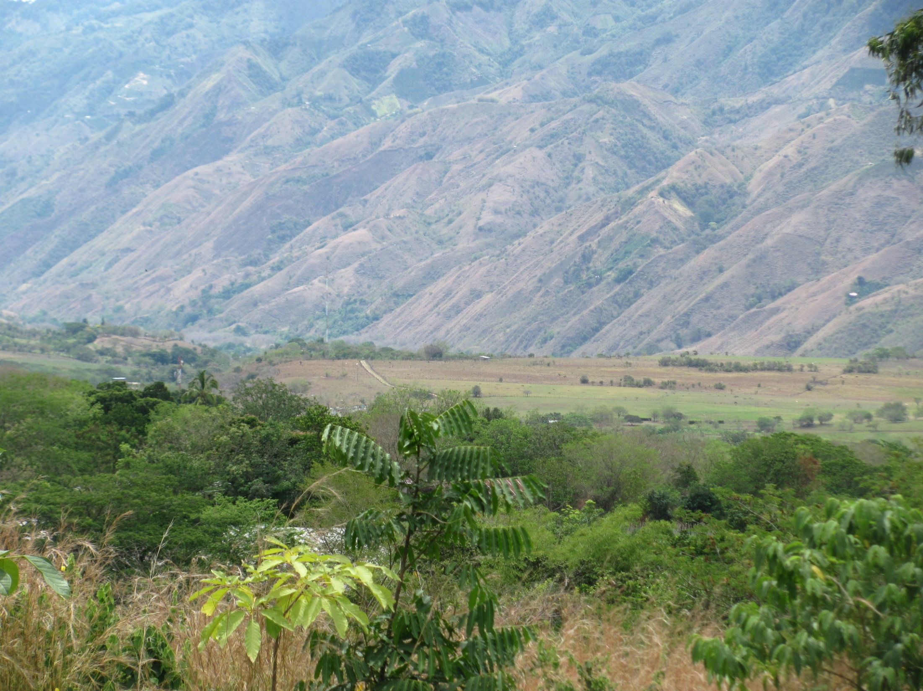




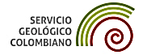
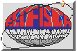
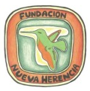
THE SEISMICITY OF THE ALGECIRAS FAULT SYSTEM, SOUTHWESTERN COLOMBIA
GERMÁN CHICANGANA Facultad de Ingeniería Civil, Universidad Santo Tomas, Villavicencio, Colombia, germanchicangana@usantotomas.edu.co
CARLOS ALBERTO VARGAS-JIMENEZ Departamento de Geociencias, Universidad Nacional de Colombia, Bogotá D.C, Colombia
HÉCTOR MORA - PAEZ GEORED, Servicio Geológico Colombiano, Bogotá D.C., Colombia

Slide 2
ABSTRACT
The Algeciras Fault System (AFS) is located in the Eastern Cordillera, south western Colombia. In this fault system has been allocated at least four big earthquakes in the last 230 years. All these earthquakes has affected mainly to Bogotá, and all these earthquakes has been magnitudes (M) > 7.0.
It described herein the seismicity registered by the Colombian National Seismological Network. Also, it shows the regional geotectonic skecht. The AFS is shaped by three thrust faults. From north to south these are: Guayuriba Fault (160 km long), the Algeciras Fault (149 km long), and the Garzon - Pitalito Fault (128 km long). The AFS is very near to the Colombian - Ecuadorian trench that is related with the subduction of the Nazca plate under South America. Nazca plate converges with South America to a speed of 7 cm/year. From the Colombian trench to the Eastern Cordillera from 2°N to 4°N there are less than 200 km away. In this región a retro arc basin located between Central and Eastern cordilleras. This basin is known as Alto Magdalena Valley (AMV). In this región the lithosphere is formed by three plates that from the west to east are: the old oceanic Caribbean plate that limits with Romeral Fault System with old continental Mesoproterozoic Grevillian (or Mexican Oaxaquian terrane) toward east, and the old continental crust of the Amazon Craton that limits by the AFS and NE trending subparallels faults with Mesoproterozoc Grenvillian terrane toward west.
The geotectonic analysis realized here help to improve the knowledge of the scope of seismic hazard for this fault system which not only affects its area of influence but also the center and west of the country, a region inhabited by more than 65% of the population of Colombia.

Slide 3
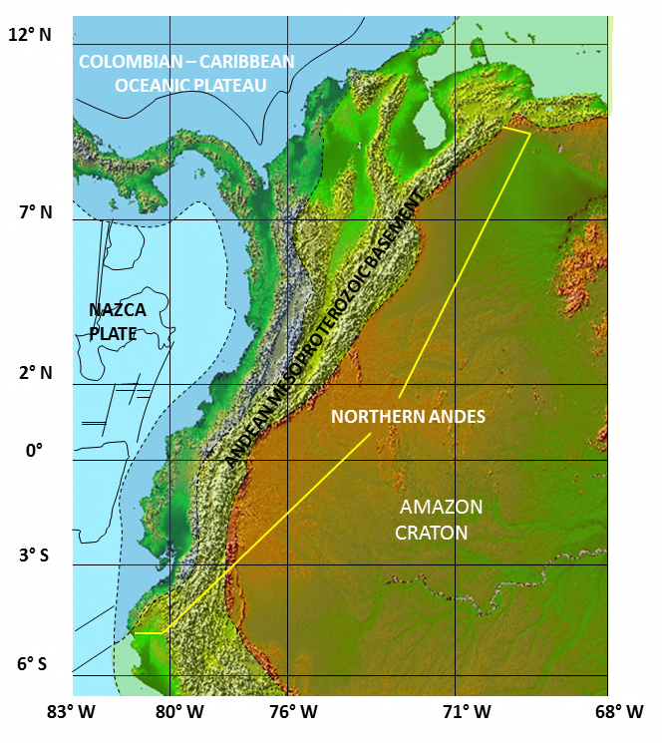

Slide 4
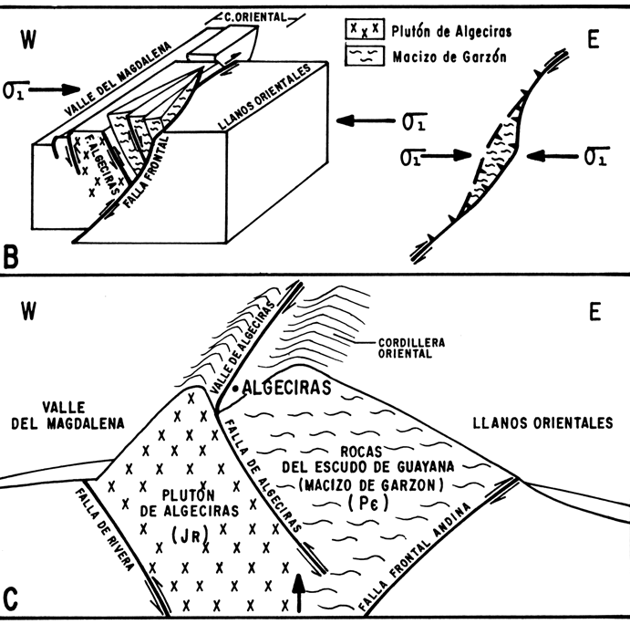
Vergara, 1996

Slide 5
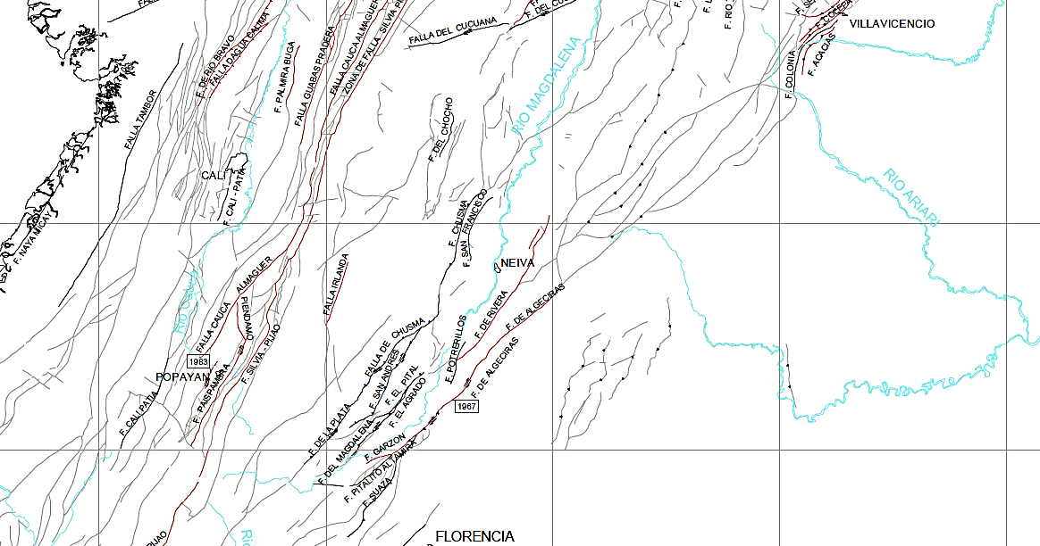
INGEOMINAS, 1999

Slide 6
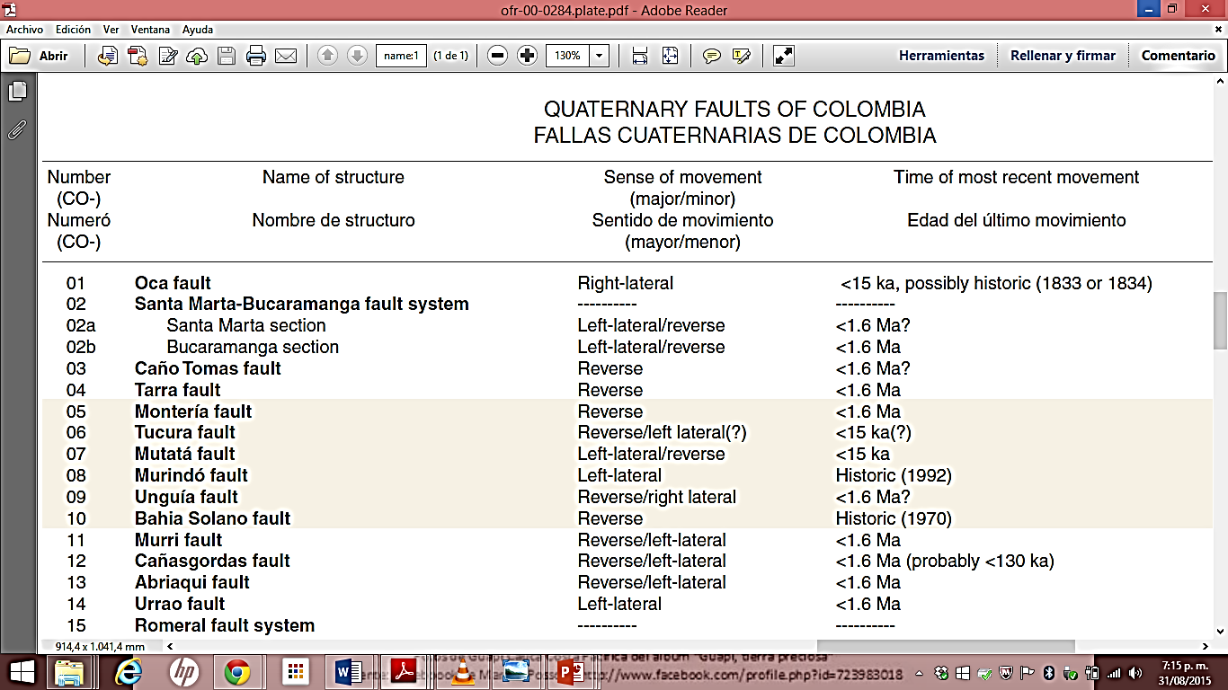
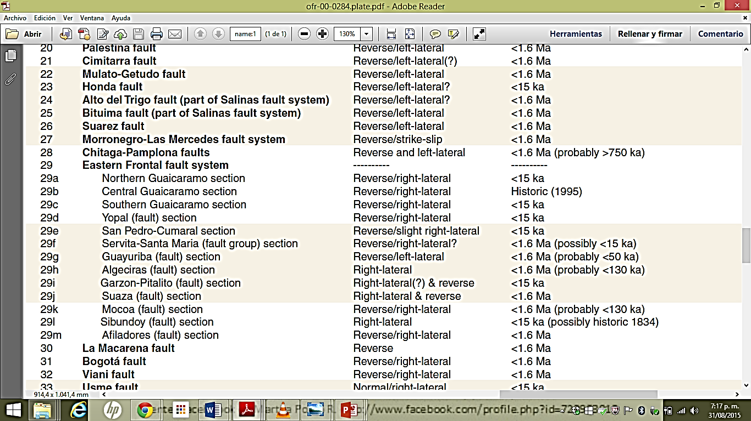
Paris et al., 2000

Slide 7
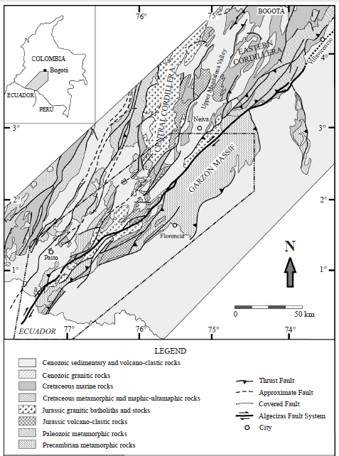
Velandia et al., 2005

Slide 8
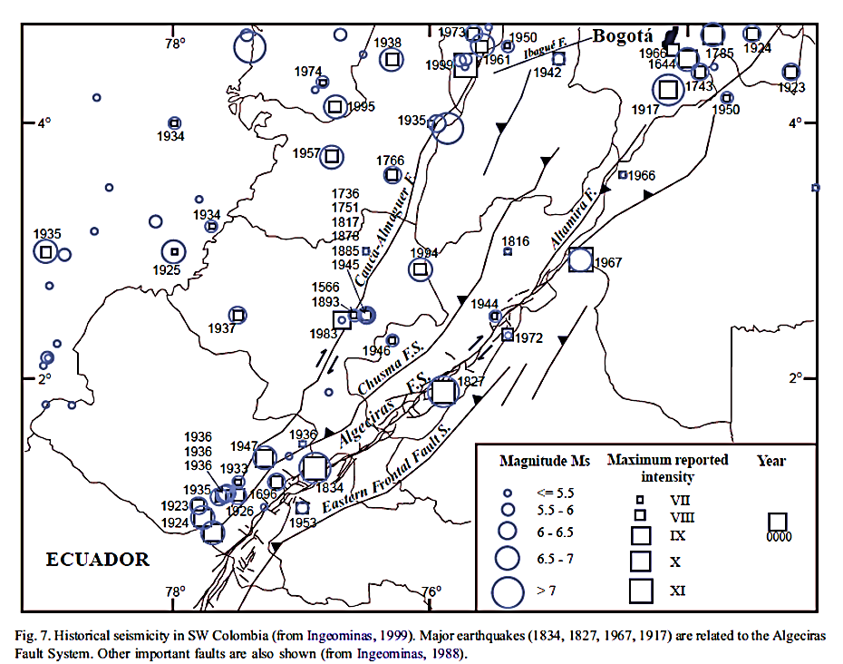
Velandia et al., 2005

Slide 9
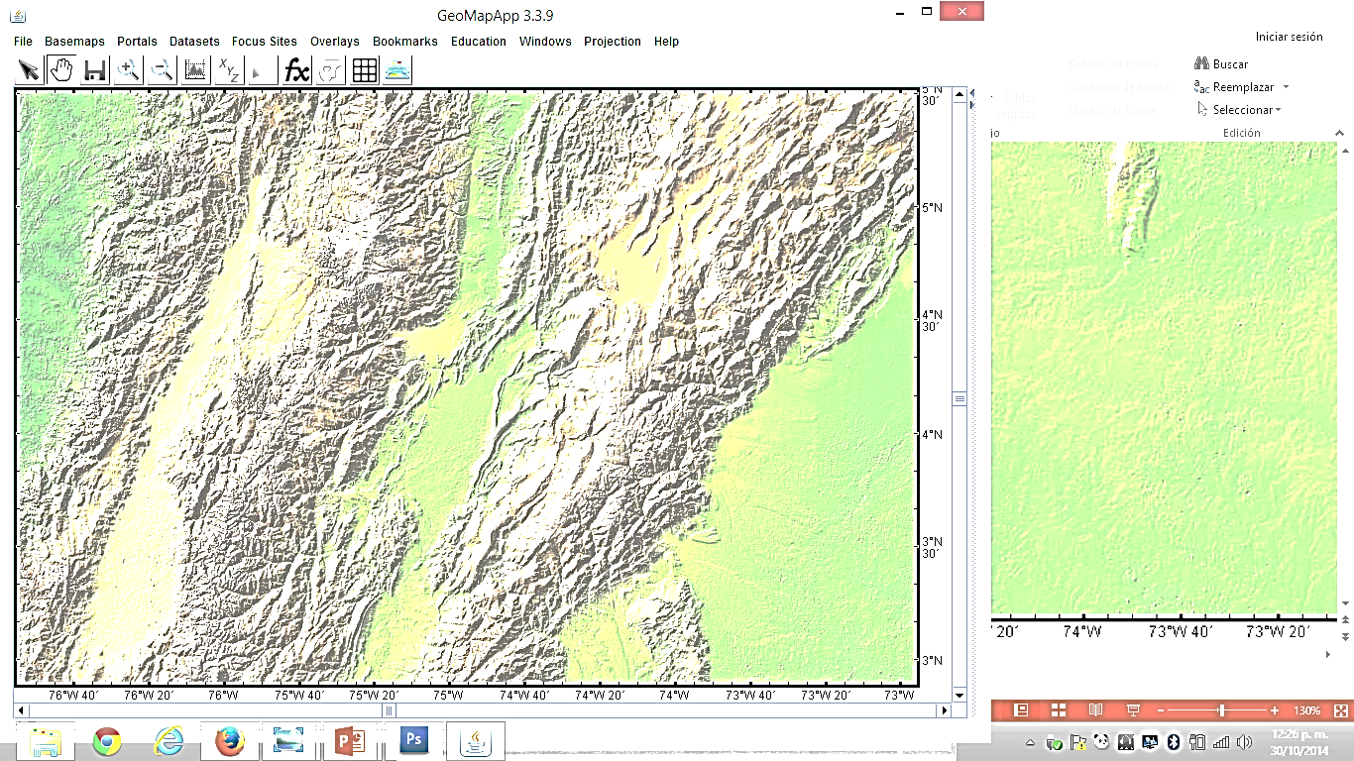
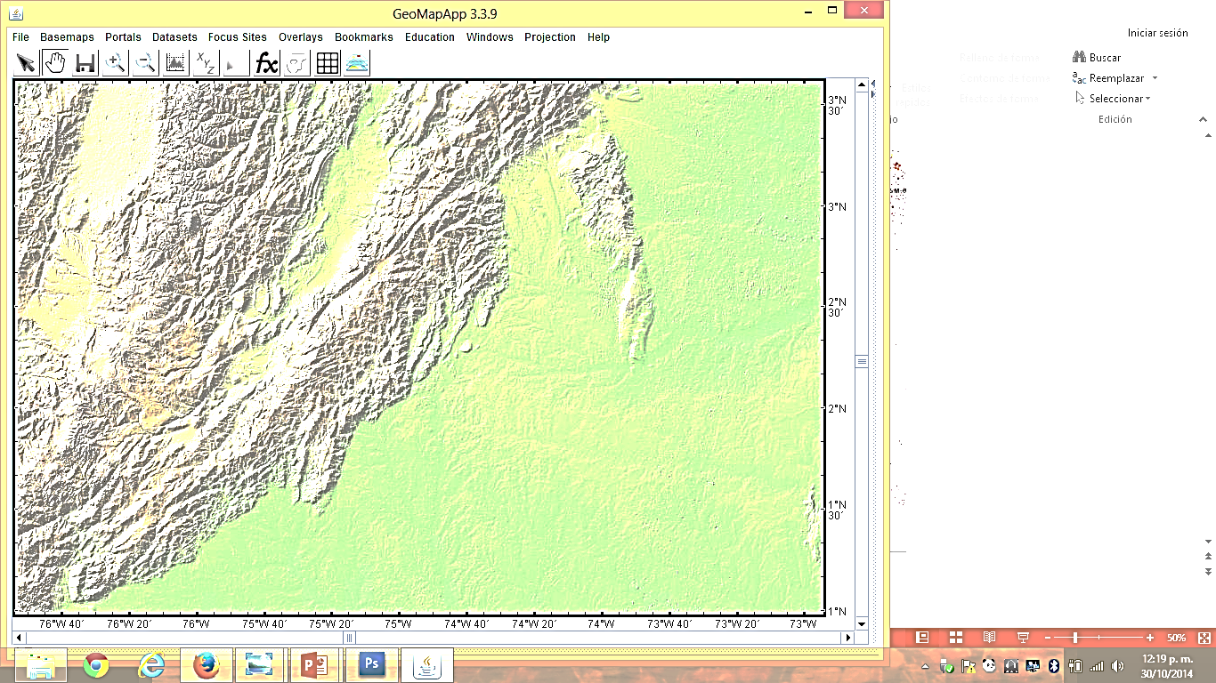

Slide 10
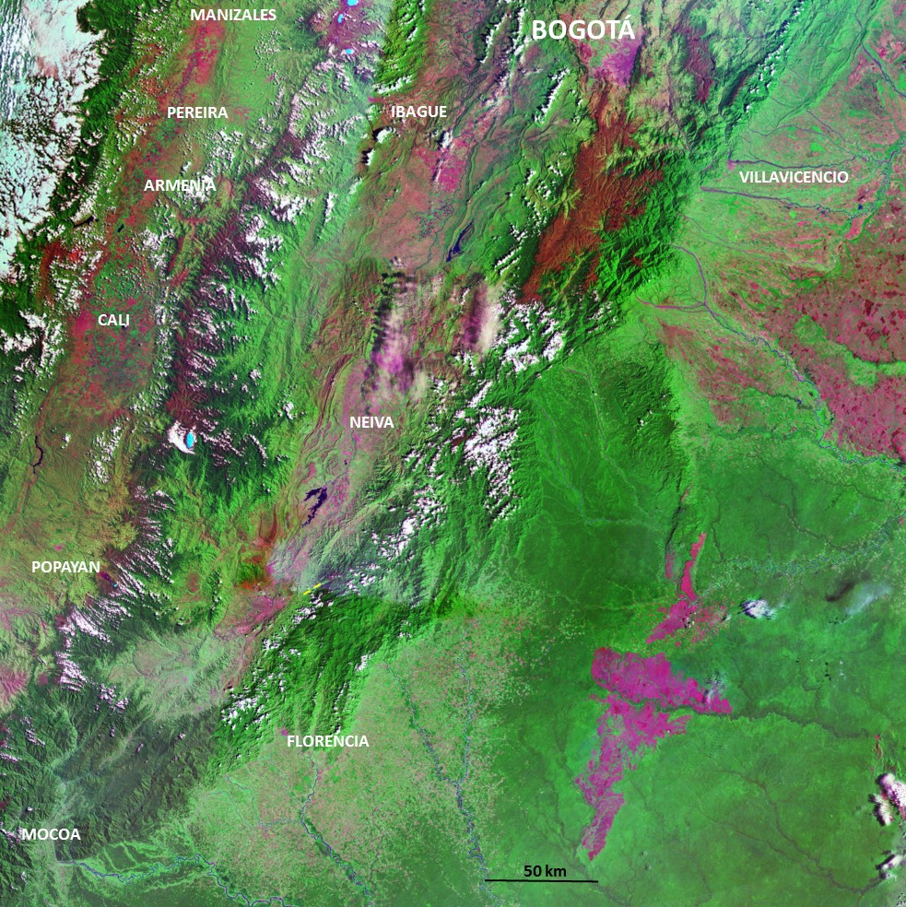

Slide 11
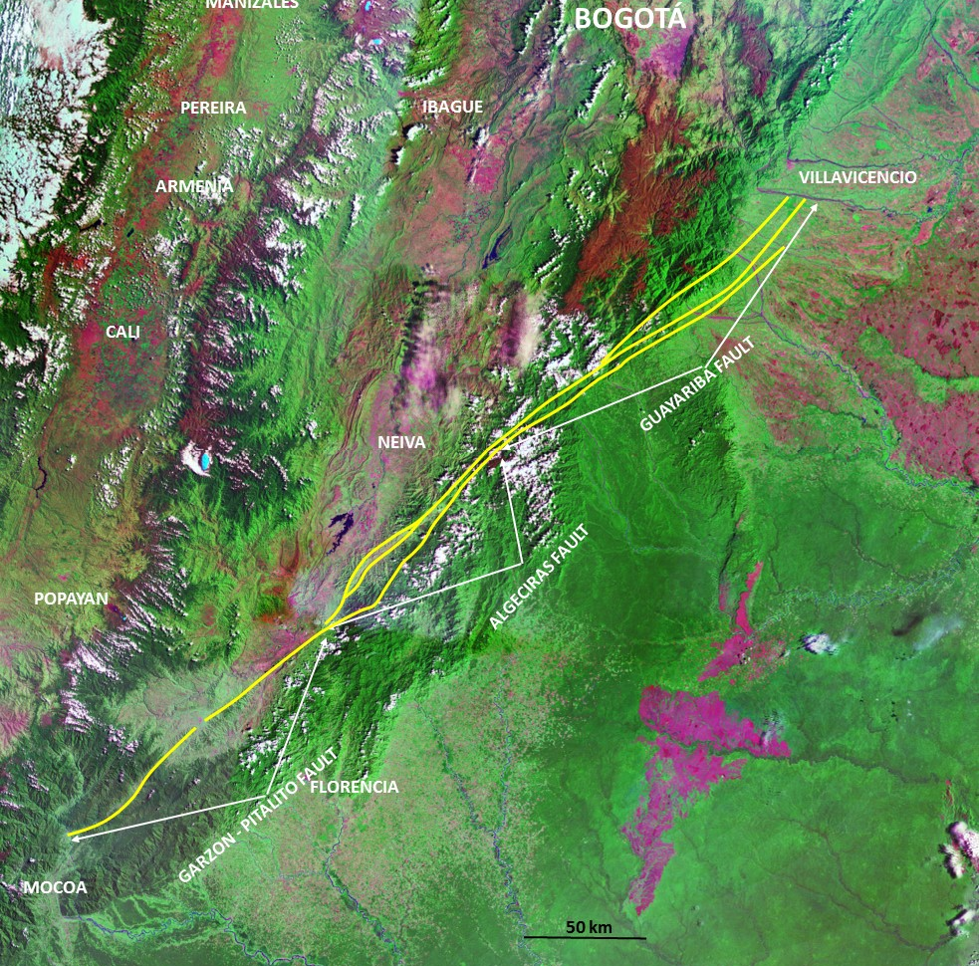

Slide 12
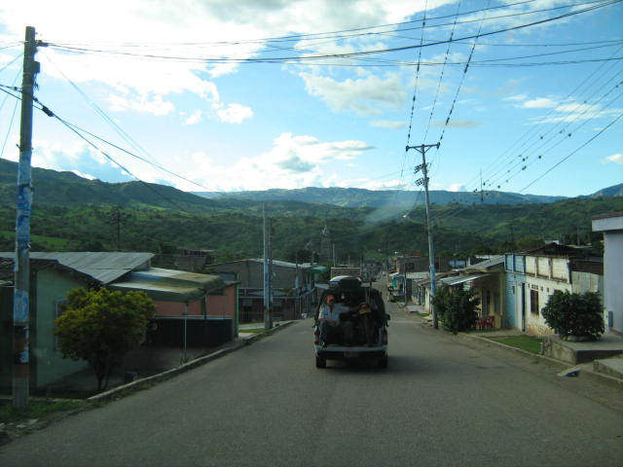
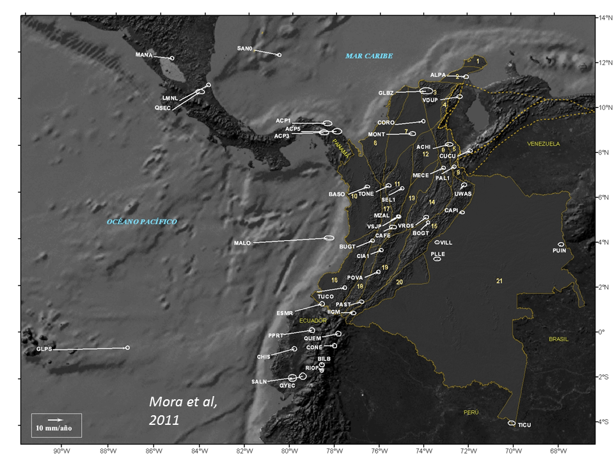
The origin of the local shallow seismicity

Slide 13
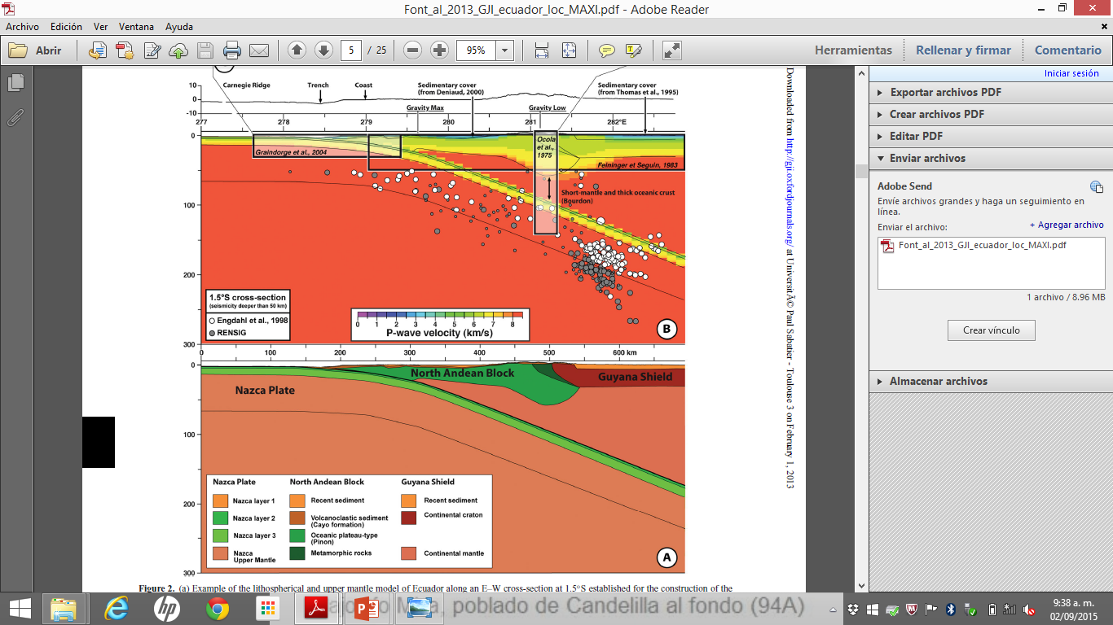
…This case is similar to the Ecuadorian
regional seismotectonic scketch…
Font et al., 2013

Slide 14
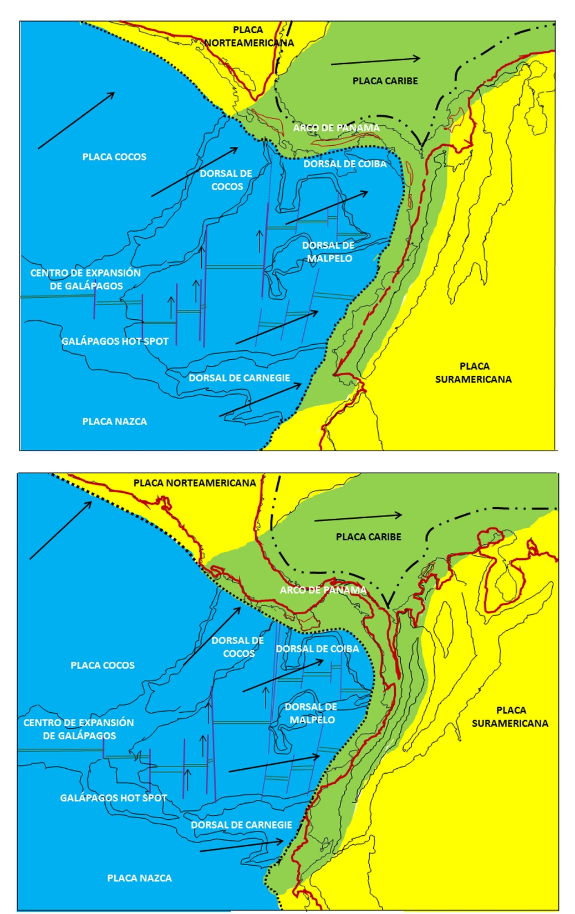
…Relationship between
Northern Andes orogenic
evolution and the subduction
development from 5 to 2,5 millions years …
Chicangana et al., 2015

Slide 15
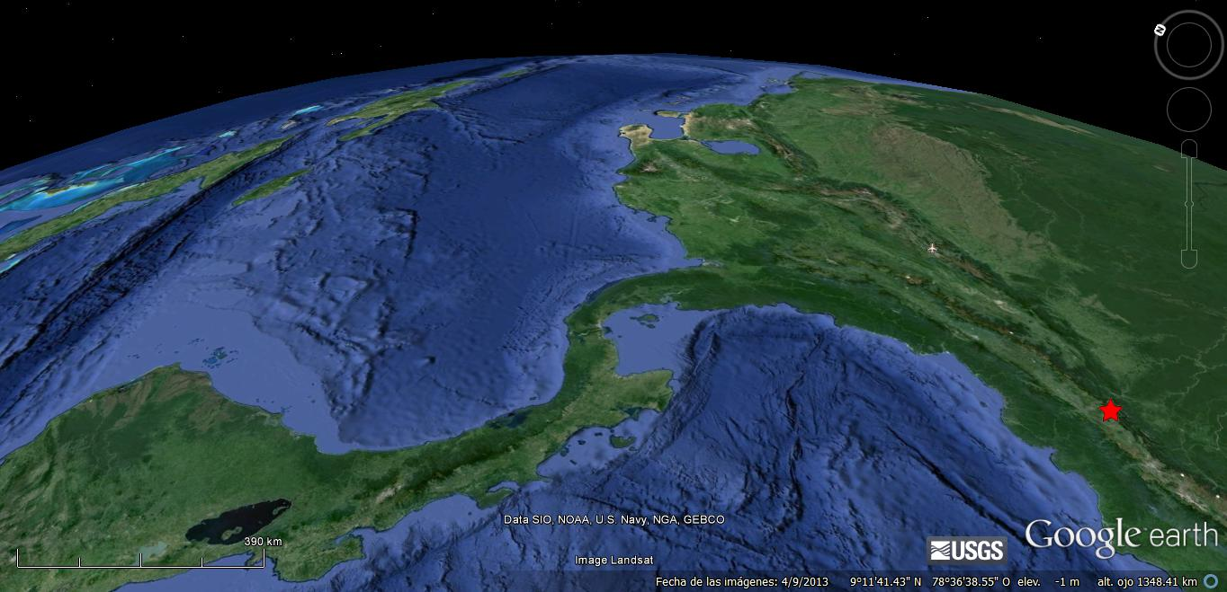
Chicangana et al., 2013

Slide 16
…Intermediate to very deep seismicity obey to the deepening development of subduction slabs…This shows the origin of the main stresses in Colombian territory…
Chicangana et al., 2013

Slide 17
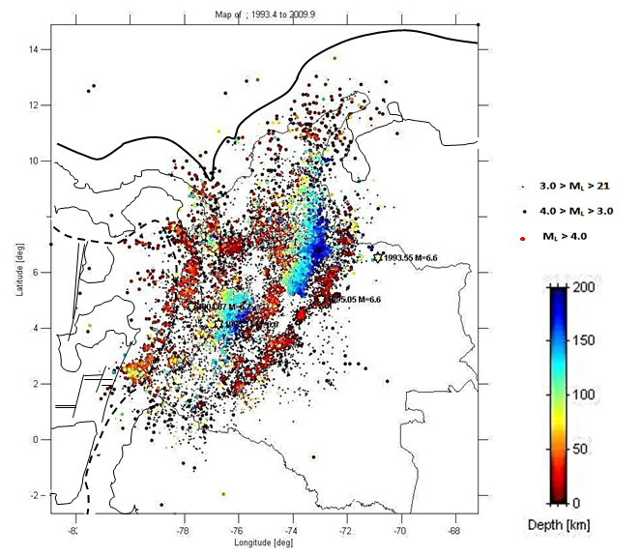
Seismicity regional map of Colombia Territory by Colombian National Seismological Network
INGEOMINAS, 2009

Slide 18
…This case is similar to the Ecuadorian
regional seismotectonic scketch…
Font et al., 2013

Slide 19
Faults

Slide 20
Guayuriba Fault

Slide 21
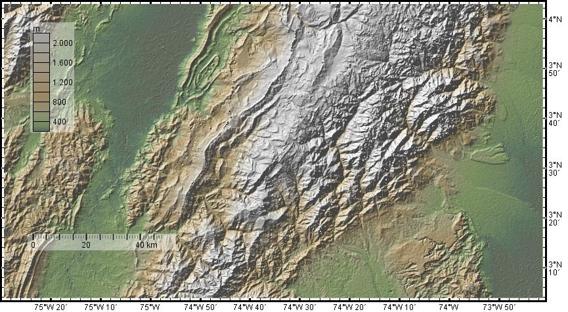

Slide 22
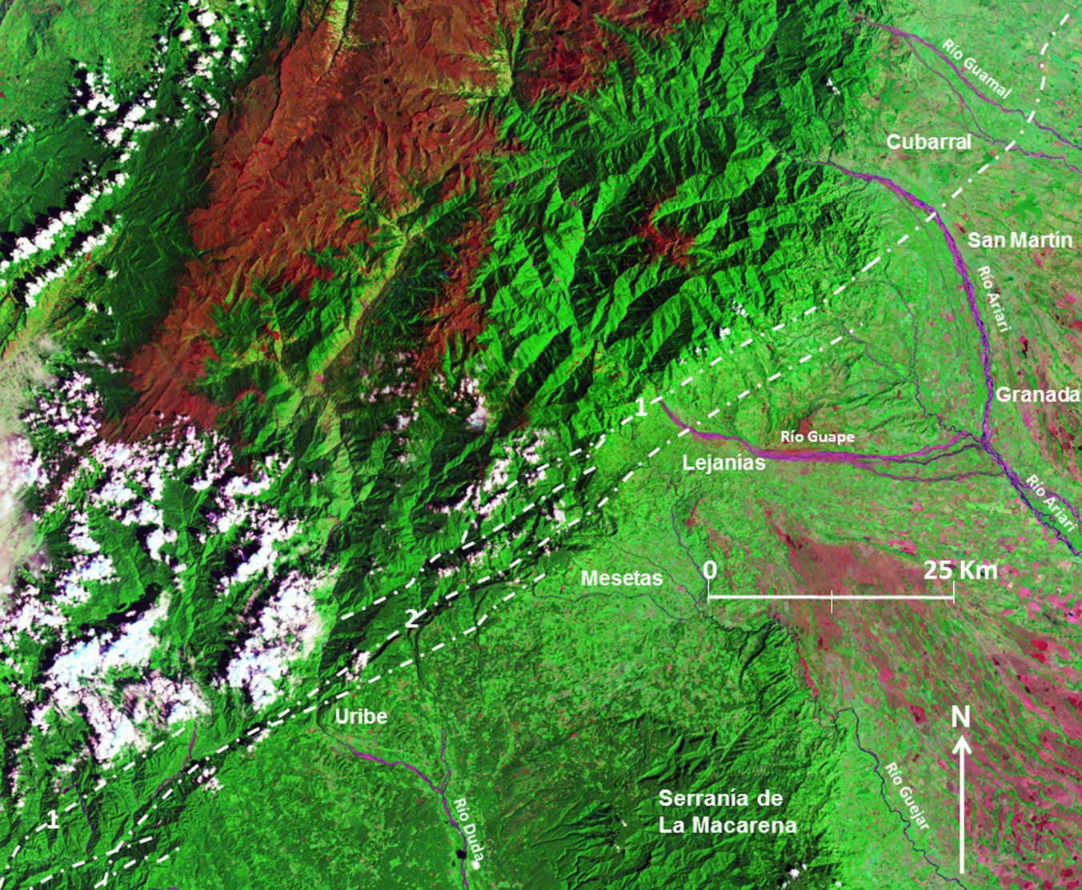

Slide 23
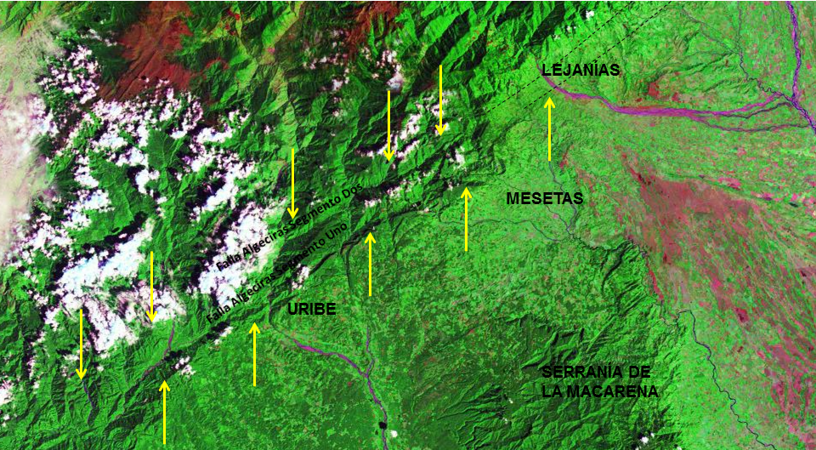
A´
A

Slide 24
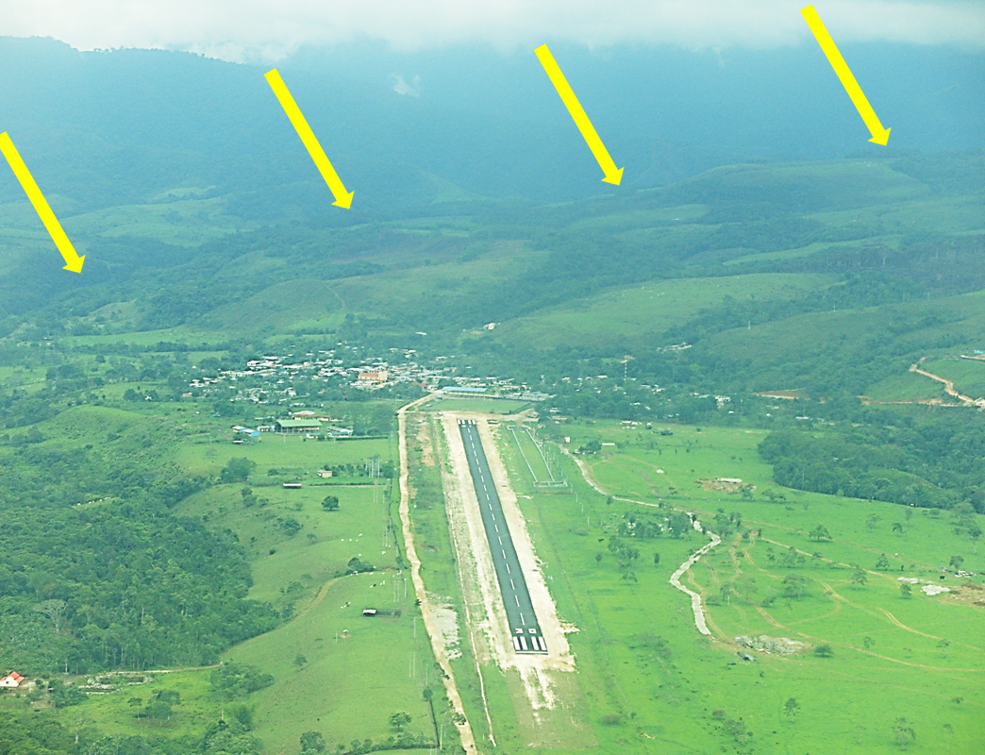

Slide 25
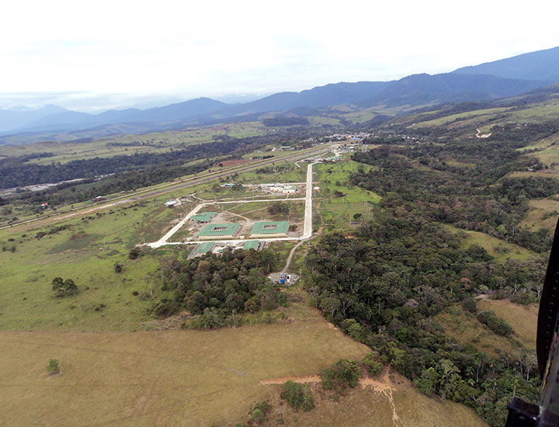

Slide 26
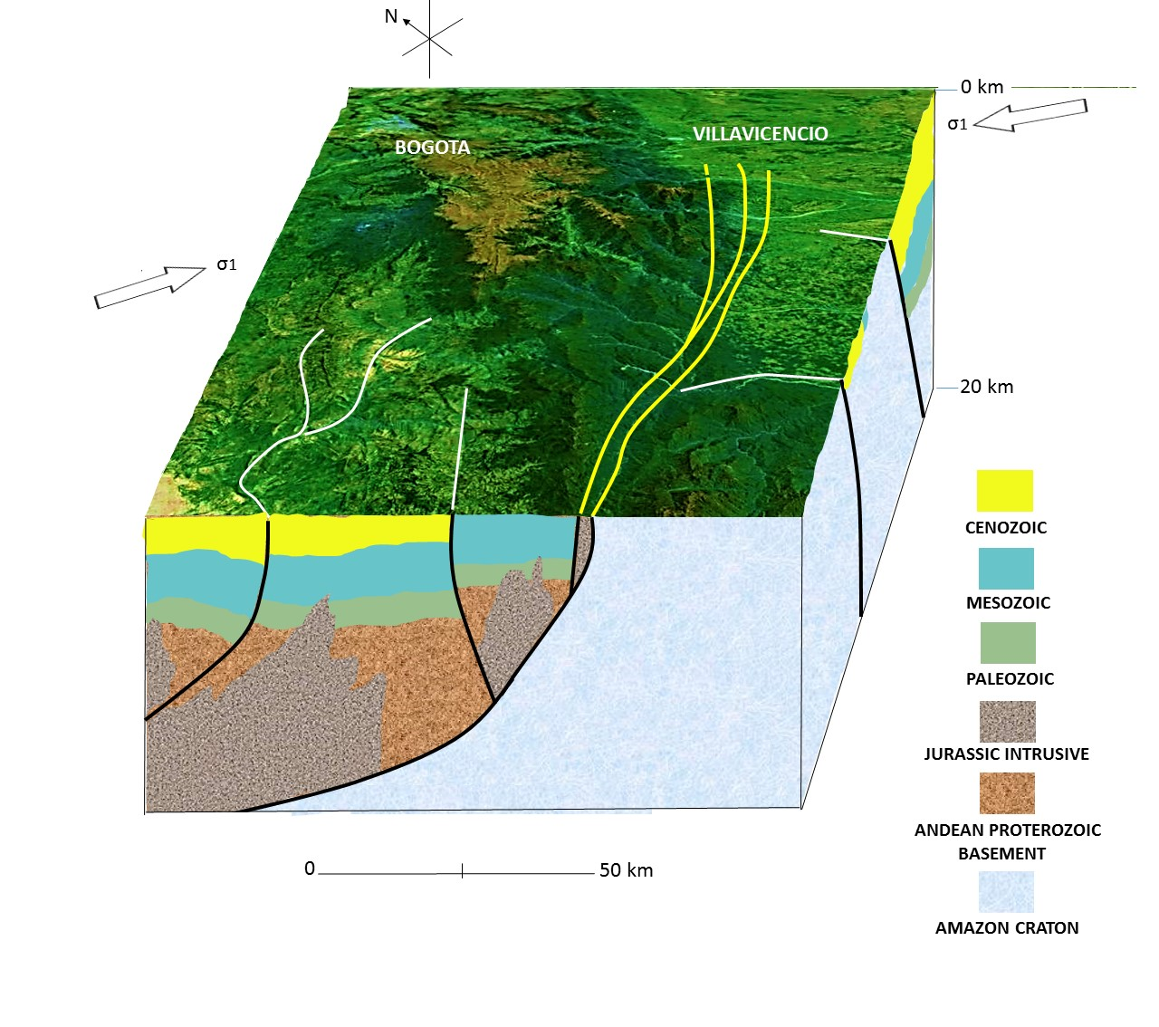

Slide 27
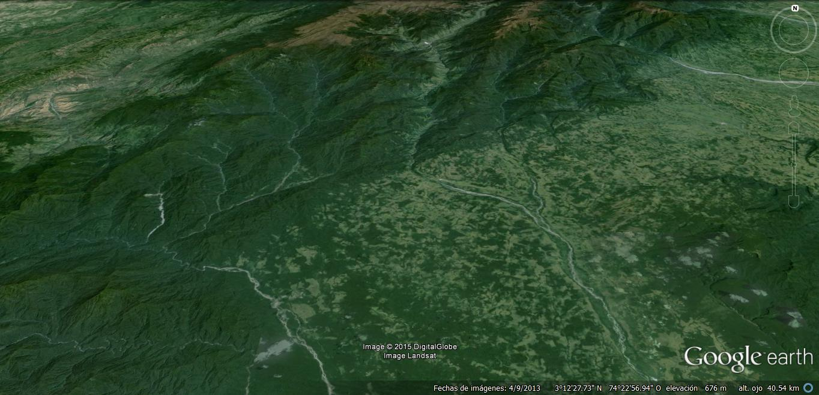

Slide 28
Algeciras Fault

Slide 29
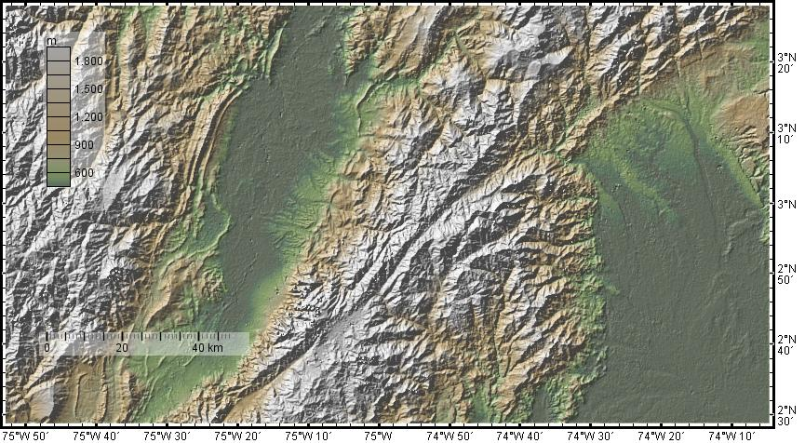

Slide 30
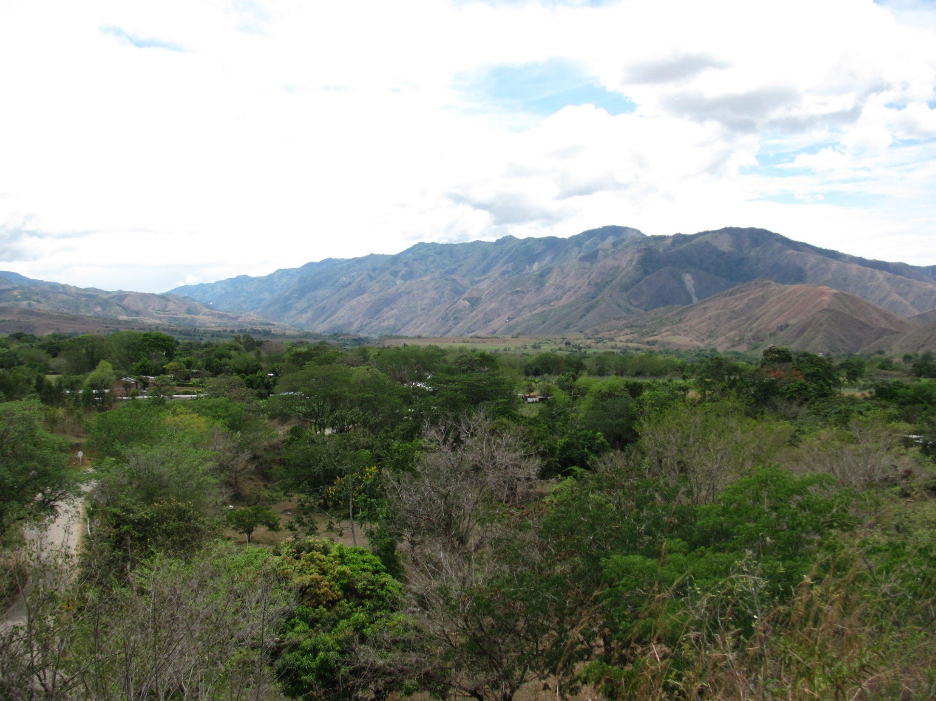

Slide 31
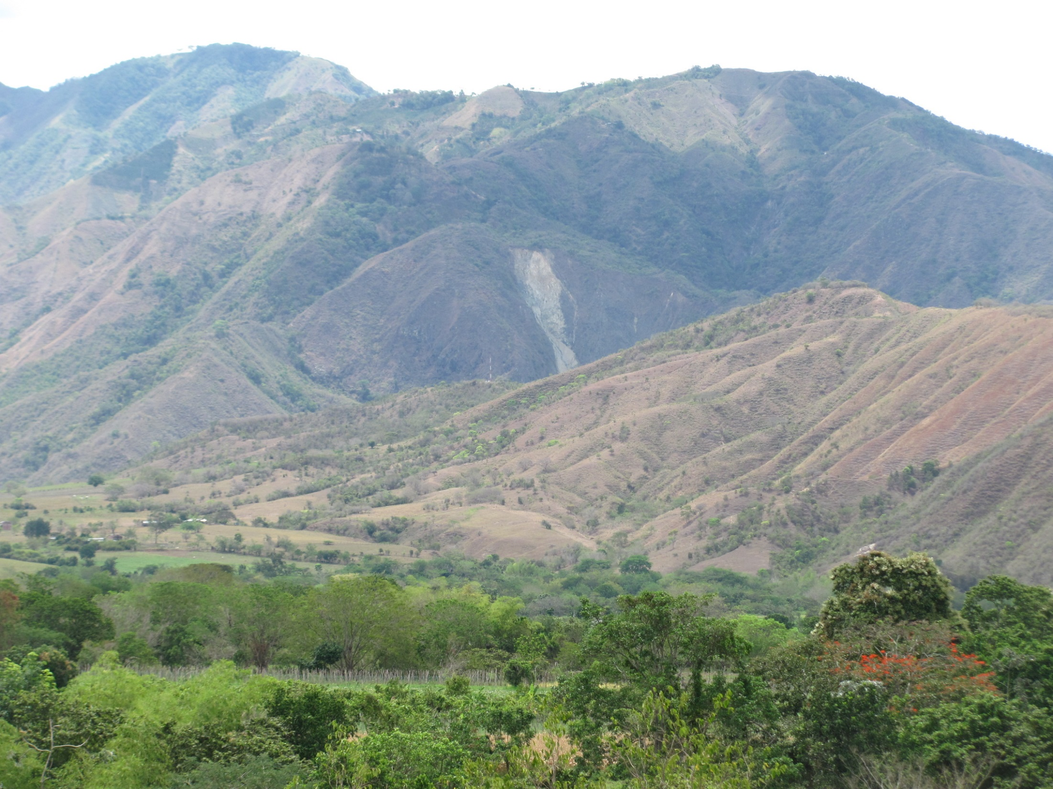

Slide 33
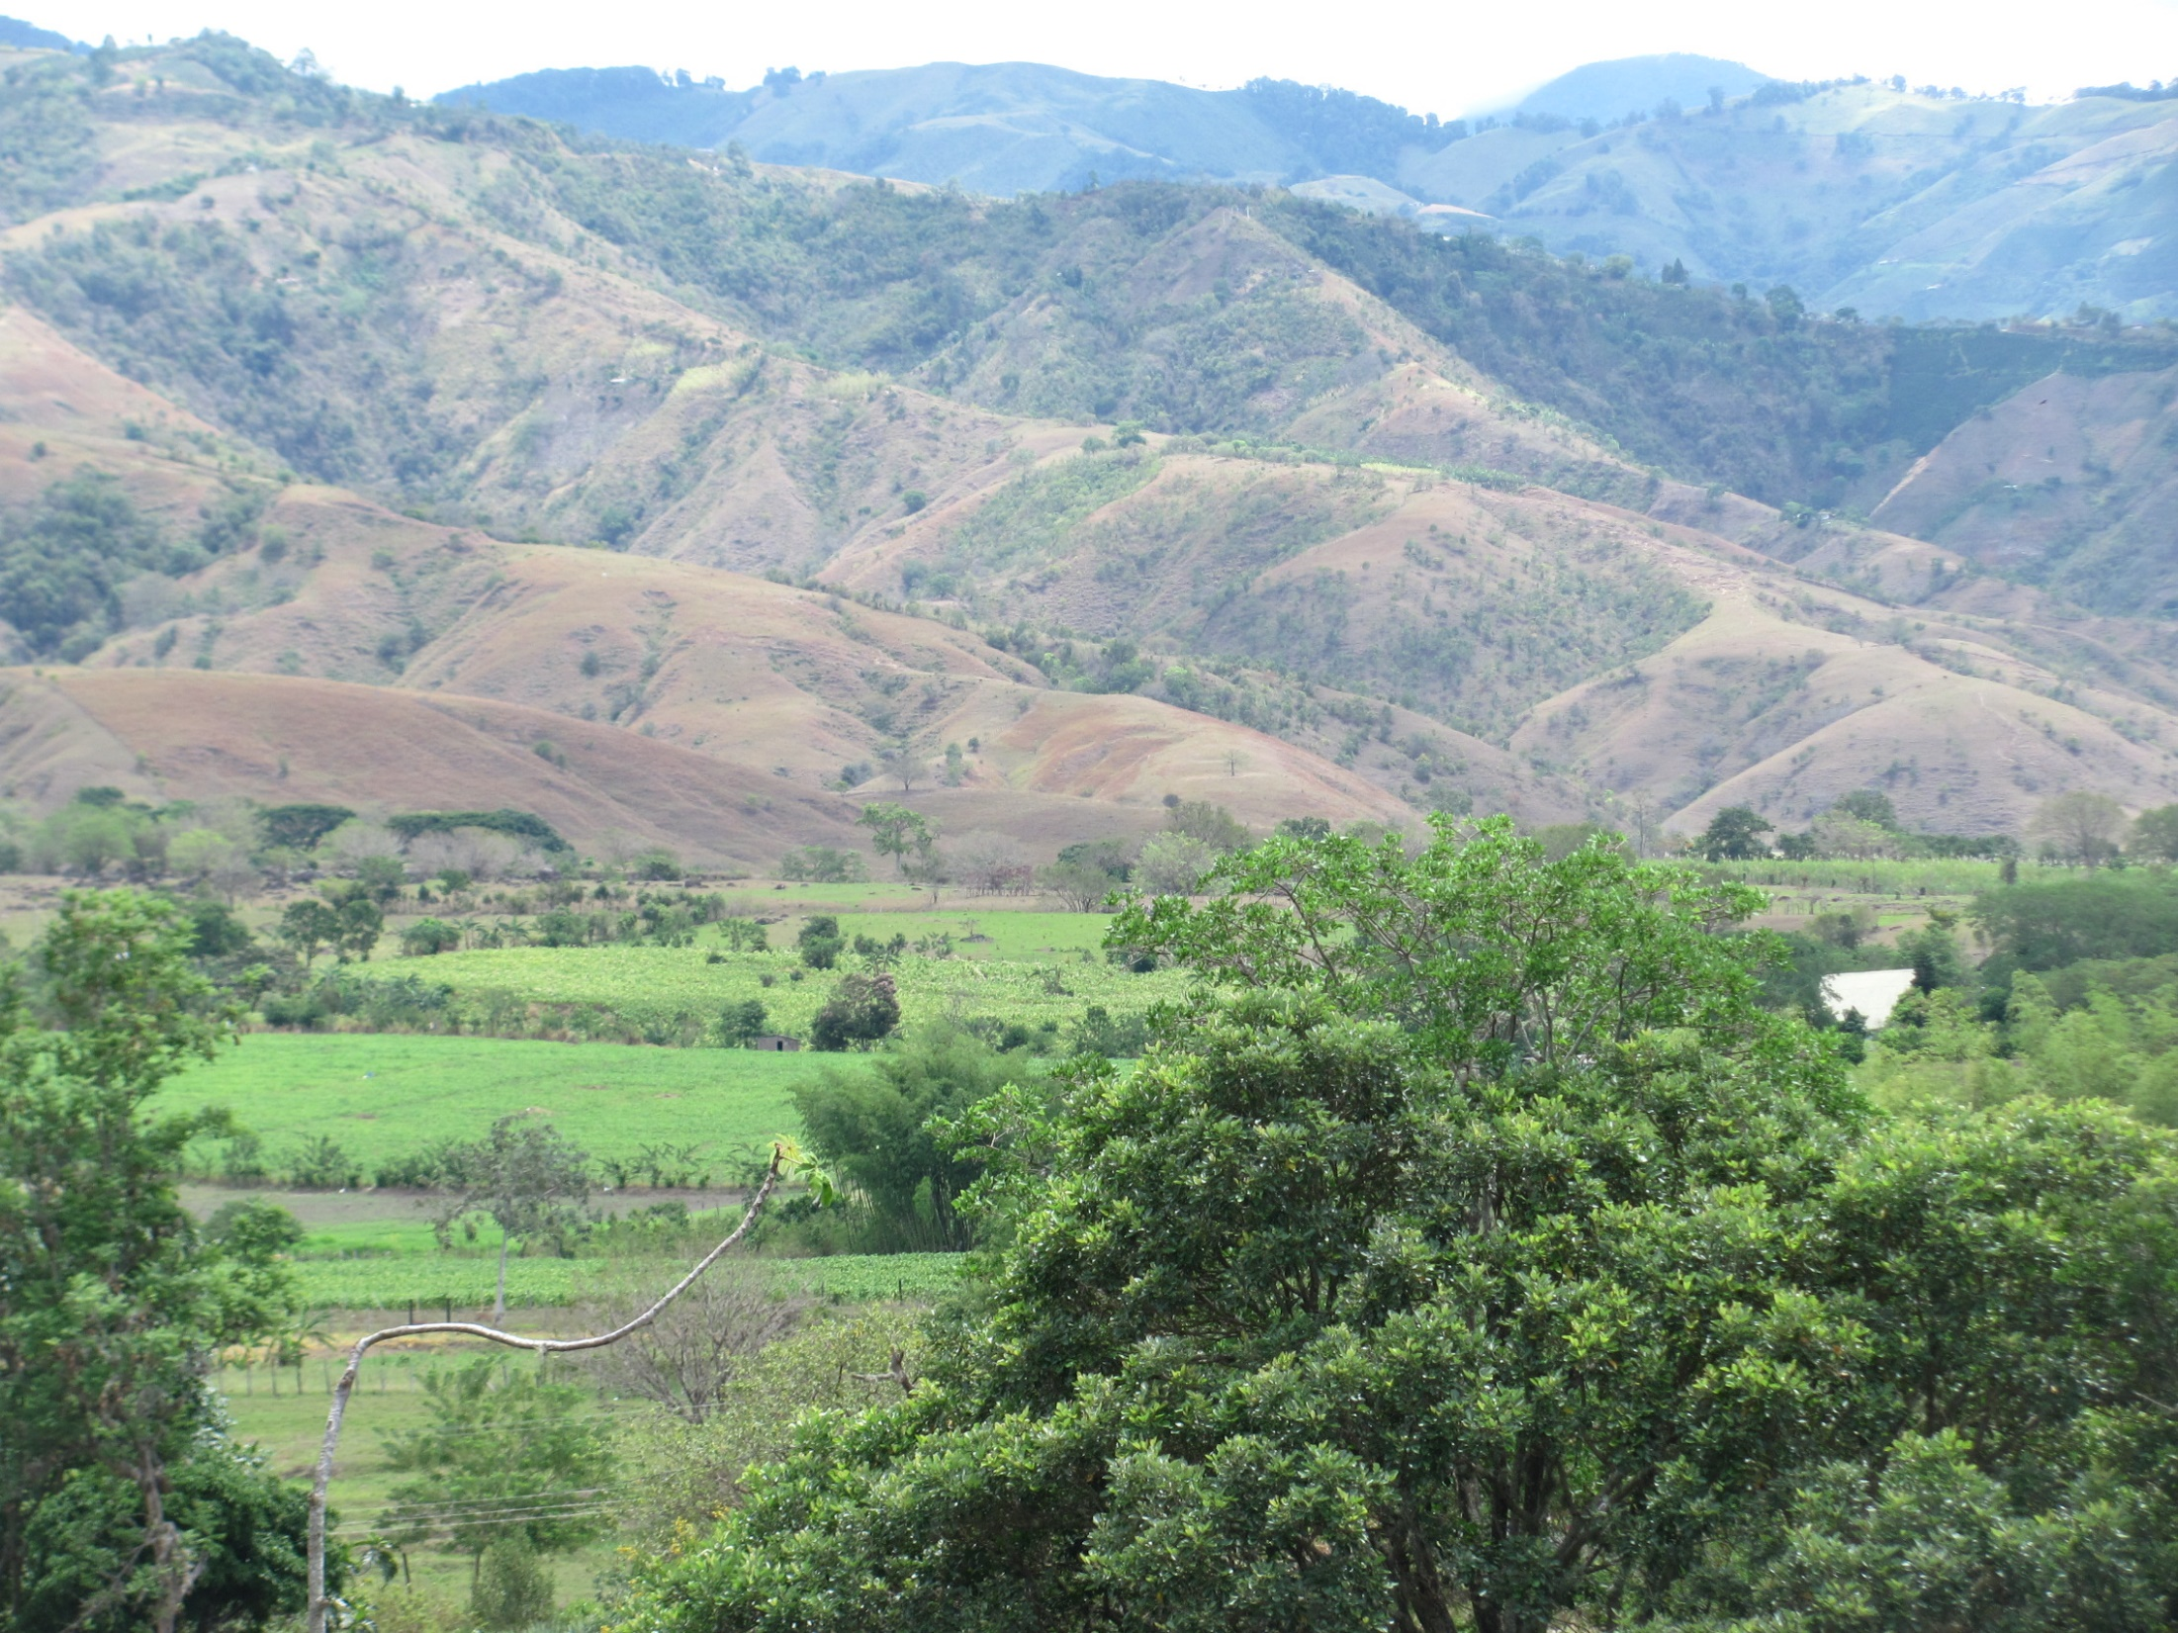

Slide 34
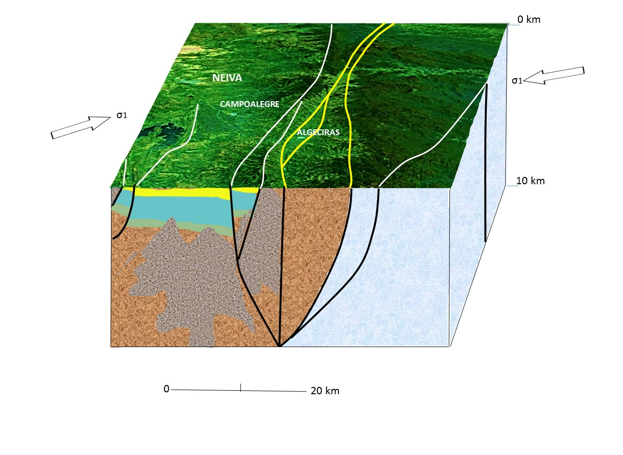

Slide 35
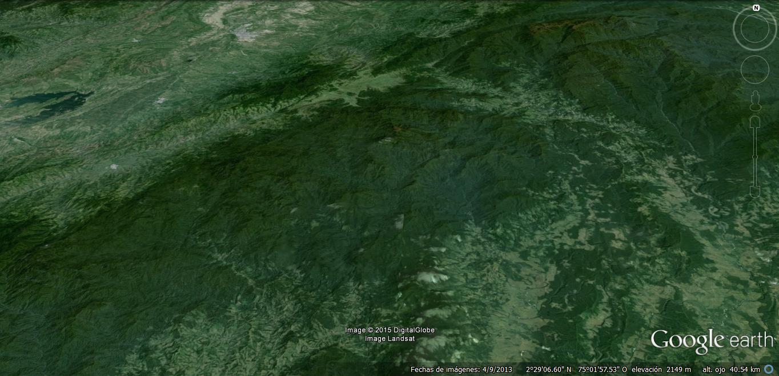

Slide 36
Garzón - Pitalito
and
Suaza
Faults

Slide 37
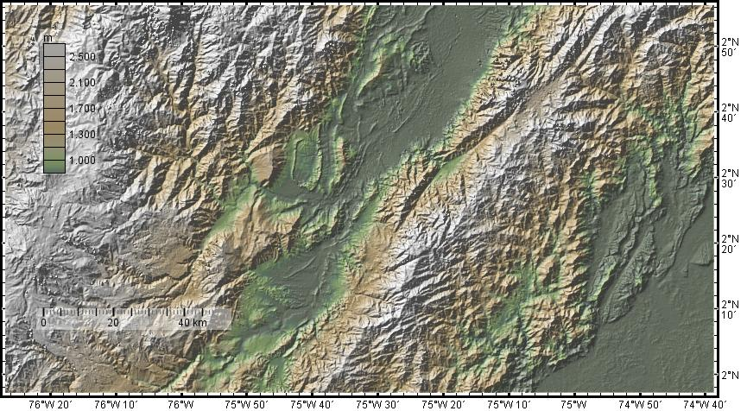

Slide 38
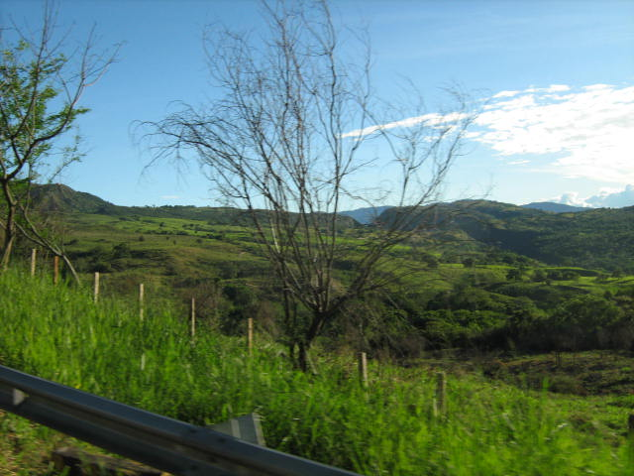

Slide 39
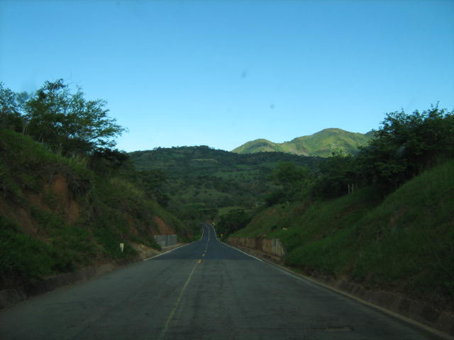

Slide 40
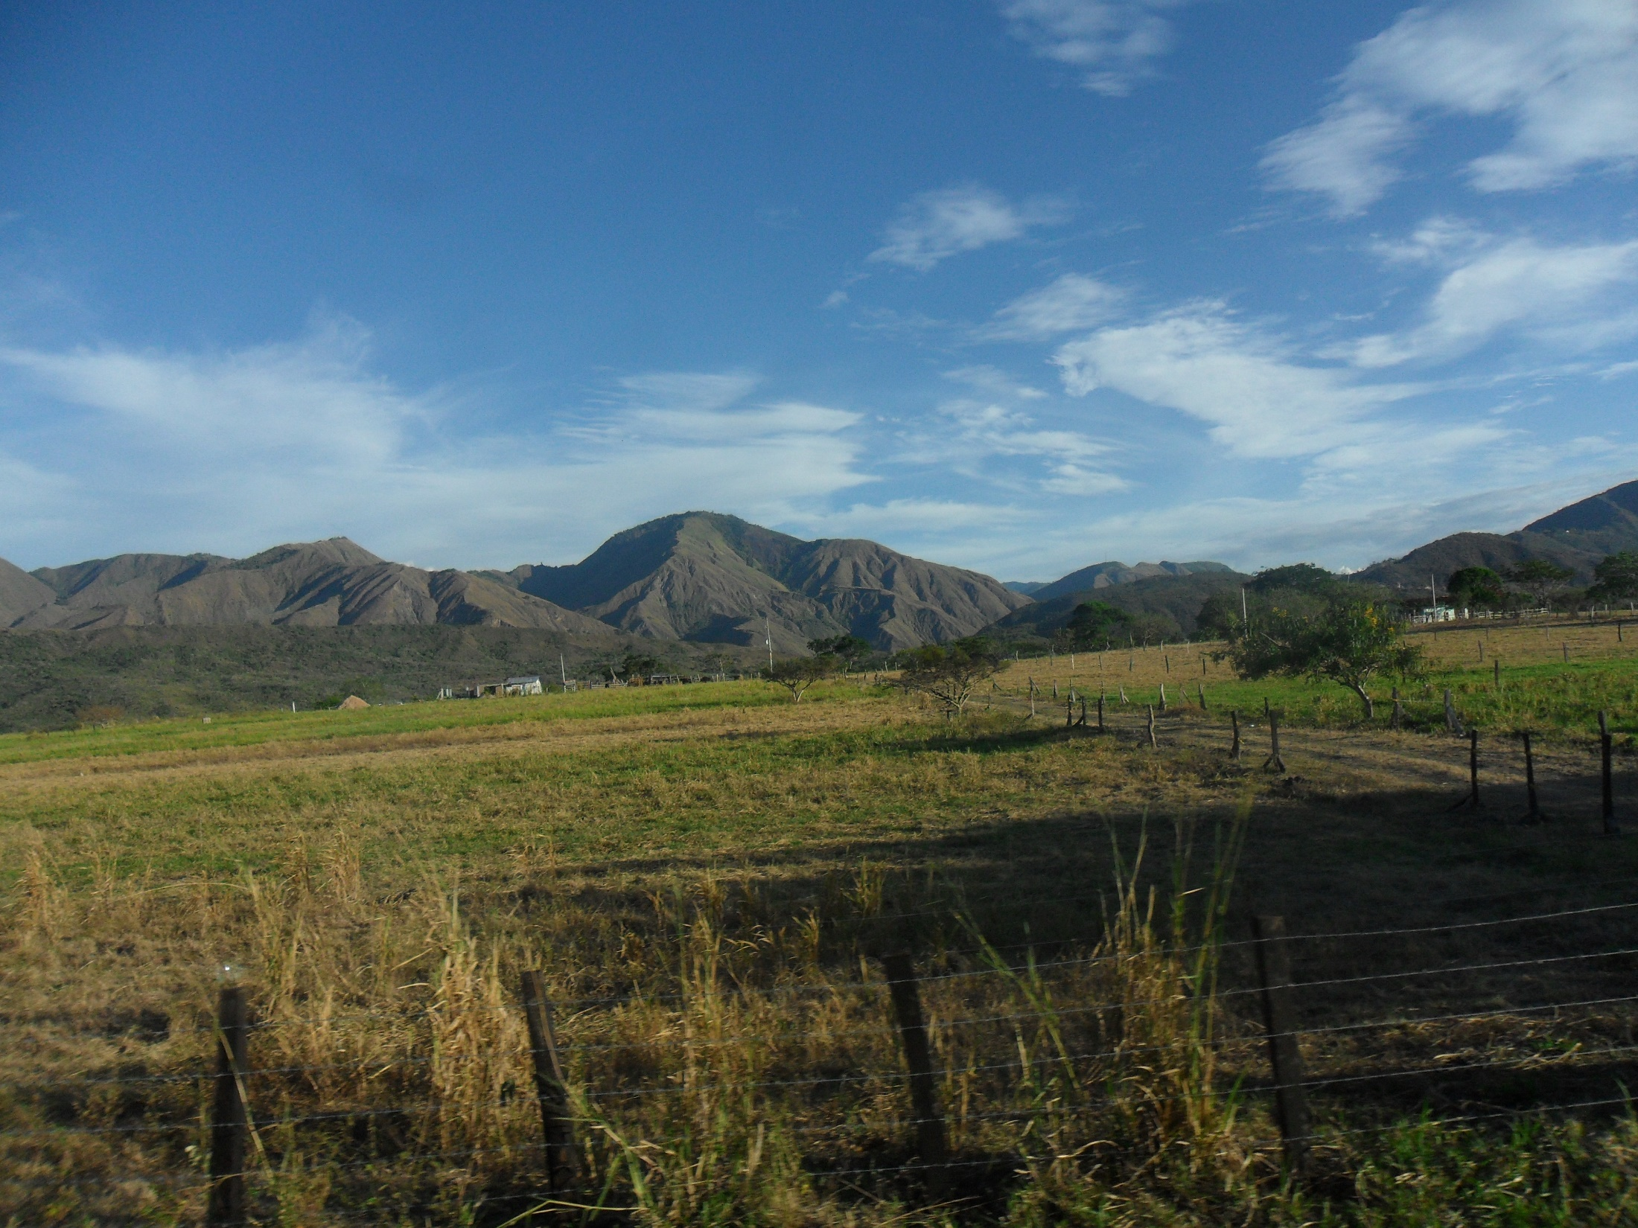

Slide 41
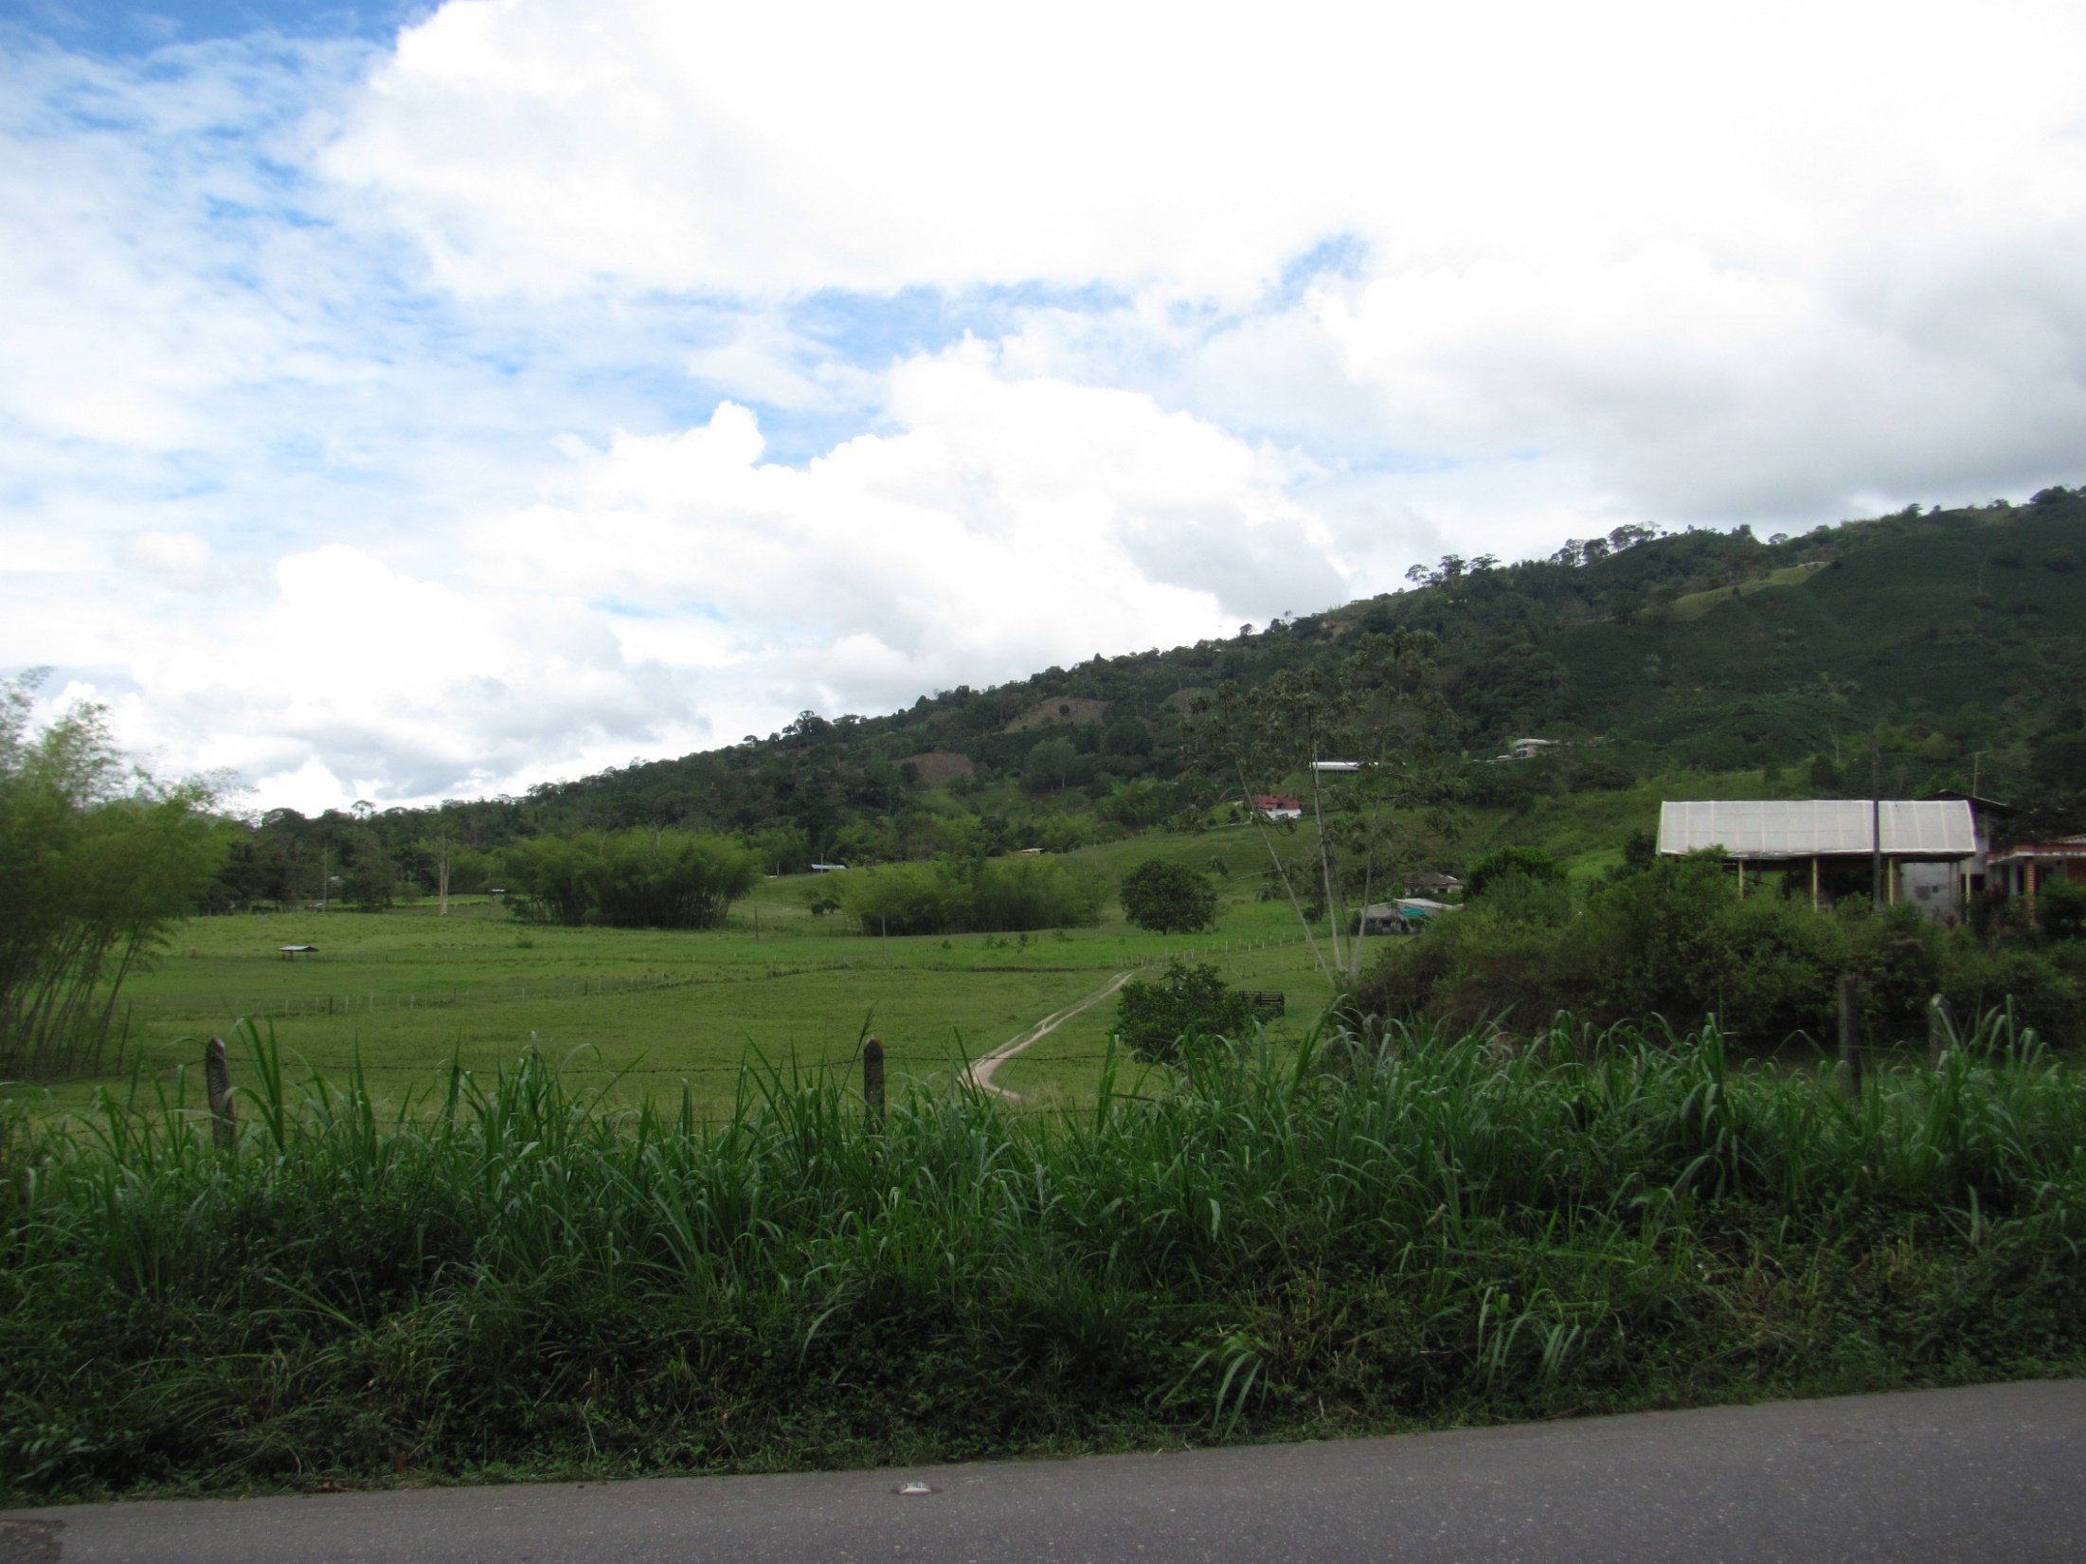

Slide 42
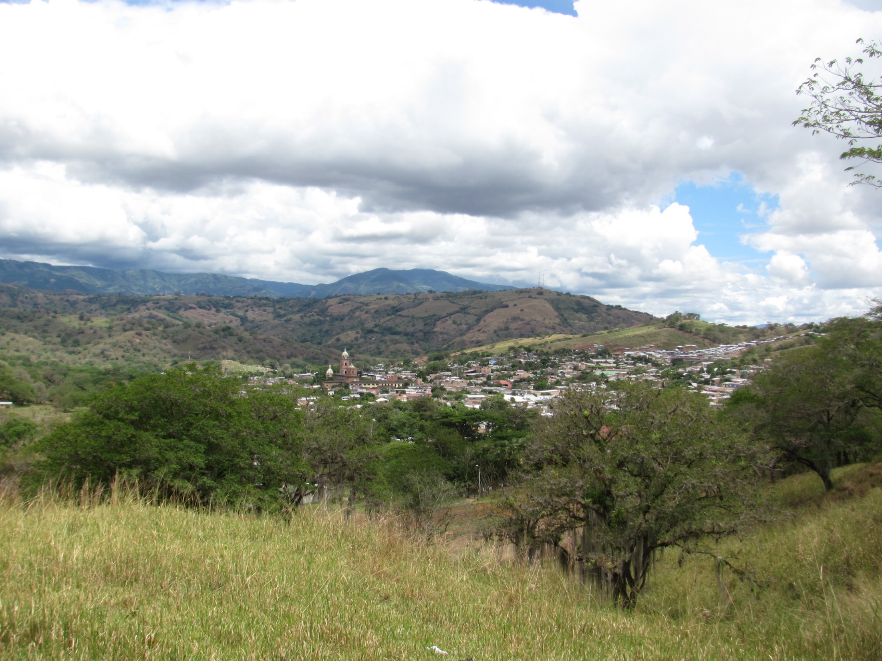

Slide 43
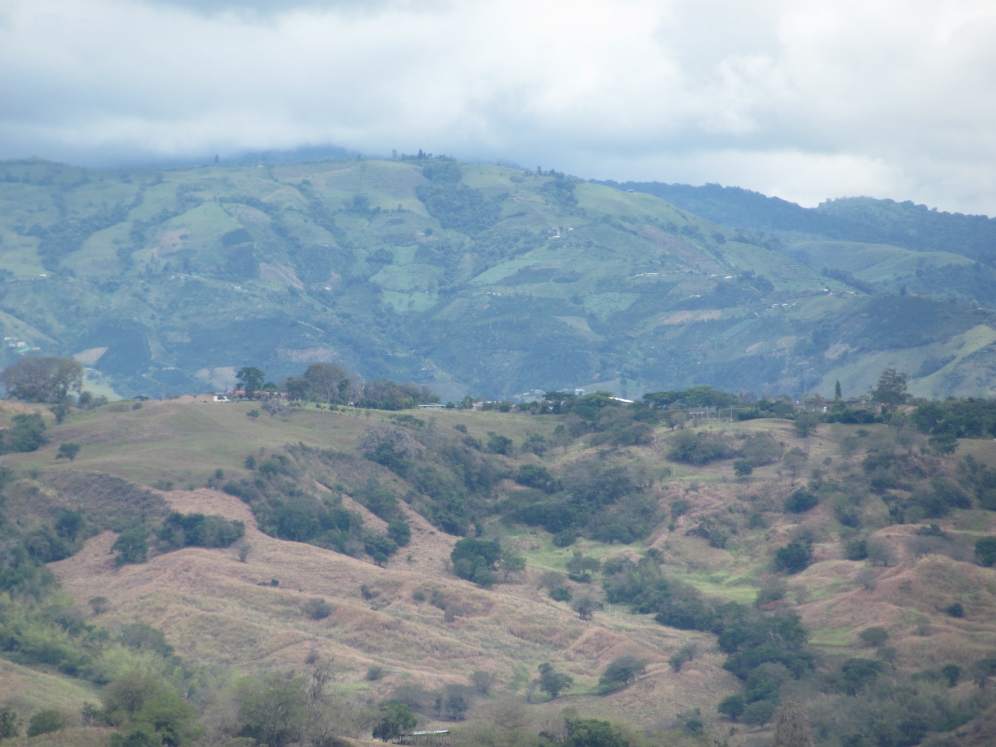

Slide 44
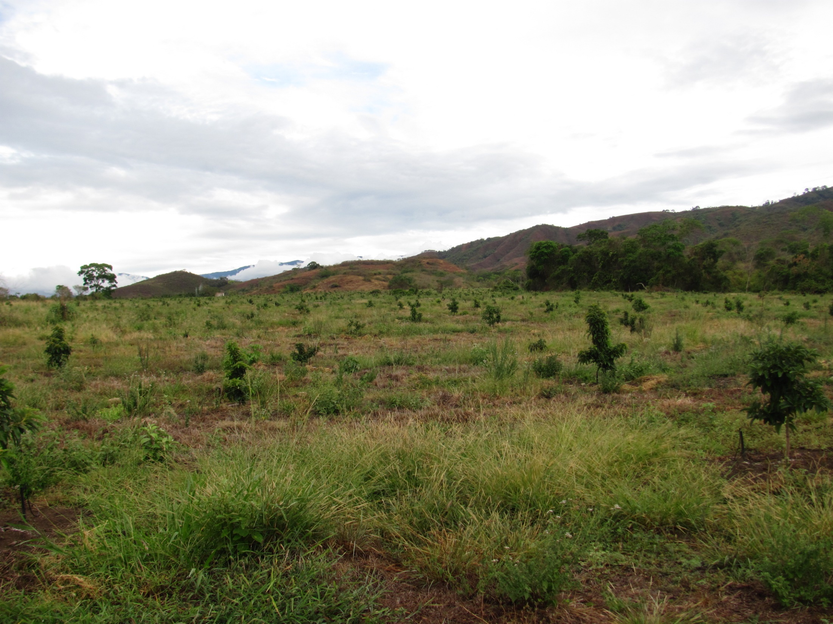

Slide 45
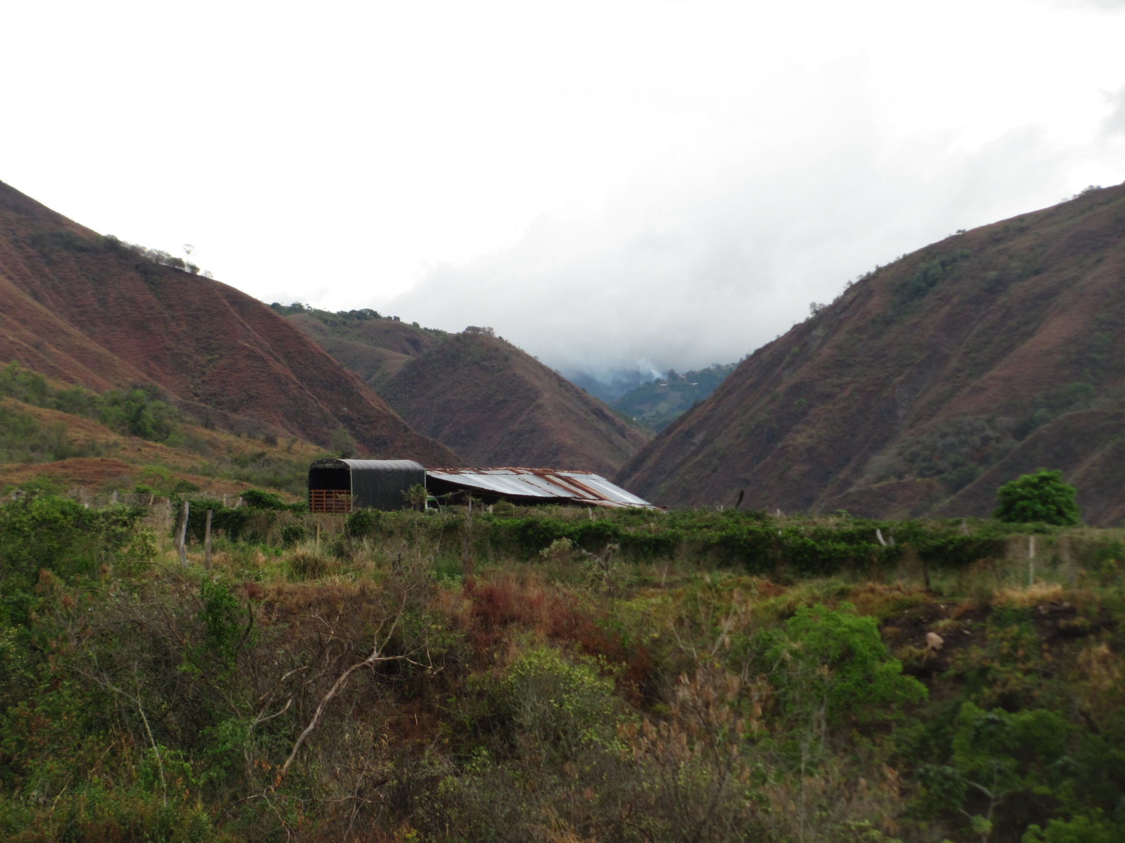

Slide 46
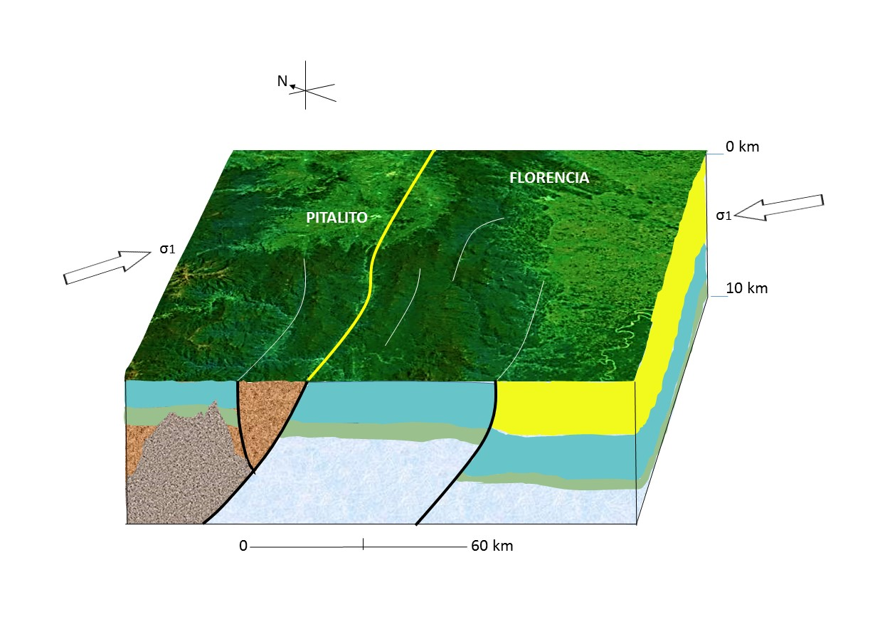

Slide 47
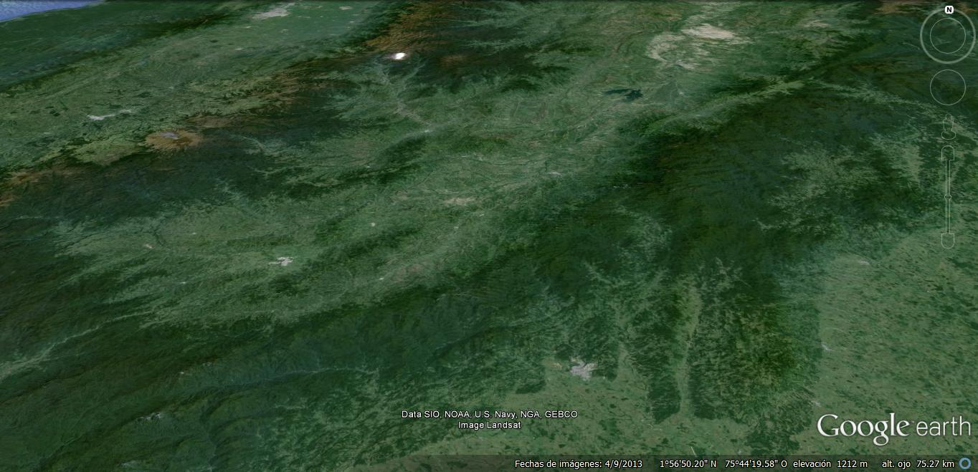

Slide 48
Historical Seismicity

Slide 49
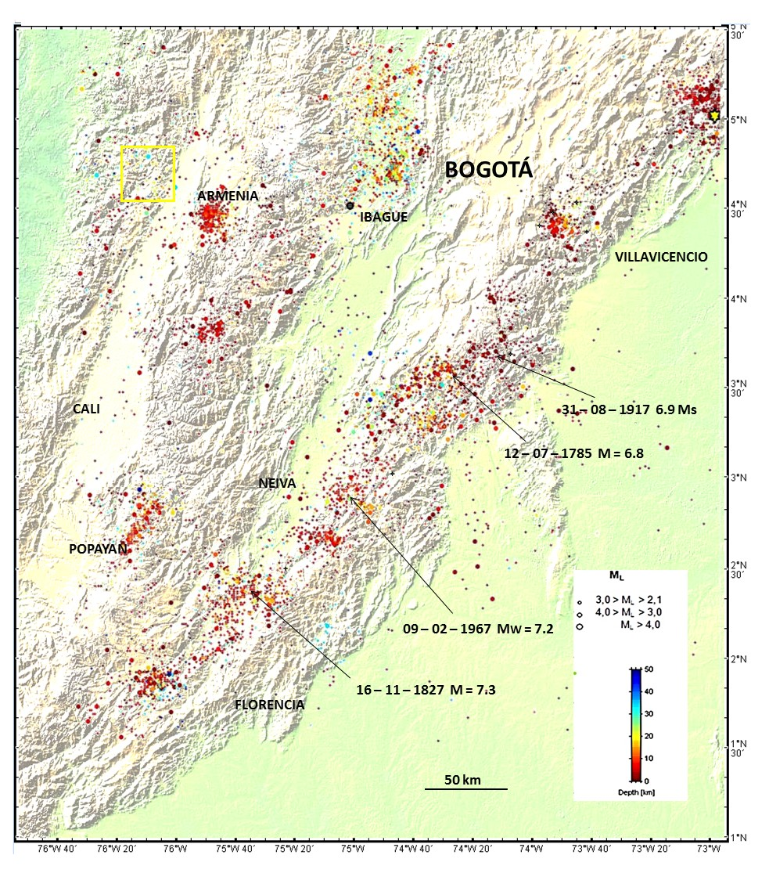

Slide 50
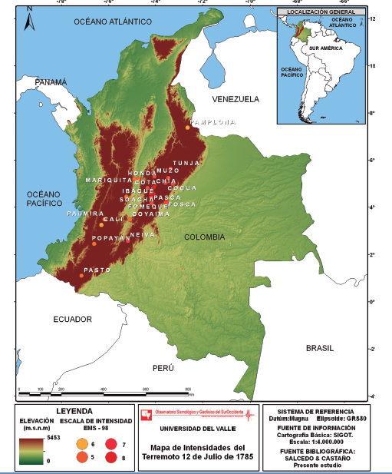
1785 Earthquake
Salcedo y Castaño, 2011

Slide 51
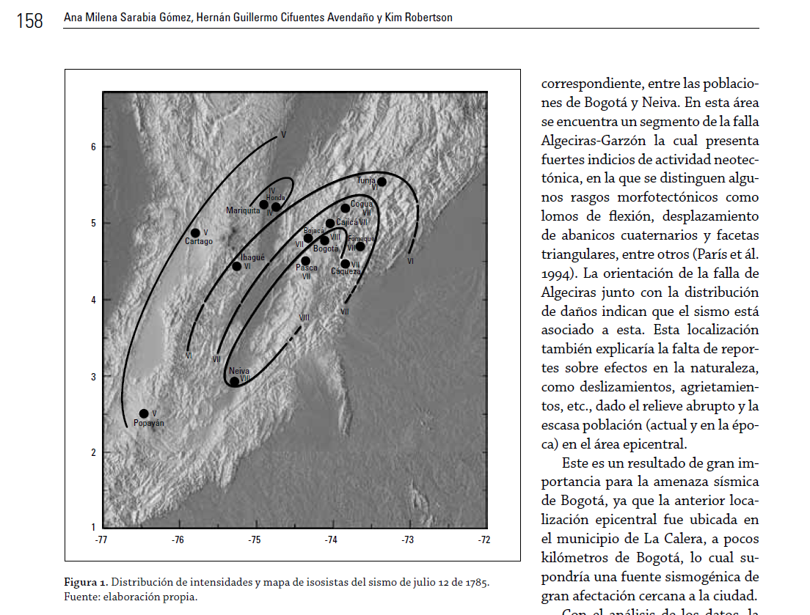
Sarabia et al., 2010

Slide 52
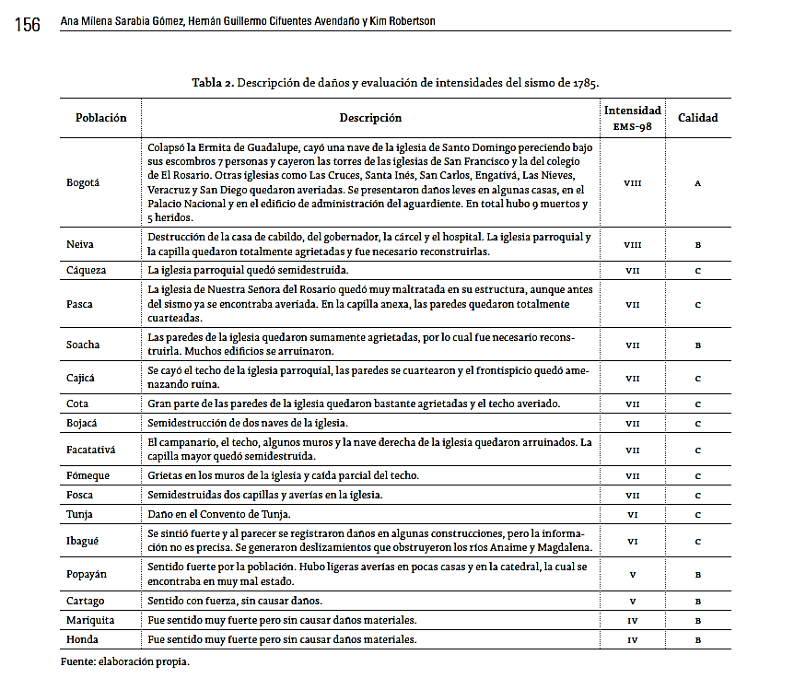
Sarabia et al., 2010

Slide 53
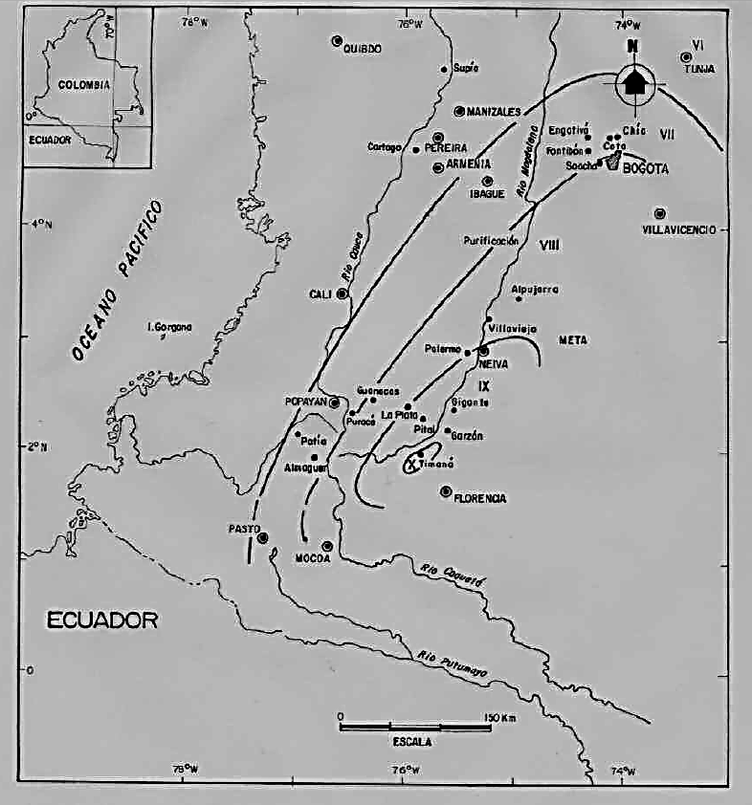
Espinosa., 2004
1827 Earthquake

Slide 54

John Milne, 1911

Slide 55

1917 Earthquake
Sarabia et al., 2010

Slide 56

Sarabia et al., 2010

Slide 57




Slide 58




Slide 59

1967 Earthquake

Slide 60


Slide 61


Slide 62


Slide 63


Slide 64

The Bogota metropolitan area
has much vulnerability to this
Fault System

Slide 65


Slide 66
CONCLUSIONS
The AFS is a continuous compound fault system with 420 km (260 miles) long. Their morfotectonic features and neotectonic evidences verified shows that these faults have a very high tectonic activity.
These faults are predominantly reverse and the regional stresses that are originated in the convergence between Nazca and South America plates.
For future work is recommended calculated the dimensions of the seismogenic zones (asperities), and thus achieve estimate the máximum magnitude that can generate these.

Slide 67
SOME REFERENCES
Chicangana, G., Vargas-Jiménez, C. A., Kammer, A., Hernández-Hernández, T. A., Ochoa – Gutiérrez, L. H. 2007. Caracterización Sismotectónica Regional Preliminar de un sector del Piedemonte Llanero colombiano: Corredor San Juan de Arama - Cumaral, Meta Boletín de Geología - UIS, 29 (1): 61 – 74.
http://revistas.uis.edu.co/index.php/revistaboletindegeologia/article/view/839
Chicangana, G., Pedraza, G, P., Vargas – Jiménez, C. 2012. Avances en el conocimiento de los patrones de sismicidad superficial en el Piedemonte Llanero colombiano, Departamentos de Casanare y Meta, Colombia. Memorias del XVI Congreso Peruano de Geología, Lima, Perú.
Chicangana, G., Vargas – Jiménez, C. A. 2013. The subduction geometry change under Colombia and orogenic evolution of the northern Andes in late Neogene times. In: First Joint Scientific Meeting of GSC and GSA Roof of the World, Chengdu, China. Session A-2: Continental deformation and deep lithosphere processes. http://gsc-gsa.csp.escience.cn/dct/page/70039
Espinosa, Armando. 2004. La Historia Sísmica de Colombia (1500 – 1830). Armenia, Colombia: GEDES - Universidad del Quindío, CD - Room.
Font, Y., Segovia, M, Vaca, S., Theunissen, T. 2013. Seismicity patterns along the Ecuadorian subduction zone: new constraints from earthquake location in a 3-D a priori velocity model. Geophys. J. Int. doi: 10.1093/gji/ggs083
INGEOMINAS, 1999. FALLAS ACTIVAS DE COLOMBIA. Cd – room.
IRIS (Incorporated Research Institutions for Seismology). 2005. “1967 Huila (Colombia) Earthquake Archive”. Incorporated Research Institutions for Seismology (IRIS). http://www.iris.edu/seismo/quakes/1967huila/
OSSO. 2014. Campos de información específica en Sismología Histórica. Observatorio Sismológico del Suroccidente, Universidad del Valle, Cali.http://osso.univalle.edu.co/index.php/sismologia/84
París, G., Machette, M.N., Dart, R. L. and Haller, K. M. 2000. Database and Map of Quaternary faults and folds of Colombia and its offshore regions, Open – File Report 00 – 0284. http://pubs.usgs.gov/of/2000/ofr-00-0284/
Salcedo, E. y Castaño, C, A. N. 2011. Reevaluación macrosísmica del terremoto del 12 de julio de 1785 en Colombia. Boletín de Geología – UIS, 33 (2): 15 – 32.
Sarabia G, A. M., Cifuentes A, H. G., y Robertson, K. 2010. Análisis histórico de los sismos ocurridos en 1785 y en 1917 en el centro de Colombia. Cuadernos de Geografía - Revista Colombiana de Geografía, 19:153-162.
Velandia, P, F., Acosta, J. Terraza, M, R. y Villegas, H. 2005. The current tectonic motion of the Northern Andes along the Algeciras Fault System in SW Colombia. Tectonophysics, 399 (1- 4): 313-329.
Vergara, H., 1996, Rasgos y Actividad Neotectónica en la Falla de Algeciras: Memorias VI (6th) Congreso Colombiano de Geología, 10 p. (Bogotá).

Slide 68

Thank You…

