Slide 1
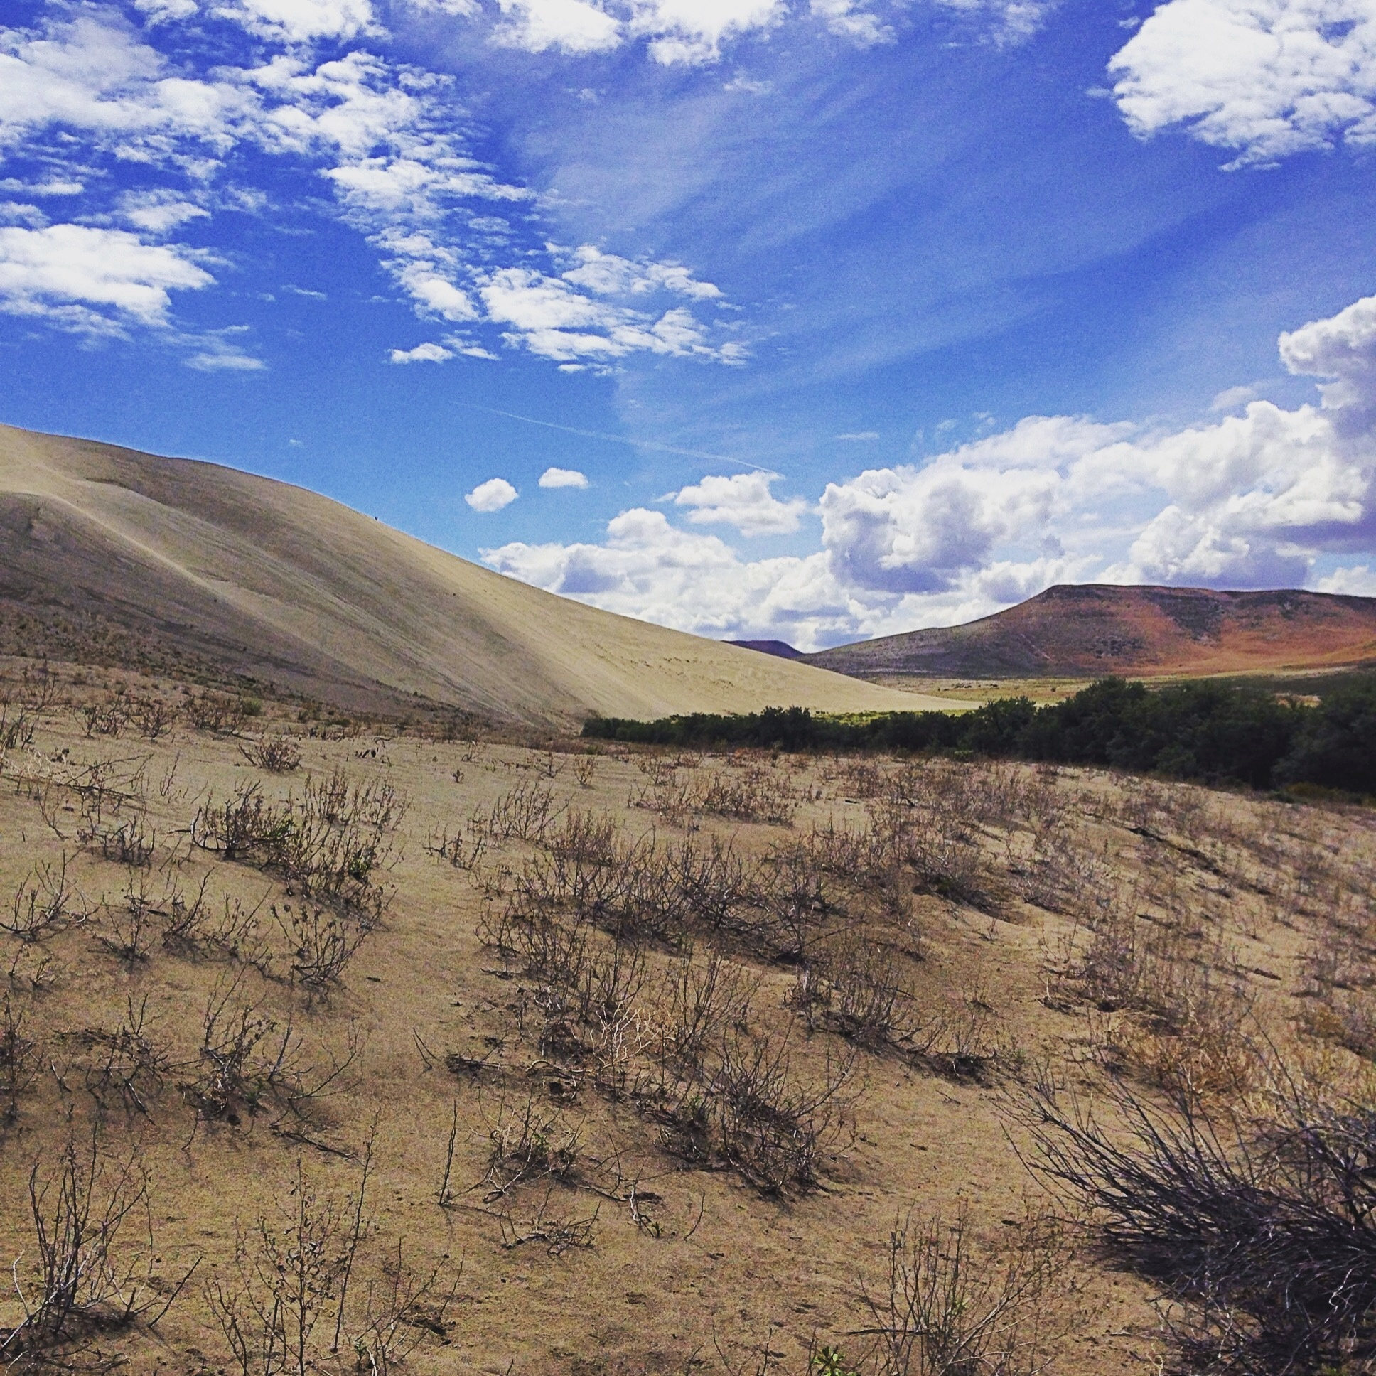




A Comparison of Dune Height Measurement Methodologies –Total Station versus dGPS
Mikayla Thomas- Schenectady, NY
Andrew Valdez- Mosca, CO
Notes:
Mikayla Thomas
I was a Geo society 2015 GeoCorps participant at GreatSandDunesNatPark&Preserve IN CO throughout the summer months
Will be talking a little bit about my summer research that I completed in conjunction w/ A. VALDEZ
Which was essentially a…..
A COMPARISON OF DUNE HT. MEASUREMENT METHODS- COMPARING THE USE OF A DGPS AND TOTAL STATN
Excited to raise some eyebrows!!!!!

Slide 2
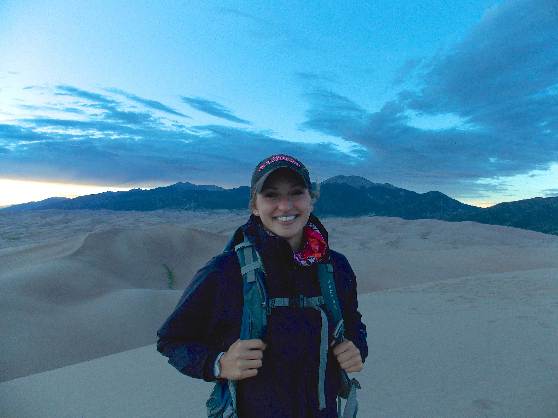
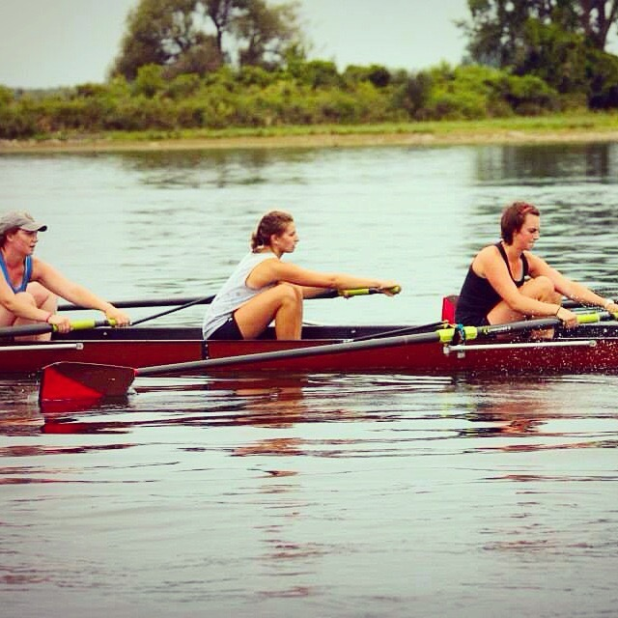
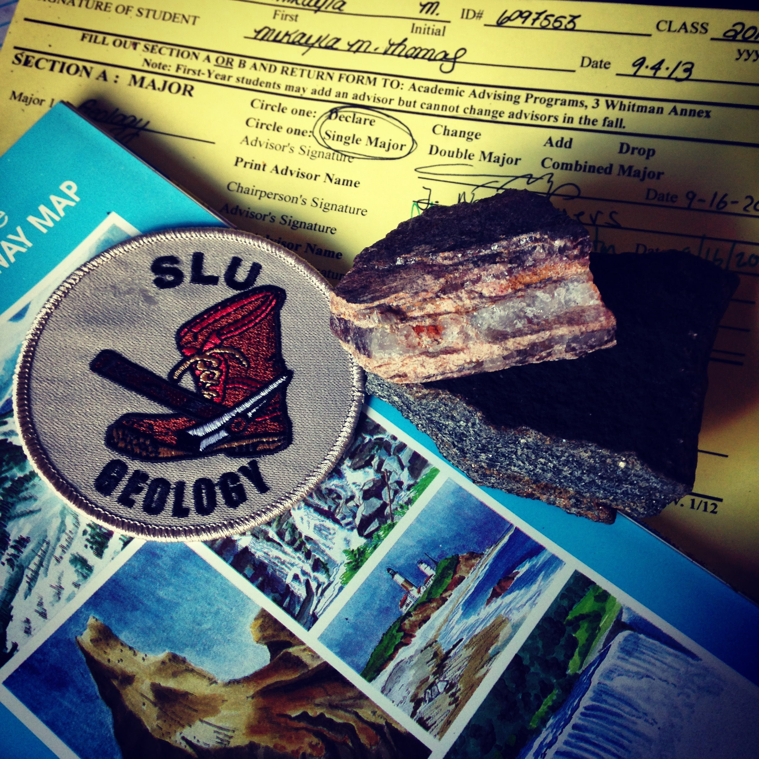
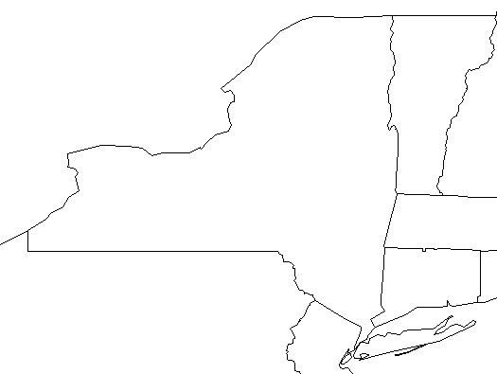
St. Lawrence
Buffalo
Albany
Notes:
Currently a junior geology major at St. Lawrence University- a small liberal arts school in upstate NY
Aside from dedicating my time to the geology department, I also participate in full time varsity athletics on the varsity women’s rowing team.
I was drawn primarily to applying for this job because of the dramatic landscape of the west- especially the opportunities for learning about Aeolian processes at GRSA.

Slide 3
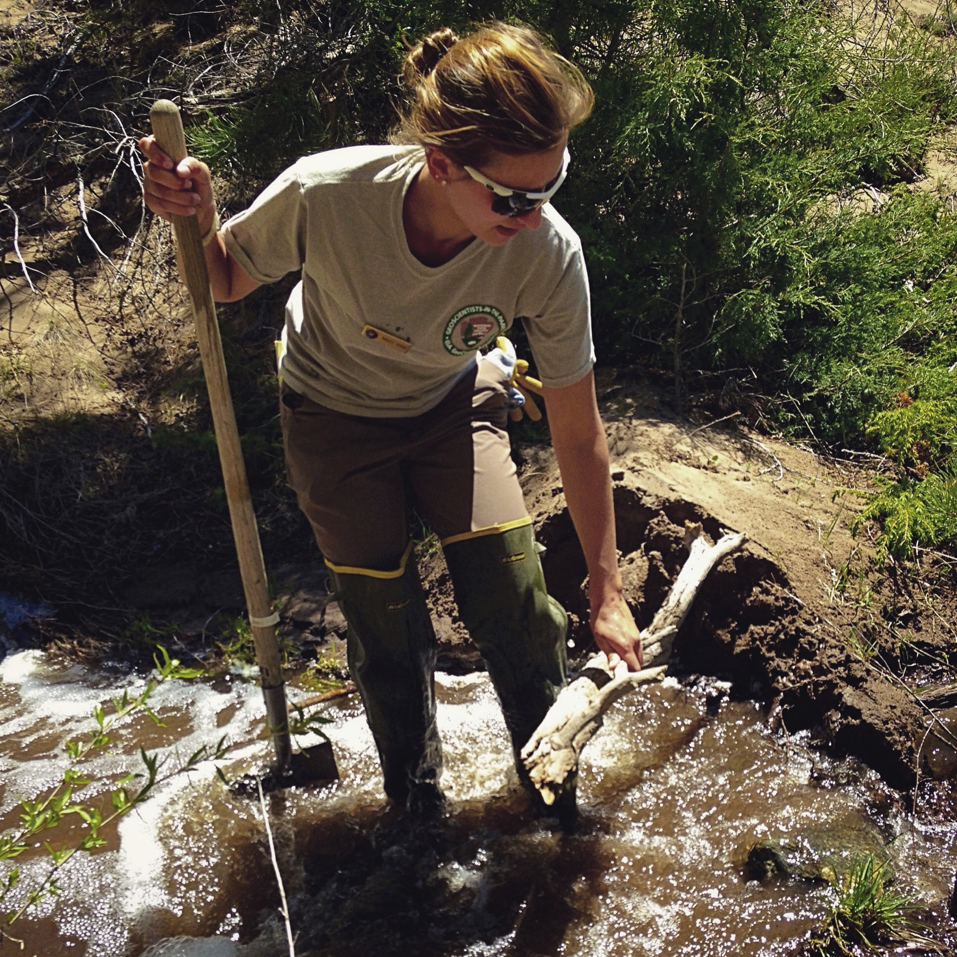
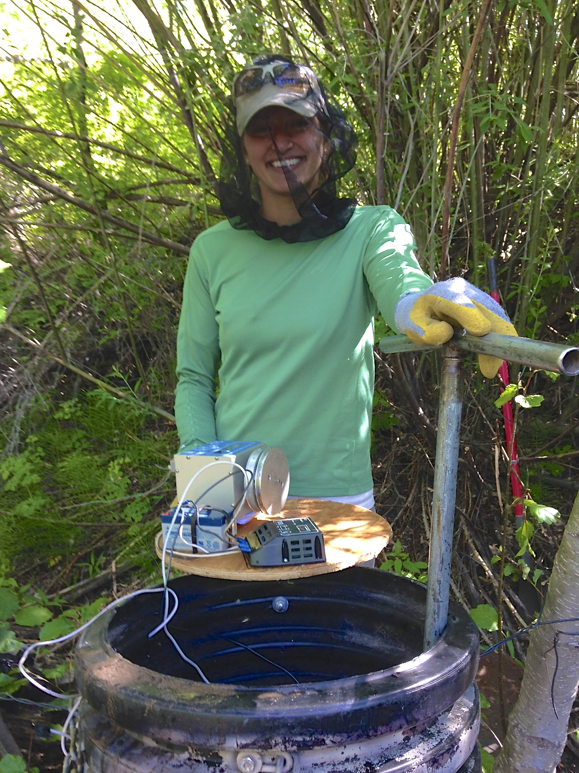
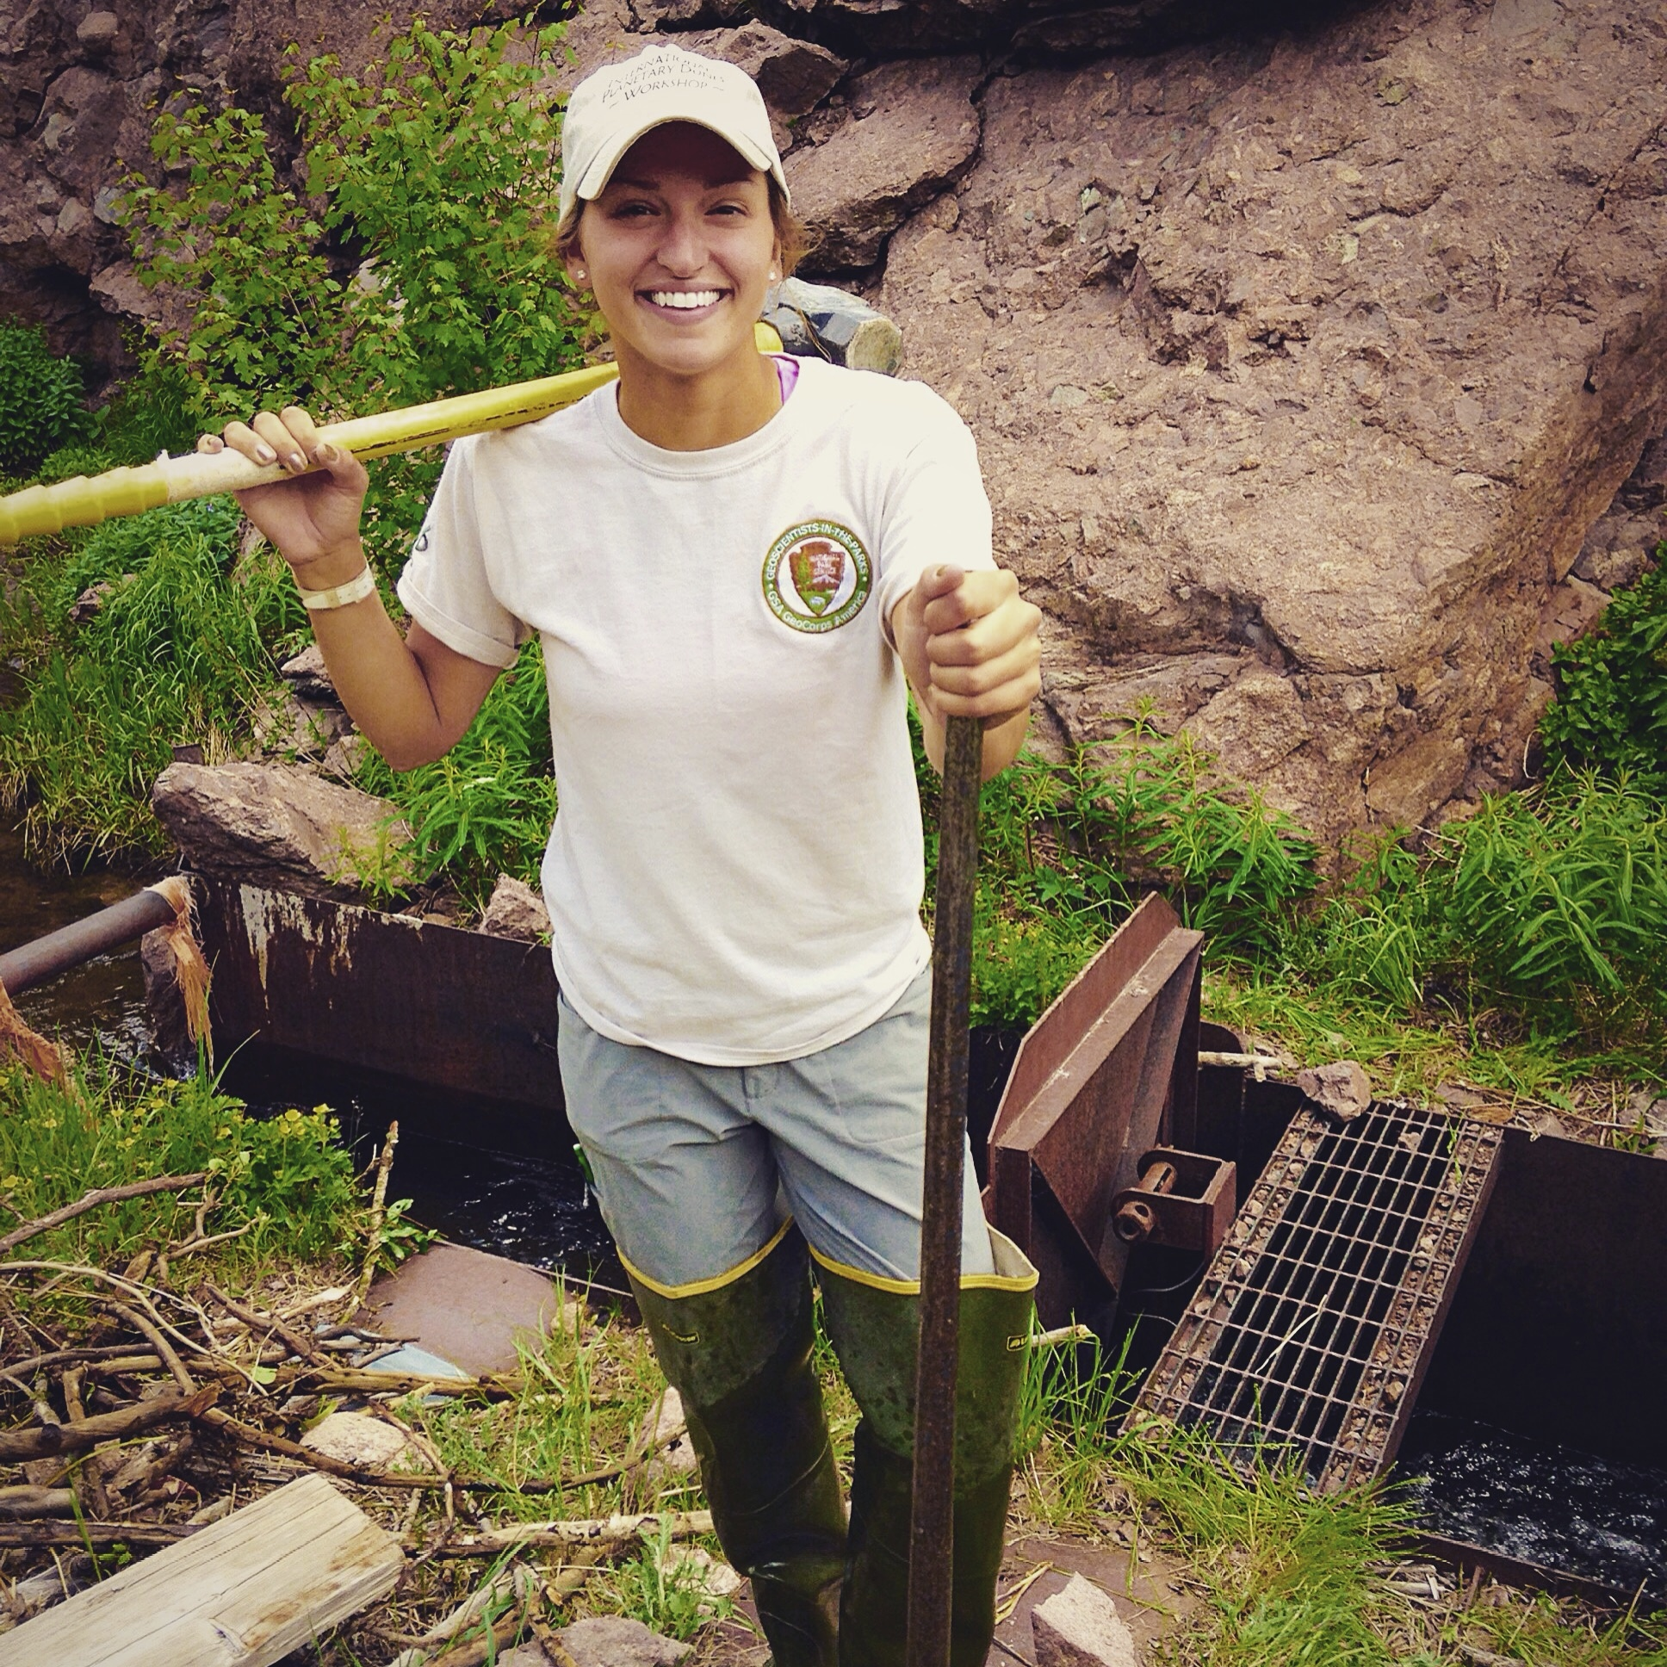
My Summer Experience at the Park:
Notes:
I had the opportunity to broaden my field horizons before initiating research
-stream gauging
-stream management
Data collection and analysis used to protect park resources
horray for the sledgehammer work!

Slide 4
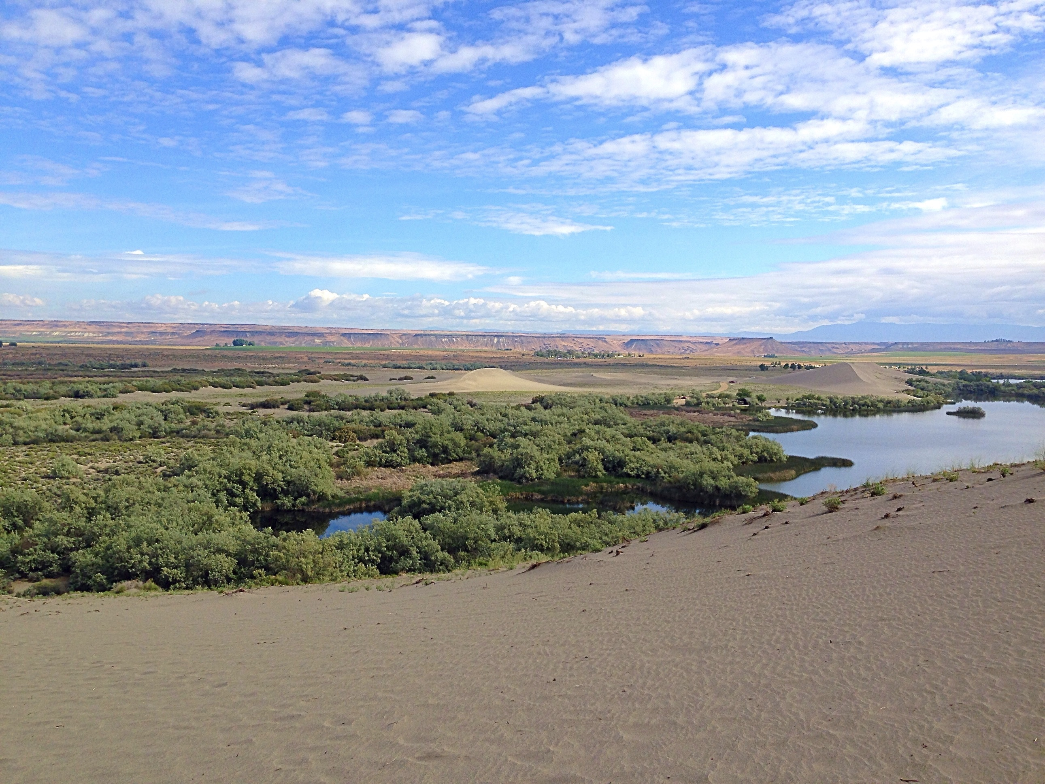
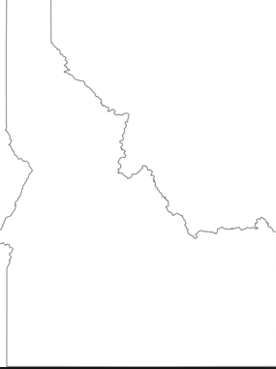
Boise
Notes:
At the beginning of my internship we attended the fourth annual international planetary dunes conference in Boise ID
On my first day of work I assisted my supervisor, Andrew, in measuring the height of the dune crests – this was my first experience working with a mapping-grade dGPS and total-station let alone my first time on a dune!
After working with this equipment, I soon realized how heavy and inconvenient the total station can be when working on 4-700ft dunes
WHY MEASURE THE DUNES?- BETTER UNDERSTAND THE FREQUENCY AND MAGNITUDE OF VERTICAL & HORIZONTAL DUNE MOVEMENT
Understand how local wind and weather regimes shape the characteristics and alterations of these dunes

Slide 5
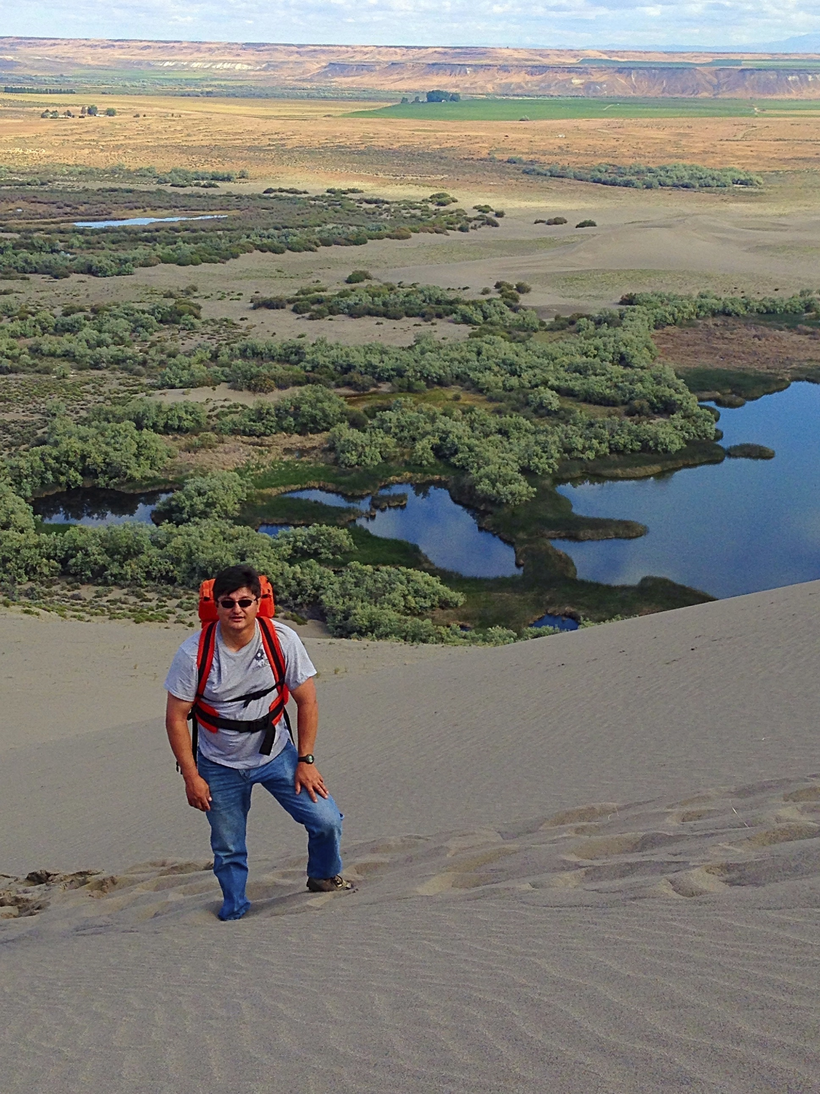

Slide 6
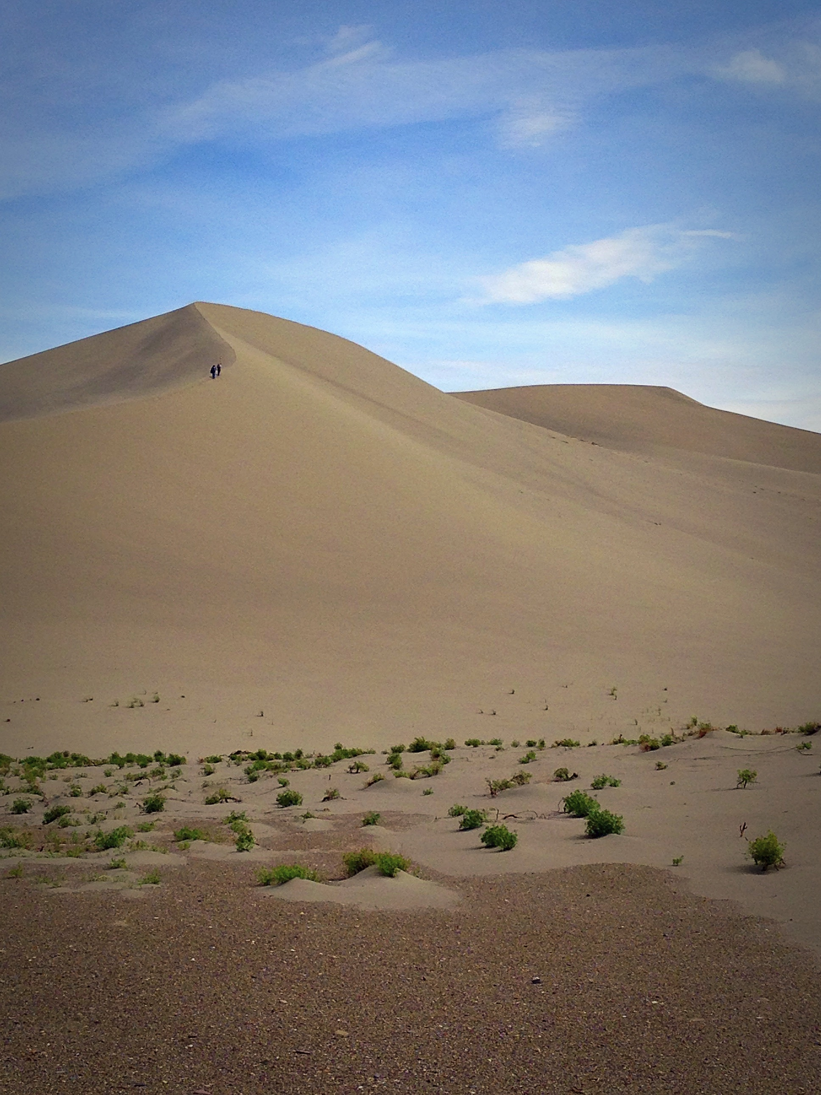
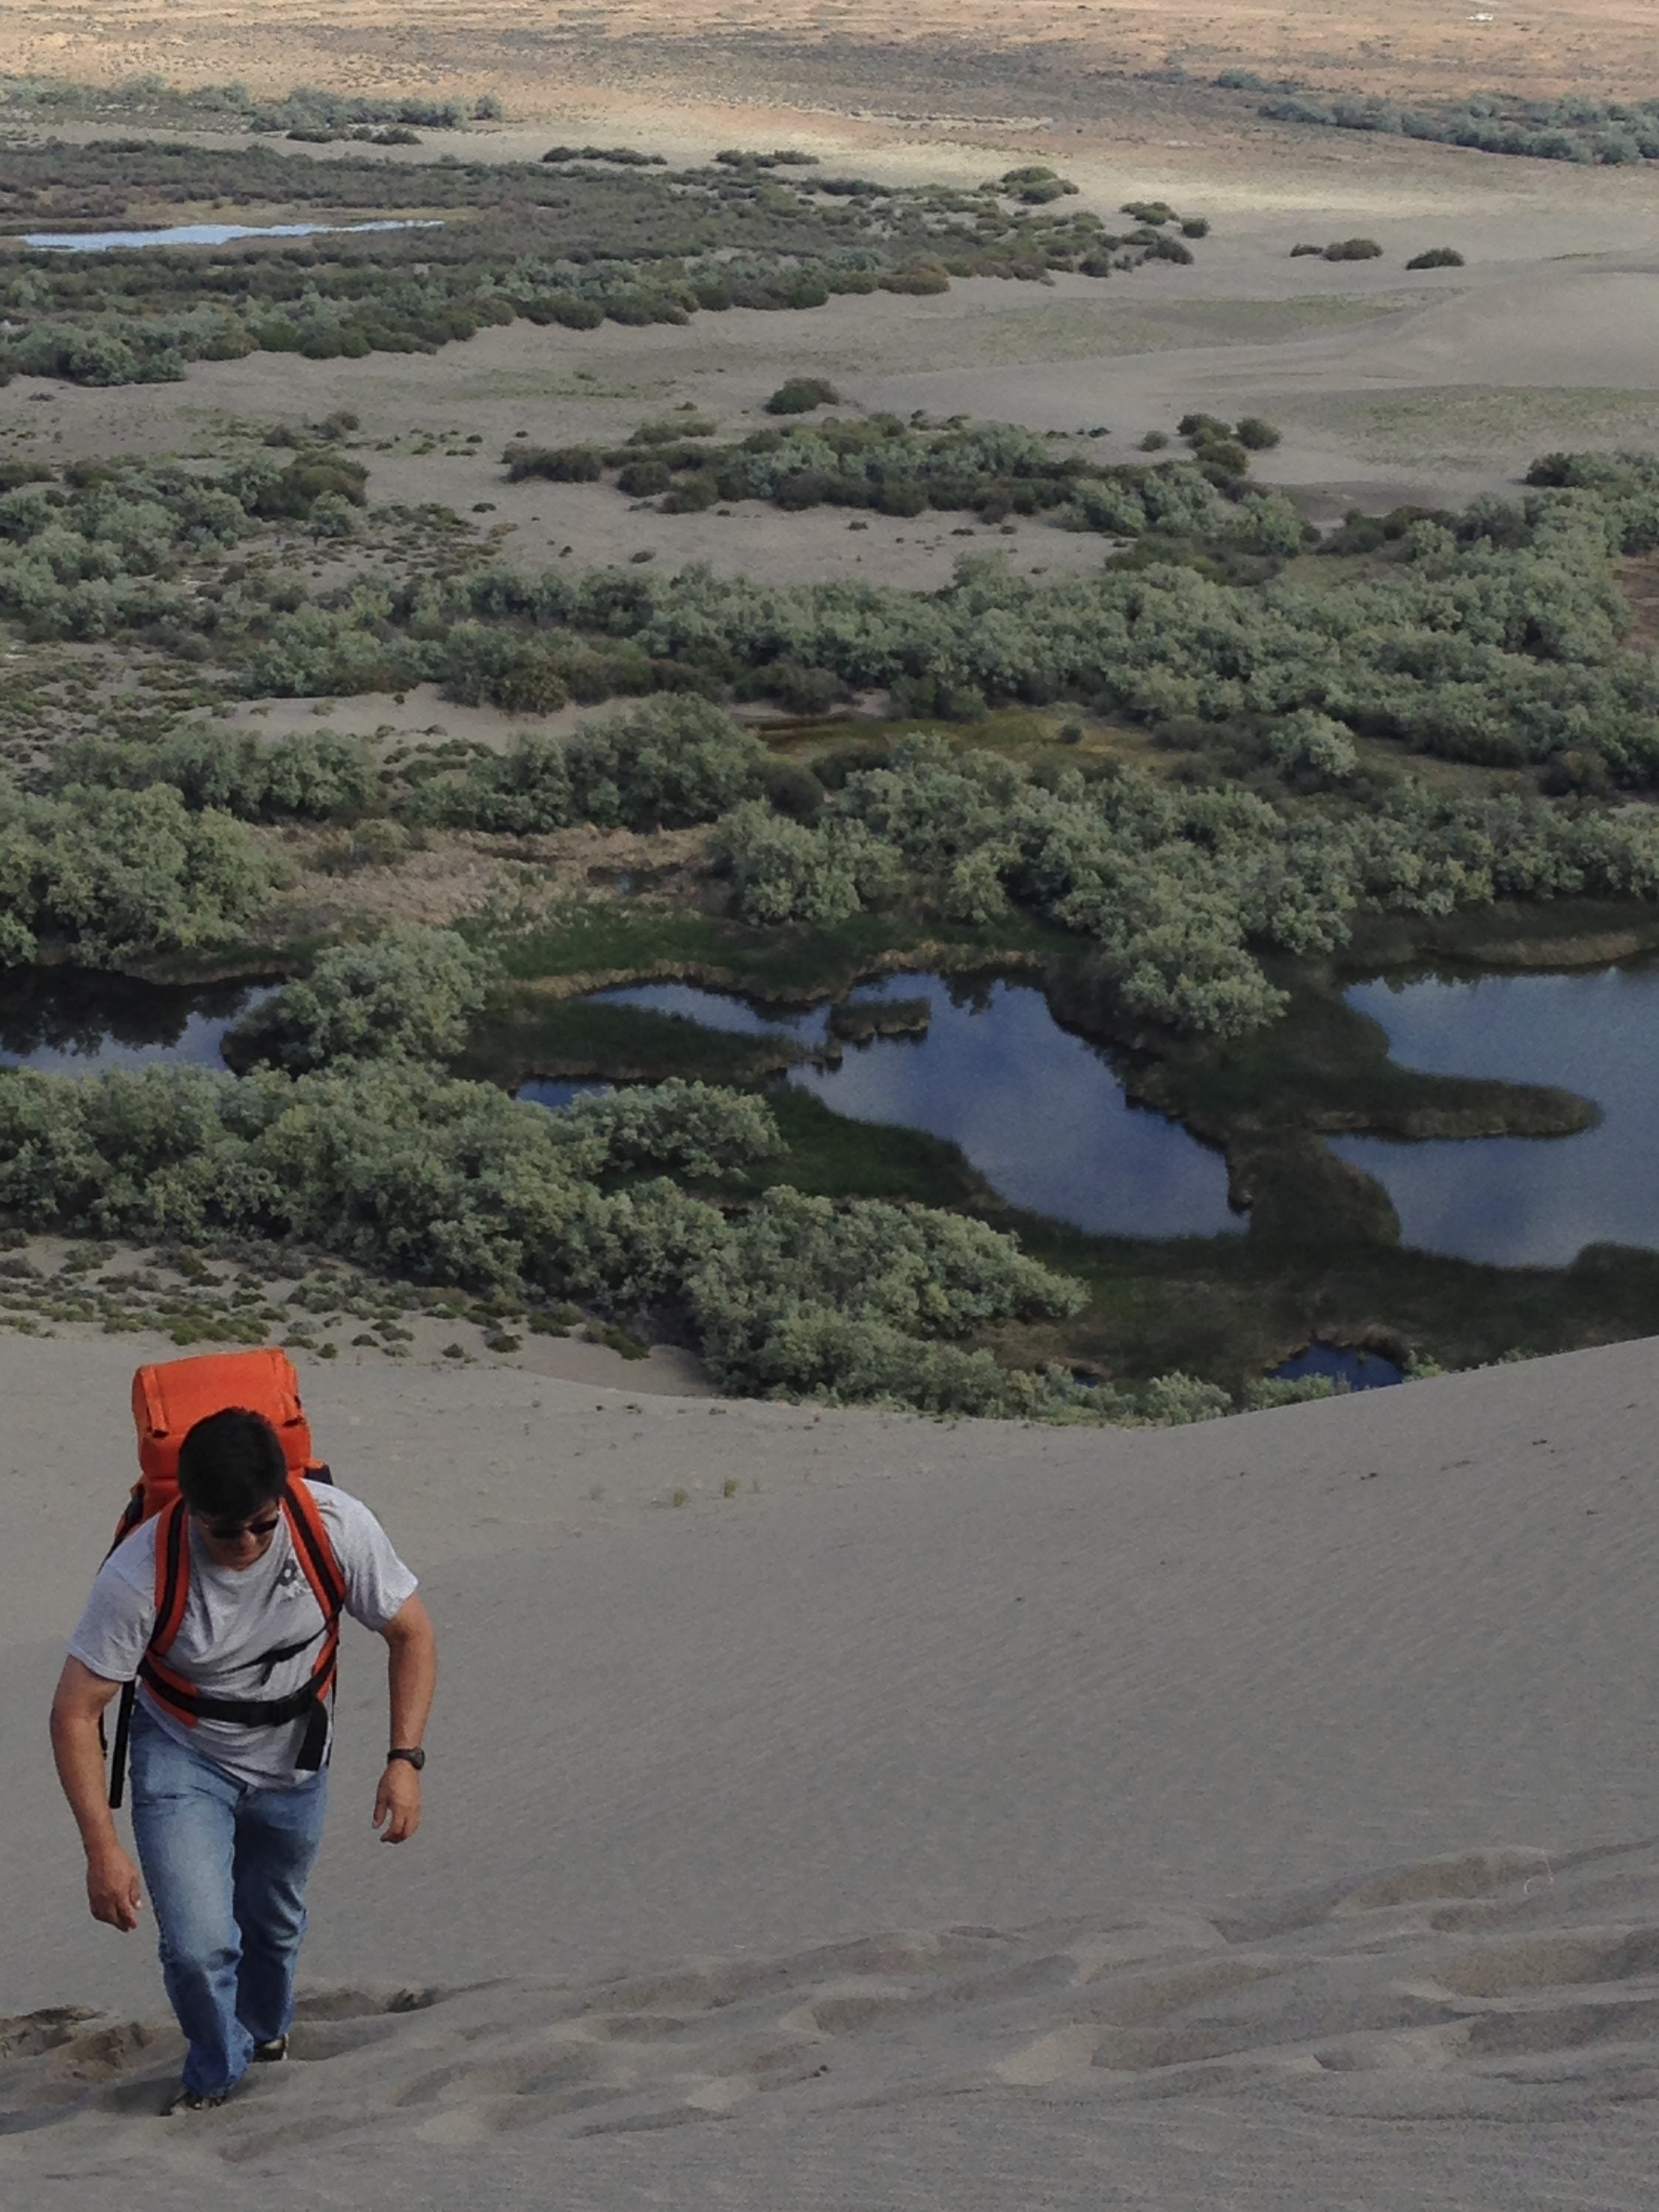

Slide 7
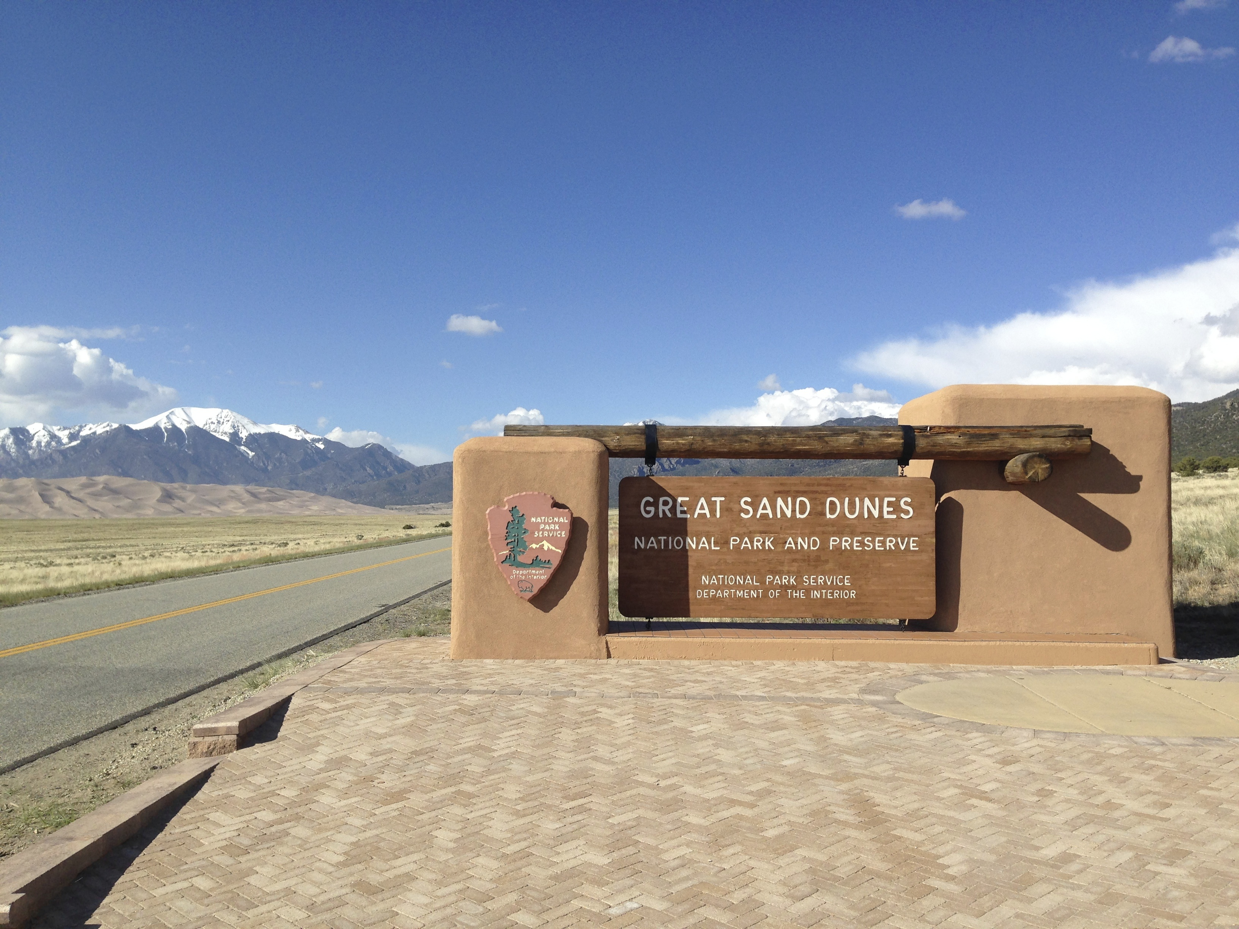
Notes:
Upon returning to the park.. UPON RETURNING TO GREAT SAND DUNES… WE REALLY DECIDED TO PUT THIS PROJECT INTO ACTION
We began to start tracking vertical and horizontal changes in dune heights
What a better place to do it than on open fields of dunes without obstructions on satellite signal

Slide 8
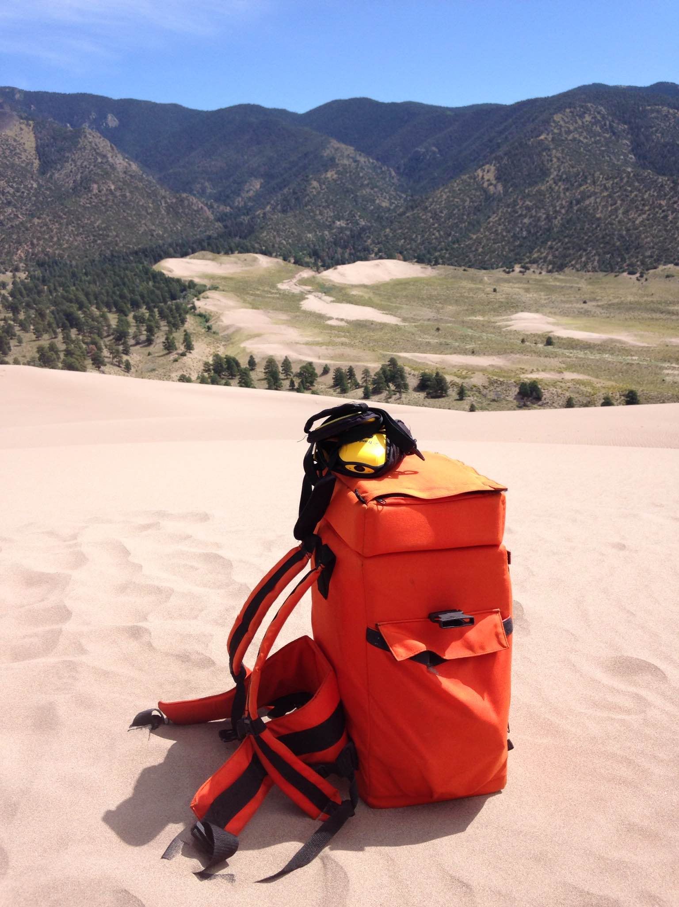
The purpose of this research was to evaluate the relative vertical accuracy of a Trimble GeoXH mapping-grade dGPS in comparison to a Nikon DTM-520 Total Station
Notes:
UPON RETURNING TO GREAT SAND DUNES… WE REALLY DECIDED TO PUT THIS PROJECT INTO ACTION
Lighten equipment load- 40lb of total weight included for the total-station pack. ultimately just want to see if removing the total station from the height measruing process as a whole
AGAIN I WANT TO STRESS THAT WE ARE NOT EVALUATING HOW ACCURATE THEY ARE TO THE ABSOLUTE VALUE OF ELEVATON- BUT COMPARE THE TWO METHODS TO ONE ANOTHER. THIS IS A relative EXPERIMENT WHO’S PURPOSE IS TO BETTER UNDERSTAND THE FUNCTIONALITY OF THE TRIMBLE FOR ANSWERING THE PROBLEM OF TRACKIND DUNE MOVEMENTS
WANT TO EMPLOY A MORE USER FRIENDLY, CHEAPER SOLUTION TO ANSWERING THE PROBLEM OF MEASURING AND TRACKING VERTICAL DUNE MOVEMENT
So apart from looking to lighten our load, this research was essentially in part, a test of how well a mapping grade dGPS unit can effectively interpret vertical elevation information.

Slide 9
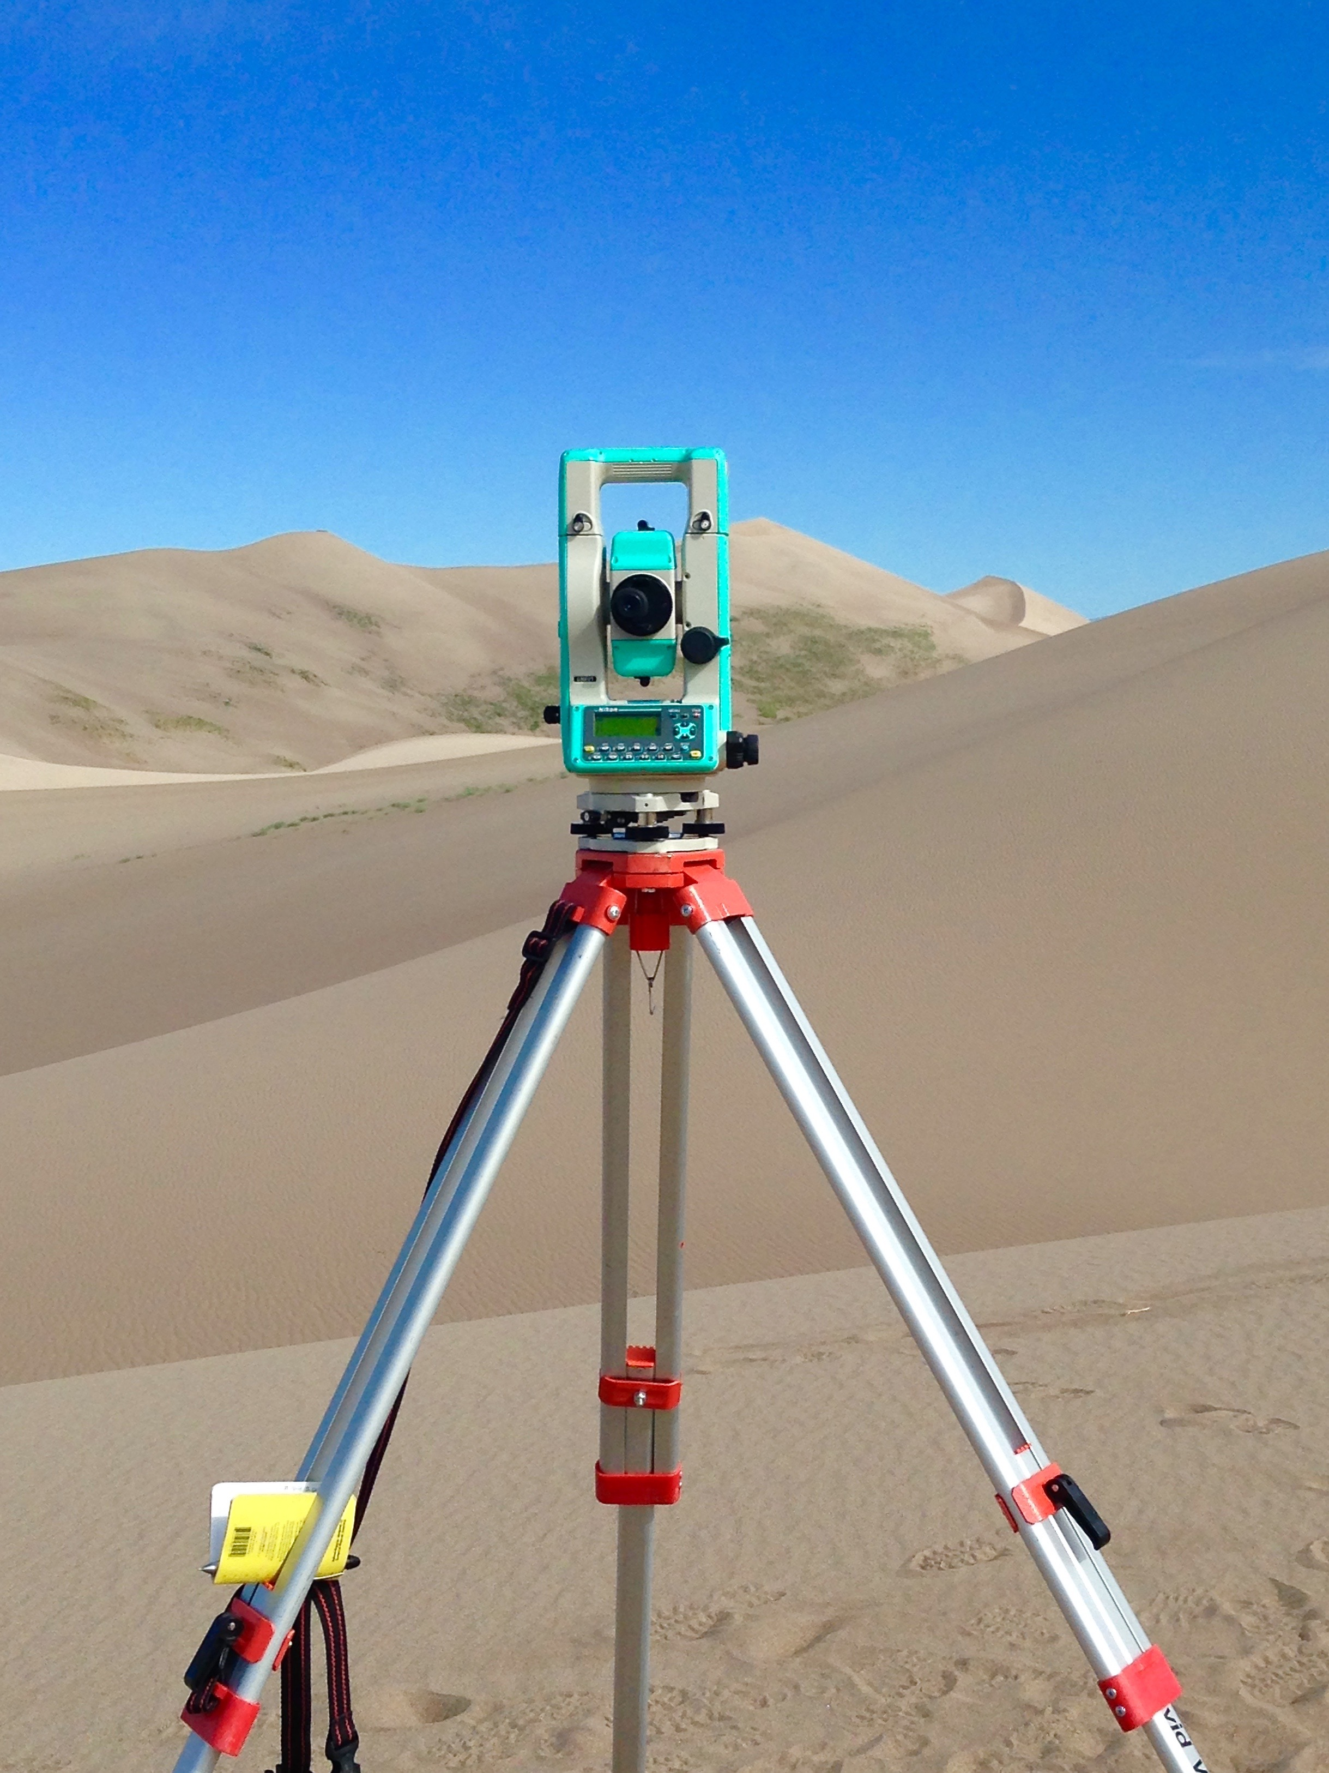
Nikon DTM-520 Total Station
Notes:
2-3mm of a km accurate.. – SURVEY GRADE, EXPENSIVE, HARD TO LUG AROUND (I love a challenge, but this was far more difficult than expected)
Used as almost “the control” measurements in the experiment– often used in construction and ect.
Uses reflective prism to measure distance by the time it takes for a laser beam to be sent out to the prism and reflected back. WHILE DOING SO- Produces bearing (horizontal) and asmath (vertical) angle. – really conceptualizes for itself a three dimensional measurement!!!
Base shots helped predict a base to calculate elevation– each shot collects Northing, Easting and Z Value –produce a three dimensional perception
convert to UTM position, actual elev. And GNSS HEIGHT. &take the difference

Slide 10
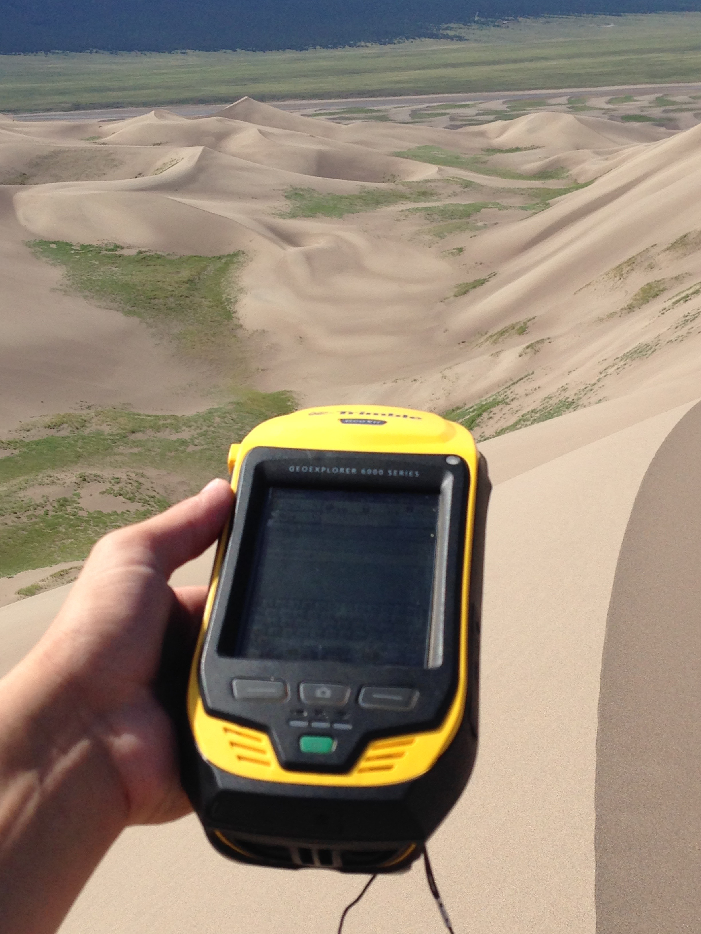
Trimble GeoXH GPS
Notes:
This is our mapping-grade Trimble– relatively inexpensive compared to the total station, by far more portable and user friendly---
Using this in our project was intended to solve our question of whether the dGPS unit is reliable enough in terms of vertical measurements to employ instead of the total station.
Known for submeter (horizontal) accuracy- vertical accuracy dependent on multiple conditions
Used to collect data for each location of total-station fore shots, also collecting spatial information for those particular locations later used to determine elevation.
Its role in the research was not only to collect information about the places the total station measurements were being recorded, but also information about the vertical elevation of those localities as well

Slide 11
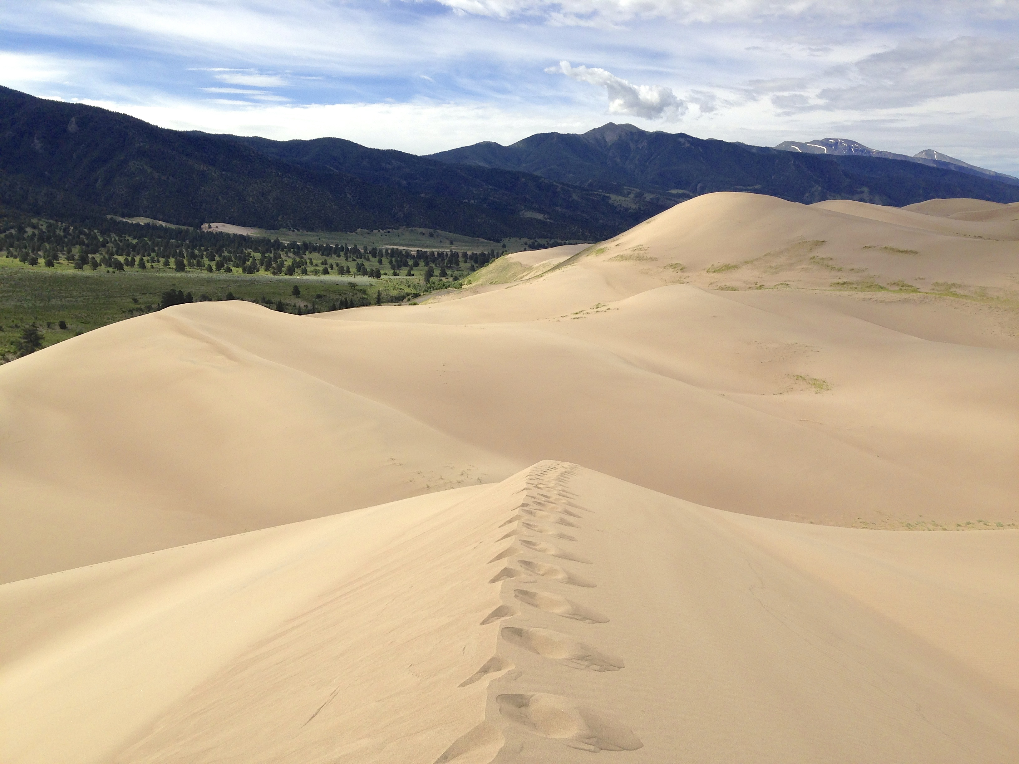
Notes:
View from top of Shocky’s dune

Slide 12
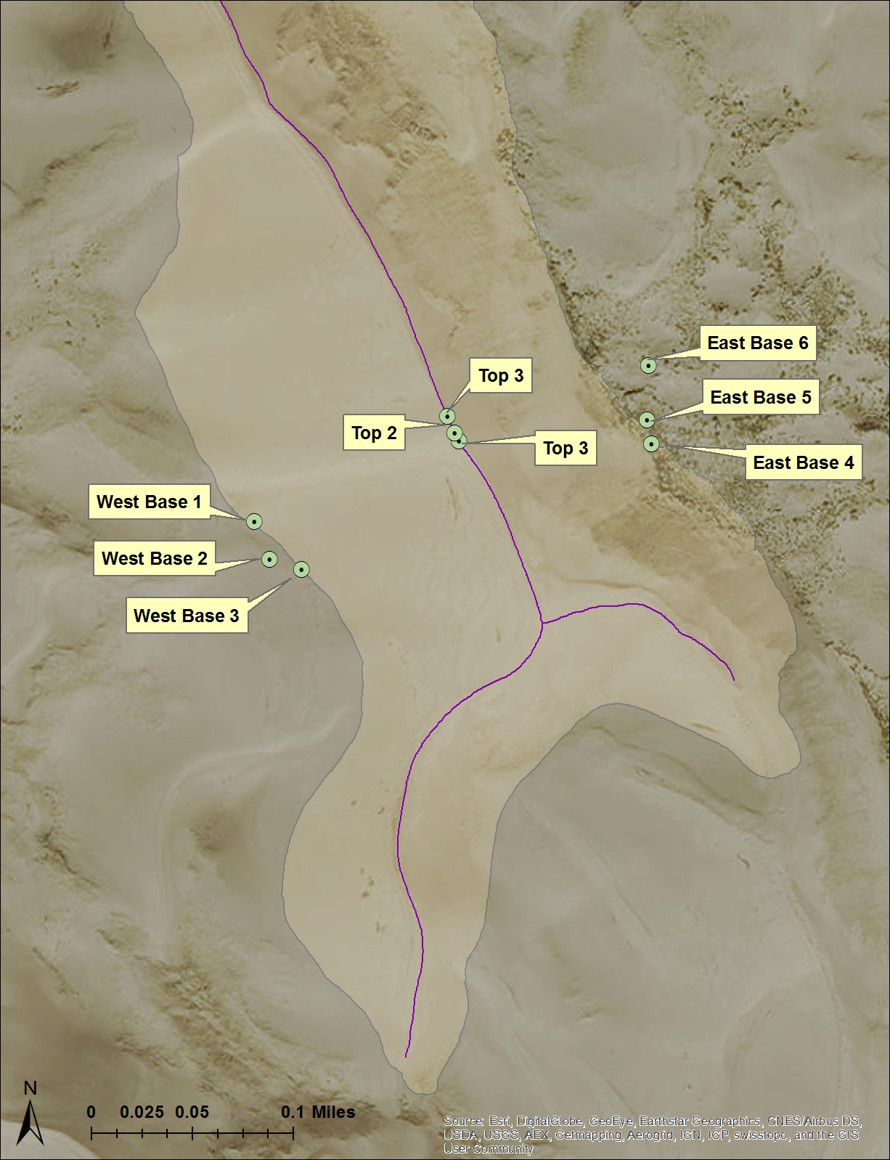
Shocky’s Dune
Notes:
A view from eyes in the sky of Shocky’s Dune– a Star Dune
Explain the mechanisms for how we took shots and where GPS points were taken
16%- 15-30cm ---= shockingkly bad differentially corrected results

Slide 13
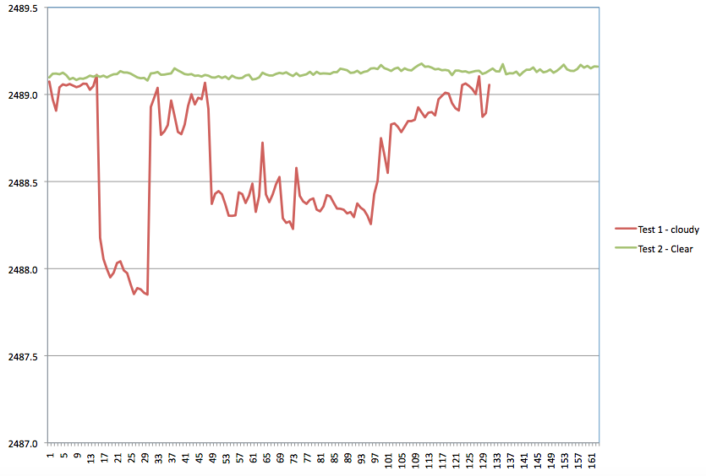
GNSS Height/ Elevation (m)
Positions Collected (Every 20 seconds)
Notes:
Differentially corrected data collected on Shocky’s dune were somewhat “Shocking” our results were quite poor. With only 16% of points taken with the gps being within 15-30cm
Inspired us to look deeper into things – ran gps to record 1pt every 20 sec for hour in fixed position- EVALUATE FLUCTUATION IN SATELITE RECONFIGURATION AND ELEVATION MEASURMT
SEE NATURAL VARIATIONS IN SATELITE SIGNAL IN A FIXED POSITION.
Dramatic changes in GNSS Height Values caused by satellite reconfiguration due to atm (cloud) interference.
What I would have done differently: alter variables to see just how important the role of differential correction is in the Trimble’s reliability

Slide 14
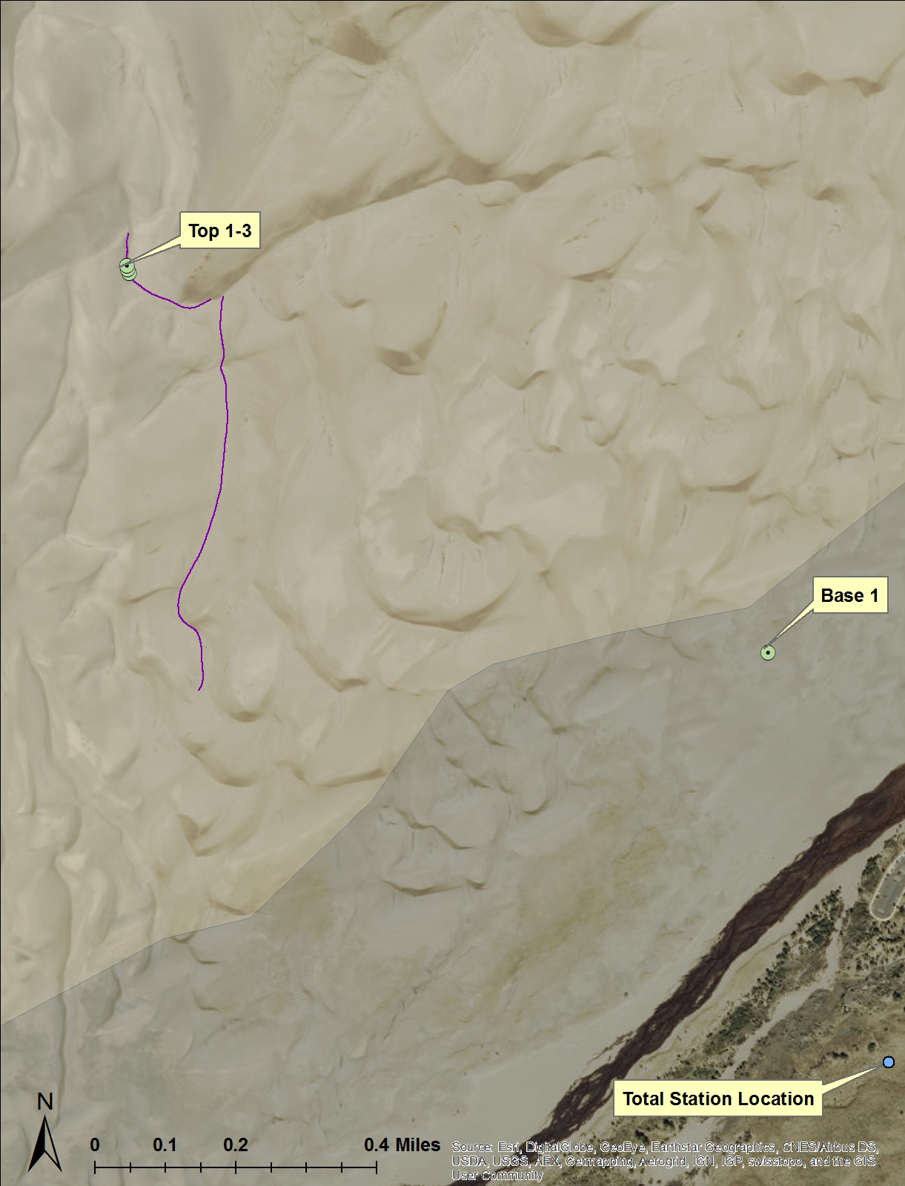
High Dune
Notes:
Mega-dune – point out the location of the total station, prism shots and base shot (used to project the base)

Slide 15
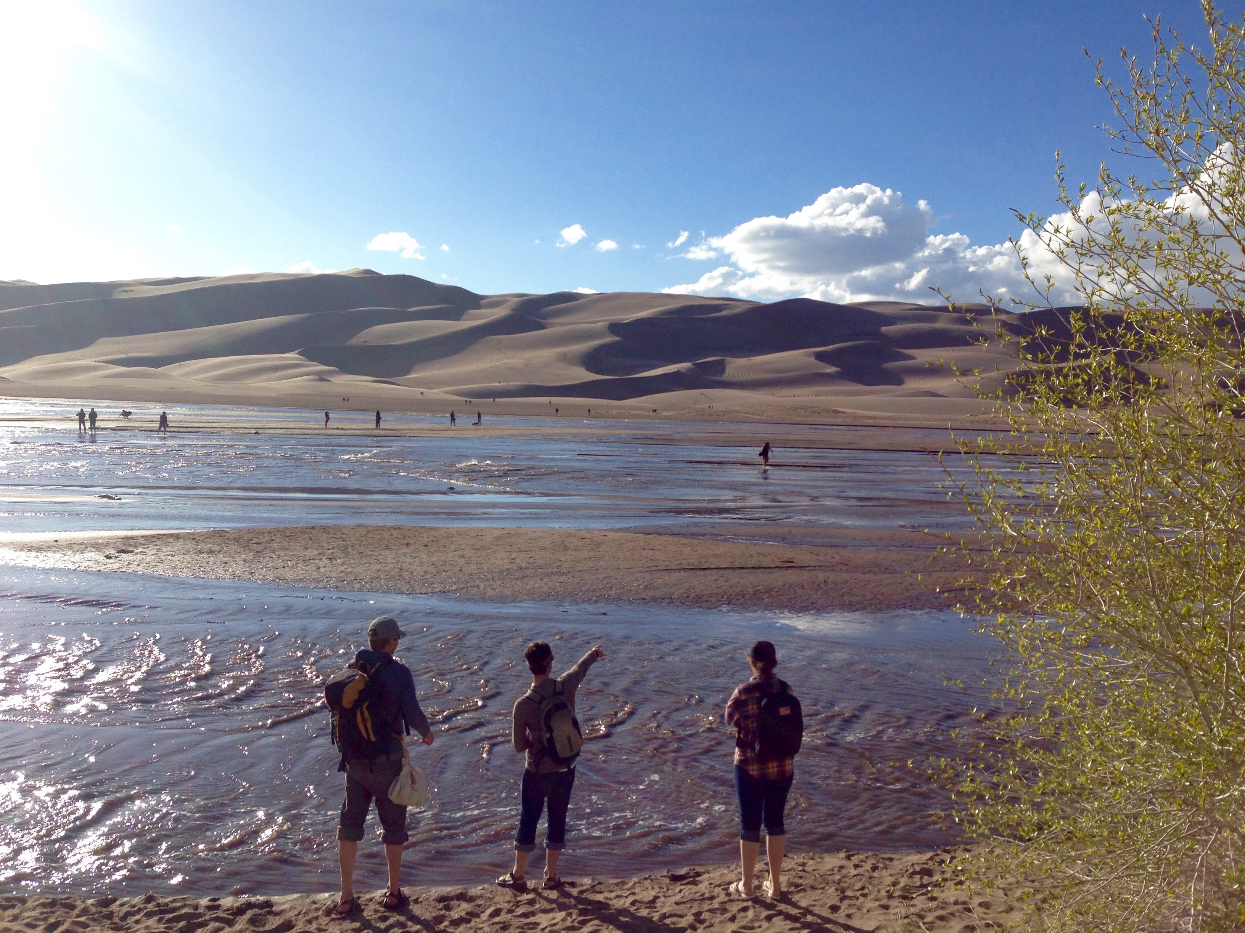
Notes:
99.5% of our differentially corrected results were within 5-15cm
Much better than shocky’s dune
All shots were within 3 inches of one other

Slide 16
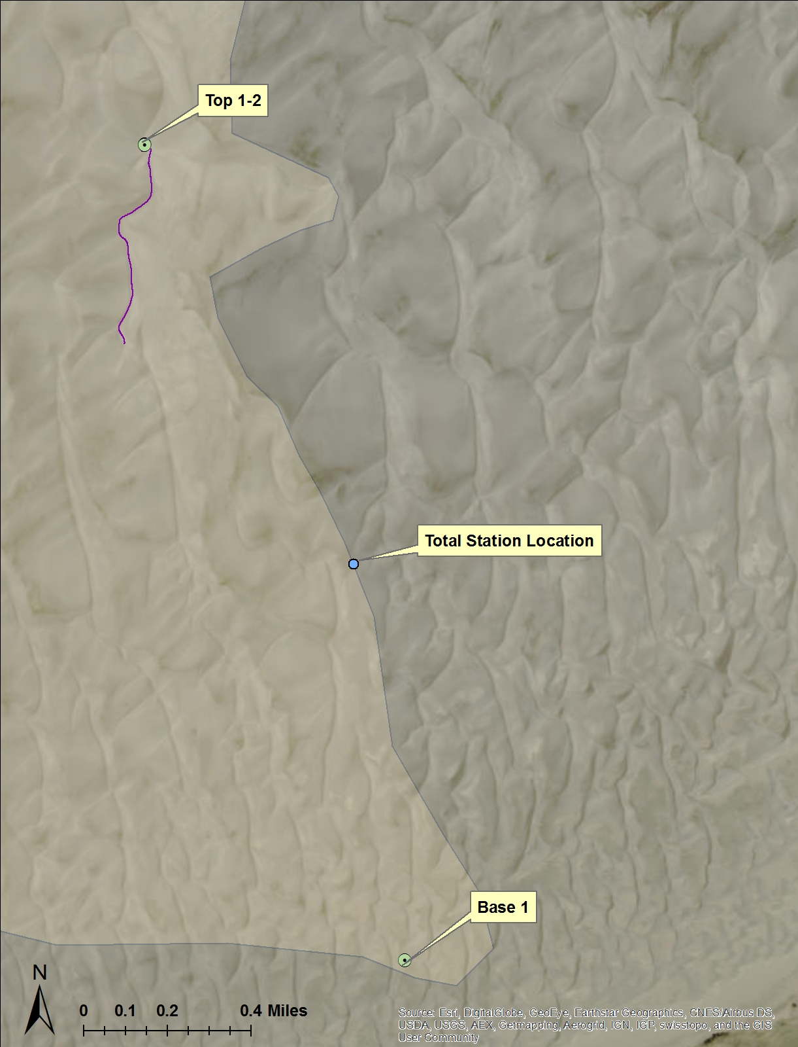
`
Star Dune
Notes:
TALLEST DUNE IN N. AMERICA– LOCATED ON star dune on the western edge of the dune field
OUR DRIVER FOR THE RESEARCH. A PRIME EXAMPLE OF THE DIFFICULTY IN HAULING THE TOTAL STATION EQUIPMENT
Almost a 6 mile round trip hike in the hot sand—8hr climb
Point out base shot, and station where the total station was set up, and where we took the three shots on top
97% 5-15cm
750 ft------ 229 meters tall

Slide 17
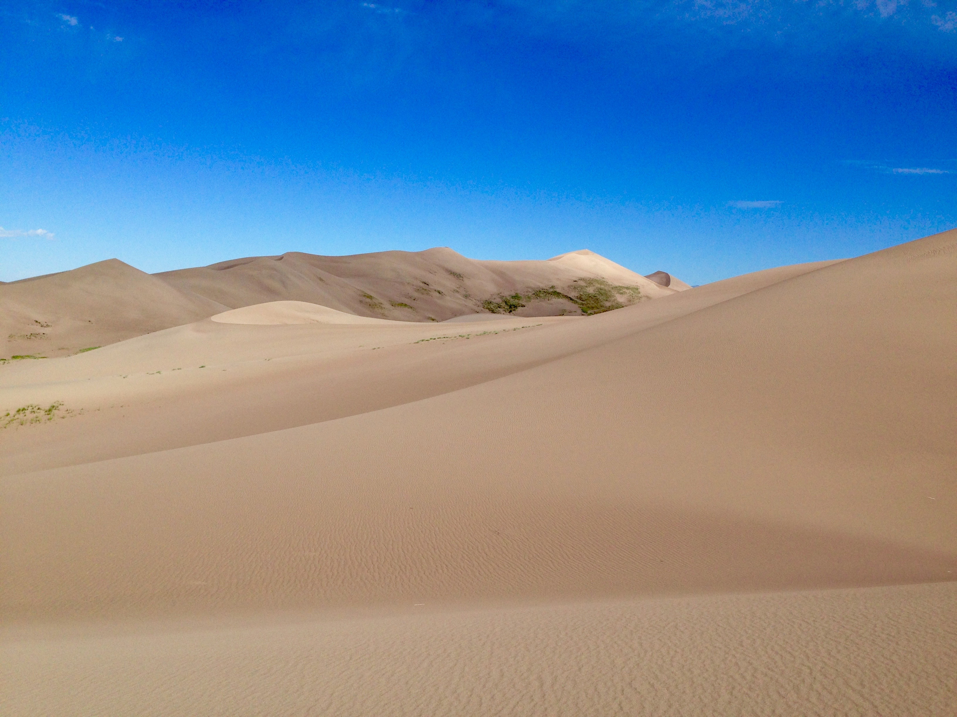

Slide 18
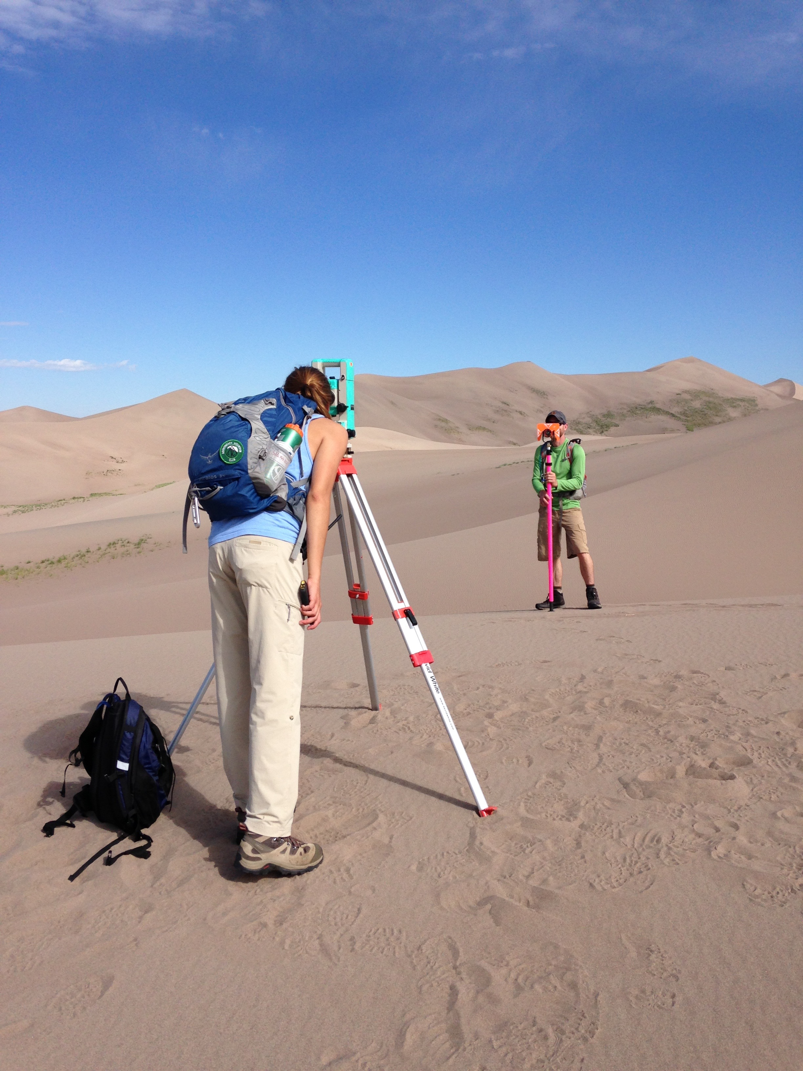

Slide 19
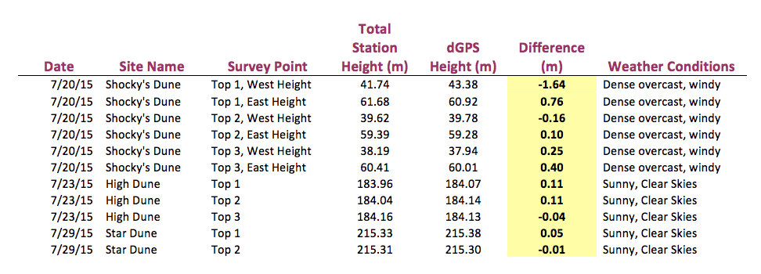
Notes:
ABSOLUTE VALUE in yellow- most important detail
FOR THE PURPOSE OF MEASURING DUNES AND RELATIVE HEIGHTS, OUR RESEARCH WAS CONCLUSIVE ENOUGH FOR DETERMINING THAT A DIFFERENTIAL MAPPING-GRADE GPS IS A VIABLE OPTION FOR MEASURING ELEVATION ON CLEAR DAYS (with the base stations running)
Would like to:
LOOK AT NEW LIDAR DATA THAT WAS SCHEDULED FORMTHIS FALL- TO SEE JUST HOW CLOSE THE VALUES PRODUCED FROM THE TOTAL STATION AND GPS WOULD HAVE BEEN FROM THE ABSOLUTE AND REAL ELEVATION AT THOSE POINTS.

Slide 20
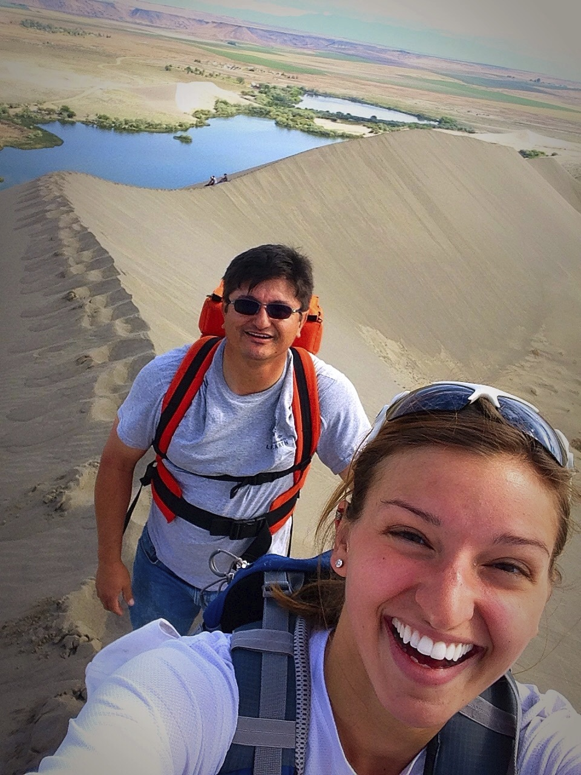
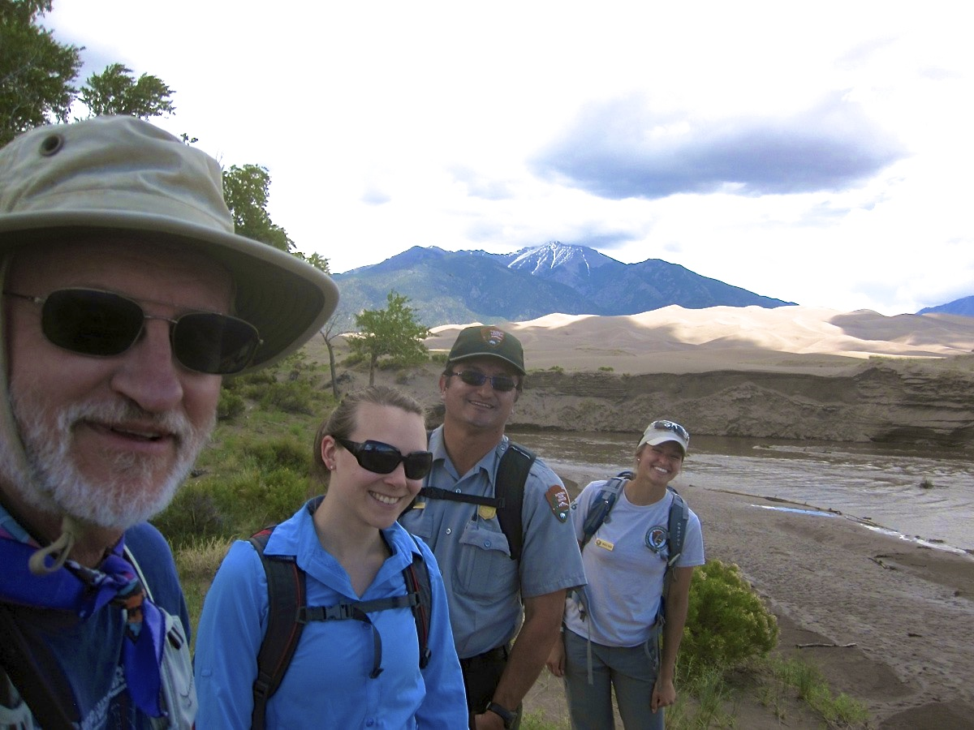
Acknowledgements
Andrew Valdez & Friends at Great Sand Dunes National Park and Preserve
The GeoCorps/Geological Society of America
St. Lawrence Geology Department
Notes:
THANKS TO GEOCORPS FOR PROVIDING A LIFE CHANGING MEMORABLE EXPERIENCE
THE SLU GEO DEPARTMENT FOR HELPING ME AND SUPPORTING ME IN GETTING THERE
Thanks for being patient with me, teaching me to use equipment and understand its mechanisms
And of course taking me to see Jurassic world in 3D when it came out– well done covering the basics!

