Slide 1


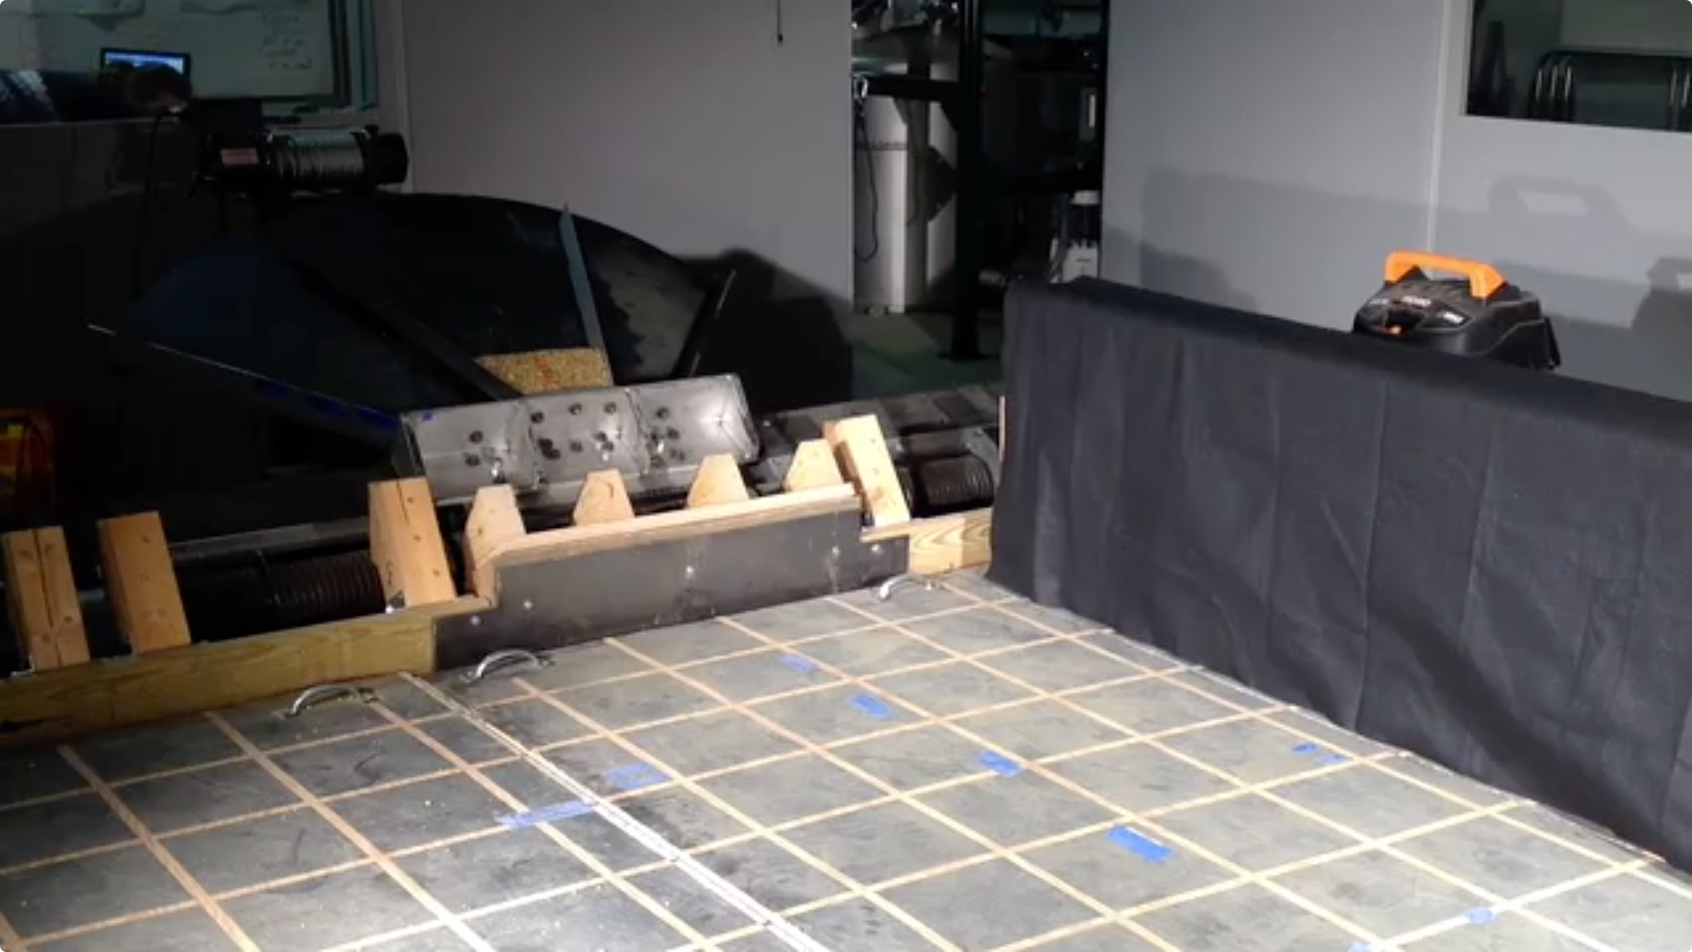
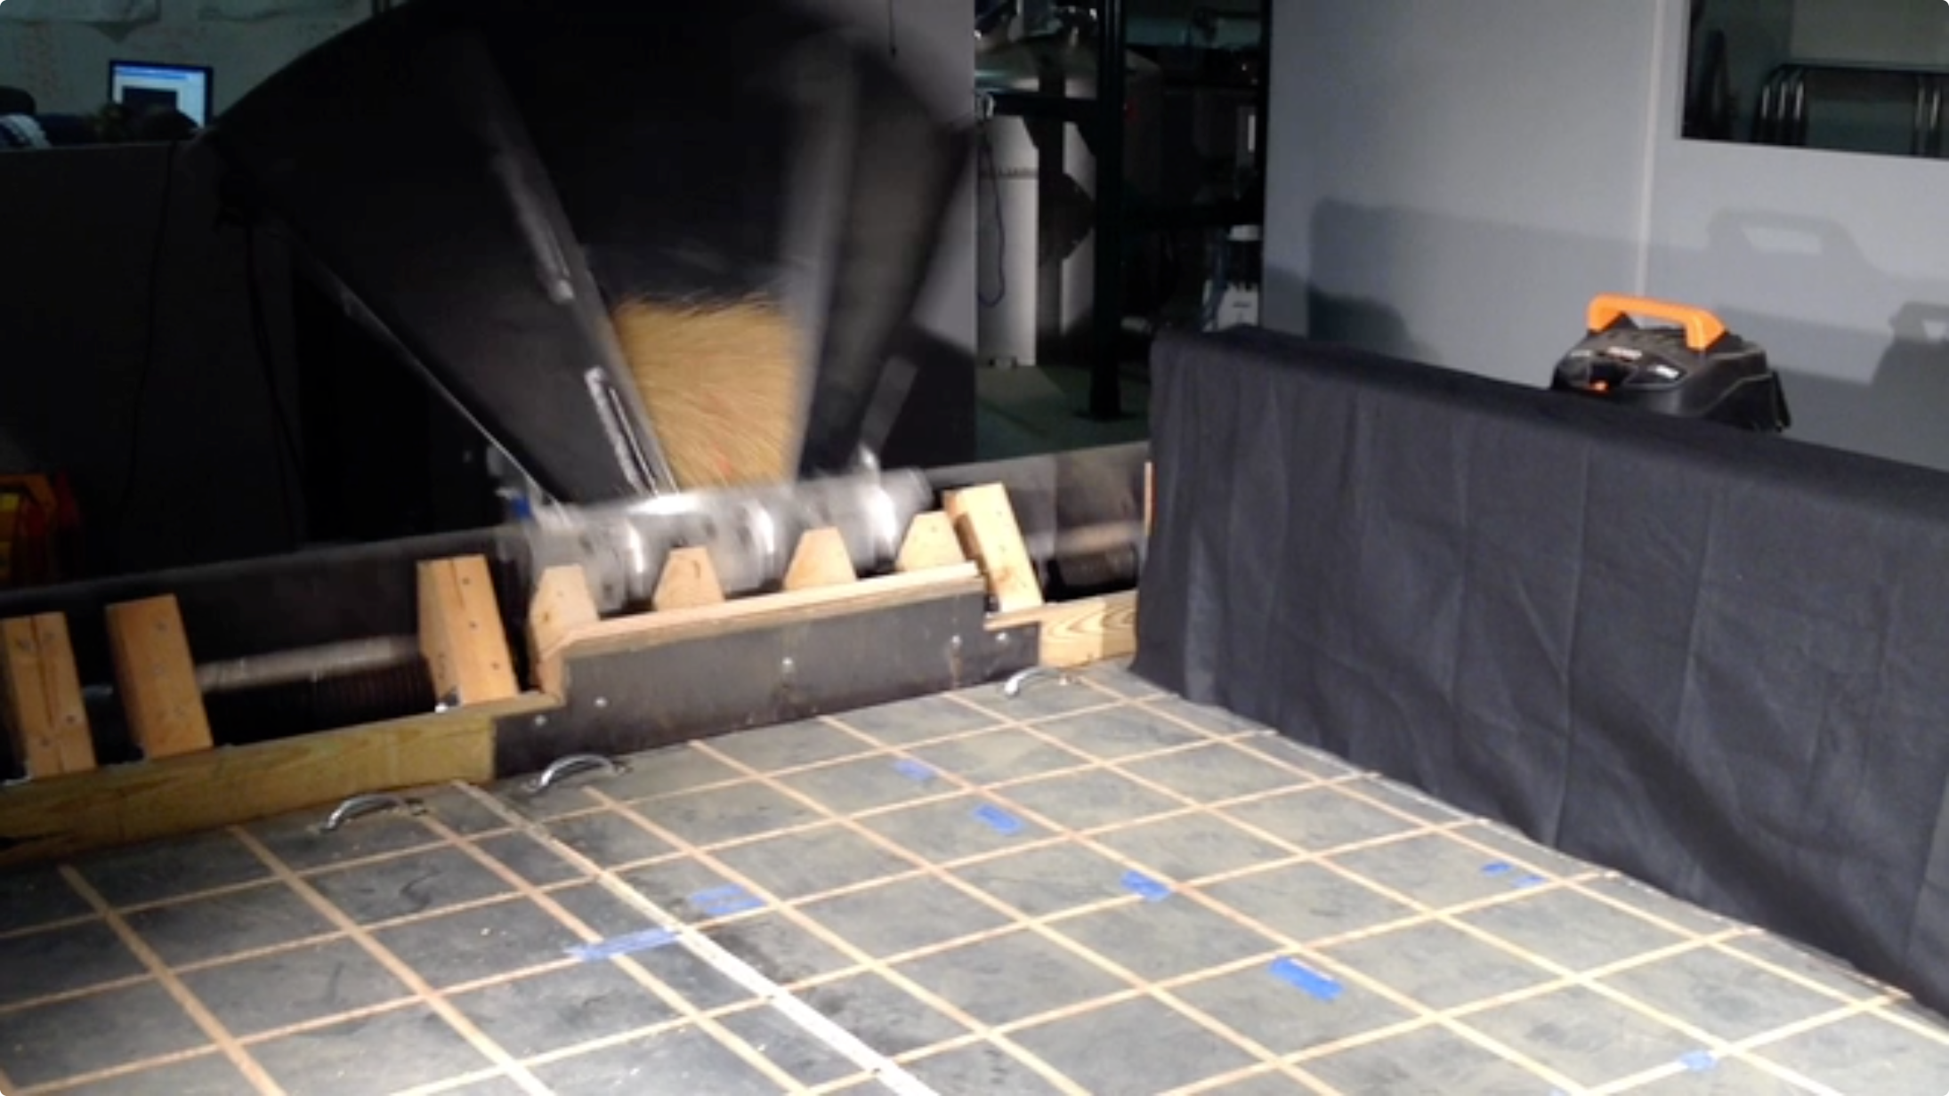
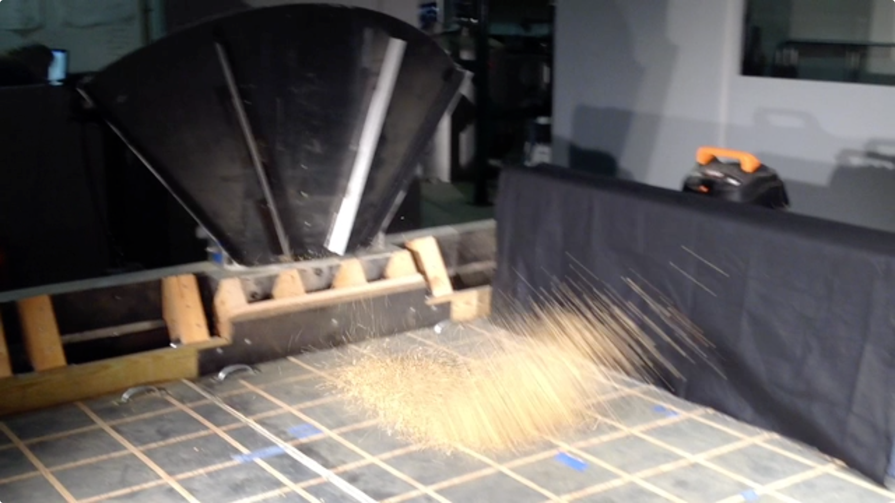
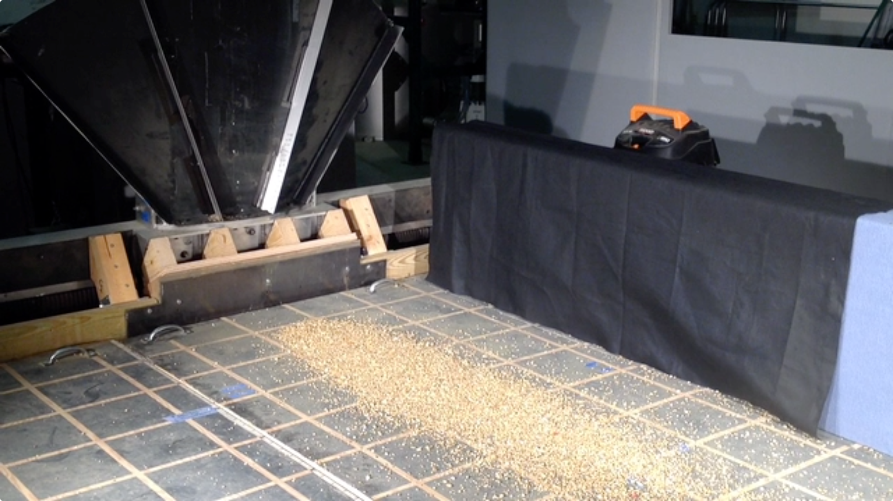
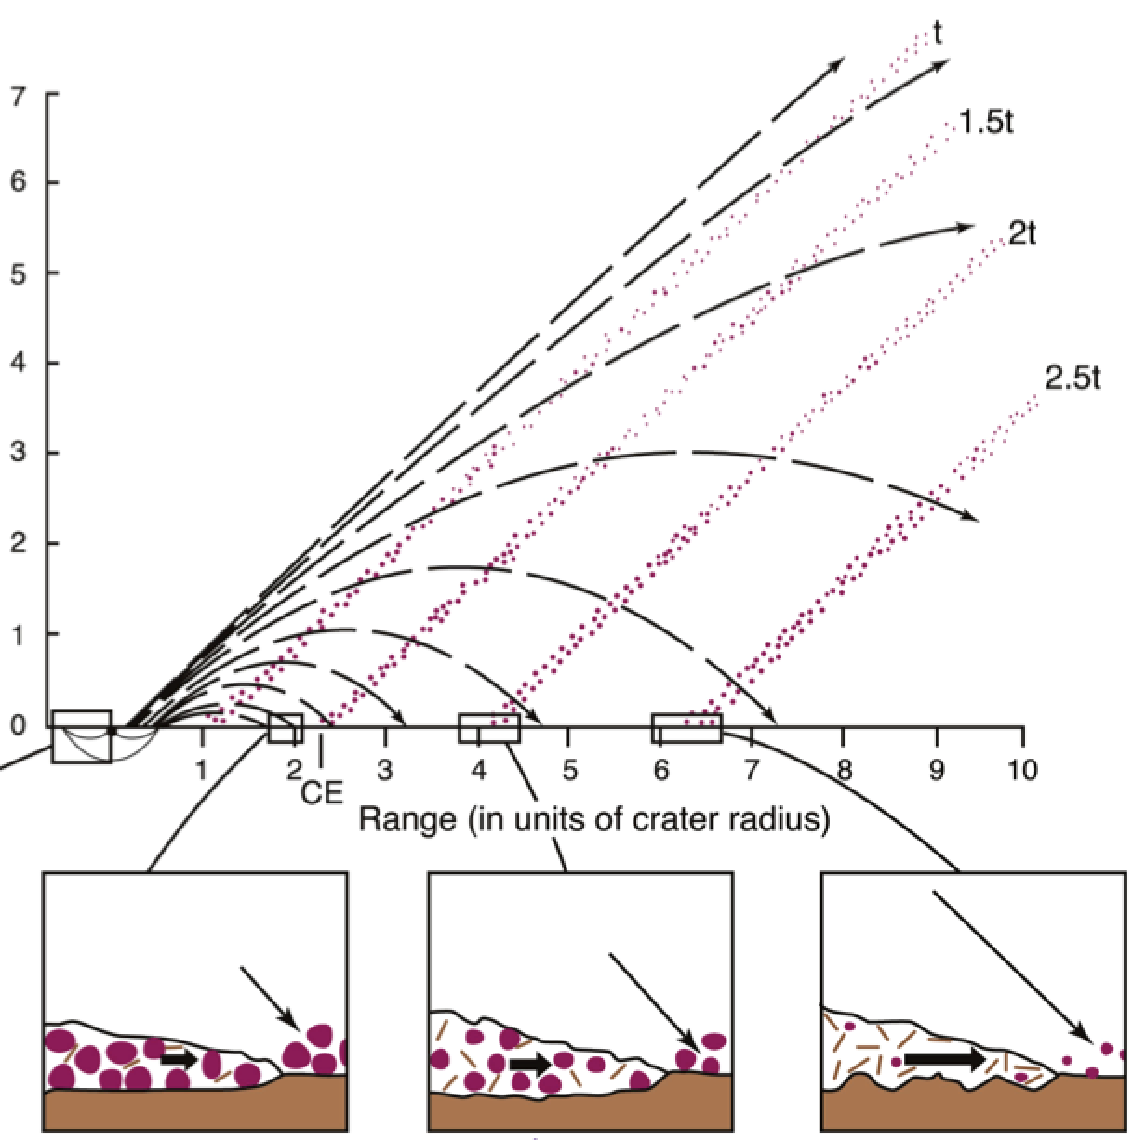
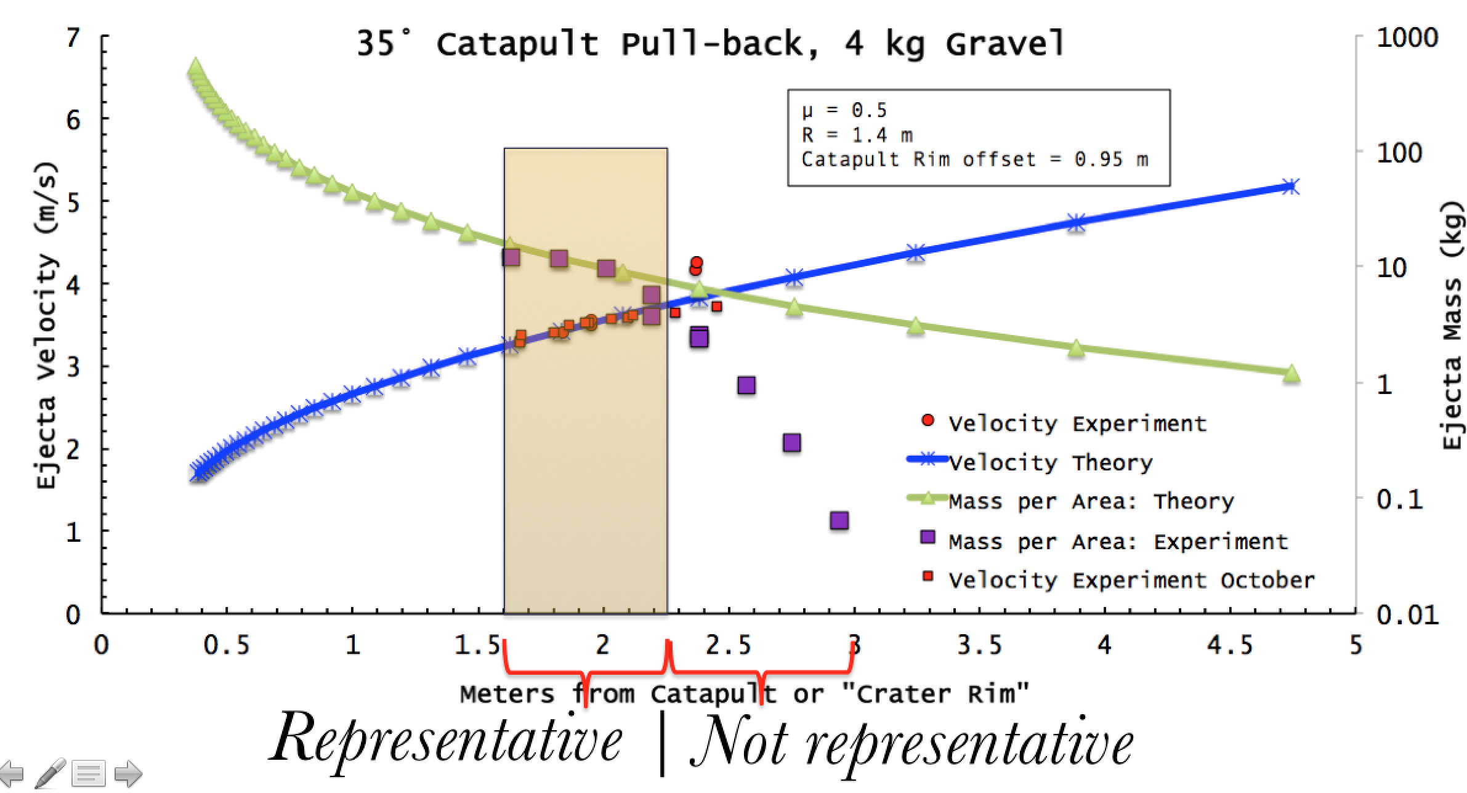
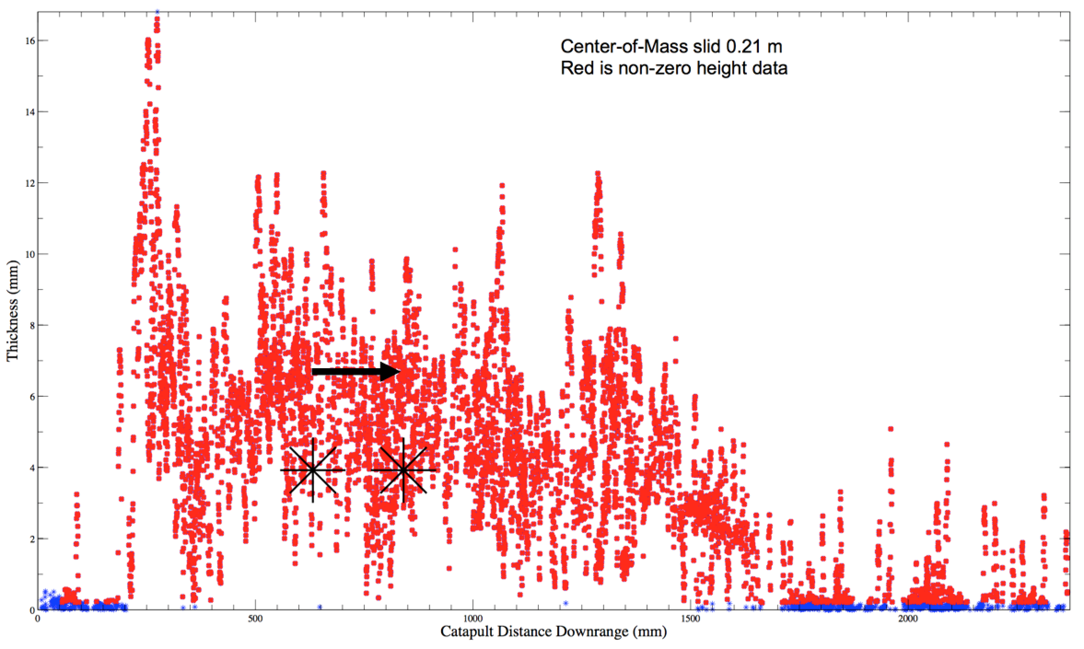
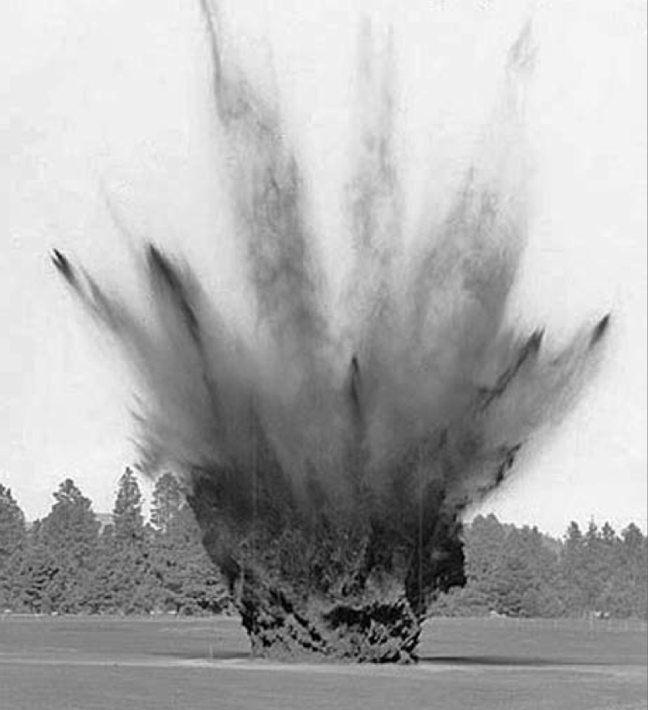
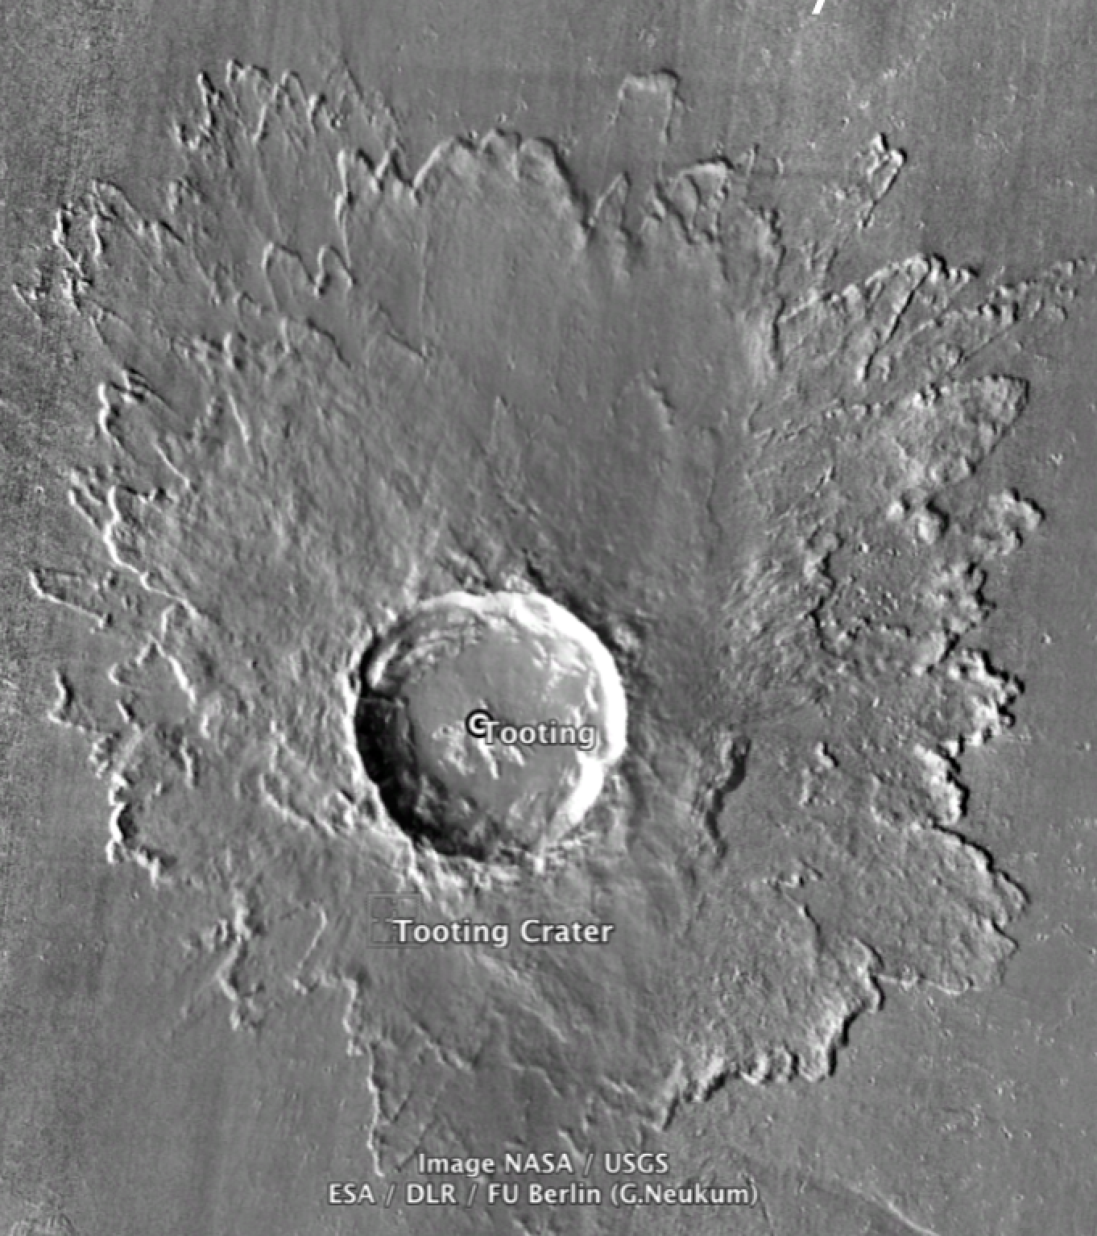
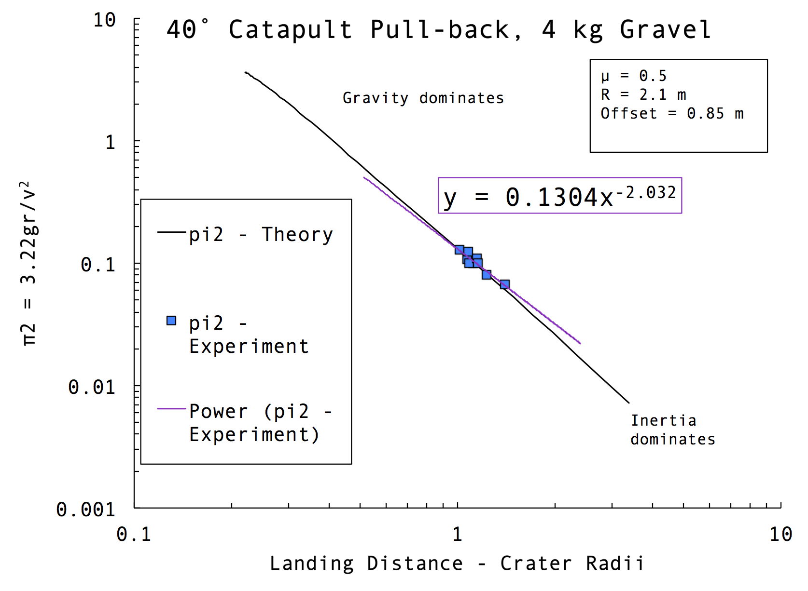
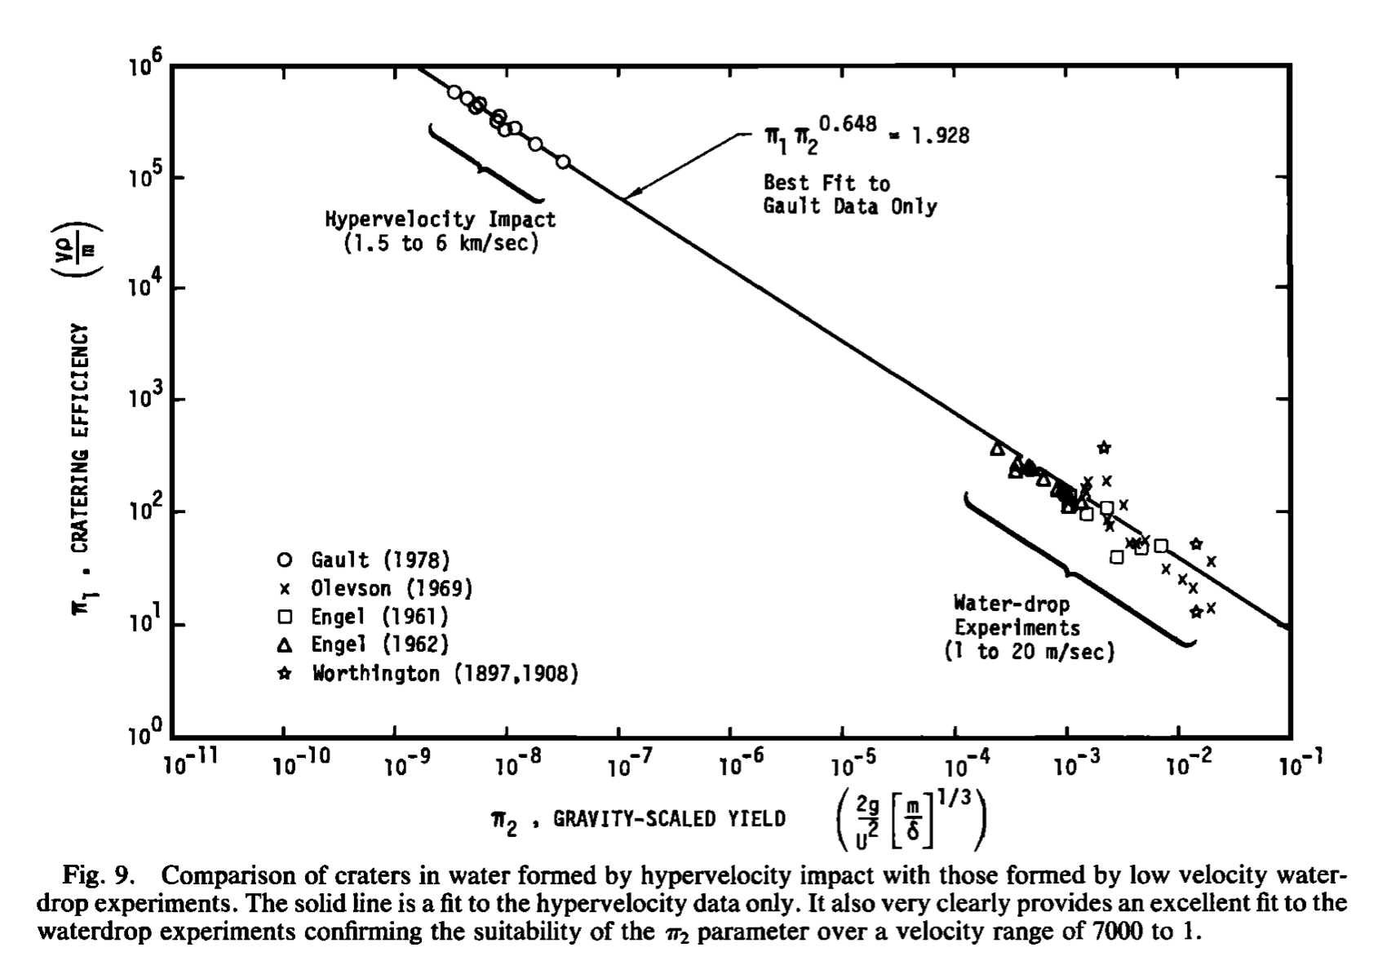
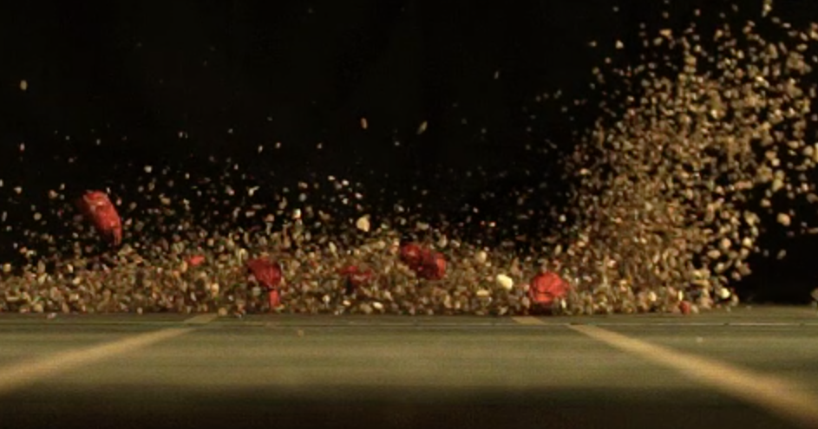
Ejecta Emplacement: Scalable Experimental Results
Kirby Runyon¹, Olivier Barnouin². ¹Johns Hopkins University, Baltimore, MD; kirby.runyon@jhuapl.edu. ²JHU/Applied Physics Laboratory, Laurel, MD, USA.
Key points: Lab ejecta curtain simulant matches velocity & mass curves predicted from theory. | Nondimensionalizing allows power-law size scaling to planetary regimes. | Ejecta “blanket” slides after deposition.
1. The ejecta catapult at APL simulates a wedge of ejecta curtain. It assumes a hypothetical impact crater formed behind it. It can fling up to 10s of kg of pea gravel as ejecta simulant a speeds between 1-10 m/s
6. Laser topography profile of deposited ejecta simulant. The left & right asterisks show the ejecta’s Center of Mass at landing (left) and after sliding, bouncing, & rolling (right). The CoM displaced 0.21 m from where ejecta originally landed. Red points are gravel topography and blue points are non-selected points on the floor. The post-sliding CoM approximately corresponds with continuous-discontinuous transition zone.
4. Using high-speed video and catchment buckets to catch the gravel, we can measure the velocity and mass distribution of the just-landed ejecta curtain (before it can slide laterally) & compare it to theory. Velocity & mass data points match theory curves corresponding to a terrestrial crater of radius = 1.4 m.
2. Impact crater ejecta is a major agent of geomorphic change & mobilizes planetary regolith with implications for sample provenance interpretation. Original figure credit: Oberbeck, 1975. Inset credit: USGS Photo P447, F106756
References:
French, B.M., 1998, Traces of Catastrophe: http://www.lpi.usra.edu/publications/books/CB-954/CB-954.intro.html, LPI Contribution No. 954.
Holsapple, K.A., Schmidt, R.M., 1982, On the scaling of crater dimensions 2. Impact Processes: JGR, v. 87, No. B3, p. 1849-1870.
Kring, D.A., Higher Educational Resources: http://www.lpi.usra.edu/exploration/training/illustrations/impactEjecta/ Center for Lunar Science & Exploration
Melosh, H.J. 1989, Impact cratering: A geologic process: Oxford UP, ISBN 0-19-504284-0.
Oberbeck, V.R., 1975, The role of ballistic erosion and sedimentation in lunar stratigraphy: Reviews of Geophys., Space Phys., p. 337-362.
USGS “gray literature” http://www.hq.nasa.gov/alsj/of2005-1190_figs_040-059.pdf
5. Left Non-dimensionalizing the velocity theory and data into the gravity-scaled velocity (π₂ = 3.22gr/v²) and crater-radius-normalized landing distance will allow applying power-law scaling rules to predict ejecta properties on other planets.
Right The goal is for one power law to describe a broad range of ejecta velocities, gravities, and excavation efficiency as demonstrated in this figure from Holsapple & Schmidt (1982).
3. This still frame from our high-speed camera (1200 fps) shows the deposition and continued bouncing and rolling of ejecta post-landing (moving left to right): ejecta deposition is a dynamic, landslide-like process that can garden regolith. Lines are 25 cm apart.
Notes:
After GSA, correct for ripple profile angle
http://www.hq.nasa.gov/alsj/of2005-1190_figs_040-059.pdf
Holsapple & Schmidt, 1982

