Slide 1
Facing Higher Sea Levels and Increased Coastal Flooding in New York City
Vivien Gornitz, Radley M. Horton, Daniel Bader, Cynthia Rosenzweig, and Philip Orton
Columbia University, NASA/Goddard Institute for Space Studies, and Stevens Institute of Technology
GSA Annual Meeting
November 3, 2015

Slide 2
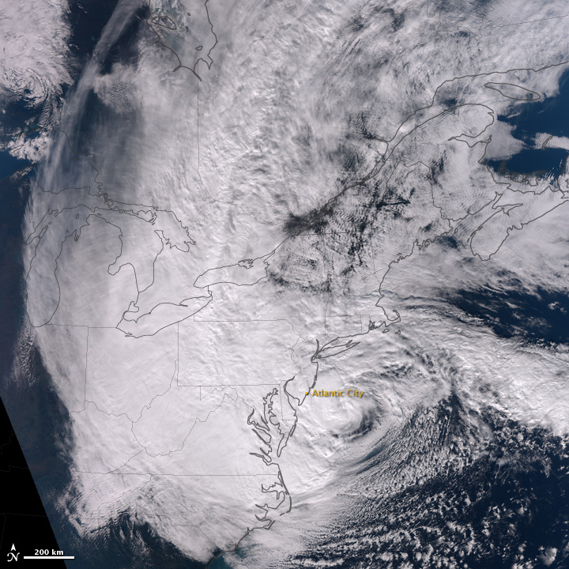
Hurricane Sandy over the mid-Atlantic states
2

Slide 3
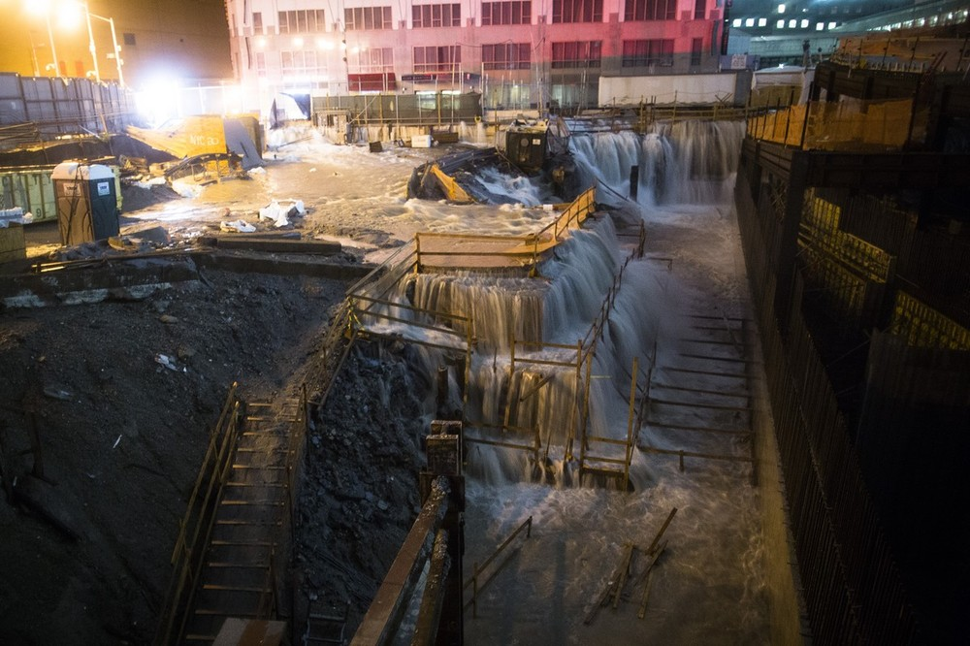
Hurricane Sandy: Water Rushing Into World Trade Center Site
3

Slide 4
THE TOP 20 COASTAL STORM FLOODS
THE BATTERY—NEW YORK CITY—LAST 77 YEARS
STORM DATE WATER LEVEL (NAVD) FT M
Hurricane Sandy 10/29/2012 11.1 3.38
Hurricane Donna 9/12/60 7.22 2.21
Nor’easter Dec. ’92 12/11/92 6.92 2.11
Hurricane Irene 8/28/2011 6.72 2.05
Nor’easter 11/25/50 6.34 1.93
Ash Wednesday storm 3/6-7/62 6.14 1.87
Nor’easter 3/13-14/2010 6.06 1.85
Halloween (“Perfect Storm”) 10/31/91 5.95 1.81
Blizzard of ’84 3/29/84 5.75 1.75
Nor’easter 1/2/87 5.60 1.70
“Storm of the Century” 3/14/93 5.58 1.70
Nor’easter 11/12/68 5.58 1.70
Nor’easter 4/13/61 5.56 1.69
Nor’easter 2/19/60 5.54 1.68
Nor’easter 3/20/96 5.51 1.68
Nor’easter 10/19/96 5.49 1.67
Hurricane Gloria 9/27/85 5.45 1.66
Long Island Express 9/21/38 5.43 1.65
Hurricane of 1944 9/14/44 5.43 1.65
Nor’Ida 11/13-14/2009 4.79 1.46
4

Slide 5
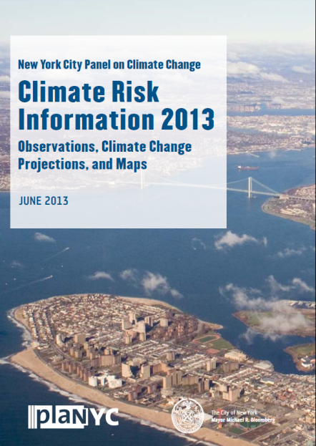
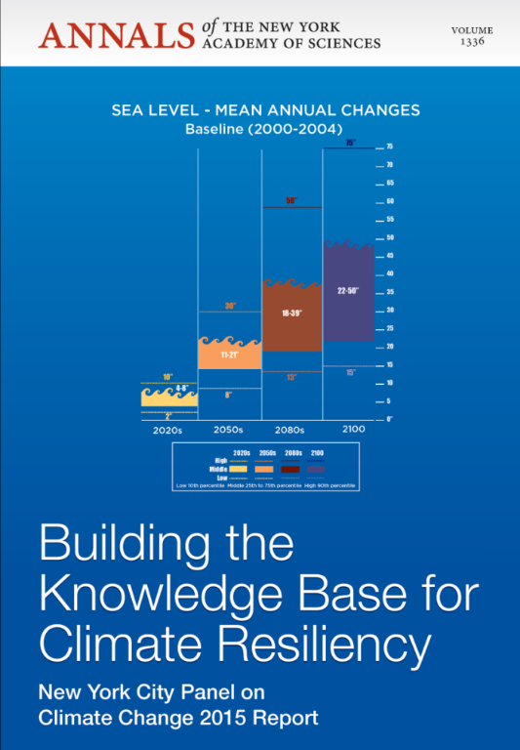
New York City Panel on Climate Change (NPCC2)
After Hurricane Sandy, Mayor Bloomberg convened the second New York City Panel on Climate Change (NPCC2), January 2013.
Climate Risk Information 2013 provides latest climate change projections and future coastal flood risk maps for NYC’s Special Initiative for Rebuilding and Resiliency (SIRR).
Building the Knowledge Base for Climate Resiliency. New York City Panel on Climate Change 2015 Report.
  Available online at the New York Academy of Sciences
5
Notes:
5

Slide 6
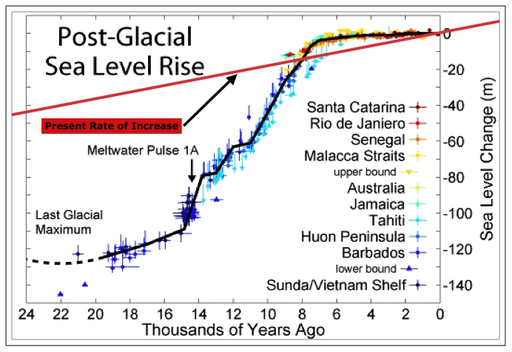
Global sea level trends
Main sources since 1990s:
- ocean warming ~ 30-40 %
glaciers melting ~ 30%
ice sheets: recent increase to >25%
- Proportions vary over this period!
After Robert A. Rohde, from published data
1.7 ± 0.2mm/yr 1900-2010
3.3 ± 0.4 mm/yr 1993-2015
IPCC, 2013; Nerem et al., 2010
www.sealevel.colorado.edu
6
Notes:
Before we make projections, need to know what’s happened globally.
Since the last ice age, long term SLR of 130 m in 20k years; some fast some slow. Superimposed in red is the present rate of rise.
The proportion has changed over the past two decades. Different sources. Ocean warming and expanding, mass additions from ice. Cuurent rate seems to be accelerating.
6

Slide 7
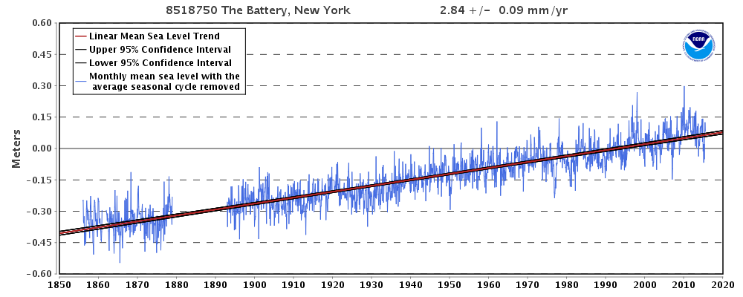
Observed Sea Level Rise, 1856 - 2014
The Battery, New York
7
Notes:
Since the last ice age, long term SLR of 130 m in 20k years; some fast some slow. Superimposed in red is the present rate of rise.
The proportion has changed over the past two decades. Different sources. Ocean warming and expanding, mass additions from ice. Cuurent rate seems to be accelerating.
7

Slide 8
RATES OF SEA LEVEL RISE
NEW YORK METROPOLITAN REGION
LOCATION SEA LEVEL RISE (mm/yr) PERIOD (years)
Atlantic City 4.08 1911-2014
Sandy Hook, NJ 4.08 1932-2014
NYC, the Battery 2.84 1856-2014
Montauk, NY 3.24 1947-2014
Port Jefferson, NY 2.44 1957-1992
Willets/Kings Point, NY 2.52 1931-2014
Bridgeport, CT 2.87 1964-2014
New London, CT 2.58 1938-2014
Data from NOAA, Oct. 27, 2015
8
Notes:
Regional sea level trends range from 2.4 to 4.1 mm/yr, or 0.1-0.16 in/yr (NOAA).

Slide 9
Components of SLR in NPCC2 scenarios
Fingerprinting
Gravitational, Rotational, Isostatic
Glacier
mass balance
Ice sheet
mass balance
Glacial Isostatic Adjustment
Steric/Dynamic
ocean changes
Land Water Storage
Solid earth/gravitation/rotation
“Fingerprint”
NYC sea level change
9
Notes:
9

Slide 10
New NPCC2 Sea Level Rise and
Coastal Flood methodology
CMIP5 GCMs and IPCC RCP scenarios—thermal expansion and local dynamic sea height
Updated rates of ice mass loss from glaciers, small ice caps, and ice sheets
Latest GIA and gravitational/rotational corrections
Land water storage contributions to sea level rise
Coupled sea level rise and FEMA ADCIRC/SWAN model simulations of tropical and extra-tropical cyclones for 100-year flood zones.
10

Slide 11
Models and Emissions Scenarios
24 CMIP5 GCMs (thermal expansion; dynamic ocean changes)
2 IPCC Representative Concentration Pathway scenarios: RCP 4.5 and RCP 8.5
10th, 25th, 75th, and 90th percentiles from model-based distribution, literature, expert judgment
1 or more grid boxes per model cover the study area
New York City Panel on Climate Change, Climate Risk Information 2013; Building the Climate Base for Climate Resiliency 2015 www.nyc.gov/planyc, www.nyc.gov/resiliency, www.ccrun.org, www.cunysustainablecities.org, www.nyas.org/Publications/Annals/
11

Slide 12
Mass redistribution from ice loss creates a “fingerprint”
At the Battery:
  1 m SLR equivalent ice loss from Greenland=~0.6 m SLR
  1 m SLR from Antarctica = ~1.2m SLR
Greenland
Antarctica
DRAFT – DO NOT CITE OR DISTRIBUTE
12
Notes:
One other complicating factor about SLR on a regional basis.
What happens when you take a block of ice and spread it over the ocean.
Reduced grav attraction
Change moment of innertia/rotation axis
Elastic rebound
Viscous flow of displaced mantle.
1,2,3 happen for our purposes, immediately; 4 takes 10s of thousands of years
Combined effects of gravitation, mantle flow and rebound, change in rotation axis.
In general sea level fall close to ice sheets. Enhanced relative to water addition in the far field.
12

Slide 13
Sea Level Rise Methodology
Sea level rise projections are the sum of seven components:
  Thermal expansion (global)--CMIP5 data
  Changes in dynamic ocean height (local)—CMIP5 data
  Ice mass loss, ice sheets (global)—expert judgment; probabalistic analysis, and literature survey
  Ice mass loss, glaciers and ice caps (global)—ranges taken from two recent studies and literature survey
  Gravitational, rotational, and isostatic “fingerprinting”—coefficients (ratios) linking sources of recent ice mass losses to local sea level changes—literature survey
  Vertical land movements (GIA) (local)--ICE-5G v1.3 VM2_L90, Peltier, 2012 (PSMSL); 2004
  Land water storage (global)—from IPCC 2013
Time slices
--2020s, 2050s, 2080s, 2100 (10-year average centered around decade)
--sea level rise relative to base period 2000-2004
13

Slide 14
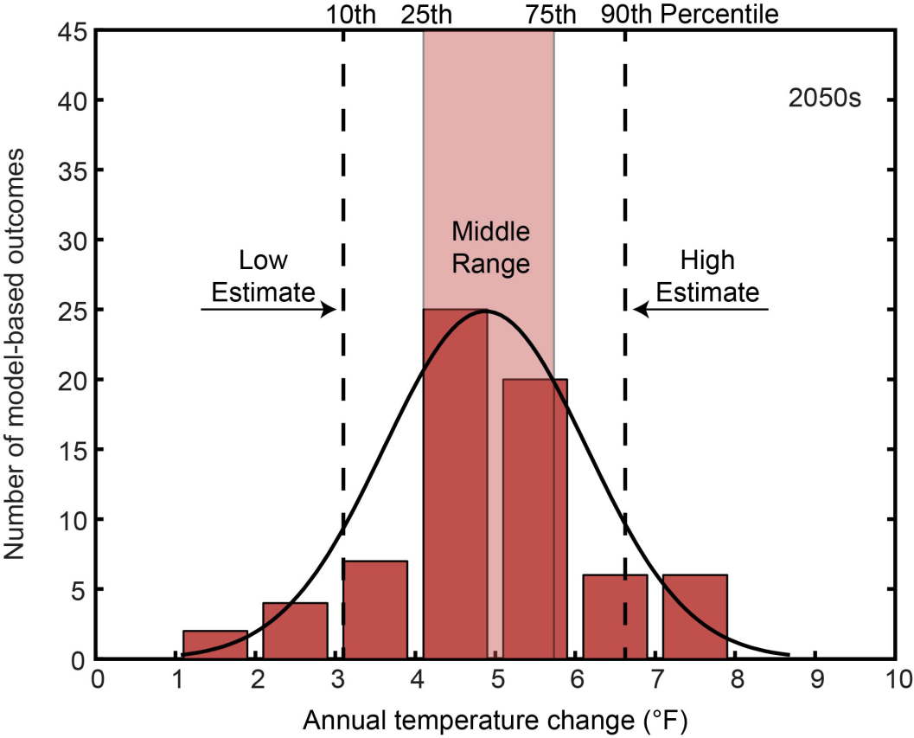
Treatment of Uncertainty
NPCC2 uncertainty distributions are based on ranges of climate model outputs and literature-derived likelihoods for different future greenhouse gas emission scenarios
Model-based results may not encompass the full range of possible future outcomes
Idealized model-based output distribution for 2050s sea level rise relative to the 2000-2004 base period. Based on 24 global climate models and 2 representative concentrations pathways. The 10th, 25th, 75th, and 90th percentiles of the distribution are illustrated.
NPCC2 CRI, 2013
14
Notes:
14

Slide 15
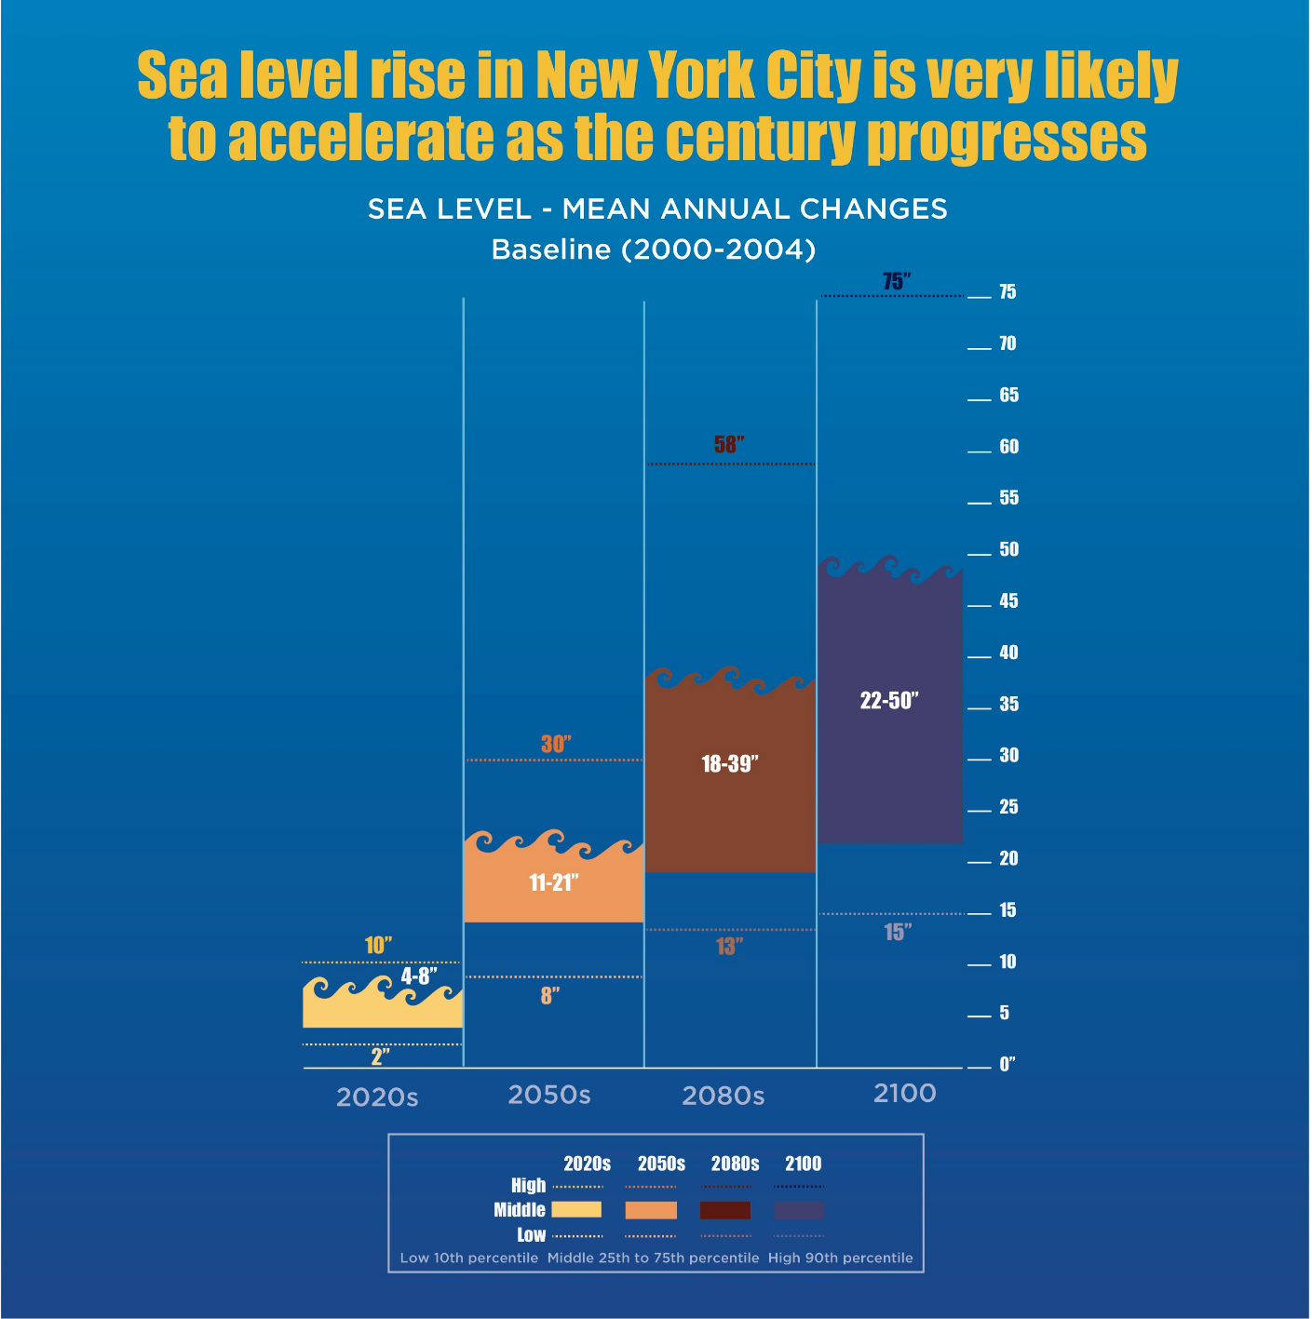
Sea Level Rise Projections for NYC
NPCC, 2015
15

Slide 16
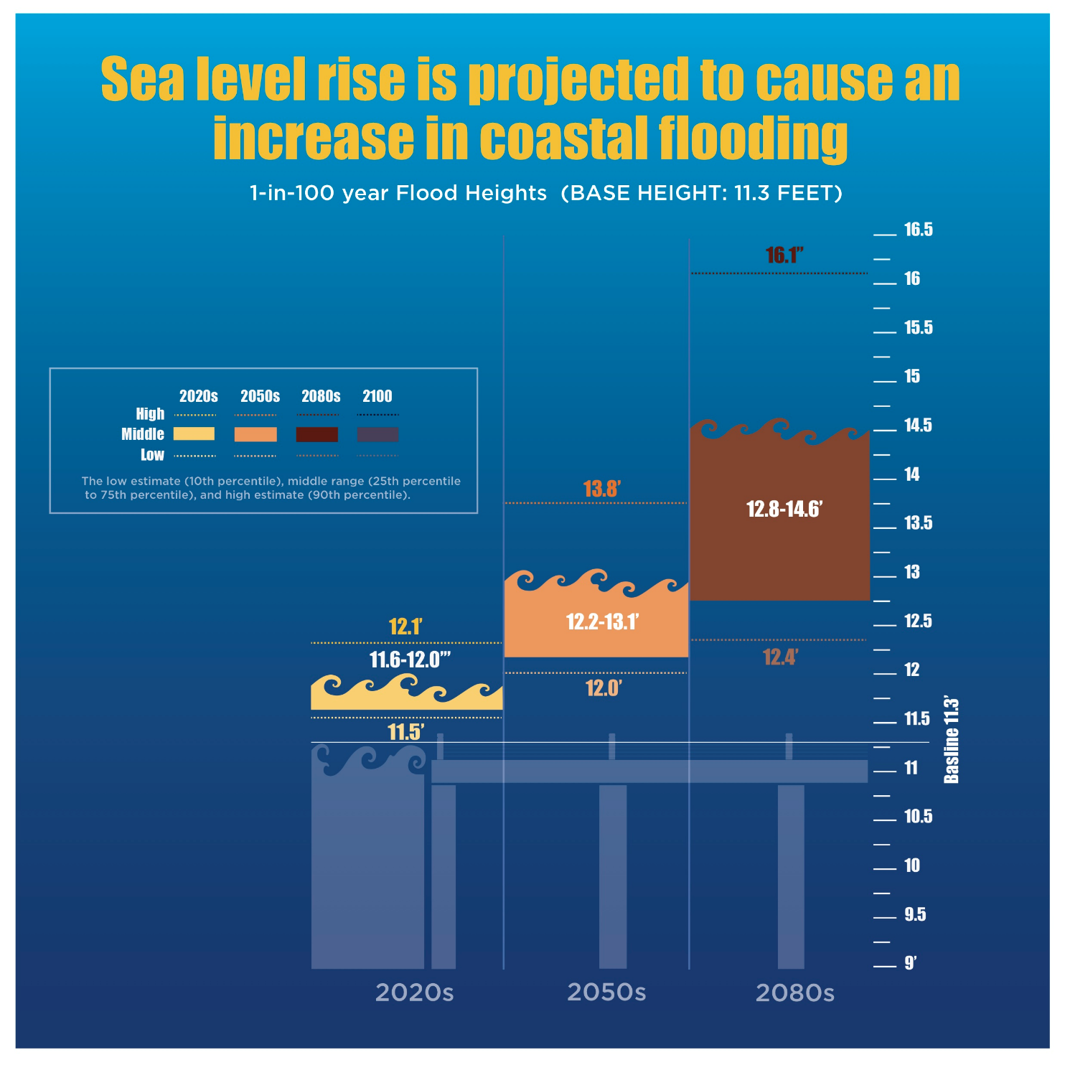
NPCC2 Coastal Flood Heights and Recurrence Periods
16
Notes:
16

Slide 17
Annual Likelihood (1% Chance) of Today’s 100-year flood
Annual chance of 100-year flood (1%) | Low estimate (10th percentile) | Middle range (25th to 75th percentile) | High estimate (90th percentile)
2020s | 1.1% | 1.1 – 1.4% | 1.5%
2050s | 1.4% | 1.6 – 2.4% | 3.6%
2080s | 1.7% | 2.0 – 5.4% | 12.7%
Coastal flooding is very likely to increase in frequency, extent, and height as a result of increased sea levels
17
Notes:
17

Slide 18
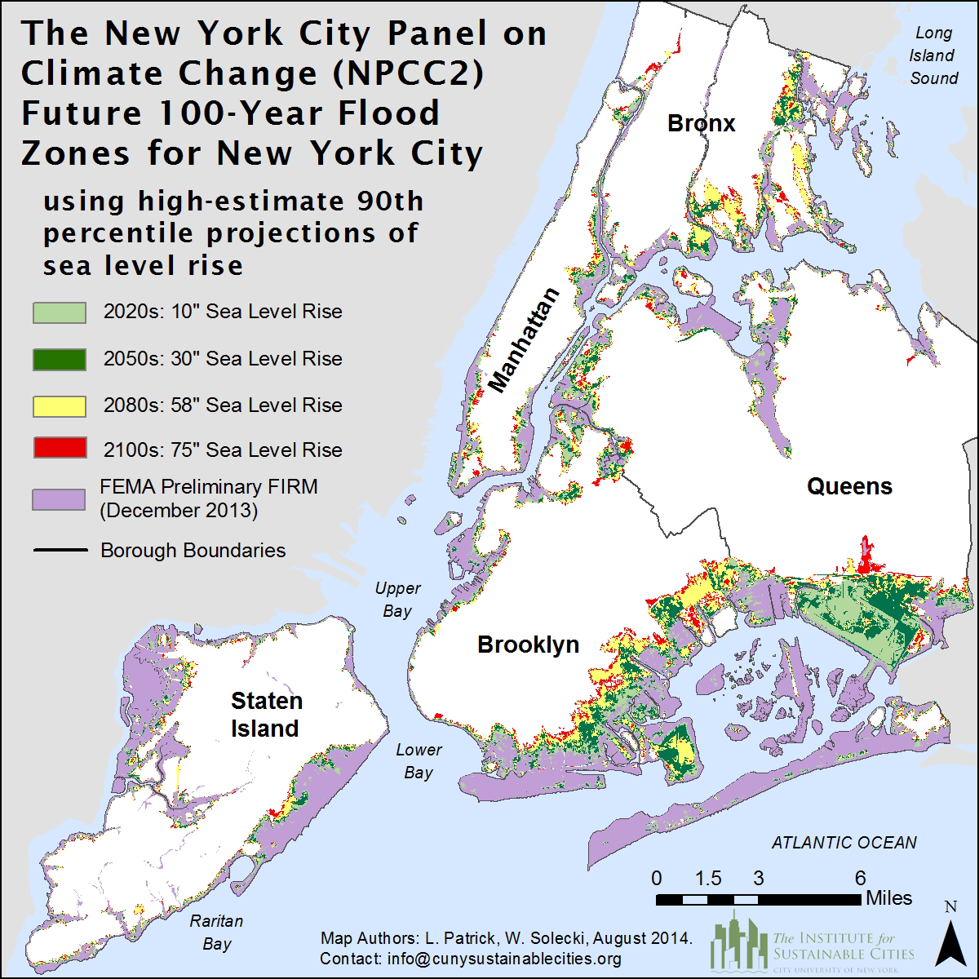
NPCC2 Future Coastal Flood Risk Maps
18
Notes:
18

Slide 19
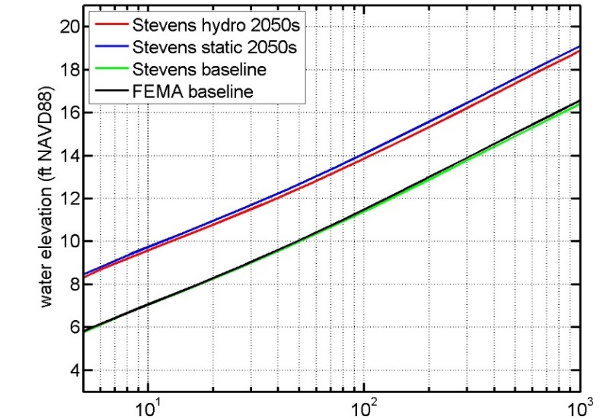
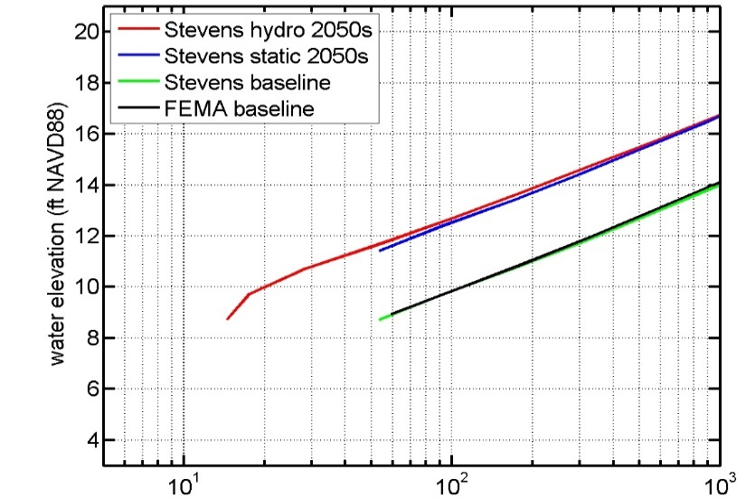
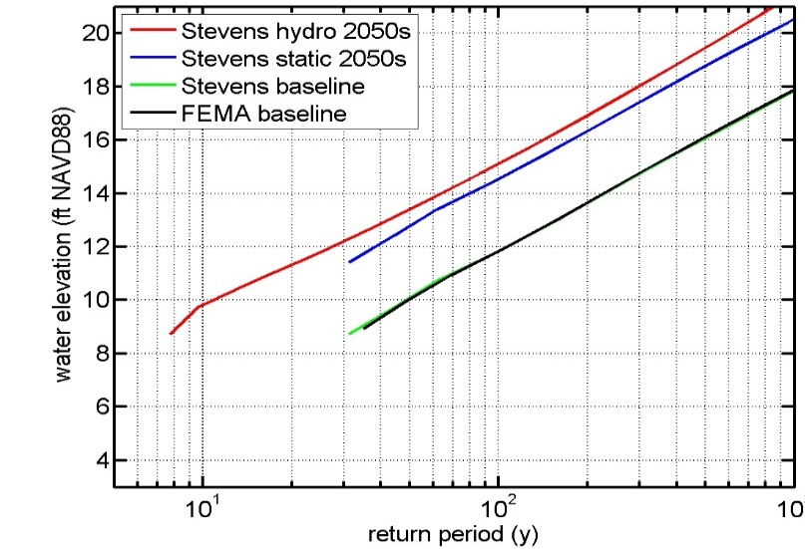
Flood Return Curves: Comparison Between Static vs Hydrodynamic Flooding Methods
“FEMA-style” flood hazard assessments with sea level rise—static vs hydrodynamic modeling
  100-year, 500-year flood heights; return periods
Battery
Howard Beach
Midland Beach
19

Slide 20
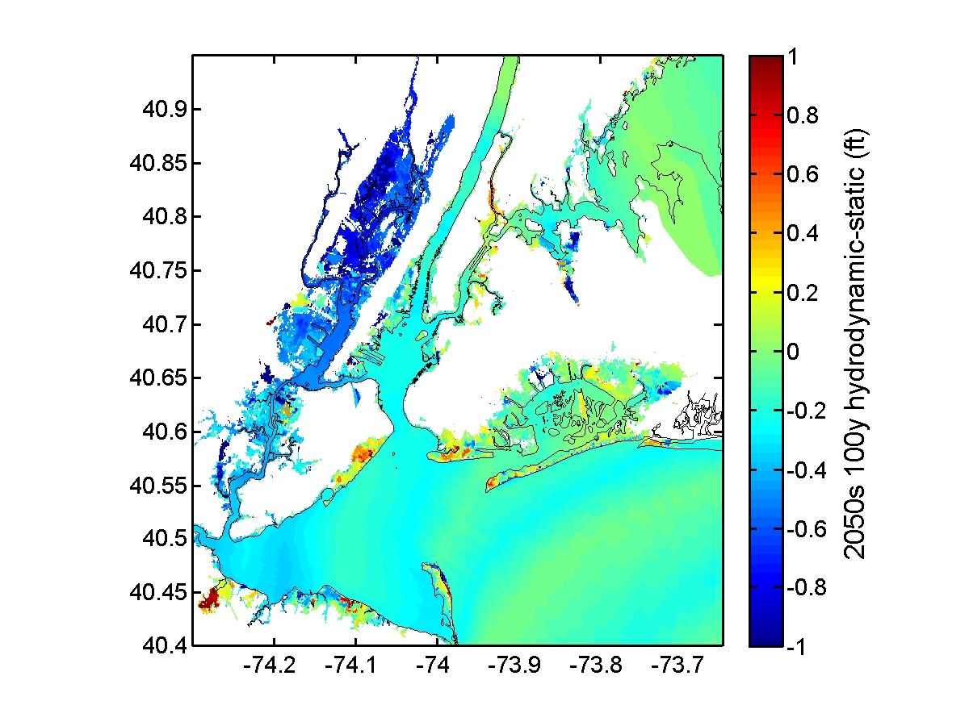
Differences between static and hydrodynamic 100-yr flood heights for2050s sea Level rise
20

Slide 21
Increasing New York City’s Coastal Resilience
Identify high risk flood-prone areas – new LIDAR mapping
Incorporate sea level rise data into FEMA’s new 100-year flood maps
Adapt existing storm emergency preparations to climate change
Improve coastal defenses: strengthen and raise seawalls; build more dikes, levees, floodgates
Raise land elevation, restore beach dunes
Create “soft edges” to dampen wave and tide energy – planting native vegetation; reducing land-sea slope
Restore or construct new wetlands, beaches, and offshore reefs
21

Slide 22
Examine effects of climate change on extreme events in the New York Metro region
        Sea level rise and storm surges
    Coastal and urban flooding
    Extreme precipitation (and temperature) events
    Determine physical processes that govern extreme coastal storm flooding on annual to decadal timescales
    Establish historical/recent baselines and trends in frequency, intensity, and physical impacts
    Establish uncertainties in projections of future sea level rise and extreme coastal flooding events
    Anticipate expected impacts of extreme climate events on people and infrastructure.
NPCC3 Climate Change Science Goals

