Slide 1
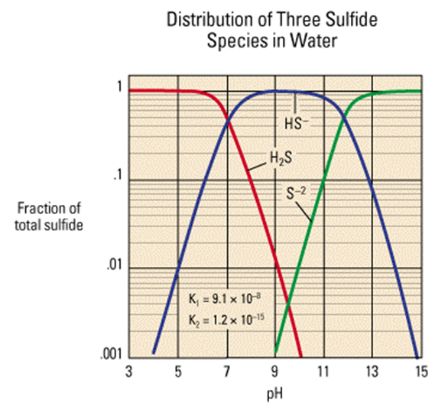
The survival of dissolved H₂S is very pH, temperature, and salinity dependent:
H₂S + H₂O → H₃O + HS
Fig. 1
diprotic acid
pKa₂ = 19 ± 2

Slide 2
Fig. 2
Chemistry of Spring Water of Active Sulfuric Acid Caves
CAVE/COUNTRY | CAVE SPRING WATER PARAMETERS
 | Temperature °C | pH | SO₄ mg/L | Cl mg/L | H₂S mg/L | DO mg/L
Cueva de Villa Luz, Mexico | 28-30 | 6.61-7.3 | 920-940 | 782-814 | 100-500 | ND-2.2
Frasassi Caves, Italy | 13.1-13.7 | 6.9-7.4 | ≤240 | 658.7 | ≤22.2 | --
Acquasanta Terme Caves, Italy | 33.1-43.4 | 6.58-6.75 | 669-957 | 1697-3100 | 13.0-28.1 | --
Montecchio Cave, Italy | 31.3-36 | 6.86 | 1313 | 18.8 | -- | --
Parrano Cave, Italy | 27 | 6.33 | 173 | 208 | 10 | --
Serpents Cave, France | 35.5-46.6 | 6.5 | 60-230 | 15-30 | 5 | --
Aghia Paraskevi Caves, Greece | 35-39.2 | 6.35-7.0 | -- | 19,467.5 | 101.6 | --
Lower Kane Cave, USA | 22.6-24 | 6.8-7.25 | 182-319 | 12.3-14.5 | 5-6 | ND
Fairy Cave, USA | 49.6 | 6.39 | 1102 | 9706 | 1.65 | 0.48

Slide 3
Fig. 3
H₂S + 2O₂ H₂SO₄
2H₂S_{(aq)} + O_{2(aq)} → 2S + 2H₂O
Further oxidation yields SO₃, S₂O₃, and finally SO₄. Biotic oxidation enhances the rate by 3 or more orders of magnitude, but the outcome is the same.
Sulfuric acid is the world’s number one industrial chemical, and over 230 million metric tons were produced in 2012. It is produced in a 4-step process:
S_{(s)} + O₂ → SO₂, 2SO₂ + O₂ → 2SO₃, SO₃ + H₂O → H₂SO₄
>200 ⁰C
2H₂S_{(g)} + 3O_{2(g)} → 2SO₂ + 2H₂O
Or as an alternative sulfur source:

Slide 4
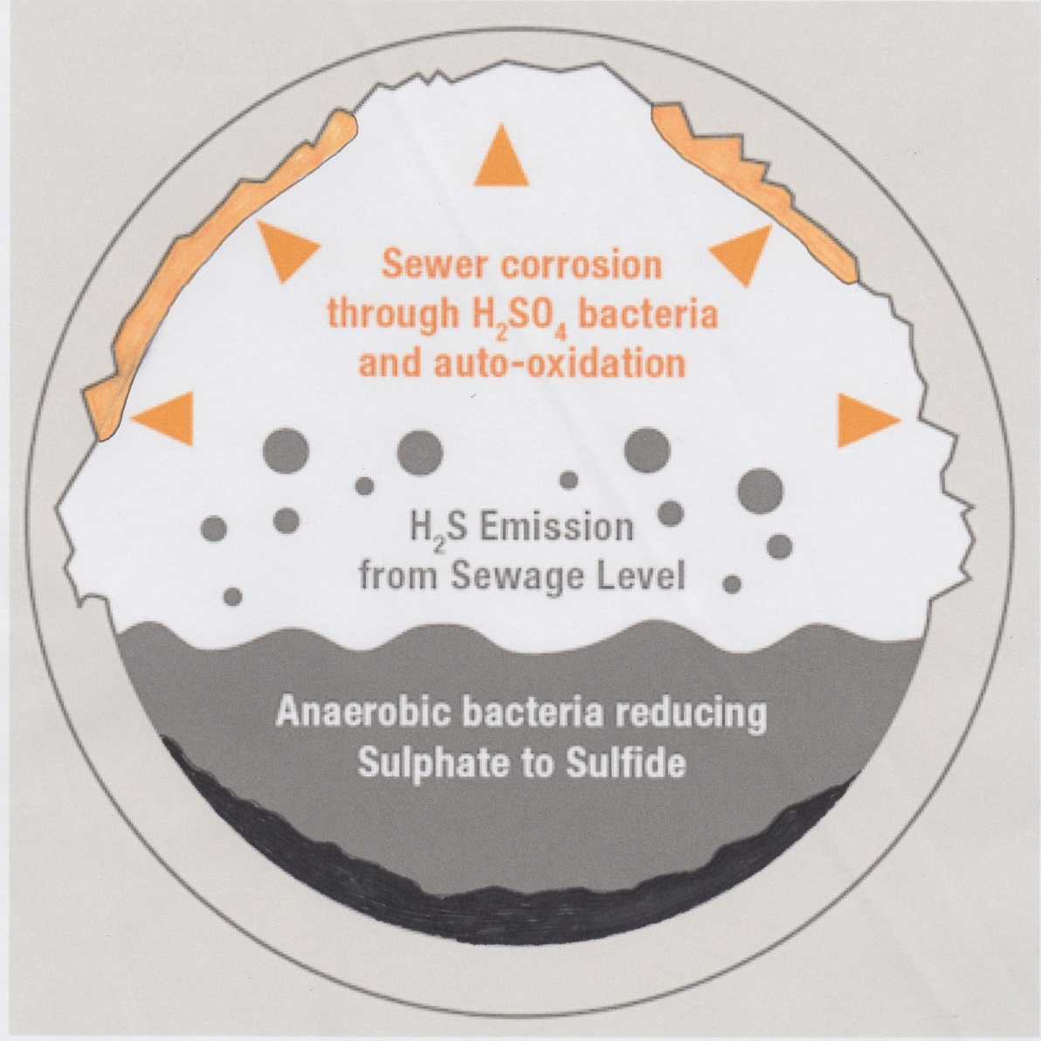
Fig. 4
A modern analog outside of speleogenesis:
Biogenic Sulfide Corrosion
pipe
gypsum rinds
Internal corrosion of concrete wastewater pipes and tanks (man-made caves) due to anaerobic sulfate-reducing bacteria generating H₂S, which is oxidized to sulfur in the condensate, which aerobic sulfur-oxidizing bacteria metabolize into H₂SO₄.
Only occurs if the pipe or tank is partially full (air space above water is required)
The acid converts CaCO₃ into gypsum
A process studied since the 1940s
biofilms

