Slide 1
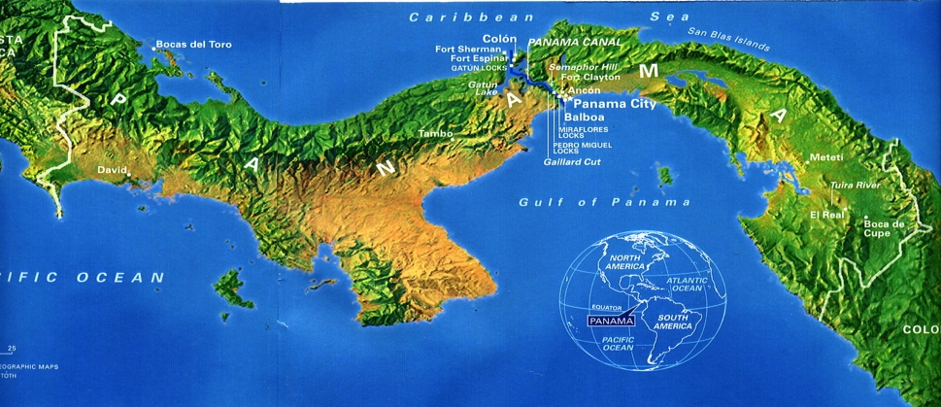

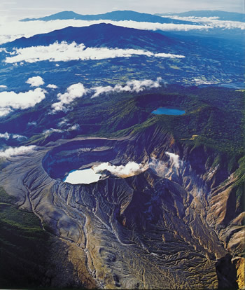
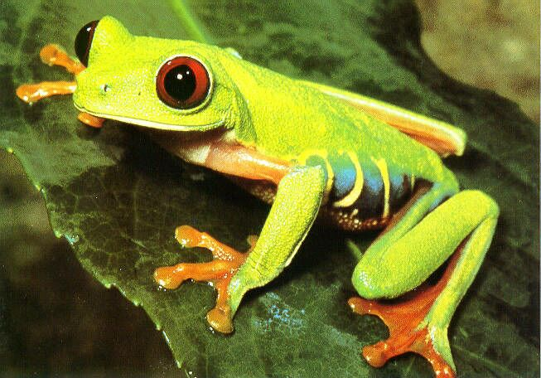
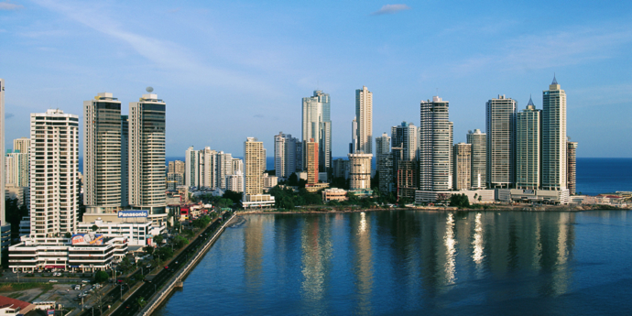
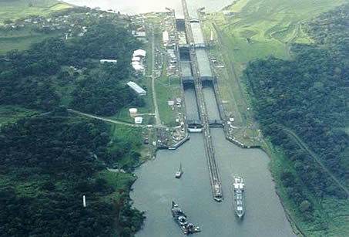
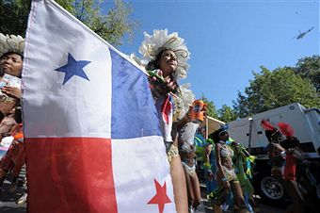
MIOCENE ARC MAGMATISM IN WESTERN PANAMA AND ITS CONSTRAINTS ON MANTLE WEDGE
AND TECTONIC CHANGE
Ruiguang Pan (rp13n@my.fsu.edu)
David W. Farris (dwfarris@fsu.edu )
Earth, Ocean and Atmospheric Science
Florida State University
Nov. 1, 2015

Slide 2
Outline
Geologic Setting and Hypothesis
Sampling and Data Collection
Major, Trace element and Isotope Geochemistry
Major Element Model: Fractional Crystallization
Trace Element Model: Partial Melting
Arc Basalt Simulating Model
Conclusions

Slide 3
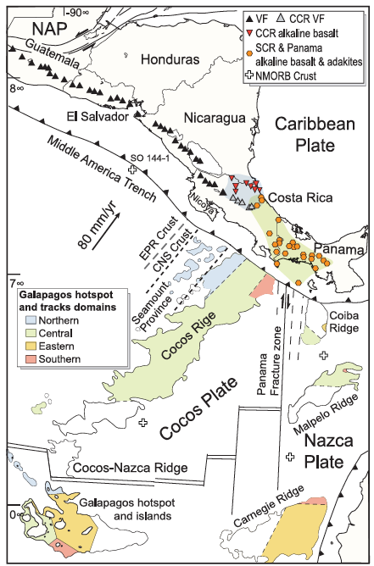
Hypothesis
Hypothesis: We propose that the geochemical variations showed the Bocas del Toro arc rocks are caused by the influx of enriched geochemical components into the mantle wedge, and low pressure fractional crystallization caused by crustal extension.
Notes:
More previous models
details

Slide 4
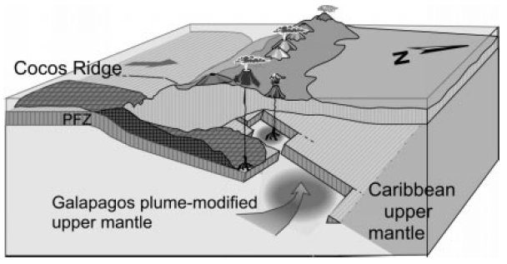
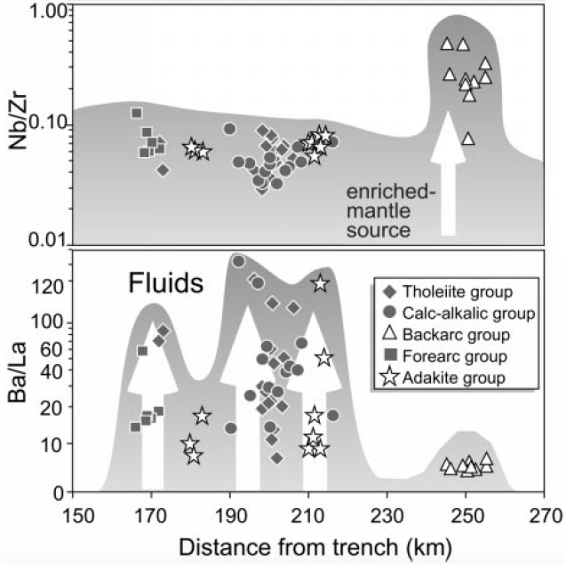
Previous Models
2-8 Ma
, Abratis (2001)

Slide 5
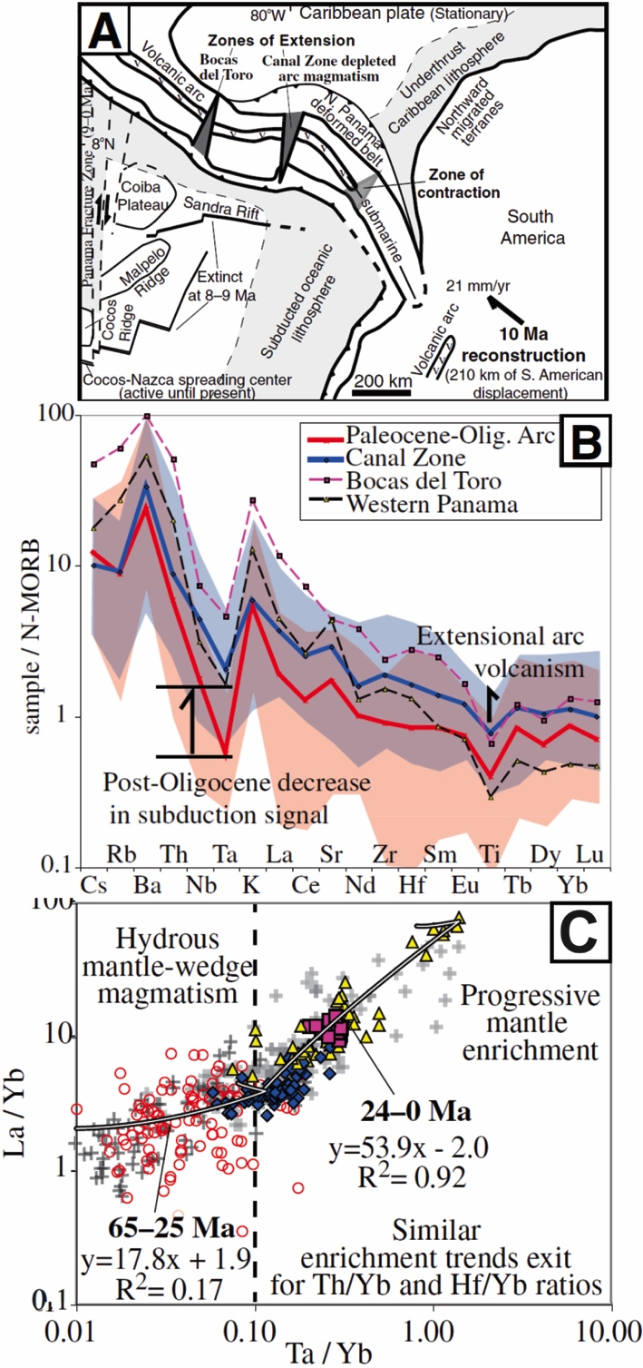
Previous Models
8-12 Ma
(Farris, 2011)

Slide 6
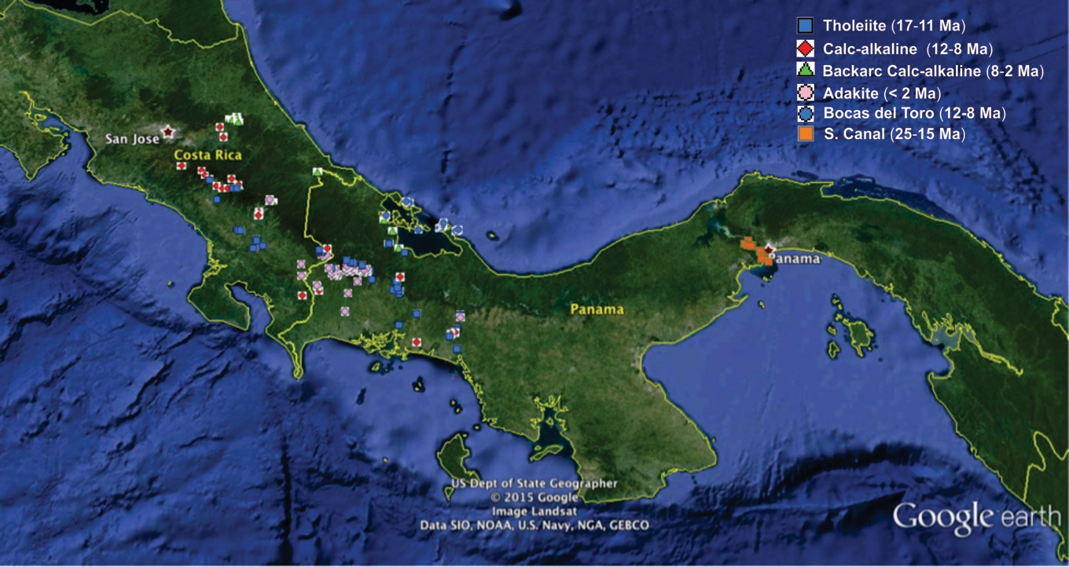
Sampling and Data Collection
Bocas del Toro
Data Background: Miocene rocks in western Panama and eastern Costa Rica.
Grouping: Five groups based on their geochemistry, ages and tectonic background: 1) Tholeiite (17-11 Ma) (Abratis et al. 2001, Wegner et al. 2010), 2) Calc-alkaline (12-8 Ma) (Abratis et al. 2001, Wegner et al. 2010), 3) Bocas del Toro (12-8 Ma) (own data, Coates et al. 2003) 4) Backarc alkaline (8-2 Ma) (Abratis et al. 2001), 5) Adakite (< 2 Ma)groups(Hidalgo et al. 2014).

Slide 7
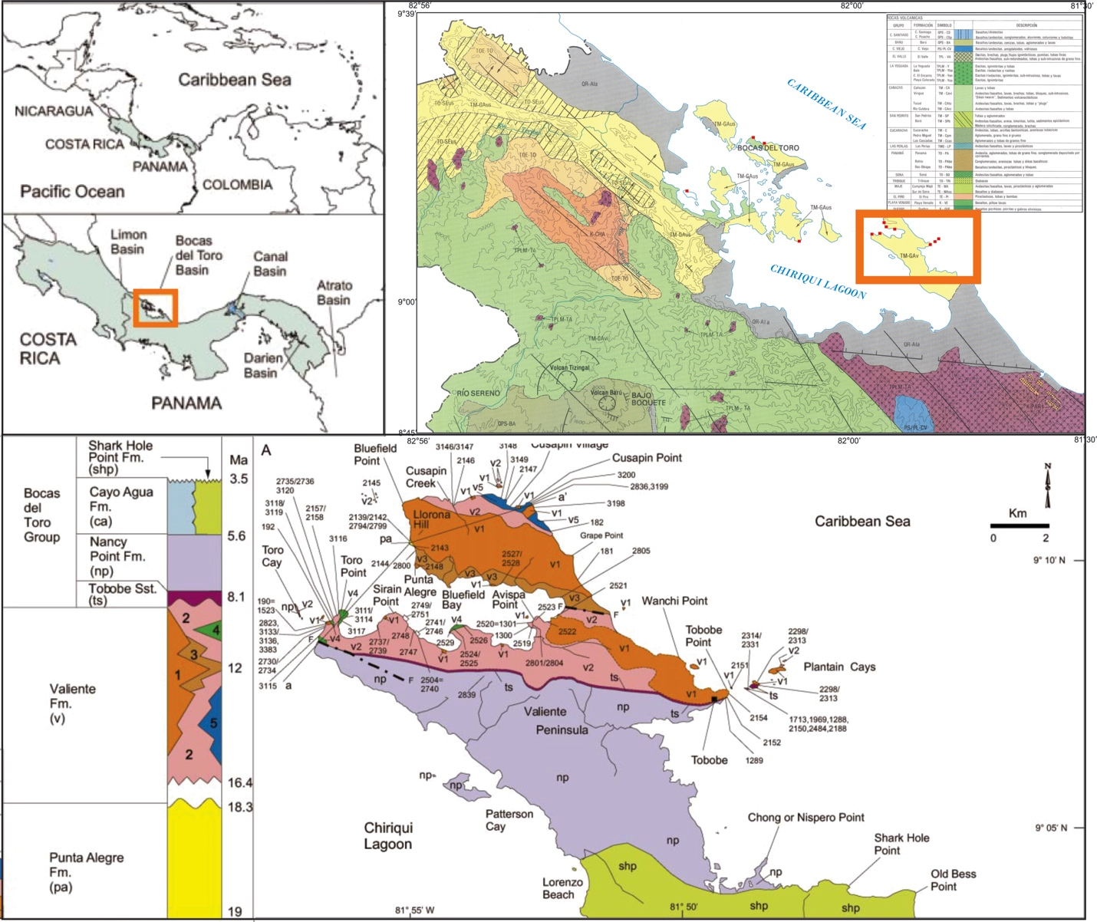
Geologic Setting
Study Area: The Bocas del Toro basin and adjacent arc areas, Western Panama
Valiente Formation (16.4 -12.0 Ma): Columnar basalt and flow breccia, volcaniclastic deposits and marine deposits
Punta Alegre Formation(21.5-18.3 Ma) : Mudstone to Foraminiferal Ooze
8-12 Ma
Coates et al. (2003)
8.1– 5.3 Ma: Basal sandstone to mudstone
5.3–3.5 Ma: Regressive deposition

Slide 8
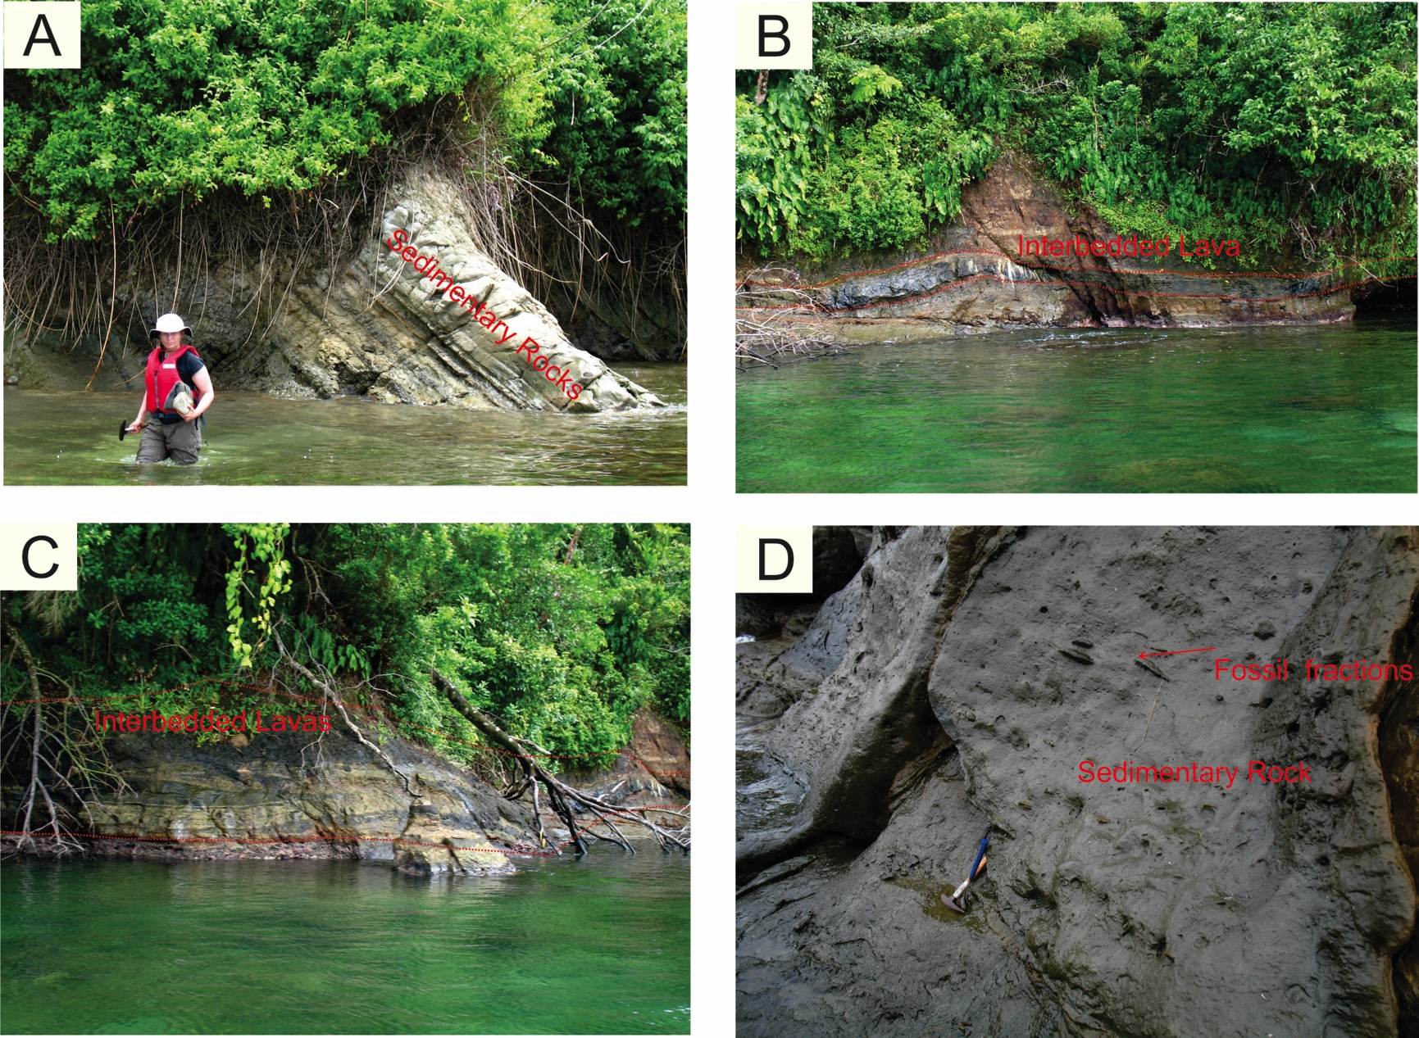
Field Pictures and Rock Types
Interbedded lavas: mainly trachy-basalt to trachy-andesite

Slide 9
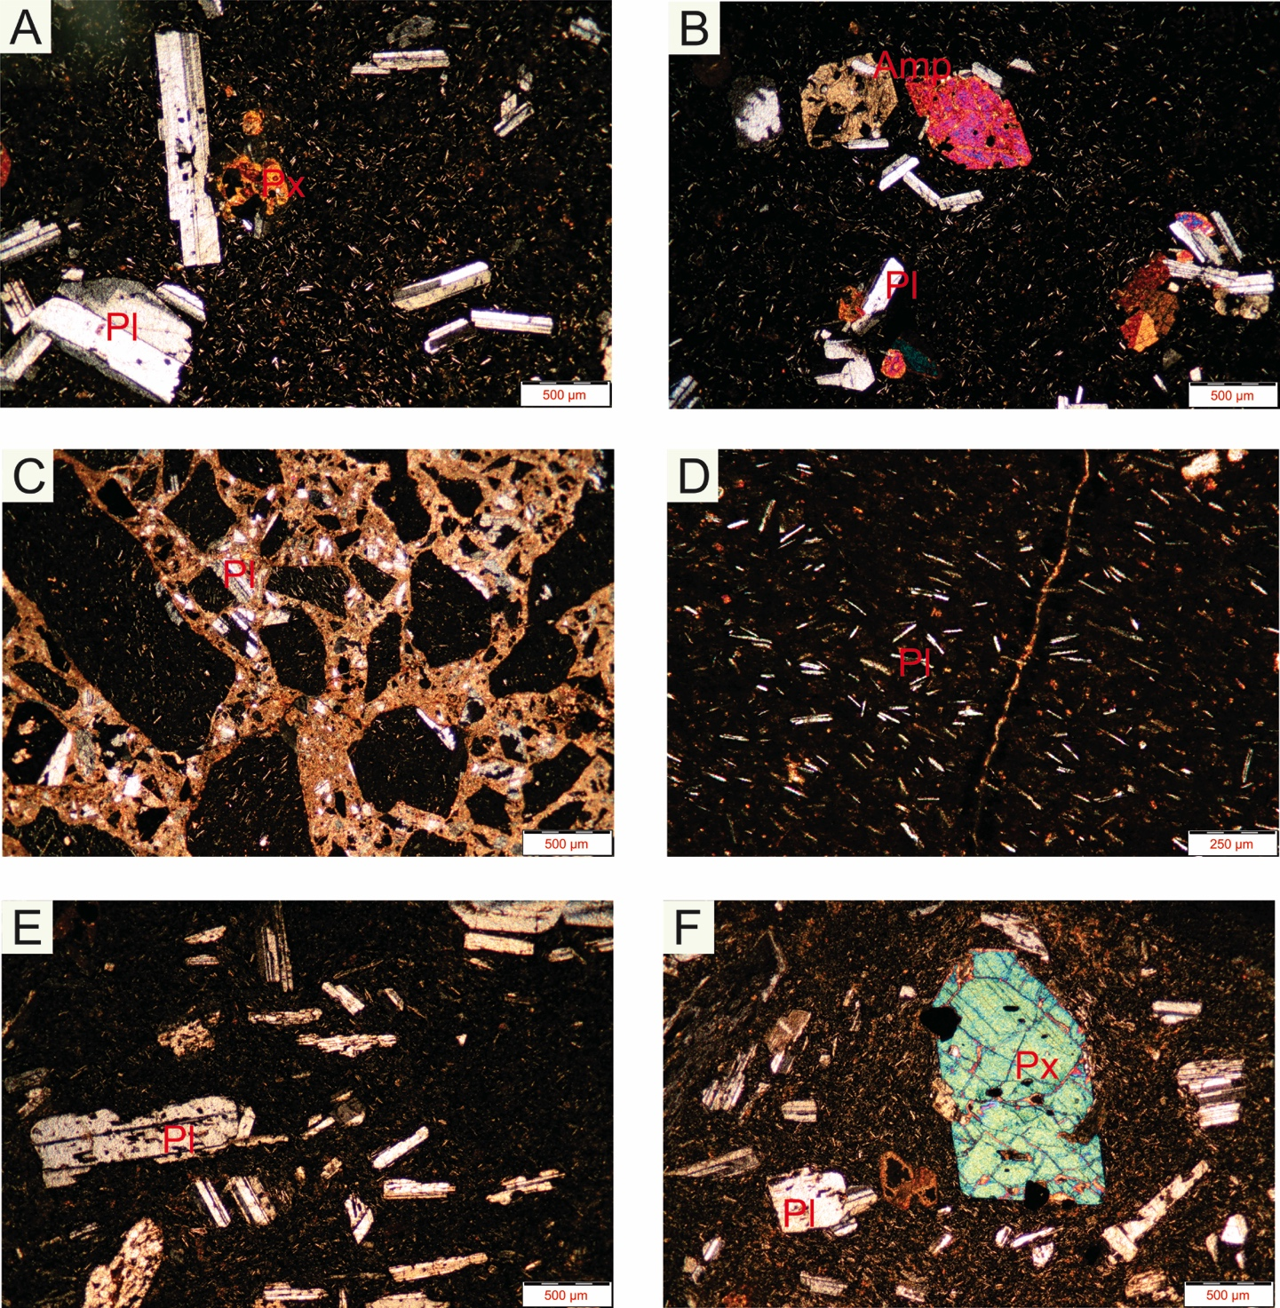
Mineralogy
Glassy and brecciated texture.
Main minerals are plagioclase, pyroxene, amphibole and some minor minerals, for example, feldspar, biotite, etc.
Marine deposition

Slide 10
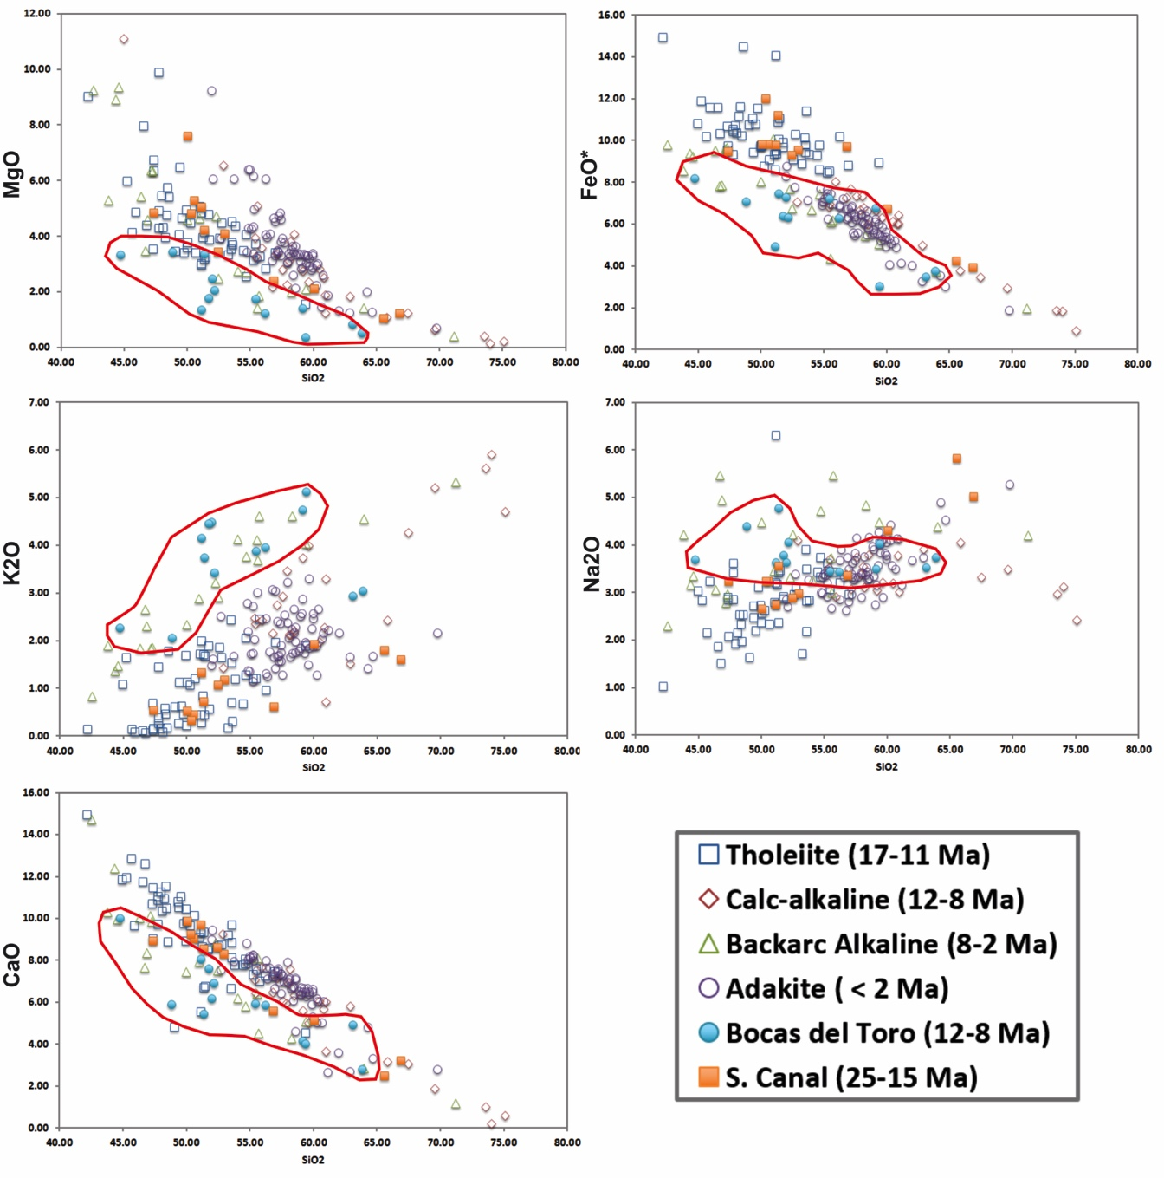
Major Element Chemistry
SiO₂: 45 wt.% to 64 wt.%
Low-MgO: 0.35 wt.%-3.43 wt.%
Very High-K₂O: 2.0wt.% -5.2wt.%
Moderate depletion in FeOt and CaO
Bocas del Toro
Bocas del Toro
Bocas del Toro
Bocas del Toro
Bocas del Toro

Slide 11
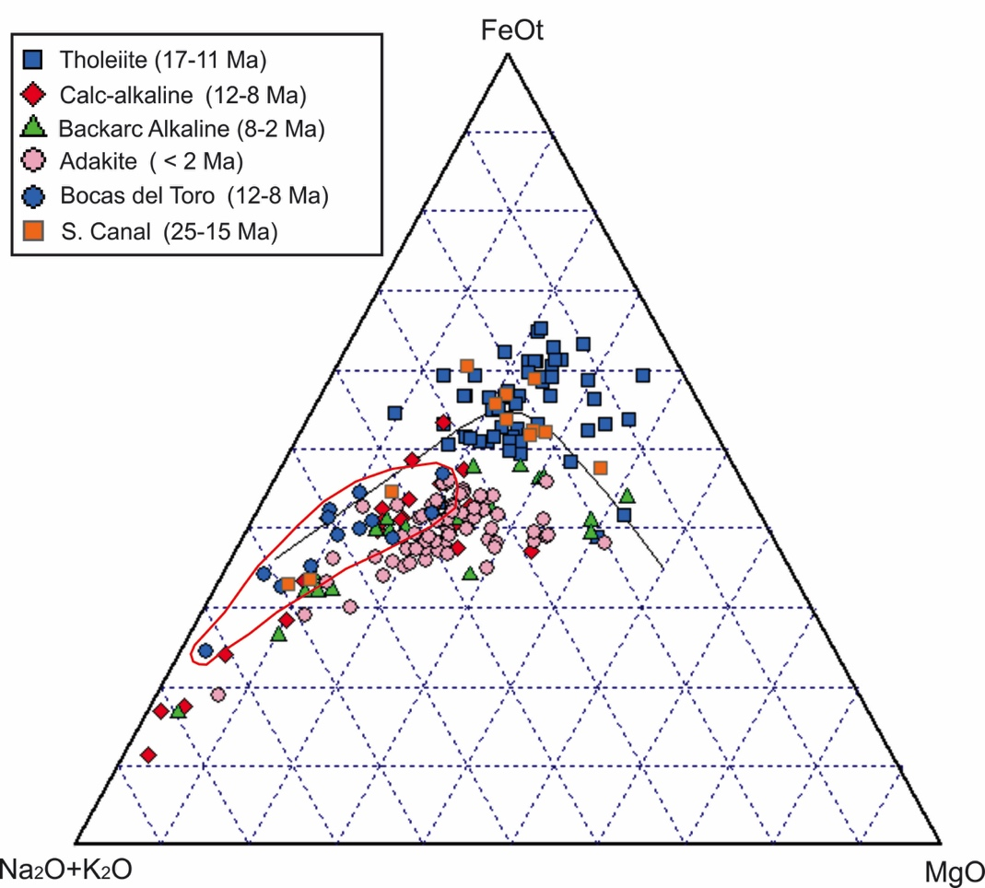
Major Element Chemistry:AFM Diagram
AFM Diagram: the Bocas samples exhibit high calc-alkaline igneous characteristics, and shows similar features to backarc alkaline and calc-alkaline groups.
Bocas del Toro

Slide 12
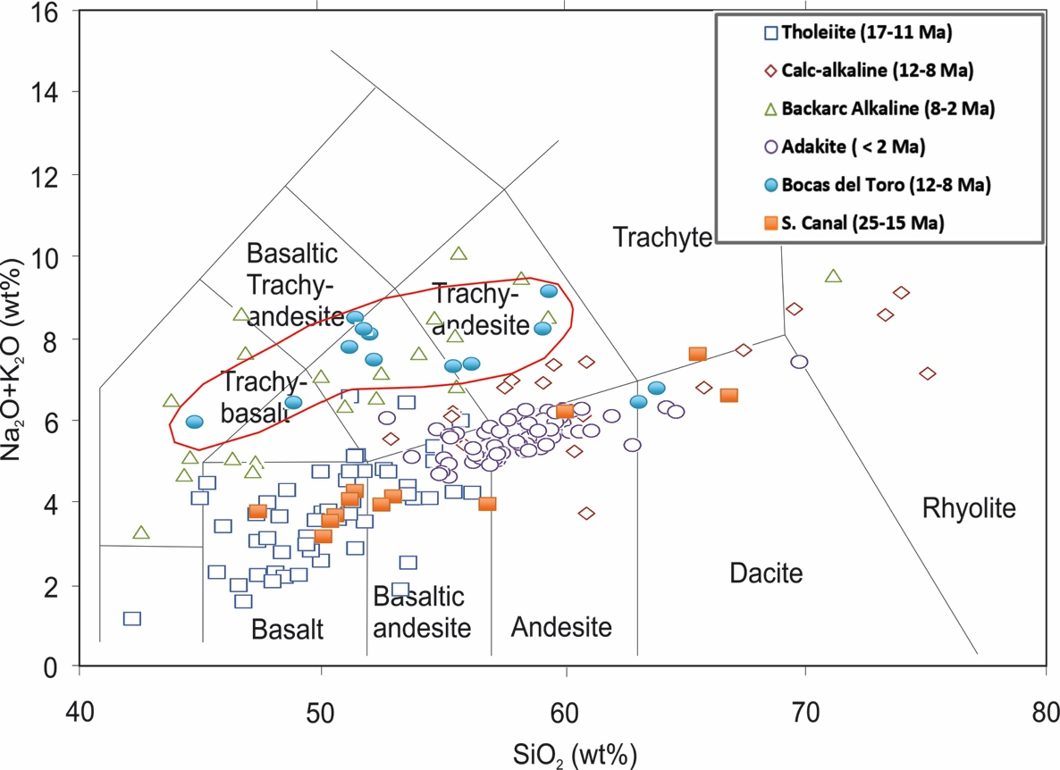
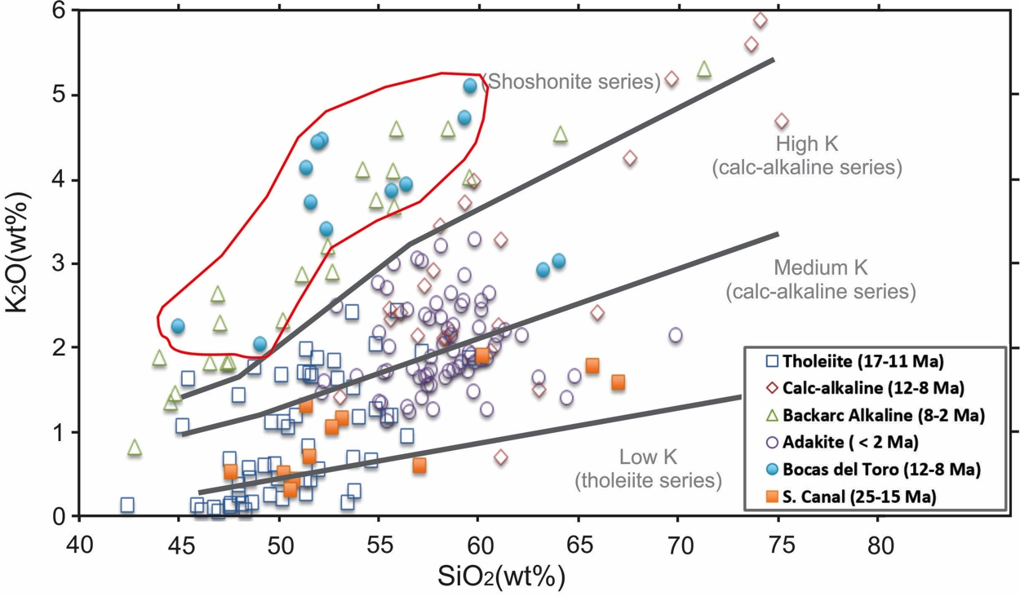
TAS Diagram and Subdivision of Subalkaline rocks
Lithology: basaltic trachy andesites and trachy andesites.
Bocas del Toro fractional crystallization is similar to the backarc alkaline group.
Bocas del Toro
K₂O vs. SiO₂: the Bocas samples belong to the Shoshonite series with highest content of K₂O
Bocas del Toro

Slide 13
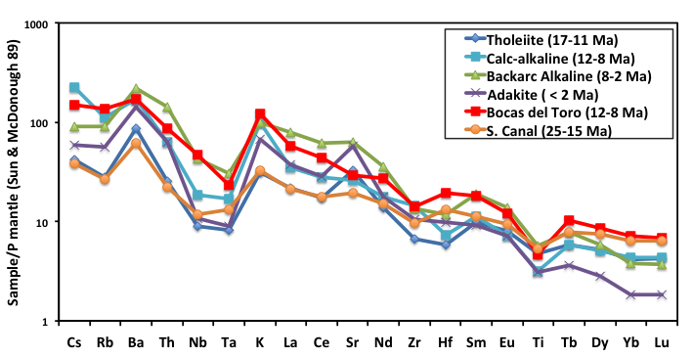
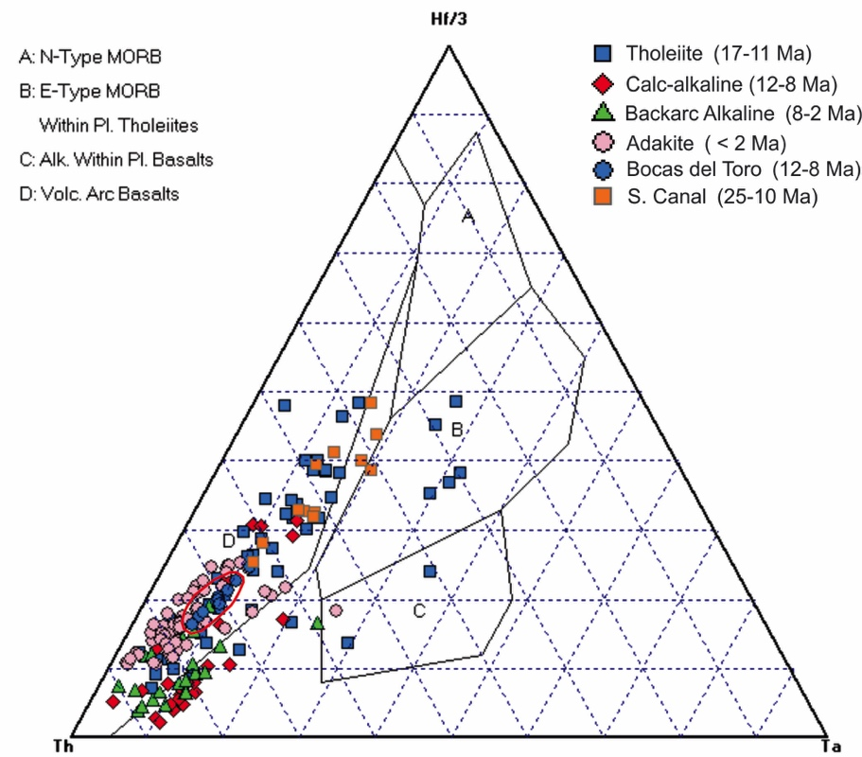
Trace Element Geochemistry and Tectonic Discrimination Diagram
Bocas del Toro
Bocas: High-K, Rb, Cs, Ba;
Decreased negative anomaly in Ta relative to arc background
Enriching in LILEs elements(K, Rb, Cs, Sr, Ba, etc.) and depletion in Nb and Ta content.
Hf/3-Th-Ta diagram: All Bocas del Toro rocks fall into the volcanic arc basalts area.
Bocas del Toro

Slide 14
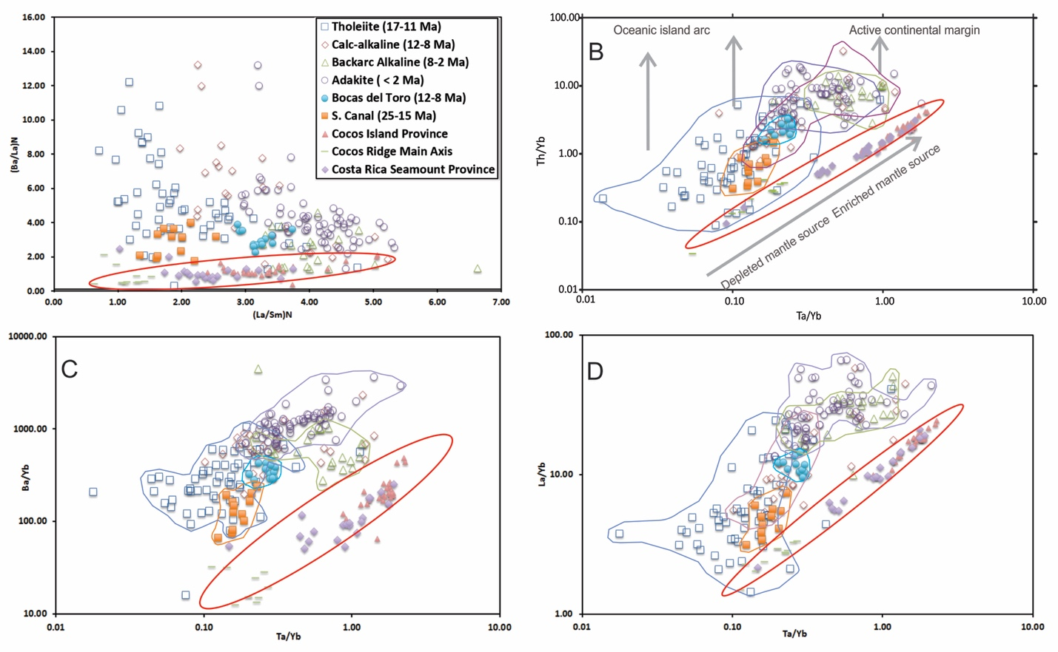
Enriched Mantle Source Influx
(Ba/La)N
Th/Yb
Bocas del Toro
Bocas del Toro
(La/Sm)N
Ta/Yb
Bocas del Toro
Bocas del Toro
Ba/Yb
La/Yb
Cocos Ridge Evolution
Cocos Ridge Evolution
Ta/Yb
Ta/Yb
The Bocas del Toro samples inherit lots of chemical nature from the enriched slab or mantle wedge and show clear feature of enriching in OIB elements (Ta, La, Th, etc.)
The Bocas samples have the lowest and closest value of (Ba/La)/N value with that of the Cocos tracks (melting products of the Galapagos hot spot ).

Slide 15
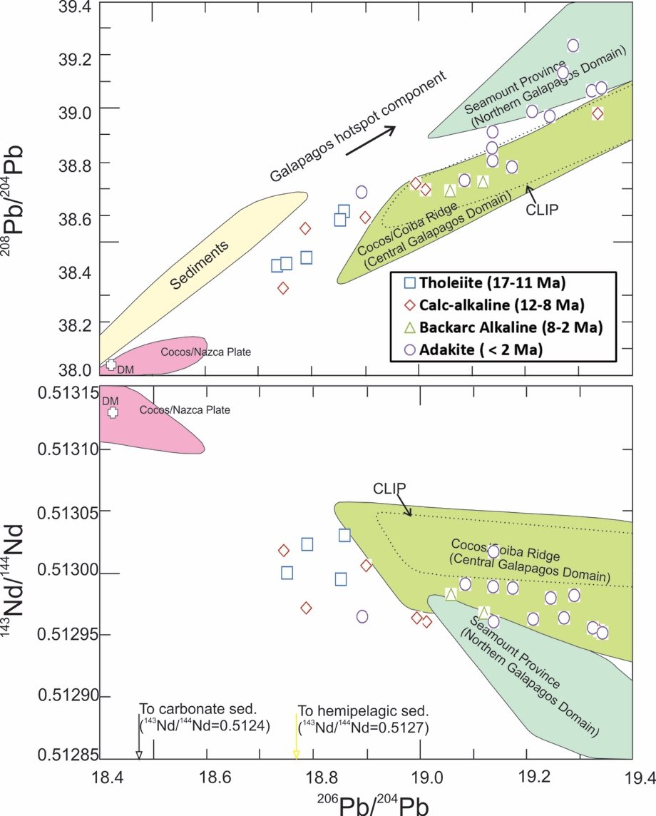
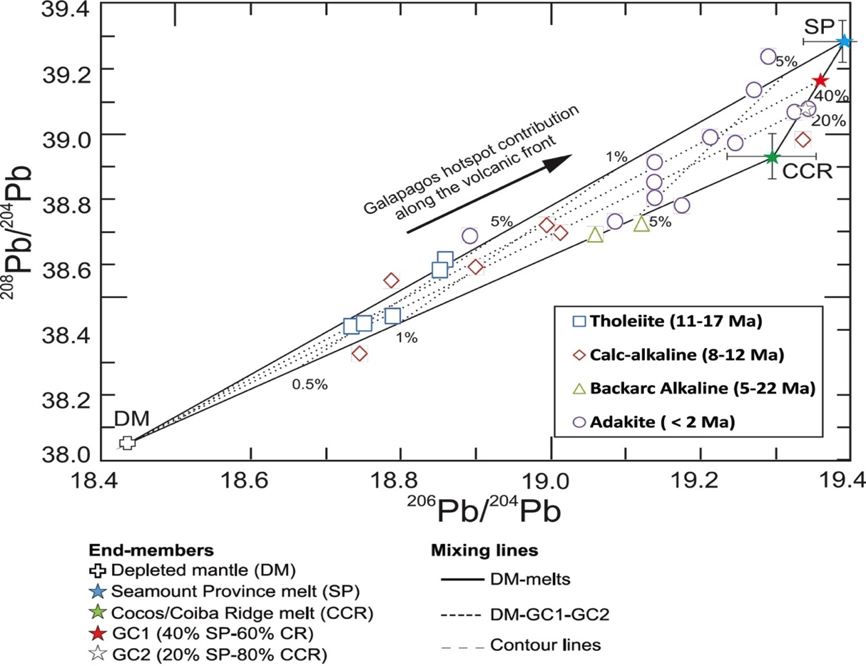
Pb-Nd isotopes
(Gazel 2009)
Younger rocks have relative stronger enriched geochemical signature of OIB. The backarc alkaline rocks fall into the Cocos Ridge area.

Slide 16
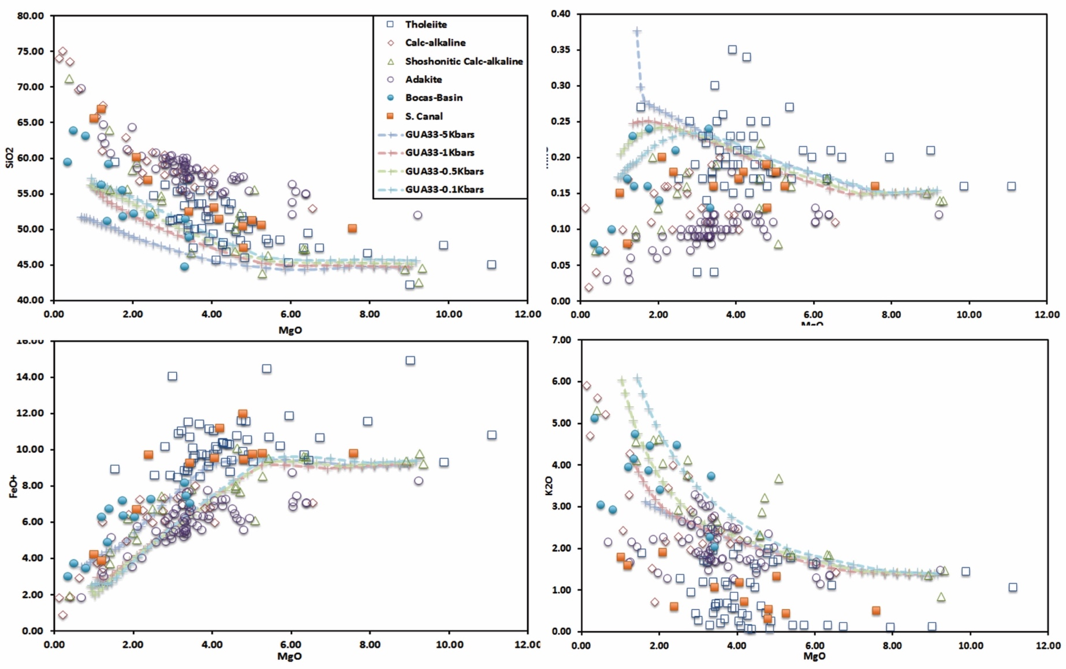
Major element Model-MELTS
0.5kbars
5kbars
0.1kbars
MnO
1kbars
SiO2
0.1kbars
5kbars
1kbars
0.5kbars
0.1kbars
5kbars
0.5kbars
FeO+
K2O
0.1, 0.5, 1 and 5 kbars
5kbars
1kbars
MgO
MgO
We choose sample GUA 33 (Abratis et al. 2001) as starting sample, which has the highest MgO(8.91 wt. %), Mg#(100Mg/(Mg+Fe) , relative higher Ni, Cr concentration.
Parameters: 1350°- 700° C; 3 wt. % H₂O content; Ni-NiO oxygen fugacity; 0.1-10kbar.
When pressure is 0.5- 1kbars. Crystallizing from around 1200 ° C to 900° C.

Slide 17
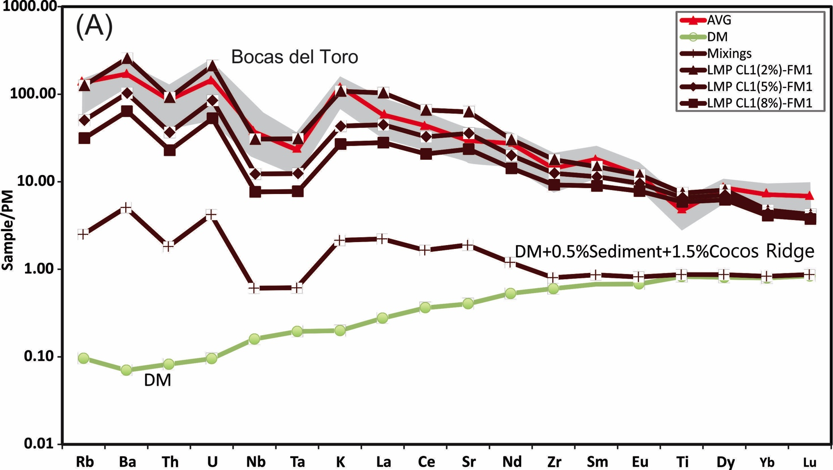
Trace Element Model : Partial Melting Process
Best fit when F=5%
(Depleted Mantle)
(Revised from Gazel 2009)
Model #1: mantle wedge +0.5% sediments + 1.5% OIB, F=5%
Depleted Mantle: inverting 8% melt fraction from the sample SO-144-1(Werner et al., 2003)
Sediment =30% carbonate + 70% hemipelagic sediments.
C_{L}/C₀ = 1/F *[1 - (1 - F)^1/D₀]

Slide 18
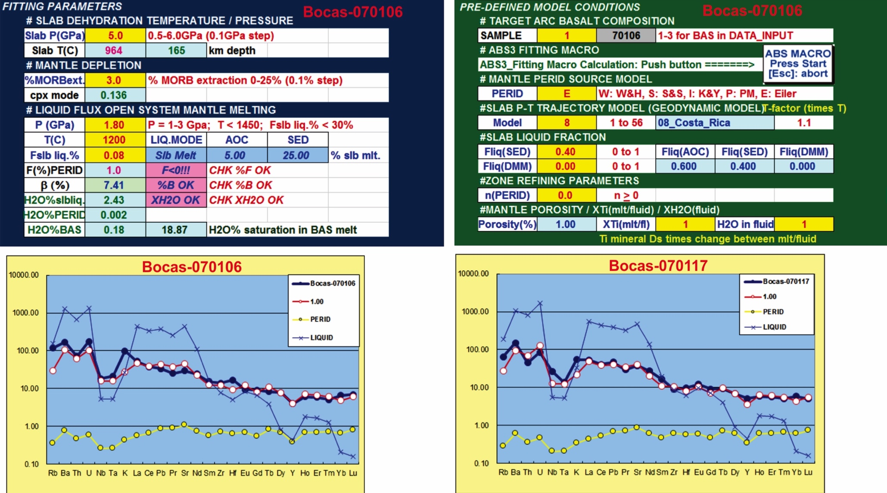
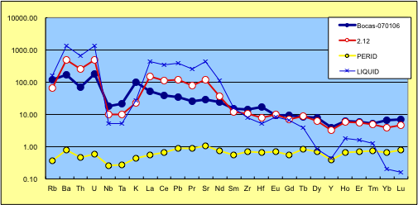
Arc Basalt Simulating Model
Bocas-070106
(with 5% fluid from slab)
(with ~1% fluid from slab)
The model suggests that the partial melt fraction is about 3.5-6%, and melting occurred in very dry conditions.
The melting pressure: 1.8 to 1.9 Gpa(~60km) , and the melting temperature 1150-1350°C, and the slab temperature is 964°C with the slab pressure 5Gpa(165km).

Slide 19
Conclusions
The Bocas del Toro arc rocks contain an enriched OIB-signature component, which may have influxed into the mantle wedge by ~1.5% of the Cocos tracks by 12 Ma.
The partial melting fraction is about 3.5-6% in the very dry condition. The melting pressure ranges from 1.8 to 1.9 Gpa (~60km) with the melting temperature 1150-1350°C.
The slab pressure and temperature during dehydration is around 5 GPa (~165km in depth) and ~964 ° C, respectively, and the estimated slab melts from altered oceanic crust(AOC) and sediments are 5% and 25%, respectively based on Arc Basalt Simulator.
The fractional crystallization was under the pressure of 0.5-1kbars, and the minerals started to crystallize from around 1200 ° C to 900° C. This Low pressure condition suggests that the crustal extension occurred at the time.

Slide 20
Thanks!
Questions & Comments

