Slide 1

The Web Service based approach for data distribution at the IRIS DMC
Chad Trabant, Tim Ahern, Robert Weekly, Yazan Suleiman, Mike Stults, Mick Van Fossen, Bruce Weertman
IRIS Data Management Center
GSA 2015 :: 324-8

Slide 2
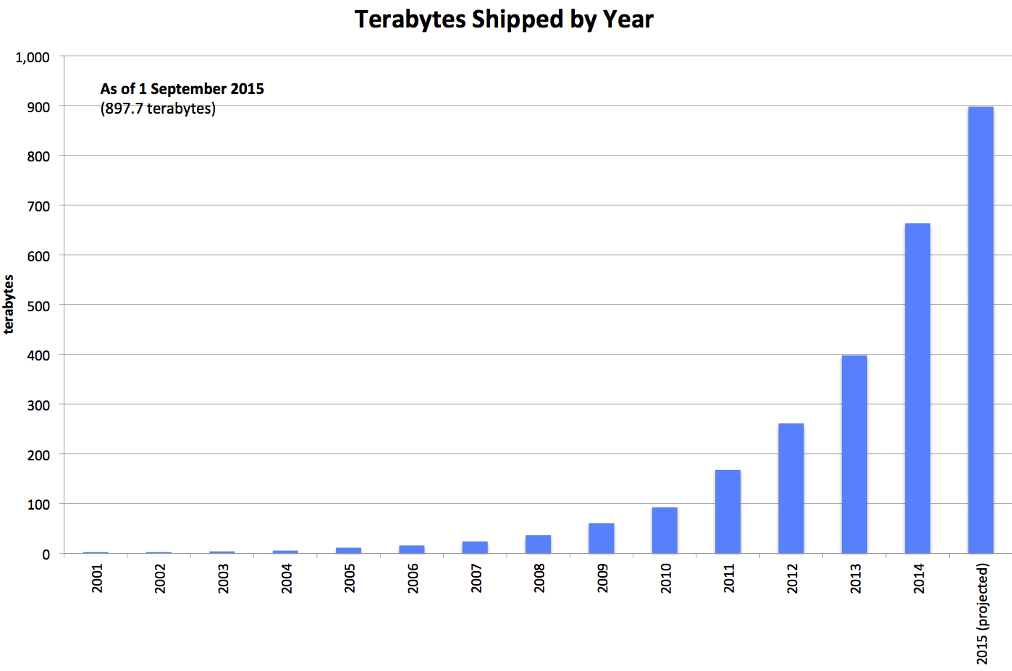
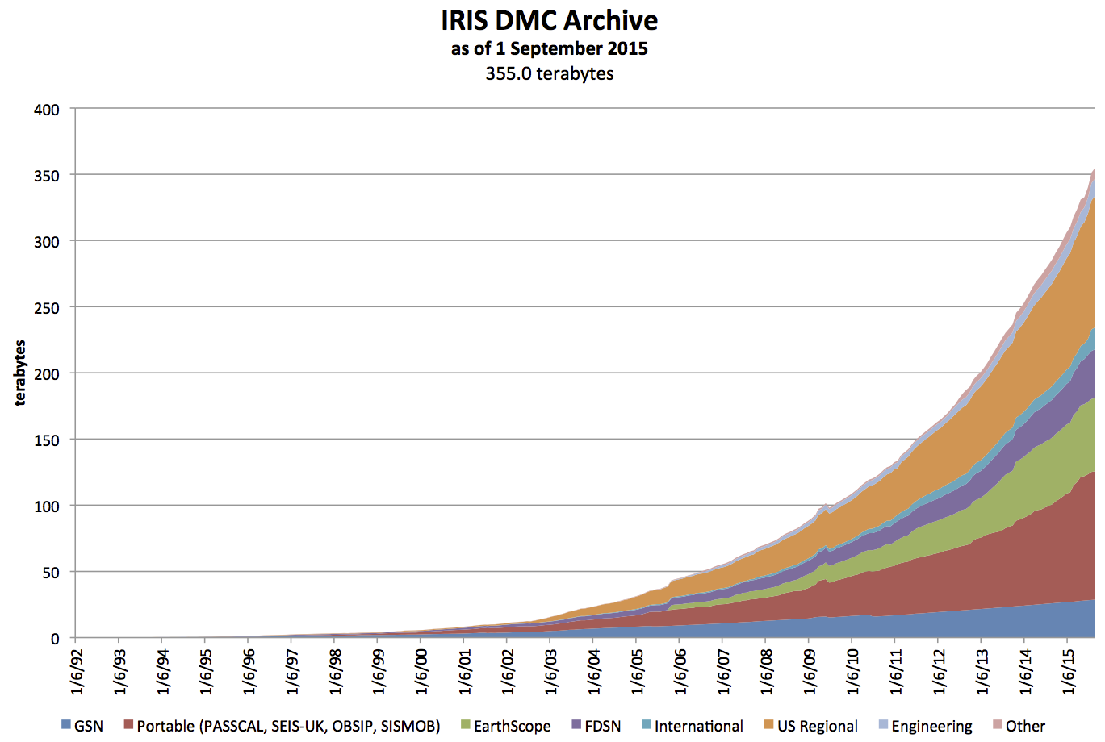

The IRIS Data Management Center (DMC)
The Incorporated Research Institutions for Seismology (IRIS):
A consortium of over 100 US universities dedicated to the operation of science facilities for the acquisition, management, and distribution of seismological data.
The IRIS Data Management Center:
Data center facility. Archiving, curating and distributing primarily seismic data since 1998.

Slide 3
Key characteristics of DMC WS approach
Build services for end users:
Use a subset of HTTP in a RESTful-style
Documentation for target end users (scientists!)
Tools and clients at multiple levels
Data in useful formats
Standardization

Slide 4
1. Use a subset of HTTP in a RESTful-style
HTTP support is ubiquitous, leverage by:
using only core HTTP features
using a RESTful calling convention
The goal: broad compatibility & usability
Notable deviations:
Use of query parameters over path, not “pure” REST
Complex queries submitted as plain, structured text
Notes:
A half-open ecosystem, we have no idea what the technology stack is on the other end; make usage as easy as possible.
No SOAP, no esoteric headers.
HTTP advantages: known ports and know protocol, good for firewalls.

Slide 5
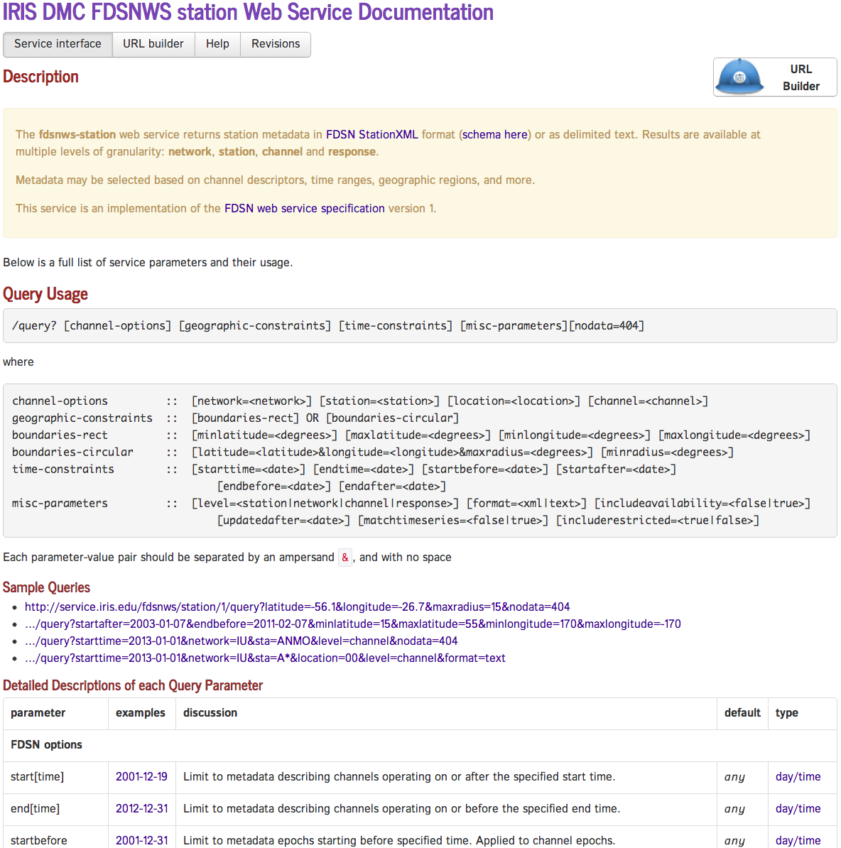
2. Documentation for target end users
Written for mortals, usable by technologists
Relevant Links
URL Builder
Description
Query Parameters
Examples
Detailed
Parameter Desc.

Slide 6
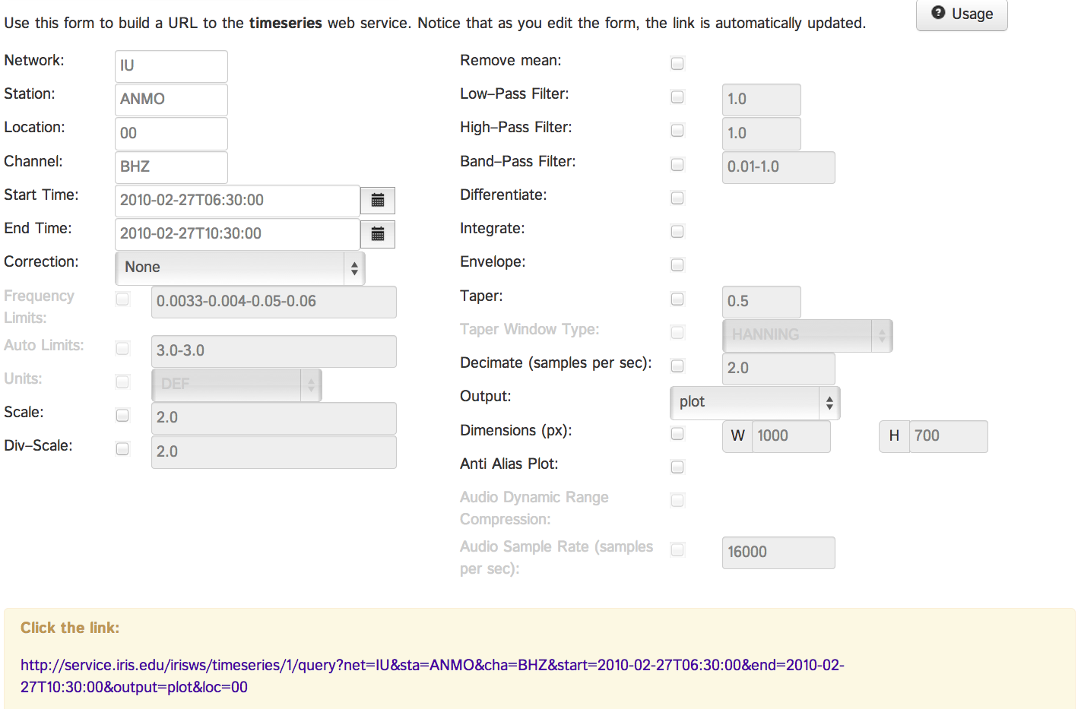
2.5 URL Builders: documentation & tool
Service Parameters
Useful for simple queries, service exploration and prototyping.
URL dynamically
Generated
from parameters

Slide 7
3. Tools and clients at multiple levels
Tools we created:
URL Builders, simple web UIs
Wilber: a web UI for earthquake-oriented data requests
Fetch scripts: command-line data access
IRIS-WS: Java library for data access
irisFetch.m: MATLAB® interface for data access
R library coming soon
Tools others have created that use our web services:
ObsPy (Python), Standing Order for Data (SOD), and many more
Notes:
We also have an R library in preparation for release.

Slide 8
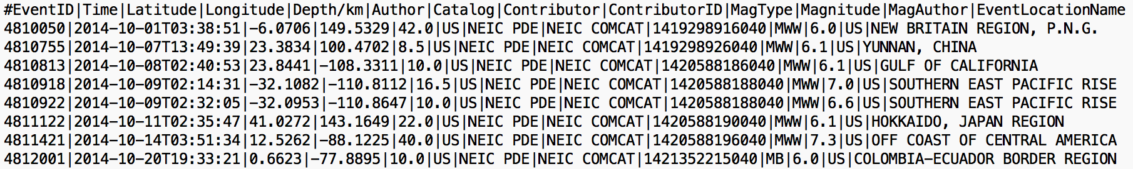
4. Data in useful formats
Deliver data in a small set of formats for maximum usability
Domain-specific standards: SEED, StationXML & QuakeML
Processed data format (de facto): SAC
Plots, when applicable
Text data, the lowest common denominator

Slide 9
5. Standardization
Propose, adopt and promote web services
In 2013 the International Federation of Seismograph Networks (FDSN) adopted 3 standard service interfaces modeled on our services.
  Today: 15+ FDSN data centers hosting 32 endpoints
  Enabling global, federated search and uniform access
In the EarthCube GeoWS Building Block project we are working to extend our service model to other sub domains of geoscience.

Slide 10
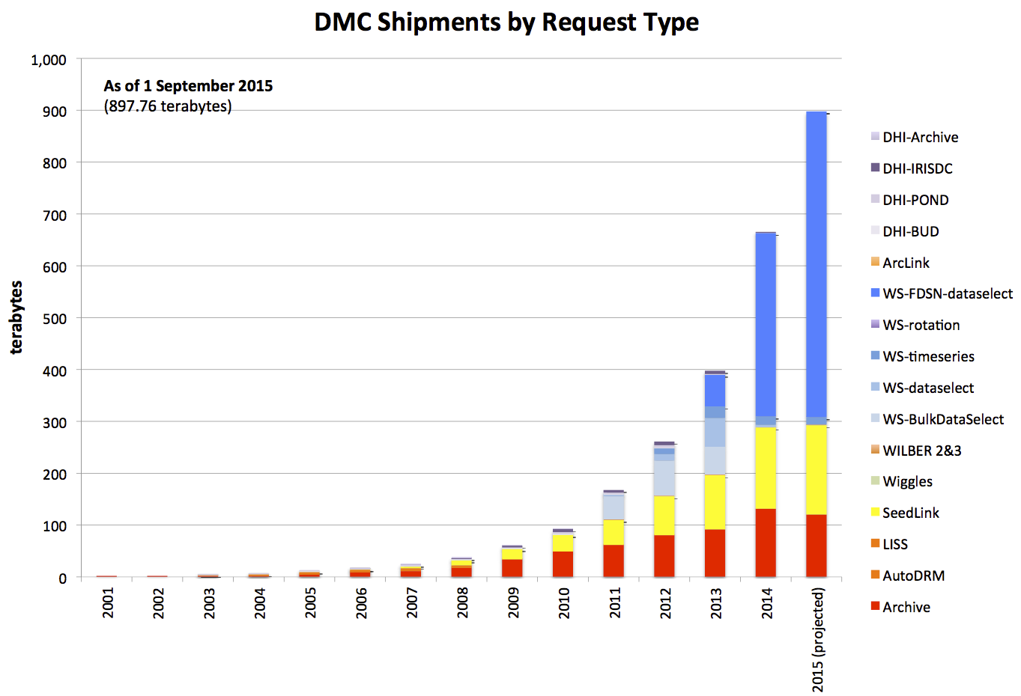
The rise of web service data extraction
Blues are direct
web service
data extraction
Mid-2014
All non-real time
data extracted
with WS

Slide 11
Limitations and challenges
HTTP header and query status are sent prior to sending data.
  Streaming data of unknown size, client does not know how much to expect.
  If a delivery is truncated there is no easy way to inform the client.
Connections left idle for long periods are prone to timeouts.
No simple multiple “thing” (e.g. files) delivery options. The option we are adopting is ZIP archives as a container for multiple things.
Notes:
Response truncation of a container such as XML is usually obvious as it is incomplete.
Our data format is not in such a container.
Multipart MIME is available but not simple to interpret on the receiving end.

Slide 12
Key advantages
Directly usable by scientific target audience.
Well suited for integration into workflows.
An abstraction layer for both internal and external uses.
A foundation for more advanced cyber infrastructure: cataloging, federation, cross-domain brokering, etc.

Slide 13
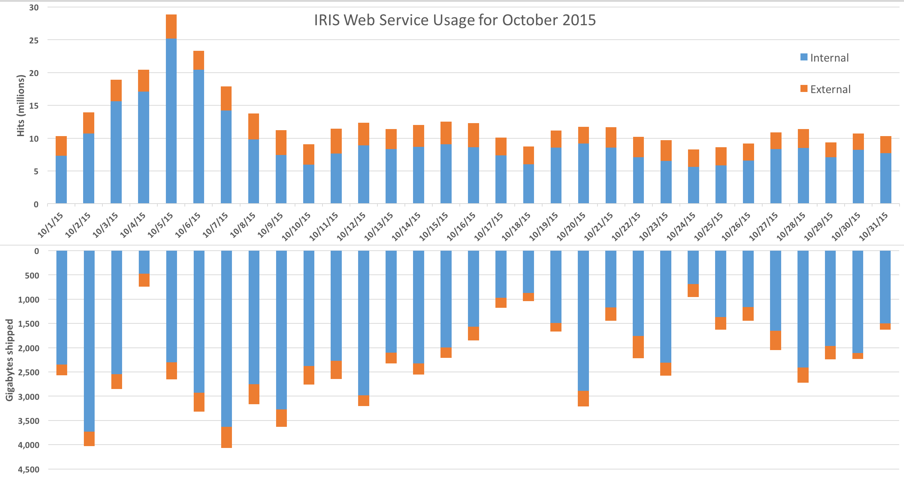
Daily web service usage (bonus panel)

