Slide 1
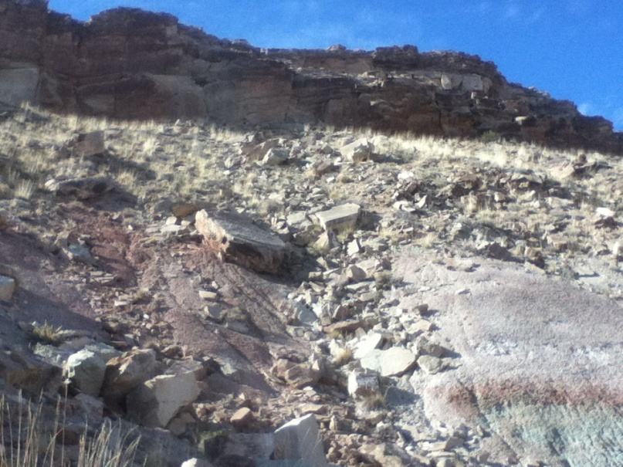
A Fossil Locality Predictive Model for the Early Cretaceous Cedar Mountain Formation, Utah, USA
Daniel Burk

Slide 2
What is a Predictive Model?
A GIS based model attempting to determine fossil locality potential
1. Start with known fossil localities
2. Compare their characteristics to other places
3. Find similar areas
4. Go look for fossils there

Slide 3
Why a Predictive Model?
Nature of field work - chancy
Potentially reduce on-the-ground search time
Few published fossil locality predictive models exist
GIS data and software are economically available, additional tools for paleontologists

Slide 4
Existing Published Fossil Locality Predictive Models
Conroy et al. (2012) – Eocene formations of Uinta Basin, UT
Egeland et al. (2010) – Paleoanthropological sites in Armenia
Emerson and Anemone (2012) – Great Divide Basin, WY
Malakhov et al. (2009) - Lower Syrdarya Uplift in Kazakhstan
Oheim (2007) - Two Medicine Formation of Montana

Slide 5
Why the Cedar Mountain Formation?
Faunal shift and climatic change in North America
Hotbed of new discoveries (McDonald et al. 2010; Senter et al. 2010; Senter et al. 2012a; Senter et al. 2012b; Taylor et al. 2011)
Active research, including presentations at this conference (Hendrix et al. 2015; Jasinski and Dodson 2015; Ludvigson et al. 2015; Suarez et al. 2015).
Accessible field area and GPS data

Slide 6
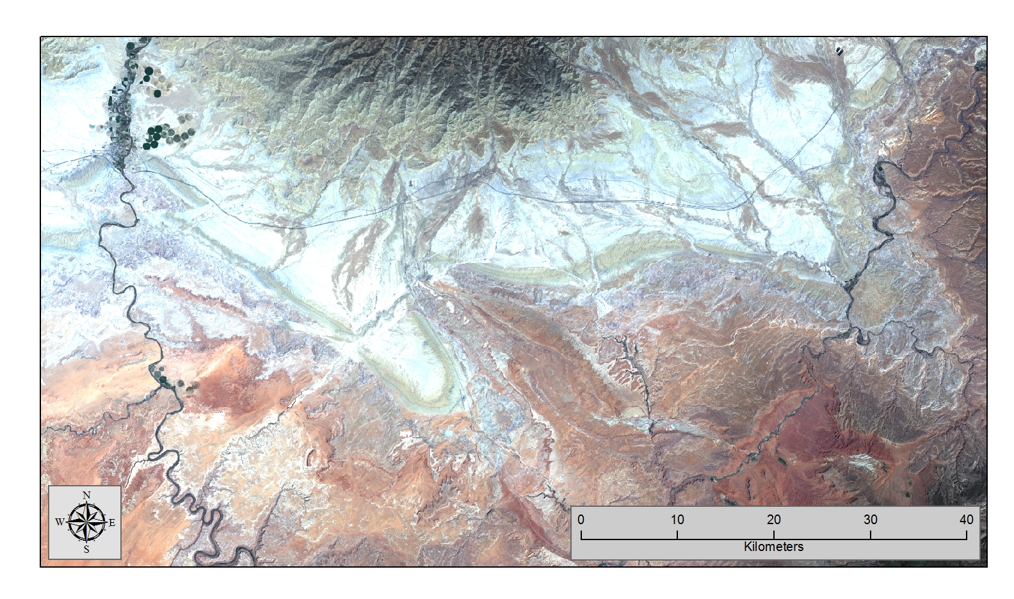
Study Area
Scene LC80360332013162LGN00, Path 36, Row 33 taken June 11, 2013 (natural color composite band combination pictured.)

Slide 7
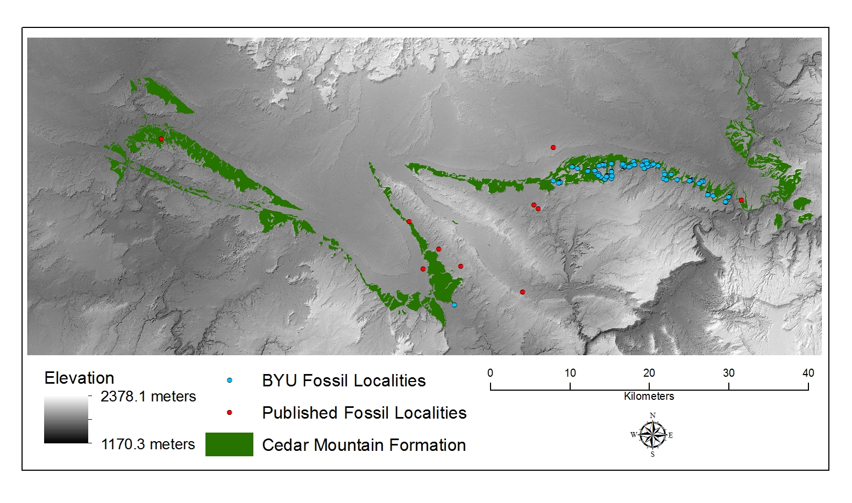
Data Sources

Slide 8
Research Methodology
Locality shape
“Clip” (Locality mask)
Landsat Locality
Summarize Statistics
Landsat Locality Summary
Weighted Suitability Analysis
Potential Localities
Landsat OLI/TIRS
Difference of Means (X₁-X₂)
Difference of Means
Field Test
Cedar Mountain shape
“Clip” (Cedar Mtn. Mask)
Landsat Formation
Summarize Statistics
Slope Locality Summary
Field Data
Observations

Slide 9
Differences of means between fossil localities and CMF (X₁-X₂)

Slide 10
Weighted Suitability Analysis
Reclassification of band values
Weights assigned
 | Band 1 | Band 2 | Band 3 | Band 4 | Band 5 | Band 6 | Band 7 | Band 10 | Band 11
% Weight | 12% | 14% | 15% | 12% | 12% | 18% | 14% | 1% | 2%

Slide 11
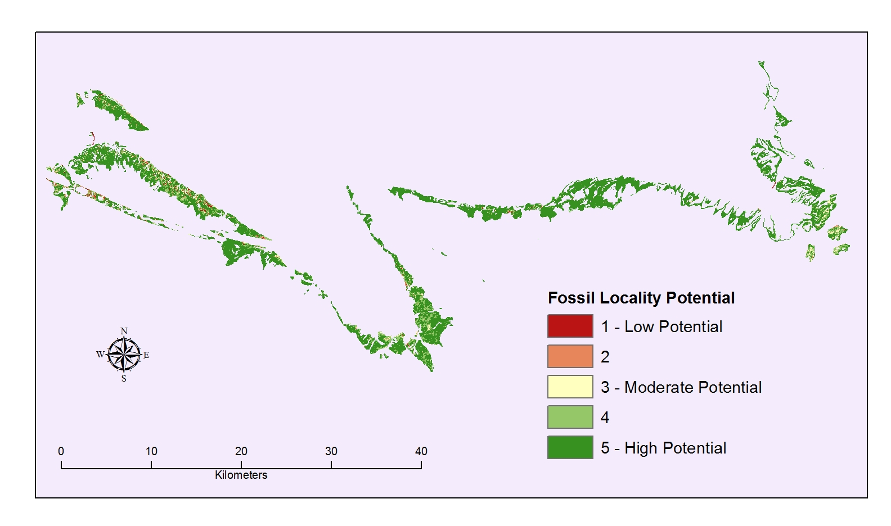
Analysis Results

Slide 12
Field Testing
10 high potential sample sites chosen (30m x 30m pixels)
Vertebrate fossils found at only one site
Observations:
Steep slopes too dangerous to prospect
Flat slopes had little to no rock outcrop
Model too inclusive

Slide 13
Reanalysis
Bands 10 and 11 removed
Bands reclassified to offer larger range of potential
Weights re-assigned
 | Band 1 | Band 2 | Band 3 | Band 4 | Band 5 | Band 6 | Band 7
% Weight | 12% | 14% | 16% | 12% | 13% | 19% | 14%

Slide 14
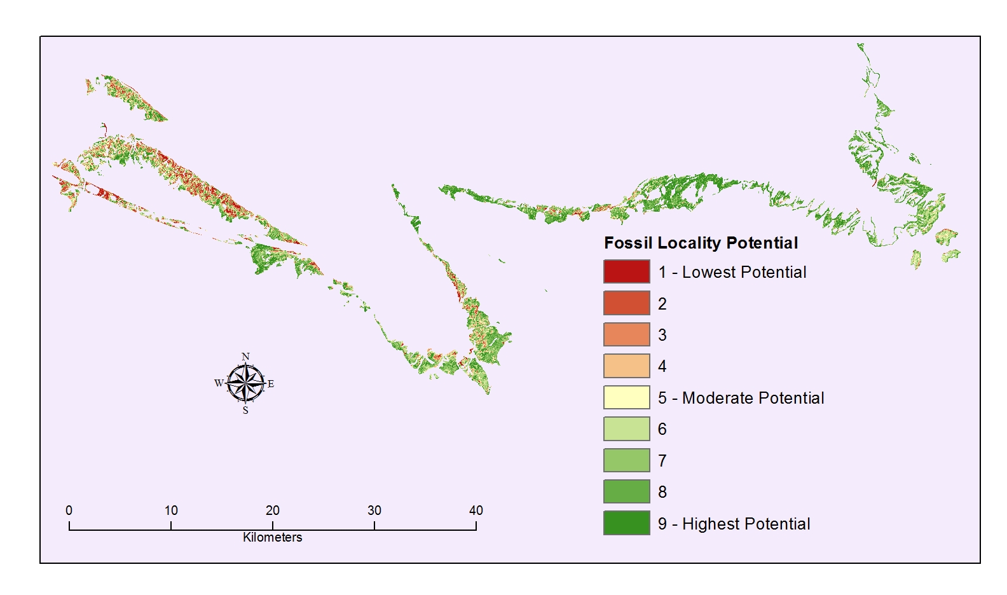
Reanalysis results

Slide 15
Reanalysis results
Unable to field test at this time
No other existing model looks exclusively at spectral reflectance data.
Number of cells assigned to each fossil potential value for the revised model

Slide 16
Surface Aspect % of Total

Slide 17
Surface slope
75% of BYU fossil localities occur on slopes between 15° and 38° (±1 standard deviation). Only 17% of CMF exposures are in that range. Slopes greater than 45° excluded from the model.

Slide 18
Refined Model

Slide 19
Model Comparison

Slide 20
Model Check and Additional Field Work
Known fossil localities checked against model for internal consistency
Additional outside sources of locality data
Additional field work data obtained
Mixed results
Fossil Potential Value | 1 | 2 | 3 | 4 | 5 | 6 | 7 | 8 | 9 | Outside | Total
BYU Localities |  |  |  |  | 5 | 4 | 4 | 5 | 12 | 68 | 98
PBDB |  |  |  |  |  |  |  |  | 1 | 9 | 10
Field Work |  | 3 |  |  |  | 1 | 1 | 1 | 1 | 4 | 11
UGS | 1 |  | 1 |  |  |  |  |  |  | 18 | 20

Slide 21
Unresolved Issues
Geologic map accuracy
Microfossil, plant, invertebrate, trace fossil sites ignored
Relative importance of sites not distinguished
Different datasets used different projected coordinate systems

Slide 22
Conclusion/Lessons Learned
Successful creation of model
High fossil potential areas identified
Landsat 8 data alone not sufficient
Knowledge of environmental factors crucial
GI/GO: Model is no better than the input data
Models are no substitute for field work, but can be a useful aid to maximize time and resources.

Slide 23
List of References
Conroy, G.C., Emerson, C.W., Anemone, R.L., and Townsend, K.E.B., 2012. Let your fingers do the walking: A simple spectral signature model for ‘remote’ fossil prospecting. Journal of Human Evolution, 63, 79–84.
Doelling, H.H., 2002. Geologic Map of the Moab and Eastern Part of the San Rafael Desert 30’x60’ Quadrangles, Grand and Emery Counties, Uah, and Mesa county, Colorado.
Egeland, C.P., Nicholson, C.M., and Gasparian, B., 2010. Using GIS and Ecological Variables to Identify High Potential Areas for Paleoanthropological Survey: An Example from Northern Armenia. Journal of Ecological Anthropology, 14 (1), 89–98.
Emerson, C.W. and Anemone, R.L., 2012. An artificial neural network-based approach to identifying mammalian fossil localities in the Great Divide Basin, Wyoming. Remote Sensing Letters, 3 (5), 453–460.
Hendrix, B., Moeller, A., Ludvigson, G.A., Joeckel, R.M., and Kirkland, J.I., 2015. A New Approach to Date Paleosols in Terrestrial Strata: A Case Study Using U-PB Zircon Ages for the Yellow Cat Member of the Cedar Mountain Formation of Eastern Utah. Presented at the 2015 GSA Annual Meeting, Baltimore, Maryland, USA: Geological Society of America.
Jasinski, S. and Dodson, P., 2015. Biostratigraphy, Paleobiogeography, and Evolution of Dromaeosaurids (Dinsauria: Dromaeosauridae) in North America. Presented at the 2015 GSA Annual Meeting, Baltimore, Maryland, USA: Geological Society of America.
Ludvigson, G.A., Gonzalez, L.A., Joeckel, R.M., and Moeller, A., 2015. Terrestrial Carbonate Records of Cretaceous (Aptian-Albian) Carbon Isotope Excursions from Deposits in North America and China. Presented at the 2015 GSA Annual Meeting, Baltimore, Maryland, USA: Geological Society of America.
Malakhov, D.V., Dyke, G.J., and King, C., 2009. Remote Sensing Applied to Paleontology- Exploration of Upper Cretaceous Sediments in Kazakhstan for Potential Fossil Sites. Palaeontologia Electronica, 12 (2), 1–10.
Oheim, K., 2007. Fossil site prediction using geographic information systems (GIS) and suitability analysis: The Two Medicine Formation, MT, a test case. Palaeogeography, Palaeoclimatology, Palaeoecology, 251 (3/4), 354–365.]
Senter, P., Kirkland, J.I., Bird, J., and Bartlett, J.A., 2010. A new troodontid theropod dinosaur from the Lower Cretaceous of Utah. PLoS One, 5 (12), 1–5.
Senter, P., Kirkland, J.I., and DeBlieux, D.D., 2012a. Martharaptor greenriverensis, a new theropod dinosaur from the Lower Cretaceous of Utah. PLoS One, 7 (8), 1-12.
Senter, P., Kirkland, J.I., DeBlieux, D.D., Madsen, S., and Toth, N., 2012b. New dromaeosaurids (Dinosauria: Theropoda) from the Lower Cretaceous of Utah, and the evolution of the dromaeosaurid tail. PLoS One, 7 (5), 1–20.
Suarez, M.B., Suarez, C., You, H., and Kirkland, J.I., 2015. The Early Cretaceous Chemostratigraphic and Paleoclimate Record of Northwest China and Western North America. Presented at the 2015 GSA Annual Meeting, Baltimore, Maryland, USA: Geological Society of America.
Taylor, M.P., Wedel, M.J., and Cifelli, R.L., 2011. A new sauropod dinosaur from the Lower Cretaceous Cedar Mountain Formation, Utah, USA. Acta Palaeontologica Polonica, 56 (1), 75–98.

Slide 24
Acknowledgements
Thanks to Dr. Rodney Scheetz at the Brigham Young University Museum of Paleontology for providing fossil locality data with which to begin the analysis.
Field work was conducted under the following permits: Utah State Permit #2015-457, Utah BLM Permit #UT08-006C, and Utah BLM Permit #UT08-014C.
Thanks to Martha Hayden (UGS) and Rebecca Hunt-Foster (BLM-UT) for providing additional fossil locality data.
Thanks to Paleobiology Database for providing locality data.
Thanks to Stephen Sandau, Dr. Brooks Britt, Garrett Tournear, Shaun McClure, Lindsay Beasley, Dr. Rodney Scheetz, Aaron Scheetz, Austin Scheetz, and Alexandra Scheetz for help with field work.
Thanks to my thesis advisor and committee Dr. Yi-Hwa Wu, Dr. Ming Hung, & Dr. John P. Pope.
Thank to William and Patricia Burk, Melissa and Ryan DeLange, and Stephen Sandau for helping me to get here.
Thanks to my wonderful wife, Faith, and our great kids, Grace, Joy, Titus, Tommy, Timmy, and #6.

Slide 25
Questions?

