Slide 1

SIMULATIONS OF A NOVEL WELL DESIGN FOR REDUCING THE RISK OF ARSENIC CONTAMINATION
Richard B. Winston¹ and Joseph D. Ayotte²
¹U.S. Geological Survey, MS 431 12201 Sunrise Valley Drive, Reston VA, 20192, United States of America, rbwinst@usgs.gov
²U.S. Geological Survey, 331 Commerce Way, Pembroke, NH 03301, United States of America

Slide 2
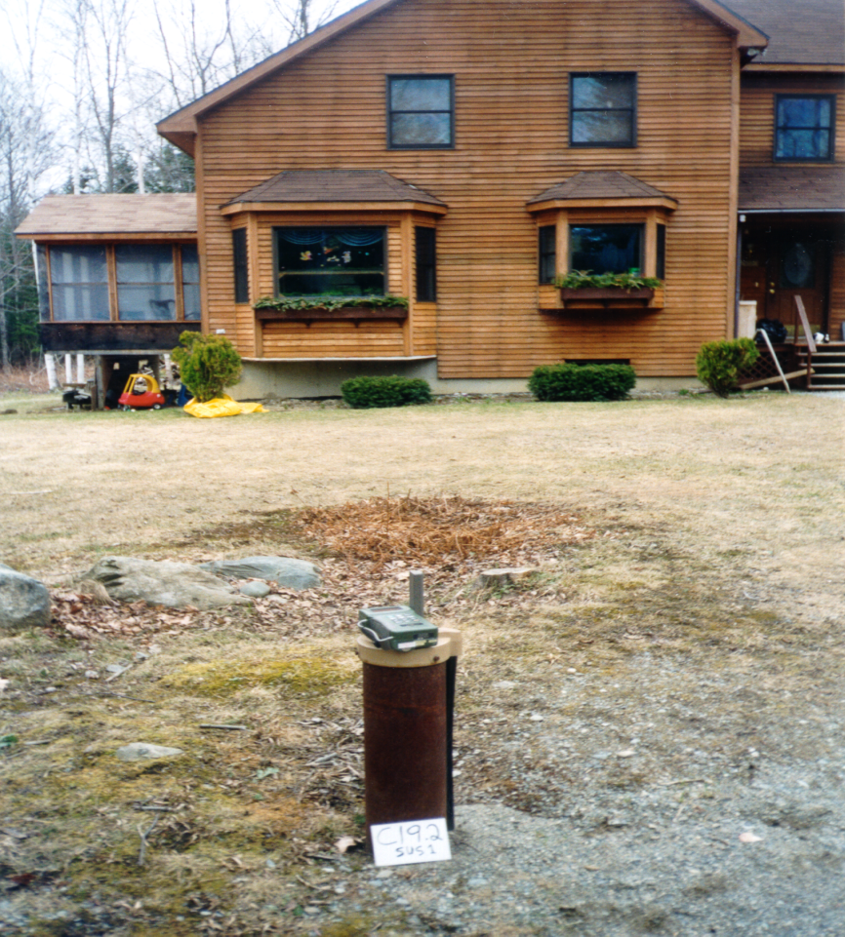
New England Arsenic Geochemistry
>90 percent of all new wells
drilled into the bedrock
aquifer.
Glacial aquifer:
acidic pH, oxic
3% of wells with arsenic > 10 ug/L
Fractured bedrock aquifer:
alkaline pH, anoxic
20% of wells with arsenic > 10 ug/L
(Ayotte et al., 2003, ES&T)
Glacial
aquifer
Low As
Fractured
Bedrock
aquifer
High As

Slide 3
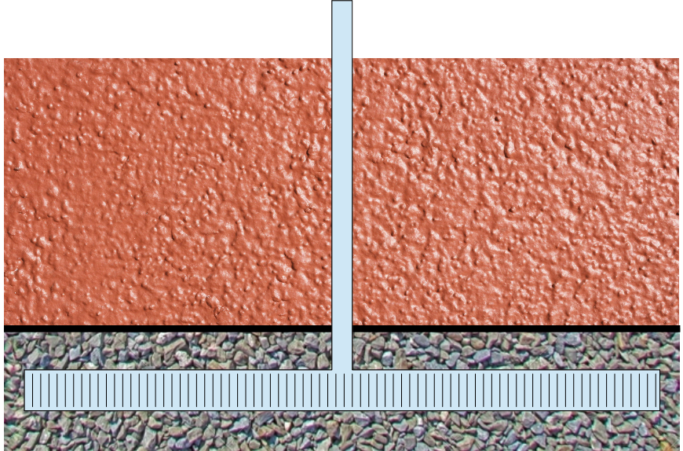
Well Design (Simplified)

Slide 4
Goal
Identify what factors pose the greatest risks for arsenic contamination.

Slide 5
Approach
Use sensitivity analysis on a series of hypothetical models to identify features that increase flow of bedrock-water into the well.
The differences in chemistry between bedrock and till were ignored. However, the acidic, oxic conditions in the till favor arsenic removal.

Slide 6
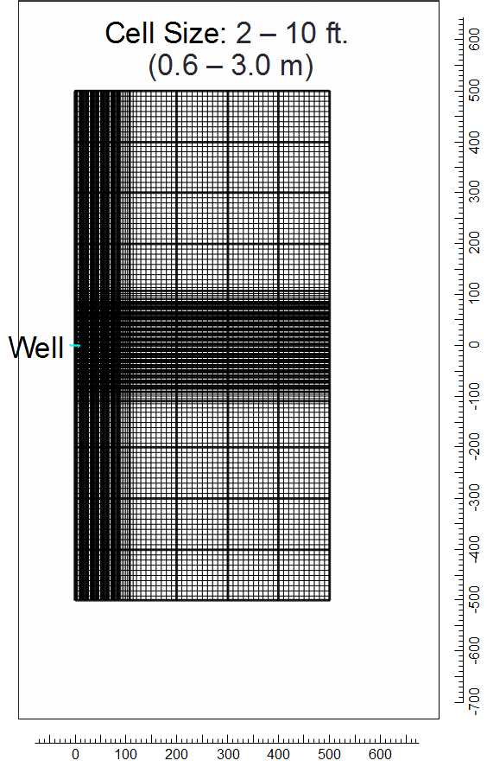
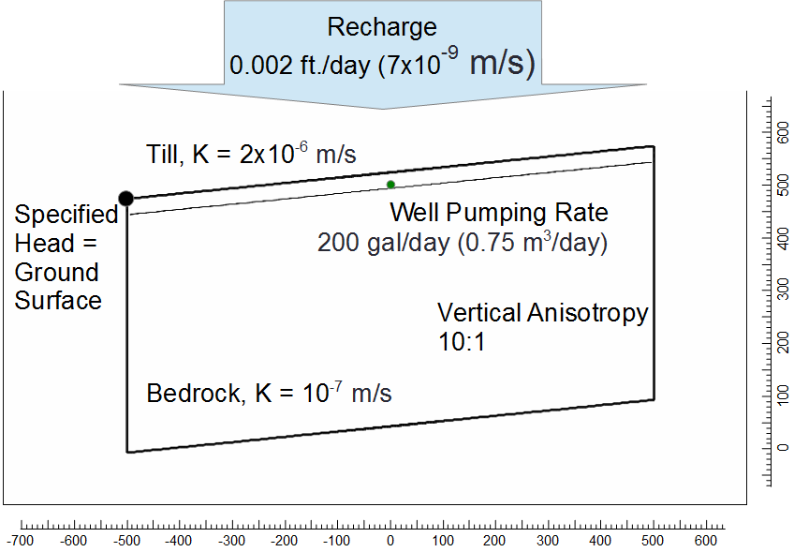
Model Characteristics
Dimensions = 500x1000 ft.

Slide 7
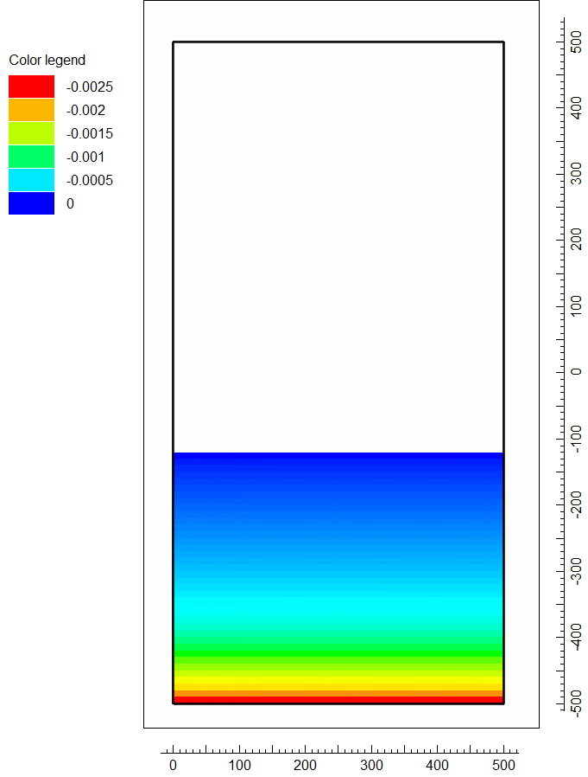
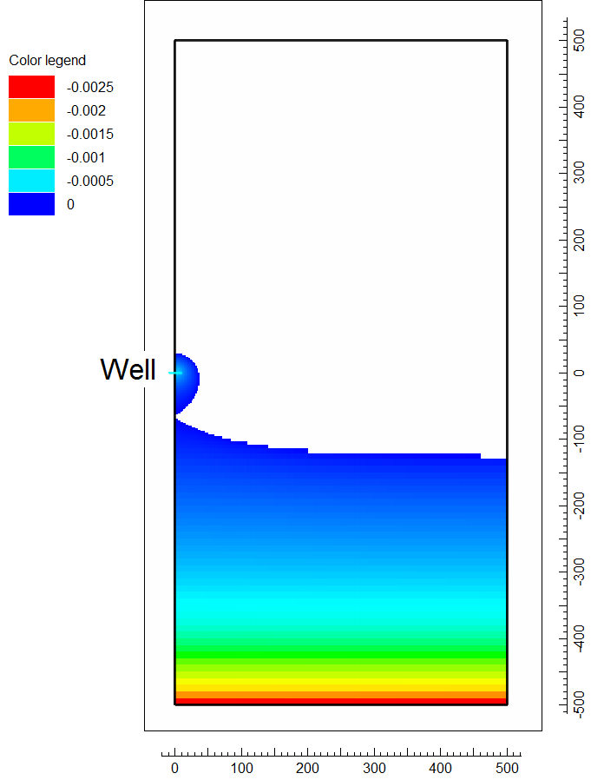
Upward Flow from Bedrock to Till
Without Well
With Well

Slide 8
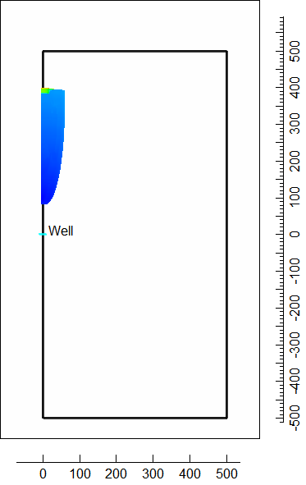
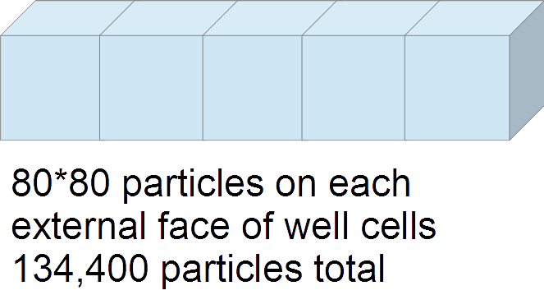
MODPATH use to Map Capture Zone

Slide 9
Arsenic Contamination Route: Water Passing Through Bedrock

Slide 10
Calculate Fraction of Water Entering the Well that has Passed Through Bedrock
Determine the fraction of flow into the well for each particle.
The MODFLOW Cell by Cell flow file records the amount of flow through each face of every active cell.
Calculate the fraction of flow associate with particles that have passed through bedrock.
Pathline files record the cell containing each particle at each point along the path

Slide 11
Sensitivity Analysis Results
Model feature that was varied | Percent of flow from bedrock
Base case | 0.58
Seasonal recharge | 0.60
No recharge | 0.59
High recharge | 0.48
Well orientation | 0.58
Increased slope and recharge | 0.47
Decreased slope and recharge | 0.92
Vertical position of well shallower | 0.25
Vertical position of well deeper | 1.13
Increased bedrock hydraulic conductivity | 8.63
Well moved 300 ft. downslope | 5.97
Well moved 100 ft. upslope | 0.18
Well 300 ft. downslope and shallower | 2.73
Both aquifers isotropic | 6.68
Till aquifer isotropic | 0.24
Bedrock aquifer isotropic | 7.89
Length of well | 0.48

Slide 12
Effect on Arsenic Concentration
Bedrock aquifer (assumed arsenic concentration = 50 μg/L)
Till aquifer (assumed arsenic concentration = 0 μg/L)
8.63% flow from Bedrock aquifer → Maximum possible concentration of arsenic in shallow well water (μg/L) = 4.32

Slide 13
Conclusions
Greatest risk factors
Natural upward flow from bedrock
High bedrock vertical hydraulic conductivity
Even in the worst case simulated, the arsenic concentration is acceptable

Slide 14
Model Characteristics
Dimensions | 1000 * 500 ft. (300 x 150 m)
Till Hydraulic Conductivity | 2x10⁻⁶ m/s
Bedrock Hydraulic Conductivity | 10⁻⁷ m/s
Recharge Rate | 0.002 ft./day (7x10⁻⁹ m/s)
Till Thickness | 30 ft. (9 m)
Bedrock Thickness | 450 ft. (135 m)
Cell size | 2 – 10 ft. (0.6 – 3.0 m)
Slope | 0.1
Pumping Rate | 200 gal/day (0.75 m³/day)

