Slide 1
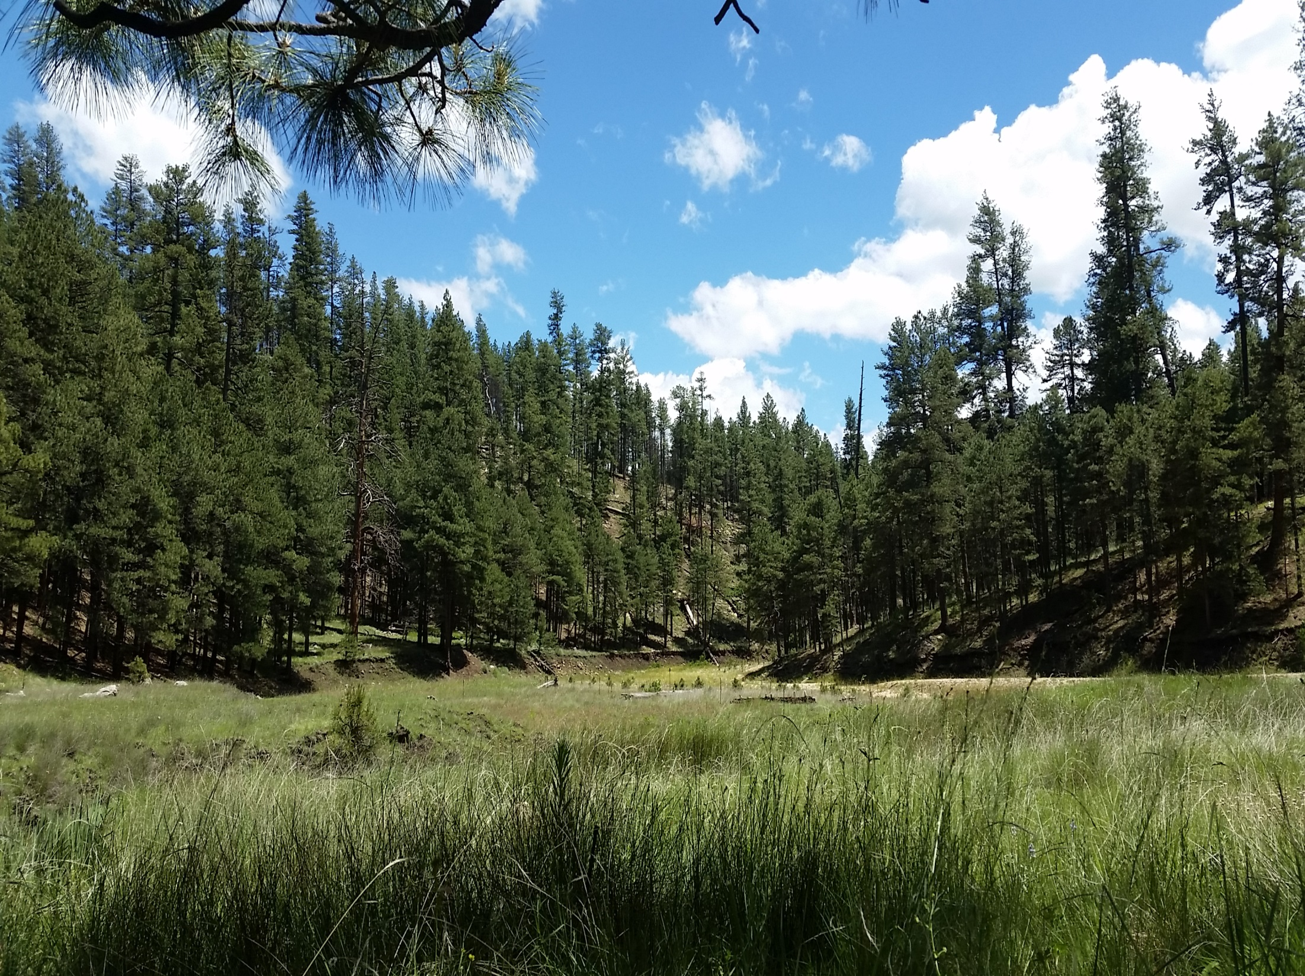



Cragin Watershed Protection Project, Cave and Karst Survey,2015
Kyle Rowinski and Joseph Sadorski Project Mentors: Polly Haessig
& Carl Beyerhelm

Slide 2
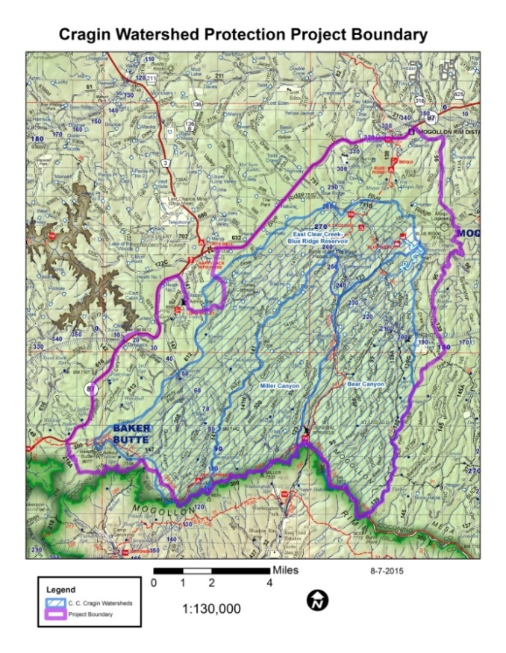
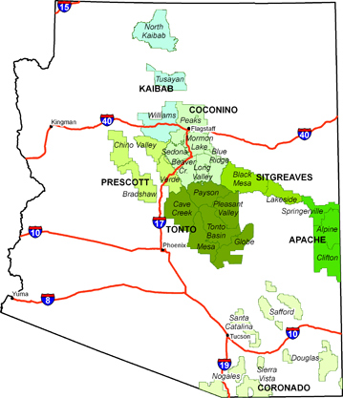
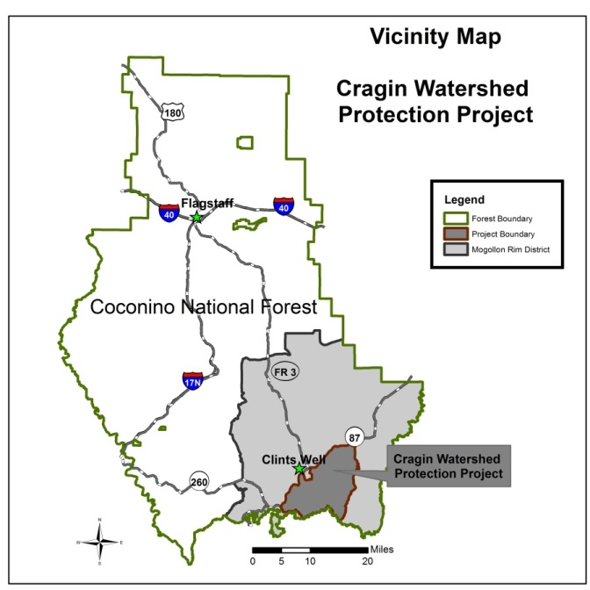
Cragin Watershed Protection Project Overview
Cragin Project • Karst • Methods • Results • Acknowledgments
Project Area: 64,000 Acres.
Includes archeology, biology, forestry, geology, and fire fighters.
Purpose:
Protect water quality of C.C. Cragin Reservoir and related watersheds (Payson, AZ water).
Promote healthy forest ecosystem, reduce wildfire potential.
Protect karst features from adverse consequences of logging and fuels reduction.
The Project Area:

Slide 3
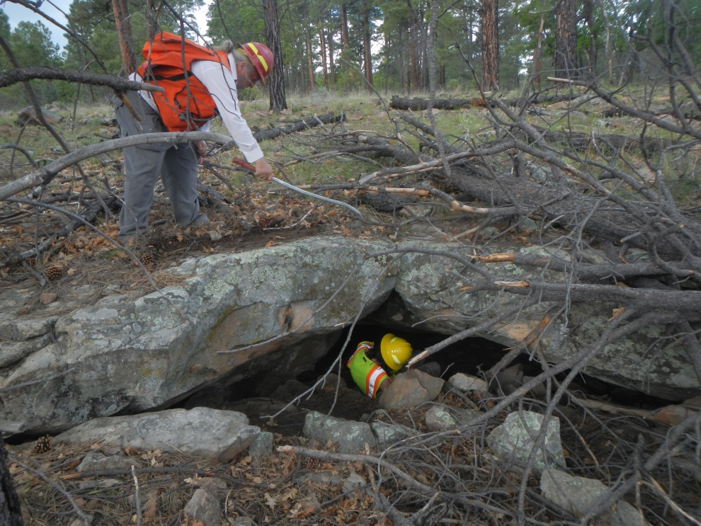
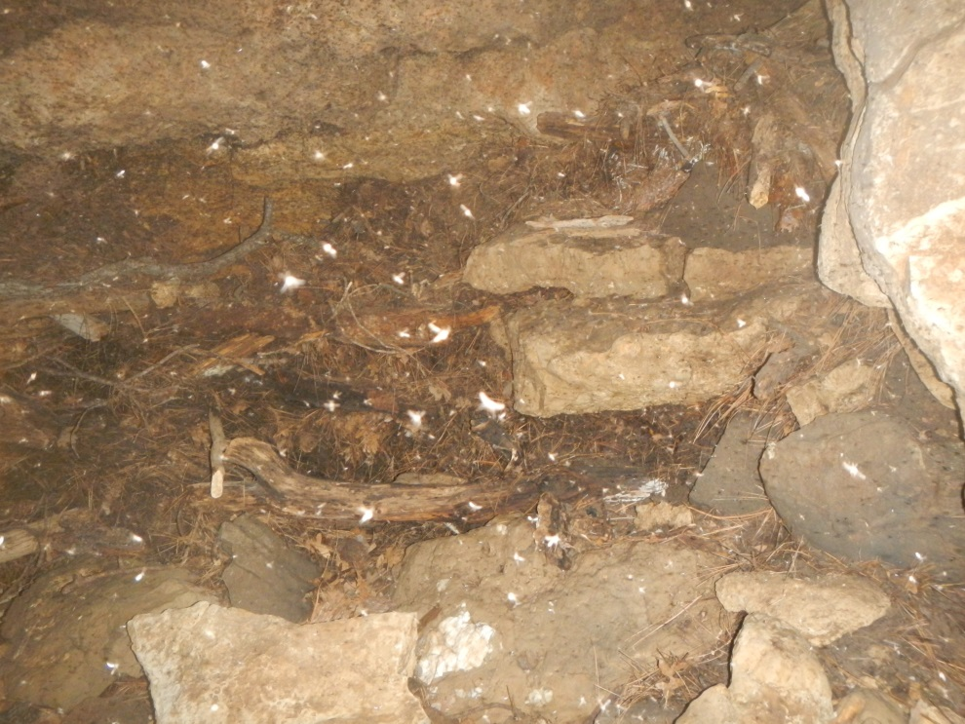
Resource Protection Within the Cragin
Cragin Project • Karst • Methods • Results • Acknowledgments
Geology:
Provide protection as necessary to Cave and Karst features and the pertaining flora and fauna.
Resource-rich areas: groundwater, minerals, and hydrocarbon deposits.

Slide 4
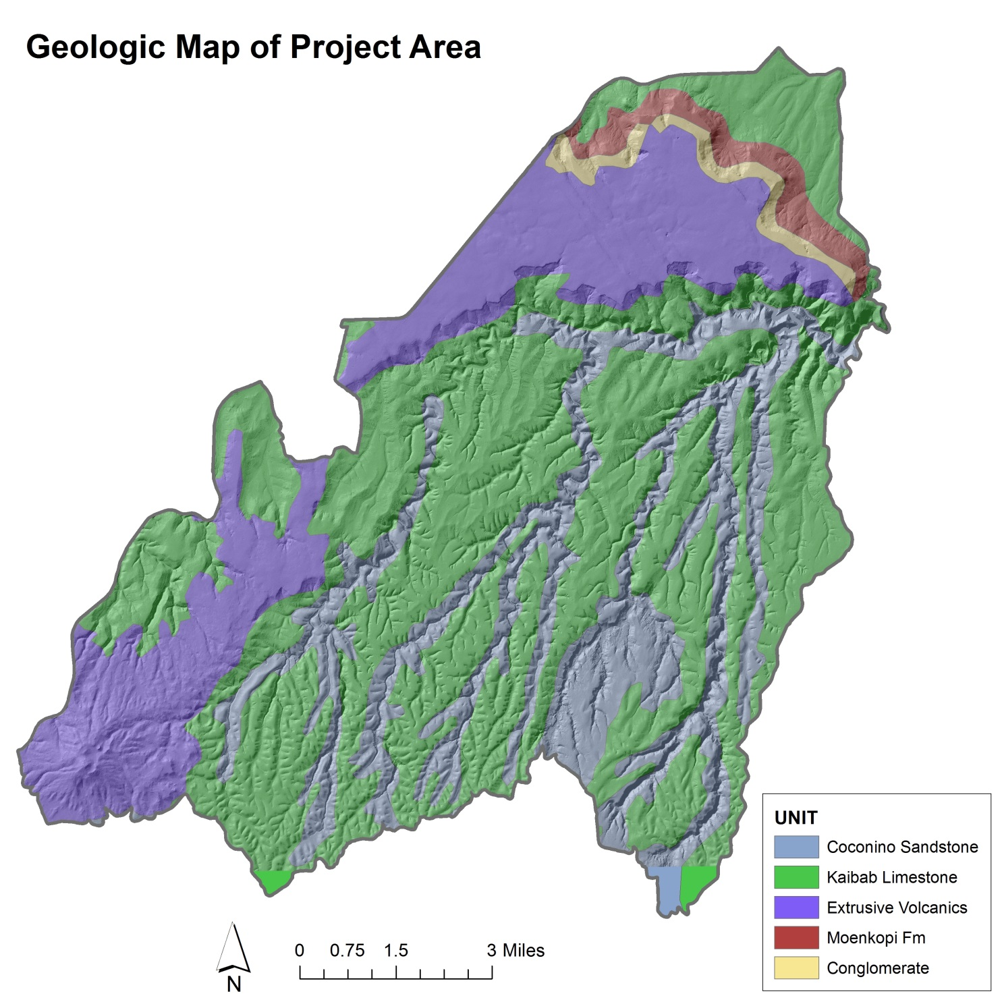
Coconino Ntl. Forest Geology
Cragin Project • Karst • Methods • Results • Acknowledgments
BRRS
Vents
C.C. Cragin Reservoir
Dip

Slide 5
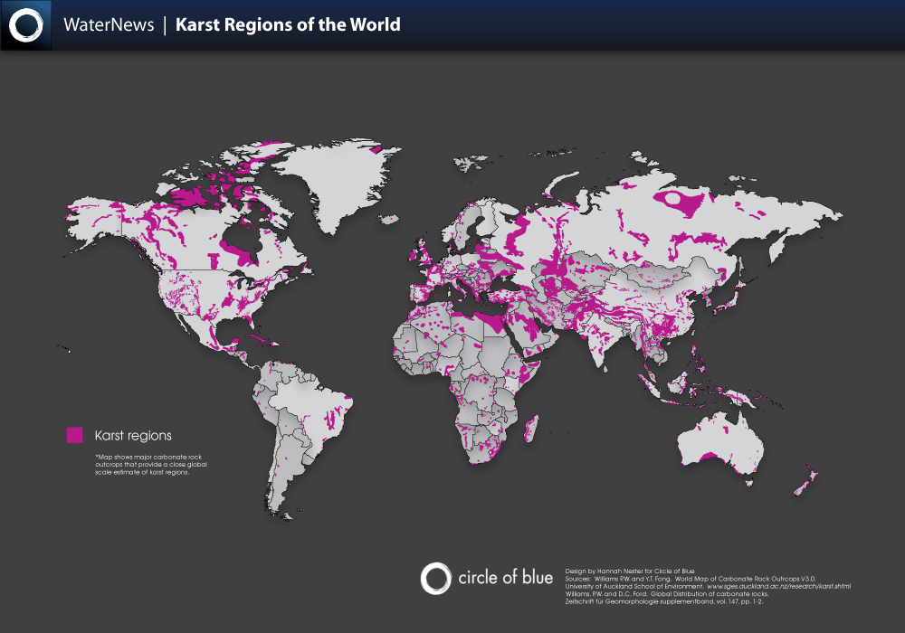
Karst Topography
Cragin Project • Karst • Methods • Results • Acknowledgments
Solution Karst: A terrain formed by the dissolution of water-soluble minerals within rock.
Limestone, Dolomite, Gypsum, Halite.
Pseudokarst: A terrain formed similarly to solution karst, but of insoluble rock.
Basalt, Granite, Sandstone, amongst others.
Features: Underlie 25% of Earth’s exposed surface!
Sinkholes, Emerging/Sinking Streams, Caves, etc…
Diagram Sources: GoodEarthGraphics.com

Slide 6
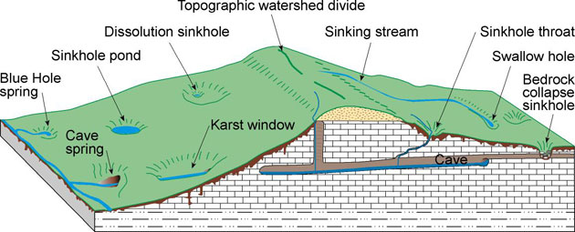
Karst Topography Cont.
Cragin Project • Karst • Methods • Results • Acknowledgments
What do karst features look like?

Slide 7
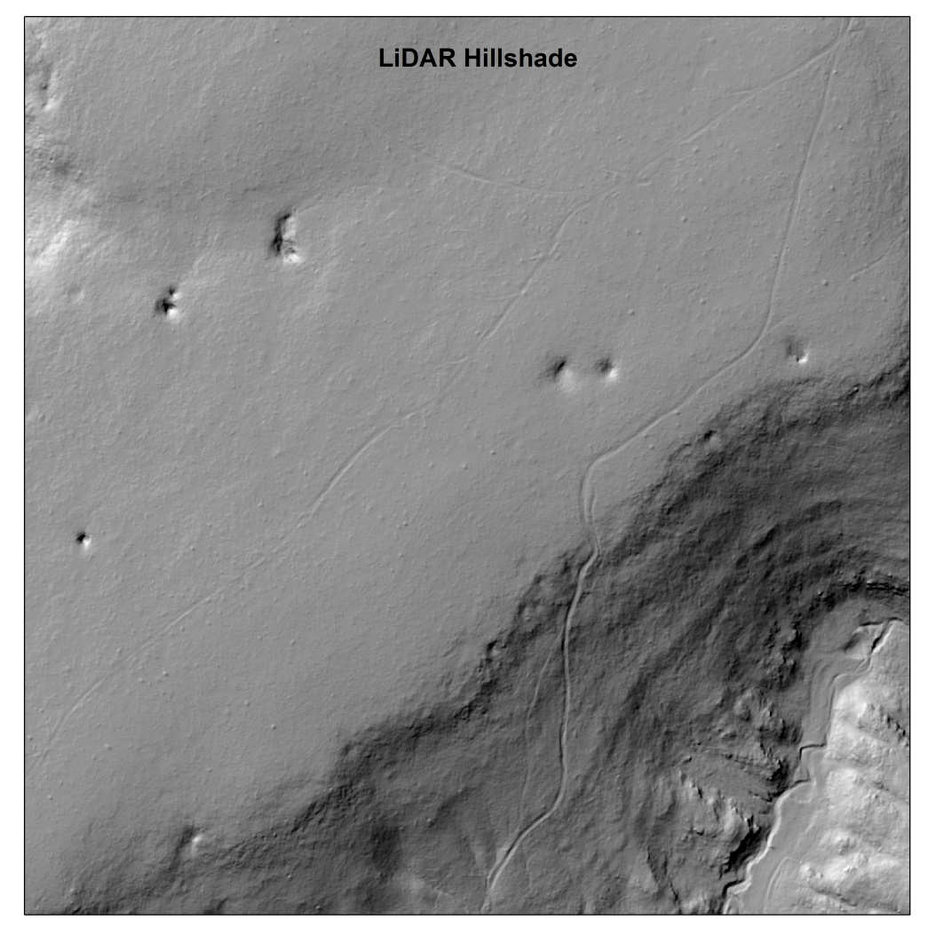
Cragin Project • Karst • Methods • Results • Acknowledgments
C.C. Cragin Karst Feature Locations
LiDAR data analysis provided the Cave and Karst survey with prospective Karst features.
Raster, DEM, and Hillshade analysis via ArcMap to recognize areas of subsidence.

Slide 8
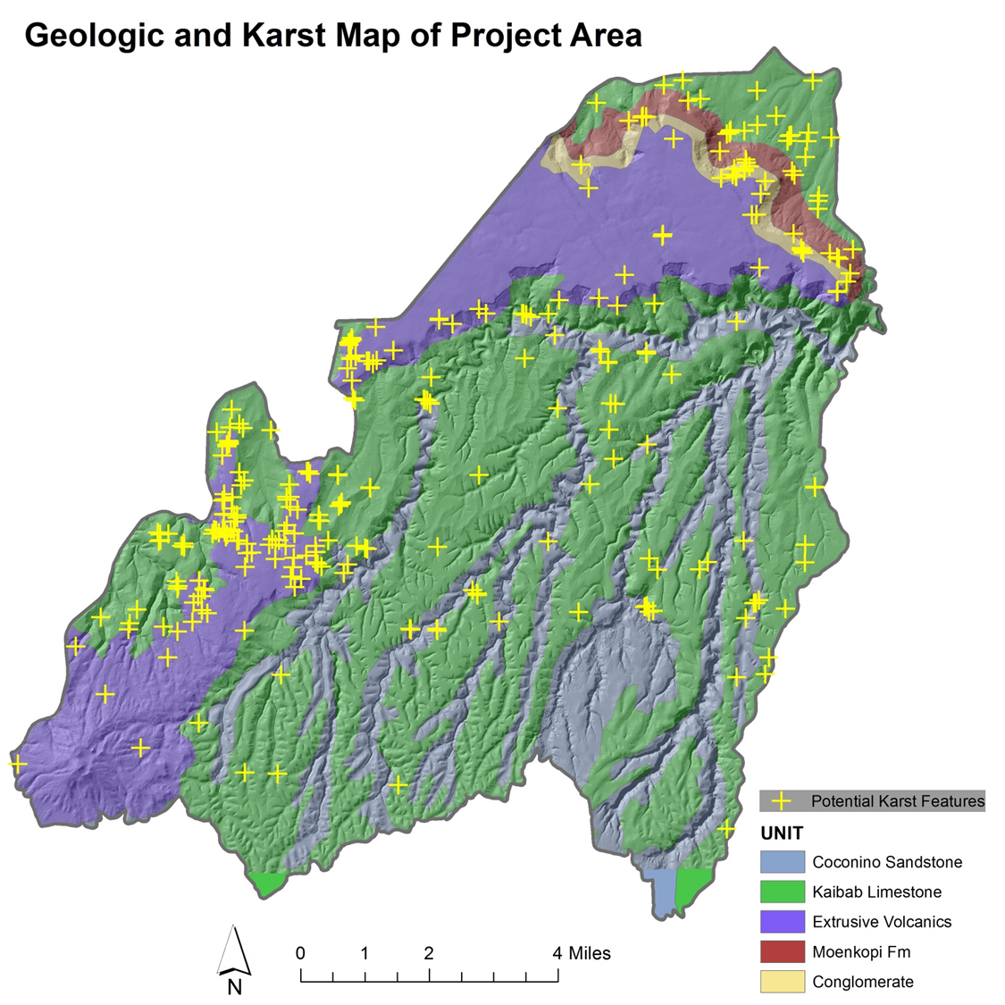
Cragin Project • Karst • Methods • Results • Acknowledgments
C.C. Cragin Possible Karst Feature Locations

Slide 9
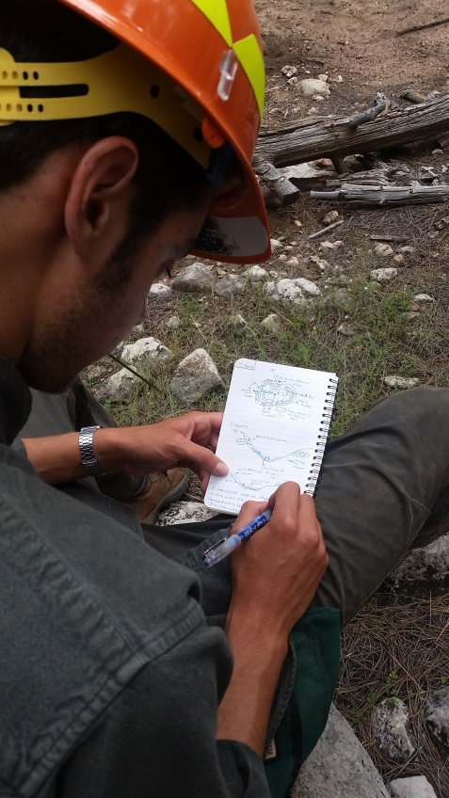
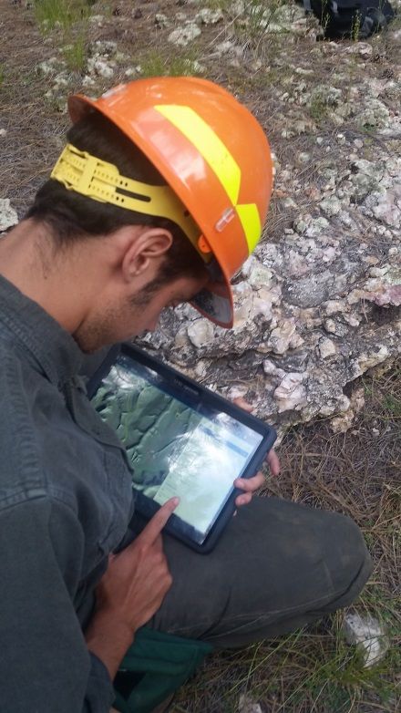
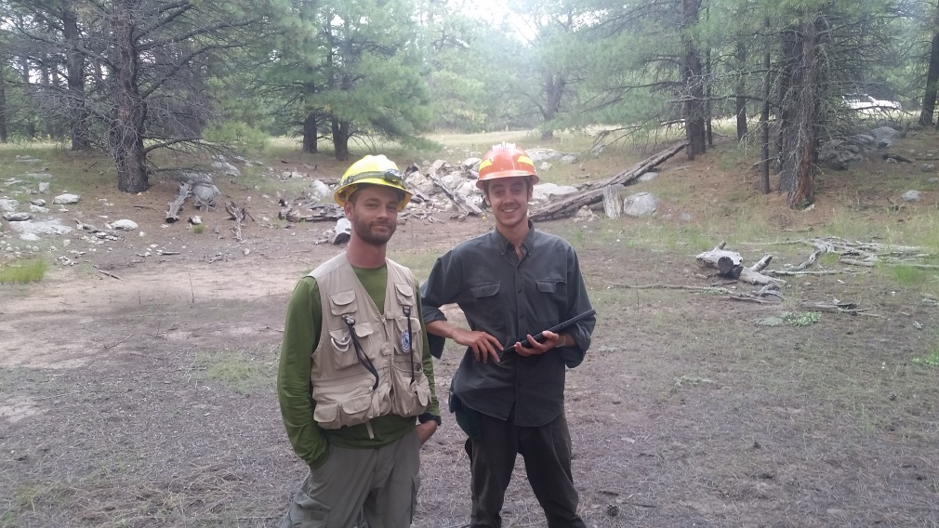
Cragin Project • Karst • Methods • Results • Acknowledgments
Field Surveying Methods and Data Collection
Driving and GPS guided hiking.
At site: Observation, discussion, note taking/sketches, and Samsung tablet use.
ArcGIS program ArcCollector.
Geodatabase set up for rapid inventory and analysis.
Photos of the feature.
Necessary to sync tablet with ArcGIS Online.
Data can be downloaded and analyzed.
Long hours in the field.

Slide 10
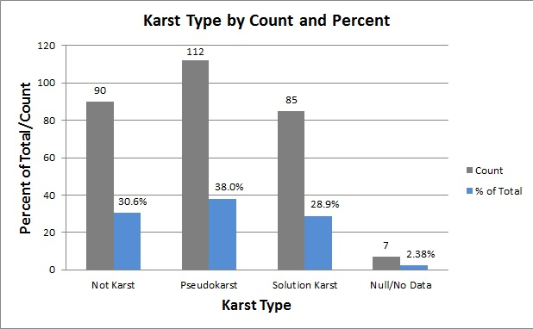
Cragin Project • Karst • Methods • Results • Acknowledgments
Results: Data

Slide 11
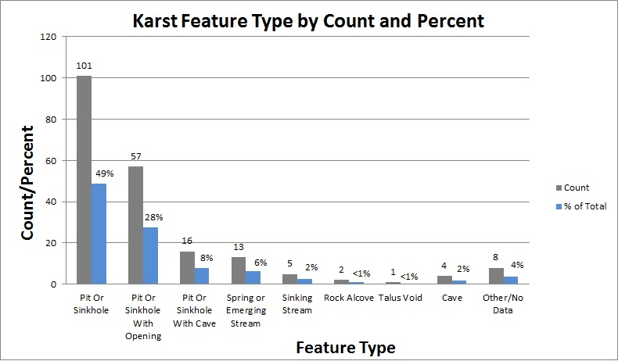
Cragin Project • Karst • Methods • Results • Acknowledgments
Results: Data Cont.
Variety of Karst types recognized within the C.C. Cragin Project area.

Slide 12
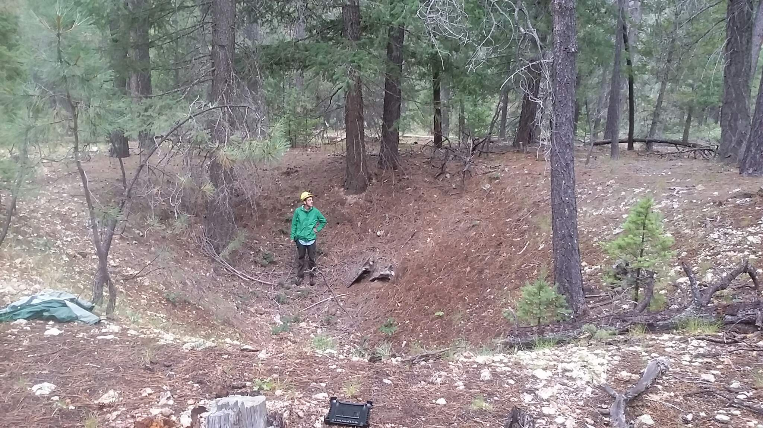
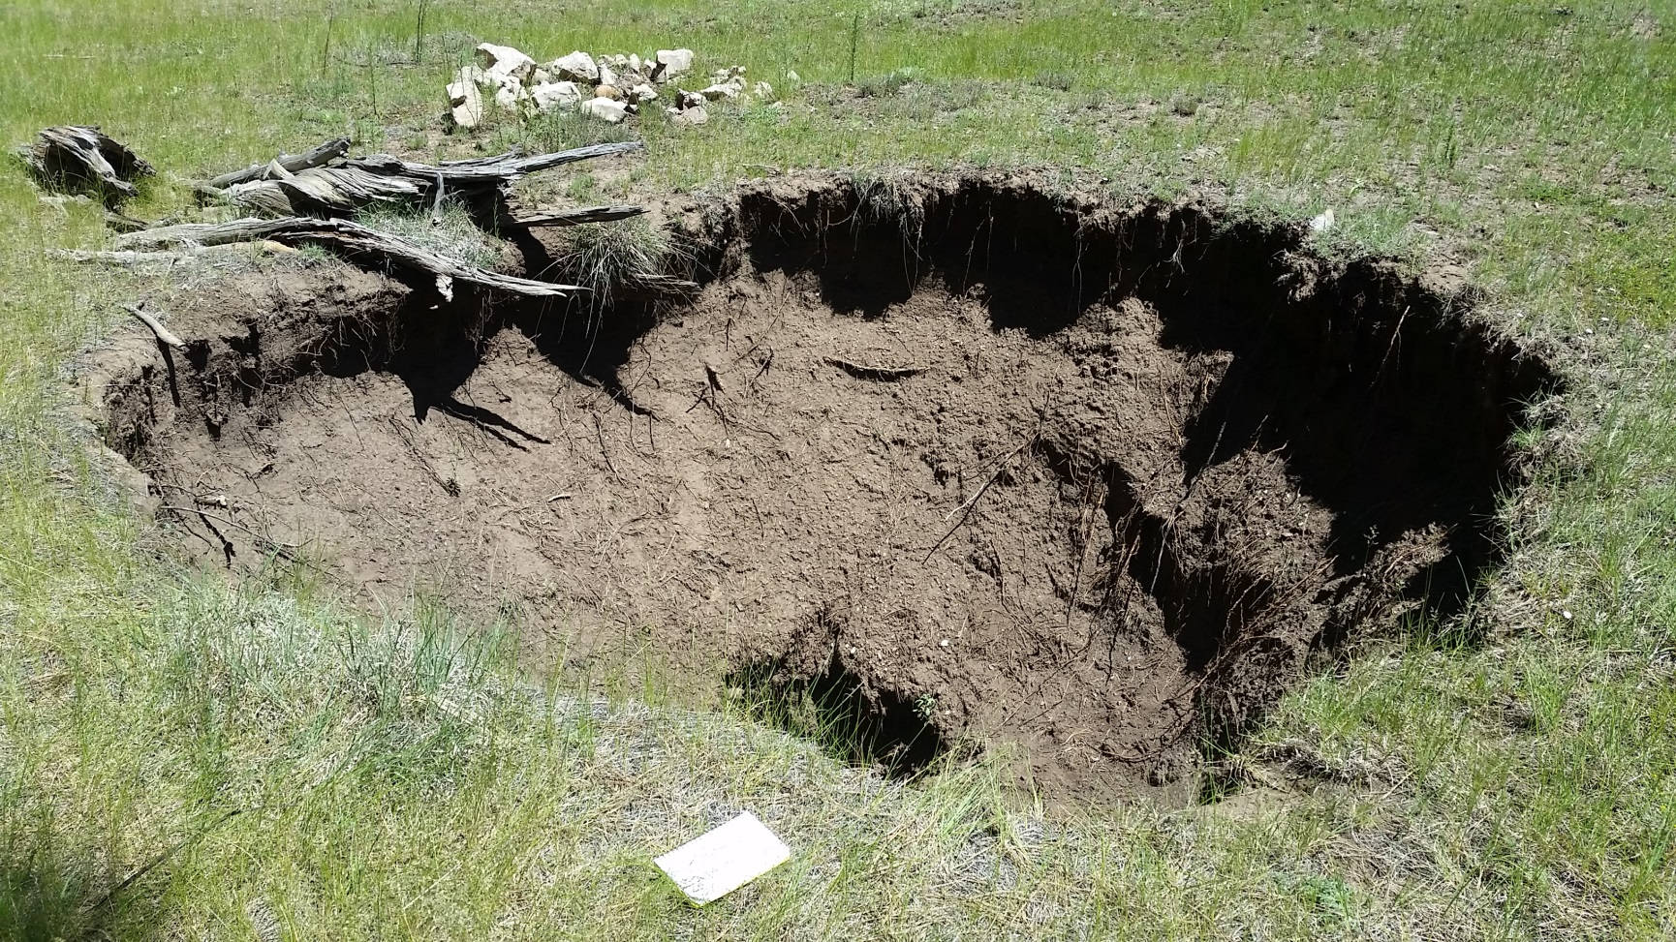
Cragin Project • Karst • Methods • Results • Acknowledgments
Solution Karst Sinkhole

Slide 13
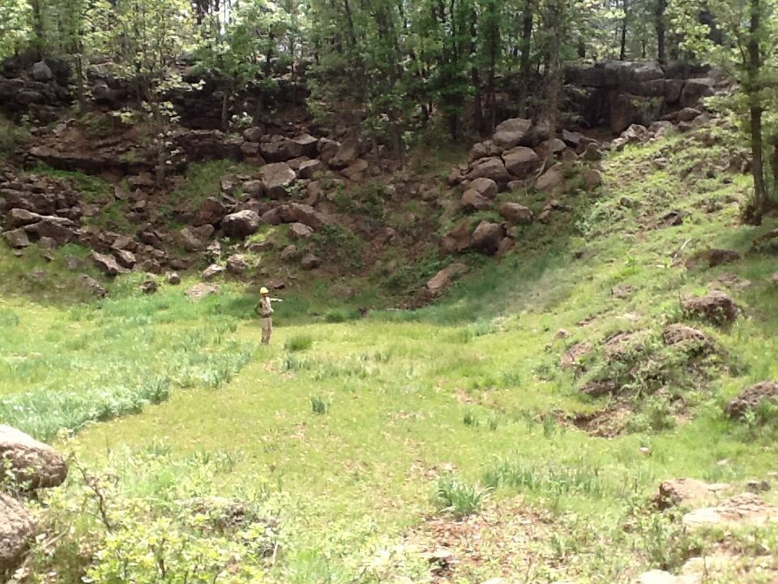
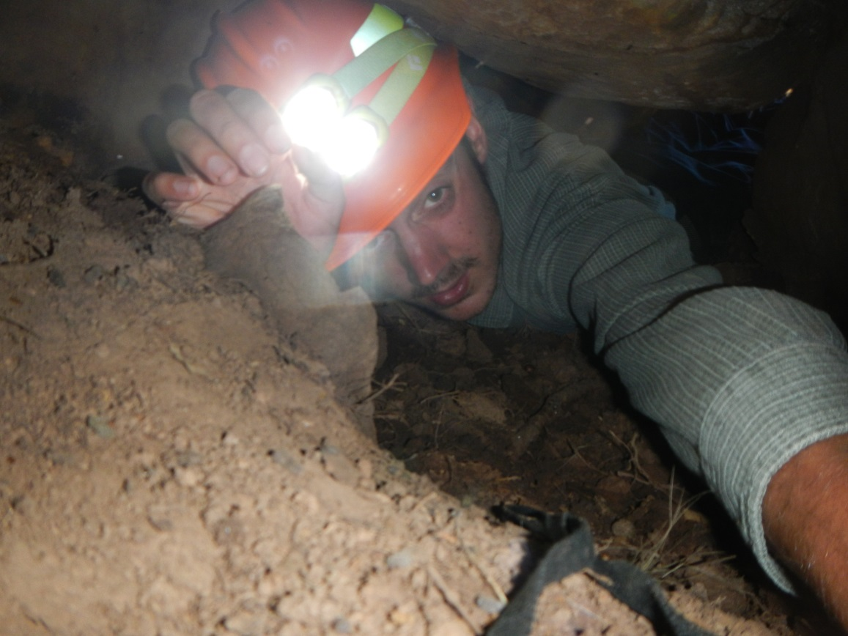
Cragin Project • Karst • Methods • Results • Acknowledgments
Pseudokarst Sinkhole

Slide 14
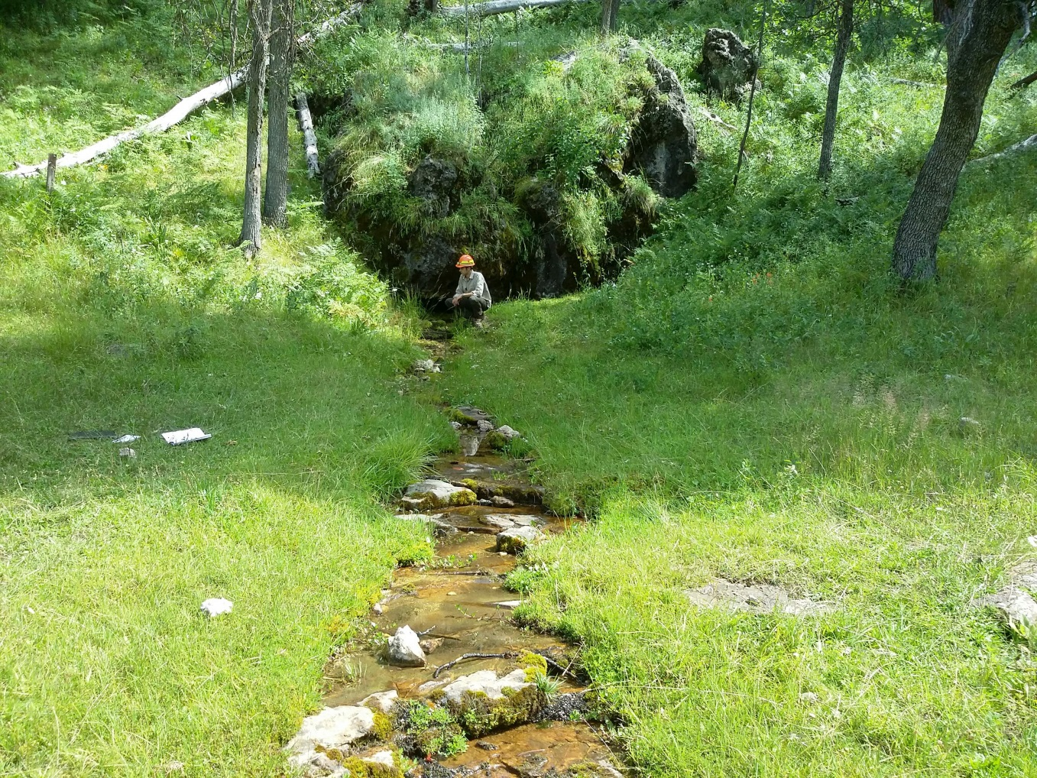
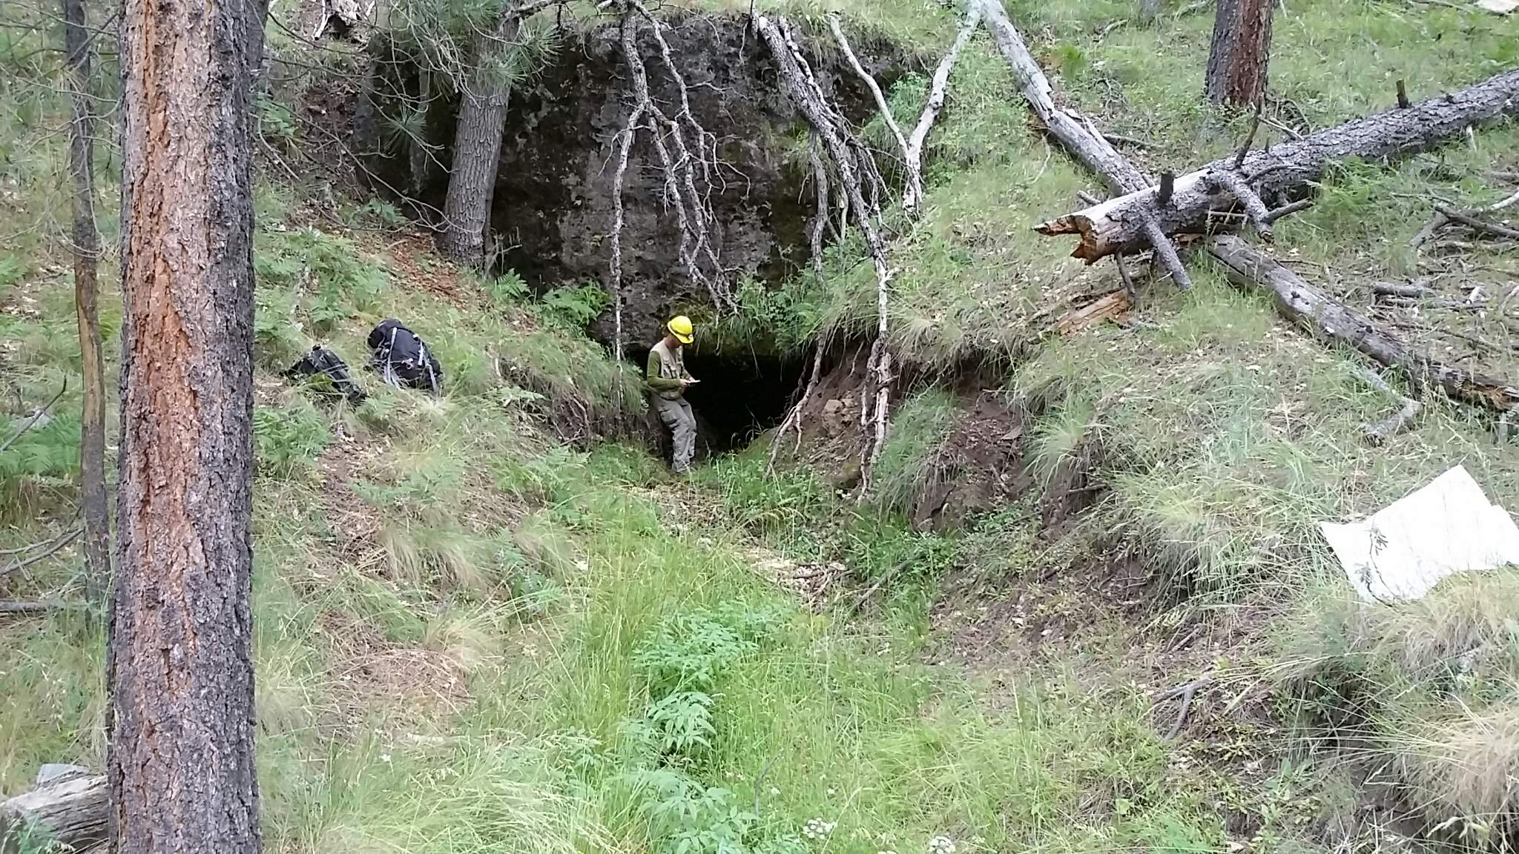
Cragin Project • Karst • Methods • Results • Acknowledgments
Emerging Stream (Spring)

Slide 15
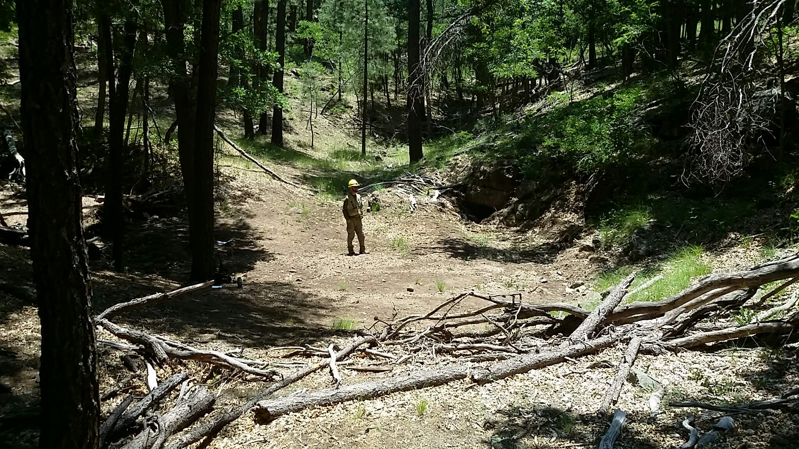
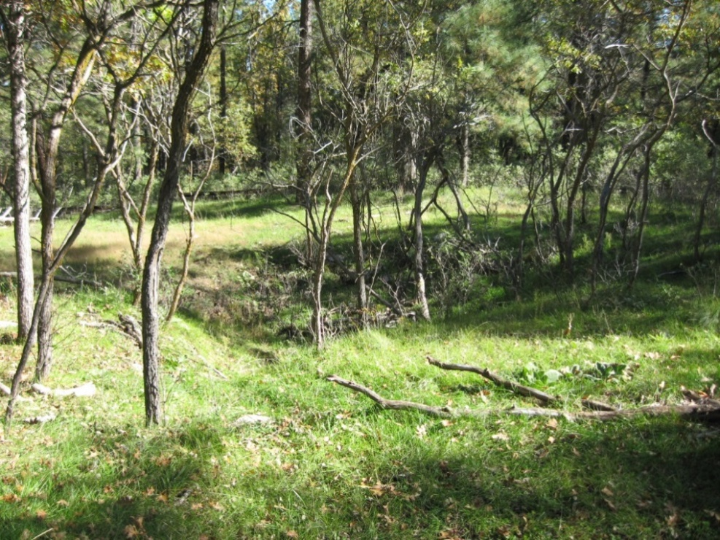
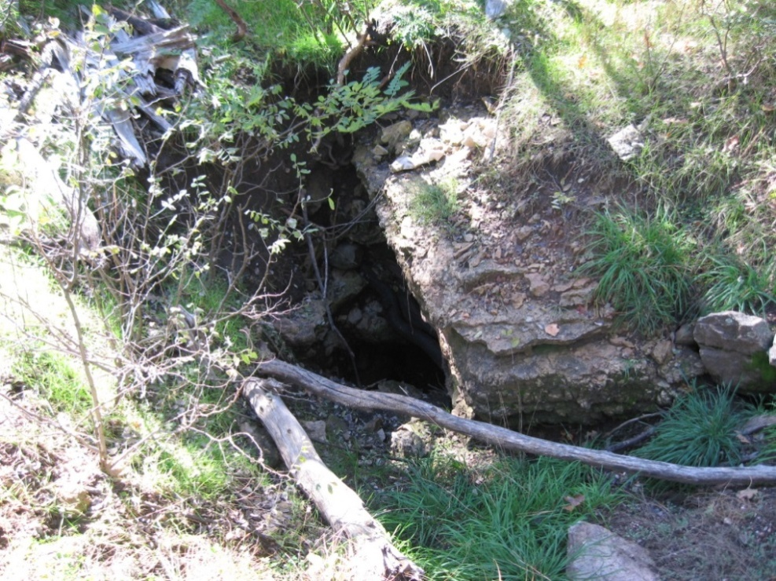
Cragin Project • Karst • Methods • Results • Acknowledgments
Sinking Stream

Slide 16
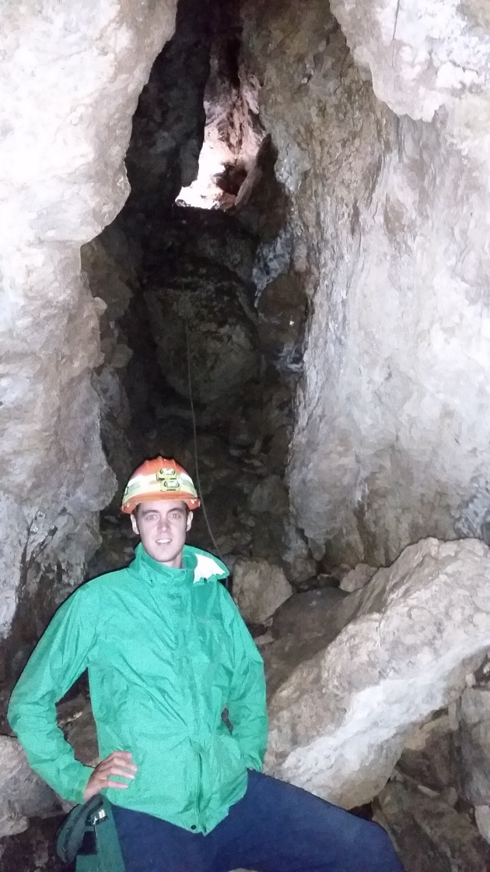
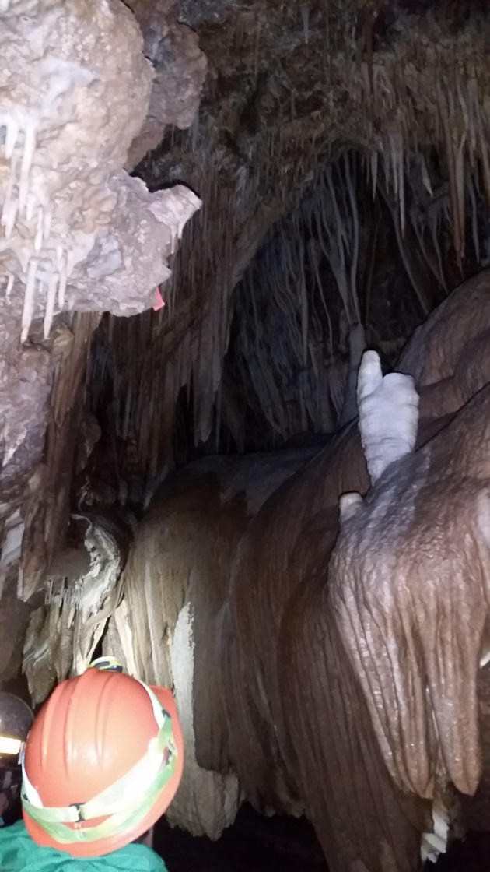
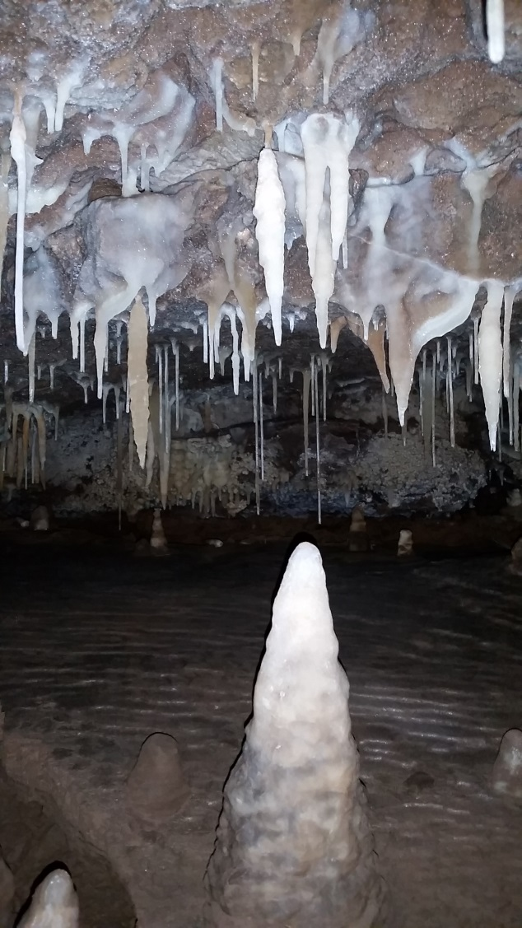
Cragin Project • Karst • Methods • Results • Acknowledgments
Caves: Kaibab Caverns
9,000 ft. long solution karst cavern system.

Slide 17
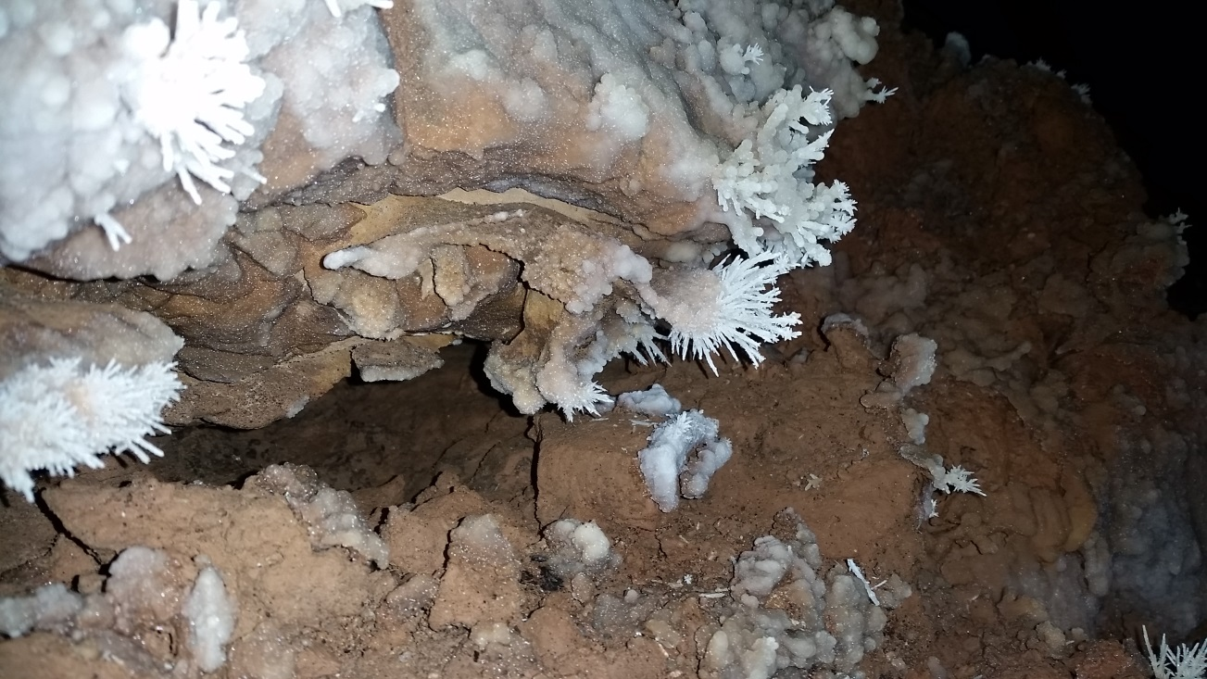
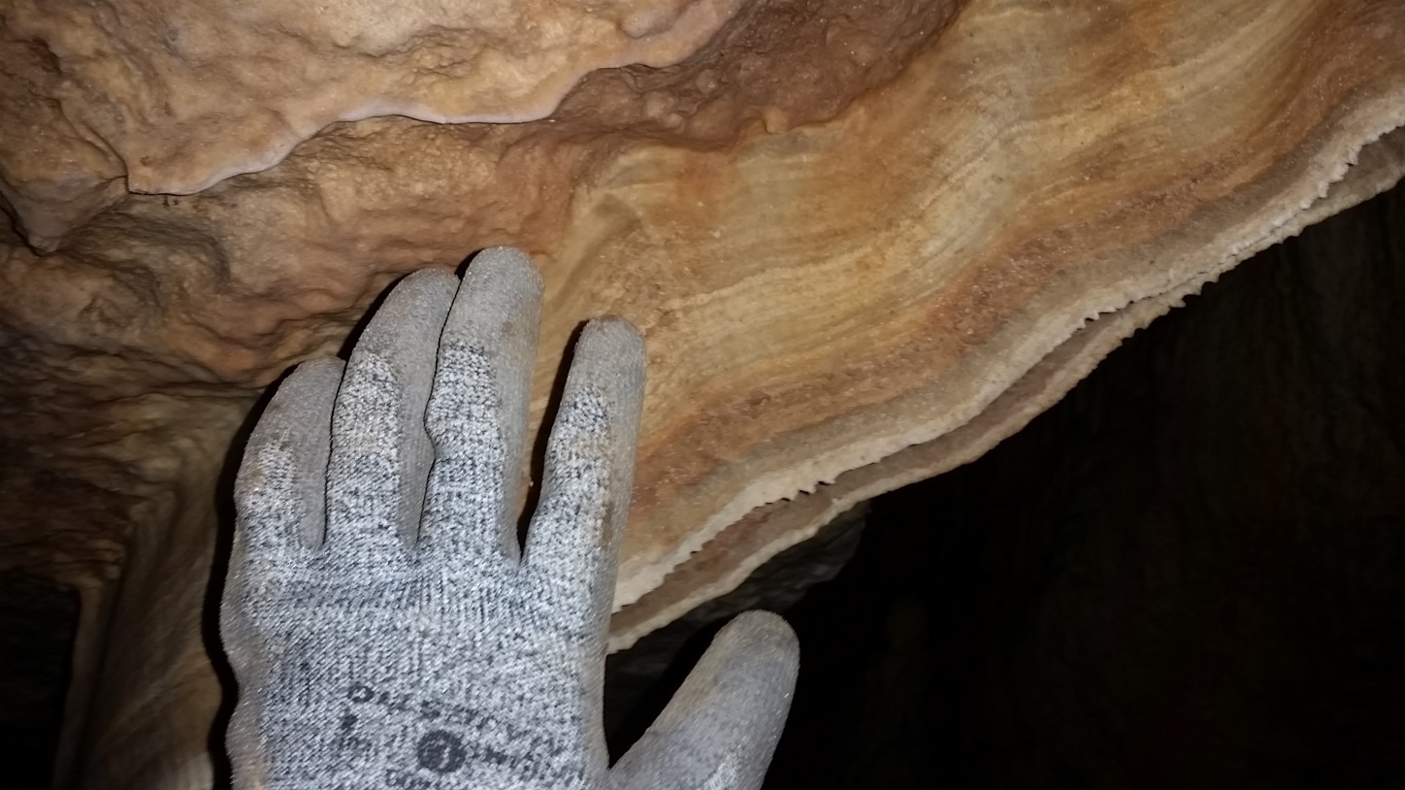
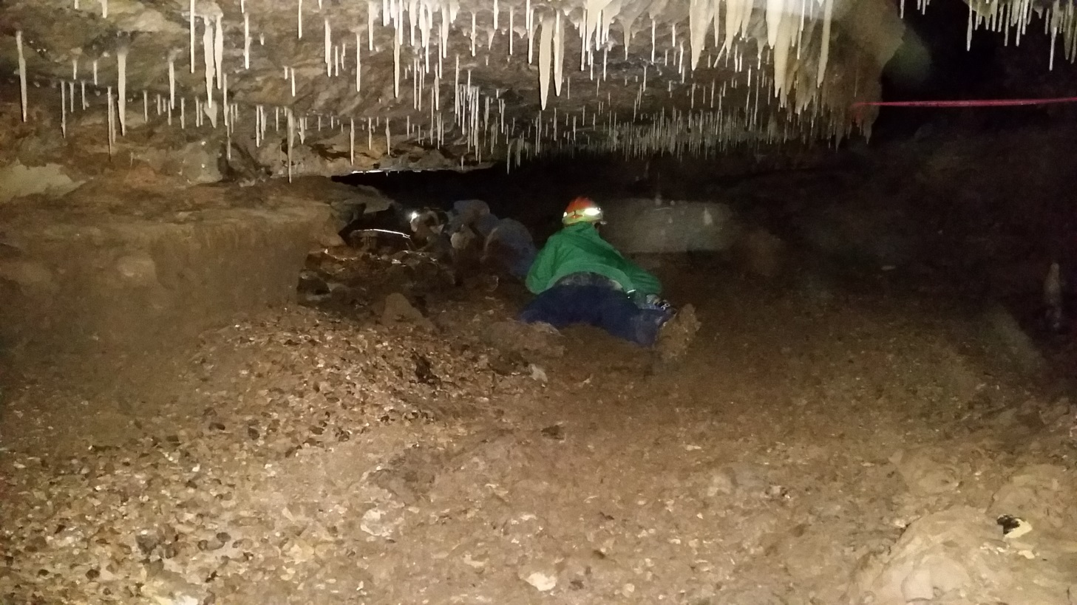
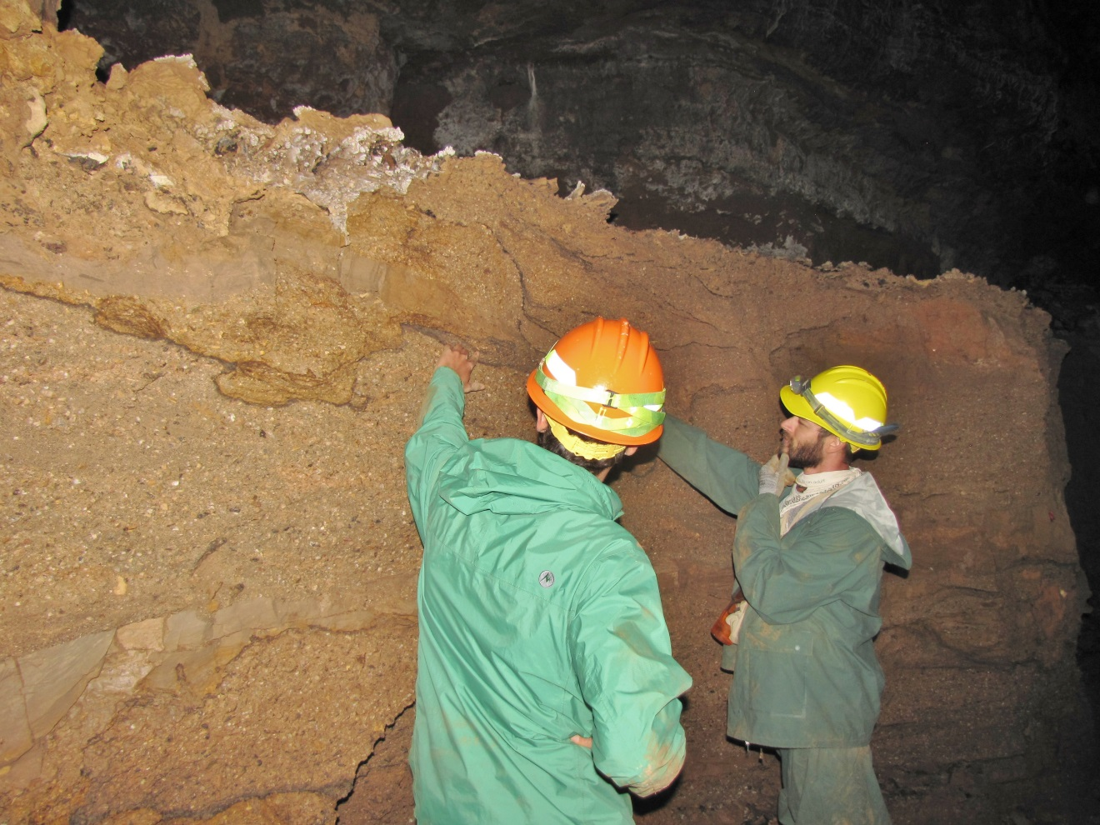
Cragin Project • Karst • Methods • Results • Acknowledgments
Caves: Kaibab Caverns Cont.

Slide 18
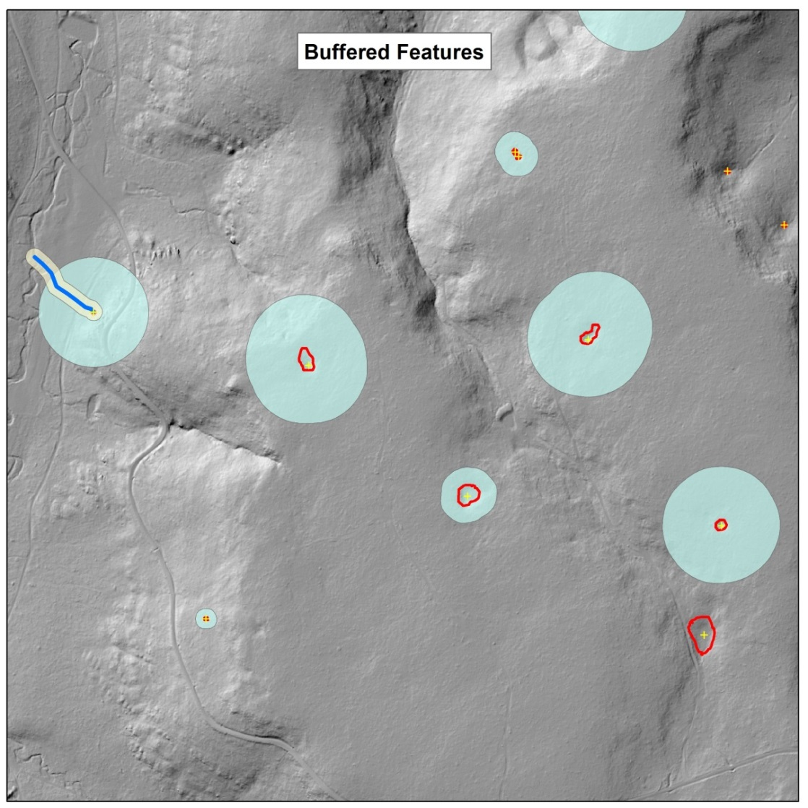
Cragin Project • Karst • Methods • Results • Acknowledgments
Data Analysis and Final Production
Data downloaded from ArcGIS Online, ArcMap used to re-digitize boundaries, assign buffer.
Level of importance assigned to each feature.
Stream channels buffered.
Final maps distributed to Forestry Planners.

Slide 19
Cragin Project • Karst • Methods • Results • Acknowledgments
Acknowledgments
Polly Haessig. GSA GeoCorps/USFS Mentor
Carl Beyerhelm. Resource Information and GIS Specialist
GSA and the USFS
Diggin Deep and Beneath the Forest
Blue Ridge Ranger Station crew
The Arizona Cave Survey crew
Mike Van Note, Larry Zimmer, Tom Gilliland, and Bob Goforth
Those who assisted us in the field:
Olivia Tempest (Coconino Forestry)
Kevin Weldon and Frances Alvarado (Prescott Ntl. Forest Geologists)
Ron Klawitter (SRP) and OC Eke (Kaibab Ntl. Forest Geologist)
Charlie Ester III (SRP)
Nicholas Steel (Happy Jack)

Slide 20
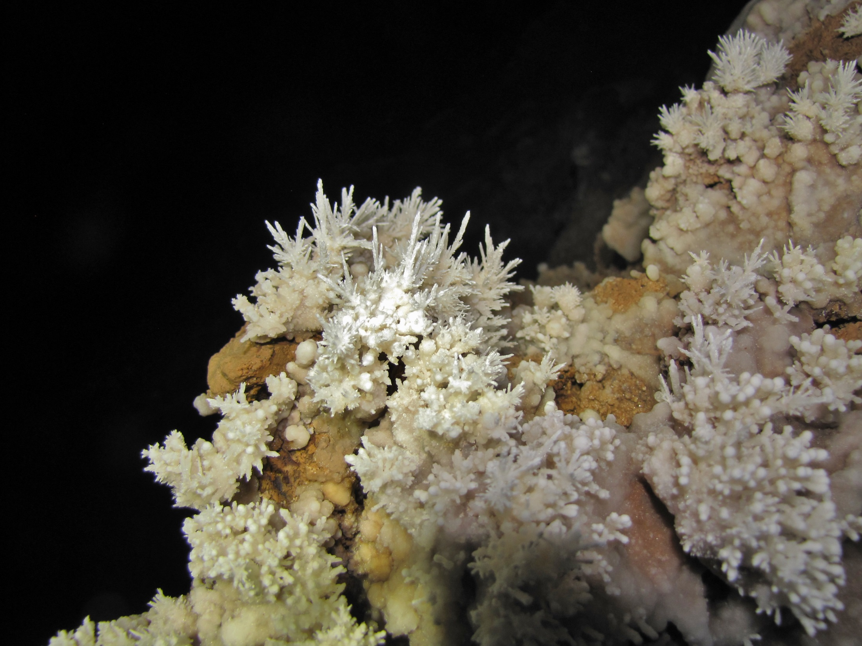
Thank you!

