Slide 1



The EarthLabs Climate Series: Supporting Students Understanding of Change Over Time and Space
Kathy Ellins, Tamara Shapiro Ledley, Karen McNeal,
Nick Haddad, Julie Libarkin, Erin Bardar,
Betsy Youngman, Candace Dunlap, Jeff Lockwood,
Susan Lynds, Anne Gold
With
funding
from

Slide 2
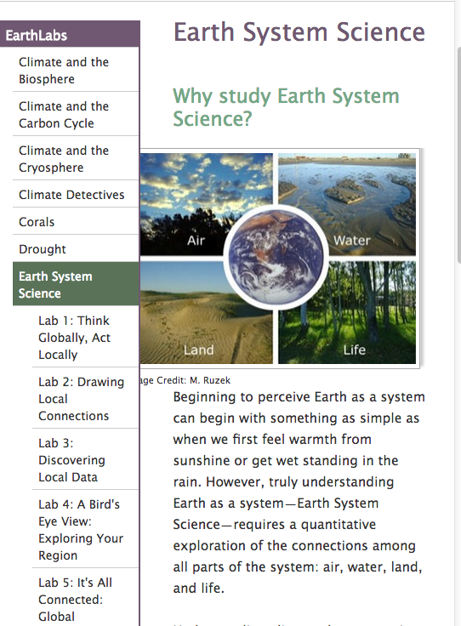
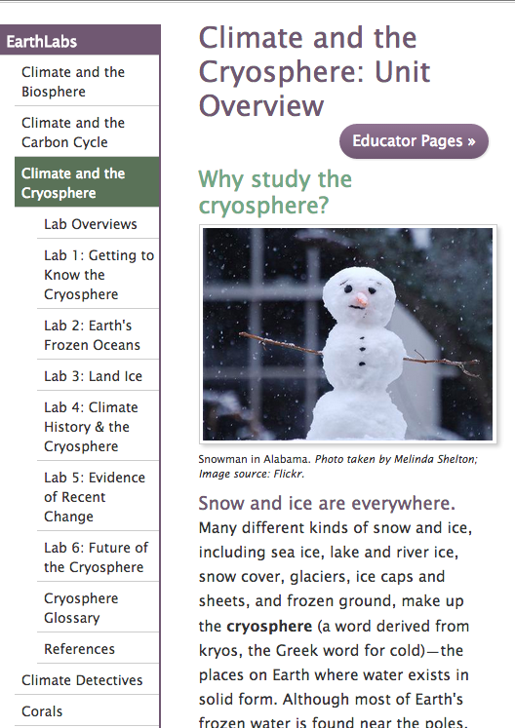
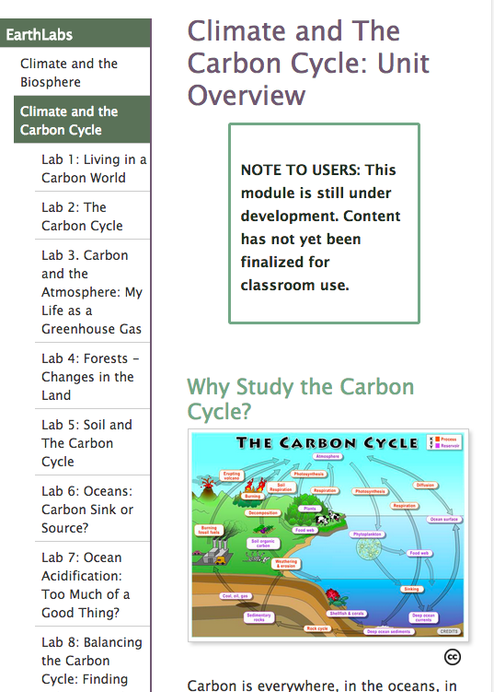
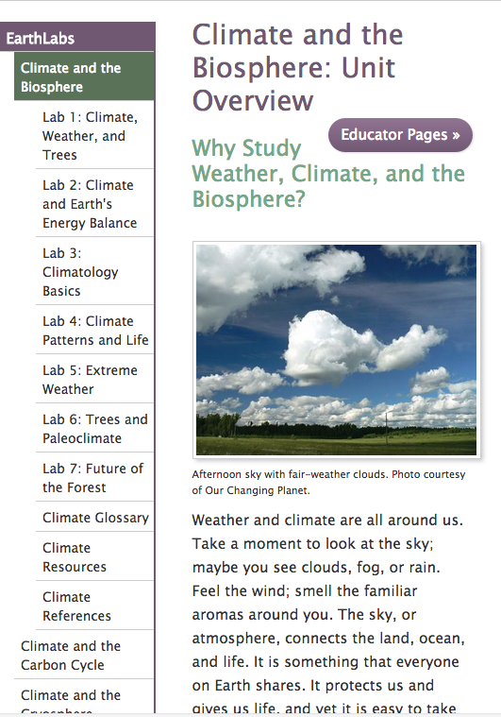
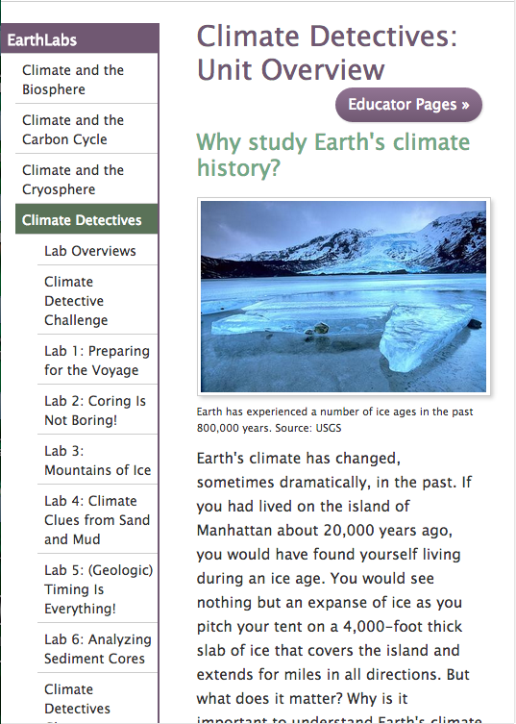
EarthLabs Climate Modules http://serc.carleton.edu/earthlabs/index.html
Project Components
Curriculum Development Professional Development Educational Research on Student Learning
Ellins et al, Journal of Geoscience Education, vol 62, No. 3, pp307-318, Sept 2014
McNeal et al, Journal of Geoscience Education, vol 62, No. 4, pp560-577, Nov 2014
Notes:
EarthLabs provides rigorous and engaging Earth and environmental science labs and teacher professional development.
The EarthLabs collection comprises eight online modules that recognize the interconnectedness of Earth’s systems and climate forcing, and are designed to promote creativity, collaboration, and interest in cutting-edge science.
Each three-week EarthLabs module contains between six and nine rigorous sequenced laboratory experiences (learning activities) that include hands-on experiments, data analysis, and critical thinking (Ledley et al. 2012; McNeal et al., 2013). Learners examine satellite imagery, numerical data, computer visualizations, and data products to build quantitative skills that enable them to objectively evaluate scientific findings for themselves.
Key climate-related themes that cut across all three modules include:
the Earth system, with the complexities of its positive and negative feedback loops;
the range of temporal and spatial scales at which climate, weather, and other Earth system processes occur; and
the recurring question, “How do we know what we know about Earth’s past and present climate?” This question introduces students to proxy data, scientific instrumentation, and modeling.
A website with a student portal and a teacher portall. Web-based support. The EarthLabs Teacher’s Guide contains pedagogical and background information to support teacher use of each lab in their classroom, as well as a direct link to the student activities for the lab.

Slide 3
9 Modules comprised of 5-9 labs each in Earth and climate science
Modules illustrate sequences for learning science concepts through data analysis and hands-on experiments.
Use satellite imagery, numerical data, and computer visualization software to explore Earth system processes
Include the use and development of quantitative skills that enable students to evaluate scientific results for themselves.

Slide 4
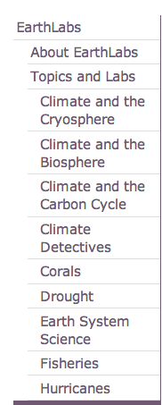
• Time requirement: 12 – 14 hours
• Each module uses a variety of instructional strategies
- readings
- videos, animations
- interactive visualizations
- hands-on lab investigations
- data analysis
- classroom discussions
http://serc.carleton.edu/earthlabs/index.html
Notes:
But…anyone can cherry-pick the specific pieces that they think will support a program they currently use.

Slide 5
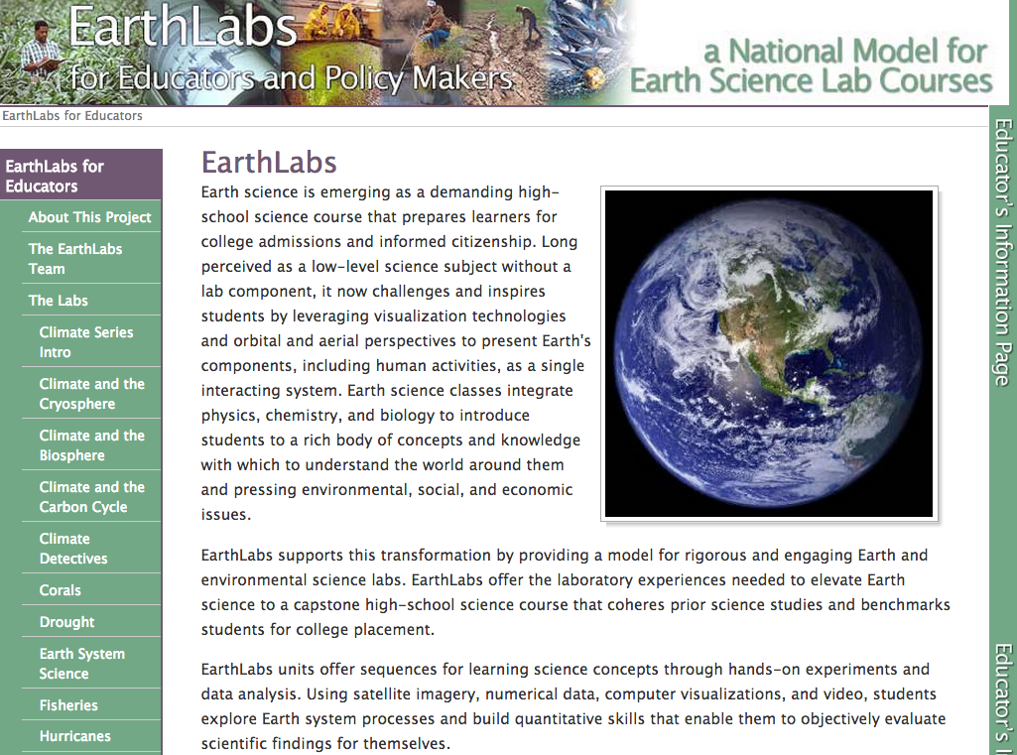
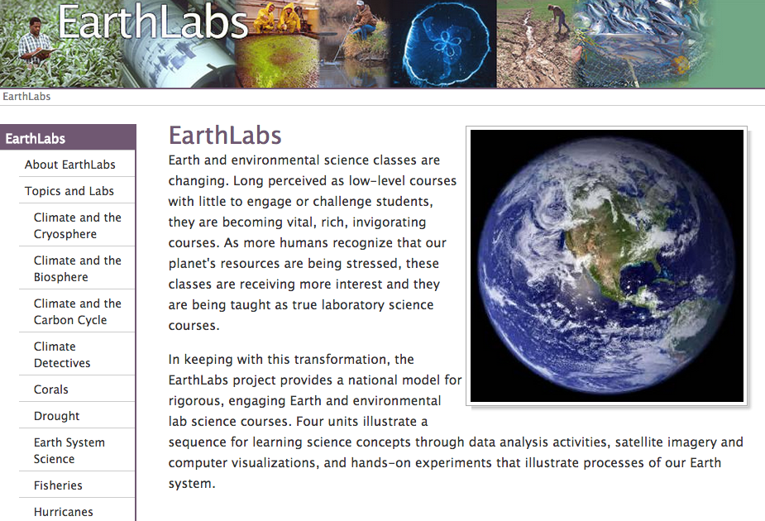
EarthLabs website has 2 Parts
Teacher Side: http://serc.carleton.edu/earthlabs
Student Side: http://serc.carleton.edu/eslabs

Slide 6
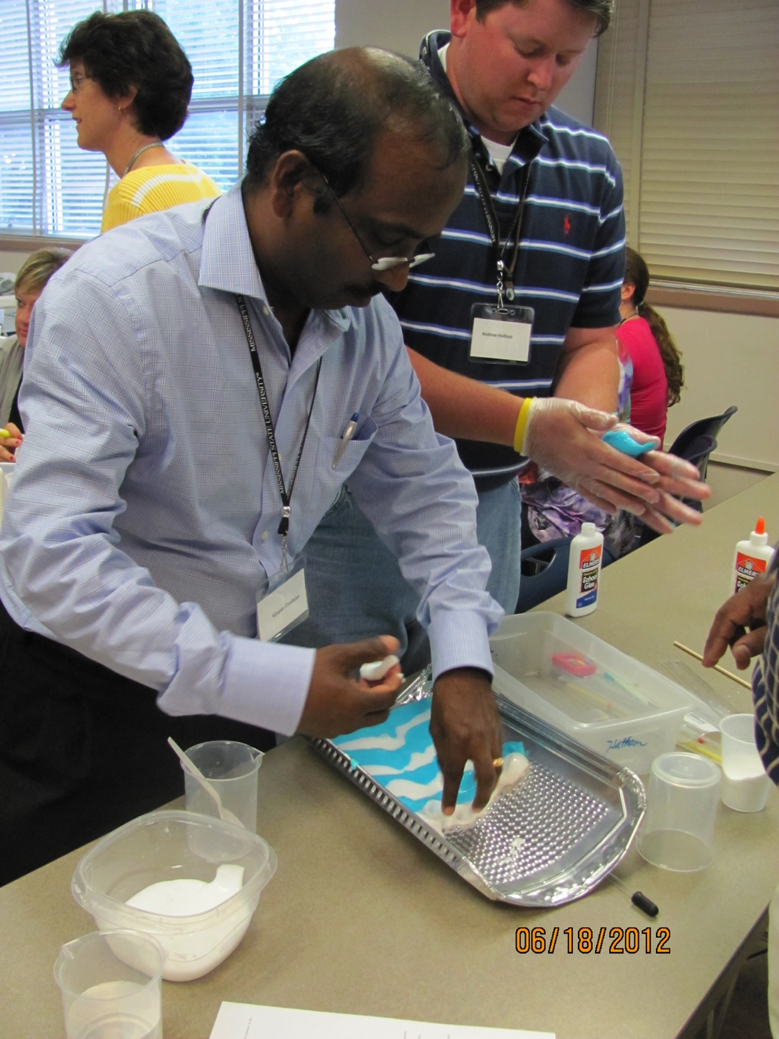
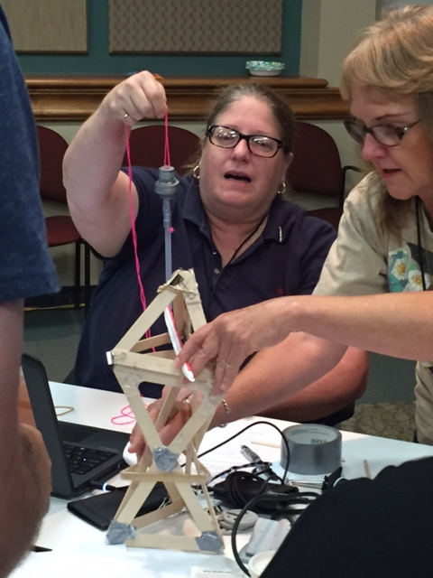
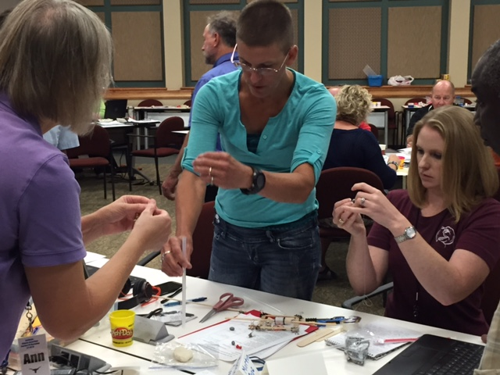
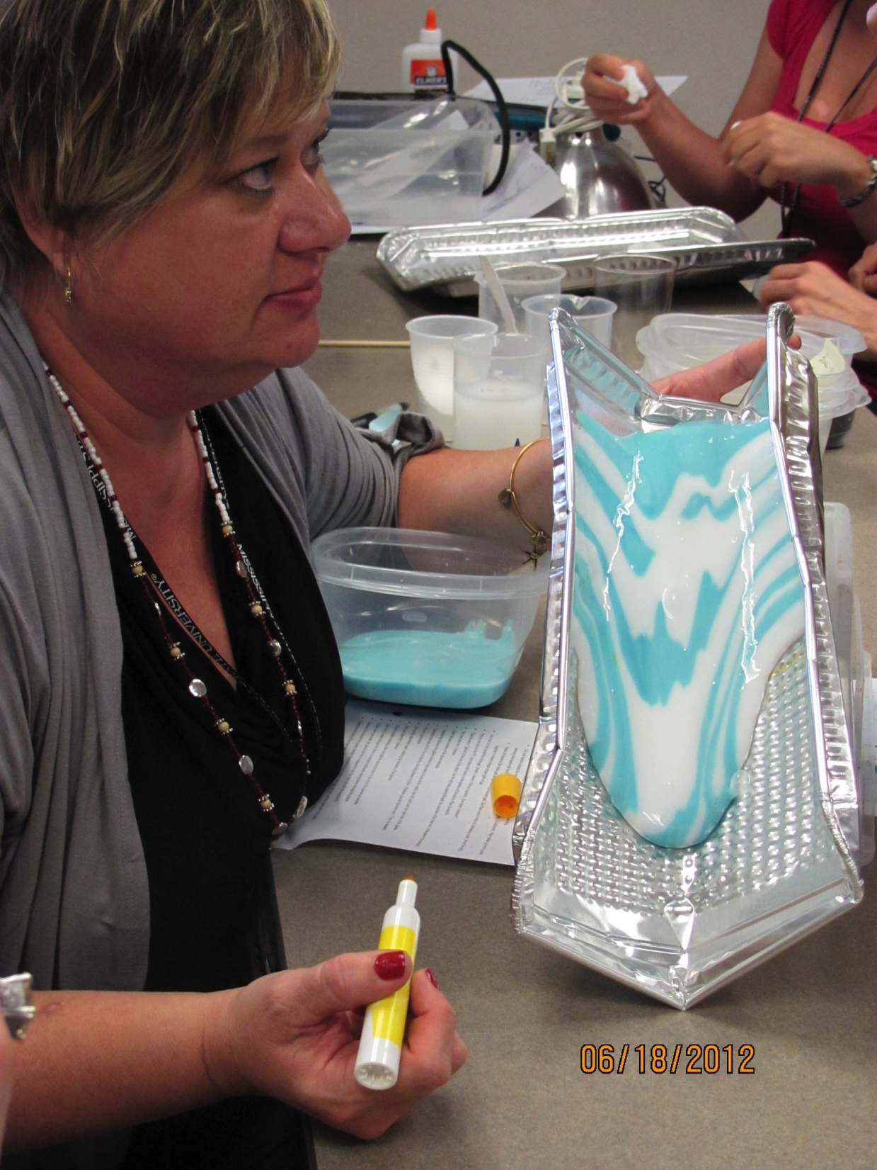
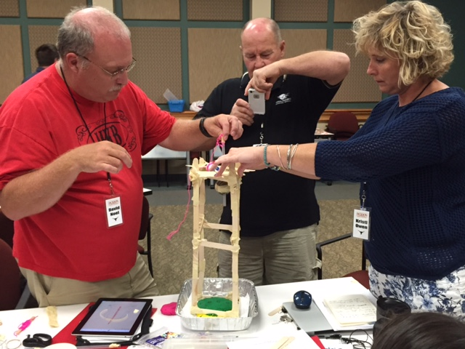
EarthLabs Professional Development Teacher Leaders Facilitating Workshops

Slide 7
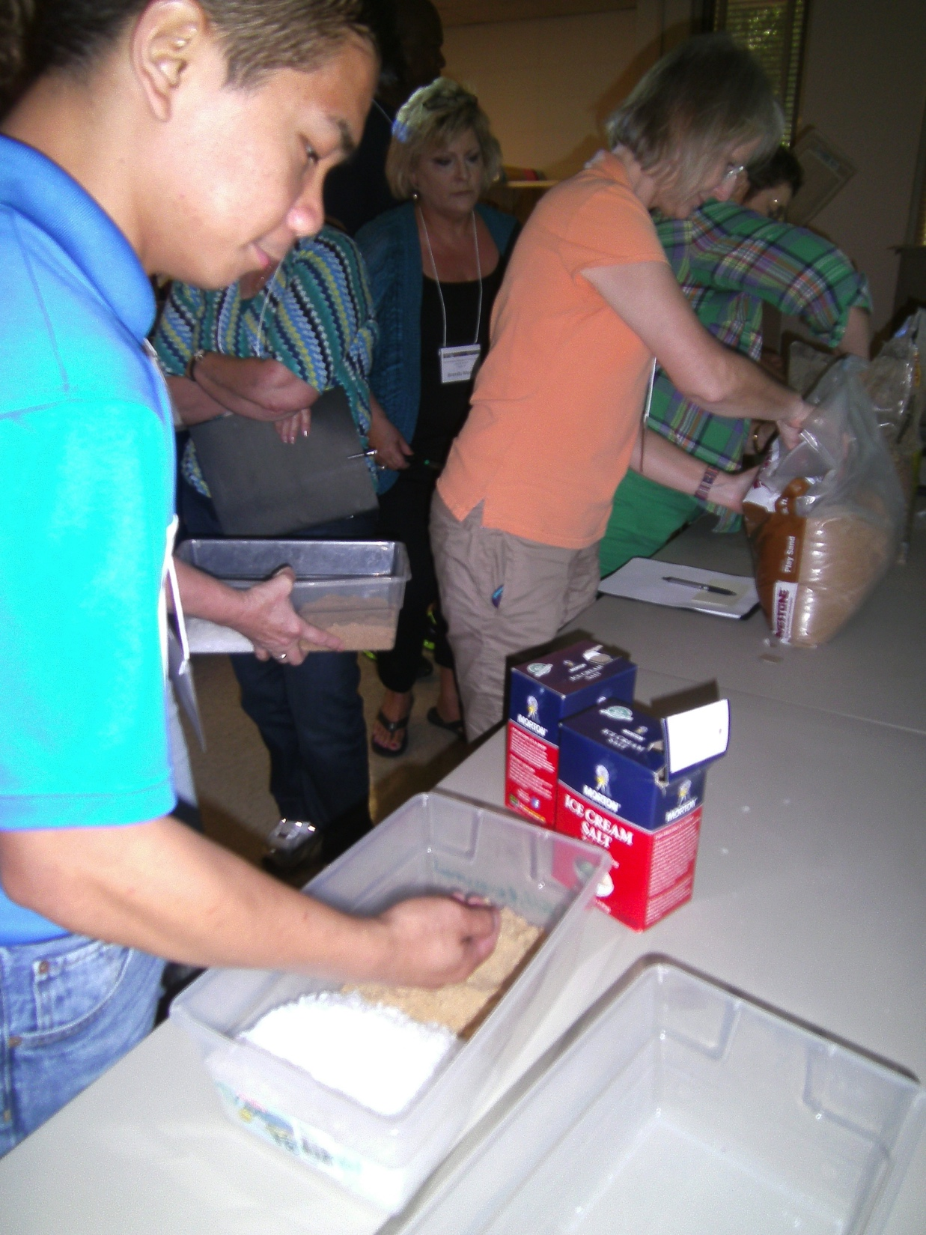
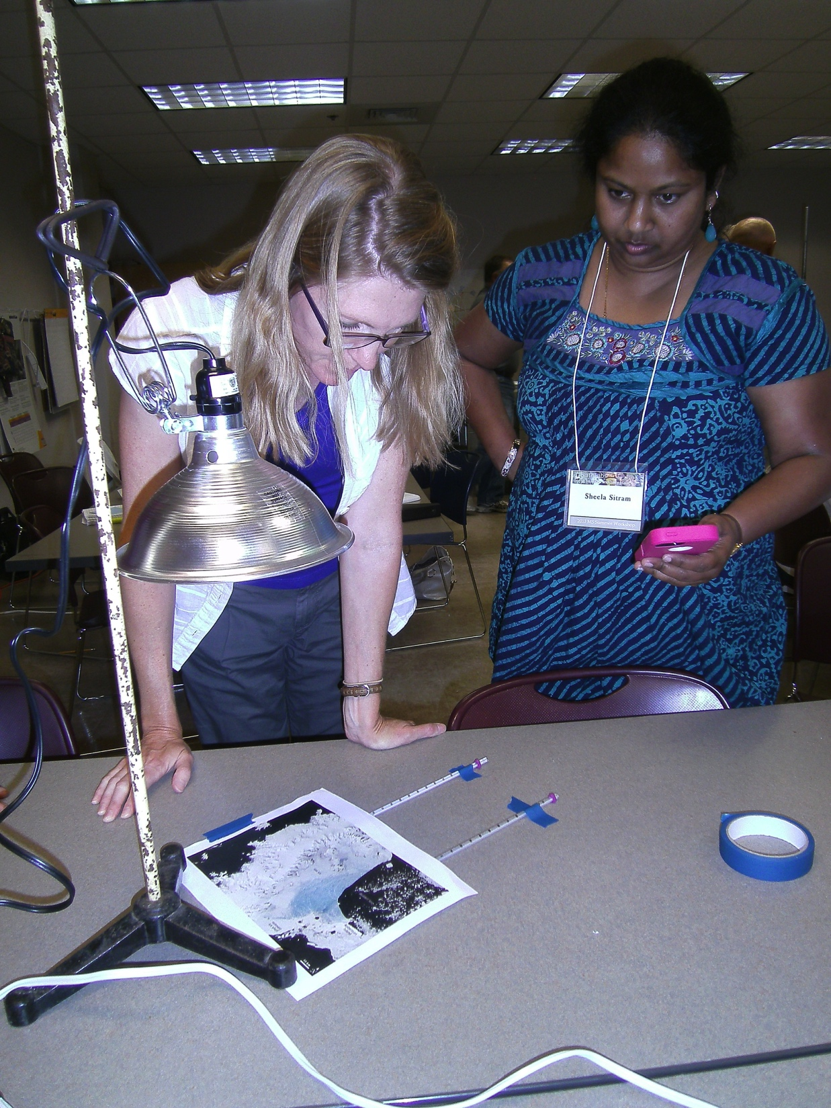
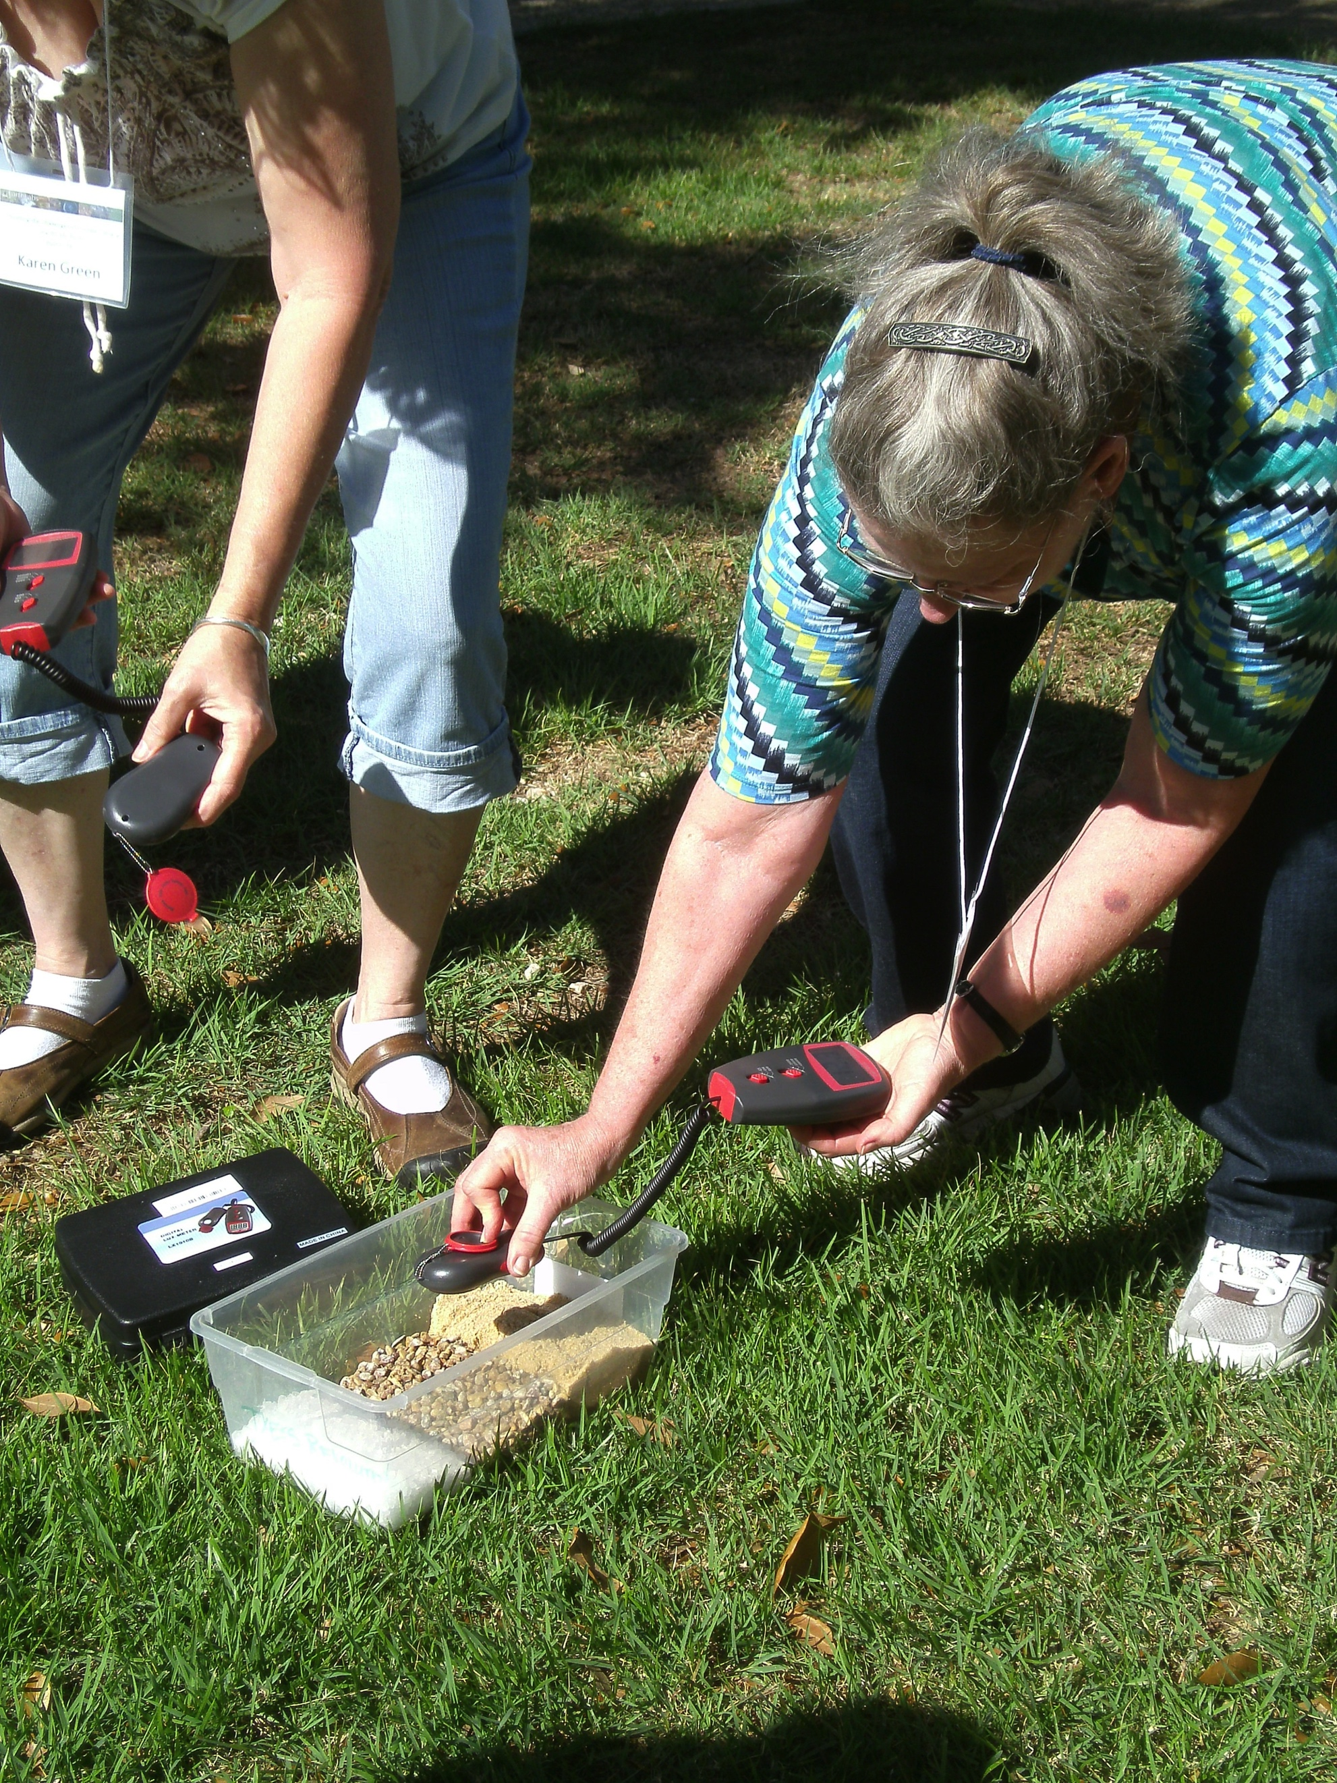
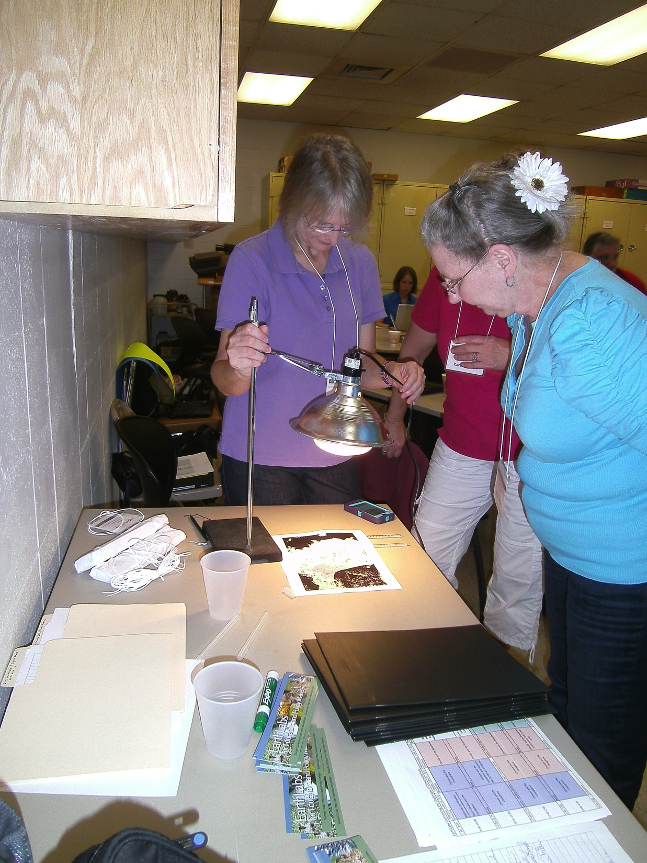
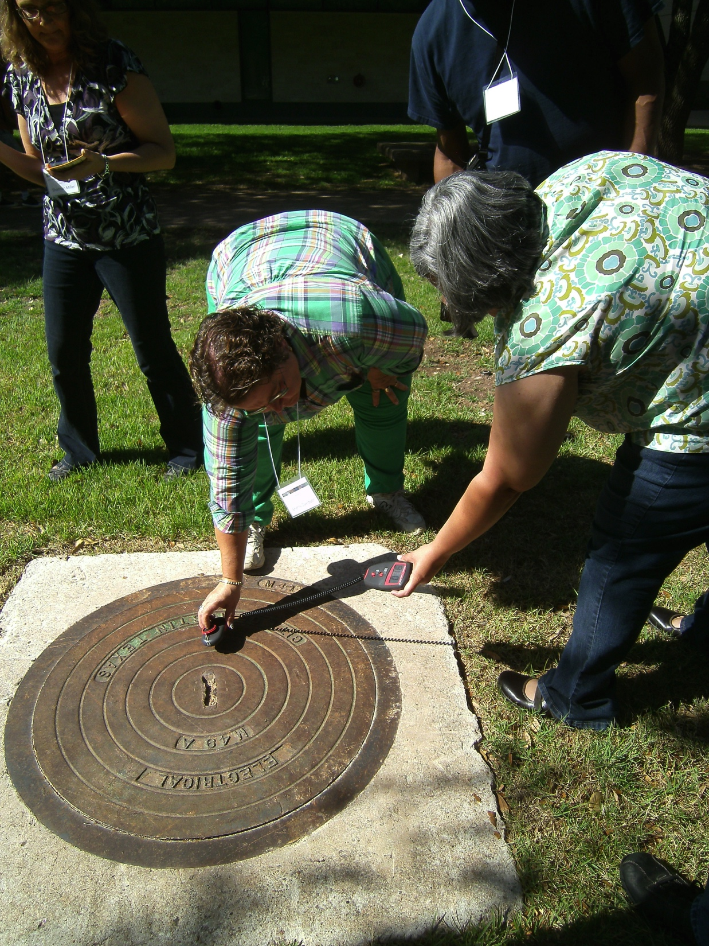
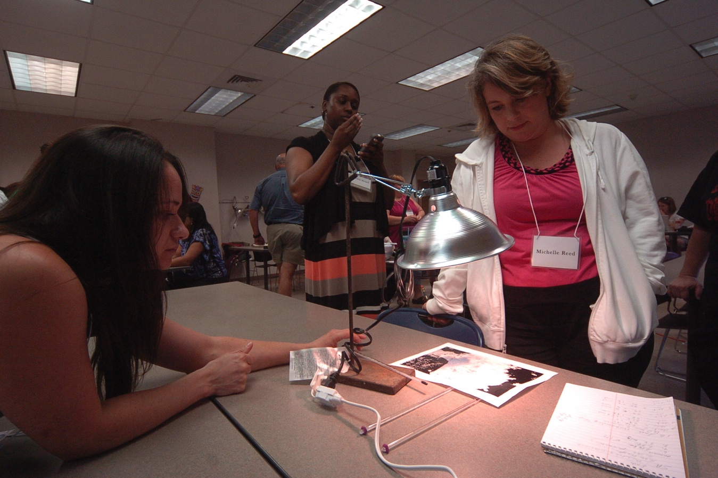
EarthLabs Professional Development Teacher Leaders Facilitating Workshops

Slide 8
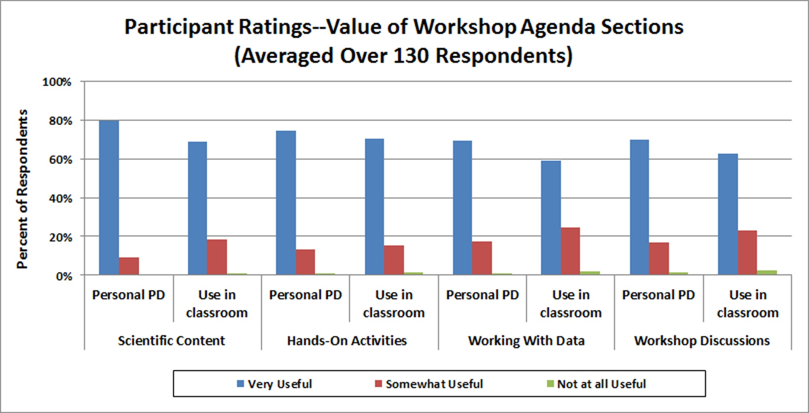
Evaluation Findings
Surveys and interviews with workshop participants between 2012 and 2015 consistently showed that participants found the workshop and the modules valuable for their teaching.

Slide 9
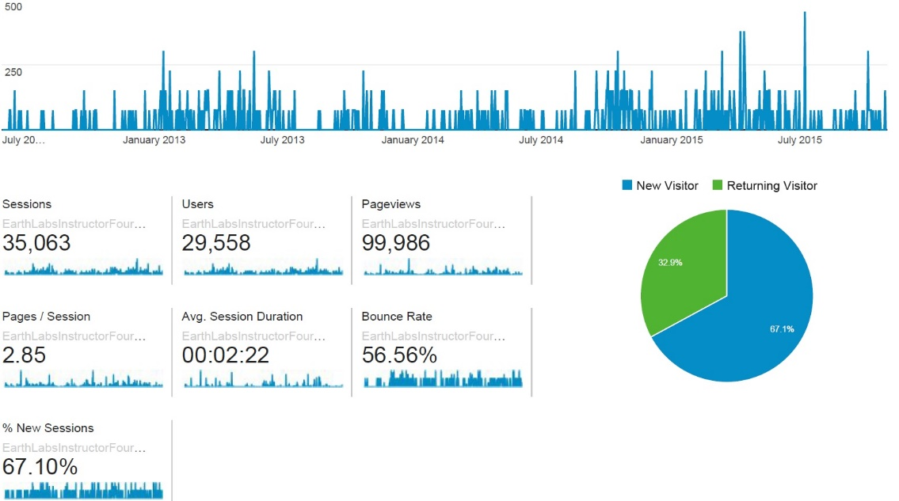
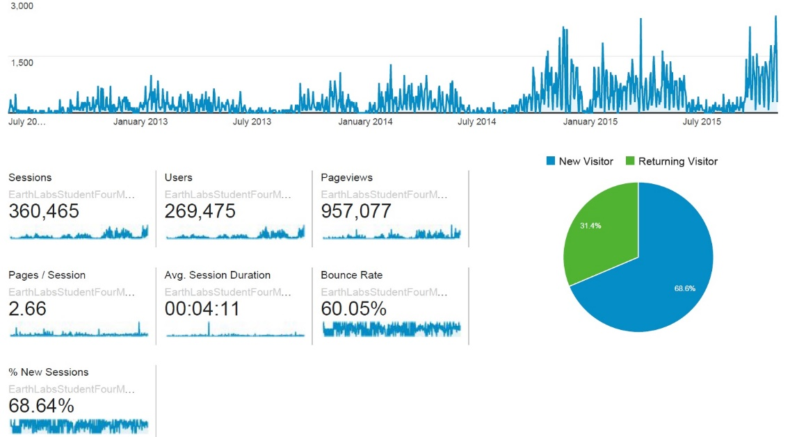
Website Sessions June 2012-October 2015
500
250
Graphs show daily sessions that included a visit to at least one EarthLabs Climate Module page
Student visits average over 4 minutes
Fewer visits during school breaks
Over 30% of visits are return visits
Student site—over 360,000 sessions
Instructor site—over 35,000 sessions
Slowly increasing Instructor visits
Increasing Student visits
Instructor website
3000
1500
Student website

Slide 10
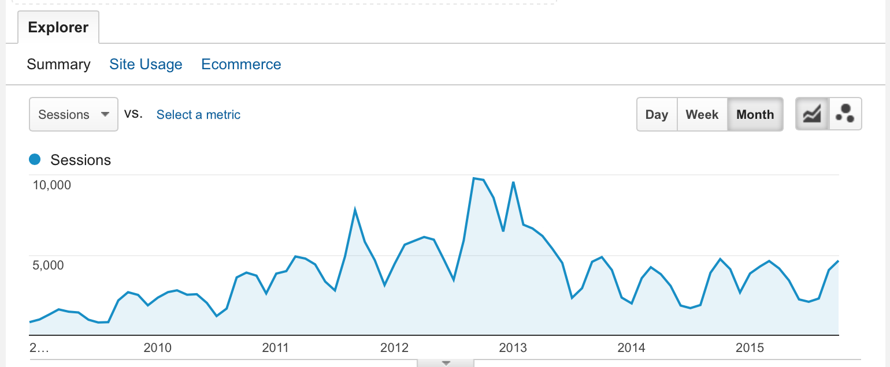
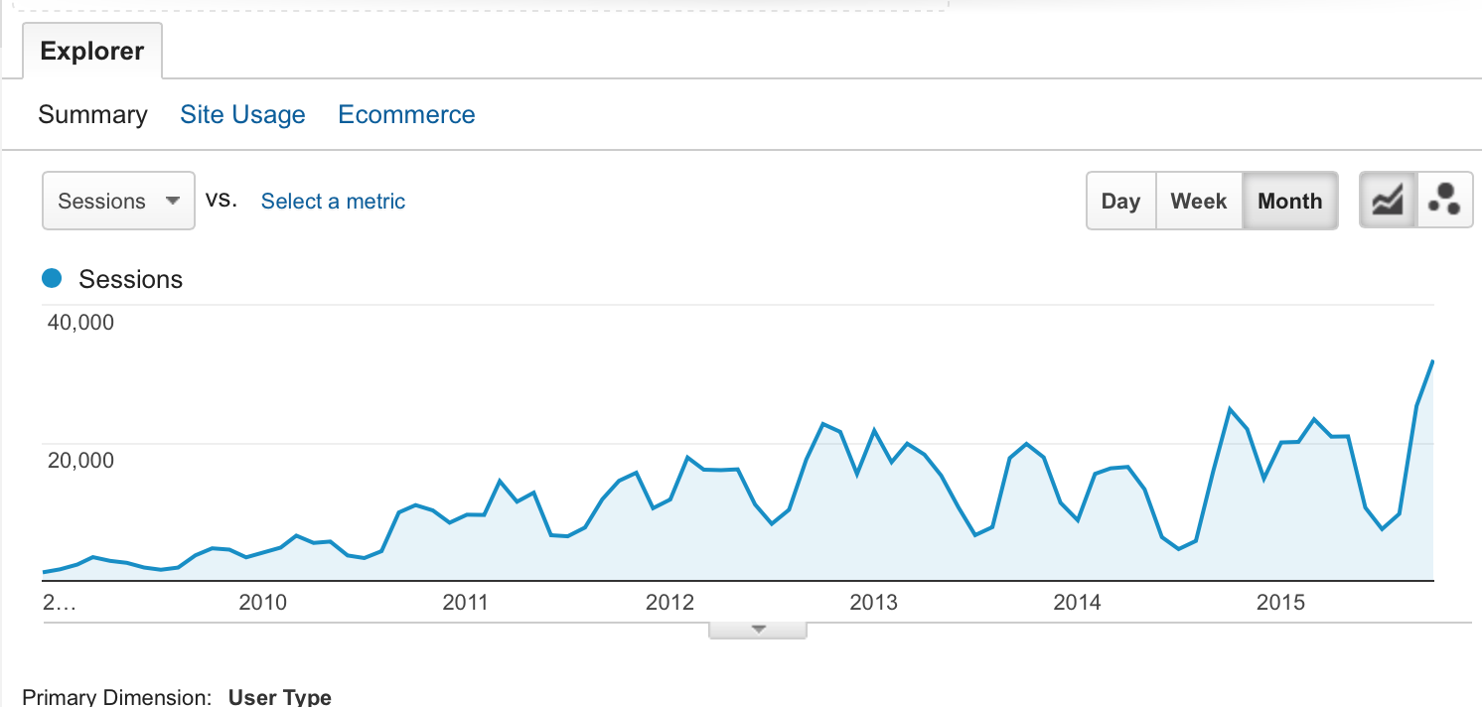
EarthLabs Website Statistics Dec 2008-Oct 2015
Instructor Site 12/1/08-10/31/15
Monthly Sessions
Instructor Site
Total Sessions: 315,748
Returning: 80,654
Engagement
10-30 min: 10,826
>30 min: 2,656
Student Site 12/1/08-10/31/15
Monthly Sessions
Student Site
Total Sessions: 969,726
Returning: 233,101
Engagement
10-30 min: 79,815
>30 min: 31,933

Slide 11
Cognitive Challenges to Understanding Climate Change – Education Research
Earth System Science
Understanding the interconnectedness of all of the components of the system
Changes in one component can have large and unanticipated impacts on other components
Change Over Time on Multiple and Embedded Time Scales
Daily, seasonal, annual, interannual, decadal, century, glacial …
Long-term change manifested as impact on shorter cycles

Slide 12
Preliminary Research Outcomes
Climate & Biosphere, Climate & Cryosphere,
and Climate & Carbon Modules
500 Students in 20 classrooms in Texas and Mississippi
Pre- and Post- Test contained
Content multiple choice questions
Affective-based multiple choice questions
Confidence question
Open ended questions
Positive gains on 90% of content questions (2%-42%)
Significant increase in student confidence in answers
Affective questions – significant gains in knowledge, awareness, and information about the Earth’s climate system

Slide 13
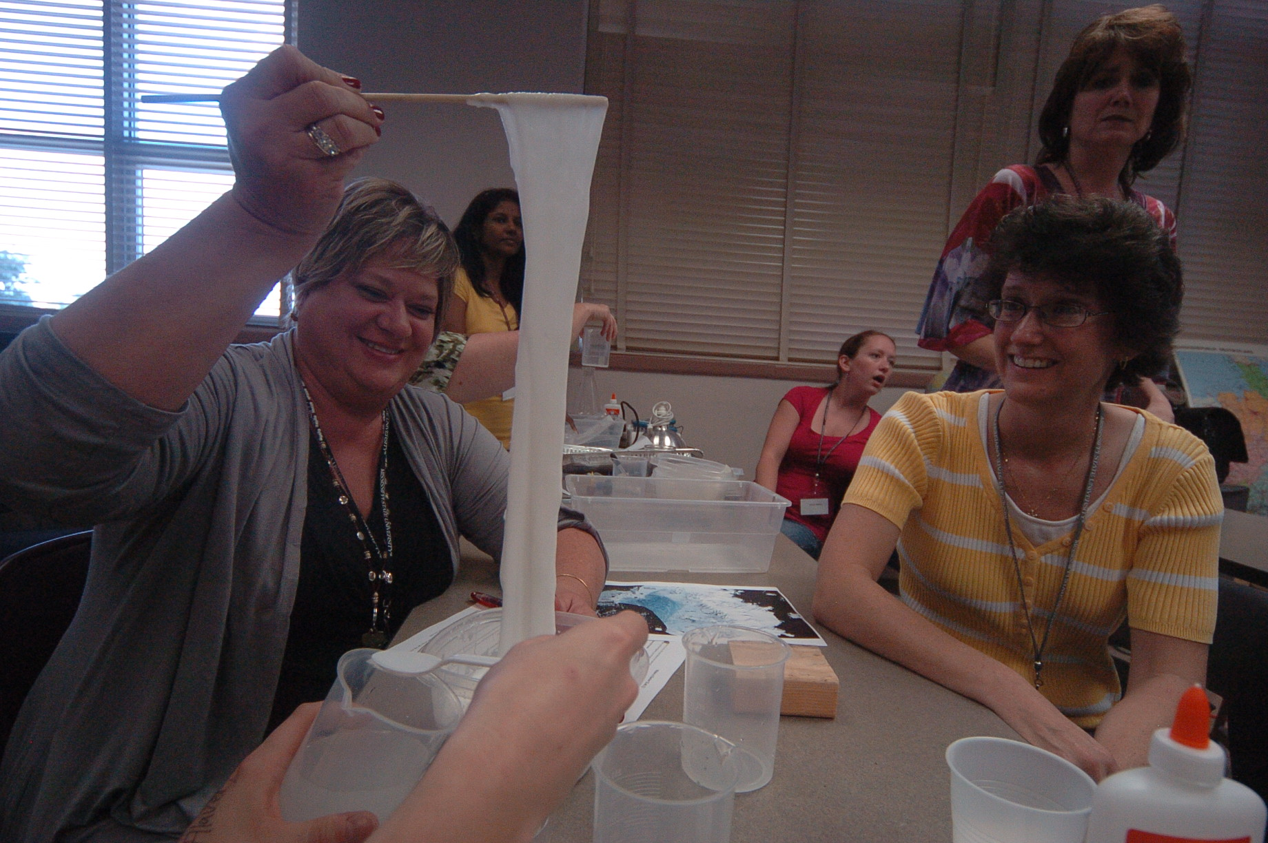


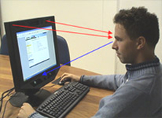
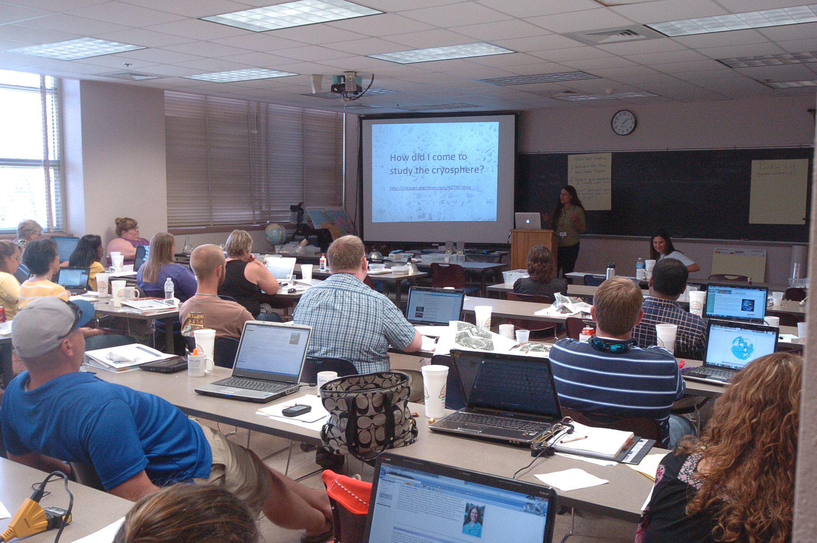
Populations & Methods
Cryosphere & Earth System Science Modules
Teachers (n=8)
Post-implementation Interviews
Post-workshop surveys
Students (n=205)
Pre-post open-ended response surveys
Classroom observations
External Users (n=49)
Eye-tracking
Interviews
http://gettingsmart.com/cms/edreformer/new-report-highlights-real-teacher-retention-crisis-america/
http://www.uxmatters.com/mt/archives/2005/12/introduction-to-eyetracking-seeing-through-your-users-eyes.php
http://www.mnsu.edu/newstudent/seminar/
Notes:
Teacher M:F 1/7 C: 7; H: 1
Student M;F 92/111 C: 87; AA: 27; H: 78; A: 11; NA: 1; O: 1
External users M:F 18/31 C: 48; AA: 5; A: 7: NA: 1

Slide 14
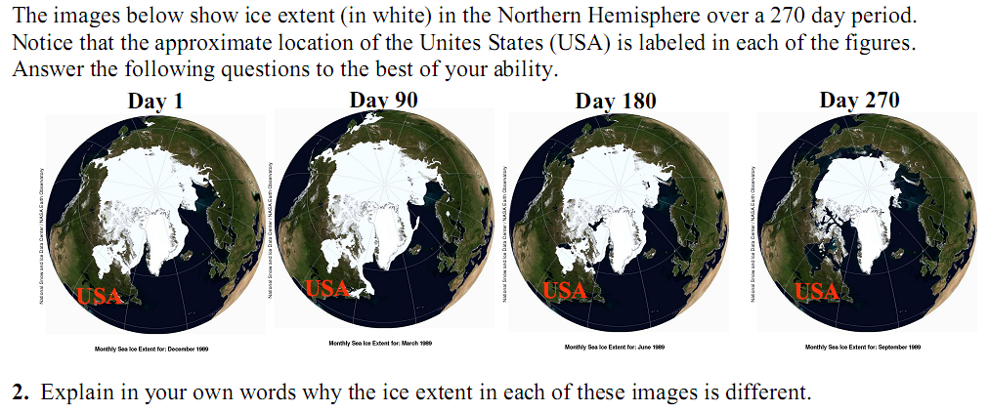
Example open-ended Cryosphere EarthLabs pre-post assessment
Notes:
Pre- and post-instruction systems thinking scores differed significantly on Wilcoxin signed ranks test (ρ = 0.08, Z = -1.74). In addition, paired student t-test analysis of pre-/post- conceptual understanding scores indicates statistically significant (ρ < 0.01) improvements where post-scores (M = 15.6) were higher than pre-scores (M =10.2).
Interestingly, students who completed only a portion of the labs exhibited no statistically significant improvements post-implementation (ρ > 0.05), whereas those engaged in all seven labs of the modules and spent nine in-class hours over the course of four weeks on these materials showed statistically significant improvements post-implementation (ρ < 0.05).

Slide 15
Example open-ended Cryosphere EarthLabs pre-post assessment
Student response: “The hemisphere is warming, causing ice to melt.”
Hemisphere
warms
9
Ice
melts
Notes:
Pre- and post-instruction systems thinking scores differed significantly on Wilcoxin signed ranks test (ρ = 0.08, Z = -1.74). In addition, paired student t-test analysis of pre-/post- conceptual understanding scores indicates statistically significant (ρ < 0.01) improvements where post-scores (M = 15.6) were higher than pre-scores (M =10.2).
Interestingly, students who completed only a portion of the labs exhibited no statistically significant improvements post-implementation (ρ > 0.05), whereas those engaged in all seven labs of the modules and spent nine in-class hours over the course of four weeks on these materials showed statistically significant improvements post-implementation (ρ < 0.05).

Slide 16
Expert response: “The images show the sea ice extent through the seasonal cycle. In the winter the sea ice extent would be the greatest. This is because there is no or little solar radiation over the region at that time of the year, causing air temperatures to be very low, resulting in a growth and expansion of sea ice at the surface of the ocean… The image for day 180 shows the sea ice extent reduced from the image for day 90 so that image shows the sea ice extent in the spring.”
Sunlight
Solar Radiation
is present
drops / is low
Air temps
rise
Air temps
36
drop
Ice temps
reach melting
Sea ice
grows
Ice
melts
Notes:
students scored below 20 points in pre-tests, but as high as 35 on post-tests, approaching the expert score of 36 points. Over half of the student respondents scored higher than 20 points in the post-assessment. Pre- and post-instruction systems thinking scores differed significantly on Wilcoxin signed ranks test (ρ = 0.08, Z = -1.74). In addition, paired student t-test analysis of pre-/post- conceptual understanding scores indicates statistically significant (ρ < 0.01) improvements where post-scores (M = 15.6) were higher than pre-scores (M =10.2). Interestingly, students who completed only a portion of the labs exhibited no statistically significant improvements post-implementation (ρ > 0.05), Self-assessed pre-/post- student confidence on the ESS module increased from an average of 1.20 to 1.94. Similar results were observed for the Cryosphere module, where students either maintained or increased their confidence level from 2.95 to 3.60.

Slide 17
Pre-post student response rubric scores
“Explain in your own words why the ice extent of these images is different”
Pre-post p <0.05
Notes:
students scored below 20 points in pre-tests, but as high as 35 on post-tests, approaching the expert score of 36 points. Over half of the student respondents scored higher than 20 points in the post-assessment. Pre- and post-instruction systems thinking scores differed significantly on Wilcoxin signed ranks test (ρ = 0.08, Z = -1.74). In addition, paired student t-test analysis of pre-/post- conceptual understanding scores indicates statistically significant (ρ < 0.01) improvements where post-scores (M = 15.6) were higher than pre-scores (M =10.2). Interestingly, students who completed only a portion of the labs exhibited no statistically significant improvements post-implementation (ρ > 0.05), Self-assessed pre-/post- student confidence on the ESS module increased from an average of 1.20 to 1.94. Similar results were observed for the Cryosphere module, where students either maintained or increased their confidence level from 2.95 to 3.60.

Slide 18
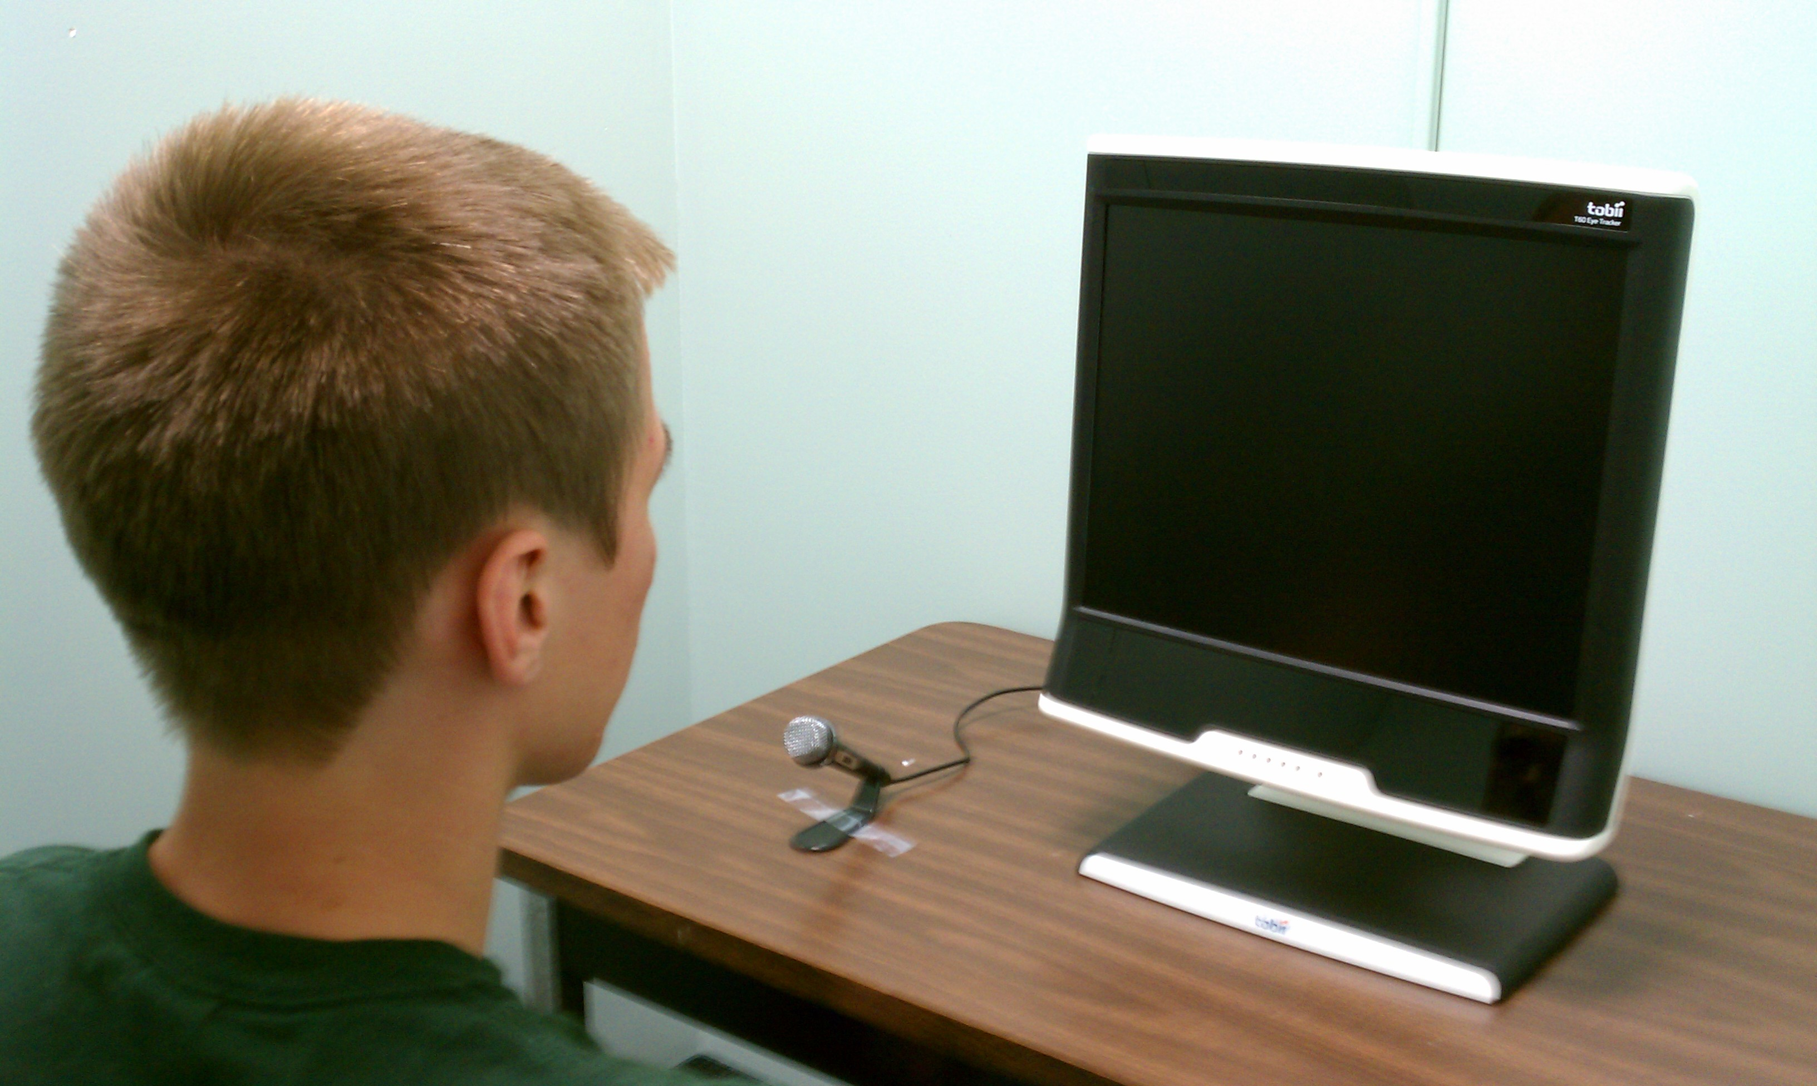

Methods: Eye-tracking studies
Pre-Study Measures
Color-blindness
Climate change conceptions
Demographics

Slide 19
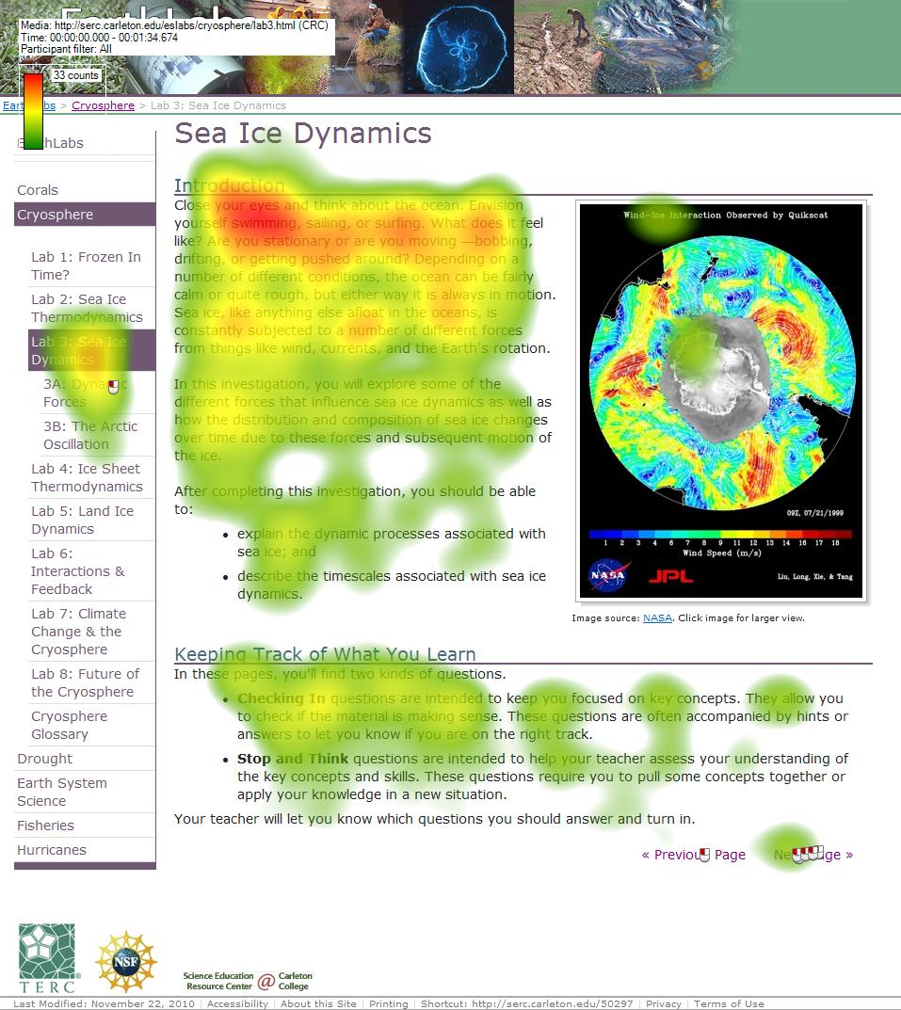
Time to complete - 23 and 32 minutes
engaged less with images than with text
difficulty engaging with some materials posted on external sites
Notes:
Overall, data indicate that students spent between 23 and 32 minutes completing the lab, engaged less with images than with text, and had difficulty engaging with some materials posted on external sites, such as graphs depicting change in climate indices over time. Each of these findings was also observed in student interactions with other lab materials, indicating that: 1) labs are sufficiently engaging for students; and 2) materials hosted by external sites (e.g., NASA, NOAA) may need modification before students can engage effectively with them.

Slide 20
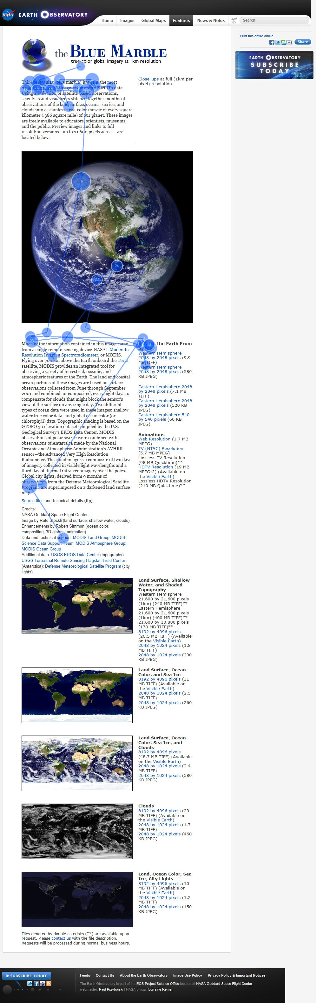
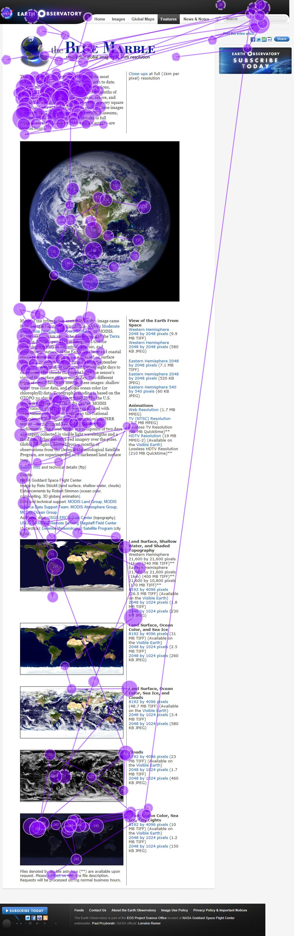
Purple path is a participant with significant attention.
Blue path is cursory and is typical of most participants.
Notes:
Two individual gaze paths for Blue Marble site (external link on EarthLabs ESS module).

Slide 21
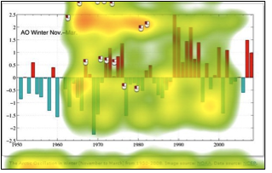
Students had difficulty knowing where to look on complex scientific graphs/figures
Notes:
Two individual gaze paths for Blue Marble site (external link on EarthLabs ESS module).

Slide 22
Conclusions
Students’ SYSTEMS UNDERSTANDING and CONCEPTUAL UNDERSTAND significantly improved after exposure to EarthLabs modules, although students did not reach mastery levels on par with expert responses.
Classroom observations combined with eye-tracking measures of external users indicate that the EarthLabs modules were ENGAGING TO USERS.
The EarthLabs CURRICULUM-RESEARCH model is an example of how research can be used to inform curriculum development.

Slide 23

Teachers Guide http://serc.carleton.edu/earthlabs
Student Guide
http://serc.carleton.edu/eslabs
CONTACT: Tamara Shapiro Ledley, Tamara_Ledley@terc.edu, 617-873-9658

