Slide 1
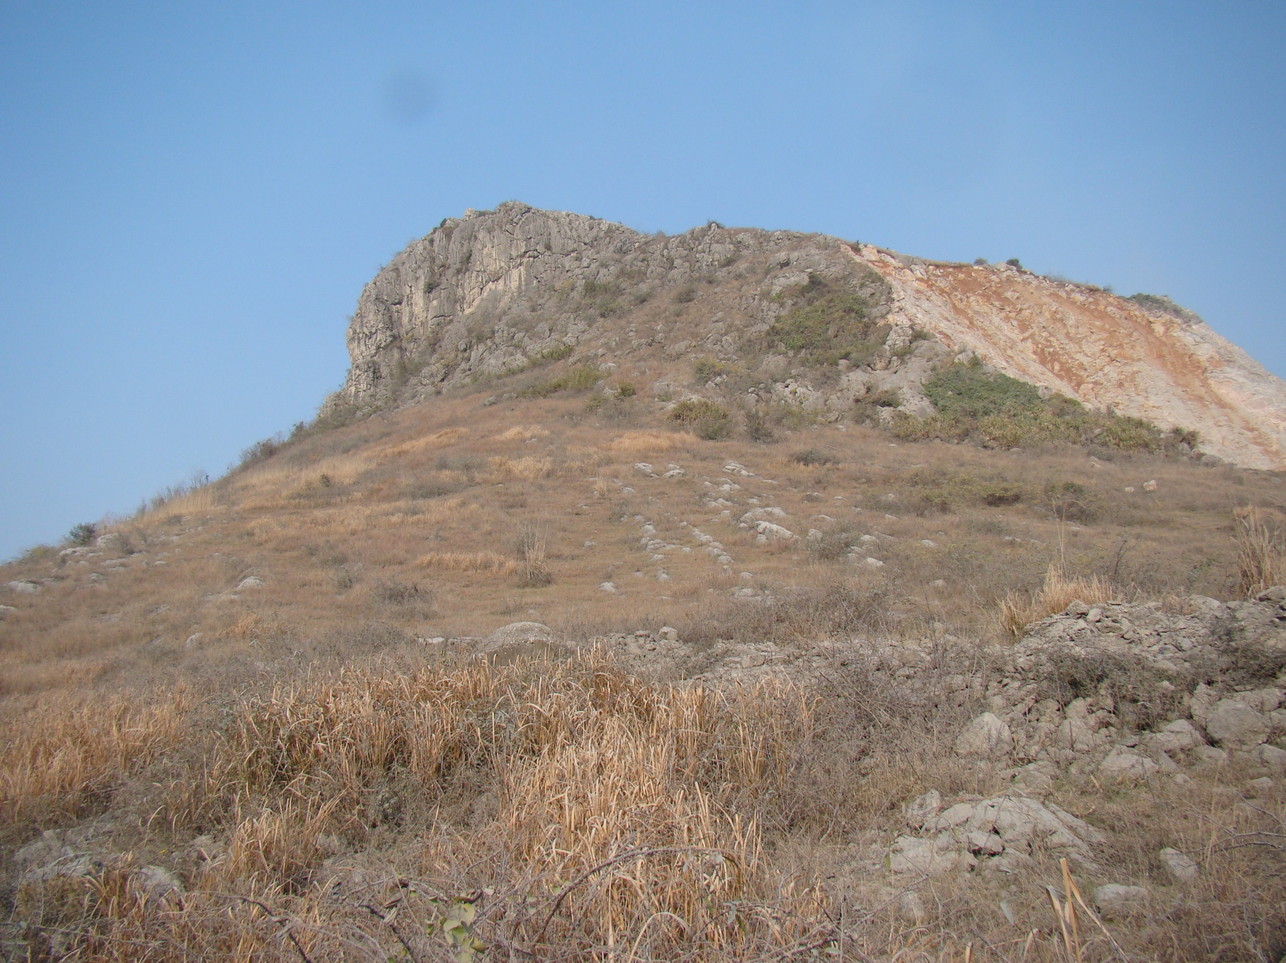
INSIGHT FROM EARLY
CORAL-STROMATOPOROID INTERGROWTHS,
LATE ORDOVICIAN OF CHINA
2015.11.02
Geological Society of America Annual Meeting
Mirinae Lee^{1, *}, Robert J. Elias², Suk-Joo Choh³, Dong-Jin Lee¹
¹Dept. of Earth and Environmental Sciences, Andong National University, Korea
²Dept. of Geological Sciences, The University of Manitoba, Canada
³Dept. of Earth and Environmental Sciences, Korea University
Notes:
Good afternoon, ladies and gentlemen. I am Mirinae Lee from Andong National University in Korea. It’s a pleasure for me to give a talk to you. Today I would like to present on early coral-stromatoporoid intergrowths from the Ordovician of China.

Slide 2
Intergrowth with stromatoporoids
tabulate coral
worm (tube)
rugose coral
“host” stromatoporoid
brachiopod
cyanobacteria
bryozoan
e.g. Mistiaen (1984), Kershaw (1987), Webby (1991), Zhen and West (1997), Tapanila and Holmer (2006)
Notes:
Various kinds of organisms lived within Paleozoic stromatoporoids. These include tabulate and rugose corals, cyanobacteria, bryozoans, brachiopods and worms. Most associations are represented by unique examples and do not recur within the fossil record, but some tabulate corals persistently maintained their relationship with stromatoporoids.

Slide 3
Tabulate-stromatoporoid intergrowth
“caunopore” association (e.g. Mistiaen, 1984)
syringoporid coral-stromatoporoid
Silurian-Devonian
less well known tabulate coral endobionts
Moyerolites: Silurian of Siberia (Sokolov and Tesakov, 1963)
Propora, Pycnolithus, Favosites and Thamnopora: Silurian of Canada (Nestor et al., 2010)
stromatoporoids
coral-stromatoporoid
intergrowths
tabulate corals
?
Syringopora
“caunopore”
O
S
D
C
450
400
350 Ma
Notes:
The most well-studied intergrowth involving tabulate corals and stromatoporoids is the so-called “caunopore” association. This is a widely known term for commensal relationships between syringoporid corals and stromatoporoids. Except for syringoporids, very little attention has been paid to other taxa of tabulate coral endobionts. There are reports of tabulate coral and stromatoporoid intergrowths from the Ordovician to the decline of stromatoporoids in the Devonian. However, such intergrowths are poorly known before the Silurian, so it remains uncertain when and how these relationships began.

Slide 4
Purpose
investigate an Ordovician coral-stromatoporoid intergrowth from China, involving the tabulate Bajgolia
examine the nature of the relationship
consider the origin and development of such an intergrowth
Notes:
In this study, we investigate a coral-stromatoporoid association from the Late Ordovician of China, which involves the tabulate coral genus Bajgolia. We will examine the nature of the relationship and will consider the origin and development of such an intergrowth.

Slide 5
Material and method
Modified from Lee et al. (2012)
Xiazhen Formation
Late Ordovician (Katian)
Modified from Lee et al. (2012)
Notes:
The Xiazhen Formation is exposed at Zhuzhai village, located near the border between Jiangxi and Zhejiang provinces in South China. The age of the formation is Late Ordovician. A total 11 Bajgolia-bearing units are recognized and labelled in ascending order from bottom to top of the formation.

Slide 6
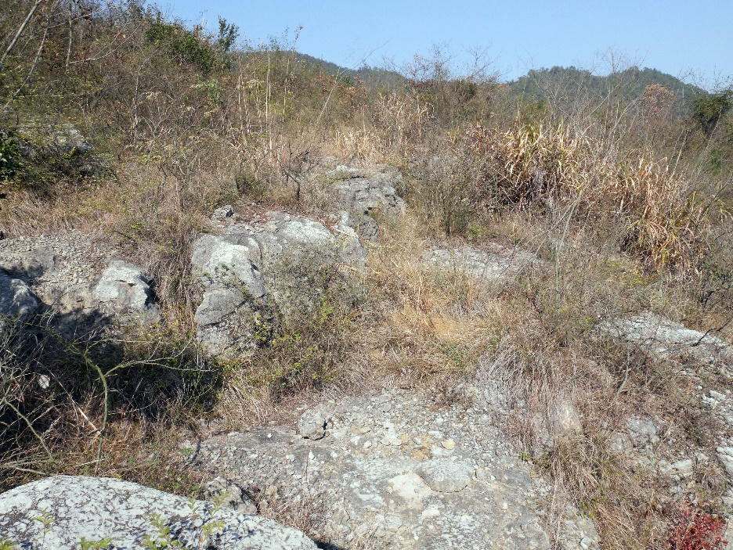
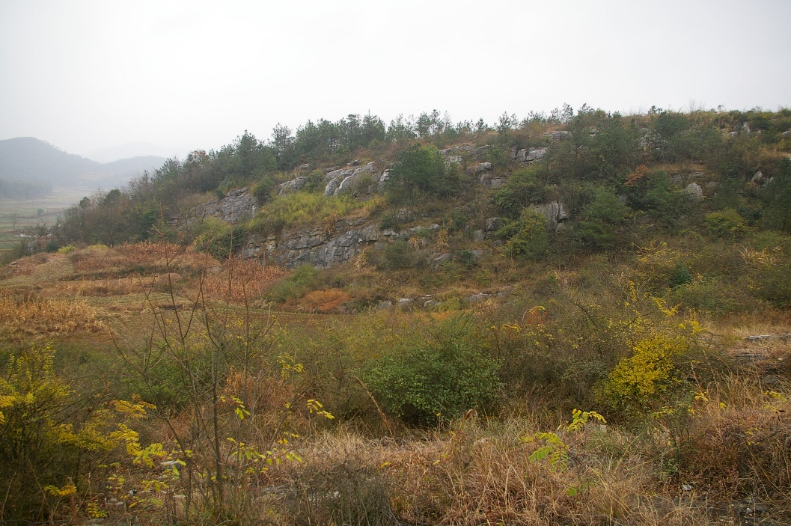
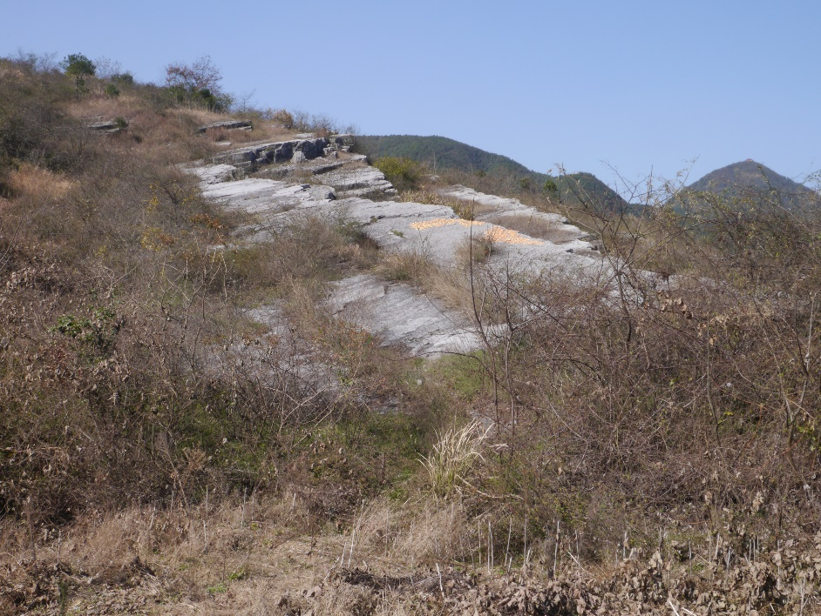
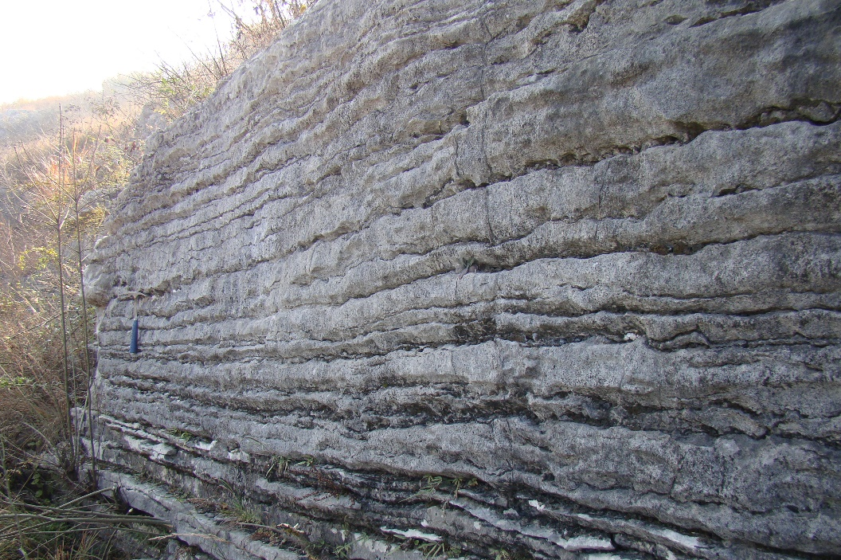
Zhuzhai, Jiangxi Province, China
Notes:
These photos show outcrops at Zhuzhai. The Xiazhen Formation is composed of mixed carbonate and siliciclastic deposits. It is fossil rich, containing diverse corals, stromatoporoids, calcareous algae, brachiopods and trilobites.

Slide 7
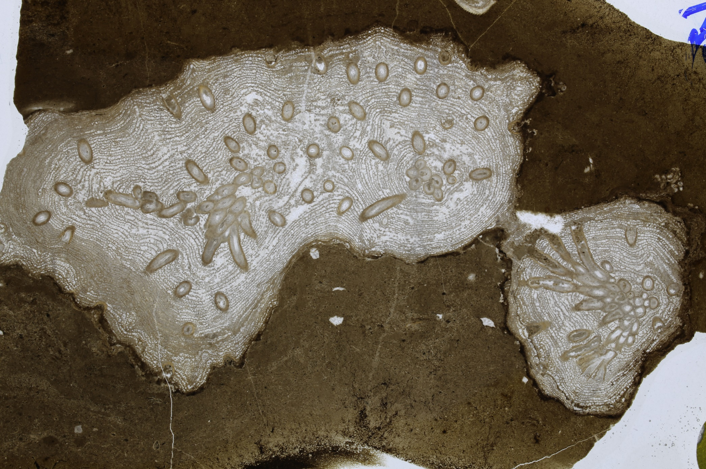
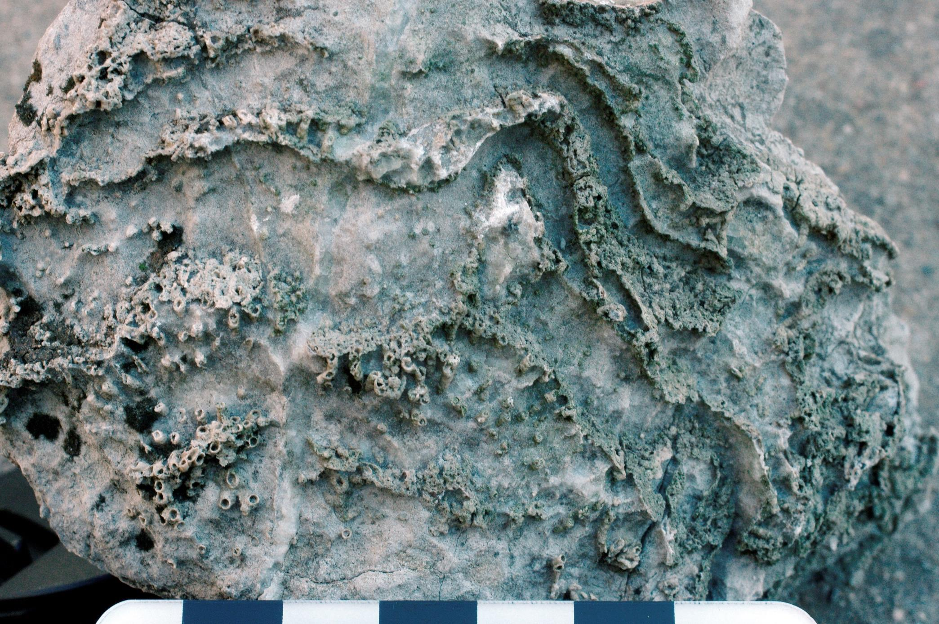
Intergrowth
endobiont
stromatoporoid
10 mm
10 mm
Notes:
The intergrowth association is conspicuous in outcrop, and the features are more clearly observed in thin sections. As you can see, tubular organisms are found within the skeleton of stromatoporoids. I will now show you each component of the intergrowth.

Slide 8
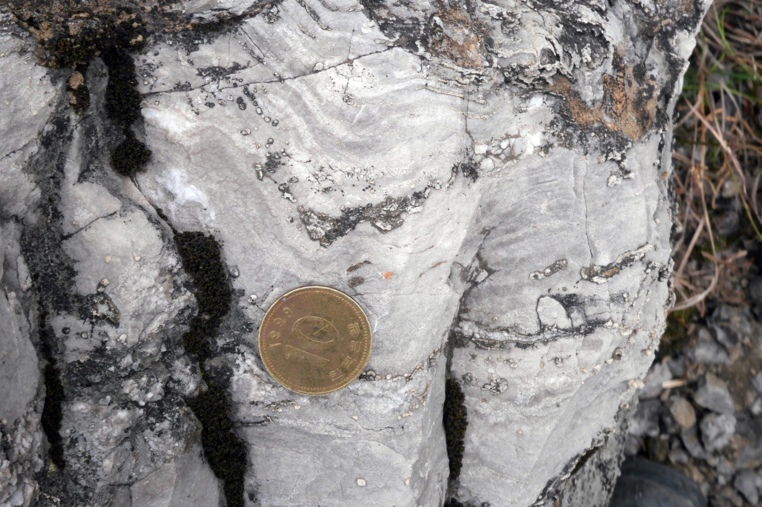
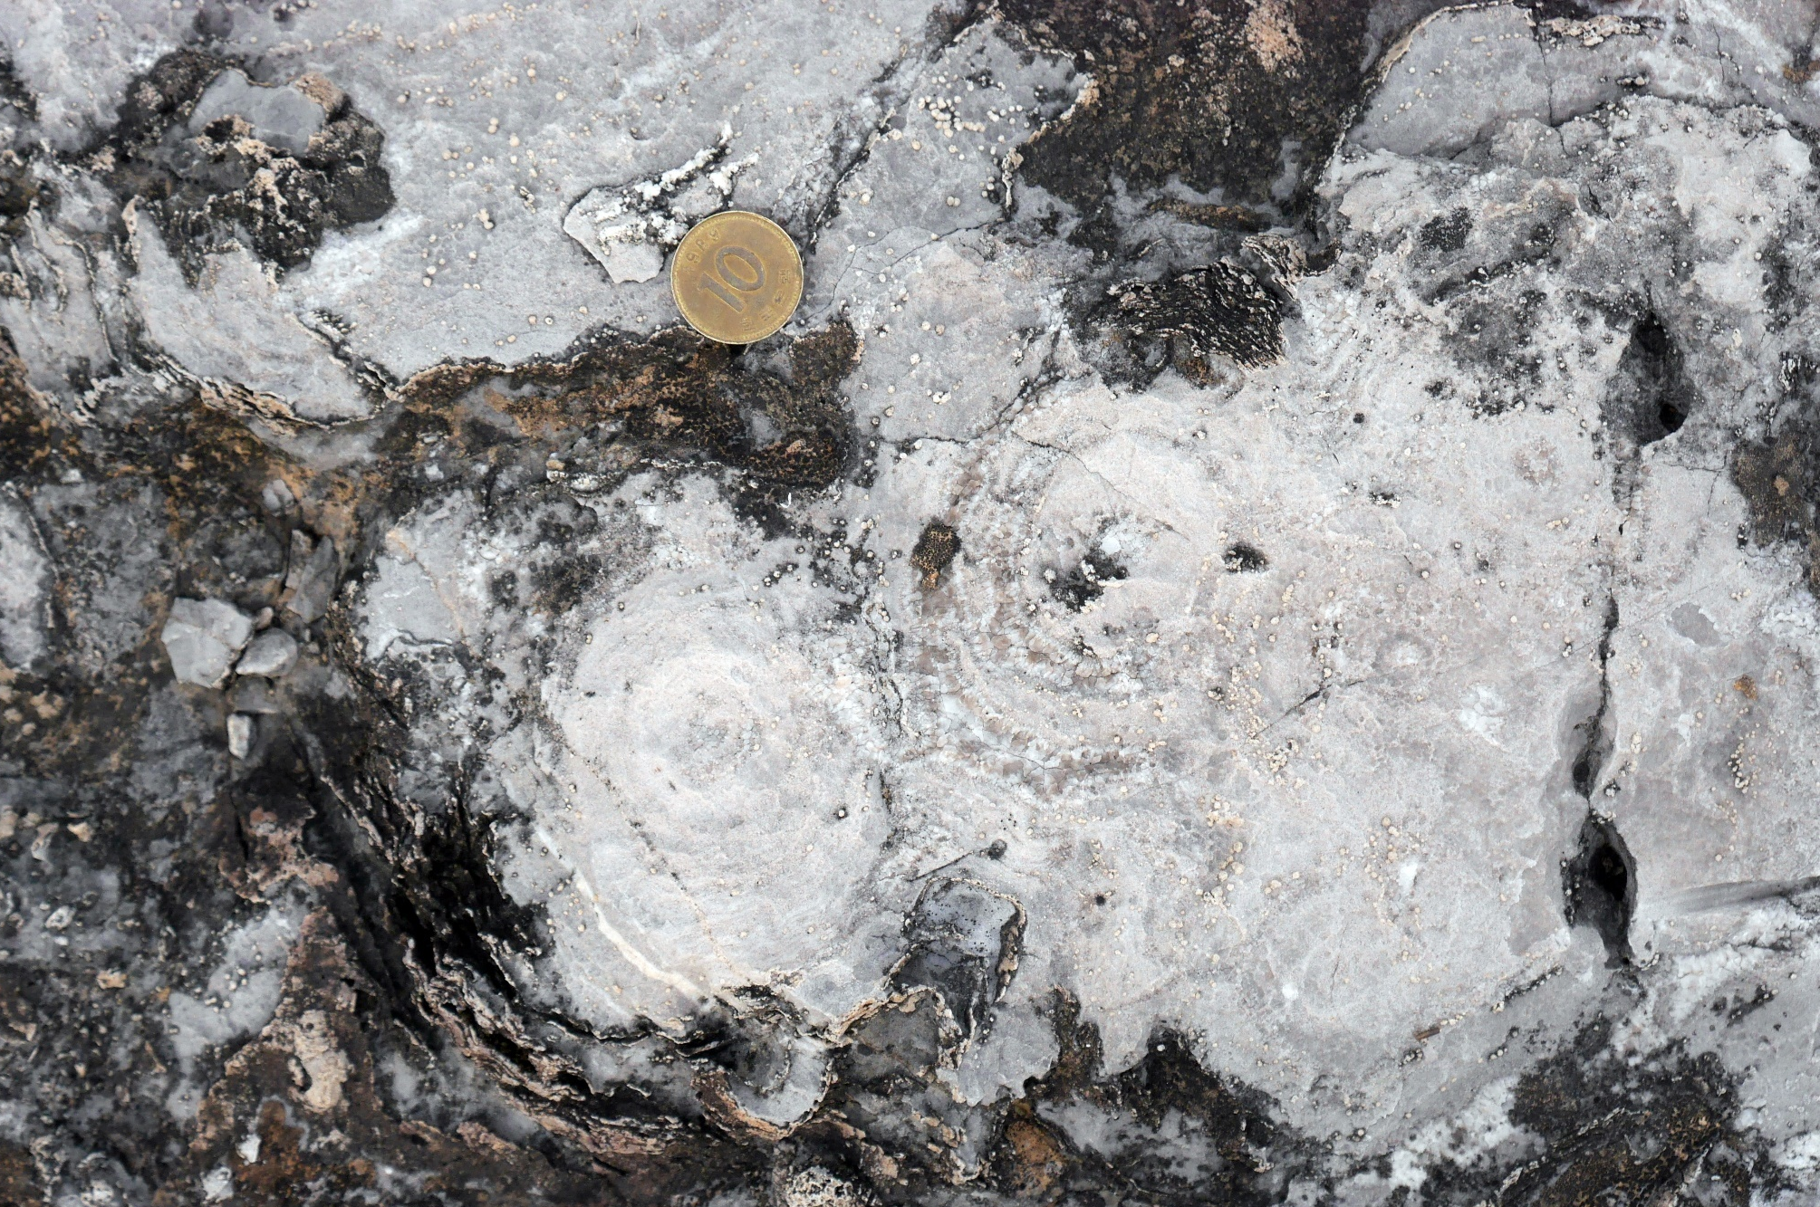
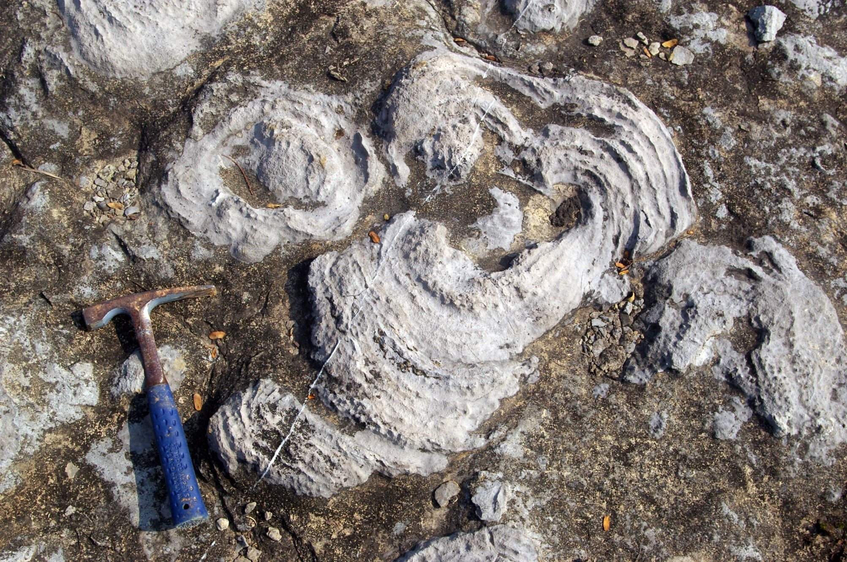
Stromatoporoids
Notes:
Stromatoporoids in the Xiazhen Formation have a variety of growth forms and sizes. These slides shows several examples of stromatoporoids in outcrop. In a recent reevaluation of stromatoporoids in the Xiazhen Formation, eight genera were recognized.

Slide 9
Stromatoporoids
only 2 of 8 genera in the Xiazhen Formation are hosts
clathrodictyid stromatoporoids
Clathrodictyon
Ecclimadictyon
1 mm
1 mm
Clathrodictyon
Ecclimadictyon
Notes:
Among the eight genera of stromatoporoids, however, only two hosted endobionts. Clathrodictyon and Ecclimadictyon are both clathrodictyids and they occur throughout the formation.

Slide 10
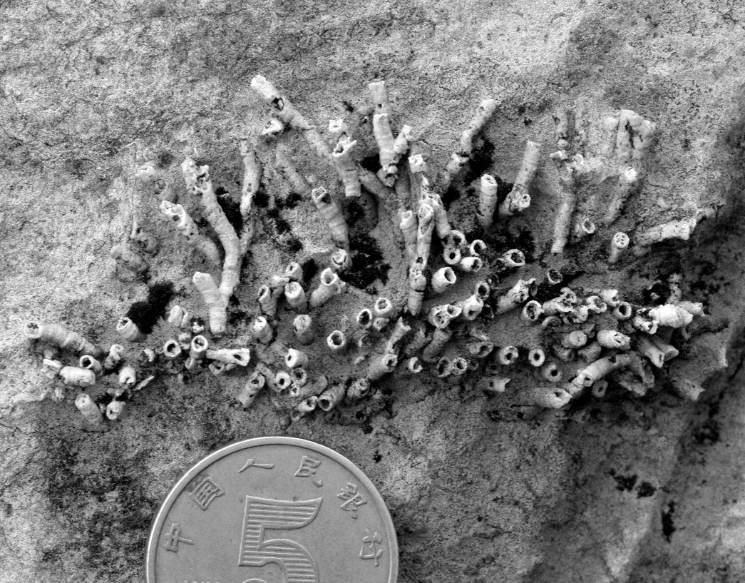
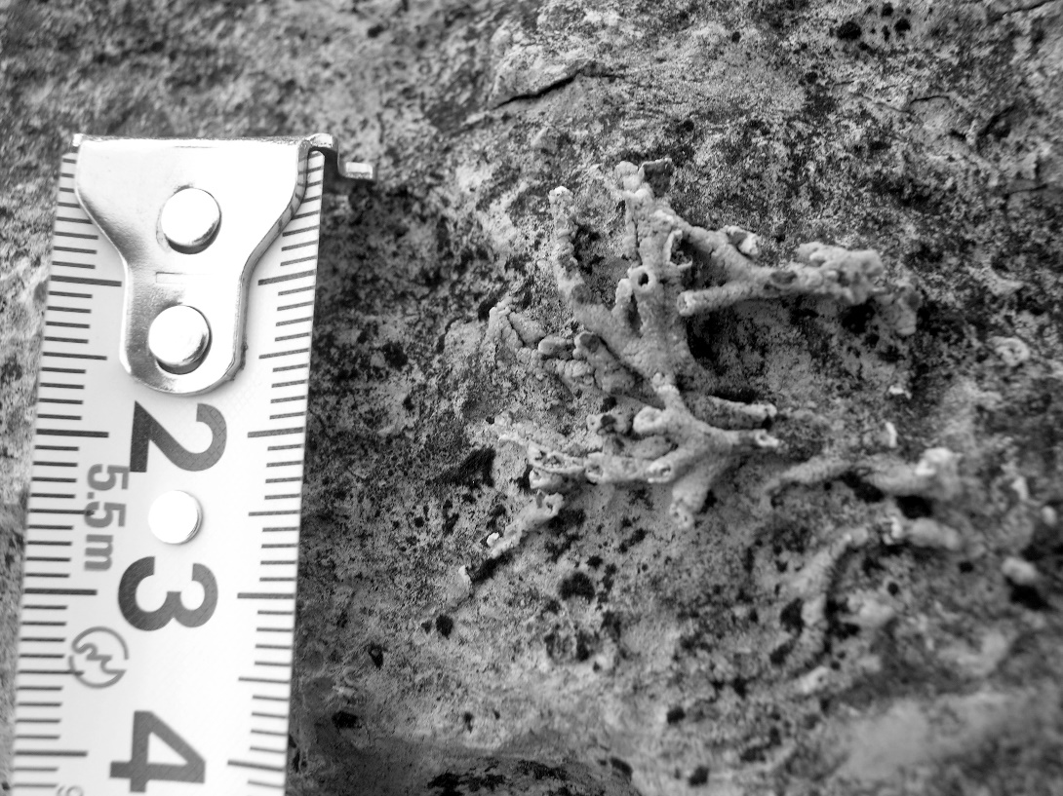
Endobiont
Bajgolia
auloporid tabulate coral (Webby, 1977; Lin et al., 1988)
Upper Ordovician of Australia and Asia
dichotomous branching growth form
bipartite fission of corallites
Notes:
Next, I will talk about the endobiont in the intergrowth. It is identified as Bajgolia, which is an auloporid tabulate coral. This genus is known from the Upper Ordovician of Australia and Asia. It is characterized by a dichotomous branching growth form with bipartite fission of corallites. You can see the nature of colonies in these outcrop photos of free-living Bajgolia in the Xiazhen Formation.

Slide 11
Stratigraphic distribution
Units | Bajgolia | Stromatoporoid | Association
B11 | free-living endobiont | Clathrodictyon Ecclimadictyon | B.-C. B.-E.
B10 | endobiont | Clathrodictyon | B.-C.
B9 | free-living | Clathrodictyon Ecclimadictyon | -
B8 | free-living endobiont | Clathrodictyon Ecclimadictyon | B.-C.
B7 | free-living endobiont | Clathrodictyon Ecclimadictyon | B.-C.
B4-6 | free-living | Clathrodictyon Ecclimadictyon (not in B6) | -
B3 | endobiont | Clathrodictyon Ecclimadictyon | B.-C.
B2 | free-living endobiont | Clathrodictyon Ecclimadictyon | B.-C.
B1 | free-living | Clathrodictyon | -
Units | Bajgolia | Stromatoporoid | Association
B11 | free-living endobiont | Clathrodictyon Ecclimadictyon | B.-C. B.-E.
B10 | endobiont | Clathrodictyon | B.-C.
B9 | free-living | Clathrodictyon Ecclimadictyon | -
B8 | free-living endobiont | Clathrodictyon Ecclimadictyon | B.-C.
B7 | free-living endobiont | Clathrodictyon Ecclimadictyon | B.-C.
B4-6 | free-living | Clathrodictyon Ecclimadictyon (not in B6) | -
B3 | endobiont | Clathrodictyon Ecclimadictyon | B.-C.
B2 | free-living endobiont | Clathrodictyon Ecclimadictyon | B.-C.
B1 | free-living | Clathrodictyon | -
Notes:
Bajgolia and stromatoporoids are present throughout the Xiazhen Formation. Bajgolia occurs both as free-living colonies and as endobionts in association with stromatoporoids. The six highlighted units contain intergrowth associations, mainly in reef and reef-related facies. Such intergrowths appear in unit B2 and recur until unit B11. In the next slides, we will consider those units in detail.

Slide 12
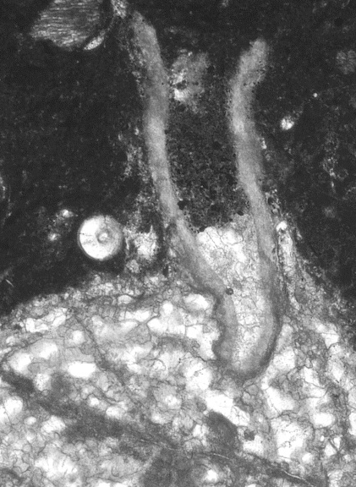
Development of intergrowth
2 mm
2 mm
unit B2
mostly fragmented free-living Bajgolia
first incorporation of Bajgolia into stromatoporoids
protruding from the stromatoporoid
Notes:
In unit B2, most Bajgolia colonies are free-living. They are commonly fragmented and randomly oriented due to breakage and transportation. We found only a few corallite of Bajgolia that grew within stromatoporoid skeleton. It is considered to represent the first incorporation of Bajgolia into stromatoporoids in the Xiazhen Formation.

Slide 13
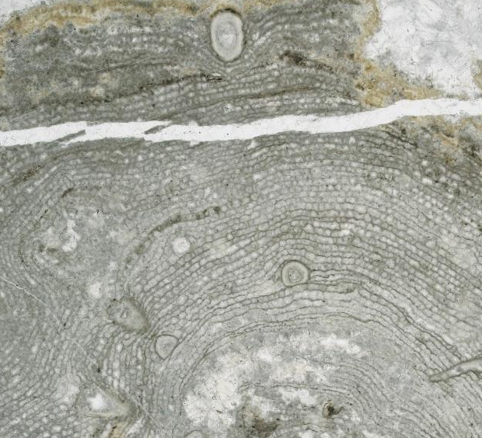
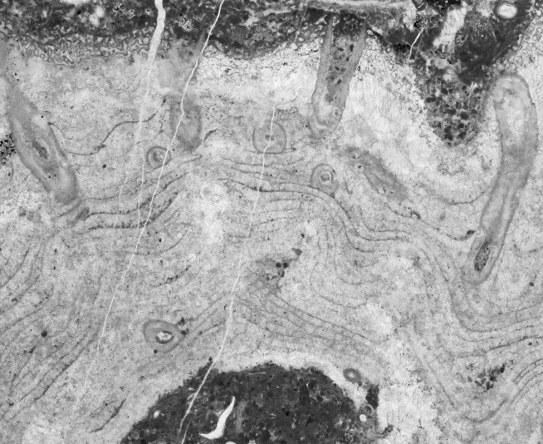
Development of intergrowth
5 mm
5 mm
unit B3
unit B7
units B3 and B7
some Bajgolia occur within Clathrodictyon
not yet common
Notes:
Units B3 and B7 contain stromatoporoids hosting Bajgolia. The hosts are Clathrodictyon, but such associations are rare.

Slide 14
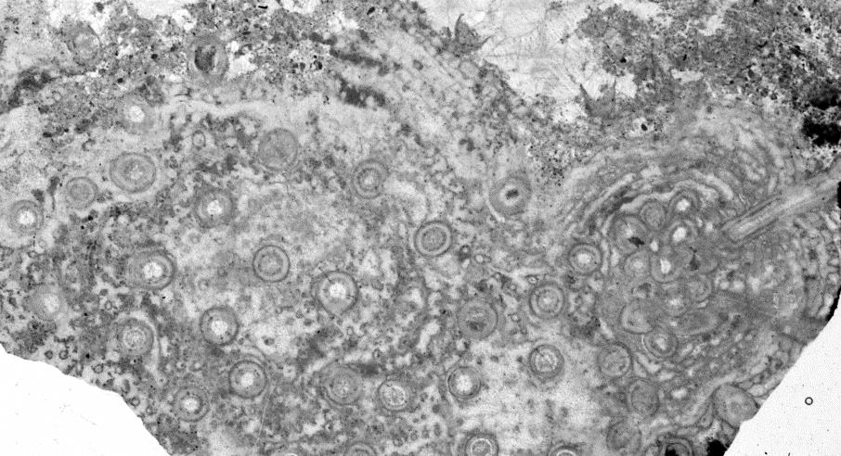
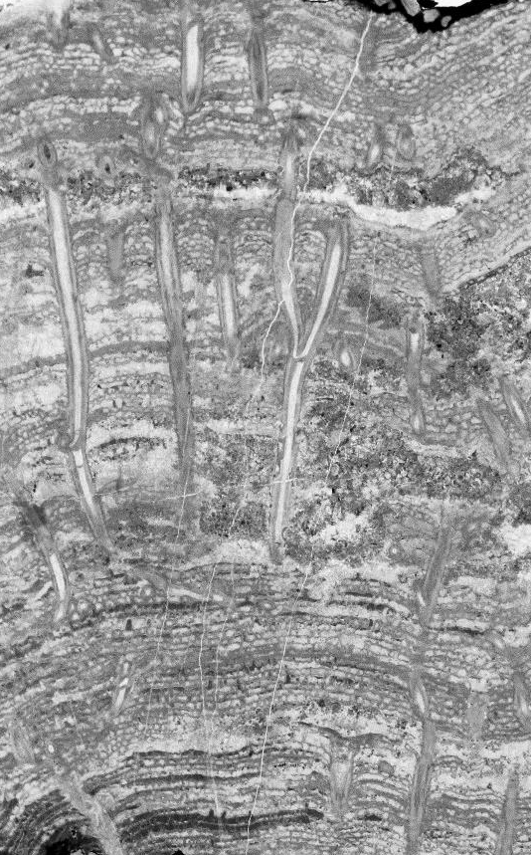
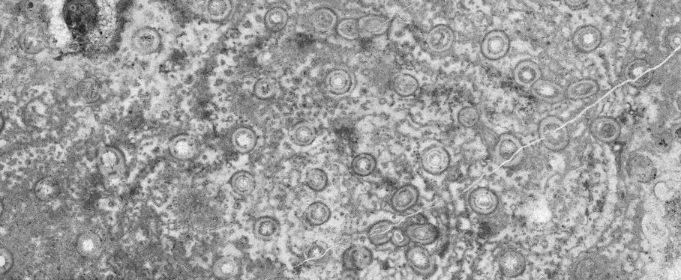
Development of intergrowth
5 mm
5 mm
5 mm
unit B8
Bajgolia commonly grew within Clathrodictyon
endobionts usually retain their growth orientation, because host stromatoporoids are seldom overturned
Notes:
In unit B8, Bajgolia is increasingly incorporated within Clathrodictyon skeletons. Most endobionts retain their growth orientation within hosts which are seldom overturned. In contrast, free-living Bajgolia are scattered within the matrix.

Slide 15
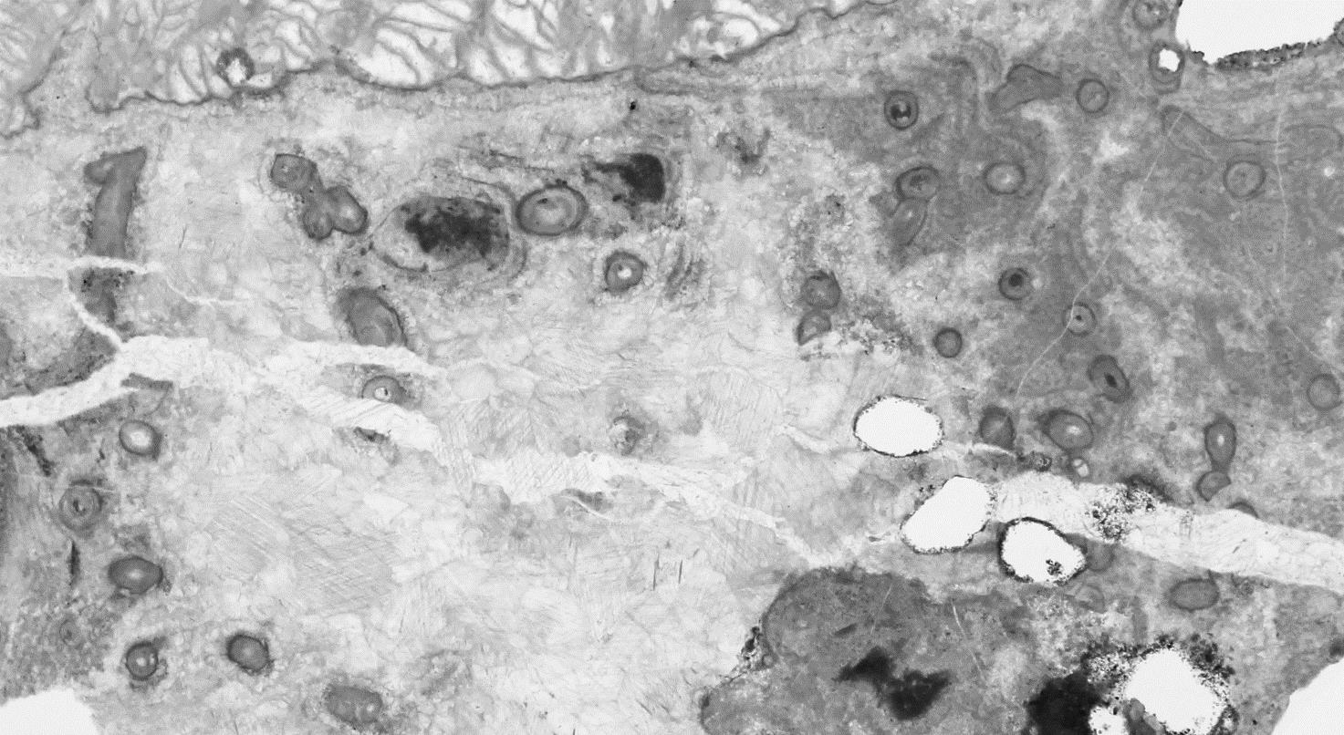
Development of intergrowth
10 mm
unit B10
Bajgolia grew within Clathrodictyon
only one specimen was found
Notes:
In unit B10, Bajgolia is continuously associated within Clathrodictyon skeletons. However, only one specimen containing endobionts was found from this unit.

Slide 16
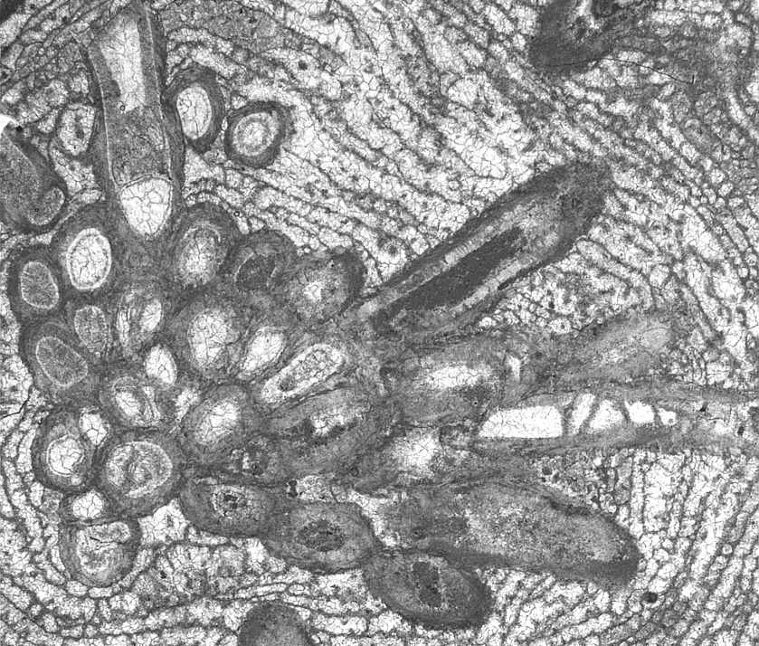
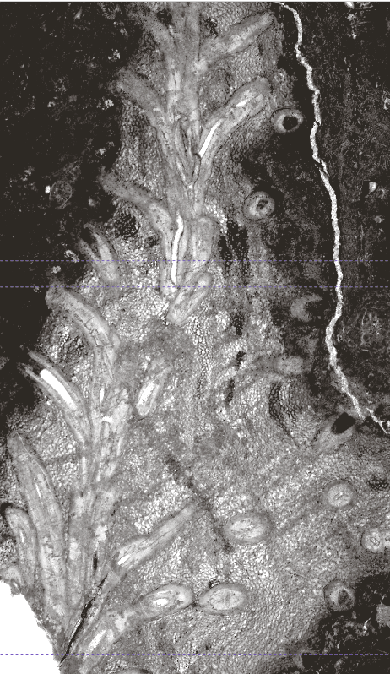
Development of intergrowth
2 mm
5 mm
unit B11
Bajgolia is increasingly incorporated with Clathrodictyon and Ecclimadictyon
some corallites protrude from the growth surface of stromatoporoid
Notes:
Unit B11 is the uppermost interval in which intergrowths occur. Endobiontic Bajgolia are associated not only with Clathrodictyon, but also with Ecclimadictyon. Corallites in the Bajgolia colonies are initially clustered, and then radiate upward and outward during growth. Some of the corallites protrude from their host, so they are exposed above the growth surface of the stromatoporoid.

Slide 17
Settlement of Bajgolia
on stromatoporoid growth surface
2 mm
larval settlement of Bajgolia onto the stromatoporoid surface → indicating how the intergrowth began
Notes:
In general, the initiation of coral-stromatoporoid intergrowth associations is poorly understood. In the Xiazhen Formation, it can be demonstrated that the incorporation of Bajgolia within stromatoporoids followed larval settlement on the growth surface of the host. Single or multiple larvae of endobiontic Bajgolia settled on the stromatoporoid’s growth surface, and subsequently grew as colonies in association with their host.

Slide 18
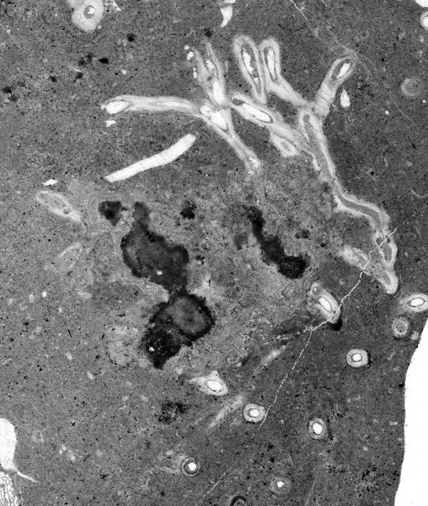
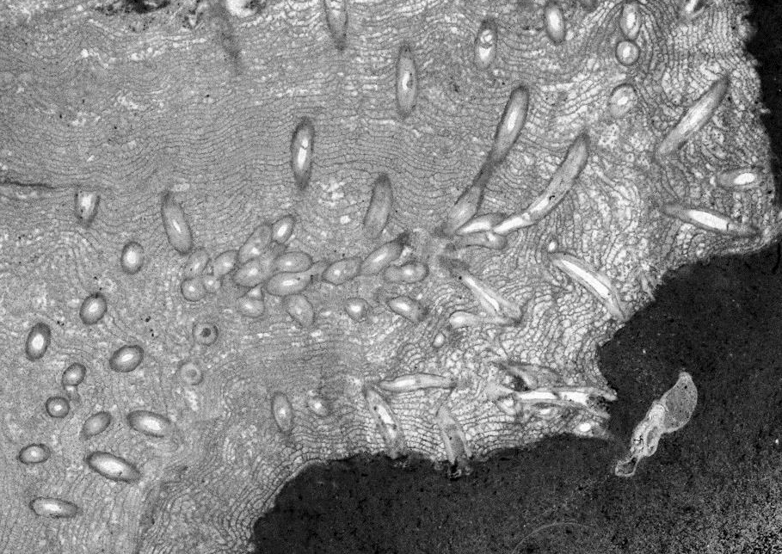
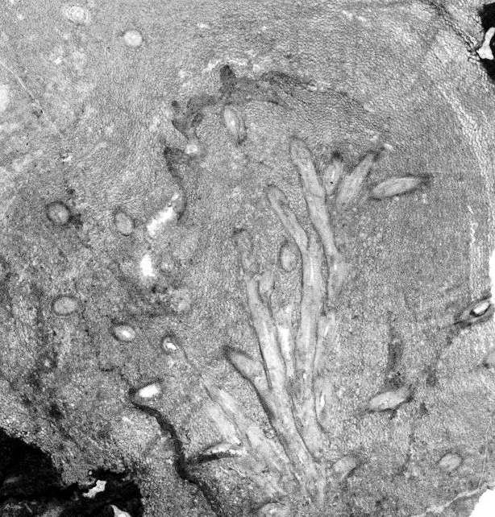
Paleoecology
no notable differences between two modes of Bajgolia
free-living vs. endobionts
endobionts in Clathrodictyon vs. Ecclimadictyon
free-living mode
endobionts in Clathrodictyon
endobionts in Ecclimadictyon
5 mm
5 mm
5 mm
all photos of thin sections are from unit B11
Notes:
Occurrences of Bajgolia in this study represent two modes of life, free-living and endobiontic. Endobiontic Bajgolia are incorporated within both Clathrodictyon and Ecclimadictyon. As you can see in these three categories, Bajgolia has a similar growth form with dichotomous branching regardless of the mode of life or the host.

Slide 19
Paleoecology
no notable differences between two modes of Bajgolia
free-living vs. endobionts
endobionts in Clathrodictyon vs. Ecclimadictyon
contrast with previous studies (e.g. Kershaw, 1987; Young and Noble, 1989)
free-living mode
endobionts in Clathrodictyon
endobionts in Ecclimadictyon
n = 22
average = 0.92 (mm)
n = 723
average = 0.97 (mm)
n = 70
average = 0.87 (mm)
all data are from unit B11
Notes:
In addition, corallite diameters in each category have similar ranges and average values within the same stratigraphic unit. These findings differ from some previous studies of tabulate coral-stromatoporoid intergrowths, in which the endobionts have smaller corallites than free-living forms. These findings also differ from some studies in which corallite size of the endobionts is negatively related to skeletal density of the host stromatoporoid. In the present study, the size of Bajgolia corallites does not seem to have been significantly affected by mode of life of the colony or the nature of the host’s skeleton.

Slide 20
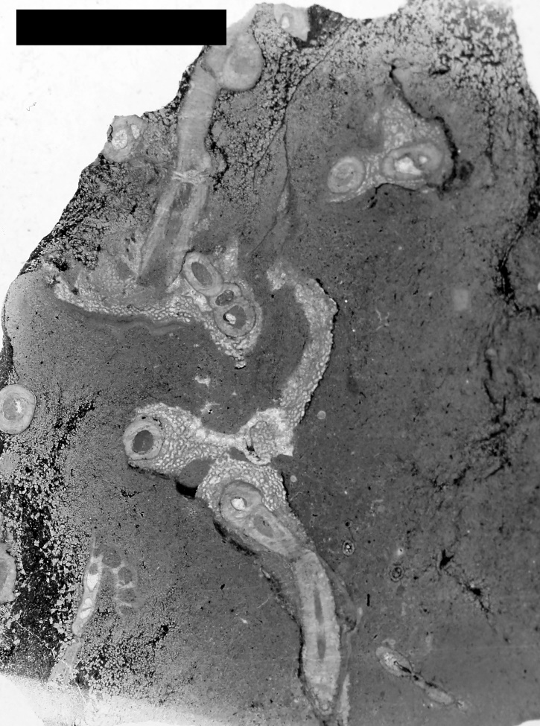
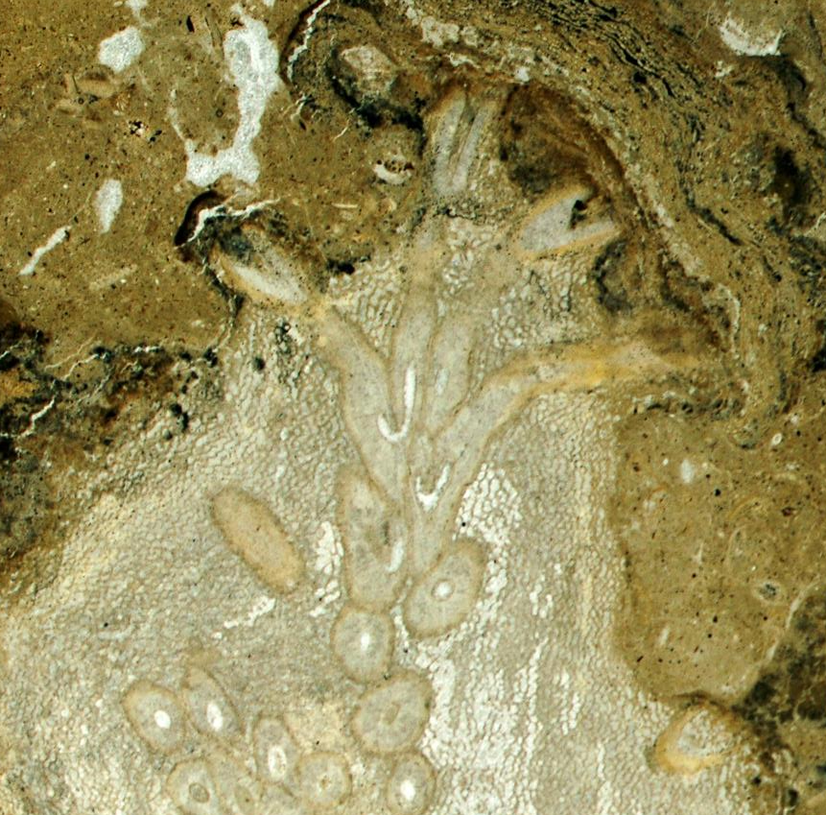
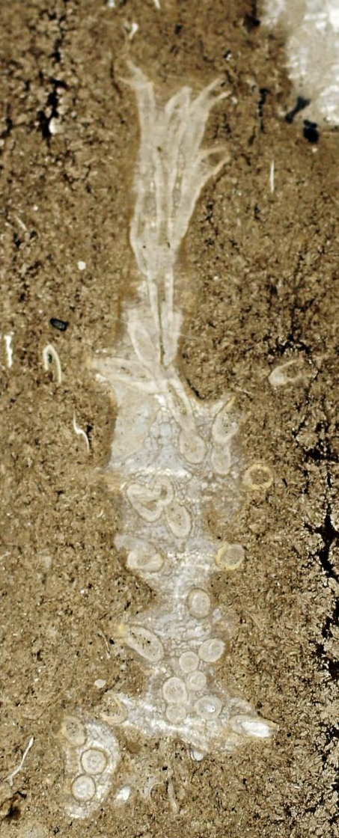
Paleoecology
endobionts protruding from the host stromatoporoid
endobionts could survive without their host
contrast with previous studies of “caunopores” (e.g. Young and Noble, 1989)
5 mm
10 mm
5 mm
Notes:
Some corallites of endobiontic Bajgolia protrude from the host stromatoporoid. This indicates that Bajgolia was able to outgrow the stromatoporoid, either while the stomatoporoid was alive or after it stopped growing. The endobionts were able to survive without being structurally supported by the stromatoporoids. This differs from previous reports on Siluro-Devonian “caunopores”, which suggested that the endobiontic syringoporids were unable to grow into free-living forms after the death of the host stromatoporoid.

Slide 21
Discussion
type of biological interaction
endobiontic Bajgolia
 | + | (minimally affected) | -
+
(minimally affected)
-
mutualism
host
stromatoporoid
commensalism
parasitism
Notes:
So, let’s discuss the type of biological interaction represented by the Bajgolia-stromatoporoid association in the Xiazhen Formation. Endobiontic Bajgolia typically benefited by remaining in growth position within the host, in contrast with free-living forms that were commonly fragmented and scattered as a result of transportation. Furthermore, as larvae of Bajgolia settled and grew on stromatoporoids, they had the advantage of a stable, elevated substrate for feeding. Assuming there was no conspicuous disadvantage or benefit for the host stromatoporoid, we can consider such an association to be commensalism. This was probably the usual type of interaction.
Perhaps, however, the endobionts reduced or otherwise negatively affected the feeding surface of host stromatoporoids. In some cases, laminae of the stromatoporoid skeleton curve downward around corallites, suggesting that growth of the host was inhibited. If so, the coral may have had a detrimental effect on the stromatoporoid, as in parasitic interaction.
On the other hand, mutualism is also a possibility. The stinging cells of the endobiontic coral may have discouraged predation or larval settlement on the host stromatoporoid, thereby providing a benefit. Furthermore, in some cases it seems that upward growth of corallites provided a framework for upward growth of the surrounding stromatoporoid, perhaps improving its feeding position or height above the substrate.

Slide 22
Discussion
type of biological interaction
commensalism?
similar to previous interpretations of “caunopore” association (e.g. Kershaw, 1987; Young and Noble, 1989)
endobiontic Bajgolia
 | + | (minimally affected) | -
+
(minimally affected)
-
mutualism
host
stromatoporoid
commensalism
parasitism
Notes:
The interpretation of the Bajgolia-stromatoporoid association as a commensal interaction is similar to many previous studies that considered the “caunopore” association to be commensal. Perhaps, the type of biological interaction in this Bajgolia-stromatoporoid associations was more variable than in the “caunopore” association.

Slide 23
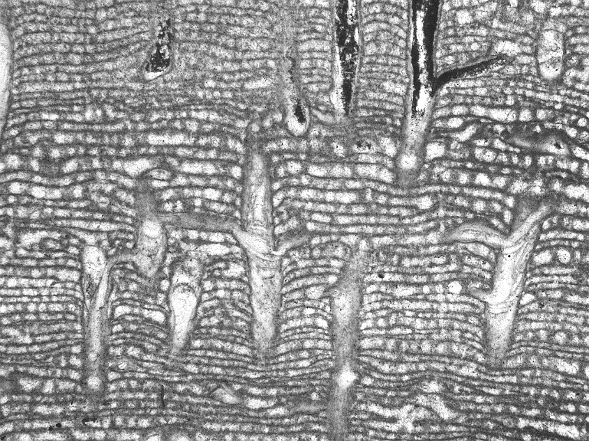
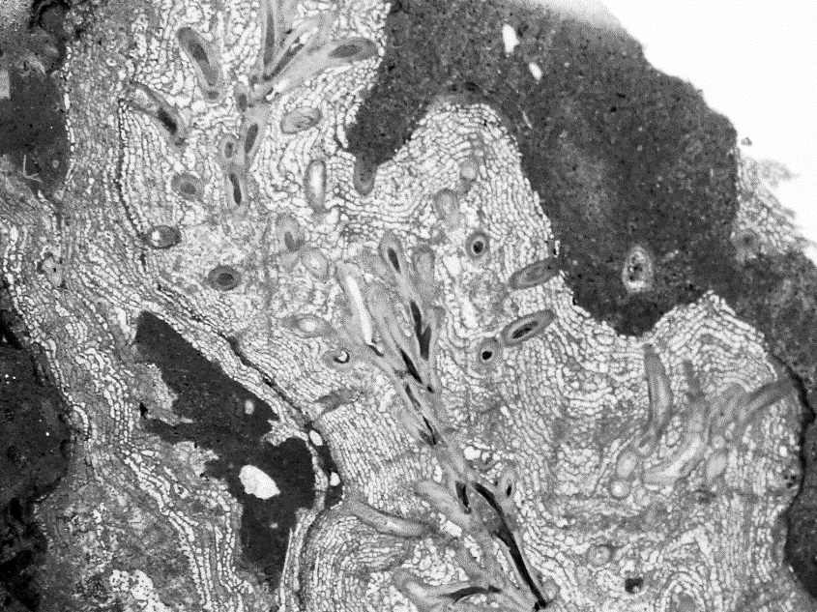
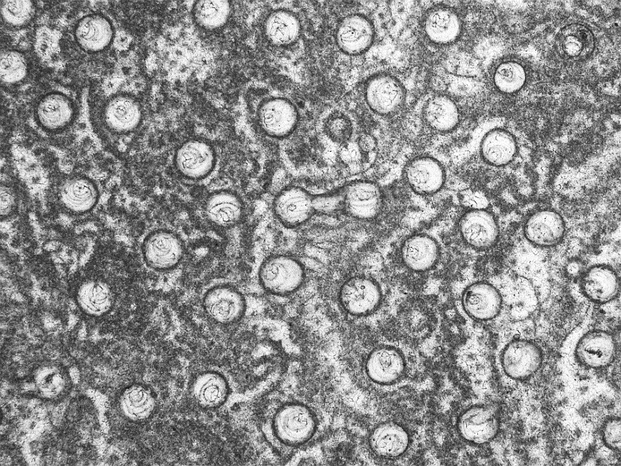
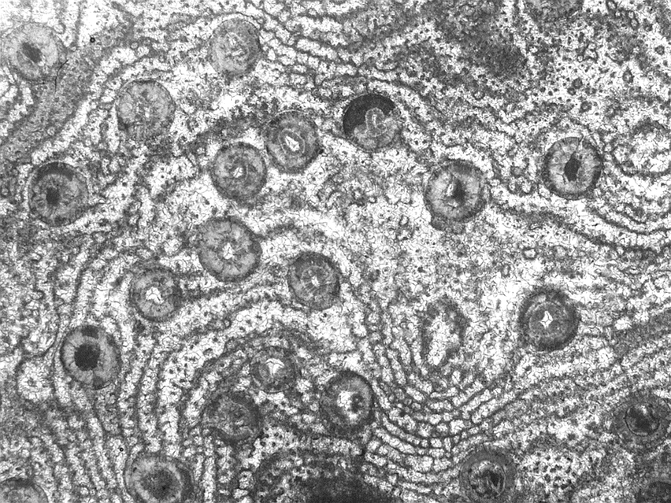
Discussion
10 mm
2 mm
2 mm
2 mm
“caunopore” association
Silurian of eastern Canada
Bajgolia-stromatoporoid
Late Ordovician of South China (this study)
Notes:
Now I will compare the well-known “caunopore” association with the Bajgolia-stromatoporoid association. In transverse section, these two intergrowths seem similar in their morphological features. In longitudinal section, however, the two endobionts show different growth characteristics within stromatoporoids, reflecting the biological differences of these taxonomically distinct corals.

Slide 24
Discussion
comparison with “caunopore” association
 | “caunopore” association | this study
endobiont | syringoporid (mostly Syringopora) | auloporid Bajgolia
common hosts | Stromatopora Stromatoporella Clathrodictyon | Clathrodictyon Ecclimadictyon
biological interaction | probably commensalism | probably commensalism
presence of free-living counterpart | no (different species of Syringopora) | yes
age | Siluro-Devonian (late Silurian-Middle Devonian) | Late Ordovician
Notes:
“Caunopores” are unknown from the Ordovician, and some authors have supposed that this association may have developed after the early Silurian. The hosts of the intergrowth in the present study are clathrodictyids, which are also one of the common hosts in Siluro-Devonian “caunopores”. Some earlier workers suggested that only stromatoporoids having continuous laminae without stout pillars, such as clathrodictyids, could host endobionts because they would have provided the most favorable substrate for settlement of coral larvae. The endobiont in the present study is the auloporid Bajgolia, whereas syringoporid corals are the endobionts in “caunopores”. The symbiotic syringoporid in “caunopores” is taxonomically different from contemporary free-living Syringopora, but both free-living and endobiontic Bajgolia in the present study are considered to represent a single species.

Slide 25
Discussion
Ordovician intergrowths of corals or coral-like organisms and stromatoporoids
Formation | Country | Age | Endobiont | Host | Reference
Xiazhen | China | L. Ord | Bajgolia | Clathrodictyon Ecclimadictyon | this study
Changwu | China | L. Ord | Eofletcheria or Reuschia? | Clathrodictyon | Lin and Webby (1988)
Sanqushan |  | L. Ord |  | Clathrodictyon Ecclimadictyon
Sanqushan | China | L. Ord | tetradiids Bajgolia | Clathrodictyon Ecclimadictyon | Young and Xu (2002)
Gordon Ls. | Australia | L. Ord | tubular organism | Clathrodictyon | Webby and Banks (1976)
Crown Point | USA | M. Ord | tubular organism? | Pachystylostroma | Kapp (1974, 1975)
 |  |  |  | Labechia
→ provide insight into the origin and development of coral-stromatoporoid associations
Notes:
There have been only a few previous reports of Ordovician corals or coral-like organisms intergrown with stromatoporoids. None of those studies provided detailed analyses of the relationships, and not all included illustrations. The outlined occurrences in China, including the highlighted Xiazhen Formation of the present study, may be contemporaneous. The overall small number of Ordovician reports probably reflects that such intergrowths were less common in the Ordovician than in the Silurian and Devonian, when “caunopore” and other associations were well established. Further studies of early intergrowths will provide greater insight into the origin and development of biological interactions between corals and stromatoporoids.

Slide 26
Conclusion
coral-stromatoporoid intergrowth
Late Ordovician, Xiazhen Formation, South China
auloporid tabulate Bajgolia + clathrodictyid stromatoporoids (Clathrodictyon and Ecclimadictyon)
origin and development of intergrowth
initiated by settlement of coral larva on stromatoporoid growth surface
initially rare → increasingly common
initially involved Clathrodictyon, eventually also Ecclimadictyon
probably commensalism, possibly parasitism and mutualism
one of the earliest coral-stromatoporoid associations
an important stage in the development of complex ecological relationships and community structure prior to Siluro-Devonian “caunopore” associations
Notes:
Let’s now summarize the presentation. A coral-stromatoporoid intergrowth from Late Ordovician of the Xiazhen Formation in South China is composed of the auloporid tabulate Bajgolia and clathrodictyid stromatoporoids. The intergrowth association was initiated by settlement of a coral larva on the stromatoporoid growth surface. During deposition of the Xiazhen Formation, such associations were initially rare and involved only Clathrodictyon, but they recurred and became increasingly common, eventually including Ecclimadictyon as well as Clathrodictyon. The Bajgolia-stromatoporoid association probably represents commensalism, but the possibilities of parasitism and mutualism cannot be ruled out. This is one of the earliest coral-stromatoporoid intergrowth associations known from the fossil record, and represents an important stage in the development of complex ecological relationships and community structure, prior to the common and widespread “caunopore” associations in the Siluro-Devonian.

Slide 27
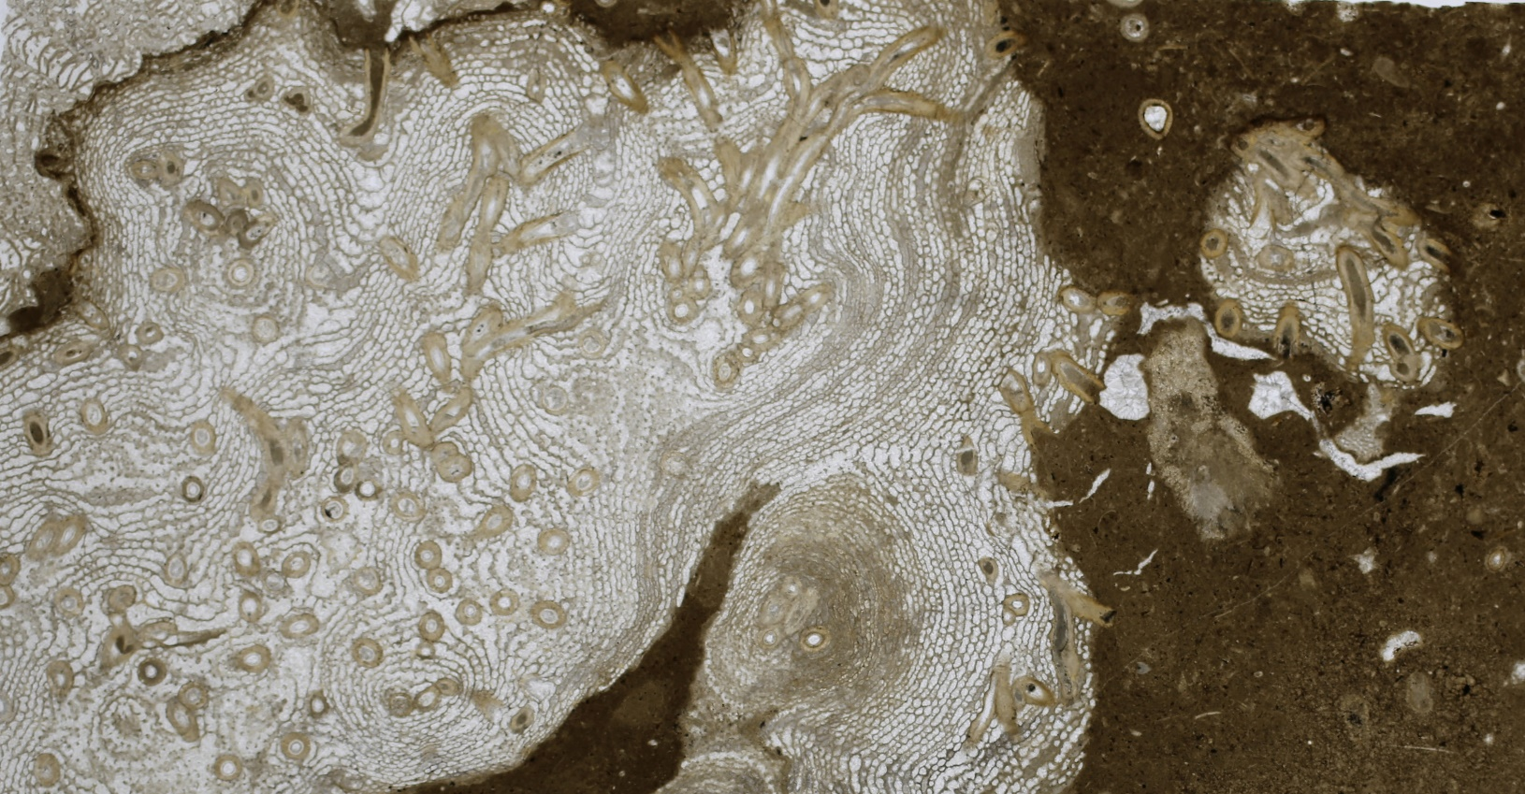
Acknowledgement
National Research Foundation of Korea
2013R1A2A2A01067612
2015R1A2A2A01007063
10 mm
Notes:
(the content of this slide was not decided yet)[PERHAPS A NICE PICTURE OF THE RELATIONSHIP, SUCH AS THIS, COULD BE INCLUDED IF THERE IS SPACE]

Slide 28
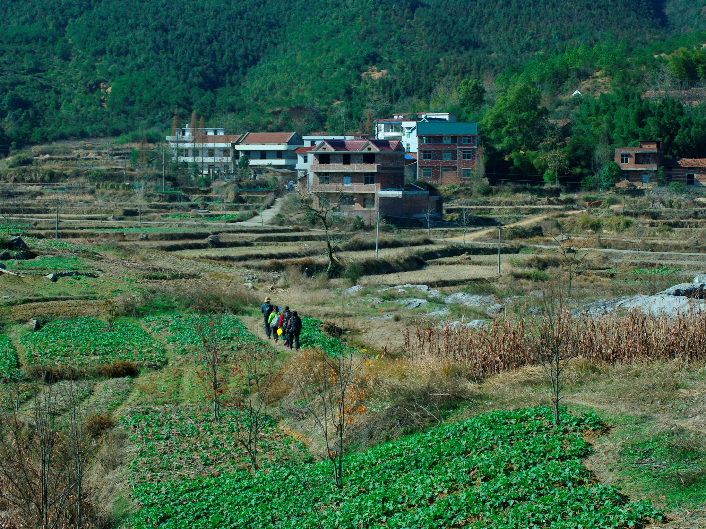
Thank you for your attention.
Notes:
Thank you for your attention.

Slide 30
Diameters
units | diameter
 | min. | max. | avg. | s.d. | n
B10 | 0.78 | 1.34 | 0.97 | 0.12 | 19
B8 | 0.61 | 1.43 | 0.97 | 0.13 | 453
B7 | 0.77 | 1.22 | 1.02 | 0.09 | 113
B3 | 1.07 | 1.73 | 1.27 | 0.13 | 25
B2 | 1.07 | 1.60 | 1.38 | 0.14 | 35
free-living mode
endobionts in Clathrodictyon
endobionts in Ecclimadictyon
n = 22
average = 0.92 (mm)
n = 723
average = 0.97 (mm)
n = 70
average = 0.87 (mm)
Notes:
(for answer the possible question about diameters ranges of Bajgolia in the other units)

