Slide 1

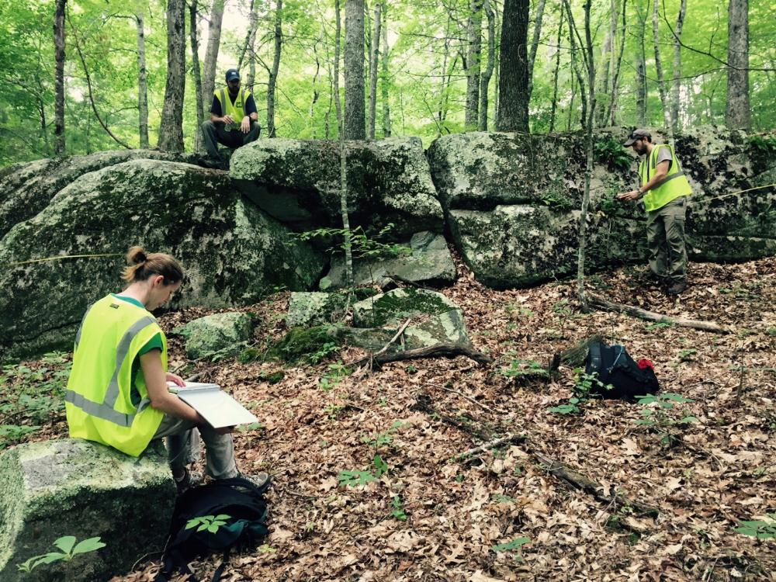

CHARACTERIZING BEDROCK FRACTURE ORIENTATION AND DENSITY USING FRACTURE TRACE ANALYSIS, OUTCROP FIELD MAPPING, AND GEOPHYSICAL BOREHOLE METHODS IN FOSTER, RHODE ISLAND
US Army Corps of Engineers
BUILDING STRONG®
Jeff Schwindaman
Hydrologist,
US Army Geospatial Center
Date: 03 November 2015

Slide 2
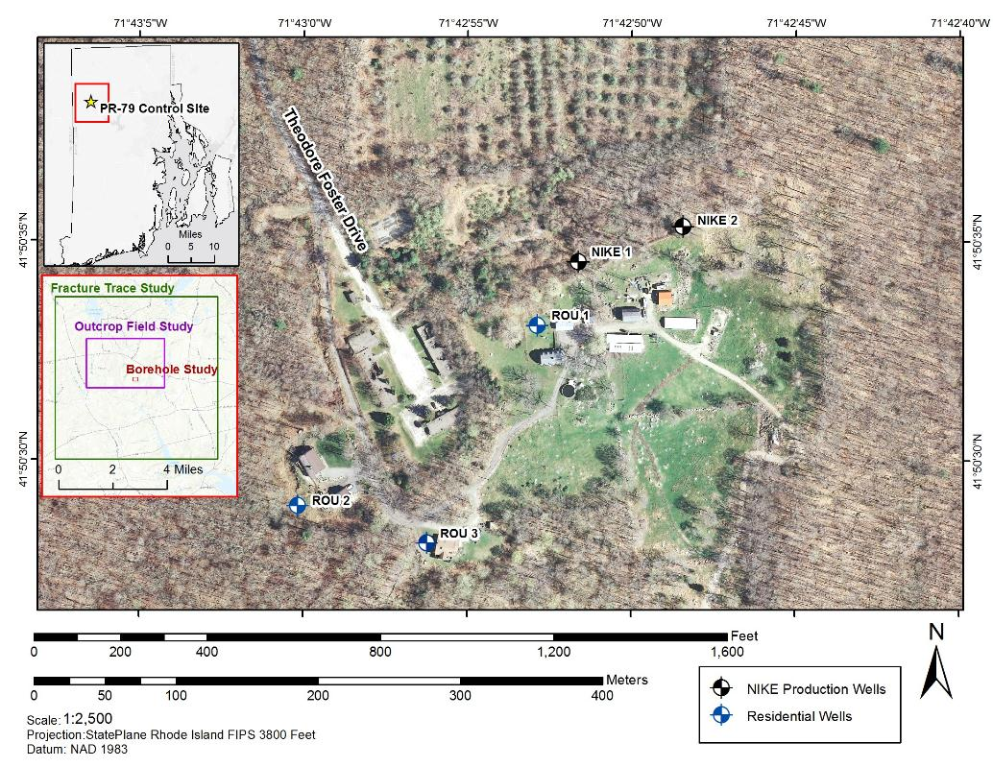
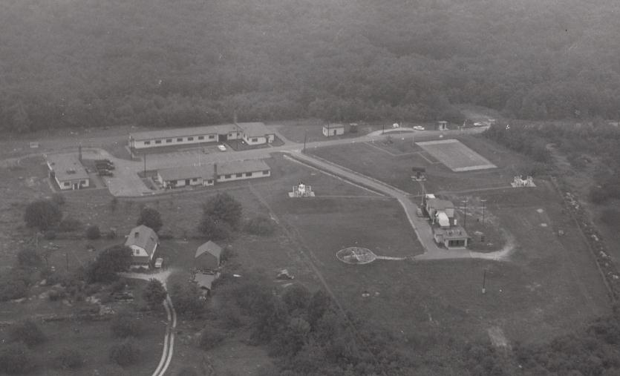
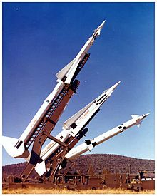
NIKE PR-79 Control Site
Approx. 14 acres in NW RI
Former NIKE missile defense network
1956 – 1963
TCE discovered in two on-site production wells, 3 residential wells
N

Slide 3
Purpose of the study
Determine potential pathways of TCE migration by characterizing the bedrock fracture pattern at the NIKE PR79 Control Site
1. Determine the location and orientation of remotely-sensed fracture traces
2. Characterize bedrock fractures in outcrop
3. Compare results with borehole geophysical data
Fracture Trace Investigation
Bedrock Fracture Characterization
Field Outcrop Investigation
Borehole Geophysical Investigation

Slide 4
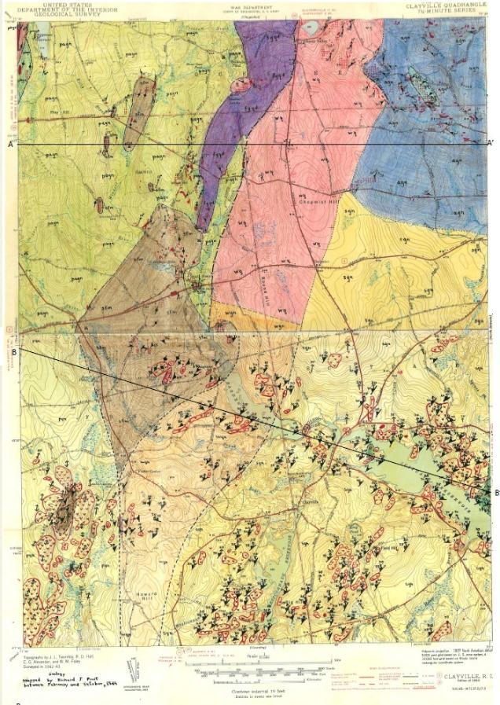
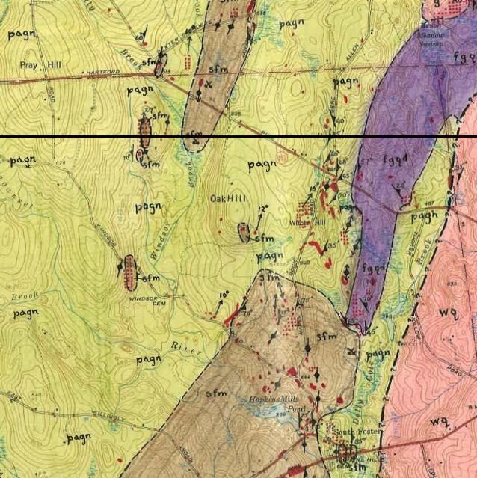
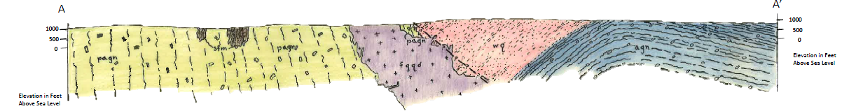




Site Geology
Ponaganset gneiss
Fine-grained quartz diorite
South Foster migmatite
Woonasquatucket quartzite
(Acker, 1950; Frost, 1950)

Slide 5
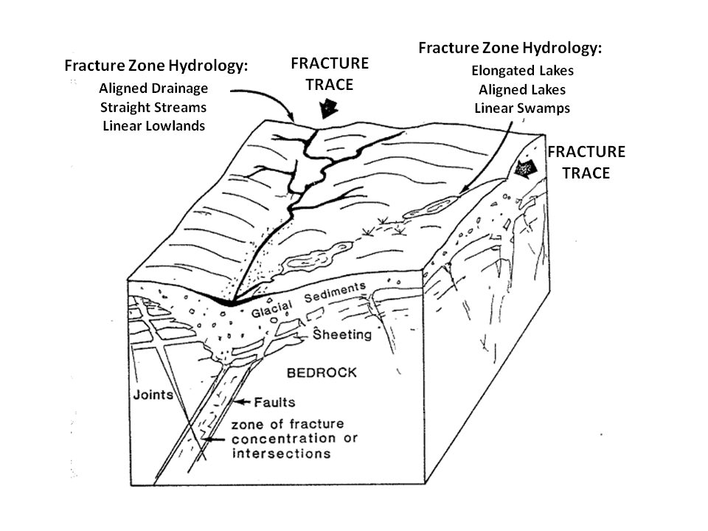
Fracture Trace Investigation

Slide 6
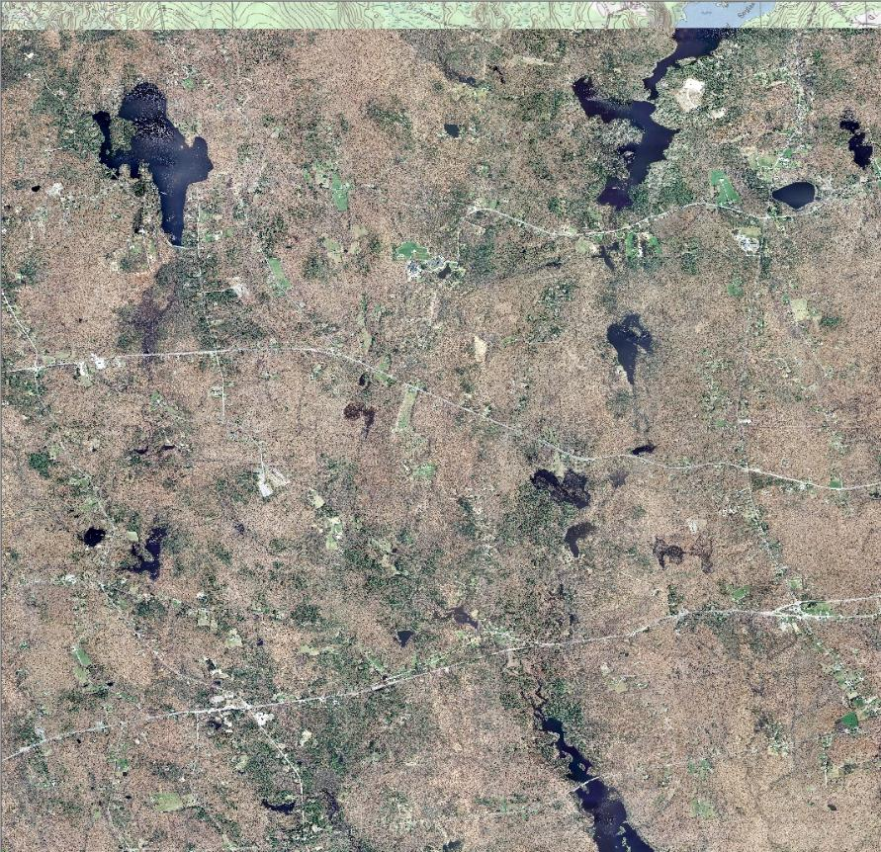
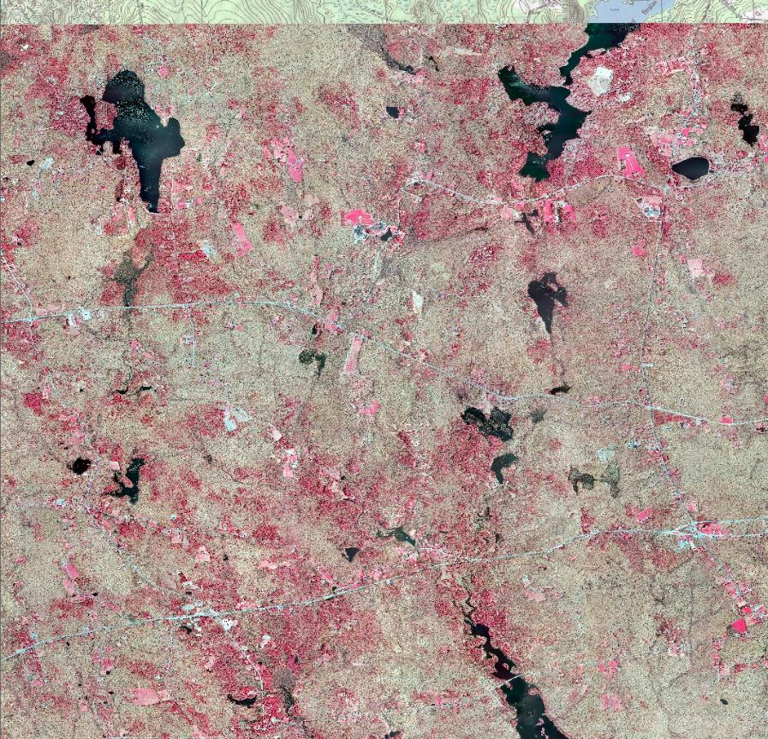
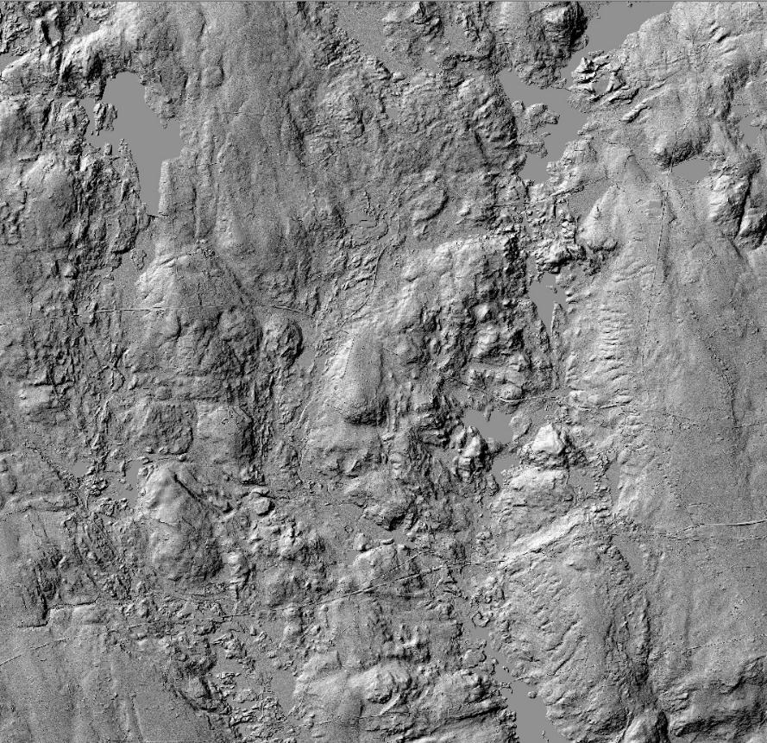
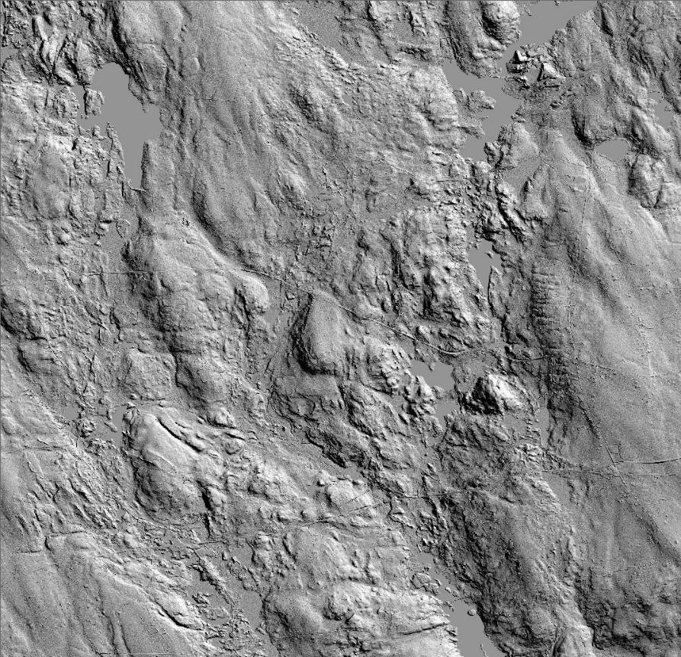
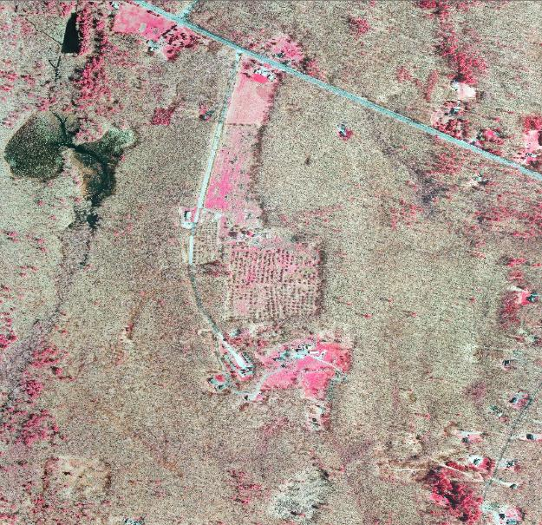
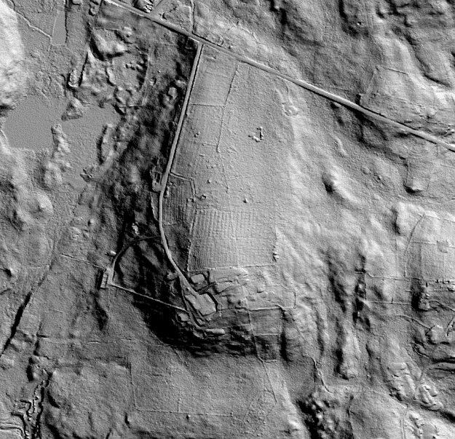
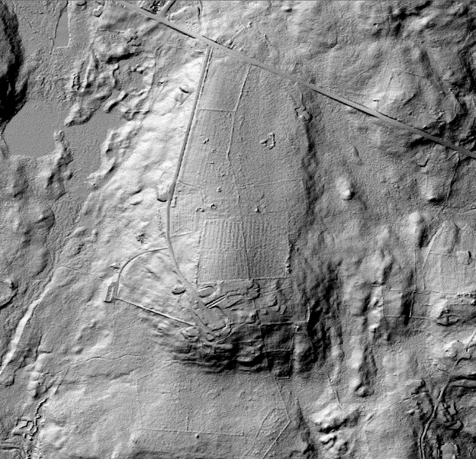
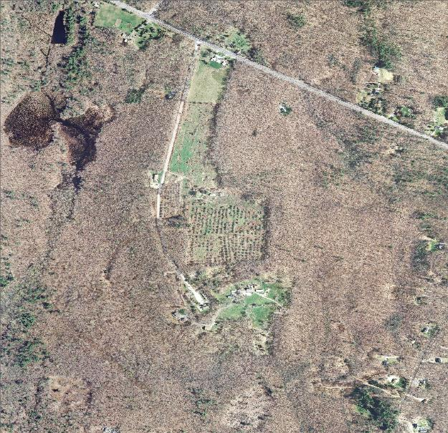
Fracture Trace Investigation
Sun Angle
Sun Angle
Bands 1, 2, 3
Bands 4, 1, 2

Slide 7
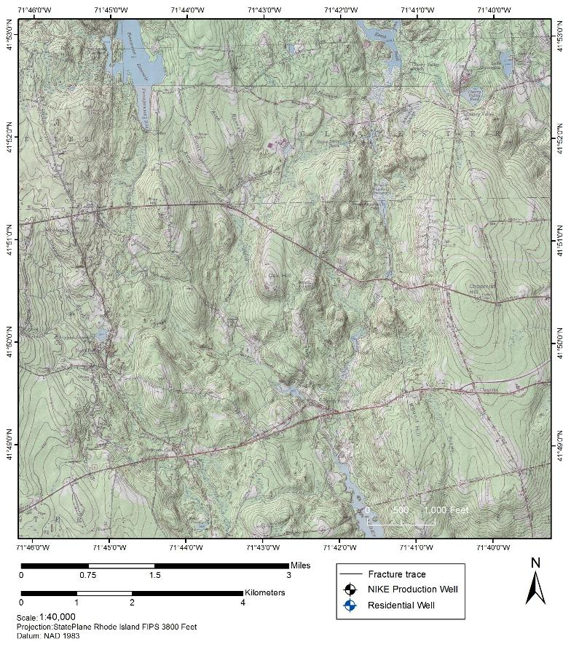
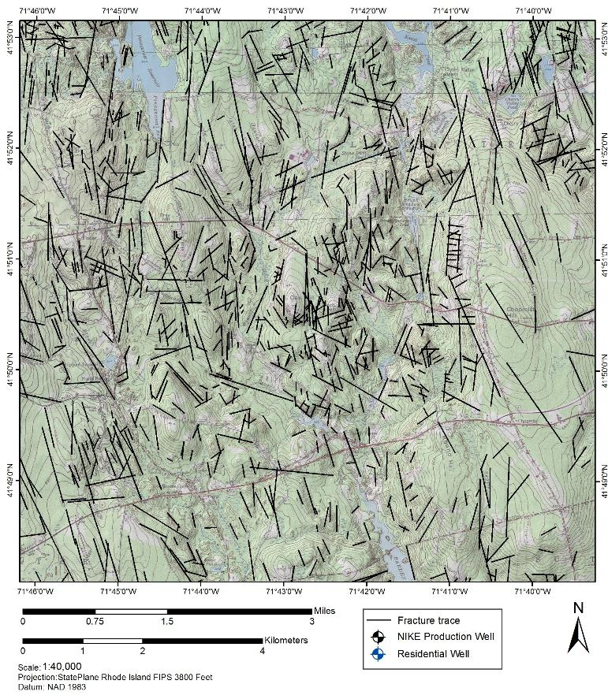
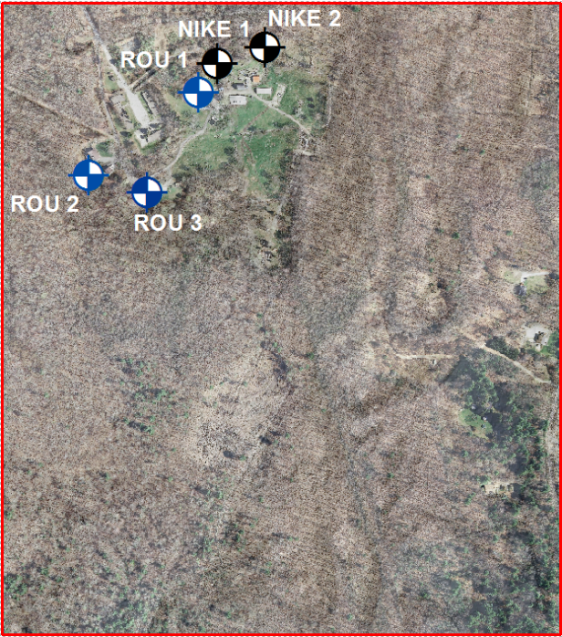
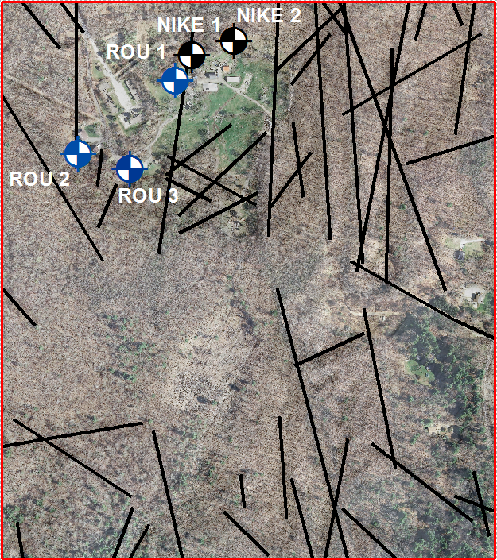
Fracture Trace Investigation

Slide 8
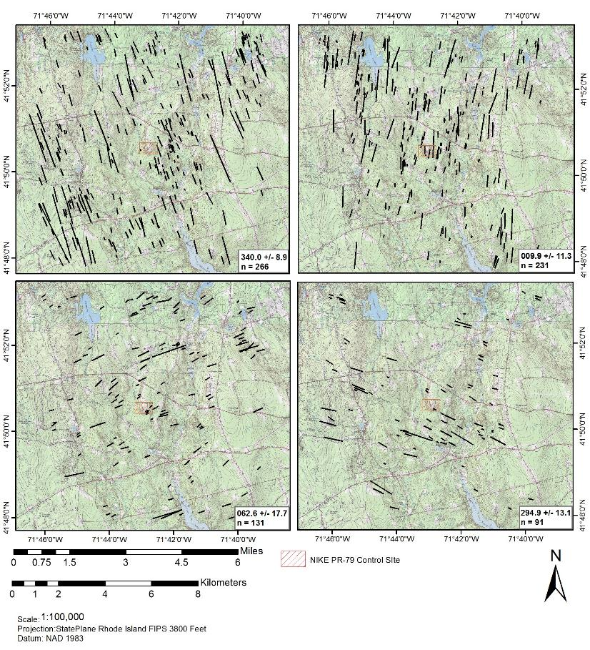
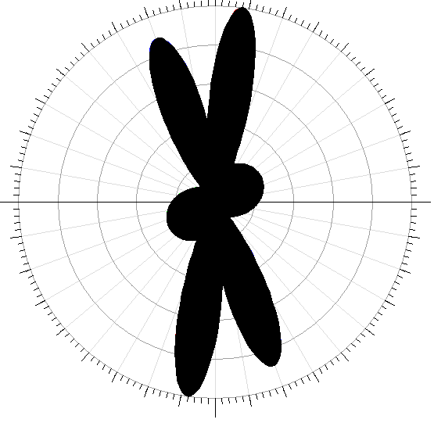
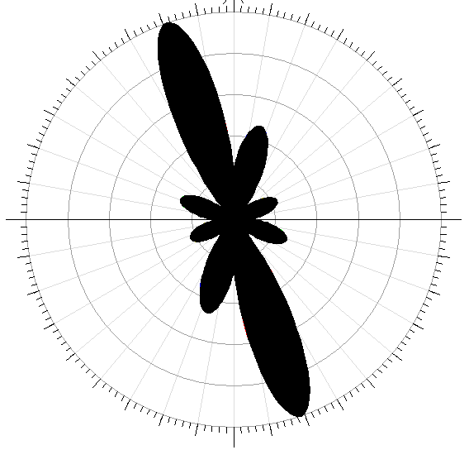
Fracture Trace Analysis
?
Structural trend?
North – NE/SW
South – NW/SE

Slide 9
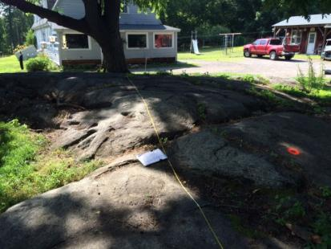
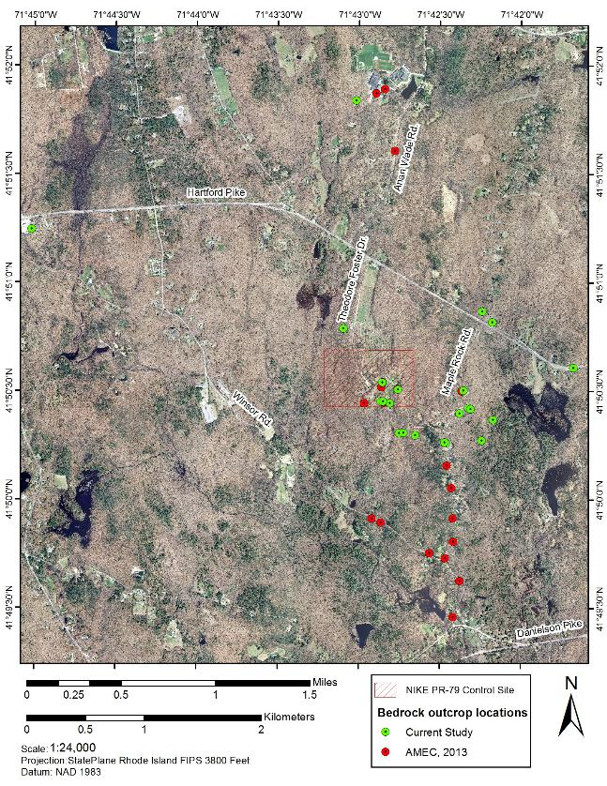
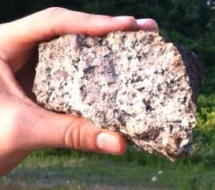
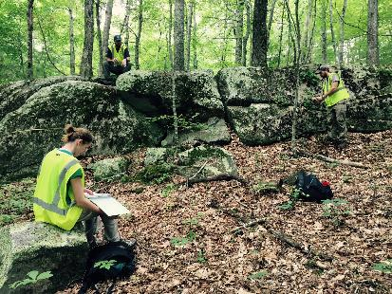
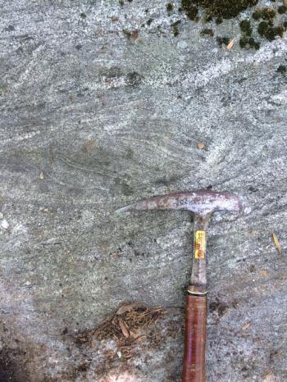
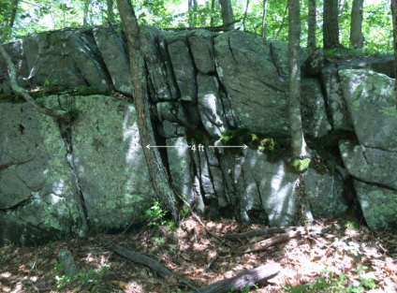
Field Outcrop Investigation

Slide 10
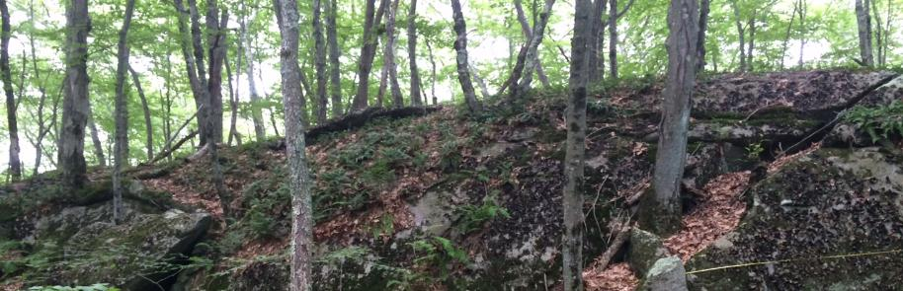
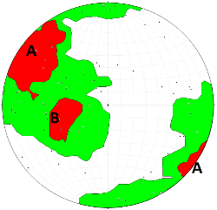
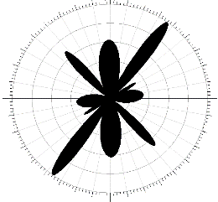
Field Outcrop Investigation
22 outcrop locations
N = 96 fractures
Float vs. Outcrop?
59 % steeply dipping (≥ 60°)
3 % shallow dipping (≤ 20°)
Average linear fracture density: 0.28 fractures/ ft
Average linear fracture spacing: 3.57 ft/fracture
Slightly to very slightly fractured (USBR Classification)
Characteristic | Average | Minimum | Maximum
Apparent Length | 7.6 ft | 1.0 ft | 26.7 ft
Openness | 4 (Moderately Wide; 0.03 to 0.1 ft) | 1 (Slightly Open; <0.003 ft) | 5 (Wide; > 0.1 ft)
Moisture | 2 (Dry, no evidence of water flow) | 1 (Dry, tight, impedes water flow) | 3 (Dry but shows evidence of water flow)
Roughness | 3 (Asperities clearly visible) | 1 (Near-normal steps and ridges on fracture surface) | 3 (Asperities clearly visible)

Slide 11
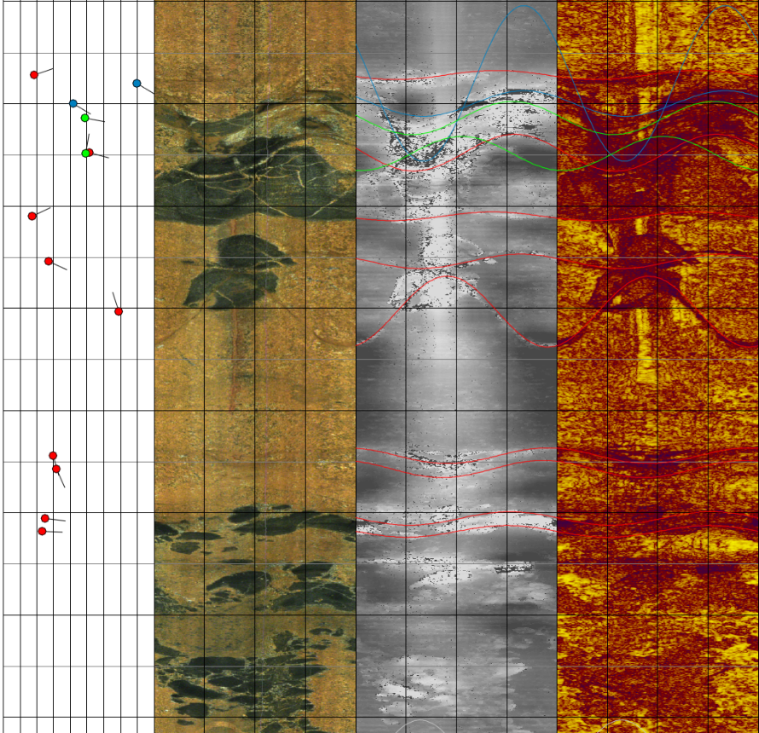
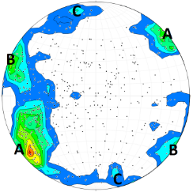
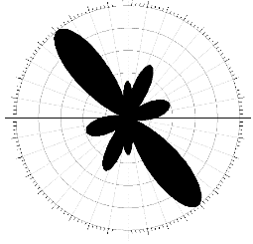
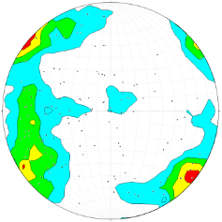
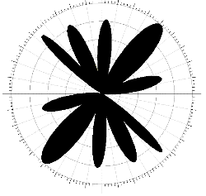

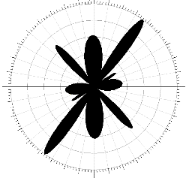
Borehole Geophysical Investigation
All Fractures
Open Fractures
Transmissive Fractures
Fracture Zones
Faults
Orientation Bias
Terzaghi Correction
Transmissive Fractures
N325° / 77°NE
N024° / 82°SW
N255° / 89°NW
73% Steeply dipping (≥ 60°)
3% Shallow dipping (≤ 20°)
Average 1D fracture density: 0.6 fractures/ft
Average fracture spacing: 1.7 ft/ fracture
Outcrop Fractures

Slide 12
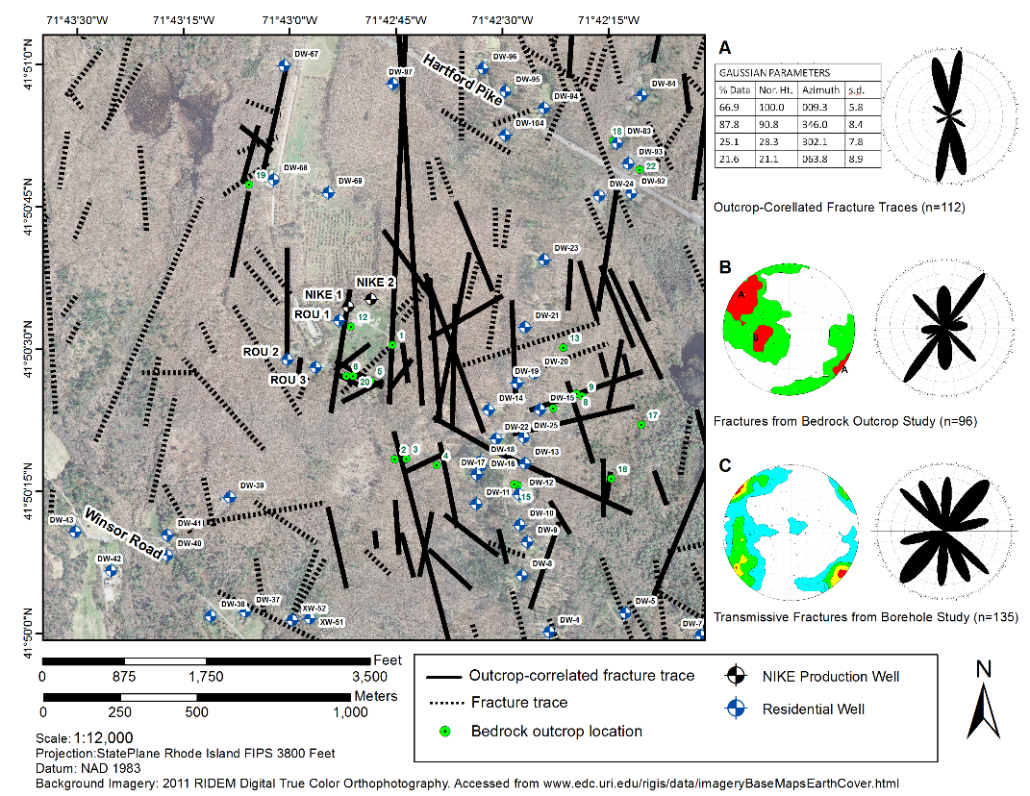
Summary and Future Work
Outcrop-correlated fracture traces
Mostly steeply dipping fractures, striking from NW to NE
Fracture spacing and density were similar between outcrop and borehole investigations
Results improve the conceptual site model and can be used for future modeling
(e.g. MODFLOW, DFN)

Slide 13
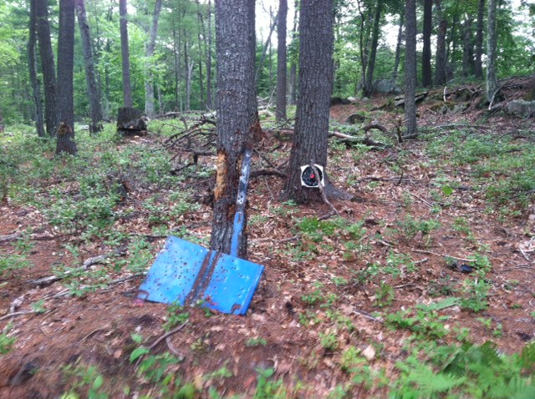
Questions?
(Field hazards not in the health and safety plan)

