Slide 1
Effects of Ocean Acidification on Large Benthic Foraminiferal Stable Isotope Composition
Paul O. Knorr, Ph.D., Bureau of Ocean Energy Management
Lisa L. Robbins, Ph.D., U.S. Geological Survey
Jonathan Wynn, Ph.D., University of South Florida
Pamela Hallock, Ph.D., University of South Florida
Peter J. Harries, Ph.D., North Carolina State University
Article submitted to ICES-JMS

Slide 2
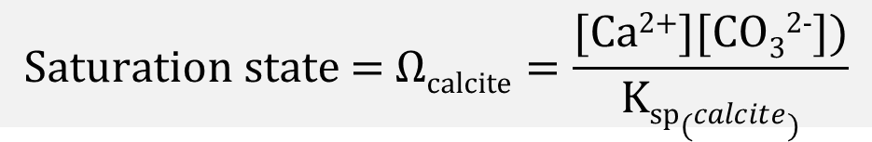

$\text{Ω}\text{calcite}$ vs pCO₂
8.0
$$\text{Saturation} \text{state}\text{ = }\text{Ω}\text{calcite}=\frac{\text{[}\text{Ca}\text{2+}\text{][}\text{CO}\text{3}\text{2−}\text{])}}{Ksp(calcite)}$$
Ω_{calcite}
4.4
Control (pH 8.0, Alkalinity is 10% CO₃²⁻, ~2025)
Treatment (pH 7.6, 4% CO₃²⁻, ~2140)
2.0
0
470
1300
3000
pCO₂ (µatm)

Slide 3
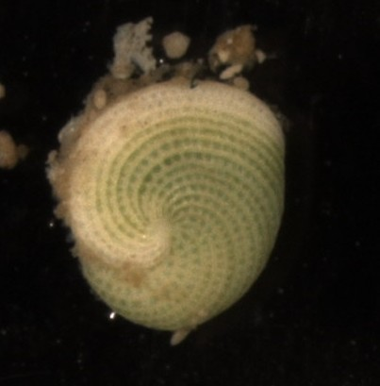
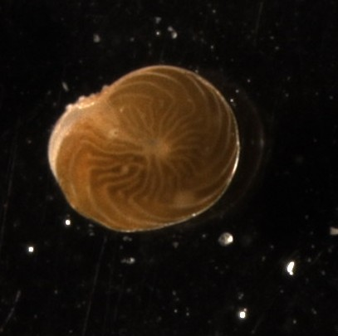
Large Benthic Forams
Miliolid (Miliolida) | Rotalid (Rotaliida)
Porcelaneous | Hyaline
Imperforate | Perforate
High-Mg calcite | Low-Mg calcite
Archaias angulatus
Amphistegina gibbosa
2 mm
2 mm

Slide 4
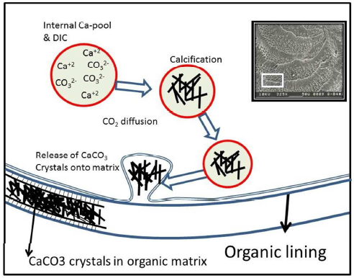
Miliolid Calcification
Modified after Ter Kuile et al. (1989) and Cotey and Hallock (1988)

Slide 5
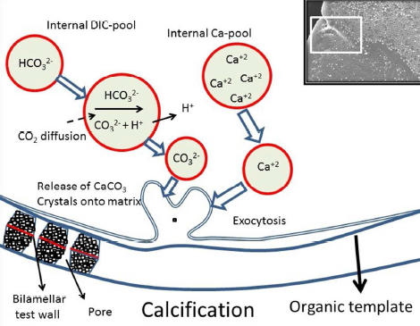
Rotalid Calcification
Modified after ter Kuile et al. (1989) and De Nooijer et al. (2014)

Slide 6
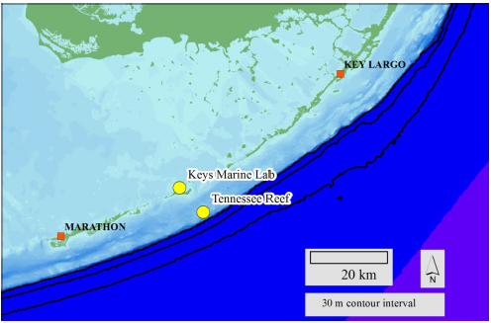
Sample Location
Miliolid
Rotalid

Slide 7
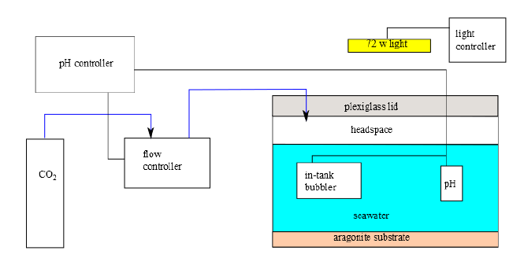
Apparatus
pH and Alkalinity analysis using Ocean Optics spectrophotometers
Stable isotope analysis using Thermo Delta V IRMS w/ Gasbench II, 2σ < 0.1 ‰
Referenced Guide to best practices for OA research and data reporting (2010)

Slide 8
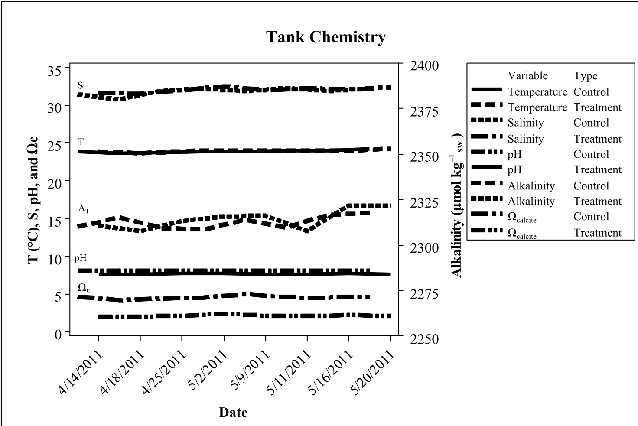
Tank Chemistry

Slide 9
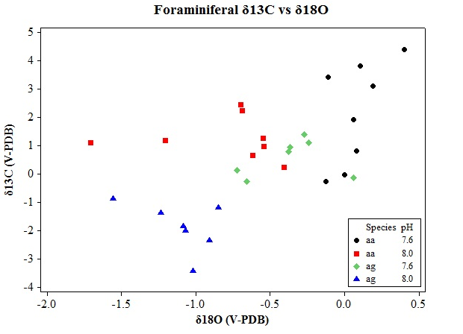
Results
n = 30

Slide 10
Results

Slide 11
Significance
 | Miliolid | Rotalid
δ¹⁸O | p < 0.005 | p < 0.005
δ¹³C | NS (p = 0.25) | p < 0.001
Tukey’s pairwise method

Slide 12

Interpretation
Miliolid
δ¹⁸O fractionation dependent on carbon speciation:
HCO₃⁻ 16‰ > CO₃²⁻
(Less CO₃²⁻ at low pH)
δ¹³C not correlated to carbon speciation, no vital effect on carbon pool
Rotalid
δ¹⁸O fractionation dependent on carbon speciation
δ¹³C consequence of vital effect on internal carbon pool; diatom endosymbionts may benefit from increased CO₂

