Slide 1
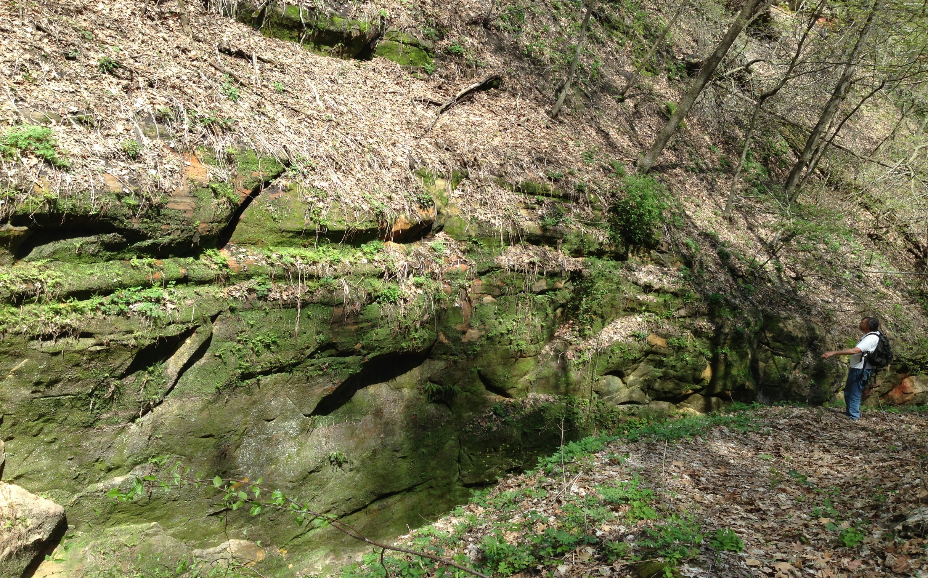
Detrital zircon Geochronology of St. peter Sandstone and Starved Rock Formation in Iowa
¹IBRAHIM, DIAR; ¹McClelland, William C., ²Pope, Michael C., ¹Witzke, Brian J., ¹Finzel, Emily S.,and ²Miller, Brent V.
¹University of Iowa, ²Texas A&M

Slide 2
St. Peter Sandstone: Middle Ordovician widely distributed across Laurentia major role in defining global stratigraphy (e.g., Dott et al., 1986).
Supported by : American Chemical Society (ACS), Petroleum Research Fund, and (Higher Committee Education Development of Iraq (HCED)

Slide 3
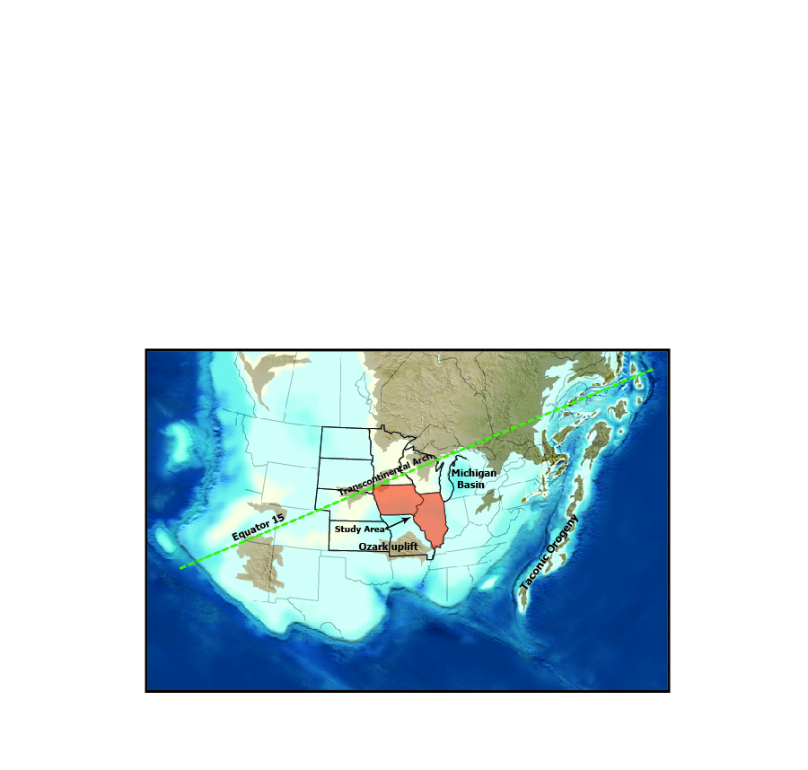
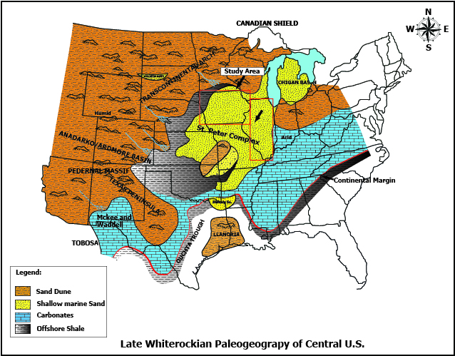
:
Middle orodovician Paleogeography:
St Peter SS
Iowa @ south 15-20 paleo-latitude, in the trade wind belt, and inundated by the Epeiric Sea.
Deposition of extensive siliciclastic rocks across the mid-continent.
(modified from Blakey, 2005)
(modified from, Witzke, 1980; Dott, 1985
and Shum, 1997)

Slide 4
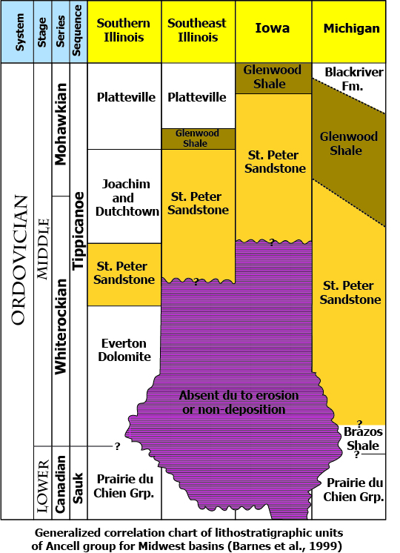
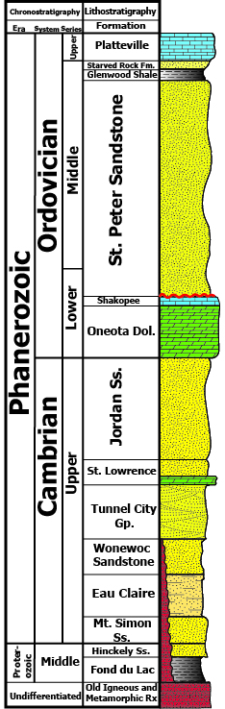
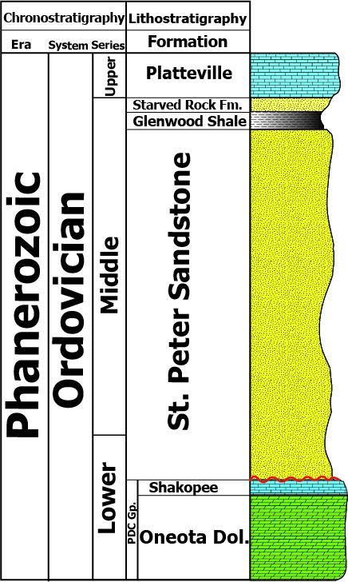
General Stratigraphy :
Generalized section
in Iowa

Slide 5
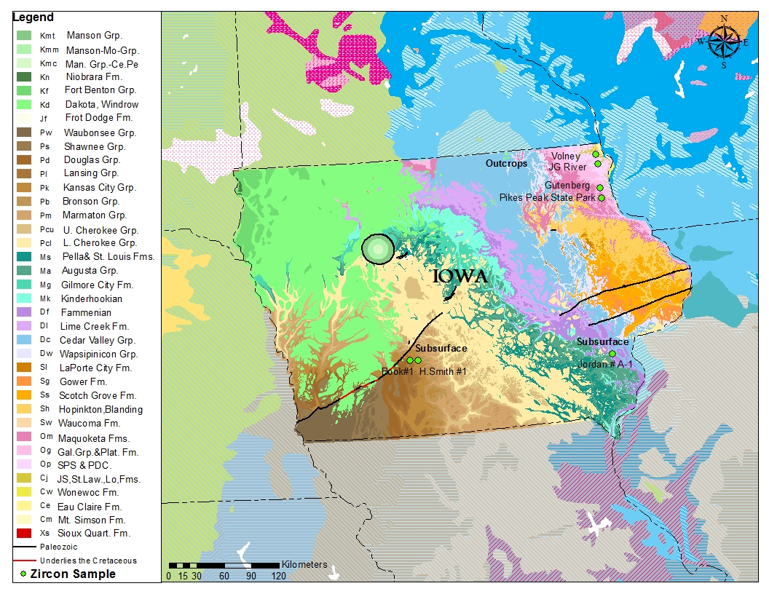
Geologic map of Iowa :
Zircon sample locations
A: Outcrop samples: 8
B: Subsurface samples: 2
C: Subsurface samples: 3
A
B
C

Slide 6
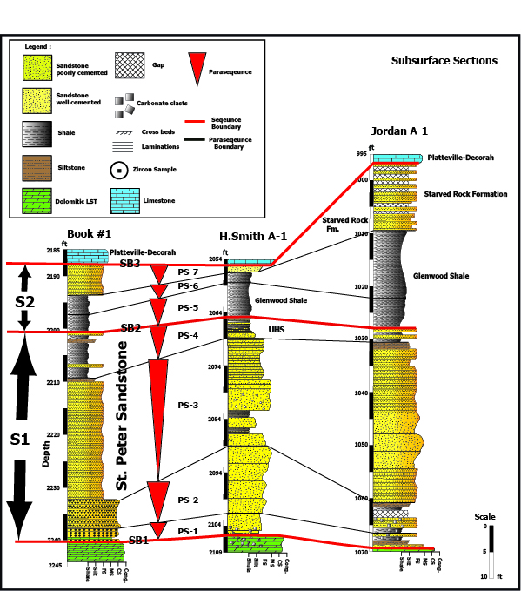
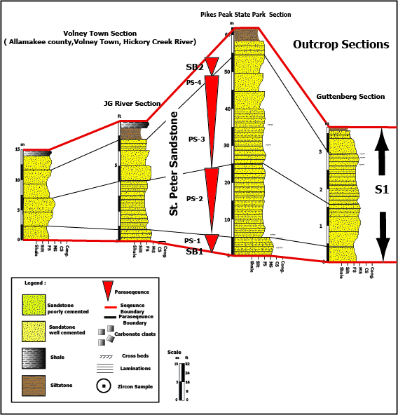
Core and out crop Sections:

Slide 7
SS-3
SS-6
B1
SS-5
SS-2
UHS
J-1
Volney
SS-4
JG River
SS-1
HSL
J-2

Slide 8
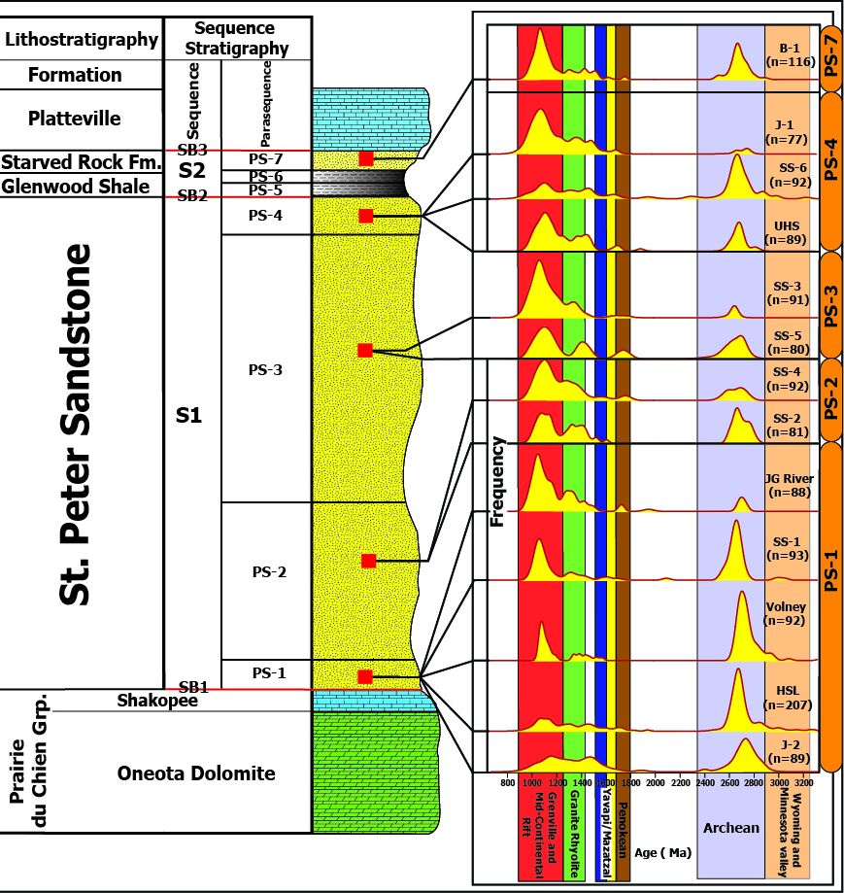
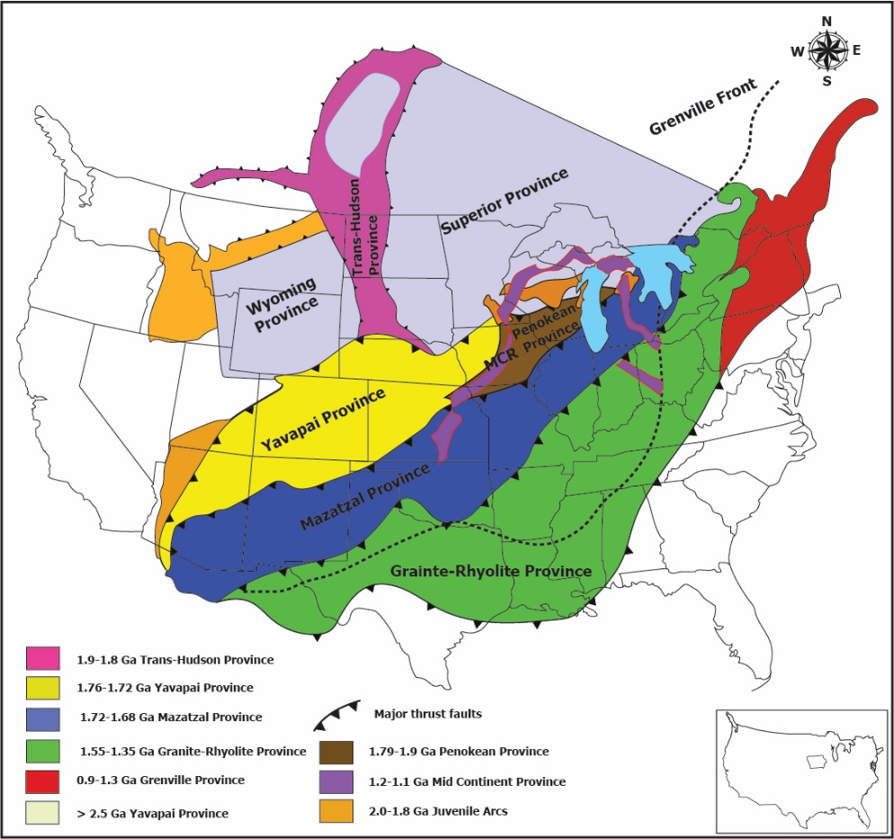
probability Density plot
Basement AGES of North America
Whitmeyer and Karlstrom, 2007

Slide 9
probability Density plot
Basement AGES of North America
Whitmeyer and Karlstrom, 2007

Slide 10
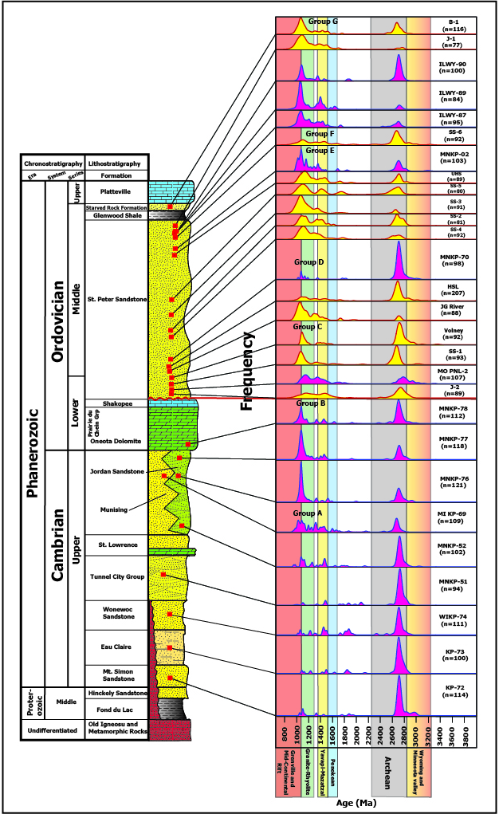
Compile with regional data from
Konstantinou et al. (2015)

Slide 11
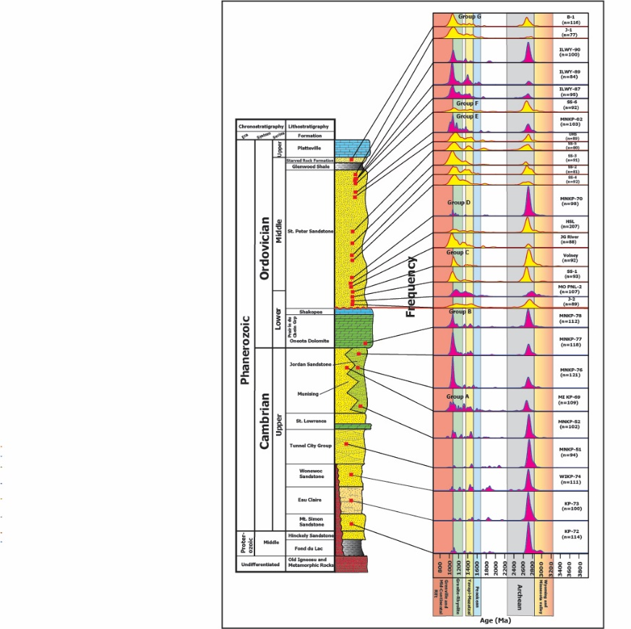
Ordovician Rocks
Probability Density Plot compilation ,
Konstantinou, 2015
Early Paleozoic Rocks

Slide 12
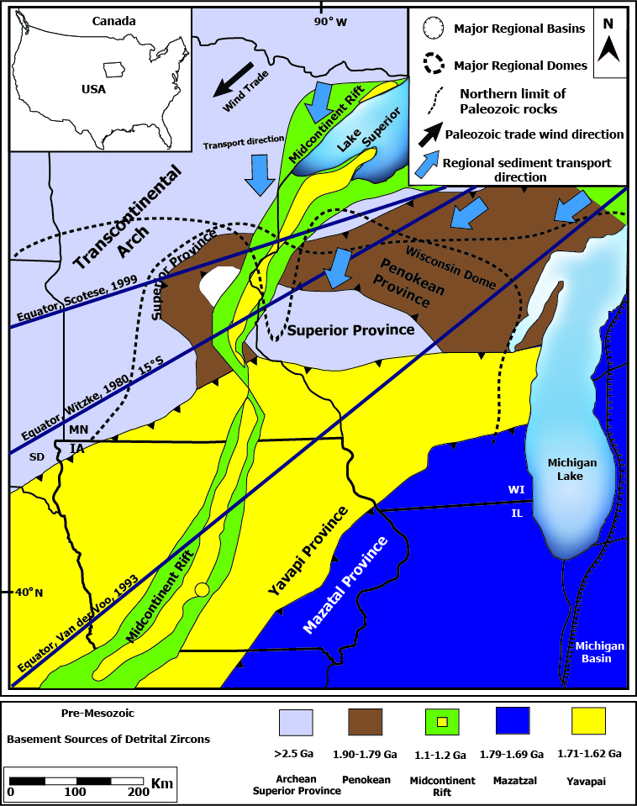
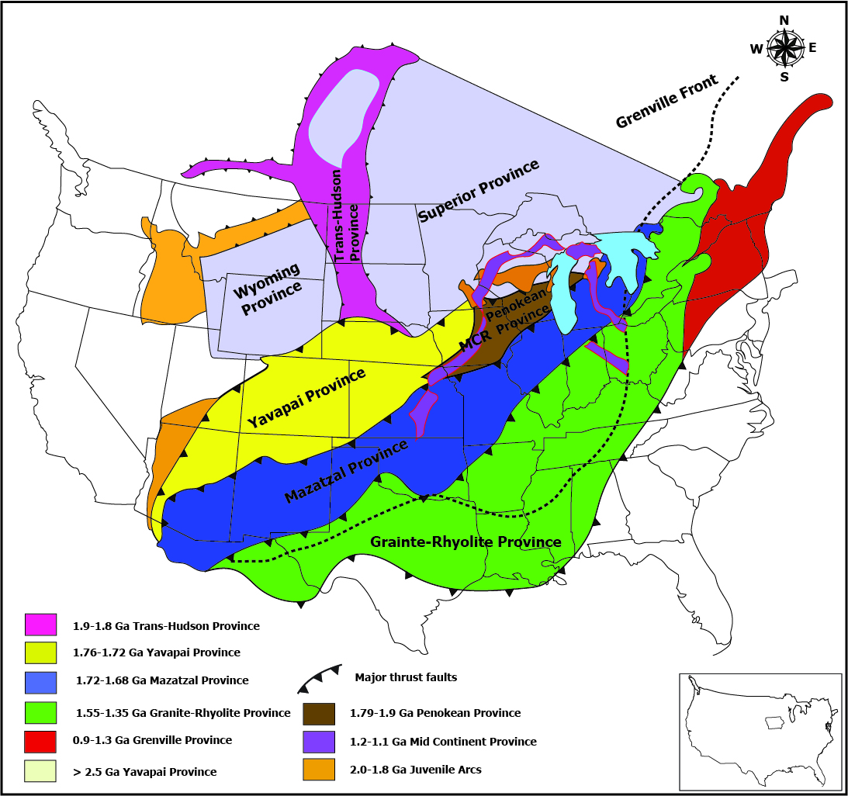
Basement ages of North America
Whitmeyer and Karlstrom, 2007
Konstantinou et al., 2015

Slide 13




Conclusion
The detrital zircon signatures record either first cycle derivation Grenville orogen, Midcontinent Rift, and Archean Superior Province
Or recycling from Paleoproterozoic and Mesoproterozoic basins (e.g., Huron, Mid-Continent Rift).
The general lack of 1800-1900 Ma grains argues against derivation from Trans-Hudson or Penokean orogen.
The combined data sets demonstrate that the shift between Grenville orogen Midcontinent Rift, and Archean Superior Province is repeated several times within the Ordovician section.
Samples dominated by Archean Superior Province occur directly above fine-grained layers associated with parasequence boundaries, suggesting that the changes in provenance is largely controlled by the effects of long-term sea level fluctuation.

