Slide 1
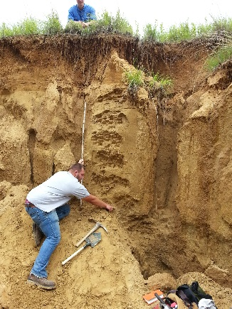
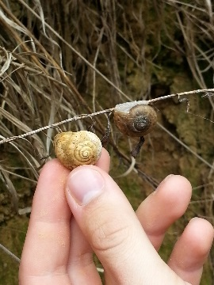

REVISITING THE JULES GEOSOL AND GASTROPOD PALEOECOLOGY IN LAST GLACIAL MAXIMUM LOESS, WESTERN ILLINOIS
David A. Grimley*, Thomas A. Nash, Jr.#, Jessica L. Conroy#,
Hong Wang*, Xiaodong Miao*, B. Brandon Curry*
*Illinois State Geological Survey
Prairie Research Institute
University of Illinois
#Department of Geology
University of Illinois

Slide 2
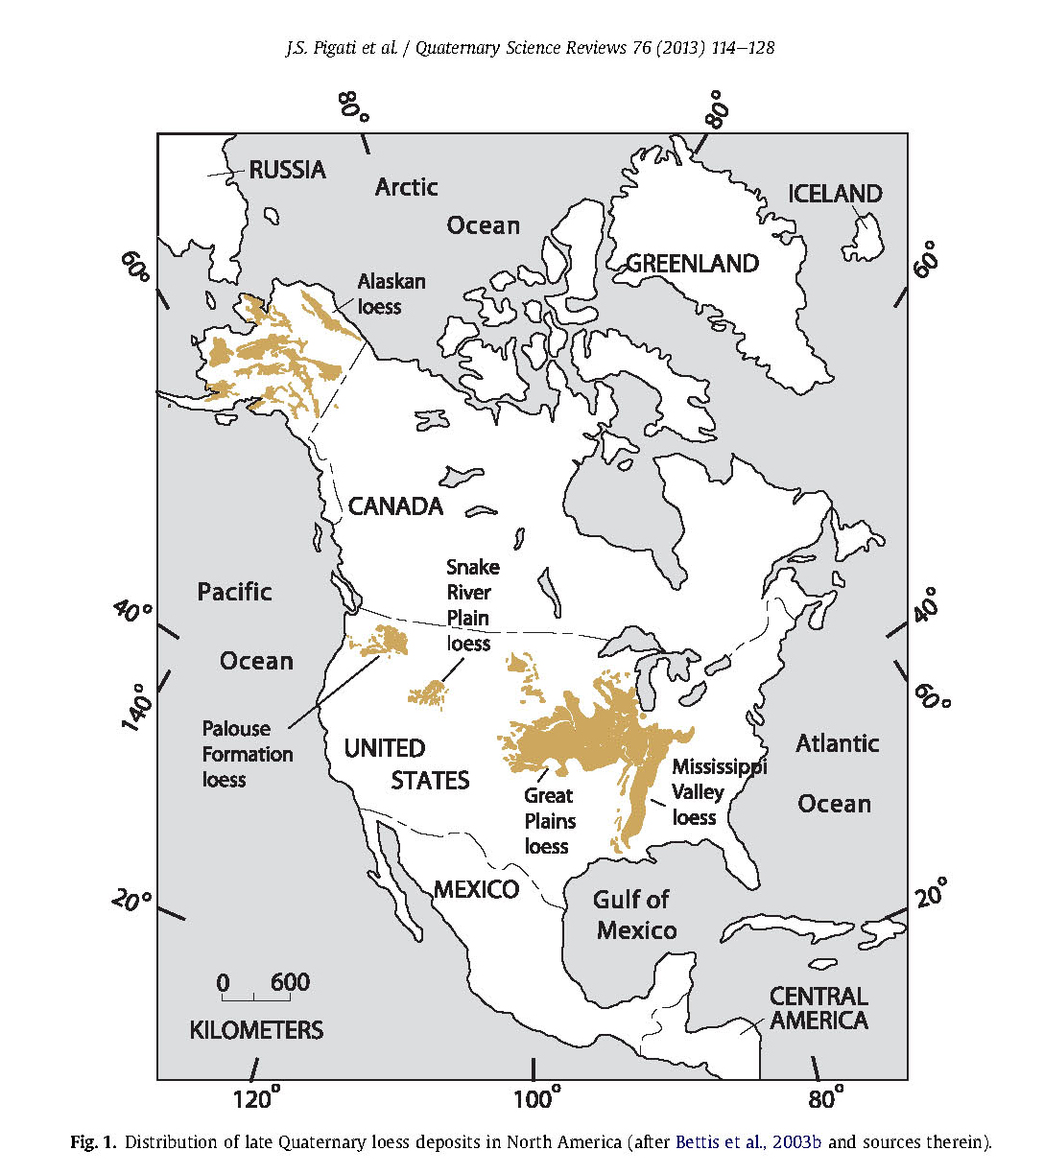
Location of Cottonwood School Section (CSS)
site in loess region of central-western Illinois
CS
Balt. GSA

Slide 3
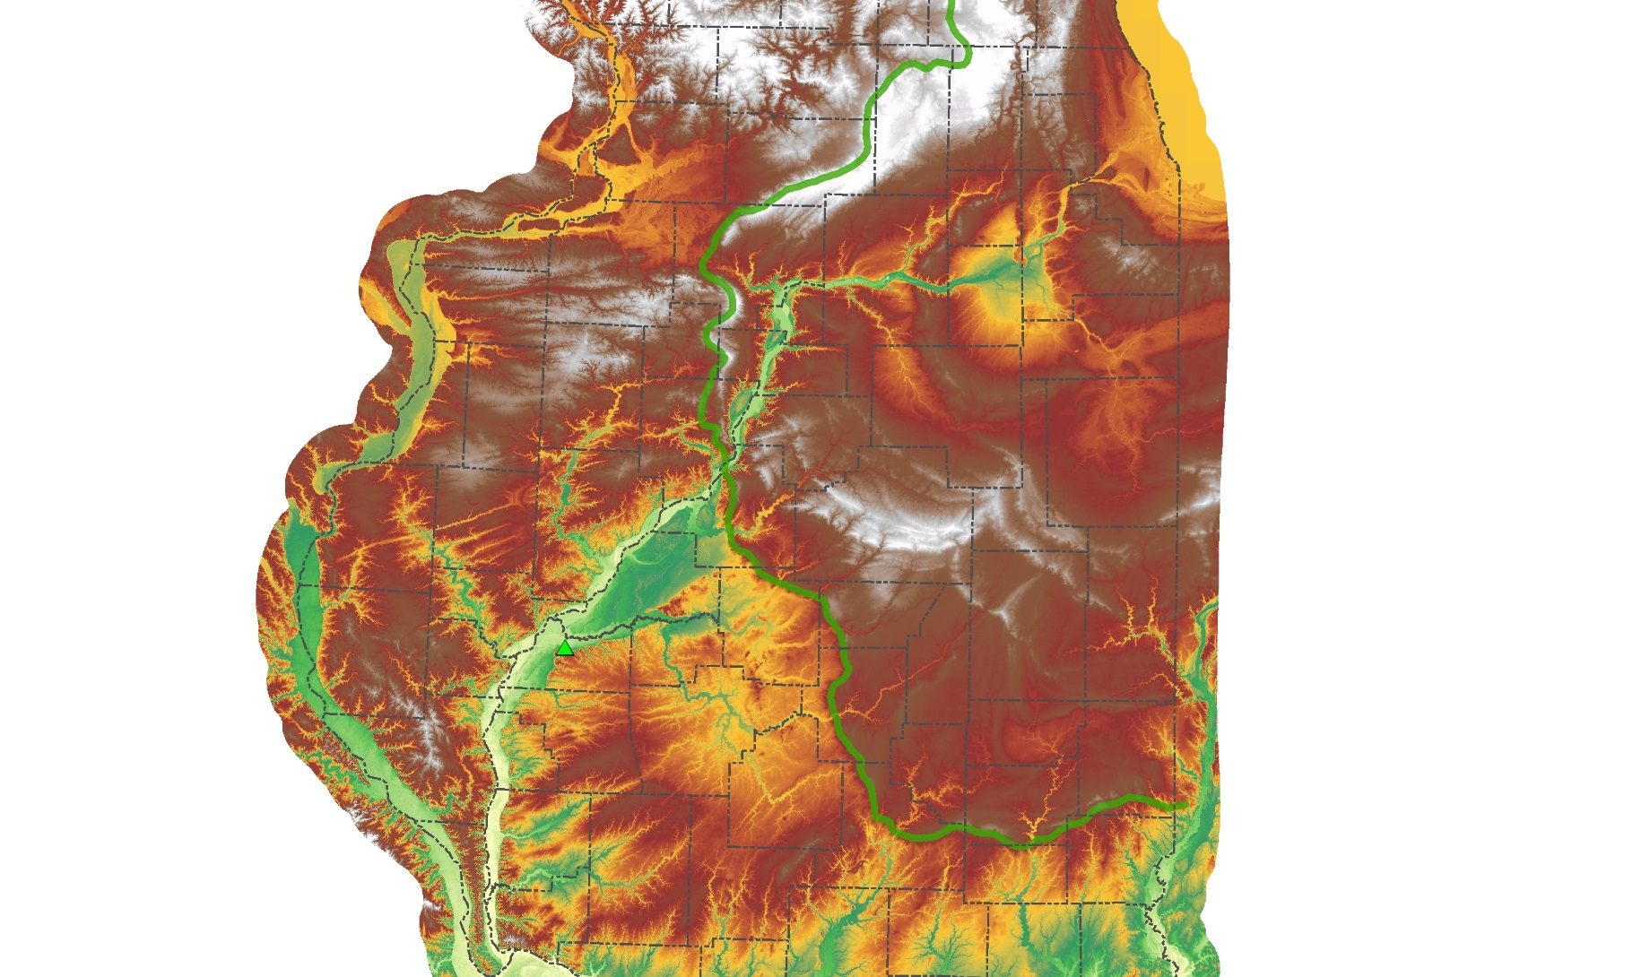
Location of CSS in Illinois
loess associated with last glaciation and meltwater discharge to large valleys
silt deflated from sparsely vegetated braided stream valleys and deposited on proximal uplands
Chicago
Peoria
~31 km
Lake Michigan Glacial Lobe
Illinois R. Valley
CSS
Miss. R. Valley
site ~ 75 km SW maximum Wisconsin Epsiode ice margin (~ 24 ka)

Slide 4
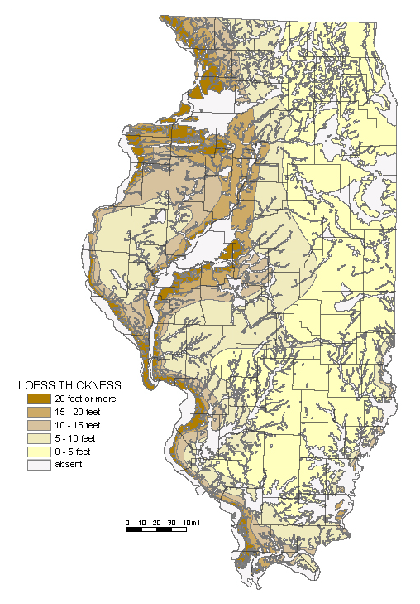
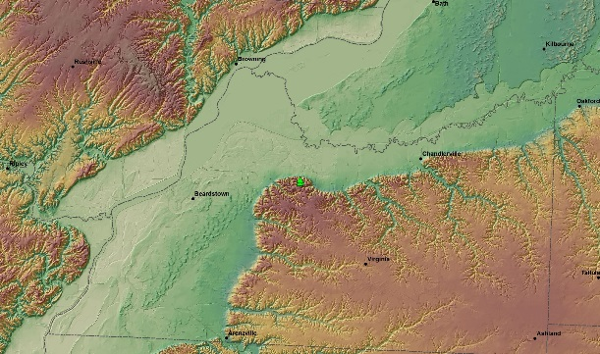
Illinois Loess Thickness Map
CSS
CSS
~ 19 km
~ 70 ft. of Wisconsin Episode loess at Cottonwood School Sections (43 ft. Peoria Silt –OIS2)

Slide 5
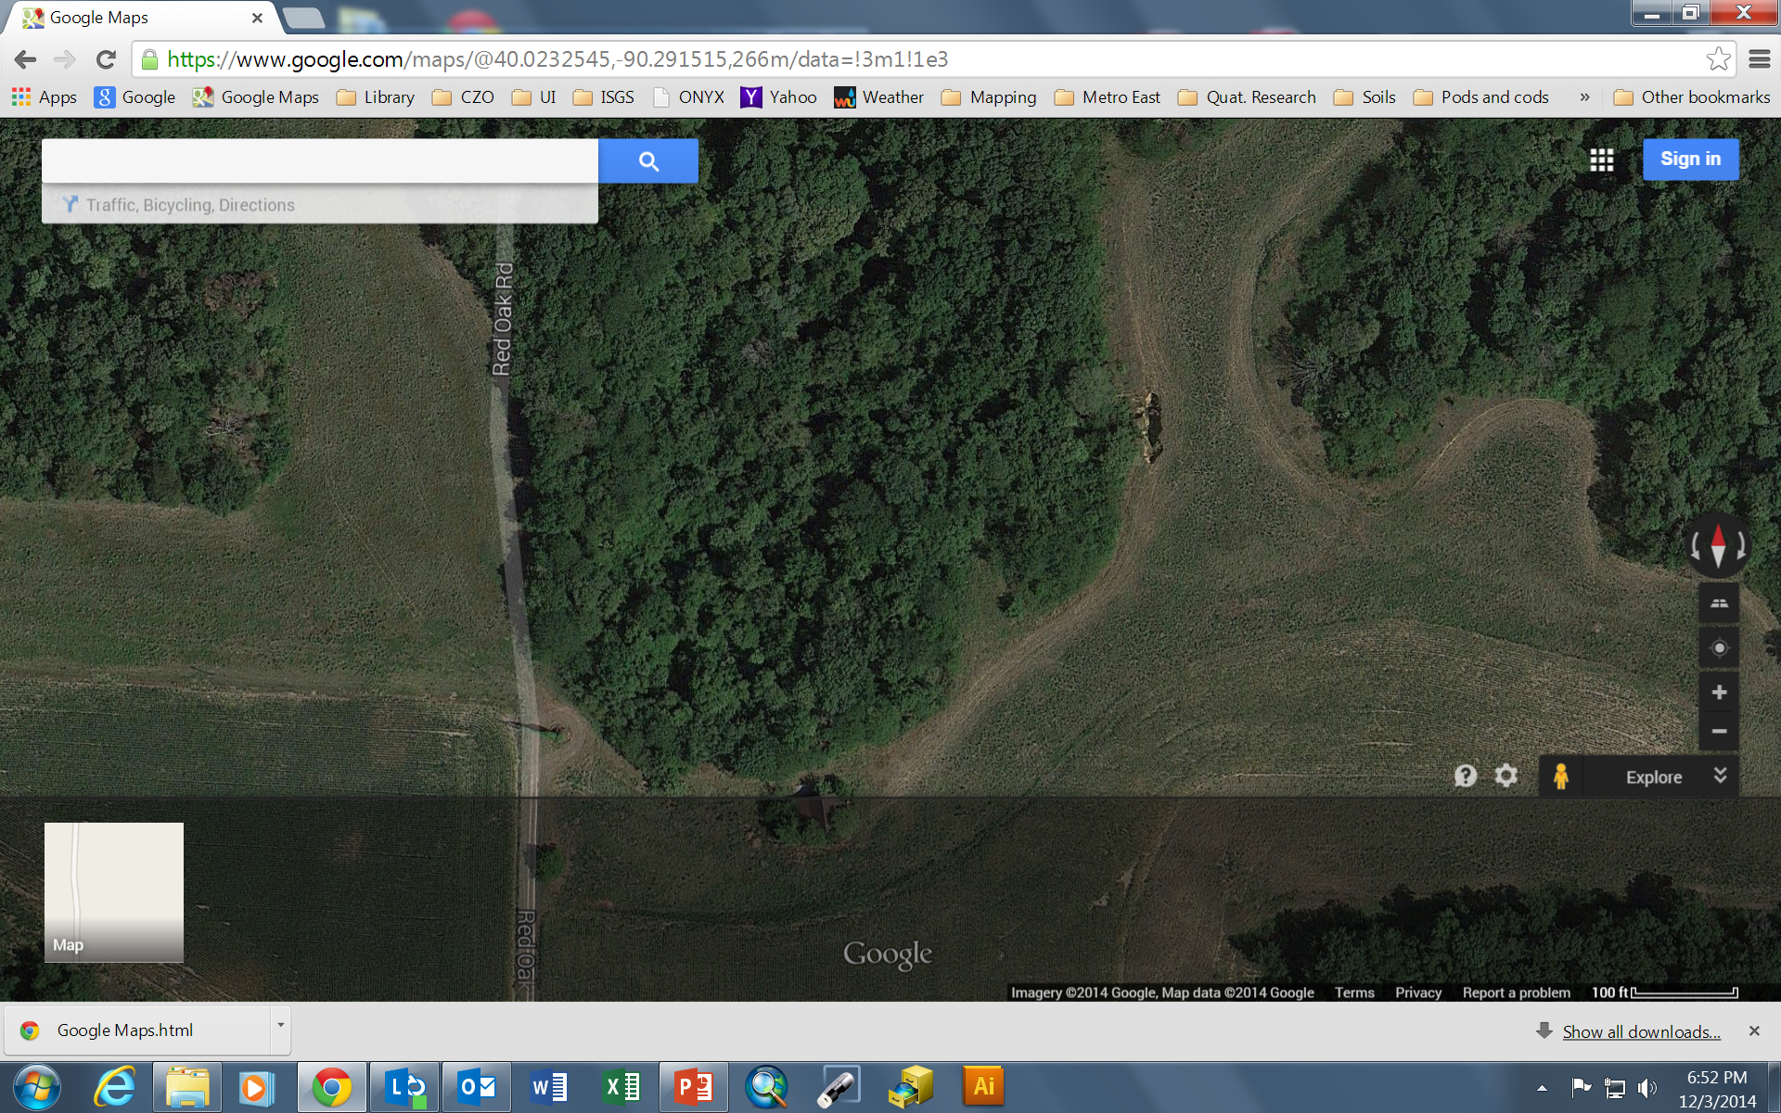
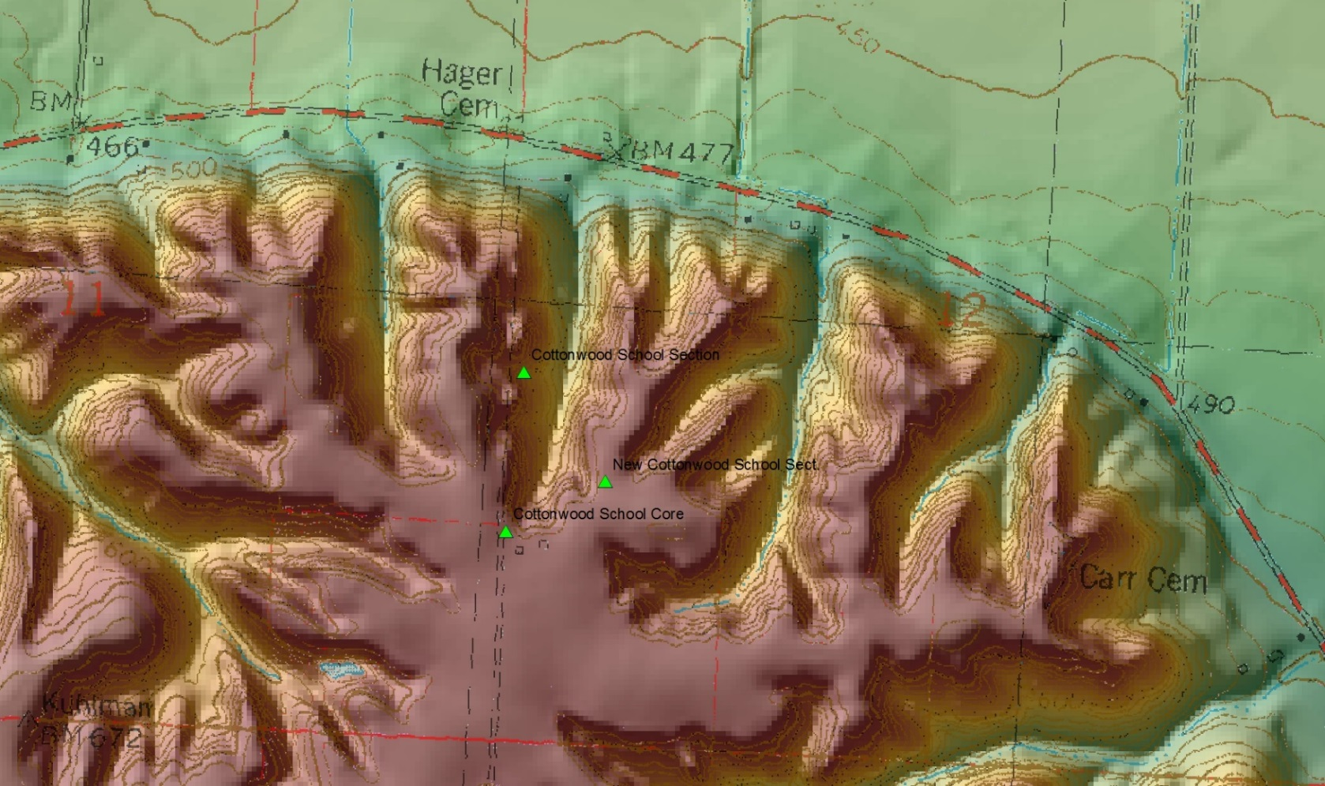
Proximity of New and Old Cottonwood School Sections
400 m

Slide 6

New Cottonwood School Section A
modern soil
UPPER PEORIA SILT (loess)
Jules Geosol (interstadial)
MIDDLE PEORIA SILT (loess)

Slide 7
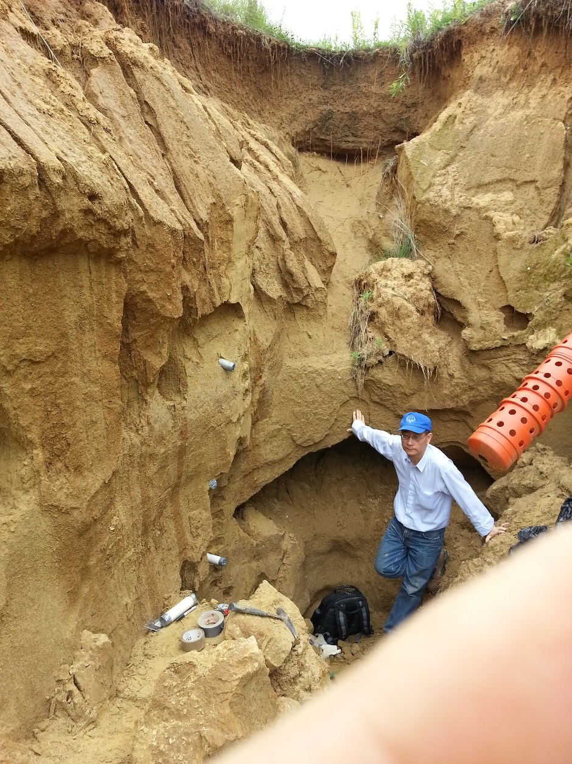
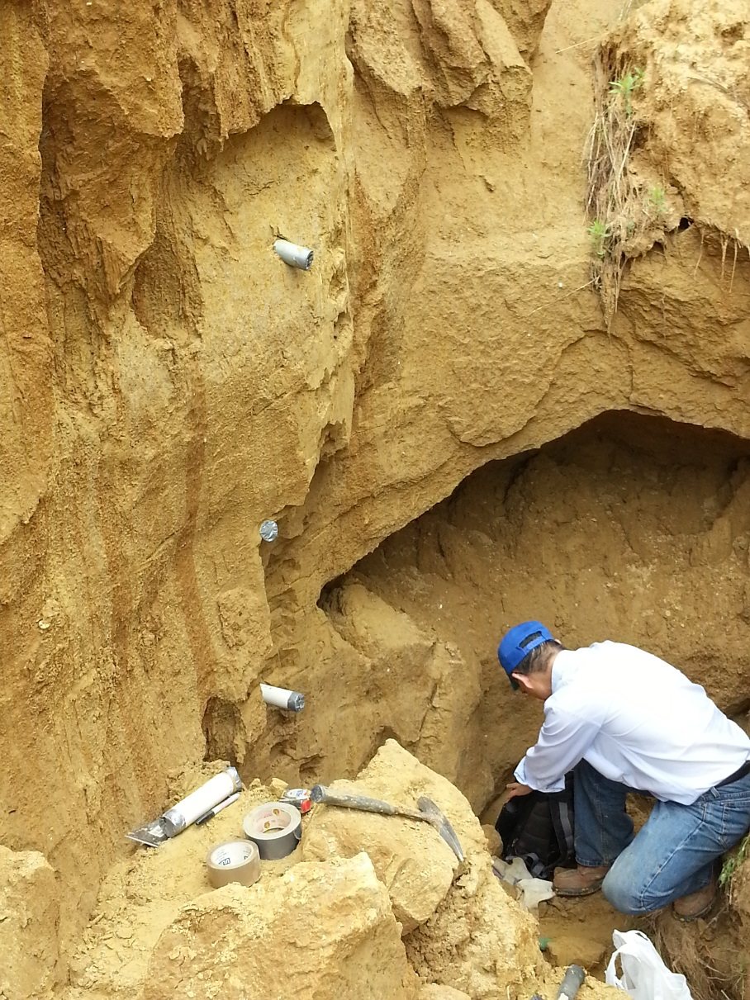
New Cottonwood School Section B
Modern Soil
Upper Peoria loess
Upper Peoria loess
Jules Gesol
Jules Geosol
Middle Peoria loess
Middle Peoria loess

Slide 8
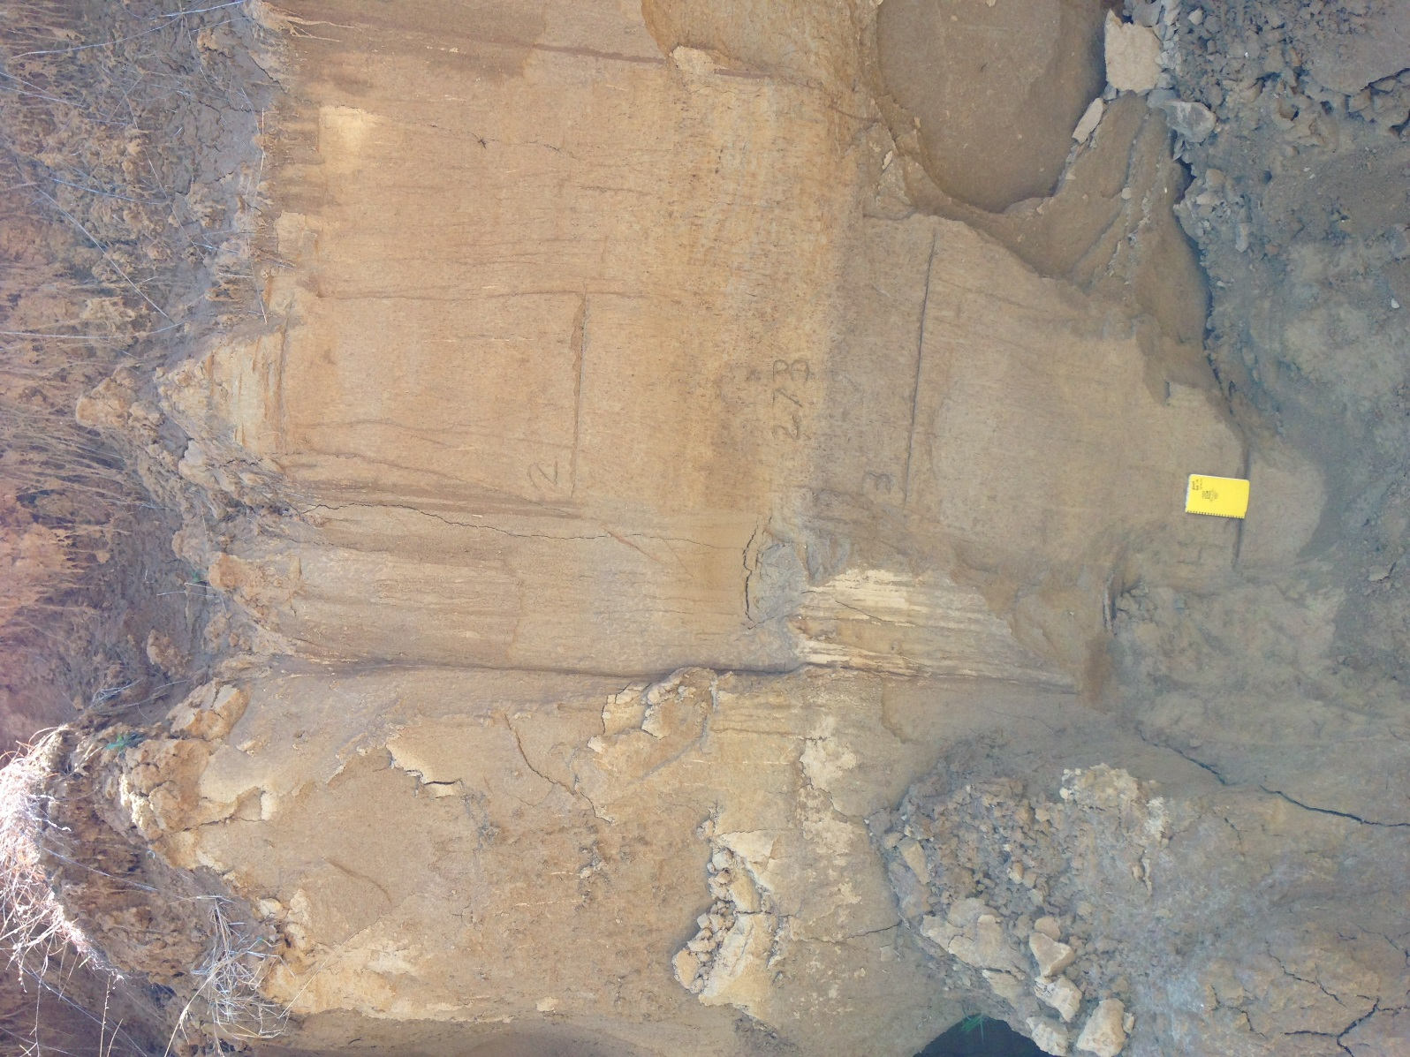
NCS Section A-B
Modern Soil / covered
Upper Peoria Silt
softer loess, gastropods more abundant
Jules Geosol
darker, with sec. carbonate, and more soil structure; cumulic A horizon
Middle Peoria Silt
softer loess, gastropods more abundant
1 m

Slide 9
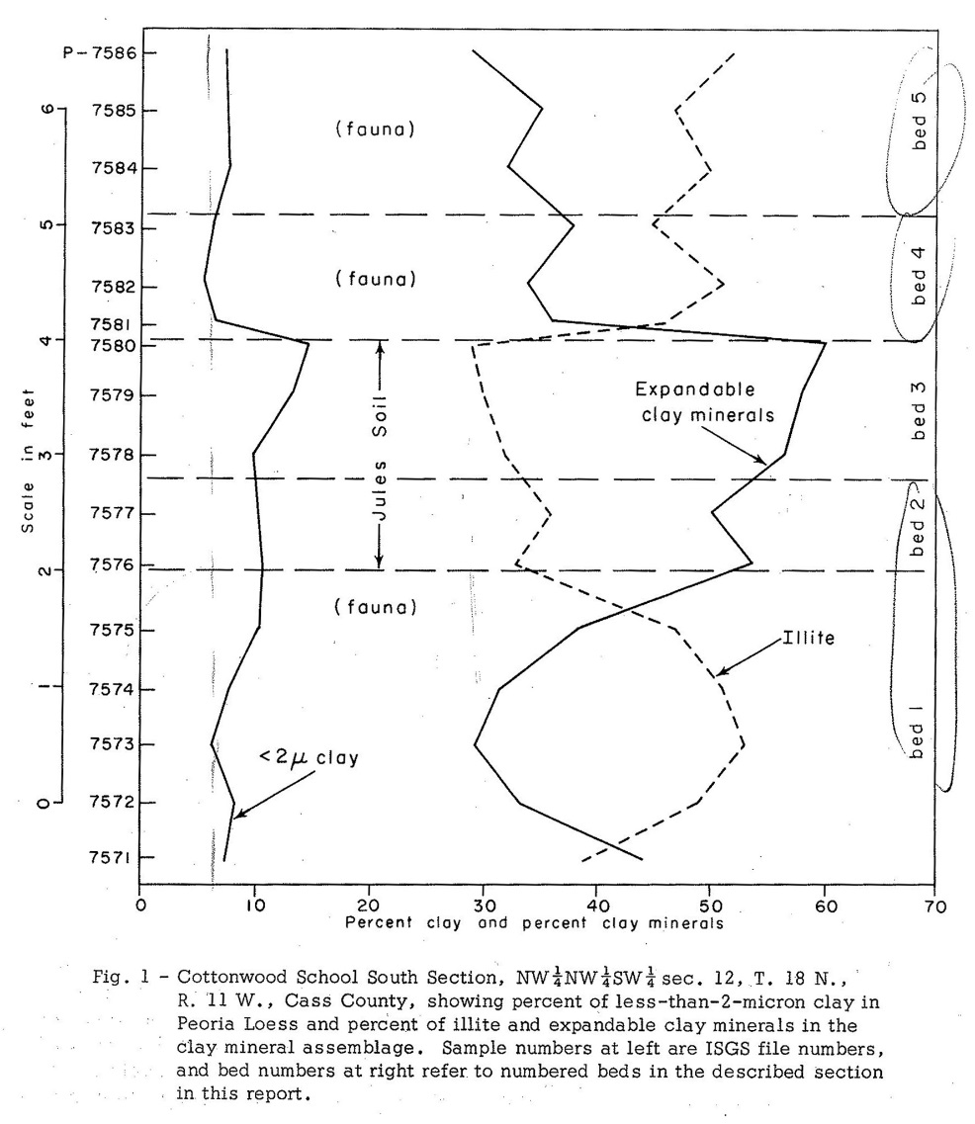
Prior Study: Cottonwood School South Section (0.5 km away);
post-Jules, Upper Peoria loess
more clay-size particles
more expandable clay minerals
infer: more distal western source and reduced local llinois Valley source
Jules Geosol
pre-Jules, Middle Peoria loess
Frye et al. 1974 (ISGS Circular 486)

Slide 10
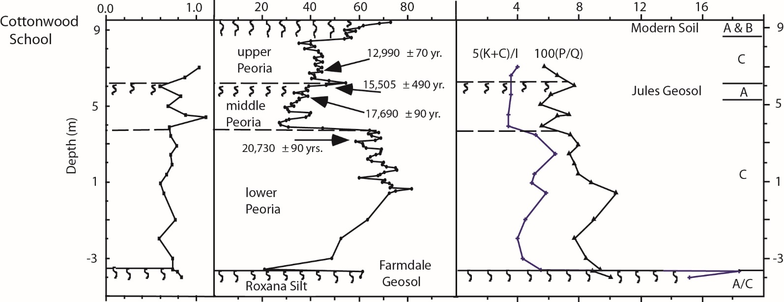
Prior Study: Cottonwood School South Section
¹⁴C Ages on Shells
Calibrated ¹⁴C Ages
15 ka
18.5 ka
~20 ka
Miss. River diversion
~25 ka
Coarse silt/ medium silt ratio
Magnetic
susceptibility
Clay mineral and feldspar/quartz ratios
(Grimley et al., QR, 1998)

Slide 11
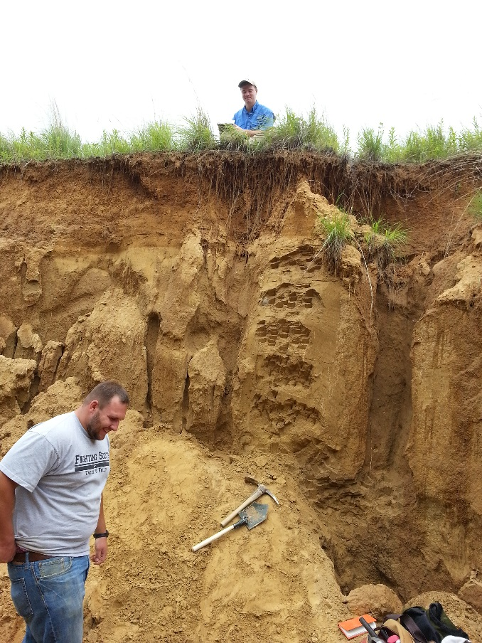
Objectives of New Study
origin of the Jules Geosol in type area (climatic change, sedimentation change ?)
confirm chronology of loess-paleosol sequence
paleoecology / paleoenvironment
lithologic data to aid correlations with other loess-paleosol sites and prior work

Slide 12
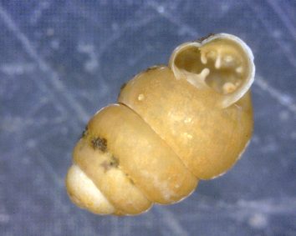
Methods of Study
Laser particle size [source changes, wind intensity, pedogenesis]
Clay mineralogy [source changes, correlations]
Magnetic susceptibility (Bartington MS2 and MS2B) [correlations, source]
Carbonate content [weathering, source, correlations]
Carbon and oxygen isotopes (on gastropod shells) [paleoclimate]
Gastropod identification [paleoecology, paleoclimate]
Chronology
radiocarbon dating of shells (best; Pigati et al., 2015)
radiocarbon dating of disseminated organic matter
optically stimulated luminescence

Slide 13
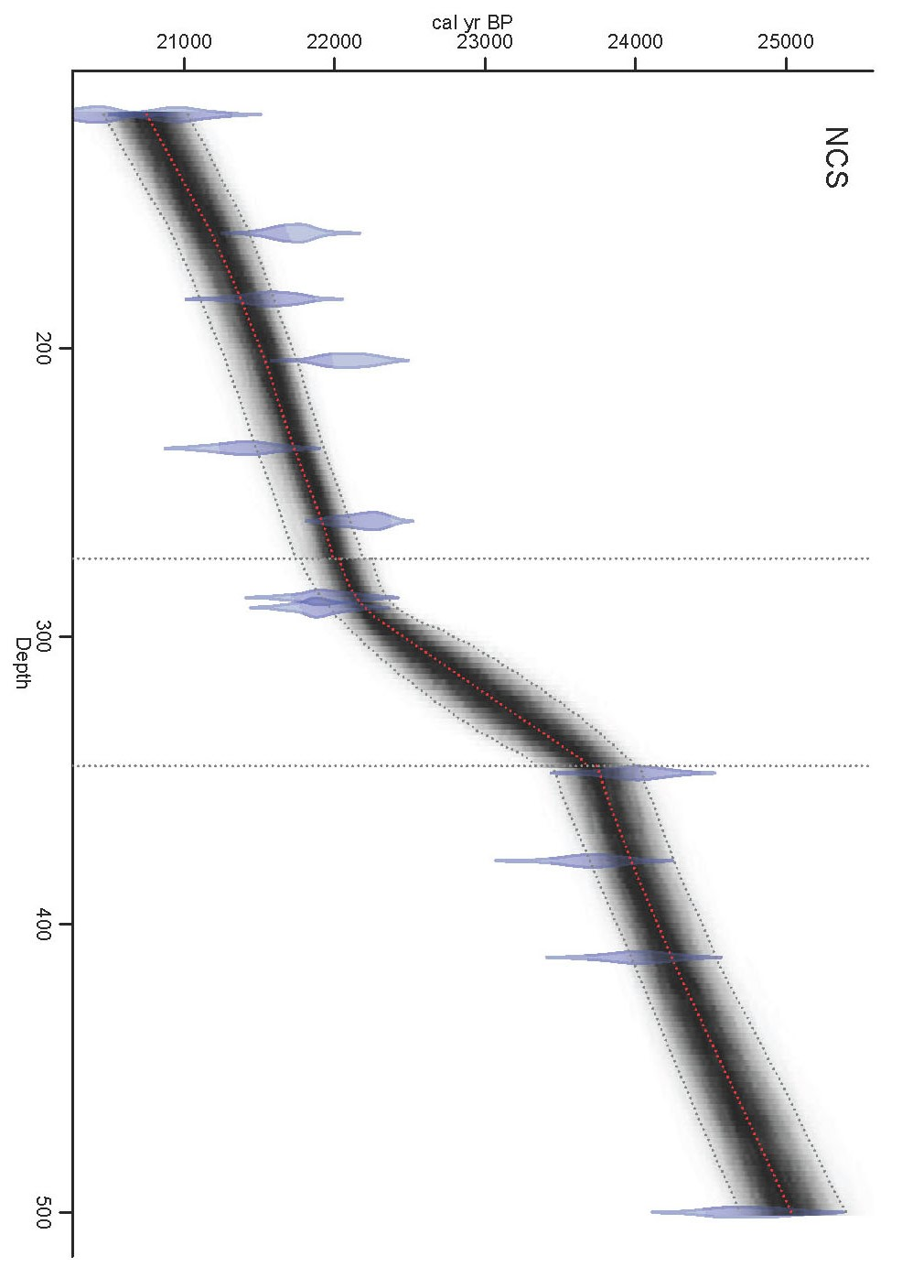
Chronologic Model
--- Bacon model (Bayesian accumumlation histories) using 13 radiocarbon ages on Succinea sp. and Webbhelix multilineata shells
Upper Peoria Silt
20.7 to 22.2 ka
~ 1 mm/yr deposition rate
Jules Geosol zone
22.2 to 23.5 ka
deposition rate slows more than half (~ 0.5 mm/yr)
~ 1 mm/yr deposition rate
Middle Peoria Silt
23.5 to 25 ka

Slide 14
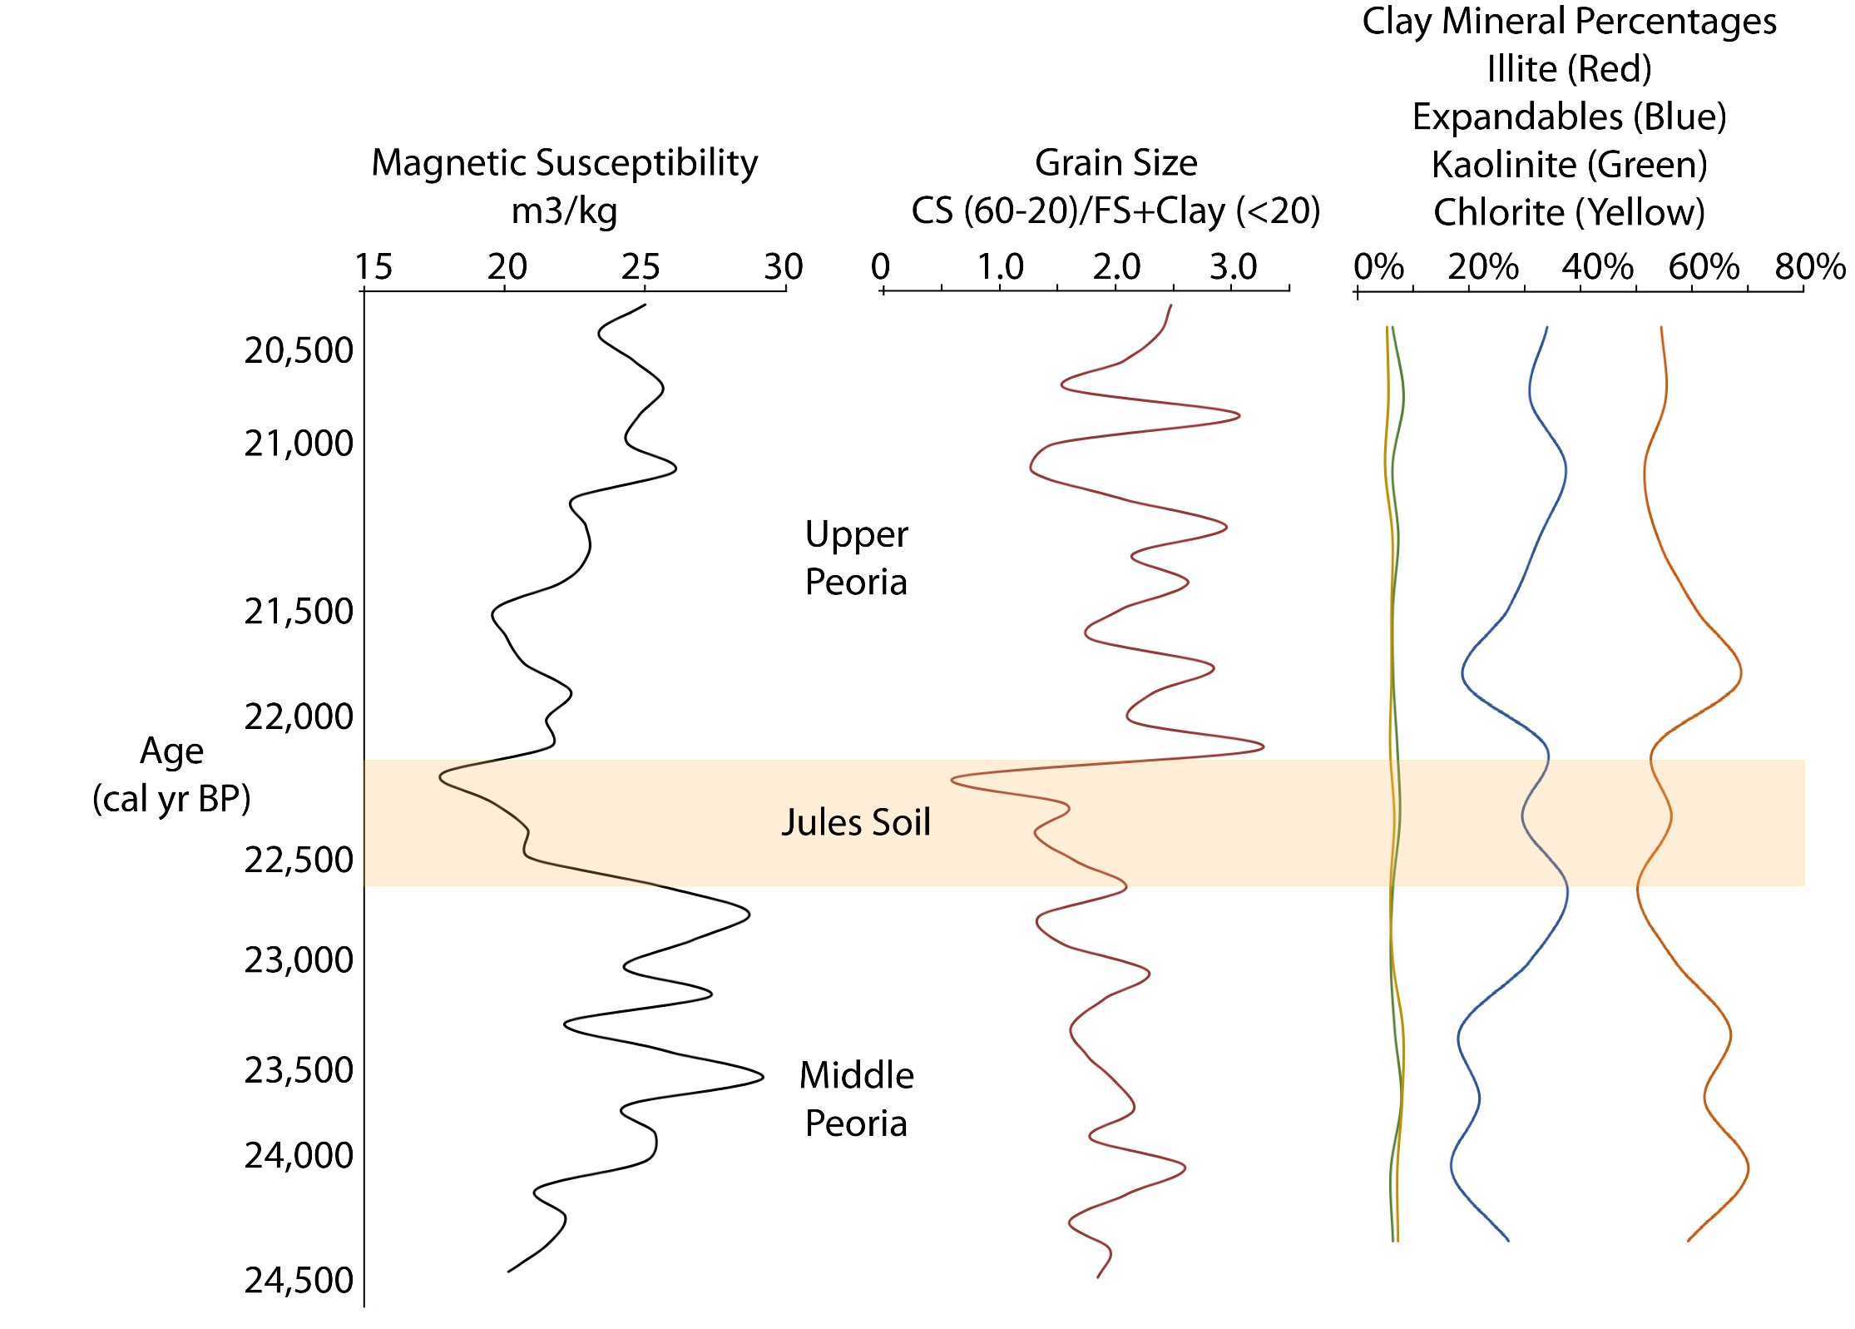
Physical and Chemical Data:
[x10⁻⁸ m³/kg]
[Coarse Silt/(Fine Silt+Clay)]
kaolinite & chlorite
expandables
illite
finer texture

Slide 15
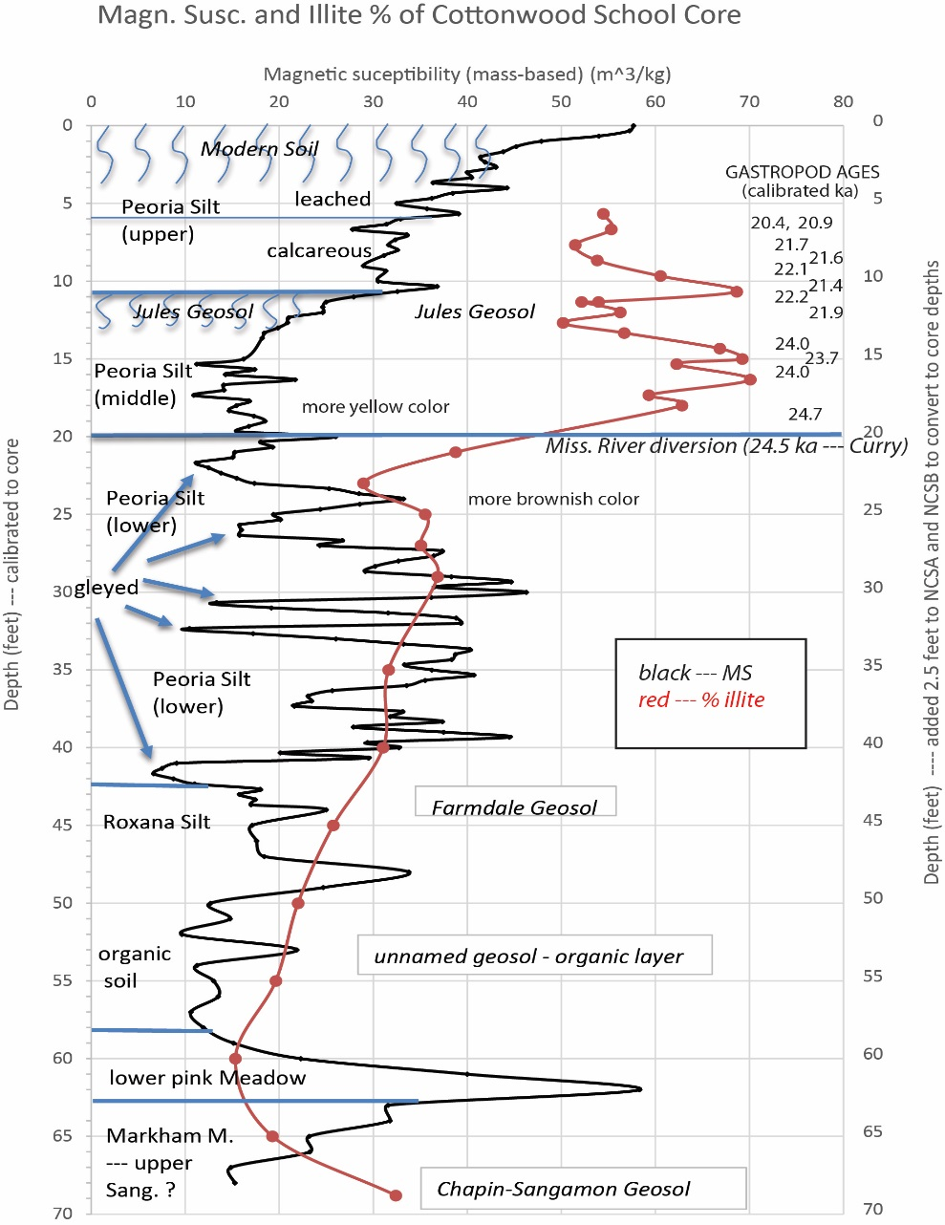
New Cottonwood School Core (drilled 300 m away from exposure)
some sec carb.

Slide 16
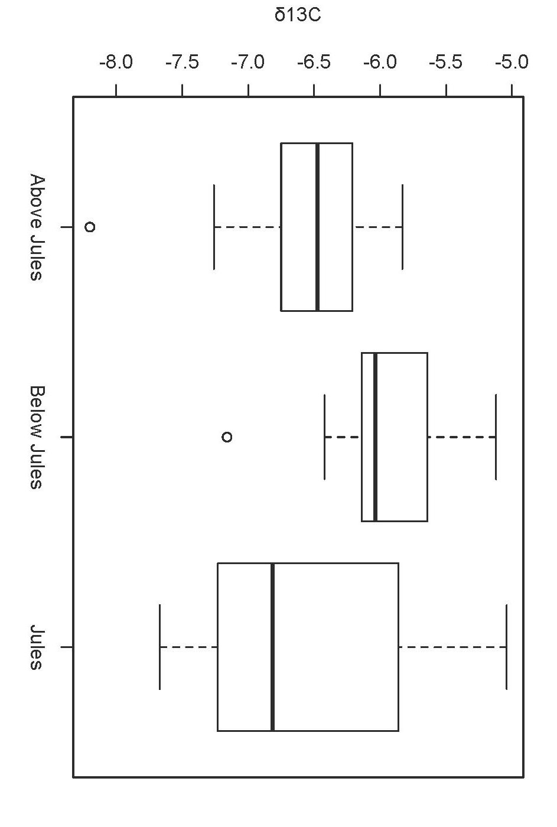
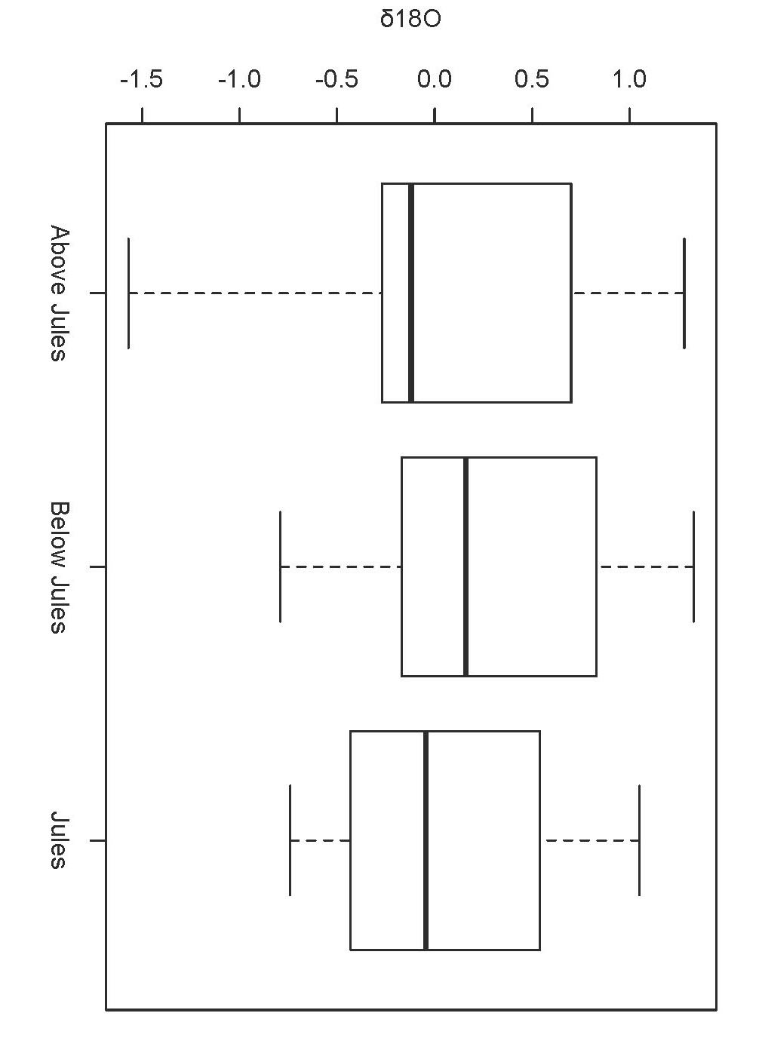
Isotopic Data: Gastropod Shells in Loess --- Jules Geosol not significantly different

Slide 17

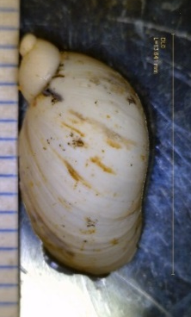
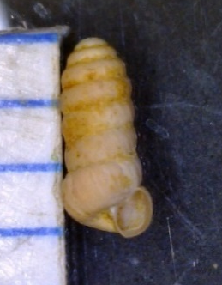
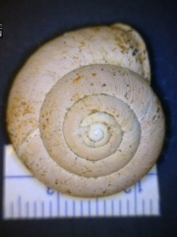
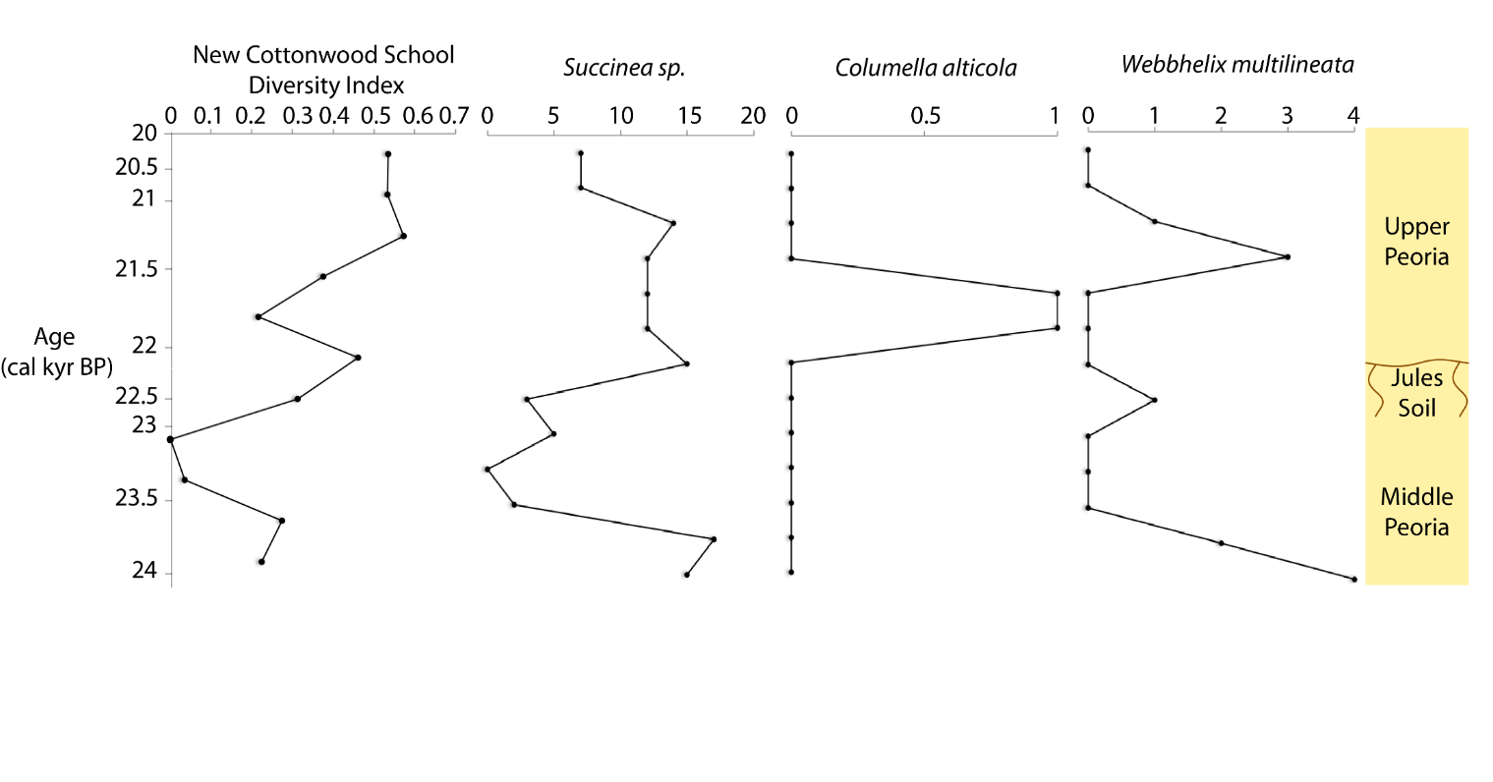
Gastropod Assemblage
in Midwest today
12 species identified
all terrestrial species
mainly woodland type assemblage
cool-cold boreal climate
wide
distribution
cold, boreal

Slide 18
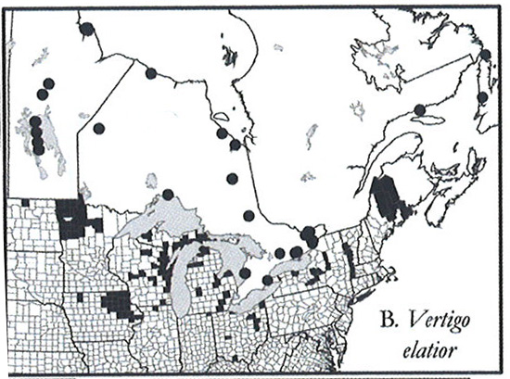

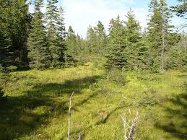
Gastropod Paleoecology
Vertigo eliator:
3 to 4 feet depth
NSCA
Individuals occur in well-decomposed humid leaf litter
in a variety of open and wooded wetland habitats, including wet prairie, fens, wet meadows, tundra, and black ash, tamarack, and black spruce swamp forests.
Nekola and Coles, 2010

Slide 19
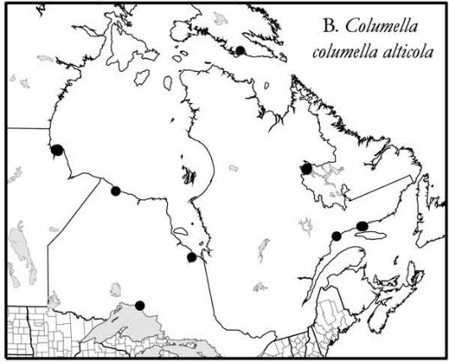
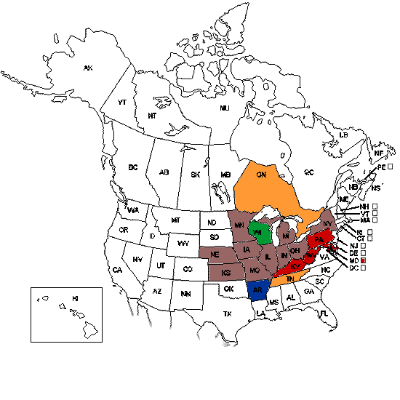
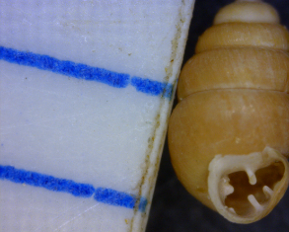
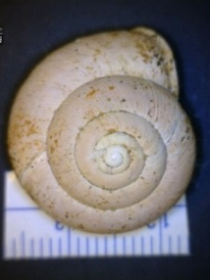
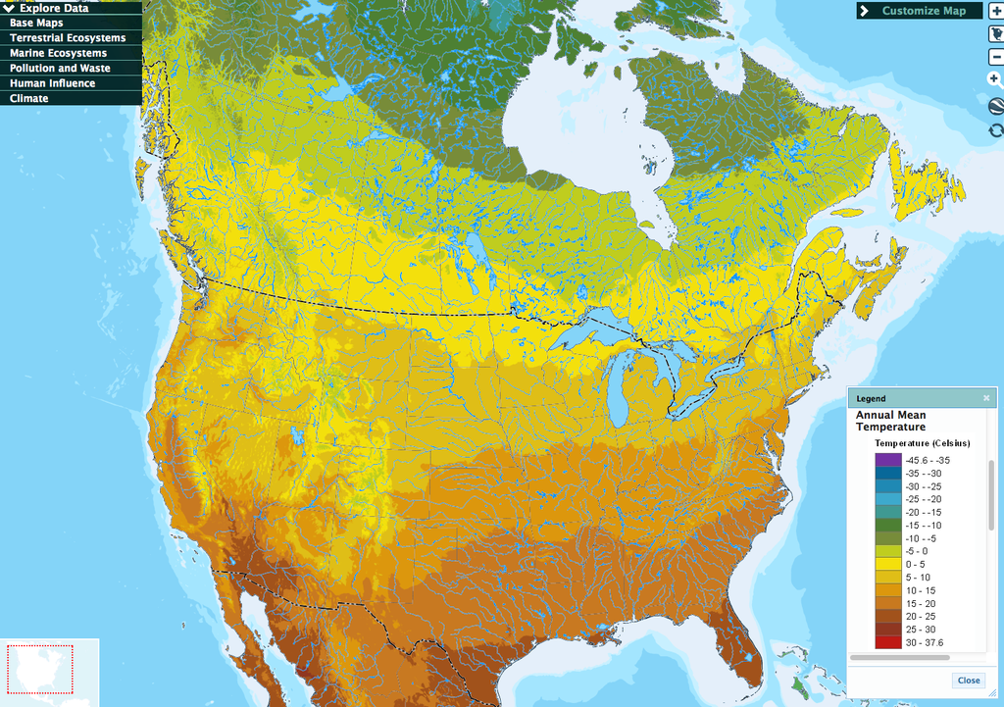
Gastropod Paleoecology / Modern Analog Distribution
Columella alticola
Vertigo eliator
Webbhelix multilineata
approx. MAT: 0° to 3° C

Slide 20
Summary of Findings, So Far
more fine silt, clay and expandable clay minerals in Jules Geosol (confirmed)
age model revised to older (Jules now 22.2 to 23.5 ka instead of ~ 19 ka) based on 13 gastropod ¹⁴C ages
modern analog gastropod distribution suggest boreal climate-ecosystem such as western Ontario (north of Lake Superior) for LGM timeframe; MAT ~ 2° C (compared with 11° C today)
a strong climatic shift is an unlikely explanation for Jules Geosol development, based on isotopic data and gastropod assemblage; so why did soil form ?

Slide 21
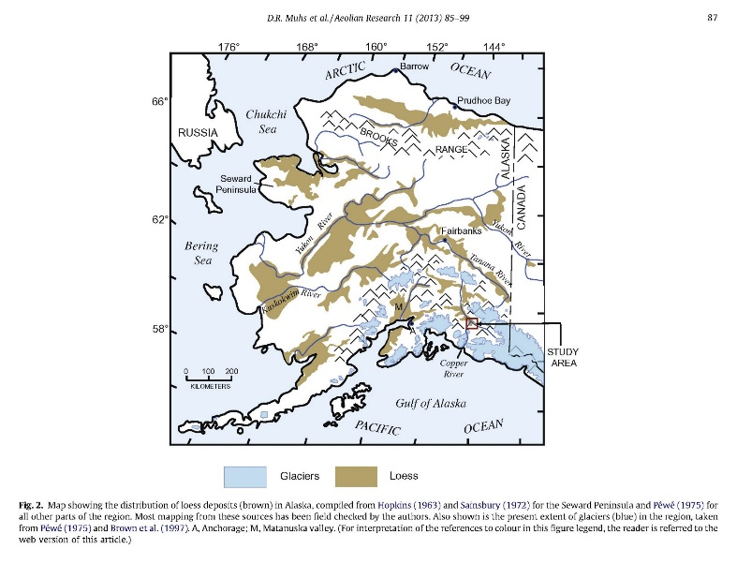
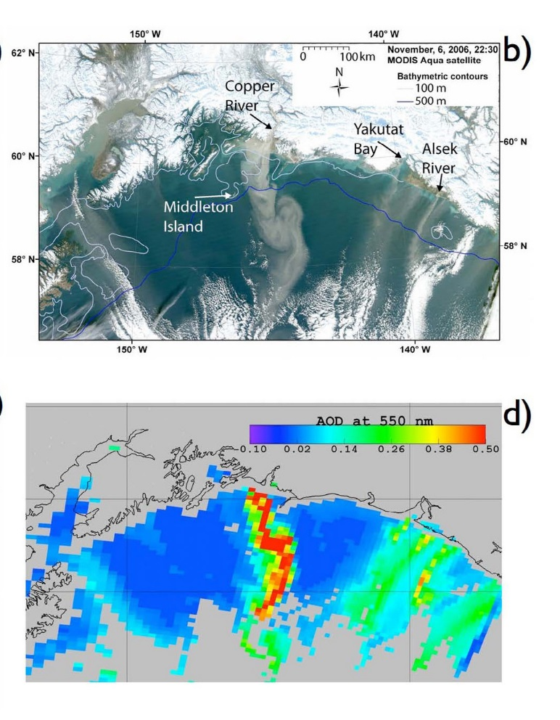
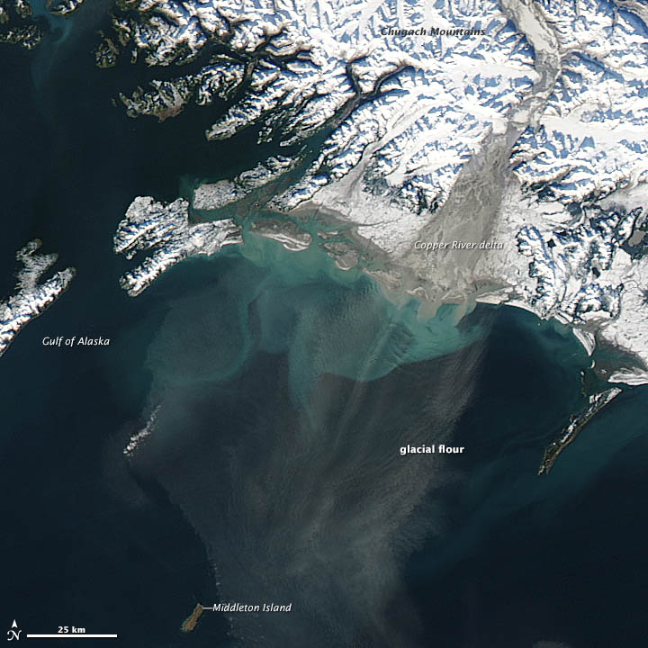
Modern Analog Dust Storms, Alaska (Oct, Nov.)
inferred aerosol optical thickness
Dust storm into Gulf of Alaska from silt deflation near Copper River.
11/6/2006 {Crusius et al., 2011}
Oct. 23, 2012, NASA, http://earthobservatory.nasa.gov/IOTD/view.php?id=79518

Slide 22
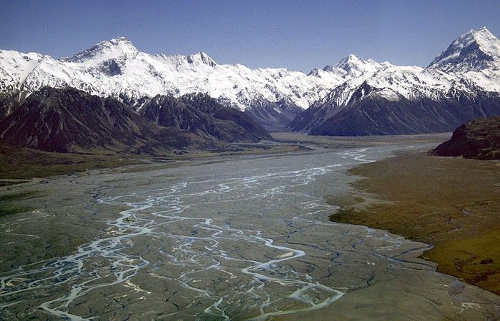
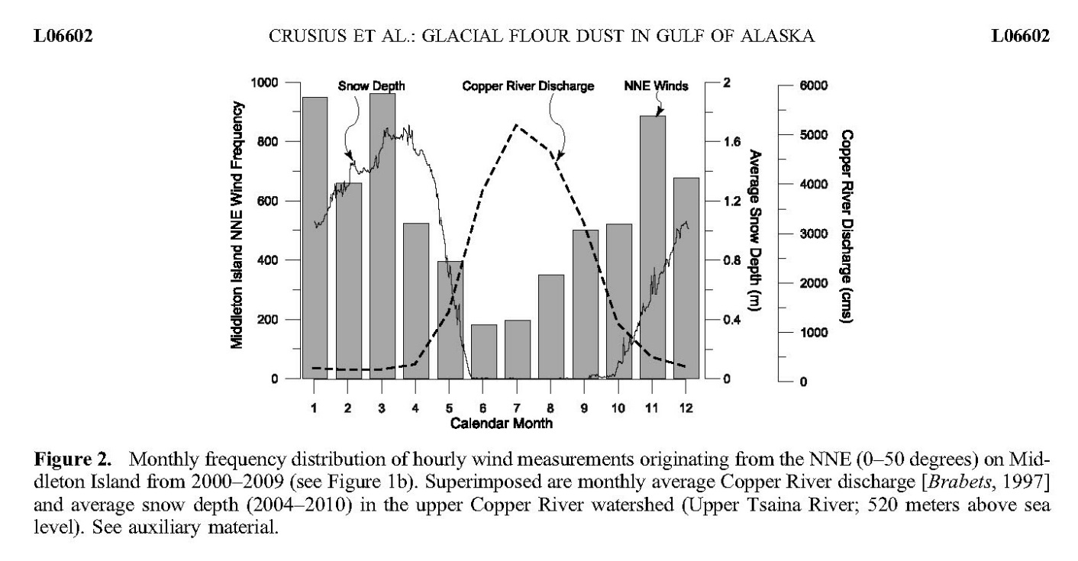
Modern Analog Glacial Dust Storms
windows for dust storms in fall (and perhaps spring)
New Zealand
melt season
snow cover
snow cover
(Crusius et al., 2011)
typical dust storms in glacifluvial environment are in the fall; after summer meltwaters have subsided, but before snowcover blankets the outwash sands and silts

Slide 23
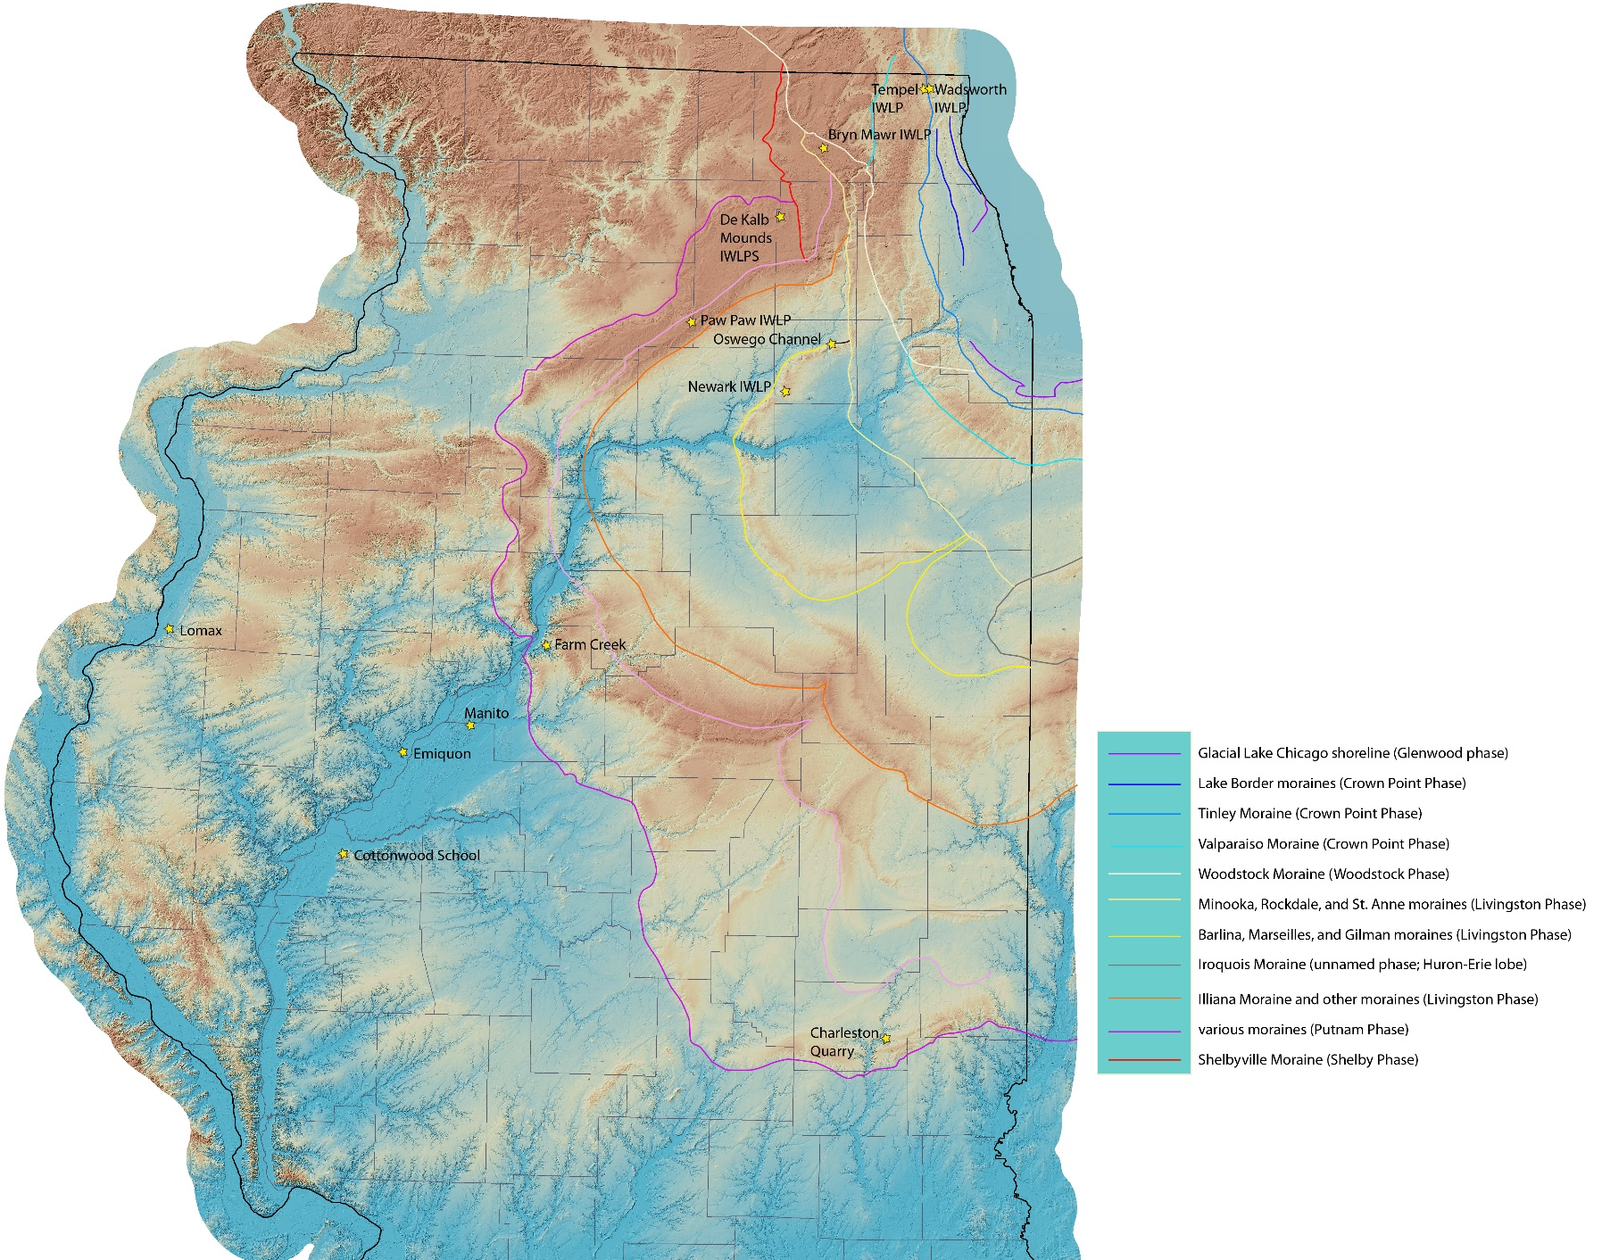
Lake Michigan Lobe Chronology
18 ka
21 ka
Marseilles Moraine
21.8 ka
Shelbyville Moraine (LGM)
24 ka

Slide 24
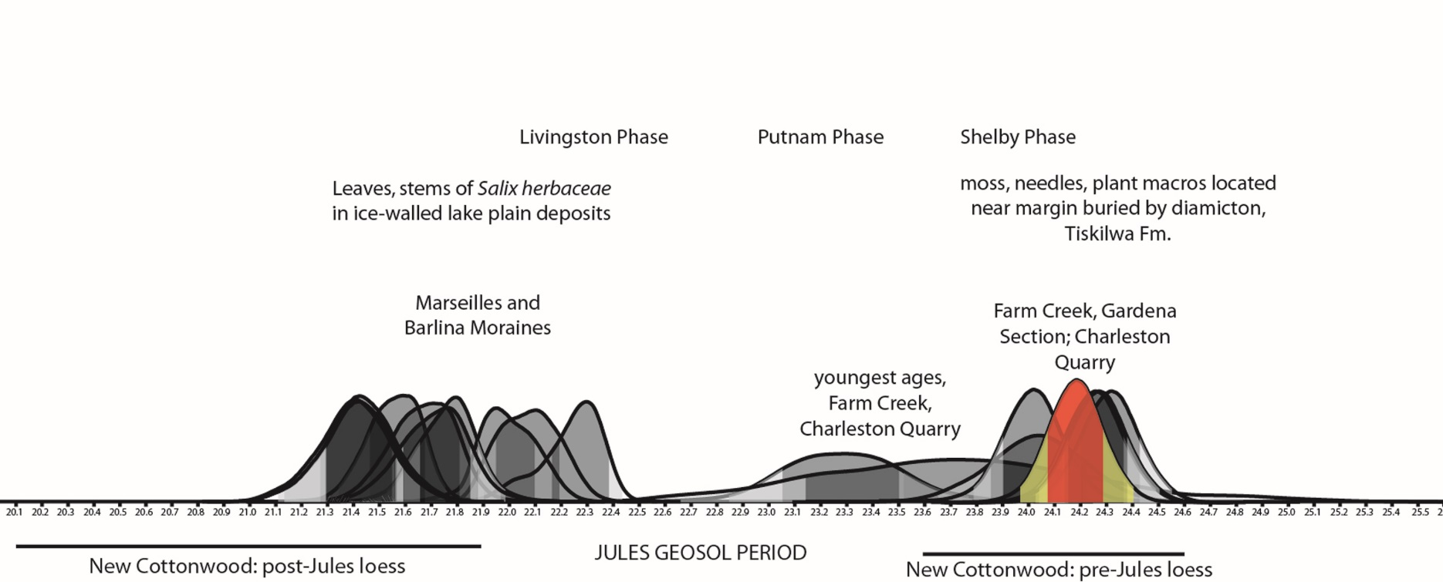
Loess-Lake Michigan Lobe chrono-correlations
Loess-Moraine
Paleosol-Retreat
Loess-Moraine
terminal moraine (LGM)
Marseilles M.
20.7 – 22.2 cal ka
22.2 – 23.5 cal ka
23.5 – 25 cal ka
JULES GEOSOL
development
rapid loess deposition
data from B.B. Curry
rapid loess deposition

Slide 25
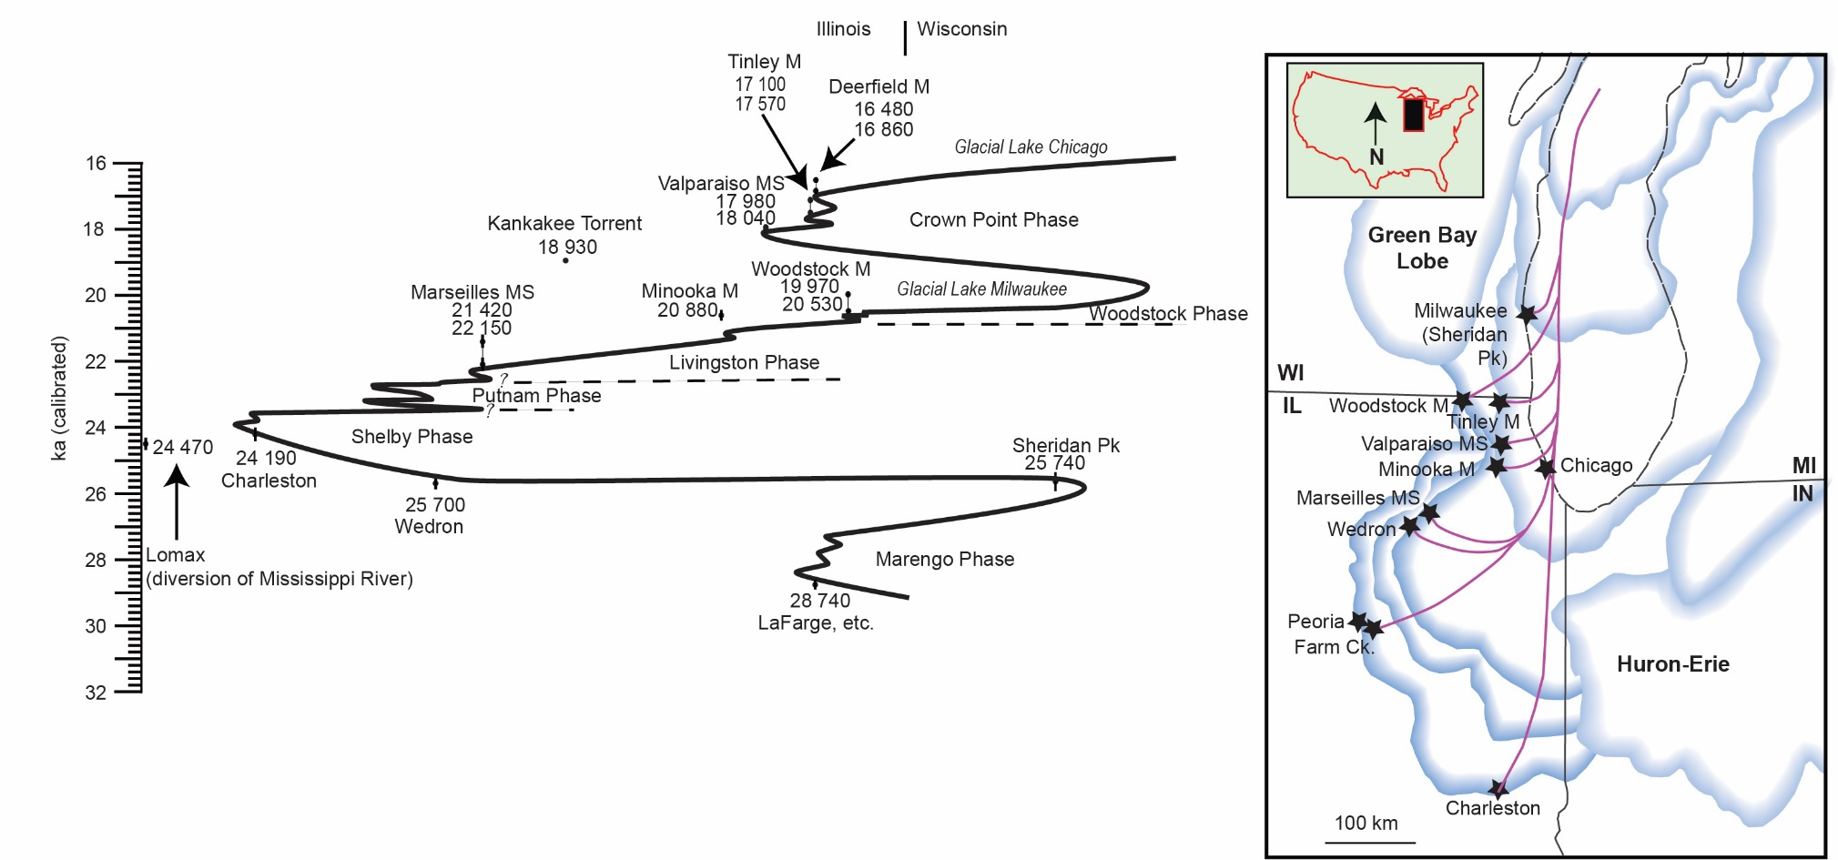
Time-Distance Diagram for Last Glacial Lake Michigan Lobe Ice Margin
loess
Jules
loess
CS
times of rapid loess deposition when ice advancing to margin or stabilizing at moraine position
more silt production

Slide 26

Possible Ideas for Slowing of Loess Deposition or Increased Soil Development during Jules Geosol development in Illinois Valley
favored: glaciogenic processes --- sediment supply, temporary change in drainage ?
hydrologic processes; discharge and floodwaters too high ?
increased snow cover in valley (preventing silt deflation)
change in vegetation cover on uplands or lowlands (traps sediment in place)
warmer or moister conditions (global or regional climatic change)
some combination of above

Slide 27

Summary
Radiocarbon ages at New Cottonwood School Section suggest two rapid pulses of loess deposition above and below the Jules Geosol
25 to 23.5 ka: loess deposition associated with LML maximum advance
23.5 to 22.2 ka: paleosol development (Jules Geosol)
22.2 to 20.7 ka: renewed rapid loess deposition
Hypothesis: paleosol origin relates to slow-down in loess deposition rate.
likely: reduction in sediment supply from L.M. Lobe during ice margin retreat (cleaner meltwaters)
possibly: high meltwater discharges or greater snowfall limiting deflation in the valley (?)
possibly: higher ppt and humidity more conducive to soil formation (and limit drying of valley sediments) ?
JULES

